Slide 1
A Public Health Approach to Alzheimer’s and Other Dementias
Dementia Capable Systems and dementia friendly communities
Notes:
DISCLAIMERS
This publication was supported by Cooperative Agreement Number 5U58DP002945-05, funded by the Centers for Disease Control and Prevention. Its contents are solely the responsibility of the authors and do not necessarily represent the official views of the Centers for Disease Control and Prevention or the Department of Health and Human Services.
The mark "CDC” is owned by the US Dept. of Health and Human Services and is used with permission. Use of this logo is not an endorsement by HHS or CDC of any particular product, service, or enterprise.
Talking Points:
This presentation entitled, Dementia Capable Systems and Dementia Friendly Communities, is part of a curriculum for public health students entitled, A Public Health Approach to Alzheimer’s and Other Dementias. It was developed by the Emory Centers for Training and Technical Assistance for the Alzheimer’s Association with funding from the Centers for Disease Control and Prevention.
This presentation addresses the public health response to the Alzheimer’s epidemic at the state and community levels and the importance of dementia capable systems and dementia friendly communities.

Slide 2
Learning Objectives
Define dementia capable system and dementia friendly community
Explain how public health can contribute to dementia capable systems through support services/programs, workforce training, and dementia friendly communities
List at least two services that may benefit a caregiver
Identify at least three professions that would benefit from workforce training
Describe at least two components of a dementia friendly community
Notes:
By the end of the presentation, you will be able to:
Define dementia capable system” and “dementia friendly community”
Explain how public health can contribute to dementia capable systems through support services/programs, workforce training, and dementia friendly communities
List at least two services that may benefit a caregiver
Identify at least three professions that would benefit from workforce training
Describe at least two components of a dementia friendly community

Slide 3
Introduction: Dementia & Alzheimer’s Disease¹
Dementia is a decline in mental ability that interferes with daily life
Alzheimer’s disease is the most common form of dementia
Progressive loss of memory and brain function
Requires increasing aid and assistance
No cure and limited treatment options
Huge financial and emotional burden
Public health plays important role in addressing Alzheimer’s disease
Notes:
Before we begin discussing dementia capable systems and dementia friendly communities in addressing Alzheimer’s disease, it may be helpful to know a little more about Alzheimer’s and dementia.
The term dementia is a general term for a decline in mental abilities that is severe enough to interfere with daily life. Dementia, which is not a disease but a syndrome, is characterized by damage to the brain cells due to age, brain injury, other conditions or diseases, heredity, or a combination of factors.
There are several types of dementia and most occur in those over 65; however, there are types of dementia that occur in those younger than 65.
Alzheimer’s disease is the most common cause of dementia. Alzheimer’s is a progressive disease that ranges from mild to severe cognitive impairment that occurs on a continuum over the course of many years, even decades. The term Alzheimer’s dementia is used to describe the stage of Alzheimer’s disease when an individual has observable symptoms such as memory loss, mood/behavior changes, and difficulty with activities of daily living. There is no cure for Alzheimer’s. While there are approved drug treatments, the goal of existing treatment is to delay or reduce symptoms, not to cure or reverse the course of the disease.
As the person with Alzheimer’s loses memory and function, caregivers, who are most often family members, are needed to provide increasing amounts of assistance. This assistance can range from helping to manage finances and household tasks to hands-on care, such as bathing, dressing, feeding, and other activities of daily living. Given the nature of the disease and its increasing prevalence, there is a huge financial, emotional, and physical impact on people with Alzheimer’s, their families, caregivers, and the health care system as a whole.
Public health plays an important role in addressing Alzheimer’s disease through surveillance, prevention, detection, and support of dementia-capable systems.
In this presentation, we will be focusing on dementia capable systems and dementia friendly communities, both of which involve government and health care agencies, organizations, and communities accommodating the needs of people with dementia and their caregivers through education, services, and support within their community.

Slide 4
Alzheimer’s: A Larger Context²
States/communities play significant role
Assessing burden
Risk reduction
Care services: health care, support services, government agencies
Public and private resources: transportation, grocery stores, places of worship, financial institutions, law enforcement
Notes:
Alzheimer’s and other dementias affect not only the individual but also families and communities. Communities have many people living with Alzheimer’s and other dementias and many others who are at risk for developing these conditions. As many as 70% of people living with Alzheimer’s and other dementias live in the community, with 74% of those individuals living with a caregiver. Family caregivers also need support. Professionals who interact with both individuals with dementia and their caregivers need training on how best to provide services and support to both.
Individuals with dementia and their caregivers rely on many care services, including health care, support services (in-home, community, and long-term care), and government agencies to meet their ongoing and changing care needs.
People with Alzheimer’s and other dementias also interact with and depend on community services and businesses such as transportation, grocery stores, places of worship, banks, and law enforcement.
Later in the module, you will learn how a public health response to the epidemic considers the unique needs of people with dementia and their caregivers on state and local levels, within institutions, and across communities.

Slide 5
Discussion Questions 1
Imagine you or someone you care about has Alzheimer’s or dementia.
What might be some of your concerns or fears about going out in your community?
How could those be addressed at a community level?
Notes:
Ask: Imagine you or someone you care about has Alzheimer’s or dementia.
What might be some of your concerns or fears about going out in your community?
How could those be addressed at a community level?
Open responses.
Video: Alzheimer’s Society (UK) (3:35 minutes)
Brief video shows simulation of what it might be like for someone with dementia to navigate everyday life in her community.
https://www.youtube.com/watch?v=Fz8ACEu7Lho

Slide 6
Two Frameworks: Dementia Capable System and Dementia Friendly Communities³
Designed to meet the needs of older adults within a community
Aim to help older adults remain independent and in the community as long as possible
Bring together community members and key stakeholders to focus on accommodations, provide support, and improve quality of life for older adults
Notes:
Given that the population of adults over age 65 is rapidly increasing, there are efforts at the national and international level to put in place infrastructure, policies, and practices from the local level upward to support older adults and their families. The vast majority of older adults want to remain independent in their homes and in their communities for as long as possible. This means having communities prepared to meet the changing and increasing needs of older adults in terms of community resources and infrastructure, health care, and social services.
Many of the issues discussed in this presentation tie into the concept of dementia friendly communities and what it means to have dementia capable systems in place that help communities be more accommodating to people with dementia and dementia caregivers.
These two frameworks aim to help communities plan for and address the challenges associated with the growing impact of dementia. While also used in other countries, in the United States, the concept of dementia friendly communities is intended to involve multiple sectors by bringing together community members and key stakeholders to enhance support and improve quality of life for all affected by dementia. The federal Administration for Community Living has also championed the dementia capable system framework, which may focus on a single sector or organization.
Both frameworks are designed to meet the needs of the rapidly increasing population affected by dementia (including caregivers) by preparing communities, health systems, and governments.
Both aim to help people living with dementia remain independent and in the community as long as possible.
Each of these frameworks has the potential to help communities begin to address the overall needs of older adults and the unique needs of people with dementia and their caregivers.

Slide 7
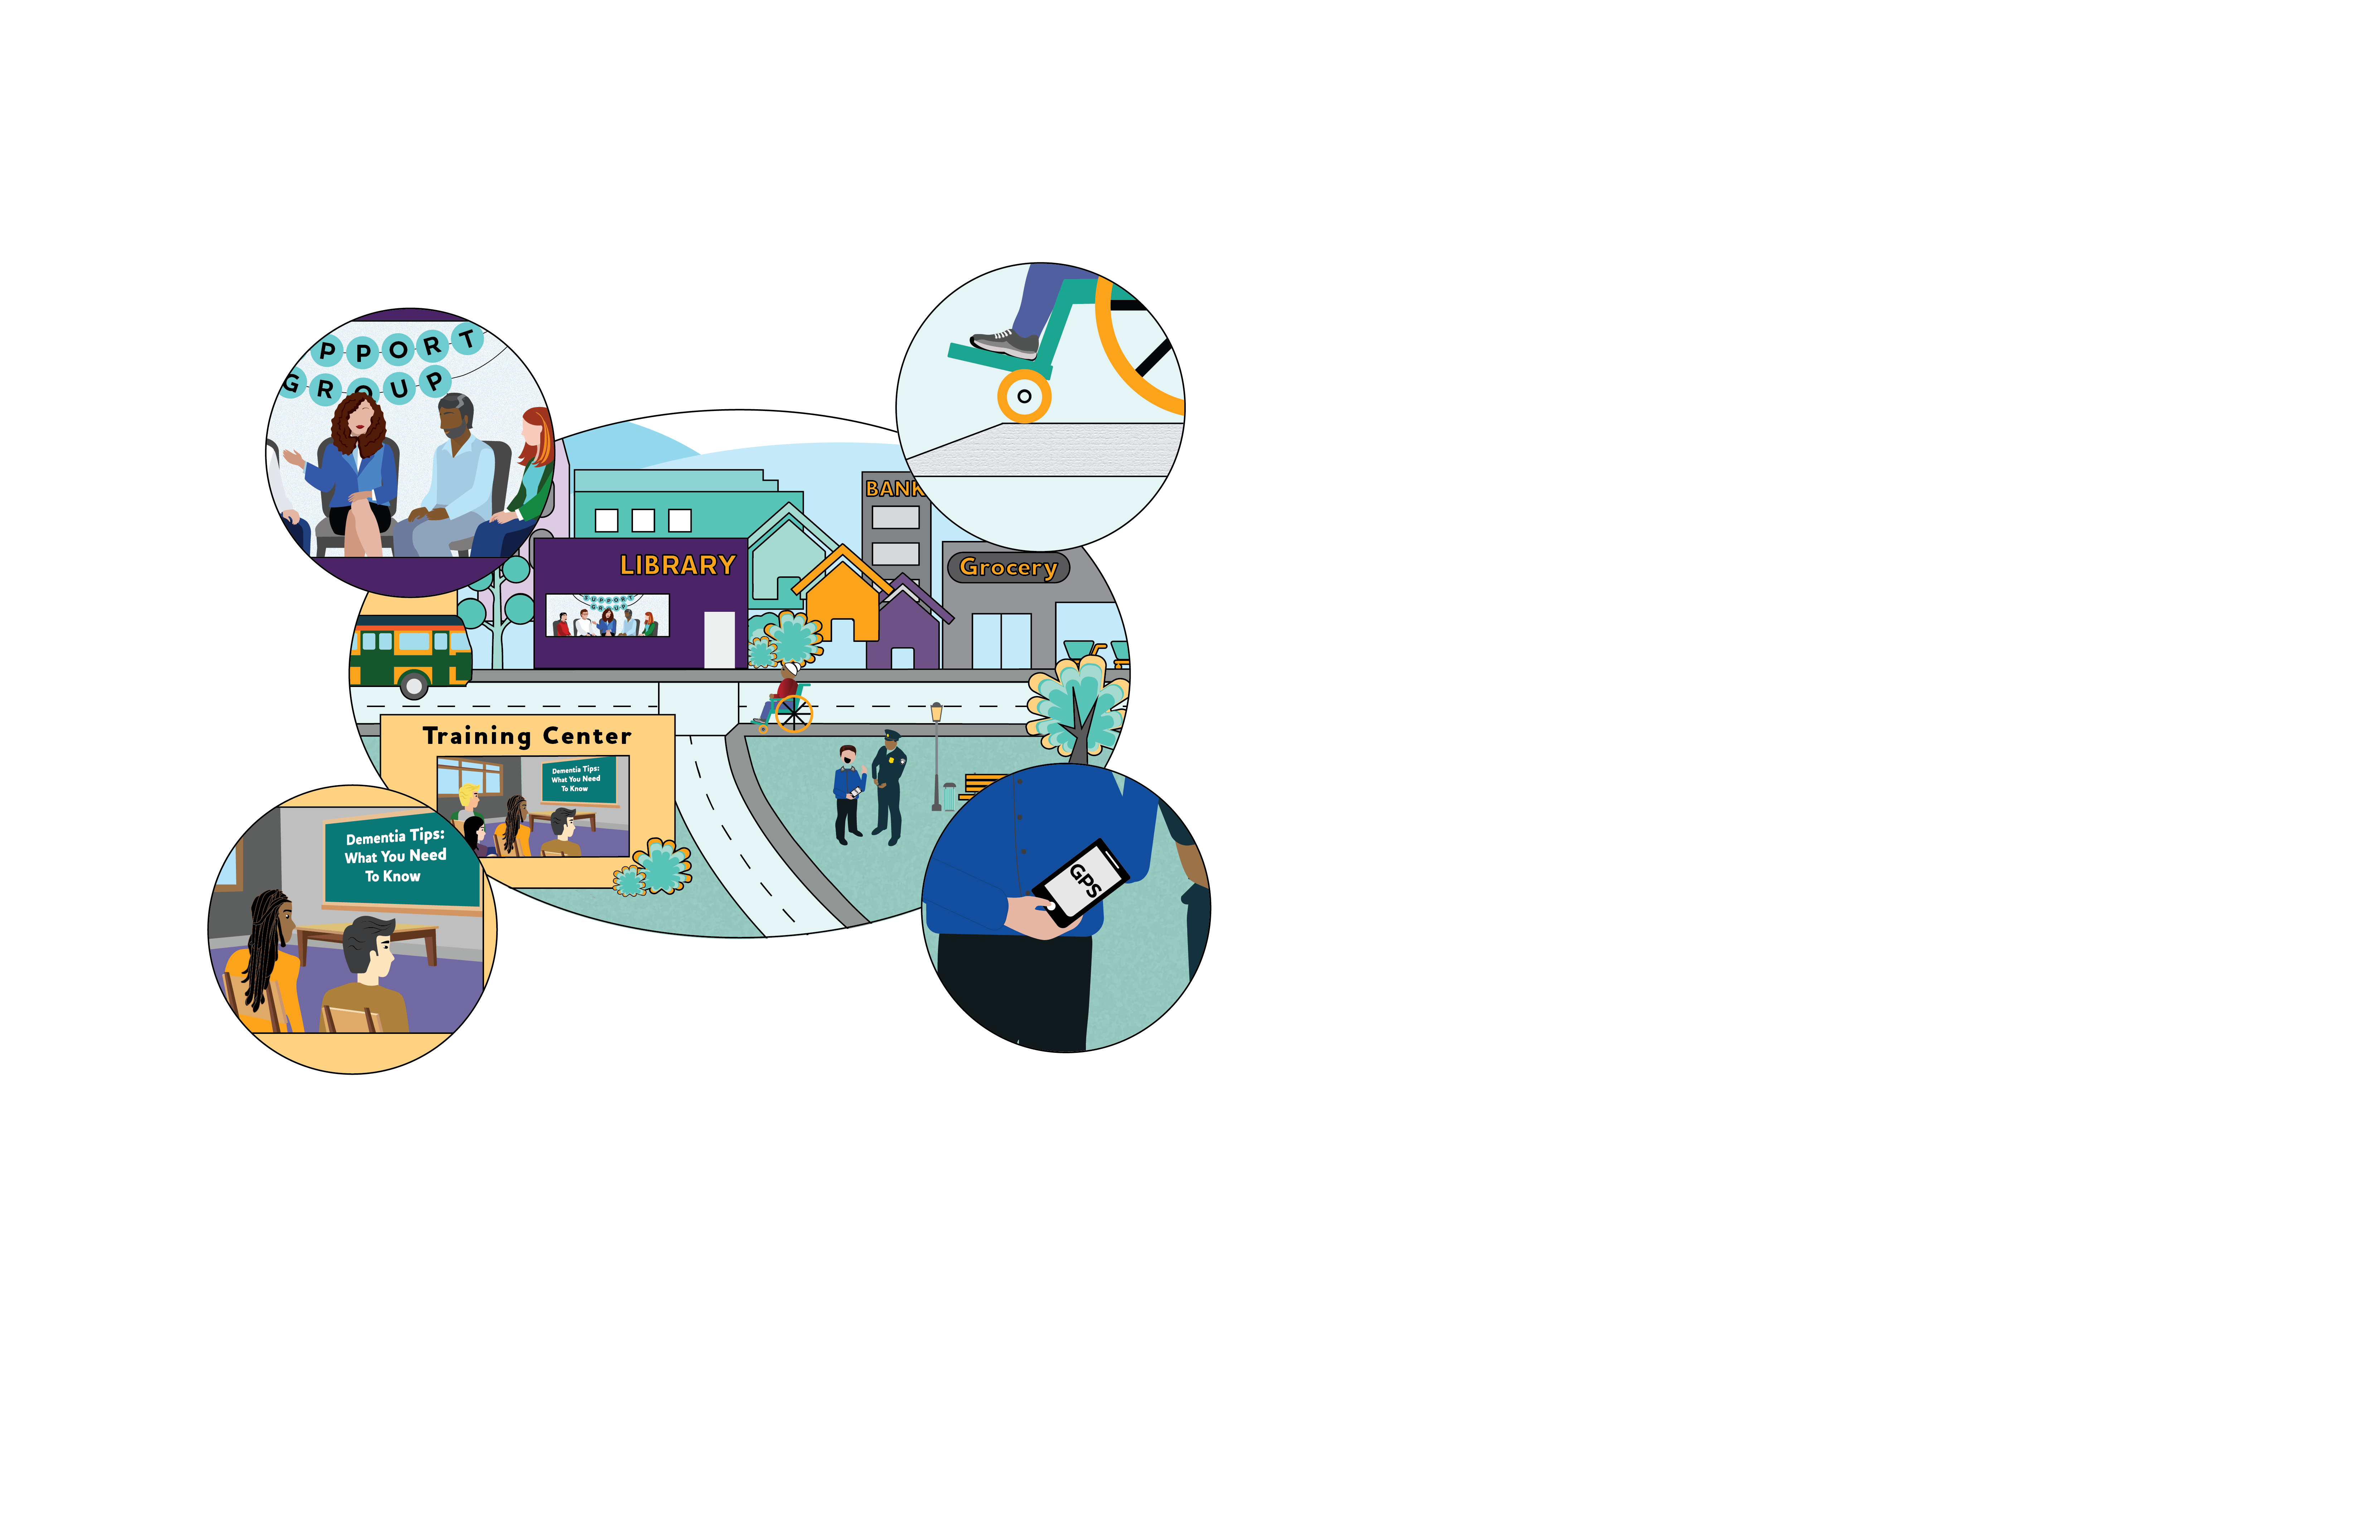
Dementia friendly communities^{4,5}
Health care, community services, resources
Safe and accessible
Transportation
Mobility
Respectful and supportive
Public education and workforce training
Technology
GPS, GIS
Registry
Notes:
In the dementia friendly community framework, people with dementia, their family, and caregivers are understood, respected, supported, and able to continue to engage with and contribute to their community. The effort to become dementia friendly is made at a community level and requires planning and participation from all sectors with involvement of those with dementia and dementia caregivers.
Although overlap exists between the concepts of dementia capable and dementia friendly, a dementia friendly community encompasses a broader goal of supporting a higher quality of life for people with dementia beyond simply meeting their physical and health needs.
In this framework, dementia friendly communities would have:
Access to quality health care and community services. While encompassing the same aspects of dementia capable systems, dementia friendly communities offer:
Resources and supports that are geographically, financially, and culturally available and accessible
Support services and activities, such as educational sessions regarding symptoms, disease processes, self-care, and providing care, as well as support groups and dementia friendly social events that are readily available throughout the community
Safety and accessibility: People can live safely, with as much independence as possible
This concept includes public transportation, walkability for leisure and to complete daily tasks, minimizing confusion when moving from place to place, and ensuring safety
Mobility considerations that may include:
Age-friendly pavements
Adequate signage
Safe pedestrian crossings
Trained safety personnel
Welcoming open spaces, including squares, parks, and playgrounds
Public education and workforce development: In these communities, residents, agencies, businesses, health care facilities, places of worship, and general service providers are learning about dementia through education and awareness efforts, so they can better assist people with the condition and their caregivers as they go about their daily lives
Technology may also play a role in the creation of dementia friendly communities:
Geographic Information Systems (GIS) and Global Positioning Systems (GPS) can help people navigate their community while still allowing family or caregivers to track their whereabouts
Community registry: Law enforcement can also create or partner with a voluntary registry for individuals with dementia
These registries have the name, home address, and contact information for family members or care partners should the individual with dementia need help from or interact with law enforcement
Evaluations are needed to better understand the utility of the dementia-friendly community framework in helping communities develop these attributes.
Additional reading: https://alz.org/media/Documents/spotlight-dementia friendly-communities.pdf

Slide 8
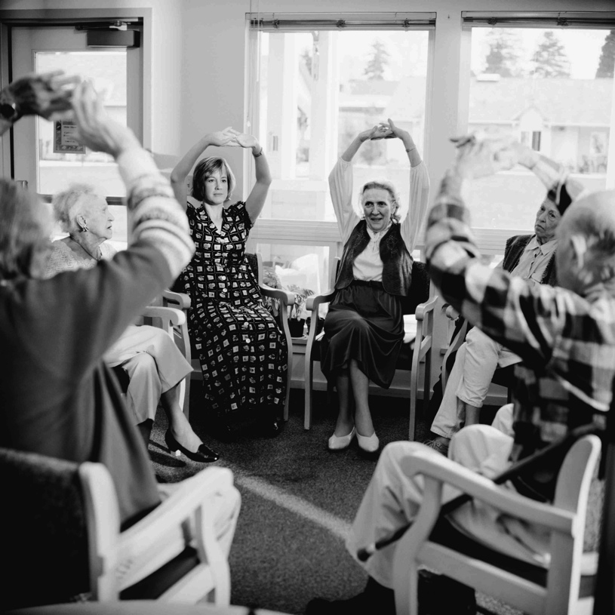
Dementia capable systems^{6,7}
Accommodate needs of population with:
Memory loss
Physical, cognitive, and/or behavioral symptoms
Co-morbidities
Knowledgeable workforce/residents:
Identify people with dementia
Work effectively with them
Inform/refer to services
Notes:
Part of creating a dementia friendly community is ensuring there are support services and infrastructure in place to meet the needs of individuals with Alzheimer’s and dementia and their caregivers. Having this support in place within the community is referred to as having dementia capable systems.
Dementia capable means being able to help people with dementia and their caregivers. This definition applies both to dementia capable systems and dementia friendly communities. More specifically, being dementia capable means being skilled in identifying people with possible dementia and working effectively with them and their caregivers, being knowledgeable about the kinds of services needed, and being able to inform or refer to agencies and individuals that provide such services.
A dementia capable system is a system that accommodates the needs of a population that, in addition to memory loss, experiences a variety of physical, cognitive, and behavioral symptoms resulting from dementia, in addition to other co-morbidities.
Dementia capable systems can be implemented at different levels, such as within a care system, a business or organization, or within a community or state. The focus of dementia capable systems is often on:
Increasing knowledge and skills of those who will help care for or interact with people who have dementia and their family members
Addressing service gaps and specialized assistance needs
Providing long term services and support systems to fulfill the needs of people with dementia and their caregivers
Public health must take an active role in fostering dementia capable systems and helping to bridge the gap between the needs of individuals and caregivers and the larger establishments within states and communities that can best meet those needs.

Slide 9
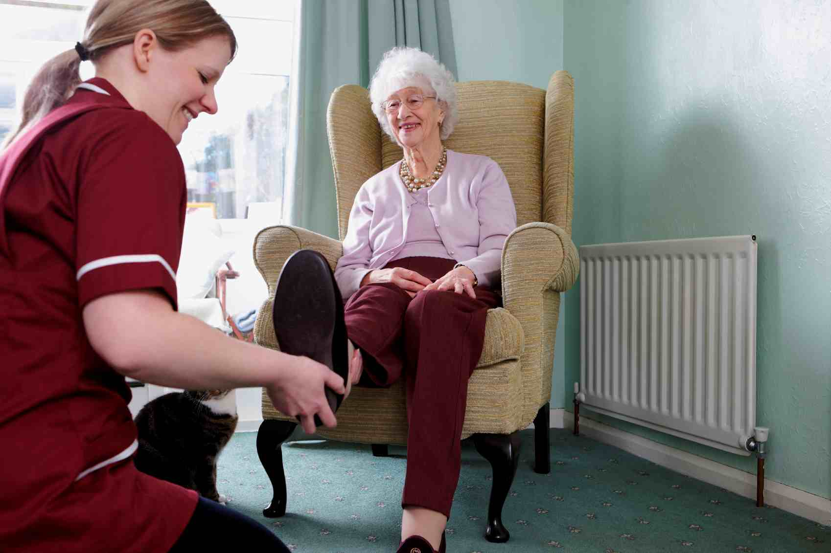
Dementia capable: public health⁸
Analyzing community support needs
Building connections to support services and programs
Providing workforce training
Establishing dementia friendly communities
Notes:
Public health can play a role in developing and supporting dementia capable systems by:
Analyzing the community support needs of people living with dementia and their caregivers
Serving to provide, inform, and connect individuals and caregivers to support services and programs
Designing, implementing and evaluating workforce training to ensure workers across a wide range of professions are able to identify and meet the needs of people with Alzheimer’s and dementia
Supporting the creation of dementia friendly communities that help people with Alzheimer’s and dementia remain safe and as independent as possible within their community
Each of these will be discussed in more detail.

Slide 10
Dementia capable: public health (continued)^{9,10}
Use data to inform the public health program and policy response to:
Cognitive health
Cognitive impairment
Caregiving
Evaluate training and programs
Estimate gap between workforce capacity and demand for services
Notes:
Public health utilizes data from available surveillance strategies and sources (local, state, national, and even global) to guide programs, priorities, and policies.
Public health practice can actively incorporate evaluation into training and programs. Programs (such as support programs for caregivers) can evaluate how accessible, effective, and impactful the program is for participants. Evaluation is key to creating and sustaining an effective program.
The number of people with Alzheimer’s is projected to triple in the next 35 years, with the number of caregivers also continuing to rise. As these populations grow, the workforce that provides support will also need to grow. This workforce includes professions such as:
Adult day workers
Community-based and long-term care services
Social workers
Occupational therapists
Healthcare professionals
Public health can prepare the workforce to provide support to people with Alzheimer’s and their caregivers by estimating demand for different types of professionals and identifying gaps in workforce readiness.

Slide 11
Support services & programs
Dementia Capable Systems and dementia friendly communities
Notes:
Public health can inform the design of support services and programs for people with Alzheimer’s and other dementias.

Slide 12
Discussion Question 2
What kinds of support services might people with Alzheimer’s and their caregivers need?
Notes:
Ask: What kinds of support services might people with Alzheimer’s and their caregivers need?
Open responses.

Slide 13
Support Services: Alzheimer’s^{11,12}
Support groups
Wellness programs
Care services, including in-home care
Legal and financial services
Residential care
Transportation
Adult day care
Notes:
Individuals with Alzheimer’s and dementia may require varying levels of care and support from numerous sources, including:
Support groups and socialization programs: aimed at persons with mild (early) stage Alzheimer’s disease, these groups can provide social support and engagement, help with planning for future needs, and provide general guidance and support for individuals and caregivers
Wellness programs: includes nutrition and physical activity programs, physical/occupational/speech therapy; may also include opportunities for cognitive stimulation, such as creative arts or intergenerational connections
Care services: includes care managers, chore services, home safety, personal care assistants, and respite
Legal or financial services: financial, health care, and end-of-life planning
Residential care: includes living options with varying levels of care, such as independent living communities, assisted living residences, and nursing homes tailored to people with dementia
Transportation: includes safe driving supports and individual and group transportation options
Adult day care: care for individuals who require regular supervision along with activities for socialization, cognitive stimulation, and physical activity; provides caregivers time to work or fulfill other responsibilities

Slide 14
Examples of Evidence-based Programs^{13,14}
Reducing Disability in Alzheimer’s Disease (RDAD) – University of Washington
Focus: teach family caregivers strategies
Minds in Motion (MIM)
Focus: improve function in early stages with mild cognitive impairment
Sharing History through Active Reminiscence and Photo – imagery (SHARP) – Oregon Health & Science University
Focus: neighborhood walking groups to trigger memories and increase social engagement
Skills2Care – Thomas Jefferson University
Focus: occupational therapy-based strategies for caregivers
Notes:
There are many examples of evidence-based programs for people with Alzheimer’s and dementia and their caregivers.
Reducing Disability in Alzheimer’s Disease (RDAD): Developed by the University of Washington, the primary aims of the RDAD program are to teach family caregivers:
Strategies to decrease challenging behaviors related to Alzheimer’s and dementia, such as depression, anxiety, agitation, and aggression
Methods to engage in and encourage physical activity in order to reduce the physical disabilities that often result in a loss of independence
RDAD consists of 12 hourly sessions, conducted in participants’ homes over three months.
Minds in Motion®: Minds in Motion is designed to improve or sustain cognitive and physical functioning in persons with mild (early) stage dementia or mild cognitive impairment (MCI). From the Alzheimer Society of Manitoba, the group-based program, delivered in community settings, includes a variety of evidence-based components, including:
Cognitive training exercises
Physical exercises (Tai Chi and Qi Gong)
Creative/community involvement activities (writing, art, photography, etc.)
Sharing History through Active Reminiscence and Photo-imagery (SHARP): Developed by Oregon Health & Science University. This program engages older African American adults in the Portland area to take group walks in familiar neighborhoods.
Using designated routes and a smart phone, the walkers are prompted with questions about landmarks to trigger memories of the location
The goal was to reduce barriers to activity and engagement within their changing neighborhoods and to increase social engagement
Skills2Care®: This occupational therapy-based intervention for caregivers and individuals with dementia living at home was developed by Thomas Jefferson University. The intervention is designed to reduce caregiver burden, improve caregiver ability to manage daily care challenges, and reduce behavioral symptoms and functional dependence in individuals with dementia. Caregivers are trained in five types of strategies:
Communication techniques
Environmental modification
Task simplification
Use of activities to engage individuals with dementia
Self-care
A resource with additional evidence-based programs can be found on the National Alzheimer’s and Dementia Resource Center site: https://nadrc.acl.gov/node/140

Slide 15
Discussion Question 3
What is the role of public health in connecting people to the services they need?
Notes:
Ask: What is the role of public health in connecting people to the services they need?
Open responses.

Slide 16
Public Health: support services¹⁵
Evidence-based programs and interventions
Information and referrals
Identify gaps in available support services
Funding, space, expertise
Notes:
Public health may serve to provide, connect, and inform individuals, families, and caregivers about support services within clinical and community settings.
Public health agencies and organizations can:
Develop and disseminate evidence-based programs and interventions
Offer information and referrals to specific support services, programs, and sources of information
Identify gaps in available support services by reviewing current support services in a community as well as identify and address disparities in services available to underserved populations
Provide funding, space, expertise, or other support for needed programs

Slide 17
Support Services: Partnerships¹⁶
Offices on Aging / Aging and Disability Resource Centers / Area Agencies on Aging
Education
Caregiver and safety assessments
Support programs
Resources
Non-profit organizations
Residential care facilities
Notes:
Public health is also in a unique position to strengthen partnerships within the community to build dementia capable systems and ensure that needed services and resources are available.
Offices on Aging/Aging and Disability Resource Centers/Area Agencies on Aging can partner with local public health departments to assess community needs, develop programs and supports, and provide referrals.
Staff may be knowledgeable about Alzheimer’s and dementia, offer caregiver and safety assessments and family caregiver supports, and have information about resources and programs available in the community for individuals with dementia and their families.
Non-profit organizations, such as the Alzheimer’s Association, have experts in the field of dementia care with a wide variety of information and educational materials and programs to support individuals, families, and caregivers. Other non-profits, such as faith-based organizations and civic groups, can be partners that may co-sponsor educational events, distribute information, offer services, provide a place for caregiver support groups to meet, etc.
Residential care facilities may be able to reach out to other health care and business partners in the community to promote awareness, support program development, and initiate dementia friendly policies.

Slide 18
Workforce training
Dementia Capable Systems and dementia friendly communities
Notes:
Public health may also play a key role in training the workforce – professionals in health-related fields as well as others – to better understand, identify, and respond to individuals with Alzheimer’s and dementia and their caregivers.

Slide 19
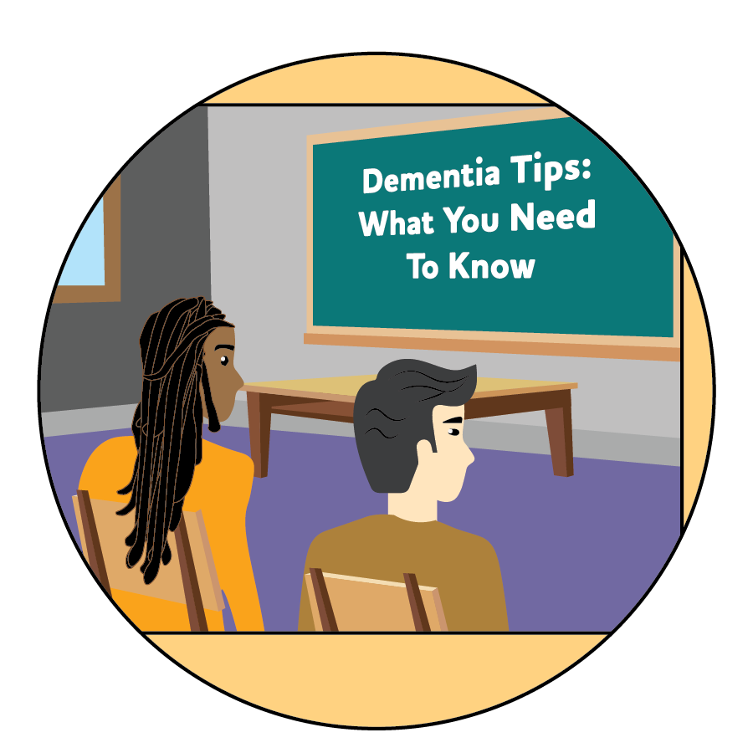
Workforce Training overview
Health care
Direct care
Public health
First responders
Other support services: transportation, customer service, faith-based organizations
Notes:
Certain professions may provide service and support to people with Alzheimer’s disease and their caregivers in a variety of ways. The workforces that would benefit from training and education include:
Health care workforce: including primary care physicians, specialists (neurologists, geriatricians, psychiatrists), nurses, community health workers, social workers, psychologists, pharmacists, and dentists
Direct care professionals: the workforce that provides the majority of the paid daily care (such as helping with bathing, dressing, housekeeping, food preparation, etc.) for people with Alzheimer’s and dementia; includes nurse aides, home health aides, and personal and home-care aides
Public health workforce including health educators, evaluators, biostatisticians, epidemiologists
First responders: including law enforcement, fire, emergency response teams, emergency medical technicians (EMTs), and adult protective services
Other professions: including transportation, customer service, and faith-based or spiritual organizations
Each of these will be discussed in more detail.

Slide 20
Discussion Question 4
What training should health care and direct care professionals receive?
Notes:
Ask: What training should health care and direct care professionals receive?
Open responses.

Slide 21
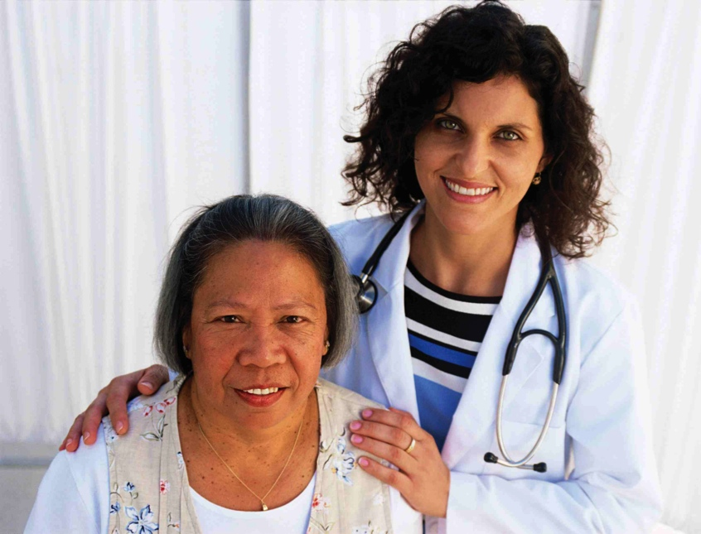
Workforce Training: Health Care & Direct Care¹⁷
Basics of dementia
Benefits of early diagnosis
How to address physical, cognitive, emotional, behavioral symptoms
Assisting caregivers
Managing co-morbidities
Use of validated assessment tools (health care)
Notes:
The health care and direct-care workforce need training and education on identifying and caring for someone with Alzheimer’s and dementia including:
The basics of dementia, including recognizing early warning signs
The benefits of early diagnosis
How to address the physical, cognitive, emotional, and behavioral symptoms of the disease to provide person-centered care. Person-centered care is a philosophy of care built around the needs of the individual with dementia and depends on interpersonal relationships with caregivers. Caregivers get to know the complete person- likes/dislikes, values/beliefs, who they are- past and present and build a caring relationship that can enhance person’s quality of life and wellbeing
How to assist caregivers as they cope with the physical and emotional aspects of their caregiving responsibilities
Management of co-morbidities (such as diabetes, hypertension, and heart disease)
The availability and use of tools and guidelines to identify dementia, including validated cognitive assessment tools (health care providers)

Slide 22
Discussion Question 5
What training should public health professionals receive?
Notes:
Ask: What training should public health professionals receive?
Open responses.

Slide 23
Workforce Training: Public Health
Alzheimer’s as a public health priority
Importance of early detection
Cognitive health and risk reduction
Types and availability of resources and supports
Caregiver burden and needs
Surveillance
Health disparities
Unique issues (stigma, abuse, advance planning)
Notes:
Public health plays a key role in surveillance, education, and prevention related to Alzheimer’s.
Training and education priorities for public health include:
Understanding Alzheimer’s as a public health priority
The importance of early detection
Cognitive health and risk reduction for Alzheimer’s
Types and availability of resources and supports for individuals with Alzheimer’s and dementia
Needs and burden of caregivers
Tracking surveillance data on cognitive decline and caregiving
Health disparities related to Alzheimer’s and dementia
Issues unique to Alzheimer’s and dementia, including stigma, potential for abuse, and the need for advance planning

Slide 24
Discussion Question 6
What training should first responders receive?
Notes:
Ask: What training should first responders receive?
Open responses.

Slide 25
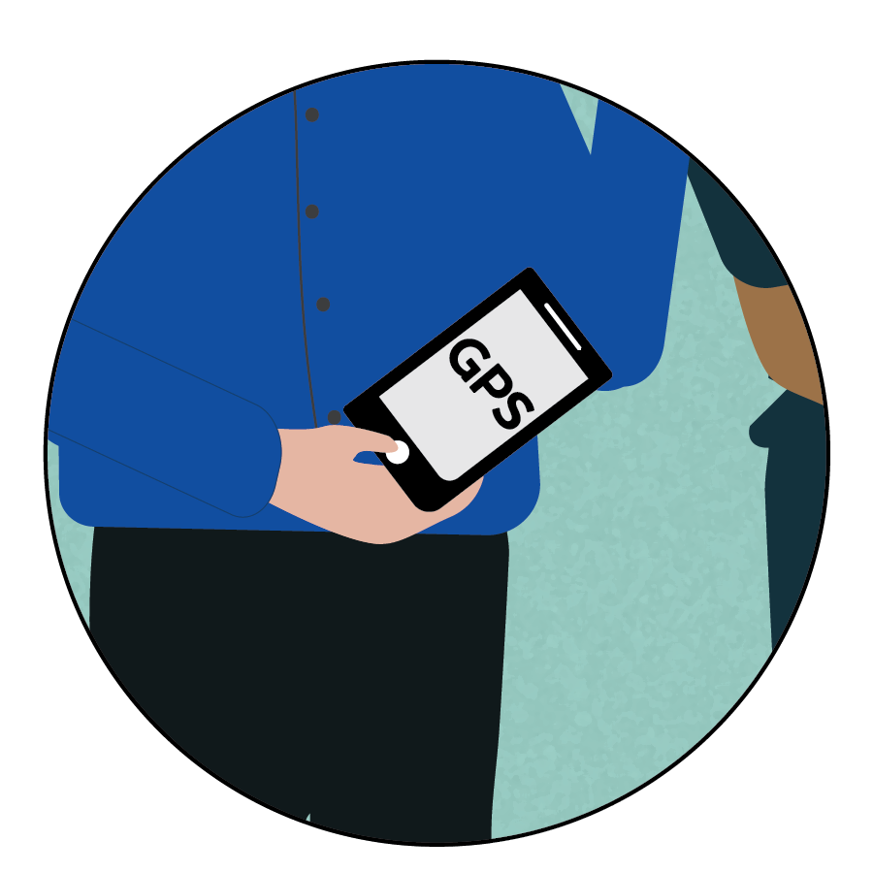
Workforce Training: First Responders
Situations involving stress or fear
Training needs:
Identifying Alzheimer’s and dementia
Effective interaction/communication
Resources
Registries, technologies
Notes:
First responders such as police, emergency medical personnel, and fire fighters may have first-hand contact with individuals with Alzheimer’s and other dementias during situations that involve stress or fear, such as:
Wandering, being lost, or disoriented
Natural or other disasters that may displace individuals with Alzheimer’s and/or separate them from their usual caregivers
Being subjected to physical, emotional, or financial abuse which is more likely to occur and can be harder to detect when an individual with dementia is no longer able to advocate for themselves or may be unable to recognize behaviors as abusive
Being reported to law enforcement for improper behavior, such as leaving a place of business after forgetting to pay for purchase
First responders and law enforcement need training on:
How to identify someone with Alzheimer’s and dementia
How to interact and communicate with people with Alzheimer’s in various situations (especially ones that are stressful for the person)
Resources to call upon for assistance or information
Existence of special needs registries or other technologies that may assist in locating individuals, their places of residence, or their caregivers
How to recognize the signs of abuse or neglect and notify adult protective services which investigates cases of abuse, neglect, or exploitation of older adults or disabled adults
Supplemental reading: Case study on EMS workers in CO
https://alz.org/media/Documents/case-study-co-ems-training.pdf

Slide 26
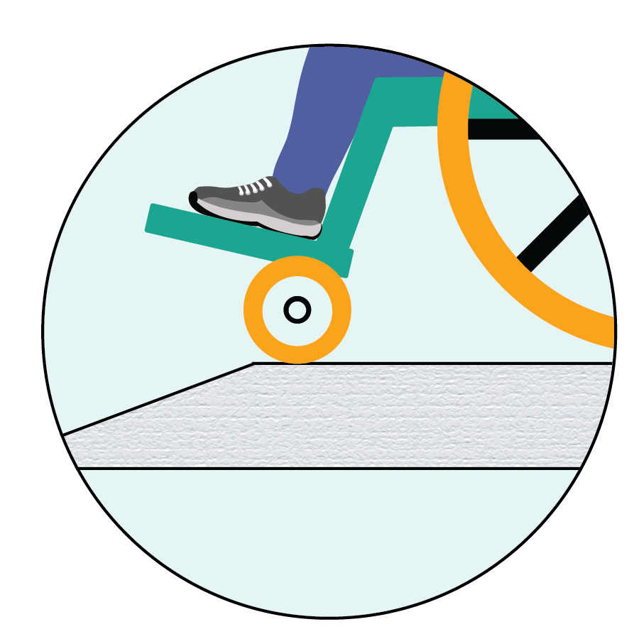
Workforce Training: Other Professions
Public transportation, customer service, faith/spiritual communities, etc.
Awareness
Recognizing need for help
Resources
Communication
Ways to assist and support
Notes:
Many other professionals come into contact with people with Alzheimer’s disease and require different levels of information:
Public transportation: For individuals with dementia, navigating public transportation can be very challenging. Operators and drivers need to be aware of the special challenges faced by individuals with dementia, as well as how to recognize the signs that someone may need help
Customer service: Those in service positions may be trained to recognize when they are dealing with someone with possible Alzheimer’s and dementia and how to best communicate with them and meet their needs
Faith or spiritual communities: These communities can be an important source of support and engagement for people with dementia, their families, and their caregivers. Church liaisons and volunteers may be trained to assist and support community members living with dementia

Slide 27
Caregiver needs and support
Dementia Capable Systems and dementia friendly communities
Notes:
Usually, the very first line of support and care for the person with dementia is a family caregiver. The family caregiver is part of the “workforce” in the sense that they have definite training needs. At the same time, they also need support themselves as they care for someone living with dementia.
Caregiving can be a rewarding experience, but also one that is high stress. As dementia progresses, caregivers often face a steep learning curve as well as the need for extra support as the person living with dementia needs more and more care. Part of making a dementia friendly community is putting in place supports and services for the caregiver. Let’s look at the needs of the dementia caregiver.

Slide 28
Support Services: Caregivers^{18,19}
Education/information/training
Alzheimer’s/dementia
Behavioral management
Available resources
Self-care
Notes:
When someone has Alzheimer’s or dementia, family members and friends who are caregivers will face an ever-changing set of needs that increase as the disease progresses. The majority of people with Alzheimer’s and dementia live in the community with many living independently until it becomes unsafe for them to continue living alone.
In 2017, 16 million family members and friends provided 18.4 billion hours of unpaid care to people with Alzheimer’s and other dementias. It is usually a daughter or daughter-in-law who takes on the role of being the primary caregiver for the individual.
As the disease progresses, the individual becomes more reliant on others for all their care needs. Many family caregivers try to meet these care needs themselves as long as possible, often reducing work hours or quitting their jobs as the level of care increases. Many arrange for the help of paid caregivers to provide additional assistance in the home, until the individual’s care needs exceed what can safely and continuously be provided in the home.
Most family caregivers are initially unprepared for the role. There is much to learn about the disease itself. At the same time, the caregiver is also taking on more of the individual’s life routines such as house maintenance, financial management, medication management, and eventually activities of daily living such as bathing, dressing, and eating.
These responsibilities typically add up to the caregiver needing support services for the person living with dementia and themselves, as well as training and ongoing education.
Support services and programs that have been found to be most effective for caregivers include multiple components to address different needs:
Education/information/training on:
Alzheimer’s and dementia and its effects on behavior throughout the continuum
Training on working with dementia-related behaviors designed to train caregivers to use specific techniques to manage behaviors that can be challenging (such as agitation, repetition, aggression, wandering)
Information on the availability of resources
Self-care, such as stress management, using respite services

Slide 29
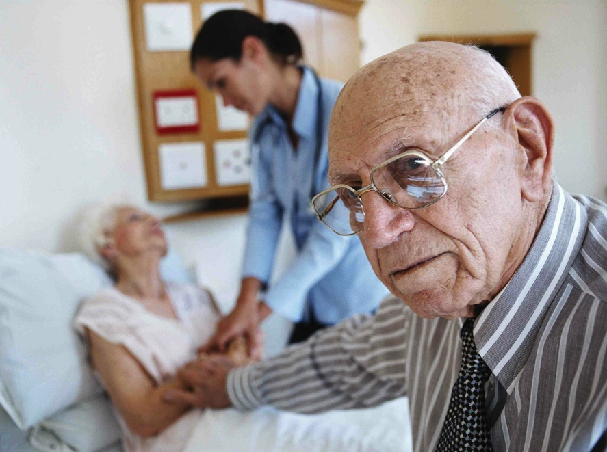
Support Services: Caregivers (continued)^{20,21}
Counseling/support groups
Case management
Respite services
Notes:
Support services for caregivers vary based on the individual need, but some of the most common forms of support include emotional support through individual counseling or support groups; care management to help manage the needs and coordinate care; and respite care which provides temporary time off.
Counseling/support groups:
Individual and family counseling
Support groups that have been found to have the most positive outcomes focus on specific objectives, such as teaching certain skills or strategies
Care management: helping to identify and manage care needs, and coordinate across care systems and providers. Professional care managers can help alleviate some of the tasks associated with caregiving, such as managing medical appointments, securing resources and services, and finding long term care if needed
Respite services: provides care for a person with Alzheimer’s disease on a temporary basis, providing much-needed time off for a family caregiver

Slide 30
Conclusion: Dementia Capable and dementia friendly
States/communities play significant role
Dementia capable systems and dementia friendly communities
Analyze community support needs
Support services and programs
Workforce training
Caregiver training and support
Notes:
In conclusion, states and communities can play an active role in reducing the burden of the Alzheimer’s and dementia. Two approaches are creating dementia capable systems and dementia friendly communities. The concepts are similar and can overlap, but the focus of both is on accommodating those with dementia and their caregivers through providing support and services within their communities. Public health must take an active role in fostering dementia capable systems and dementia friendly communities through:
Analyzing community support needs for those with dementia and their caregivers, and using those findings to design effective programs, policies, and best practices
Serving to provide, inform, and connect individuals and caregivers to support services and programs
Designing and implementing workforce training to ensure workers across a wide range of professions are able to identify and meet the needs of people with Alzheimer’s and dementia
Providing caregivers with the support and training they need to better care for the person living with dementia
Supporting the creation of dementia friendly communities that help people with Alzheimer’s and dementia remain safe and as independent as possible

Slide 31
For More Information
For more information, please visit:
Alzheimer’s Association website at http://www.alz.org
CDC’s Alzheimer’s Disease and Healthy Aging Program at https://www.cdc.gov/aging/
Notes:
For more information on the topics covered in this presentation, please go to the Alzheimer’s Association website at http://www.alz.org or the Centers for Disease Control and Prevention’s Alzheimer’s Disease and Healthy Aging Program at https://www.cdc.gov/aging/. There you can find resources, latest research and information.

Slide 32
COmpetencies
Academy for Gerontology in Higher Education (AGHE):
I.6.7 Promote and apply the use of appropriate forms of evidence-based interventions and technologies for older adults, their families, and caregivers
II.4.5 Provide the following groups information and education in order to build a collaborative aging network:
Key persons in the community (police officers, firefighters, mail carriers, locale service providers, and others)
Aging workforce professionals and personnel (paid and unpaid; full-and part-time) in the field of aging
Council on Education for Public Health (CEPH) Foundational Competencies:
2. Locate, use, evaluate, and synthesize public health information (bachelors level)
4. Interpret results of data analysis for public health research, policy, or practice (masters level)
Council on Linkages Between Academia and Public Health Practice:
8A3. Describes the ways public health, health care, and other organizations can work together or individually to impact the health of a community
8A4. Contributes to development of a vision for a healthy community (e.g., emphasis on prevention, health equity for all, excellence, and innovation)
Notes:
(This slide can be edited as needed or removed)
The content in this presentation supports the development of the following competencies:
Academy for Gerontology in Higher Education (AGHE):
I.6.7 Promote and apply the use of appropriate forms of evidence-based interventions and technologies for older adults, their families, and caregivers
II.4.5 Provide the following groups information and education in order to build a collaborative aging network:
Key persons in the community (police officers, firefighters, mail carriers, locale service providers, and others)
Aging workforce professionals and personnel (paid and unpaid; full-and part-time) in the field of aging
Council on Education for Public Health (CEPH) Foundational Competencies
2. Locate, use, evaluate, and synthesize public health information (bachelors level)
4. Interpret results of data analysis for public health research, policy, or practice (masters-level)
Council on Linkages Between Academia and Public Health Practice:
8A3. Describes the ways public health, health care, and other organizations can work together or individually to impact the health of a community
8A4. Contributes to development of a vision for a healthy community (e.g., emphasis on prevention, health equity for all, excellence, and innovation)

Slide 33
References 1
¹ Alzheimer’s Association. (2019) 2019 Alzheimer’s Disease Facts and Figures.
² Alzheimer’s Association. (2019) 2019 Alzheimer’s Disease Facts and Figures.
³ Turner, N., Morken, L. (2016) Better Together: A Comparative Analysis of Age-Friendly and Dementia Friendly Communities. AARP International Affairs. Retrieved from https://www.aarp.org/content/dam/aarp/livable-communities/livable-documents/documents-2016/Better-Together-Research-Report.pdf
⁴ U.S. Administration for Community Living/Administration on Aging. (2014) Dementia-Capable States and Communities: The Basics.
⁵ The Gerontological Society of America. (2015) Dementia Friendly, Dementia Capable, and Dementia Positive: Concepts to Prepare for the Future.
⁶ Alzheimer’s Association and Centers for Disease Control and Prevention. Healthy Brain Initiative, State and Local Public Health Partnerships to Address Dementia: The 2018-2023 Road Map. Chicago, IL: Alzheimer’s Association; 2018.
⁷ Tilly, J., Weiner, J., Gould, E., and O’Keefe, J. (2011) Making the Long-Term Services and Supports System Work for People with Dementia and Their Caregivers. Washington, DC: Administration for Community Living. Retrieved from https://acl.gov/sites/default/files/triage/BH-Brief-Dementia-Capable-Basics.pdf
⁸ Alzheimer’s Association and Centers for Disease Control and Prevention. Healthy Brain Initiative, State and Local Public Health Partnerships to Address Dementia: The 2018-2023 Road Map. Chicago, IL: Alzheimer’s Association; 2018.
⁹ Alzheimer’s Association. (2019) 2019 Alzheimer’s Disease Facts and Figures.
¹⁰ Alzheimer’s Association and Centers for Disease Control and Prevention. Healthy Brain Initiative, State and Local Public Health Partnerships to Address Dementia: The 2018-2023 Road Map. Chicago, IL: Alzheimer’s Association; 2018.
¹¹ US. Administration on Aging. (2011) Dementia Capability Toolkit. Retrieved from https://www.aarp.org/content/dam/aarp/livable-communities/old-learn/health/Dementia-Capability-Toolkit-2011-AARP.pdf

Slide 34
References 2
¹²Tilly, J., Wiener, J., & Gould, E. (2014) Dementia-Capable States and Communities: The Basics. Washington, DC: Administration for Community Living. Retrieved from: https://acl.gov/sites/default/files/triage/BH-Brief-Dementia-Capable-Basics.pdf
¹³ Alliance for Aging Research. (2012) Translating Innovation to Impact: Evidence-based Interventions to Support People with Alzheimer’s Disease and their Caregivers at Home and in the Community.
¹⁴ Oregon Health & Sciences University. (2017) Preserving Memories to Maintain Cognitive Health.
¹⁵ Alzheimer’s Association and Centers for Disease Control and Prevention. Healthy Brain Initiative, State and Local Public Health Partnerships to Address Dementia: The 2018-2023 Road Map. Chicago, IL: Alzheimer’s Association; 2018.
¹⁶ ACT on Alzheimer’s. (2014) Alzheimer’s Disease Curriculum, Module X: Caregiver Support.
¹⁷ Fazio, S., Pace, D., Flinner, J. & Kallmyer, B. (2018) The Fundamentals of Person-Centered Care for Individuals With Dementia. The Gerontologist, 58(1), S10–S19. https://doi.org/10.1093/geront/gnx122
¹⁸ ACT on Alzheimer’s. (2014) Alzheimer’s Disease Curriculum, Module X: Caregiver Support.
¹⁹ Alzheimer’s Association and Centers for Disease Control and Prevention. Healthy Brain Initiative, State and Local Public Health Partnerships to Address Dementia: The 2018-2023 Road Map. Chicago, IL: Alzheimer’s Association; 2018.
²⁰ ACT on Alzheimer’s. (2014) Alzheimer’s Disease Curriculum, Module X: Caregiver Support.
²¹ Alzheimer’s Association. (2019) 2019 Alzheimer’s Disease Facts and Figures.

