Slide 1
Instructions
Intended use
West Nile virus social media graphics for Instagram. Dimensions: 1080 x 1080 pixels.
State and Local Health Departments may add information to slides 4 and 6. Text on slides 8-16 is intended to be static, though the text may still be customized to fit style requirements, if desired.
Branding
State and Local Health Departments may change design colors and add branding elements to align with any branding restrictions.
Exporting slides as .jpg or .png
File > Save a Copy
Change “PowerPoint Presentation (*.pptx)” to “JPEG File Interchange Format (*.jpg)” or “PNG Portable Network Graphics Format (*.png)”
Save
Questions or requests
Contact CDC-INFO at 800-232-4636 or https://www.cdc.gov/cdc-info/index.html

Slide 2
General Outbreak Alerts

Slide 3
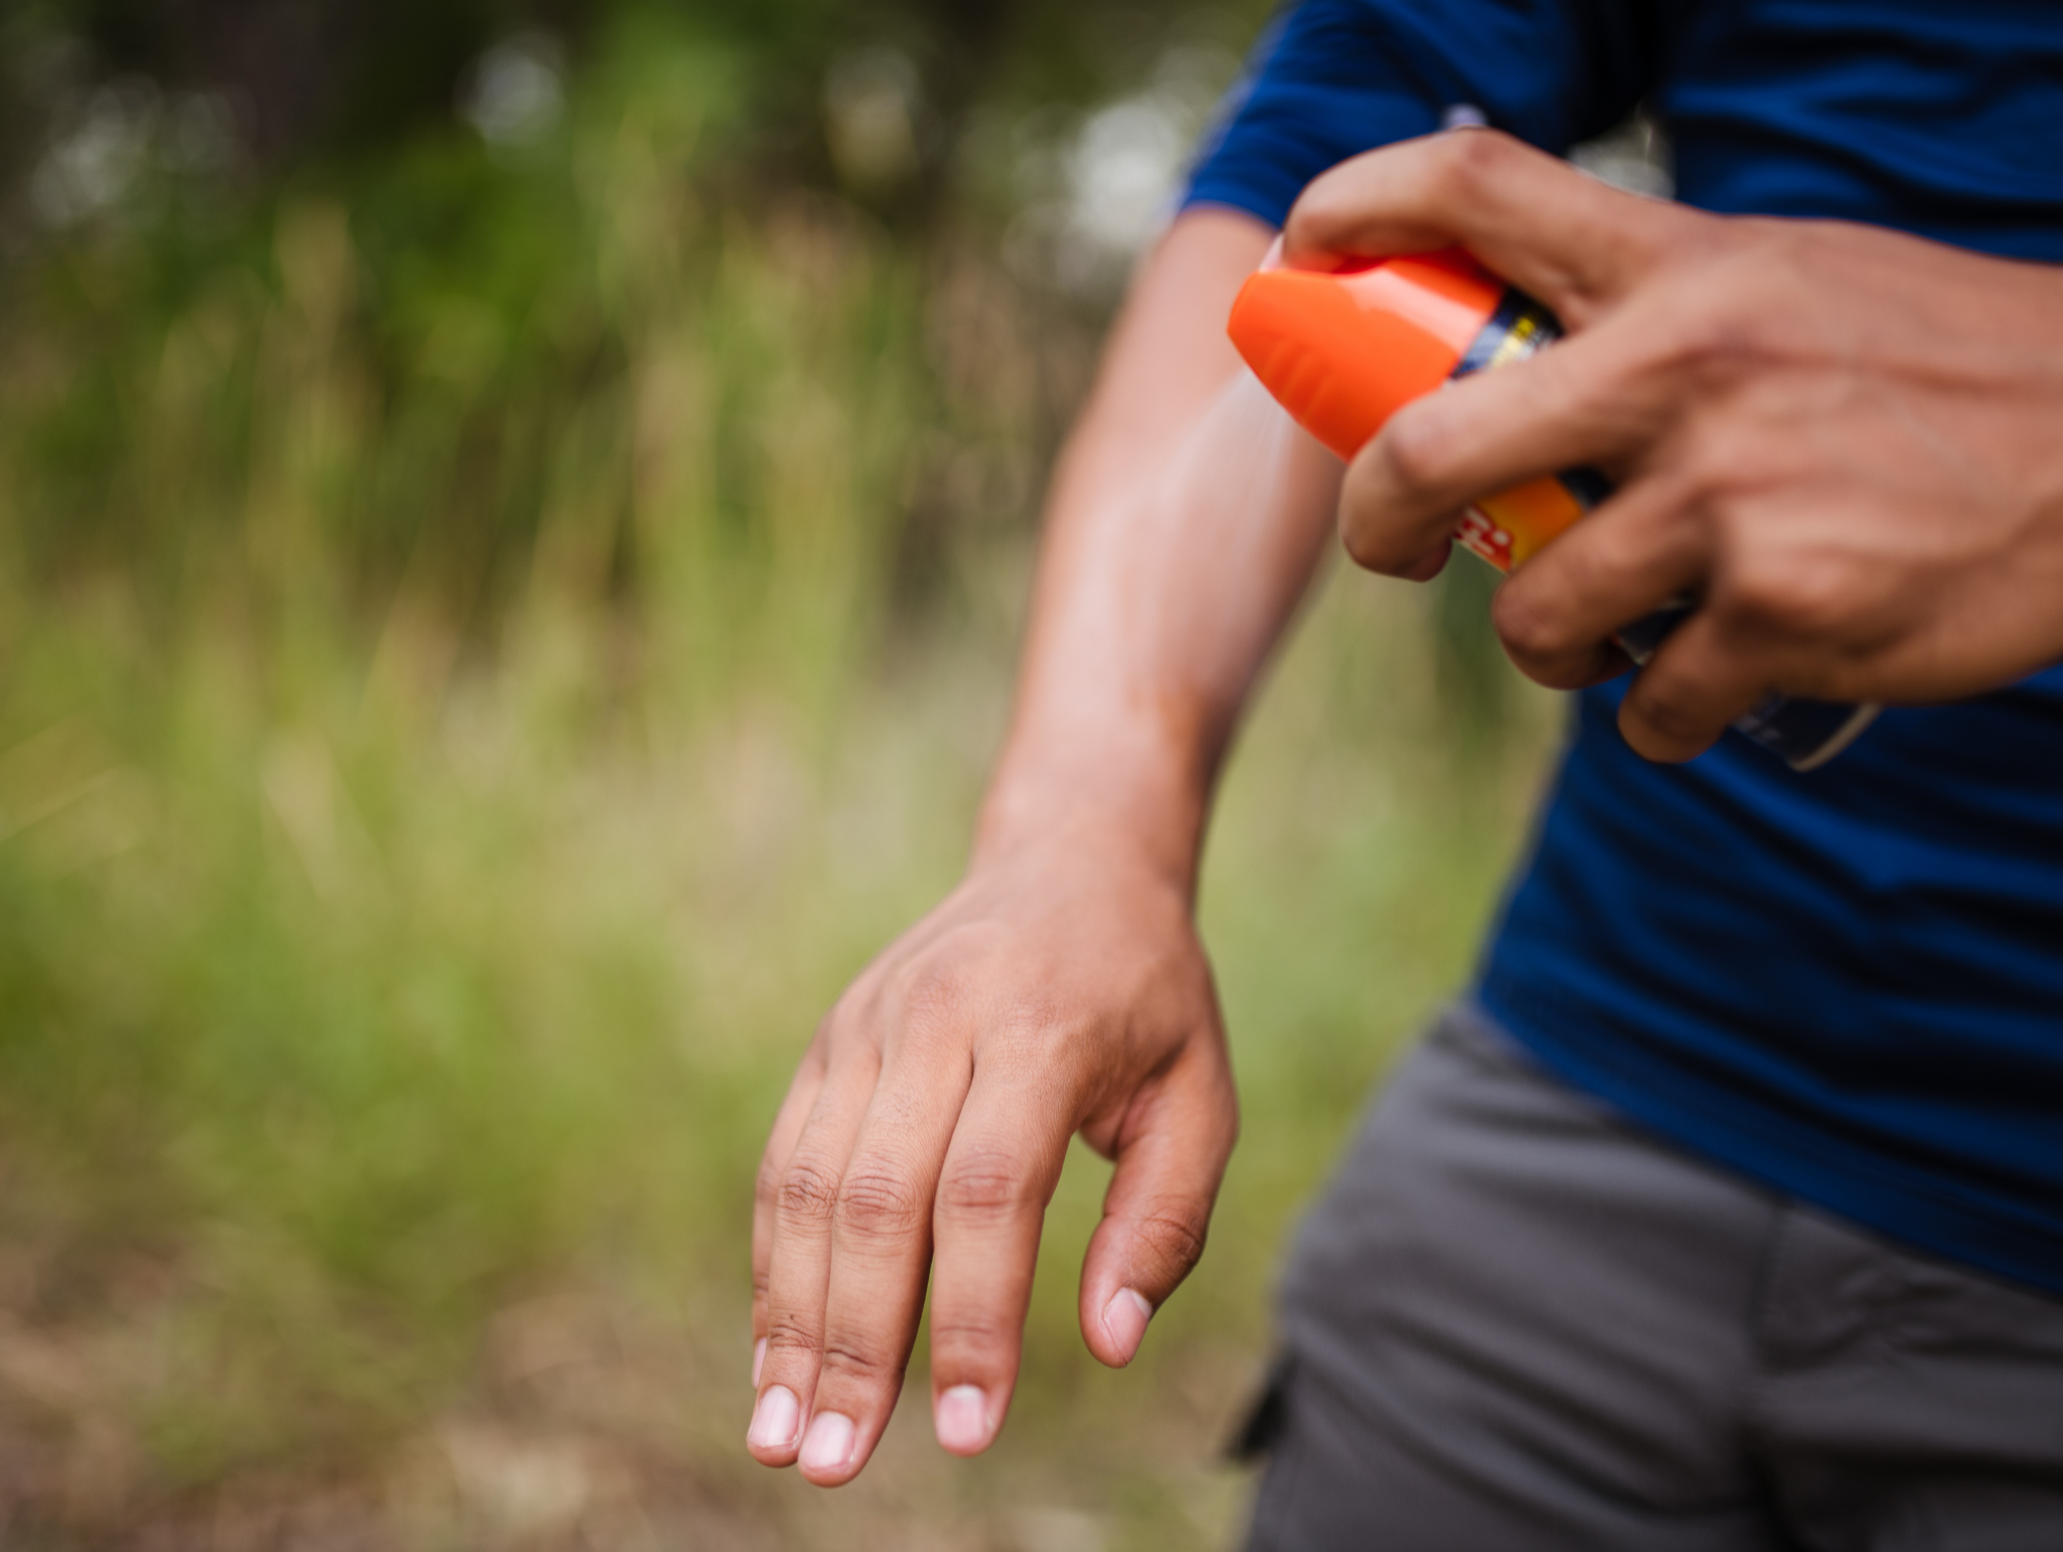
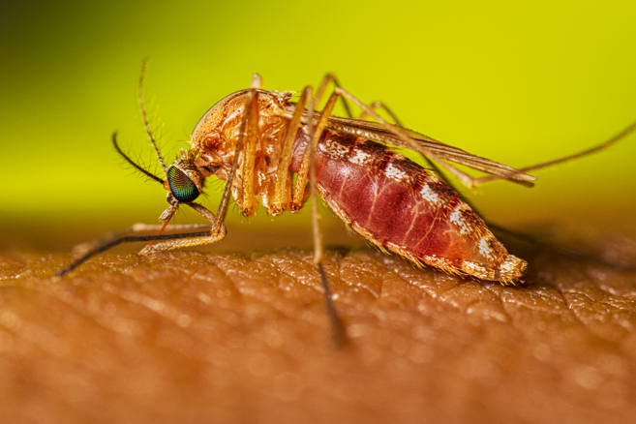
West Nile Virus Alert
West Nile Virus
ALERT
Stay safe! Prevent mosquito bites.

Slide 4
West Nile Virus Alert, Customize
West Nile Virus
ALERT
Stay safe! Prevent mosquito bites.
[INSERT LOCATIONS IMPACTED OR OTHER INFORMATION]

Slide 5

West Nile Virus Outbreak
West Nile Virus
OUTBREAK
Stay safe! Prevent mosquito bites.

Slide 6
West Nile Virus Outbreak, Customize
West Nile Virus
OUTBREAK
Stay safe! Prevent mosquito bites.
Key outbreak update 1, ideally less than 10 words
Key outbreak update 2, ideally less than 10 words
Key outbreak update 3, ideally less than 10 words
As of [DATE]

Slide 7
Populations with higher risk of severe illness

Slide 8

Living with cancer, diabetes, high blood pressure, or kidney disease?
You are at higher risk of severe illness if you get West Nile virus.

Slide 9

Mosquito bite prevention is important for everyone, especially as you get older.
Risk of severe illness from West Nile virus increases with age.

Slide 10

What do leukemia, lymphoma, rheumatoid arthritis & multiple sclerosis have in common?
They are treated with medicines— like rituximab or ocrelizumab— that make it hard for your body to fight West Nile virus.

Slide 11

If you’ve received an organ transplant, you’re at higher risk of severe illness from West Nile virus.
Stay safe! Prevent mosquito bites.

Slide 12
For Healthcare Providers

Slide 13

Clinicians, consider diagnosis, neuroinvasive
Clinicians,
Consider West Nile virus in patients with meningitis or encephalitis.
West Nile virus can leave your patients paralyzed or with long-term neurological damage.

Slide 14

Clinicians, consider diagnosis, overall
Clinicians,
Consider West Nile virus as a diagnosis if…
It’s mosquito season
+
Your patient has flu-like symptoms or unexplained neurological symptoms

Slide 15

Clinicians, testing
Clinicians,
Do you know how to test for West Nile virus?
Test for specific IgM antibodies in CSF or serum.
+
If needed, state labs can confirm with a neutralizing antibody test.

Slide 16

Clinicians, CME credit
Clinicians,
Do you need CME credit?
Learn how to diagnose and manage West Nile virus disease.
https://bit.ly/WestNileTraining

