Slide 1
Instructions
Intended use
West Nile virus sign for print and outdoor use. Dimensions: 18 x 24 inches.
Branding
State and Local Health Departments may change design colors and add branding elements to align with any branding restrictions.
Exporting slides as a different file type
File > Save a Copy
Change “PowerPoint Presentation (*.pptx)” to whichever file type you prefer, such as .pdf, .jpg, .png, etc.
Save
Questions or requests
Contact CDC-INFO at 800-232-4636 or https://www.cdc.gov/cdc-info/index.html

Slide 2




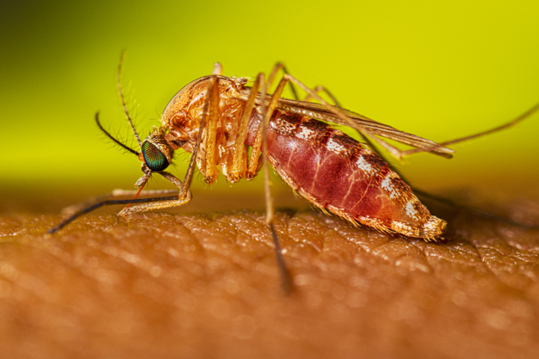
WEST NILE VIRUS HAS BEEN DETECTED IN THIS AREA
Why it matters
People can get sick from the bite of an infected mosquito.
Symptoms of mild illness can include fever, fatigue, aches, and joint pain. Severe illness can include high fever, stupor, disorientation, coma, tremors, muscle weakness, vision loss, numbness, and paralysis.
Risk of severe illness increases with age or if you have a chronic medical condition or weakened immune system due to a health condition or medication.
Prevent mosquito bites
Use EPA-registered mosquito repellent
Wear long, loose-fitting shirts and pants
Avoid being outside from dusk to dawn
Use screens on windows and doors or air conditioning

