Slide 1
Instructions
Intended use
West Nile virus postcard mailer for print. Dimensions: 5.5 x 4.3 inches.
Branding
State and Local Health Departments may change design colors and add branding elements to align with any branding restrictions.
Exporting slides as a different file type
File > Save a Copy
Change “PowerPoint Presentation (*.pptx)” to whichever file type you prefer, such as .pdf, .jpg, .png, etc.
Save
Questions or requests
Contact CDC-INFO at 800-232-4636 or https://www.cdc.gov/cdc-info/index.html

Slide 2
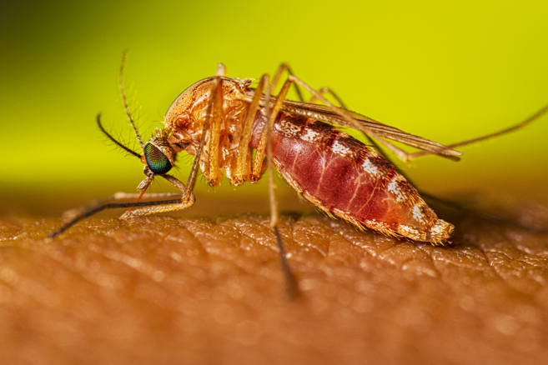





West Nile Virus Alert
[INSERT AREA(S) IMPACTED]
West Nile virus has been detected in [INSERT SURVEILLANCE EVENT].
Some people are at higher risk of severe illness:
Use EPA-registered repellent
Wear long, loose-fitting shirts and pants
Avoid being outside from dusk to dawn
Use screens on windows and doors or air conditioning
Risk increases with age
People with cancer, diabetes, high blood pressure, or kidney disease
People with weakened immune systems due to a health condition or medication
[INSERT URL]
Contact us: [INSERT INFO]
Notes:
5.5 x 4.3 inches

