Slide 1
Instructions
Intended use
West Nile virus flyer for print. Dimensions: 8.5 x 11 inches.
State and Local Health Departments may customize the text to specify areas impacted, surveillance events, and where the public can find more information.
Branding
State and Local Health Departments may change design colors and add branding elements to align with any branding restrictions.
Exporting slides as a different file type
File > Save a Copy
Change “PowerPoint Presentation (*.pptx)” to whichever file type you prefer, such as .pdf, .jpg, .png, etc.
Save
Questions or requests
Contact CDC-INFO at 800-232-4636 or https://www.cdc.gov/cdc-info/index.html

Slide 2
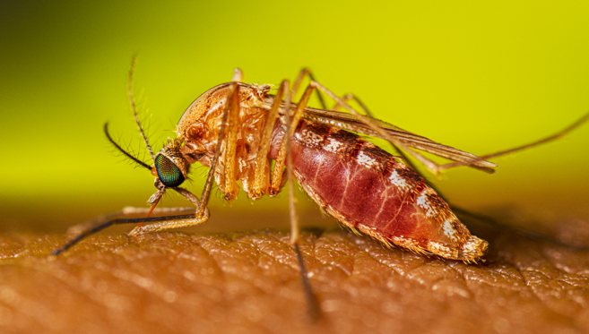









West Nile Virus Alert
[INSERT AREA(S) IMPACTED]
West Nile virus has been detected in [INSERT SURVEILLANCE EVENT].
Some people are at higher risk of severe illness:
Risk increases with age
People with chronic medical conditions, such as cancer, diabetes, high blood pressure, kidney disease
People with a weakened immune system due to a health condition or medication
Stay Safe
Know the Signs
Most people develop symptoms within 2 weeks after being bitten by an infected mosquito. 80% of people have no symptoms.
Use EPA-registered mosquito repellent
Wear long, loose-fitting shirts and pants
20% of people develop fever, head or body aches, joint pain, vomiting, diarrhea, or rash.
Less than 1% of people develop severe illness, including confusion, tremors, coma, muscle weakness, or paralysis.
Avoid being outside from dusk to dawn
Use screens on windows and doors or air conditioning
[INSERT URL]
Contact us: [INSERT INFO]
Notes:
8.5 x 11 inches

