Slide 1
WCMS Template Package 4 (TP4): UX Best Practices
July 17, 2018

Slide 2
Template 4.X: UX Recommendations
Key items to review:
Viewports
Grids
Themes
Icons
Site Identity
Navigation
Area Under Left Navigation
Containers
If there is time…..
Template Types
Breadcrumbs
Page Sharing
Feature Area
Visual Element
Page Title
Page Language
Page Format
Page Last Reviewed
Persistent Content Area
Fonts
Links
Images
Accordions / Tabs
4th Level Nav / Multipage Nav
Tables

Slide 3
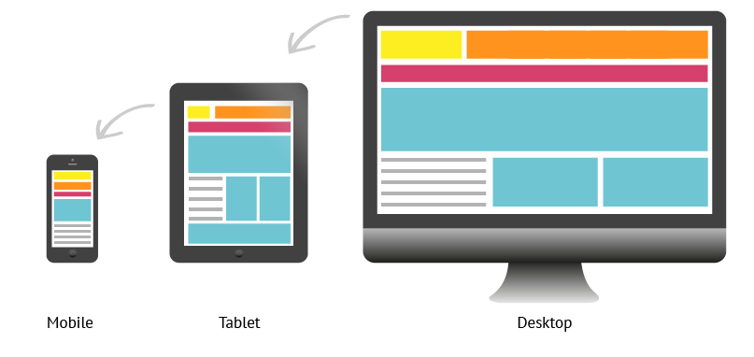
OVERVIEW Viewports
Most design decisions have been grouped into 2 categories: “Mobile” (XS, S, M) and “Desktop” (L, XL, XXL).

Slide 4
UX RECCOMENDATION Viewports
Test designs in different viewports: Most external traffic is estimated to be viewing the TP4 pages in XS (42%), XL (28%), and XXL (13%).
Ensure that designs are optimized for XS (Viewport 1) and XL (Viewport 5) at a minimum.

Slide 5
OVERVIEW Grids
TP4 includes 12 Grid Columns
15 px left / right gutters
30 px gutter (15 px each left / right margins)

Slide 6
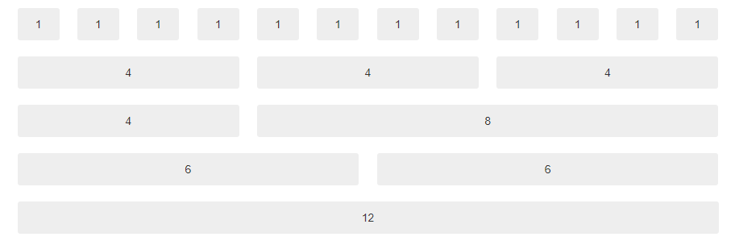
UX RECCOMENDATION Grids
Use a consistent column structure on your pages: Use common grid layouts for visual balance.

Slide 7
UX RECCOMENDATION Grids
Avoid changing the grid too many times on a page: While variation in the layout can make a page more interesting and also helps keep a page from feeling “boxy”, changing the number of columns too many times may make a page feel jumbled and cluttered.
Avoid nested rows and columns as these can also cause complexity and added risk.
Design in ‘sections’: If you do change the number of columns used on a page, consider designing sections to group related content and ensure that the layout flows seamlessly.
Create visual hierarchy: Ensure that the most important element have a visual hierarchy so that it is easy to determine the ‘order of importance’ of a page.

Slide 8
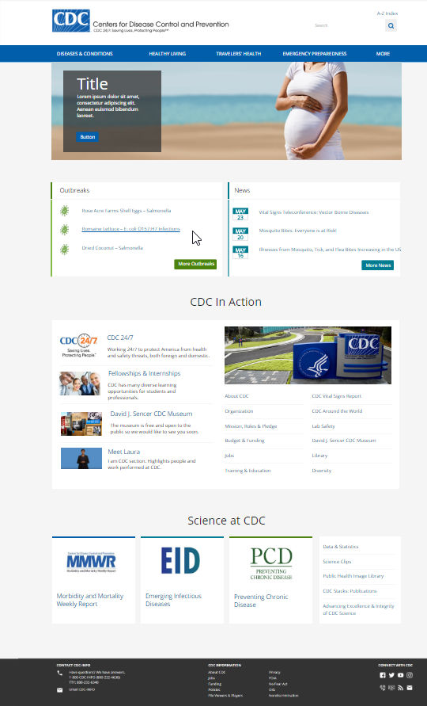
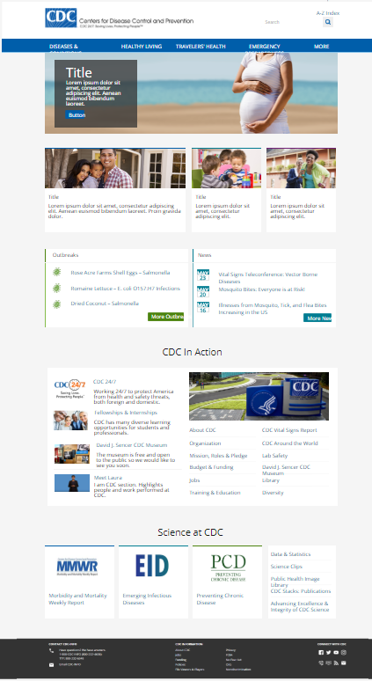
EXAMPLE:
Varying the grid in ‘screenfuls’ or ‘chunks’ can help to create distinct sections of a page that each have a defined purpose.
The homepage is using 4 columns as a base (within the 12 column grid).
Jumbotron: 100%
Features: 50%; 25%; 25:
Outbreaks / News: 50%
CDC in Action: 50%
Science at CDC: 25%

Slide 9
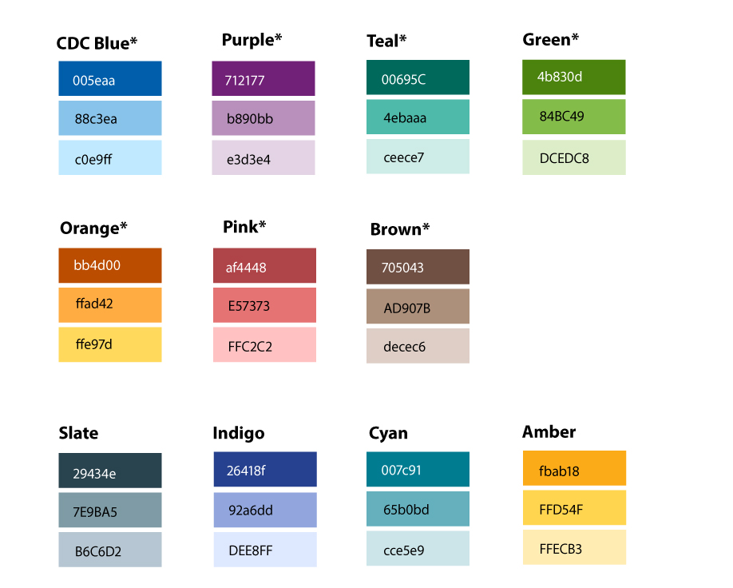
OVERVIEW Themes
TP4 includes “Main” and “Accent” themes made up the colors below.
75% of current CDC.gov web pages use either the blue, purple, or green themes.
Examples:

Slide 10
OVERVIEW Themes
Ability to mix and match any shade from the two color palettes: A main theme (3 shades) and accent theme (3 shades) for a total of 6 colors, plus 6 grays, and white – for a total of 14 different colors to use

Slide 11
UX RECCOMENDATION Themes
Follow 60-30-10 Rule for designing a full page
60% White / Gray
30% Main Theme
10% (OR LESS) Accent Theme
Use shades of the main color for visual interest: Using variations of the Main theme (primary, secondary, tertiary) colors can be used to help create visual interest and variation.
Use accent sparingly: The accent color should be used sparingly to draw attention to key items.
Avoid mixing colors too much: Avoid mixing colors the main and accent themes “too much”. When the colors are used together, it should be done with accent borders or buttons and not with background shading.
Limit use of color in your pages and when used, ensure color is strategic: The areas that do receive color gain more attention, such as text, images, and individual elements like buttons.

Slide 12
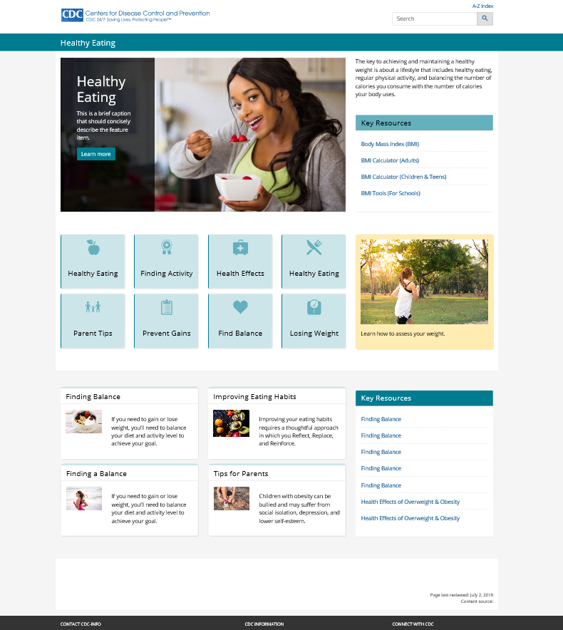
EXAMPLE:
Following the 60-30-10 Rule helps to keep the page fresh and clean, without overusing color.
60% White / Gray
30% Main Theme
10% (OR LESS) Accent Theme

Slide 13
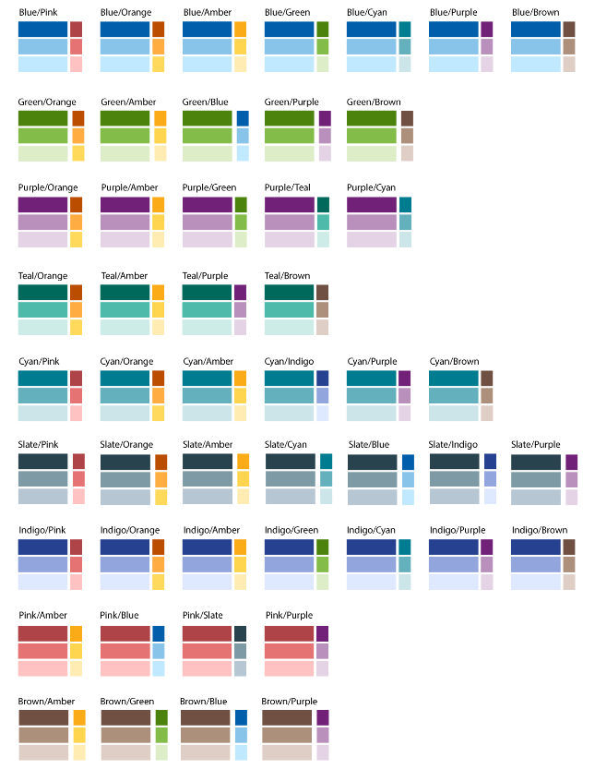
UX RECCOMENDATION Themes
Use recommended color pairings.

Slide 14
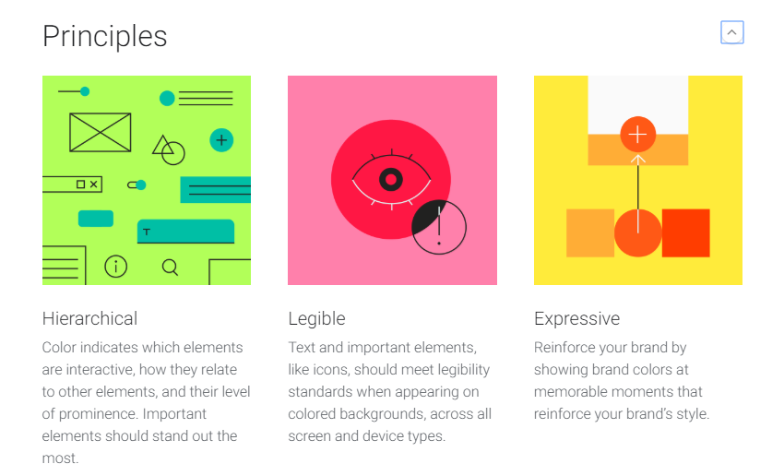
GOOGLE RECOMMENDATIONS Themes: General Guidelines
Use color to communicate page hierarchy
Ensure text and icons are accessible and legible
Use color to reinforce brand
https://material.io/design/color/the-color-system.html#color-usage-palettes

Slide 15
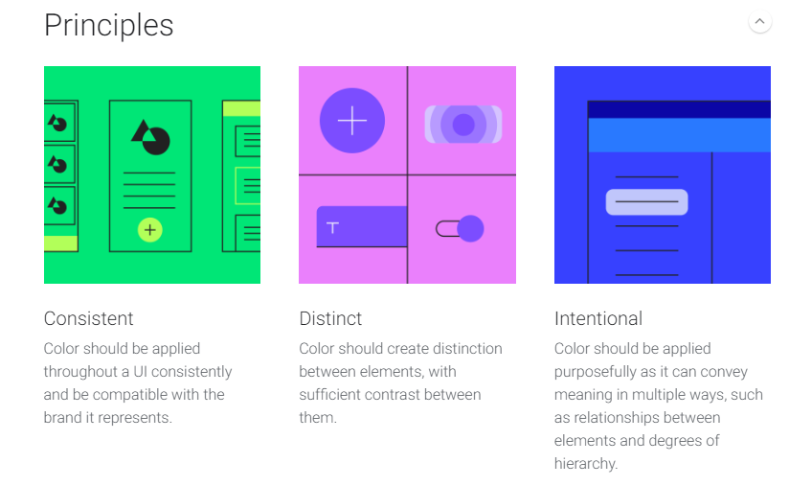
GOOGLE RECOMMENDATIONS Themes: General Guidelines
Use color to consistently
Use color to create distinction between elements
Use color intentionally to convey meaning and relationship between elements or to use degrees of hierarchy
https://material.io/design/color/applying-color-to-ui.html#

Slide 16
GOOGLE RECOMMENDATIONS Themes: Main Color
The main color is the color displayed most frequently across your app’s screens and components. If you don’t have an accent color, your main color can also be used to accent elements.
To create contrast between UI elements, such as distinguishing a top app bar from a system bar, you can use light or dark variants of your primary color on each elements.
Create contrast by using light and dark variants of your main theme (primary, secondary and tertiary color)
https://material.io/design/color/the-color-system.html#color-usage-palettes

Slide 17
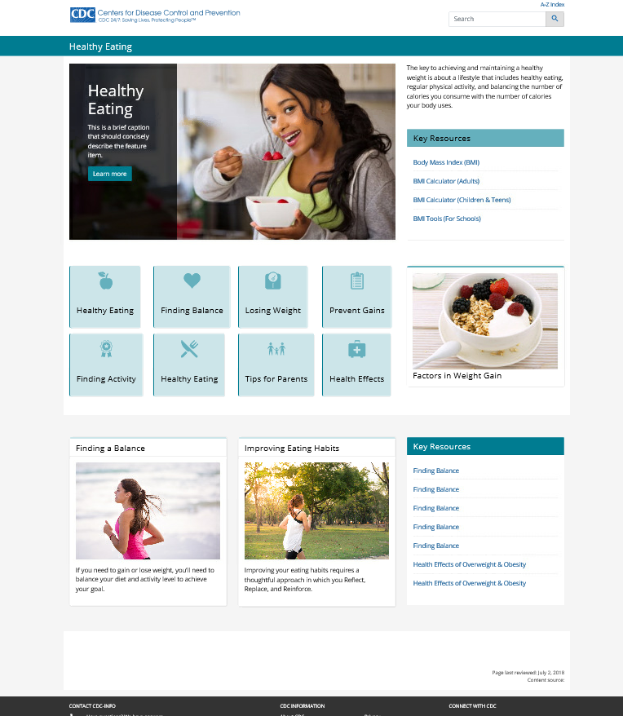
EXAMPLE:
Using shades of a single color can provide a uniform and attractive layout

Slide 18
GOOGLE RECOMMENDATIONS Themes: Accent Color
An accent color provides more ways to accent and distinguish your product. Having an accent color is optional, and should be applied sparingly to accent select parts of your UI.
Accent colors are best for:
Floating action buttons
Highlighting selected text
Links and headlines
Use accent colors sparingly
Use accent colors to communicate actions or interactive elements
Reserve the accent-primary colors for small elements like borders, buttons, heading, etc.
Use light colors for background colors (white, gray, main-tertiary, accent-tertiary).
https://material.io/design/color/the-color-system.html#color-usage-palettes

Slide 19
EXAMPLE:
Using accent colors sparingly can help to draw attention to key items or highlight important information.

Slide 20
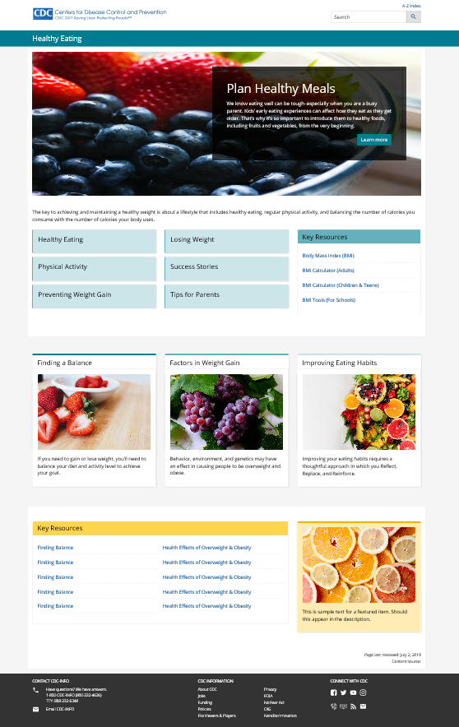
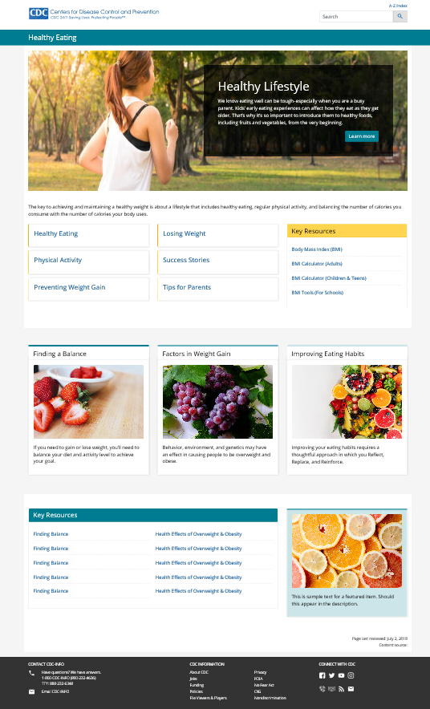
EXAMPLE:
Using colors in the same palette for different sections of the page can help to provide cohesiveness, while also providing visual interest by varying the color choices used throughout the page.

Slide 21
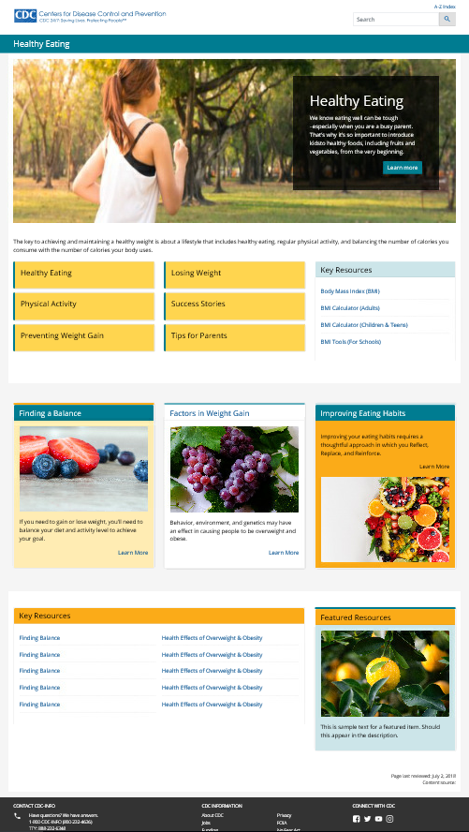
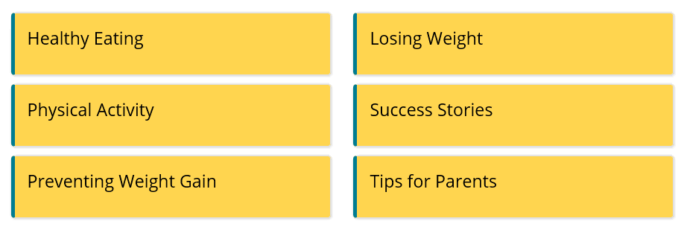
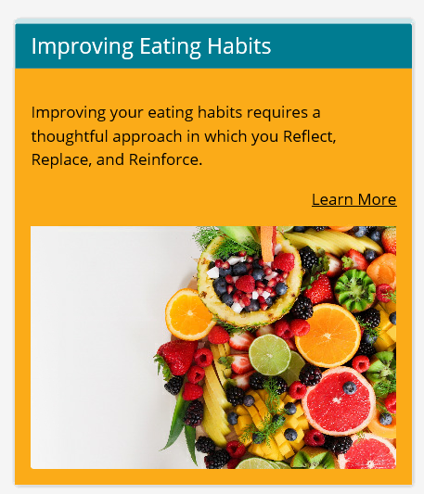
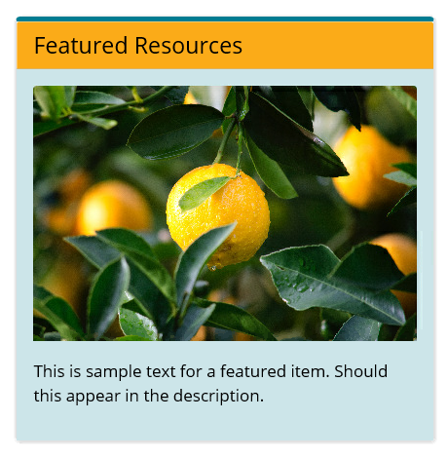
What NOT to do
EXAMPLE:
Avoid mixing colors too much: Avoid mixing colors the main and accent themes “too much”. When the colors are used together, it should be done with accent borders or buttons and not with background shading.
Use accent colors sparingly to draw attention.
Avoid using dark or especially bright colors for background colors.

Slide 22
What NOT to do
EXAMPLE:
Using too much color can actually distract from a page and make it hard to focus on any one item.
Judiciously using color can help to draw attention to items and highlight key content.
Color can also be used to help group related items and create visual separation between sections of a page.

Slide 23
What NOT to do
EXAMPLE:
Using too much color can actually distract from a page and make it hard to focus on any one item.
Judiciously using color can help to draw attention to items and highlight key content.
Color can also be used to help group related items and create visual separation between sections of a page.

Slide 24
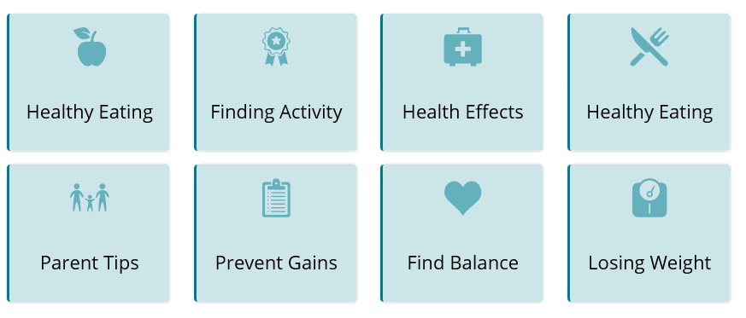
ACCESSIBILITY Themes
WCAG standards
All text should be legible and meet accessibility standards. The Web Content Accessibility Guidelines (WCAG 2.0) level AA requires a 4.5.1 color contrast between text and background for normal text, and 3:1 to large text.
Ensure contrast between background colors and icons is sufficient to pass 508
https://material.io/design/color/the-color-system.html#color-usage-palettes

Slide 25
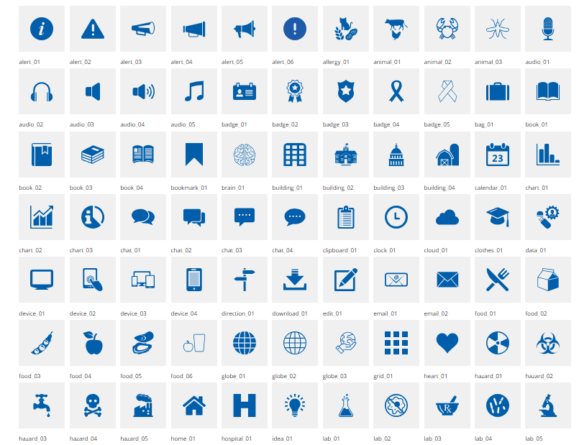
OVERVIEW Icons
All icons in SVG
Different size options
Color options

Slide 26
UX RECCOMENDATION Icons
Ensure color selections pass 508 and WCAG AA standards.

Slide 27
UX RECCOMENDATION Icons
Consider using a white or light gray background when using icons with color.
Consider using a dark background with a white icon.

Slide 28
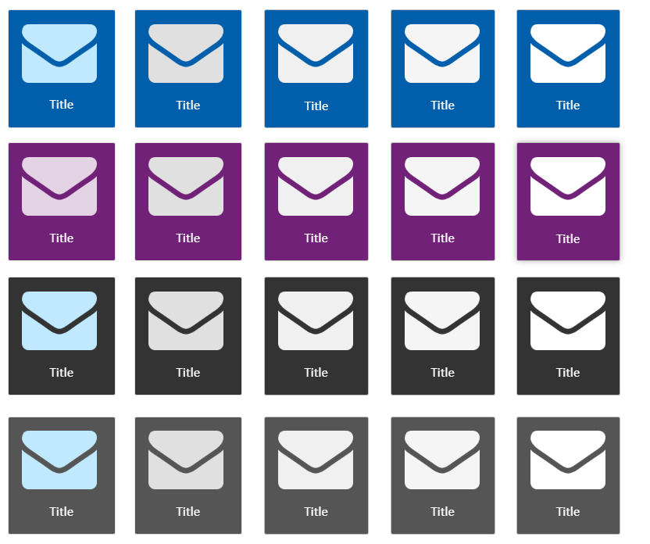
UX RECCOMENDATION Icons
If Background Color is set to
bg-primary
gray-darkest
gray-darker
Icon color options are:
[theme]-tertiary
gray- medium
gray
gray-light
white [default]

Slide 29
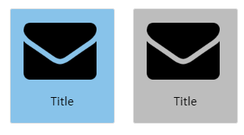
UX RECCOMENDATION Icons
If Background Color is set to
bg-secondary
gray-dark
Icon color options are:
black

Slide 30
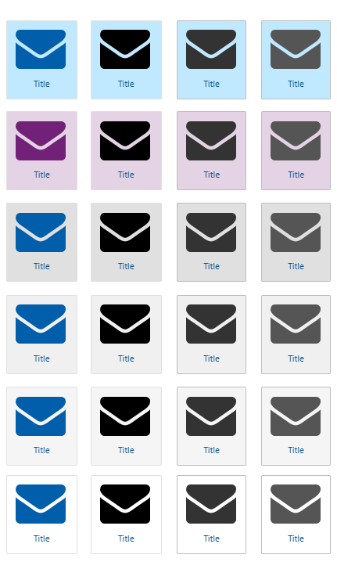
UX RECCOMENDATION Icons
If Background Color is set to
bg-tertiary
gray-medium
gray
gray-light
White
Icon color options are:
[theme]-primary [default]
black
gray-darkest
gray-darker

Slide 31
UX RECCOMENDATION Icons
Use when using a background color, select an icon color from the same palette.
Avoid mixing background colors and icon colors from different color palettes.

Slide 32
OVERVIEW Site Title Bar
Site Title
Site Title + Description (description hidden in mobile by default)
Site Title + Image (option to hide image in mobile)
Site Title + Description + Image

Slide 33
OVERVIEW Site Title Bar
When to use:
When the topic requires additional imagery beyond the textual title that must persist near the top of every page
When the campaign requires an image or a banner that must persist near the top of every page
When outbreak information must persist near the top of every page
When NOT to use:
If possible, avoid repeating the Topic Title text in the image
As a logo or image that does not comply with CDC’s branding policies or competes with the CDC brand, effectively creating a co-brand
As a way to inject a non-standard color palette onto every page in the site

Slide 34
UX RECCOMENDATION Site Title Bar
Use images that do not increase the height of the site title bar on desktop viewports.
Use white images.
Use images to brand a site.
Hide description in mobile.
Use of Site Identity (images) need to be approved by DMB. Email Lisa Richman or contact the WCMS helpdesk to coordinate approval.

Slide 35
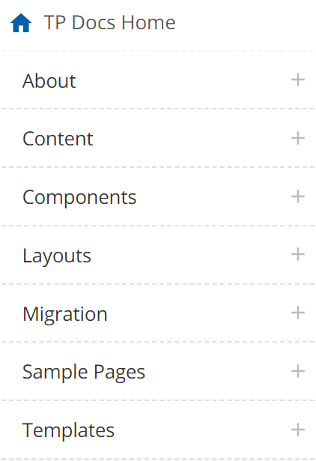
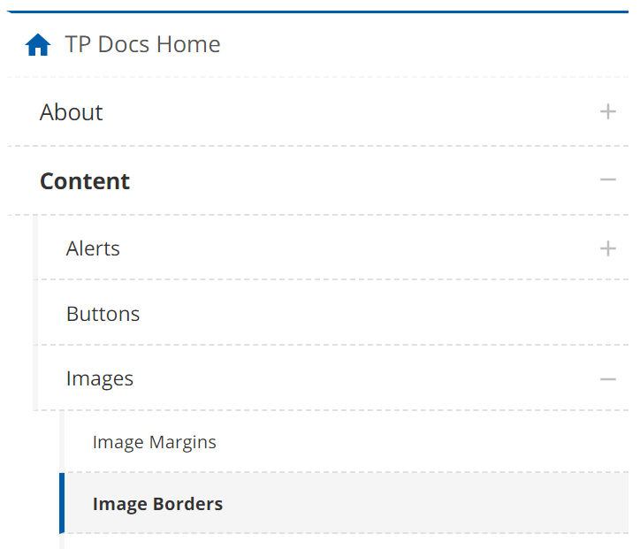
OVERVIEW Navigation
Left navigation shown in “desktop” viewports.
Section and Bottom navigation shown in “mobile” viewports.
Section Navigation
Bottom Navigation
Left Navigation

Slide 36
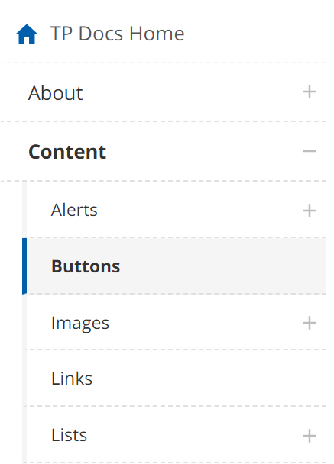
UX RECCOMENDATION Navigation: Left / Bottom
Home Link:
Use a short label for the “Home” link. Try to avoid wrapping for this link.
Level One:
Aim for no more than 7 – 10 items.
Navigation structures larger than 7 items can be unwieldy and difficult to use.
Use short labels that are easy to scan.
Level Two & Level Three:
Aim for 3-7 items.
Avoid only having 1-2 items.
Use short labels that are easy to scan.
External Links:
External links should NOT be added to left navigation. Left Navigation should include internal (CDC.gov) links only and in most cases should only include links to pages within the specific sub-site the navigation represents.
Left Navigation

Slide 37
UX RECCOMENDATION Navigation: Section
Use short labels when overriding section nav label.
Try to avoid long labels that wrap onto too many rows.
Avoid navigation structures with only 1 child page.
Section Navigation

Slide 38
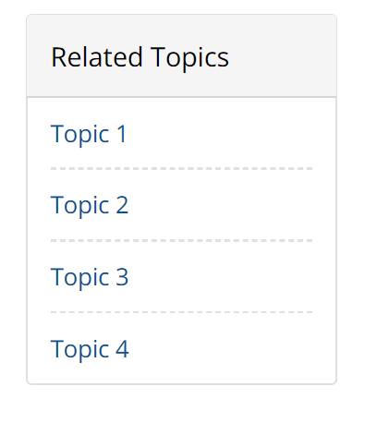
OVERVIEW Area Under Left Navigation
Shown in L, XL, XXL viewports under left navigation
Shown in XS, S, M viewports under bottom navigation

Slide 39
UX RECCOMENDATION Area Under Left Navigation
Avoid images and other brightly colored items.
Avoid colors from the main or accent theme.
Use ‘gray-lightest’ and keep containers ‘neutral’.

Slide 40
OVERVIEW Containers
Navigation Buttons: large navigation elements, often used in groups
Cards: variety of uses, built from Bootstrap 4 cards
Vertical Layout: brief content in short columnar layout
Horizontal Layout: wider content, better for summaries and lists
Containers have a variety of design options:
Width
Content Elements Header, Image, Title, Subtitle, Description, Source/Date, List
Colors all colors based on 2 themes, grays, white
Alignment/Position top, right, bottom, left based on Element
Margin and Padding many options based on Element
Interactive Elements Clickable Container, Links, Buttons
Other Visual Styles Border, Accent Border, Shadow

Slide 41
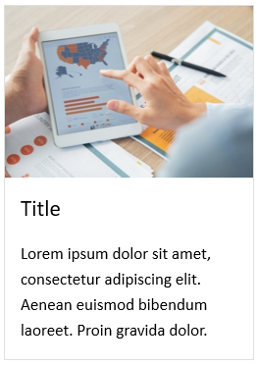
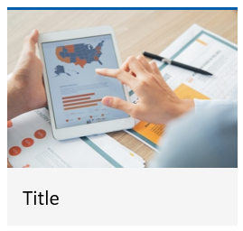
UX RECCOMENDATION Containers
Use neutral colors (white / gray) as the background color the majority of your cards. Colored backgrounds should be used sparingly to draw attention or highlight key content.

Slide 42
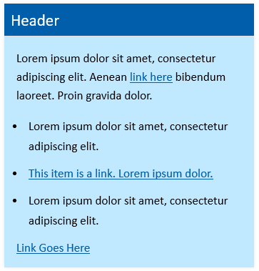
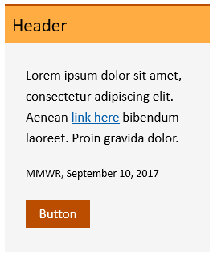
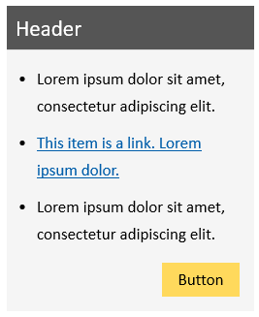
UX RECCOMENDATION Containers
Avoid using too many different styles on a page.
Avoid using too many colors in a single container. Most containers will look best with a single color (using different shades) or a single color with a small accent (such as a button).
Use of a single color with varying shades in a card.
Use of a single color with a small accent color.

Slide 43
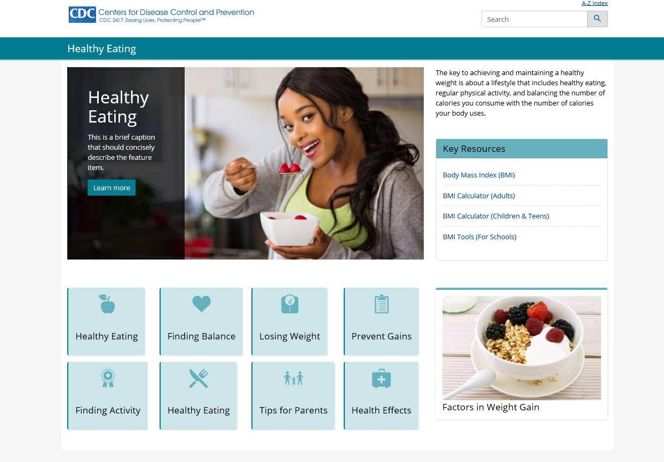
EXAMPLE:
Using variations of the primary shade can help to tie a page together and be visually appealing.

Slide 44
EXAMPLE:
Using variations of the primary shade can help to tie a page together and be visually appealing.

Slide 45
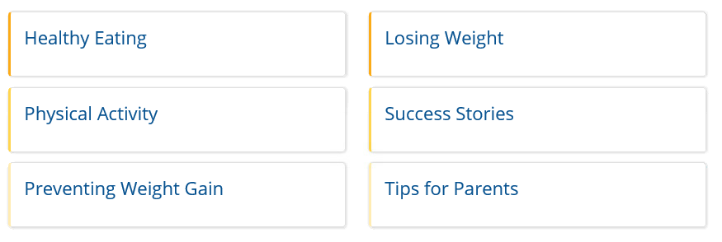
UX RECCOMENDATION Containers
Use borders and shading consistently on your pages to provide a cohesive look and feel.

Slide 46
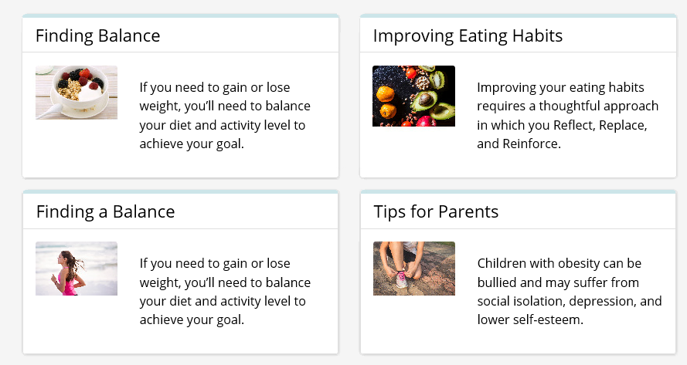
EXAMPLE:
Using borders can help “group” a set of cards so that users mentally see these items as “like” items.

Slide 47
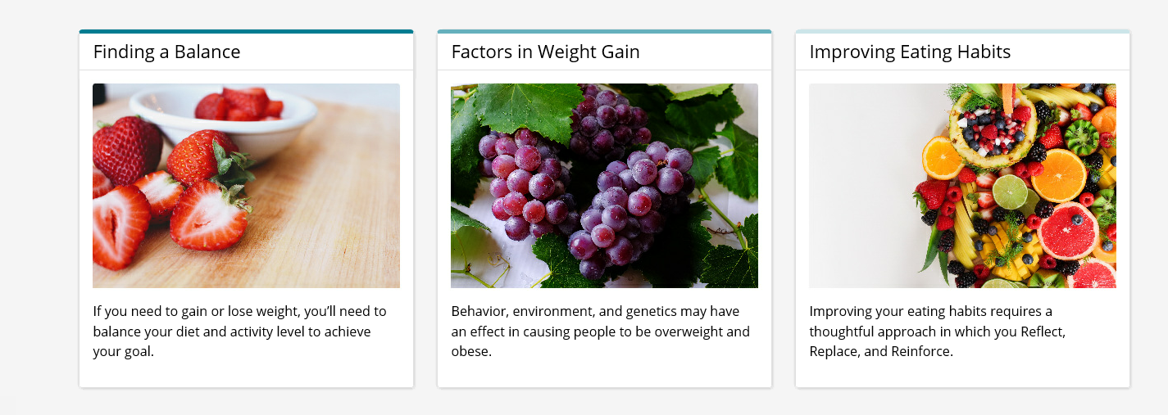
EXAMPLE:
Using different shades of the same color for borders can provide visual interest. Example below uses ‘main-primary’ for the first card, ‘main-secondary’ for the second card, and ‘main-tertiary’ for the third card.

Slide 48
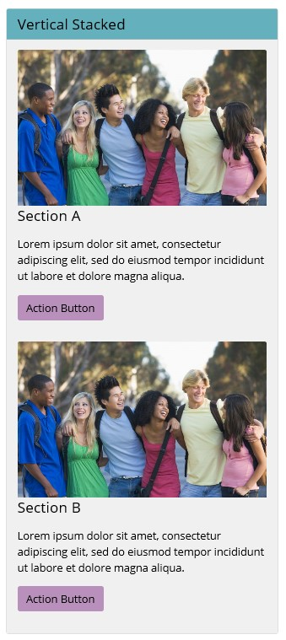
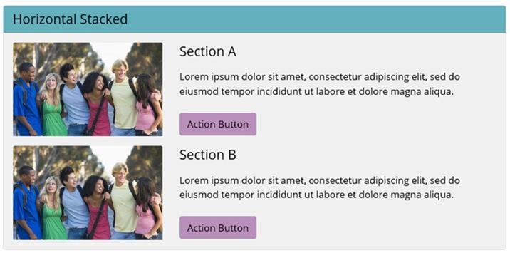
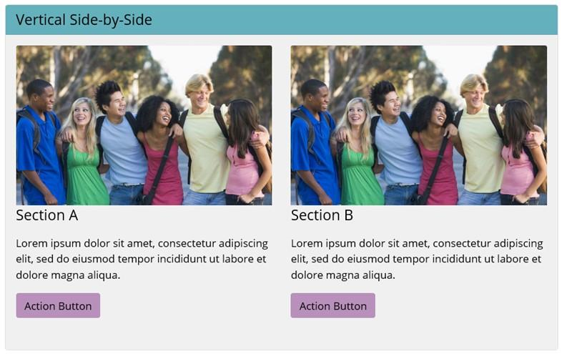
UX RECCOMENDATION Containers
Use headings when creating cards with sections.

Slide 49
UX RECCOMENDATION Containers
Use background row shading to visually group a set of related cards.

Slide 50
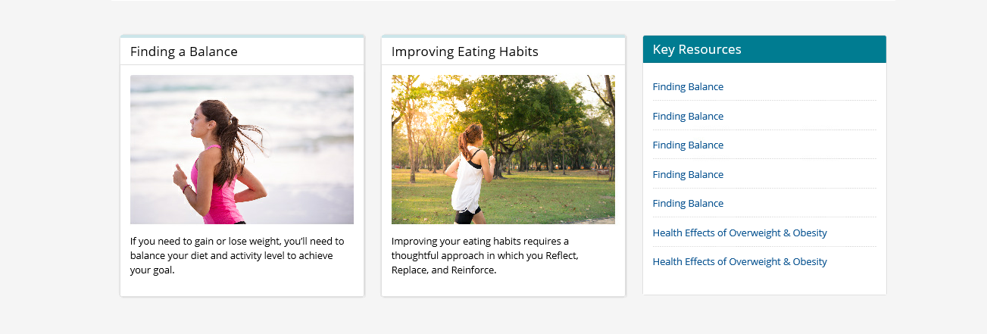
EXAMPLE:
Using background rows (especially ‘gray-lightest’) can help to set off an area of a page and group similar items into ‘screenfuls’ or smaller ‘chunks’.

Slide 51
OVERVIEW Template Types
Homepage: primary landing page for entire site, provides access to primary content areas, promotes key messages
Landing Page: pages within a site that have child items (not an option in WCMS)
Content Page: more detailed and descriptive content

Slide 52
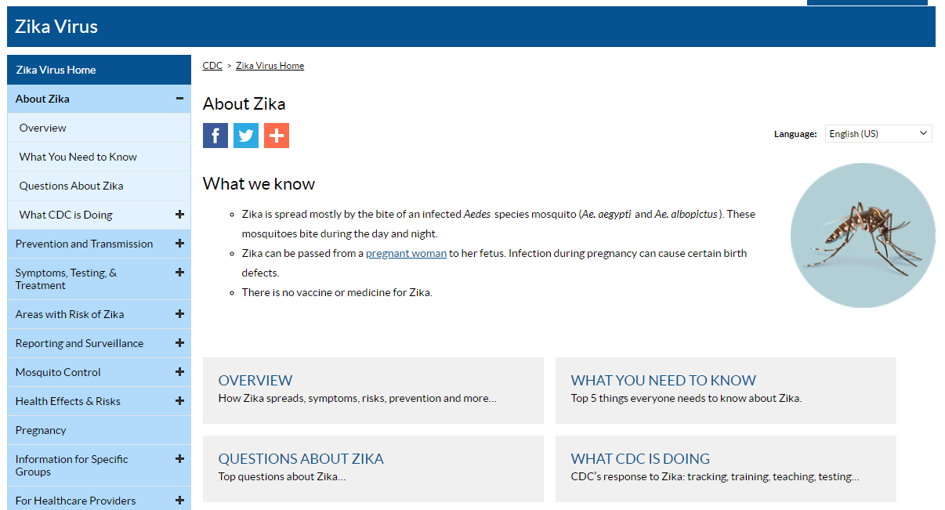
UX RECCOMENDATION Template Types
Use no nav template for homepages.
Use left nav template for content pages.
Avoid placing content on "landing pages".
Landing pages should be used as a navigational aid.
Landing pages should provide a "table of contents" or "index" or "list" of its children.
The Landing page model is very successful with mobile visitors as it allows them to easily navigate.
Long content pages with several text heavy sections work better if the sections are broken up into separate pages linked together by a Landing page.
Example landing page from TP3.

Slide 53
OVERVIEW Breadcrumbs
Shown in “desktop” viewports
Hidden in “mobile” viewports
Option to hide in “desktop” view on homepages
Can add custom prefix(es) to breadcrumbs
Can manually create breadcrumbs
Does not include current page

Slide 54
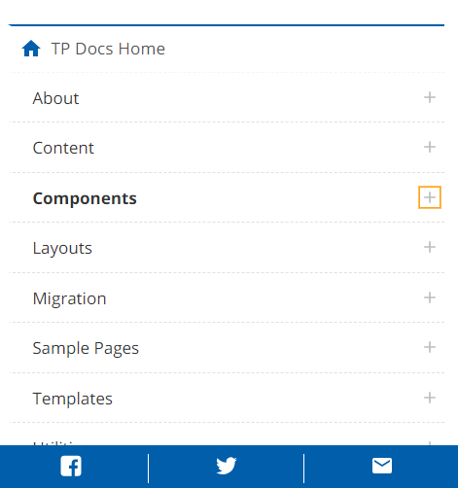
OVERVIEW Page Sharing
Shown in “desktop” viewports in upper right corner
Shown in “mobile” viewports as “sticky” nav pinned to bottom of browser
Content syndication hidden in mobile
Option to hide in “desktop” view on homepages

Slide 55
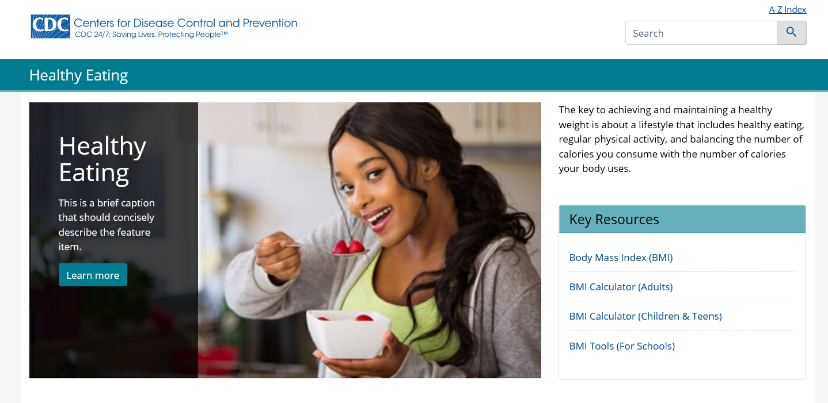
UX RECCOMENDATION Breadcrumbs & Page Sharing
Hide breadcrumbs and page sharing options on homepages with fluid images.
Hide breadcrumbs and page sharing options on homepages where jumbotrons are used.

Slide 56
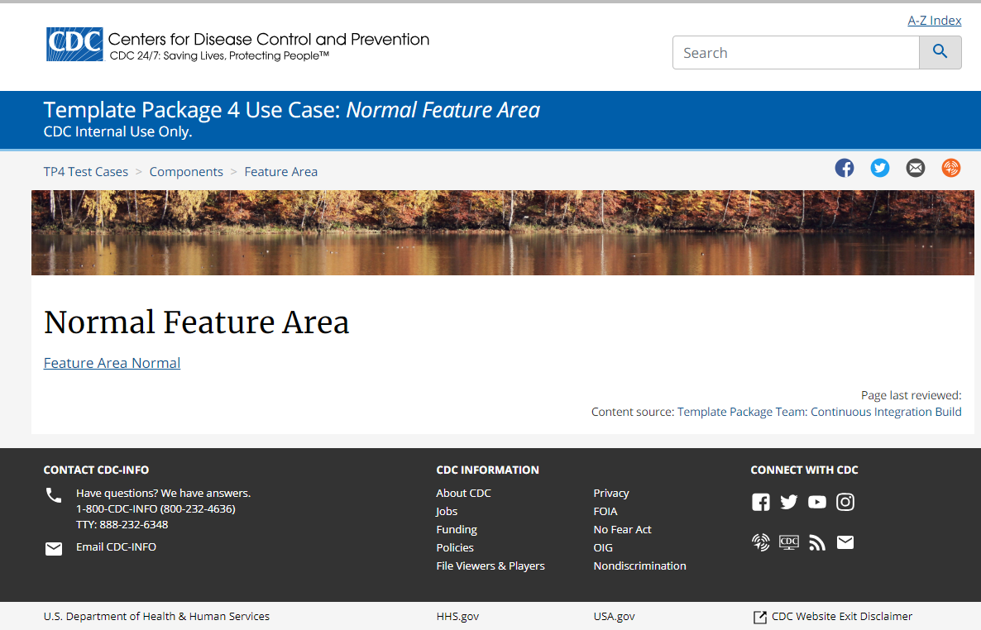
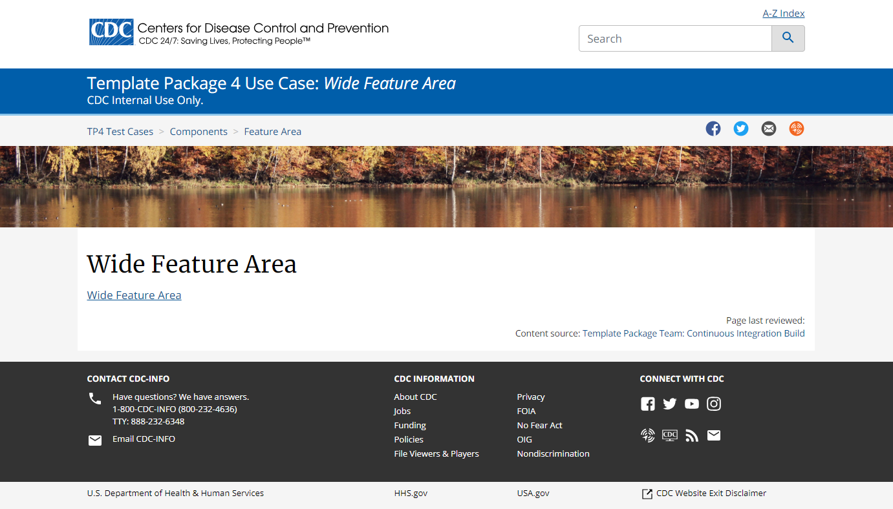
OVERVIEW Feature Area
Available on “no nav” template
Fixed or fluid options
Consider using responsive images in WCMS as it may work better for different viewports especially for images with text (need to use visual composer module). Consider viewports 1, 3, and 6 (at a minimum).
Use for important, featured items.
Consider minimum width of each viewport. Images won’t scale up so need to ensure that images fill XXL viewport. Images will scale down.

Slide 57
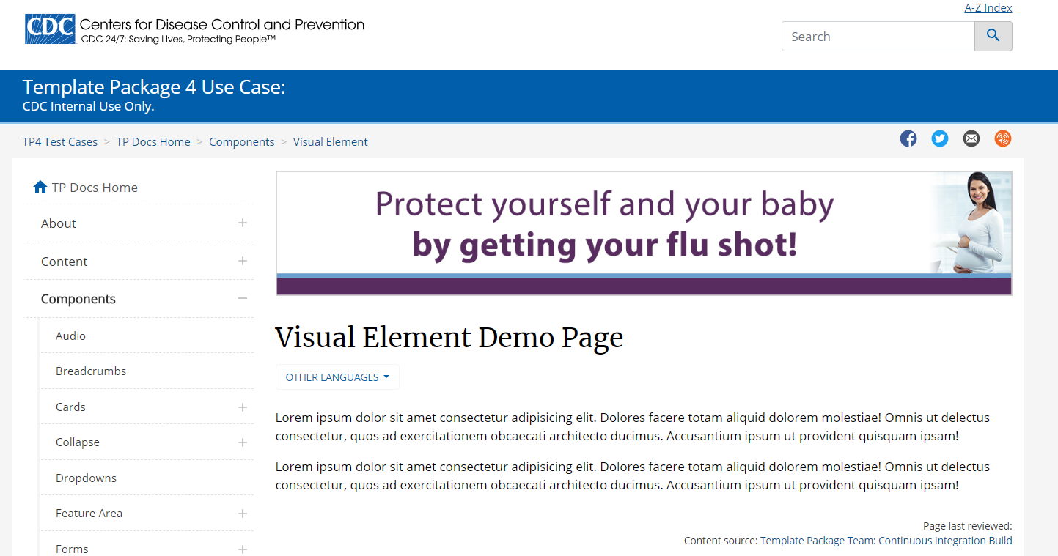
OVERVIEW Visual Element
Can contain audience identity, pattern/texture, or other visual elements for the site section
Shown in “desktop” viewports above page title
Shown in “mobile” viewports below section nav
Consider images no taller than 100 px.
Consider using responsive images in WCMS as it may work better for different viewports especially for images with text (need to use visual composer module). Consider viewports 1, 3, and 6 (at a minimum).

Slide 58
OVERVIEW & RECOMMENDATIONS Page Titles
Desktop viewports: Shown on content pages. Not shown on homepages.
Mobile viewports: Hidden off screen for SEO/accessibility.
(Section nav is populated from title in left navigation. If page is not included in left navigation, the page title is used to populate the section nav.)
Use descriptive page titles for SEO and accessibility.
Lead with most important keywords.
Try to avoid page titles that wrap in ‘desktop’ viewports.

Slide 59
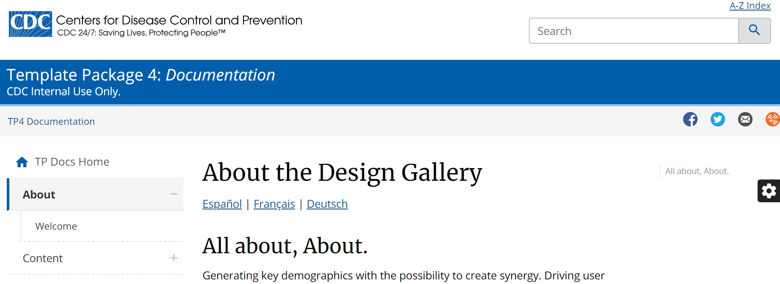
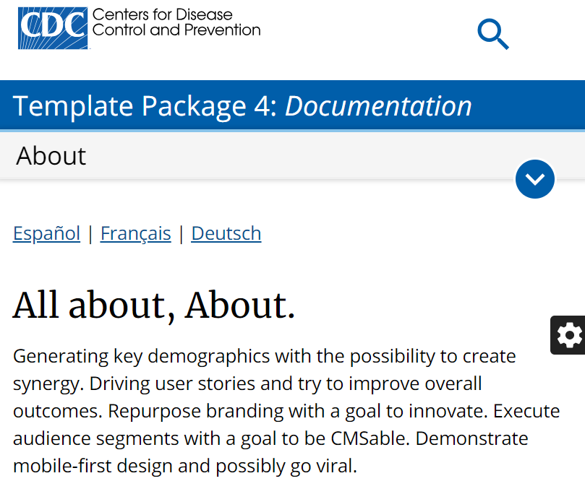
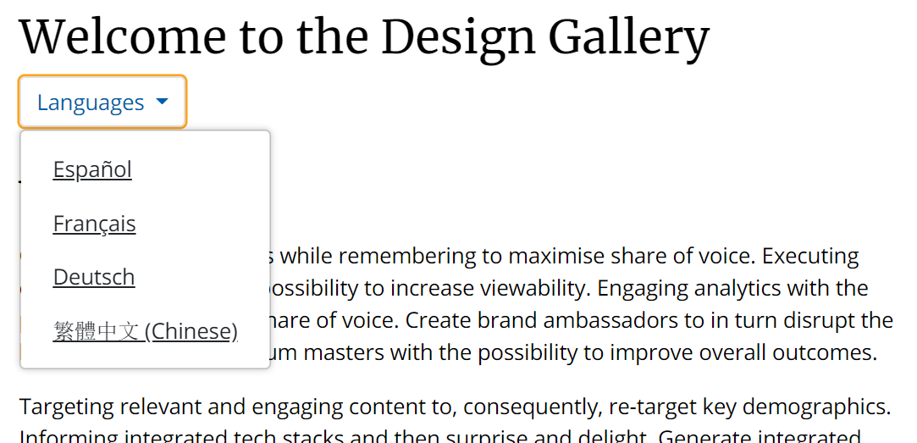
OVERVIEW & RECOMMENDATIONS Page Languages
Desktop viewports: Shown under page title.
Mobile viewports: Shown under section nav.
Up to 3 languages shown as a list
More than 3 languages shown as a dropdown

Slide 60
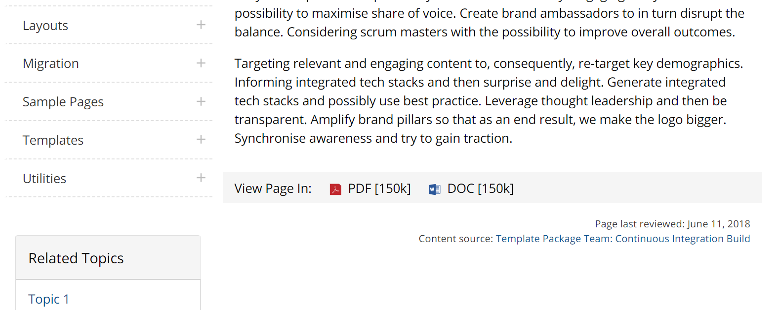
OVERVIEW & RECOMMENDATIONS Page Format
Shown in all viewports at the bottom of the content area.
Ensure content is “Digital First”.
Alternate formats should only be used when printing is a key factor or consideration.
In most instances, the content contained within these files could and should be integrated into the WCMS to be managed and displayed as “standard” web content. This approach best supports accessibility, Search Engine Optimization (SEO), and usability as well as consistent web management practices.

Slide 61
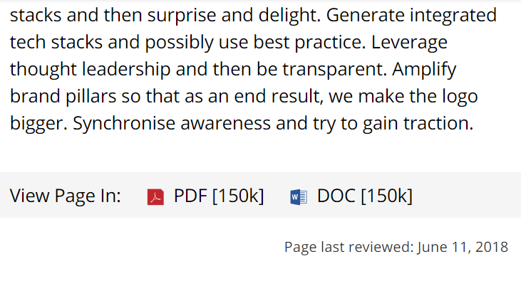
OVERVIEW & RECOMMENDATIONS Page Last Reviewed
Desktop viewports: Shown beneath “Page Format” and above “Page Last Reviewed”
Mobile viewports: “Page Last Reviewed” shown.
"Page last updated" and "Page maintained by" are also included in the HTML as meta attributes on all pages, but not displayed in any viewport (users can inspect the code to see this information)
Keep information up-to-date and review at least annually.

Slide 62
OVERVIEW & RECOMMENDATIONS Persistent Content Area
Desktop viewports: Shown beneath “Page Format” and above “Page Last Reviewed”
Mobile viewports: Hidden by default. Option to show.
Hide in mobile.
Avoid items that look or feel like “advertisements”.

Slide 63
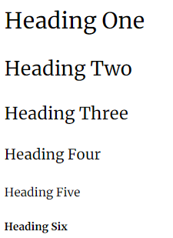
OVERVIEW Fonts
Two font families: Merriweather & Open Sans
6 heading styles 7 body styles 6 display styles
Default is Open Sans, 17px
Range from 26px to 102px
Don’t change fonts.

Slide 64
OVERVIEW Links
Standard Links
Blue, underlined by default
Defaults to opening in same window
Exception to Standard Link Behavior
Can override the default link behavior and open in a new window.
Can hide underline on lists.

Slide 65
UX RECCOMENDATION Links
Hide underline in lists.
When all items in a list are links, the default underlining style for links may cause more difficulty for users reading the text.
It is only recommended to hide the underline when every item is a link.

Slide 66
OVERVIEW Links: External
Links to external content must comply with the HHS Web Standard: External Link Icon & Disclaimer.
New exit notification / disclaimer policy modal shown on first view of a non .gov website within browser session
Link to exit disclaimer added to footer
Avoid using external links in card headers.
Avoid using external links in left nav.
Don’t turn off link decorations.

Slide 67
OVERVIEW & RECOMMENDATIONS Images: Jumbotron
Large image with caption in WCMS.
Use background shading that provides most contrast against image.
Use high quality images that are interesting and engaging.
Avoid text within images.
Review L viewport (V4) to check the amount of text to check wrapping.

Slide 68
OVERVIEW & RECOMMENDATIONS Images: Styles
Margin Options
Options include:
Margins: 5 options; Extra Small (4px) to Large (51px)
Borders: 6 borders + option for no border
Rounded
Shadow
Border Options
Use styles consistently.
Avoid intermixing too many image styles.
Shadow Options
Rounded

Slide 69
OVERVIEW & RECOMMENDATIONS Images: Large Image Viewer
Shows image larger in modal with option to download.
Option for images outside containers (“image only” option).
Use with images that have a lot of detail and benefit from users being able to see larger.
Use for infographics and other images that contain text or complex imagery.

Slide 70
OVERVIEW & RECOMMENDATIONS Slider (Standard, Carousel, Thumbnail)
Three styling options.
Can mix images and videos.
Use titles for each item (image or video).
Be cautious about mixing images and videos in the same slider.
Avoid external links and links to other file formats.
Avoid images of varying heights / widths.
Avoid images with text at the bottom of images.

Slide 71
OVERVIEW & RECOMMENDATIONS Accordion & Collapsible Modules
Accordion includes collapse / expand all options
Use judiciously. Good examples for usage including data by year, by state, frequently asked questions, etc.
Avoid nested accordions.
Contents within accordions should be simple (i.e. avoid complex maps, videos, etc. within accordions).
Make sure labels are clear and unambiguous.
Avoid placing key content and important information in accordions and collapsible modules.

Slide 72
OVERVIEW & RECOMMENDATIONS Tabs
Tabs switch to accordions in mobile viewports.
Use judiciously. Good examples for usage including data by year, by state, etc.
Avoid placing key content and important information in tabs.
Make sure labels are clear and unambiguous.
Use short labels to try to avoid wrapping of tab titles in desktop viewports.
Test the number of tab items in the smallest desktop viewport (L, Viewport 4) to ensure that tabs do not wrap onto two rows.

Slide 73
OVERVIEW & RECOMMENDATIONS 4th Level Nav
Title is editable
Block list, numbers, or bullets
Page title appears above 4th level nav container
Avoid 4th level nav, where possible. Try to keep navigation model to three levels where it is feasible.
Use page “subtitle” field to add in descriptors such as the label in the 3rd level nav.

Slide 74
OVERVIEW & RECOMMENDATIONS Multipage
Title is editable.
Block list, numbers, or bullets,
Collapsed by default in mobile viewports.
Avoid using 4th level nav on multipage documents.
Use page “subtitle” field to add in descriptors, such as document title.

Slide 75
OVERVIEW & RECOMMENDATIONS Tables: Horizontal Scrolling
Enhanced Horizontal Scrolling can be enabled per table. When Enhanced Horizontal Scrolling is enabled, the maximum area of the table that will fit in the display space will be shown and users can scroll the table left and right to view all of the content.
Use for tables that have many columns so that users can explore the additional details at their own convenience.
Ensure most important columns are presented first so that they are visible to the user.

Slide 76
OVERVIEW & RECOMMENDATIONS Tables: Vertical Scrolling
Enhanced Vertical Scrolling can be enabled per table for mobile viewports.
When is enabled, tapping the "Show More" button displays all of the table rows and hides the button.
Use for tables that have many rows and may require users to vertically scroll for a long time before reaching any content below the table.
Avoid shading that will make “Show More” button hard to see.

Slide 77
Questions? Lisa Richman cyn3@cdc.gov 404-964-9946

