Slide 1
Limiting Heat Burden While Wearing Personal Protective Equipment (PPE)
Developed for Healthcare Workers and Site Coordinators Providing Care
in West African Countries Affected by the Ebola Outbreak
October 17, 2014

Slide 2
Purpose
Working in the harsh conditions in West Africa and other risk factors, including wearing PPE, puts healthcare workers at risk for heat-related illnesses.

Slide 3
Objectives
Know what tools can help with monitoring temperatures and humidity.
Understand risk factors for heat-related illness.
Recognize symptoms of heat-related illnesses and know first aid.
Learn recommendations for limiting the heat burden and protecting yourself from heat-related illnesses.

Slide 4
Harsh Conditions at the Worksite
Length of work shift:
Shorter work shifts may not be possible where PPE supplies are limited.
Shift length is also affected by the large workloads and limited number of workers.
Limited electrical power:
Air-conditioning and fans may not be available.
Limited access to electrolyte replacement fluids.
Other illnesses:
Contaminated food or water can result in severe vomiting and diarrhea, which can lead to fluid loss and dehydration, increasing the risk for developing a heat-related illness.
Limited or no medical oversight for healthcare workers while in the rest area.
Limited number of healthcare workers:
Only 2 days to adjust to working in a hot, humid environment before starting to work with patients.

Slide 5
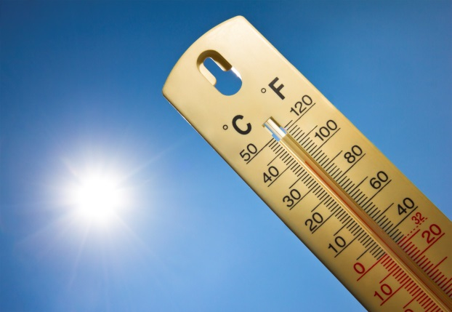
Monitor Temperatures
Monitor temperature and humidity daily.
Download the OSHA Heat Safety Tool at https://www.osha.gov/SLTC/heatillness/heat_index/heat_app.html or using the heat index table.
Heat index is a measure of how hot it feels when humidity is taken into account with air temperature.
As the heat index increases, take more frequent rest breaks and drink more water and/or electrolyte replacement fluids.

Slide 6
Heat Index Table
Heat index | Risk level | Protective measures
Less than 91°F (33°C) | Lower (caution) | Basic health and safety planning
91°F–103°F (33°C–39°C) | Moderate | Implement precautions and heighten awareness
103°F–115°F (39°C–46°C) | High | Additional precautions to protect workers
Greater than 115°F (46°C) | Very high to extreme | Even more aggressive protective measures

Slide 7
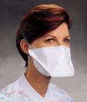
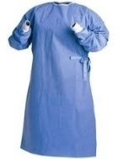
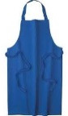
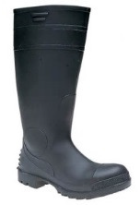
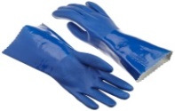
PPE: A Risk Factor for Heat-related Illness
Wearing PPE increases your risk for heat-related illnesses.
PPE:
Reduces or eliminates exposure to hazardous chemicals, physical hazards, and disease-causing organisms such as Ebola.
Reduces the body’s normal way of getting rid of heat by sweat evaporation.
Holds excess heat and moisture inside PPE, making the worker’s body even hotter.
Increases the physical effort to perform duties while carrying the extra weight of the PPE.
Photo courtesy of Kimberly-Clark
Examples of PPE you may be required to wear.

Slide 8
Other Risk Factors for Heat-related Illnesses
High temp. & humidity
Previous heat-related illness
Direct sun exposure
Advanced age (60+)
Indoor heat sources
Lack of recent heat exposure
Limited air movement
Heat Illness
Pregnancy
Dehydration
Certain medications
Physical exertion
Current or pre-existing medical conditions
PPE & clothing

Slide 9
Heat-related Illnesses
Heat-related illnesses can vary in symptoms and severity.
SEVERITY
Heat Rash
Heat Cramps
Heat Exhaustion
Heat Stroke
Less Severe - - - - - - - - - - - - - - - - - - - - - - - - - - - - - - - - - - - - - - - More Severe
Discomfort - - - - - - - - - - - - - - - - - - - - - - - - - - - - - - - - - - - - - - - - - - - Death

Slide 10
Heat Rash
 Symptoms
Looks like red cluster of pimples or small blisters that usually appears on the:
neck
upper chest
groin
under the breasts
in elbow creases
 First Aid
Keep rash area dry.
Change out of sweaty clothes into fresh dry clothes frequently.
Apply powder to increase comfort.
Do not use ointments and creams.

Slide 11
Heat Cramps
 Symptoms
Muscle cramps, pain, or spasms in the abdomen, arms, or legs
 First Aid
Drink water and have a snack, and/or electrolyte-replacement drinks every 15 to 20 minutes.
Do not take salt tablets.
Get medical help if the worker:
has heart problems,
is on a low sodium diet, or
if cramps do not subside within one hour.

Slide 12
Heat Syncope (Fainting)
 Symptoms
Fainting
Dizziness
Light-headedness during prolonged standing or suddenly rising from a sitting or lying position
 First Aid
Sit or lie down in a cool place or remove worker that has fainted from hot area.
Drink water or other cool liquids slowly.
Use cool compresses.

Slide 13
Heat Exhaustion
 Symptoms
Headache
Nausea
Dizziness
Weakness
Irritability
Thirst
Heavy sweating
Elevated body temperature
Decreased urine output
 First Aid
Get medical evaluation and treatment for the worker.
Remove worker from hot area and give cool liquids to drink.
Remove PPE.
Cool the worker with cold compresses or wet head, face, and neck with cold water.
Seat the worker in an air-conditioned area or next to a misting fan.

Slide 14
Rhabdomyloysis (breakdown of skeletal muscle)
 Symptoms
Muscle cramps/pain
Abnormally dark colored urine (tea or cola-colored)
Weakness
Exercise intolerance
 First Aid
Stop activity.
Drink water.
Get immediate care at the nearest medical facility.
Ask to be checked for rhabdomyolysis (blood/urine creatine kinase and myoglobin tests).
Notes:
Rhabdomyolysis, which is the breakdown of skeletal muscle, may be a consequence of heat stroke. Rhabdomyolysis can be fatal if it causes seizures, irregular heart rhythms, and kidney failure.

Slide 15
Heat Stroke
 Symptoms
Confusion
Loss of consciousness
Hot, dry skin or profuse sweating
Seizures
Very high body temperature
Heat stoke may be fatal!
 First Aid
Get professional medical care immediately.
Move the worker to a shaded, cool area and remove PPE.
Cool the worker quickly with a cold water bath. Keep the head out of the water.
Wet the skin, place cold wet cloths on skin, or soak clothing with cool water.
Circulate the air to speed cooling.
Do not try to give oral fluids if the worker seems sedated or has slurred speech.

Slide 16
Recommendations for Preventing Heat-related Illness
Take time to acclimatize.
Stay well hydrated.
Watch for signs/symptoms of heat-related illnesses.
Take time to rest and cool down.

Slide 17
Take Time to Acclimatize
Gradually increase work time in hot environmental conditions over a 7-14 day period.
If not possible, implement shorter work shifts for workers until they are adjusted to the heat.
For workers new to the climate, schedule no more than 20% of the usual work shift on day 1 and a no more than 20% increase on each additional day.
For workers with previous experience with the job in this climate, schedule no more than a 50% of the usual work shift on day 1, 60% on day 2, 80% on day 3, and 100% on day 4.

Slide 18
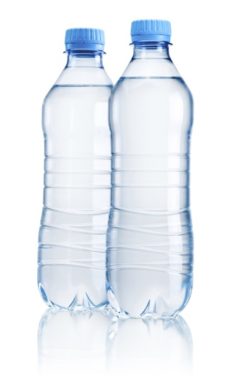
Stay Well Hydrated
Arrive for your shift well hydrated.
Drink frequently enough that you do not feel thirsty.
Rehydrate during every rest break.
Tell your supervisor and do not start your shift if you have recently vomited or had diarrhea.
Do not use caffeine, alcohol, and other stimulants.

Slide 19
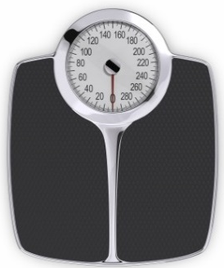
Stay Well Hydrated (continued)
Consider keeping a weight scale in the rest area.
Weigh yourself before putting on PPE at the beginning of your shift and after removing it (and removing sweat-soaked scrubs) on the last shift of the day.
Record your body weight changes. ≥ 2% body weight loss = possible decreased heat tolerance
Alert your supervisor if you have lost body weight during a shift. Example: If starting weight is 150 lbs., then a 2% loss would be 3 lbs. (150 lbs. X 0.02 = 3 lbs.)

Slide 20
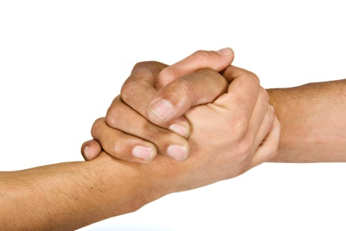
Watch for Signs/Symptoms of Heat-related Illness
Avoid working alone. Designate a buddy.
Ask your buddy how he feels periodically, and encourage rest and water breaks as needed.
Tell your buddy if you do not feel well.
Follow emergency procedures if someone has heat-related symptoms.

Slide 21
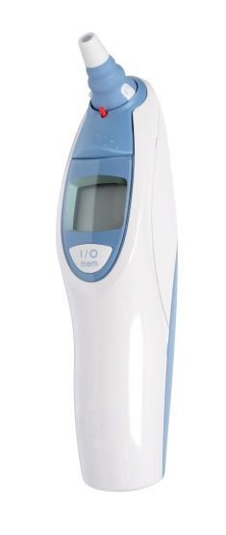
Watch for Symptoms of Heat-related Illness (continued)
Assign a trained person who knows first aid to monitor the rest area for symptoms of heat-related illness. Additional monitor duties may include:
Doing a mental health assessment on those entering and leaving the rest area. Asking them to answer basic questions like their name, etc.
Using an infrared thermometer to assess aural (ear canal) temperature. Temperature ≥ 102.2°F (39°C) means they should not return to work. Return to work only after temperature decreases to 100.4°F (38°C).
Telling workers it is time for their break.
Ensuring that the rest area is well stocked with water and electrolyte replacement fluids and that cooling devices work properly.

Slide 22
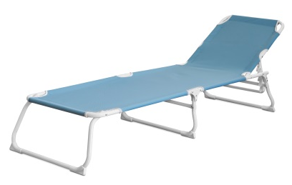
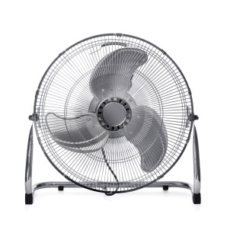
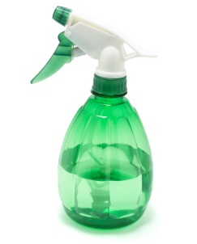
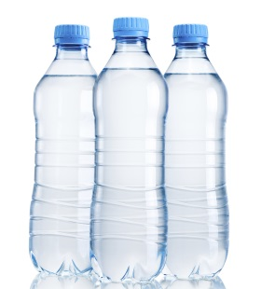
Take Time to Rest and Cool Down
The rest area should include:
Shaded area, chairs, and cots.
Electric fans with misters or squirt bottles.
Bottled water and electrolyte replacement fluids.
Basic first aid equipment, bucket containing cool water to quickly cool down a person, and spare communication equipment to call for evacuation.
Follow all local emergency plans and procedures if an evacuation is needed.
Consider keeping a change of scrubs in the rest area to change out of sweaty scrubs.
Arrive for your shift well rested.

Slide 23
Key Points
Wearing PPE will increase your risk for heat-related illnesses.
Take time to acclimatize.
Stay well hydrated.
Watch for symptoms of heat-related illnesses.
Take time to rest and cool down.

Slide 24
Additional Resources
NIOSH Heat Stress Topic Page http://www.cdc.gov/niosh/topics/heatstress/
OSHA-NIOSH INFOSHEET: Protecting Workers from Heat Illness http://www.cdc.gov/niosh/docs/2011-174/
NIOSH Fast Facts: Protecting Yourself from Heat Stress http://www.cdc.gov/niosh/docs/2010-114/pdfs/2010-114.pdf

