Slide 2
Answers to Your Questions about
EBOLA

Slide 3
What is
EBOLA?
Ebola is a virus that lives in bats and some other animals who live in Africa.

Slide 4
What is
EBOLA?
People can get Ebola in West Africa by preparing these sick animals for food.

Slide 5
What is
EBOLA?
People can spread the virus to other people when they are very sick. This is the main way that people are now getting Ebola in West Africa.

Slide 6
What have you heard about
the Ebola outbreak?
The Ebola outbreak is happening in countries in West Africa.

Slide 7
What have you heard about
the Ebola outbreak?
The three most affected countries are
Guinea
Liberia
Sierra Leone
Guinea
Sierra Leone
Liberia

Slide 8
What have you heard about
the Ebola outbreak?
People living in West Africa have gotten sick and some have died.
Guinea
Sierra Leone
Liberia

Slide 9
What have you heard about
the Ebola outbreak?
FAST FACT:
An outbreak is when more people get sick with a disease than scientists and doctors expect.
Guinea
Sierra Leone
Liberia

Slide 10
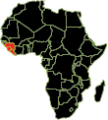
What is
Africa?
Africa is one of the seven continents.
There are 54 countries in Africa.

Slide 11
What is
Africa?
Africa is about 8,000 miles from the United States.

Slide 12
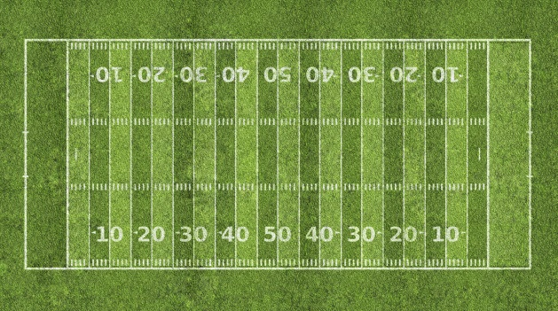
What is
Africa?
FAST FACT:
8,000 miles equals
47 million feet
or about 150,000 football fields

Slide 13
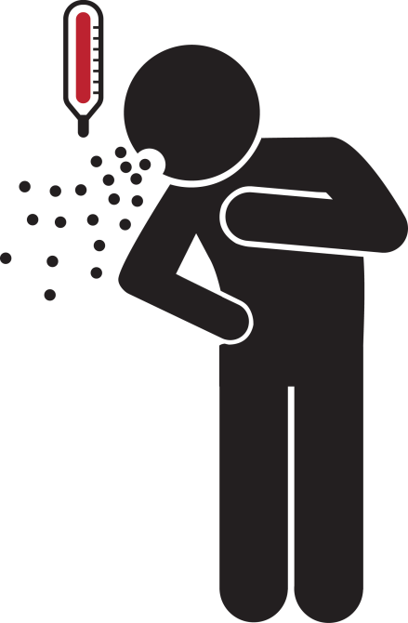
How do people get
EBOLA?
People get Ebola by touching
Body fluids from a person who is sick with or has died from Ebola. Examples of body fluids include blood, vomit, pee, poop, sweat, or spit.

Slide 14
How do people get
EBOLA?
People get Ebola by touching
Objects with germs from the virus on them like needles that can cut someone.

Slide 15
How do people get
EBOLA?
People get Ebola by touching
Infected animals (blood or meat).

Slide 16
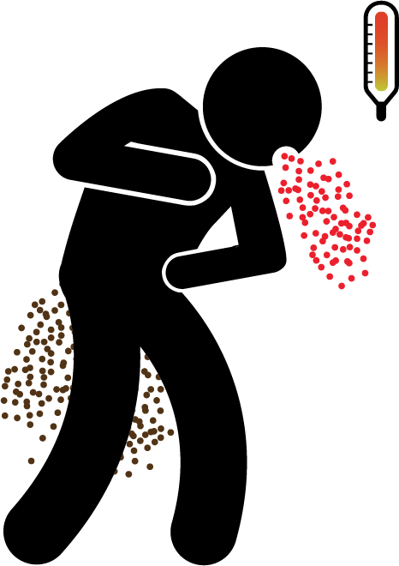
How do people get
EBOLA?
FAST FACT:
People cannot give Ebola to someone else until they have symptoms.

Slide 17
How do people get
EBOLA?
FAST FACT:
Even people infected with Ebola in the early stages are very unlikely to give Ebola to other people.

Slide 18
What happens when someone gets sick
with EBOLA?
A person sick with Ebola will have symptoms within 2 to 21 days from getting Ebola. They cannot give Ebola to someone else until they are showing symptoms.

Slide 19
What happens when someone gets sick
with EBOLA?
Symptoms include
Fever
Headache
Tiredness
Weakness
Diarrhea

Slide 20
What happens when someone gets sick
with EBOLA?
Symptoms include
Symptoms include
Vomiting
Stomach pain
Muscle pain
Unexplained bleeding or bruising

Slide 21
Do people get better after getting
EBOLA?
Only 3 in 10
Only 3 in 10 of the people who have gotten Ebola during this outbreak have gotten better.
The sooner someone gets treatment, the more likely they are to get better.

Slide 22
Do people get better after getting
EBOLA?
Only 3 in 10
Once a person has recovered from Ebola, they cannot spread Ebola to anyone else.

Slide 23
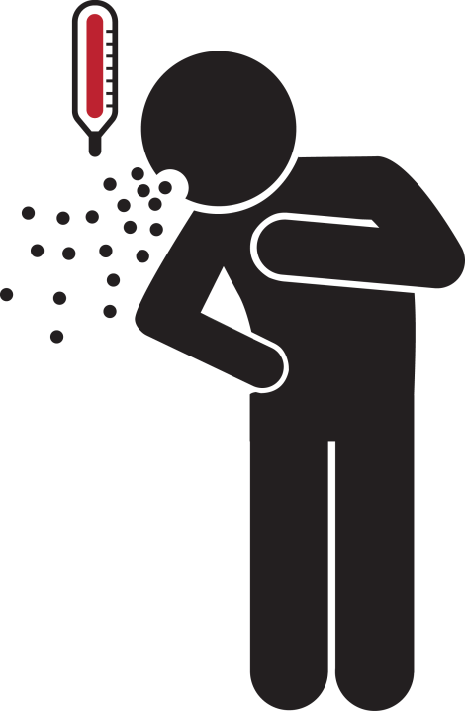
Should you be worried about getting
EBOLA?
The outbreak is in West Africa, which is very far away.
Remember, you can only get Ebola if you had contact with someone who is sick with Ebola.

Slide 24
Should you be worried about getting
EBOLA?
We have had a few cases of Ebola in the United States, but an outbreak is very unlikely.
If you are worried about Ebola, talk to your parents or a school counselor.

Slide 25
Should you be worried about getting
EBOLA?
FAST FACT:
There are 316 million people in the United States, but we’ve only had 4 cases of Ebola.

Slide 26
How do you keep yourself
Well?
An Ebola outbreak is unlikely in the United States. You are much more likely to get the flu or a cold. Protect yourself from colds and flu by keeping yourself healthy.

Slide 27
How do you keep yourself
Well?
Wash your hands often with soap and water or hand sanitizer.
Avoid close contact with people who are sick.

Slide 28
How do you keep yourself
Well?
Avoid touching your eyes, nose, and mouth. Germs spread this way.
Get your flu shot.

Slide 29
How are we helping the people in
in Africa?
CDC is
Working with the countries in West Africa to stop the outbreak.

Slide 30
How are we helping the people in
in Africa?
CDC is
Talking to and helping travelers who have come back from West Africa.

Slide 31
How are we helping the people in
in Africa?
CDC is
Teaching doctors and nurses how to care for people with Ebola.
Training people in West Africa to care for people with Ebola.

Slide 32
cdc.gov/ebola

