Slide 1
Ebola Virus Disease
CDC Slides for U.S. Healthcare Workers*
For the most up-to-date information, please visit www.cdc.gov/ebola.
*Presentation contains materials from CDC, MSF, and WHO
Centers for Disease Control and Prevention
Office of the Director
1

Slide 2
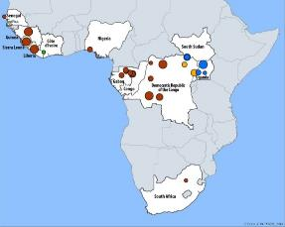
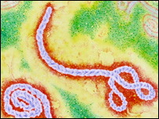
Ebola Virus
Prototype Viral Hemorrhagic Fever Pathogen
Filovirus: enveloped, non-segmented, negative-stranded RNA virus
Severe disease with high case fatality
Absence of specific treatment or vaccine
>20 previous Ebola and Marburg virus outbreaks
2014 West Africa Ebola outbreak caused by Zaire ebolavirus species (five known Ebola virus species)
2

Slide 3
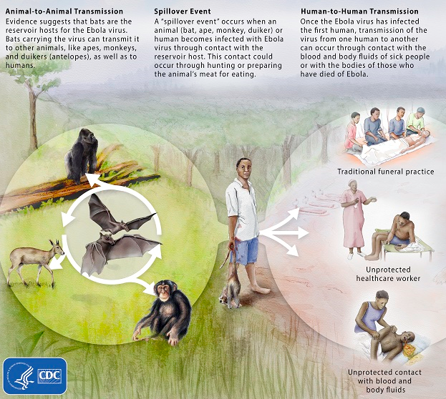
Ebola Virus
Zoonotic virus – bats the most likely reservoir, although species unknown
Spillover event from infected wild animals (e.g., fruit bats, monkey, duiker) to humans, followed by human-human transmission
3

Slide 4
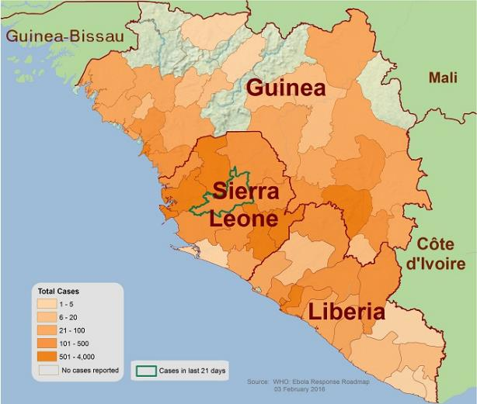
Outbreak Distribution — West Africa, February 6, 2016
Map includes total confirmed Ebola cases reported to WHO
4

Slide 5
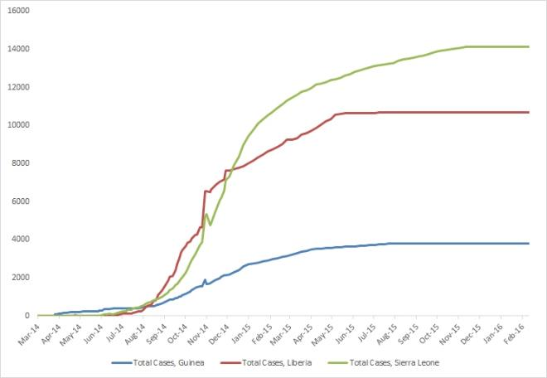
2014 Ebola Outbreak Reported Cases (Suspected, Probable, and Confirmed) in Guinea, Liberia, and Sierra Leone
This graph shows the total reported cases (suspected, probable, and confirmed) in Guinea, Liberia, and Sierra Leone provided in WHO situation reports beginning on March 25, 2014, through the most recent situation report on February 7, 2016.
5

Slide 6
Ebola Cases and Deaths¹
 | Reporting Date | Total Cases (Suspected, Probable, and Confirmed) | Confirmed Cases | Total Deaths
Guinea | 28 Dec 15 | 3,804 | 3,351 | 2,536
Sierra Leone² | 7 Feb 16 | 14,124 | 8,706 | 3,956
Liberia³ | 14 Jan 16 | 10675 | 3160 | 4809
Italy⁴ | 20 May 15 | 1 | 1 | 0
United Kingdom⁴ | 29 Dec 14 | 1 | 1 | 0
Nigeria⁴ | 15 Oct 14 | 20 | 19 | 8
Spain⁴ | 27 Oct 14 | 1 | 1 | 0
Senegal⁴ | 15 Oct 14 | 1 | 1 | 0
United States⁴ | 24 Oct 14 | 4 | 4 | 1
Mali⁴ | 23 Nov 14 | 8 | 7 | 6
TOTAL |  | 28,639 | 15,251 | 11,316
¹ Total cases include probable, suspected, and confirmed cases. Reported by WHO using data from ministries of health.
² On November 7, 2015, WHO declared Sierra Leone free of Ebola virus transmission. On January 14, 2016, a new case of Ebola was confirmed in a woman who died on January 12.
³ WHO first declared Liberia free of Ebola virus transmission on May 9, 2015. The country subsequently experienced a cluster of six Ebola cases in June 2015 and was declared free of transmission again on September 3, 2015. A second cluster of three cases was reported in November 2015, and WHO declared the country free of transmission for the third time on January 14, 2016.
⁴ In these countries, which previously had locally acquired or imported Ebola cases, at least 42 days (two incubation periods) have elapsed since the last day that any person in the country had contact with a person with confirmed Ebola.
6

Slide 7
Ebola Cases (United States)
Ebola has been diagnosed in the United States in 4 people: 1 (the index patient) who traveled to Dallas, Texas from Liberia, 2 healthcare workers who cared for the index patient, and 1 medical aid worker who traveled to New York City from Guinea
Index patient – Symptoms developed on September 24, 2014, approximately 4 days after arrival; sought medical care at Texas Health Presbyterian Hospital of Dallas on September 26, 2014; was admitted to hospital on September 28, 2014; testing confirmed Ebola on September 30, 2014; patient died October 8, 2014.
TX Healthcare Worker, Case 2 – Cared for index patient; was self-monitoring and presented to hospital reporting low-grade fever; diagnosed with Ebola on October 11, 2014; recovered and released from NIH Clinical Center October 24, 2014
Information on U.S. Ebola cases available at http://www.cdc.gov/vhf/ebola/outbreaks/2014-west-africa/united-states-imported-case.html.
7

Slide 8
Ebola Cases (United States)
TX Healthcare Worker, Case 3 – Cared for index patient; was self-monitoring and reported low-grade fever; diagnosed with Ebola on October 15, 2014; recovered and released from Emory University Hospital in Atlanta October 28, 2014
NY Medical Aid Worker, Case 4 – Worked with Ebola patients in Guinea; was self-monitoring and reported fever; diagnosed with Ebola on October 24, 2014; recovered and released from Bellevue Hospital in New York City November 11, 2014
Information on U.S. Ebola cases available at http://www.cdc.gov/vhf/ebola/outbreaks/2014-west-africa/united-states-imported-case.html.
8

Slide 9
Ebola Cases (United States)
During this outbreak, 6 health workers and 1 journalist have been infected with Ebola virus while in West Africa and transported to hospitals in the United States.
1 of the health workers died on November 17, 2014, after being transported from Sierra Leone to Nebraska Medical Center
9

Slide 10
Ebola Virus Transmission
Virus present in high quantity in blood, body fluids, and excreta of symptomatic Ebola patients
Opportunities for human-to-human transmission
Direct contact (through broken skin or unprotected mucous membranes) with an Ebola patient’s blood or body fluids
Sharps injury (with contaminated needle or other sharp)
Direct contact with the corpse of a person who died of Ebola
Indirect contact with an Ebola patient’s blood or body fluids via a contaminated object (soiled linens or used utensils)
Possibly, contact with semen from a recovered male Ebola patient
Ebola can also be transmitted via contact with blood, fluids, or meat of an infected animal
Limited evidence that dogs become infected with Ebola virus
No reports of dogs or cats becoming sick with or transmitting Ebola
10

Slide 11
Human-to-Human Transmission
Infected persons are not contagious until onset of symptoms
Possible that the virus can be transmitted through semen of a man who has survived Ebola
Infectiousness of body fluids (e.g., viral load) increases as patient becomes more ill
Remains from deceased infected persons are highly infectious
Human-to-human transmission of Ebola virus via inhalation (aerosols) has not been demonstrated
11

Slide 12
Ebola Risk Assessment
High Risk Exposure
In any country: Percutaneous (e.g., needle stick) or mucous membrane exposure to blood or body fluids from a person with Ebola who has symptoms Direct contact with a person with Ebola who has symptoms, or the person’s body fluids, while not wearing appropriate personal protective equipment (PPE) Lab processing of blood or body fluids from a person with Ebola who has symptoms while not wearing appropriate PPE or without using standard biosafety precautions Providing direct care in a household setting to a person with Ebola who has symptoms
In countries with widespread transmission or cases in urban areas with uncertain control measures*: Direct contact with a dead body while not wearing appropriate PPE
*CDC website to check current affected areas: http://www.cdc.gov/vhf/ebola/outbreaks/2014-west-africa/distribution-map.html

Slide 13
Ebola Risk Assessment (Continued)
Some Risk Exposure
In any country: Being in close contact with a person with Ebola who has symptoms, while not wearing appropriate PPE (for example, in households, healthcare facilities, or community settings) Close contact is defined as being for a prolonged period of time while not wearing appropriate PPE within approximately 3 feet (1 meter) of a person with Ebola while the person was symptomatic
In countries with widespread transmission*: Direct contact with a person with Ebola who has symptoms, or the person’s body fluids, while wearing appropriate PPE Providing any direct patient care in non-Ebola healthcare settings Being in the patient-care area of an Ebola treatment unit
*CDC website to check current affected areas: http://www.cdc.gov/vhf/ebola/outbreaks/2014-west-africa/distribution-map.html

Slide 14
Ebola Risk Assessment (Continued)
Low (But Not Zero) Risk Exposure
In any country: Brief direct contact (such as shaking hands) with a person with Ebola who has symptoms, while not wearing appropriate PPE Brief proximity with a person with Ebola who has symptoms (such as being in the same room, but not in close contact) while not wearing appropriate PPE Lab processing of blood or body fluids from a person with Ebola who has symptoms while wearing appropriate PPE and using standard biosafety precautions Traveling on an airplane with a person with Ebola who has symptoms and having had no identified some or high risk exposures
In countries with widespread transmission, cases in urban areas with uncertain control measures, or former widespread transmission and current, established control measures*: Having been in one of these countries and having had no known exposures
In any country other than those with widespread transmission*: Direct contact with a person with Ebola who has symptoms, or the person’s body fluids, while wearing appropriate PPE Being in the patient-care area of an ETU
*CDC website to check current affected areas: http://www.cdc.gov/vhf/ebola/outbreaks/2014-west-africa/distribution-map.html

Slide 15
Ebola Risk Assessment (Continued)
No Identifiable Risk of Exposure
Lab processing of Ebola-containing specimens in a Biosafety Level 4 facility
Any contact with a person who isn’t showing symptoms of Ebola, even if the person had potential exposure to Ebola virus
Contact with a person with Ebola before the person developed symptoms
Any potential exposure to Ebola virus that occurred more than 21 days previously
Having been in a country with Ebola cases, but without widespread transmission, cases in urban settings with uncertain control measures, or former widespread transmission and now established control measures, and not having had any other exposures
Having stayed on or very close to a plane or ship (i.e., to inspect the outside of the ship or plane or to load or unload supplies) the entire time the airplane or ship was in a country with widespread transmission or a cases in urban settings with uncertain control measures*, and having had no direct contact with anyone from the community
Having had lab-confirmed Ebola and subsequently been determined by public health authorities to no longer be infectious (i.e., Ebola survivors)
*CDC website to check current affected areas: http://www.cdc.gov/vhf/ebola/outbreaks/2014-west-africa/distribution-map.html

Slide 16
Ebola Virus Pathogenesis
Direct infection of tissues
Immune dysregulation
Hypovolemia and vascular collapse
Electrolyte abnormalities
Multi-organ failure, septic shock
Disseminated intravascular coagulation (DIC) and coagulopathy
Lancet. Mar 5, 2011; 377(9768): 849–862.
16

Slide 17
Early Clinical Presentation
Acute onset; typically 8-10 days after exposure (range 2-21 days)
Signs and symptoms
Initial: Fever, chills, myalgias, malaise, anorexia
After 5 days: GI symptoms, such as nausea, vomiting, watery diarrhea, abdominal pain
Other: Headache, conjunctivitis, hiccups, rash, chest pain, shortness of breath, confusion, seizures
Hemorrhagic symptoms in 18% of cases
Other possible infectious causes of symptoms
Malaria, typhoid fever, meningococcemia, Lassa fever and other bacterial infections (e.g., pneumonia) – all very common in Africa
17

Slide 18
Clinical Features
Nonspecific early symptoms progress to:
Hypovolemic shock and multi-organ failure
Hemorrhagic disease
Death
Non-fatal cases typically improve 6-11 days after symptoms onset
Fatal disease associated with more severe early symptoms
Fatality rates of 70% have been historically reported in rural Africa
Intensive care, especially early intravenous and electrolyte management, may increase the survival rate
18

Slide 19
Clinical Manifestations by Organ System in West African Ebola Outbreak
Organ System | Clinical Manifestation
General | Fever (87%), fatigue (76%), arthralgia (39%), myalgia (39%)
Neurological | Headache (53%), confusion (13%), eye pain (8%), coma (6%)
Cardiovascular | Chest pain (37%),
Pulmonary | Cough (30%), dyspnea (23%), sore throat (22%), hiccups (11%)
Gastrointestinal | Vomiting (68%), diarrhea (66%), anorexia (65%), abdominal pain (44%), dysphagia (33%), jaundice (10%)
Hematological | Any unexplained bleeding (18%), melena/hematochezia (6%), hematemesis (4%), vaginal bleeding (3%), gingival bleeding (2%), hemoptysis (2%), epistaxis (2%), bleeding at injection site (2%), hematuria (1%), petechiae/ecchymoses (1%)
Integumentary | Conjunctivitis (21%), rash (6%)
WHO Ebola Response team. NEJM. 2014
19

Slide 20
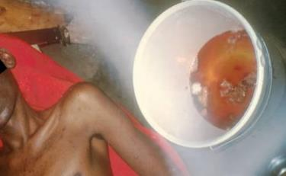
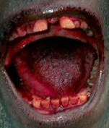
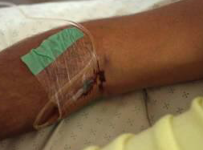
Examples of Hemorrhagic Signs
Hematemesis
Gingival bleeding
Bleeding at IV Site
20

Slide 21
Laboratory Findings
Thrombocytopenia (50,000-100,000/mL range)
Leukopenia followed by neutrophilia
Transaminase elevation: elevation serum aspartate amino-transferase (AST) > alanine transferase (ALT)
Electrolyte abnormalities from fluid shifts
Coagulation: PT and PTT prolonged
Renal: proteinuria, increased creatinine
21

Slide 22
EVD: Expected Diagnostic Test Results Over Time
Critical information: Date of onset of fever/symptoms
IgM
IgG
viremia
0
3
10
days post onset of symptoms
Fever
RT-PCR
ELISA IgM
ELISA IgG
IgM: up to 3-6 months
IgG: 3-5 years or more (life-long persistance?)
22

Slide 23
Ebola Virus Diagnosis
Real Time PCR (RT-PCR)
Used to diagnose acute infection
More sensitive than antigen detection ELISA
Identification of specific viral genetic fragments
Performed in select CLIA-certified laboratories
RT-PCR sample collection
Volume: minimum volume of 4mL whole blood
Plastic collection tubes (not glass or heparinized tubes)
Whole blood preserved with EDTA is preferred
Whole blood preserved with sodium polyanethol sulfonate (SPS), citrate, or with clot activator is acceptable
23

Slide 24
Other Ebola Virus Diagnostics
Virus isolation
Requires Biosafety Level 4 laboratory;
Can take several days
Immunohistochemical staining and histopathology
On collected tissue or dead wild animals; localizes viral antigen
Serologic testing for IgM and IgG antibodies (ELISA)
Detection of viral antibodies in specimens, such as blood, serum, or tissue suspensions
Monitor the immune response in confirmed Ebola patients
24

Slide 25
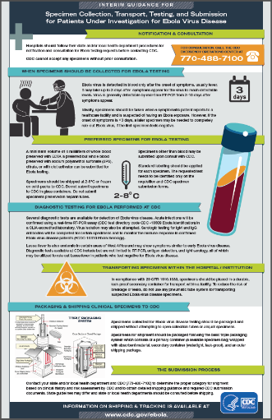
Laboratories
CDC has developed interim guidance for U.S. laboratory workers and other healthcare personnel who collect or handle specimens
This guidance includes information about the appropriate steps for collecting, transporting, and testing specimens from patients who are suspected to be infected with Ebola
Specimens should NOT be shipped to CDC without consultation with CDC and local/state health departments
Information available at: http://www.cdc.gov/vhf/ebola/healthcare-us/laboratories/index.html
25

Slide 26
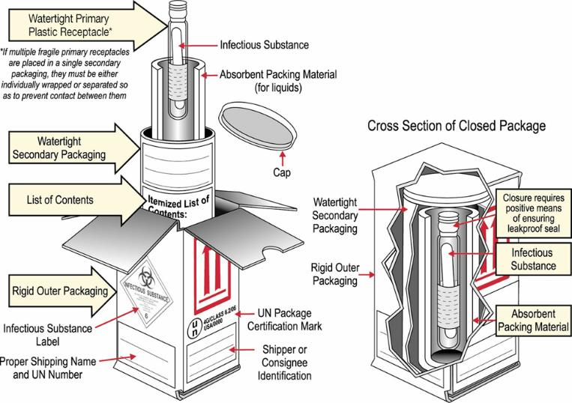
Packaging & Shipping Clinical Specimens to CDC for Ebola Testing
http://www.cdc.gov/vhf/ebola/hcp/packaging-diagram.html
26

Slide 27
Interpreting Negative Ebola RT-PCR Result
If symptoms started ≥3 days before the negative result
Ebola is unlikely → consider other diagnoses
Infection control precautions for Ebola can be discontinued unless clinical suspicion for Ebola persists
If symptoms started <3 days before the negative RT-PCR result
Interpret result with caution
Repeat the test at ≥72 hours after onset of symptoms
Keep in isolation as a suspected case until a repeat RT-PCR ≥72 hours after onset of symptoms is negative
27

Slide 28
Clinical Management of Ebola: Supportive, but Aggressive
Hypovolemia and sepsis physiology
Aggressive intravenous fluid resuscitation
Hemodynamic support and critical care management if necessary
Electrolyte and acid-base abnormalities
Aggressive electrolyte repletion
Correction of acid-base derangements
Symptomatic management of fever and gastrointestinal symptoms
Avoid NSAIDS
Multisystem organ failure can develop and may require
Oxygenation and mechanical ventilation
Correction of severe coagulopathy
Renal replacement therapy
Reference: Fowler RA et al. Am J Respir Crit Care Med. 2014
28

Slide 29
Investigational Therapies for Ebola Patients
No approved Ebola-specific prophylaxis or treatment
Ribavirin has no in-vitro or in-vivo effect on Ebola virus
Therapeutics in development with limited human clinical trial data
Convalescent serum
Therapeutic medications
ZMapp – three chimeric human-mouse monoclonal antibodies
Tekmira – lipid nanoparticle small interfering RNA
Favipiravir – oral RNA-dependent RNA polymerase inhibitor
Vaccines – in clinical trials
Chimpanzee-derived adenovirus with an Ebola virus gene inserted
Attenuated vesicular stomatitis virus with an Ebola virus gene inserted
References: ¹Huggins, JW et al. Rev Infect Dis 1989; ²Jarhling, P et al. JID 2007; ³Mupapa, K et al. JID 1999 S18; ⁴Olinger, GG et al. PNAS 2012; ⁵Dye, JM et al. PNAS 2012; ⁶Qiu, X et al. Sci Transl Med 2013; ⁷Qiu, X et al. Nature 2014; ⁸Geisbert, TW et al. JID 2007; ⁹Geisbert, TW et al. Lancet 2010; ¹⁰Kobinger, GP et al. Virology 2006; ¹¹Wang, D et al. J Virol 2006; ¹²Geisbert, TW et al. JID 2011; ¹³Gunther et al. JID 2011; ¹⁴Oestereich, L et al. Antiviral Res. 2014.
29
Notes:
Ribavirin: ¹Huggins, JW et al. Rev Infect Dis 1989;
Convalescent serum: ²Jarhling, P et al. JID 2007; ³Mupapa, K et al. JID 1999 S18; ⁵Dye, JM et al. PNAS 2012;
Z-MAPP:⁴Olinger, GG et al. PNAS 2012; ⁶Qiu, X et al. Sci Transl Med 2013; ⁷Qiu, X et al. Nature 2014
Tekmira: ⁸Geisbert, TW et al. JID 2007; ⁹Geisbert, TW et al. Lancet 2010;
ChAd-3: ¹⁰Kobinger, GP et al. Virology 2006; ¹¹Wang, D et al. J Virol 2006;
VSV: ¹²Geisbert, TW et al. JID 2011; ¹³Gunther et al. JID 2011
Favipiravir: ¹⁴Oestereich, L et al. Antiviral Res. 2014.

Slide 30
Patient Recovery
Patients who survive often have signs of clinical improvement by the second week of illness
Associated with the development of virus-specific antibodies
Antibody with neutralizing activity against Ebola persists greater than 12 years after infection
Prolonged convalescence
Includes arthralgia, myalgia, abdominal pain, extreme fatigue, and anorexia; many symptoms resolve by 21 months
Significant arthralgia and myalgia may persist for >21 months
Skin sloughing and hair loss has also been reported
References: ¹WHO Ebola Response Team. NEJM 2014; ²Feldman H & Geisbert TW. Lancet 2011; ³Ksiazek TG et al. JID 1999; ⁴Sanchez A et al. J Virol 2004; ⁵Sobarzo A et al. NEJM 2013; and ⁶Rowe AK et al. JID 1999.
30

Slide 31
Practical Considerations for Evaluating Patients for Ebola in the United States
CDC encourages all U.S. healthcare providers to assess patients for
International travel within the last 21 days, or
Contact with someone with confirmed Ebola, and
Fever or other symptoms of Ebola
If a patient has both exposure and symptoms, know the initial steps to take
CDC has developed documents to facilitate these evaluations
http://www.cdc.gov/vhf/ebola/healthcare-us/evaluating-patients/evaluating-travelers.html
31

Slide 32
Algorithm available at http://www.cdc.gov/vhf/ebola/pdf/could-it-be-ebola.pdf
32

Slide 33
Interim Guidance for Monitoring and Movement of Persons with Ebola Exposure
CDC has created guidance for monitoring people exposed to Ebola virus but without symptoms
RISK LEVEL | PUBLIC HEALTH ACTION
 | Monitoring | Restricted Public Activities | Restricted Travel
HIGH risk | Direct Active Monitoring | Yes | Yes
SOME risk | Direct Active Monitoring | Case-by-case assessment | Case-by-case assessment
LOW risk | Active Monitoring for some; Direct Active Monitoring for others | No | No
NO risk | No | No | No
www.cdc.gov/vhf/ebola/hcp/monitoring-and-movement-of-persons-with-exposure.html

Slide 34
EVD Summary
The 2014 Ebola outbreak in West Africa is the largest in history and has affected multiple countries
Think Ebola: U.S. healthcare providers should be aware of clinical presentation and risk factors for Ebola
Human-to-human transmission by direct contact
No human-to-human transmission via inhalation (aerosols)
No transmission before symptom onset
Early case identification, isolation, treatment and effective infection control are essential to prevent Ebola transmission
34

Slide 35
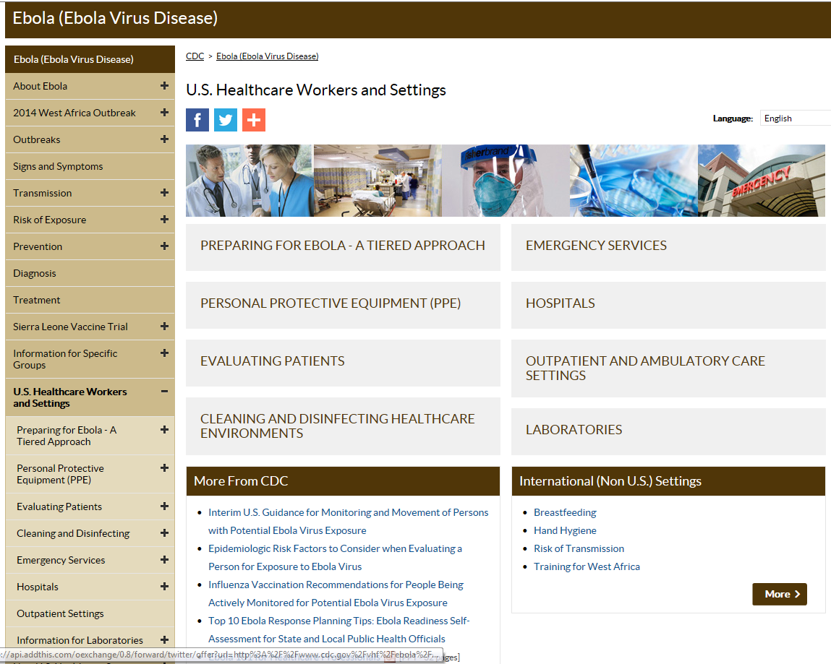
Centers for Disease Control and Prevention
Office of the Director
35

