Slide 1
Infection Prevention and Control for Healthcare Workers
Preparing Healthcare Workers to Work in Ebola Treatment Units (ETUs) in Africa
This presentation is current as of December, 2014. This presentation contains materials from Centers for Disease Control and Prevention (CDC), Médecins Sans Frontières (MSF), and World Health Organization (WHO).
U.S. Department of Health and Human Services
Centers for Disease Control and Prevention
version 12.03.2014
Notes:
This lecture describes infection prevention and control principles for healthcare workers in Ebola Treatment Units (ETUs) in Africa. Please note infection prevention and control measures described in this lecture are somewhat different from those used in hospitals in the United States. In addition, these infection prevention and control recommendations might be different from those you encounter in the ETU to which you are deployed. However, the principles described should help you understand the rationale underlying infection prevention and control recommendations, and help you stay safe during deployment.

Slide 2
Learning Objectives
Explain the rationale for recommended infection prevention and control principles for Ebola virus
Describe infection prevention and control practices currently recommended for Ebola virus
Describe the principles of using personal protective equipment (PPE) safely in the ETU
Notes:
The learning objectives for this lecture are to:
Explain the rationale for recommended infection prevention and control principles for Ebola virus
Describe infection prevention and control principles currently recommended for Ebola virus
Describe the principles of using personal protective equipment (PPE) safely in the ETU

Slide 3
Routes of Ebola Virus Transmission
Established route
Direct contact with blood or other body fluids
Eyes or other mucous membranes
Breaks in the skin
Percutaneous injuries from objects contaminated with infectious materials (e.g., needlestick injury)
Possible routes
Sexual contact
Breastfeeding
No evidence of aerosol transmission
Person-to-person transmission of Ebola virus via inhalation (aerosols) has not been demonstrated
Epidemiology is not consistent with aerosol transmission
Notes:
First, let’s review how Ebola virus is transmitted. A primary transmission route is contact transmission. Direct contact means contact with body fluids such as blood, saliva, mucus, vomit, urine, or feces from an infected person, whether alive or dead. This can occur if you touch your eyes, nose, mouth, or abrasion with contaminated hands or other objects. Percutaneous injuries, such as a needlestick, can also transmit the virus.
Sexual contact and breastfeeding may be possible routes for virus transmission.
Ebola can theoretically be transmitted by large droplets generated by coughing, sneezing, or talking. These large droplets may be produced during certain medical procedures, such as resuscitation, suctioning, or bronchoscopy. However, there is no evidence of aerosol transmission through tiny airborne droplets containing virus that remain suspended in the air for long periods of time, or dust particles containing the virus. Airborne transmission does not fit the epidemiologic pattern seen in this epidemic or other Ebola outbreaks.
By understanding the ways that Ebola virus is transmitted, you will be able to understand why standard, contact, and droplet precautions are recommended.

Slide 4
Precautions for Managing Ebola Virus Infection Key Elements
Standard, contact, and droplet precautions recommended
Hand and respiratory hygiene
Personal protective equipment (PPE)
Injection and medication safety
Appropriate use/cleaning of patient care equipment, instruments, and devices
Environmental cleaning
Safe management of corpses
Notes:
The key elements of healthcare precautions that we will discuss today are hand and respiratory hygiene, PPE, and injection and medication safety. However, other infection prevention and control measures are also critically important, including appropriate use and cleaning of patient care equipment, cleaning of the ETU environment, and safe management of corpses. These measures will be discussed in a later lecture.

Slide 5
Principles for Managing Ebola Virus Infection Facilities Where Patients with Ebola Present
Triage and rapid isolation of suspected cases
Standard precautions
Perform hand hygiene
Use of PPE (e.g., gloves, suits, masks)
Safe injection practices
Safe handling, cleaning and disinfection of equipment and surfaces
Ensure safe waste management
Notes:
Standard infection prevention and control principles, similar to those you would routinely follow in a U.S. healthcare setting, are the minimum required in the ETU and in patient intake areas. Triage and rapid isolation of suspected cases are critical to eliminate unprotected contact between patients suspected to have Ebola, staff, and other possibly uninfected persons/people.
Standard principles you are already familiar with are also used in the ETU:
Perform hand hygiene.
Use PPE, including gloves, suits, and masks and facial protection (goggles/shields) when you interact with patients suspected to have Ebola.
Ensure safe injection practices and safe handling, cleaning, and disinfection of equipment and surfaces.
Ensure safe waste management.

Slide 6
Principles for Managing Ebola Virus Infection Patient Precautions in the ETU
Place patients in single rooms, if available (if not possible, separate suspected and confirmed patients)
For cohorts, place patient beds at least one to two meters apart (three to six feet) and arrange to keep this distance between patients
Limit patient movement and eliminate unprotected contact with non-infected persons (challenging among family cohorts, and with young children)
Use disposable equipment or dedicated reusable equipment for each patient (clean and disinfect between each patient use)
Notes:
For maximum infection prevention and control, placing patients in a single room is optimal. However, in African ETUs, it is far more common to have multiple patients in an open area. If this is the case, then patients suspected to have Ebola and those confirmed to have Ebola should be in separate areas, with beds at least one to two meters, or three to six feet, apart. You will want to restrict movement between the two areas. However, this can be challenging when family cohorts wish to remain together, especially those where young children are involved. And as expected, you will want to use disposable equipment where possible, or disinfect all equipment between patients. You will hear more about ETU setup and design in another lecture.

Slide 7
Hand Hygiene
Notes:
Hand hygiene cannot be stressed enough. It is a critical component to stop the spread of the Ebola virus disease.

Slide 8
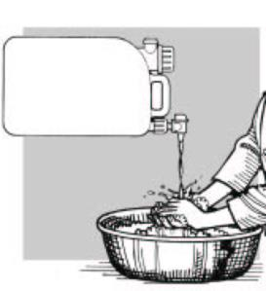
Hand Hygiene Outside the ETU High-risk Zone
Regularly wash hands, including before entering and leaving the ETU
Soap and water
0.05% chlorine solution
Alcohol-based hand rub
Contaminated hands are the most common way to transfer contaminated material to mucous membranes (eyes, mouth, nose)
Notes:
Outside the high-risk zone of the ETU, when hands are ungloved, wash your hands regularly. This includes when entering and leaving the ETU environment. Use soap and water, 0.05% chlorine solution, or an alcohol-based hand rub. Contaminated hands are the most common way to transfer contaminated material to mucous membranes in the eyes, mouth, and nose.

Slide 9
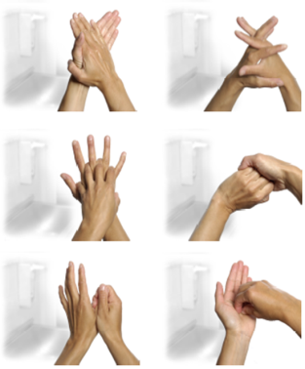
Hand Hygiene
Notes:
Handwashing must be very thorough. This slide shows how to perform good hand hygiene and appropriate techniques.

Slide 10
Hand Hygiene: Gloved Hands in the ETU High-risk Zone
Wear double gloves at all times
Remove gloves if they become torn or damaged
Always perform hand hygiene between patients
Perform hand hygiene with first set of gloves still on before donning new gloves
Notes:
While in the high-risk zone of the ETU, always remember to wear double gloves. Remove any gloves that become torn or damaged. If you suspect you have torn a glove through to skin level, leave the ETU immediately and remove PPE following your ETU’s doffing procedures. You can then re-don a new set of PPE following the usual procedures.
Perform hand hygiene with gloves on between patients. Even if your ETU requires you to change your outer gloves between patients, you must perform hand hygiene with the first set of gloves still on before donning the new gloves. You don’t want to transfer pathogens between patients, including many other pathogens besides Ebola virus. In the suspect area, note not everyone has EVD, and those who don’t are at high risk of acquiring it while in the suspect area. Therefore, healthcare workers must be very careful in practicing hand hygiene between patients.

Slide 11
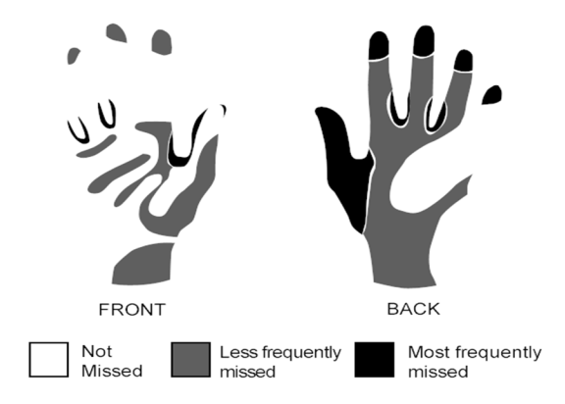
Hand Hygiene The Parts Typically Forgotten
The use of gloves does not replace the need to practice hand hygiene after taking off gloves. Hands must also be washed after removing gloves.
Notes:
This slide shows the typical parts of the hands missed due to poor hand hygiene technique. In studies, the black and dark gray areas shown here, including the backs of fingers and hands, are most often missed. Thorough handwashing might seem basic and routine, but it could be a potentially lifesaving step for infection prevention and control. Please pay careful attention to hand hygiene at all times, both inside and outside the ETU.
It is important to note that wearing gloves does not mean you can skip hand hygiene. You must perform hand hygiene after removing your gloves.

Slide 12
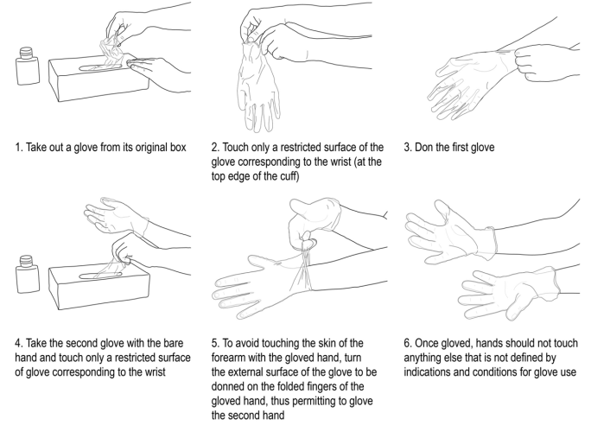
How to Don (Put On) Gloves
Notes:
Donning and doffing of gloves are important. This slide shows the steps in donning gloves. After removing a glove from the original container, try to touch only the cuff edge of the glove as you put it on. Then use your ungloved hand to take the second glove out of the box. Avoid touching your forearm with your gloved hand by hooking your gloved fingers around the cuff of the second glove, and pulling it onto the second hand. Then put on the second pair of gloves using the same technique. Once you have on gloves, don’t touch things not meant to be touched with gloved hands, including your face.

Slide 13
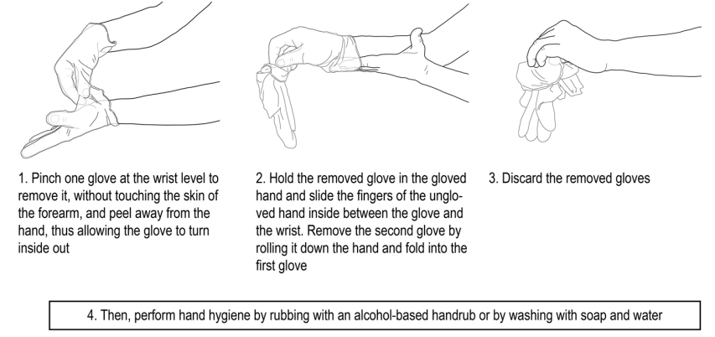
How to Safely Doff (Remove) Gloves
Notes:
Removing gloves is a critical step in the doffing process. You will be tired and eager to get out of your hot PPE. But you must still pay close attention to removing your gloves to avoid contaminating yourself. Start by pinching one glove at your wrist and peeling it away. Typically, this turns the glove inside out. Hold the glove you removed in your other gloved hand. Slide the fingers of your ungloved hand between glove and wrist; then roll the glove down your hand, folding it into the first glove. Do this gently. Don’t snap the gloves off. This can eject droplets of contaminated material onto surfaces or onto you. Discard the gloves safely; then perform hand hygiene. In African ETUs, hand hygiene will often be done with a 0.05% chlorine solution, but soap and water or an alcohol-based hand rub are also effective.

Slide 14
Personal Protective Equipment (PPE) Principles
Notes:
Other PPE, in addition to gloves, are essential elements of healthcare precautions in an ETU. PPE will vary depending on the practices of your ETU. However, certain principles are universal.

Slide 15
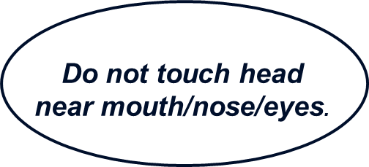
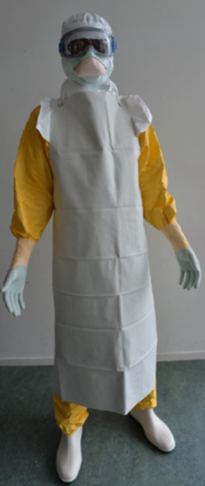
Healthcare Worker PPE in the ETU High-risk Zone
All persons entering the ETU high-risk zone or in direct contact with patients with suspected or confirmed Ebola should wear :
2 pairs gloves
Disposable fluid-resistant suit or gown
Waterproof apron
Face shield or goggles
Face mask (N95 respirator)
Hood
Notes:
The general infection prevention and control principle for PPE is to cover all mucous membranes and skin. Here is the checklist for PPE you need to be wearing before you start caring for patients who might have Ebola virus disease (EVD). All persons entering the ETU high-risk zone or in direct contact with patients with suspected or confirmed Ebola should wear double gloves, a disposable fluid-resistant suit, and a waterproof apron. The protection of mucous membranes around the face is critically important. ETU workers typically wear a face shield or goggles, a face mask, and a hood for protection. Healthcare workers should also wash hands frequently and not touch their heads near their mouths, noses or eyes.
Although aerosol generating procedures are not common in the ETU, an N95 respirator is typically used. The N95 respirator, in conjunction with a face shield or goggles, the hood and with optional surgical mask, serve to protect skin and mucous membranes from droplet contamination.

Slide 16
Possible PPE Differences (1 of 3)
Differences in PPE and protocols depending on the ETU
Hoods
Hood attached to suits
Separate hood
Eye protection
Goggles
Face shield
Face mask
N95 respirator
Surgical mask
Notes:
There will be differences in PPE and protocols depending on the ETU. For example, the head covering might be a hood attached to a suit, or a separate hood. Eye protection might be goggles or a face shield. The mask used in your ETU might be an N95 respirator or just a surgical mask. As long as mucous membranes are protected, and chances for transfer of virus to your face are minimized, you will greatly reduce your risk of infection, regardless of the equipment you are wearing.

Slide 17
Possible PPE Differences (2 of 3)
At least two types of protective suits in common use, with or without built-in hoods
Both repel liquids and aerosols
One type is coated to enhance barrier protection against liquids
Heat strain is a greater concern
Typically can work <1 hour
Gowns may be used in some ETUs in place of suits
Apron
Disposable
Reusable
Notes:
There are at least two types of protective suits commonly used in West Africa. They can be with or without built-in hoods. You might see them referred to by the brand names Tyvek® and Tychem®. Both repel liquids and aerosols. Tychem® is coated to enhance barrier protection against liquids. This makes it hotter to work in, and heat strain is a greater concern. In most suits, you can typically work for less than one hour before heat strain becomes a risk. In some ETUs, gowns may be used in place of suits. In all ETUs, a waterproof apron is used, which might be disposable or reusable.

Slide 18
General PPE Principles
Use PPE that is standard in the ETU where you work
Safety is attained through
Rigorous adherence to systematic infection prevention and control practices
Consistent adherence to the specific detailed steps of PPE donning and doffing (regardless of style of PPE)
Donning should be done with your buddy and an observer
Doffing is a high-risk activity and is done with a doffing coach
Notes:
Use PPE that is standard in the ETU where you work. The PPE used should provide maximum protection for mucous membranes and reduce the chances for getting virus on your skin. Safety is attained through rigorous adherence to systematic infection prevention and control practices. Your goal should be to consistently adhere to the specific detailed steps of PPE donning, and especially doffing, regardless of the style of PPE. Donning should be done with your buddy, the person who will be working in the ETU with you, to ensure you have no exposed skin or PPE tears. Clearly, doffing is a high-risk activity; you should not do it alone. Your ETU should have a doffing coach who directs you as you remove the PPE step by step.

Slide 19
Principles of Donning PPE
The primary infection prevention and control principle is to ensure mucous membranes and skin are covered
Remember how many pieces of PPE you need so you always have everything before donning
Follow recommended order of donning to aid muscle memory and adherence to the correct PPE, visually inspect PPE components
A trained observer should observe the donning process
Ask your buddy to visually inspect your suit and PPE integrity
Memorize your appearance in the mirror after donning to reinforce adherence
Notes:
As noted before, the primary infection prevention and control principle when donning PPE is to ensure mucous membranes and skin are covered. Remember how many pieces of PPE you need so you always have everything available before donning. Follow the recommended order when donning. This will aid in what is known as muscle memory as well as adherence to the correct PPE. It is also important to have a trained observer to oversee the donning process for all healthcare workers. Ask your buddy, to also visually inspect your suit and PPE integrity. And finally, memorize your appearance in the mirror after donning PPE to reinforce adherence to correct practices.

Slide 20
Principles of Doffing PPE
A trained coach should coach you through the doffing process
Remove the most contaminated PPE first
This is why the apron and the outer gloves are removed first
Protect the eyes and mucus membranes
This is why you close eyes when removing anything from the head
Remove eye protection as late as possible in the doffing process
Keep the gloved hands clean so they can remove PPE without spreading contamination
This is why the gloved hands are rinsed with 0.5% chlorine solution after each piece of PPE is removed
This is why you grasp the back corner of the mask, not the front, to remove it
Dirty touches dirty; clean touches clean
Notes:
Removing, or doffing, PPE is the time when mistakes are easy to make, and they can have severe consequences. Therefore, you should rely on a trained coach to assist you through the doffing process. While you may be hot and eager to remove PPE, it is critical that you carefully remove PPE following directions. Do not rush. The process can take up to 20 minutes.
You will be heavily contaminated when you leave the ETU, even if you have no visible body fluids or blood on your PPE. When doffing, the idea is that dirty surfaces should only touch dirty surfaces, and clean surfaces should only touch other clean surfaces.
Remove the most contaminated PPE first. This is why you should start by removing your apron and outer gloves. Protect your eyes and mucous membranes. Close your eyes when removing anything from your head. Be aware that the doffing sequence may vary based on whether the mask and face shield are worn under the hood (WHO protocol) or placed over the hood (MSF protocol). With the WHO protocol the hood is removed before the mask and face shield; in the MSF protocol the hood is removed after. Always use your gloved hands to grasp the back corner of your mask - not the front - to remove it.

Slide 21
Common PPE Mistakes
Healthcare worker (HCW) errors
Uncovering wrists with vigorous movement (tall people are particularly prone to this)
Adjusting goggles – gloves are contaminated
Removing goggles too early during doffing, risk face contamination
Notes:
Certain mistakes are easy to make in the ETU. An example is uncovering your wrists with vigorous movement when the suit slides up your wrist. Tall people are particularly prone to this. Adjusting goggles should never be done in the ETU because your gloves will be contaminated. Also removing goggles too early during doffing is a dangerous mistake because you might contaminate your face and mucous membranes.

Slide 22
Common PPE Hazards
Situations that can result in hazards for healthcare workers
Flies coming in through holes on the side of the goggles
Eyeglasses falling off when removing the goggles
Notes:
Other problems can arise from circumstances beyond your control, but you must think before addressing them. Sometimes small flies or bugs come in through holes on the side of the goggles or under the face mask and it’s natural to reach for your goggles to deal with this annoyance. Don’t do it. Always consider your hands to be contaminated.
Eyeglasses can fall off when removing the goggles. Let them fall, and figure out what to do with the help of your doffing coach. An eyeglass strap can help you avoid pulling your glasses off accidentally.

Slide 23
Injection Safety
Notes:
We’ll now talk about injection safety as an element of healthcare precautions.

Slide 24
Use of Needles and Sharps in the ETU General Rules
Handle all needles and sharps with extreme care
Dispose in puncture-proof, sealed containers
NEVER recap sharps
Never direct the point of a used needle toward anyone, including yourself
Do not remove used needles from disposable syringes
Do not bend, break, or otherwise manipulate used needles by hand
Never carry used sharps in your hands
Position sharps container at location of procedure
Notes:
Before talking specifically about phlebotomies, it is important to discuss the extreme care needed while using needles and sharps in the high-risk zone of the ETU.
Using needles and sharps in the ETU requires extreme care. It is critical to adhere to some general rules.
Dispose of used sharps in puncture-proof and sealed containers.
Never recap sharps.
Never direct the point of a used needle toward anyone, including yourself.
Do not remove used needles from disposable syringes.
Do not bend, break, or otherwise manipulate used needles by hand.
Never carry used sharps in your hands.
Position the sharps container near the location of a procedure.

Slide 25
Preparing to Draw Blood from ETU Patients Key Points
Limit phlebotomies to the minimum necessary
Ensure all supplies have been gathered and all sample tubes and containers are labeled before entering the high-risk zone
Assess safety risk to you vs. patient benefit before attempting a blood draw
There are situations when NOT to attempt a blood draw Example: inadequate PPE available or a combative person
Ensure appropriate lighting
Two ETU staff are needed: one to perform the procedure, the other to assist in handling the specimen and controlling the patient
Establish how the sample will be sent out of the high-risk zone
Ensure there is a designated lab ready to receive the specimen and that they are aware that a sample is coming
Notes:
Understanding the importance of safety measures when handling needles and sharps will help in performing phlebotomies in the ETU.
The first principle of a blood draw in the ETU is to limit phlebotomies to the absolute minimum necessary.
Before entering the high-risk zone to perform a phlebotomy, ensure all supplies have been gathered and all sample tubes and containers are labeled.
Before attempting a blood draw, assess the safety risk to yourself versus the potential benefit to the patient. There are situations when you should not attempt a blood draw - for example, when only inadequate PPE is available, or when the patient is combative.
Be sure you have adequate light. Two staff members are needed for the blood draw. One will perform the procedure, and the other will assist in handling the specimen and controlling the patient.
Also, establish how the sample will be transported out of the high-risk zone. Ensure there is a designated lab ready to receive the specimen and they are aware a sample is coming.

Slide 26
Phlebotomy Supplies Needed at Bedside
Sharps container (if not already near patient bed)
Labeled sample tube (preferably plastic)
Blood sampling system (many facilities in West Africa do not have auto-locking IVs or needles)
Tourniquet (single use)
Skin antiseptic wipe (70% ethanol or iodine)
Gauze pad
Adhesive bandage
Labeled sealable bag and biohazard bag for transport
0.5% chlorine sprayer (if not already near patient bed)
Notes:
The equipment you will need to have within easy reach include a sharps container. If there is not one already near the patient’s bed, place one there for safety. Have a labeled sample tube, preferably a plastic tube, available. Know the blood sampling system. Note most facilities in West Africa do not have auto-locking IVs or needles. You will need a single-use tourniquet, and a skin antiseptic wipe consisting of either 70% ethanol or iodine. You will also need a gauze pad and adhesive bandage to cover the site after blood is drawn. Have ready a labeled sealable bag and biohazard bag for transport, and a 0.5% chlorine solution sprayer.

Slide 27
Preparing for a Phlebotomy in the ETU
Perform a risk assessment
Is it safe to draw blood from the patient? (Are they agitated, restless, or combative?)
Where is the sharps container located?
Where is the handwashing station?
What is the protocol for a needlestick injury?
Discuss the procedure with the patient
Set up the blood draw area so equipment is easily within reach
Place the sharps container directly next to you
Instruct your buddy to hold the labeled blood collection tube, 0.5% chlorine spray bottle, and labeled bags
Notes:
When preparing to perform a phlebotomy, start by conducting a risk assessment by asking the following questions of yourself and your buddy:
Is it safe to draw blood from the patient? (Are they agitated, restless, or combative?)
Where is the sharps container located?
Where is the handwashing station?
What is the protocol for a needlestick injury?
Whenever possible, it is preferable to have the patient sit in a chair for the procedure for safety and to reduce risk of contamination. This is only done if the patient is able to move unassisted or can be moved without risk to the healthcare worker. Sometimes the cots in the ETU are on the floor. The floor or cot could be covered in contaminated materials such as feces, vomit, or blood.
Discuss the procedure with the patient. Then set up the blood draw area so equipment is easily within reach.

Slide 28
Performing a Phlebotomy in the ETU
Disinfect the area where the needlestick will occur
Hold the arm distal to insertion site with one hand and place needle into vein with the other
Assure that your hand and your buddy’s hands are not near the needle insertion site
Ask your buddy to give you the labeled blood collection tube
Collect blood in the specimen tube and apply pressure to the site
Discard the needle immediately into a sharps container
Have your buddy spray the specimen tube with 0.5% chlorine solution and bag specimen, then spray bag
Bandage the needle entry site
If the patient bleeds profusely, hold pressure for five minutes; then secure the bandage and instruct the patient to hold pressure over the site
Notes:
To perform a phlebotomy, cleanse the skin where you will be inserting the needle.
Hold the arm distal to the insertion site with one hand and place the needle into the vein with the other. Assure your hand and your buddy’s hands are not near the needle insertion site.
Ask your buddy to give you the labeled blood collection tube.
Collect blood in the specimen tube and apply pressure to the site.
Discard the needle immediately into a sharps container. On the next slide we will discuss sharps containers in the ETU. For now, it important to perform the next step in the phlebotomy procedure and have your buddy spray the specimen tube with 0.5% chlorine solution, bag the specimen, then spray the bag.
Bandage the needle entry site. If the patient bleeds profusely, hold pressure for five minutes and then secure the bandage and instruct the patient to keep pressure on the site.

Slide 29
Sharps Containers in the ETU
Used sharps should be immediately placed in designated container
Puncture-resistant containers are best but often not available
Place containers for sharps as close as possible to where they are used
Never carry sharps in your hand, use kidney dish or similar container if used sharps need to be transported
Seal puncture-resistant containers with a lid and replace when 3/4 full
Ensure the containers are placed in an area that is not easily accessible to visitors, particularly children
Notes:
Sharps containers in the ETU are also a concern. Used sharps should be immediately placed in a designated container. Puncture-resistant containers are best but often not available. For example, cardboard containers are used in some MSF facilities so the container and waste can be more easily incinerated.
Ensure containers for sharps are placed as close as possible to the immediate area where the objects are being used to limit the distance between use and disposal. Ensure the containers remain upright at all times. If the sharps container is not nearby, place sharps in a kidney dish or similar container to carry to the sharps container. Never carry sharps in your hands. Replace the containers when they are three quarters full, and when appropriate, seal the containers with a lid. Never force additional sharps into the container to make room. Also, never leave sharps on the floor and make sure others don’t do it. Sharps on the floor can make you stumble and fall.
Ensure the containers are placed in an area not easily accessible to visitors, particularly children. For example, containers should not be placed on floors, or on the lower shelves in areas where children might have access.

Slide 30
Transporting Specimen to the Laboratory and Phlebotomy Clean-up
Bagging the Specimen
Spray the inside and outside of the sealable labeled bag with 0.5% chlorine solution
Place the specimen bag into a biohazard bag
Transport the bag to the lab using the ETU protocol
Do NOT recap needles
Ensure all sharps are in a sharps container
Collect disposable materials and place in a waste container
All healthcare workers involved must wash gloved hands in 0.5% chlorine solution
Notes:
Once the blood specimen is obtained, have your buddy spray the inside and the outside of a sealable labeled bag with 0.5% chlorine solution. Then place the specimen bag into a biohazard bag which is also sprayed. The bag should be transported to the lab using the protocol determined for your ETU. Do not recap needles. Ensure all sharps are in a sharps container, and collect disposable materials and place in a waste container. All healthcare workers involved must wash gloved hands in 0.5% chlorine solution.

Slide 31
Summary
The ETU in a resource-limited setting is a higher-risk environment than a United States hospital
All personnel in a single facility should adhere to the same infection prevention and control practices
WHO, MSF, and CDC infection prevention and control guidelines are updated frequently, and might differ slightly
All are based on experience, the clinical care environment, science, and expert opinion
Consistent adherence to infection prevention and control practices and appropriate use of PPE will mitigate risk of HCW infection
Notes:
In summary, successful infection prevention and control in the ETU requires care, attention to detail and protocol, and cooperation among staff.
The ETU in a resource-limited setting is a higher-risk environment than a U.S. hospital. Infection prevention and control principles must balance best feasible patient care with maintaining healthcare worker safety. All personnel in a single facility should adhere to the same infection prevention and control rules. WHO, MSF, and CDC infection prevention and control guidelines are updated frequently and might differ slightly. But all are based on experience, the clinical care environment, science, and expert opinion.
The key to protecting your health is consistent adherence to infection prevention and control practices and appropriate use of PPE.
Whenever you are in the ETU, carefully observe the actions of other healthcare workers as well as your own, and don’t hesitate to bring any actions that increase risk to the attention of your buddy, supervisor, or team.

Slide 32
http://www.cdc.gov/vhf/ebola
U.S. Department of Health and Human Services
Centers for Disease Control and Prevention

