Slide 1
Vaccinating Pregnant Patients
Slides for General Use
Updated August 2017

Slide 2
The slides in this deck can be used to share information about maternal vaccination with colleagues, practice team, and partners.
They are intended to provide background on why maternal vaccination is important, as well as share vaccination guidelines, practice standards, and resources for implementation and patient education.

Slide 3
BACKGROUND

Slide 4
Recommended Vaccines
CDC has guidelines for the vaccines women will need before, during, and after pregnancy.

Slide 5
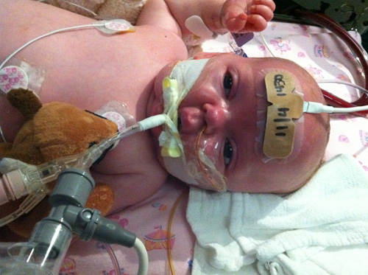
Pertussis (Whooping Cough) and Infants
Pertussis is a contagious respiratory disease characterized by a severe cough that can last for weeks or months
DTaP vaccine is recommended at 2, 4, 6, 15-18 months, and 4-6 years to prevent pertussis and reduce the severity of symptoms
Young infants are at greatest risk for getting pertussis and suffering from life-threatening complications
Image: www.cdc.gov/pertussis/about/photos.html

Slide 6
Pertussis Trends
Despite high DTaP coverage, more than 32,000 cases were reported in the U.S. in 2014, including 7 deaths among infants less than 3 months old.
Multiple factors are contributing to the pertussis resurgence
Current efforts focused on:
Protecting infants by vaccinating pregnant women; and
Routine childhood and adolescent pertussis vaccine recommendations
Source: CDC, National Notifiable Diseases Surveillance System and Supplemental Pertussis Surveillance System

Slide 7
Maternal Tdap Recommendation
Tdap recommendations have changed over time
Administer Tdap in the early part of gestational weeks 27 through 36 during each pregnancy
Image: CDC

Slide 8
Tdap coverage among pregnant women by timing of vaccination, 2013-14 through 2016-17*, Internet panel survey, United States
* Women who had a live birth during August-March preceding each survey. 2016-17 estimates are preliminary.

Slide 9
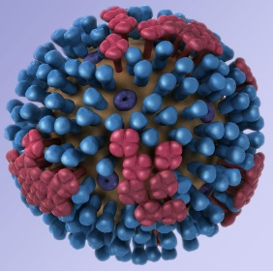
Influenza
Contagious respiratory illness caused by influenza viruses that infect the nose, throat, and lungs
Causes mild to severe illness, including death (~3,000-49,000 deaths per year)
Signs/symptoms include fever, cough, sore throat, runny nose, muscle or body aches, headache, fatigue, vomiting and diarrhea sometimes occur
Flu viruses spread mainly by droplets, also contact
Image: CDC

Slide 10
Influenza and Pregnant Women
Pregnant and postpartum women are at higher risk for severe illness and complications from influenza than women who are not pregnant.
Flu is more likely to cause severe illness, hospitalization, and death in pregnant women.
Pregnant women with flu may also have a greater chance for premature labor and delivery.
Image: CDC

Slide 11
Maternal Flu Vaccine Recommendation
By the end of October, if possible, to help ensure protection before flu activity begins to increase

Slide 12
Influenza Vaccination Coverage Among Pregnant Women, 2010-11 through 2016-17 Influenza Seasons
* Beginning in 2012-13 season, women vaccinated since July 1 were counted as vaccinated. In prior seasons, only women vaccinated since August 1 were counted as vaccinated.
† 2016-17 estimate is preliminary.

Slide 13
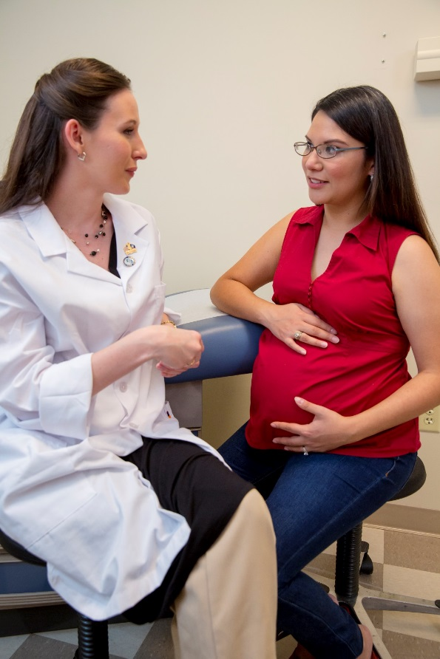
Low Maternal Vaccination Rates
Coverage of recommended vaccines for pregnant women remains low—leaving a number of pregnant women and their infants at risk for complications from vaccine-preventable diseases
Image: CDC

Slide 14
IMPROVING MATERNAL VACCINATION RATES
Image: CDC

Slide 15
Strategies for Vaccine Assessment
Include standing orders or protocols for nursing staff to assess and administer needed vaccines.
Integrate vaccine prompts into electronic medical records.
Use reminders to help your practice stay on top of vaccines that are due soon or overdue.
Send patients reminders about missed vaccines or vaccines that are due soon.
Review how your practice does in keeping patients up to date on vaccines.

Slide 16
We know pregnant women have questions once they realize they need vaccines…
Are these diseases really dangerous?
Is it safe for me and my baby?
Can’t I just get it after my baby is born (like my last pregnancy)?
Why every pregnancy?
Why hasn’t my doctor talked to me about this?
Is it enough to just make sure everyone around my baby is vaccinated (or if we stay away from sick people)?

Slide 17
And they may look to many sources for pregnancy-related information…

Slide 18
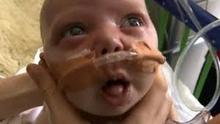
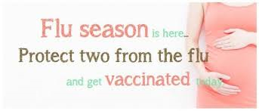
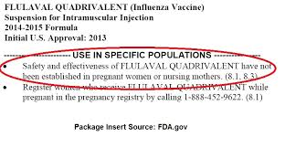
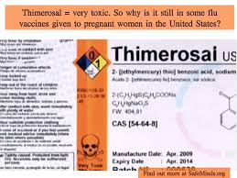
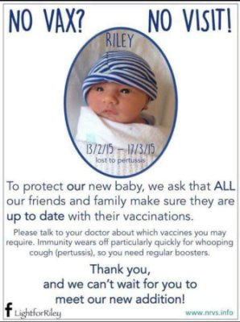
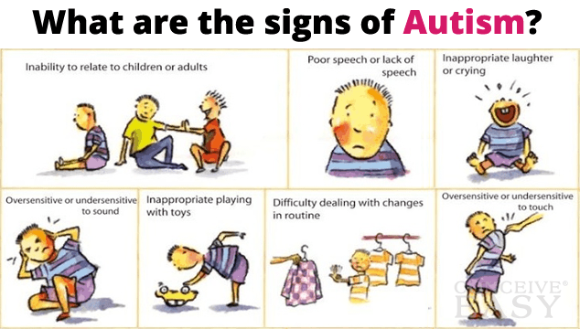
Those sources may have conflicting information…

Slide 19
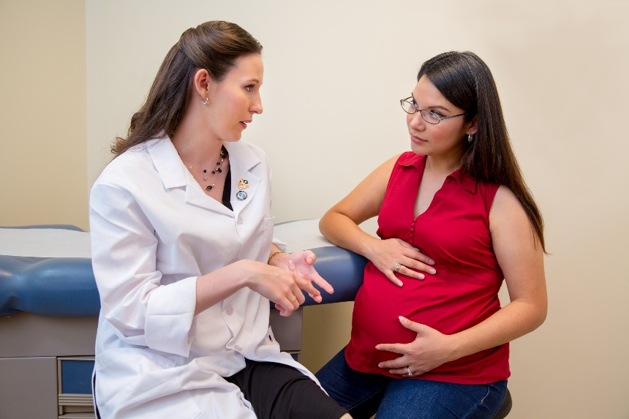
But, they trust their ob-gyn or midwife the most.
“For me, I'm just going to see my doctor today and I'm going to say ‘I'm 28 weeks today, do you think I should get my whooping cough vaccination?’” (Pregnant with 1st Child – San Diego)
“I obviously have to ask the doctor.” (Pregnant with 2nd+ Child – Atlanta)
Image: CDC

Slide 20
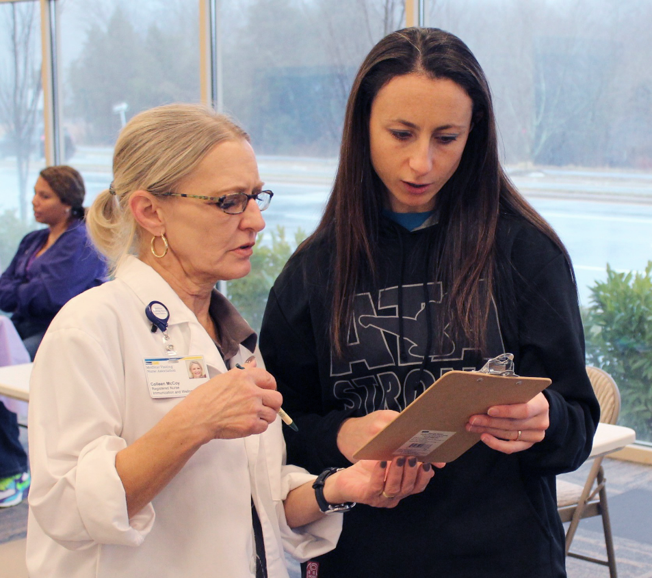
Your Strong Recommendation Makes a Difference
Most pregnant women:
Aren’t aware they need vaccines
Trust their prenatal care providers’ recommendations about how to keep themselves and their babies healthy
Image: CDC (PHIL)

Slide 21
Vaccination coverage for pregnant women by provider recommendation and/or offer, 2015-16 flu season

Slide 22
Best Practices for Maternal Vaccine Recommendation
Present vaccination as a standard part of prenatal care
Pair Tdap with glucose tolerance test
Ensure your staff is on board
Use standing orders
Provide a strong recommendation
SHARE additional information (as needed)
SHARE tailored reasons why the recommended vaccine is right for the patient.
HIGHLIGHT positive experiences with vaccines (personal or in your practice) to reinforce the benefits and strengthen confidence in vaccination.
ADDRESS patient questions and any concerns about the vaccines.
REMIND your patients about the protection vaccines can help provide.
EXPLAIN the potential costs of getting the disease.

Slide 23
SHARE tailored reasons why the recommended vaccine is right for the patient
“This vaccine can protect you from the flu, which is more likely to cause severe illness for you because changes in your immune system, heart, and lungs during pregnancy make you more prone to complications from flu. Also, if you get the flu, you have a greater chance for serious problems for your baby, like premature labor and delivery.”
“Whooping cough can be a threat to you or your baby. Since 2010, we see between 10,000 and 50,000 cases of whooping cough each year in the United States. The whooping cough vaccine during your pregnancy will help pass some early protection against this disease to your baby.”

Slide 24
HIGHLIGHT positive experiences with vaccines
Highlight positive experiences with vaccines (personal or in your practice) to reinforce the benefits and strengthen confidence in vaccination.
Tell your pregnant patients that CDC, ACOG, ACNM and you recommend they get Tdap and flu vaccines during their pregnancy.

Slide 25
ADDRESS patient questions and any concerns about the vaccines
“Whooping cough vaccine has been carefully studied by medical and scientific experts. Getting the vaccine during pregnancy does not put you at increased risk for pregnancy complications like low birth weight or preterm delivery.”
“The flu shot has been given to millions of pregnant women over many years. Flu shots have not been shown to cause harm to pregnant women or their babies.”
“The most common side effects are mild, like redness, swelling, or pain in your arm where the shot was given. This should go away within a few days.”

Slide 26
REMIND your patients about the protection vaccines can help provide
“Getting the whooping cough vaccine now will not only help protect you from getting whooping cough and passing it on to your baby, but it will also pass protection on to your baby. That way, your baby will be born with some protection against this very dangerous disease.”
“Flu activity is really picking up right now, and CDC says to expect even more cases in the coming months. That is why I want to make sure I help protect you and your baby now.”

Slide 27
EXPLAIN the potential costs of getting the disease
Serious health effects associated with each disease for mom and baby
Time lost (such as missing work or family obligations)
Financial costs

Slide 28
Steps to Improve Vaccine Administration
Recommend and offer vaccines at the same visit.
Train and educate your staff on vaccine administration.
Properly store and handle vaccines.
Distribute Vaccine Information Statements (VIS) to patients.
Ensure proper care for patients.
Follow standard precautions to control infection.
Be aware of and prepared for potential adverse reactions.
TIP: Standing orders save time and reduce missed opportunities by authorizing nurses, pharmacists, and other healthcare professionals (where allowed by state law) to assess patient vaccine status and administer vaccinations without examination or direct order from the attending provider.

Slide 29
Vaccine Administration Resources
CDC General Immunization Training www.cdc.gov/vaccines/ed/courses.htm
Immunization Skills Self-Assessment www.immunize.org/catg.d/p7010.pdf
Storage and Handling www.cdc.gov/vaccines/recs/storage
Dose and Route Chart www.immunize.org/catg.d/p3084.pdf
Vaccine Information Statements (VIS) www.cdc.gov/vaccines/hcp/vis
Guide to Infection Prevention for Outpatient Care www.cdc.gov/HAI/settings/outpatient/outpatient-care-guidelines.html
Chart of Medical Management of Vaccine Reactions in Patients www.immunize.org/catg.d/p3082.pdf

Slide 30
Vaccine Referral Options
Pharmacies
HealthMap Vaccine Finder vaccine.healthmap.org Free online service where users can search by zip code for providers who offer vaccines.
Health Departments www.vaccines.gov/getting/where/ Check your state to see if they provide routine vaccinations or can help you identify other local vaccine providers.
Travel Clinics wwwnc.cdc.gov/travel/page/find-clinic
Remind patients to check with their insurance plans regarding which providers their insurance includes for vaccine services.

Slide 31
Steps in Documentation
To ensure patients get the vaccines they need and to prevent unnecessary vaccination, you should:
Record vaccination in patients’ medical records
Provide documentation of vaccines received to patients for their personal records
Document vaccinations in immunization information systems (IIS)
Even if you do not administer vaccines in your office, follow up with your patients to ensure they received the recommended vaccines from another immunization provider.

Slide 32
Immunization Information Systems (IIS)
Consolidate vaccination records for your patients
Help you assess your patients’ immunization status
Make sure your patients have completed necessary vaccine series
Reduce chances for unnecessary doses of vaccine or missed opportunities to provide vaccines
Facilitate use of reminder and recall notifications to send to patients
Make calculation of your office’s immunization coverage rates easier
WWW.CDC.GOV/VACCINES/PROGRAMS/IIS

Slide 33
RESOURCES
CDC and Acog

Slide 34
CDC Digital Resources
Website
Quiz
Motion graphic
WWW.CDC.GOV/VACCINES/PREGNANCY

Slide 35
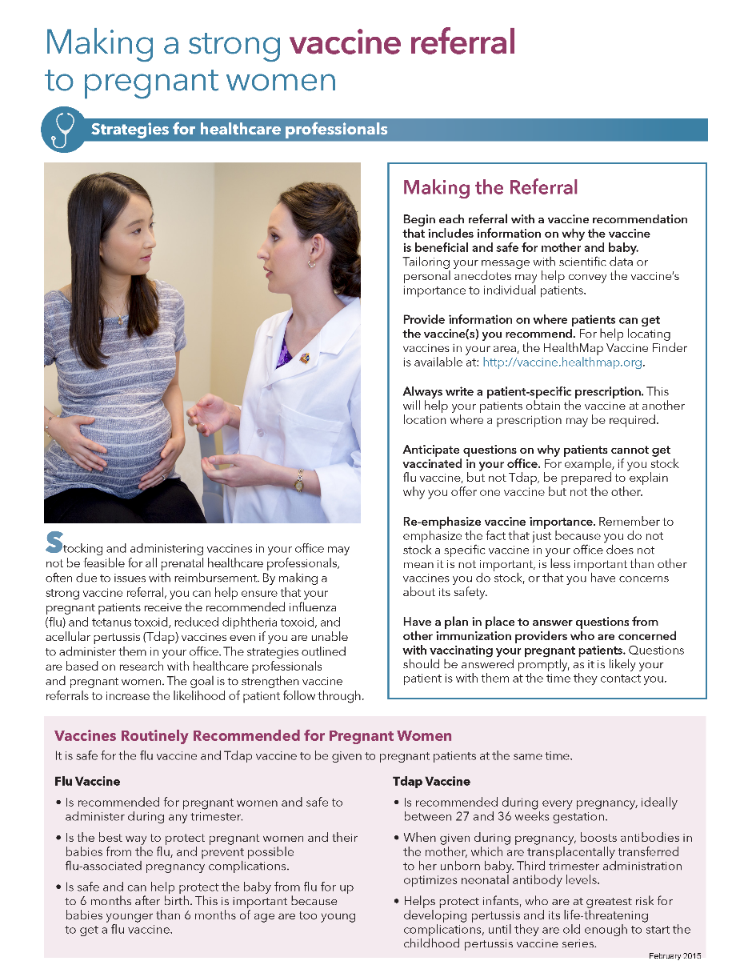
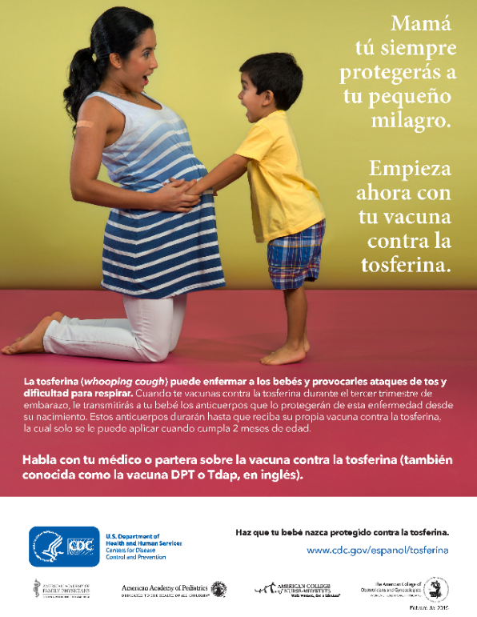
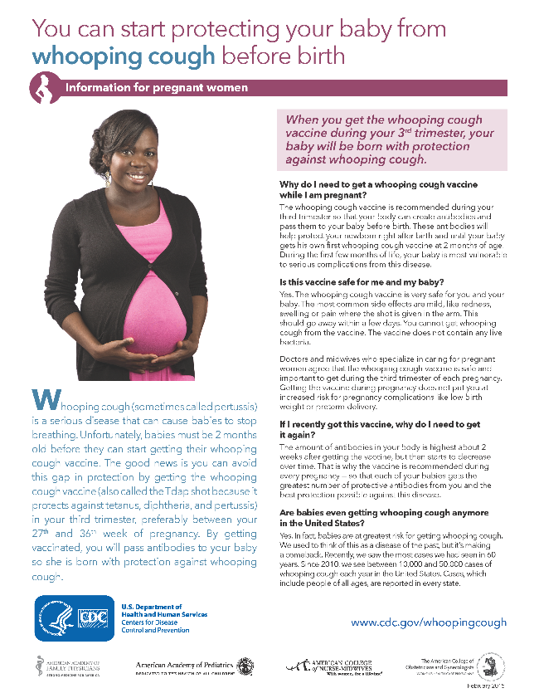
CDC Print Resources
WWW.CDC.GOV/VACCINES/PREGNANCY

Slide 36
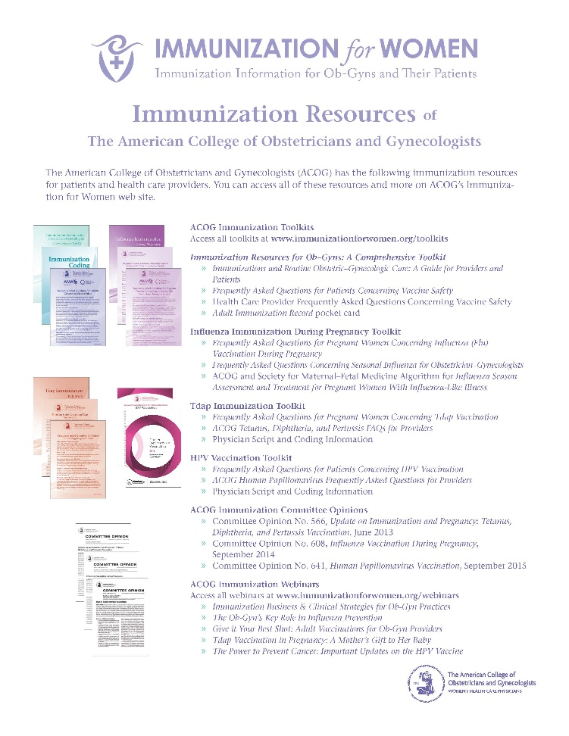
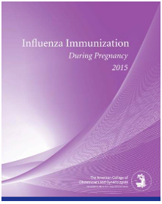
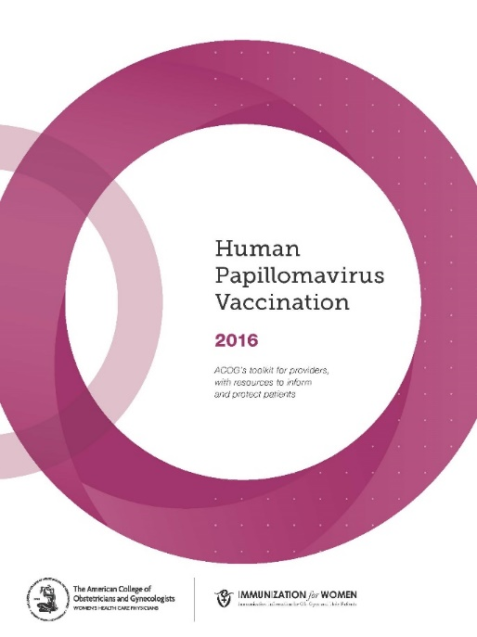
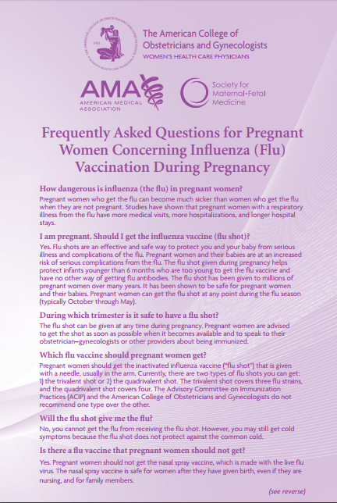
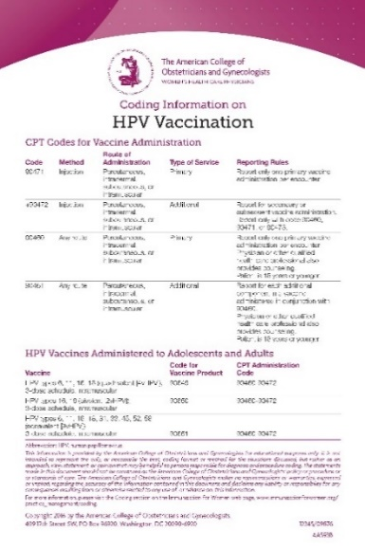
ACOG Resources to Improve Adult Immunization Rates: Tool Kits & Other Materials
http://immunizationforwomen.org/providers/resources/toolkits/default.php

Slide 37
ACOG Resources to Improve Adult Immunization Rates: Immunization for Women website: Practice Management
http://immunizationforwomen.org/providers/practice-management/default.php

Slide 38
What Can You Do?
GET VACCINATED
TALK to pregnant women about vaccines
Tell them it’s important for them and their babies
Make that conversation and recommendation memorable and compelling
USE our resources and encourage others to do the same
Include our maternal vaccine resources in prenatal information packets
Have resources in prominent locations in your office
EDUCATE your staff about maternal vaccines
Find a Vaccine Champion that can help!
ENCOURAGE pregnant women to ask questions
PROMOTE CDC’s maternal vaccine website and materials
Tell us what else you need to help you.
WWW.CDC.GOV/VACCINES/PREGNANCY

