Slide 1
The following document is for historical purposes and is no longer being updated. Please go to the COVID-19 Vaccination Clinical & Professional Resources for more recent information.

Slide 2
Building Confidence in COVID-19 Vaccines Among Your Patients: Tips for the Healthcare Team
Developed by:
CDC COVID-19 Response
Vaccine Task Force
June 2021
Notes:
Thanks for joining us today. Today I will be discussing some strategies to help build vaccine confidence and have conversations with patients around COVID-19 vaccination.

Slide 3
Presentation Overview
Elements of vaccine confidence
Strategies for building vaccine confidence
Strategies for talking with patients about COVID-19 vaccine
Communication resources
Notes:
Whether in your office, hospital, or through a telehealth visit, building confidence in COVID-19 vaccination among your patients is critical to setting expectations, ensuring vaccine uptake, and helping protect our communities. Vaccine confidence may seem like a vague concept, but there are concrete things we can do to foster it and help make it visible in our health system or clinic.
Here’s what we will be discussing in this presentation:
Elements of vaccine confidence;
Strategies for building vaccine confidence and talking with patients about COVID-19 vaccine; and
Relevant communication resources.

Slide 4
Elements of Vaccine Confidence
Notes:
I’ll start with defining vaccine confidence.

Slide 5
Defining Vaccine Confidence
Vaccine confidence is the trust that patients, parents, or healthcare professionals have in:
recommended vaccines;
professionals who administer vaccines; and
processes and policies that lead to vaccine development, licensure, manufacturing, and recommendations for use.
Notes:
We can address vaccine hesitancy by building vaccine confidence, which is a multi-faceted concept, based largely on trust.
Vaccine confidence is the trust that patients, parents, or providers have in:
recommended vaccines;
providers who administer vaccines; and
processes and policies that lead to vaccine development, licensure, manufacturing, and recommendations for use.
A person must have trust in all three of these items to feel fully confident in their decision to get vaccinated. The foundation of trust is critical, and this is something that must be built over time. This is a critical concept to think about when working with patient populations who may have a history of mistrust in the medical establishment or the government.
Healthcare personnel’s impact is often centered in helping patients trust in vaccine administrators, but healthcare personnel can also help build trust in the processes and policies by helping patients to understand new vaccine technologies, what to expect in terms of side effects, and how these vaccines are being continuously monitored for safety.

Slide 6
Willingness to Accept a Vaccine Falls on a Continuum
Notes:
This slide shows how the willingness to accept a vaccine falls on a continuum.
The vaccine demand continuum illustrates behaviors, whereas confidence is both a feeling and can be acted on. Most people may fall in the middle of this spectrum with a wait-and-see approach.
We want to move people toward the right. The closer you get to active demand on the right side of the continuum, the increasing confidence the person likely feels in the vaccine, the vaccinator, and the health system, because they actively chosen vaccination. This requires effort.
People vote with their feet. If there is sufficient confidence and trust and ability, then people will seek out vaccines, overcoming barriers to do so. People with less confidence or motivation or ability may be less willing to try and overcome real or perceived barriers to vaccination.
It’s also important to note that where a person falls on the continuum may depend on whether the person is considering this relative to themselves or others that they care about such as minor child, adult child with disabilities, an older adult parent, etc.

Slide 7
Strategies for Building Vaccine Confidence
Notes:
So now let’s discuss some specific strategies and examples for building vaccine confidence.

Slide 8
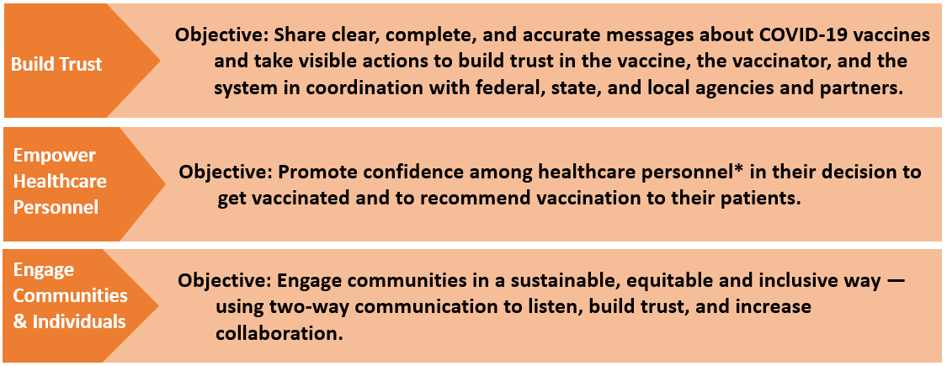
A National Strategy to Reinforce Confidence in COVID-19 Vaccines
*Personnel = All staff working in healthcare settings, including physicians, physician assistants/nurse practitioners, nurses, allied health professionals, pharmacists, support staff, and community health workers
https://www.cdc.gov/vaccines/covid-19/vaccinate-with-confidence.html
Notes:
This slide shows CDC’s Vaccinate with Confidence strategy, which aims to build confidence in COVID vaccine, the providers who vaccinate, and the vaccination system. It’s not a communication campaign, but rather a framework for thinking about interventions to increase vaccine confidence.
There are three components to the framework. The first aims to build trust by sharing clear, complete, and accurate messages about COVID-19 vaccine in collaboration with federal, state, and local agencies and partners.
The second aims to empower healthcare personnel by helping them to feel confident in their own decision to get vaccinated and to recommend vaccination to their patients. This is the element that is most important for our discussion today.
The third focuses on how to engage communities in a sustainable, equitable, and inclusive way in order to increase collaboration. This is closely related to the first element about building trust.

Slide 9
A component of the National Strategy to Reinforce Confidence in COVID-19 vaccines
Tactics
Engage local and national professional associations, health systems, and healthcare personnel
Ensure healthcare systems and medical practices are equipped to create a culture that builds confidence in COVID-19 vaccination.
Strengthen the capacity of healthcare professionals to have empathetic vaccine conversations using motivational interviewing techniques.
Notes:
These are some of the tactics that CDC will be using to empower healthcare personnel.
Engaging national professional associations, health systems, and healthcare personnel often and early to ensure a clear understanding of the vaccine development and approval process, new vaccine technologies, and the benefits of vaccination.
Ensuring healthcare systems and medical practices are equipped to create a culture that builds confidence in COVID-19 vaccination.
Strengthening the capacity of healthcare professionals to have empathetic vaccine conversations, address myths and common questions, provide tailored vaccine information to patients, and use motivational interviewing techniques when needed.
As member of the healthcare team, you have an important role to play in all three of these tactics. We will talk more about this in the coming slides.

Slide 10
Keys to Building Demand for Vaccines
Make vaccines:
Accessible (easy to get)
Beneficial (health benefits outweigh perceived or real risk of getting COVID-19 or perceived or real side effects from vaccination)
Convenient (reduce out of pocket, social, and opportunity costs)
Desirable (appealing)
Normative (presented as a social default)
Necessary (indispensable for accessing things they want to get back to doing)
Notes:
To build vaccine demand for the public, we need to make sure people feel the vaccines are:
Easy and convenient to get;
Beneficial and desirable to them;
And important to be able to safely return to doing many of the things they enjoy.
Healthcare providers can help convey these messages and information to patients, wherever they interact with them.

Slide 11
Strategies to Build COVID-19 Vaccine Confidence Among Healthcare Professionals
Host discussions where personnel at different levels can ask questions and share concerns in a safe space.
Share key messages with staff through emails, breakroom posters, and other channels.
Highlight the experiences of employees who were initially hesitant to get vaccinated, but who later made the decision to get the vaccine.
Encourage senior leaders to be vaccine champions.
Notes:
The idea of building COVID-19 vaccine confidence may seem daunting, especially in a busy workplace. But there are concrete steps your facility can take, such as:
hosting discussions among staff on COVID-19 vaccines,
sharing key messages,
highlighting success stories,
and encouraging senior leaders to be vaccine champions.
It is important to engage with all the types of staff across your organization in these efforts, not only those in direct patient care roles, to create a culture supportive of vaccination.

Slide 12
Talking with Patients about COVID-19 Vaccination
Notes:
Now we’ll spend some of the remaining time discussing specific strategies and language you can use to build confidence and address patient questions about COVID-19 vaccines.

Slide 13
The Role of Healthcare Professionals
Healthcare professionals are patients’ and parents’ most trusted source of information on vaccines.
Your answers to their questions matter and will help them make an informed decision about getting a COVID-19 vaccination for themselves or their children.
Your strong vaccine recommendation is the most important part of the conversation.
www.cdc.gov/vaccines/covid-19/hcp/engaging-patients.html
Notes:
Healthcare professionals are patients’ and parents’ most-trusted source of information on vaccines. Your answers to their questions matter and will help them make an informed decision about getting a COVID-19 vaccination for themselves or their children.
Whether you have these discussions with your patients during an in-person office or hospital encounter, through messages on your patient portal, at a telemedicine visit, or during consultation in your pharmacy, your strong vaccine recommendation is the most important part of the conversation.

Slide 14
Lead with Listening
Do not make assumptions about whether your patients will choose to get vaccinated or the reasons for their decisions.
Instead, begin with an open-ended question, such as “What are your thoughts on getting a COVID-19 vaccination today?”
Actively listen and seek to understand the patient’s point of view.
Recognize that these conversations can take time and may continue over the course of multiple encounters.
Notes:
First, lead with listening.
While a presumptive approach may be effective for routine immunizations where we assume patients plan to get themselves or their children vaccinated, instead, a shared decision-making approach may be more effective for a new vaccine like COVID-19.
Do not make assumptions about whether or why your patients will choose to get vaccinated.
Instead, begin with an open-ended question, like "What are your thoughts on getting the COVID-19 vaccine?“ OR When wrapping up your visit with the patient, you could say, “Before I let you go, I’ve been checking in with all my patients about the COVID-19 vaccines. Have you gotten one yet?”
Then, actively listen and seek to understand the patient’s point of view.

Slide 15
Use Patient-Centered Communication Techniques
Use open-ended questions to promote dialogue. Ask about readiness to vaccinate and what questions or concerns they may have.
Paraphrase any information shared to show that you have heard and understood it.
Praise measures already taken to protect themselves or their children from COVID-19, like mask wearing and physical distancing. Then frame vaccination as a safe and effective way to help protect them and their loved ones from getting COVID-19.
Ask for permission to share more information on COVID-19 vaccines. This will foster openness and connection.
Notes:
Use patient-centered communication techniques, such as:
Open-ended questions to promote dialogue and get a sense of the patient’s readiness for vaccination and any specific concerns on their mind.
Paraphrase any information shared to show that you have understood it. For example, you might say, “It sounds like you are most concerned about the vaccine’s side effects.”
Provide positive feedback for any protective measures they may mention they are already taking, such as wearing masks.
Ask if you may provide some additional information from sources you trust. If they agree, they will be more willing to listen to you instead of feeling like they’re involuntarily receiving unsolicited information.

Slide 16
Respond to Questions and Concerns with Empathy
Respond to questions and concerns in a non-judgmental, respectful, and empathic way.
Provide accurate answers using clear, simple language. Explore questions patients ask most often about vaccines (see URLs below).
Some concerns may stem from mistrust in the medical establishment or the government as result of collective or individual mistreatment and traumas. Acknowledging past traumas may promote patients’ trust in you and your message.
Acknowledge uncertainty about what we don’t yet know about COVID-19 vaccines. This can help build trust.
www.cdc.gov/vaccines/covid-19/hcp/answering-questions.html
www.cdc.gov/coronavirus/2019-ncov/vaccines/faq.html
Notes:
It is important to show compassion and empathy in this space, as it is normal for people to have questions about a newer vaccine.
Respond to their questions or concerns by providing answers using clear, simple language.
Help navigate to accurate resources. Some language you could use might be “I trust this website for accurate medical information. They also have some great resources for patients that can be found here…”
When considering strategies for building confidence, we must be sensitive to the long-standing health and social inequities faced by racial and ethnic minority groups and other groups experiencing health disparities.
People may have a mistrust or fear in healthcare providers, institutions, or government after experiencing very real mistreatment or disrespectful care from these institutions.
Avoid stigmatizing language and ensure you and your staff are trained to identify and interrupt all forms of discrimination.
Finally, acknowledge uncertainty about what we don’t yet know about COVID-19 vaccines. This can help to build trust.

Slide 17
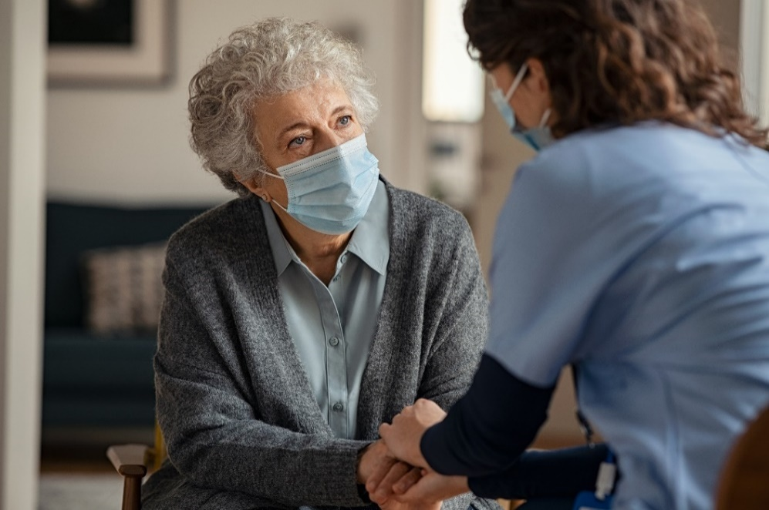
Give Your Strong Recommendation
Let your patients know that you recommend COVID-19 vaccination for them. Your strong recommendation is critical for vaccine acceptance.
Tailor your recommendation to include any relevant reasons why COVID-19 vaccination might be important for this particular patient.
Notes:
Once you’ve answered their questions and shared information, give your strong recommendation.
Let the patient know that you recommend COVID-19 vaccination for the them, and tailor your recommendation to include any relevant reasons why COVID-19 vaccination might be particularly important for that specific patient, such as their age, job, or health conditions.

Slide 18
Give Your Strong Recommendation (cont’d)
Talk about your personal decision and experience in getting a COVID-19 vaccine and your experience treating COVID-19 patients.
Share the benefits of getting vaccinated, including:
Protecting themselves and others who may be more vulnerable, and
Enabling them to get back to activities they have missed.
Explain what they can do when they’ve been fully vaccinated.
Notes:
Share your own experience with getting vaccinated.
The example you model in choosing to receive the vaccine is critical, as is your willingness to share and celebrate that experience.
Emphasize some of the benefits to getting vaccinated, including protecting themselves and their community, and explain what activities they can safely return to doing once vaccinated.

Slide 19
Examples
“I strongly recommend you get a COVID-19 vaccine…”
“…This shot is especially important for you because of your [job/underlying health condition/vulnerable family member].”
“…I believe in this vaccine so strongly that I got vaccinated as soon as it was available to me, and I recommended that everyone in my family do the same.”
“I have seen what COVID-19 can do to patients and their families. I want to protect you as best I can from COVID-19 infection and complications.”
Notes:
Here are some examples of language you could use, such as saying:
“…I believe in this vaccine so strongly that I got vaccinated as soon as it was available to me, and I recommended that everyone in my family did the same.”

Slide 20
Key Messages About COVID-19 Vaccination
You can help stop the COVID-19 pandemic by getting a COVID-19 vaccine.
COVID-19 vaccines are safe and effective.
COVID-19 vaccines are free.
After COVID-19 vaccination, you might have some temporary side effects. These are normal signs that your body is building protection.
Once you are fully vaccinated, you can resume most activities that you stopped doing because of the COVID-19 pandemic, such as gathering indoors with family and friends, without wearing a mask.
Notes:
These are some of the key messages around COVID-19 vaccines to emphasize with patients; these can be woven into conversations or included in written materials provided by your facility:
That individuals can help stop the pandemic by getting a COVID-19 vaccine.
That the vaccines are safe, effective, and free.
That after vaccination, they may experience side effects. These are normal and expected.
And that once fully vaccinated, they can resume activities they have missed.

Slide 21
Address Misinformation About COVID-19 Vaccination by Sharing Key Facts
COVID-19 vaccines cannot give you COVID-19.
People who have already gotten sick with COVID-19 may still benefit from getting vaccinated.
There is currently no evidence that COVID-19 vaccination causes any problems with pregnancy or fertility.
COVID-19 vaccines do not change your DNA in any way.
https://www.cdc.gov/coronavirus/2019-ncov/vaccines/facts.html
Notes:
If patients mention myths they have heard about COVID-19 vaccines, use the conversation as an opportunity to address misinformation by sharing key facts.
Let them know that it’s easy to be confused by all the information that is circulating, some of which may be conflicting.
CDC has facts and messaging to counteract common myths.
Some of these key messages are shown here.

Slide 22
Help Individuals Find Their Motivation for Getting Vaccinated
Steer the conversation away from “why not?” and toward the important reasons that matter to them—their “why.”
The reasons that someone may choose to get vaccinated will always be those that are most compelling to them personally.
You may choose to share your reasons for getting vaccinated or discuss common goals you may have, like visiting with family safely.
Notes:
Everyone who chooses to get vaccinated does it for a reason—to protect their family, to be less anxious, to visit their parents, or to get back to activities like seeing friends or returning to school. After addressing concerns with empathy and facts, you can steer the conversation from “why not” to the important reasons that matter to them—their “why.”
Once someone decides on their “why,” help them make a commitment to get vaccinated. Help make the path to vaccination shorter, easier, and less stressful for them.

Slide 23
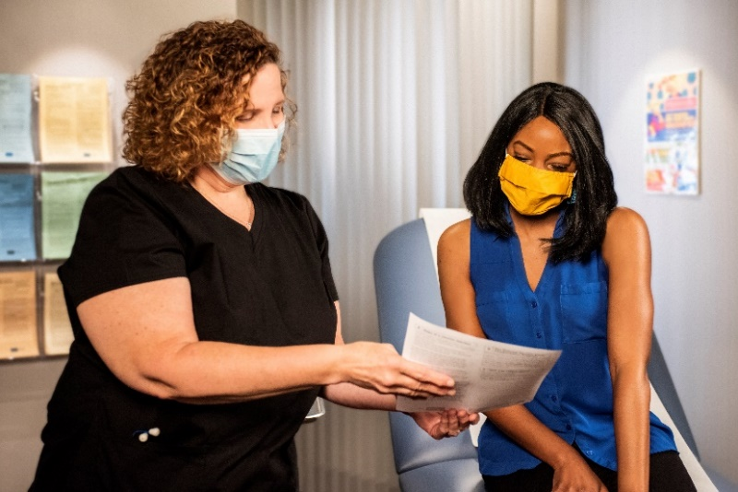
Wrap Up the Conversation
Encourage patients or parents to take at least one action, such as:
Scheduling a vaccination appointment with your office, a pharmacy, or another vaccination site, or
Reading any handouts that you provide to them.
If they decline vaccination, acknowledge that this is their decision, and keep the door open to revisiting the topic during future visits.
Notes:
In wrapping up the conversation, encourage your patients to take at least one action, such as:
Scheduling a vaccination appointment, if they are ready to do so, OR,
If they declined vaccination, they can read the additional information you provide them about the COVID-19 vaccines.
If the patient seems open to getting vaccinated, share information on the closest vaccination sites in your area. Make sure you have that information readily available in formats that are easy to use and understand.
If they are not ready for vaccination yet, let them know that you and other healthcare providers are always open to discussing their questions or concerns at future visits.

Slide 24
It Will Take More Than One Conversation to Change Minds
Vaccine hesitancy, especially when rooted in lack of trust rather than lack of information, is best addressed through trusted messengers in trusted spaces.
Encourage two-way dialogue and allow space for people to ask questions.
Notes:
Recognize that it will likely take multiple encounters to move people toward vaccine acceptance.

Slide 25
Resources
Notes:
Lastly, I wanted to share a few CDC resources.

Slide 26
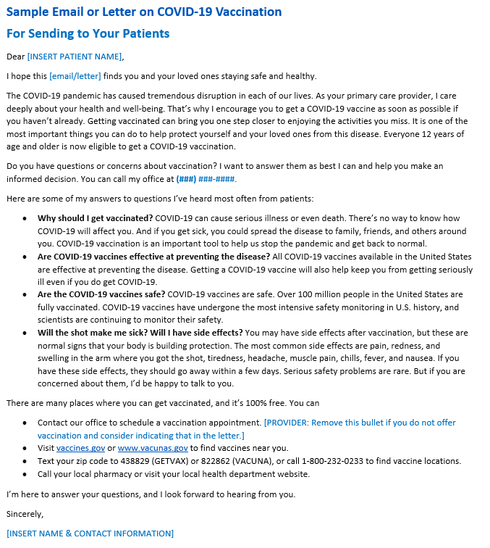
Sample Email or Letter on COVID-19 Vaccination To Send to Your Patients
https://www.cdc.gov/vaccines/covid-19/downloads/Sample-Physician-Letter-COVID-19-Vaccine.docx
Notes:
Our webpage also includes a sample letter on COVID-19 vaccination that you can customize to send to your patients.

Slide 27
Resources for Talking with Patients about COVID-19 Vaccination
COVID-19 data and vaccination tracker: https://covid.cdc.gov/covid-data-tracker/#datatracker-home
Vaccines for COVID-19 – information for patients: https://www.cdc.gov/coronavirus/2019-ncov/vaccines/index.html
Where to find a COVID-19 vaccine: https://www.vaccines.gov/
Preparing to provide COVID-19 vaccines: https://www.cdc.gov/vaccines/covid-19/training.html
Talking with patients about COVID-19 vaccines: www.cdc.gov/vaccines/hcp/covid-conversations
Frequently asked questions about COVID-19 vaccination: https://www.cdc.gov/coronavirus/2019-ncov/vaccines/faq.html
COVID-19 Vaccines for Children and Teens: https://www.cdc.gov/coronavirus/2019-ncov/downloads/vaccines/toolkits/COVID-19-Vaccine-for-Preteens_Teens-508.pdf
Clinician Outreach and Communication (COCA) Call – What every clinician should know about COVID-19 vaccine safety and effectiveness and how to address patient questions and concerns: https://emergency.cdc.gov/coca/calls/2021/callinfo_030921.asp
Notes:
These are additional resources on our website to help healthcare professionals with COVID-19 vaccine conversations.

Slide 28
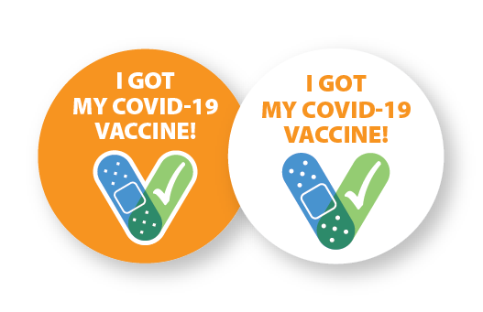
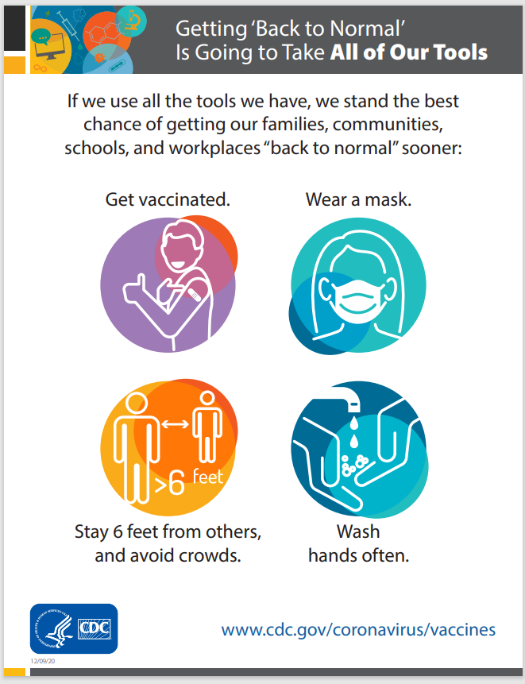
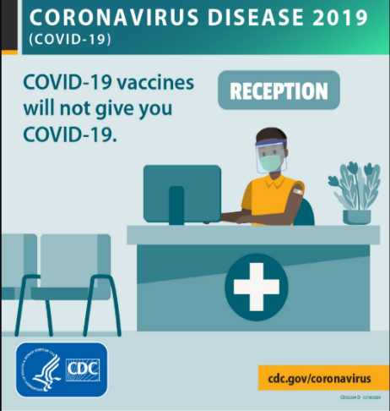
COVID-19 Vaccination Communication Toolkit for Medical Centers, Clinics, and Clinicians
Stickers
Social media
Slides
Fact sheets & FAQs
Posters
www.cdc.gov/vaccines/covid-19/health-systems-communication-toolkit.html
Notes:
And we also have publicly available a communications toolkit specific to healthcare systems, with slide decks, fact sheets, social media posts, and stickers to amplify messaging around COVID-19 vaccines.

Slide 29
Vaccine Safety Monitoring Systems
Existing systems and data sources are used to monitor safety of vaccines post-authorization and post-licensure, such as:
Vaccine Adverse Event Reporting System (VAERS)
Vaccine Safety Datalink (VSD)
Clinical Immunization Safety Assessment (CISA)
Biologics Effectiveness and Safety System (BEST)
New systems have been developed to monitor COVID-19
vaccine safety, such as v-safe:
Active surveillance that uses text messaging to initiate web-based survey monitoring.
Provides telephone follow up to anyone who reports medically significant adverse events.
Notes:
The United States has a robust post-licensure monitoring system that has been in place for decades to ensure the safety of routine vaccines. It includes several components, shown here.
These existing data systems have validated analytic methods that can rapidly detect statistical signals for possible vaccine safety problems. These systems are being scaled up to fully meet the needs of the nation.
New systems have been developed to further enhance safety monitoring capabilities. One example is V-Safe—an active surveillance system that uses text messaging to initiate web-based survey monitoring. V-safe will provide telephone follow up to anyone who reports medically significant adverse events. V-safe will complement the existing safety monitoring systems. People who use v-safe can still submit reports to VAERS.
As you can see, robust systems on vaccine safety are in place for these COVID-19 vaccines, just as any other vaccine. And it’s important to note that the safety monitoring for both VAERS and vsafe are required to monitor safety effects by race and ethnicity.

Slide 30
Notes:
Thank you very much for your time today and for all you do for your patients and communities. Feel free to contact me directly if you have any additional questions [SHARE CONTACT INFORMATION].
You can also call CDC directly at 800-CDC-INFO.

