Slide 1
CDC Fiscal Year 2015 Funding Profile for American Indian and Alaska Native Tribes and Tribal Organizations
CDC/ATSDR Tribal Advisory Committee Meeting
February 10, 2016
Georgia Moore, MS
Associate Director for Policy
CDC’s Office for State, Tribal, Local and Territorial Support
Centers for Disease Control and Prevention
Office of the Chief Financial Officer

Slide 2
About the Funding Profile Data
Includes funding CDC/ATSDR
Obligated and provided to tribes and tribal organizations as primary grantees through cooperative agreements and grants in fiscal year (FY) 2015 (October 1, 2014 – September 30, 2015)
Provided to Tribal Epidemiology Centers through an Interagency Agreement with the Indian Health Service
Awarded to American Indian/Alaska Native (AI/AN) tribes or tribal organizations through contracts
“Obligated” refers to new funding (any funding carried over from a previous year or years is not included)

Slide 3
About the Funding Profile Data (cont.)
Excludes
The value of vaccines purchased by CDC and delivered through the Vaccines for Children program
Any funds transferred to CDC/ATSDR from other federal agencies or entities (i.e., funds that are not part of CDC/ATSDR’s appropriations)

Slide 4
CDC Funding to AI/AN Tribes and Tribal Organizations: FY15 Overview and Comparison to FY14
 | FY14 | FY15 | Comparison FY15 +/- FY14
All Funding (grants/cooperative agreements/contracts) | $96,740,061 | $140,715,200 | +$44,025,139
Cooperative Agreement and Grant Funding | $36,317,246 | $35,578,385 | -$738,851
Contract Funding | $60,422,815 | $105,186,805 | +$44,763,990
Number of Grantees Funded (cooperative agreements and grants) | 51 | 62 | +11
Funding Mechanisms | 11 funding opportunity announcements (FOAs); 1 grant | 11 FOAs; 1 grant | No change in total mechanisms; some variation in funding FOAs and amounts
Notes:
Speaker note: Even under the new data parameters, which better target only funding provided directly to tribes and tribal organizations, an increase was observed from FY 2013 to FY 2014

Slide 5
CDC FY15 Grant and Cooperative Agreement Funding to Tribes and Tribal Organizations by Funding Center or Office
Funding Center or Office | Total FY15 Funding
National Center for Chronic Disease Prevention and Health Promotion | $33,095,944
National Center for HIV/AIDS, Viral Hepatitis, STD, and TB Prevention | $731,911
National Center for Immunization and Respiratory Diseases | $100,000
Office for State, Tribal, Local and Territorial Support | $1,650,530
Total | $35,578,385
Notes:
Speaker note: Even under the new data parameters, which better target only funding provided directly to tribes and tribal organizations, an increase was observed from FY 2013 to FY 2014

Slide 6
CDC FY15 Grant and Cooperative Agreement Funding by American Indian and Alaska Native Tribe Funded
Tribe | Total FY15 Funding*
Bad River Band of Lake Superior Chippewa | $100,000
Catawba Indian Nation | $199,804
Cherokee Nation | $1,004,300
Cheyenne River Sioux Tribe | $535,101
Fond du Lac Reservation | $255,644
Hopi Tribe | $482,694
Kalispel Tribe of Indians | $97,067
KAW Nation of Oklahoma | $384,877
Kickapoo Tribe in Kansas | $240,490
Lower Brule Sioux Tribe | $200,000
Navajo Nation | $1,211,985
Nez Perce Tribe | $200,000
Pascua Yaqui Tribe | $100,000
Pawnee Nation of Oklahoma | $267,346
Pueblo of Santa Ana | $120,651
Red Cliff Band of Lake Superior Chippewa | $200,000
San Carlos Apache Tribe | $186,936
Santee Sioux Tribe of Nebraska | $45,615
Sault Ste. Marie Tribe of Chippewa Indians | $1,959,823
Tohono O'odham Nation | $143,534
Winnebago Tribe of Nebraska | $178,393
Total | $8,114,260
21 tribes funded
*Funding totals may include funding from more than one CDC program and FOA/grant
Notes:
Speaker note: Even under the new data parameters, which better target only funding provided directly to tribes and tribal organizations, an increase was observed from FY 2013 to FY 2014

Slide 7
CDC FY15 Funding to AI/AN Tribes and Tribal Organizations by FOA or Grant
Funding Opportunity Announcement or Grant | FY15 Funding
DP14-1421: A Comprehensive Approach to Good Health and Wellness in Indian Country (Financed solely by Prevention and Public Health Fund) | $13,319,266
DP14-1417: Partnerships to Improve Community Health (PICH) | $4,201,137
DP14-1419: Racial and Ethnic Approaches to Community Health (REACH) (Financed in part by the Prevention and Public Health Fund) | $2,165,957
DP12-1205: Cancer Prevention and Control Programs for State, Territorial and Tribal Organizations (Breast and cervical cancer - $6,802,102; Comprehensive cancer control - $1,811,146) | $8,613,248
DP15-1502: Integrating Colorectal Cancer Screening within Chronic Disease Programs | $732,400
DP13-1302: Well Integrated Screening and Evaluation for Women Across the Nation (WISEWOMAN) | $1,001,600
DP13-1314: Consortium of National Networks to Impact Populations Experiencing Tobacco-Related and Cancer Health Disparities | $622,536
PS13-001: Natural History and Prevention of Viral Hepatitis among Alaska Natives | $181,911
PS15-1502: Comprehensive High Impact HIV Prevention Projects for Community-Based Organizations | $350,000
OT13-1302: OSTLTS Partnerships Building Capacity of the Public Health System to Improve Population Health through National, Non-Profit Organizations (Financed in part by 2013 Prevention and Public Health Fund) | $1,612,233
OT13-1303: Tribal Public Health Capacity Building and Quality Improvement | $547,067
Preventive Health and Health Services Block Grant | $91,230
Notes:
Speaker note: Even under the new data parameters, which better target only funding provided directly to tribes and tribal organizations, an increase was observed from FY 2013 to FY 2014

Slide 8
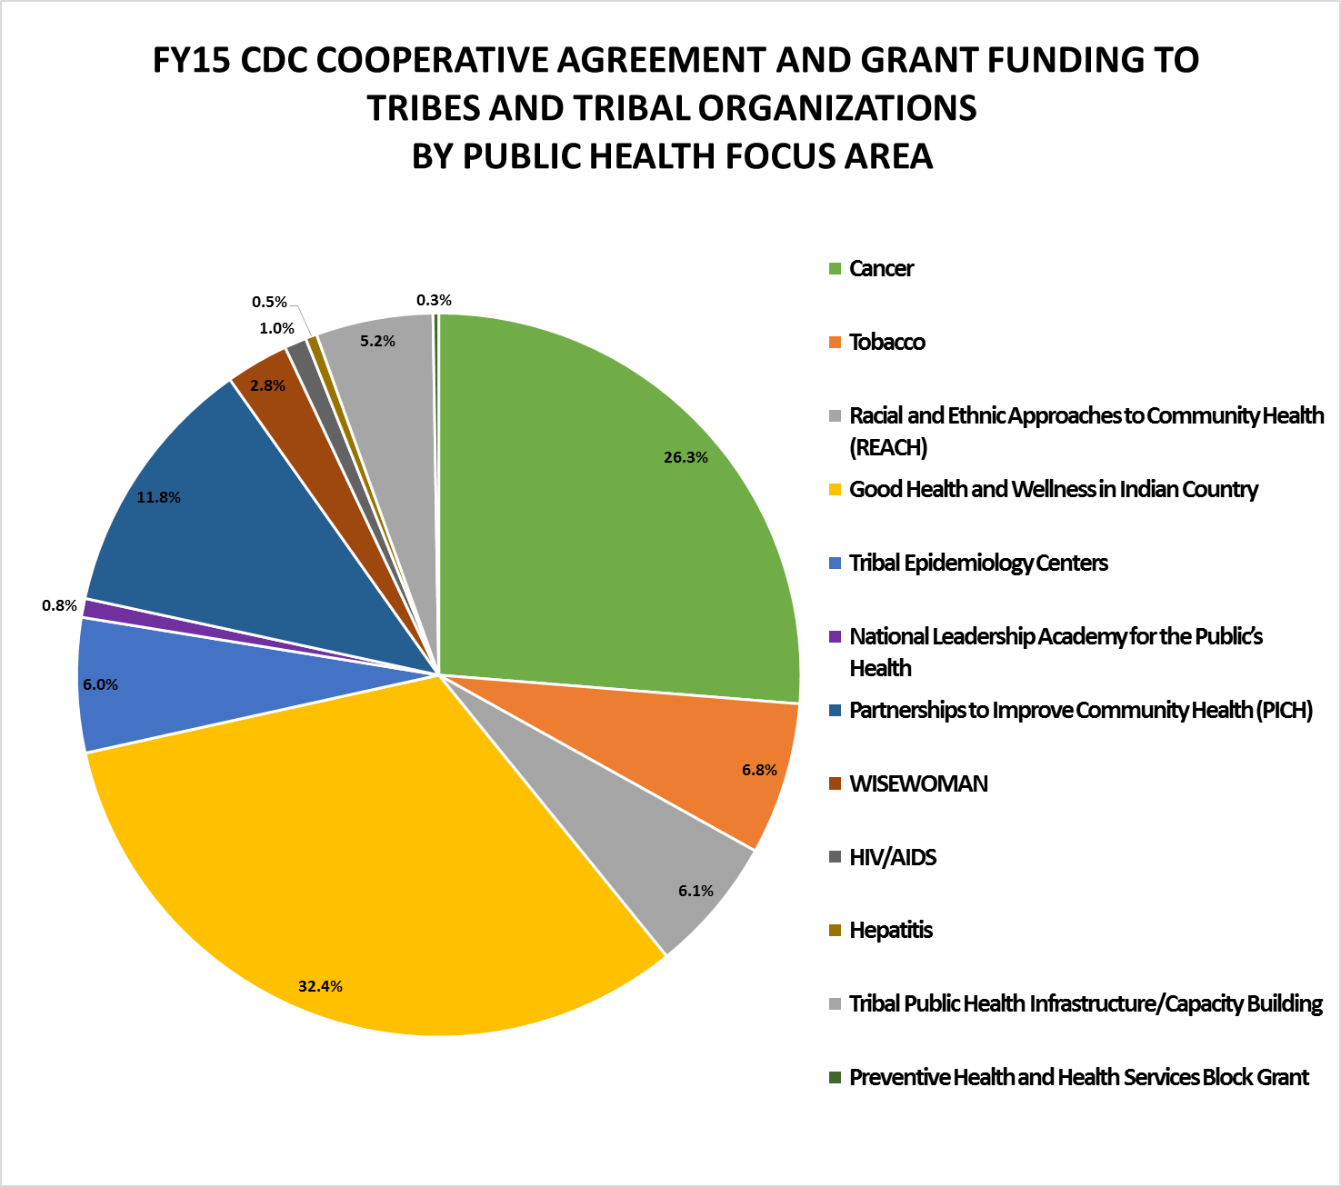
Notes:
This image is a pie chart showing the percentage of FY15 cooperative agreement and grant funding CDC awarded to tribes and tribal organizations by public health focus area.
The percentage of funding by focus areas is as follows:
32.4% for the Good Health and Wellness in Indian Country program
26.3% for cancer prevention and control
11.8% for the Partnerships to Improve Community Health program
6.8% for Tobacco control
6.1% for the Racial and Ethnic Approaches to Community Health or REACH program
6.0% for Tribal Epidemiology Centers
5.2% for tribal public health infrastructure and capacity building programs
2.8% for the WISEWOMAN program
1.0% for HIV/AIDS
0.8% for the National Leadership Academy for the Public's Health program
0.5% for hepatitis prevention and control, and
0.3% for the Preventive Health and Health Services Block Grant

Slide 9
Getting Engaged

Slide 10
Fiscal Year Budget Activities Overlap
Always: Conducting activities for three fiscal years
Currently
FY16: Implementing FY16 budget activities
FY17
President’s FY17 budget released on 2/9/16
CDC’s FY17 budget materials posted at www.cdc.gov/Budget/
CDC will begin responding to related budget inquiries and requests, and continue planning for FY17
FY18: Will soon start planning for FY18 budget request
When to provide input/feedback and engage CDC in program and resource planning?
Always – NOW!

Slide 11
Examples of Factors CDC Considers in Budget and Program Planning
Congressional legislation, appropriations, directives, and priorities
Guidance and directives—including priorities and funding levels—from White House (through OMB), HHS, and CDC director and other CDC leaders
Evidence base—health statistics; research and program results; known best practices and practice-based evidence; and results of ASTHO, NACCHO, and other surveys of public health system

Slide 12
Examples of Factors CDC Considers in Budget and Program Planning (cont.)
National strategies and action plans
Input from stakeholders (e.g., health departments, grantees, national organizations)
In FY15 CDC-wide bill language: “$10,000,000 shall be available until September 30, 2018, for acquisition of real property, equipment, construction, and renovation of facilities”

Slide 13
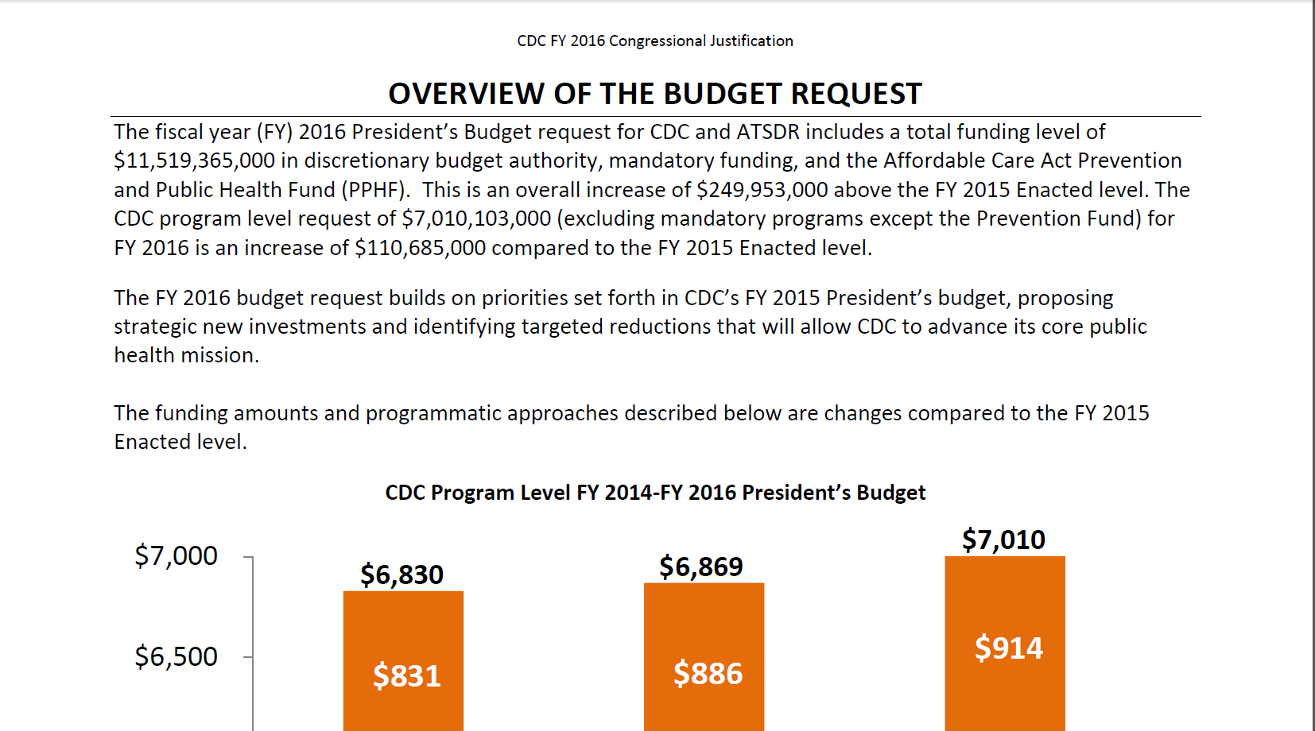
Is a request; not necessarily what finally receive from Congress
Statement of funding priorities and strategies for upcoming year
CDC budget materials:
www.cdc.gov/budget/documents/fy2016/fy-2016-overview-and-detail-table.pdf

Slide 14
Communicate with CDC (and Others) Early and Often
Community and health department status, needs, barriers, ideas, and success stories
How federal (and even state and local) priorities, proposals, bills/legislation/regulation, and resource decisions will affect, or are affecting, your health department and the public’s health
How CDC can improve its public health programs, activities, services, processes, and resourcing

Slide 15
Some Key Points in Time to Pay Attention (“Which Way Is the Wind Blowing?” Moments)
Release of president’s budget and federal agency budget materials (usually 1st Monday in Feb)
Release of House and Senate budget resolutions (statements of priorities and intent)
Release and markups of House and Senate bills
Congressional press conferences
Congressional appropriations hearings (usually webcast from House and Senate websites)

Slide 16
Some Key Points in Time to Pay Attention (“Which Way Is the Wind Blowing?” Moments) (cont.)
Passage and content of final appropriations, including committee reports
Release of funding opportunity announcements (FOAs) from federal agencies that put the appropriations into action
Technical assistance webinars for potential applicants
Initiation of accountability activities and release of those results

Slide 17
Communication and Collaboration
Subscribe to CDC’s email subscription service for news and updates (www.cdc.gov/Other/emailupdates/), Facebook page or Twitter feed
What sources of tribal information would you recommend CDC staff subscribe to?
Subscribe to Grants.gov alerts for grant and cooperative agreement funding opportunities and FedBizOpps.gov for contract opportunities

Slide 18
Communication and Collaboration (cont.)
Serve on and/or attend meetings of CDC’s advisory committees; provide input to committee members representing you; provide written statement or testimony, when applicable
CDC federal advisory committees—
www.cdc.gov/about/advisory.htm
CDC/ATSDR Tribal Advisory Committee
State, Tribal, Local and Territorial Subcommittee to the Advisory Committee to the Director
Participate in the twice-yearly CDC/ATSDR Tribal Consultation and/or request a specific tribal consultation

Slide 19
Communication and Collaboration (cont.)
Communicate challenges and needs at anytime to CDC
The Office for State, Tribal, Local and Territorial Support or its Tribal Support Unit can connect you to the right person or source at CDC to help address your issue
If you are a current grantee, let your project officer know about any specific challenges or issues that might be improved in the current or next grant cycle
Share lessons learned with CDC and the field

Slide 20
Federal Register
Official publication of the US government that
Informs citizens of their rights and obligations
Documents federal agencies’
Provides a forum for public participation in the democratic process
Publishes daily Monday–Friday, except federal holidays
Federal agencies legally required to publish certain items
Official site
www.archives.gov/federal-register/the-federal-register/

Slide 21
Federal Register (cont.)
Four types of entries
Presidential documents (e.g., executive orders and proclamations)
Rules and regulations (e.g., policy statements and interpretations of rules)
Proposed rules (e.g., petitions for rulemaking and other advance proposals)
Notices (e.g., scheduled hearings and meetings open to the public, grant applications, administrative orders, and other announcements of government actions)

Slide 22
Federal Register (cont.)
Consider how information affects your program and stakeholders
Provide input and comments
Make stakeholders aware of opportunities to provide input and of items that affect them

Slide 23
Participate today!
Submit your comments on proposed regulations and related documents published by the US federal government
Search and review original regulatory documents, as well as comments submitted by others
Help improve federal regulations by submitting your comments

Slide 24
Budget Information Resources

Slide 25
www.cdc.gov/funding/

Slide 26
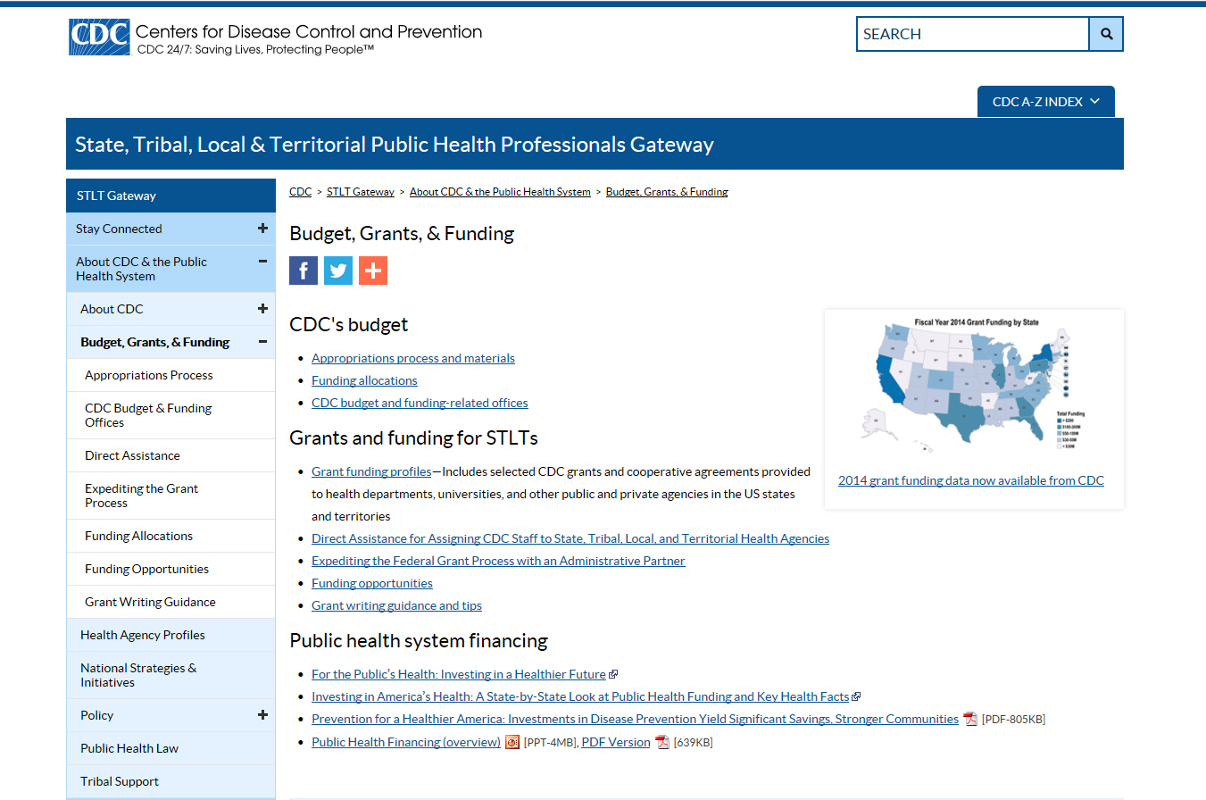
www.cdc.gov/stltpublichealth/GrantsFunding/index.html

Slide 27
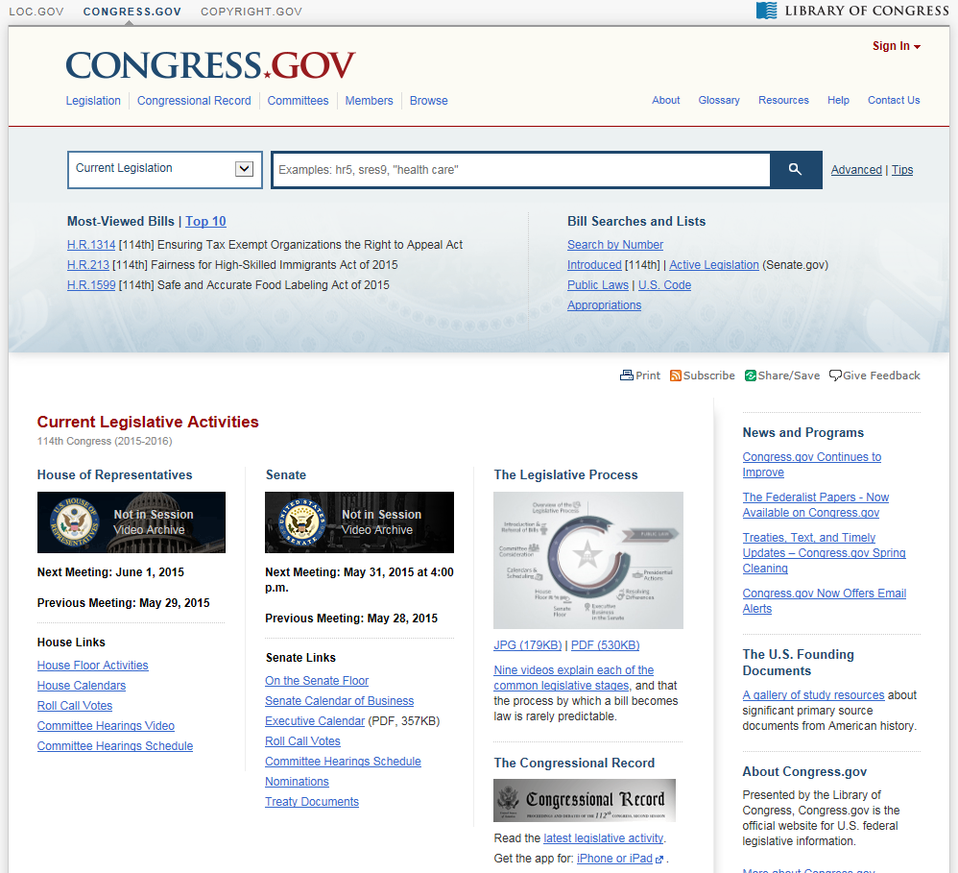

Slide 28
Resources
CDC
Budget (CJ and related resources)
www.cdc.gov/budget/
Grant Funding Profiles Tool
http://wwwn.cdc.gov/FundingProfiles/FundingProfilesRIA/
Public Health System Financing
www.cdc.gov/stltpublichealth/GrantsFunding/index.html
Funding Opportunity Announcements
www.grants.gov
President’s budget
www.whitehouse.gov/omb/budget
US budget
Copies (GPO)
www.gpo.gov/fdsys/browse/collection.action?collectionCode=BUDGET
How Congress Works: The Budget Process
www.rules.senate.gov/public/index.cfm?p=BudgetProcess

Slide 29
Resources (cont.)
USASpending.gov
Information on each federal award (e.g., name of entity receiving the award, amount of award, funding agency, award type)
www.usaspending.gov
Tracking Accountability in Government Grants System
Central repository for grants awarded by the 11 HHS Operating Divisions
http://taggs.hhs.gov/

Slide 30
Thank you!
Centers for Disease Control and Prevention
Office for State, Tribal, Local and Territorial Support

