Slide 1
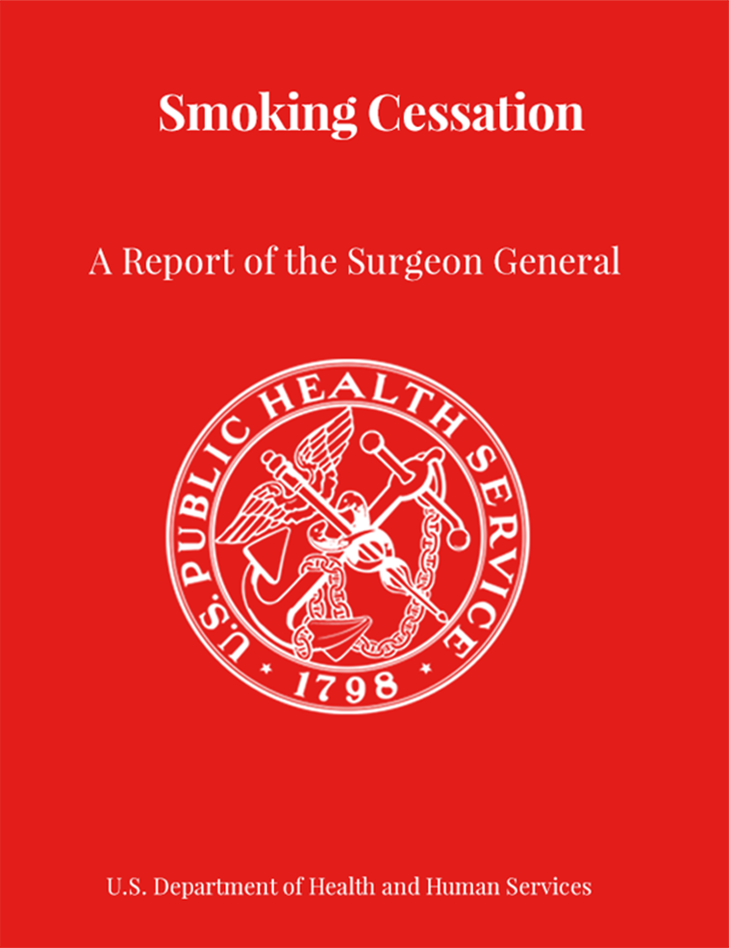
SMOKING CESSATION A REPORT OF THE SURGEON GENERAL
Speaker’s Name, Title
PRESENTATION DATE

Slide 2
What’s New in this Report?
Report was released January 23, 2020, in Washington, D.C.
Represents the 34th tobacco-related Surgeon General’s report published since 1964.
Serves as the 1st Surgeon General’s report on smoking cessation in 30 years, highlighting what we’ve learned in the past three decades.
Documents how quitting smoking decreases the risk of various diseases.
Provides an overview of effective clinical and health systems interventions to help adults quit smoking.
Reviews the evidence on the effects of population-based policy interventions on smoking cessation.
Addresses emerging issues in the field of tobacco control, including e-cigarettes, web-based cessation technology, and population- based policies.
VADM Jerome M. Adams, MD, MPH
20th Surgeon General of the United States

Slide 3
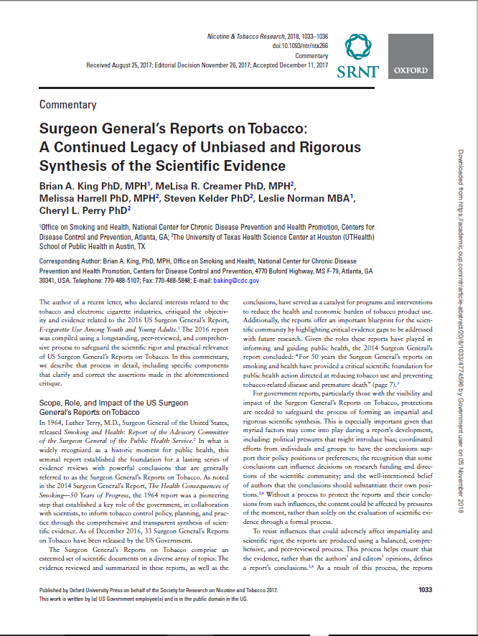
Surgeon General's Report compilation process
Surgeon General’s reports are compiled using a longstanding, peer-reviewed, and comprehensive process to safeguard their scientific rigor and practical relevance.
5
Each chapter is written by established experts who provide an unbiased and scientifically rigorous synthesis of the most current evidence. Chapter authors craft conclusions supported by the evidence including causal determinations.
Chapters are reviewed by senior scientific editors, who provide independent consideration of the presented evidence to evaluate the basis for the conclusions and revise them as appropriate.
The entire report is reviewed by expert peer-reviewers. Reviewers’ comments are addressed by senior scientific editors in consultation with authors.
The report then completes mandatory scientific clearance processes and senior scientific editors address revisions in consultation with authors to produce the final report.
2
6
3
7
4
8

Slide 4
2020 Surgeon General’s Report At a Glance
More than 150 individuals involved, including authors,
editors, and peer reviewers
8 Comprehensive chapters consisting of more than 700 pages of the latest scientific evidence on smoking cessation
10 Major Conclusions
101 Chapter Conclusions

Slide 5
2020 Surgeon General’s Report cHAPTER Outline
1
Chapter 1
5
Chapter 5
Introduction, Conclusions, and the Evolving Landscape of Smoking Cessation
The Benefits of Smoking Cessation on Overall Morbidity, Mortality, and Economic Costs
2
Chapter 2
6
Chapter 6
Patterns of Smoking Cessation Among U.S. Adults, Young Adults, and Youth
Interventions for Smoking Cessation and Treatments for Nicotine Dependence
3
Chapter 3
7
Chapter 7
Clinical-, System-, and Population-Level Strategies that Promote Smoking Cessation
New Biological Insights into Smoking Cessation
4
Chapter 4
8
Chapter 8
The Health Benefits of Smoking Cessation
Vision for the Future

Slide 6
10 MAJOR CONCLUSIONS
1. Smoking cessation is beneficial at any age. Smoking cessation improves health status and enhances quality of life.
2. Smoking cessation reduces the risk of premature death and can add as much as a decade to life expectancy.
3. Smoking places a substantial financial burden on smokers, healthcare systems, and society. Smoking cessation reduces this burden, including smoking-attributable healthcare expenditures.
4. Smoking cessation reduces risk for many adverse health effects, including reproductive health outcomes, cardiovascular diseases, chronic obstructive pulmonary disease, and cancer. Quitting smoking is also beneficial to those who have been diagnosed with heart disease and chronic obstructive pulmonary disease.

Slide 7
10 MAJOR CONCLUSIONS
5. More than three out of five U.S. adults who have ever smoked cigarettes have quit. Although a majority of cigarette smokers make a quit attempt each year, less than one-third use cessation medications approved by the U.S. Food and Drug Administration (FDA) or behavioral counseling to support quit attempts.
6. Considerable disparities exist in the prevalence of smoking across the U.S. population, with higher prevalence in some subgroups. Similarly, the prevalence of key indicators of smoking cessation—quit attempts, receiving advice to quit from a health professional, and using cessation therapies—also varies across the population, with lower prevalence in some subgroups.
7. Smoking cessation medications approved by the U.S. Food and Drug Administration (FDA) and behavioral counseling are cost-effective cessation strategies. Cessation medications approved by the FDA and behavioral counseling increase the likelihood of successfully quitting smoking, particularly when used in combination. Using combinations of nicotine replacement therapies can further increase the likelihood of quitting.

Slide 8
10 MAJOR CONCLUSIONS
8. Insurance coverage for smoking cessation treatment that is comprehensive, barrier-free, and widely promoted increases the use of these treatment services, leads to higher rates of successful quitting, and is cost-effective.
9. E-cigarettes, a continually changing and heterogeneous group of products, are used in a variety of ways. Consequently, it is difficult to make generalizations about efficacy for cessation based on clinical trials involving a particular e-cigarette, and there is presently inadequate evidence to conclude that e-cigarettes, in general, increase smoking cessation.
10. Smoking cessation can be increased by raising the price of cigarettes, adopting comprehensive smokefree policies, implementing mass media campaigns, requiring pictorial health warnings, and maintaining comprehensive statewide tobacco control programs.

Slide 9
Stakeholders Who Can Take Action
Researchers
Health systems and insurers
Federal
government
Individuals, families, and communities
Public health and healthcare professionals
Civic, business and community leaders
State, local, tribal, and territorial governments
Voluntary health agencies, non governmental organizations, and other community-and faith-based organizations

Slide 10
KEY TAKEAWAYS FROM THIS REPORT
34 million adults in the U.S. still smoke and therefore continue to be at risk of developing smoking-related diseases.
One of the most important actions people can take to improve their health is to quit smoking—this is true regardless of their age or how long they’ve been smoking.
There are proven treatments and strategies to help people quit smoking successfully.
In addition to ensuring people have access to the interventions we know work, it’s also important that we continue to explore novel strategies to help people quit.
As a nation we can and must do more to ensure that proven cessation treatments are reaching the people that need them.

Slide 11
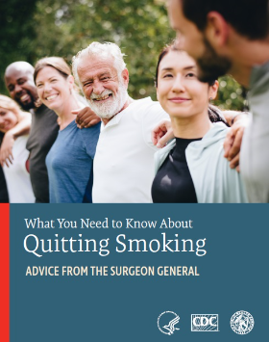
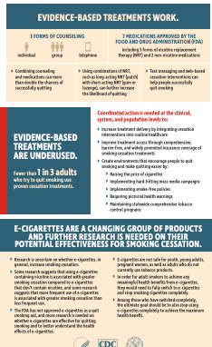
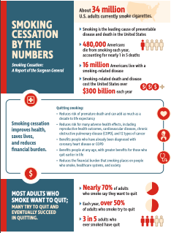
Resources Available
To read the full report and access related materials, visit:
www.SurgeonGeneral.gov
To learn more about tobacco control and prevention and quitting smoking, visit:
www.CDC.gov/tobacco
www.CDC.gov/quit
www.smokefree.gov
Contact Info:
SGReports@cdc.gov

