Slide 1
Tuberculosis in the United States
1993–2019*
Division of Tuberculosis Elimination
National Tuberculosis Surveillance System
*Data updated as of June 10, 2020
Notes:
Tuberculosis in the United States—National Tuberculosis Surveillance System, Highlights from 2019. This slide set was prepared by the Division of Tuberculosis Elimination, National Center for HIV/AIDS, Viral Hepatitis, STD, and TB Prevention (NCHHSTP), Centers for Disease Control and Prevention (CDC), U.S. Department of Health and Human Services (HHS). It provides recent trends and highlights of data collected through the National Tuberculosis Surveillance System (NTSS) for 2019. Since 1953, through the cooperation of state and local health departments, CDC has collected information on newly reported cases of tuberculosis (TB) disease in the United States. The data presented here were collected by the revised TB case report introduced in 2009. Each individual TB case report (Report of Verified Case of Tuberculosis, or RVCT) is submitted electronically to CDC. The data for this slide set are based on TB case reports for 1993–2019 received by CDC as of June 10, 2020. All case counts and rates for years 1993–2018 have been updated, and data from 2019 has been added.

Slide 2
Progress Towards Tuberculosis (TB) Elimination,
United States, 1983–2019
26,673 TB cases in 1992
Case Rate: 10.4 per 100,000
No. of Cases
8,916 TB cases in 2019
Case Rate: 2.7 per 100,000
Year
Notes:
This graph shows the annual number of TB cases in the United States for each year from 1982 to 2019. In 1992, 26,673 cases were reported in the United States, with a case rate of 10.4 cases per 100,000 population. In 2019, 8,.916 cases were reported, with a case rate of 2.7 cases per 100,000. The TB elimination threshold is <1 case per 100,000 population, which is approximately 330 cases per year for the current U.S. population.

Slide 3
Reported TB Cases and Rates
United States, 1993–2019
Number of cases
Cases per 100,000 persons
Notes:
During 2019, the United States reported the lowest number of TB cases (8,916) and lowest incidence rate (2.7 cases per 100,000 persons) on record. With the exception of 2015, the U.S. TB case count and incidence rate have declined every year since 1992.
There was an annual incidence rate decrease (−1.7%) from 2018 to 2019.

Slide 4
Total TB Case Rates and
Annual Percent Change in Rate, 2010–2019
Cases per 100,000 persons
Annual percent change in rate*
Notes:
Annual incidence rate decreased from 2.8 cases per 100,000 in 2018 to 2.7 cases per 100,000 in 2019, a 1.7% decrease. The incidence rate of TB continues to decline, but the annual rate of decline has leveled off and is inadequate to achieve TB elimination in the United States this century.

Slide 5
Reported TB-Related Deaths* and Mortality Rates
United States, 1993–2018
Number of deaths
Deaths per 100,000 persons
*National Vital Statistics System Underlying Cause of Death (based on deaths reported through 2018)
Notes:
The National Vital Statistics System (NVSS) reported 542 TB-related deaths (0.2 deaths per 100,000 persons) where TB was the underlying cause of death for 2018, the most recent year for which data are available. This represents a 5.2% increase in deaths and a 4.7% increase in the mortality rate from 2017, above the historical low of 470 deaths (0.1 deaths per 100,000 persons) reported in 2015.
National Vital Statistics System accessed from CDC WONDER as of June 17, 2020: https://wonder.cdc.gov/controller/datarequest/D76;jsessionid=820CCEC1DEC9CBC40CFD9E610AF5

Slide 6
Majority of TB Cases Occur in Four States,
United States, 2019
8%
District of
Columbia
24%
13%
6%
Notes:
Among U.S. states, the majority (51%) of TB cases continue to be reported from 4 states: California (23.7%), Texas (13.0%), New York state (including New York City, 8.5%), and Florida (6.3%). These states are also the most populous states in the United States and estimates of the TB incidence rate are presented on the next slide to account for the size of the underlying population in each state.

Slide 7
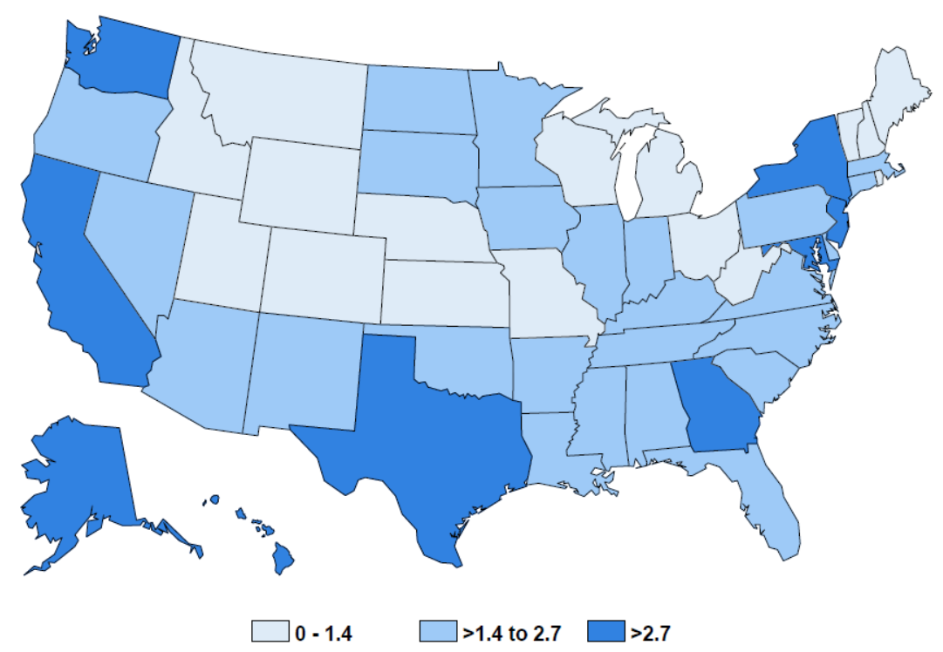
TB Case Rates by Reporting Area
United States, 2019
2.9
3.9*
NJ (3.5)
MD (3.5)
5.3
District of
Columbia (3.4)
2.8
4.0
7.9
7.0
TB incidence rate (per 100,000 persons)
*Includes NYC
Notes:
Nine states and the District of Columbia had incidence rates higher than the national rate in 2019. Alaska had the highest rate (7.9 cases per 100,000 persons, followed by Hawaii (7.0), California (5.3), Texas (4.0), New York (including New York city*, 3.9), New Jersey and Maryland (3.5), Washington (2.9) and Georgia (2.8).
Note: New York City, which is a distinct reporting area, had an incidence rate of 6.8 per 100,000 persons. When New York City is analyzed separately, the remainder of New York state has an incidence rate of 1.7 per 100,000 persons.

Slide 8
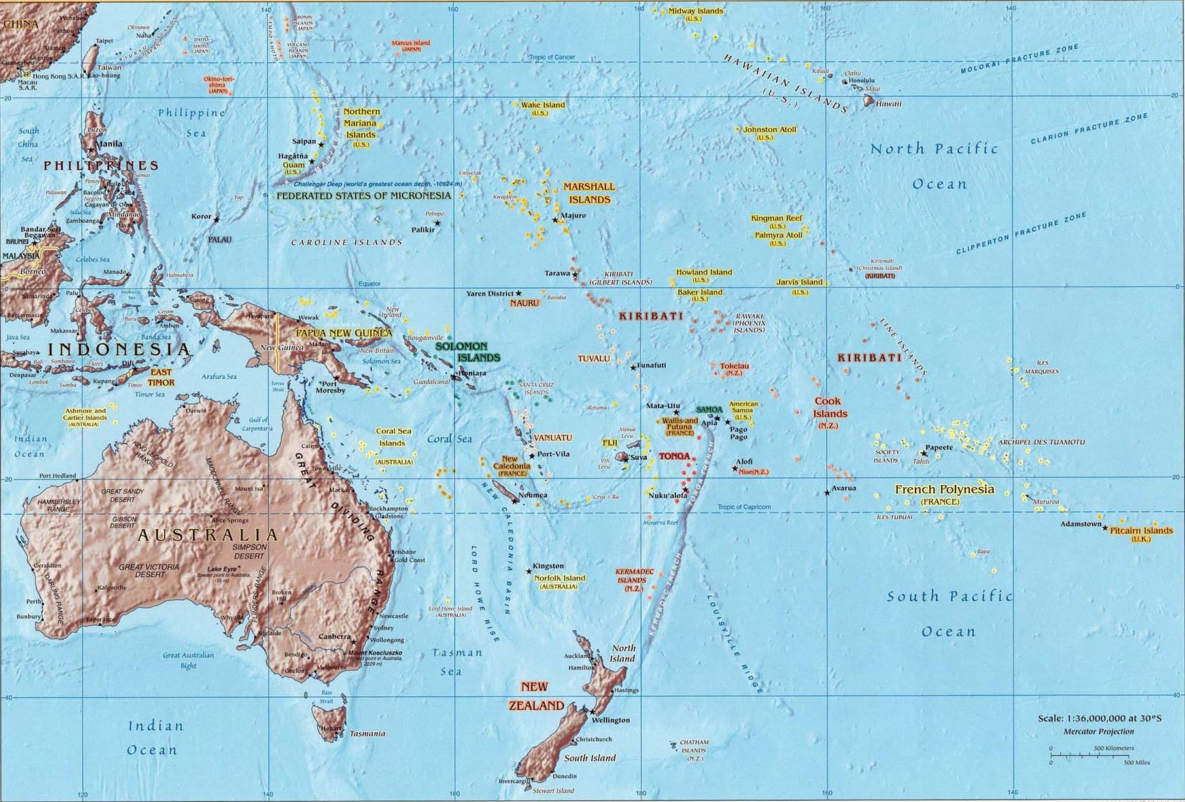
Map of U.S.-Affiliated Pacific Islands and Hawaii by TB Case Rates*, 2019
Northern
Mariana Islands
98.6
Guam
47.0
Hawaii
7.0
Marshall Islands
383.1
Palau
33.3
Federated States of Micronesia
79.8
American Samoa
2.0
*Cases per 100,000 persons
Notes:
Among the U.S. territories, incidence rates ranged from 0.9 (U.S. Virgin Islands, not shown) to 98.6 (Commonwealth of the Northern Marianas Islands). For the three freely associated states, reported incidence rates were 33.3 for the Republic of Palau, 79.8 for the Federated States of Micronesia, and 383.1 for the Republic of the Marshall Islands.

Slide 9
TB Cases and Rates Among U.S.-born versus
Non-U.S.–born Persons, United States, 1993–2019
Number of cases
Cases per 100,000 persons
Notes:
Demographic characteristics of persons with TB remain similar to previous years, with the majority of reported TB cases occurring among non-U.S.–born persons (6,364 cases; 71.4%). The incidence rate among non-U.S.–born persons continues to decrease, with the 2019 rate (14.2 cases per 100,000 persons) representing the lowest rate on record. However, the annual decline is smaller than in previous years. TB cases among U.S.-born persons decreased in 2019 with 2,541 cases (28.5%) and 0.9 cases per 100,000 persons.

Slide 10
TB Cases by Origin of Birth, 2019
(N=8,905)
Non-U.S.–born
(Rate: 14.2 per 100,000)
U.S.-born
(Rate: 0.9 per 100,000)
$$–$$
Notes:
In 2019, 71.4% of TB cases occurred among non-U.S.–born persons. The rate among non-U.S.–born persons is 16 times the rate among U.S.-born persons.

Slide 11
Countries of Birth Among Non-U.S.–born Persons Reported with TB, United States, 2019 (N=6,364)
Notes:
The most common countries of birth among non-U.S.–born TB patients remained similar to previous years, with Mexico (18.6%) the most frequently reported country of birth, followed by the Philippines (12.5%), India (9.1%), Vietnam (7.9%), and China (6.1%).

Slide 12
Countries of Birth Among Non-U.S.–born Persons Reported with TB, United States, 2019 (N=6,364)
Notes:
The most common countries of birth among non-U.S.–born TB patients remained similar to previous years, with Mexico (18.6%) the most frequently reported country of birth, followed by the Philippines (12.5%), India (9.1%), Vietnam (7.9%), and China (6.1%).
Note: this slide is a duplicate of the previous slide to provide an alternative visual display of the same data.

Slide 13
TB Case Rates for Top 10 Countries of Birth*
United States, 2015–2019
U.S. Rate/100,000 persons
*The top 10 countries were selected based on their ranked 5-year rate of TB cases by country of birth in the United States. This list of top countries also includes the region of Other Africa.
†The Other Africa region consists of Angola, Botswana, Central African Republic, Chad, Equatorial Guinea, Gabon, Lesotho, Namibia, Sao Tome & Principe, and Swaziland.
Notes:
The countries of birth with the highest U.S. incidence rates are the Republic of the Marshall Islands (168.8 cases per 100,000 persons), followed by the Republic of the Congo (143.8 cases per 100,000 persons), Somalia (87.3 cases per 100,000 persons), and Myanmar (81.2 cases per 100,000 persons). U.S. population estimates by country of birth were used for the denominator and were obtained from the U.S. Census Bureau, American Community Survey (ACS) Public Use Microdata Sample data, 2014–2018, 5-year file.

Slide 14
Percentage of TB Cases Among Non-U.S.–born Persons by Years Since Initial Arrival in the United States at Diagnosis, 2019 (N=6,364)
Percentage of TB cases
Years in the United States
Notes:
Almost 14% of TB cases reported among non-U.S.–born persons in 2019 were diagnosed within 1 year of arrival in the United States.

Slide 15
Reported TB Cases by Race/Ethnicity,*
United States, 2010–2019
Number of cases
* All races are non-Hispanic; multiple race indicates two or more races reported for a person but does not include persons of Hispanic/Latino origin.
Notes:
The distribution of race/ethnicity among persons with TB has been relatively consistent since 2010.

Slide 16
Reported TB Cases by Race/Ethnicity,*
United States, 2019
(N=8,868)†
American Indian/Alaska Native, 1%
Native Hawaiian/Pacific Islander, 1%
Multiple race, 1%
* All races are non-Hispanic; multiple race indicates two or more races reported for a person but does not include persons of Hispanic/Latino origin.
† Excludes unknown/missing values
Notes:
In 2019, non-Hispanic Asian persons continue to represent the largest proportion of TB patients (35.3%), followed by Hispanic persons (30.2%), non-Hispanic Black persons (19.7%), non-Hispanic White persons (11.4%), Native Hawaiian/Other Pacific Islander persons (1.2%), American Indian/Alaska Native persons (0.9%), and persons of multiple races (0.8%).

Slide 17
Reported TB Cases Among U.S.-born Persons by Race/Ethnicity,* United States, 2010–2019
Number of cases
* All races are non-Hispanic; multiple race indicates two or more races reported for a person but does not include persons of Hispanic/Latino origin.
Notes:
The number of TB cases reported among U.S-born persons has declined, but the distribution of race/ethnicity among U.S.-born persons with TB has been relatively consistent since 2010.

Slide 18
Reported TB Cases Among Non-U.S.–born Persons by Race/Ethnicity,* United States, 2010–2019
Number of cases
* All races are non-Hispanic; multiple race indicates two or more races reported for a person but does not include persons of Hispanic/Latino origin.
Notes:
The distribution of race/ethnicity among non-U.S.–born persons with TB has been relatively consistent since 2010.

Slide 19
TB Case Rates by Race/Ethnicity*, United States, 2010–2019
Native Hawaiian/Other Pacific Islander
Asian
Cases per 100,000 persons
Hispanic/Latino
Black/African American
American Indian/Alaska Native
Multiple Race
White
*All races are non-Hispanic; multiple race indicates two or more races reported for a person but does not include persons of Hispanic/Latino origin.
Notes:
When expressed as incidence rates, non-Hispanic Native Hawaiians/other Pacific Islander persons had the highest incidence rate (17.6 cases per 100,000 persons), followed by non-Hispanic Asian persons (16.7 cases per 100,000 persons). Hispanic persons (4.5 cases per 100,000 persons) and non-Hispanic Blacks (4.3 cases per 100,000 persons) were essentially similar in rate. The rate for Non-Hispanic American Indians/Alaska Native persons was 3.4 cases per 100,000 persons, with persons of multiple races (0.9 cases per 100,000 persons) and non-Hispanic White persons (0.5 cases per 100,000 persons) having the lowest incidence rates. Downward trends continued among non-Hispanic Asian persons and non-Hispanic Black persons. Rates increased slightly from 2017 to 2018 among American Indians/Alaska Native and Native Hawaiians/Other Pacific Islander persons but decreased slightly from 2018 to 2019. Incidence rates remained essentially unchanged in 2019 among all other racial/ethnic groups.

Slide 20
Reported TB Cases by Origin and Race/Ethnicity*, United States, 2019†
Non-U.S.–born persons§
(N=6,335)
U.S.-born persons
(N=2,541)
Asian
Hispanic/Latino
Black/African American
White
Native Hawaiian/ Pacific Islander
Multiple Race
<1%
American Indian/ Alaska Native
* All races are non-Hispanic; multiple race indicates two or more races reported for a person but does not include persons of Hispanic/Latino origin.
† Percentages are rounded.
§ American Indian/Alaska Native accounted for <1% of cases among non-U.S.–born persons (not shown).
Notes:
The distribution of race/ethnicity among persons with TB continued to differ markedly by origin of birth. Among U.S.-born TB patients, non-Hispanic Black persons represented the largest percentage of cases (35.9%), followed by non-Hispanic White persons (29.9%), Hispanic persons (24.2%), and non-Hispanic Asian persons (4.6%). Approximately half of TB cases reported among non-U.S.–born persons occurred among non-Hispanic Asian persons (47.6%), followed by Hispanic persons (32.6%), non-Hispanic Black persons (13.2%), and non-Hispanic White persons (4.0%).
The decline in TB cases since 2003 has been lower among US-born Hispanic persons (38.4%) and non-US–born Hispanic persons (32.8%) compared with US-born (68.0%) and non-US–born (39.5%) non-Hispanic White persons. TB cases have declined since 2003 among US-born non-Hispanic Black persons (70.5%) more than among non-US–born non-Hispanic Black persons (21.1%), which may be attributable, in part, to progress in preventing TB transmission in the United States (Table 3).

Slide 21
Reported TB Cases by Origin and Race/Ethnicity*, United States, 2019†
Non-U.S.–born persons§
(N=6,335)
U.S.– born persons
(N=2,541)
Asian
Hispanic/Latino
Black/ African American
White
Native Hawaiian/
Pacific Islander
Multiple Race
American Indian/ Alaska Native§
* All races are non-Hispanic; multiple race indicates two or more races reported for a person but does not include persons of Hispanic/Latino origin.
† Percentages are rounded.
§ American Indian/Alaska Native accounted for <1% of cases among non-U.S.–born persons (not visible).
Notes:
The distribution of race/ethnicity among persons with TB continued to differ markedly by origin of birth. Among U.S.-born TB patients, non-Hispanic Black persons represented the largest percentage of cases (35.9%), followed by non-Hispanic White persons (29.9%), Hispanic persons (24.2%), and non-Hispanic Asian persons (4.6%). Approximately half of TB cases reported among non-U.S.–born persons occurred among non-Hispanic Asian persons (47.6%), followed by Hispanic persons (32.6%), non-Hispanic Black persons (13.2%), and non-Hispanic White persons (4.0%).
The decline in TB cases since 2003 has been lower among US-born Hispanic persons (38.4%) and non-US–born Hispanic persons (32.8%) compared with US-born (68.0%) and non-US–born (39.5%) non-Hispanic White persons. TB cases have declined since 2003 among US-born non-Hispanic Black persons (70.5%) more than among non-US–born non-Hispanic Black persons (21.1%), which may be attributable, in part, to progress in preventing TB transmission in the United States (Table 3).
Note: this slide is a duplicate of the previous slide to provide an alternative visual display of the same data.

Slide 22
Reported TB Cases by Age Group,
United States, 1993–2019
Number of cases
Notes:
Distribution of TB patients by age group remains similar to past years with a plurality of cases occurring among persons aged 45–64 years (29.9%), followed closely by persons aged 25–44 years (29.3%) and persons aged ≥65 years (27.2%). In contrast, only 11.2% of reported TB cases occurred among children and young adults aged <25 years. Of note, the percentage of TB cases among persons aged ≥65 years has steadily increased from 19.9% in 2010 to 27.2% in 2019 while other age group percentage distributions have not fluctuated as markedly.

Slide 23
TB Case Rates by Age Group,
United States, 1993–2019
Cases per 100,000 persons
Year
Notes:
Incidence rates by age group did not follow the proportionate distribution, however. The oldest age group (≥65 years) had the highest incidence rate overall (4.5 cases per 100,000 persons), and the incidence rate generally decreased with decreasing age. However, the youngest group (0–4 years) had an incidence rate approximately twice that of the second youngest group (5–14 years). This observation might be attributable to cohorts with increased risk for TB exposure and infection, compared with the present, moving through time into older age groups.

Slide 24
Distribution of Sex by Age Group,
United States, 2019
Males (N=5,361)
Females (N=3,555)
Age Group
0–4 years (N=215)
5–14 years (N=152)
15–24 years (N=850)
25–44 years (N-2,612)
45–64 years (N=2,665)
≥65 years (N=2,422)
Notes:
Men continued to represent the majority (60.1%) of TB patients overall, although the male:female ratio is close to 1 among children aged ≤14 years. This might indicate that the factors that caused men to be disproportionately represented among TB patients might become more influential in adulthood.

Slide 25
Pediatric TB Cases by Age Group, 1993–2019
Notes:
Overall, the number of TB cases in all pediatric age groups decreased from 1993 through 2019. The most notable drop was among the toddler/preschool group (age 1–4 years).

Slide 26
Pediatric TB Case Rates by Age Group, 1993–2019
Cases per 100,000 persons
Year
Notes:
TB case rates by age group also decreased since 1993. The case rate among children 1–4 years declined steadily, and the highest case rate for pediatric cases in 2019 occurred in children <1 year.

Slide 27
Pediatric TB Cases by Age Group, 2019
(N=367)
Notes:
In 2019, the toddler/preschool group (age 1–4 years) comprised 43% of pediatric TB cases. Next most common was the adolescent age group, ages 10–14 years, with 23%. This age group has TB most similar to adult TB.

Slide 28
Number of Pediatric TB Cases among U.S.-born and Non-U.S.–born* Children, 1993–2019
*Non-U.S.–born refers to persons born outside the United States or its territories or not born to a U.S. citizen
Notes:
In contrast to overall U.S. TB cases, where over two-thirds of cases were among non-U.S.–born persons, only 74 cases (22.0%) of pediatric cases were among non-U.S.–born children in 2019, and the fraction has been fairly stable (20–30%) since 1993.

Slide 29
Pediatric TB Case Rates for U.S.-born and
Non-U.S.–born* Children, 1993–2019
*Non-U.S.–born refers to persons born outside the United States or its territories or not born to a U.S. citizen
Notes:
The majority (78%) of pediatric TB cases in 2019 occurred among U.S.-born children, but the pediatric TB case rate remains higher among non-U.S.–born (4.2 per 100,000 persons) than U.S.-born (0.5 per 100,000 persons) children. However, the difference between case rates among U.S.-born compared with non-U.S.–children has declined over time. In 1994, the case rate was 11 times higher among non-U.S.–born children compared to U.S.-born children; in 2019, the case rate was 8 times higher.

Slide 30
Number of U.S. Pediatric TB Cases among U.S.-Born Children by Parent/Guardian Status, 2010–2019
*At least one parent/guardian was non-U.S.–born
Notes:
Since 2010, the ability to identify the origin of birth for parents/guardians of pediatric cases of TB has been available for all jurisdictions. For this timeframe, U.S.-born pediatric TB has been among patients where at least one parent/guardian was non-U.S.–born has been the largest group. U.S.-born children of non-U.S.–born persons may be more likely to travel to their familial homeland or be exposed to non-U.S.–born persons in the United States who have infectious TB.

Slide 31
Number of Pediatric TB Cases among U.S.-born
Children by Parent/Guardian Status, 2019 (N=293)
*At least one parent/guardian was non-U.S.–born.
Notes:
In 2019, the majority (175 cases; 59.7%) of U.S.-born pediatric TB cases continued to be in patients with at least one non-U.S.–born parent/guardian.

Slide 32
Number of U.S. TB Cases by Case Verification Criteria, 1993–2019
*NAA=nucleic acid amplification
Notes:
The majority of U.S. TB cases continued to be verified through positive culture, with other laboratory-confirmation methods (i.e., nucleic acid amplification or smear microscopy) only representing a limited proportion of verified cases. In the absence of laboratory confirmation, many were also confirmed by meeting the clinical criteria for a verified TB case or diagnosed by a provider. Since 2009, there has been a sharp drop in the number of provider diagnosis cases with the corresponding expansion of the proportion of cases verified by clinical criteria related to the 2009 RVCT revision that included adding the ability to report IGRA and classifying clinical cases based on a positive IGRA as an alternative to a positive TST. However, the percentage verified among clinical criteria continues to decrease as proportionately more cases are verified through laboratory techniques. It is important to note that some cases verified by culture may also be positive on NAA as culture confirmation supersedes NAA in the case verification criteria classification.

Slide 33
Percentage of U.S. TB Cases by Case
Verification Criteria, 2019 (N=8,916)
*NAA=nucleic acid amplification
Notes:
In 2019, the majority of U.S. TB cases continued to be verified through positive culture (7,087 cases; 79.5%), with other laboratory-confirmation methods (i.e., nucleic acid amplification or smear microscopy) representing a combined 2.7% (236) of verified cases. In addition, 1,177 cases (13.2%) were confirmed by clinical criteria and 416 (4.7%) by provider diagnosis. It is important to note that some cases verified by culture may also be positive on NAA as culture confirmation supersedes NAA in the case verification criteria classification.

Slide 34
U.S. TB Cases by Site of Disease, 2019
*Any pulmonary involvement which includes cases that are pulmonary only and both pulmonary and extrapulmonary.
Patients may have more than one disease site but are counted in mutually exclusive categories for surveillance purposes.
Note: Percentages are rounded.
Notes:
A vast majority of U.S. TB cases had pulmonary involvement (79.4%). Among the 20.6% of U.S. TB cases with only extrapulmonary involvement, TB of the lymphatic system remained most common (34.9%), followed by TB of the pleura (18.3%) and TB of bones and joints (8.4%). TB meningitis, a particularly serious form of the disease, continued to decrease, with 4.4% of extrapulmonary cases involving the meninges. “Other” includes all other extrapulmonary sites of disease, e.g., ocular, hepatic.

Slide 35
TB Cases* by Initial Drug Regimen,
United States, 1993–2019
*Alive at diagnosis
†IRZE=isoniazid, rifampin, pyrazinamide, and ethambutol
Notes:
Since the early 2000s, the percentage of patients on a drug regimen of four or more drugs that is not the recommended four-drug regimen of isoniazid, rifampin, pyrazinamide, and ethambutol has increased from 4.9% in 2004 to 11.5% in 2019.

Slide 36
Percentage of TB Cases*, by Initial Drug Regimen, United States, 2019 (N=8,676)
Notes:
During 2019, 82.5% of all reported TB cases were started on IRZE, and an additional 11.5% of cases were started on a different 4-drug regimen.

Slide 37
Mode of Treatment Administration Among Persons Reported with TB, United States, 1993–2017*
Percentage of all
treatment modes†
Year
DOT=directly observed therapy; SA=self-administered therapy.
* Data available through 2017 only. †Percentage of total cases among persons alive at diagnosis, with an initial regimen of one or more drugs prescribed and excluding cases with unknown mode of treatment administration.
Notes:
Since 1993, the percentage of TB patients receiving at least a portion of their medication through Directly Observed Therapy has risen from 36% in 1993 to over 94% in 2017, the most recent year with full data available.

Slide 38
Mode of Treatment Administration Among Persons Reported with TB*, United States, 2017 (N=8,707)
*Percentage of total cases among persons alive at diagnosis, with an initial regimen of one or more drugs prescribed and excluding cases with unknown mode of treatment administration.
Notes:
During 2017, the most recent year with treatment completion data available, 61.2% of cases were treated exclusively by using DOT, whereas an additional 32.9% of patients received a combination of DOT and self-administered treatment.

Slide 39
Completion of TB Therapy,
United States, 1993–2017*
National Goal†:
95%
*Data available through 2017 only.
†National goal: for patients with newly diagnosed TB disease for whom ≤12 months of treatment is indicated, 95% complete treatment within 12 months.
Notes:
The national goal for treatment completion is that, for patients with newly diagnosed TB disease for whom ≤12 months of treatment is indicated, 95% complete treatment within 12 months. Although the percentage of eligible patients completing therapy in 1 year has risen since 1993, the nation as a whole is still short of the 95% goal, and the percentage has been relatively level since 2009.

Slide 40
TB Cases by Reason Therapy Stopped, 2017
(N=8,839)
Outcomes for patients who
did not complete treatment
*Data available through 2017 only. Among all patients who were alive at diagnosis and started on TB treatment.
Notes:
Successful therapy completion for TB patients is a major performance indicator for TB programs. Among patients during 2017 who were alive at diagnosis and started on TB treatment, 87.2% had completed TB treatment successfully. However, 6.7% of all patients died before completing TB treatment; 1.8% moved out of the U.S. within one year; 1.2% were lost to follow-up before completing treatment; 0.7% refused treatment and 2.0% did not complete treatment for other or unknown reasons. Thirty patients (0.3%) had to permanently stop TB treatment because of an adverse treatment event.

Slide 41
Isoniazid Resistance Among U.S.-born versus
Non-U.S.–born Persons, United States, 1993–2019
Notes:
In 2019, 631 isoniazid-resistant TB cases were reported in the United States, a slight decrease from 637 cases during 2018. However, as a percentage of all TB cases, the proportion that were resistant to isoniazid has remained relatively steady at approximately 9%. The trend in the proportion of U.S.-born TB cases with isoniazid resistance remained relatively constant at 6.6% as did the trend for non-U.S.–born cases at 10.5%.

Slide 42
Cases of MDR TB by History of TB,
United States, 1993–2019
*Based on initial isolates from persons with no prior history of TB; multidrug-resistant TB (MDR TB) is defined as resistance to at least isoniazid and rifampin.
Notes:
The percentage of all MDR cases occurring among persons with no previous history of TB disease (i.e., primary MDR TB) has remained steady for the past several years at approximately 1%.

Slide 43
HIV Coinfection by Age Among Persons
Reported with TB, United States, 2011–2019
Notes:
Coinfection with HIV is a major risk factor for progression of latent TB infection to TB disease. Among 8,690 cases that were alive at diagnosis in 2019, HIV status was known for 90.7%, and 4.7% of persons with known HIV status were coinfected with HIV. Among TB cases diagnosed in persons 25–44 years of age, 95.2% had known HIV status, and 7.6% of these persons were HIV positive. In persons 45-64 years old, 93.7% had known HIV status, and 6.0% were HIV positive.

Slide 44
Selected Risk Factors by Origin of Birth,
United States, 2019
Notes:
Among reported risk factors for TB, diabetes mellitus (20.7%) was most commonly reported, followed by having been a close contact of a person with infectious TB (8.2%) or having an immunocompromising condition other than HIV (8.2%). Having been a contact of a person with infectious TB was proportionately more common among U.S.-born persons (17.5%), compared with non-U.S.–born persons (4.5%). Diabetes mellitus, however, was proportionately more common among non-U.S.–born persons (23.1%), compared with U.S.-born persons (14.4%).

Slide 45
TB Cases Among Persons Aged ≥15 with Other
Selected Risk Factors, 2019
(N=8,549)
Notes:
Among persons ≥15 years of age, 1.8% of TB cases occurred among persons who were residents of a long-term–care facility at the time of their TB diagnostic evaluation, 3.1% occurred among persons who were residents of a correctional facility at the time of their TB diagnostic evaluation, and 4.6% occurred among persons aged ≥15 years who experienced homelessness in the year before their TB diagnostic evaluation.

Slide 46
TB Cases among Residents of Correctional Facilities*,
Aged ≥15, 1993–2019
*Correctional facilities include federal prisons, state prisons, local jails, juvenile correctional facilities, other correctional facilities, or unknown type of correctional facility.
Notes:
The percentage of cases diagnosed with TB while a resident of a correctional facility continued to decline in 2019, from 3.5% in 2018, compared with 3.1% in 2019.

Slide 47
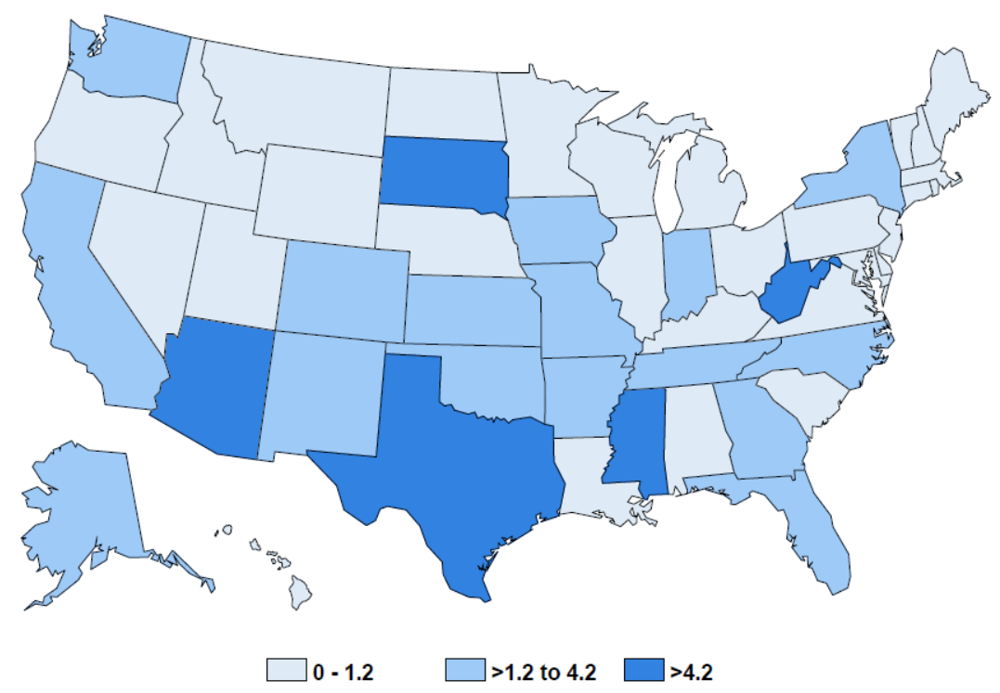
Percentage of TB Cases among Residents of Correctional Facilities* by Reporting Area, Aged ≥15, 2019
13%
10%
25%
10%
15%
Percentage of cases among residents of correctional facilities
*Correctional facilities include federal prisons, state prisons, local jails, juvenile correctional facilities, other correctional facilities, or unknown type.
Notes:
The states with the highest percentage of their cases diagnosed among residents of correctional facilities in 2019 were Arizona (25.3%, 43 of 170), Mississippi (15.4%, 8 of 52), South Dakota (12.5%, 2 of 16), West Virginia (10.0%, 1 of 10) and Texas (9.7%, 99 of 1,016).
Note: categories based on Jenks natural breaks method.

Slide 48
TB Cases among Residents of Correctional Facilities Aged ≥15 by Type of Facility, 1993–2019
*Includes Immigration and Customs Enforcement (ICE) detention centers, tribal jails operated by Indian reservations, police lockups (temporary holding facilities for person who have not been formally charged in court), military stockades and jails, or federal park facilities
Notes:
Among residents of correctional facilities with TB during 2019 over 15 years old, 27.9% were from local jails, 15.5% from state prisons, 14% from federal prisons, and 39.6% from other correctional facilities.
In 2019, 119 (44.9%) of cases occurred in person under ICE custody, which can include ICE facilities or persons in any correction facility who are also under ICE custody.

Slide 49
Substance Use Disorder Among TB Patients ≥15 Years, United States, 2019
(N=8,549)
Notes:
Substance use disorder is also a TB risk factor. Overall, 1.2% of all 2019 TB patients aged ≥15 years reported injection-drug use (IDU) during the year preceding diagnosis. Reported use of non-injection drugs among patients aged ≥15 years was higher (7.5%) than IDU, as was excessive use of alcohol (8.1%).

Slide 50
Primary Occupation Among U.S. TB Patients Aged ≥15 Years, 2019
(N=8,549)
Percentage of TB Cases
Occupation
Notes:
In the past, healthcare personnel, migrant workers and correctional employees were more likely to be represented as occupations among persons with TB. In 2019, the percentages were 4%, 1%, and <1% respectively; the largest category of occupations fell into the other category. Unemployed persons comprised 22% of TB cases and almost 34% were either retired or not seeking employment.

Slide 51
Deaths Attributed to TB, 2017*
Among TB patients diagnosed in 2017,
Of those deaths,
9% died
1/3 attributed to TB
before diagnosis or during treatment
* Data available through 2017.
Notes:
Among TB cases diagnosed during 2017, a total of 768 (8.6%) patients died, with 265 (33.3%) of those deaths attributed to TB disease or treatment. Of the 833 deaths, 165 (21.5%) were dead at the time of TB diagnosis; 29.7% of those deaths were attributed to TB. The remaining 603 (78.5%) deaths occurred after diagnosis; 34.3% of these deaths were attributed to TB.

Slide 52
Sputum Culture Conversion,
United States, 2017*
(N=5,115)
Reasons sputum culture conversion not documented
* Data available through 2017 only; among patients with a positive sputum culture.
Notes:
Conversion of a patient’s positive sputum culture to negative is a key indicator of treatment effectiveness. Among 5,115 cases during 2017 with positive sputum cultures, 4,422 (86.5%) had documented sputum culture conversion to negative. Among the 632 (12.4%) cases for which sputum culture conversion was undocumented, the most common reason was that the patient had died (36.1%) before sputum culture conversion; however, a proportion of these cases (19.0%) did not have a known reason reported for not having documented sputum culture conversion.

Slide 53
National TB Genotyping Surveillance Coverage*
United States†, 2004–2019
National Goal:
100%
Proportion of culture confirmed TB cases genotyped (%)
* The proportion of culture-confirmed TB cases with at least one genotyped isolate.
† Includes 50 states and the District of Columbia.
Notes:
This slide shows the increase in genotyping surveillance coverage from 2004 to 2019. In 2004 the proportion of culture confirmed TB cases with at least one genotyped isolate was 52.6%; in 2019 it was 97.0%. The national goal for genotyping surveillance coverage is 100.0%.

Slide 54
Definitions for TB Genotyping in the United States
Spoligotype: 000000000003771
Initial 12-locus MIRU-VNTR*:
223325173533
Sequentially assigned for each unique spoligotype and initial 12-locus MIRU-VNTR combination
Additional 12-locus MIRU-VNTR (MIRU2)†:
444534423428
PCRType:
PCR00002
+
Sequentially assigned for each unique spoligotype and 24-locus MIRU-VNTR combination
GENType:
G00010
* MIRU-VNTR=Mycobacterial interspersed repetitive unit–variable number tandem repeat.
† The complete set of 24 loci is referred to as 24-locus MIRU-VNTR and is used for U.S. GENType designations.
Notes:
This slide shows the schematic for sequential assignment of unique spoligotypes and initial 12-locus MIRU-VNTR combination or 24-locus MIRU-VNTR combination.

Slide 55
Number of County-based TB Genotype Clusters* by Cluster Size, United States, 2017–2019
* Genotype clusters are defined as two or more cases with matching spoligotype and 24-locus MIRU-VNTR (GENType) within a county during the specified 3-year time period.
Notes:
This slide shows the number of county-based TB genotype clusters by the size of the clusters; a genotype cluster is defined as two or more cases with matching spoligotype and 24-locus MIRU-VNTR (GENType) within a county during the specified 3-year time period. During 2017–2019, there were 900 two-case clusters, 222 three-case clusters, 95 four-case clusters, 37 five-case clusters, 25 six-case clusters, 21 seven-case clusters, 13 eight-case clusters, 10 nine-case clusters, and 28 case clusters that were greater or equal to 10 TB cases in size.

Slide 56
TB Genotype Clusters by
TB GIMS* Alert Levels†, United States, 2017–2019
* TB GIMS=Tuberculosis Genotyping Information Management System
† Alert levels are determined by the log likelihood ratio (LLR) statistic for a given cluster, identifying higher than expected geospatial concentrations for a TB genotype cluster in a specific county, compared to the national distribution of that genotype; TB GIMS generates alert level notifications based on this statistic: “No alert” is indicated if LLR is between 0–<5, “medium” is for LLR of 5–<10 and “high” alert is for clusters with LLR ≥10.
Notes:
Clusters are classified into alert levels on the basis of a log-likelihood ratio (LLR) calculation; clusters with an LLR of 5–<10 are classified as a medium alert level, and clusters with an LLR ≥10 are classified as a high alert level. Clustered cases were often part of medium- (23.2%) or high-level alerts (17.2%). At the cluster level, 388 (28.7%) of 1,351 clusters identified nationally were either medium- or high-level alerts.

Slide 57
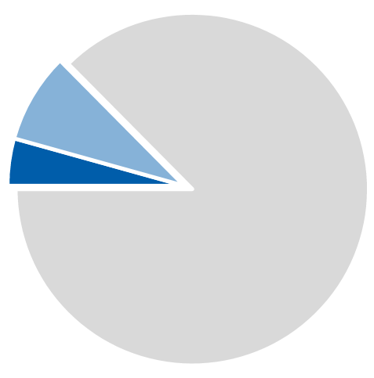
Genotyped TB Cases Estimated to be Attributed to Recent Transmission, United States, 2018–2019
Recent transmission*
12.5% (n=1,703)
8.4%
(n=1,146)
4.1% (n=557)
Limited recent transmission
Not recent transmission§
87.5% (n=11,874)
Extensive recent transmission†
* A TB case is designated as attributed to recent transmission if a plausible source case can be identified in a person who i) has the same M. tuberculosis genotype, ii) has an infectious form of TB disease, iii) resides within 10 miles of the TB case, iv) is 10 years of age or older, and v) was diagnosed within 2 years before the TB case.
† A TB case is designated as attributed to extensive recent transmission when the criteria above for recent transmission are met, and furthermore the case belongs to a plausible transmission chain of six or more cases. Otherwise, the case is designated as attributed to limited recent transmission.
§ Cases not attributed to recent transmission may be misclassified in children <5 years old or indeterminate in persons with a recent U.S. arrival due to limitations of the plausible-source case method.
Notes:
Nationally, CDC attributed 1,703 (12.5%) of 13,577 genotyped cases reported during 2018–2019 to recent transmission.

Slide 58
Genotyped Cases Estimated to be Attributed to Limited and Extensive Recent Transmission, United States, 2016–2019
n=1,703
Limited recent transmission
Extensive recent transmission†
* A TB case is designated as attributed to recent transmission if a plausible source case can be identified in a person who i) has the same M. tuberculosis genotype, ii) has an infectious form of TB disease, iii) resides within 10 miles of the TB case, iv) is 10 years of age or older, and v) was diagnosed within 2 years before the TB case.
† A TB case is designated as attributed to extensive recent transmission when the criteria above for recent transmission are met, and furthermore the case belongs to a plausible transmission chain of six or more cases. Otherwise, the case is designated as attributed to limited recent transmission.
Notes:
CDC has provided national estimates of recent transmission and extensive recent transmission throughout a 2-year period since the publication of Reported Tuberculosis in the United States, 2016. The number of cases attributed to recent transmission has declined. By comparison, estimates were 1,787 cases during 2016–2017 and 1,703 during 2018–2019.

Slide 59
Percentages of TB Cases Estimated to be Attributed and Not Attributed to Recent Transmission, by Origin of Birth*, 2018–2019
7.7%
(n=748)
†
§
Non-U.S.–born
U.S.-born
* Cases with unknown origin of birth not shown (n=11).
† A TB case is designated as attributed to recent transmission if a plausible source case can be identified in a person who i) has the same M. tuberculosis genotype, ii) has an infectious form of TB disease, iii) resides within 10 miles of the TB case, iv) is 10 years of age or older, and v) was diagnosed within 2 years before the TB case.
§ Cases not attributed to recent transmission may be misclassified in children <5 years old or indeterminate in persons with a recent U.S. arrival due to limitations of the plausible-source case method.
Notes:
A greater proportion of genotyped cases were attributed to recent transmission among U.S.-born persons (24.9%) than among non-U.S.–born persons (7.7%).

Slide 60
Proportion of TB Cases Estimated to be Attributed to Recent Transmission and Extensive Recent Transmission for Select Race/Ethnicity Groups, United States, 2016–2019
40.3%
(n=60)
32.3%
(n=50)
35.1%
(n=59)
18.6%
(n=24)
20.5%
(n=577)
19.7%
(n=521)
20.2%
(n=34)
20.1%
(n=30)
12.3%
(n=19)
8.6%
(n=243)
7.2%
(n=190)
4.6%
(n=6)
Recent Transmission*
Extensive Recent Transmission†
*A TB case is designated as attributed to recent transmission if a plausible source case can be identified in a person who i) has the same M. tuberculosis genotype, ii) has an infectious form of TB disease, iii) resides within 10 miles of the TB case, iv) is 10 years of age or older, and v) was diagnosed within 2 years before the TB case.
†A TB case is designated as attributed to extensive recent transmission when the criteria above for recent transmission are met, and furthermore the case belongs to a plausible transmission chain of six or more cases.
Notes:
Greater proportions of cases attributed to recent transmission and extensive recent transmission were identified among Native Hawaiian/Pacific Islander, non-Hispanic Black, and American Indian/Alaska Native persons, compared with national average estimates.

Slide 61
Proportion of TB Cases Estimated to be Attributed to Recent Transmission and Extensive Recent Transmission for Select Race/Ethnicity Groups, United States, 2016–2019
13.8%
(n=508)
12.6%
(n=485)
12.5%
(n=208)
12.3%
(n=195)
7.7%
(n=389)
7.4%
(n=372)
2.6%
(n=133)
4.1%
(n=152)
3.1%
(n=117)
4.1%
(n=68)
3.9%
(n=62)
2.3%
(n=116)
Recent Transmission*
Extensive Recent Transmission†
*A TB case is designated as attributed to recent transmission if a plausible source case can be identified in a person who i) has the same M. tuberculosis genotype, ii) has an infectious form of TB disease, iii) resides within 10 miles of the TB case, iv) is 10 years of age or older, and v) was diagnosed within 2 years before the TB case.
†A TB case is designated as attributed to extensive recent transmission when the criteria above for recent transmission are met, and furthermore the case belongs to a plausible transmission chain of six or more cases.
Notes:
Lower proportions of cases attributed to recent transmission and extensive recent transmission were identified among non-Hispanic Asian persons, compared with national average estimates. Lower proportions of cases were attributed to extensive recent transmission among persons of Hispanic ethnicity, compared with national average estimates.

Slide 62
Division of Tuberculosis Elimination
National Center for HIV/AIDS, Viral Hepatitis, STD, and TB Prevention
Centers for Disease Control and Prevention
1600 Clifton Road NE, US 12-4
Atlanta, GA 30329
Phone: 404-639-8120
Internet Address: http://www.cdc.gov/tb/
Notes:
For more information, please contact Division of Tuberculosis Elimination at http://www.cdc.gov/tb/.

