Slide 1
Tuberculosis in the United States
National Tuberculosis Surveillance System
Highlights from 2015
National Center for HIV/AIDS, Viral Hepatitis, STD, and TB Prevention
Division of Tuberculosis Elimination

Slide 2
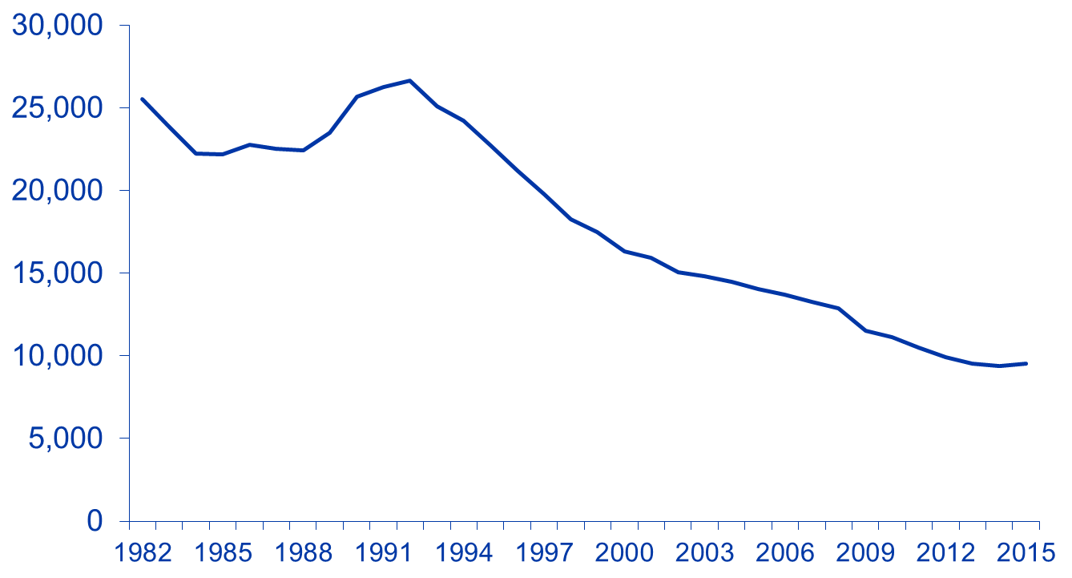
Reported Tuberculosis (TB) Cases
United States, 1982–2015*
No. of cases
Year
*As of June 9, 2016.

Slide 3
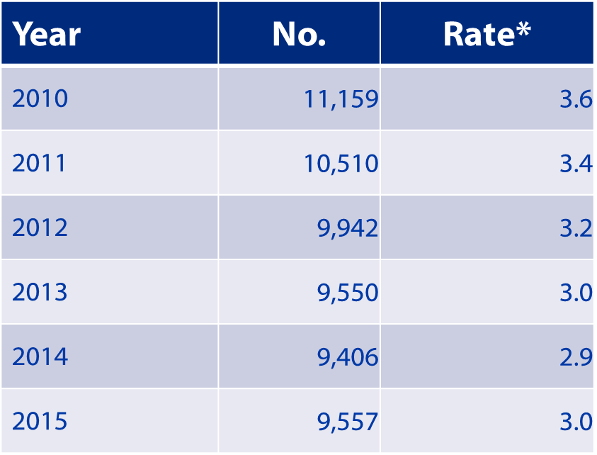
TB Morbidity United States, 2010–2015
* Cases per 100,000 population; as of June 9, 2016.

Slide 4
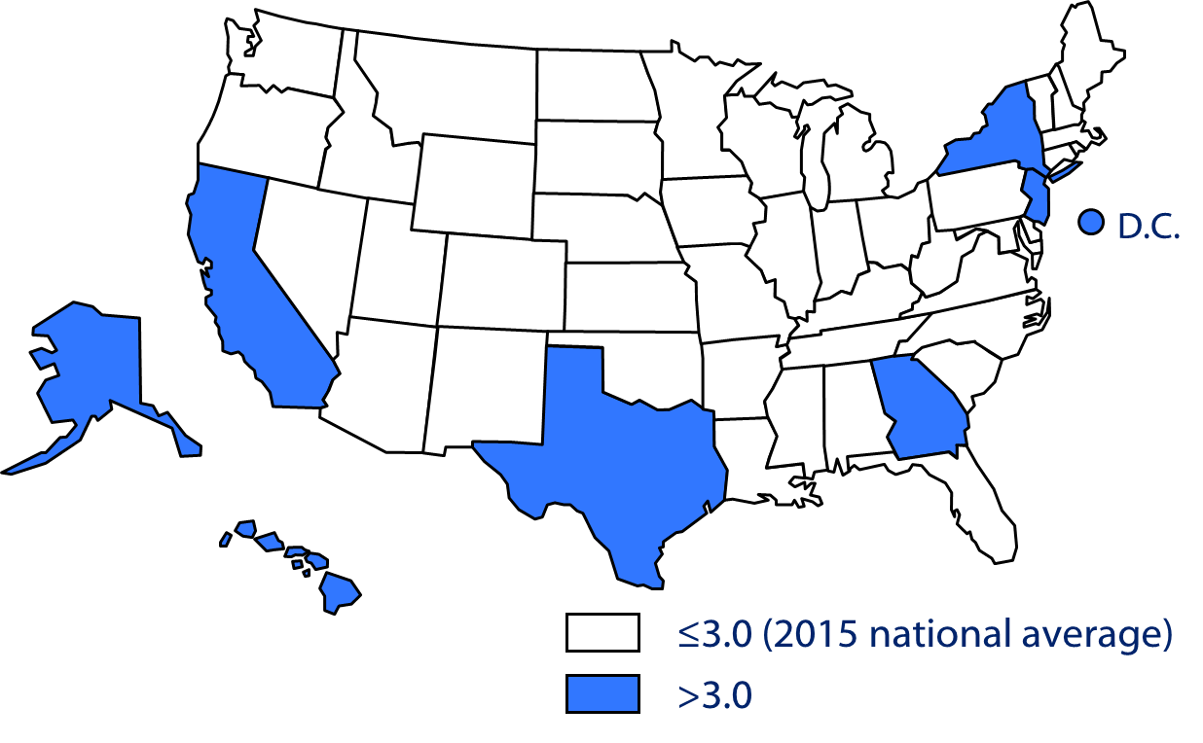
TB Case Rates,* United States, 2015
*Cases per 100,000 population; as of June 9, 2016.

Slide 5
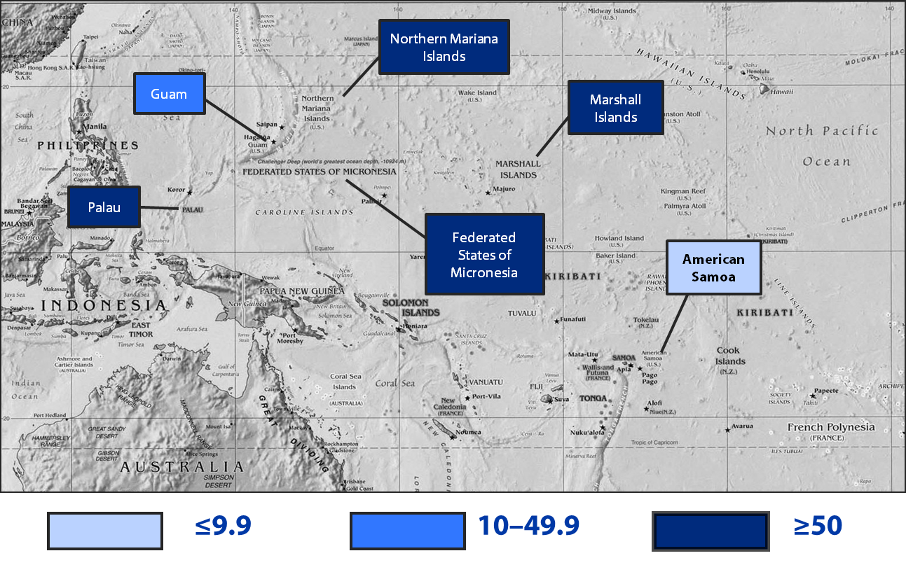
Map of U.S.-Affiliated Pacific Islands,
by TB Case Rates,* 2015
* Cases per 100,000 population; as of June 9, 2016.

Slide 6
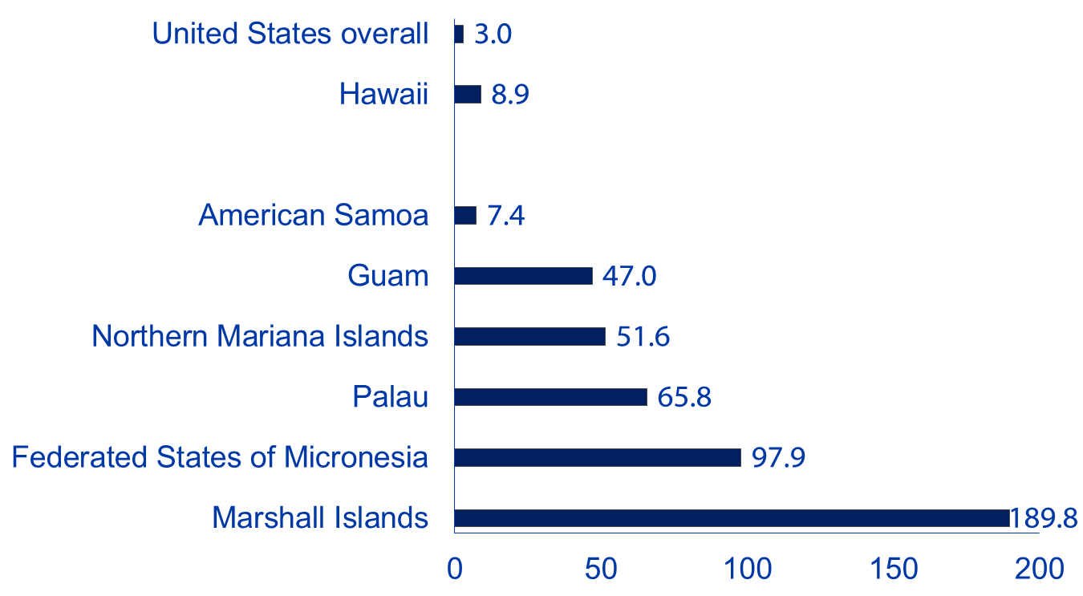
TB Case Rates,* U.S.-Affiliated Pacific Islands, 2015
* Cases per 100,000 population; as of June 9, 2016.

Slide 7
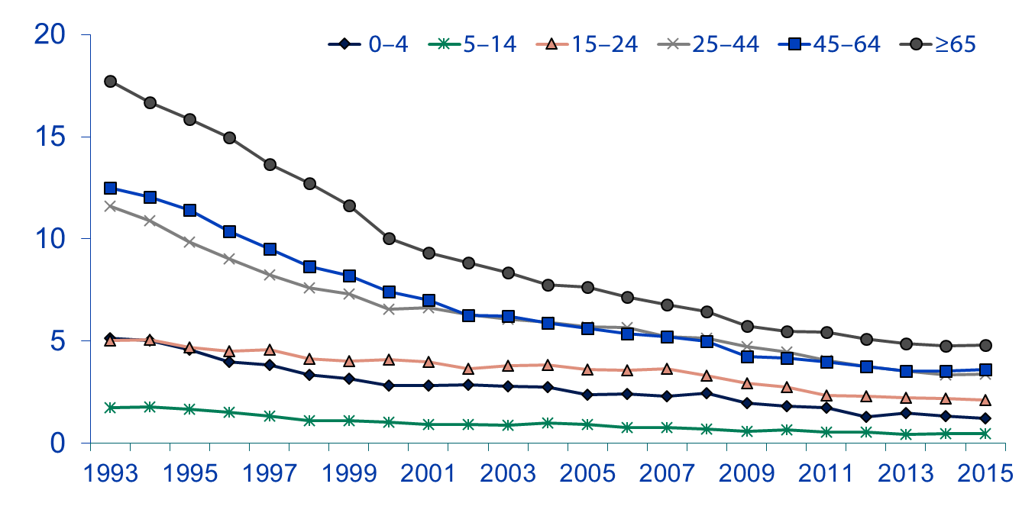
TB Case Rates,* by Age Group,
United States, 1993–2015
Cases per 100,000 population
Age group (yrs)
* As of June 9, 2016.

Slide 8
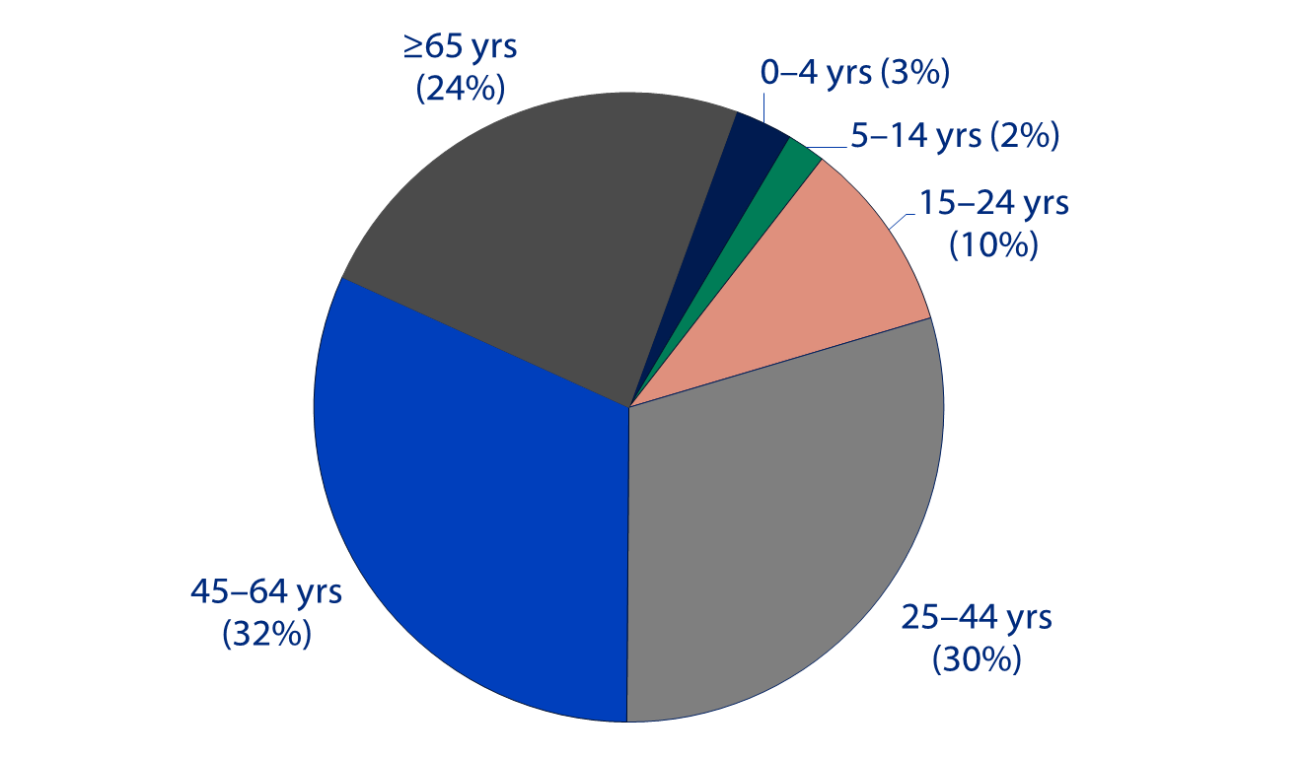
Reported TB Cases, by Age Group,
United States, 2015*
* As of June 9, 2016.

Slide 9
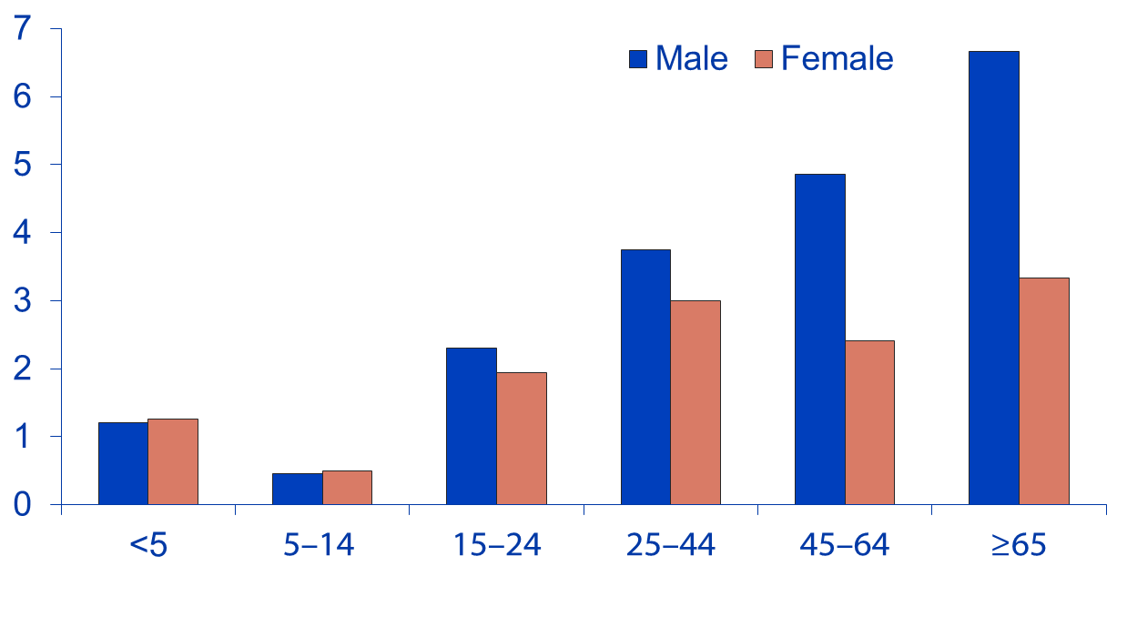
TB Case Rates, by Age Group and Sex,
United States, 2015*
Cases per 100,000 population
Age group (yrs)
* As of June 9, 2016.

Slide 10
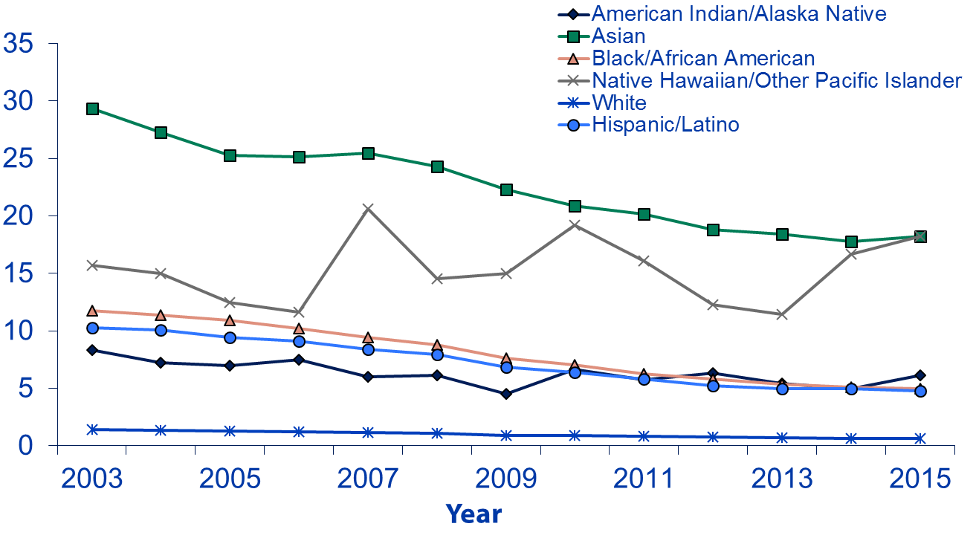
TB Case Rates by Race/Ethnicity,*
United States, 2003–2015†
Cases per 100,000 population
* All races are non-Hispanic.
† As of June 9, 2016.

Slide 11
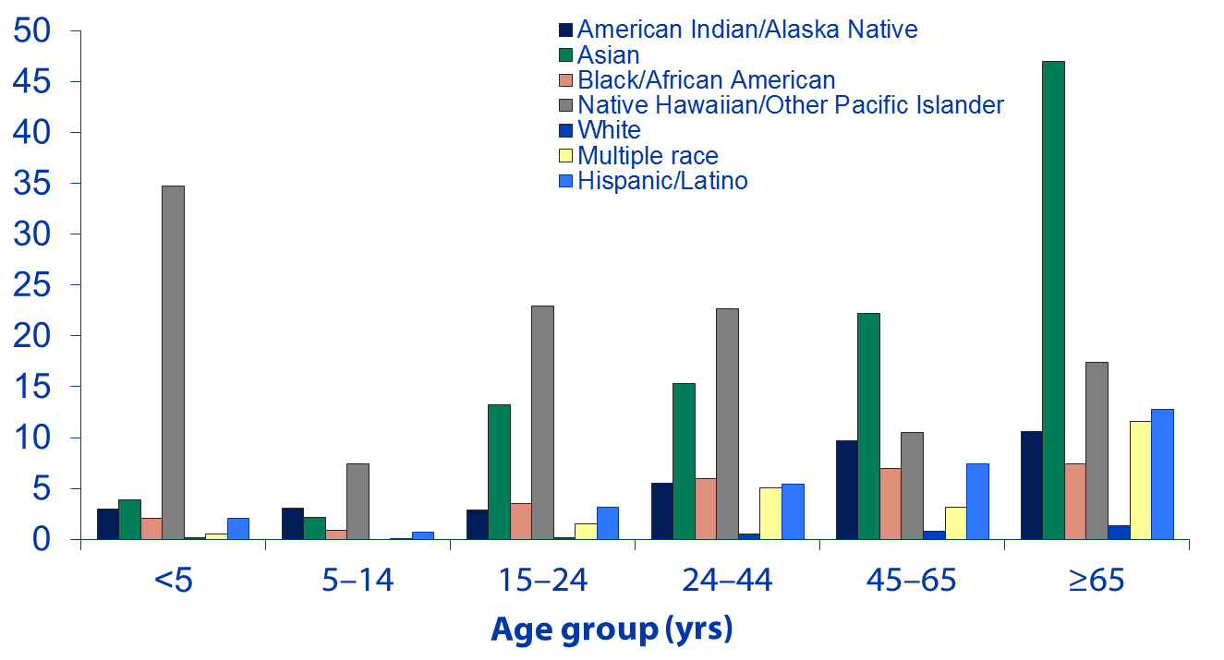
TB Case Rates, by Age Group and Race/Ethnicity,*
United States, 2015†
Cases per 100,000 population
* All races are non-Hispanic; multiple race indicates two or more races reported for a person, but does not include persons of Hispanic/Latino origin.
† As of June 9, 2016.

Slide 12
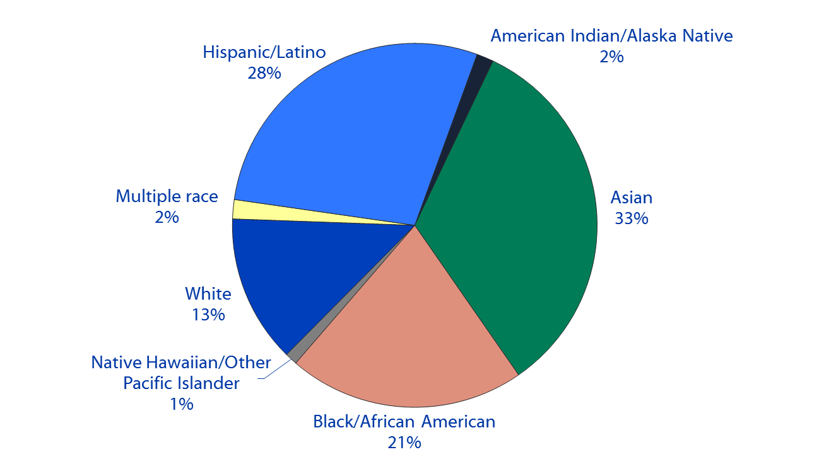
Reported TB Cases, by Race/Ethnicity,*
United States, 2015†
* All races are non-Hispanic; multiple race indicates two or more races reported for a person, but does not include persons of Hispanic/Latino origin. Unknown race consisted of 0.3% and is not shown.
† As of June 9, 2016.

Slide 13
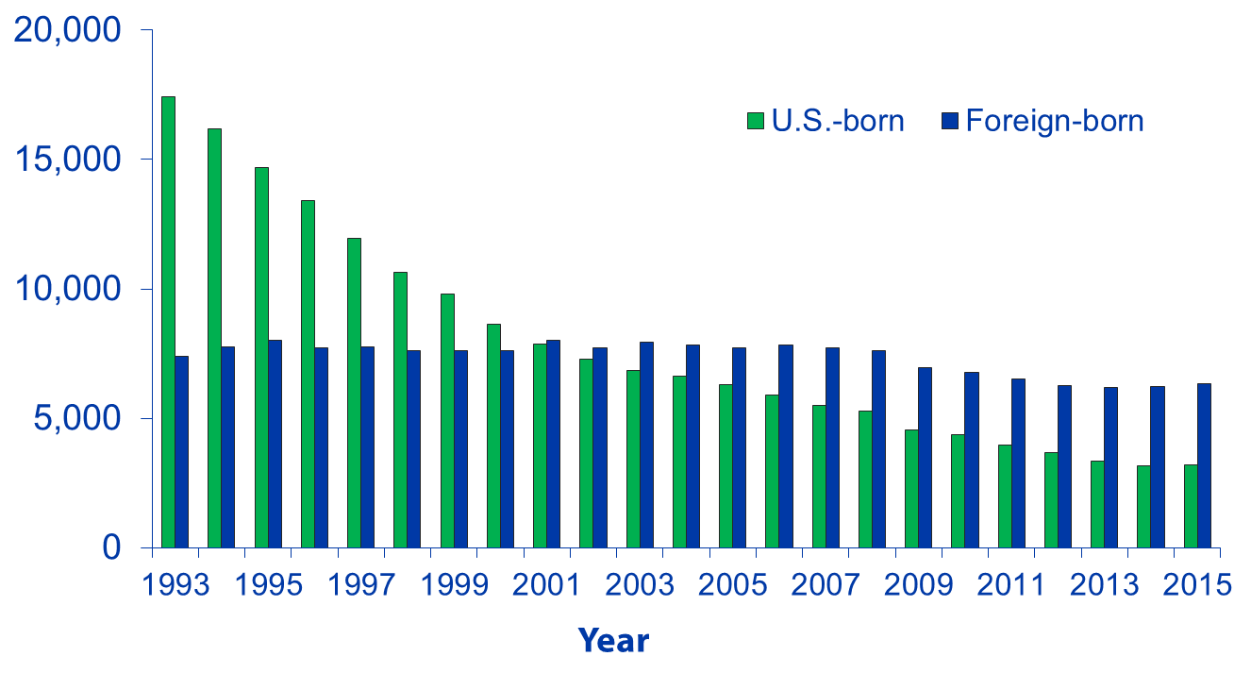
Number of TB Cases Among U.S.-Born versus
Foreign-Born Persons, United States, 1993–2015*
No. of cases
* As of June 9, 2016.

Slide 14
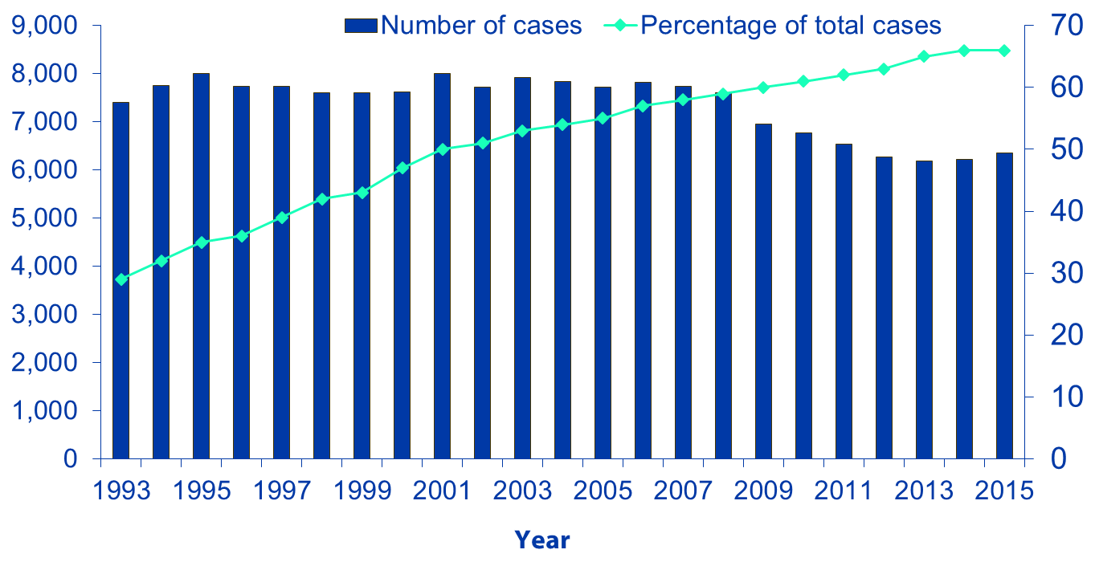
Trends in TB Cases Among Foreign-Born Persons,
United States, 1993–2015*
No. of cases
Percentage
* As of June 9, 2016.

Slide 15
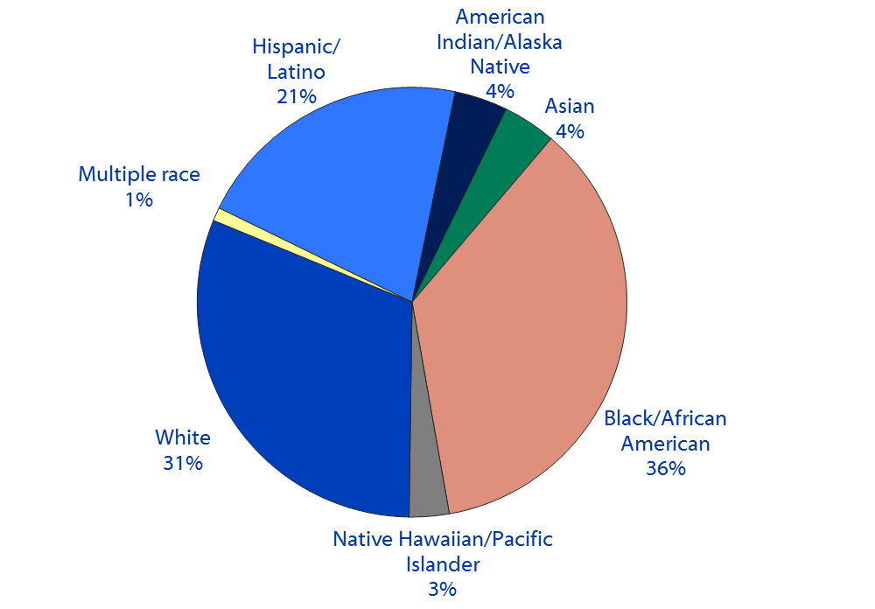
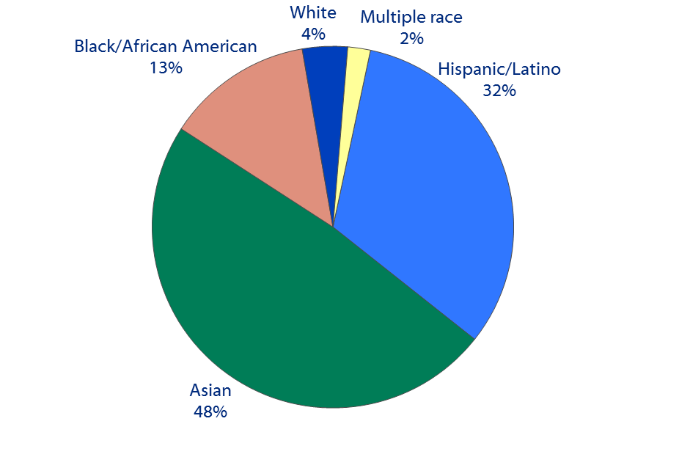
Reported TB Cases, by Origin and Race/Ethnicity†, United States, 2015*
U.S.-born persons
Foreign-born persons§
† All races are non-Hispanic; multiple race indicates two or more races reported for a person, but does not include persons of Hispanic/Latino origin.
* As of June 9, 2016.
§ American Indian/Alaska Native and Native Hawaiian/Other Pacific Islander accounted for <1% of cases among foreign-born persons and are not shown.

Slide 16
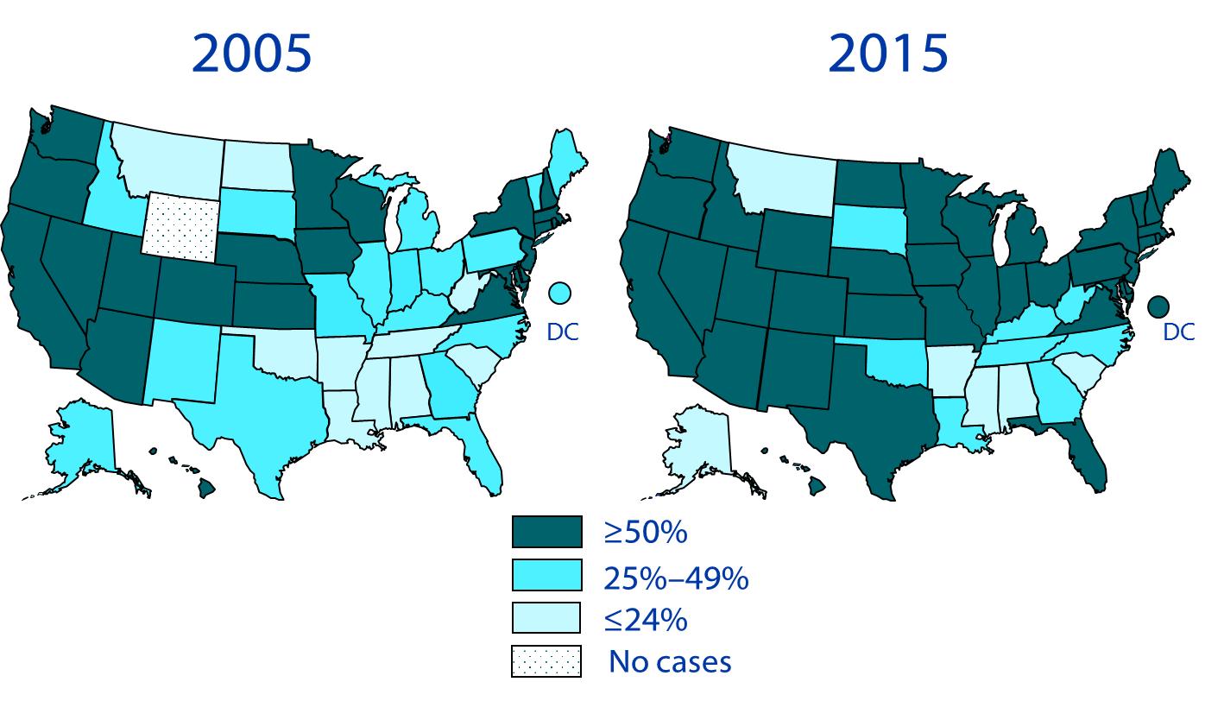
Percentage of Foreign-Born Persons
Among TB Cases, United States,* 2005 and 2015
* As of June 9, 2016.

Slide 17
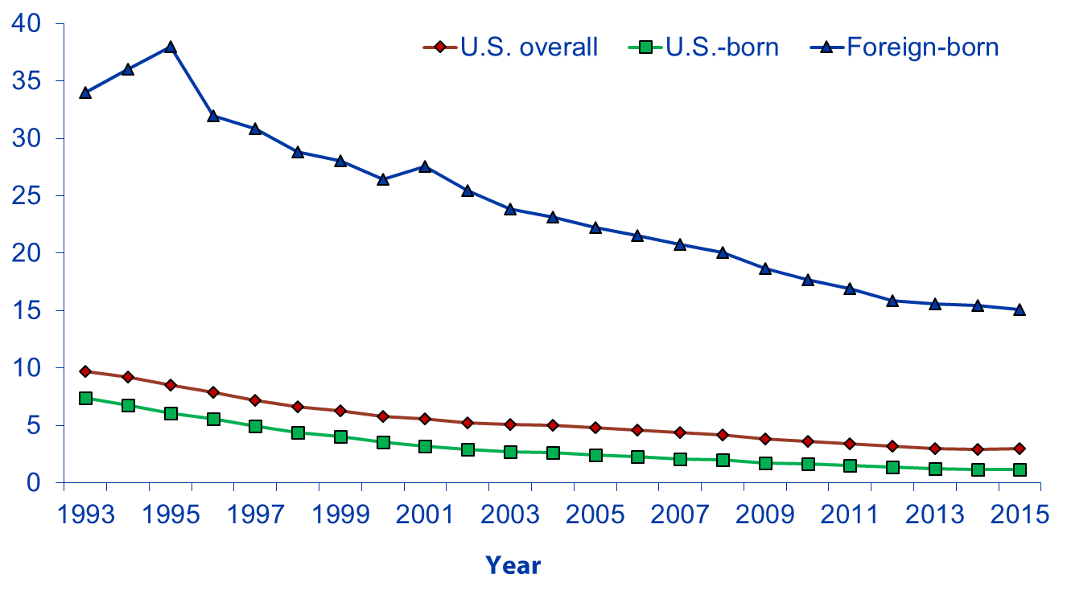
TB Case Rates Among U.S.-Born versus Foreign-Born Persons, United States, 1993–2015*
Cases per 100,000 population
* As of June 9, 2016.

Slide 18
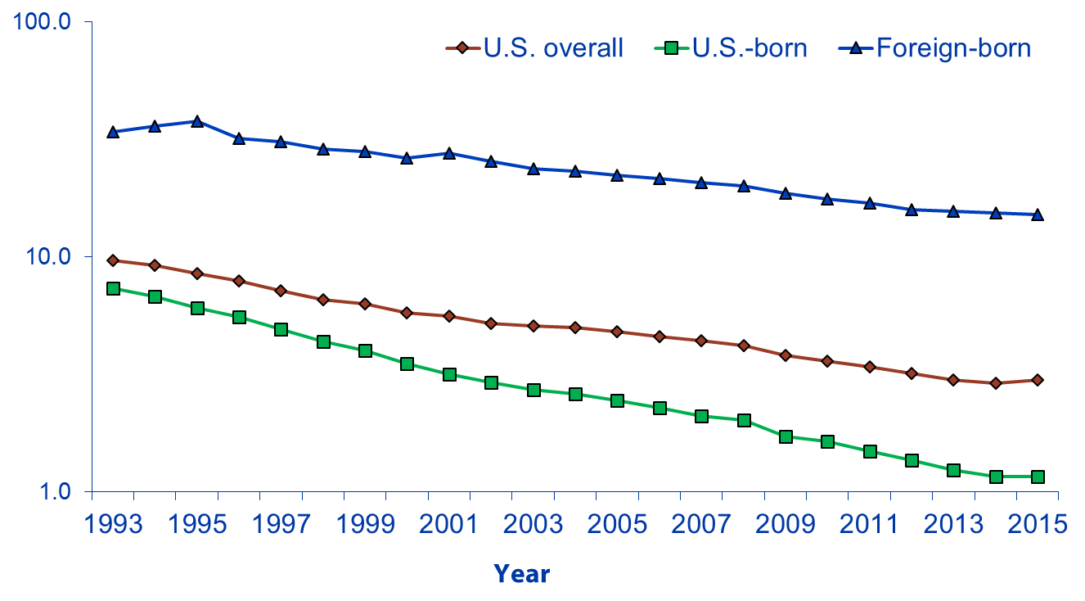
TB Case Rates Among U.S.-Born versus Foreign-Born Persons, United States,* 1993–2015†
Cases per 100,000 population
* Includes the same data as previous slide, but rates are presented on a logarithmic scale.
† As of June 9, 2016.

Slide 19
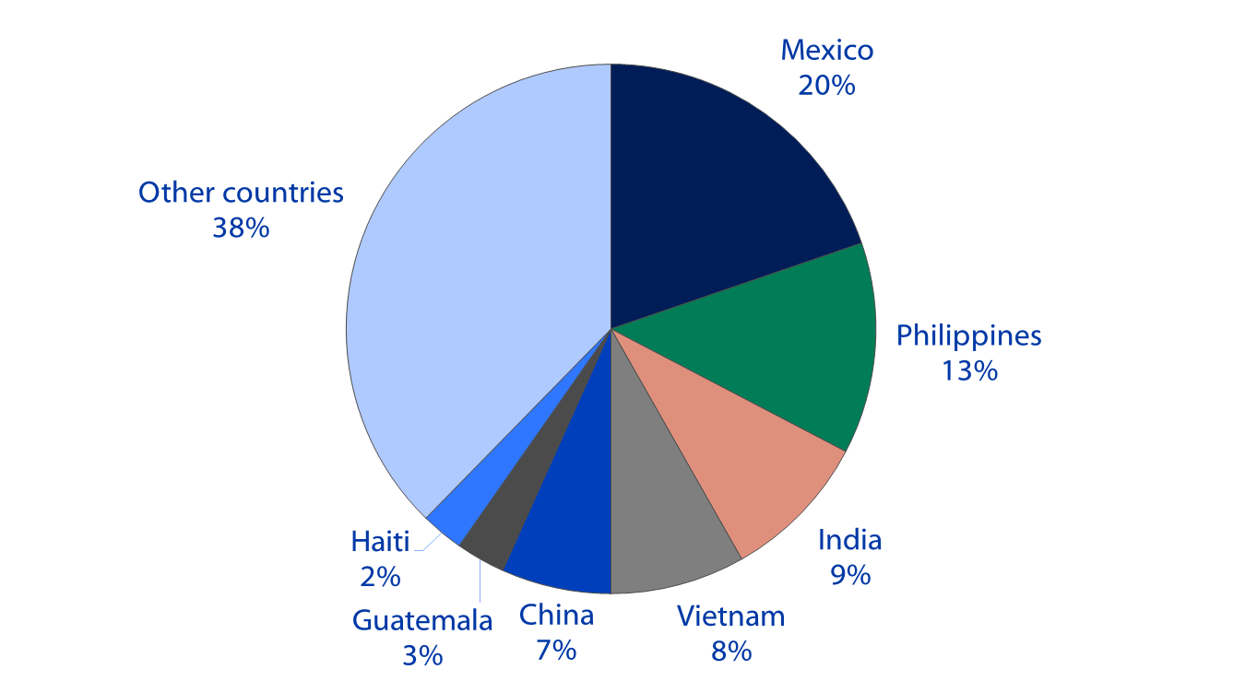
Countries of Birth Among Foreign-Born Persons Reported with TB, United States, 2015*
* As of June 9, 2016.

Slide 20
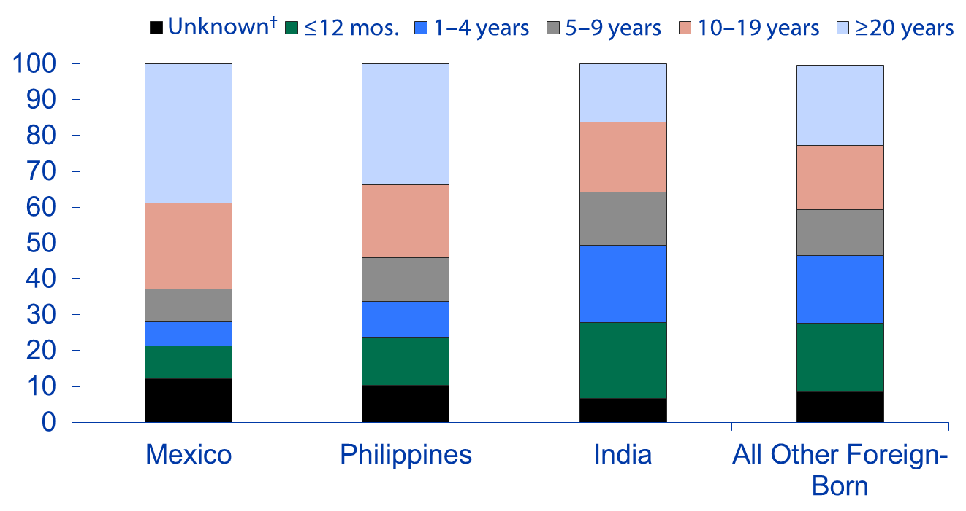
Percentage of Foreign-Born Persons with TB,
by Time of Residence in U.S. Before Diagnosis, 2015*
Percentage
* As of June 9, 2016.
† Foreign-born TB patients for whom information on length of residence in the United States before diagnosis is unknown or missing.

Slide 21
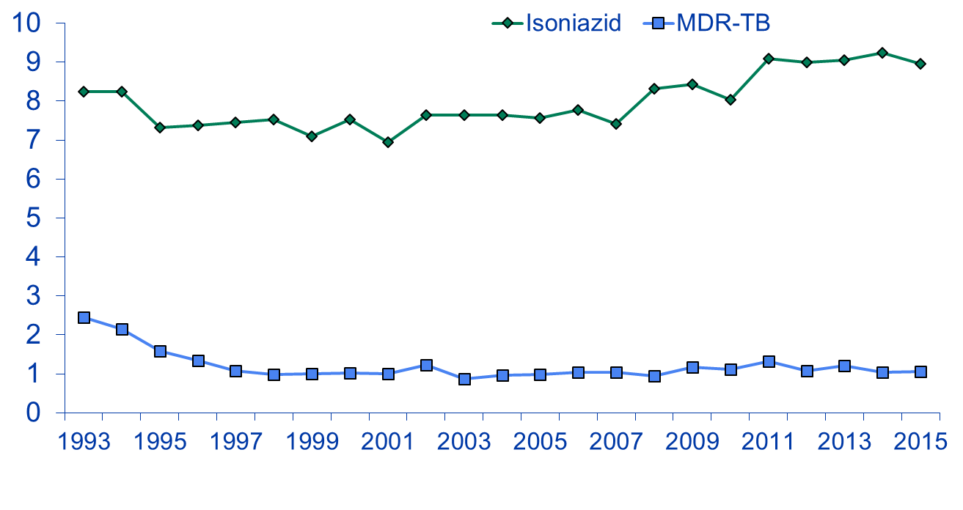
Primary Anti-TB Drug Resistance,
United States, 1993–2015*
Resistant (%)
Year
* As of June 9, 2016.
Note: Based on initial isolates from persons with no prior history of TB; multidrug-resistant TB (MDR-TB) is defined as resistance to at least isoniazid and rifampin.

Slide 22
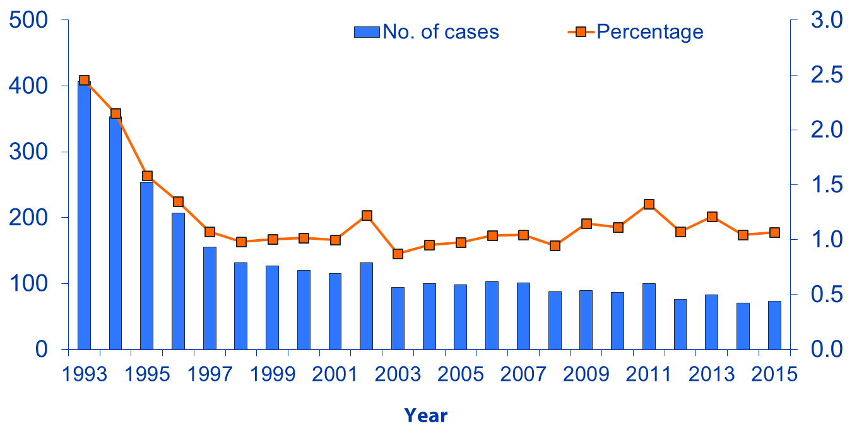
Primary MDR-TB,
United States, 1993–2015*
No. of cases
Percentage
* As of June 9, 2016.
Note: Based on initial isolates from persons with no prior history of TB; multidrug resistant TB (MDR-TB) defined as resistance to at least isoniazid and rifampin.

Slide 23
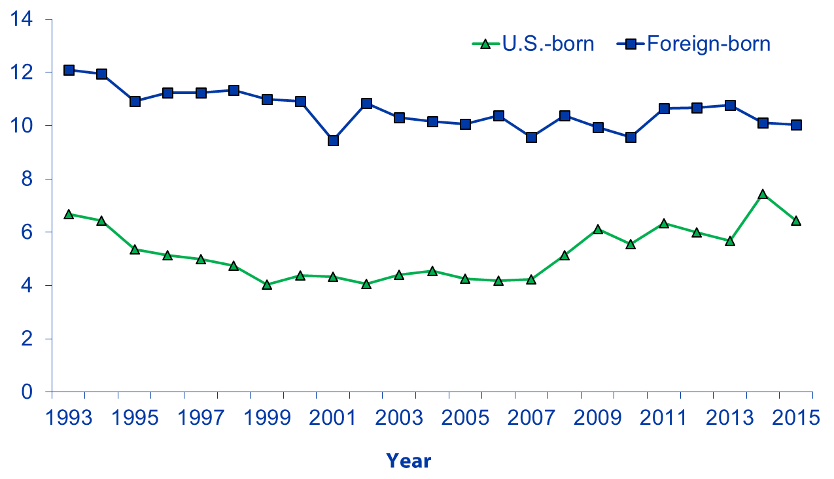
Primary Isoniazid Resistance
Among U.S.-Born versus Foreign-Born Persons,
United States, 1993–2015*
Resistant (%)
* As of June 9, 2016.
Note: Based on initial isolates from persons with no prior history of TB.

Slide 24
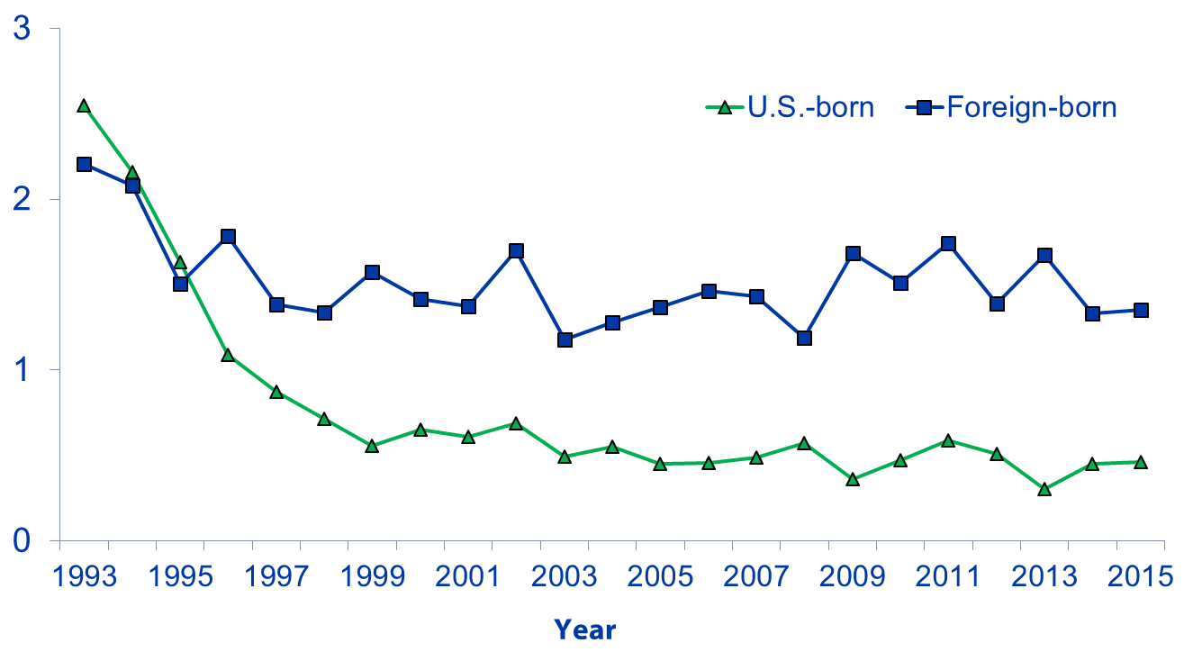
Primary MDR-TB Among U.S.-Born versus Foreign-Born Persons,
United States, 1993–2015*
Resistant (%)
* As of June 9, 2016.
Note: Based on initial isolates from persons with no prior history of TB; multidrug resistant TB (MDR-TB) defined as resistance to at least isoniazid and rifampin.

Slide 25
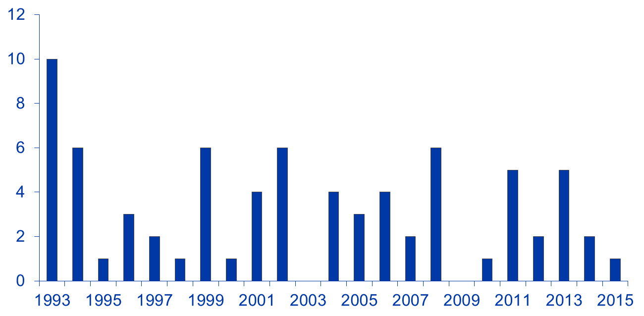
XDR-TB* Case Count, Defined on Initial DST,†
by Year, 1993–2015§
Case count
Year of diagnosis
* XDR-TB , extensively drug-resistant TB.
† DST, drug susceptibility test.
§ As of June 9, 2016.
Note: XDR-TB is defined as resistance to isoniazid and rifampin, plus resistance to any fluoroquinolone and at least one of three injectable second-line anti-TB drugs.

Slide 26
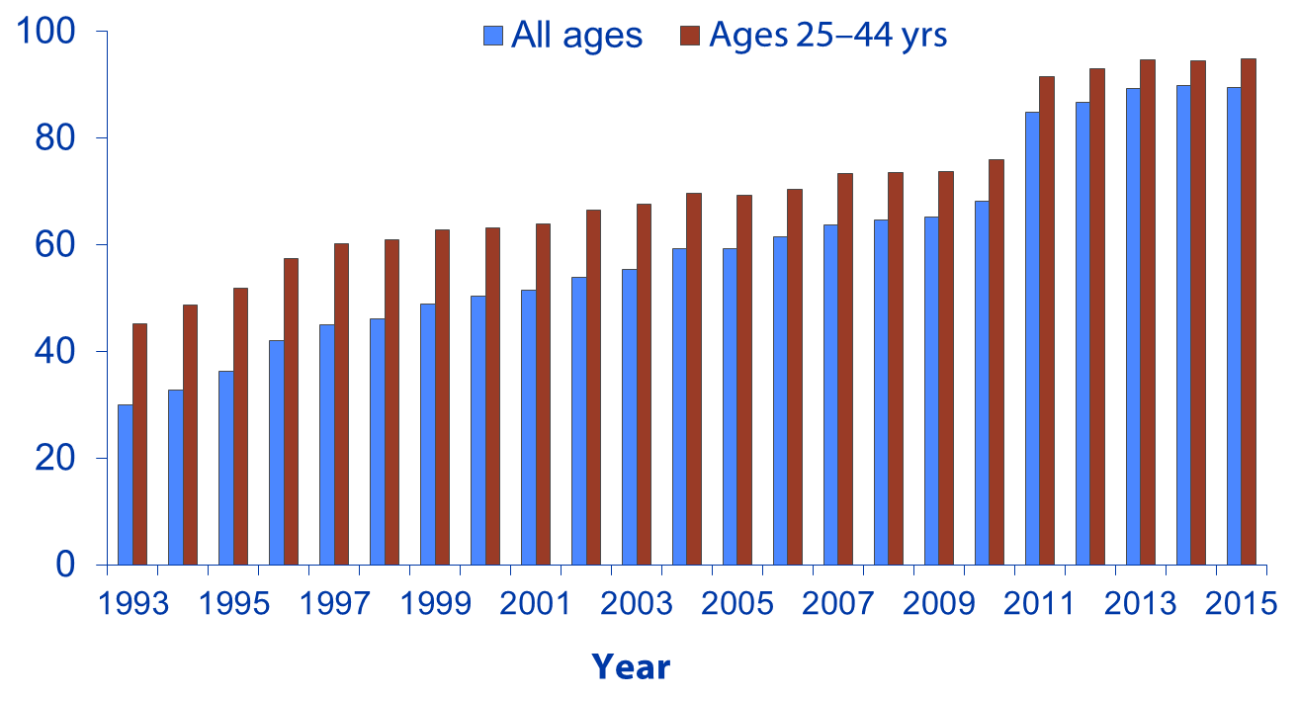
Reporting of HIV Test Results Among Persons with TB, by Age Group, United States, 1993–2015*
With test results (%)
* As of June 9, 2016.
Note: Includes persons with positive, negative, or indeterminate human immunodeficiency virus (HIV) test results and persons from California with co-diagnosis of TB and acquired immunodeficiency syndrome (AIDS). Rhode Island did not report HIV test results for years 1993–1997. HIV test results for Vermont are not included for years 2007–2010. HIV test results for California are not included for years 2005–2010.

Slide 27
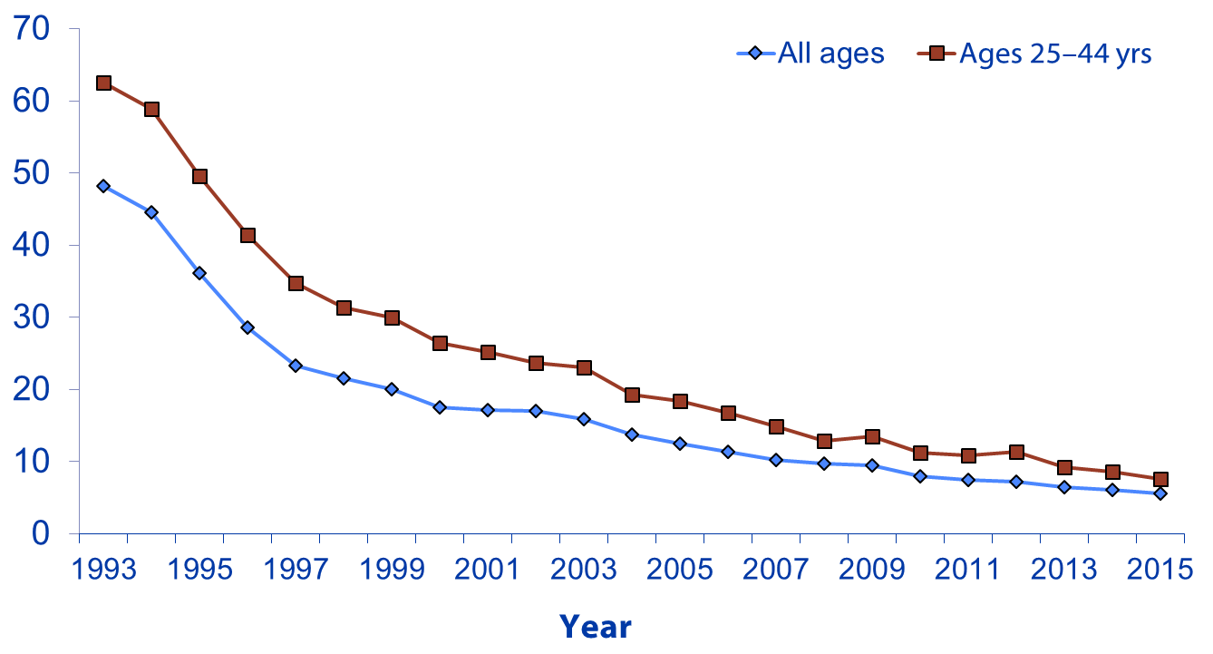
Estimated HIV Coinfection Among Persons
Reported with TB, United States, 1993–2015*
Coinfection (%)
* As of June 9, 2016.
Note: Minimum estimates are based on reported HIV-positive status among all TB patients in the age group.

Slide 28
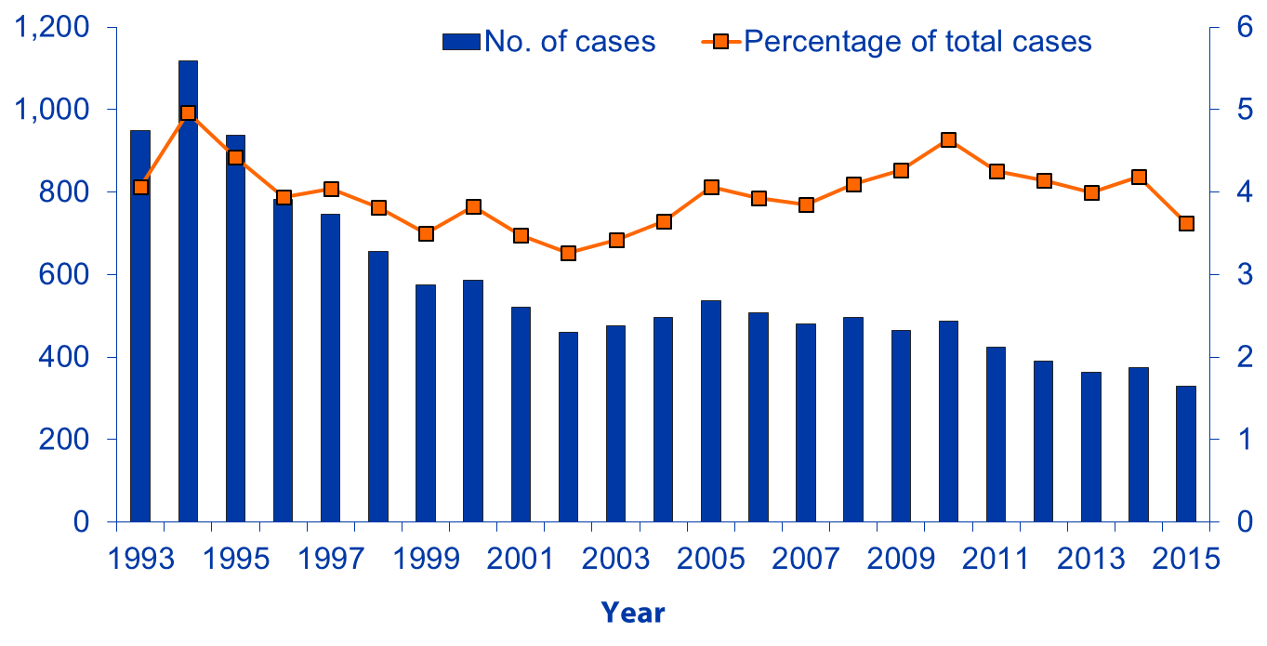
TB Cases Among Persons Aged ≥15 Years Residing in Correctional Facilities,
United States, 1993–2015*
No. of cases
Percentage
* As of June 9, 2016.
Note: Resident of correctional facility at time of TB diagnosis.

Slide 29
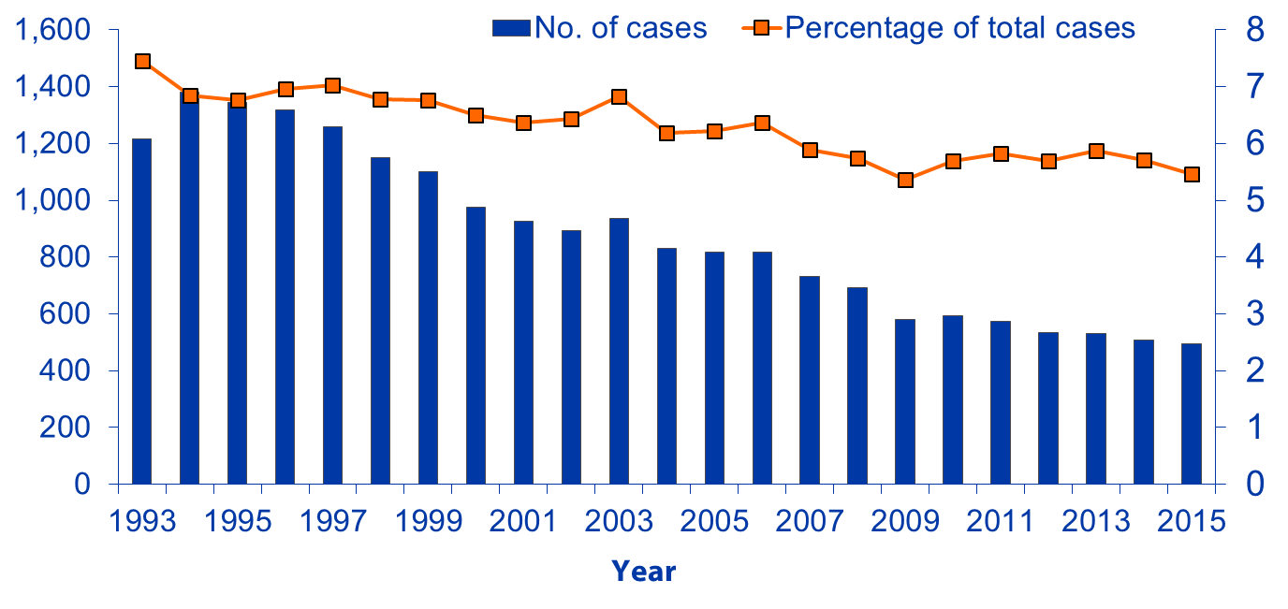
TB Cases Reported Among Homeless Persons
During the 12 Months Before Diagnosis,
Ages ≥15 Years, United States, 1993–2015*
No. of cases
Percentage
* As of June 9, 2016.
Note: Homeless during the 12 months before TB diagnosis.

Slide 30
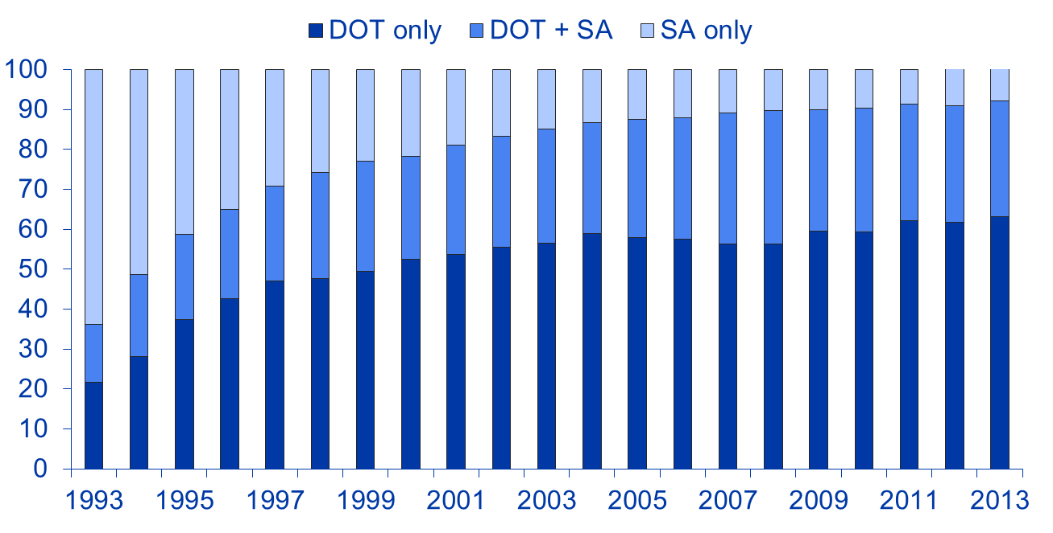
Mode of Treatment Administration
Among Persons Reported with TB,
United States, 1993–2013*
Percentage†
Year
DOT, directly observed therapy; SA, self-administered therapy.
* As of June 9, 2016; data available through 2013 only.
† Percentage of total cases among persons alive at diagnosis, with an initial regimen of one or more drugs prescribed and excluding cases with unknown mode of treatment administration.

Slide 31
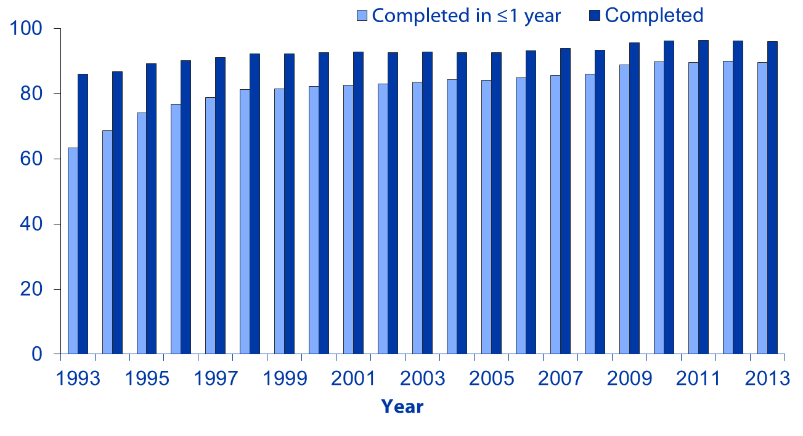
Completion of TB Treatment Therapy,
United States, 1993–2013*
Percentage
* As of June 9, 2016; data available through 2013 only.
Note: Includes persons alive at diagnosis, with initial drug regimen of one or more drugs prescribed, who did not die within one year of initiating treatment; excludes persons with initial rifampin-resistant isolate, patients with bone and joint disease, meningeal disease, or disease of the central nervous system, or pediatric patients (ages 0–14 years) with miliary disease or positive blood culture or a positive nucleic acid amplification test on a blood specimen, and those who moved out of the country within one year of initiating treatment.

Slide 32
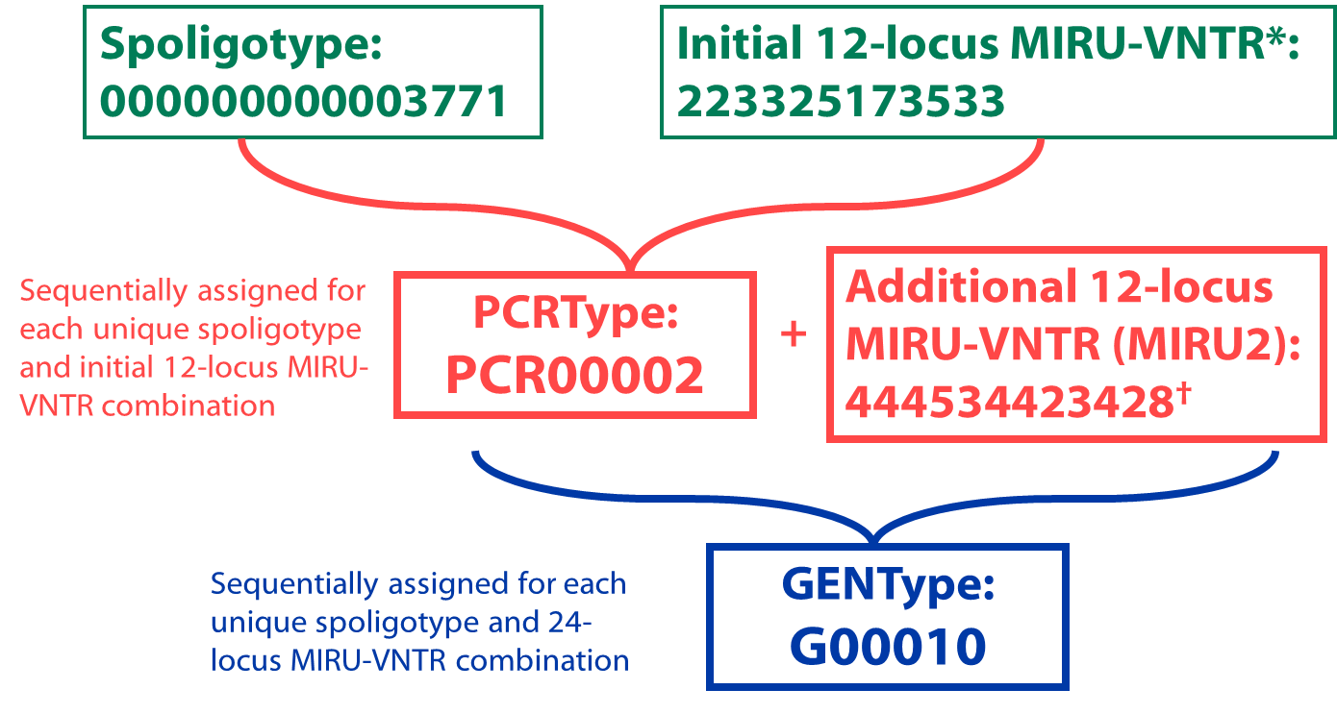
Definition for Mycobacterium tuberculosis Genotyping in the United States
* MIRU-VNTR, mycobacterial interspersed repetitive unit–variable number tandem repeat.
† The complete set of 24 loci is referred to as 24-locus MIRU-VNTR and is used for GENType designation for genotype in the United States.

Slide 33
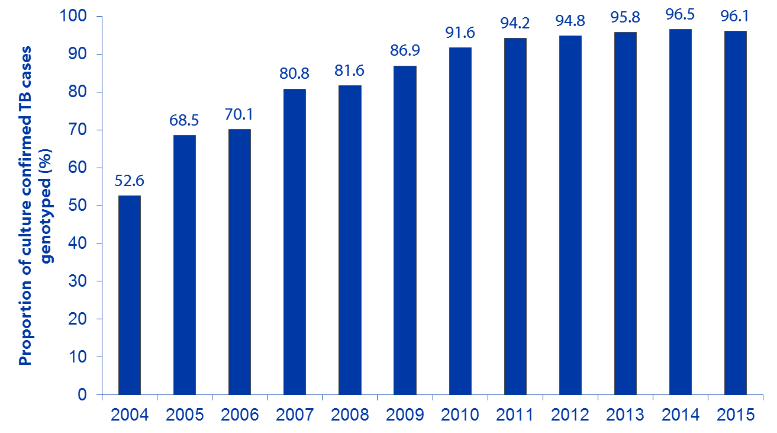
National Mycobacterium tuberculosis Genotyping Surveillance Coverage,* by Year, United States,† 2004–2015
National Indicator
94.0%
Year
* The proportion of positive cultures with at least one genotyped isolate.
† Includes all 50 states and the District of Columbia.

Slide 34
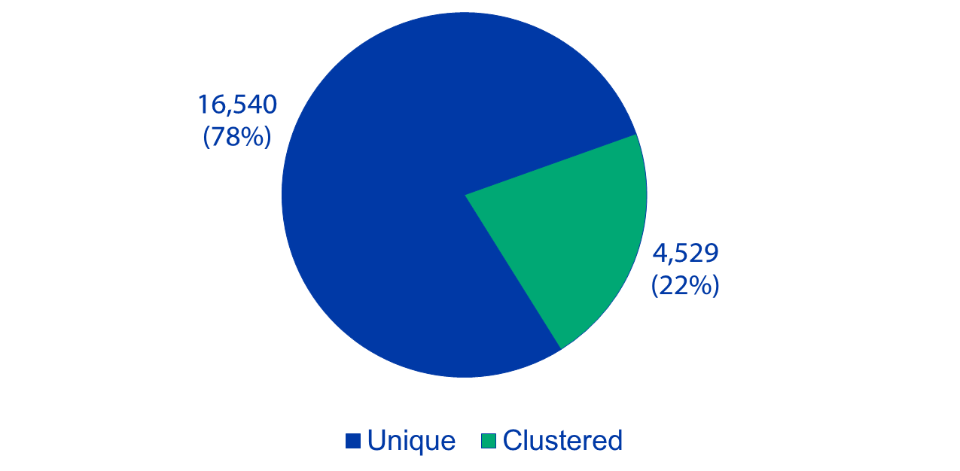
Number and Percentage of Unique* and
County-GENType Clustered† Cases,
United States, 2013–2015
* A unique case is a case with a spoligotype and 24-locus MIRU-VNTR (GENType) that does not match any other case in that county during the specified 3-year period.
† Two or more cases with matching spoligotype and 24-locus MIRU-VNTR (GENType) within a county during the specified 3-year period.

Slide 35
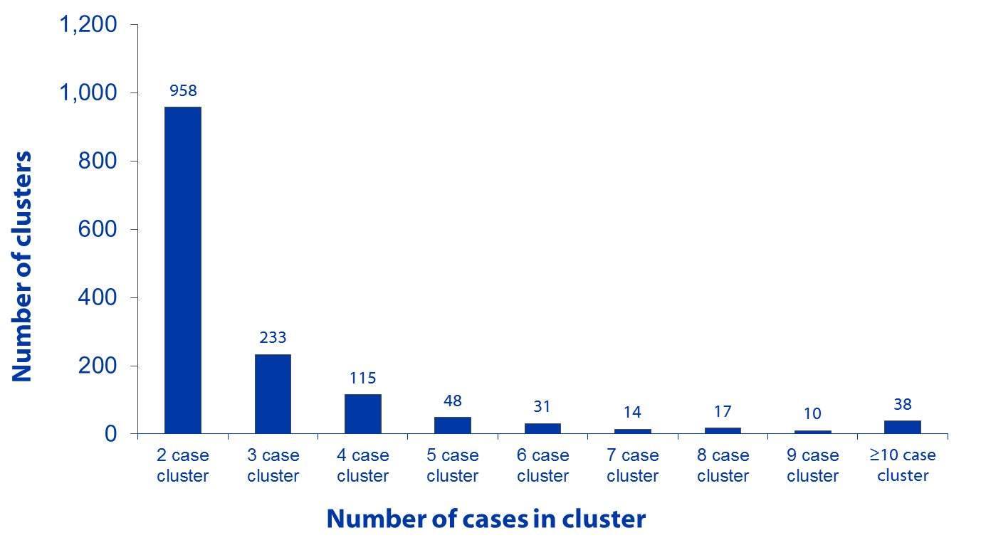
Number of County-Based Mycobacterium tuberculosis Genotype Clusters,* by Cluster Size,
United States, 2013–2015
* Genotype cluster is defined as two or more cases with matching spoligotype and 24-locus MIRU-VNTR (GENType) within a county during the specified 3-year period.

Slide 36
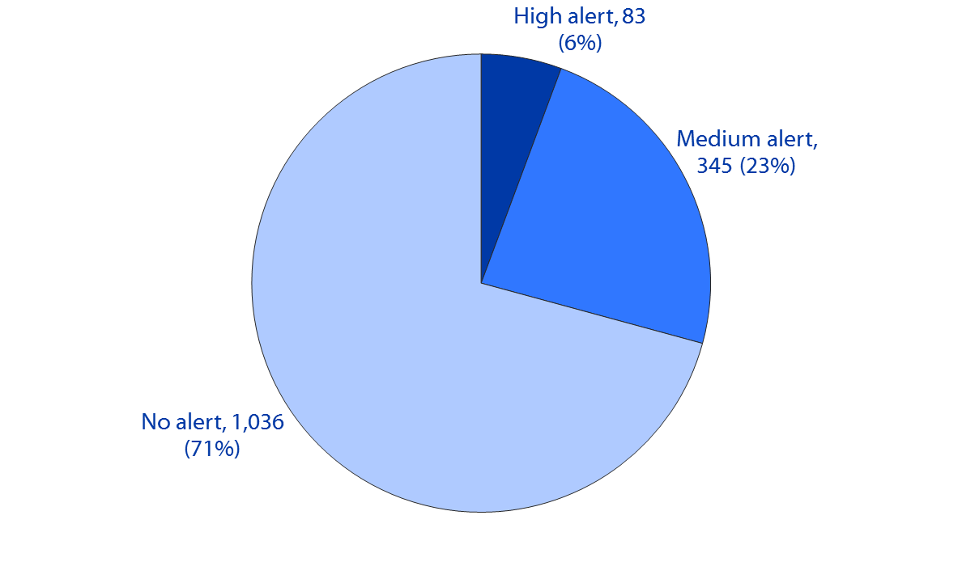
Mycobacterium tuberculosis Genotype Clusters, by TB GIMS* Alert Levels,† United States, 2013–2015
* TB GIMS, Tuberculosis Genotyping Information Management System.
† Alert level is determined by the log likelihood ratio statistic (LLR) for a given cluster, identifying higher than expected geospatial concentrations for a TB genotype cluster in a specific county, compared with the national distribution of that genotype; TB GIMS generates alert-level notifications on the basis of this statistic: No alert is indicated if LLR is 0–<5; medium is for LLR of 5–<10; and high alert is for clusters with LLR ≥10.

