Slide 1
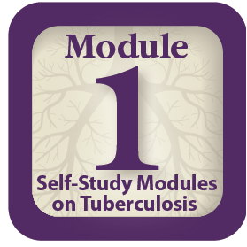
Self-Study Modules on Tuberculosis, 1-5
Centers for Disease Control and Prevention
Division of Tuberculosis Elimination
2016
Notes:
Introduce yourself to participants. Include your name and what organization you represent.
Ask participants to introduce themselves, stating their names and organizations
Provide information about the following:
Location of restrooms
Refreshments, if provided
Discuss ground rules and the parking lot
Ask participants to sign participant roster

Slide 2
CDC Self-Study Modules on Tuberculosis, 1-5
Module 1: Transmission and Pathogenesis of TB
Module 2: Epidemiology of TB
Module 3: Targeted Testing and the Diagnosis of Latent TB Infection and TB Disease
Module 4: Treatment of Latent TB Infection and TB Disease
Module 5: Infectiousness and Infection Control
Notes:
Explain to participants that the presentations were created using the print-based Self-Study Modules on Tuberculosis, 1-5
Ask who has worked through the print-based modules before
Review slide content
Mention that each module includes content about that topic
State that study questions and case studies are included in each module to help reinforce and apply content

Slide 3
Self-Study Modules on Tuberculosis
Transmission and Pathogenesis of Tuberculosis
Notes:
Introduce Module 1

Slide 4
Module 1: Objectives
At completion of this module, learners will be
able to
Describe the history of tuberculosis (TB).
Explain how TB is spread (transmission).
Define drug-resistant TB.
Explain the difference between latent TB infection (LTBI) and TB disease.
Explain how LTBI and TB disease develop (pathogenesis).
Describe the classification system for TB.
Notes:
State objectives of presentation
Background and Objectives - Module 1, p. 1

Slide 5
Module 1: Overview
History of TB
TB Transmission
Drug-Resistant TB
TB Pathogenesis
Progression from LTBI to TB disease
Sites of TB disease
TB Classification System
Case Studies
Notes:
Review slide content

Slide 6
History of TB
Notes:
Introduce section
History of TB - Module 1, pp. 5-6

Slide 7
History of TB (1)
TB has affected humans for millennia
Historically known by a variety of names, including:
Consumption
Wasting disease
White plague
TB was a death sentence for many
Vintage image circa 1919
Image credit: National Library of Medicine
Notes:
Before showing slide, ask participants if they know of other names for TB
Review slide content
History of TB - Module 1, p. 5
[Image credit: U.S. National Library of Medicine]

Slide 8
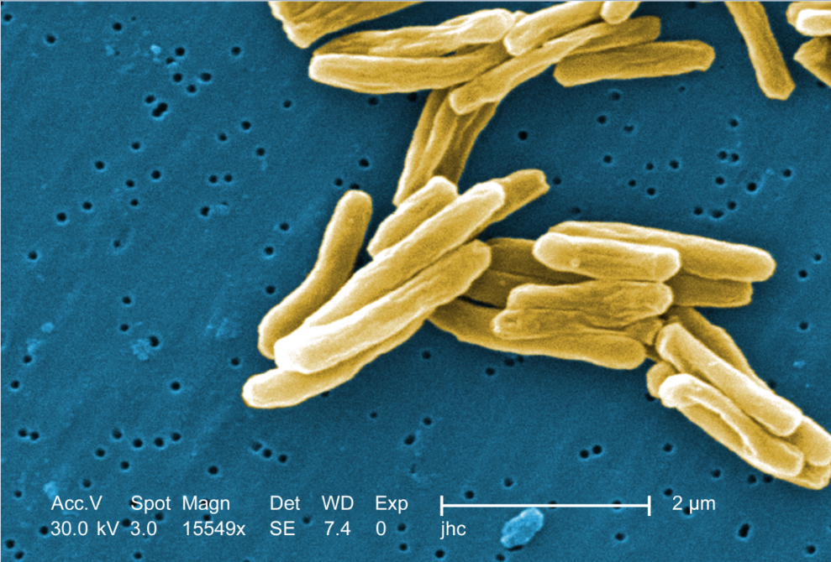
History of TB (2) Scientific Discoveries in 1800s
Until mid-1800s, many believed TB was hereditary
1865 Jean Antoine-Villemin showed TB was contagious
1882 Robert Koch discovered M. tuberculosis, the bacterium that causes TB
Mycobacterium tuberculosis
Image credit: Janice Haney Carr
Notes:
Review slide content
Note that the image is of Mycobacterium tuberculosis
History of TB - Module 1, p. 5
[Image credit: Janice Haney Carr]

Slide 9
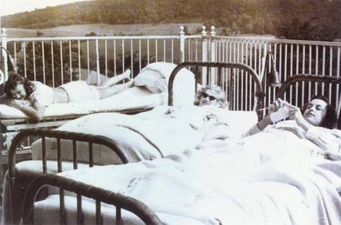
History of TB (3) Sanatoriums
Before TB antibiotics, many patients were sent to sanatoriums
Patients followed a regimen of bed rest, open air, and sunshine
TB patients who could not afford sanatoriums often died at home
Sanatorium patients resting outside
Notes:
Review slide content
Explain that the image is of women at a sanatorium resting outside
Note that it used to be believed that cool, fresh air was beneficial for TB patients
History of TB - Module 1, p. 5

Slide 10
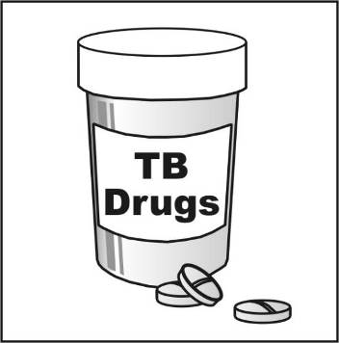
Breakthrough in the Fight Against TB (1)
Drugs that could kill TB
bacteria were discovered
in 1940s and 1950s
Streptomycin (SM) discovered in 1943
Isoniazid (INH) and
p-aminosalicylic acid (PAS) discovered between 1943 and 1952
Notes:
Review slide content
History of TB - Module 1, p. 5

Slide 11
Breakthrough in the Fight Against TB (2)
TB death rates in U.S. began to drop dramatically
Each year, fewer people died from TB
Most TB sanatoriums in U.S. had closed by mid 1970s
Notes:
Review slide content
Mention that as the number of cases and deaths declined, many people began to hope that TB could be eliminated from the U.S., like smallpox and polio
History of TB - Module 1, p. 5

Slide 12
TB Resurgence
Increase in TB in mid 1980s
Contributing factors:
Inadequate funding for TB control programs
HIV epidemic
Increased immigration from countries where TB is common
Spread of TB in homeless shelters and correctional facilities
Increase and spread of multidrug-resistant TB
March 16, 1992 Newsweek Magazine Cover
Notes:
Before showing the slide, ask participants why there was an increase in TB in the U.S. during the mid 1980s
Review slide content
TB Resurgence - Module 1, p. 5 and Module 2, p. 4

Slide 13
TB Prevention and Control Efforts
Increased governmental funding for TB control programs began in 1992
Number of TB cases declined from 1993 to 2014
No. of Cases
Year
Reported TB Cases, U.S., 1982-2014
Notes:
Review slide content
Point out the increase (1980s) and decrease (after 1993) in TB cases on the graph
Stress that prevention and control efforts must be maintained since TB continues to be reported in almost every state and not all states have seen a decrease in TB cases
TB Prevention and Control Efforts - Module 2, pp. 4-5

Slide 14
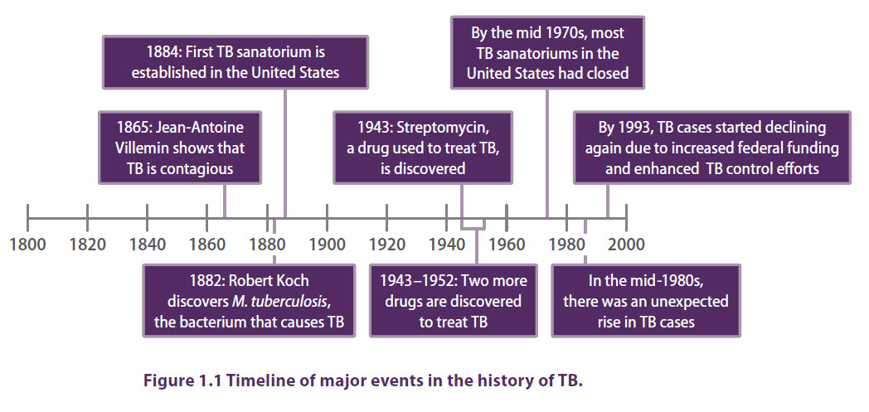
TB History Timeline
Notes:
Recap the major events in the history of TB
TB History Timeline - Module 1, p. 6

Slide 15
History of TB Study Question 1.1
In what year was each of the following
discoveries made?
TB was shown to be contagious
1865
The bacterium that causes TB was discovered
1882
The first drug that could kill TB bacteria was discovered
1943
Notes:
Introduce study questions
Ask participants to turn to p. 6 (if participants have print-based modules)
Ask for a volunteer to read question
Ask participants for answers
Click enter for the answer to appear
Note: All study questions and case studies are animated. The question appears first. Click “enter” and the answer will appear.
Answers – Module 1, p. 26

Slide 16
TB Transmission
Notes:
Introduce section
Ask participants how TB is transmitted
TB Transmission - Module 1, pp. 7-8

Slide 17
TB Transmission (1)
Transmission is defined as the spread of an organism, such as M. tuberculosis, from one person to another.
Notes:
Ask for a volunteer to read the definition of transmission
Definition of Transmission – Module 1, p. 7

Slide 18
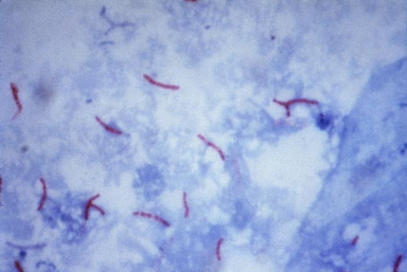
TB Transmission (2) Types of Mycobacteria
M. tuberculosis causes most TB cases in U.S.
Mycobacteria that cause TB:
M. tuberculosis
M. bovis
M. africanum
M. microti
M. canetti
Mycobacteria that do not cause TB
e.g., M. avium-complex
M. tuberculosis
Notes:
State that mycobacteria are members of the bacteria family
Explain that not all mycobacteria cause TB
Review slide content
Types of Mycobacteria - Module 1, p. 7

Slide 19
TB Transmission (3)
TB is spread person to person through the air via droplet nuclei
M. tuberculosis may be expelled when an infectious person:
Coughs
Speaks
Sings
Transmission occurs when another person inhales droplet nuclei
Notes:
Review slide content
Note that droplet nuclei are very small particles, less than 1/5,000 of an inch, and can remain suspended in the air for several hours
Emphasize that transmission is more likely to occur in poorly ventilated and enclosed areas
TB Transmission - Module 1, p. 7

Slide 20
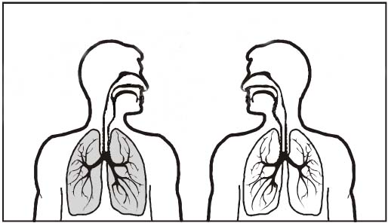
TB Transmission (4)
Dots in air represent droplet nuclei containing
M. tuberculosis
Notes:
Note that this image depicts airborne transmission. The individual on the left has infectious TB disease and is expelling it into the air. The individual on the right is inhaling the droplet nuclei into their lungs.
Note: Dots in the image are animated. Click “enter” once to start animation.
TB Transmission - Module 1, p. 8

Slide 21
TB Transmission (5)
Probability that TB will be transmitted depends on:
Infectiousness of the TB patient
Environment in which the exposure occurred
Frequency and duration of the exposure
Susceptibility (immune status) of the exposed individual
The best way to stop transmission is to:
Isolate infectious persons
Provide treatment to infectious persons as soon as possible
Notes:
Emphasize that not everyone who is exposed to TB becomes infected; it depends on many factors
Review slide content
Note that the length of time required for a patient to be considered noninfectious after starting treatment varies
TB Transmission - Module 1, p. 8

Slide 22
TB Transmission Study Question 1.2
What organism causes TB?
M. tuberculosis
What are four other tuberculous mycobacteria?
M. bovis, M. africanum, M. microti, and M.
canetti
Notes:
Introduce study questions
Ask participants to turn to p. 10 (if participants have print-based modules)
Ask for a volunteer to read question
Ask participants for answers
Answers – Module 1, p. 26

Slide 23
TB Transmission Study Question 1.3
How is TB spread?
TB is spread from person to person through the air via droplet nuclei containing M. tuberculosis.
Notes:
Read question
Ask participants for answers
Answers – Module 1, p. 26

Slide 24
TB Transmission Study Question 1.4
The probability that TB will be transmitted depends on what four factors?
Infectiousness of the TB patient
Environment in which exposure occurred
Frequency and duration of the exposure
Susceptibility (immune status) of the exposed individual
Notes:
Read question
Ask participants for answers
Answers – Module 1, p. 26

Slide 25
Drug-Resistant TB
Notes:
Introduce section

Slide 26
Drug-Resistant TB (1)
Caused by M. tuberculosis organisms resistant to at least one TB treatment drug
Resistant means drugs can no longer kill the bacteria
Notes:
Review slide content
Note that drug-resistant TB is more difficult to treat because there are fewer treatment options
Drug-Resistant TB - Module 1, p. 9

Slide 27
Drug-Resistant TB (2)
Mono-resistant | Resistant to any one TB treatment drug
Poly-resistant | Resistant to at least any 2 TB drugs (but not both isoniazid and rifampin)
Multidrug- resistant (MDR TB) | Resistant to at least isoniazid and rifampin, the 2 best first-line TB treatment drugs
Extensively drug-resistant (XDR TB) | Resistant to isoniazid and rifampin, PLUS resistant to any fluoroquinolone AND at least 1 of the 3 injectable anti-TB drugs (e.g., amikacin, kanamycin, or capreomycin)
Notes:
Review slide content
Note that XDR TB is the most difficult type of drug-resistant TB to treat
Explain that patients with drug-resistant TB should be closely monitored to see if they are responding to treatment; they should also remain in isolation until they are no longer infectious
Drug-Resistant TB - Module 1, p. 9

Slide 28
Drug-Resistant TB (3)
Primary Resistance | Caused by person-to-person transmission of drug-resistant organisms
Secondary Resistance (acquired) | Develops during TB treatment: Patient was not treated with an appropriate regimen OR Patient did not follow treatment regimen as prescribed
Notes:
State that drug-resistant TB can be caused in two ways, primary and secondary
Review slide content
Note that drug-resistant TB can be transmitted in the same way as drug-susceptible TB; however, because it takes longer to diagnose, patients with drug-resistant TB may be infectious for longer periods of time
Drug-Resistant TB - Module 1, p. 9

Slide 29
Drug-resistant TB Study Question 1.5
What is drug-resistant TB?
Drug-resistant TB is caused by M. tuberculosis organisms that are resistant to at least one anti-TB drug.
Drug-resistant TB can be difficult to treat.
Notes:
Introduce study questions
Ask participants to turn to p. 10 (if participants have print-based modules)
Ask for a volunteer to read question
Ask participants for answers
Answers – Module 1, p. 26

Slide 30
Drug-resistant TB Study Question 1.6
What is the difference between primary and secondary drug resistance?
Primary resistance is caused by person-to-person transmission of drug-resistant organisms.
Secondary resistance develops during TB treatment. Either the patient was not treated with the right TB drugs or the patient did not follow the prescribed treatment regimen.
Notes:
Read question
Ask participants for answers
Answers – Module 1, p. 26

Slide 31
TB Pathogenesis
Notes:
Introduce section
Ask participants if they can explain pathogenesis
TB Pathogenesis - Module 1, p. 11

Slide 32
TB Pathogenesis (1)
Pathogenesis is defined as the way an infection or disease develops in the body.
Notes:
Ask for a volunteer to read the definition of pathogenesis
TB Pathogenesis - Module 1, p. 11

Slide 33
TB Pathogenesis (2) Latent TB Infection (LTBI)
LTBI occurs when tubercle bacilli are in the body, but the immune system is keeping them under control
LTBI is detected by the Mantoux tuberculin skin test (TST) or by an interferon-gamma release assay (IGRA), such as:
QuantiFERON®-TB Gold In-Tube (QFT-GIT)
T-Spot®.TB test (T-SPOT)
People with LTBI are NOT infectious
Notes:
Review slide content
LTBI – Module 1, p. 12

Slide 34
TB Pathogenesis (3) TB Disease
TB disease develops when the immune system cannot keep tubercle bacilli under control
May develop very soon after infection or many years after infection
About 10% of all people with normal immune systems who have LTBI will develop TB disease at some point in their lives
People with TB disease are often infectious
Notes:
Review slide content
TB Disease – Module 1 p. 16

Slide 35
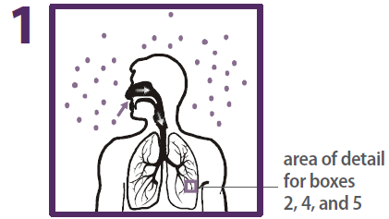
TB Pathogenesis (4)
Droplet nuclei containing tubercle bacilli are inhaled, enter the lungs, and travel to small air sacs (alveoli)
Notes:
Review slide content
Explain that the dots in the air represent droplet nuclei being inhaled into the person’s lungs
TB Pathogenesis – Module 1 p. 16

Slide 36
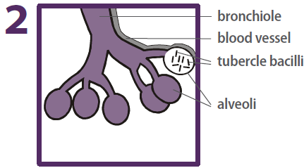
TB Pathogenesis (5)
Tubercle bacilli multiply in alveoli, where
infection begins
Notes:
Review slide content
TB Pathogenesis – Module 1 p. 16

Slide 37
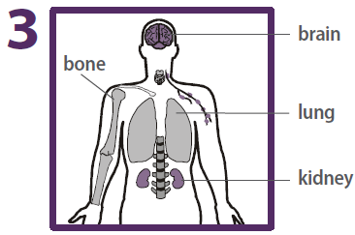
TB Pathogenesis (6)
A small number of tubercle bacilli enter bloodstream and spread throughout body
Notes:
Review slide content
State that tubercle bacilli can reach any part of the body, but areas where TB disease is more likely to develop include:
Lungs
Kidneys
Brain
Bones
TB Pathogenesis – Module 1, p. 17

Slide 38
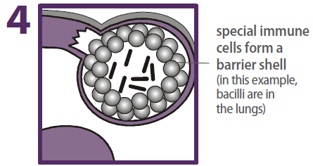
TB Pathogenesis (7) LTBI
Within 2 to 8 weeks the immune system produces special immune cells called macrophages that surround the tubercle bacilli
These cells form a barrier shell that keeps the bacilli contained and under control (LTBI)
Notes:
Review slide content
Call attention to the barrier shell around the bacilli that is keeping the tubercle bacilli contained (upper left corner of figure)
TB Pathogenesis – Module 1, p. 17

Slide 39
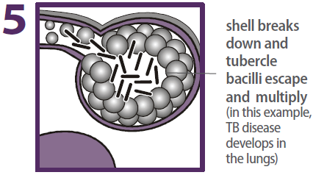
TB Pathogenesis (8) TB Disease
If the immune system CANNOT keep tubercle bacilli under control, bacilli begin to multiply rapidly and cause TB disease
This process can occur in different places in the body
Notes:
Review slide content
Explain that the barrier shell around the bacilli has broken (upper left corner of figure)
Note: The red circle around broken barrier shell is animated. Click “enter” for the circle to appear.
TB Pathogenesis – Module 1, p. 17

Slide 40
LTBI vs. TB Disease (1)
Person with LTBI | Person with TB Disease (in the lungs)
Has a small number of TB bacteria in his or her body that are alive, but under control | Has a large number of active TB bacteria in his or her body
Cannot spread TB bacteria to others | May spread TB bacteria to others
Does not feel sick, but may become sick if the bacteria become active in his or her body | May feel sick and may have symptoms such as cough, fever, or weight loss
TST or IGRA results usually positive | TST or IGRA results usually positive
Chest x-ray usually normal | Chest x-ray usually abnormal
Notes:
Review each row of the table, comparing LTBI and TB disease
Refer participants to p. 12 to follow along
LTBI vs. TB Disease – Module 1, p. 12

Slide 41
LTBI vs. TB Disease (2)
Person with LTBI | Person with TB Disease (in the lungs)
Sputum smears and cultures negative | Sputum smears and cultures may be positive
Should consider treatment for LTBI to prevent TB disease | Needs treatment for TB disease
Does not require respiratory isolation | May require respiratory isolation
Not a case of TB | A case of TB
Notes:
Review each row of the table, comparing LTBI and TB disease
Refer participants to p. 12 to follow along
LTBI vs. TB Disease – Module 1, p. 12

Slide 42
TB Pathogenesis Study Question 1.7
When a person inhales droplet nuclei containing M. tuberculosis, where do the droplet nuclei go?
Most of the larger droplet nuclei become lodged in the upper respiratory tract, where infection is unlikely to develop
However, droplet nuclei may reach the small air sacs of the lung (the alveoli), where infection may begin
Notes:
Introduce study questions
Ask participants to turn to p. 13 (if participants have print-based modules)
Ask for a volunteer to read question
Ask participants for answers
Answers – Module 1, p. 26

Slide 43
TB Pathogenesis Study Question 1.8
After the tubercle bacilli reach the small air sacs of the lung (the alveoli), what happens to the tubercle bacilli?
Tubercle bacilli multiply in alveoli and some enter the lymph nodes and bloodstream and spread throughout the body
Bacilli may reach any part of the body
Within 2 to 8 weeks, the immune system usually intervenes, halting multiplication and preventing further spread
Notes:
Ask for a volunteer to read question
Ask participants for answers
Answers – Module 1, p. 27

Slide 44
TB Pathogenesis Study Question 1.9
In people with LTBI (but not TB disease), how does the immune system keep the tubercle bacilli under control?
The immune system produces special immune cells that surround the tubercle bacilli. The cells form a shell that keeps the bacilli contained and under control.
Notes:
Ask for a volunteer to read question
Ask participants for answers
Answers – Module 1, p. 27

Slide 45
TB Pathogenesis Study Question 1.10
How is LTBI detected?
LTBI is detected by the Mantoux tuberculin skin test (TST) or blood tests such as interferon-gamma release assays (IGRAs), which include the QuantiFERON®-TB Gold In-tube (QFT-GIT) or the T-SPOT®.TB test (T-SPOT).
Notes:
Ask participants to turn to p. 16 (if participants have print-based modules)
Read question
Ask participants for answers
Answers – Module 1, p. 27

Slide 46
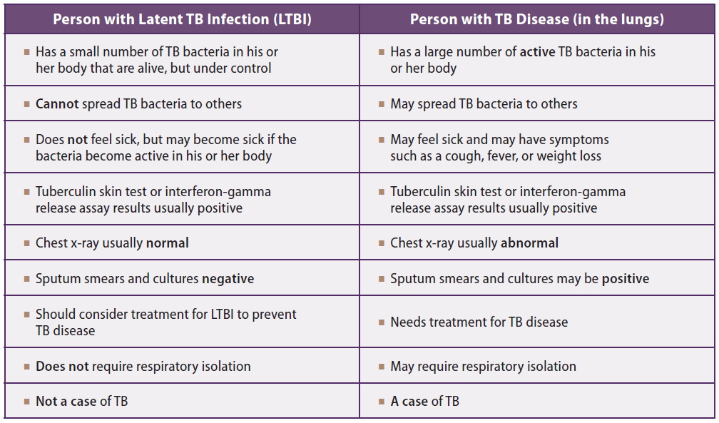
TB Pathogenesis Study Question 1.11
What are the major similarities and differences between LTBI and TB disease? List characteristics of each.
Notes:
Read question
Ask participants for answers
Answers – Module 1, pp. 27-28

Slide 47
TB Pathogenesis Study Question 1.12
What happens if the immune system cannot keep the tubercle bacilli under control and the bacilli begin to multiply rapidly?
When this happens, TB disease develops. The risk that TB disease will develop is higher for some people than for others.
Notes:
Read question
Ask participants for answers
Answers – Module 1, p. 28

Slide 48
TB Pathogenesis
Progression from LTBI to TB Disease
Notes:
Introduce section
Progression from LTBI to TB Disease – Module 1, pp. 18-19

Slide 49
Progression to TB Disease (1)
Risk of developing TB disease is highest the first 2 years after infection
People with LTBI can be given treatment to prevent them from developing TB disease
Detecting TB infection early and providing treatment helps prevent new cases of TB disease
Notes:
Review slide content
Explain that since the risk of progressing to TB disease is the highest in the first two years after infection, it is important to detect TB infection early
Progression to TB Disease – Module 1, p. 18

Slide 50
Progression to TB Disease (2)
Some conditions increase probability of LTBI progressing to TB disease
Infection with HIV
History of untreated or inadequately treated TB disease
Recent TB infection (within the past 2 years)
Immunosuppressive therapy such as tumor necrosis factor-alpha (TNF) antagonists, systemic corticosteroids, or immunosuppressive drug therapy following organ transplantation
Abusing drugs or alcohol or smoking cigarettes
Silicosis
Diabetes mellitus
Chronic renal failure
Certain types of cancer (e.g., leukemia, cancer of the head, neck, or lung)
Certain intestinal conditions
Low body weight
Notes:
Review slide content
Tell participants that some of these terms can be found in the glossary of print-based Module 1, pp. 2-4
Progression to TB Disease – Module 1, pp. 18-19

Slide 51
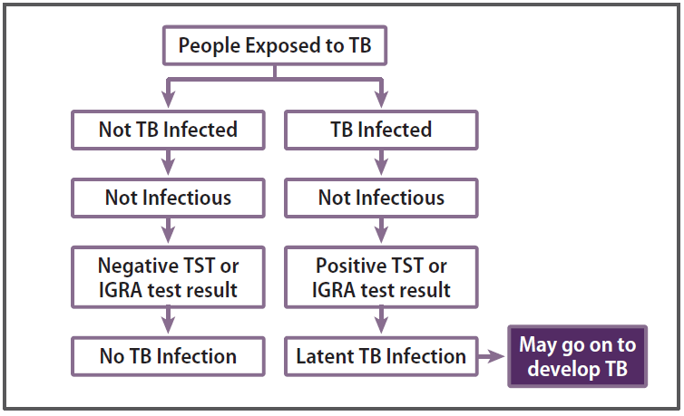
Progression to TB Disease (3)
Notes:
Review slide content
Emphasize that not everyone exposed to TB becomes infected with TB, and not everyone that becomes infected with TB develops TB disease
Progression to TB Disease – Module 1, p. 18

Slide 52
Progression to TB Disease (4) TB and HIV
In an HIV-infected person,
TB can develop in one of
two ways:
Person with LTBI becomes infected with HIV and then develops TB disease as the immune system is weakened
Person with HIV infection becomes infected with M. tuberculosis and then rapidly develops TB disease
Image credit: Mississippi State Department of Health
Notes:
Before showing slide, ask participants what is the strongest known risk factor for the progression of TB disease in people with TB infection
Note that worldwide TB is responsible for the deaths of 1 in 3 people living with HIV/AIDS; making it the leading cause of death for people infected with HIV
Review slide content
TB and HIV – Module 1, p. 19
[Image credit: Mississippi State Department of Health]

Slide 53
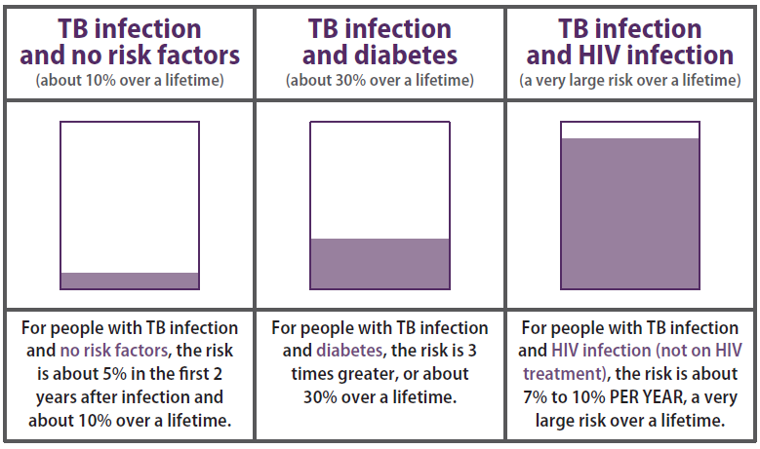
Progression to TB Disease (5) TB and HIV
People who are infected with both M. tuberculosis and HIV are much more likely to develop TB disease
Notes:
Review slide content
Ask why the risk is so much greater with HIV infection
TB and HIV – Module 1, p. 19

Slide 54
Progression to TB Disease Study Question 1.13
What percentage of people who have LTBI (but not HIV infection) usually develop TB disease?
About 10% of all people with LTBI will develop TB disease at some point
In U.S., about 5% of recently infected will develop TB disease in first year or two after infection
Additional 5% will develop disease later in life
Remaining 90% will remain free of disease for the rest of their lives
Notes:
Introduce study questions
Ask participants to turn to p. 20 (if participants have print-based modules)
Ask for a volunteer to read question
Ask participants for answers
Answers – Module 1, p. 28

Slide 55
Progression to TB Disease Study Question 1.14
What conditions appear to increase the risk that LTBI will progress to TB disease?
Infection with HIV
History of untreated or inadequately treated TB disease
Recent TB infection (within the past 2 years)
Immunosuppressive therapy such as tumor necrosis factor-alpha (TNF) antagonists, systemic corticosteroids, or immunosuppressive drug therapy following organ transplantation
Abusing drugs or alcohol or smoking cigarettes
Silicosis
Diabetes mellitus
Chronic renal failure
Certain types of cancer (e.g., leukemia, cancer of the head, neck, or lung)
Certain intestinal conditions
Low body weight
Notes:
Ask for a volunteer to read question
Ask participants for answers
Answers – Module 1, pp. 28-29

Slide 56
Progression to TB Disease Study Question 1.15
How does being infected with both M. tuberculosis
and HIV affect the risk for TB disease?
Much more likely to develop TB disease
Risk of developing TB disease is 7% to 10% EACH YEAR (if HIV is not being treated)
In an HIV-infected person, TB disease can develop in two ways:
Person with LTBI becomes infected with HIV and then develops TB disease as the immune system is weakened
Person with HIV infection becomes infected with M. tuberculosis and then rapidly develops TB disease
Notes:
Ask for a volunteer to read question
Ask participants for answers
Answers – Module 1, p. 29

Slide 57
TB Pathogenesis
Sites of TB Disease
Notes:
Introduce section
Note that some patients who have extrapulmonary TB also have pulmonary TB
Sites of TB Disease, Module 1, p. 22

Slide 58
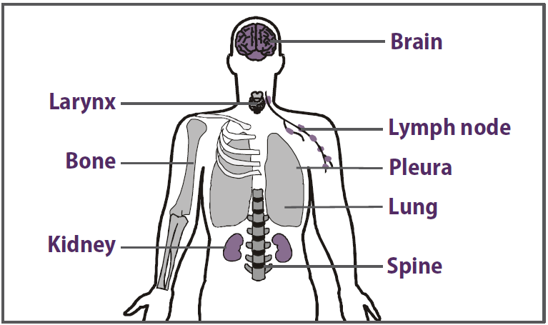
Sites of TB Disease (1)
Bacilli may reach any part of the body, but common sites include:
Notes:
Review slide content
Sites of TB Disease – Module 1, p. 22

Slide 59
Sites of TB Disease (2)
 | Location | Frequency
Pulmonary TB | Lungs | Most TB cases are pulmonary
Extrapulmonary TB | Places other than lungs such as: Larynx Lymph nodes Pleura Brain Kidneys Bones and joints | Found more often in: HIV-infected or other immunosuppressed persons Young children
Disseminated TB | Carried to all parts of body, through bloodstream | Rare
Notes:
Review slide content
Note that disseminated TB is rare, but very serious
Sites of TB Disease – Module 1, p. 22

Slide 60
Sites for TB Study Question 1.16
What part of the body is the most common
site for TB disease?
Lungs are the most common site
What are some other common sites?
- Larynx
- Lymph nodes
- Pleura (membrane around the lungs)
- Brain
- Kidneys
- Bones and joints
Notes:
Introduce study questions
Ask participants to turn to p. 24 (if participants have print-based modules)
Ask for a volunteer to read question
Ask participants for answers
Answers – Module 1, p. 29

Slide 61
TB Pathogenesis
TB Classification System
Notes:
Introduce section
TB Classification System Module 1, p. 23

Slide 62
TB Classification System (1)
Based on pathogenesis of TB
Class | Type | Description
0 | No TB exposure Not infected | No history of TB exposure Negative result to a TST or to an IGRA
1 | TB exposure No evidence of infection | History of TB exposure Negative result to a TST or an IGRA (done at least 8 to 10 weeks after exposure)
2 | TB infection No TB disease | Positive result to a TST or to an IGRA Negative smears, molecular tests, and cultures No clinical or x-ray evidence of active TB disease
Notes:
Review slide content
State that this classification system is sometimes referred to as the American Thoracic Society (ATS) classification system
TB Classification System – Module 1, p. 23

Slide 63
TB Classification System (2)
Based on pathogenesis of TB
Class | Type | Description
3 | TB, clinically active | Positive culture for M. tuberculosis OR Positive result to a TST or to an IGRA, and clinical, bacteriological, or x-ray evidence of current active TB disease
4 | Previous TB disease (not clinically active) | Medical history of TB disease Abnormal but stable x-ray findings Positive result to a TST or to an IGRA Negative smears, molecular tests, and cultures (if done) No clinical or x-ray evidence of active TB disease
5 | TB suspected | Signs and symptoms of TB disease, but diagnostic evaluation not complete
Notes:
Review slide content
State that any TB patient with a classification of 3 or 5 should receive treatment for TB, and should be reported to the health department
TB Classification System – Module 1, p. 23

Slide 64
TB Classification System Study Question 1.17
What is the classification system for TB based on? What is it used for?
The current classification system is based on the pathogenesis of TB. Many health departments and private health care providers use this system when describing patients.
Notes:
Ask participants to turn to p. 24 (if participants have print-based modules)
Read question
Ask participants for answers
Answers – Module 1, p. 29

Slide 65
Case Studies
Notes:
Introduce case studies

Slide 66
Module 1: Case Study 1.1 (1)
A 30-year-old man visits the health department for a TST because he is required to have one before starting his new job as a health care worker. He has an 18 mm positive reaction to the TST. He has no symptoms of TB, and his chest x-ray findings are normal.
Notes:
Ask participants turn to p. 15 (if participants have print-based modules)
Read case study
Case Study 1.1 – Module 1, p. 15

Slide 67
Module 1: Case Study 1.1 (2)
Should this be considered a case of TB?
No. The man described above has LTBI. He has an 18 mm positive reaction to the TST, but no evidence of TB disease. Therefore, this is not a case of TB.
Should this man be considered infectious?
No, he should not be considered infectious. This man has LTBI, not TB disease. People with TB infection and no evidence of TB disease are not infectious.
Notes:
Read questions
Ask participants for answers
Answers – Module 1, p. 30

Slide 68
Module 1: Case Study 1.2 (1)
A 45-year-old woman is referred to the health department by her private physician because she was found to have LTBI as part of an employee testing program. She is overweight, with high blood pressure. Upon further questioning, she reports that she has injected illegal drugs in the past, but has never been tested for HIV infection.
Notes:
Ask participants turn to p. 21 (if participants have print-based modules)
Read case study
Case Study 1.2 – Module 1, p. 21

Slide 69
Module 1: Case Study 1.2 (2)
What conditions does this woman have that increase the risk that she will develop TB disease?
Drug abuse increases the risk that LTBI will progress to TB disease. This woman may also be at risk for HIV infection because of her injection drug use. HIV is the strongest known risk factor for developing TB disease. This woman should be offered HIV counseling, testing, and referral. Overweight and high blood pressure are NOT risk factors for TB disease.
Notes:
Read case study question
Ask participants for answers
Ask if there are any questions about Module 1 before moving on to Module 2
Answers – Module 1, p. 30

