Slide 1
Epidemiology of Tuberculosis Among Non-U.S.–Born Persons in the United States, 1993–2017*
Division of Tuberculosis Elimination
Surveillance, Epidemiology, and Outbreak Investigations Branch
* As of June 1, 2018
Notes:
Epidemiology of Tuberculosis Among Non-U.S.–Born Persons, United States, 1993–2017*
Surveillance, Epidemiology, and Outbreak Investigations Branch
Division of Tuberculosis Elimination
Centers for Disease Control and Prevention (CDC)
* As of June 1, 2018

Slide 2
Background: Non-U.S.–Born Persons with TB in the United States
In 2017:
A total of 9,105 tuberculosis (TB) cases were reported in the United States
6,384 (70.1%) were in non-U.S.–born persons
2,705 (29.7%) were in U.S.-born persons
16 (0.2%) were in persons whose country of birth was unknown
Notes:
Tuberculosis (TB) is a reportable condition in all United States jurisdictions, and public health authorities report TB cases to the Centers for Disease Control and Prevention (CDC) in a standard format. TB in non-U.S.–born populations is of particular interest because they account for two-thirds of TB cases in the United States. The majority of TB cases among non-U.S.–born persons are estimated to arise from reactivation of latent TB infection (LTBI) likely acquired in their birth countries rather than from recent transmission. Achieving the goal of eliminating TB will require development of more efficient tools and approaches to the diagnosis and treatment of LTBI. This slide set presents data for TB cases among non-U.S.–born persons for the years 1993 through 2017, reported as of June 2018.
In 2017, of the 9,105 reported cases of TB, non-U.S.–born persons accounted for 70.1% (6,384 of 9,105) of reported TB cases and U.S.-born persons accounted for 29.7% (2,705).

Slide 3
The National Tuberculosis Surveillance System
Evolved from a program begun in 1953 that collected information on each newly reported case of TB disease in the United States
Currently includes 60 reporting areas (the 50 states, the District of Columbia, New York City, Puerto Rico, and 7 other U.S.-affiliated jurisdictions in the Pacific Ocean and the Caribbean Sea)
In 1986, all reporting areas began submitting information on TB patients’ countries of birth
Since 1993, CDC has collected additional risk factor, clinical, and laboratory information on each reported case
Notes:
Since 1953, through the cooperation of state and local health departments, CDC has collected information on newly reported cases of TB disease in the United States. Currently, 60 jurisdictions report cases, including 50 states, the District of Columbia, New York City, Puerto Rico, and 7 U.S.-affiliated jurisdictions in the Pacific Ocean and the Caribbean Sea. Public health authorities report cases electronically to the CDC through the standardized Report of Verified Case of Tuberculosis (RVCT) form. In 1986, all reporting areas began submitting information on TB patients’ countries of birth. Since 1993, CDC has collected additional risk factor, clinical, and laboratory information on each reported case. These reports constitute the National Tuberculosis Surveillance System (NTSS).

Slide 4
Non-U.S.–Born Persons in the United States
Non-U.S.–born persons are those who were born outside of the United States or a U.S. territory* to parents who were not U.S. citizens
May be naturalized U.S. citizens, legal permanent residents, visitors, workers, students, or persons with other visa statuses
U.S. Census Bureau estimated the 2017 non-U.S.–born population in the United States at 43.5 million† (13.6% of the U.S. population)
*U.S. territories include American Samoa, Guam, Puerto Rico, U.S. Virgin Islands, and Commonwealth of the Northern Mariana Islands
† U.S. Census Bureau. Current Population Survey via Data Ferrett (http://dataferrett.census.gov/), accessed September 14, 2018
Notes:
For surveillance purposes, a non-U.S.–born person is someone who was born outside the 50 states, the District of Columbia, or a U.S. territory* to parents who were not U.S. citizens. Non-U.S.–born persons may be naturalized U.S. citizens, legal permanent residents, visitors, workers, students, or persons with other visa statuses. The U.S. Census Bureau estimated the 2017 non-U.S.–born population in the United States at 43.5 million¹ (13.6% of the U.S. population). Persons born abroad to a U.S. citizen are considered U.S.-born.
* U.S. territories include American Samoa, Guam, Puerto Rico, U.S. Virgin Islands, and Commonwealth of the Northern Mariana Islands
† U.S. Census Bureau. Current Population Survey via Data Ferrett (http://dataferrett.census.gov/), accessed September 14, 2018

Slide 5
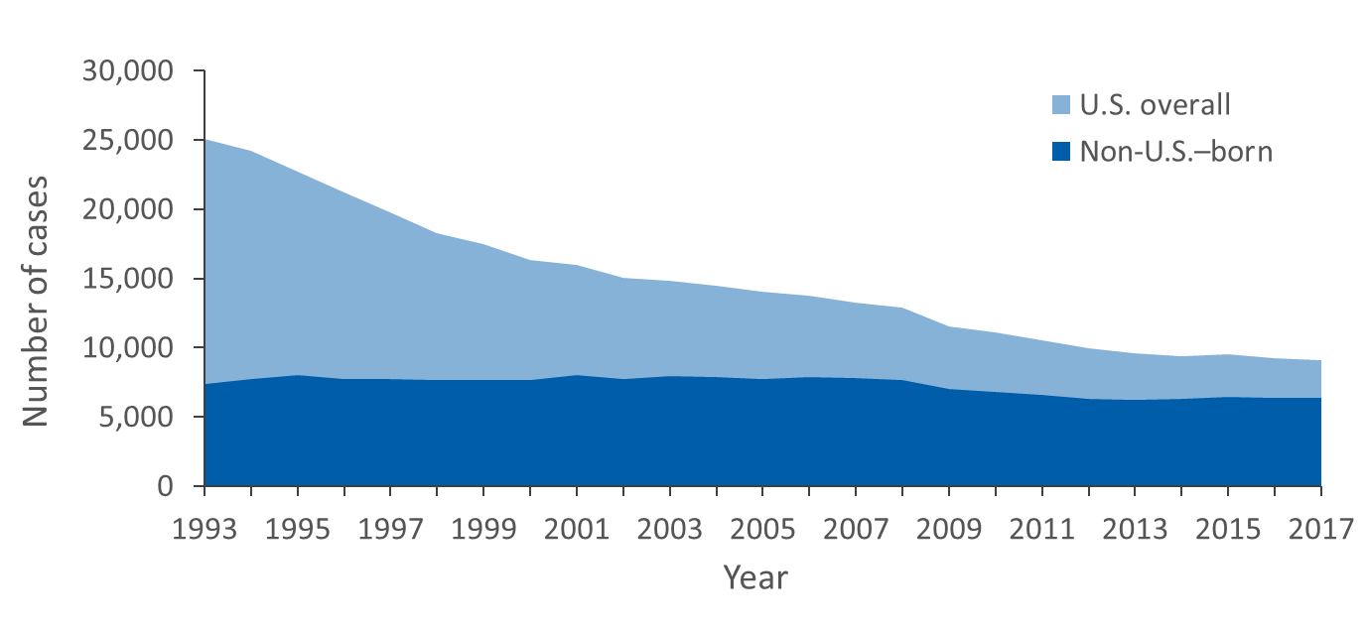
Reported TB Cases Among Non-U.S.–Born Persons Compared with All TB Cases, United States, 1993–2017
Notes:
While the overall numbers of TB cases reported in the United States have declined substantially since 1993, the number of cases among non-U.S.–born persons remained stable before 2009, with approximately 7,400–8,000 cases per year. In 2009, the number of TB cases among non-U.S.–born persons decreased to 6,996 and continued to decline through 2013, when 6,222 cases were recorded. In 2014, the number of cases among non-U.S.–born persons began to increase again; the number peaked at 6,406 in 2015, then declined to 6,384 in 2017.

Slide 6
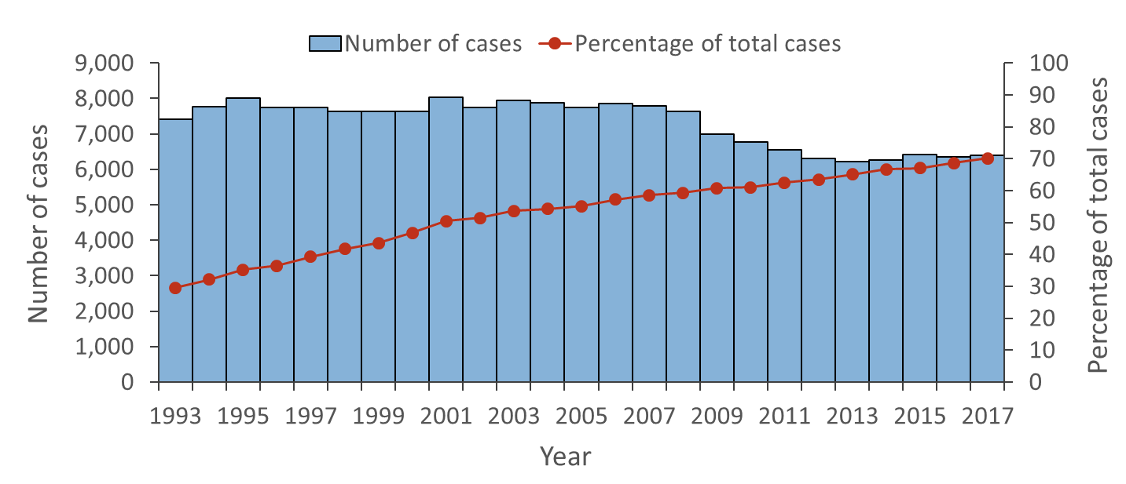
Number and Percentage of TB Cases Among Non-U.S.–Born Persons, United States, 1993–2017
Notes:
Although the number of TB cases in non-U.S.–born persons has declined since 1993, the percentage of all TB cases occurring in non-U.S.–born persons increased from 29.5% in 1993 (7,403 of 25,102) to 70.1% in 2017 (6,384 of 9,105).

Slide 7
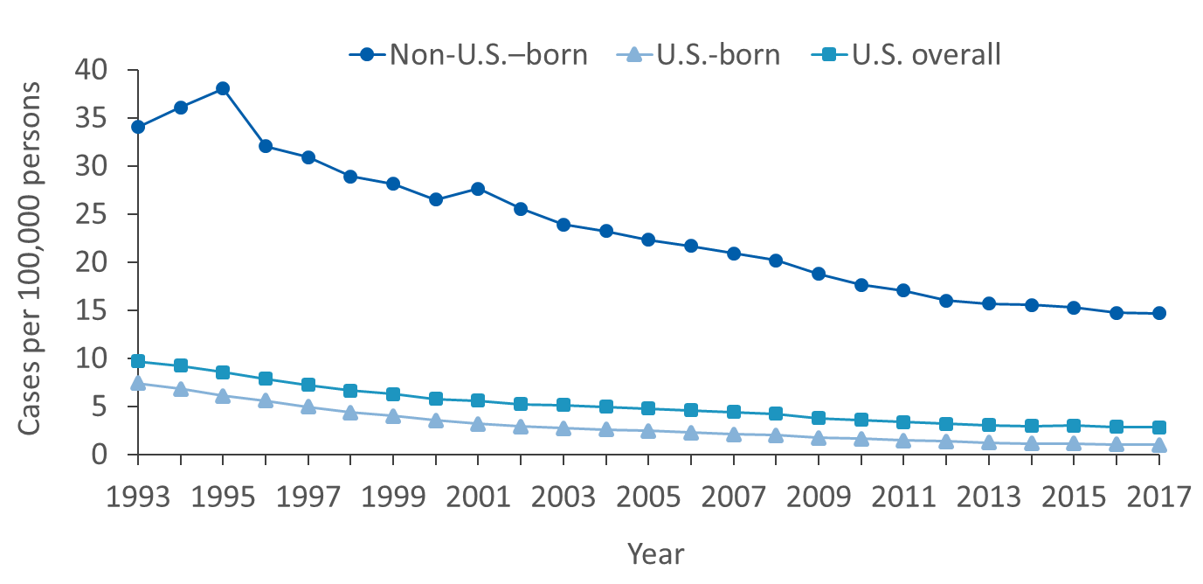
TB Case Rates Among U.S.-Born and Non-U.S.–Born Persons, United States, 1993–2017
Notes:
TB rates among non-U.S.–born persons remain higher than those among the U.S.-born population. During 1993–2017, the rate among U.S.-born persons decreased from 7.4 cases/100,000 population to 1.0, whereas the rate among non-U.S.–born persons decreased from 34.0 cases/100,000 population to 14.7. The TB case rate in non-U.S.–born was 4.6 times that of U.S.-born in 1993 and 15.0 times in 2017.
Denominator for computing rates by birth country for year 1993 was obtained from Quarterly Estimates of the United States Foreign-Born and Native Resident Populations: April 1, 1990–July 1, 1999 (http://www.census.gov/population/estimates/nation/nativity/fbtab001.txt), accessed September 14, 2018.
Denominators for computing the 1994–2017 rates by birth country are based on the U.S. Census Bureau, Current Population Survey via Data Ferrett (http://dataferrett.census.gov/), accessed September 14, 2018.
Denominator for computing U.S. overall rate from 1993–2017 was obtained from the following sources: Bridged-Race 1990–1999 Intercensal Population Estimates for 1990–1999 (ftp://ftp.cdc.gov/pub/health_statistics/nchs/datasets/nvss/bridgepop/documentationbridgedintercena1.doc), Intercensal Estimates of the Resident Population for the United States, Regions, States, and Puerto Rico: April 1, 2000 to July 1, 2010 (https://www.census.gov/data/tables/time-series/demo/popest/intercensal-2000-2010-state.html) and Annual Estimates of the Resident Population for the United States, Regions, States, and Puerto Rico: April 1, 2010 July 1, 2017 (http://www.census.gov/data/tables/2017/demo/popest/nation-total.html); accessed 10/29/2018.

Slide 8
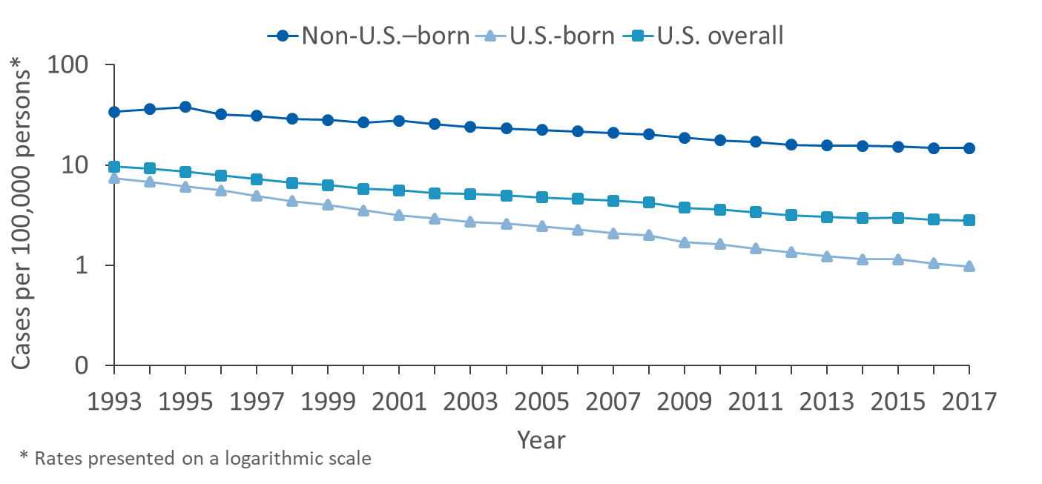
TB Case Rates Among U.S.-Born and Non-U.S.–Born Persons, United States, 1993–2017
Notes:
The chart presents the same data as on Slide 7 on a logarithmic scale to better illustrate the trends. The trend lines indicate a greater rate of decrease among U.S.-born compared with non-U.S.–born persons during 1993–2017.
Denominator for computing rates for year 1993 was obtained from Quarterly Estimates of the United States Foreign-Born and Native Resident Populations: April 1, 1990–July 1, 1999 (http://www.census.gov/population/estimates/nation/nativity/fbtab001.txt), accessed September 14, 2018.
Denominators for computing the 1994–2017 rates are based on the U.S. Census Bureau, Current Population Survey via Data Ferrett (http://dataferrett.census.gov/), accessed September 14, 2018.
Denominator for computing U.S. overall rate from 1993–2017 was obtained from the following sources: Bridged-Race 1990–1999 Intercensal Population Estimates for 1990–1999 (ftp://ftp.cdc.gov/pub/health_statistics/nchs/datasets/nvss/bridgepop/documentationbridgedintercena1.doc), Intercensal Estimates of the Resident Population for the United States, Regions, States, and Puerto Rico: April 1, 2000 to July 1, 2010 (https://www.census.gov/data/tables/time-series/demo/popest/intercensal-2000-2010-state.html) and Annual Estimates of the Resident Population for the United States, Regions, States, and Puerto Rico: April 1, 2010 July 1, 2017 (http://www.census.gov/data/tables/2017/demo/popest/nation-total.html); accessed 10/29/2018.

Slide 9
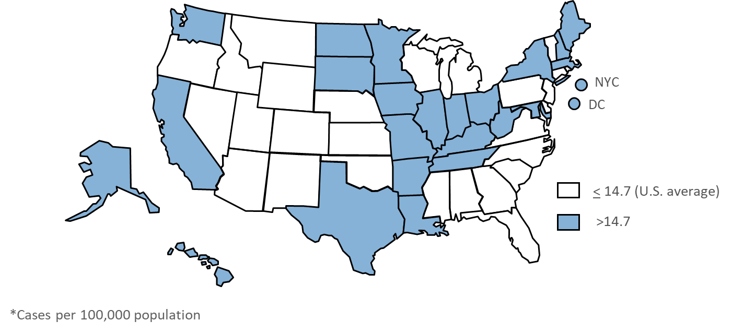
TB Case Rates* Among Non-U.S.–Born Persons, by Reporting Area, 2017
Notes:
The rate of TB among non-U.S.–born persons in the United States varies by region of the country. In 2017, TB rates among non-U.S.–born persons were generally lower in the Southeast and the mountain states, and generally higher in the Midwest, California, Texas, and Hawaii. NOTE that the distribution of case rates does not necessarily reflect the overall geographic distribution of non-U.S.–born persons in the United States. For example, the TB case rate among non-U.S.–born persons in Maine was higher than the national average of 14.7 per 100,000 in 2017, but the proportion of Maine’s population that was non-U.S.–born (2.3%) was much lower than the national percentage (13.6%).†
† U.S. Census Bureau. Current Population Survey July 2017 estimates from Data Ferrett (http://dataferrett.census.gov/); accessed 9/17/2018.

Slide 10
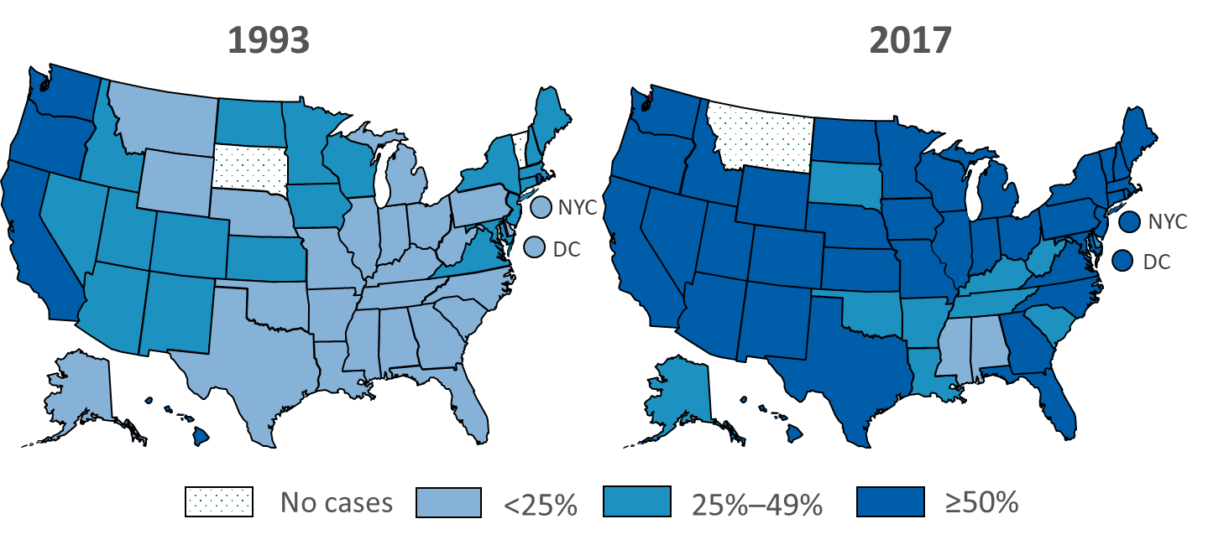
Percentage of Non-U.S.–Born Persons Among All TB Cases, by Reporting Area, 1993 and 2017
Notes:
Since 1993, the proportion of TB cases occurring in non-U.S.–born persons has increased in almost every reporting area; however, the proportion has remained somewhat lower in Southeastern states, e.g., Mississippi and Alabama.

Slide 11
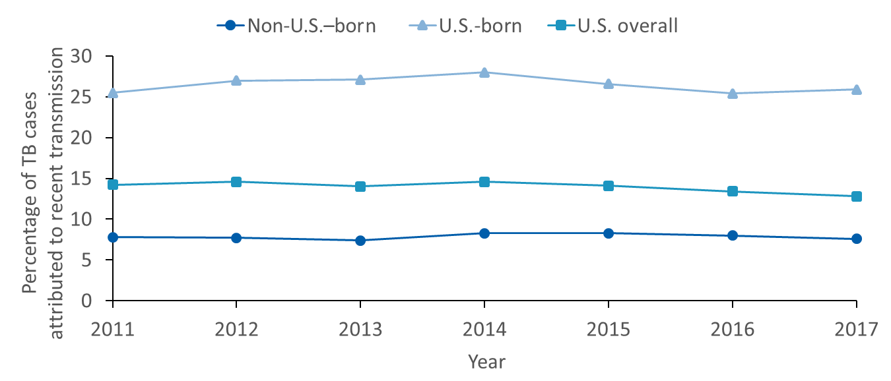
Estimates of Percentages of TB Cases Attributed to Recent Transmission Among U.S.-Born and Non-U.S.–Born Persons, 2011–2017
Notes:
Genotyping can often help distinguish TB cases that resulted from recent transmission from those that result from reactivation of infection acquired years earlier. A given TB case is attributed to recent transmission when a plausible source case with the following characteristics is identified in the molecular surveillance data: (1) has the same genotype, (2) has respiratory TB (pulmonary or laryngeal), (3) is at least 10 years old, (4) was diagnosed within two years of the other case, and (5) lived within 10 miles of the other case based on zip codes.
From 2011 to 2017, fewer than 10% of TB cases among non-U.S.–born persons were likely the result of recent transmission. This suggests that more than 90% of TB cases among non-U.S.–born persons are the result of reactivation of LTBI acquired years ago, likely in their country of origin.

Slide 12
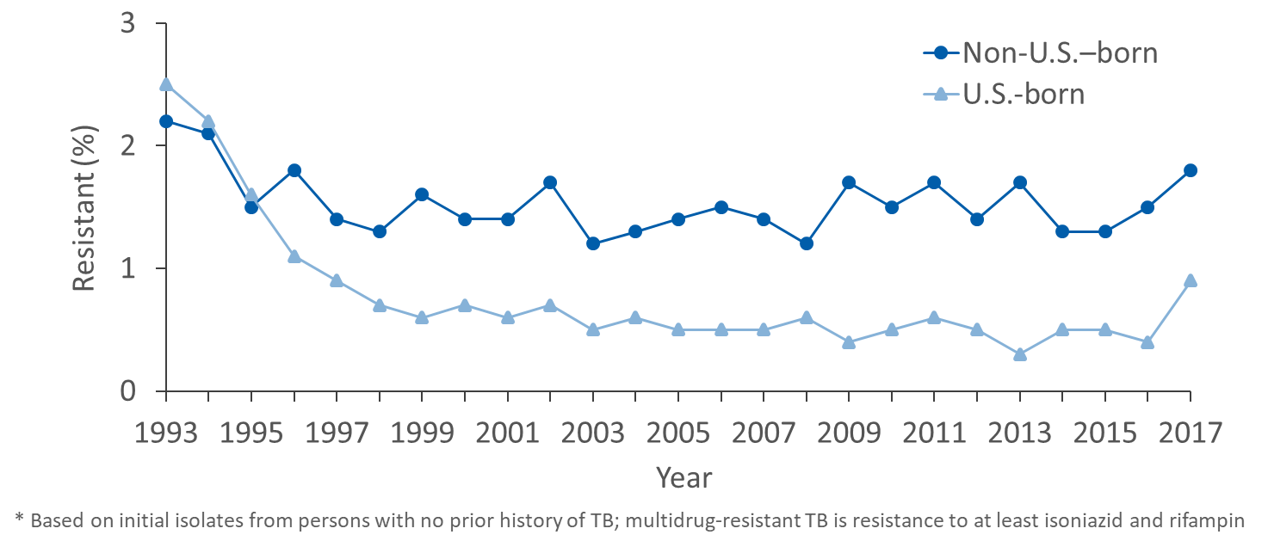
Primary Multidrug-Resistant* TB Among U.S.-Born and Non-U.S.–Born Persons, United States, 1993–2017
Notes:
A case of primary multidrug-resistant (MDR) TB is defined as isolation of M. tuberculosis complex organisms resistant to at least isoniazid and rifampin from a person with no prior history of TB. The percentage of TB cases that are primary MDR TB has declined among U.S.-born and non-U.S.–born persons since 1993, although the decline in U.S.-born persons has been greater. As a result, the proportion of primary MDR-TB cases diagnosed in non-U.S.–born persons increased from approximately 25% in 1993 to 85% in 2017 (not shown on slide). Among U.S.-born persons with TB, the percentage with primary MDR TB has been less than 1% since 1997 and was 0.9% in 2017. Among non-U.S.–born persons, the percentage with primary MDR TB has remained between 1.2 and 1.8% since 1995; it was 1.8% in 2017.

Slide 13
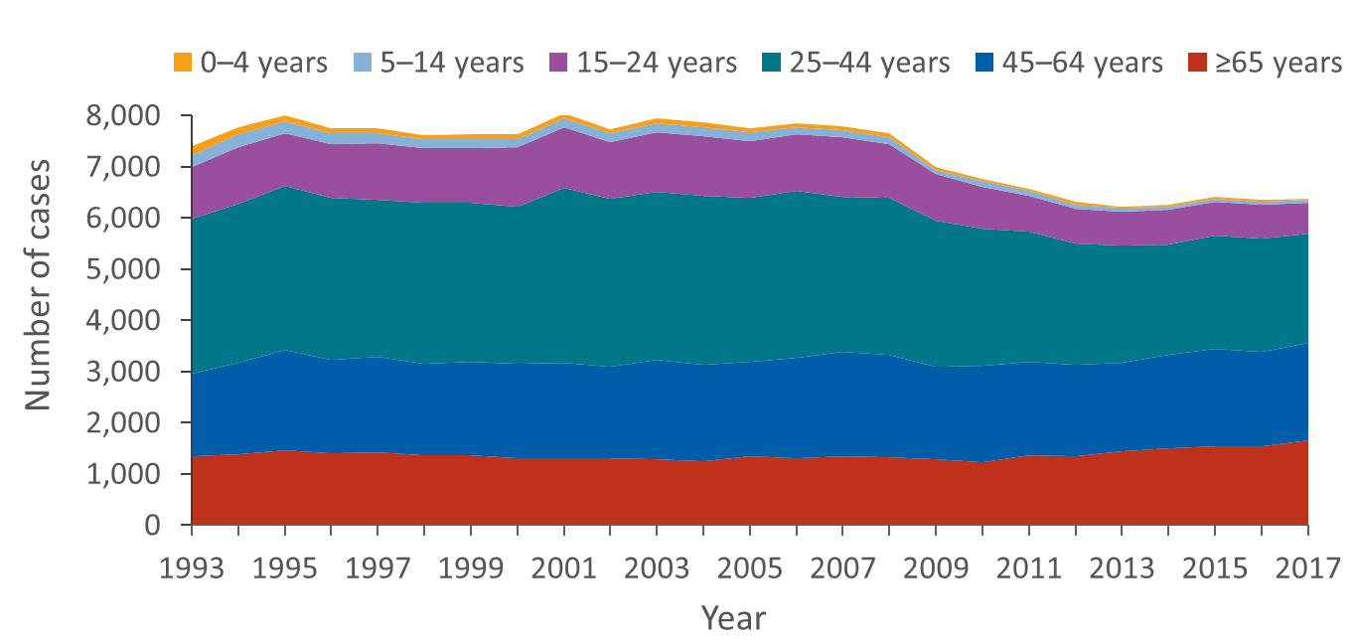
Reported TB Cases Among Non-U.S.–Born Persons by Age Group, United States, 1993–2017
Notes:
During 1993–2007, the distribution of TB cases among non-U.S.–born persons in different age groups was relatively stable. After 2007, the number of TB cases declined in persons aged 15–24 and 25–44 years whereas the number of TB cases increased in the ≥65 years age group. Overall, the majority of cases have been reported in persons 25–44 years old; however, in recent years, an increasing number of cases have been reported in ages 45 and older.

Slide 14
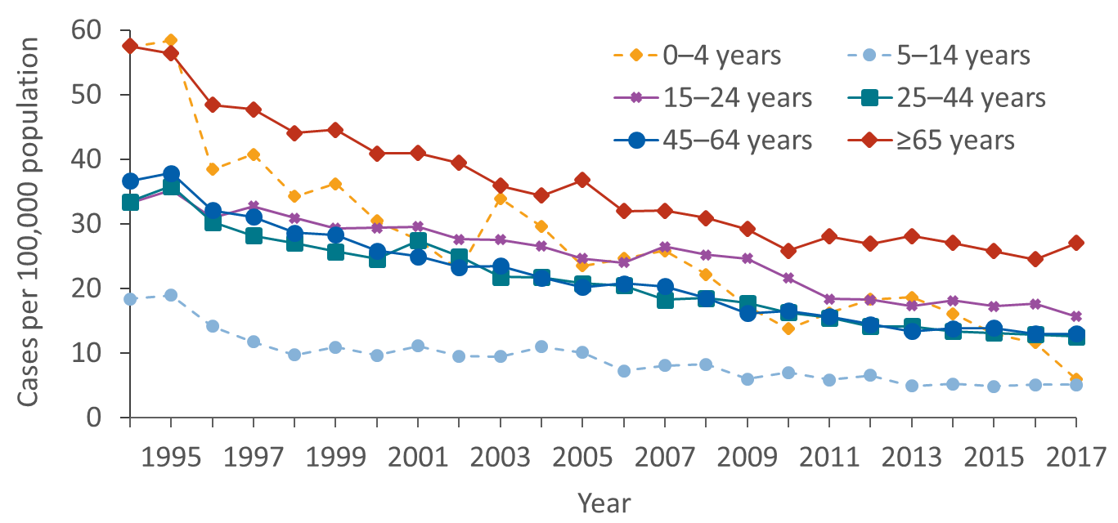
TB Case Rates Among Non-U.S.–Born Persons by Age Group, 1994–2017
Notes:
TB case counts give a sense of the burden of TB but have limited value for comparisons because they do not indicate the total population from where those cases arose, i.e., do not provide denominator data. In contrast, TB rates indicate the frequency of TB cases that occur in a defined population over a specified period of time, e.g., yearly as in this graph, and these rates can be used for comparisons. Rates can be used to compute an estimated number of cases, given a specified population and specified time period.
Overall, TB rates have declined over time in all age groups. Persons aged ≥65 years had consistently the highest rates from 1994–2017 whereas persons aged 5–14 years had the lowest. The youngest age group (0–4) was also among the highest rates in the early 1990s, peaking at 58.4 per 100,000 persons in 1995. Since then, rates in the youngest children have declined to 5.9 per 100,000 persons in 2017, similar to children aged 5–14 years.
Denominators for computing the 1994–2017 rates from the U.S. Census Bureau, Current Population Survey via Data Ferrett (http://dataferrett.census.gov/), accessed September 14, 2018.

Slide 15
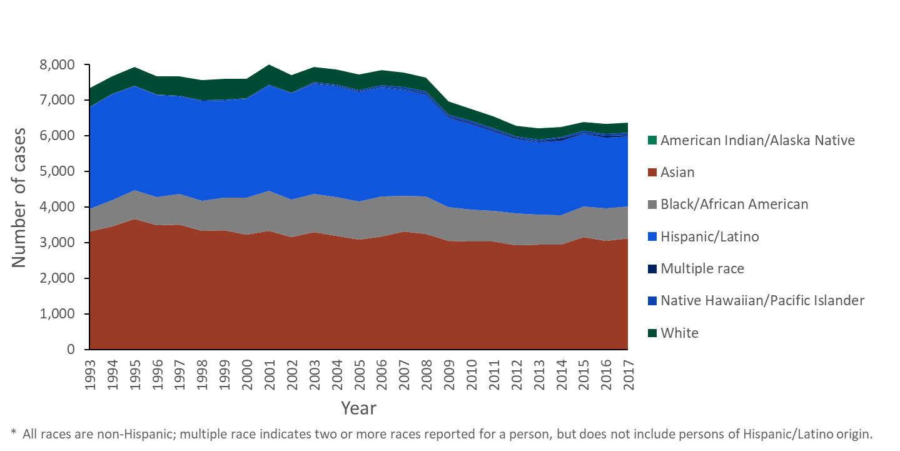
Reported TB Cases Among Non-U.S.–Born Persons by Race/Ethnicity*, United States, 1993–2017
Notes:
The distribution of TB cases by race and ethnicity differs greatly between U.S.-born and non-U.S.–born persons. While persons of Asian race/ethnicity accounted for almost half of TB cases among non-U.S.–born persons in 2017, those with Asian race/ethnicity accounted for 5% of TB cases among U.S.-born persons. Almost a third of U.S.-born persons with TB were white, compared with only 4% of non-U.S.–born persons with TB. Blacks/African-Americans accounted for 37% of TB cases among U.S.-born persons, but only 14% of TB cases among non-U.S.–born persons. About one in three non-U.S.–born persons with TB was Hispanic or Latino, compared with one in five U.S.-born persons with TB.
* Non-USB, Non-U.S.–born persons; † USB, U.S.-born persons. All races are non-Hispanic; multiple race indicates two or more races reported for a person, but does not include persons of Hispanic/Latino origin

Slide 16
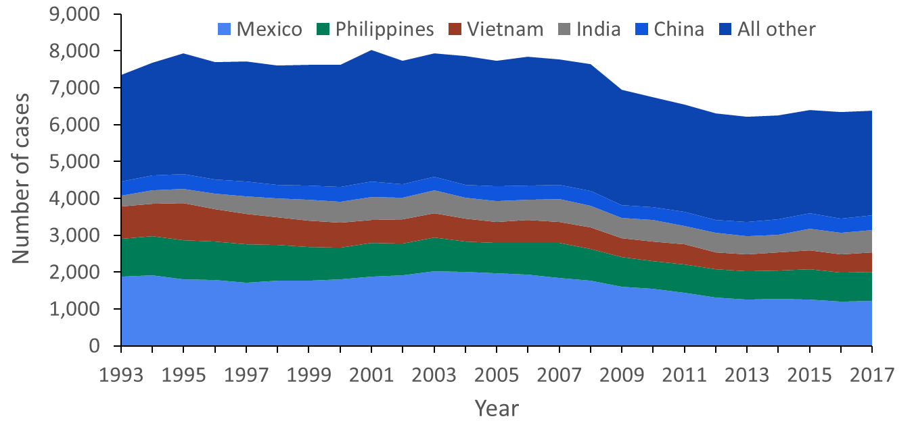
Countries of Birth Among Non-U.S.–Born Persons Reported with TB, United States, 2017
Notes:
Over half of non-U.S.–born persons reported with TB were born in one of the five countries in the graph above. During 2017, these top five countries accounted for 56% of all cases among non-U.S.–born persons, with Mexico accounting for 19%; the Philippines, 12%; India, 9%; Vietnam, 8%; and China, 6%.

Slide 17
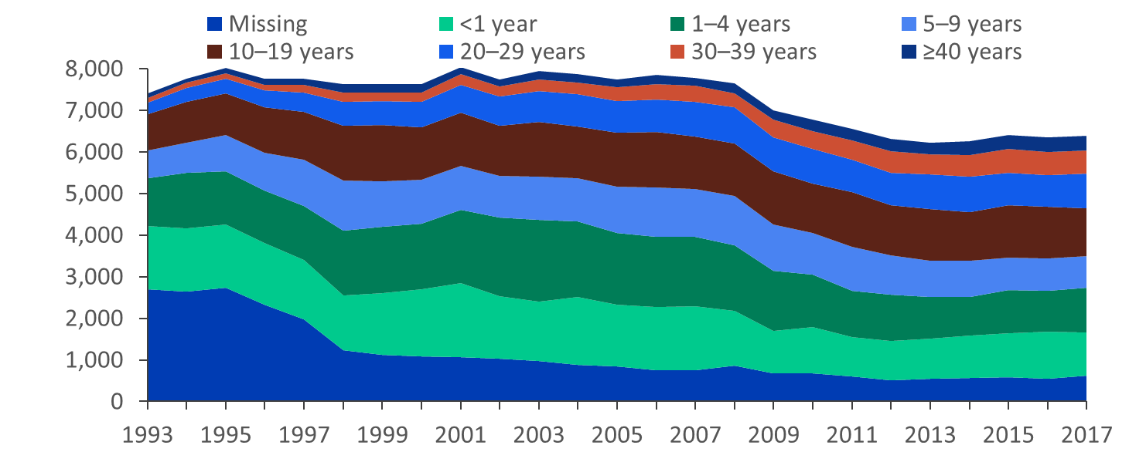
TB Cases Among Non-U.S.–Born Persons by Length of U.S. Residence Before Diagnosis, 1993–2017
Number of cases
Year
Notes:
The proportion of TB cases occurring among long-term residents (5 or more years) in the United States has increased since 1993, due primarily to a higher proportion of TB cases among persons who have resided in the United States for 10 or more years. This is consistent with the presumption that most TB cases among non-U.S.–born persons are the result of reactivation of remotely acquired infection rather than recent transmission.
NOTE that the length of U.S. residence is counted as the time between first arrival to the United States and date of report of TB to the health department. It is possible that some of these persons traveled outside of the United States after their first arrival and acquired infection more recently.

