Slide 1
Providing Feedback
Notes:
Note to facilitator: if you have an exercise that can help explain the importance of providing constructive feedback, please feel free to include it during this session

Slide 2
Why is Feedback Important?
Essential to an individual’s learning process
Provides the participant information about their performance they may not otherwise see
Gives the participant an opportunity to ask specifically how they can improve
Boosts confidence for someone who may not realize how good they really are!
2
Notes:
Review slide content
Explain that it is difficult to learn, improve a skill, or gain confidence without feedback

Slide 3
Giving Feedback
It takes 8 - 9 positive comments to undo the damage of
1 negative comment
1 Positive Comment
1 Positive Comment
1 Positive Comment
1 Negative Comment
1 Positive Comment
=
1 Positive Comment
1 Positive Comment
1 Positive Comment
1 Positive Comment
1 Positive Comment
3
Notes:
Review slide content

Slide 4
Components of Constructive Feedback
Actual behavior
Descriptive
Specific
Nonjudgmental
Invites a response
4
Notes:
Review slide content
Note to facilitator: these components are covered in detail with the next slides

Slide 5
1. Actual Behavior
Comment on what the person does (behavior) and not what you think of them
5
Notes:
Review slide content

Slide 6
2. Be Descriptive
Use words that describe actions instead of
adjectives about the person
Appropriate: “I observed that you rarely paused while speaking”
Inappropriate: “You talk way too fast”
Appropriate: “I see you tend to keep your eyes on your notes”
Inappropriate: “You don’t seem very friendly”
6
Notes:
Review slide content

Slide 7
3. Be Specific
Aimed at concrete, specific, changeable, behaviors
Things which can be focused on:
Rate of speech
Use of jargon
Technique
Content
Things not to focus on:
Speech qualities (e.g., high pitch, accent)
Nervousness
Physical challenges
7
Notes:
Review slide content
Emphasize that feedback should only be about changeable behaviors – never focus on physical challenges that are not changeable

Slide 8
4. Nonjudgmental
Use “I” statements – not “You…”
“I see you have another way of doing it…” vs. “Your technique is wrong.”
“I wish you projected more and made eye contact” vs. “You looked depressed.”
8
Notes:
Review slide content

Slide 9
5. Invite Response
“How do you think you did?”
“Would you have done anything differently?”
9
Notes:
Review slide content

Slide 10
Order of Feedback
Start off positive: “I liked when…”
Emphasize strengths
Focus on unique contributions and creativity
Mention challenges that were handled well
Transition into areas needing improvement (1-3)
State what the improvement could be
Example: “I think you have a very pleasant voice. I wish you could project better so others can hear you.”
End with a summary and positive general statement
10
Notes:
Review slide content
State that “the sandwich approach” keeps comments positive in the beginning, constructive advice in the middle, and positive at the end

Slide 11
Receiving Feedback
Accept feedback without being defensive
Listen to comments without interrupting
Accept feedback with appreciation – feedback is not easy to provide
Request further clarification if needed
11
Notes:
Review slide content

Slide 12
Concluding Thoughts
Everyone brings unique experiences to the interviewing process
Your peers are the best teachers you will have – value their feedback
12
Notes:
Review slide content
Remind participants that to be an effective interviewer, it takes practice, practice, practice. Don’t worry about making mistakes here. That is what we are here for.
Emphasize that this environment is safe to try new techniques

Slide 13
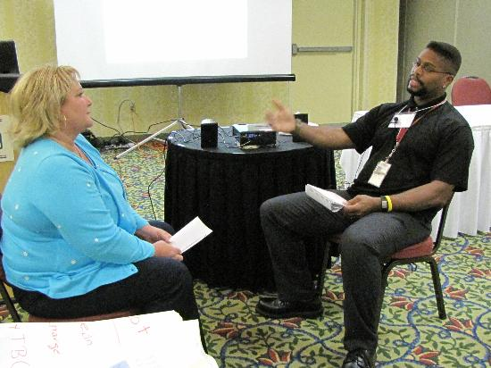
TB Interview Demonstration by Facilitators
Notes:
Note to facilitator: This role play is to be demonstrated by the facilitators (Appendix S)
35 minutes for the interview
5 minutes for the interviewer self-assessment
5 minutes for case/patient feedback
10 minutes for observer/facilitator feedback
30 minutes for group discussion

