Slide 1
Cultural and Diversity Considerations
Notes:
Explain to participants that this section will focus on the need to consider culture and life situations when communicating with cases and contacts during a CI
Note for facilitator: Use examples about groups commonly seen in the participant’s jurisdiction (e.g., homeless, prison populations)

Slide 2
Learning Objectives
After this session, participants will be able to:
Define cultural competency
State the four elements of cross cultural communication
Notes:
Review learning objectives for this session

Slide 3
The Importance of Cultural Competency
Health care workers need to be aware of, and sensitive to, cultural diversity, life situations, and other various factors that shape a person’s identity.
The first step is an open, non-judgmental attitude.
Notes:
Review the slide content
Explain that life situation is also very important (e.g., marriage or partner status, homelessness, joblessness, literacy level, or medical problems that affect quality of life)

Slide 4
What is Culture?
Culture has been defined in a number of ways, but most simply, as the learned and shared behavior of a community of interacting human beings.
Notes:
Review slide content
Emphasize that understanding culture is important when trying to build rapport with someone
Ask participants if they agree with this definition of culture. What else would they include in the definition?

Slide 5
What is Cultural Competency?
Cultural competency refers to an ability to interact effectively with people of different cultures.
Notes:
Review the slide content

Slide 6
What are Some Examples of Diversity Categories/Cultural Groups?
Geography
Culture
Gender
Spirituality
Parental Status
Homeless persons
Substance users
Language
Disability
Sexual orientation
Age
Incarcerated persons
Profession (e.g., healthcare workers)
Notes:
Review slide content
Ask participants if they can think of other diversity categories, especially when considering groups affected by TB

Slide 7
Four Elements for Cross-Cultural Communication
Awareness of one’s own cultural values
Are you attentive to your own preconceived notions of other cultural groups?
Awareness and acceptance of cultural differences
Do you look for opportunities to meet and interact with individuals who are from cultures other than your own?
7
Notes:
Review slide content
Explain to participants that there are four basic cross-cultural communication skills

Slide 8
Four Elements for Cross-Cultural Communication
Development of cultural knowledge
Are you familiar with the worldviews of cultural groups other than your own?
Ability to adapt to the cultural context of the case
Do you know how to navigate cross-cultural interactions?
8
Notes:
Review slide content

Slide 9
What Can Culture Affect? (1)
Description and communication of symptoms
Perceived causes of illness; understanding of infection, transmission, and contacts
Health-seeking behavior
Understanding of disease process, treatment expectations, and decision making
9
Notes:
Review slide content
State that it is important to recognize that your culture has an influence on how you interact with others
Point out that there is a wide variety of reasons that influence health seeking behavior including mistrust of authority, inability to communicate in the language of the health-care provider, and difficulty understanding the cultural norms of the health care providers

Slide 10
What Can Culture Affect? (2)
Interaction with the health care system and health care professionals
Attitudes towards helpers and authorities; reluctance to reveal contacts
How a person identifies and describes their contacts
10
Notes:
Review slide content

Slide 11
Cultural Diversity Exercise
Refer to Appendix M
11
Notes:
Explain that this exercise will help everyone understand diversity and how we define ourselves
Note to facilitator: Follow instructions provided in Appendix M: “Exercise – What is Diversity? – Instructions for Facilitator”
Note to facilitator: Please feel free to use other cultural competency activities in place of this exercise

Slide 12
Ask Questions to Get to Know the Individual Case
How do you prefer to be addressed?
Where were you born?
How long have you been in the U.S.?
Are you more comfortable reading information in your native language or in English?
How are important healthcare decisions are made in your family?
Are there certain health care procedures and tests that your culture prohibits?
12
Notes:
Review slide content
Ask participants how often they use questions such as these during an interview
State that health care workers need to focus on the person being interviewed

Slide 13
What do You Want to Find Out? (1)
Language and literacy level
Health knowledge and health beliefs
Health seeking behaviors
Daily routine activities
Relevant relationships
Living situation
Visitors and/or travel
13
Notes:
Review slide content
State that these are examples of personal information you need from an individual to perform a good CI

Slide 14
What do You Want to Find Out? (2)
Decision making preferences
Perception of and knowledge of U.S. health care system
Perception of “western” medicine
Other health belief systems
Relevant incentives
Notes:
Review slide content

Slide 15
Use Open-Ended Questions to Generate Helpful Conversation
How did you feel when you learned you had TB?
How do you feel about knowing that you may have infected others with TB?
What matters most as you are being treated for TB?
Tell me about anything that may affect your treatment, home visits, etc.
15
Notes:
Review slide content
State that open-ended questions are best for generating helpful conversation. The responses will help the interviewer learn more about the person and could lead to important insights.

Slide 16
Cultural and Diversity Concerns in Contact Investigation (1)
Culture affects:
Knowledge
Attitudes and beliefs about TB transmission
Beliefs about the BCG vaccine
Risks and benefits of LTBI treatment
Identification of contacts
16
Notes:
Review slide content
Discuss beliefs surrounding the BCG vaccine and its affect on TST. For example, some patients may believe that a positive TST is the result of a BCG vaccination they received as a child

Slide 17
Cultural and Diversity Concerns in Contact Investigation (2)
Understanding who a contact is:
Nuclear family, extended family
Members of a group living situation
Residents of a nursing home, shelter, or jail
Fellow drinkers, substance users
Members of a church, temple, or mosque
Co-workers, supervisor, or boss
Visitors
17
Notes:
Review the slide content
State that talking about social groups, car pooling to work (very common in migrant workers, for example) can provide useful information about contacts

Slide 18
Cultural and Diversity Concerns in Contact Investigation (3)
Cultural background may influence the case’s willingness to reveal names:
Immigration status
Reasons not to give correct name
Reasons to hide someone or not name them
Reluctance to identify contacts
18
Notes:
Review slide content
Point out that immigration status is important to persons not in the US legally
Point out that some cases may not want to provide names because they are afraid of losing a job or being deported
Point out reasons why some cases may hide someone or not name them as a contact: to not get them in trouble, maintain friendship, not get kicked out of the house, not have them know or suspect your medical condition, etc.

Slide 19
Naming Systems
Different cultures have different naming systems
First, middle, last?
Two last names?
Family name first?
Ask for all names, nicknames, aliases
Make sure forms and registry can accommodate
Have the case agree to always use the same name
19
Notes:
Review the slide content
Stress that it is important for investigators to determine what naming system is used

Slide 20
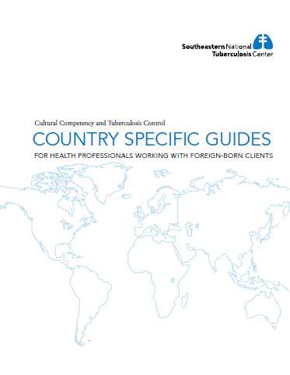
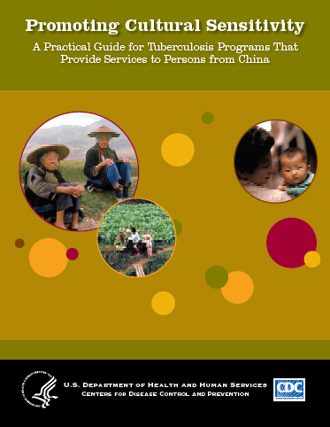
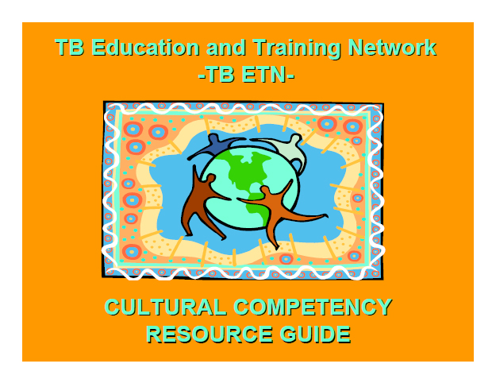
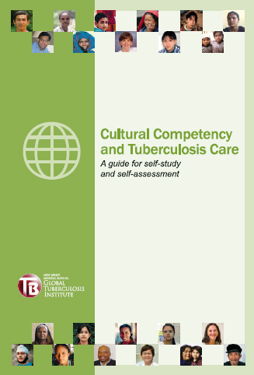
Cultural Competency Resources
Appendix N
20
Notes:
State that there are numerous cultural competency resources available from the RTMCCs and CDC. The TB Education and Training Network (TB ETN) cultural competency resource guide is a great way to find resources. It can be downloaded from the Find TB Resources website: www.findtbresources.org//behavioral.aspx#OtherResources
Note to facilitator: The facilitator should become familiar with these resources and briefly describe each to the participants.
The GTBI and HNTC guides focus on cultural competency skills building
The CDC and SNTC resources focus on specific cultural information for different ethnic groups. These are great resources to help provide insight on cultural norms and health-seeking behaviors for different ethnic groups. However, participants should be reminded that these are generalizations, and that it is important to know the individual and his or her personal beliefs. It is important not to make assumptions or “stereotype” people based on general ideas about their culture.
Refer participants to Appendix N for more information about these resources

Slide 21
Working with Interpreters
Notes:
State that this section will cover how to effectively work with interpreters
Ask participants if they have worked with interpreters before

Slide 22
Language Access Barrier
45 million people in the United States speak a language other than English at home
22
Notes:
Review the slide content
Note that approximately 14% of the U.S. population speak a language other than English at home (~45 million out of ~315 million U.S. population)

Slide 23
Impact of Language Barriers
Less likely to receive care
Less likely to understand care
Increased risk of medical errors
Reduced quality of care
Less satisfied with care
23
Notes:
Review slide content

Slide 24
Using an Interpreter
Make sure you agree on ground rules with both the case and the interpreter before the interview begins
Always speak directly to the case
Ask for clarification as needed
Children should not be used as interpreters!
24
Notes:
Review slide content
Explain to participants that although a trained interpreter is always preferred, there are times when a trained interpreter may not be available. Planning is required when asking an untrained interpreter to interpret (e.g., bilingual staff member). It is the health care worker’s responsibility to conduct a pre-session with the untrained interpreter. It is also helpful to provide the interpreter with disease-specific education materials and any questions that will be asked of the case. Request that the interpreter review the materials and questions before meeting with the case.
Explain that using untrained family members as medical interpreters is strongly discouraged; however, do not exclude them if the case wants them to be part of the clinic visit.

Slide 25
Resource for Interpretation
Video and viewer’s guide
Making the Connection
www.currytbcenter.ucsf.edu
25
Notes:
Show participants a clip from the “Making the Connection” DVD (minutes 14:30 – 20:50)
Explain that this portion of the video shows how to correctly use an interpreter when meeting with a patient
State that the DVD is available through the Curry International TB Center website. The viewer’s guide also contains many resources for choosing and using interpreters
After the clip is over, ask participants what they thought of the video (e.g., what went well?)

Slide 26
Review
What is cultural competency?
What are the four elements of cross cultural communication?
Notes:
Ask participants for answers to review questions
Note to facilitator: answers to review questions:
Cultural competency refers to an ability to interact effectively with people of different cultures
2. The four elements of cross cultural communication:
Awareness of one’s own cultural values
Awareness and acceptance of cultural differences
Development of cultural knowledge
Ability to adapt to fit the cultural context of the case

