Slide 1
PS20-2001: Tuberculosis Elimination Cooperative Agreement (CoAg) – Laboratory Component Informational Call
Division of Tuberculosis Elimination
Stephanie Johnston, MS
Team Lead/Laboratory Capacity Team
June 17, 2019

Slide 2
Background
Support for laboratories began in 1992 focused on upgrade of TB methodologies
Change in focus for 2015-2019 project period to laboratory strengthening
Focus for 2020-2024 remains laboratory strengthening

Slide 3
Public Health Laboratory Strengthening
Laboratory component consists of 3 elements described beginning on page 23 of the NOFO
Ensure availability of high quality and prompt core laboratory services for TB.
Promote continual advancement of laboratory efficiency and quality assurance through the use of local data (your laboratory specific data).
Collaborate with partners (e.g., healthcare providers, TB programs, and other laboratories) to ensure optimal use of laboratory services and timely flow of information.

Slide 4
Definitions
Elements – CDC CoAg goals
Objectives – CoAg awardee goals
Activities – Plans/strategies within the laboratory to achieve objectives
Measure of success – results/outcomes the laboratory wants to achieve
Local data – laboratory specific data
Workload indicators – data to understand volume and complexity of testing
Turnaround time indicators – data to monitor progress in meeting national recommendations

Slide 5
Laboratory Element 1: Availability of High Quality and Prompt Core Laboratory Services
Workload Indictors | Turnaround Time Indicators
Focused on understanding the volume and complexity of testing Data should be included for testing performed in house or through referral New for 2020-2024 Indicator added to capture volume of individual patients for whom in-house molecular DST performed by PHL Clinical specimens/sediments MTBC isolates | Used for monitoring progress in meeting national recommendations Facilitates the identification of effective testing practices and algorithms and those possibly needing examination New for 2020-2024 Indicator added to capture mean and range TAT in days for in-house molecular DST Clinical specimens/sediments MTBC isolates Indicator added to capture mean number of days between specimen collection and test result for IGRA

Slide 6
Volume Considerations for Laboratory Elements 2 and 3
Different level of required activities based on volume
Consideration for differences in level of funding, staff, and capacity to support activities
Description of requirements on page 20 of NOFO
New Tiers For Each Element Based on Volume | Work Plan Requirement
≤1,000 clinical specimens/year 1,001 – 5,000 clinical specimens/year ≥ 5,001 clinical specimens/year | Tier 1 ̶ Provide at least one measurable objective Tier 2 ̶ Provide at least two measurable objectives Tier 3 ̶ Provide at least three measurable objectives

Slide 7
Laboratory Element 2: Promote Continual Advancement of Laboratory Efficiency and Quality Assurance through the Use of Local Data (Your Laboratory-Specific Data)
Different level of required activities based on volume for this element
Potential Areas of Focus
Assessment of testing algorithms and workload trends to identify potential sources of delay Examine or develop written policies to eliminate redundant testing Examine business practices for process improvements Conduct laboratory assessments using standard tool

Slide 8
Laboratory Element 3: Collaborate with Partners to ensure Optimal Use of Laboratory Services and Timely Flow of Information
Different level of required activities based on volume for this element
Potential Areas of Focus
Develop and initiate educational opportunity for TB Program or clinical laboratory partners Collaborative development of specimen collection guidelines Promotion of laboratory services to improve test ordering Collaborative development of nuclei acid amplification testing guidelines for jurisdiction Incorporate more providers into electronic ordering and reporting systems across the jurisdiction

Slide 9
Application Process
20 page limit for the entire application, due to CDC 9/5/2019
To include (page 44):
Laboratory CoAg Point of Contact (telephone number & email)
Laboratory Organizational Chart
Overview of Testing Algorithms and Methods
Work Plan Spreadsheet (Year 1 only)
Line item budget (true needs not required)
Will not include for Year 1:
Workload volume and performance measure TAT data

Slide 10
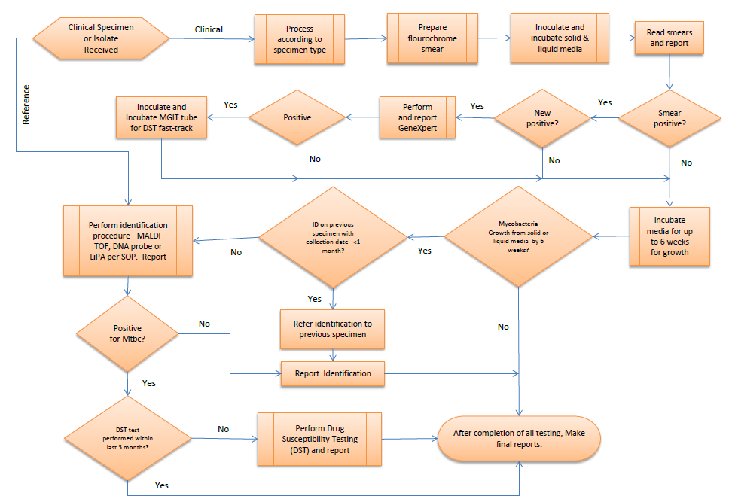
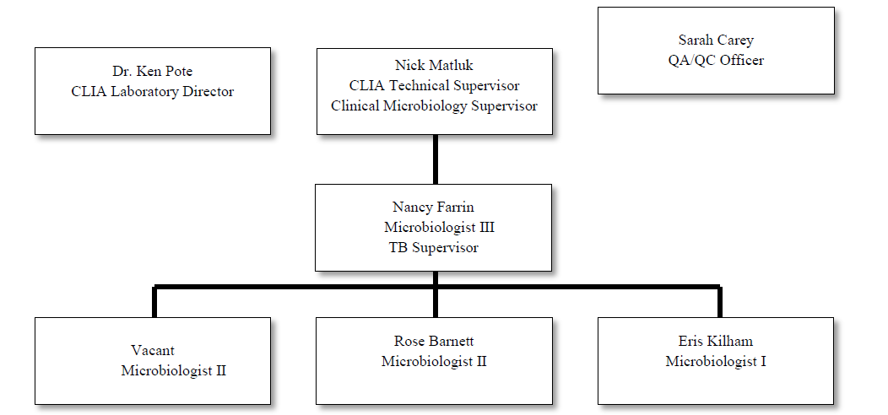
Contact, Organizational Chart, & Testing Algorithm/Methods
Laboratory CoAg Point of Contact (telephone number & email)
Laboratory Organizational Chart
Overview of Testing Algorithms (visual if possible) and Methods
Notes:
Completed as have done in past

Slide 11
Work Plan
New
Excel document provided on the DTBE NOFO webpage under Sample Work Plans/Laboratory Work Plan
https://www.cdc.gov/tb/education/funding-opportunity-notice.htm
CDC-RFA-PS20-2001 applicants may use this layout if desired. Alternatively, applicants may choose to format their required work plan in a different manner, as long as it contains all of the required elements for each strategy.
Laboratory objectives for Elements 1, 2, and 3 over 5 years (2020-2024) with activities to achieve the objectives listed

Slide 12
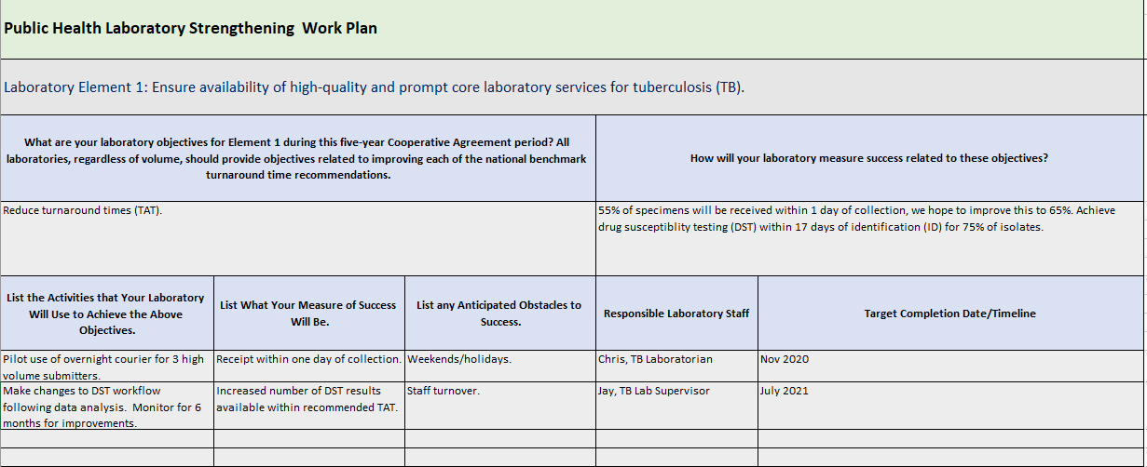
https://www.cdc.gov/tb/education/funding-opportunity-notice.htm

Slide 13
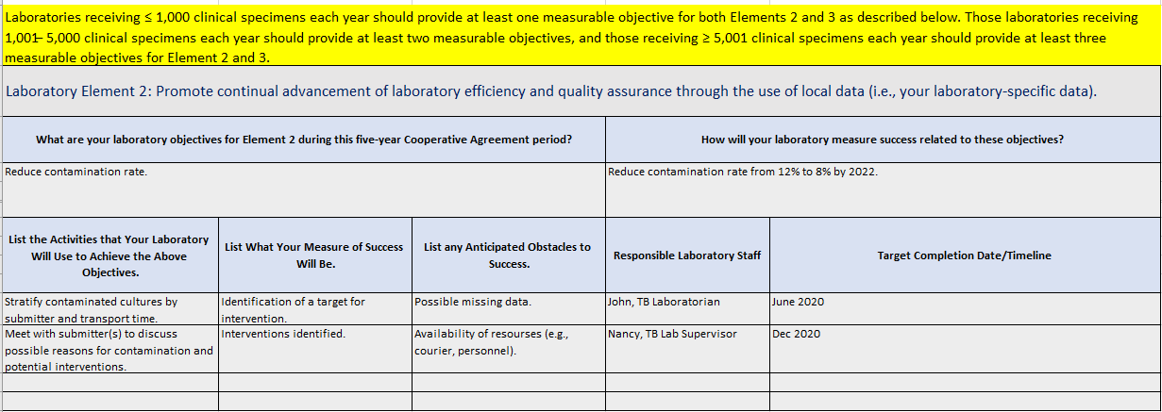

Slide 14
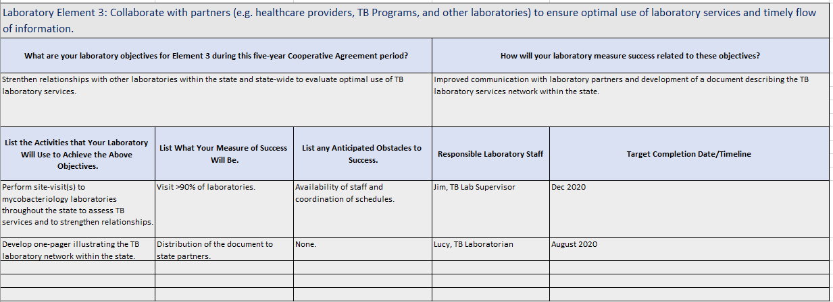

Slide 15
Budget
Line-item budget only (reflects anticipated funding level)
Estimate anticipated using 2019 funding levels + 20% increase
To include:
Salaries & Wages (e.g., name or vacant)
Fringe Benefits (supply the percentage)
Consultant Costs
Equipment
Supplies (per unit cost for items)
Travel (e.g., flights, hotel, per diem)
Other (e.g., conference or training registration fees)
Total Direct Costs
Total Indirect Costs (supply the percentage)
Contractual Costs

Slide 16
Laboratory Specific Funding Restrictions
Laboratories performing first-line drug susceptibility testing for <50 patient isolates/year should refer isolates to National DST Reference Center
As such, laboratories reporting, as part of this application, DST for <50 patient isolates/year may not request funding support for reagents and supplies associated with growth-based DST.
Laboratories within this category may request the use of funds for shipping supplies and costs for access to referral services such as those available at the National DST Reference Center for MTB.

Slide 17
Laboratory Funding Formula Remains Unchanged for 2020-2024
 |  | Per patient basis
 | Total # specimens | TB culture inoculated | Isolates received for ID | NAA testing of clinical specimen | DST for first-line drugs | Lab System – Equal Amounts
FY2020 | 10% | 15% | 15% | 25%* | 25% | 10%
*Base amount determined by number of patients for whom clinical specimen is received with remaining funds distributed by number of patients positive by direct detection for M. tuberculosis.

Slide 18
Workload Volume and Turnaround Time (TAT) Data
LCT will ask awardees to collect 2018 and the first half of 2019 data separately from the application
Using new OMB template documents provided to awardees
Sent by Laboratory Consultants
Due August 2nd

Slide 19
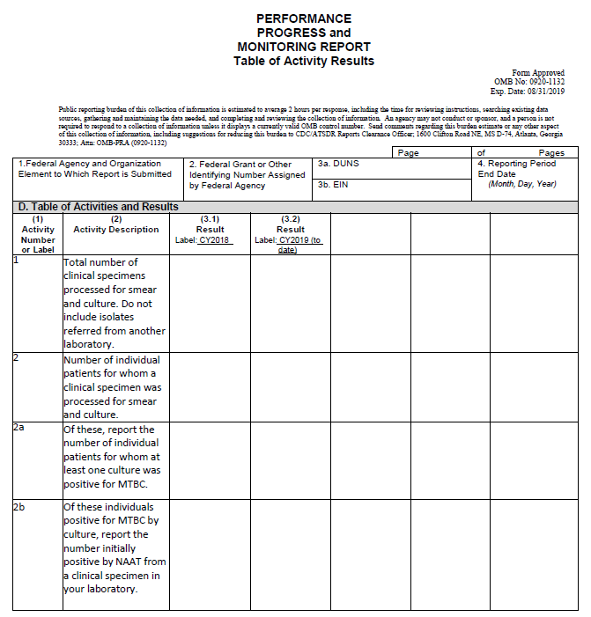
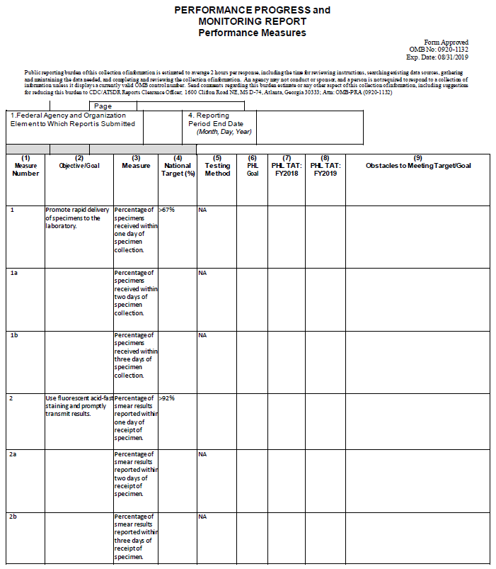

Slide 20
Important Upcoming Dates
August 2, 2019 2018/First Half of 2019 Workload Volume and TAT Data Due
September 5, 2019 TB CoAg Application Due
March 31, 2020 2018/2019 Closeout Report Due
August 31, 2020 January 2020 – June 30, 2020 Annual Performance Report Due

Slide 21
Questions?
After this call, questions concerning the NOFO application must be sent to 2020nofo@cdc.gov

