Slide 1

Tuberculosis (TB) Disease in the United States
1993–2024*
U.S. Centers for Disease Control and Prevention
Division of Tuberculosis Elimination
National Center for HIV, Viral Hepatitis, STD, and TB Prevention
National Tuberculosis Surveillance System
*Data updated as of July 10, 2025
Notes:
Tuberculosis in the United States—National Tuberculosis Surveillance System, Highlights from 2024. This slide set was prepared by the Division of Tuberculosis Elimination, National Center for HIV, Viral Hepatitis, STD, and TB Prevention (NCHHSTP), Centers for Disease Control and Prevention (CDC), U.S. Department of Health and Human Services (HHS). This presentation provides recent trends and highlights of data collected through the National Tuberculosis Surveillance System (NTSS) for 2024.
Since 1953, through the cooperation of state and local health departments, CDC has collected information on newly reported cases of tuberculosis (TB) disease in the United States. Each individual TB case report (Report of Verified Case of Tuberculosis, or RVCT) is submitted electronically to CDC. The data for this slide set are based on TB case reports for 1993–2024 received by CDC as of July 10, 2025. All case counts and rates for years 1993–2023 have been updated, and data from 2024 have been added.

Slide 2
Progress Towards TB Elimination, United States, 1982–2024
26,673 TB cases in 1992
Incidence rate: 10.4 per 100,000
10,388 TB cases in 2024
Incidence rate: 3.1 per 100,000
Notes:
This graph shows the annual number of TB cases in the United States for each year during 1982–2024, and the TB elimination threshold goal of <1 case per 1,000,000 (1 million) persons, which is approximately 335 cases per year for the current U.S. population. In 1992, 26,673 cases were reported in the United States, with an incidence rate of 10.4 cases per 100,000 persons. TB cases and incidence rates have declined substantially since 1992, but the annual rate of decline has been inadequate to achieve TB elimination goals. TB cases and incidence rates declined considerably in 2020, coinciding with the COVID-19 pandemic. TB cases subsequently rose in 2021, 2022, and 2023. In 2024, 10,388 cases were reported, with an incidence rate of 3.1 cases per 100,000 persons, representing a fourth consecutive year of increasing case counts and rates and a 7.9% increase in case count and 6.9% increase in incidence rate compared with 2023.

Slide 3
TB Cases and Incidence Rates, United States, 1993–2024
10,388 TB cases in 2024
Incidence rate: 3.1 per 100,000
Notes:
During 2024, the United States reported 10,388 TB cases and an incidence rate of 3.1 cases per 100,000 persons, the highest recorded TB rate in the U.S. since 2012. Except for 2015, the U.S. TB case count and incidence rate declined every year during 1993 to 2020.

Slide 4
TB Incidence Rates and Annual Percent Change in Rate,*
United States, 2010–2024
*Annual percent change in rate based on unrounded data
Notes:
The top graph shows incidence rates (cases per 100,000 persons) since 2010. The bottom graph shows annual percentage change in incidence rate, with any value >0 representing an increase from the previous year and any value <0 representing a decrease from the previous year. The percentage changes are calculated based off of unrounded incidence rates.
While the incidence rate increased by 6.9% from 2023 (2.9 cases per 100,000 persons) to 2024 (3.1 cases per 100,000 persons), it is still a 15.2% decrease when compared with 2010 (calculations made using unrounded rates).

Slide 5
TB-Related Deaths* and Mortality Rates, United States, 1993–2023
572 TB-related deaths in 2023
Mortality rate: 0.2 per 100,000
*National Vital Statistics System Underlying Cause of Death (based on deaths reported through 2023)
Notes:
The National Vital Statistics System (NVSS) reported 572 TB-related deaths (0.2 deaths per 100,000 persons) where TB was the underlying cause of death for 2023, the most recent year for which death certificate data are available. The population-level mortality rates have remained stable since the early 2000s, despite recent increases in TB case counts.
It is important to note that under current NVSS guidance, deaths caused by TB among persons with comorbid HIV infections are classified with HIV as the underlying cause of death, not TB, and are not included here.
National Vital Statistics System accessed from CDC WONDER as of July 7, 2025: https://wonder.cdc.gov/

Slide 6
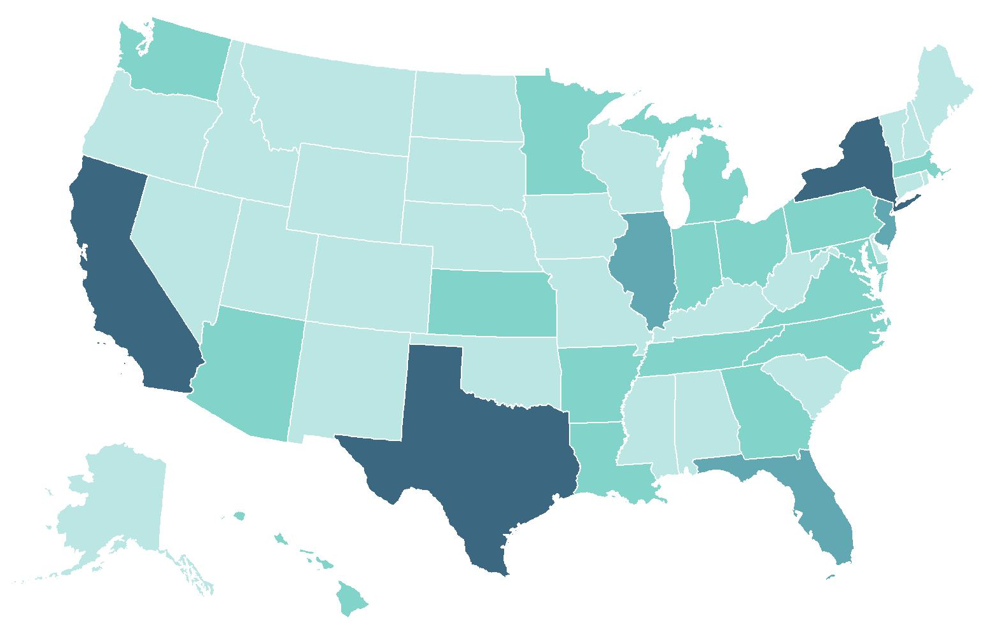
California 20% (n=2,109)
TB Cases and Percentages by Reporting Area,
United States, 2024 (N=10,388)
New York*
10% (n=1,083)
Florida
6% (n=675)
Number of TB cases
≤99
Texas
12% (n=1,279)
100–299
300–999
≥1000
* Includes New York City
Notes:
As in past years, four U.S. states combined reported approximately half (49.5%) of all U.S. TB cases in 2024: California (20.3%), n=2,109), Texas (12.3%, n=1,279), New York state (including New York City) 10.4%, n=1,083) and Florida (6.5%, n=675). These states are also the most populous states in the United States but only represent about a third of the total U.S. population.
Note: ranges were determined based on the Jenks Natural Breaks method, then rounded to the nearest 100.

Slide 7
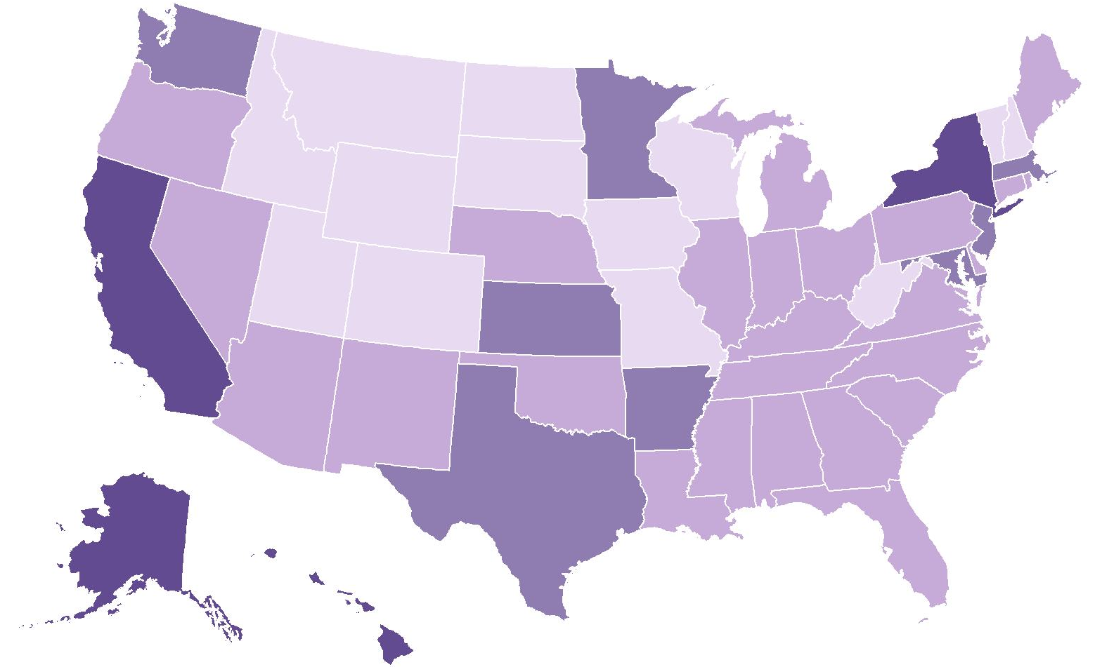
TB Incidence Rates* by Reporting Area, United States, 2024
Washington
3.2
New York
5.5†
Minnesota
3.3
Massachusetts
3.6
New Jersey
3.6
California
5.3
Maryland
3.5
Kansas
3.8
District of Columbia
4.7
Arkansas
3.9
Incidence rate
Alaska
12.3
Hawaii
8.1
<1.5
1.5–<2.9
Texas
4.1
2.9–<4.5
*Cases per 100,000 persons
†Includes New York City
≥4.5
Notes:
In 2024, 12 states and the District of Columbia had incidence rates higher than the national rate of 3.1 cases per 100,000. Alaska had the highest rate (12.3), followed by Hawaii (8.1), California (5.3), New York (including New York City, 5.5), Texas (4.1), District of Columbia (4.7), Arkansas (3.9), Kansas (3.8), New Jersey (3.6), Maryland (3.5), Massachusetts (3.6), Minnesota (3.3) and Washington (3.2).
Note: New York City, which is a distinct reporting area, had an incidence rate of 9.8 cases per 100,000 persons. When New York City was analyzed separately, the remainder of New York state had an incidence rate of 2.2 cases per 100,000 persons, which makes NYC the second highest jurisdictional incidence rate if it were to be included in the list of states and DC.

Slide 8
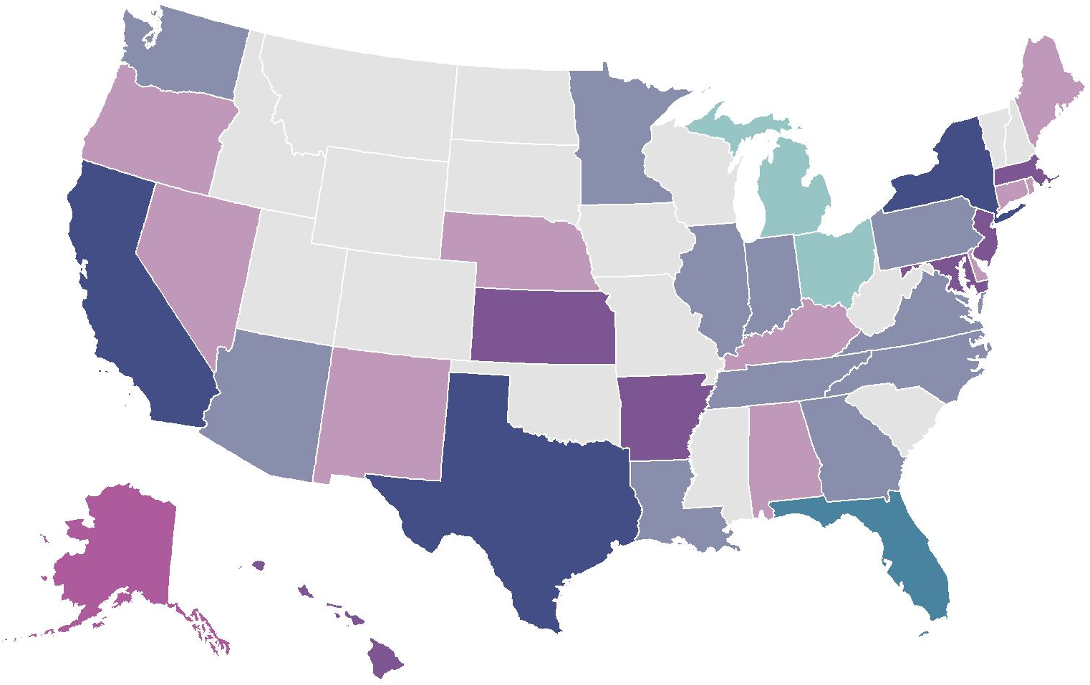
TB Cases and Incidence Rates* by Reporting Area,
United States, 2024
100–499
≤99
≥500
≥3.4
1.7–<3.4
<1.7
Incidence rate*
*Cases per 100,000 persons
Note: New York includes New York City
Case count
Notes:
This map shows each state shaded based on two scales, one representing TB case counts and one representing incidence rates, overlaid. Case counts reflect the overall burden of testing, treating, and preventing TB in each jurisdiction, but the incidence provides a clearer picture of epidemiologic risk by jurisdiction. The lighter shades represent lower values, and darker shades represent higher values on each measure. In 2024, three states had both high case counts and high TB incidence (California, Texas, and New York, which includes New York City).
States with low case count and low incidence rate, such as Idaho, are shown in light grey. (n=16)
States with low case count but medium incidence rate, such as Oregon, are shown in light pink. (n=10)
States with low case count but high incidence rate, such as Alaska and District of Columbia, are shown in magenta. (n=2)
States with medium case count but low incidence rate, such as Ohio and Michigan, are shown in light teal. (n=2)
States with medium case count and medium incidence rate, such as Georgia, are shown in light indigo (the middle of the color key). (n=11)
States with medium case count and high incidence rate, such as Hawaii, are shown in purple. (n=6)
None of the states had a high case count but low incidence rate, so turquoise is not found on the map.
Florida was the only state with high case count and medium incidence rate, shown in teal. (n=1)
States with high case count and high incidence rate, such as California, are shown in dark indigo. (n=3)

Slide 9
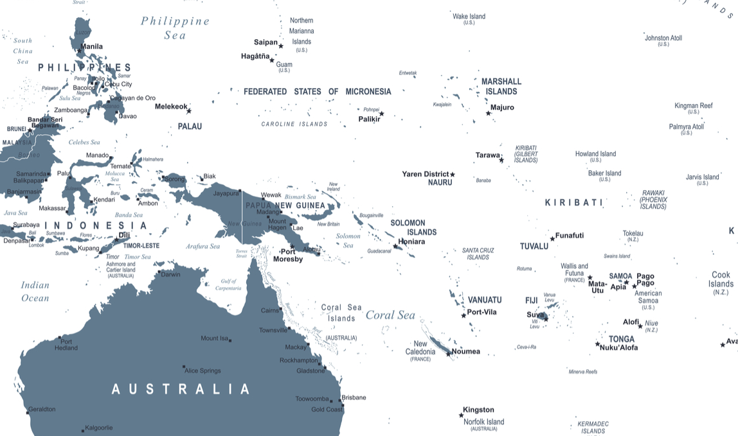
TB Incidence Rates* by U.S.-Affiliated Pacific Islands, 2024
Northern Mariana Islands
19.6
Guam
35.4
Republic of Marshall Islands
250.3
Republic of Palau
22.6
Federated States of Micronesia
126.4
American Samoa
25.1
*Cases per 100,000 persons
Notes:
Among the U.S.-Affiliated Pacific Islands (U.S. territories and freely associated states), incidence rates (cases per 100,000 persons) ranged from 19.6 (Northern Mariana Islands, n=10) to 250.3 (Republic of the Marshall Islands, n=94). For comparison purposes, Hawaii’s incidence rate is 10.0 per 100,000 persons.

Slide 10
TB Cases and Incidence Rates by Origin of Birth,*
United States, 1993–2024
*Persons born in the United States, certain U.S. territories, or elsewhere to at least one U.S. citizen parent are categorized as U.S.-born. All other persons are categorized as non-U.S.–born.
Notes:
Most reported TB cases occurred among non-U.S.–born persons (n=8,016, 77.2%); 2,298 (22.1%) cases occurred among U.S.-born persons, and 74 (0.7%) cases were reported with an unknown origin of birth. The percentage of cases among non-U.S.–born persons has gradually increased over time in the past decade, from 66.8% in 2014 to 77.2% in 2024.

Slide 11
TB Incidence Rates by Origin of Birth,* United States, 2011–2024
4% change in rate from 2023 to 2024
2% change in rate
from 2023 to 2024
*Persons born in the United States, certain U.S. territories, or elsewhere to at least one U.S. citizen parent are categorized as U.S.-born. All other persons are categorized as non-U.S.–born.
Notes:
Incidence rates for U.S.-born persons are shown in the left figure in purple, and incidence rates for non-U.S.–born persons are shown on the right figure in blue. Note that the scales of the y-axes for these figures are different.
Among both U.S.-born and non-U.S.–born persons, TB incidence rates declined during 2011 to 2020 and increased in 2021. In 2024, the incidence rates of both groups increased. The incidence rate among non-U.S.–born persons increased by 4.0% from 15.1 cases per 100,000 persons to 15.7 cases per 100,000 persons. The incidence rate among U.S.-born persons was 0.8 cases per 100,000 persons both years, with a 2.1% change from 2023 to 2024 when using unrounded numbers.

Slide 12
TB Incidence Rates and Percentages by Origin of Birth,*
United States, 2024 (N=10,388)
Origin of birth unknown, <1%
U.S.-born, 22%
(Rate: 0.8 per 100,000)
$$–$$
Non-U.S.–born, 77%
(Rate: 15.7 per 100,000)
*Persons born in the United States, certain U.S. territories, or elsewhere to at least one U.S. citizen parent are categorized as U.S.-born. All other persons are categorized as non-U.S.–born.
Notes:
In 2024, 8,016 (77.2%) cases occurred among non-U.S.–born persons and 2,298 (22.1%) cases among U.S.-born persons. The TB incidence rate among non-U.S.–born persons of 15.7 per 100,000 persons was nearly 20 times the rate of 0.8 per 100,000 persons among U.S.-born persons (using unrounded rates).

Slide 13
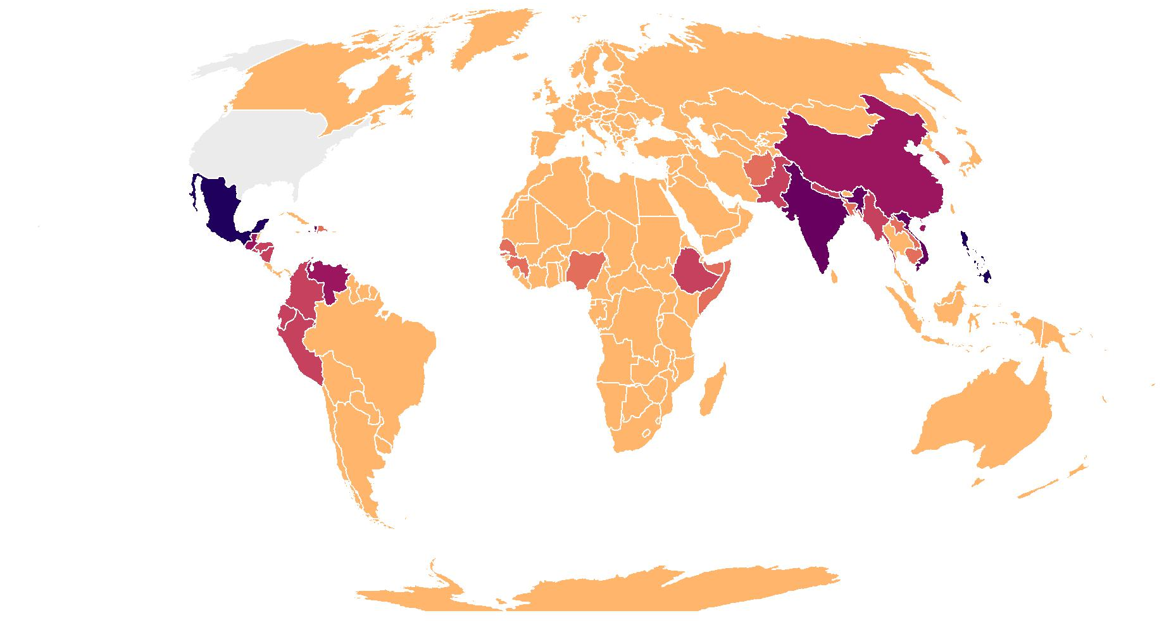

TB Cases by Countries of Birth Among Non-U.S.–Born* Persons,
United States, 2024 (N=8,016)
Mexico
16% (n=1,307)
Haiti
6% (n=471)
Philippines
10% (n=783)
Vietnam
6% (n=483)
India
7% (n=592)
N/A
0 - 49
50 - 99
100 - 249
250 - 399
400 - 599
600 +
*Persons born in the United States, certain U.S. territories, or elsewhere to at least one U.S. citizen parent are categorized as U.S.-born. All other persons are categorized as non-U.S.–born.
Notes:
In 2024, almost half (45.4%) of U.S. TB disease cases among non-U.S. persons were among persons born in five countries: Mexico (16.3%), Philippines (9.8%), India (7.4%), Vietnam (6.0%), and Haiti (5.9%).

Slide 14
Percentage of TB Cases Among Non-U.S.–Born* Persons by Years Since Arrival in the United States Prior to Diagnosis, 2024 (N=8,016)
*Persons born in the United States, certain U.S. territories, or elsewhere to at least one U.S. citizen parent are categorized as U.S.-born. All other persons are categorized as non-U.S.–born.
Notes:
This slide shows the percentage of TB cases among non-U.S.–born persons by number of years since initial arrival in the United States prior to diagnosis. In 2024, most TB cases among non-U.S.–born persons were among those who have been in the United States for at least 5 years (51.3%). Almost a quarter (23.6%) of TB cases among non-U.S.–born persons in 2024 were among those who arrived in the United States less than one year prior to diagnosis.

Slide 15
Percentage of TB Cases Among Non-U.S.–Born* Persons by Years in the United States Prior to Diagnosis, 2010–2024
*Persons born in the United States, certain U.S. territories, or elsewhere to at least one U.S. citizen parent are categorized as U.S.-born. All other persons are categorized as non-U.S.–born.
Notes:
Since 2010, persons who have lived in the United States for at least 20 years prior to TB diagnosis have comprised the greatest percentage of cases among non-U.S.–born persons, compared to those who have lived in the United States for less than 1 year, 1–4 years, 5–9 years, and 10–19 years.
During 2010–2024, the percentages of persons who were diagnosed 1–4 years, 5–9 years, or 10–19 years after arrival remained relatively consistent, with the percentages fluctuating within 5%. Since 2021, the percentage of cases that occurred among persons who were diagnosed within 1 year of arrival has increased from 9.7% in 2021 to 23.6% in 2024.

Slide 16
TB Cases by Race/Ethnicity,* United States, 2011–2024
Other race
Multiple race
Native Hawaiian or Other Pacific Islander
American Indian or Alaska Native
White
Black or African American
Hispanic or Latino
Asian
*Persons who identified as Hispanic or Latino were categorized as "Hispanic," regardless of self-reported race. Persons who did not identify as Hispanic or Latino were categorized by self-reported race; if more than one race was reported, the person was categorized as "Multiple race.” “Other race” was first reported as a new race category in 2023.
Notes:
This graph shows overall TB case counts since 2011 by race/ethnicity. In 2024, case counts were highest among persons identifying as Hispanic or Latino (3,882), followed by Asian (2,998), and Black or African American (2,063). TB case counts were lower among persons identifying as White (812), Native Hawaiian or Other Pacific Islander (251), Multiple race (141), American Indian or Alaska Native (113), and Other race (86). Compared with 2023, TB case counts increased among all racial/ethnic groups except among persons identifying as White (2023: 895; 2024: 812).

Slide 17
Percentage of TB Cases by Race/Ethnicity,* United States, 2011–2024
Other race
Multiple race
Native Hawaiian or Other Pacific Islander
American Indian or Alaska Native
White
Black or African American
Hispanic or Latino
Asian
*Persons who identified as Hispanic or Latino were categorized as “Hispanic,” regardless of self-reported race. Persons who did not identify as Hispanic or Latino were categorized by self-reported race; if more than one race was reported, the person was categorized as “Multiple race.” “Other race” was first reported as a new race category in 2023.
Notes:
This 100% stacked bar chart shows percentage distributions over time by race/ethnicity. The distribution of racial/ethnic identity among persons with TB disease was relatively consistent from 2011 to 2021 with some visible fluctuations. During those years, the largest percentage of TB cases was among persons who identified as Asian (2023: 30.9%; 2024: 28.9%). Since 2023, the largest percentage of TB cases has been among persons who identified as Hispanic or Latino (2023: 36.9%; 2024: 37.4%).

Slide 18
Percentage of TB Cases by Race/Ethnicity,*United States, 2024 (N=10,388)
*Persons who identified as Hispanic or Latino were categorized as "Hispanic," regardless of self-reported race. Persons who did not identify as Hispanic or Latino were categorized by self-reported race; if more than one race was reported, the person was categorized as "Multiple race.“
Notes:
This bar chart shows the percentage of TB cases by race/ethnicity for 2024. Hispanic or Latino persons were the most frequently reported race/ethnicity group among all cases (37.4%), followed by Non-Hispanic Asian persons (28.9%), non-Hispanic Black or African American persons (19.9%), and non-Hispanic White persons (7.8%). All other non-Hispanic race groups (American Indian or Alaska Native persons, Native Hawaiian or Other Pacific Islander persons, persons who identify with more than one race, persons who identify as Other race) and those with unknown or missing race/ethnicity information each represented 1–2% of cases.

Slide 19
TB Incidence Rates by Race/Ethnicity,* United States, 2011–2024
Native Hawaiian or Other Pacific Islander
Asian
Hispanic or Latino
Black or African American
American Indian or Alaska Native
Multiple race
White
*Persons who identified as Hispanic or Latino were categorized as "Hispanic," regardless of self-reported race. Persons who did not identify as Hispanic or Latino were categorized by self-reported race; if more than one race was reported, the person was categorized as "Multiple race.” Population data for “Other race” were not available.
Notes:
TB incidence rates (cases per 100,000 persons) vary by racial/ethnic groups. In 2024, persons identifying as Native Hawaiian or Other Pacific Islander had the highest rate (37.2), followed by those who identify as Asian (13.6). Persons who identified as Multiple race and White had the lowest rates at 1.7 and 0.4, respectively. The largest increase in rate was seen among Native Hawaiian or Other Pacific Islander persons from 27.4 in 2023 to 37.2 in 2024. Since 2020, the largest percentage increases in incidence rates were seen among Native Hawaiian or Other Pacific Islander persons from 8.2 in 2020 to 37.2 in 2024 (353.7%), persons who identify with more than one race from 0.8 in 2020 to 1.7 in 2024 (112.5%), and Hispanic or Latino persons from 3.4 in 2020 to 5.7 in 2024 (67.6%).

Slide 20
TB Cases Among U.S.-Born* Persons by Race/Ethnicity,†
United States, 2011–2024
Other race
Multiple race
Native Hawaiian or Other Pacific Islander
American Indian or Alaska Native
White
Black or African American
Hispanic or Latino
Asian
*Persons born in the United States, certain U.S. territories, or elsewhere to at least one U.S. citizen parent are categorized as U.S.-born. All other persons are categorized as non-U.S.–born.
†Persons who identified as Hispanic or Latino were categorized as "Hispanic," regardless of self-reported race. Persons who did not identify as Hispanic or Latino were categorized by self-reported race; if more than one race was reported, the person was categorized as "Multiple race.“ “Other race” was first reported as a new race category in 2023.
Notes:
In 2024, among U.S.-born persons, the greatest number of cases were among persons who identified as Black or African American (n=769), Hispanic or Latino (n=663), and White (n=513). From 2020 to 2024, the number of TB cases increased among all race/ethnicity groups, except Black or African Americans. The largest percentage increases in cases among U.S.-born persons from 2020 to 2024 were seen among Native Hawaiian or Other Pacific Islander persons (112.5%), persons who identify with more than one race (72.7%), and American Indian or Alaska Native persons (41.0%).

Slide 21
TB Incidence Rates Among U.S.-Born* Persons by Race/Ethnicity,† United States, 2011–2024
Native Hawaiian or
Other Pacific Islander
American Indian or
Alaska Native
Black or African American
Hispanic or Latino
Asian
Multiple race
White
*Persons born in the United States, certain U.S. territories, or elsewhere to at least one U.S. citizen parent are categorized as U.S.-born. All other persons are categorized as non-U.S.–born.
†Persons who identified as Hispanic or Latino were categorized as "Hispanic," regardless of self-reported race. Persons who did not identify as Hispanic or Latino were categorized by self-reported race; if more than one race was reported, the person was categorized as "Multiple race.“ Population data for “Other race” were not available.
Notes:
Since 2011, the highest TB incidence rates (cases per 100,000 persons) among U.S.-born persons have occurred among persons who identify as Native Hawaiian or Other Pacific Islander and American Indian or Alaska Native. That pattern continued in 2024 with incidence rates of 10.0 among Native Hawaiian or Other Pacific Islander persons and 4.7 among American Indian or Alaska Native persons. The rates among Native Hawaiian or Other Pacific Islander persons and American Indian or Alaska Native persons have greater year-to-year variability than all other groups because of low case counts and smaller population sizes.
Incidence rates among U.S.-born persons have declined or remained relatively steady over time among Black or African American persons, Hispanic or Latino persons, Asian persons, White persons, and persons who identify with more than one race. Since 2020, the incidence rate of Hispanic or Latino persons has increased, from 1.2 cases per 100,000 persons in 2020 to 1.6 cases per 100,000 persons in 2024. White persons and persons who identify with more than one race continue to have the lowest rates among all race groups.

Slide 22
TB Cases Among Non-U.S.–Born* Persons by Race/Ethnicity,†
United States, 2011–2024
Other race
Multiple race
Native Hawaiian or Other Pacific Islander
American Indian or Alaska Native
White
Black or African American
Hispanic or Latino
Asian
*Persons born in the United States, certain U.S. territories, or elsewhere to at least one U.S. citizen parent are categorized as U.S.-born. All other persons are categorized as non-U.S.–born.
†Persons who identified as Hispanic or Latino were categorized as "Hispanic," regardless of self-reported race. Persons who did not identify as Hispanic or Latino were categorized by self-reported race; if more than one race was reported, the person was categorized as "Multiple race. “Other race” was first reported as a new race category in 2023.
Notes:
The number of TB cases reported among non-U.S.–born persons increased from 2023 (n=7,330) to 2024 (n=8,016). Over 75% of non-U.S.–born cases occurred among Hispanic or Latino persons (n=3,194) and Asian persons (n=2,877). During 2011 to 2021 the distribution of TB cases by race/ethnicity among non-U.S.–born persons was relatively consistent. Starting in 2022, the percentage of TB cases among non-U.S.–born Hispanic and Latino persons increased from approximately 32% since 2018 to 37.0% in 2022. In 2023, the percentage of TB cases among person who identify as Hispanic and Latino (39.8%) surpassed that of those who identify as Asian (39.0%) and remained higher in 2024 (39.8%, 35.9%, respectively).
The percentage of TB cases among non-U.S.–born Black and African American persons increased again in 2024 (15.9%), making it the highest ever reported among this group. Other racial identities and persons who identify with more than one race had the lowest number of cases for 2024. The bars do not appear for Multiple race and American Indian or Alaskan Native in the graph for certain years due to the small number of cases among these groups.

Slide 23
TB Incidence Rates Among Non-U.S.–Born* Persons by Race/Ethnicity,† United States, 2011–2024
Native Hawaiian or Other Pacific Islander
Multiple race
Black or African American
Asian
Hispanic or Latino
White
*Persons born in the United States, certain U.S. territories, or elsewhere to at least one U.S. citizen parent are categorized as U.S.-born. All other persons are categorized as non-U.S.–born.
†Persons who identified as Hispanic or Latino were categorized as "Hispanic," regardless of self-reported race. Persons who did not identify as Hispanic or Latino were categorized by self-reported race; if more than one race was reported, the person was categorized as "Multiple race.” Population data for “Other race” were not available.
Notes:
In 2024, among non-U.S.–born persons, persons who identified as Native Hawaiian or Other Pacific Islander had the highest incidence rate with 54.7 cases per 100,000 persons, followed by those who reported more than one race (50.9) and those who identified as Black or African American (24.5). The rates among Native Hawaiian or Other Pacific Islander persons and persons who identified with more than one race have greater year-to-year variability than all other groups because of low case counts and smaller populations. Persons who identify as White have the lowest incidence rates among all race/ethnicity groups of non-U.S.–born persons.

Slide 24
TB Incidence Rates Among Non-U.S.–Born and U.S.-Born* Persons by Race/Ethnicity,† United States, 2011–2024
Non-U.S.–born§
U.S.–born
*Persons born in the United States, certain U.S. territories, or elsewhere to at least one U.S. citizen parent are categorized as U.S.-born. All other persons are categorized as non-U.S.–born.
†Persons who identified as Hispanic or Latino were categorized as "Hispanic," regardless of self-reported race. Persons who did not identify as Hispanic or Latino were categorized by self-reported race; if more than one race was reported, the person was categorized as "Multiple race." Population data for “Other race” were not available.
§Non-U.S-born American Indian/Alaska Native are not displayed because some years have zero cases, which cannot be displayed in a log-scale graph.
Notes:
These figures show TB incidence rates by race/ethnicity among non-U.S.–born persons and U.S.-born persons, separately on the log scale. Non-U.S.–born American Indian or Alaska Native persons did not have any reported TB cases in years 2012, 2014, 2015, 2016, 2019, 2020, and 2022; therefore, their data are not presented in the non-U.S.–born graph since zeros cannot be displayed on the log scale.
For all race/ethnicity groups, incidence rates are higher among non-U.S.–born persons compared with U.S.-born persons. In 2024, The incidence rate per 100,000 population among non-U.S.–born Asian persons was much higher than the rate among U.S.-born Asian persons (22.4 vs.1.3, respectively). Similarly, the rate per 100,000 population was higher among non-U.S.–born Black or African American (24.5), Hispanic (13.1), and Native Hawaiian or Other Pacific Islander (54.7) persons compared with U.S.-born persons of the same racial/ethnic identity (Black or African American: 2.1, Hispanic: 1.6, Native Hawaiian or Other Pacific Islander: 10.0).

Slide 25
Percentage of TB Cases by Origin* and Race/Ethnicity,†
United States, 2024
Non-U.S.–born persons
(N=8,016)
U.S.-born persons
(N=2,298)
Hispanic or Latino
Asian
Black or
African American
White
Native Hawaiian or
Other Pacific Islander
Multiple race
Other race
American Indian or
Alaska Native
* Persons born in the United States, certain U.S. territories, or elsewhere to at least one U.S. citizen parent are categorized as U.S.-born. All other persons are categorized as non-U.S.–born.
† Persons who identified as Hispanic or Latino were categorized as "Hispanic," regardless of self-reported race. Persons who did not identify as Hispanic or Latino were categorized by self-reported race; if more than one race was reported, the person was categorized as "Multiple race.”
Notes:
The distribution of self-identified race/ethnicity among persons with TB disease continued to differ markedly by origin of birth in 2024. Almost 40% of the TB cases reported among non-U.S.–born persons occurred among persons who identify as Hispanic (39.8%), followed by Asian (35.9%), Black or African American (15.9%), and White (3.7%). Among U.S.-born persons with TB disease, persons who identify as Black or African American represented the largest percentage of cases (33.5%), followed by Hispanic or Latino (28.9%), White (22.3%), and Asian (4.6%) persons.

Slide 26
TB Incidence Rates* by Origin† and Race/Ethnicity,§
United States, 2024
Non-U.S.–born persons
(N=8,016)
U.S.-born persons
(N=2,298)
Native Hawaiian or
Other Pacific Islander
Multiple race
Black or
African American
Asian
Hispanic or Latino
White
American Indian or Alaska Native
*Cases per 100,000 persons
†Persons born in the United States, certain U.S. territories, or elsewhere to at least one U.S. citizen parent are categorized as U.S.-born. All other persons are categorized as non-U.S.–born.
§Persons who identified as Hispanic or Latino were categorized as "Hispanic," regardless of self-reported race. Persons who did not identify as Hispanic or Latino were categorized by self-reported race; if more than one race was reported, the person was categorized as "Multiple race.” Population data for “Other race” were not available.
Notes:
During 2024, TB incidence rates (cases per 100,000 persons), were higher for every race and ethnicity group among non-U.S.-born persons compared with U.S.-born persons except for persons who identified as American Indian or Alaska Native. Among non-U.S.–born persons with TB disease, persons who identified as Native Hawaiian or other Pacific Islander had the highest incidence rate (54.7) followed by persons of more than one race (50.9), Black or African American persons (24.5), Asian persons (22.4), Hispanic or Latino persons (13.1), White persons (3.7), and American Indian or Alaska Native persons (3.1). Population data for “Other race” were not available.
Among U.S.-born persons with TB disease, Native Hawaiian or Other Pacific Islander persons had the highest incidence rate (10.0), followed by American Indian or Alaska Native persons (4.7), Black or African American persons (2.1), Hispanic or Latino persons (1.6), and Asian persons (1.3). Persons who identified with more than one race (0.5) and White persons (0.3) had the lowest rates.

Slide 27
TB Cases by Age Group, United States, 1993–2024
Notes:
Every age group saw an increase in cases in 2024 compared with 2023 except for those in the 65 and older age group (2023: 2,528; 2024: 2,502). Those in the 25-44 age group had the largest increase in number of cases (2023: 3,009; 2024: 3,502) followed by age group 15–24 (2023: 1,024; 2024: 1,145) and age 45-64 (2023: 2,601; 2024: 2,671). The percent increase in cases from 2023 to 2024 was 9.8% among those in the 5–14 age group, 16.4% in the 25–44 age group and 11.8% in the 15–24 age group.

Slide 28
Percentage of TB Cases by Age Group, United States, 2024 (N=10,388*)
*This total includes TB cases with missing or unknown age.
Notes:
This bar chart shows the percentage of TB cases by age group for 2024. The largest percentage of TB cases occurred among persons 25 to 44 years old (33.7%), followed by persons 45 to 64 years old (25.7%), persons 65 years or older (24.1%), and persons 15 to 24 years old (11.0%). Approximately 5% of all TB cases occurred among children 0 to 14 years of age. Data on age was missing or unknown for less than 0.5% (n=45) of TB cases.

Slide 29
TB Incidence Rates by Age Group, United States, 1993–2024
Notes:
This graph displays the TB incidence rates (cases per 100,000 persons) by age group on a log scale. Incidence rates are higher among adults than children less than 15 years old. Among persons aged 15 years and older, the incidence rates increase with age. In 2024, persons 65 years or older had the highest TB incidence rate (4.1), and children ages 5 to 14 years had the lowest rate (0.6). Incidence increased in 2024 compared with 2023 for all age groups except persons 65 years or older (2023: 4.3; 2024: 4.1).

Slide 30
TB Cases Among U.S.-Born* Persons by Age Group,
United States, 1994–2024
*Persons born in the United States, certain U.S. territories, or elsewhere to at least one U.S. citizen parent are categorized as U.S.-born. All other persons are categorized as non-U.S.–born.
Notes:
This graph shows the number of cases among U.S.-born persons by age group per year from 1994 to 2024. Among U.S.-born persons, all age groups except those 45–64 years of age and 65 years and older experienced an increase in cases in 2024 compared with 2023.

Slide 31
TB Incidence Rates* Among U.S.-Born† Persons by Age Group,
United States, 1994–2024
*Population Source: U.S. Census Bureau, Current Population Survey Basic Monthly: https://data.census.gov/mdat/
†Persons born in the United States, certain U.S. territories, or elsewhere to at least one U.S. citizen parent are categorized as U.S.-born. All other persons are categorized as non-U.S.–born.
Notes:
This graph displays the TB incidence rates (cases per 100,000 persons) among U.S.-born persons, by age group, on a log scale. Since 1994, incidence rates have declined among all age groups. Among U.S.-born persons in 2024, TB incidence rates were highest among children in the 0–4 age group at 1.3 per 100,000 persons, followed by persons in age group ≥65 (1.0), 45–64 (0.9), 25–44 (0.8), 15–24 (0.7), and 5–14 (0.3). The 5–14 years age group has consistently had the lowest rate among all age groups since 1994.

Slide 32
TB Cases Among Non-U.S.–Born* Persons by
Age Group, United States, 1994–2024
* Persons born in the United States, certain U.S. territories, or elsewhere to at least one U.S. citizen parent are categorized as U.S.-born. All other persons are categorized as non-U.S.–born.
Notes:
This graph shows the number of cases among non-U.S.–born persons by age group per year from 1994 to 2024. In 2024, the highest number of TB cases among non-U.S.–born persons was among persons 25–44 years (n=2,915), followed by those in age group 45–64 years and ≥65 (n=2,080 and n=1,981, respectively). The lowest number of TB cases among non-U.S.–born persons was among children 0–4 years of age (n=33). In 2024, case counts among non-U.S.–born persons increased in all age groups compared with 2023 except among adults 65 years and older.

Slide 33
TB Incidence Rates* Among Non-U.S.–Born† Persons by
Age Group, United States, 1994–2024
* Population Source: U.S. Census Bureau, Current Population Survey Basic Monthly: https://data.census.gov/mdat/
† Persons born in the United States, certain U.S. territories, or elsewhere to at least one U.S. citizen parent are categorized as U.S.-born. All other persons are categorized as non-U.S.–born.
Notes:
This graph displays the TB incidence rates (cases per 100,000 persons) among non-U.S.–born persons, by age group, on a log scale. Since 1994, incidence rates have declined by 50% or more in each age group, except for age group 15–24, which declined 39%. Among non-U.S.–born persons in 2024, TB incidence rates were highest among persons in age group ≥65 (22.8 per 100,000 persons), followed by persons in age group 15–24 (20.3), 25–44 (16.2), 45–64 (11.7), 0–4 (8.0), and 5–14 (6.0).

Slide 34
Percentage of TB Cases by Sex and Age Group, United States, 2024
Males (N=6,392)
Age group
Females (N=3,935)
0–4 years (N=266)
5–14 years (N=257)
15–24 years (N=1,144)
25–44 years (N=3,495)
45–64 years (N=2,669)
≥65 years (N=2,496 )
Notes:
As in previous years, males continued to represent the majority (61.9%) of persons with TB disease overall. Percentages of TB case counts were higher among males than females for all age groups except among children in the 5–14 age group.

Slide 35
Pediatric* TB Cases by Origin of Birth,† United States, 1993–2024
* Children aged less than 15 years
† Persons born in the United States, certain U.S. territories, or elsewhere to at least one U.S. citizen parent are categorized as U.S.-born. All other persons are categorized as non-U.S.–born.
Notes:
In contrast to overall U.S. TB cases, for which over three quarters of cases were among non-U.S.–born persons, only 155 (29.7%) of 522 cases in children less than 15 years old occurred among non-U.S.–born persons in 2024. The percentage of non-U.S.–born persons among pediatric cases has fluctuated between 20% and 30% since 1993.

Slide 36
Pediatric TB Incidence Rates* by Origin of Birth,†
United States, 1994–2024
* Population Source: U.S. Census Bureau, Current Population Survey Basic Monthly: https://data.census.gov/mdat/
† Persons born in the United States, certain U.S. territories, or elsewhere to at least one U.S. citizen parent are categorized as U.S.-born. All other persons are categorized as non-U.S.–born.
Notes:
In 2024, the majority (70.3%) of children less than 15 years old with TB disease were U.S.-born, however, the incidence rate (cases per 100,000 persons) was higher among non-U.S.–born children compared with U.S.-born children. For children aged 0–4 years old, the incidence rate among non-U.S.–born children (8.0) was more than 6 times the rate among U.S.-born children (1.3). For children aged 5–14 years, the incidence rate among non-U.S.–born children (6.0) was 20 times the rate among U.S.-born children (0.3).
Calculations done using unrounded incidence rates.

Slide 37
Percentage of TB Cases by Site of Disease, United States, 2024
* Persons might have more than one extrapulmonary site of disease.
Notes:
Most TB cases had pulmonary TB only (70.9%), 16.8% had extrapulmonary TB only, and 11.8% had both pulmonary and extrapulmonary TB. There were a total of 3,375 extrapulmonary sites of disease. Among these, lymphatic (28.1%) and pleural (24.1%) sites of disease were the most common, followed by bone or joint (7.5%), peritoneal (5.5%), meningeal (4.8%), genitourinary (3.4%), and laryngeal (0.8%). “Other” (25.7%) includes all other extrapulmonary sites of disease (e.g., ocular, hepatic).

Slide 38
Percentage of TB Cases* by Initial Drug Regimen,
United States, 1993–2024
HRZE†
HPMZ§
Other 4+ drug regimen¶
* Persons alive at diagnosis with initial drug regimen information.
† H, isoniazid; R, rifampin; Z, pyrazinamide; E, ethambutol.
§ Four-month regimen with H, isoniazid; P, rifapentine; M, moxifloxacin; and Z, pyrazinamide.
¶ A drug regimen with at least four drugs, other than HRZE and HPMZ.
Notes:
Since 2001, the percentage of patients started on HRZE, the standard initial four-drug regimen of isoniazid, rifampin, pyrazinamide, and ethambutol, has remained above 80%. In some situations, including known or suspected drug resistance or a clinical contraindication to the standard initial therapy, a different four-drug regimen could be clinically appropriate. In 2024, 95% of persons with TB disease were initially started on a CDC recommended regimen or another multi-drug regimen that contained at least four drugs. During 2022 to 2024, less than 1% of TB cases were among patients started on HPMZ, a daily 4-month regimen with rifapentine, isoniazid, pyrazinamide, and moxifloxacin that was first recommended by CDC in 2022. The HPMZ column color is pink but may be hard to see due to the percentages being less than 1%. Use of initial regimens with less than four drugs has represented <7% of reported cases, each year since 2011.

Slide 39
Percentage of TB Cases* by Initial Drug Regimen,
United States, 2024 (N=10,037)
Other 4+ drug regimen†, 7%
HPMZ¶, <1%
* Persons alive at diagnosis with initial drug regimen information.
† A drug regimen with at least four drugs, other than HRZE and HPMZ.
¶ Four-month regimen with H, isoniazid; P, rifapentine; M, moxifloxacin; and Z, pyrazinamide.
§ H, isoniazid; R, rifampin; Z, pyrazinamide; E, ethambutol.
Notes:
Of the 10,037 people diagnosed with TB in 2024 who were prescribed TB therapy, 88.1% started on the standard TB regimen, isoniazid, rifampin, pyrazinamide, and ethambutol (HRZE), 6.6% started on a regimen with at least four drugs other than HRZE and HPMZ, and 4.8% started on a regimen of less than four drugs, including persons who were not prescribed any drugs. Less than 1% of people with TB were prescribed HPMZ, a daily 4-month regimen with rifapentine, isoniazid, pyrazinamide, and moxifloxacin.

Slide 40
Percentage of TB Cases by Method of Treatment Administration,* United States, 1993–2022†
DOT§ only
DOT and SAT§
*Persons on an initial drug therapy with at least one drug.
†Most recent year for which data are complete.
§DOT=directly observed therapy; SAT=self-administered therapy.
Notes:
The percentage of persons with TB disease receiving at least a portion of their medication by directly observed therapy (DOT) has risen from 35.4% in 1993 to 91.2% in 2022, the most recent year with data available. The percentage of patients receiving treatment exclusively by directly observed therapy was higher in 2022 (66.3%) than in any previous year reported. DOT includes both in person and electronic (video call or other electronic method).

Slide 41
Percentage of TB Cases* by Method of Treatment Administration, United States, 2022† (N=8,007)
*Persons on an initial drug therapy with at least one drug.
†Most recent year for which data are complete.
Notes:
During 2022, the most recent year for which treatment completion data are available, 66.3% of patients were administered treatment exclusively by directly observed therapy (DOT), 3.5% solely by self-administered therapy (SAT), and 24.9% by a combination of DOT and SAT.

Slide 42
*Persons alive at diagnosis who started TB therapy and for whom therapy <1 year was indicated.
†Most recent year for which data are complete.
§National goal: for 92% of patients with newly diagnosed TB disease for whom ≤12 months of treatment is indicated to complete treatment within 12 months.
Percentage of TB Cases* by Completion of TB Therapy,
United States, 1993–2022†
National Goal:§
92%
Notes:
The national goal is for 92% of patients to complete treatment within 12 months if a treatment duration of ≤12 months is indicated. Among patients eligible to complete TB therapy within 12 months, 86.7% did so in 2022, the most recent year for which data on treatment status are available. Although this is a substantial increase compared with 63.4% in 1993, it is still short of the national goal of 92%. Overall, 92.6% of patients in 2022 completed TB therapy, either within or after 12 months, similar to the percentage in 2021 (93.5%).

Slide 43
TB Cases Resistant to Isoniazid* by Origin of Birth,†
United States, 1993–2024
*Starting in 2023, information on drug resistance included results of molecular drug susceptibility testing in addition to growth-based susceptibility testing for isoniazid and rifampin. An isolate is considered resistant to isoniazid or rifampin if either the growth-based test or molecular test detects resistance.
†Persons born in the United States, certain U.S. territories, or elsewhere to at least one U.S. citizen parent are categorized as U.S.-born. All other persons are categorized as non-U.S.–born.
Notes:
Since 1995, most isoniazid-resistant TB cases in the United States have been reported among non-U.S.–born persons. In 2024, 675 TB cases were reported as resistant to isoniazid among persons with a known origin of birth. Of those, 90 cases (13.3%) were among U.S.-born persons.

Slide 44
Number and Percentage of Multidrug-Resistant (MDR)* TB Cases† by History of TB, United States, 1993–2024
*Starting in 2023, information on drug resistance included results of molecular drug susceptibility testing in addition to growth-based susceptibility testing for isoniazid and rifampin. An isolate is considered resistant to isoniazid or rifampin if either the growth-based test or molecular test detects resistance.
†Excludes persons with unknown origin of birth.
Notes:
Multidrug-resistant (MDR) TB is defined as TB resistant to at least isoniazid and rifampin. In 2024, there were 115 cases of MDR TB, including 7 cases among persons with unknown history of previous TB. Among persons in the United States with no previous history of TB disease, less than 2% have been classified as MDR TB since 1995.

Slide 45
Percentage of HIV Coinfection* by Origin of Birth† Among Persons with TB, United States, 2011–2024
* Persons alive at diagnosis with HIV test results
† Persons born in the United States, certain U.S. territories, or elsewhere to at least one U.S. citizen parent are categorized as U.S.-born. All other persons are categorized as non-U.S.–born.
Notes:
Coinfection with HIV is a major risk factor for progression of latent TB infection to TB disease. Among 10,152 persons who were alive at TB diagnosis in 2024, HIV status was known for 90.3% (n=9,167). Among the persons with TB and a known HIV status, the percentage of HIV coinfection decreased from 7.5% in 2011 to 4.6% in 2024 for all persons, from 10.7% in 2011 to 5.3% in 2024 for U.S.-born persons, and from 5.7% in 2011 to 4.3% in 2024 for non-U.S.–born persons. The percentage of HIV coinfection among all three groups has been relatively stable since 2018.

Slide 46
Percentage of Selected Medical Risk Factors Among Persons with TB by Origin of Birth,* United States, 2024
* Persons born in the United States, certain U.S. territories, or elsewhere to at least one U.S. citizen parent are categorized as U.S.-born. All other persons are categorized as non-U.S.–born.
† Excludes HIV and other conditions elsewhere represented in this figure.
§ Diagnosed with hepatitis B or C (acute or chronic).
Notes:
Among all reported medical risk factors for TB disease, diabetes mellitus (21.9%) was reported most frequently by all persons with TB, followed by non-HIV immunosuppression (6.4%), viral hepatitis (3.2%), end stage renal disease (2.3%), TNF-α inhibitors (1.5%), and post-organ transplantation (0.7%). Diabetes mellitus was more common among non-U.S.–born persons (24.0%), compared with U.S.-born persons (15.0%).

Slide 47
Percentage of Social and Behavioral Risk Factors Among Persons Aged ≥15 Years with TB, United States, 2024
* At the time of TB diagnosis
† Within past 12 months prior to TB diagnosis
Notes:
Among persons who had social and behavioral risk factor information available and were at least 15 years of age, the most common risk factor reported was being a current or former tobacco smoker (31.4%), followed by ever experiencing homelessness (9.4%), history of ever being incarcerated (8.8%), noninjecting drug use (7.8%), experiencing homelessness within the past 12 months prior to TB diagnosis (7.3%), excess alcohol use (7.3%), incarceration within past 12 months prior to diagnosis (3.6%), being a resident of a long-term care facility (1.6%), and injecting drug use (1.0%). History of cigarette smoking was added to the 2020 RVCT.

Slide 48
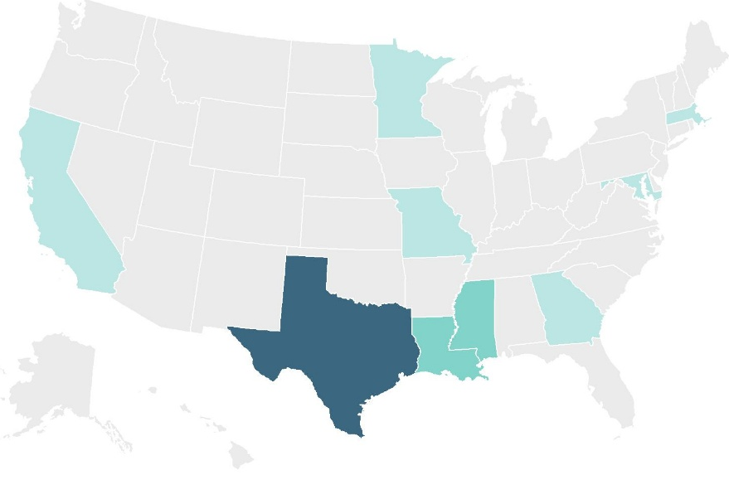
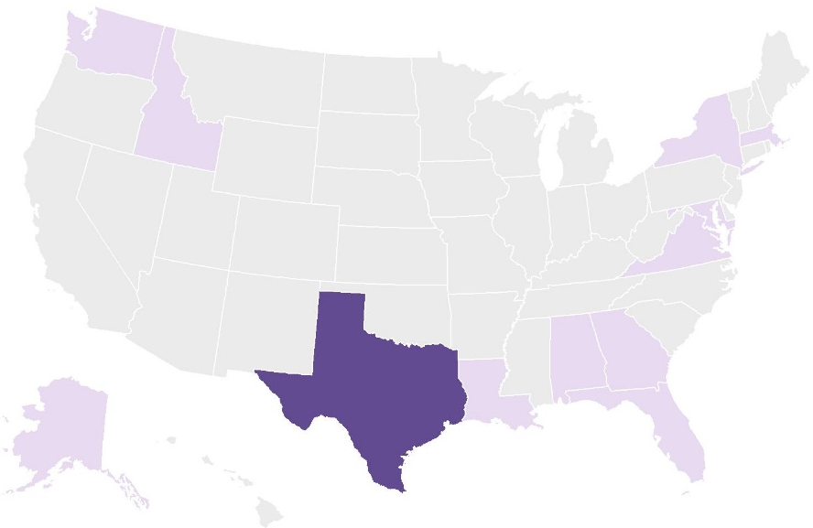
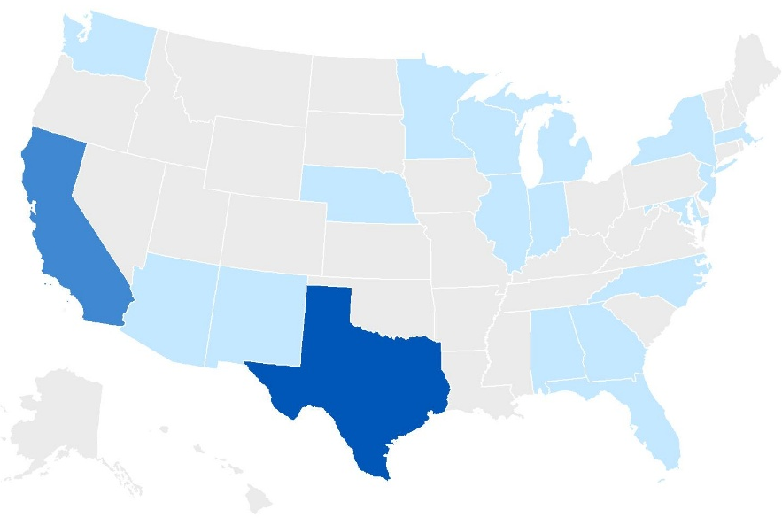
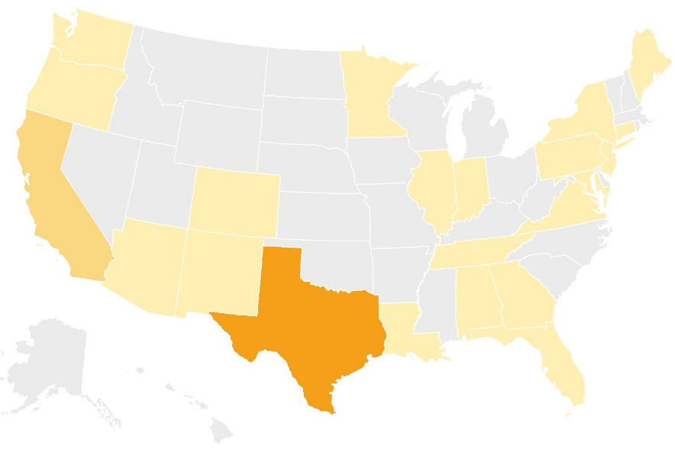
TB Cases Among Incarcerated Persons Aged ≥15 Years by Type of Facility, United States, 2024
Federal prisons (N=47)
State prisons (N=69)
Number of
TB cases
Number of
TB cases
0
0
1–4
1–4
5–9
5–24
10–19
25–44
>20
>45
Local jails (N=110)
Other facilities (N=110)
Number of
TB cases
Number of
TB cases
0
0
1–9
1–9
10–24
10–19
25–44
20–39
>45
>40
Notes:
This slide displays the number of TB cases diagnosed among residents of state prisons, federal prisons, local jails, and other facilities in 2024 as four separate maps. Each map is color-coded so that as the number of TB cases increases, the color becomes darker. Texas had the greatest number of cases among persons who resided in federal prisons (n=25), state prisons (n=49), local jails (n=45), and other facilities (n=61) at the time of diagnosis. Other facilities include Immigration and Customs Enforcement (ICE) detention centers, Indian reservation facilities (e.g., tribal jails), military stockades and jails, federal park police facilities, police lockups (i.e., temporary holding facilities for persons who have not been formally charged in court), juvenile facilities, or other correctional facilities that are not included in the other specific choices.

Slide 49
Percentage of TB Cases by Status and Cause of Death, United States, 2022*
Dead at diagnosis
(N=246)
Died after diagnosis
(N=612)
TB cause of death
TB not cause
of death
Unknown cause of death
*Most recent year for which data are complete; Year the case was counted, not the year the person died.
Notes:
Whole-genome multilocus sequence typing (wgMLST) can be used to identify clusters of TB cases with genetically similar TB bacteria, which can be evidence supporting recent transmission. A TB case is attributed to recent transmission if a plausible source case can be identified in a person who had an M. tuberculosis isolate with the same wgMLSType that differed by ≤5 single nucleotide polymorphisms, had an infectious form of TB, was 10 years of age or older, resided within 100 miles of the case, and was diagnosed within 2 years before the case. A TB genotype cluster is defined as two or more cases with matching whole-genome multilocus sequence type (wgMLSType) in the same county during a 3-year period. During 2022–2024, there were 1,268 TB genotype clusters involving 3,794 total cases. Clusters of 2 or 3 cases comprised 85.5% of all clusters. There were 33 large clusters (≥10 cases) that contained 599 total cases (15.8% of all clustered cases).
For more information on TB whole-genome sequencing and genotyping, please visit: https://www.cdc.gov/tb/php/genotyping/whole-genome-sequencing.html.

Slide 50
Number of County-based TB Genotype Clusters* by Cluster Size, United States, 2022–2024
* Clusters have two or more cases with matching whole-genome multilocus sequence type (wgMLSType) within a county during the specified 3-year period.
Notes:
Whole-genome multilocus (wgMLST) sequence typing can be used to identify clusters of TB cases with genetically similar TB bacteria, which can represent recent transmission. A TB genotype cluster is defined as two or more cases with matching whole-genome multilocus sequence type (wgMLSType) in the same county during a 3-year period. During 2022–2024, there were 1,268 TB genotype clusters involving 3,794 total cases. Clusters of 2 or 3 cases comprised 85.5% of all clusters. There were 33 large clusters (≥10 cases) that contained 599 total cases (15.8% of all clustered cases).
For more information on TB whole-genome sequencing and genotyping, please visit: https://www.cdc.gov/tb/php/genotyping/whole-genome-sequencing.html.

Slide 51
TB Genotype Clusters* by TB GIMS† Alert Levels,§
United States, 2022–2024 (N=1,268)
​* Clusters have two or more cases with matching whole-genome multilocus sequence type (wgMLSType) within a county during the specified 3-year period.
† TB GIMS, Tuberculosis Genotyping Information Management System.
§ Alert levels are based on a log-likelihood ratio (LLR), which calculates the geographical concentration of a genotype in a county compared to the rest of the country during a 3-year period. TB GIMS generates “medium alerts” for clusters with LLR of 4 to <10 and “high alerts” for clusters with LLR ≥10.
Notes:
CDC issues alerts for TB genotype clusters based on a log-likelihood ratio (LLR), which calculates the concentration of a genotype in a county compared to the rest of the country during a 3-year period. “Medium alerts” are issued for clusters with an LLR of 4 to <10 and “high alerts” for clusters with an LLR ≥10 TB cases. During 2022–2024, 49.3% (n=625) of 1,268 clusters identified nationally generated either medium alerts (42.3%, n=536) or high-level alerts (7.0%, n=89).

Slide 52
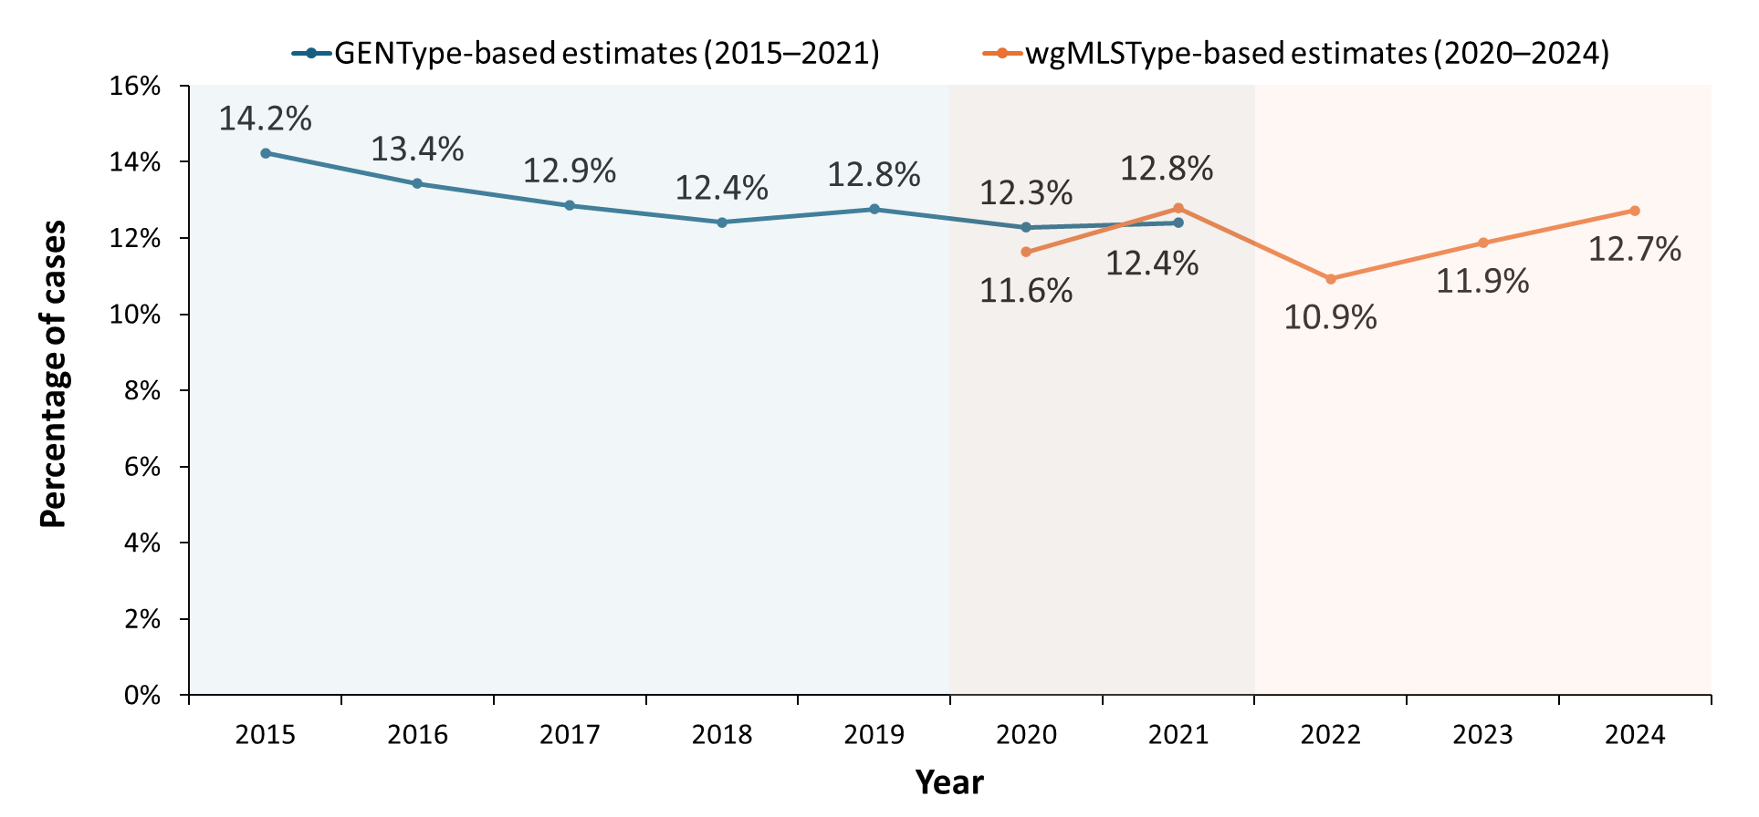
Percentage of TB Cases Attributed to Recent Transmission,*
United States, 2015–2024
* A case is attributed to recent transmission if a plausible source case can be identified in a person who had an M. tuberculosis isolate with the same GENType (GENType-based estimates) or the same wgMLSType and differed by ≤5 single nucleotide polymorphisms (wgMLSType-based estimates), had an infectious form of TB, was 10 years of age or older, resided within 10 miles (GENType-based estimates) or 100 miles (wgMLSType-based estimates) of the case, and was diagnosed within 2 years before the case.
Notes:
The 2024 annual TB surveillance report includes estimates of recent transmission for the first time since 2021 based on an updated method that incorporates whole-genome sequencing data. This slide displays the estimated percentage of U.S. TB cases attributed to recent transmission by year and genotyping method. Based on conventional genotyping (GENType), the percentage of cases attributed to recent transmission declined from 14.2% in 2015 to 12.4% in 2021. The updated estimate for 2021 based on whole-genome multilocus sequence typing (wgMLSType) was 12.8%. After a decline in 2022 to 10.9%, the estimated percentage of cases attributed to recent transmission increased to 11.9% in 2023 and 12.7% in 2024.

Slide 53
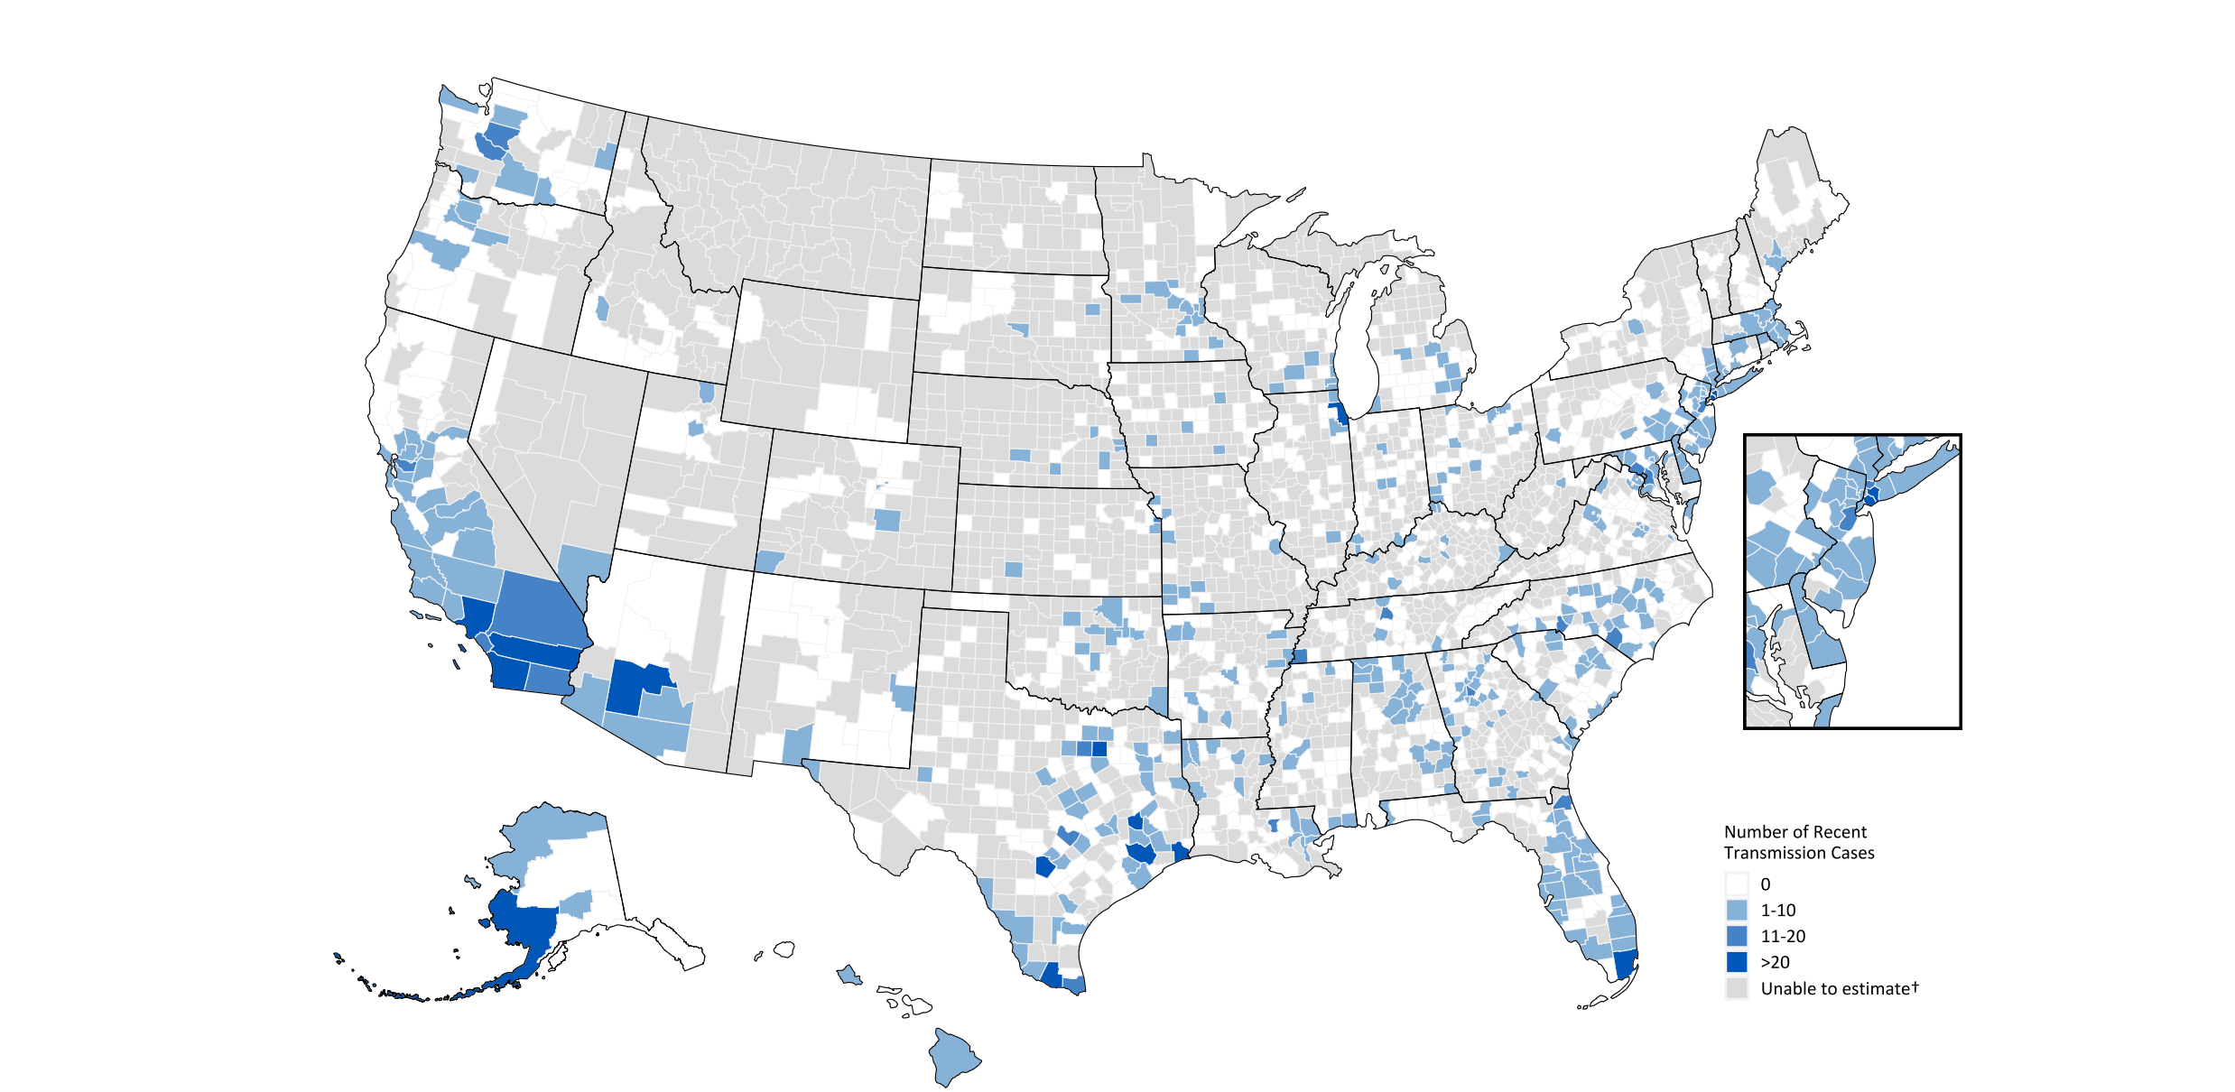
Number of Tuberculosis Cases Attributed to Recent Transmission,* United States, 2023–2024
​* A case is attributed to recent transmission if a plausible source case can be identified in a person who had an M. tuberculosis isolate with the same wgMLSType that differed by ≤5 single nucleotide polymorphisms, had an infectious form of TB, was 10 years of age or older, resided within 100 miles of the case, and was diagnosed within 2 years before the case.
† Counties shaded gray had no genotyped cases that could be evaluated for recent transmission during 2023–2024.
Notes:
This map shows the number of TB cases in each county or county-equivalent area that were attributed to recent transmission during 2023–2024. Fifteen counties reported ≥20 cases attributed to recent transmission during this period, 22 reported 11–20 cases, 370 reported 1–10 cases, and 810 reported 0 cases. The remaining 1,903 counties had no genotyped cases that could be evaluated for recent transmission during 2023–2024.

Slide 54
Percentage of TB Cases Attributed to Recent Transmission,*
United States, 2023–2024 (N=14,648)
Recent transmission, 12%
Not recent transmission,†
88%
* A case is attributed to recent transmission if a plausible source case can be identified in a person who had an M. tuberculosis isolate with the same wgMLSType that differed by ≤5 single nucleotide polymorphisms, had an infectious form of TB, was 10 years of age or older, resided within 100 miles of the case, and was diagnosed within 2 years before the case.
† Cases not attributed to recent transmission might be misclassified in children <5 years old and in persons with recent U.S. arrival due to limitations of the plausible-source case method.
Notes:
Out of 14,648 genotyped TB cases reported nationwide during 2023–2024 with sufficient data, CDC attributed 12.3% (n=1,804) to recent transmission (≤2 years before diagnosis) in the United States. The remaining 12,844 (87.7%) were not attributed to recent transmission; these could represent transmission >2 years before diagnosis or transmission outside the United States.

Slide 55
Percentage of TB Cases Attributed to Recent Transmission* by
Origin of Birth,† United States, 2023–2024
Non-U.S.–born
(N=11,468)
U.S.-born
(N=3,105)
Recent transmission, 7%
Recent transmission, 33%
Not recent
transmission,§
Not recent transmission,§
* A case is attributed to recent transmission if a plausible source case can be identified in a person who had an M. tuberculosis isolate with the same wgMLSType that differed by ≤5 single nucleotide polymorphisms, had an infectious form of TB, was 10 years of age or older, resided within 100 miles of the case, and was diagnosed within 2 years before the case.
† Excludes persons with unknown origin of birth (n=75).
§ Cases not attributed to recent transmission may be misclassified in children <5 years old and in persons with a recent U.S. arrival due to limitations of the plausible-source case method.
Notes:
The percentage of genotyped TB cases attributed to recent transmission among U.S.-born persons (32.9%, n=1,023) was nearly 5 times the percentage among non-U.S.–born persons (6.7%, n=772). The remaining 67.1% (n=2,082) of genotyped cases among U.S.-born persons and 93.3% (n=10,696) among non-U.S.–born persons were not attributed to recent transmission; these could represent transmission >2 years before diagnosis or transmission outside the United States.

Slide 56
Percentage of TB Cases Attributed to Recent Transmission* by Race/Ethnicity,† United States, 2023–2024
* A case is attributed to recent transmission if a plausible source case can be identified in a person who had an M. tuberculosis isolate with the same wgMLSType that differed by ≤5 single nucleotide polymorphisms, had an infectious form of TB, was 10 years of age or older, resided within 100 miles of the case, and was diagnosed within 2 years before the case.
† Persons who identified as Hispanic or Latino were categorized as "Hispanic," regardless of self-reported race. Persons who did not identify as Hispanic or Latino were categorized by self-reported race; if more than one race was reported, the person was categorized as "Multiple race.“
Notes:
Among racial/ethnic groups, the percentage of TB cases attributed to recent transmission was greatest among American Indian or Alaska Native persons (59.6%, n=93), Native Hawaiian or Other Pacific Islander persons (33.1%, n=81), and Black or African American persons (19.3%, n=506).

Slide 57
* A case is attributed to recent transmission if a plausible source case can be identified in a person who had an M. tuberculosis isolate with the same wgMLSType that differed by ≤5 single nucleotide polymorphisms, had an infectious form of TB, was 10 years of age or older, resided within 100 miles of the case, and was diagnosed within 2 years before the case.
Percentage of TB Cases Attributed to Recent Transmission* by
Age Group, United States, 2023–2024
Notes:
The percentage of TB cases attributed to recent transmission was higher among younger age groups than older groups. Of the 147 cases that occurred among children 0 to 4 years old, 57.8% (n=85) were attributed to recent transmission, compared with 4.4% (n=174) of the 3,993 cases among adults 65 years or older.

Slide 58
Percentage of TB Cases Attributed to Recent Transmission* by Selected Risk Factors, United States, 2023–2024
†
†
§
†
†
†
* A case is attributed to recent transmission if a plausible source case can be identified in a person who had an M. tuberculosis isolate with the same wgMLSType that differed by ≤5 single nucleotide polymorphisms, had an infectious form of TB, was 10 years of age or older, resided within 100 miles of the case, and was diagnosed within 2 years before the case.
† Within past 12 months prior to TB diagnosis.
§ At the time of TB diagnosis.
Notes:
The percentage of TB cases attributed to recent transmission was higher than the national average during 2023–2024 (12%, n=1,804) among persons reporting noninjecting drug use (33%, n=379), injecting drug use (29%, n=43), incarceration (24%, n=98), excess alcohol use (22%, n=253), homelessness (20%, n=201), current or former smoking (15%, n=678), and HIV coinfection (15%, n=93). The percentage of cases attributed to recent transmission was lower than the national average among persons with non-HIV immunosuppression (9%, n=99) and diabetes (8%, n=310).

Slide 59
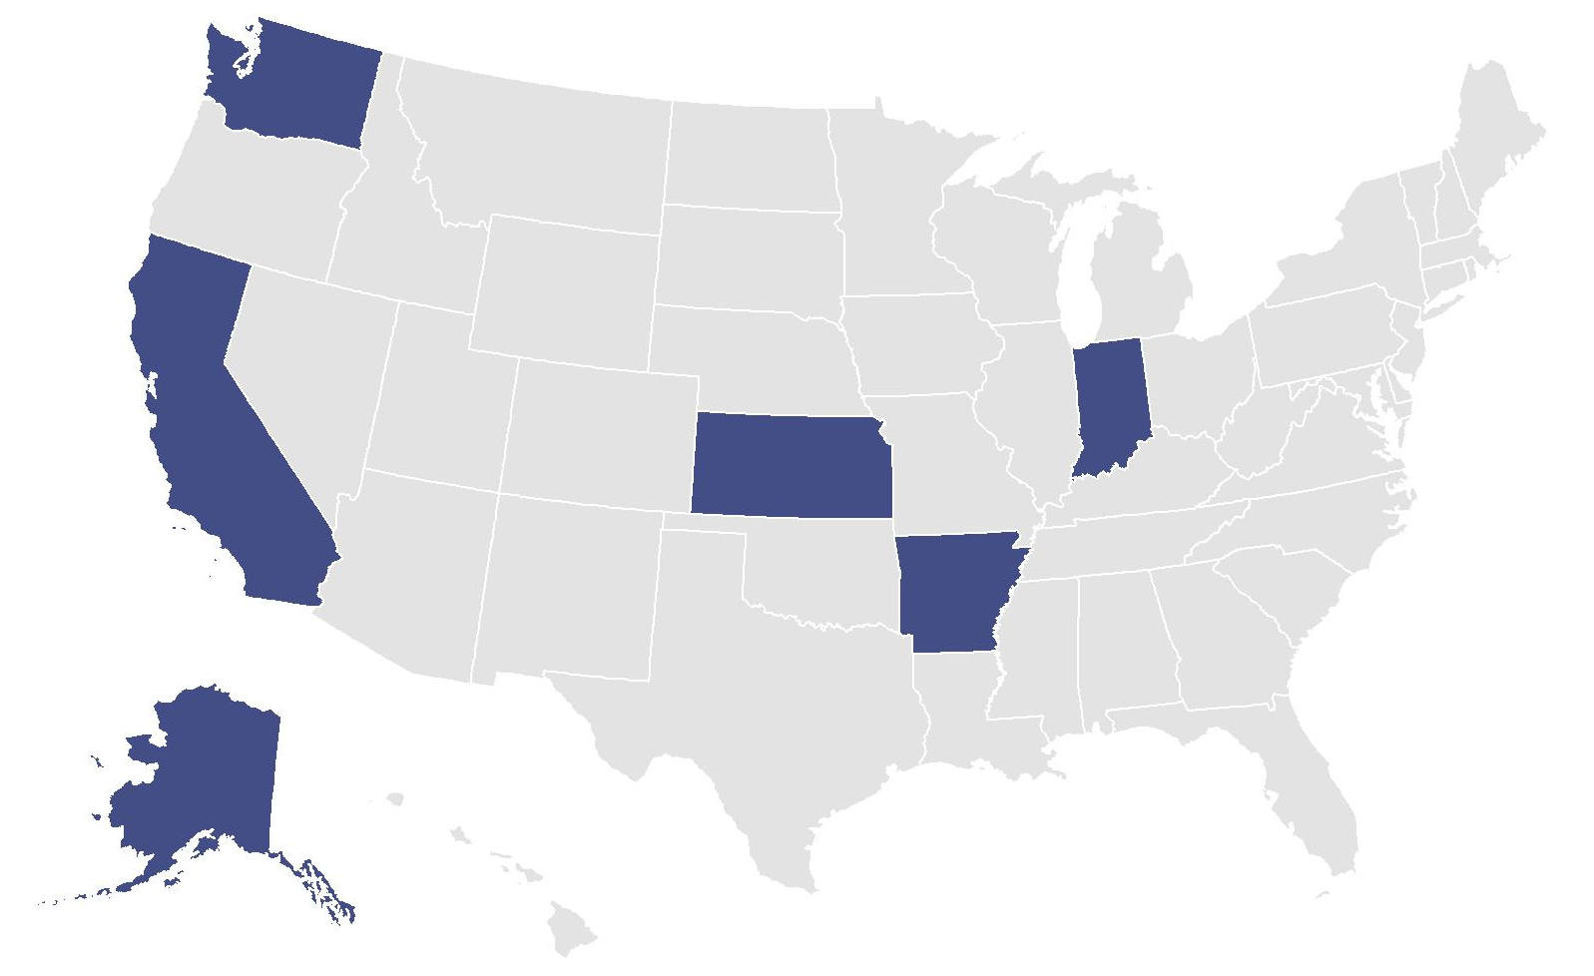
New Large Outbreaks* of TB by Reporting Area,† United States, 2024
Number of large outbreaks
0
1
* Defined as 10 or more cases of tuberculosis related by recent transmission during a 3-year period. Ongoing large outbreaks that were detected before 2024 are not included.
† Reporting area for at least 50% of cases in the large outbreak.
Notes:
Six new large outbreaks of TB occurred in the United States in 2024. This map displays the six states where the majority of cases in each outbreak were reported: Alaska, Arkansas, California, Indiana, Kansas, and Washington.

Slide 60
Select Characteristics of New Large Outbreaks* of TB, United States, 2024
Outbreak 1
Outbreak 2
Outbreak 3
Outbreak 4
Outbreak 5
Outbreak 6
Outbreak 1
Outbreak 1
Outbreak 1
Outbreak 1
Outbreak 1
Outbreak 1
Outbreak 1
Total cases |  | 64 |  | 16 |  | 16 |  | 12 |  | 11 |  | 10
Cases reported in 2024 |  | 64 |  | 16 |  | 15 |  | 5 |  | 6 |  | 7
Median age, years |  | 29 |  | 6 |  | 6.5 |  | 14.5 |  | 37 |  | 31
U.S.-born† |  | 21 (33%) |  | 11 (69%) |  | 9 (56%) |  | 6 (50%) |  | 11 (100%) |  | 10 (100%)
Experiencing homelessness§ |  | 0 (0%) |  | 0 (0%) |  | 0 (0%) |  | 0 (0%) |  | 8 (73%) |  | 1 (10%)
Substance use§,¶ |  | 5 (8%) |  | 1 (6%) |  | 0 (0%) |  | 0 (0%) |  | 9 (82%) |  | 4 (40%)
* Defined as 10 or more cases of tuberculosis related by recent transmission during a 3-year period. Ongoing large outbreaks that were detected before 2024 are not included.
† Persons born in the United States, certain U.S. territories, or elsewhere to at least one U.S. citizen parent are categorized as U.S.-born. All other persons are categorized as non-U.S.–born.
§ Within past 12 months prior to TB diagnosis.
¶ Substance use includes persons reporting excess alcohol use, injecting drug use, or noninjecting drug use.
Notes:
The six large outbreaks of TB in 2024 ranged in size from 10 to 64 cases each. The median age of persons with TB in each outbreak ranged from 6 to 37 years. At least 50% of cases occurred in U.S.-born persons in five of the six outbreaks. One outbreak predominantly involved persons who reported experiencing homelessness and using alcohol to excess or drugs.

Slide 61
