Slide 1
Sexually Transmitted Disease
Division of STD Prevention
Surveillance 2018
STDs in Women and Infants

Slide 2
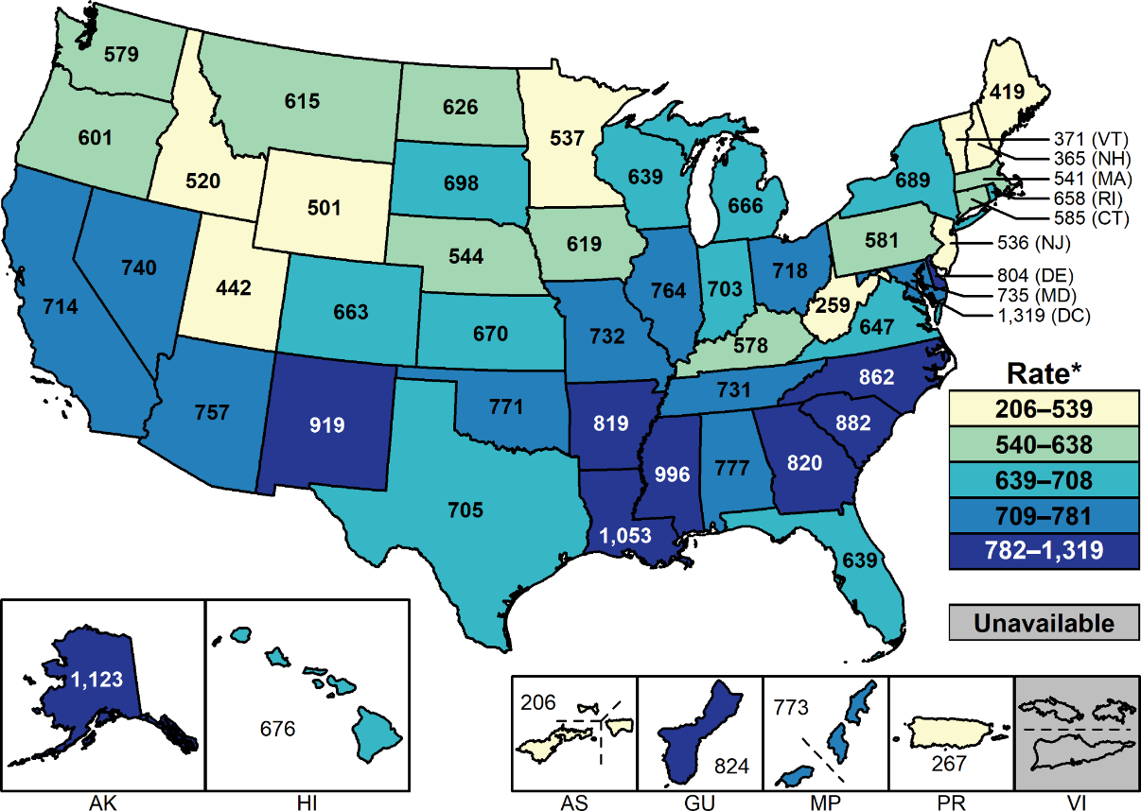
Chlamydia — Rates of Reported Cases Among Females by State and Territory, United States, 2018
* Per 100,000.
NOTE: See Sections A1.11 in the Appendix for more information on interpreting reported rates in US territories.
Notes:
United States map showing rates of reported cases of chlamydia among females by state and territory. Regionally, among all females, chlamydia case rates were highest among females in the South, with a rate of 744.2 cases per 100,000 females in 2018.

Slide 3
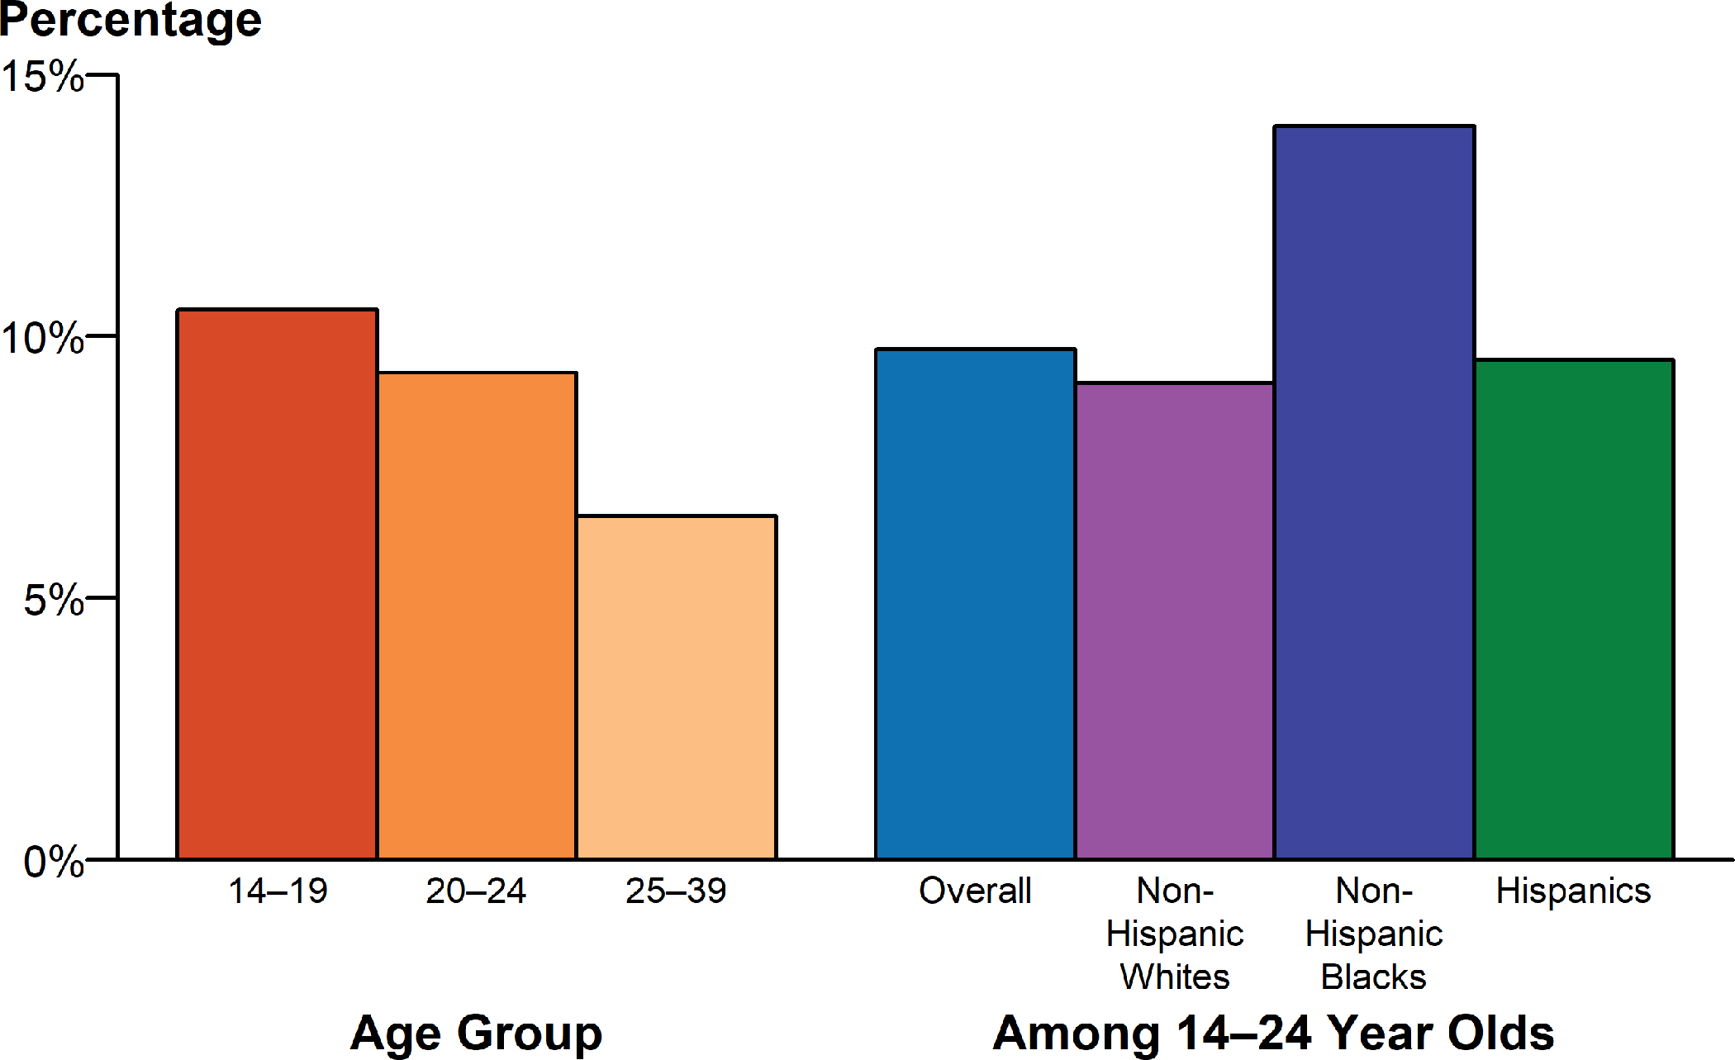
Chlamydia — Positivity Among Females Aged 14–39 Years by Race/Hispanic Ethnicity and Age Group in Clinics* Providing Family Planning and Reproductive Health Services, STD Surveillance Network (SSuN), 2018
* Includes clinics (n=26) that tested >100 females for chlamydia in 2018 and testing coverage was >60%.
NOTE: See section A2.2 in the Appendix for SSuN methods.
Notes:
Bar graph showing chlamydia positivity among females aged 14 to 39 years by race/Hispanic ethnicity and age group in clinics providing family planning and reproductive health services during 2018. In 2018, the overall positivity of chlamydia among females aged 14–24 years was 9.8%, but for females 14–19 years of age, chlamydia positivity was 10.5%. For females between the ages of 14–24 years, chlamydia positivity among non-Hispanic Blacks was about 1.5 times those of non-Hispanic Whites or Hispanics.

Slide 4
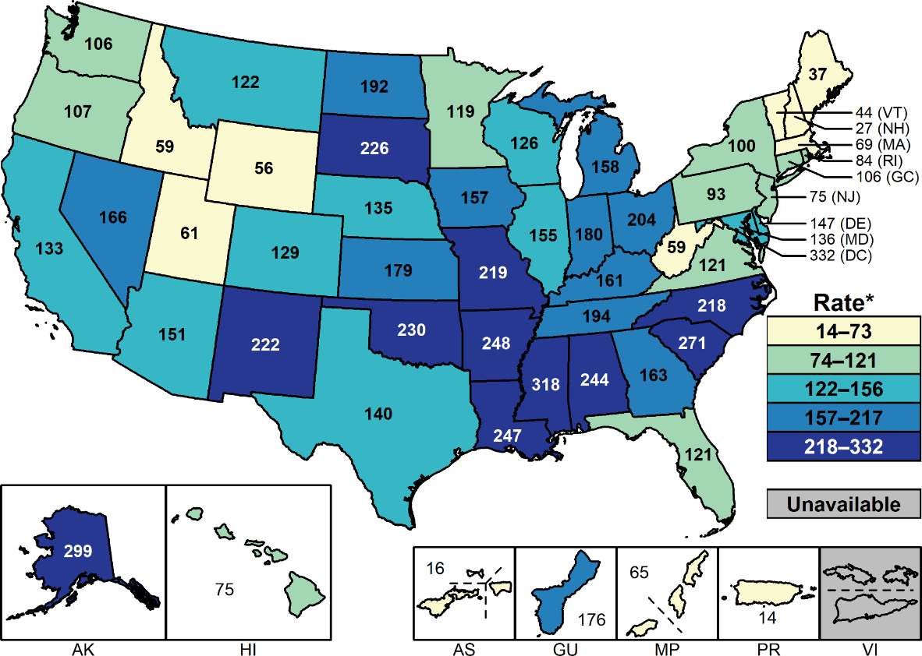
Gonorrhea — Rates of Reported Cases Among Females by State and Territory, United States, 2018
* Per 100,000.
NOTE: See Sections A1.11 in the Appendix for more information on interpreting reported rates in US territories.
Notes:
United States map showing rates of reported cases of gonorrhea among females by state and territory. Rates of reported chlamydia cases exceeded gonorrhea case rates among females in all regions.

Slide 5
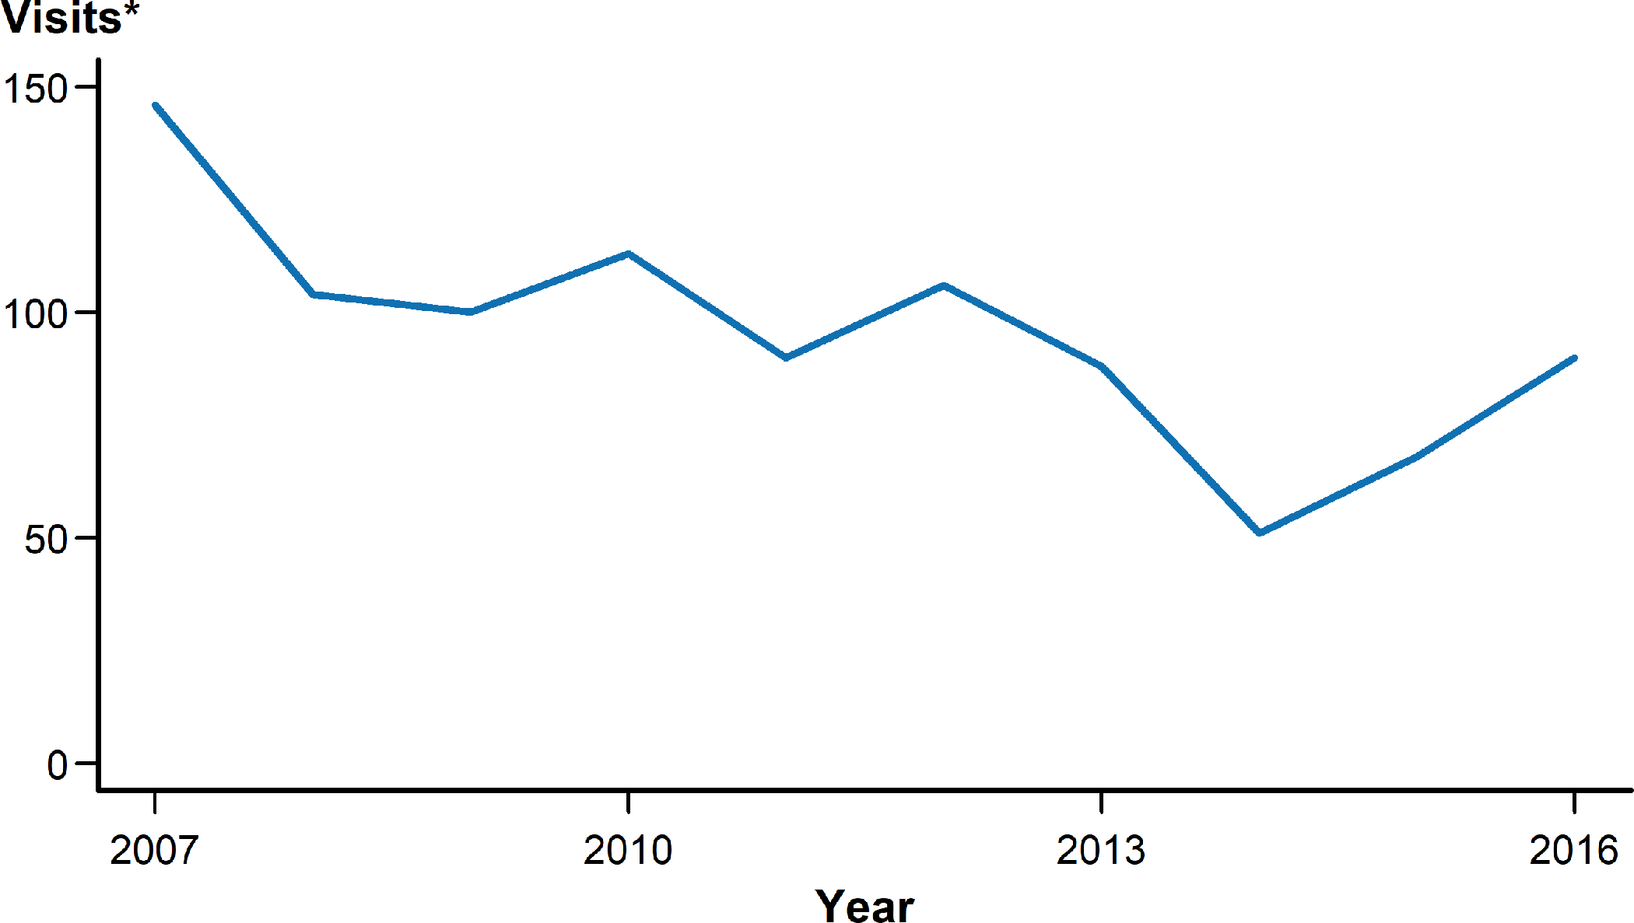
Pelvic Inflammatory Disease — Initial Visits to Physicians’ Offices Among Females Aged 15–44 Years, United States, 2007–2016
* In thousands.
NOTE: The relative standard errors for these estimates are 23%–16%. See section A2.5 in the Appendix and Table 44.
SOURCE: National Disease and Therapeutic Index, IMS Health, Integrated Promotional Services™, IMS Health Report, 1966–2016.
Notes:
Line graph showing initial visits to physicians’ offices for pelvic inflammatory disease among United States females aged 15 to 44 years during 2007 to 2016. According to 2007–2016 data from the National Disease and Therapeutic Index, the number of initial visits to physicians’ offices where females aged 15–44 years were diagnosed with pelvic inflammatory disease decreased by 38.3% from 146,000 to 90,000 visits.

Slide 6
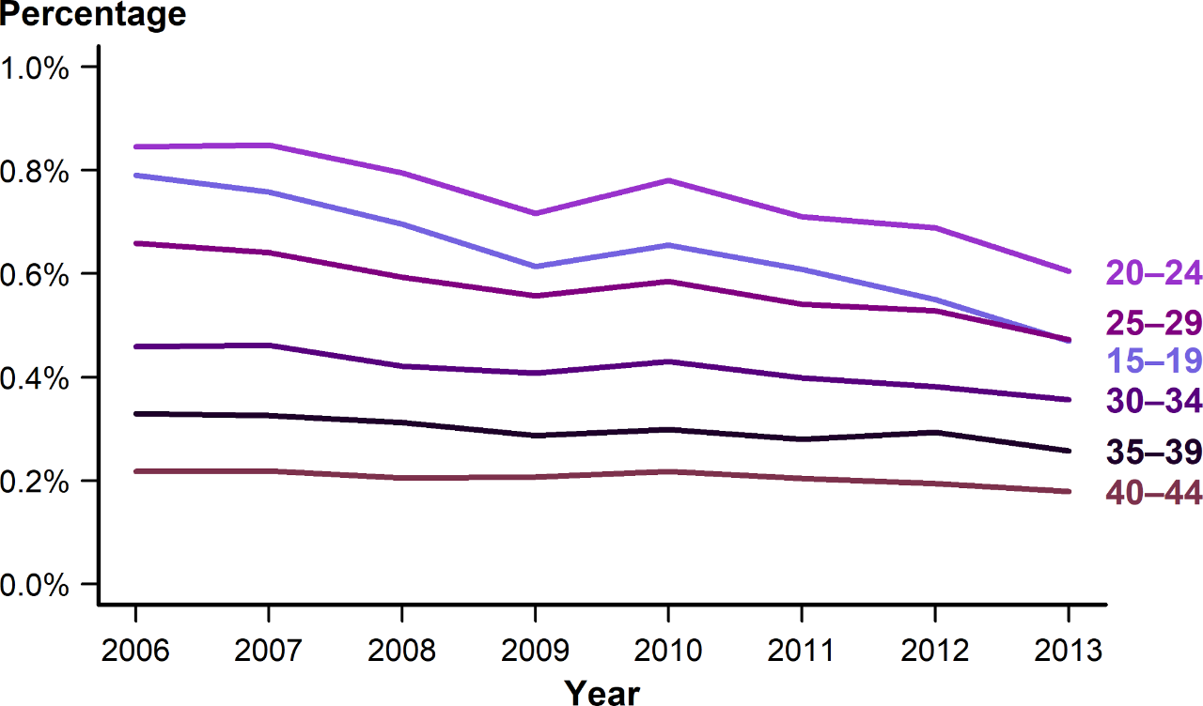
Estimated Percentage of Acute Pelvic Inflammatory Disease Emergency Department Visits Among Females Aged 15–44 Years by Age Group and Year, United States, 2006–2013
SOURCE: Kreisel, K, Flagg, EW, Torrone E. Trends in pelvic inflammatory disease emergency department visits, United States, 2006–2013. Am J Obstet Gynecol. 2018;218(1):117.e1–117.e10.
Notes:
Line graph showing the estimated percentage of acute pelvic inflammatory disease emergency department visits among United States females aged 15 to 44 years by age group and year during 2006 to 2013. The percentage of emergency department visits with an acute pelvic inflammatory disease diagnosis decreased during 2006–2013 among females aged 15–44 years, with the largest decreases among females aged 15–19 years.

Slide 7
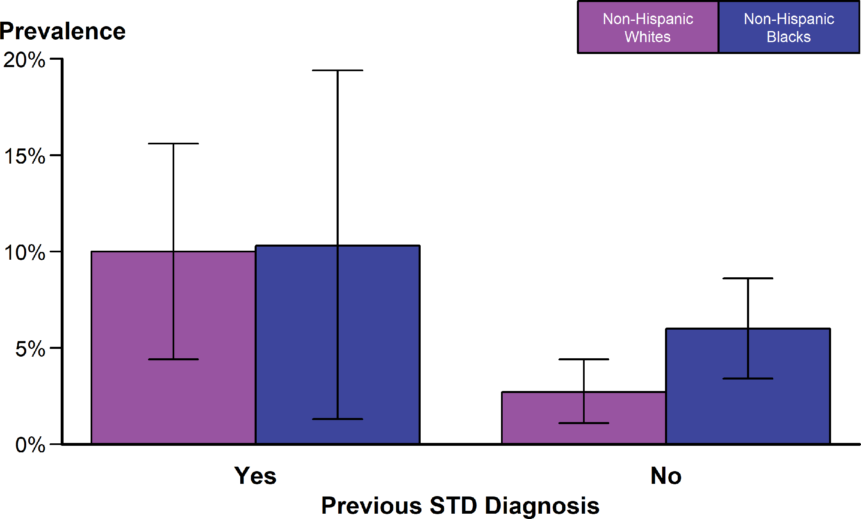
Pelvic Inflammatory Disease — National Estimates of Lifetime Prevalence Among Sexually-Experienced Women Aged 18–44 Years by Race/Hispanic Ethnicity and Previous STD Diagnosis, National Health and Nutrition Examination Survey (NHANES), 2013–2014
NOTE: Error bars indicate 95% confidence intervals. Prevalence estimates among non-Hispanic Black women with a previous STD diagnosis have a relative standard error >40% but <50%.
SOURCE: Kreisel, K, Torrone, E, Bernstein, K, et al. Prevalence of pelvic inflammatory disease in sexually experienced women of reproductive age — United States, 2013–2014. MMWR Morb Mortal Wkly Rep. 2017;66(3):80–83.
Notes:
Bar graph showing national estimates of lifetime prevalence of pelvic inflammatory disease among sexually-experienced women aged 18 to 44 years by race/Hispanic ethnicity and previous STD diagnosis. Data from the 2013–2014 cycle of the National Health and Nutrition Examination Survey indicate that sexually-experienced non-Hispanic Black and non-Hispanic White females reporting a previous STD diagnosis had nearly equal self-reported lifetime pelvic inflammatory disease prevalence (10.3% vs. 10.0%). However, the lifetime prevalence of pelvic inflammatory disease among sexually-experienced non-Hispanic Black females was 2.2 times that among non-Hispanic White females if no previous STD was diagnosed (6.0% vs. 2.7%).

Slide 8
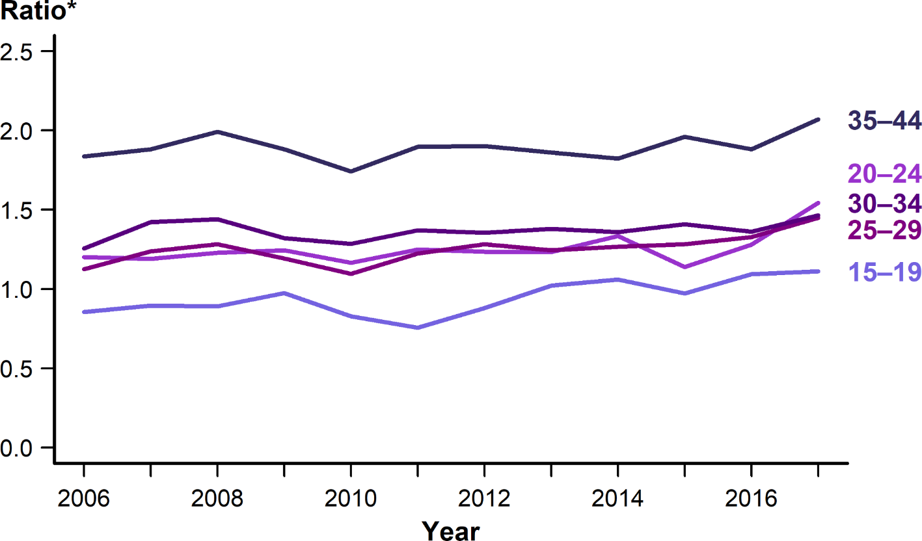
Ectopic Pregnancy — Ratio* Among Commercially Insured Females with Live Births Aged 15–44 Years by Age Group, 2006–2017
* Ratios represent the number of ectopic pregnancy diagnoses per 100,000 live births.
SOURCE: MarketScan Commercial Claims and Encounters Database, Truven Health Analytics, Ann Arbor, MI, 2006–2017.
Notes:
Line graph showing ratio of ectopic pregnancy among commercially insured females with live births aged 15 to 44 years by age group from 2006 to 2017. Data from MarketScan Commercial Claims and Encounters Database suggest that the ratio of ectopic pregnancy diagnoses to commercially insured females aged 15–44 years with live births have marginally increased across all age groups during 2006–2017. As in previous years, in 2017, the highest ratio of ectopic pregnancy diagnoses per 100,000 live births was among women aged 35–44 years.

Slide 9
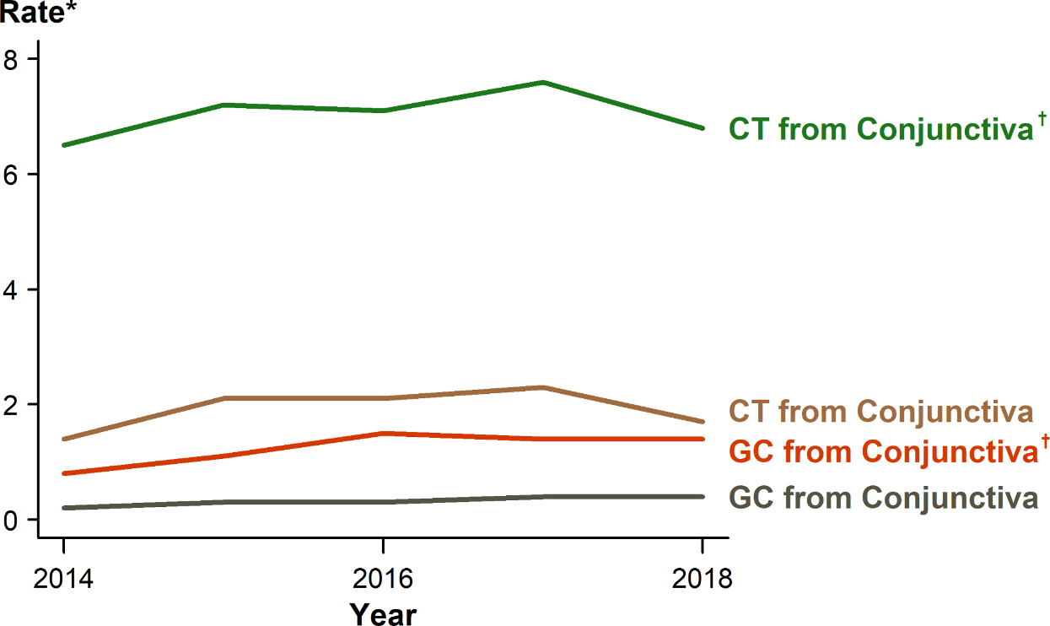
Chlamydia and Gonorrhea — Rates of Reported Cases Among Infants <1 Year of Age by Year and Specimen Source, United States, 2014–2018
* Per 100,000 live births.
† Includes cases with specimen source reported as missing, unknown, or other.
ADAPTED FROM: Kreisel K, Weston E, Braxton J, et al. Keeping an eye on chlamydia and gonorrhea conjunctivitis in infants in the United States, 2010–2015. Sex Transm Dis. 2017;44(6):356–358.
ACRONYMS: CT = Chlamydia; GC = Gonorrhea.
Notes:
Line graph showing rates of reported cases of chlamydia and gonorrhea among United States infants younger than one year of age by year and specimen source. During 2014–2018, 438 chlamydia or gonorrhea cases among infants aged less than one year with a specimen source of either ‘eye’ or ‘conjunctiva’ (conjunctivitis infections) were reported to CDC. The overall reported rate of chlamydial conjunctivitis in infants was relatively stable during 2014–2018, ranging from 1.4 to 2.3 cases per 100,000 live births. Similarly, the rate of gonococcal conjunctivitis in infants remained relatively constant and low during 2014–2018, ranging from 0.2–0.4 cases per 100,000 live births.

Slide 10
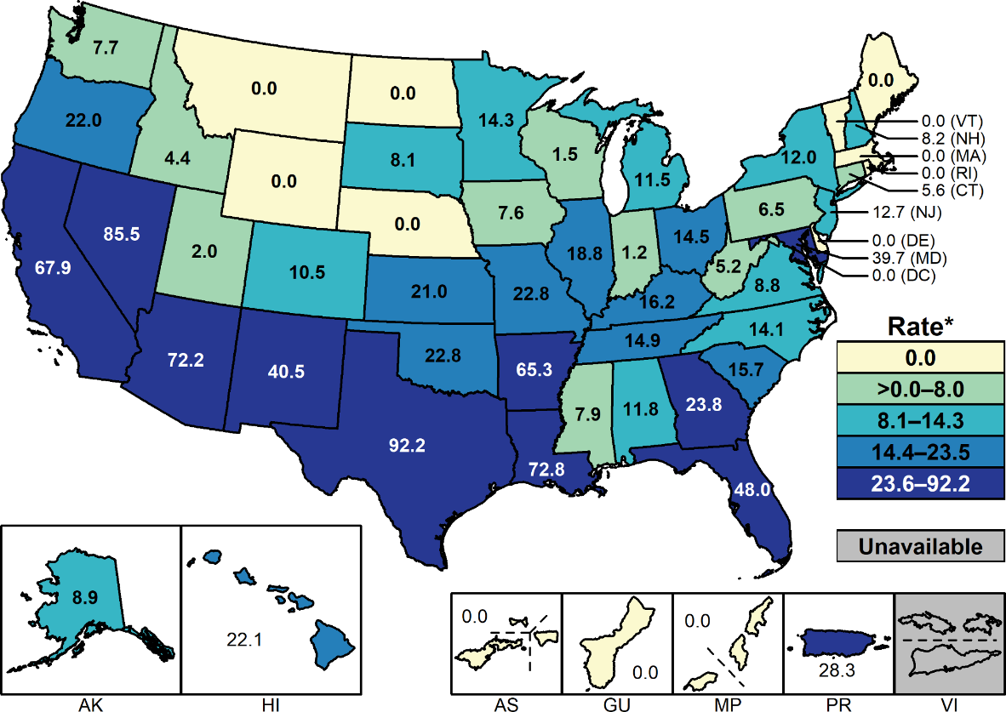
Congenital Syphilis — Rates of Reported Cases by State and Territory, United States, 2018
* Per 100,000 live births.
NOTE: See Section A1.11 in the Appendix for more information on interpreting rates for US territories.
Notes:
United States map showing 2018 rates of reported congenital syphilis cases by state and territory. Rates of reported cases of congenital syphilis ranged from 0.0 to 92.2 cases per 100,000 live births. The highest rates of reported congenital syphilis cases were observed in the West and South.

Slide 11
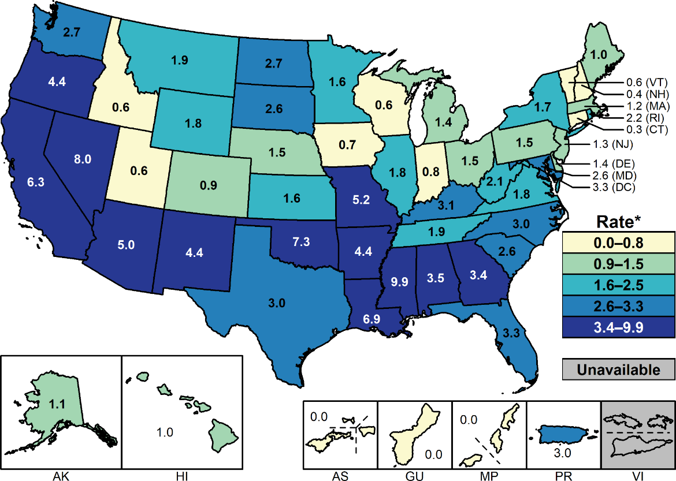
Primary and Secondary Syphilis — Rates of Reported Cases Among Females by State and Territory, United States, 2018
* Per 100,000.
NOTE: See Sections A1.11 in the Appendix for more information on interpreting reported rates in US territories.
Notes:
United States map showing 2018 rates of reported primary and secondary syphilis cases among females by state and territory. Rates of reported primary and secondary syphilis cases among females ranged from 0.0 to 9.9 cases per 100,000 population. The highest rates of reported primary and secondary syphilis cases among females were observed in the West and South.

