Slide 1
Sexually Transmitted Disease
Division of STD Prevention
Surveillance 2018
SYPHILIS

Slide 2
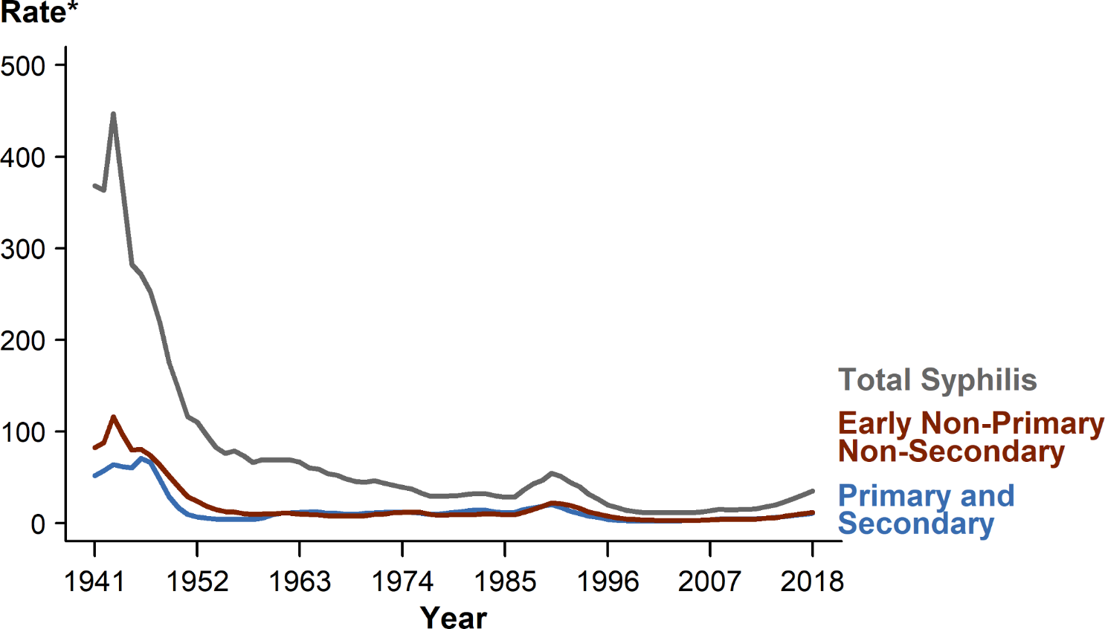
Syphilis — Rates of Reported Cases by Stage of Infection, United States, 1941–2018
* Per 100,000.
NOTE: See section A1.3 in the Appendix for more information on syphilis case reporting.
Notes:
Line graph showing United States rates of reported total syphilis, primary and secondary syphilis, and early non-primary non-secondary syphilis dating back to 1941, when syphilis reporting began; current increases in syphilis can be seen in the context of historically high syphilis rates from the 1940s. In 2018, 115,045 total cases of syphilis representing all stages of disease were reported in the United States; this is the highest number of total syphilis cases recorded since 1991. The 2018 case count for total syphilis reflects a 13.3% increase from 2017 when there were 101,584 cases. Reports of primary and secondary syphilis and early non-primary non-secondary syphilis cases—incident stages of infection—increased as well during 2017–2018.

Slide 3
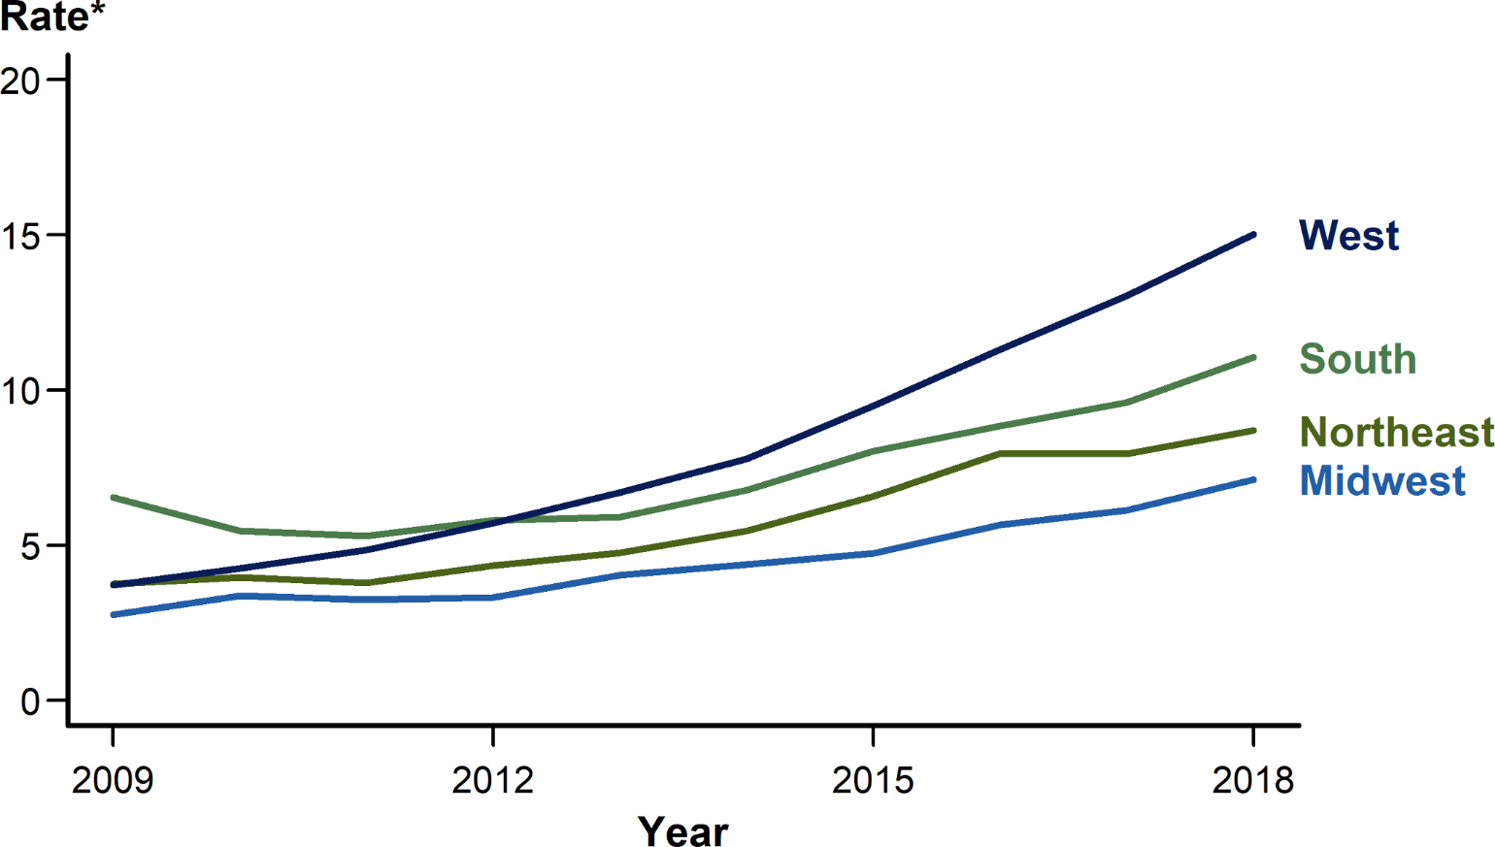
Primary and Secondary Syphilis — Rates of Reported Cases by Region, United States, 2009–2018
* Per 100,000.
Notes:
Line graph showing rates of reported primary and secondary syphilis cases by United States region from 2009 to 2018. In 2018, the West had the highest rate of reported primary and secondary syphilis cases with 15.0 cases per 100,000 population, followed by the South with 11.1 cases per 100,000 population, the Northeast with 8.7 cases per 100,000 population, and the Midwest with 7.1 cases per 100,000 population. During 2017–2018, the primary and secondary syphilis rate increased 16.4% in the Midwest, 15.6% in the South, 15.4% in the West, and 10.1% in the Northeast.

Slide 4
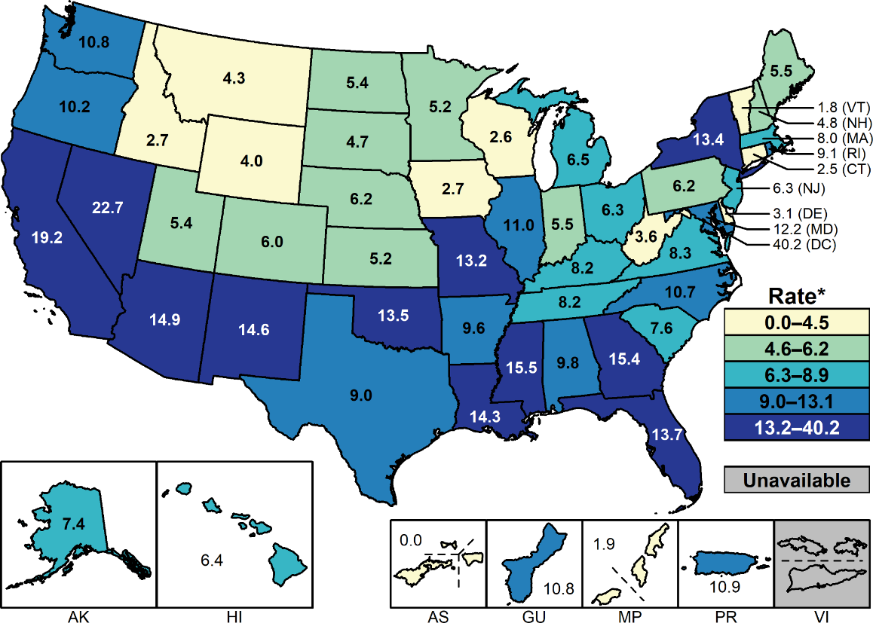
Primary and Secondary Syphilis — Rates of Reported Cases by State and Territory, United States, 2018
* Per 100,000.
NOTE: Section A1.11 in the Appendix for more information on interpreting reported rates in US territories.
Notes:
United States map showing 2018 rates of reported primary and secondary syphilis cases by state and territory. Rates of reported primary and secondary syphilis cases per 100,000 population ranged by state from 1.8 in Vermont to 22.7 in Nevada. The rate of reported primary and secondary syphilis cases in the District of Columbia was 40.2 cases per 100,000 population.

Slide 5
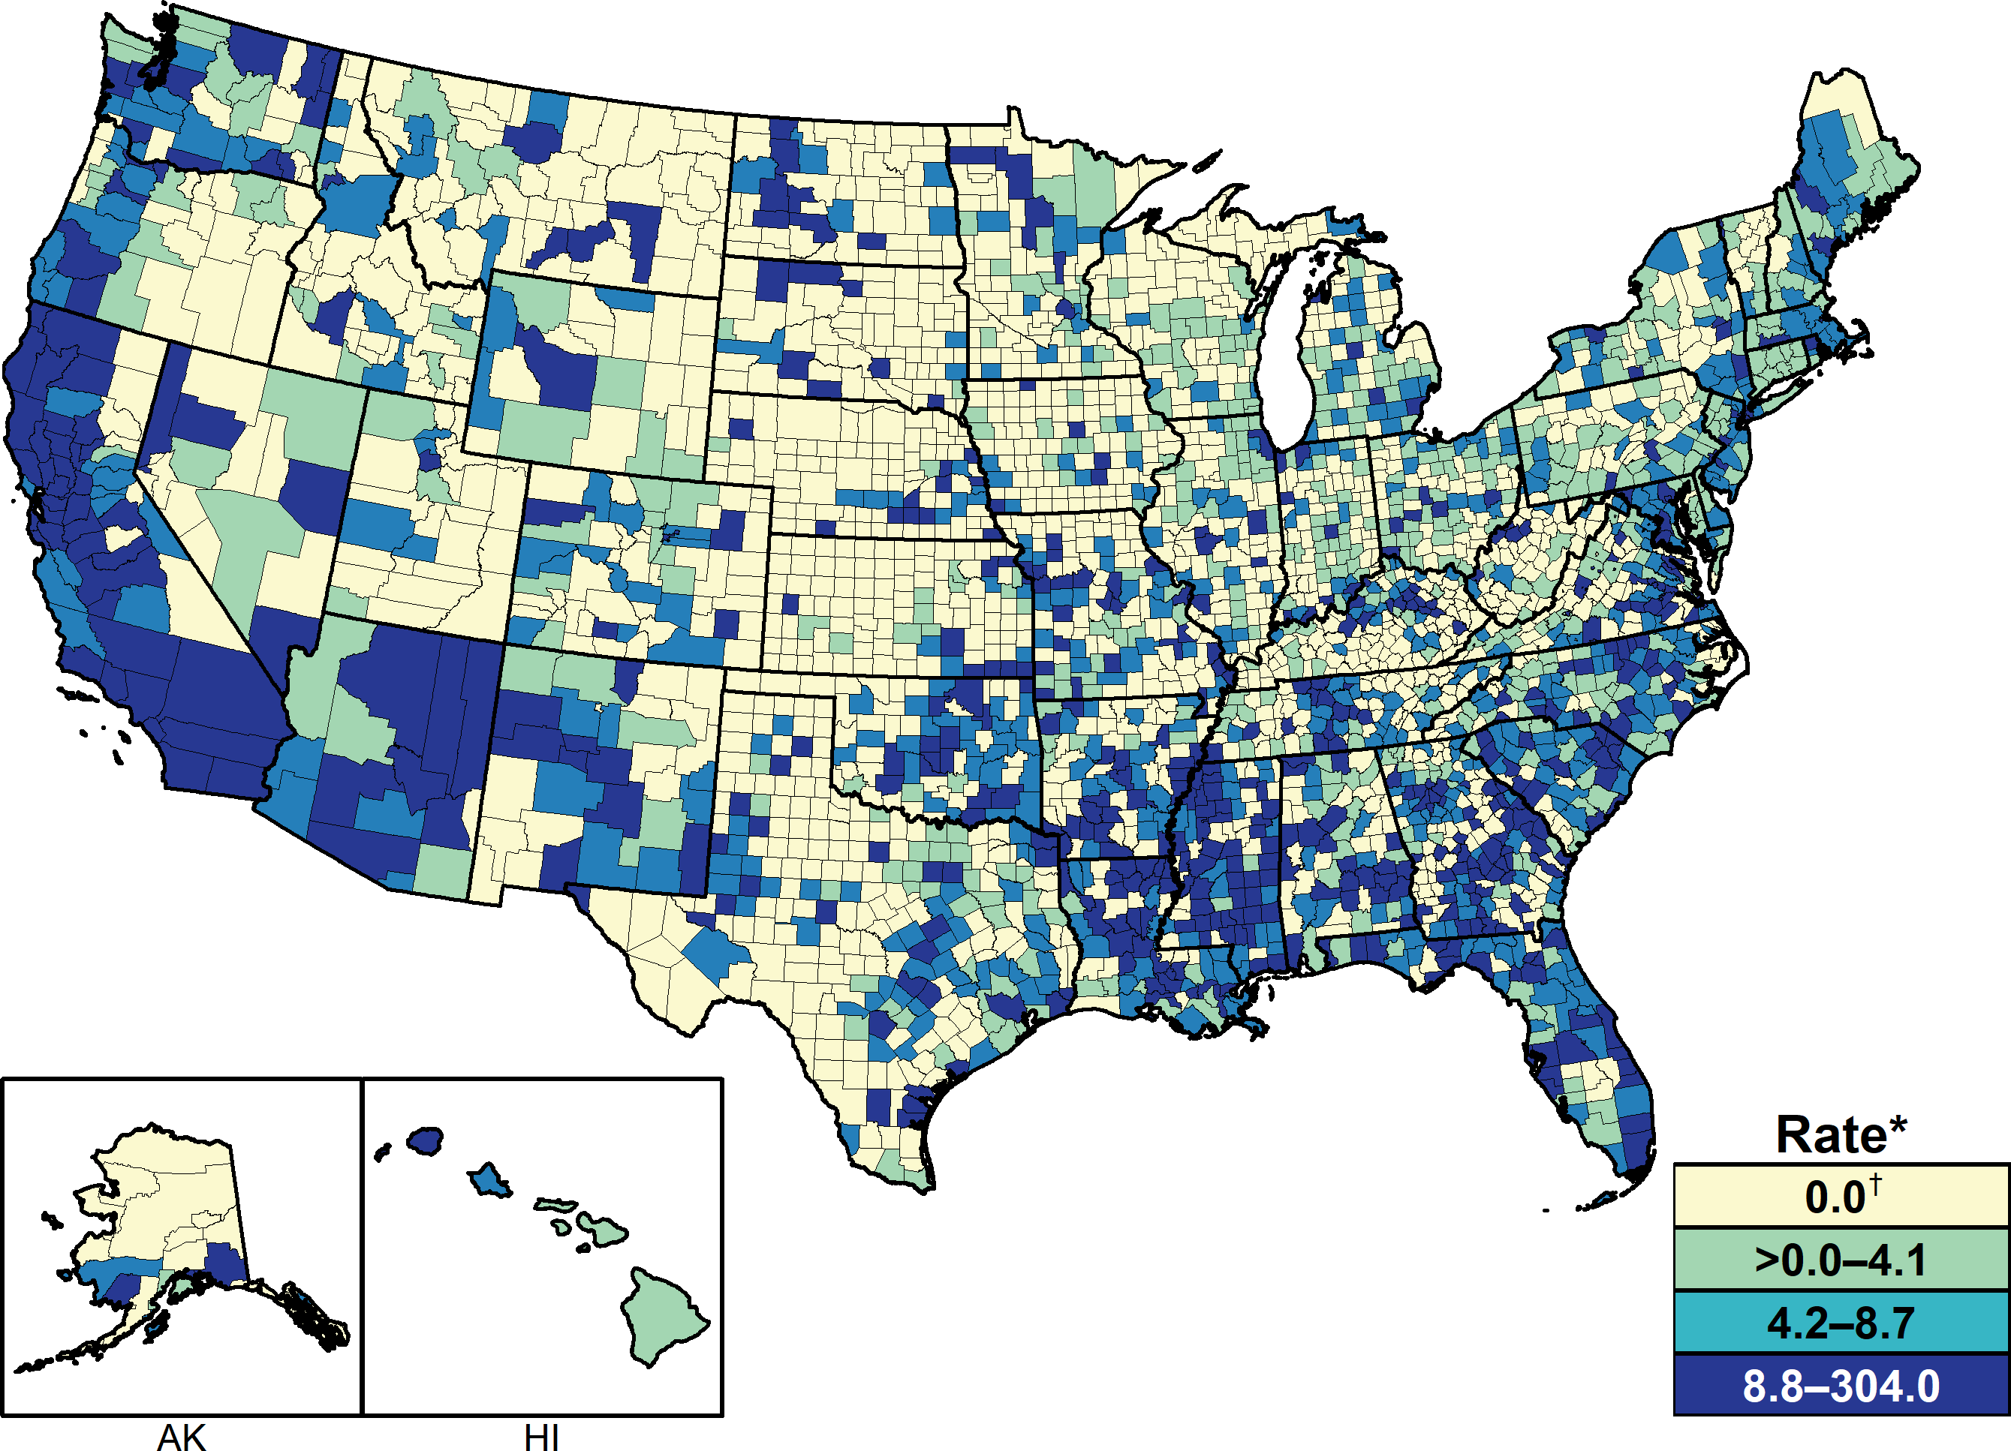
Primary and Secondary Syphilis — Rates of Reported Cases by County, United States, 2018
* Per 100,000.
† In 2018, 1,498 (47.7%) of 3,142 counties in the United States reported no cases of primary and secondary syphilis. See section A1.4 in the Appendix for more information on county-level rates.
Notes:
United States map showing 2018 rates of reported primary and secondary syphilis cases by county; morbidity ranged from 0 to 304 cases per 100,000 population. In 2018, 61.5% of reported primary and secondary syphilis cases occurred in 70 counties or independent cities. Of 3,142 counties in the United States, 556 (17.7%) had a primary and secondary syphilis rate of 8.8 cases per 100,000 population or greater, 557 (17.7%) reported a rate from 4.2 to 8.7 cases per 100,000 population, 531 (17.0%) reported a rate from more than 0.0 to 4.1 cases per 100,000 population, and 1,498 (47.7%) counties reported no cases of primary and secondary syphilis in 2018.

Slide 6
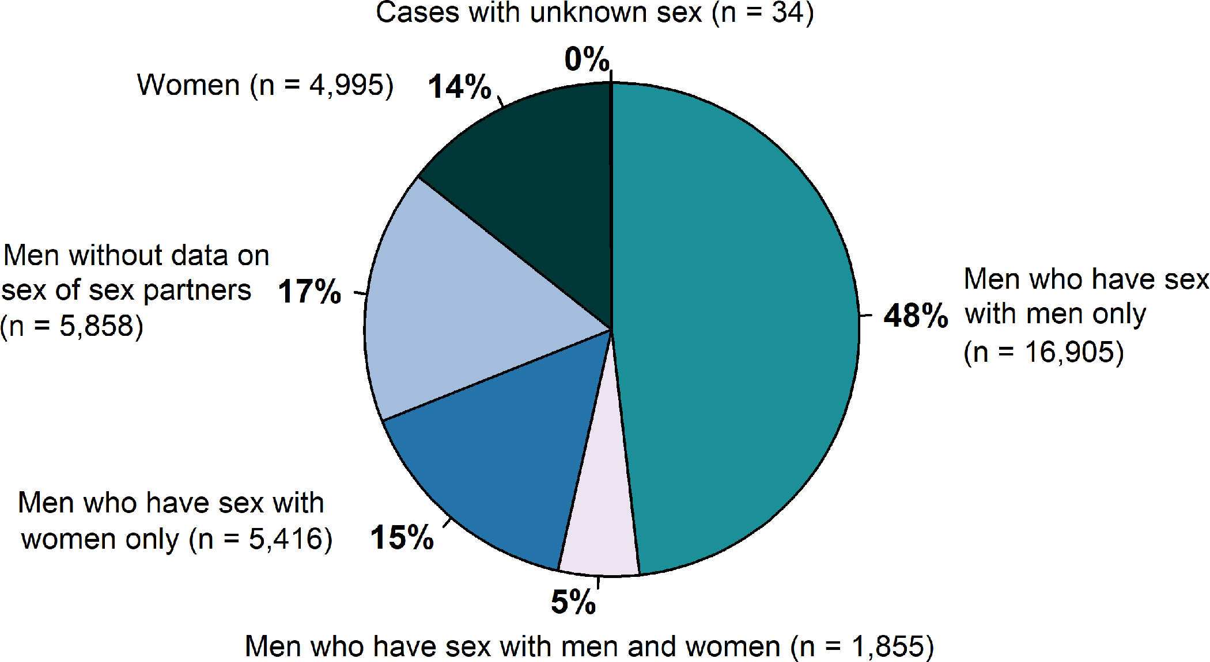
Primary and Secondary Syphilis — Distribution of Cases by Sex and Sex of Sex Partners, United States, 2018
Notes:
Pie graph showing the distribution of primary and secondary syphilis cases by sex and sex of sex partners in the United States in 2018. Men accounted for 85.7 % of reported primary and secondary syphilis cases. Of 35,063 reported primary and secondary syphilis cases in 2018, 18,760 (53.5%) were among men who have sex with men, including 16,905 (48.2%) cases among men who had sex with men only and 1,855 (5.3%) cases among men who have sex with both men and women. Overall, 5,416 (15.4%) cases were among men who have sex with women only, 4,995 (14.2%) were among women, 5,858 (17%) were among men without information about sex of sex partners, and 34 (0.1%) were cases reported with unknown sex. Among the 24,176 male cases with information on sex of sex partners, 77.6% occurred among men who have sex with men.

Slide 7
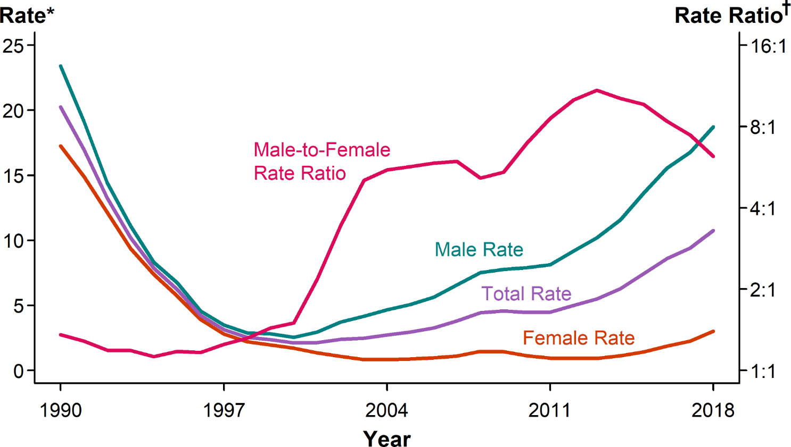
Primary and Secondary Syphilis — Rates of Reported Cases by Sex and Male-to-Female Rate Ratios, United States, 1990–2018
* Per 100,000.
† Log scale.
Notes:
Line graph showing rates of reported primary and secondary syphilis cases by sex as well as the male-to-female rate ratio in the United States during 1990 to 2018. Among men, the rate of primary and secondary syphilis has increased every year since 2000, increasing 11.3% during 2017–2018. In contrast, the primary and secondary syphilis rate among women fluctuated between 0.8 and 1.7 cases per 100,000 females during 2000–2013, but has increased substantially since 2013. During 2014–2018, the primary and secondary syphilis rate among women more than doubled (172.7% increase). Although the male-to-female rate ratio for primary and secondary syphilis increased from 1990 to 2013, the rate ratio is now declining due to the increasing rate of female syphilis.

Slide 8
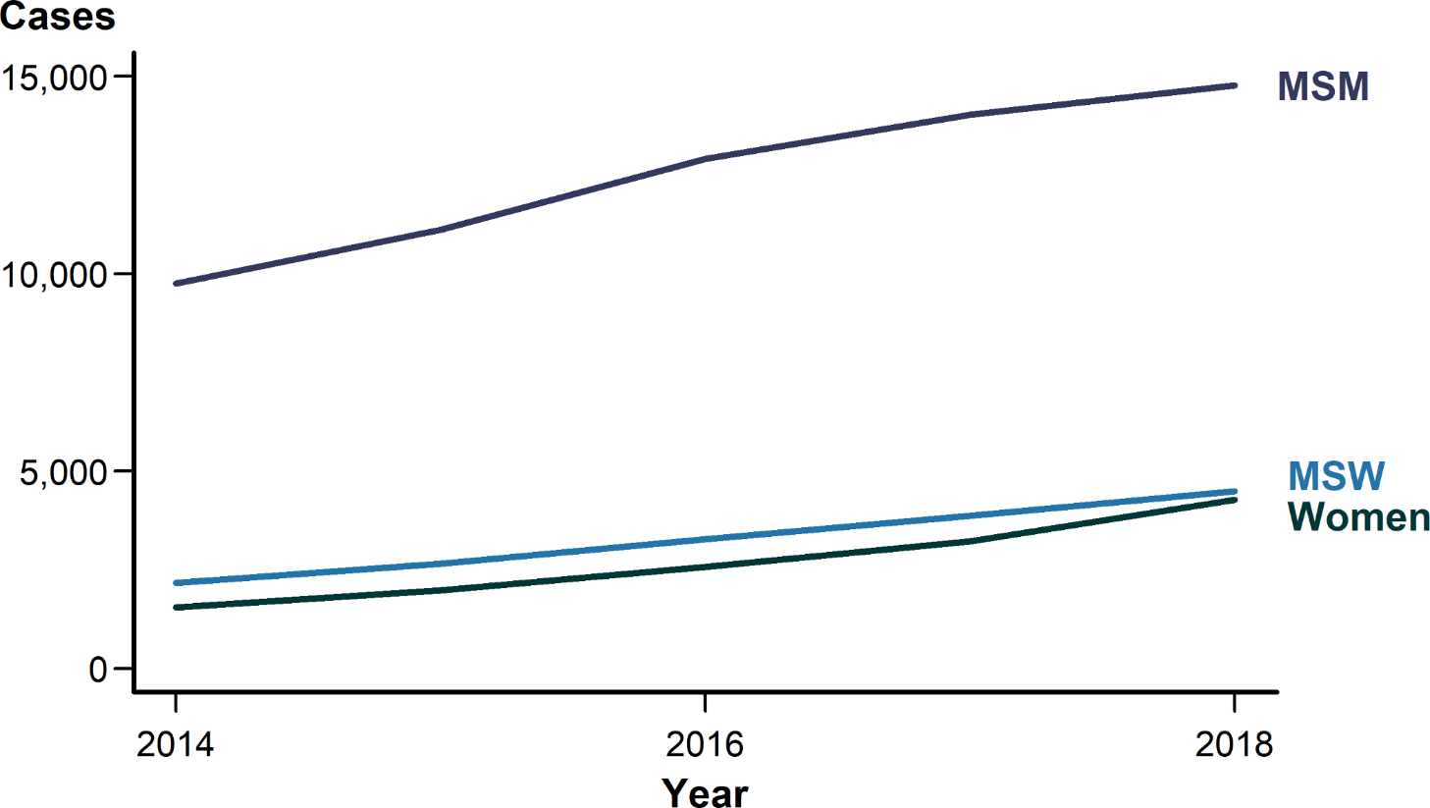
Primary and Secondary Syphilis — Reported Cases by Sex and Sex of Sex Partners, 36 States*, 2014–2018
* 36 states were able to classify ≥70% of reported cases of primary and secondary syphilis as either MSM, MSW, or women for each year during 2014–2018.
ACRONYMS: MSM = Gay, bisexual, and other men who have sex with men; MSW = Men who have sex with women only.
Notes:
Line graph showing reported cases of primary and secondary syphilis from 2014 to 2018 among the 36 states that consistently classified sex and sex of sex partners for 70% or more of reported cases. In these 36 states, the number of primary and secondary cases increased 5.3% among men who have sex with men, 16.3% among men who have sex with women only, and 32.9% among women during 2017–2018.

Slide 9
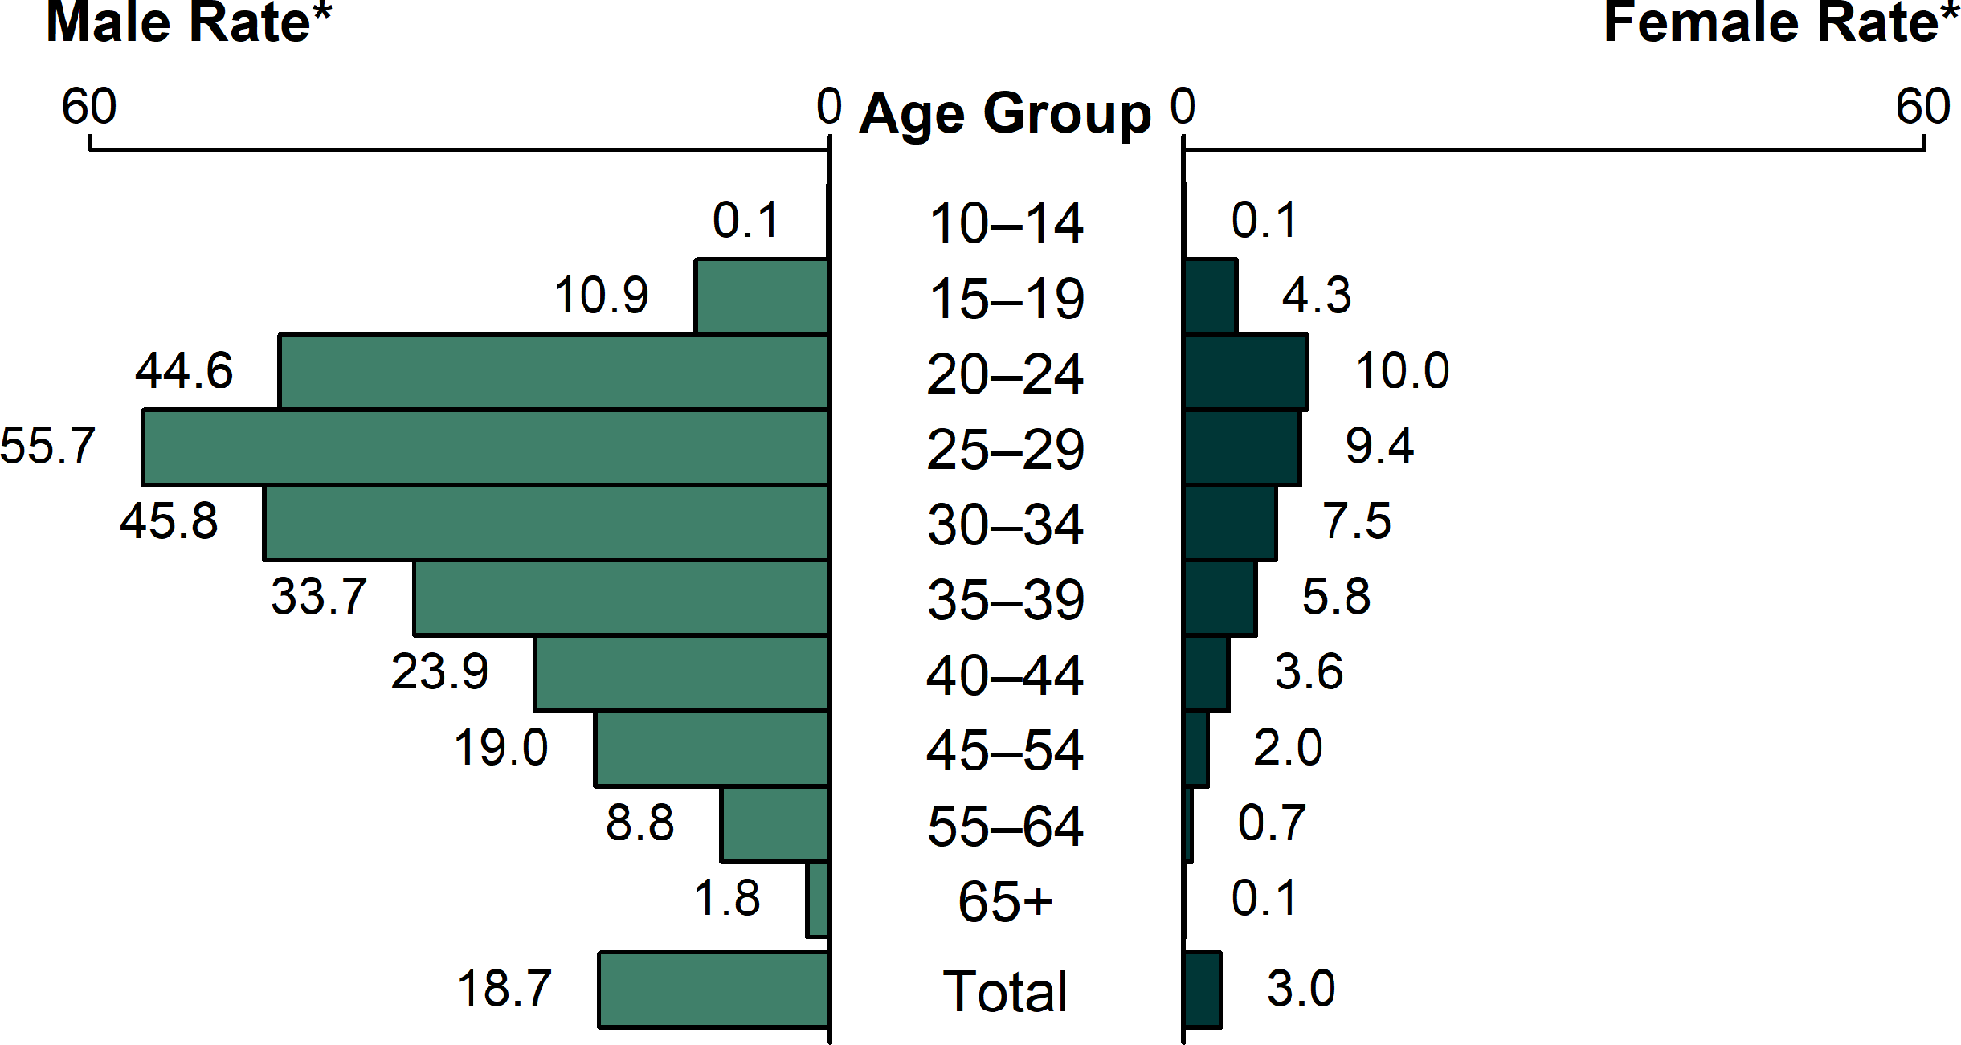
Primary and Secondary Syphilis — Rates of Reported Cases by Age Group and Sex, United States, 2018
* Per 100,000.
Notes:
Bar graph showing rates of reported primary and secondary syphilis cases by age group and sex in the United States in 2018. The highest rates were observed among men aged 25–29 years with 55.7 cases per 100,000 males, men aged 30–34 years with 45.8 cases per 100,000 males, and men aged 20–24 years with 44.6 cases per 100,000 males. The highest rates among females were among those aged 20–24 years with 10.0 cases per 100,000 females and those aged 25–29 years with 9.4 cases per 100,000 females.

Slide 10
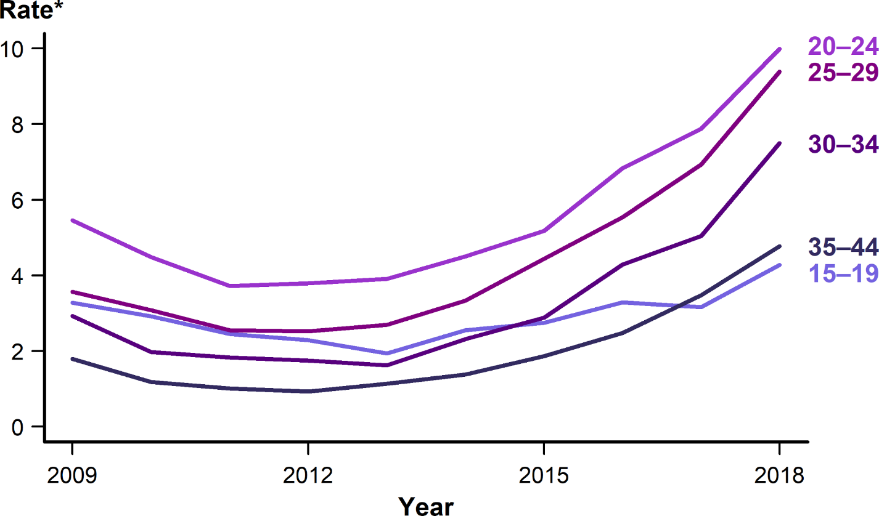
Primary and Secondary Syphilis — Rates of Reported Cases Among Females Aged 15–44 Years by Age Group, United States, 2009–2018
* Per 100,000.
Notes:
Line graph showing rates of reported primary and secondary syphilis cases among females aged 15–44 years by age group during 2009 to 2018. During 2017–2018, the rate of reported primary and secondary syphilis cases among females aged 15–44 increased in all age groups. All age groups followed a similar U-shaped pattern with declines that reached their nadir in 2012 or 2013 and peaked in 2018.

Slide 11
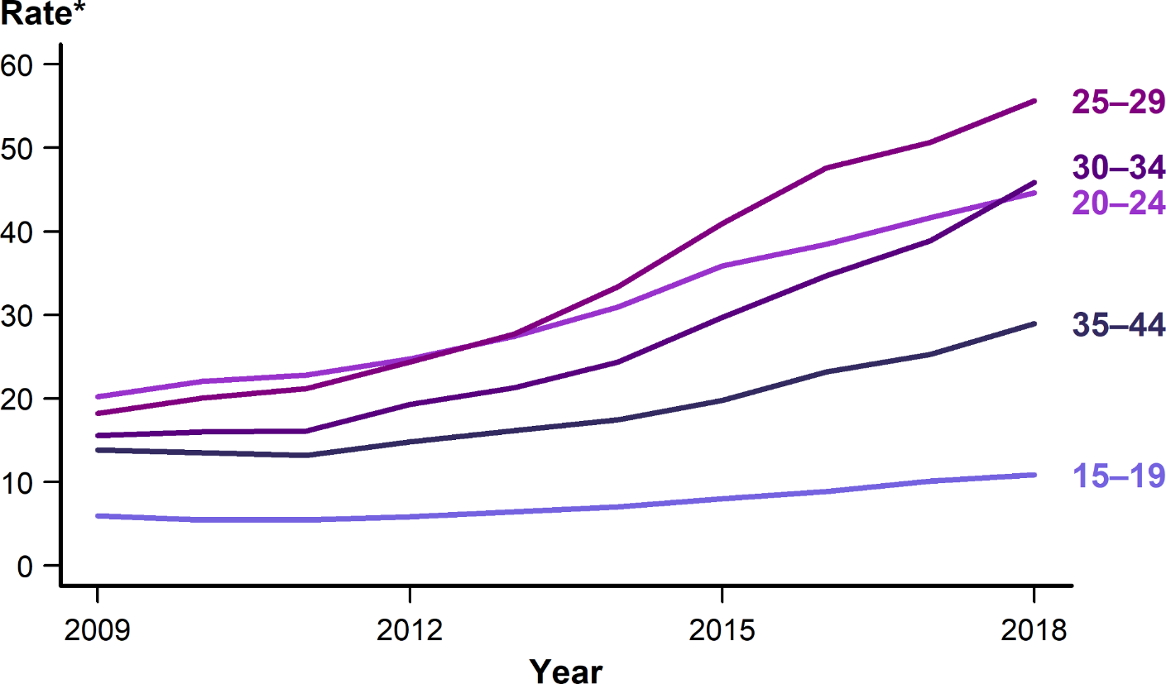
Primary and Secondary Syphilis — Rates of Reported Cases Among Males Aged 15–44 Years by Age Group, United States, 2009–2018
* Per 100,000.
Notes:
Line graph showing rates of reported primary and secondary syphilis cases among males aged 15–44 years by age group during 2009 to 2018. During 2017–2018, the rate of reported primary and secondary syphilis cases among females aged 15–44 increased in all age groups. All age groups followed a similar pattern with linear increases of different slope over the 10-year period.

Slide 12
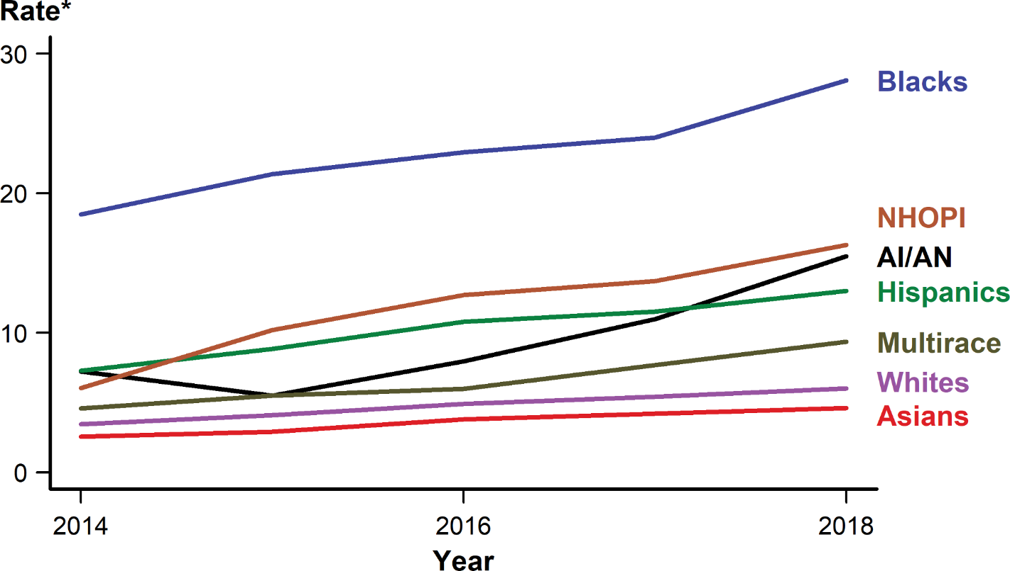
Primary and Secondary Syphilis — Rates of Reported Cases by Race/Hispanic Ethnicity, United States, 2014–2018
* Per 100,000.
NOTE: See Section A1.5 in the Appendix for information on reporting STD case data for race/Hispanic ethnicity.
ACRONYMS: AI/AN = American Indians/Alaska Natives; NHOPI = Native Hawaiians/Other Pacific Islanders.
Notes:
Line graph showing rates of reported primary and secondary syphilis cases by race/Hispanic ethnicity in the United States during 2014 to 2018. The primary and secondary syphilis rate increased among all race/Hispanic ethnicity groups over the 5-year period. During 2017–2018, American Indians/Alaska Natives increased 40.9%, those who identified as Multirace increased 22.1%, Native Hawaiians/Other Pacific Islanders increased 19.0%, Whites increased 11.1%, Blacks increased 17.1%, Hispanics increased 13.0%, and Asians increased 9.5%.

Slide 13
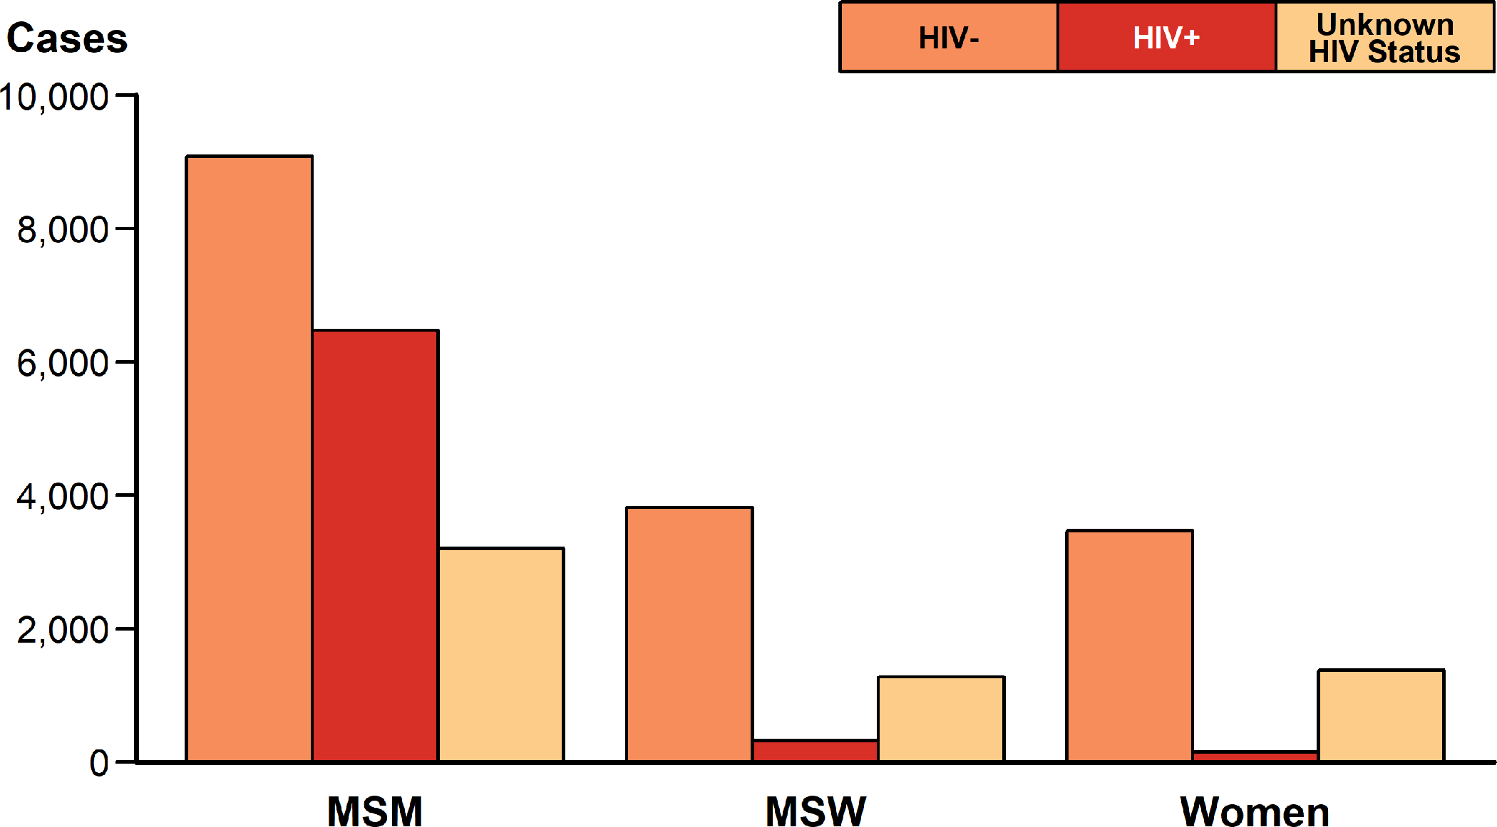
Primary and Secondary Syphilis — Reported Cases by Sex and Sex of Sex Partners and HIV Status, United States, 2018
ACRONYMS: MSM = Gay, bisexual, and other men who have sex with men; MSW = Men who have sex with women only.
Notes:
Bar graph showing reported cases of primary and secondary syphilis by sex and sex of sex partners and HIV status in the United States in 2018. Among cases with known HIV status, 41.6% of cases among men who have sex with men were HIV-positive, compared with 7.9% of cases among men who have sex with women only, and 4.0% of cases among women.

Slide 14
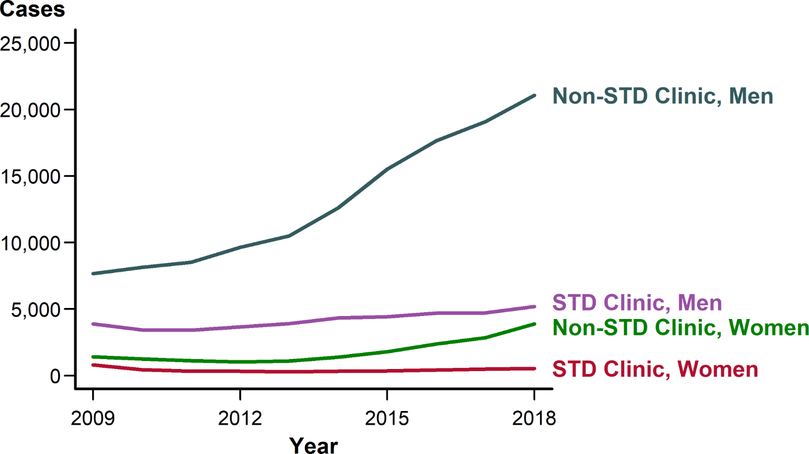
Primary and Secondary Syphilis — Reported Cases by Reporting Source and Sex, United States, 2009–2018
Notes:
Line graph showing reported cases of primary and secondary syphilis by reporting source and sex in the United States during 2009 to 2018. The number of cases reported from STD clinics has remained relatively stable for males and females during this time while the number of cases reported from non-STD clinics has increased for both males and females.

Slide 15
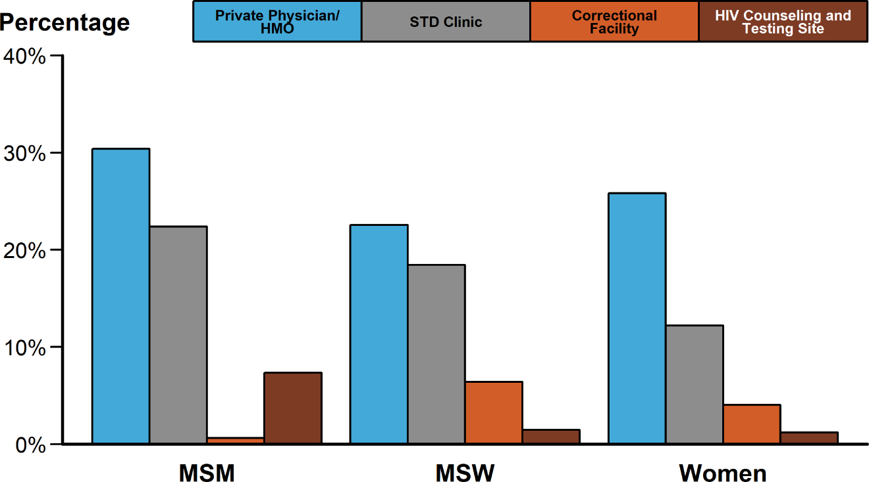
Primary and Secondary Syphilis — Percentage of Reported Cases* by Sex and Sex of Sex Partners and Selected Reporting Sources, United States, 2018
* Of all primary and secondary syphilis cases, 12.5% had a missing or unknown reporting source. Among all cases with a known reporting source, the reporting source categories presented represent 55.4% of cases.
ACRONYMS: HMO = Health maintenance organization; MSM = Gay, bisexual, and other men who have sex with men; MSW = Men who have sex with women only.
Notes:
Bar graph showing the percentage of reported cases of primary and secondary syphilis by sex and sex of sex partners and selected reporting sources. The selected reporting sources include private physicians/health maintenance organizations, STD clinics, correctional facilities, and HIV counseling and testing sites. Of cases reported among men who have sex with men, private physicians/health maintenance organizations and STD clinics reported the highest proportion of cases at 30.4% and 22.4% of cases, respectively. Although private physicians/health maintenance organizations and STD clinics are also the most common reporting sources for women and men who have sex with women, correctional facilities make up a more significant reporting source in these two groups.

Slide 16
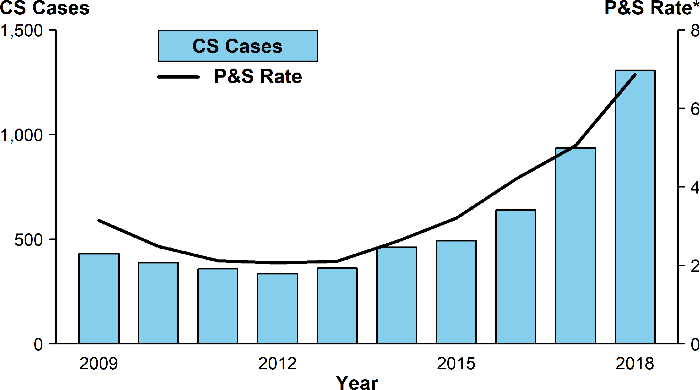
Congenital Syphilis — Reported Cases by Year of Birth and Rates of Reported Cases of Primary and Secondary Syphilis Among Females Aged 15–44 Years, United States, 2009–2018
* Per 100,000.
ACRONYMS: CS = Congenital syphilis; P&S = Primary and secondary syphilis.
Notes:
Bar graph showing reported cases of congenital syphilis by year of birth and rates of reported cases of primary and secondary syphilis among females aged 15–44 years in the United States from 2009 to 2018. Cases of congenital syphilis are represented by a bar graph and rates of syphilis among females are represented by a super-imposed line graph. In 2018, there were a total of 1,306 reported cases of congenital syphilis. As has been noted historically, this graph shows similar, parallel patterns of change for female syphilis rates and congenital syphilis case-counts. Both declined from 2009 until 2012 or 2013 and both increased, in parallel, through 2018.

