Slide 1
Sexually Transmitted Disease
Division of STD Prevention
Surveillance 2018
STDs in Racial and Ethnic Minorities

Slide 2
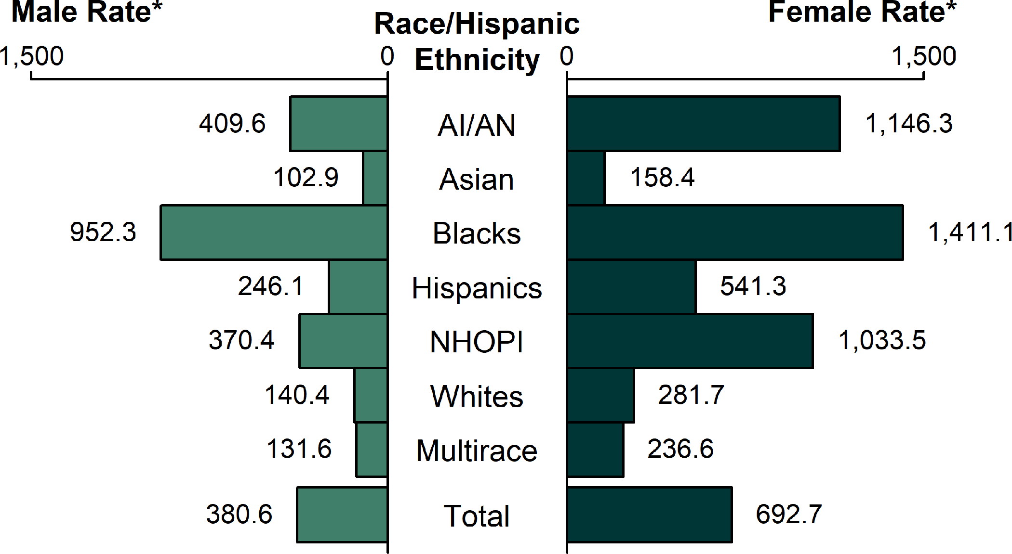
Chlamydia — Rates of Reported Cases by Race/Hispanic Ethnicity and Sex, United States, 2018
* Per 100,000.
NOTE: See Section A1.5 in the Appendix for information on race/Hispanic ethnicity in STD case reporting.
ACRONYMS: AI/AN = American Indians/Alaska Natives; NHOPI = Native Hawaiians/Other Pacific Islanders.
Notes:
Bar graph showing rates of reported cases of chlamydia by race/Hispanic ethnicity and sex in the United States. In 2018, the overall rate of reported chlamydia cases among Blacks in the United States was 1,192.5 cases per 100,000 population. The rate of reported chlamydia cases among Black females was five times the rate among White females (1,411.1 and 281.7 cases per 100,000 population, respectively). The rate of reported chlamydia cases among Black males was 6.8 times the rate among White males (952.3 and 140.4 cases per 100,000 population, respectively).

Slide 3
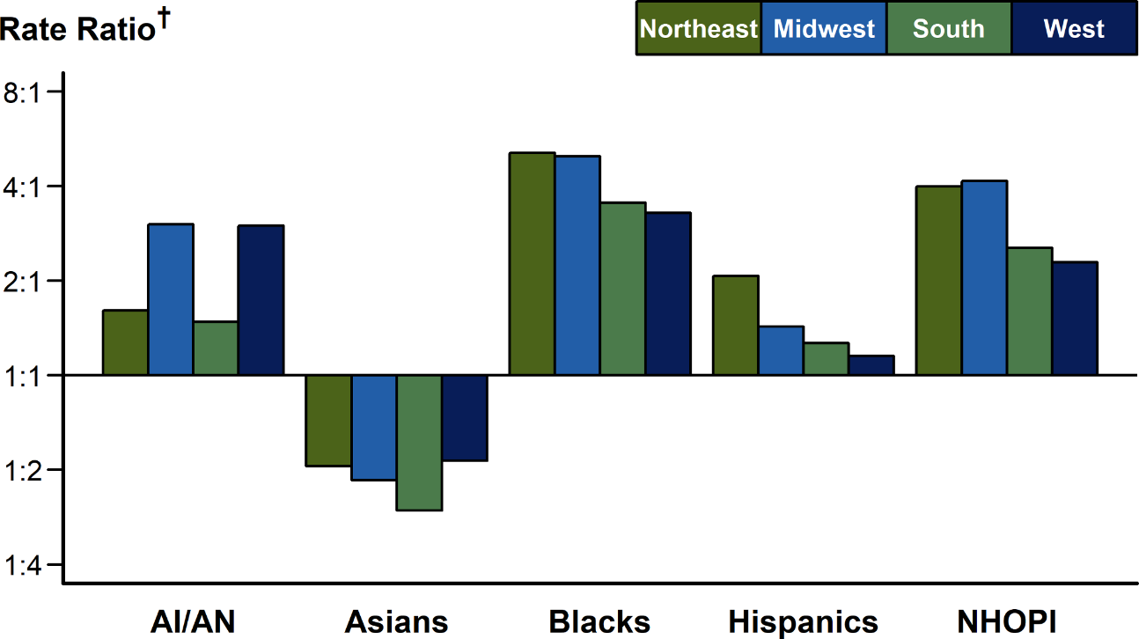
Chlamydia — Rate Ratios* Among Females Aged 15–24 Years by Race/Hispanic Ethnicity and Region, United States, 2018
* For the rate ratios, Whites are the reference population.
† Y-axis is log scale.
NOTE: See Section A1.5 in the Appendix for information on reporting STD case data for race/Hispanic ethnicity.
ACRONYMS: AI/AN = American Indians/Alaska Natives; NHOPI = Native Hawaiians/Other Pacific Islanders.
Notes:
Bar graph showing rate ratios of chlamydia among females aged 15 to 24 years by race/Hispanic ethnicity and United States region. Among females aged 15–24 years, the population targeted for chlamydia screening, rate ratios of chlamydia were highest among Blacks in all United States regions.

Slide 4
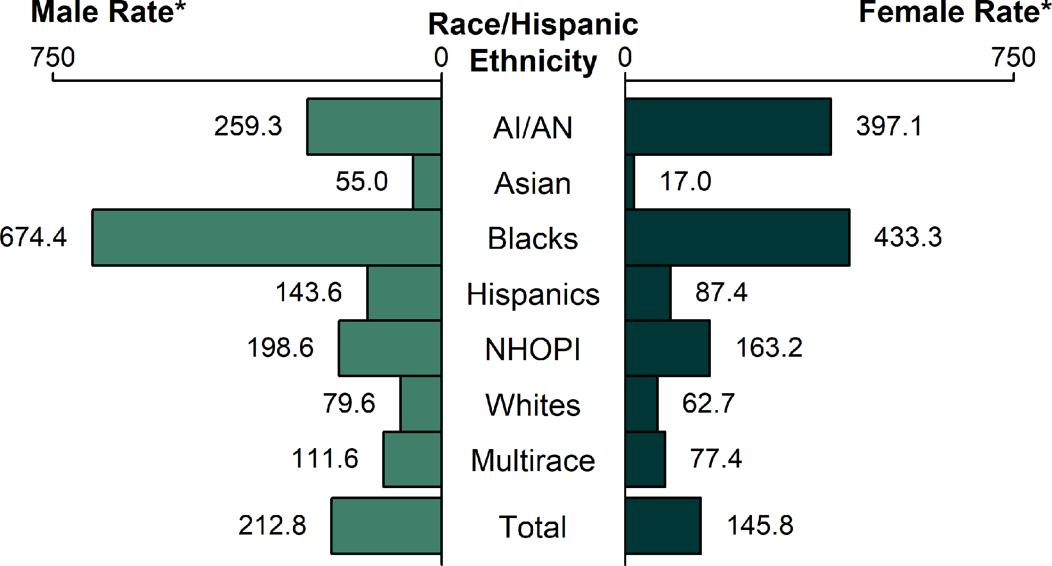
Gonorrhea — Rates of Reported Cases by Race/Hispanic Ethnicity and Sex, United States, 2018
* Per 100,000.
NOTE: See Section A1.5 in the Appendix for information on race/Hispanic ethnicity in STD case reporting.
ACRONYMS: AI/AN = American Indians/Alaska Natives; NHOPI = Native Hawaiians/Other Pacific Islanders.
Notes:
Bar graph showing rates of reported cases of gonorrhea by race/Hispanic ethnicity and sex in the United States. In 2018, the disparity between gonorrhea rates for Blacks and Whites was larger for Black males (8.5 times the rate among White males) than Black females (6.9 times the rate among White females). The disparity between gonorrhea rates for American Indians/Alaska Natives and Whites was larger for American Indians/Alaska Native females (6.3 times the rate among White females) than for American Indians/Alaska Native males (3.3 times the rate among White males). The disparity between gonorrhea rates for Native Hawaiians/Other Pacific Islanders and Whites was larger for Native Hawaiians/Other Pacific Islander females (2.6 times the rate among White females) and Native Hawaiians/Other Pacific Islander males (2.5 times the rate among White males). The disparity between gonorrhea rates for Hispanics and Whites was larger for Hispanic females (1.4 times the rate among White females) and Hispanic males (1.8 times the rate among White males). The disparity between gonorrhea rates for Asians and Whites was larger for Asian females (0.3 times the rate among White females) than for Asian males (0.7 times the rate among White males).

Slide 5
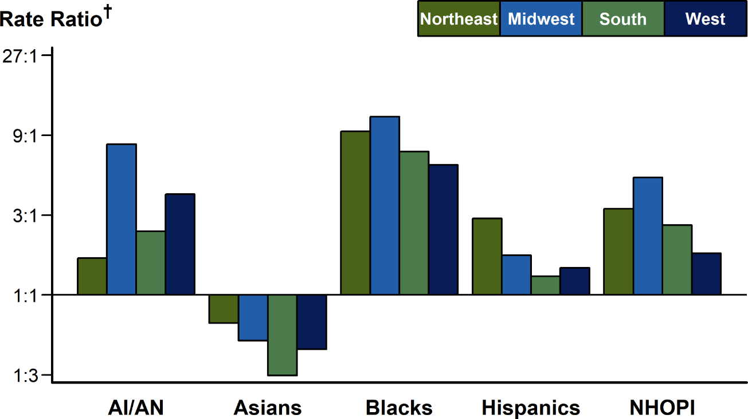
Gonorrhea — Rate Ratios* by Race/Hispanic Ethnicity and Region, United States, 2018
* For the rate ratios, Whites are the reference population.
† Y-axis is log scale.
NOTE: See Section A1.5 in the Appendix for information on race/Hispanic ethnicity in STD case reporting.
ACRONYMS: AI/AN = American Indians/Alaska Natives; NHOPI = Native Hawaiians/Other Pacific Islanders.
Notes:
Bar graph showing rate ratios of gonorrhea by race/Hispanic ethnicity and United States region. As in previous years, the disparity in gonorrhea rates for Blacks in 2018 was larger in the Midwest and Northeast than in the South and West. The disparity in gonorrhea rates for American Indian/Alaska Natives and Native Hawaiians/Other Pacific Islanders, each, was larger in the Midwest than in the West, Northeast, and South. The disparity in gonorrhea rates for Hispanics was higher in the Northeast than in the Midwest, South, and West. In 2018, gonorrhea rates among Asians were lower than rates among Whites in all four regions of the United States.

Slide 6
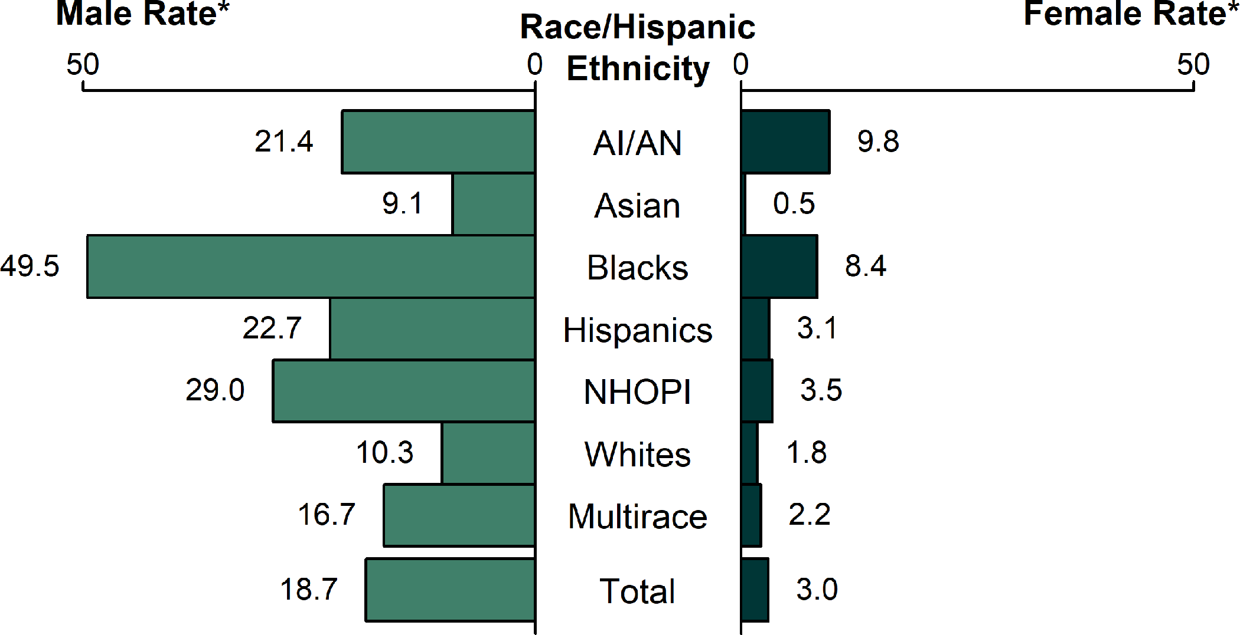
Primary and Secondary Syphilis — Rates of Reported Cases by Race/Hispanic Ethnicity and Sex, United States, 2018
* Per 100,000.
NOTE: See Section A1.5 in the Appendix for information on reporting STD case data for race/Hispanic ethnicity.
ACRONYMS: AI/AN = American Indians/Alaska Natives; NHOPI = Native Hawaiians/Other Pacific Islanders.
Notes:
Bar graph showing rates of reported primary and secondary syphilis cases by race/Hispanic ethnicity and sex in the United States in 2018. The highest rates overall were observed among Black men with 49.5 cases per 100,000 males and and Native Hawaiian Other Pacific Islander men with 29.0 cases per 100,000 males. The highest rates among women were among American Indian/Alaska Natives with 9.8 cases per 100,000 females and Blacks with 8.4 cases per 100,000 females. In general, non-White males and females have a disproportionate burden of reported primary and secondary syphilis relative to White males and females. The only sub-groups with rates lower than their White counterparts are Asian males and females.

Slide 7
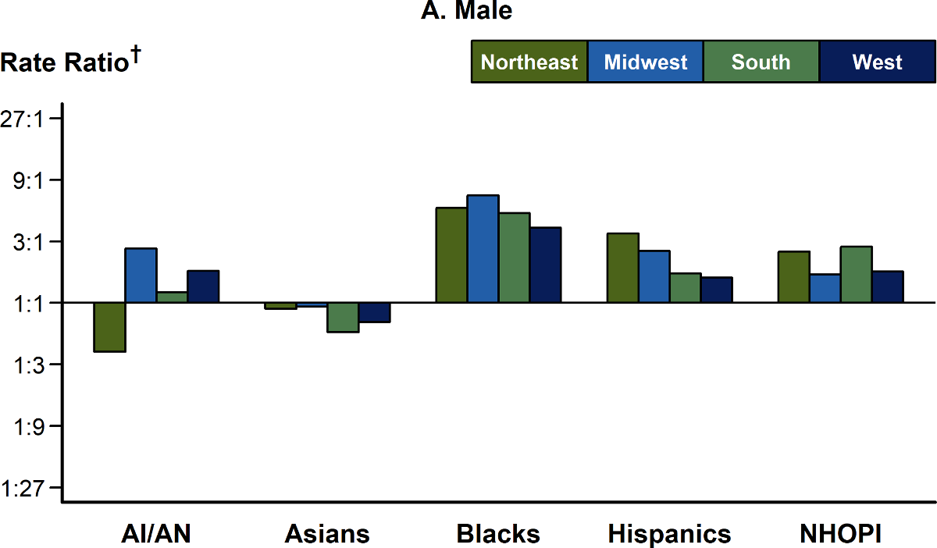
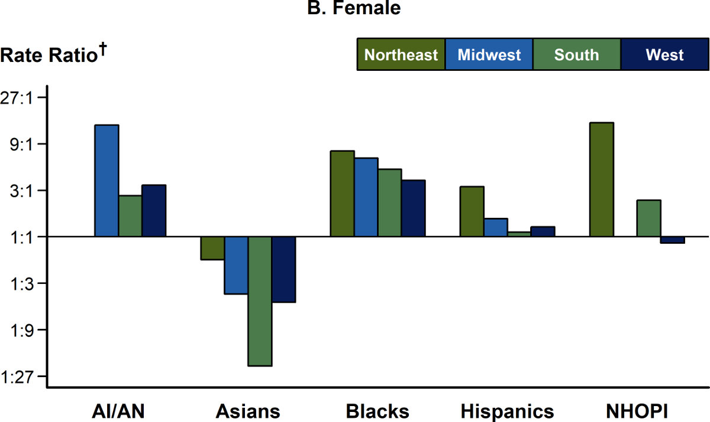
Primary and Secondary Syphilis — Rate Ratios* by Sex, Race/Hispanic Ethnicity, and Region, United States, 2018
* For the rate ratios, Whites are the reference population.
† Y-axis is log scale.
NOTE: See Section A1.5 in the Appendix for information on reporting STD case data for race/Hispanic ethnicity.
ACRONYMS: AI/AN = American Indians/Alaska Natives; NHOPI = Native Hawaiians/Other Pacific Islanders.
Notes:
Two-panel figure showing rate ratios of primary and secondary syphilis by sex, race/Hispanic ethnicity, and United States region. These two sets of bar graphs, one for males and one for females, depict the racial rate ratios of reported cases of primary and secondary syphilis by region in 2018. Across both sexes, the rates of reported primary and secondary syphilis cases among American Indians/Alaska Natives, Blacks, Hispanics, and Native Hawaiians/Other Pacific Islanders were higher than the rate among Whites in 2018. Similar disparities were seen in all regions of the United States.

Slide 8
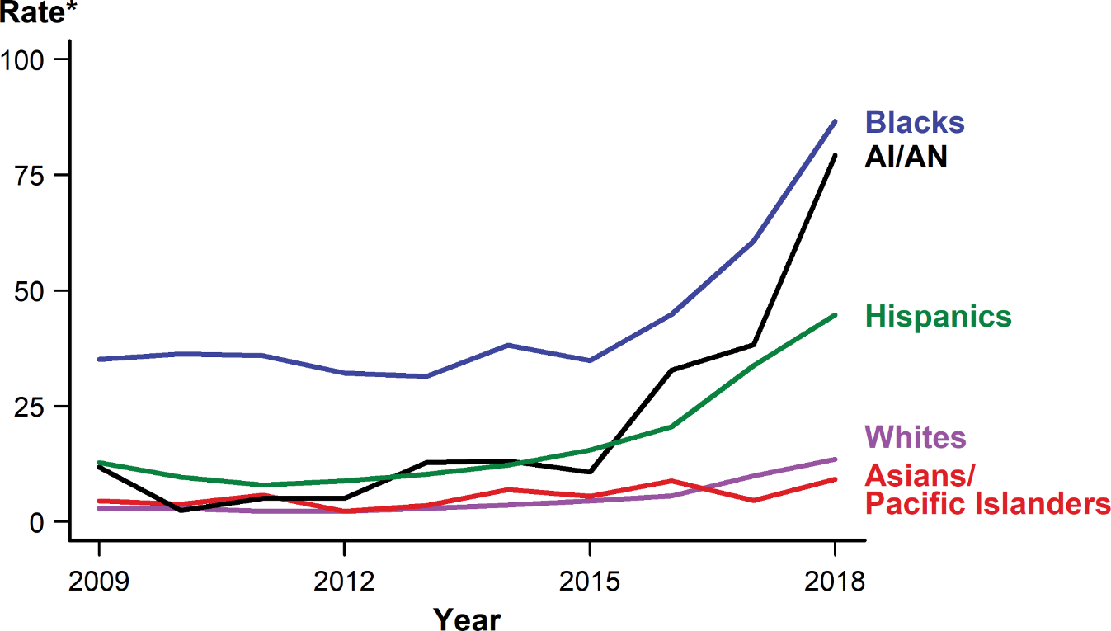
Congenital Syphilis — Rates of Reported Cases by Year of Birth and Race/Hispanic Ethnicity of Mother, United States, 2009–2018
* Per 100,000 live births.
NOTE: National Center for Health Statistics bridged race categories are presented to allow the display of data across several years. See Section A1.5 in the Appendix for information on reporting STD case data for race/Hispanic ethnicity.
ACRONYMS: AI/AN = American Indians/Alaska Natives.
Notes:
Line graph showing rates of reported congenital syphilis cases by year of birth and race/Hispanic ethnicity in the United States during 2009 to 2018. Rates of reported congenital syphilis cases increased for all race/Hispanic ethnicity groups during 2014–2018, including a 500% increase among American Indians/Alaska Natives (from 13.2 to 79.2 cases per 100,000 live births), a 275% increase among Whites (from 3.6 to 13.5 cases per 100,000 live births), a 263% among Hispanics (from 12.3 to 44.7 cases per 100,000 live births), a 127% increase among Blacks (from 38.2 to 86.6 cases per 100,000 live births), and a 31% increase among Asian/Pacific Islanders (from 7.0 to 9.2 cases per 100,000 live births).

Slide 9
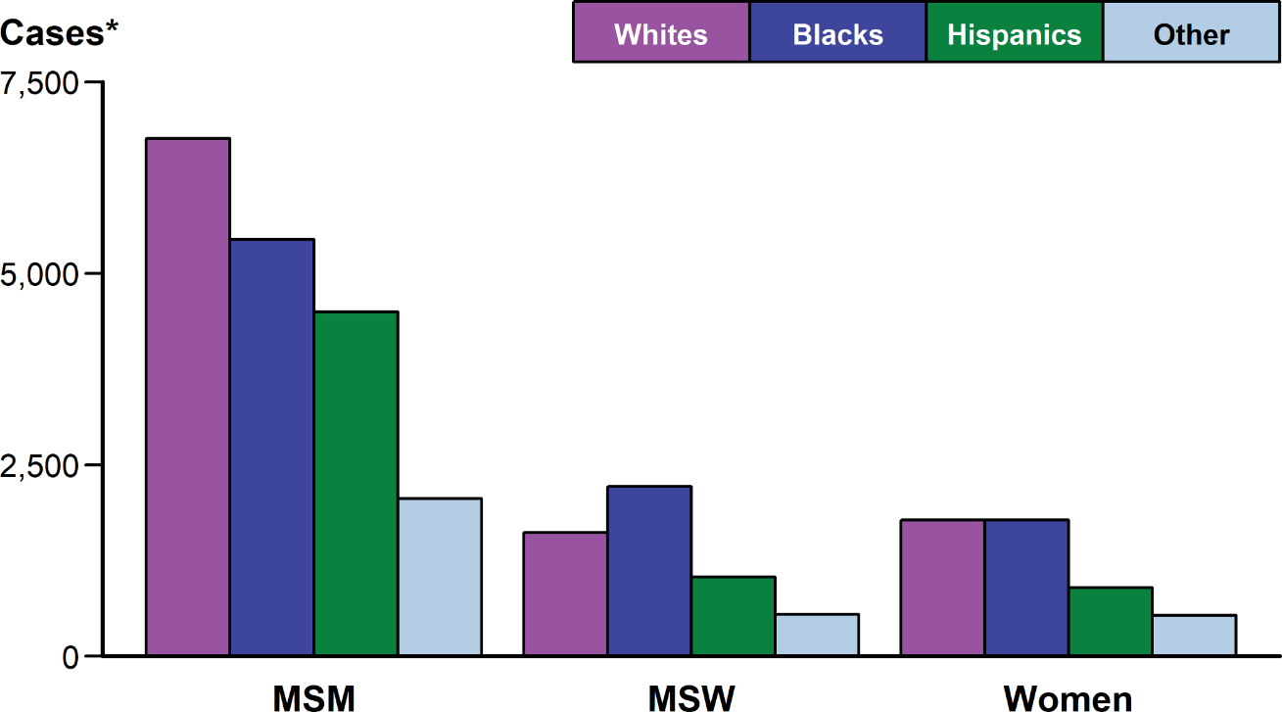
Primary and Secondary Syphilis — Reported Cases* by Sex and Sex of Sex Partners and Race/Hispanic Ethnicity, United States, 2018
* Of all reported cases of primary and secondary syphilis, 16.7% were among men without data on sex of sex partners, and <0.1% were cases with unknown sex; 6.1% of all cases had missing or unknown race/Hispanic ethnicity. Cases with missing or unknown race/Hispanic ethnicity are included in the “Other” category.
NOTE: See Section A1.5 in the Appendix for information on reporting STD case data for race/Hispanic ethnicity.
ACRONYMS: MSM = Gay, bisexual, and other men who have sex with men; MSW = Men who have sex with women only.
Notes:
Bar graph showing reported primary and secondary syphilis cases by sex and sex of sex partners and race/Hispanic ethnicity in the United States in 2018. Four race/Hispanic ethnicity groups (Whites, Blacks, Hispanics, and Other) are shown. Across all four race/Hispanic ethnicity groups, men who have sex with men accounted for the highest proportion of primary and secondary syphilis cases. Of primary and secondary syphilis cases among men who have sex with men, 36% were White, 29% were Black, and 24% were Hispanic.

