Slide 1
Sexually Transmitted Disease
Division of STD Prevention
Surveillance 2018
Other Sexually Transmitted Diseases

Slide 2
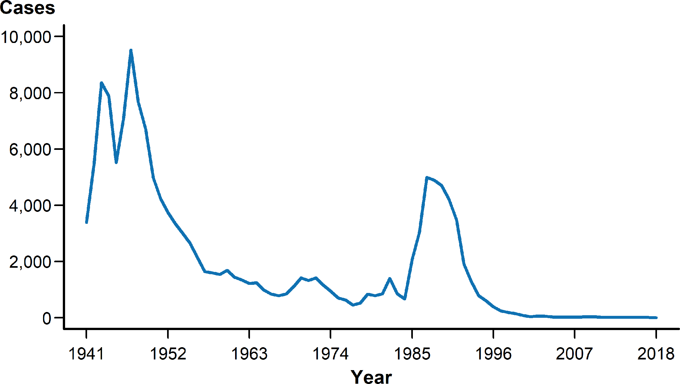
Chancroid — Reported Cases by Year, United States, 1941–2018
NOTE: See section A1.3 in the Appendix for more information on chancroid case reporting.
Notes:
Line graph showing reported cares of chancroid in the United States by year from 1941 to 2018. Chancroid has declined since 1987; since 2000, the annual number of reported cases has been less than 100, and since 2011, the annual number of reported cases has been less than 20. In 2018, only three cases of chancroid were reported in the United States.

Slide 3
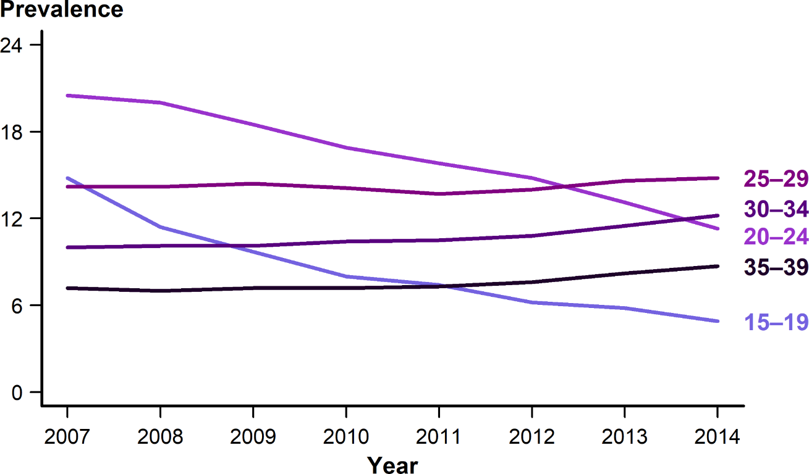
Cervical Intraepithelial Neoplasia Grades 2 and 3 — Prevalence per 1000 Person-Years Among Female Enrollees in Private Health Plans Aged 15–39 Years, by Age Group and Year, 2007–2014
SOURCE: Flagg EW, Torrone EA, Weinstock H. Ecological association of human papillomavirus vaccination with cervical dysplasia prevalence in the United States, 2007–2014. Am J Public Health. 2016;106(12):2211–2218.
Notes:
Line graph showing cervical intraepithelial neoplasia grades 2 and 3 prevalence per 1,000 person-years among female enrollees in private health plans aged 15 to 39 years by age group and year from 2007 to 2014. Annual prevalence of high-grade histologically-detected cervical intraepithelial neoplasia grades 2 and 3 during 2007–2014 was estimated using health-care claims from 9 million females aged 15–39 years who received cervical cancer screening in a given calendar year. Prevalence of cervical intraepithelial neoplasia grades 2 and 3 decreased significantly in females aged 15–19 and 20–24 years. Among those aged 15–19 years, annual percent change in cervical intraepithelial neoplasia grades 2 and 3 prevalence was -19.8% during 2007–2009 and -12.1% during 2009–2014. For women aged 20–24 years, annual percent change was -6.7% during 2007– 2012, and -12.5% during 2012–2014. No decreases in cervical intraepithelial neoplasia grades 2 and 3 prevalence were observed among women aged 25–39 years.

Slide 4
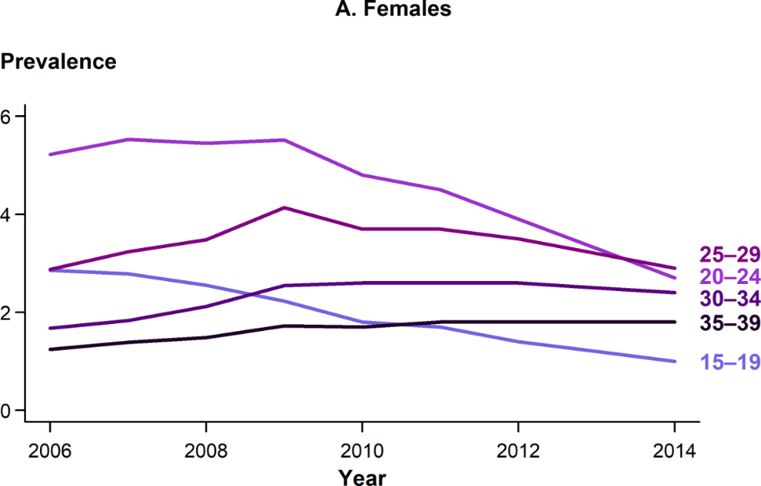
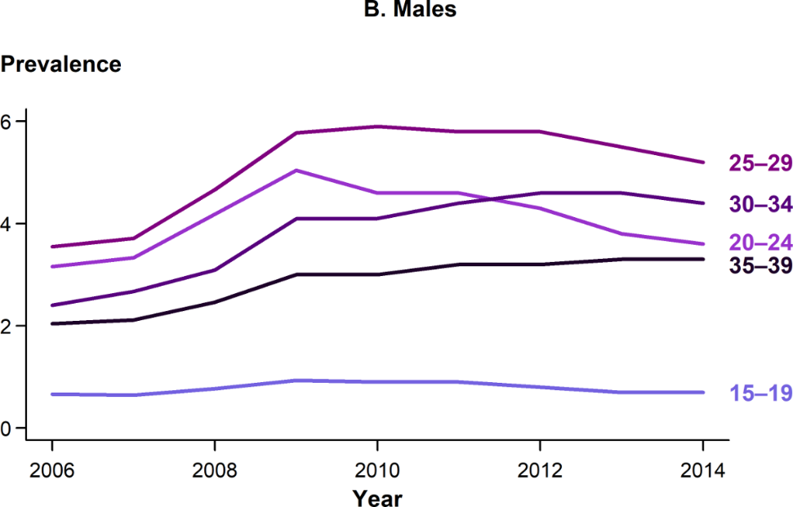
Anogenital Warts — Prevalence per 1000 Person-Years Among Enrollees in Private Health Plans Aged 15–39 Years by Sex, Age Group, and Year, 2006–2014
SOURCE: Flagg EW, Torrone EA. Declines in anogenital warts among age groups most likely to be impacted by human papillomavirus vaccination, United States, 2006–2014. Am J Public Health. 2018;108(1):112–119.
Notes:
Two-panel figure showing prevalence of anogenital warts per 1,000 person-years among enrollees in private health plans aged 15 to 39 years by sex, age group, and year from 2006 to 2014. Prevalence of anogenital warts among adolescent females aged 15–19 years declined non-significantly during 2006–2008, and then significantly decreased (annual percent change=-14.1) through 2014. Among women aged 20–24 years, genital wart prevalence was stable during 2006–2009, but declined significantly during 2009–2014 (annual percent change=-12.9). Prevalence among women aged 25–29 years also decreased significantly from 2009–2014 (annual percent change=-6.0). Prevalence increased or was stable during the entire period for women aged 30–39 years. Among males, anogenital wart prevalence increased significantly during 2006–2009 for all age groups except those aged 15–19 years. From 2009 to 2014, rates decreased somewhat among male adolescents aged 15–19 years (annual percent change=-5.4), but decreased significantly among men aged 20–24 years (annual percent change=-6.5). Among men aged 25–29 years, prevalence declined non-significantly during 2010–2014 (annual percent change=-1.7); prevalence increased or was stable throughout the entire period for men aged 30–39 years.

Slide 5
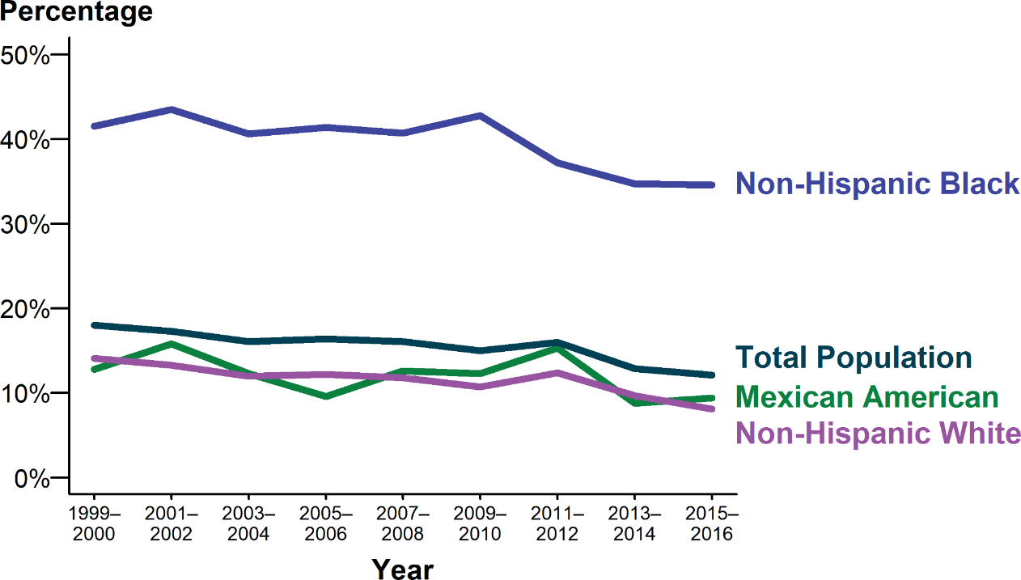
Herpes Simplex Virus Type 2 — National Estimates of Trends in Age-Adjusted Seroprevalence Among Persons Aged 14–49 Years by Race/ Hispanic Ethnicity, National Health and Nutrition Examination Survey (NHANES), 1999–2000 through 2015–2016
NOTE: Age-adjusted by the direct method to the 2000 US Census population, using age groups 14–19, 20–29, 30–39, and 40–49 years. Total population includes all race/Hispanic ethnicity groups, including those not shown separately.
SOURCE: McQuillan G, Kruszon-Moran D, Flagg EW, et al. Prevalence of herpes simplex virus type 1 and type 2 in persons aged 14–49: United States, 2015–2016. NCHS data brief, no 304. Hyattsville, MD: National Center for Health Statistics. 2018.
Notes:
Line graph showing national estimates of trends in age-adjusted seroprevalence of herpes simplex virus type 2 among persons aged 14 to 49 years by race/Hispanic ethnicity. National Health and Nutrition Examination Survey data indicate the seroprevalence of herpes simplex virus type 2 in the United States has decreased from 1999–2000 to 2015–2016; age-adjusted seroprevalence declined from 18.0% in 1999–2000 to 12.1% in 2015–2016. Although these declines were observed among all race/Hispanic ethnicity groups, herpes simplex virus type 2 seroprevalence was highest among non-Hispanic Blacks throughout the entire time period.

Slide 6
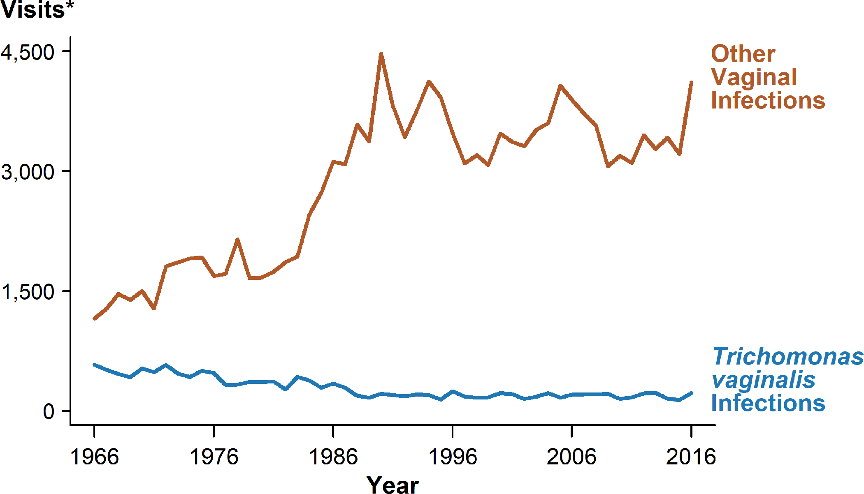
Trichomonas vaginalis and Other Vaginal Infections Among Females — Initial Visits to Physicians’ Offices, United States, 1966–2016
* In thousands.
NOTE: The relative standard errors for Trichomonas vaginalis infection estimates range from 23% to 17% and for other vaginal infection estimates range from 13% to 8%. See Section A2.5 in the Appendix and Table 44.
SOURCE: National Disease and Therapeutic Index, IMS Health, Integrated Promotional Services™, IMS Health Report, 1966–2016.
Notes:
Line graph showing initial visits to physicians’ offices for Trichomonas vaginalis and other vaginal infections among females in the United States from 1966 to 2016. Initial visits to physicians’ offices among females for Trichomonas vaginalis infection appear to have been fairly stable since the 1990’s; the number of initial visits in 2016 was 222,000.

