Slide 1
Sexually Transmitted Disease
Division of STD Prevention
Surveillance 2018
Gonorrhea

Slide 2
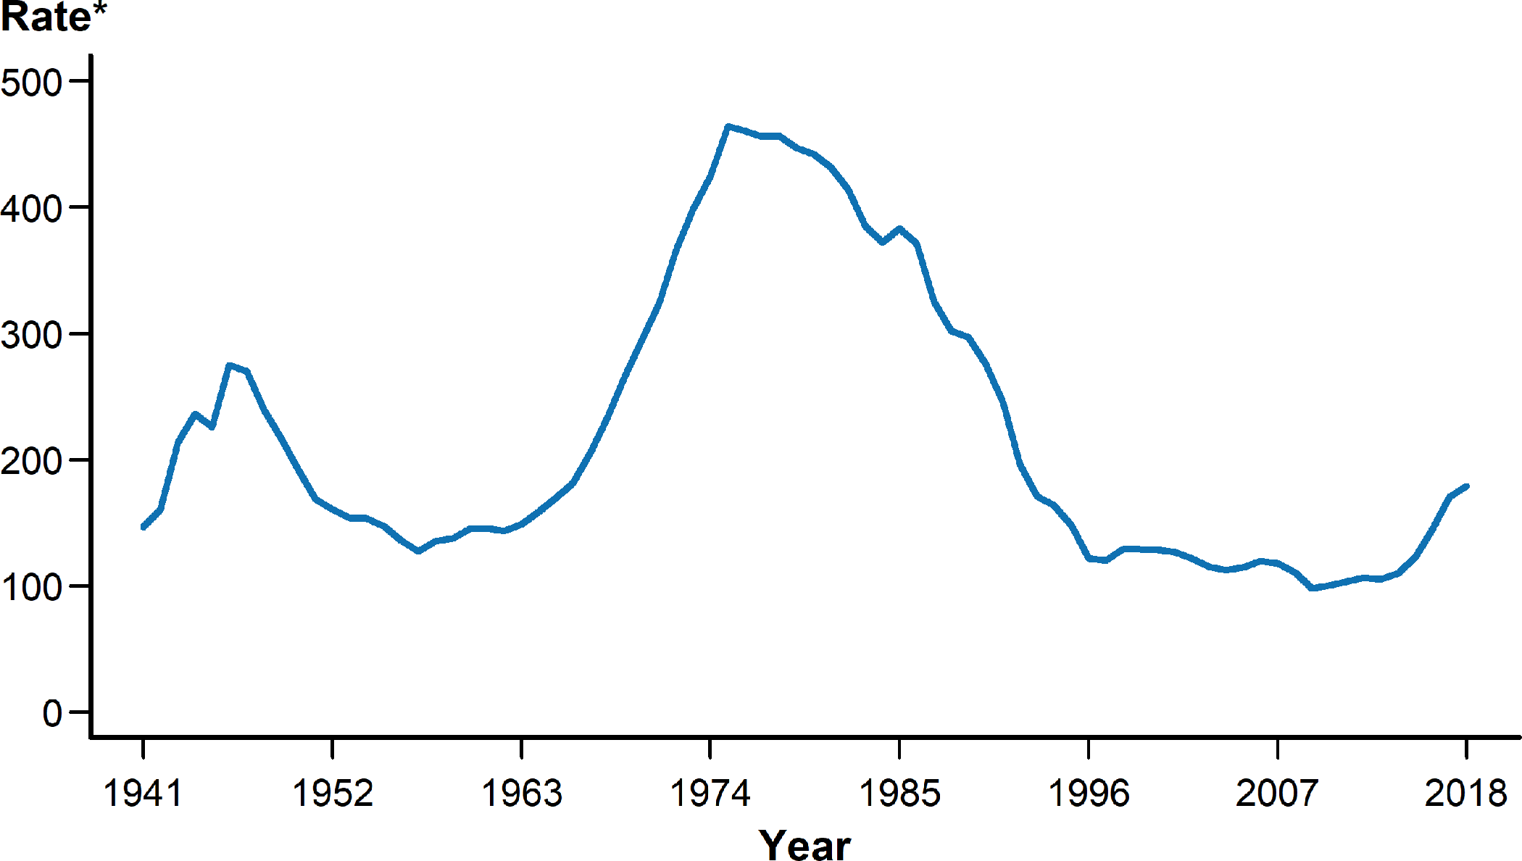
Gonorrhea — Rates of Reported Cases by Year, United States, 1941–2018
* Per 100,000.
NOTE: See section A1.3 in the Appendix for more information on gonorrhea case reporting.
Notes:
Line graph showing rates of reported cases of gonorrhea in the United States by year from 1941 to 2018. In 2018, a total of 583,405 cases of gonorrhea were reported in the United States, yielding a rate of 179.1 cases per 100,000 population. During 2017–2018, the rate of reported gonorrhea cases increased 5.0%, and increased 82.6% since the historic low in 2009.

Slide 3
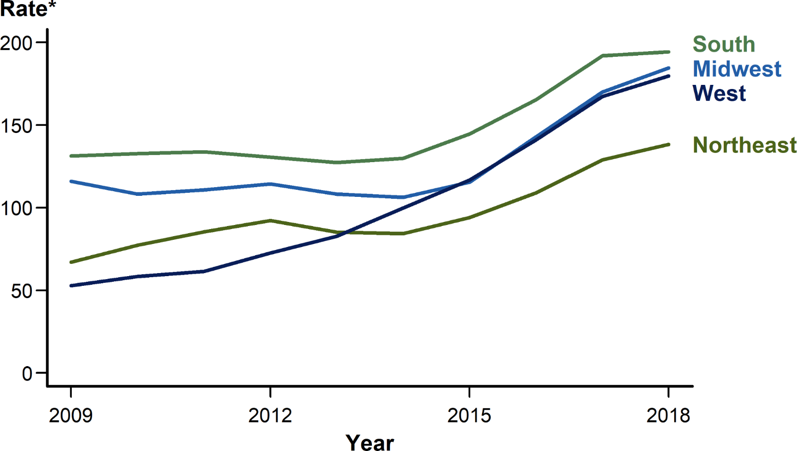
Gonorrhea — Rates of Reported Cases by Region, United States, 2009–2018
* Per 100,000.
Notes:
Line graph showing rates of reported cases of gonorrhea in the United States by region from 2009 to 2018. The South had the highest rate of reported gonorrhea cases (194.4 cases per 100,000 population) among the four regions of the United States in 2018, followed by the Midwest (184.5 cases per 100,000 population), the West (179.7 cases per 100,000 population), and the Northeast (138.4 cases per 100,000 population). During 2017–2018, the gonorrhea rate increased in all four regions: 8.5% in the Midwest, 7.4% in the West, 7.3% in the Northeast, and 1.3% in the South. During 2014–2018, the rate of gonorrhea increased by 79.9% (from 99.9 to 179.7 cases per 100,000 population) in the West and by 73.7% (from 106.2 to 184.5 cases per 100,000 population) in the Midwest, while the Northeast and South had lower overall increases during this time period (64.0% and 49.7%, respectively).

Slide 4
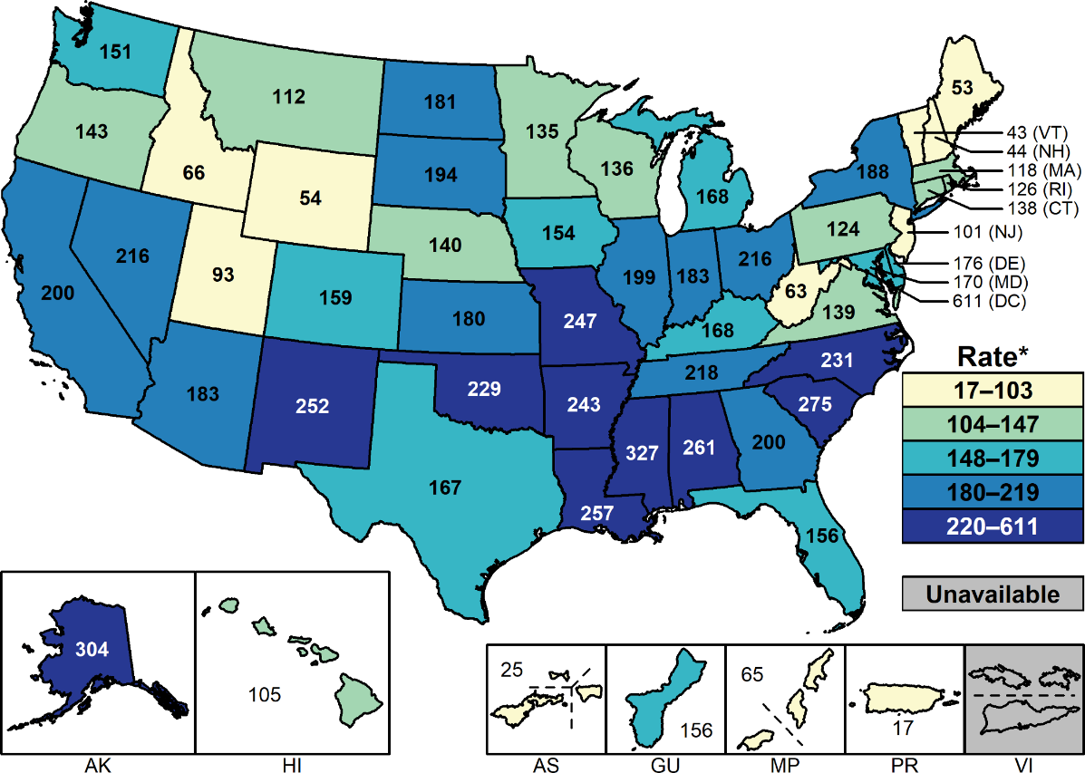
Gonorrhea — Rates of Reported Cases by State and Territory, United States, 2018
* Per 100,000.
NOTE: See Section A1.11 in the Appendix for more information on interpreting reported rates in US territories.
Notes:
United States map showing rates of reported cases of gonorrhea by state and territory. In 2018, rates of reported gonorrhea cases per 100,000 population ranged by state from 43.0 in Vermont to 326.7 in Mississippi; the gonorrhea rate in the District of Columbia was 611.0 cases per 100,000 population.

Slide 5
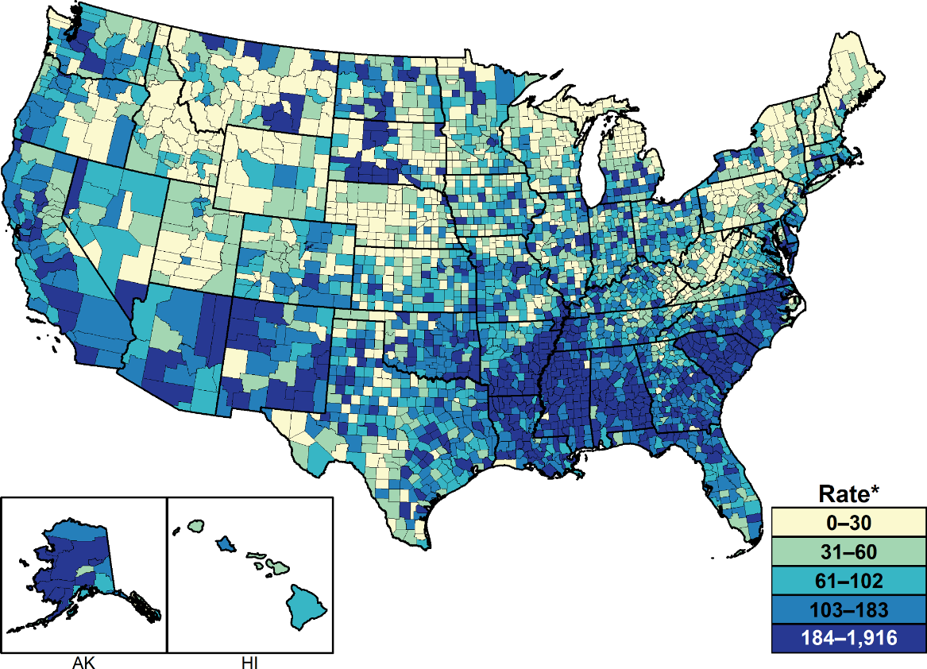
Gonorrhea — Rates of Reported Cases by County, United States, 2018
* Per 100,000.
NOTE: See section A1.4 in the Appendix for more information on county-level rates.
Notes:
United States map showing rates of reported cases of gonorrhea by county. In 2018, 93.4% of all counties in the United States reported at least one case of gonorrhea; however, 49.0% of reported gonorrhea cases occurred in just 70 counties or independent cities. The rate ranged from 0.0 to 30.0 cases per 100,000 population in 627 counties (20.0%), 31.0 to 60.0 cases per 100,000 population in 625 counties (20.0%), from 61.0 to 102.0 cases per 100,000 population in 629 counties (20.0%), from 103.0 to 183.0 cases per 100,000 population in 628 counties (20.0%), and was 184.0 cases per 100,000 population or more in 633 counties (20.1%). As in previous years, counties with the highest gonorrhea rates were concentrated in the South.

Slide 6
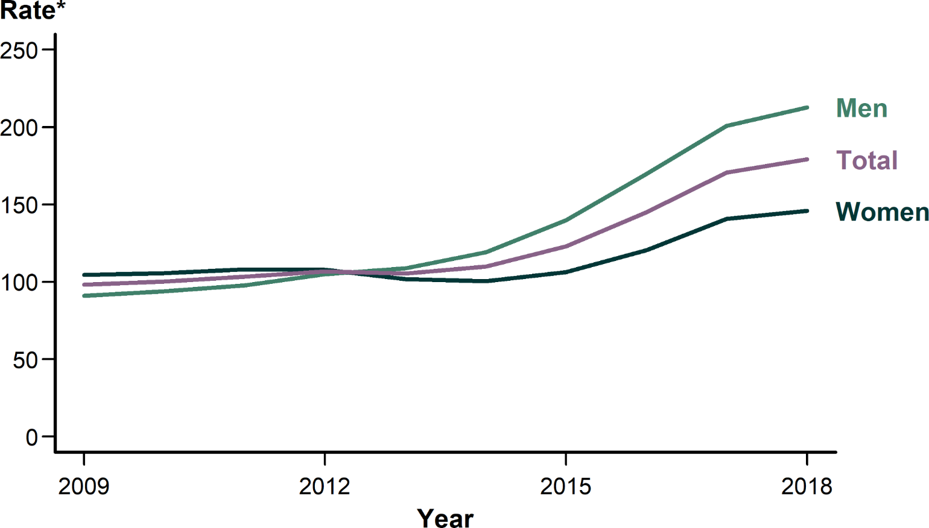
Gonorrhea — Rates of Reported Cases by Sex, United States, 2009–2018
* Per 100,000.
Notes:
Line graph showing rates of reported cases of gonorrhea in the United States by sex from 2009 to 2018. As was observed during 2014–2017, the rate of reported gonorrhea cases among males was higher than the rate among females in 2018. During 2017–2018, the gonorrhea rate among males increased 6.0% (from 200.8 to 212.8 cases per 100,000 males) and the rate among females increased 3.6% (from 140.7 to 145.8 cases per 100,000 females). During 2014–2018, the rate among males increased 78.7% (from 119.1 to 212.8 cases per 100,000 males) and the rate among females increased 45.2% (from 100.4 to 145.8 cases per 100,000 females).

Slide 7
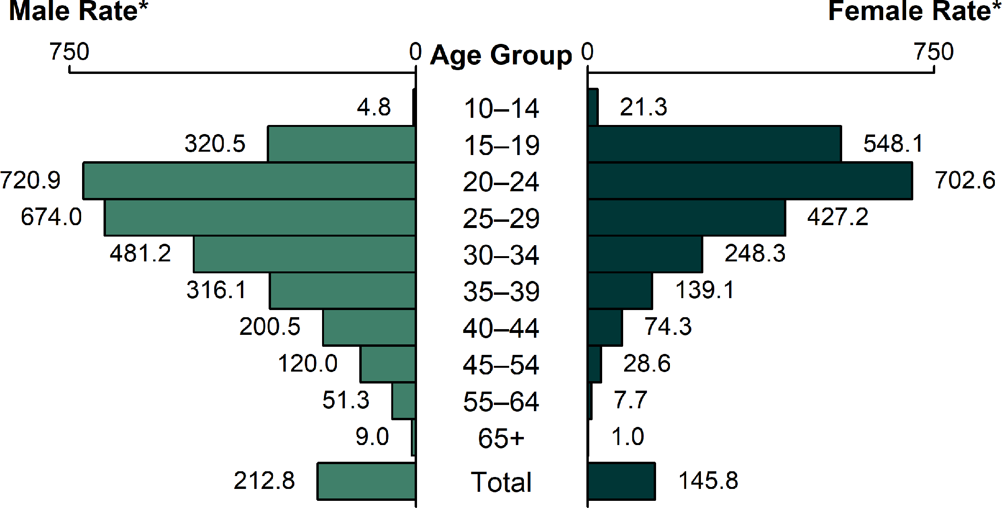
Gonorrhea — Rates of Reported Cases by Age Group and Sex, United States, 2018
* Per 100,000.
Notes:
Bar graph showing rates of reported cases of gonorrhea in the United States by age group and sex. In 2018, rates of reported gonorrhea cases continued to be highest among adolescents and young adults. In 2018, the highest rates among females were observed among those aged 20–24 years (702.6 cases per 100,000 females) and 15–19 years (548.1 cases per 100,000 females). Among males, the rate was highest among those aged 20–24 years (720.9 cases per 100,000 males) and 25–29 years (674.0 cases per 100,000 males).

Slide 8
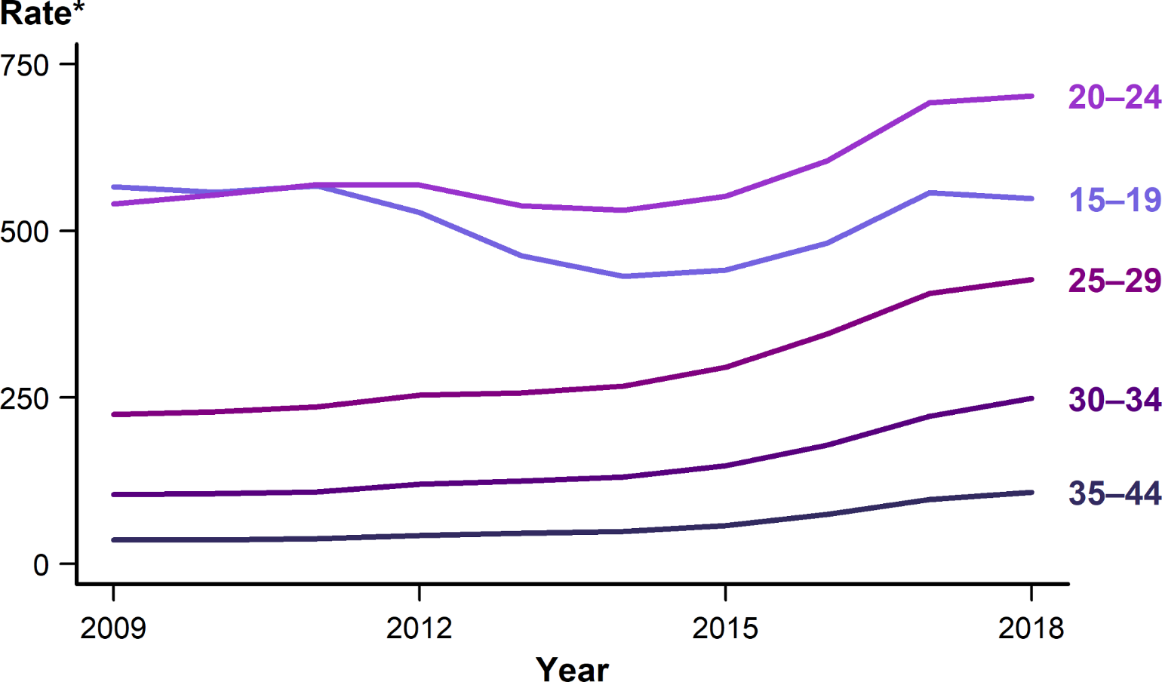
Gonorrhea — Rates of Reported Cases Among Females Aged 15–44 Years by Age Group, United States, 2009–2018
* Per 100,000.
Notes:
Line graph showing rates of reported cases of gonorrhea in the United States among females aged 15–44 years by age group from 2009–2018. Increases in rates of reported gonorrhea cases were observed in most age groups for females during 2017–2018. However, rates decreased 1.7% among females aged 15–19 years (from 557.3 to 548.1 cases per 100,000 females).

Slide 9
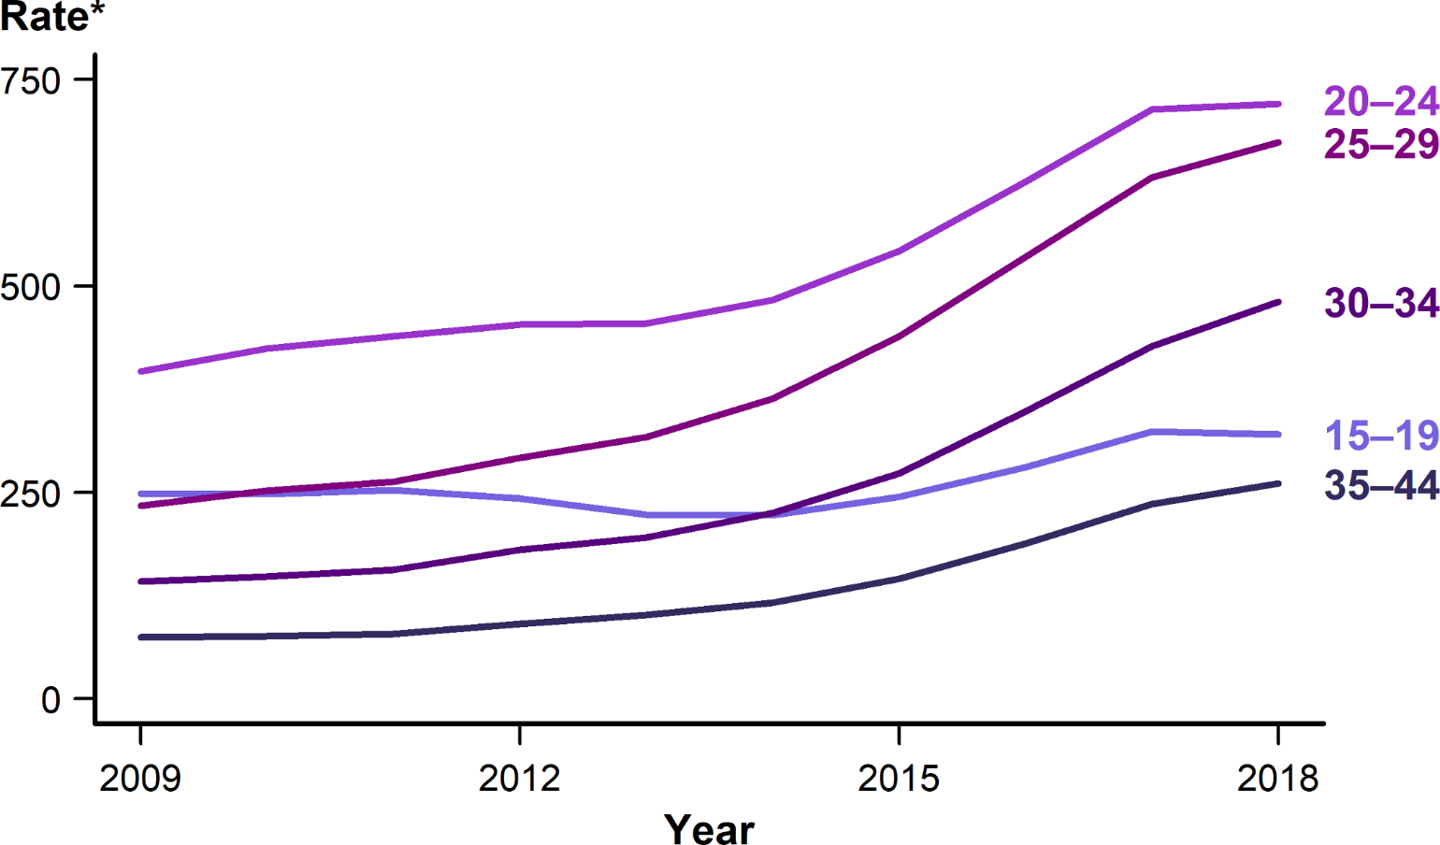
Gonorrhea — Rates of Reported Cases Among Males Aged 15–44 Years by Age Group, United States, 2009–2018
* Per 100,000.
Notes:
Line graph showing rates of reported cases of gonorrhea in the United States among males aged 15–44 years by age group from 2009–2018. Increases in rates of reported gonorrhea cases were observed in most age groups for males during 2017–2018. However, rates decreased 0.9% among males aged 15–19 years (from 323.3 to 320.5 cases per 100,000 males).

Slide 10
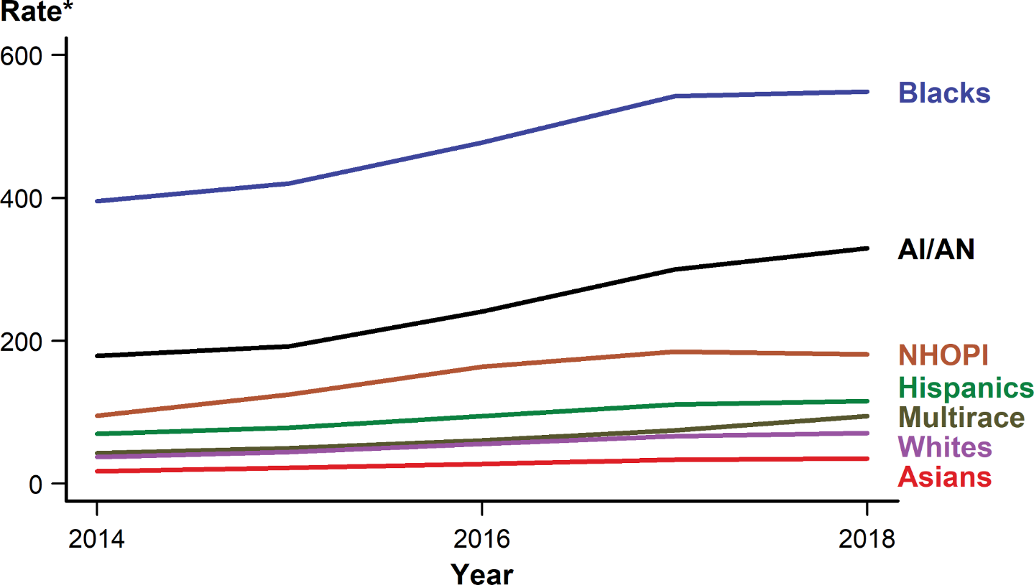
Gonorrhea — Rates of Reported Cases by Race/Hispanic Ethnicity, United States, 2014–2018
* Per 100,000.
NOTE: See Section A1.5 in the Appendix for information on reporting STD case data for race/Hispanic ethnicity.
ACRONYMS: AI/AN = American Indians/Alaska Natives; NHOPI = Native Hawaiians/Other Pacific Islanders.
Notes:
Line graph showing rates of reported cases of gonorrhea in the United States by race/Hispanic ethnicity from 2014 to 2018. In 2018, the rate of reported gonorrhea cases remained highest among Blacks (548.9 cases per 100,000 population). During 2014–2018, for all five years during that period, the gonorrhea rate increased among all race/Hispanic ethnicity groups: 119.5% among Multirace persons, 99.4% among Asians, 90.3% among Native Hawaiians/Other Pacific Islanders, 89.1% among Whites, 84.2% among American Indians/Alaska Natives, 66.0% among Hispanics, and 38.8% among Blacks.

Slide 11
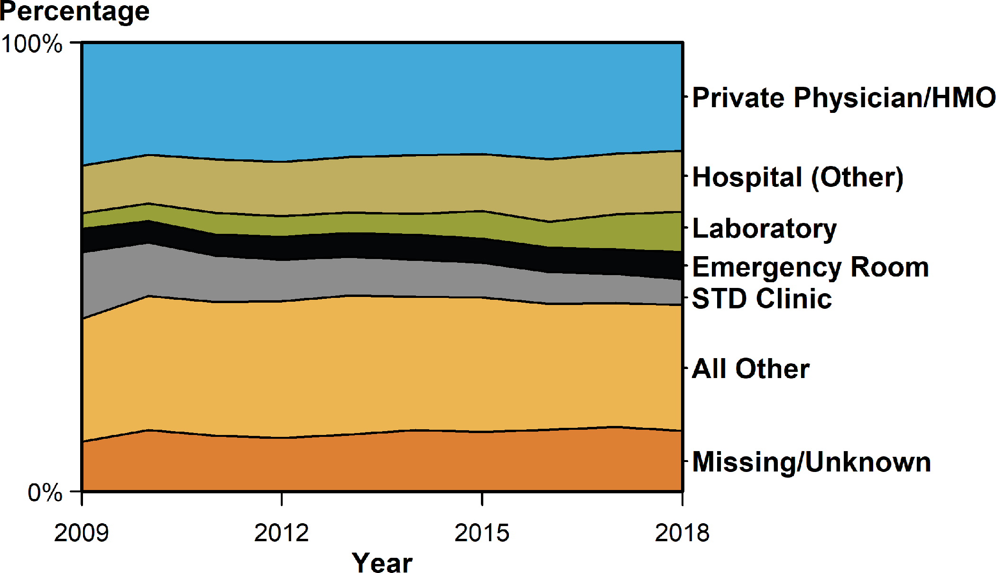
Gonorrhea — Percentage of Reported Cases Among Females by Reporting Source*, United States, 2009–2018
* See section A1.7 in the Appendix for information on classification of reporting sources and a full list of reporting sources.
ACRONYMS: HMO = Health maintenance organization.
Notes:
Area graph showing the percentage of reported cases of gonorrhea among females in the United States by reporting source from 2009 to 2018. During 2009–2018, the percent of gonorrhea cases reported by STD clinics declined 42.6% among females; however, the percent of gonorrhea cases with missing/unknown reporting source increased 80.4% among females. During 2017–2018, the percent of gonorrhea cases reported by STD clinics decreased 7.5% among females. In 2018, the largest proportion of cases among females were reported by private physicians/health maintenance organizations (24.1 %), followed by other hospital clinics/facilities (13.6 %), laboratories (9.0 %), emergency rooms (6.0%), and STD clinics (5.8%).

Slide 12
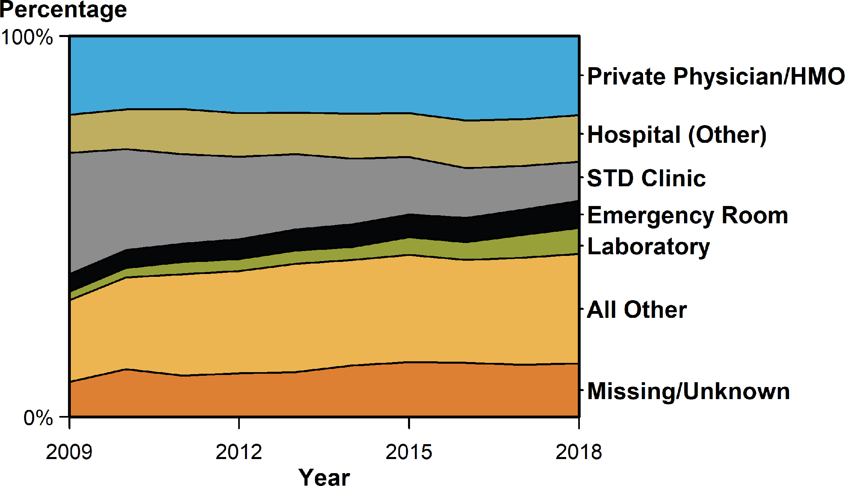
Gonorrhea — Percentage of Reported Cases Among Males by Reporting Source*, United States, 2009–2018
* See section A1.7 in the Appendix for information on classification of reporting sources and a full list of reporting sources.
ACRONYMS: HMO = Health maintenance organization.
Notes:
Area graph showing the percentage of reported cases of gonorrhea among males in the United States by reporting source from 2009 to 2018. During 2009–2018, the percent of gonorrhea cases reported by STD clinics declined 19.8% among males; however, the percent of gonorrhea cases with missing/unknown reporting source increased 277.3% among males. During 2017–2018, the percent of gonorrhea cases reported by STD clinics decreased 4.9% among males. Among males, private physicians/health maintenance organizations (20.7 %) were the most common reporting source, followed by other hospital clinics/facilities (12.3%), STD clinics (10.3%), emergency rooms (7.1%), and laboratories (6.9 %).

Slide 13
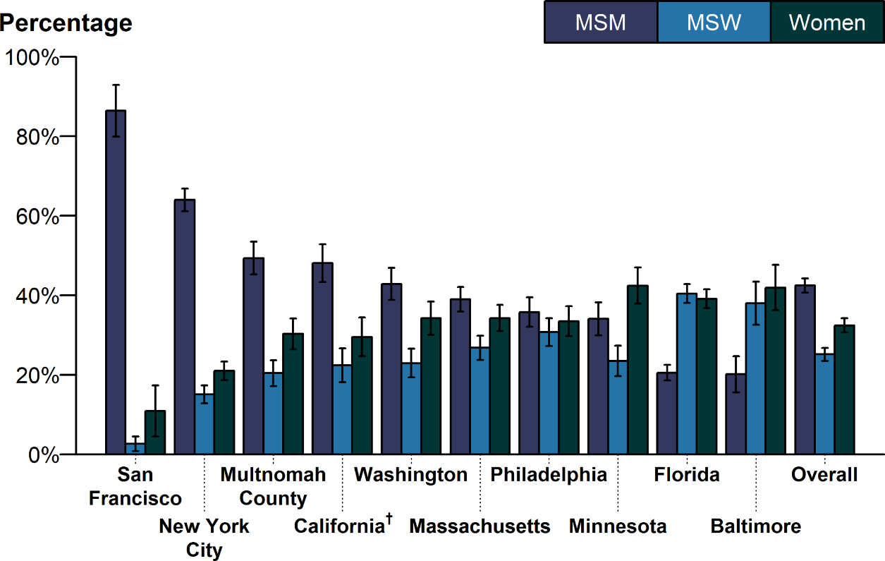
Estimated Proportion* of MSM, MSW, and Women Among Gonorrhea Cases by Jurisdiction, STD Surveillance Network (SSuN), 2018
* Estimate based on weighted analysis of data obtained from interviews (n=6,842) conducted among a random sample of reported gonorrhea cases during January to December 2018.
† California data exclude San Francisco (shown separately).
NOTE: See section A2.2 in the Appendix for SSuN methods.
ACRONYMS: MSM = Gay, bisexual, and other men who have sex with men; MSW = Men who have sex with women only.
Notes:
Bar graph showing the estimated proportion of men who have sex with men, men who have sex with women only, and women among gonorrhea cases by SSuN jurisdiction in 2018. The estimated burden of disease represented by men who have sex with men (including men who have sex with both men and women), men who have sex with women only, and women varied substantially across collaborating sites based on weighted analysis. San Francisco had the highest proportion of gonorrhea cases estimated to be among men who have sex with men (86.4%), while Baltimore had the lowest proportion of cases among men who have sex with men (20.1%). In total, across all SSuN sites, 42.5% of gonorrhea cases were estimated to be among men who have sex with men, 25.1% among men who have sex with women only, and 32.4% among women.

Slide 14
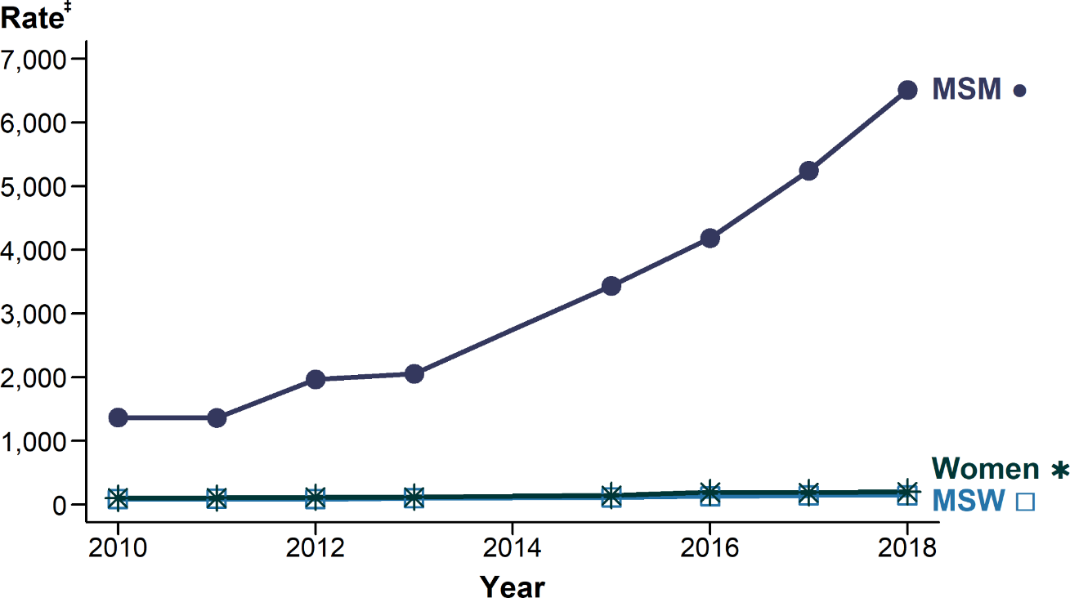
Gonorrhea — Estimated* Rates of Reported Gonorrhea Cases by MSM, MSW, and Women, STD Surveillance Network (SSuN)†, 2010–2018
* Estimates based on interviews among a random sample of reported cases of gonorrhea (n=21,417); cases weighted for analysis. Data not available for 2014; 2013–2015 trend interpolated; trends lines overlap for MSW and women in this figure.
† Sites include Baltimore, Philadelphia, New York City, Washington State, San Francisco, and California (excluding San Francisco).
‡ Per 100,000.
ADAPTED FROM: Stenger M, Pathela P, Anschuetz G, et al. Increases in the rate of Neisseria gonorrhoeae among gay, bisexual and other men who have sex with men (MSM) — findings from the STD Surveillance Network 2010–2015. Sex Transm Dis. 2017;44(7):393–397.
ACRONYMS: MSM = Gay, bisexual, and other men who have sex with men; MSW = Men who have sex with women only.
Notes:
Line graph showing the estimated rates of reported gonorrhea cases by men who have sex with men, men who have sex with women only, and women from 2010 to 2018. The estimated gonorrhea case rate among men who have sex with men increased 375.5% during 2010–2018, from 1,368.6 cases per 100,000 men who have sex with men in 2010 to 6,508.0 cases per 100,000 men who have sex with men in 2018. Over the same time period, case rates among women and men who have sex with women only also increased by 95.2% and 69.3%, respectively.

Slide 15
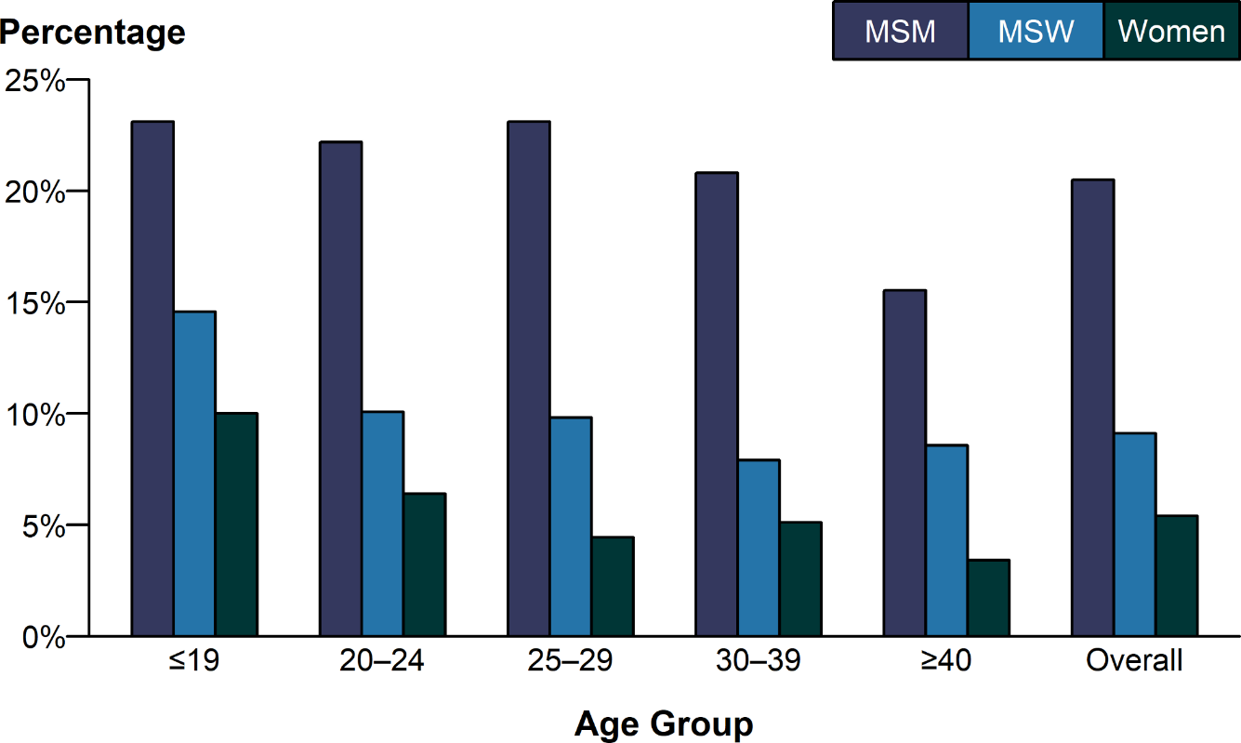
Gonorrhea — Proportion of STD Clinic Patients* Testing Positive by Age Group and Sex and Sex of Sex Partners, STD Surveillance Network (SSuN), 2018
* Results are based on data obtained from unique patients with known sex of sex partners (n=77,314) attending SSuN STD clinics who were tested ≥1 time for gonorrhea in 2018.
NOTE: See section A2.2 in the Appendix for SSuN methods.
ACRONYMS: MSM = Gay, bisexual, and other men who have sex with men; MSW = Men who have sex with women only.
Notes:
Bar graph showing the proportion of STD clinic patients testing positive for gonorrhea by age group and sex and sex of sex partners. In 2018, the proportion of STD clinic patients who tested positive for gonorrhea varied by sex and sex of sex partners, as well as age group. The overall prevalence, represented by the average of the mean value by nine of the 10 SSuN jurisdictions, where data was available, was 20.5% for men who have sex with men, 9.1% for men who have sex with women only, and 5.4% for women. Among those attending these clinics, men who have sex with men disproportionately had higher positivity rates when compared to men who have sex with women only and women in all age groups. Although overall gonorrhea positivity rates declined with increasing age for women, men who have sex with men, and men who have sex with women only, a slower decline by age was observed in men who have sex with men less than 40 years of age.

Slide 16
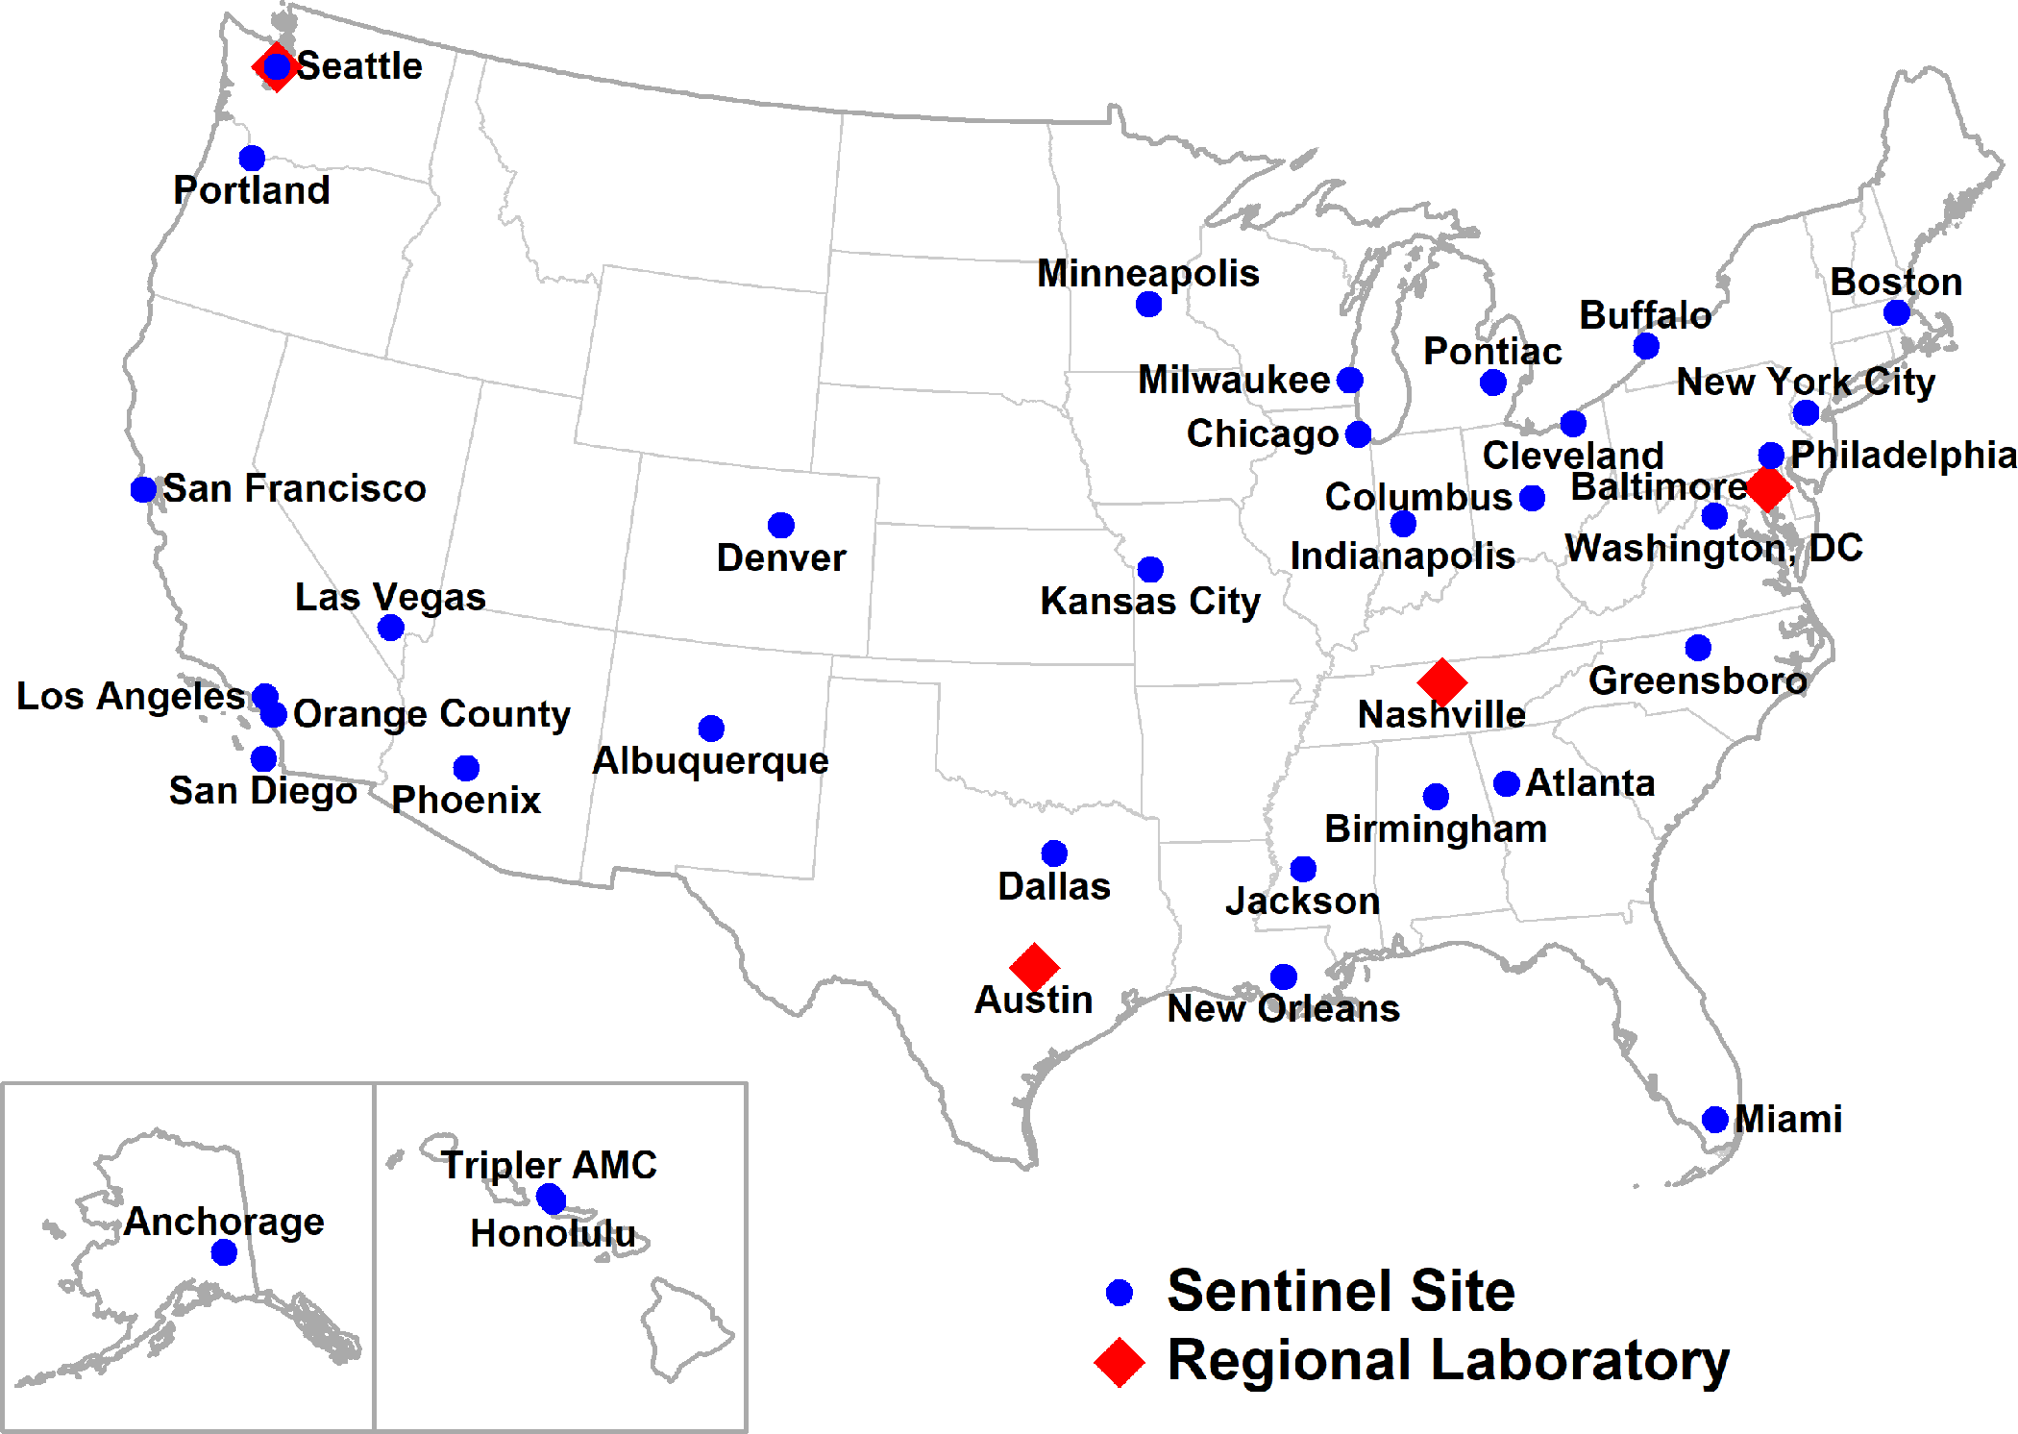
Location of Participating Sentinel Sites and Regional Laboratories, Gonococcal Isolate Surveillance Project (GISP), United States, 2018
NOTE: Seattle is both a sentinel site and a regional laboratory.
Notes:
United States map showing the location of sentinel sites and regional laboratories participating in the Gonococcal Isolate Surveillance Project in 2018.

Slide 17
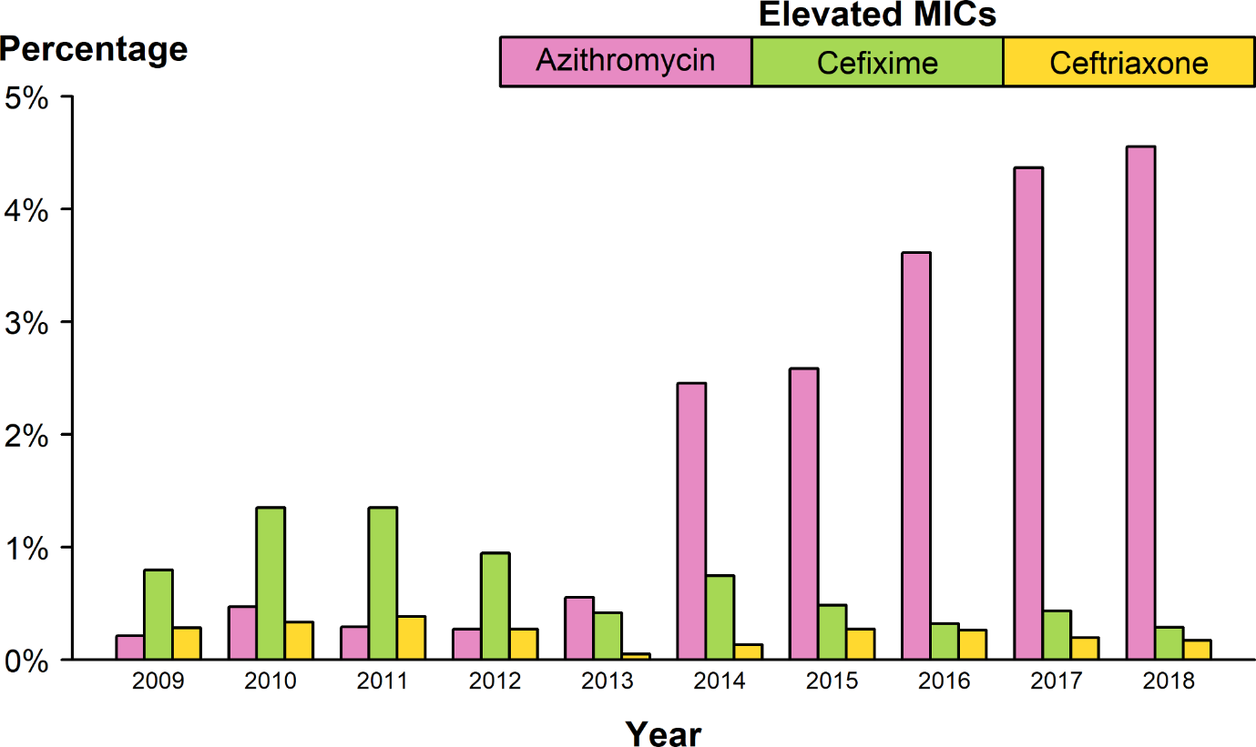
Neisseria gonorrhoeae — Percentage of Isolates with Elevated Minimum Inhibitory Concentrations (MICs) to Azithromycin, Cefixime, and Ceftriaxone, Gonococcal Isolate Surveillance Project (GISP), 2009–2018
NOTE: Elevated MIC = Azithromycin: ≥ 2.0 μg/mL; Cefixime: ≥ 0.25 μg/mL; Ceftriaxone: ≥ 0.125 μg/mL.
Notes:
Bar graph showing the percentage of Neisseria gonorrhoeae isolates with elevated minimum inhibitory concentrations to azithromycin, cefixime, and ceftriaxone from 2009 to 2018. During 2009–2018, the percentage of Neisseria gonorrhoeae isolates that exhibited elevated ceftriaxone minimum inhibitory concentrations, defined as ≥ 0.125 µg/mL, fluctuated between 0.1% and 0.4%. In 2018, 0.2% of isolates had elevated ceftriaxone minimum inhibitory concentrations. The percentage of isolates with elevated cefixime minimum inhibitory concentrations ( ≥ 0.25 µg/mL) declined from 1.4% in 2011 to 0.3% in 2018. During 2012–2014, the percentage of isolates with elevated azithromycin minimum inhibitory concentrations ( ≥ 2 µg/mL) ranged from 0.3% to 2.5% with a sharp increase during 2013–2014 (0.6% to 2.5%); during 2014–2018, the percentage increased from 2.5% to 4.6%.

Slide 18
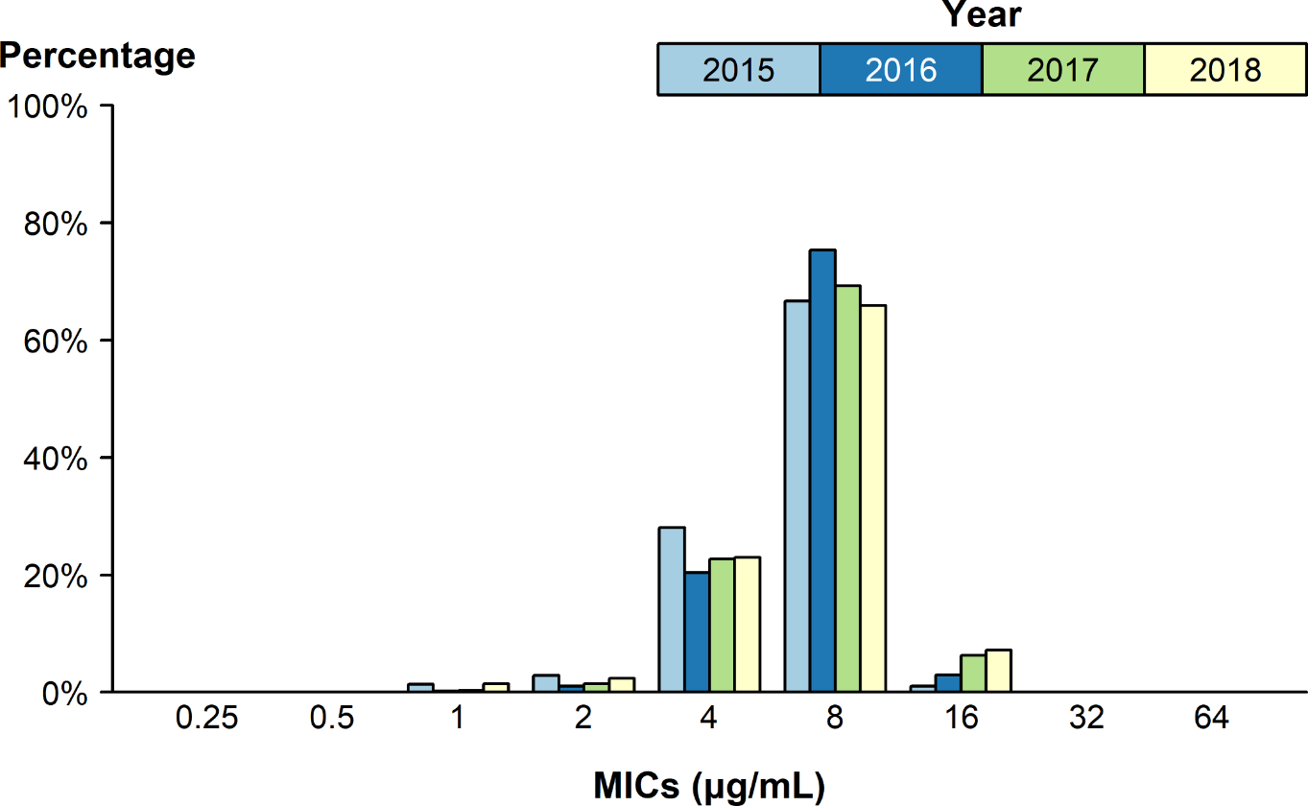
Neisseria gonorrhoeae — Distribution of Gentamicin Minimum Inhibitory Concentrations (MICs) by Year, Gonococcal Isolate Surveillance Project (GISP), 2015–2018*
* In 2018, the antibiotic susceptibility testing range for gentamicin was expanded from MICs of 1 µg/mL–32 µg/mL in previous years to 0.25 µg/mL–64 µg/mL.
Notes:
Bar graph showing the distribution of gentamicin minimum inhibitory concentrations among Neisseria gonorrhoeae isolates by year from 2015 to 2018. Between 2015 and 2017, 66.7–75.3% of all tested Neisseria gonorrhoeae isolates had a gentamycin minimum inhibitory concentration value of 8 µg/mL. In 2018, 0.02% of all tested Neisseria gonorrhoeae isolates had a gentamycin minimum inhibitory concentration above 16 µg/mL.

Slide 19
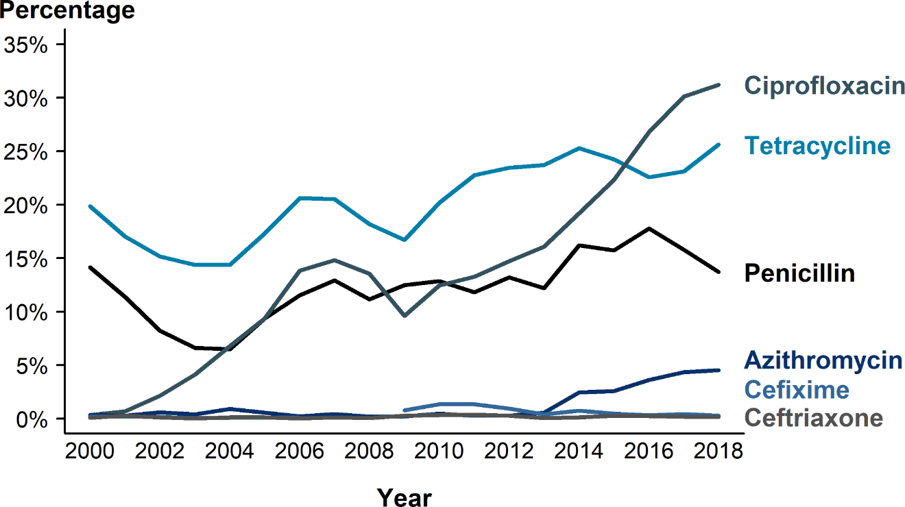
Neisseria gonorrhoeae — Prevalence of Tetracycline, Penicillin, or Fluoroquinolone Resistance* or Elevated Cefixime, Ceftriaxone, or Azithromycin Minimum Inhibitory Concentrations (MICs)†, by Year — Gonococcal Isolate Surveillance Project (GISP), 2000–2018
* Resistance = Fluoroquinolone (ciprofloxacin): MIC ≥ 1.0 µg/mL; Penicillin: MIC ≥ 2.0 µg/mL or Beta-lactamase positive; Tetracycline: MIC ≥ 2.0 µg/mL.
† Elevated MICs = Azithromycin: MIC ≥ 1.0 µg/mL (2000–2004), MIC ≥ 2.0 µg/mL (2005–2018); Ceftriaxone: MIC ≥ 0.125 µg/mL; Cefixime: MIC ≥ 0.25 µg/mL.
NOTE: Cefixime susceptibility was not tested in 2007 and 2008.
Notes:
Line graph showing the prevalence of tetracycline, penicillin, or fluoroquinolone resistance or elevated cefixime, ceftriaxone, or azithromycin minimum inhibitory concentrations among Neisseria gonorrhoeae isolates by year from 2000 to 2018. In 2018, 31.2% of Neisseria gonorrhoeae isolates collected from GISP sites were resistant to ciprofloxacin, 25.6% to tetracycline, and 13.7% to penicillin.

Slide 20
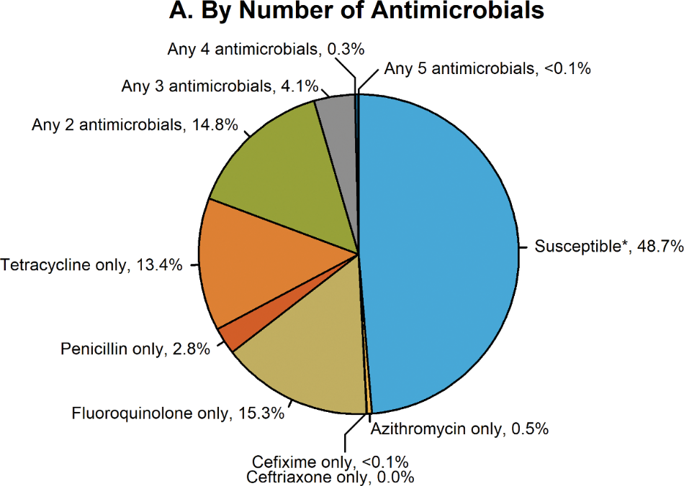
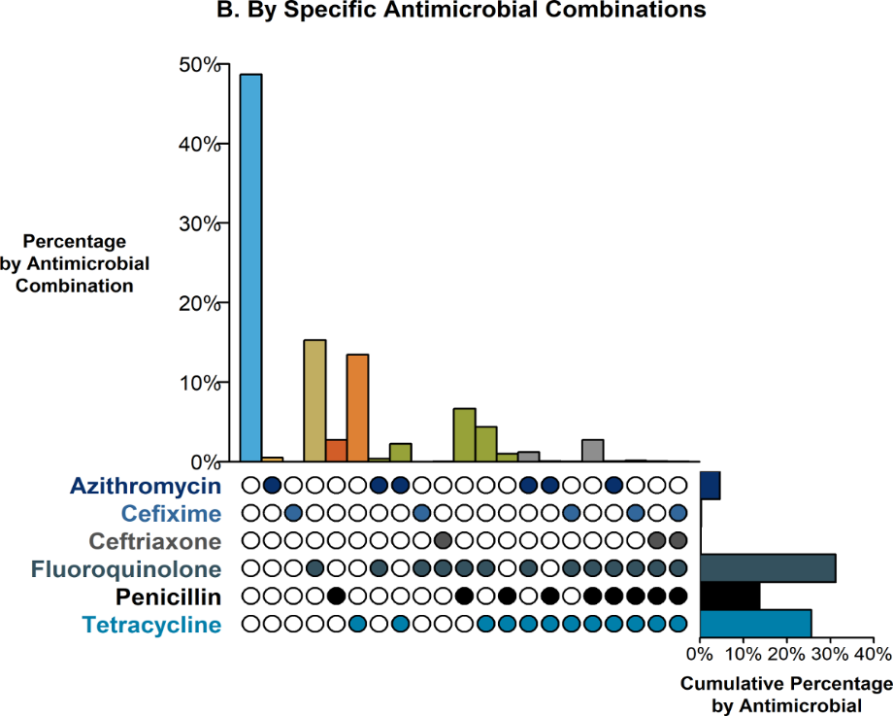
Resistance or Elevated MIC Patterns of Neisseria gonorrhoeae Isolates to Antimicrobials, Gonococcal Isolate Surveillance Project (GISP), 2018
* Susceptible category only includes isolates with penicillin, tetracycline, and fluoroquinolone MIC values that are considered susceptible and isolates with ceftriaxone, cefixime, and azithromycin MIC values that are not considered elevated.
NOTE: Elevated MIC = Ceftriaxone: MIC ≥ 0.125 μg/mL; Cefixime: MIC ≥ 0.25 μg/mL; Azithromycin: MIC ≥ 2.0 μg/mL. Resistance = Tetracycline: MIC ≥ 2.0 μg/mL; Fluoroquinolone: MIC ≥ 1.0 μg/mL; Penicillin: MIC ≥ 2.0 μg/mL or Beta-lactamase positive. In Panel B, a filled circle reflects resistance or elevated MIC to a specific antimicrobial; only antimicrobial combinations with non-zero percentages are shown.
ACRONYMS: MIC = Minimum Inhibitory Concentration.
Notes:
Two-panel figure showing resistance or elevated minimum inhibitory concentration patterns of Neisseria gonorrhoeae isolates to antimicrobials during 2018. The different susceptibility patterns seen in GISP in 2018 are shown. Panel A, a pie graph, demonstrates the percentage of Neisseria gonorrhoeae isolates with resistance or elevated minimum inhibitory concentrations to azithromycin, cefixime, ceftriaxone, fluoroquinolone, tetracycline, and penicillin. Panel B, an UpSet graph, further highlights the specific combinations of resistance or elevated minimum inhibitory concentrations across antimicrobials (vertical bars). The overall percentage of reduced susceptibility for each antimicrobial (horizontal bars) are the same percentages seen for 2018 in Figure 31. Of all the Neisseria gonorrhoeae isolates collected in GISP in 2018, 4.5% demonstrated resistance or elevated minimum inhibitory concentrations to at least three antibiotics tested with the majority of the combinations including tetracycline, penicillin and ciprofloxacin; no isolates with elevated azithromycin minimum inhibitory concentrations had elevated ceftriaxone minimum inhibitory concentrations. In 2018, 48.7% of all tested isolates were susceptible to all antibiotics tested.

Slide 21
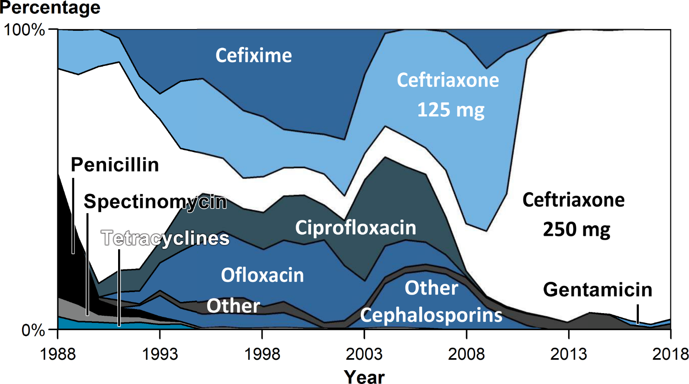
Distribution of Primary Antimicrobial Drug Used to Treat Gonorrhea Among Participants, Gonococcal Isolate Surveillance Project (GISP), 1988–2018
NOTE: For 2018, “Other” includes azithromycin 2 g (0.3%), no therapy documented (0.5%), and other less frequently used drugs (1.2%).
Notes:
Area graph showing the distribution of primary antimicrobial drug used to treat gonorrhea among GISP participants from 1988 to 2018. The proportion of GISP participants treated for gonorrhea with ceftriaxone 250 mg increased from 84.0% in 2011 to 98.1% in 2017 but decreased slightly to 96.5% in 2018. Participants treated with gentamicin 240 mg increased from 0.2% in 2015 to 1.4% in 2018 and participants treated with cefixime 400 mg decreased from 0.3% in 2015 to 0.1% in 2018.

Slide 22
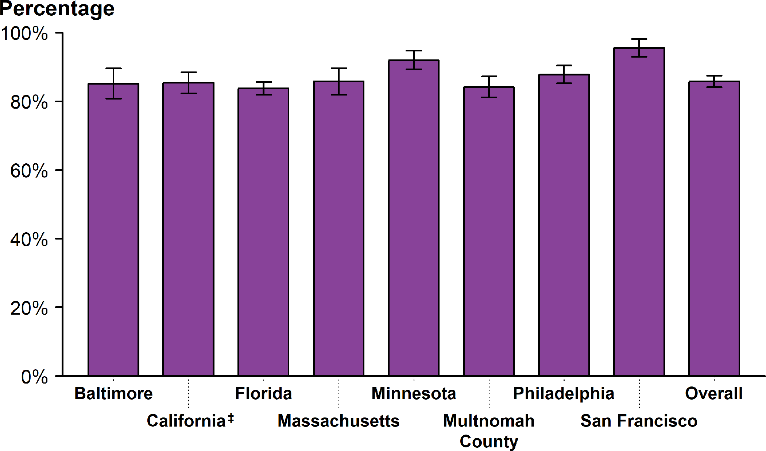
Gonorrhea — Estimated Proportion of Cases Treated by Recommended Treatment Regimen* and Jurisdiction†, STD Surveillance Network (SSuN), 2018
* In 2018, the recommended treatment for uncomplicated gonorrhea was treatment with 250 mg dose of ceftriaxone plus 1 g dose of azithromycin.
† Includes SSuN jurisdictions with all treatment information documented for ≥80% of cases.
‡ California data exclude San Francisco.
NOTE: See section A2.2 in the Appendix for SSuN methods.
ADAPTED FROM: Weston EJ, Workowski K, Torrone E, et al. Adherence to CDC recommendations for the treatment of uncomplicated gonorrhea – STD Surveillance Network (SSuN), United States, 2016. MMWR Morb Mortal Wkly Rep. 2018;67:473–76.
Notes:
Bar graph showing the estimated proportion of gonorrhea cases treated by recommended treatment regimen and SSuN jurisdiction during 2018. In 2018, based on weighted analysis of SSuN jurisdictions with documented treatment information (i.e., antimicrobials and dosages) for 80% or more of cases, 85.8% (95% CI = 84.1–87.5) of reported patients with gonorrhea in SSuN jurisdictions received the recommended treatment for uncomplicated gonorrhea. The proportion of reported patients that received the recommended dual treatment ranged from 83.8% (95% CI = 81.9–85.6) in Florida to 95.5% (95% CI = 92.9–98.1) in San Francisco, California.

