Slide 1
Sexually Transmitted Disease
Surveillance 2018
Chlamydia

Slide 2
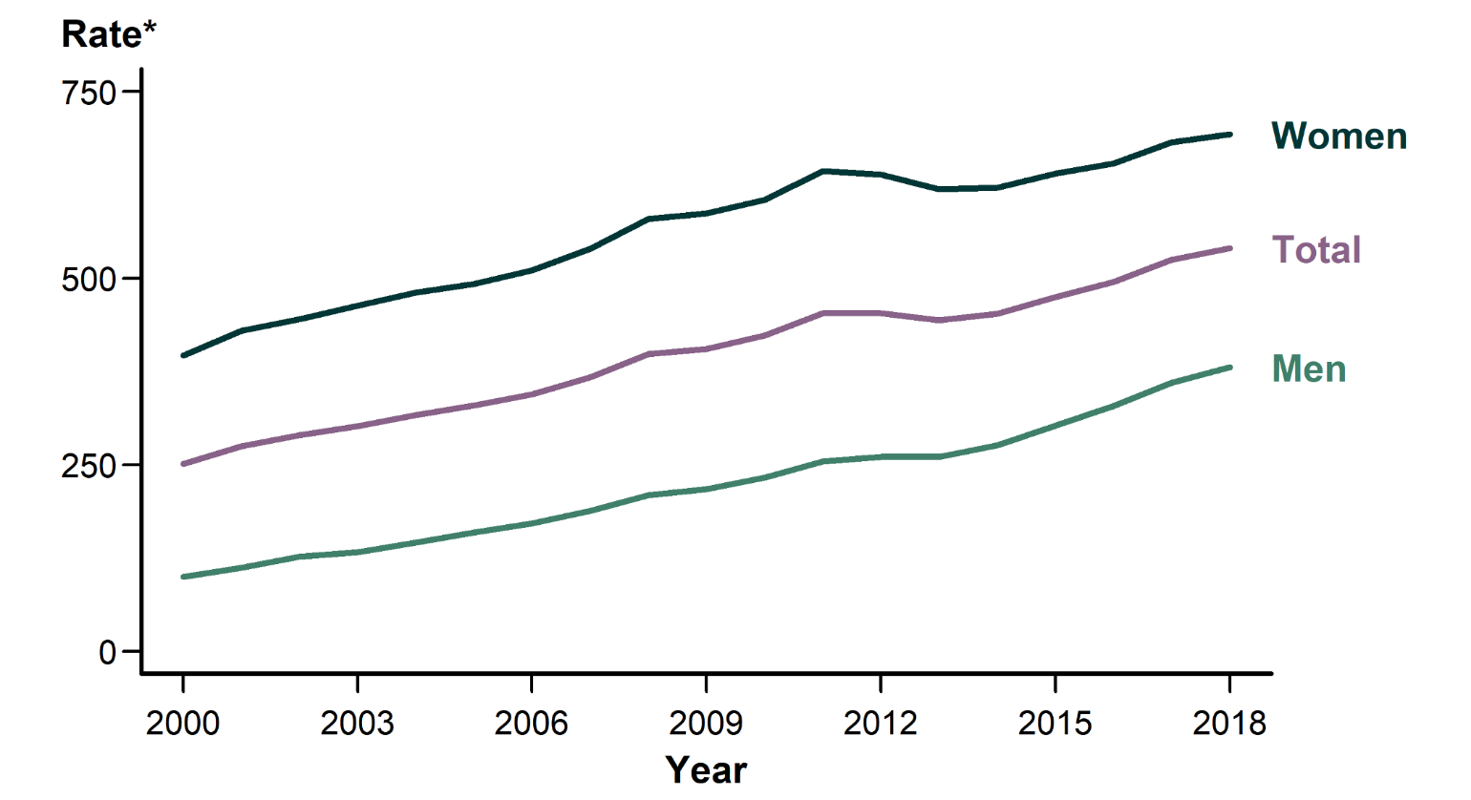
Chlamydia — Rates of Reported Cases by Sex, United States, 2000–2018
* Per 100,000.
NOTE: See sections A1.3 and A1.8 in the Appendix for more information on chlamydia case reporting and interpreting trends in chlamydia case reports.
Notes:
Line graph showing rates of reported cases of chlamydia in the United States by sex from 2000 to 2018. In 2018, a total of 1,758,668 chlamydial infections were reported to CDC in 50 states and the District of Columbia. This case count corresponds to a rate of 539.9 cases per 100,000 population. In 2018, 1,145,063 cases of chlamydia were reported among females for a rate of 692.7 cases per 100,000 females. Among males, 610,447 cases of chlamydia were reported for a rate of 380.6 cases per 100,000 males.

Slide 3
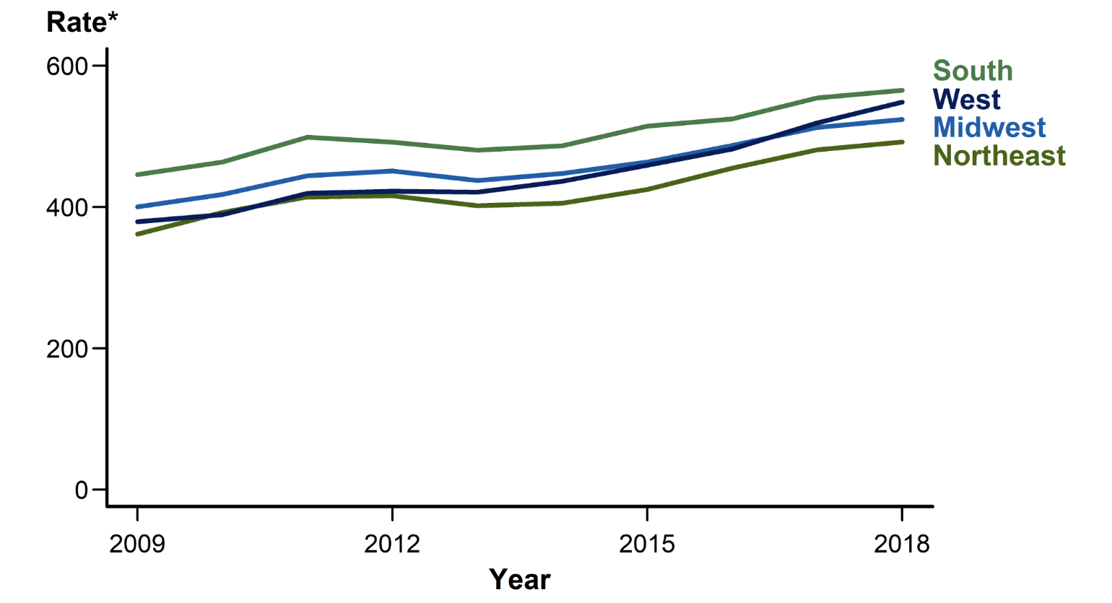
Chlamydia — Rates of Reported Cases by Region, United States, 2009–2018
* Per 100,000.
Notes:
Line graph showing rates of reported cases of chlamydia in the United States by region from 2009 to 2018. In 2018, rates of reported cases of chlamydia were highest in the South (565.2 cases per 100,000 population, 1.9% increase from 2017), followed by the West (548.5, 5.6% increase from 2017), Midwest (524.0, 2.2% increase from 2017), and Northeast (492.1, 2.3% increase from 2017). During 2012–2013, rates decreased in the Northeast, Midwest, and South and remained stable in the West. Rates started increasing in 2013, and have increased in all regions over each of the last five years. During 2014–2018, the largest increase occurred in the West (436.4 to 548.5 cases per 100,000 population, 25.7% increase).

Slide 4
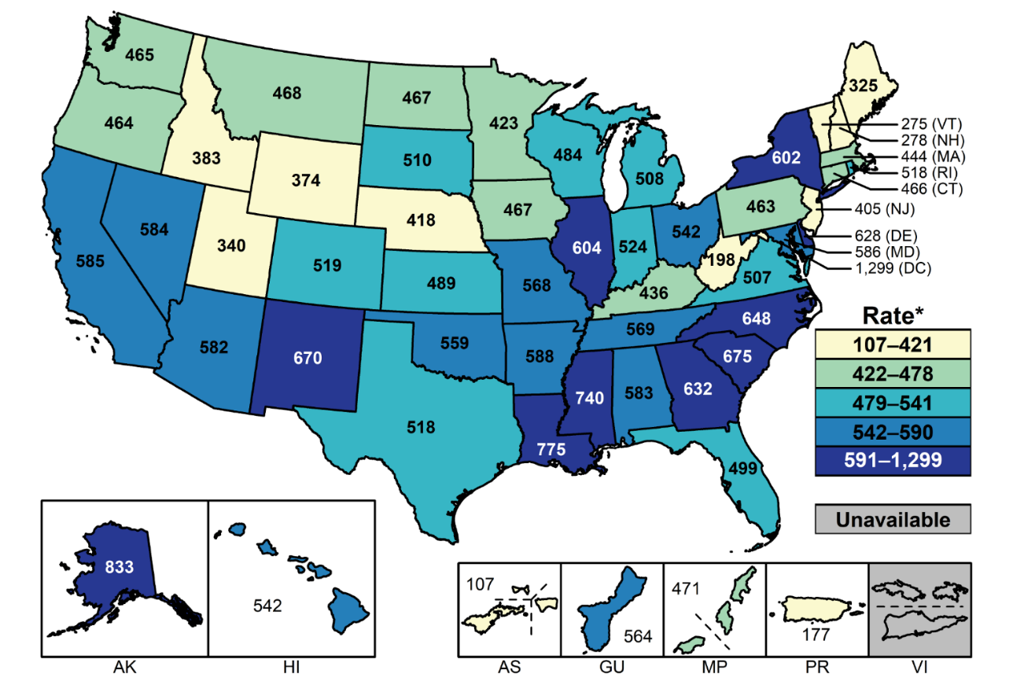
Chlamydia — Rates of Reported Cases by State and Territory, United States, 2018
* Per 100,000.
NOTE: See Section A1.11 in the Appendix for more information on interpreting reported rates in US territories.
Notes:
United States map showing rates of reported cases of chlamydia by state and territory. In 2018, rates of reported cases of chlamydia by state ranged from 198.2 cases per 100,000 population in West Virginia to 832.5 cases per 100,000 population in Alaska; the rate for the District of Columbia was 1,298.9 cases per 100,000 population.

Slide 5
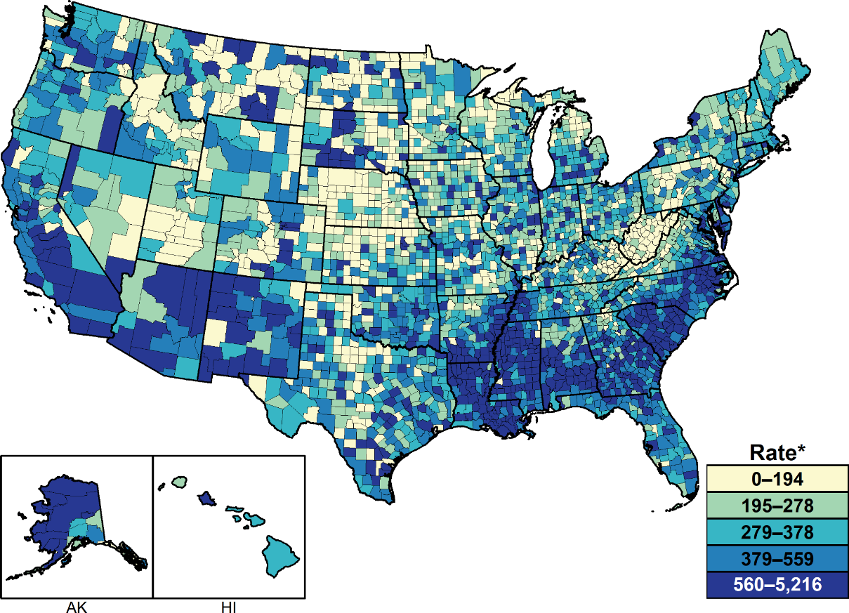
Chlamydia — Rates of Reported Cases by County, United States, 2018
* Per 100,000.
NOTE: See section A1.5 in the Appendix for more information on county-level rates.
Notes:
United States map showing rates of reported cases of chlamydia by county. In 2018, 628 (20.0%) of 3,142 counties had rates of reported chlamydia at or higher than 560 cases per 100,000 population. Seventy counties and independent cities reported 44% of all chlamydia cases in 2018.

Slide 6
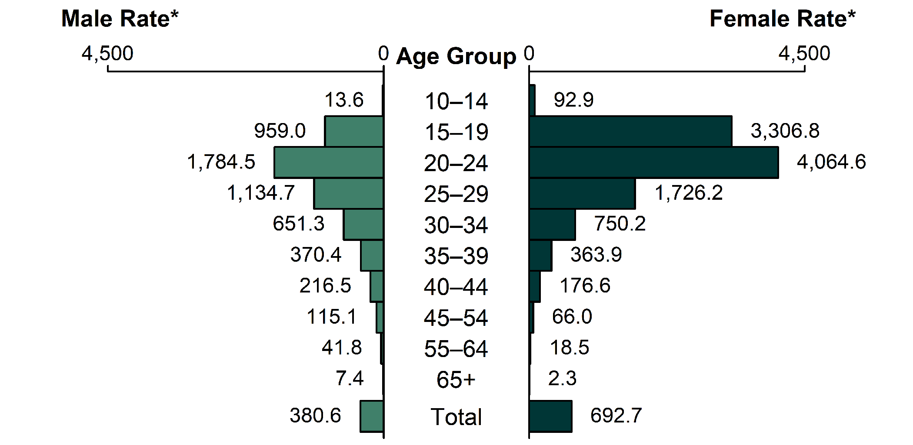
Chlamydia — Rates of Reported Cases by Age Group and Sex, United States, 2018
* Per 100,000.
Notes:
Bar graph showing rates of reported cases of chlamydia in the United States by age group and sex. In 2018, 97.4% of all reported chlamydia cases in females were among those aged 15–44 years. The highest age-specific rates of reported cases of chlamydia in 2018 were among those aged 15–19 years (3,306.8 cases per 100,000 females) and 20–24 years (4,064.6 cases per 100,000 females). In 2018, 94.0% of all reported chlamydia cases in males were among those aged 15–44 years. The age-specific rates of reported cases of chlamydia among males, although substantially lower than rates among females, were highest in those aged 20–24 years (1,784.5 cases per 100,000 males).

Slide 7
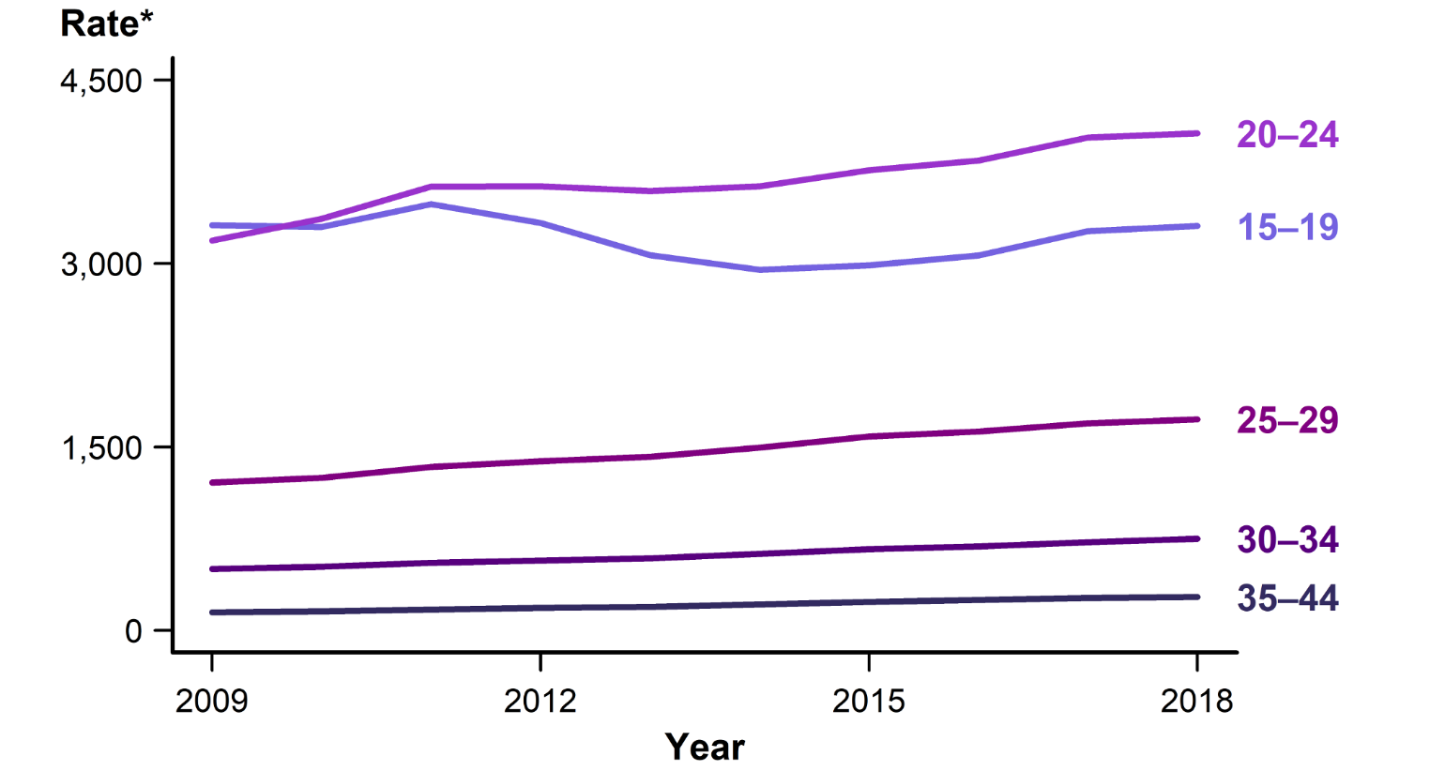
Chlamydia — Rates of Reported Cases Among Females Aged 15–44 Years by Age Group, United States, 2009–2018
* Per 100,000.
Notes:
Line graph showing rates of reported cases of chlamydia in the United States among females aged 15–44 years by age group from 2009–2018. Increases have been observed in recent years in rates of reported cases of chlamydia among all age groups in females aged 15–44 years. The rate among 15–19 year old females increased 1.3% during 2017–2018, with a total increase of 12.1% during 2014–2018 (2,949.3 to 3,306.8 cases per 100,000 females). The rate among 20–24 year old females increased 0.8% during 2017–2018, with a total increase of 11.9% during 2014–2018 (3,632.7 to 4,064.6 cases per 100,000 females).

Slide 8
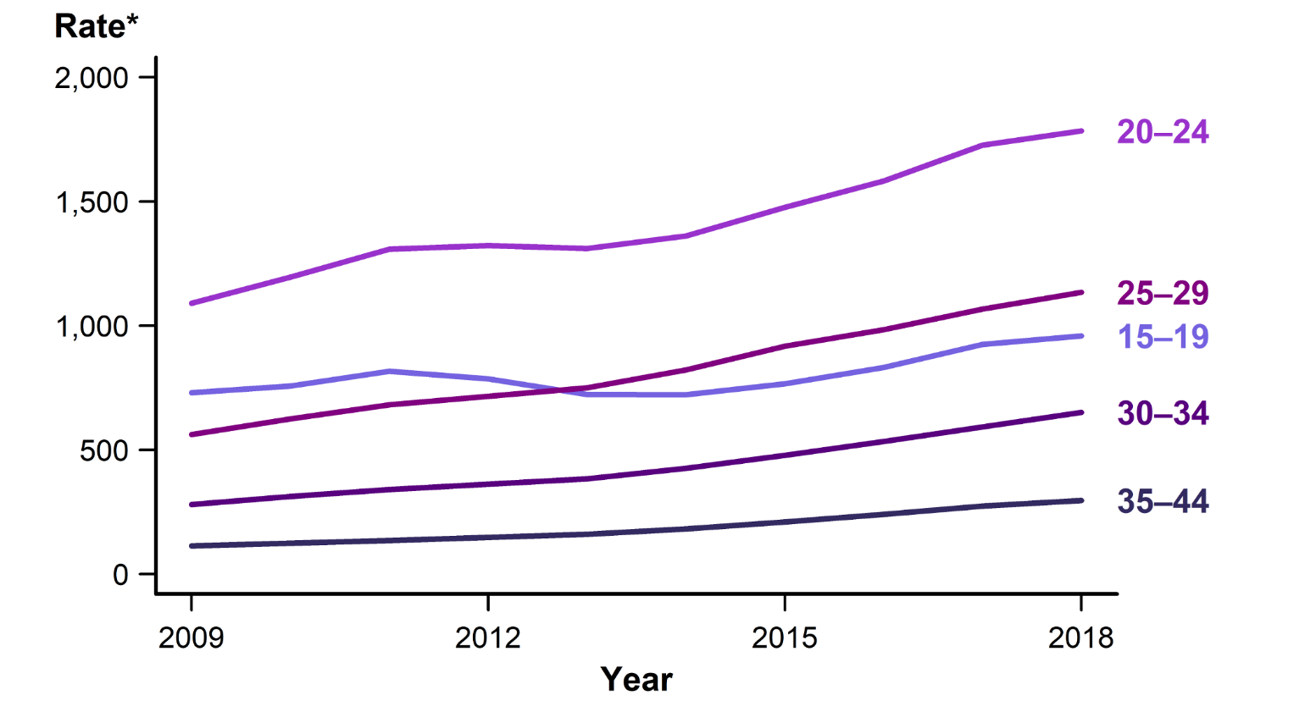
Chlamydia — Rates of Reported Cases Among Males Aged 15–44 Years by Age Group, United States, 2009–2018
* Per 100,000.
Notes:
Line graph showing rates of reported cases of chlamydia in the United States among males aged 15–44 years by age group from 2009–2018. Increases have been observed in rates of reported cases of chlamydia among all age groups in males aged 15–44 years. The rate among 15–19 year olds increased 3.7% during 2017–2018, with a total increase of 32.8% during 2014–2018 (from 722.4 to 959.0 cases per 100,000 males). The rate among 20–24 year old males increased 3.3% during 2017–2018, with a total increase of 31.1% during 2014–2018 (1,361.3 to 1,784.5 cases per 100,000 males).

Slide 9
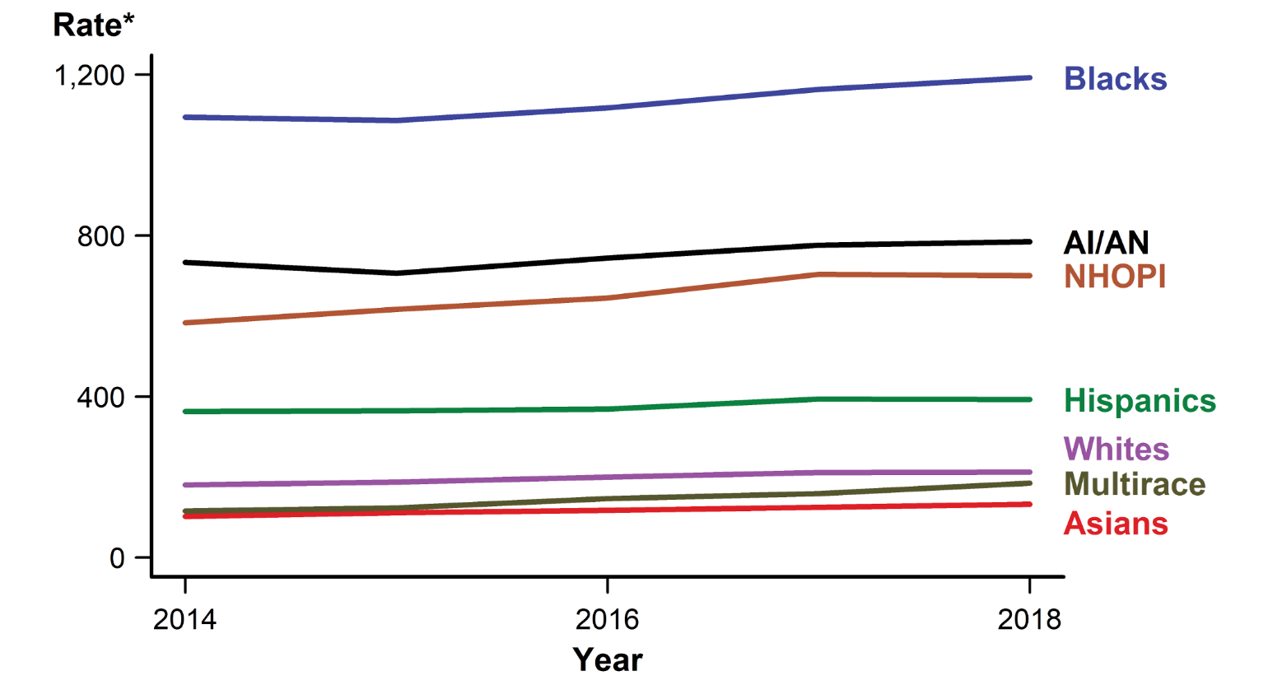
Chlamydia — Rates of Reported Cases by Race/Hispanic Ethnicity, United States, 2014–2018
* Per 100,000.
NOTE: See Section A1.5 in the Appendix for information on reporting STD case data for race/Hispanic ethnicity.
ACRONYMS: AI/AN = American Indians/Alaska Natives; NHOPI = Native Hawaiians/Other Pacific Islanders.
Notes:
Line graph showing rates of reported cases of chlamydia in the United States by race/Hispanic ethnicity from 2014 to 2018. In 2018, rates of reported cases of chlamydia were highest among Black, American Indian/Alaska Native, and Native Hawaiian/Other Pacific Islander persons. During 2014–2018, rates of reported chlamydia cases increased among all racial/Hispanic ethnicity groups, with American Indians/Alaska Natives increasing 7.0%, Hispanics 8.1%, Blacks 9.0%, Whites 17.6%, Native Hawaiians/Other Pacific Islanders 20.1%, Asians 29.3%, and Multirace 59.7%. During 2017–2018, rates increased among some racial/Hispanic ethnicity groups (Whites: 0.3%, American Indians/Alaska Natives: 1.1%, Blacks: 2.5%, Asians: 5.7%, and Multirace: 16.4%), and decreased among others (Native Hawaiians/Other Pacific Islanders: -0.4% and Hispanics: -0.4%).

Slide 10
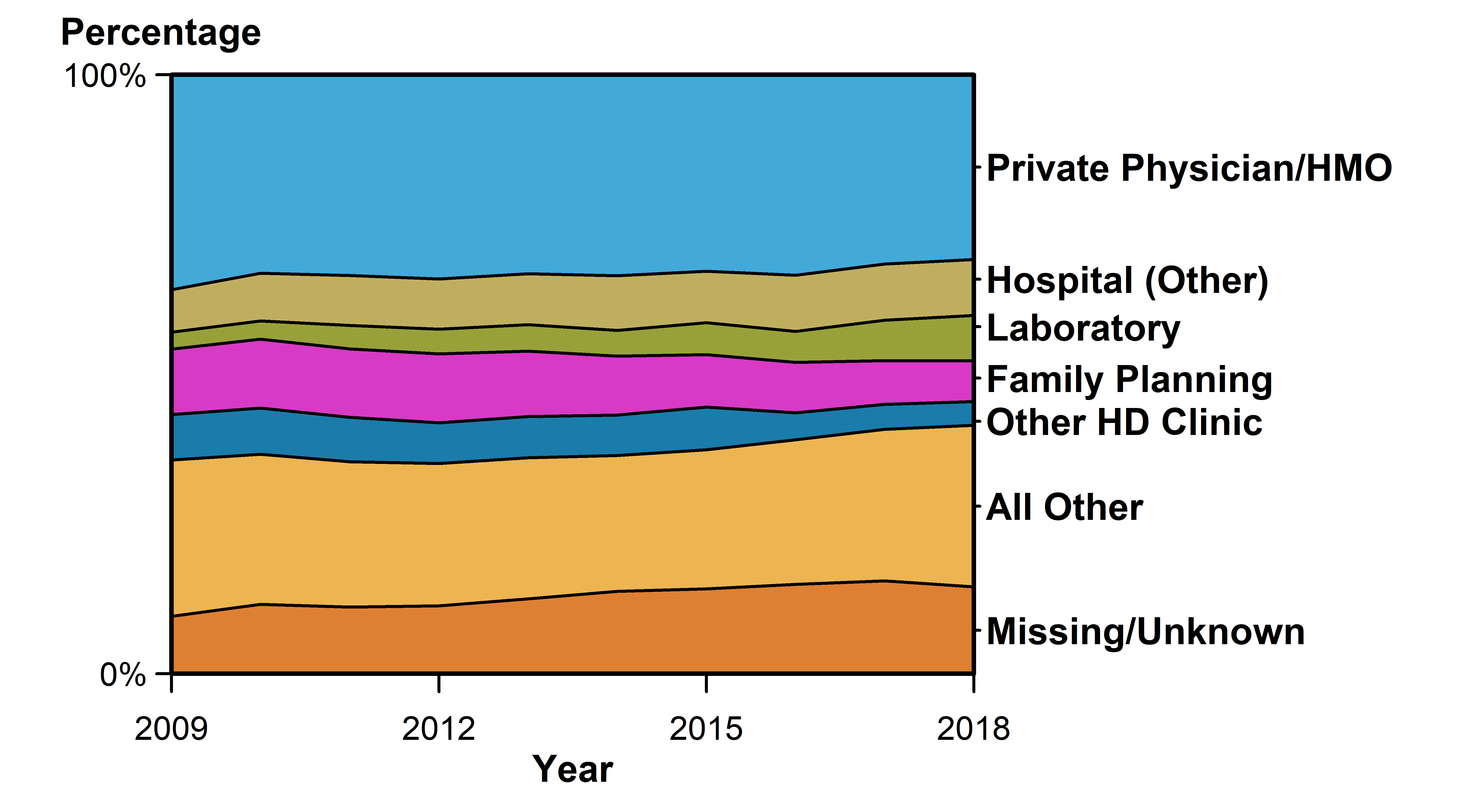
Chlamydia — Percentage of Reported Cases Among Females by Reporting Source*, United States, 2009–2018
* See section A1.7 in the Appendix for information on classification of reporting sources and a full list of reporting sources.
ACRONYMS: HMO = Health maintenance organization; HD = Health department.
Notes:
Area graph showing the percentage of reported cases of chlamydia among females in the United States by reporting source from 2009 to 2018. In 2018, among females, only 3.5% of chlamydia cases were reported through an STD clinic, with a large proportion of cases (30.9%) being reported from a private physician/health maintenance organization.

Slide 11
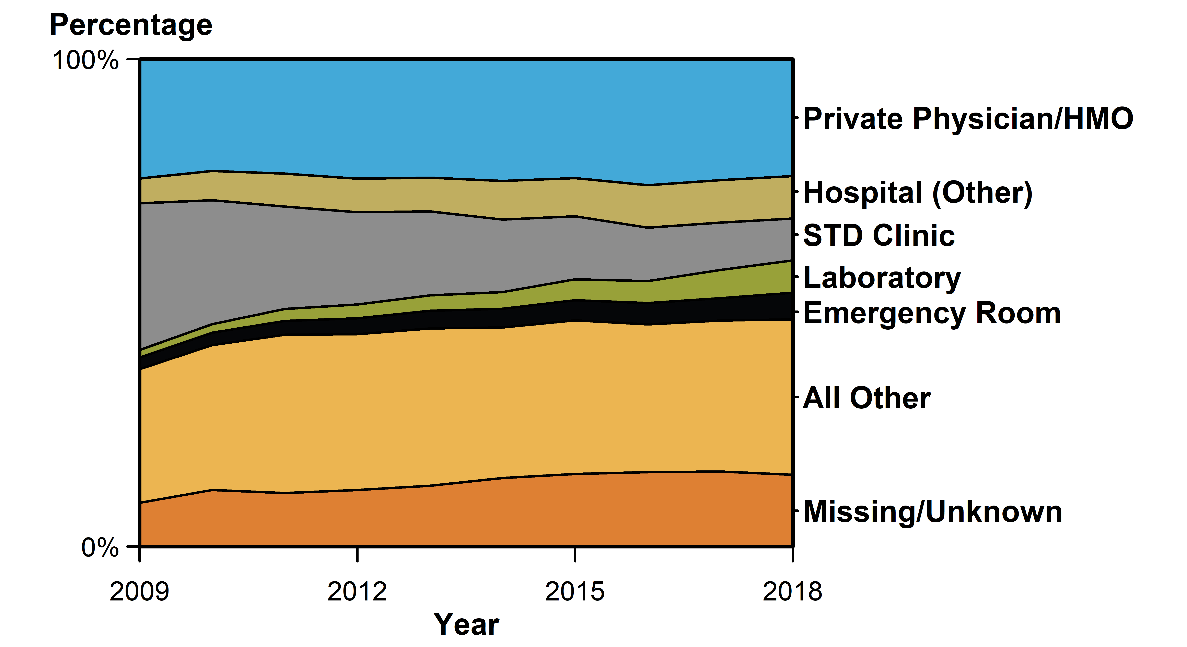
Chlamydia — Percentage of Reported Cases Among Males by Reporting Source*, United States, 2009–2018
* See section A1.7 in the Appendix for information on classification of reporting sources and a full list of reporting sources.
ACRONYMS: HMO = Health maintenance organization.
Notes:
Area graph showing the percentage of reported cases of chlamydia among males in the United States by reporting source from 2009 to 2018. The proportion of male cases reported from STD clinic sites has decreased substantially over time, from 30.1% in 2009 to 8.6% in 2018. Nearly one quarter (24.0%) of male cases were reported from a private physician/health maintenance organization.

Slide 12
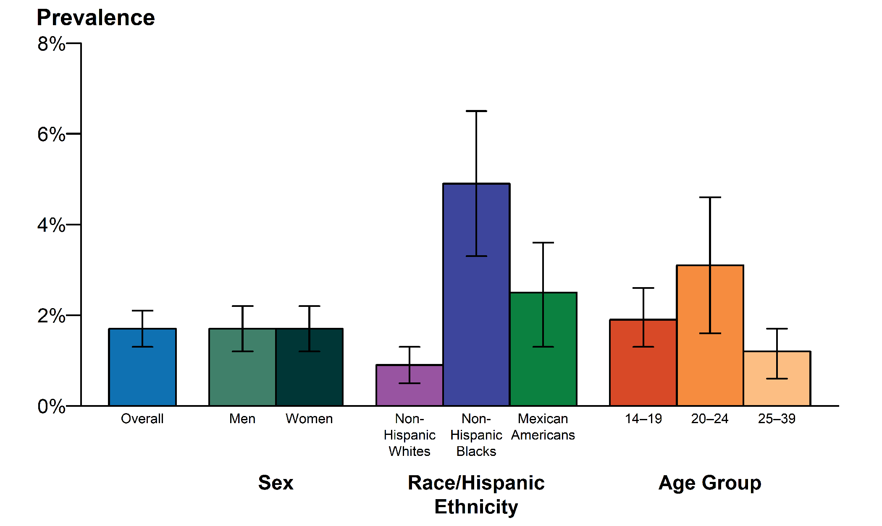
Chlamydia — National Estimates of Prevalence Among Persons Aged 14–39 Years by Sex, Race/Hispanic Ethnicity, or Age Group, National Health and Nutrition Examination Survey (NHANES), 2013–2016
NOTE: Error bars indicate 95% confidence intervals. Overall prevalence estimates include all race/Hispanic ethnicity groups, including those not shown separately.
ADAPTED FROM: Torrone E, Papp J, Weinstock H. Prevalence of Chlamydia trachomatis genital infection among persons aged 14–39 years — United States, 2007–2012. MMWR Morb Mortal Wkly Rep. 2014;63(38):834–838.
Notes:
Bar graph showing national estimates of chlamydia prevalence among persons aged 14–39 years by sex, race/Hispanic ethnicity, or age group from 2013 to 2016. During 2013–2016, the overall prevalence of chlamydia among persons aged 14–39 years was 1.7% (95% Confidence Interval: 1.3–2.1).

Slide 13
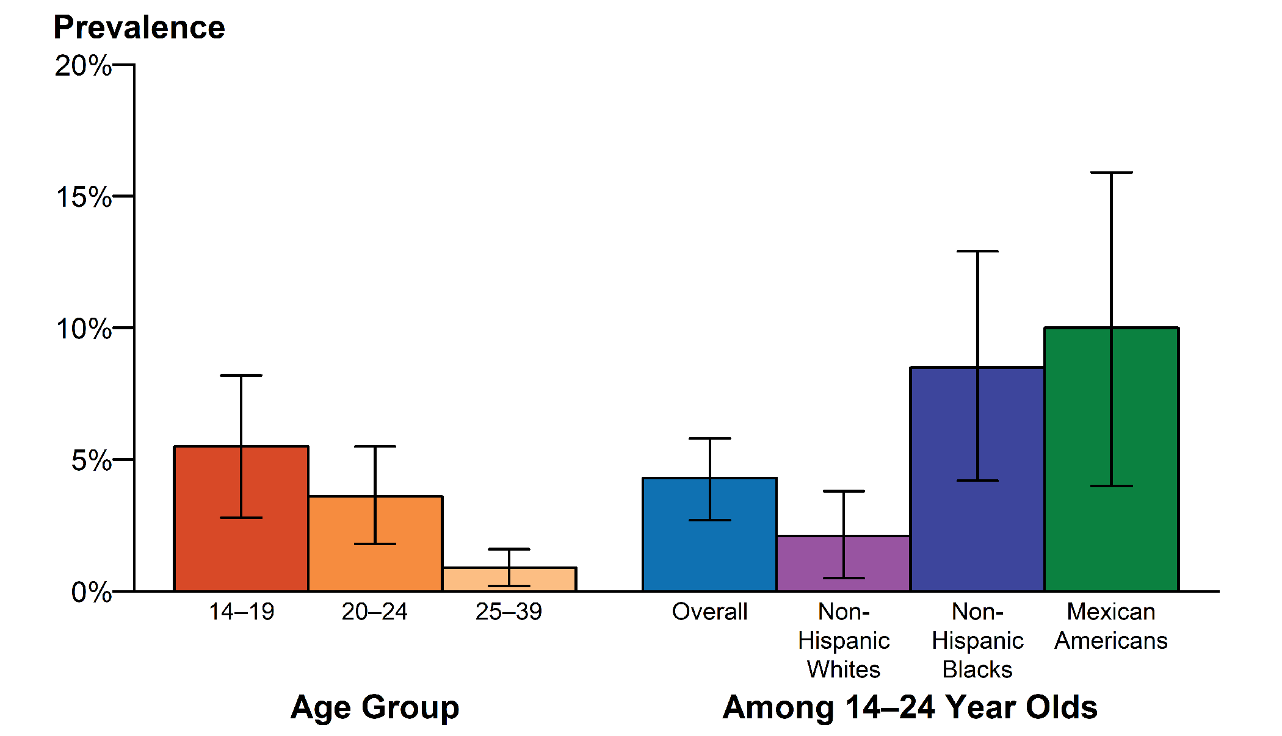
Chlamydia — National Estimates of Prevalence Among Sexually-Active Females Aged 14–39 Years by Race/Hispanic Ethnicity and Age Group, National Health and Nutrition Examination Survey (NHANES), 2013–2016
NOTE: Error bars indicate 95% confidence intervals. Overall prevalence estimates include all race/Hispanic ethnicity groups, including those not shown separately.
ADAPTED FROM: Torrone E, Papp J, Weinstock H. Prevalence of Chlamydia trachomatis genital infection among persons aged 14–39 years — United States, 2007–2012. MMWR Morb Mortal Wkly Rep. 2014;63(38):834–838.
Notes:
Bar graph showing national estimates of chlamydia prevalence among sexually-active females aged 14–39 years by race/Hispanic ethnicity and age group from 2013 to 2016. Among sexually-active females aged 14–24 years, the population targeted for screening, prevalence was 4.3% (95% Confidence Interval: 2.7–5.8), with the highest prevalence among Mexican American females (10.0%, 95% Confidence Interval: 4.0–15.9).

Slide 14
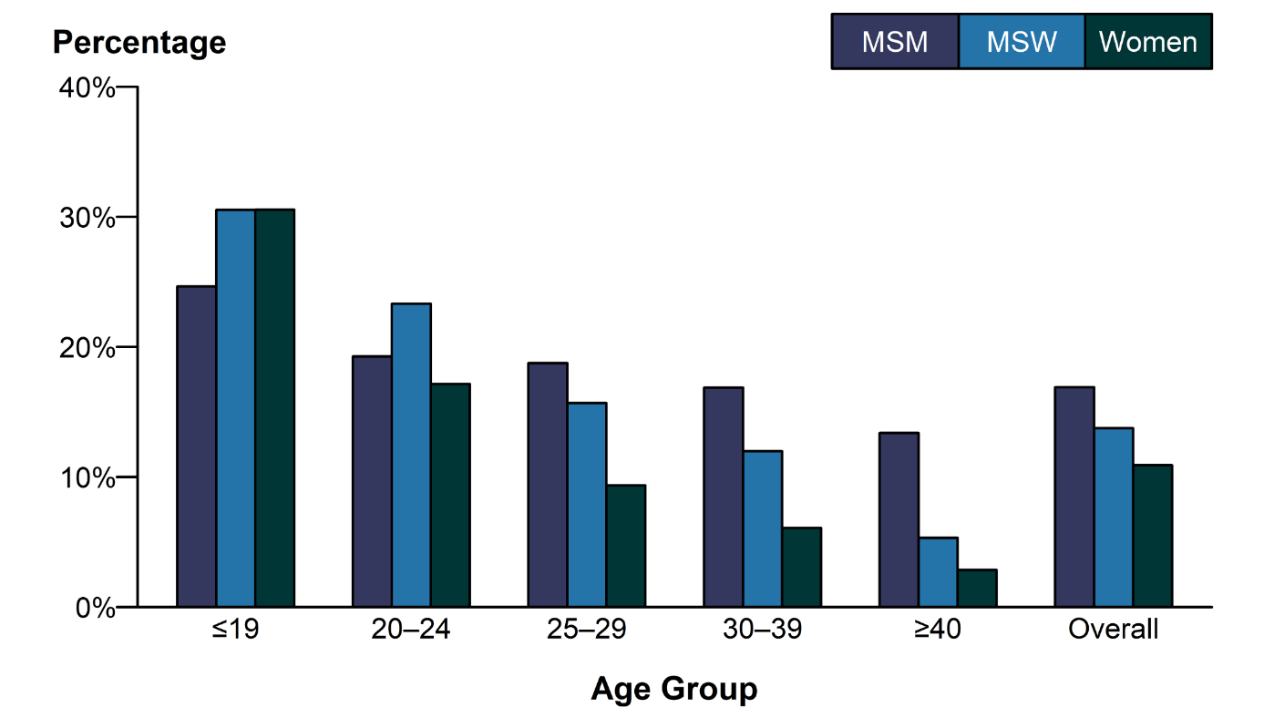
Chlamydia — Proportion of STD Clinic Patients Testing Positive* by Age Group and Sex and Sex of Sex Partners, STD Surveillance Network (SSuN), 2018
* Results are based on unique patients with known sex of sex partners (n=83,691) attending SSuN STD clinics who were tested ≥1 time for chlamydia in 2018.
NOTE: See Section A2.2 in the Appendix for SSuN methods.
ACRONYMS: MSM = Gay, bisexual, and other men who have sex with men; MSW = Men who have sex with women only.
Notes:
Bar graph showing the proportion of STD clinic patients testing positive for chlamydia by age group and sex and sex of sex partners. In 2018, the proportion of STD clinic patients testing positive for chlamydia varied by sex and sex of sex partners, as well as age. Women and men who have sex with women only aged 19 years or younger had the highest positivity; positivity was nearly equal at 30.6% and 30.5%, respectively. Positivity among all those tested decreased with age, though the decrease in positivity by age was not as pronounced for men who have sex with men. The overall positivity, represented by the average of the mean value by the contributing SSuN jurisdictions, was 16.9% for men who have sex with men, 13.8% for men who have sex with women only, and 10.9% for women.

Slide 15
Sexually Transmitted Disease
Division of STD Prevention
Surveillance 2018
Gonorrhea

Slide 16
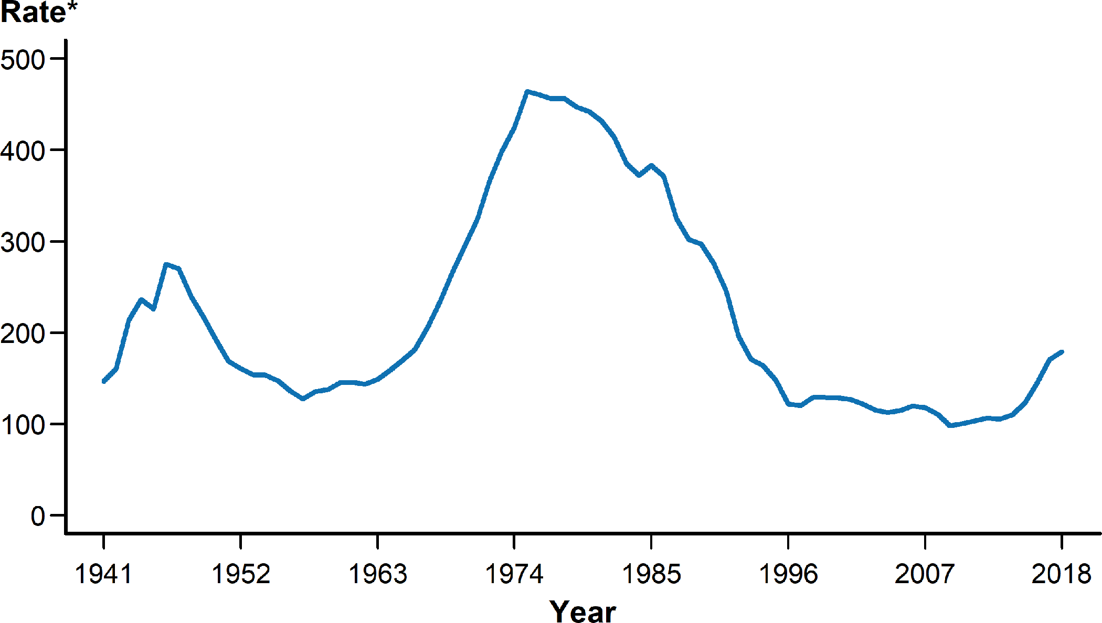
Gonorrhea — Rates of Reported Cases by Year, United States, 1941–2018
* Per 100,000.
NOTE: See section A1.3 in the Appendix for more information on gonorrhea case reporting.
Notes:
Line graph showing rates of reported cases of gonorrhea in the United States by year from 1941 to 2018. In 2018, a total of 583,405 cases of gonorrhea were reported in the United States, yielding a rate of 179.1 cases per 100,000 population. During 2017–2018, the rate of reported gonorrhea cases increased 5.0%, and increased 82.6% since the historic low in 2009.

Slide 17
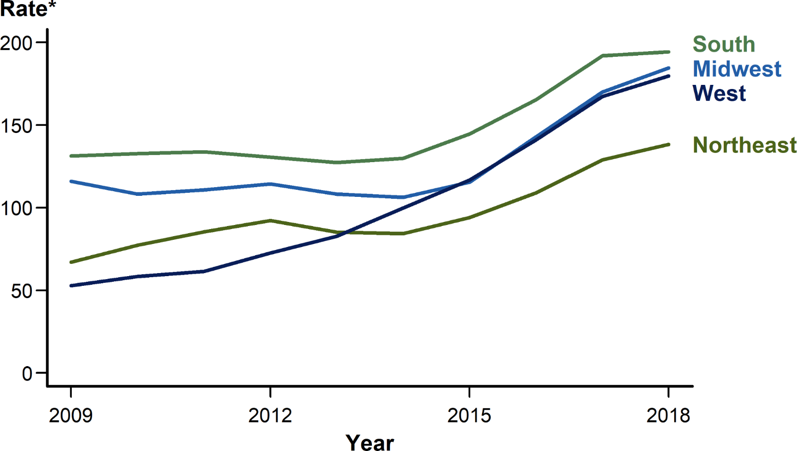
Gonorrhea — Rates of Reported Cases by Region, United States, 2009–2018
* Per 100,000.
Notes:
Line graph showing rates of reported cases of gonorrhea in the United States by region from 2009 to 2018. The South had the highest rate of reported gonorrhea cases (194.4 cases per 100,000 population) among the four regions of the United States in 2018, followed by the Midwest (184.5 cases per 100,000 population), the West (179.7 cases per 100,000 population), and the Northeast (138.4 cases per 100,000 population). During 2017–2018, the gonorrhea rate increased in all four regions: 8.5% in the Midwest, 7.4% in the West, 7.3% in the Northeast, and 1.3% in the South. During 2014–2018, the rate of gonorrhea increased by 79.9% (from 99.9 to 179.7 cases per 100,000 population) in the West and by 73.7% (from 106.2 to 184.5 cases per 100,000 population) in the Midwest, while the Northeast and South had lower overall increases during this time period (64.0% and 49.7%, respectively).

Slide 18
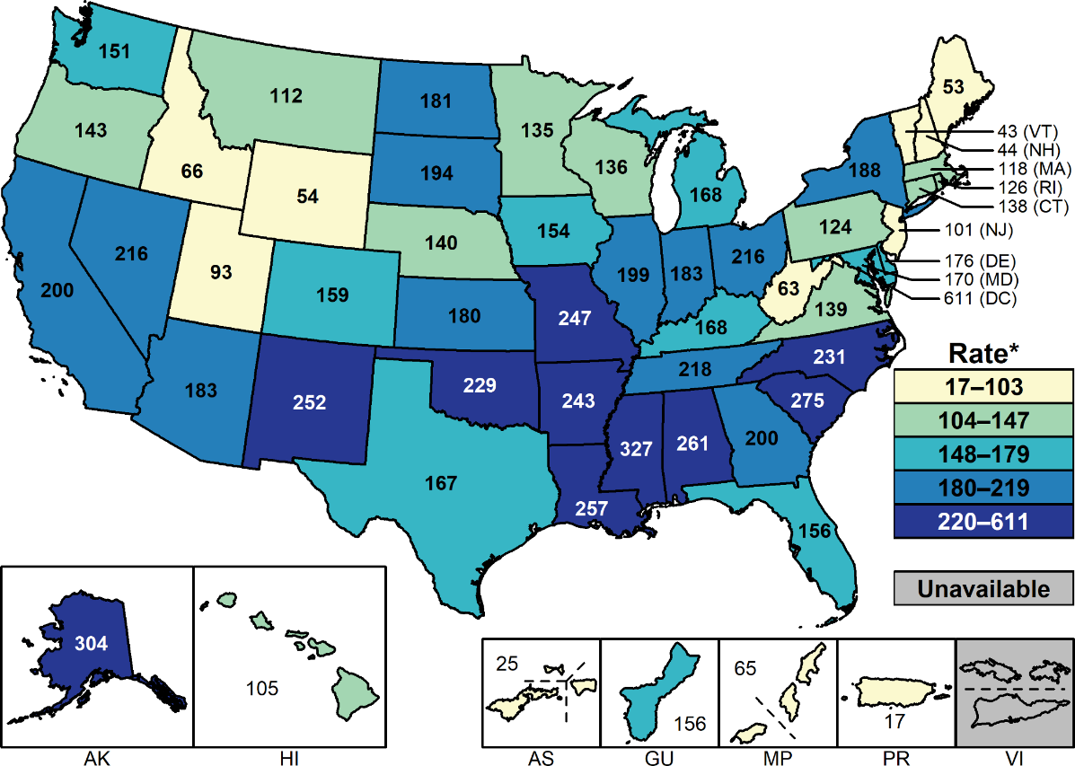
Gonorrhea — Rates of Reported Cases by State and Territory, United States, 2018
* Per 100,000.
NOTE: See Section A1.11 in the Appendix for more information on interpreting reported rates in US territories.
Notes:
United States map showing rates of reported cases of gonorrhea by state and territory. In 2018, rates of reported gonorrhea cases per 100,000 population ranged by state from 43.0 in Vermont to 326.7 in Mississippi; the gonorrhea rate in the District of Columbia was 611.0 cases per 100,000 population.

Slide 19
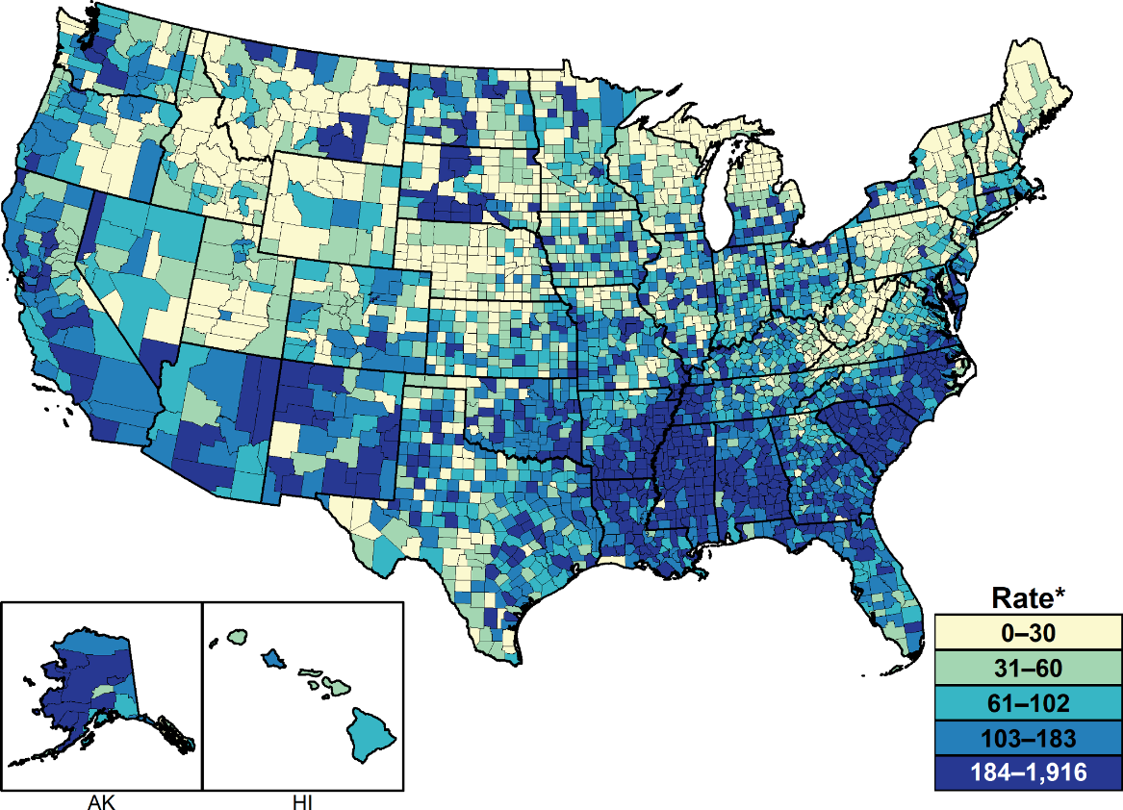
Gonorrhea — Rates of Reported Cases by County, United States, 2018
* Per 100,000.
NOTE: See section A1.4 in the Appendix for more information on county-level rates.
Notes:
United States map showing rates of reported cases of gonorrhea by county. In 2018, 93.4% of all counties in the United States reported at least one case of gonorrhea; however, 49.0% of reported gonorrhea cases occurred in just 70 counties or independent cities. The rate ranged from 0.0 to 30.0 cases per 100,000 population in 627 counties (20.0%), 31.0 to 60.0 cases per 100,000 population in 625 counties (20.0%), from 61.0 to 102.0 cases per 100,000 population in 629 counties (20.0%), from 103.0 to 183.0 cases per 100,000 population in 628 counties (20.0%), and was 184.0 cases per 100,000 population or more in 633 counties (20.1%). As in previous years, counties with the highest gonorrhea rates were concentrated in the South.

Slide 20
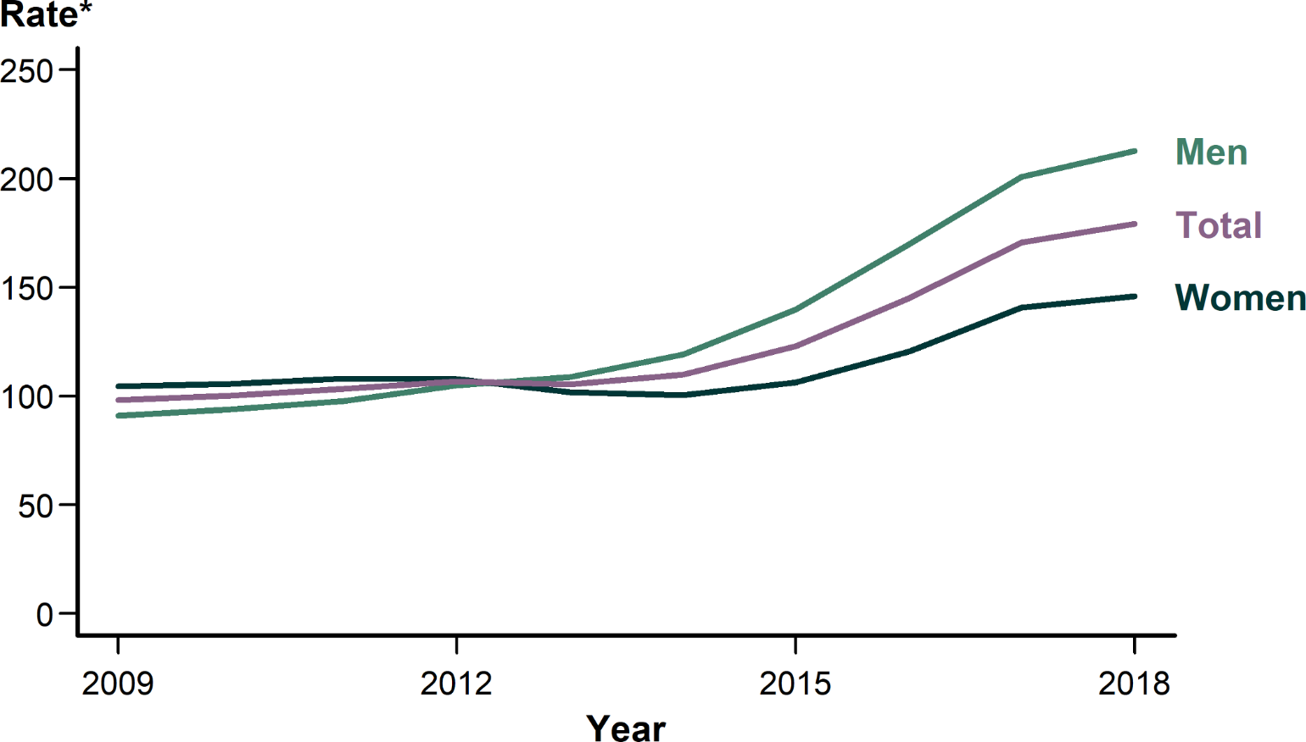
Gonorrhea — Rates of Reported Cases by Sex, United States, 2009–2018
* Per 100,000.
Notes:
Line graph showing rates of reported cases of gonorrhea in the United States by sex from 2009 to 2018. As was observed during 2014–2017, the rate of reported gonorrhea cases among males was higher than the rate among females in 2018. During 2017–2018, the gonorrhea rate among males increased 6.0% (from 200.8 to 212.8 cases per 100,000 males) and the rate among females increased 3.6% (from 140.7 to 145.8 cases per 100,000 females). During 2014–2018, the rate among males increased 78.7% (from 119.1 to 212.8 cases per 100,000 males) and the rate among females increased 45.2% (from 100.4 to 145.8 cases per 100,000 females).

Slide 21
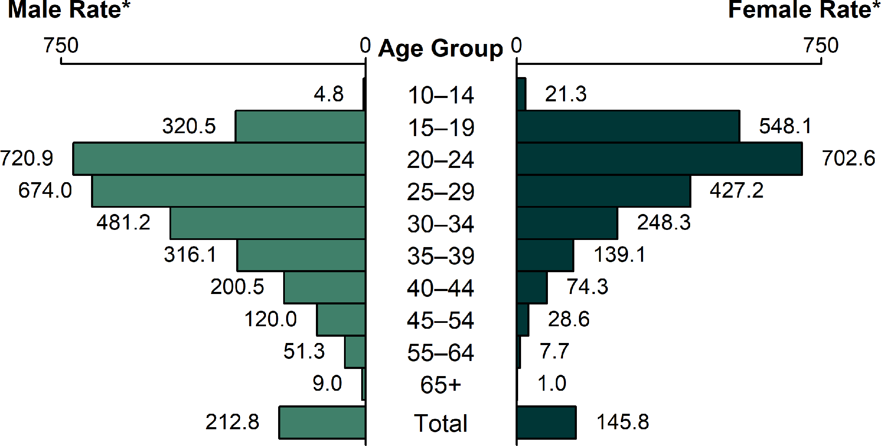
Gonorrhea — Rates of Reported Cases by Age Group and Sex, United States, 2018
* Per 100,000.
Notes:
Bar graph showing rates of reported cases of gonorrhea in the United States by age group and sex. In 2018, rates of reported gonorrhea cases continued to be highest among adolescents and young adults. In 2018, the highest rates among females were observed among those aged 20–24 years (702.6 cases per 100,000 females) and 15–19 years (548.1 cases per 100,000 females). Among males, the rate was highest among those aged 20–24 years (720.9 cases per 100,000 males) and 25–29 years (674.0 cases per 100,000 males).

Slide 22
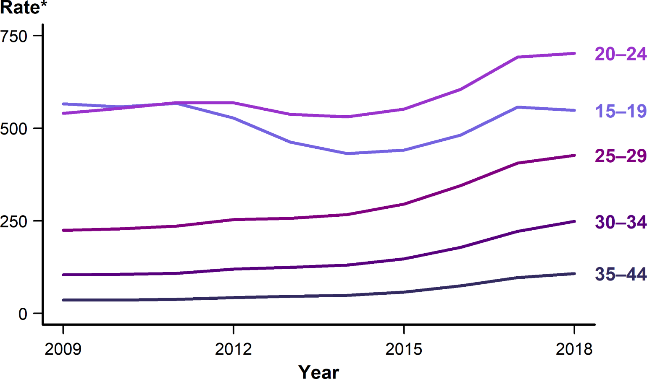
Gonorrhea — Rates of Reported Cases Among Females Aged 15–44 Years by Age Group, United States, 2009–2018
* Per 100,000.
Notes:
Line graph showing rates of reported cases of gonorrhea in the United States among females aged 15–44 years by age group from 2009–2018. Increases in rates of reported gonorrhea cases were observed in most age groups for females during 2017–2018. However, rates decreased 1.7% among females aged 15–19 years (from 557.3 to 548.1 cases per 100,000 females).

Slide 23
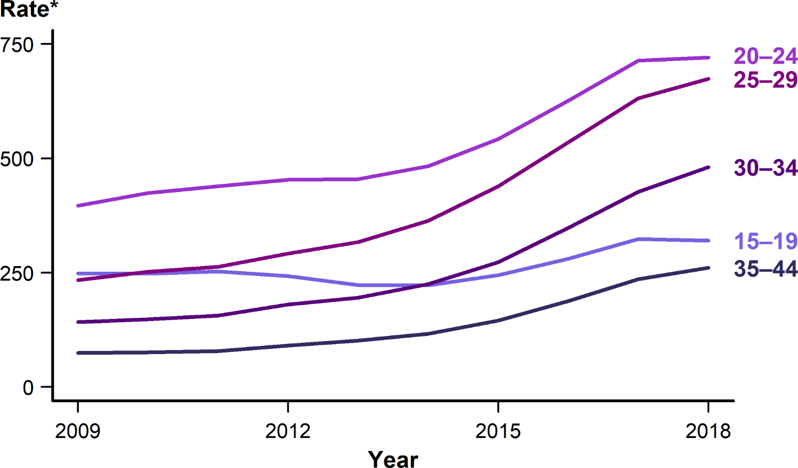
Gonorrhea — Rates of Reported Cases Among Males Aged 15–44 Years by Age Group, United States, 2009–2018
* Per 100,000.
Notes:
Line graph showing rates of reported cases of gonorrhea in the United States among males aged 15–44 years by age group from 2009–2018. Increases in rates of reported gonorrhea cases were observed in most age groups for males during 2017–2018. However, rates decreased 0.9% among males aged 15–19 years (from 323.3 to 320.5 cases per 100,000 males).

Slide 24
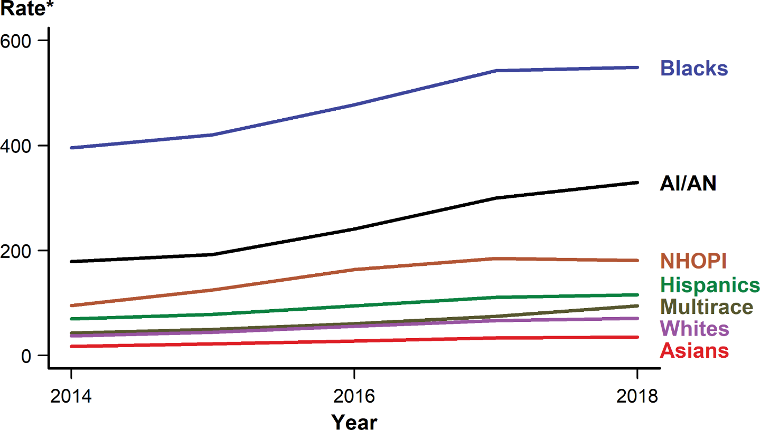
Gonorrhea — Rates of Reported Cases by Race/Hispanic Ethnicity, United States, 2014–2018
* Per 100,000.
NOTE: See Section A1.5 in the Appendix for information on reporting STD case data for race/Hispanic ethnicity.
ACRONYMS: AI/AN = American Indians/Alaska Natives; NHOPI = Native Hawaiians/Other Pacific Islanders.
Notes:
Line graph showing rates of reported cases of gonorrhea in the United States by race/Hispanic ethnicity from 2014 to 2018. In 2018, the rate of reported gonorrhea cases remained highest among Blacks (548.9 cases per 100,000 population). During 2014–2018, for all five years during that period, the gonorrhea rate increased among all race/Hispanic ethnicity groups: 119.5% among Multirace persons, 99.4% among Asians, 90.3% among Native Hawaiians/Other Pacific Islanders, 89.1% among Whites, 84.2% among American Indians/Alaska Natives, 66.0% among Hispanics, and 38.8% among Blacks.

Slide 25
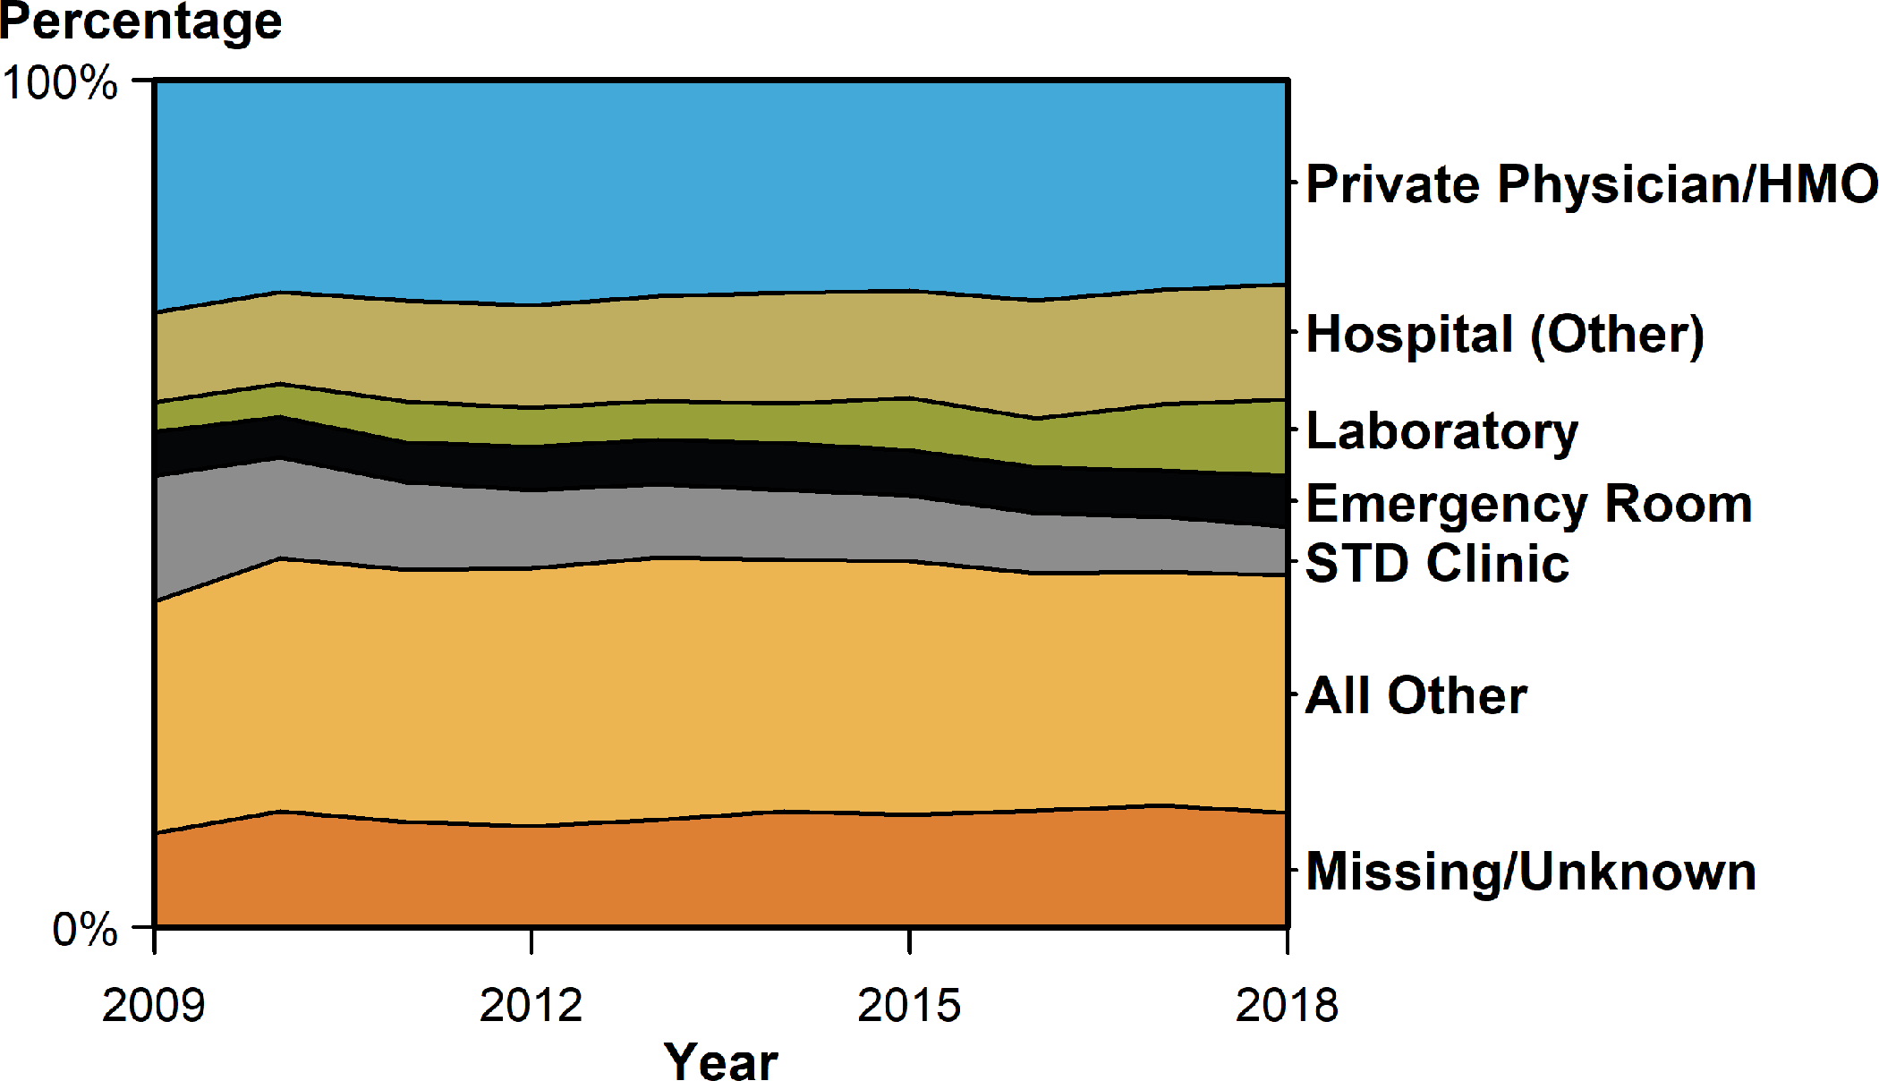
Gonorrhea — Percentage of Reported Cases Among Females by Reporting Source*, United States, 2009–2018
* See section A1.7 in the Appendix for information on classification of reporting sources and a full list of reporting sources.
ACRONYMS: HMO = Health maintenance organization.
Notes:
Area graph showing the percentage of reported cases of gonorrhea among females in the United States by reporting source from 2009 to 2018. During 2009–2018, the percent of gonorrhea cases reported by STD clinics declined 42.6% among females; however, the percent of gonorrhea cases with missing/unknown reporting source increased 80.4% among females. During 2017–2018, the percent of gonorrhea cases reported by STD clinics decreased 7.5% among females. In 2018, the largest proportion of cases among females were reported by private physicians/health maintenance organizations (24.1 %), followed by other hospital clinics/facilities (13.6 %), laboratories (9.0 %), emergency rooms (6.0%), and STD clinics (5.8%).

Slide 26
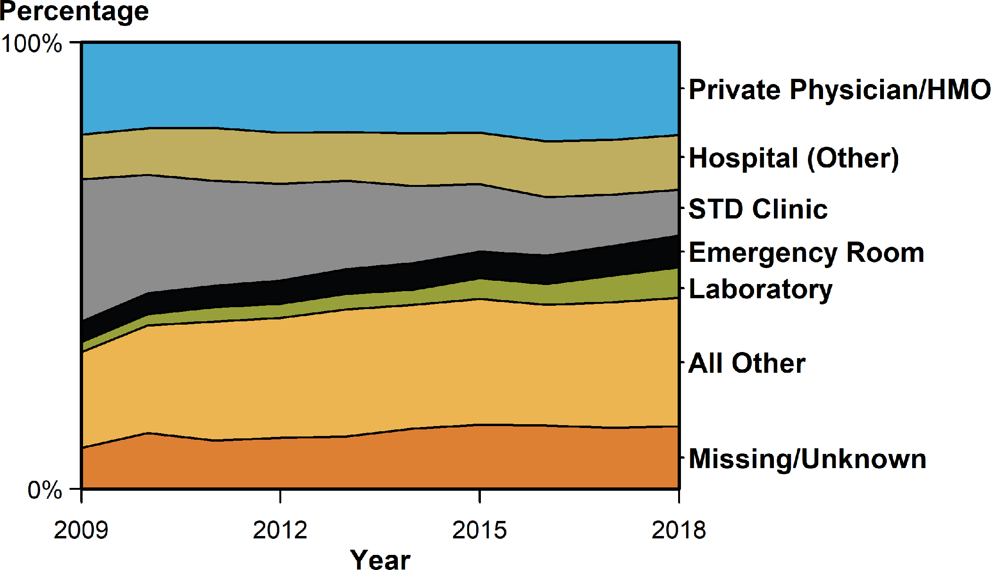
Gonorrhea — Percentage of Reported Cases Among Males by Reporting Source*, United States, 2009–2018
* See section A1.7 in the Appendix for information on classification of reporting sources and a full list of reporting sources.
ACRONYMS: HMO = Health maintenance organization.
Notes:
Area graph showing the percentage of reported cases of gonorrhea among males in the United States by reporting source from 2009 to 2018. During 2009–2018, the percent of gonorrhea cases reported by STD clinics declined 19.8% among males; however, the percent of gonorrhea cases with missing/unknown reporting source increased 277.3% among males. During 2017–2018, the percent of gonorrhea cases reported by STD clinics decreased 4.9% among males. Among males, private physicians/health maintenance organizations (20.7 %) were the most common reporting source, followed by other hospital clinics/facilities (12.3%), STD clinics (10.3%), emergency rooms (7.1%), and laboratories (6.9 %).

Slide 27
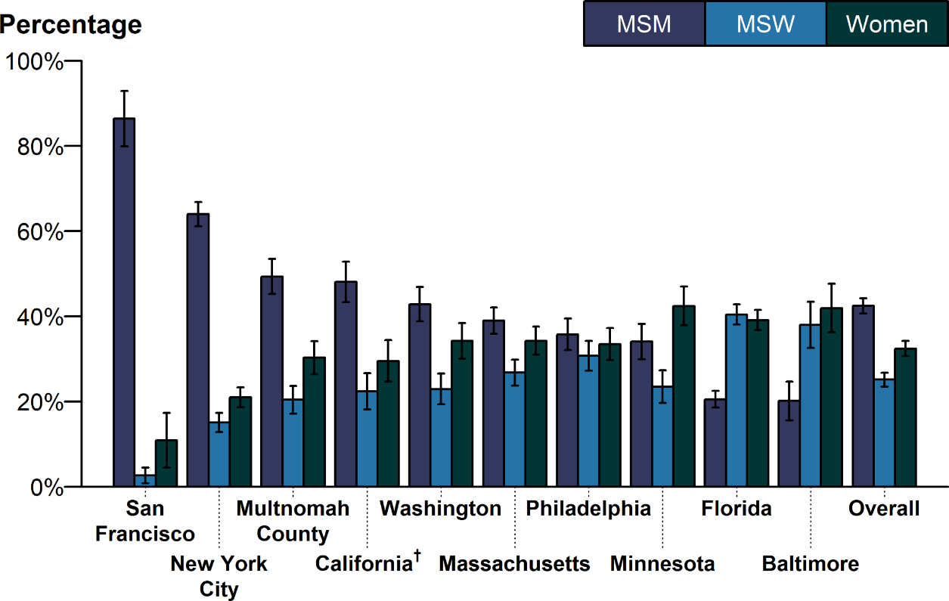
Estimated Proportion* of MSM, MSW, and Women Among Gonorrhea Cases by Jurisdiction, STD Surveillance Network (SSuN), 2018
* Estimate based on weighted analysis of data obtained from interviews (n=6,842) conducted among a random sample of reported gonorrhea cases during January to December 2018.
† California data exclude San Francisco (shown separately).
NOTE: See section A2.2 in the Appendix for SSuN methods.
ACRONYMS: MSM = Gay, bisexual, and other men who have sex with men; MSW = Men who have sex with women only.
Notes:
Bar graph showing the estimated proportion of men who have sex with men, men who have sex with women only, and women among gonorrhea cases by SSuN jurisdiction in 2018. The estimated burden of disease represented by men who have sex with men (including men who have sex with both men and women), men who have sex with women only, and women varied substantially across collaborating sites based on weighted analysis. San Francisco had the highest proportion of gonorrhea cases estimated to be among men who have sex with men (86.4%), while Baltimore had the lowest proportion of cases among men who have sex with men (20.1%). In total, across all SSuN sites, 42.5% of gonorrhea cases were estimated to be among men who have sex with men, 25.1% among men who have sex with women only, and 32.4% among women.

Slide 28
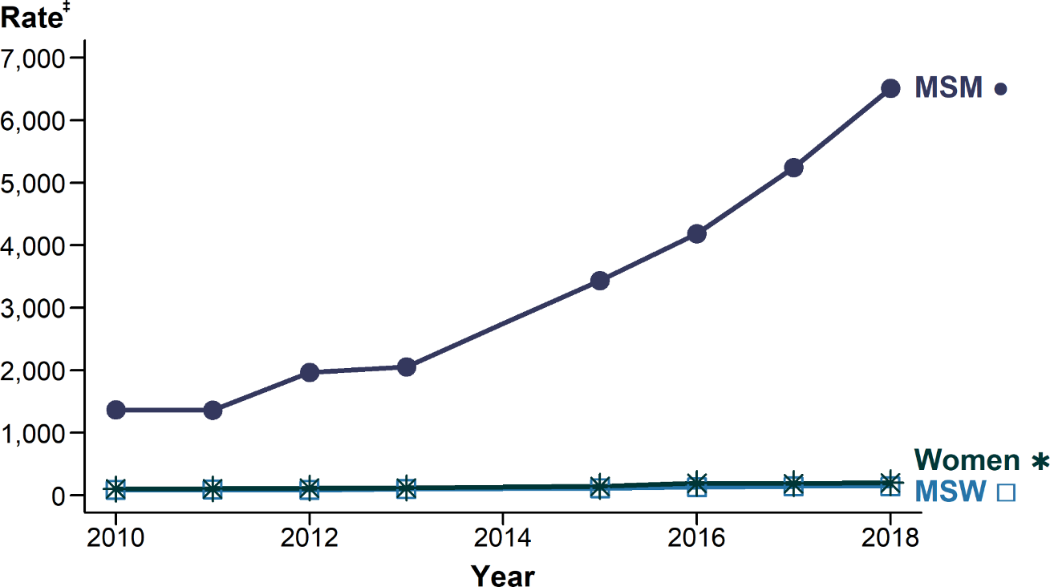
Gonorrhea — Estimated* Rates of Reported Gonorrhea Cases by MSM, MSW, and Women, STD Surveillance Network (SSuN)†, 2010–2018
* Estimates based on interviews among a random sample of reported cases of gonorrhea (n=21,417); cases weighted for analysis. Data not available for 2014; 2013–2015 trend interpolated; trends lines overlap for MSW and women in this figure.
† Sites include Baltimore, Philadelphia, New York City, Washington State, San Francisco, and California (excluding San Francisco).
‡ Per 100,000.
ADAPTED FROM: Stenger M, Pathela P, Anschuetz G, et al. Increases in the rate of Neisseria gonorrhoeae among gay, bisexual and other men who have sex with men (MSM) — findings from the STD Surveillance Network 2010–2015. Sex Transm Dis. 2017;44(7):393–397.
ACRONYMS: MSM = Gay, bisexual, and other men who have sex with men; MSW = Men who have sex with women only.
Notes:
Line graph showing the estimated rates of reported gonorrhea cases by men who have sex with men, men who have sex with women only, and women from 2010 to 2018. The estimated gonorrhea case rate among men who have sex with men increased 375.5% during 2010–2018, from 1,368.6 cases per 100,000 men who have sex with men in 2010 to 6,508.0 cases per 100,000 men who have sex with men in 2018. Over the same time period, case rates among women and men who have sex with women only also increased by 95.2% and 69.3%, respectively.

Slide 29
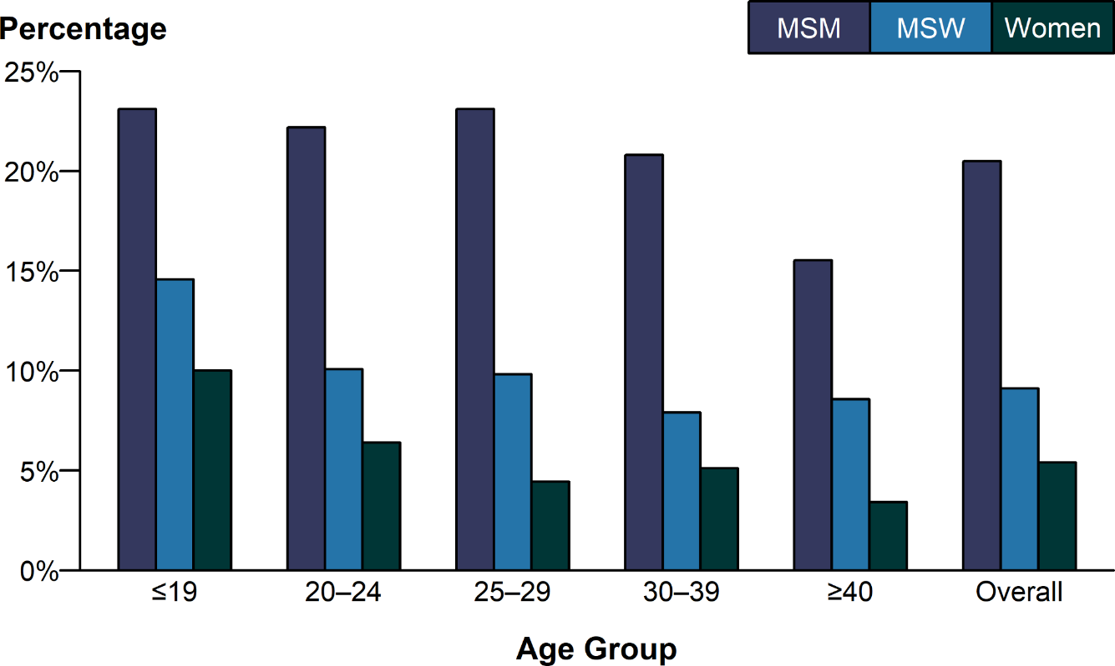
Gonorrhea — Proportion of STD Clinic Patients* Testing Positive by Age Group and Sex and Sex of Sex Partners, STD Surveillance Network (SSuN), 2018
* Results are based on data obtained from unique patients with known sex of sex partners (n=77,314) attending SSuN STD clinics who were tested ≥1 time for gonorrhea in 2018.
NOTE: See section A2.2 in the Appendix for SSuN methods.
ACRONYMS: MSM = Gay, bisexual, and other men who have sex with men; MSW = Men who have sex with women only.
Notes:
Bar graph showing the proportion of STD clinic patients testing positive for gonorrhea by age group and sex and sex of sex partners. In 2018, the proportion of STD clinic patients who tested positive for gonorrhea varied by sex and sex of sex partners, as well as age group. The overall prevalence, represented by the average of the mean value by nine of the 10 SSuN jurisdictions, where data was available, was 20.5% for men who have sex with men, 9.1% for men who have sex with women only, and 5.4% for women. Among those attending these clinics, men who have sex with men disproportionately had higher positivity rates when compared to men who have sex with women only and women in all age groups. Although overall gonorrhea positivity rates declined with increasing age for women, men who have sex with men, and men who have sex with women only, a slower decline by age was observed in men who have sex with men less than 40 years of age.

Slide 30
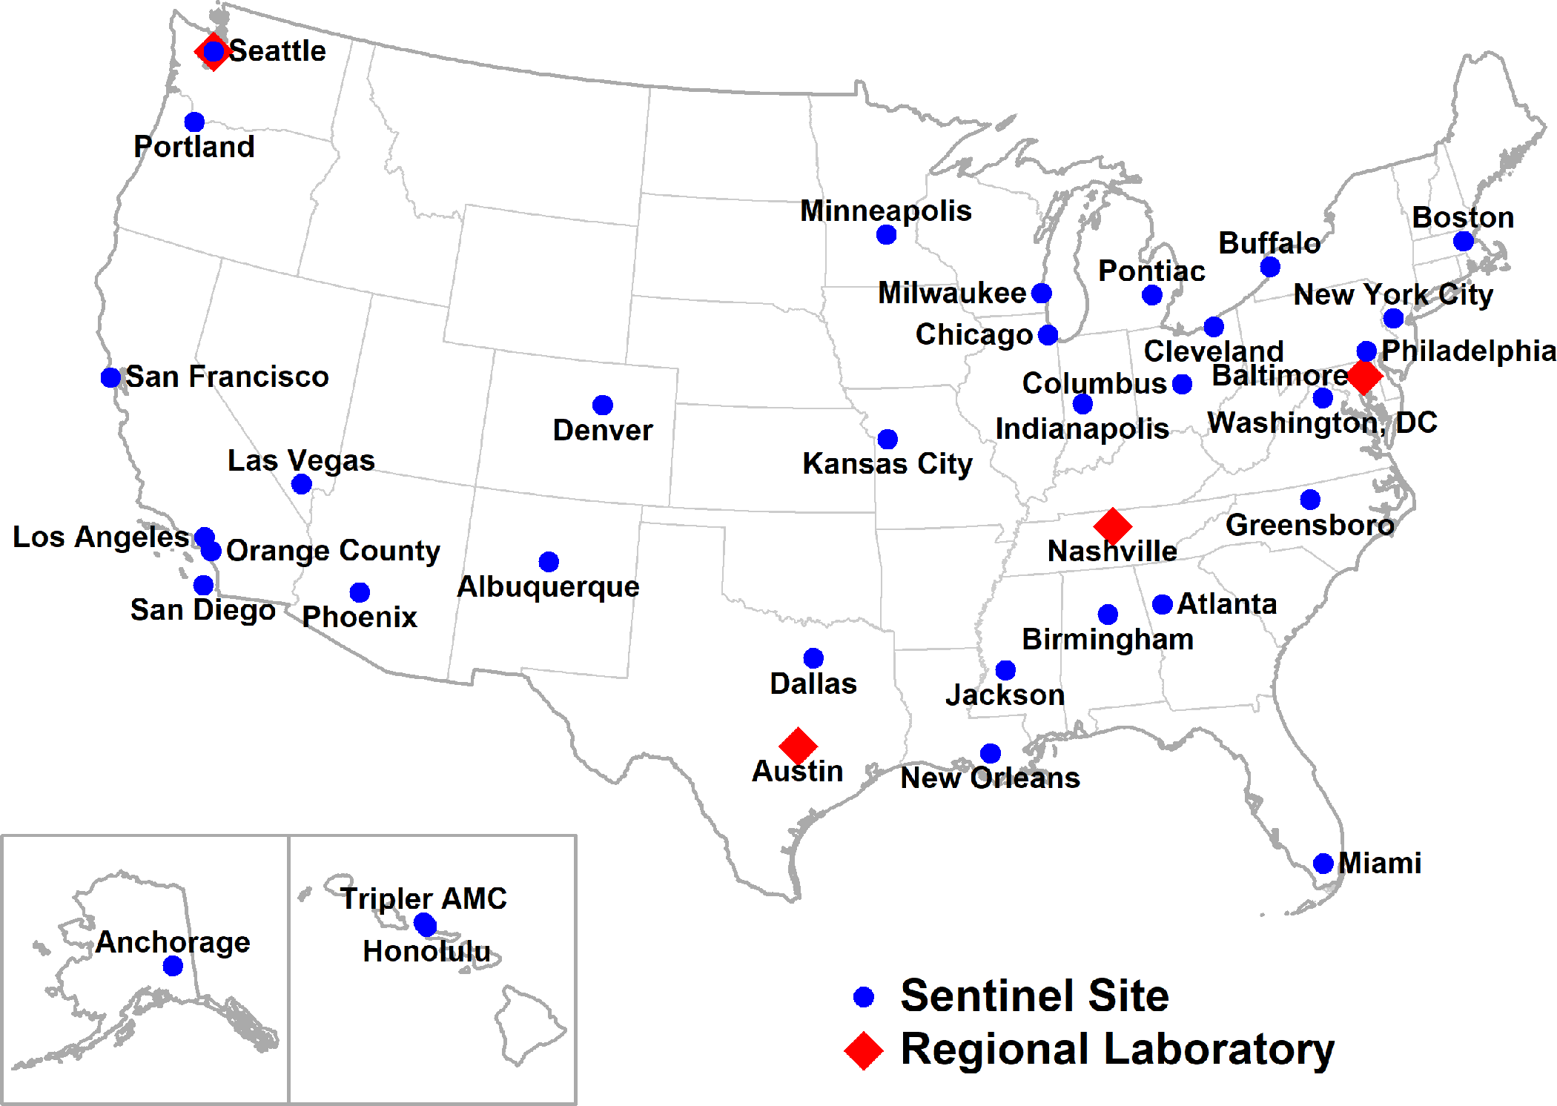
Location of Participating Sentinel Sites and Regional Laboratories, Gonococcal Isolate Surveillance Project (GISP), United States, 2018
NOTE: Seattle is both a sentinel site and a regional laboratory.
Notes:
United States map showing the location of sentinel sites and regional laboratories participating in the Gonococcal Isolate Surveillance Project in 2018.

Slide 31
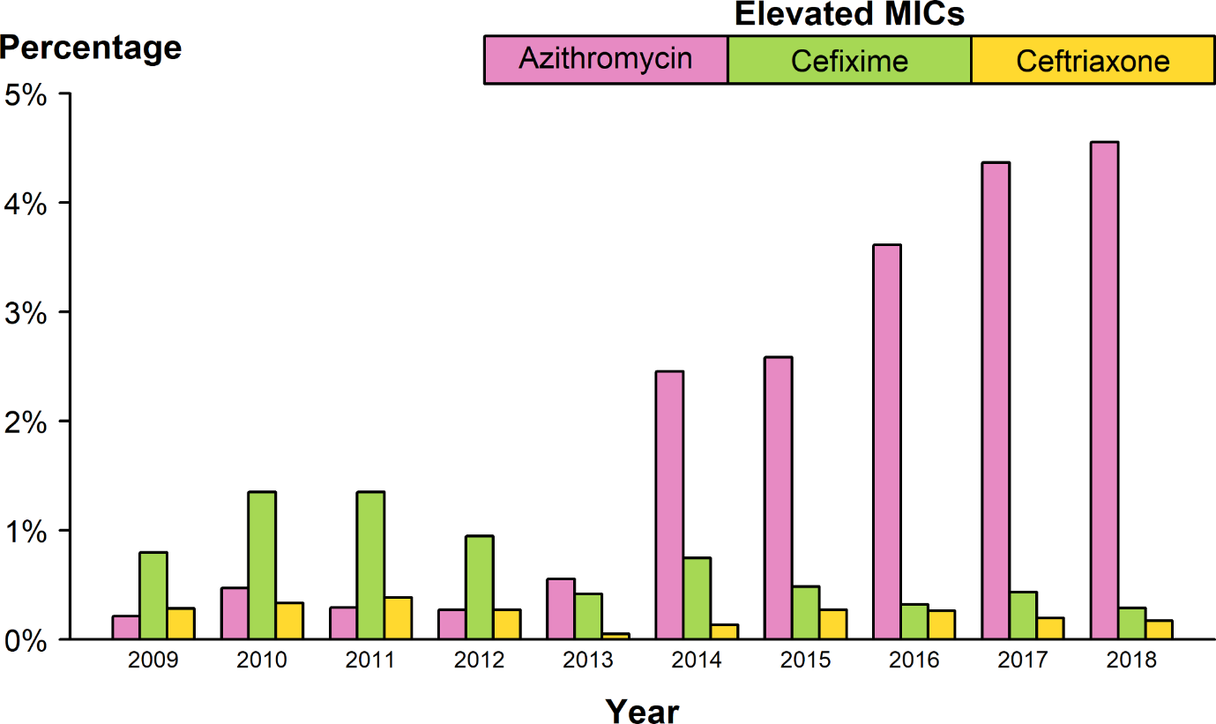
Neisseria gonorrhoeae — Percentage of Isolates with Elevated Minimum Inhibitory Concentrations (MICs) to Azithromycin, Cefixime, and Ceftriaxone, Gonococcal Isolate Surveillance Project (GISP), 2009–2018
NOTE: Elevated MIC = Azithromycin: ≥ 2.0 μg/mL; Cefixime: ≥ 0.25 μg/mL; Ceftriaxone: ≥ 0.125 μg/mL.
Notes:
Bar graph showing the percentage of Neisseria gonorrhoeae isolates with elevated minimum inhibitory concentrations to azithromycin, cefixime, and ceftriaxone from 2009 to 2018. During 2009–2018, the percentage of Neisseria gonorrhoeae isolates that exhibited elevated ceftriaxone minimum inhibitory concentrations, defined as ≥ 0.125 µg/mL, fluctuated between 0.1% and 0.4%. In 2018, 0.2% of isolates had elevated ceftriaxone minimum inhibitory concentrations. The percentage of isolates with elevated cefixime minimum inhibitory concentrations ( ≥ 0.25 µg/mL) declined from 1.4% in 2011 to 0.3% in 2018. During 2012–2014, the percentage of isolates with elevated azithromycin minimum inhibitory concentrations ( ≥ 2 µg/mL) ranged from 0.3% to 2.5% with a sharp increase during 2013–2014 (0.6% to 2.5%); during 2014–2018, the percentage increased from 2.5% to 4.6%.

Slide 32
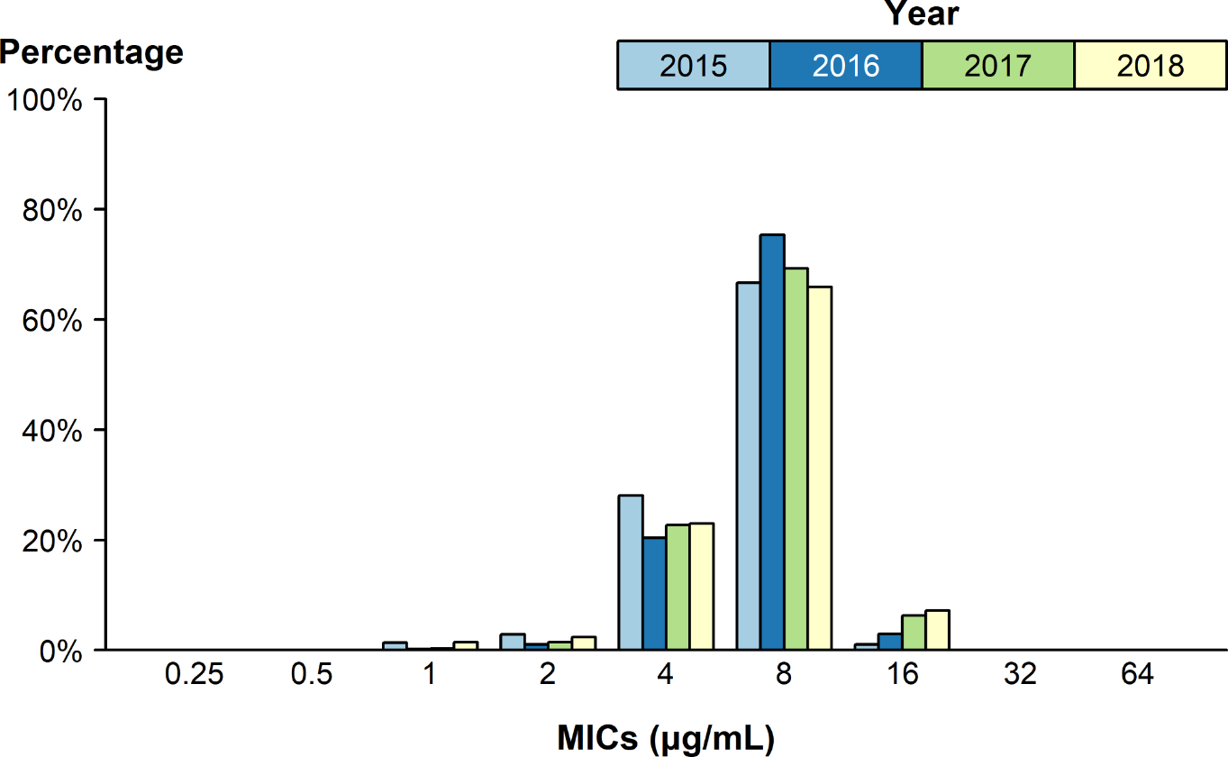
Neisseria gonorrhoeae — Distribution of Gentamicin Minimum Inhibitory Concentrations (MICs) by Year, Gonococcal Isolate Surveillance Project (GISP), 2015–2018*
* In 2018, the antibiotic susceptibility testing range for gentamicin was expanded from MICs of 1 µg/mL–32 µg/mL in previous years to 0.25 µg/mL–64 µg/mL.
Notes:
Bar graph showing the distribution of gentamicin minimum inhibitory concentrations among Neisseria gonorrhoeae isolates by year from 2015 to 2018. Between 2015 and 2017, 66.7–75.3% of all tested Neisseria gonorrhoeae isolates had a gentamycin minimum inhibitory concentration value of 8 µg/mL. In 2018, 0.02% of all tested Neisseria gonorrhoeae isolates had a gentamycin minimum inhibitory concentration above 16 µg/mL.

Slide 33
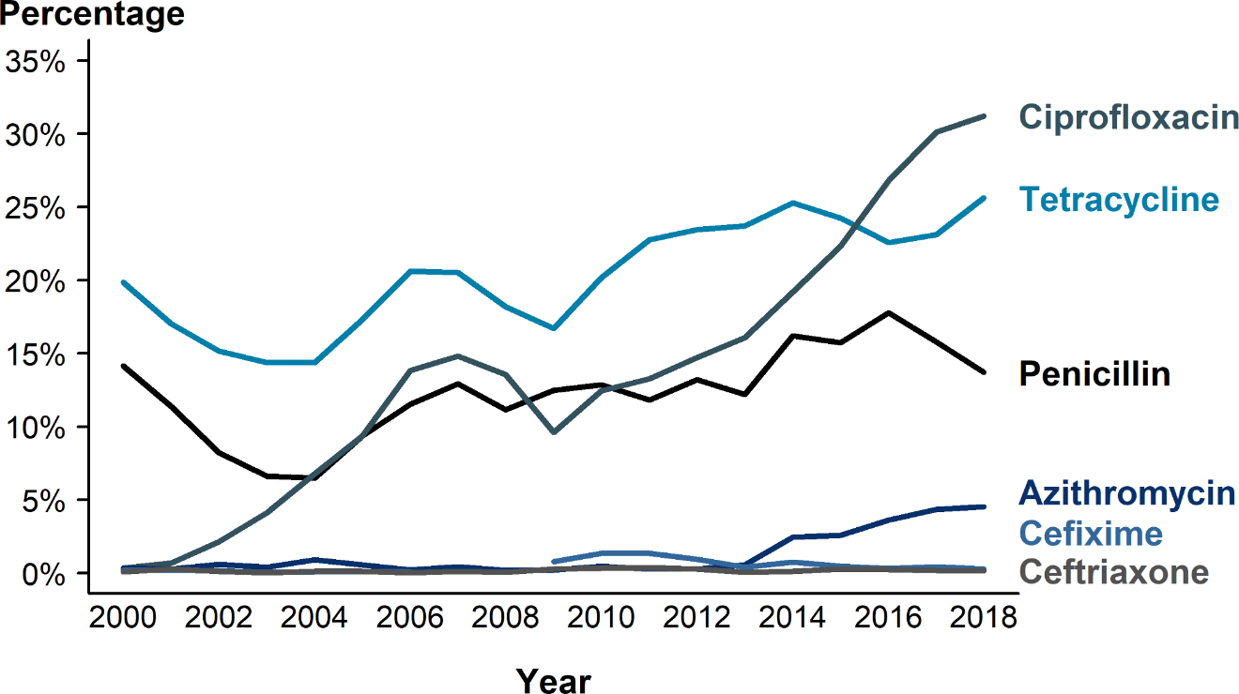
Neisseria gonorrhoeae — Prevalence of Tetracycline, Penicillin, or Fluoroquinolone Resistance* or Elevated Cefixime, Ceftriaxone, or Azithromycin Minimum Inhibitory Concentrations (MICs)†, by Year — Gonococcal Isolate Surveillance Project (GISP), 2000–2018
* Resistance = Fluoroquinolone (ciprofloxacin): MIC ≥ 1.0 µg/mL; Penicillin: MIC ≥ 2.0 µg/mL or Beta-lactamase positive; Tetracycline: MIC ≥ 2.0 µg/mL.
† Elevated MICs = Azithromycin: MIC ≥ 1.0 µg/mL (2000–2004), MIC ≥ 2.0 µg/mL (2005–2018); Ceftriaxone: MIC ≥ 0.125 µg/mL; Cefixime: MIC ≥ 0.25 µg/mL.
NOTE: Cefixime susceptibility was not tested in 2007 and 2008.
Notes:
Line graph showing the prevalence of tetracycline, penicillin, or fluoroquinolone resistance or elevated cefixime, ceftriaxone, or azithromycin minimum inhibitory concentrations among Neisseria gonorrhoeae isolates by year from 2000 to 2018. In 2018, 31.2% of Neisseria gonorrhoeae isolates collected from GISP sites were resistant to ciprofloxacin, 25.6% to tetracycline, and 13.7% to penicillin.

Slide 34
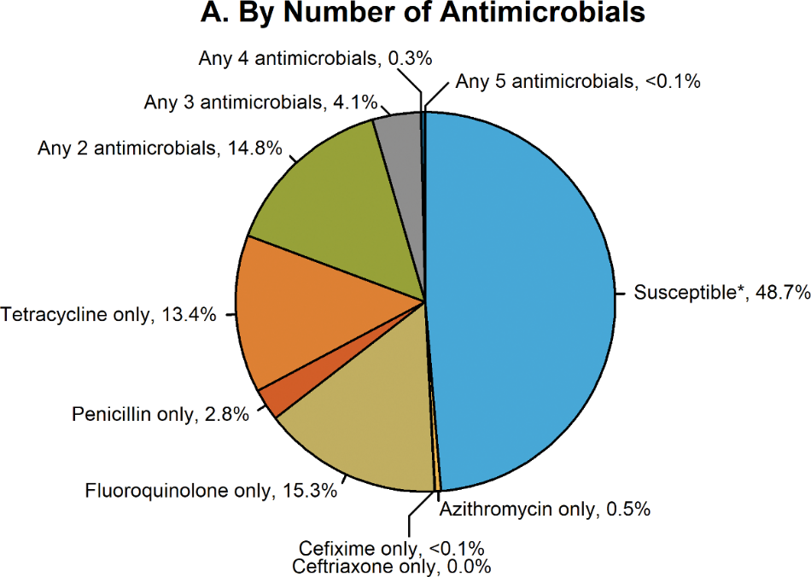
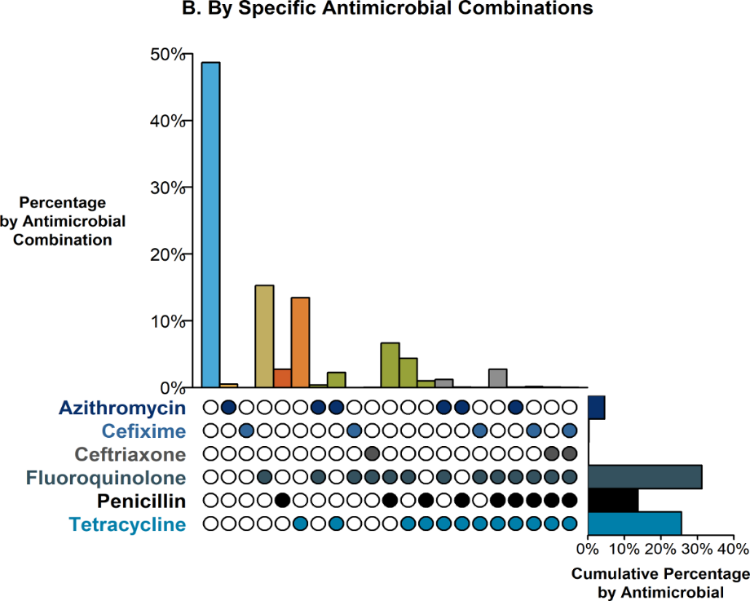
Resistance or Elevated MIC Patterns of Neisseria gonorrhoeae Isolates to Antimicrobials, Gonococcal Isolate Surveillance Project (GISP), 2018
* Susceptible category only includes isolates with penicillin, tetracycline, and fluoroquinolone MIC values that are considered susceptible and isolates with ceftriaxone, cefixime, and azithromycin MIC values that are not considered elevated.
NOTE: Elevated MIC = Ceftriaxone: MIC ≥ 0.125 μg/mL; Cefixime: MIC ≥ 0.25 μg/mL; Azithromycin: MIC ≥ 2.0 μg/mL. Resistance = Tetracycline: MIC ≥ 2.0 μg/mL; Fluoroquinolone: MIC ≥ 1.0 μg/mL; Penicillin: MIC ≥ 2.0 μg/mL or Beta-lactamase positive. In Panel B, a filled circle reflects resistance or elevated MIC to a specific antimicrobial; only antimicrobial combinations with non-zero percentages are shown.
ACRONYMS: MIC = Minimum Inhibitory Concentration.
Notes:
Two-panel figure showing resistance or elevated minimum inhibitory concentration patterns of Neisseria gonorrhoeae isolates to antimicrobials during 2018. The different susceptibility patterns seen in GISP in 2018 are shown. Panel A, a pie graph, demonstrates the percentage of Neisseria gonorrhoeae isolates with resistance or elevated minimum inhibitory concentrations to azithromycin, cefixime, ceftriaxone, fluoroquinolone, tetracycline, and penicillin. Panel B, an UpSet graph, further highlights the specific combinations of resistance or elevated minimum inhibitory concentrations across antimicrobials (vertical bars). The overall percentage of reduced susceptibility for each antimicrobial (horizontal bars) are the same percentages seen for 2018 in Figure 31. Of all the Neisseria gonorrhoeae isolates collected in GISP in 2018, 4.5% demonstrated resistance or elevated minimum inhibitory concentrations to at least three antibiotics tested with the majority of the combinations including tetracycline, penicillin and ciprofloxacin; no isolates with elevated azithromycin minimum inhibitory concentrations had elevated ceftriaxone minimum inhibitory concentrations. In 2018, 48.7% of all tested isolates were susceptible to all antibiotics tested.

Slide 35
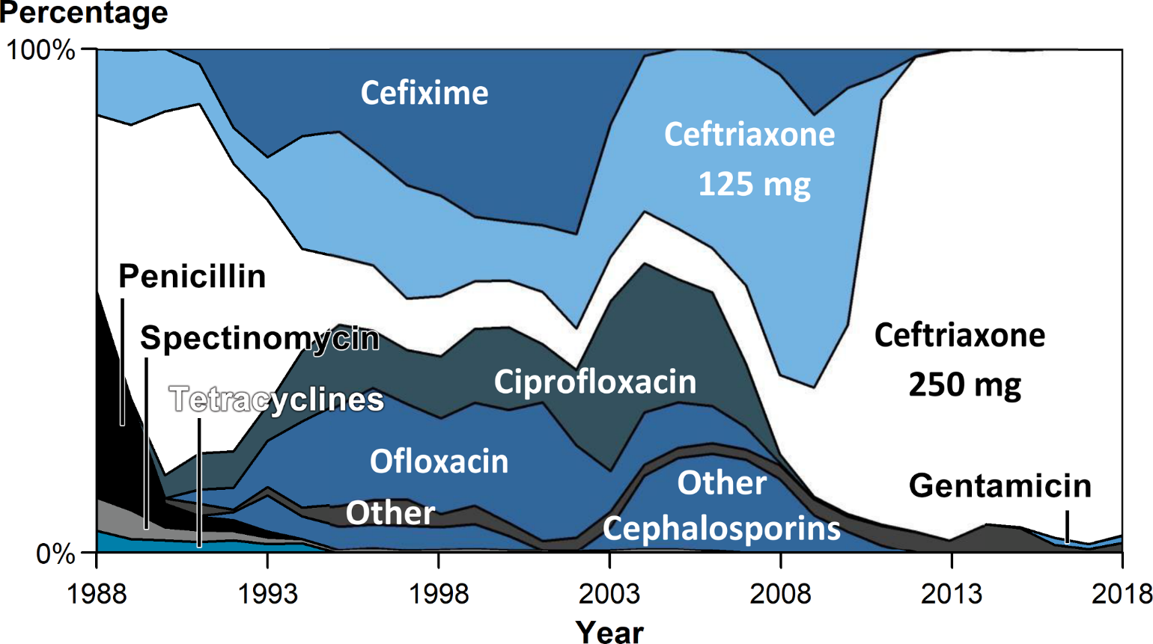
Distribution of Primary Antimicrobial Drug Used to Treat Gonorrhea Among Participants, Gonococcal Isolate Surveillance Project (GISP), 1988–2018
NOTE: For 2018, “Other” includes azithromycin 2 g (0.3%), no therapy documented (0.5%), and other less frequently used drugs (1.2%).
Notes:
Area graph showing the distribution of primary antimicrobial drug used to treat gonorrhea among GISP participants from 1988 to 2018. The proportion of GISP participants treated for gonorrhea with ceftriaxone 250 mg increased from 84.0% in 2011 to 98.1% in 2017 but decreased slightly to 96.5% in 2018. Participants treated with gentamicin 240 mg increased from 0.2% in 2015 to 1.4% in 2018 and participants treated with cefixime 400 mg decreased from 0.3% in 2015 to 0.1% in 2018.

Slide 36
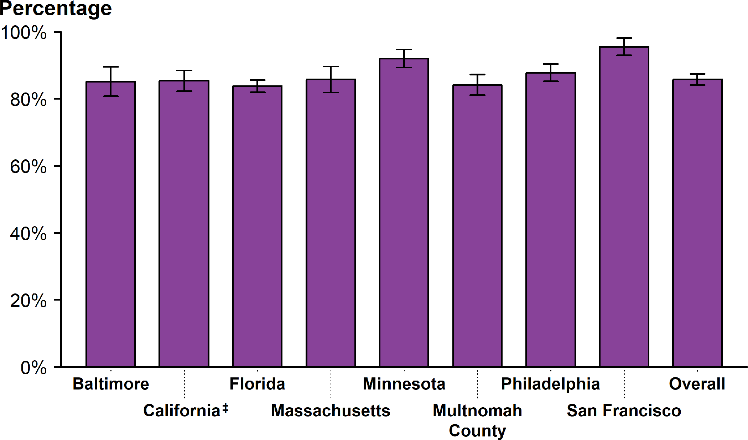
Gonorrhea — Estimated Proportion of Cases Treated by Recommended Treatment Regimen* and Jurisdiction†, STD Surveillance Network (SSuN), 2018
* In 2018, the recommended treatment for uncomplicated gonorrhea was treatment with 250 mg dose of ceftriaxone plus 1 g dose of azithromycin.
† Includes SSuN jurisdictions with all treatment information documented for ≥80% of cases.
‡ California data exclude San Francisco.
NOTE: See section A2.2 in the Appendix for SSuN methods.
ADAPTED FROM: Weston EJ, Workowski K, Torrone E, et al. Adherence to CDC recommendations for the treatment of uncomplicated gonorrhea – STD Surveillance Network (SSuN), United States, 2016. MMWR Morb Mortal Wkly Rep. 2018;67:473–76.
Notes:
Bar graph showing the estimated proportion of gonorrhea cases treated by recommended treatment regimen and SSuN jurisdiction during 2018. In 2018, based on weighted analysis of SSuN jurisdictions with documented treatment information (i.e., antimicrobials and dosages) for 80% or more of cases, 85.8% (95% CI = 84.1–87.5) of reported patients with gonorrhea in SSuN jurisdictions received the recommended treatment for uncomplicated gonorrhea. The proportion of reported patients that received the recommended dual treatment ranged from 83.8% (95% CI = 81.9–85.6) in Florida to 95.5% (95% CI = 92.9–98.1) in San Francisco, California.

Slide 37
Sexually Transmitted Disease
Division of STD Prevention
Surveillance 2018
SYPHILIS

Slide 38
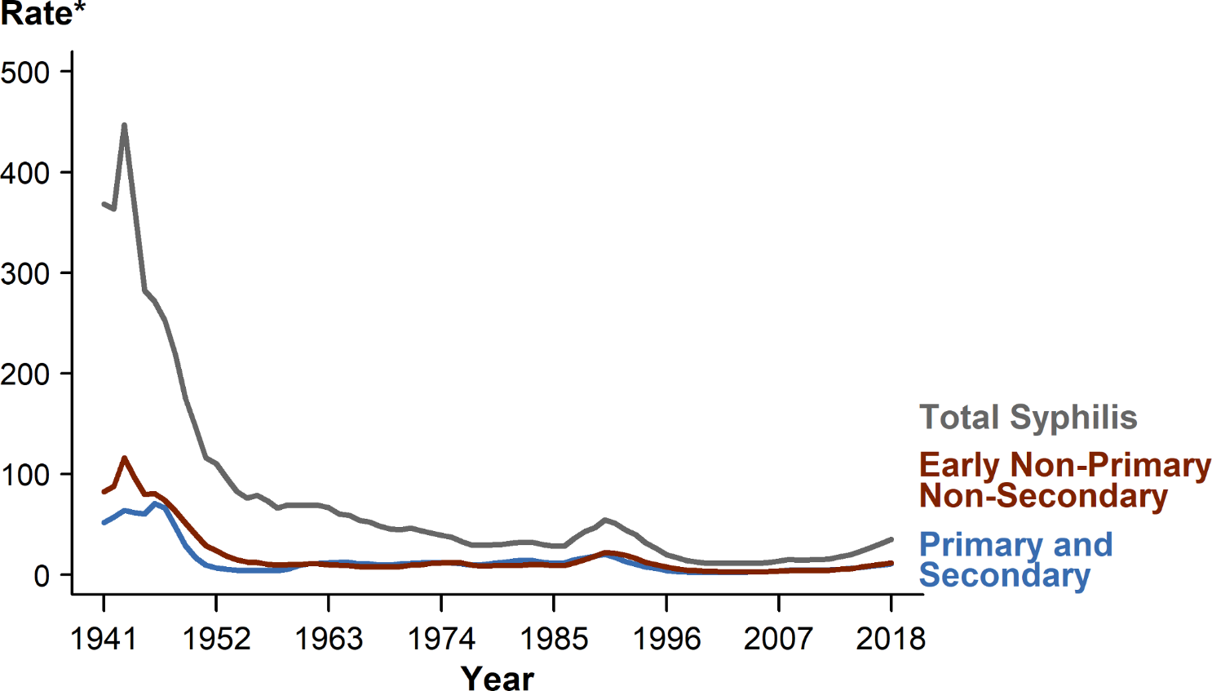
Syphilis — Rates of Reported Cases by Stage of Infection, United States, 1941–2018
* Per 100,000.
NOTE: See section A1.3 in the Appendix for more information on syphilis case reporting.
Notes:
Line graph showing United States rates of reported total syphilis, primary and secondary syphilis, and early non-primary non-secondary syphilis dating back to 1941, when syphilis reporting began; current increases in syphilis can be seen in the context of historically high syphilis rates from the 1940s. In 2018, 115,045 total cases of syphilis representing all stages of disease were reported in the United States; this is the highest number of total syphilis cases recorded since 1991. The 2018 case count for total syphilis reflects a 13.3% increase from 2017 when there were 101,584 cases. Reports of primary and secondary syphilis and early non-primary non-secondary syphilis cases—incident stages of infection—increased as well during 2017–2018.

Slide 39
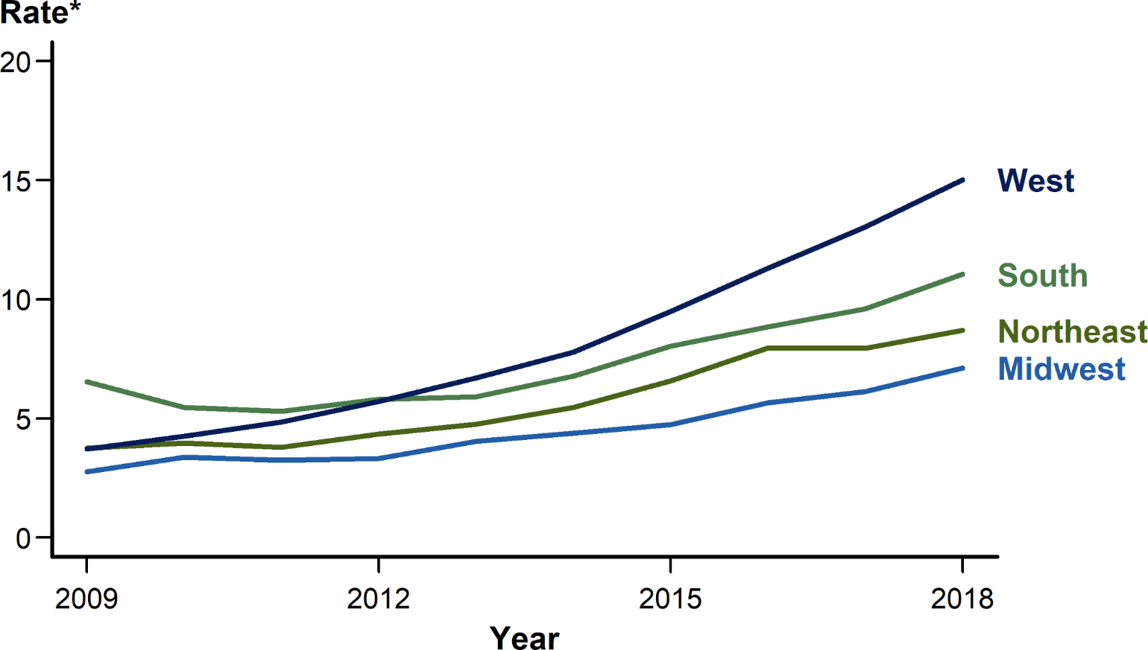
Primary and Secondary Syphilis — Rates of Reported Cases by Region, United States, 2009–2018
* Per 100,000.
Notes:
Line graph showing rates of reported primary and secondary syphilis cases by United States region from 2009 to 2018. In 2018, the West had the highest rate of reported primary and secondary syphilis cases with 15.0 cases per 100,000 population, followed by the South with 11.1 cases per 100,000 population, the Northeast with 8.7 cases per 100,000 population, and the Midwest with 7.1 cases per 100,000 population. During 2017–2018, the primary and secondary syphilis rate increased 16.4% in the Midwest, 15.6% in the South, 15.4% in the West, and 10.1% in the Northeast.

Slide 40
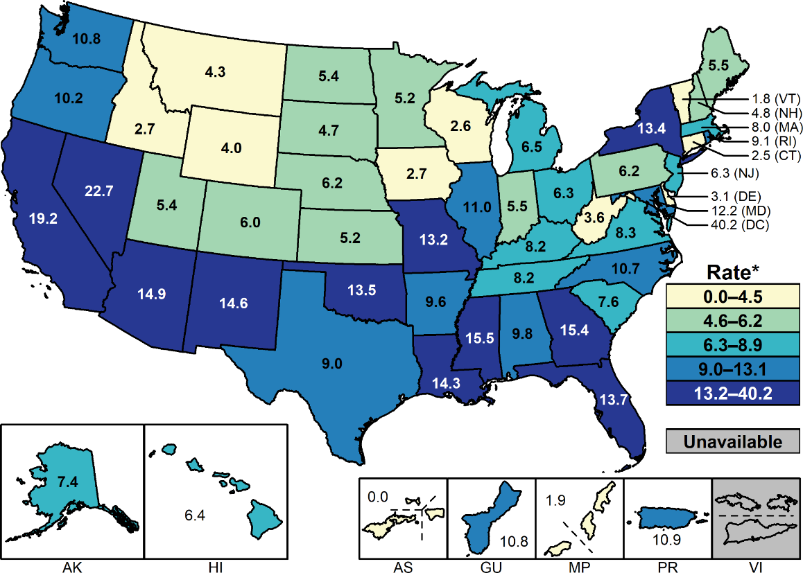
Primary and Secondary Syphilis — Rates of Reported Cases by State and Territory, United States, 2018
* Per 100,000.
NOTE: Section A1.11 in the Appendix for more information on interpreting reported rates in US territories.
Notes:
United States map showing 2018 rates of reported primary and secondary syphilis cases by state and territory. Rates of reported primary and secondary syphilis cases per 100,000 population ranged by state from 1.8 in Vermont to 22.7 in Nevada. The rate of reported primary and secondary syphilis cases in the District of Columbia was 40.2 cases per 100,000 population.

Slide 41
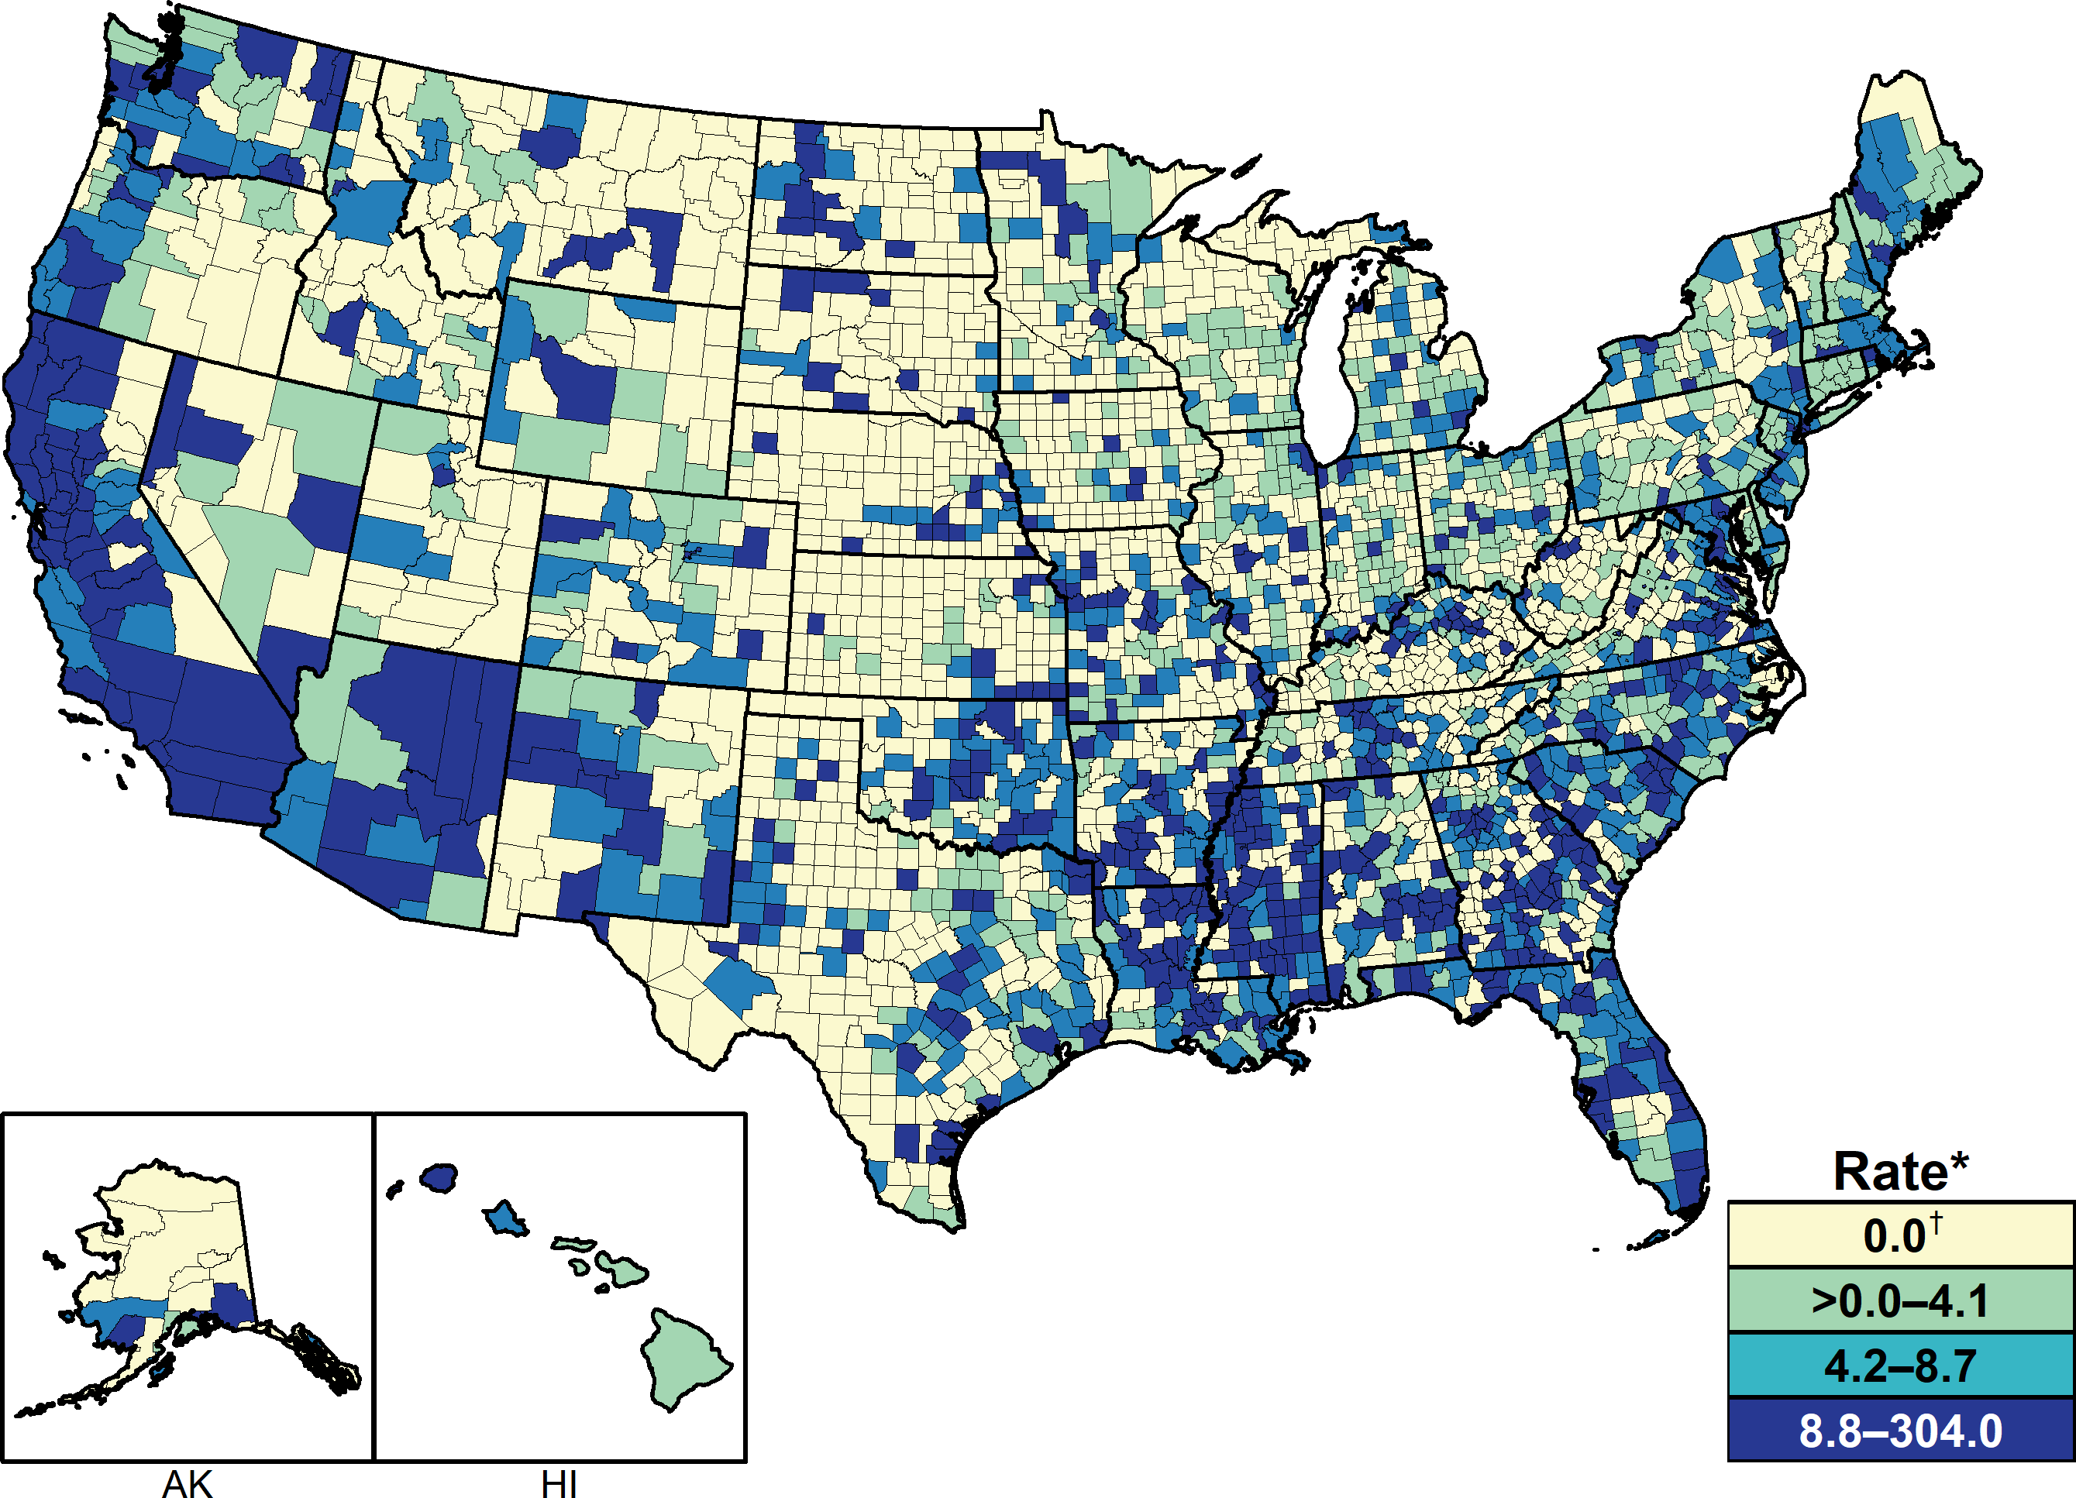
Primary and Secondary Syphilis — Rates of Reported Cases by County, United States, 2018
* Per 100,000.
† In 2018, 1,498 (47.7%) of 3,142 counties in the United States reported no cases of primary and secondary syphilis. See section A1.4 in the Appendix for more information on county-level rates.
Notes:
United States map showing 2018 rates of reported primary and secondary syphilis cases by county; morbidity ranged from 0 to 304 cases per 100,000 population. In 2018, 61.5% of reported primary and secondary syphilis cases occurred in 70 counties or independent cities. Of 3,142 counties in the United States, 556 (17.7%) had a primary and secondary syphilis rate of 8.8 cases per 100,000 population or greater, 557 (17.7%) reported a rate from 4.2 to 8.7 cases per 100,000 population, 531 (17.0%) reported a rate from more than 0.0 to 4.1 cases per 100,000 population, and 1,498 (47.7%) counties reported no cases of primary and secondary syphilis in 2018.

Slide 42
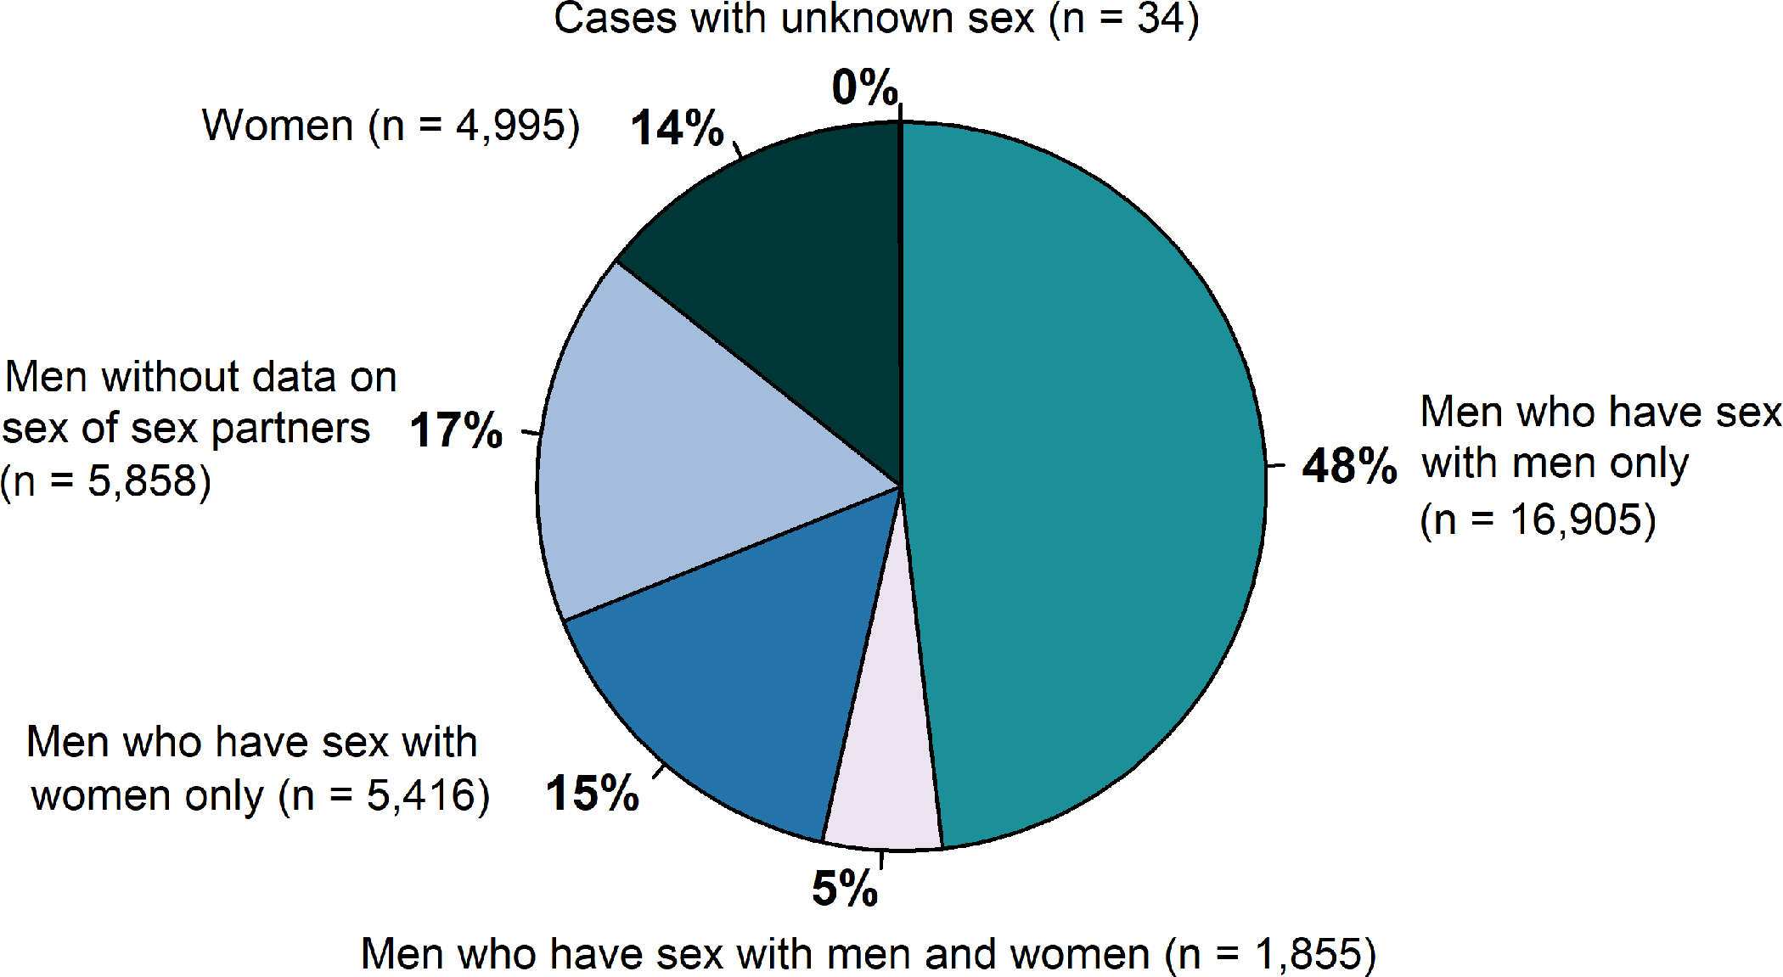
Primary and Secondary Syphilis — Distribution of Cases by Sex and Sex of Sex Partners, United States, 2018
Notes:
Pie graph showing the distribution of primary and secondary syphilis cases by sex and sex of sex partners in the United States in 2018. Men accounted for 85.7 % of reported primary and secondary syphilis cases. Of 35,063 reported primary and secondary syphilis cases in 2018, 18,760 (53.5%) were among men who have sex with men, including 16,905 (48.2%) cases among men who had sex with men only and 1,855 (5.3%) cases among men who have sex with both men and women. Overall, 5,416 (15.4%) cases were among men who have sex with women only, 4,995 (14.2%) were among women, 5,858 (17%) were among men without information about sex of sex partners, and 34 (0.1%) were cases reported with unknown sex. Among the 24,176 male cases with information on sex of sex partners, 77.6% occurred among men who have sex with men.

Slide 43
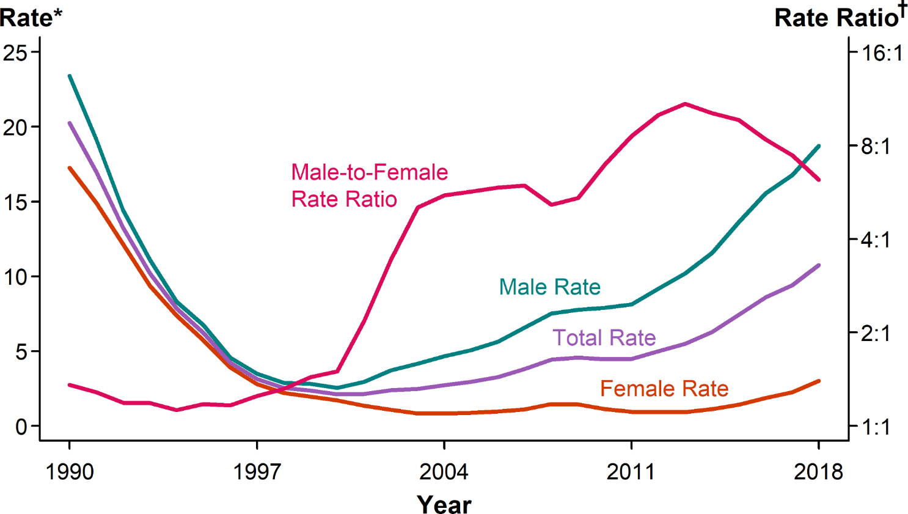
Primary and Secondary Syphilis — Rates of Reported Cases by Sex and Male-to-Female Rate Ratios, United States, 1990–2018
* Per 100,000.
† Log scale.
Notes:
Line graph showing rates of reported primary and secondary syphilis cases by sex as well as the male-to-female rate ratio in the United States during 1990 to 2018. Among men, the rate of primary and secondary syphilis has increased every year since 2000, increasing 11.3% during 2017–2018. In contrast, the primary and secondary syphilis rate among women fluctuated between 0.8 and 1.7 cases per 100,000 females during 2000–2013, but has increased substantially since 2013. During 2014–2018, the primary and secondary syphilis rate among women more than doubled (172.7% increase). Although the male-to-female rate ratio for primary and secondary syphilis increased from 1990 to 2013, the rate ratio is now declining due to the increasing rate of female syphilis.

Slide 44
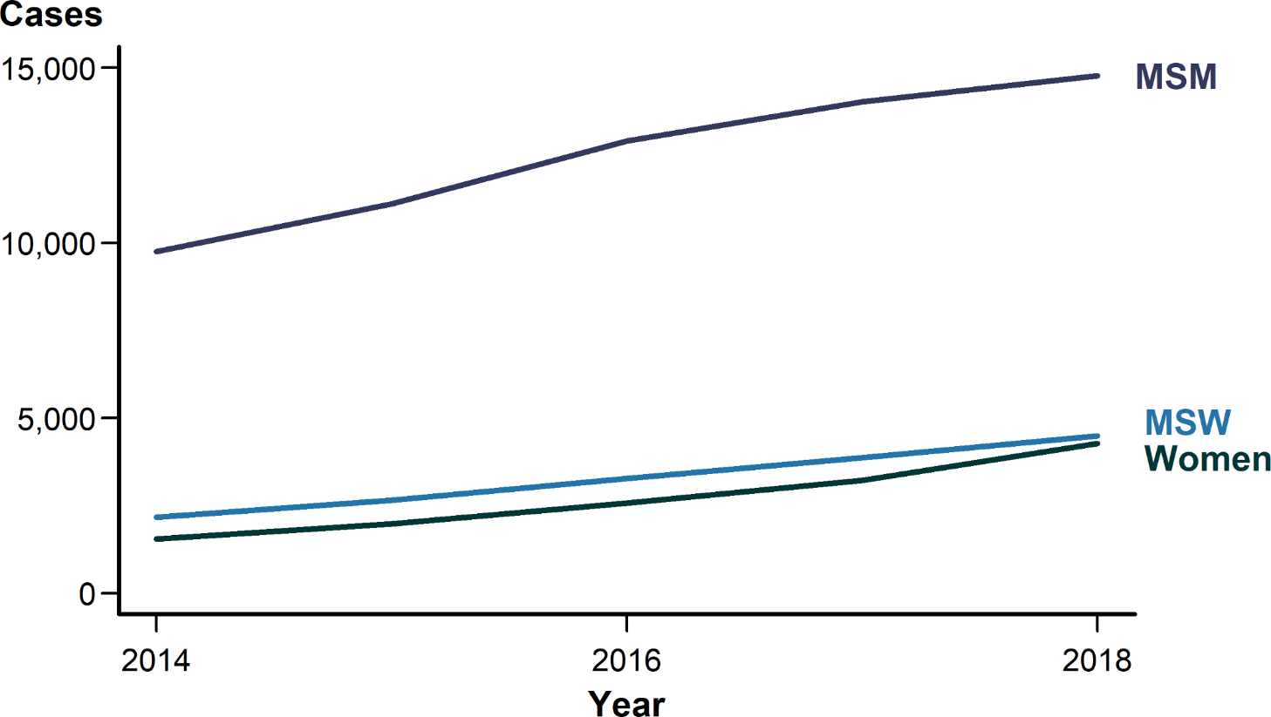
Primary and Secondary Syphilis — Reported Cases by Sex and Sex of Sex Partners, 36 States*, 2014–2018
* 36 states were able to classify ≥70% of reported cases of primary and secondary syphilis as either MSM, MSW, or women for each year during 2014–2018.
ACRONYMS: MSM = Gay, bisexual, and other men who have sex with men; MSW = Men who have sex with women only.
Notes:
Line graph showing reported cases of primary and secondary syphilis from 2014 to 2018 among the 36 states that consistently classified sex and sex of sex partners for 70% or more of reported cases. In these 36 states, the number of primary and secondary cases increased 5.3% among men who have sex with men, 16.3% among men who have sex with women only, and 32.9% among women during 2017–2018.

Slide 45
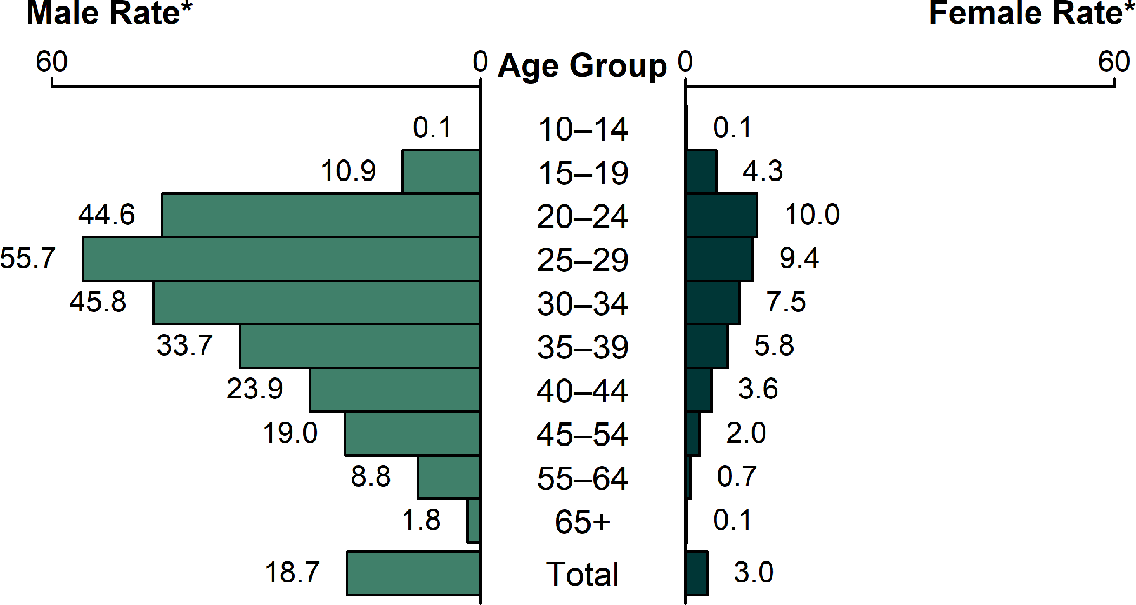
Primary and Secondary Syphilis — Rates of Reported Cases by Age Group and Sex, United States, 2018
* Per 100,000.
Notes:
Bar graph showing rates of reported primary and secondary syphilis cases by age group and sex in the United States in 2018. The highest rates were observed among men aged 25–29 years with 55.7 cases per 100,000 males, men aged 30–34 years with 45.8 cases per 100,000 males, and men aged 20–24 years with 44.6 cases per 100,000 males. The highest rates among females were among those aged 20–24 years with 10.0 cases per 100,000 females and those aged 25–29 years with 9.4 cases per 100,000 females.

Slide 46
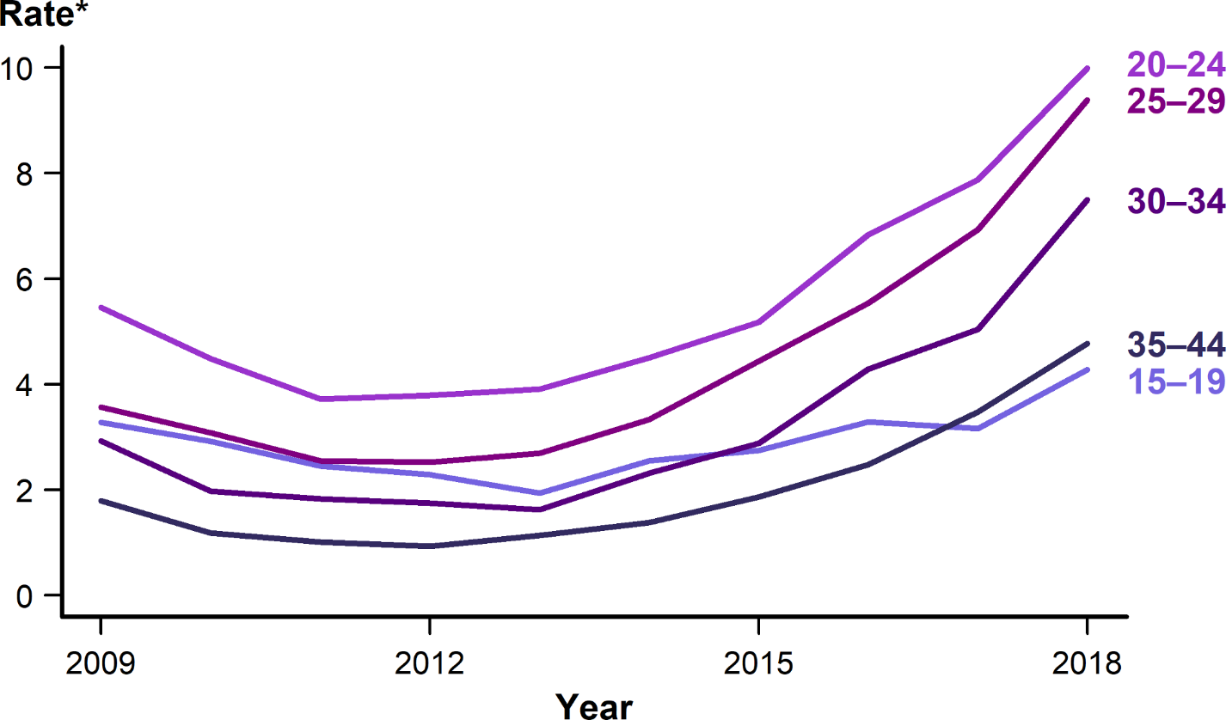
Primary and Secondary Syphilis — Rates of Reported Cases Among Females Aged 15–44 Years by Age Group, United States, 2009–2018
* Per 100,000.
Notes:
Line graph showing rates of reported primary and secondary syphilis cases among females aged 15–44 years by age group during 2009 to 2018. During 2017–2018, the rate of reported primary and secondary syphilis cases among females aged 15–44 increased in all age groups. All age groups followed a similar U-shaped pattern with declines that reached their nadir in 2012 or 2013 and peaked in 2018.

Slide 47
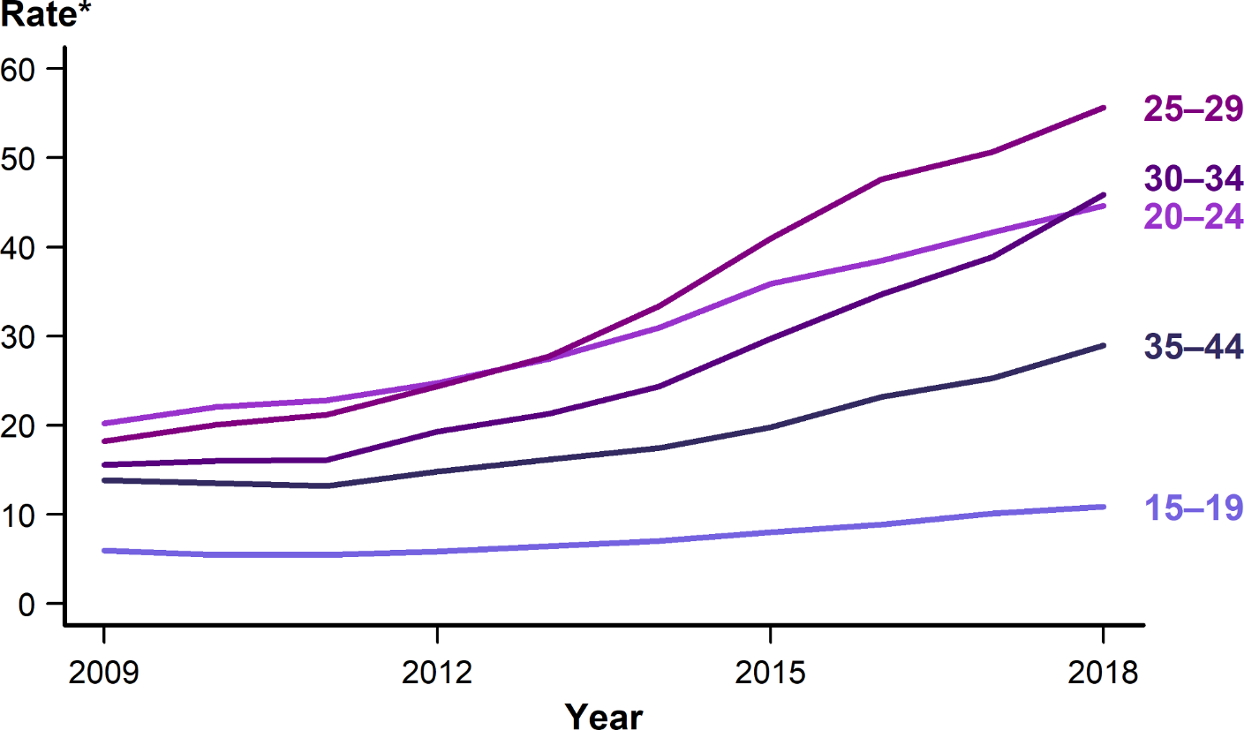
Primary and Secondary Syphilis — Rates of Reported Cases Among Males Aged 15–44 Years by Age Group, United States, 2009–2018
* Per 100,000.
Notes:
Line graph showing rates of reported primary and secondary syphilis cases among males aged 15–44 years by age group during 2009 to 2018. During 2017–2018, the rate of reported primary and secondary syphilis cases among females aged 15–44 increased in all age groups. All age groups followed a similar pattern with linear increases of different slope over the 10-year period.

Slide 48
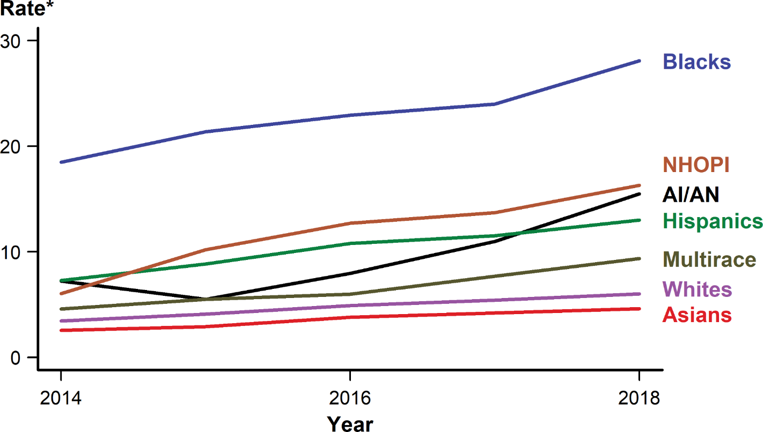
Primary and Secondary Syphilis — Rates of Reported Cases by Race/Hispanic Ethnicity, United States, 2014–2018
* Per 100,000.
NOTE: See Section A1.5 in the Appendix for information on reporting STD case data for race/Hispanic ethnicity.
ACRONYMS: AI/AN = American Indians/Alaska Natives; NHOPI = Native Hawaiians/Other Pacific Islanders.
Notes:
Line graph showing rates of reported primary and secondary syphilis cases by race/Hispanic ethnicity in the United States during 2014 to 2018. The primary and secondary syphilis rate increased among all race/Hispanic ethnicity groups over the 5-year period. During 2017–2018, American Indians/Alaska Natives increased 40.9%, those who identified as Multirace increased 22.1%, Native Hawaiians/Other Pacific Islanders increased 19.0%, Whites increased 11.1%, Blacks increased 17.1%, Hispanics increased 13.0%, and Asians increased 9.5%.

Slide 49
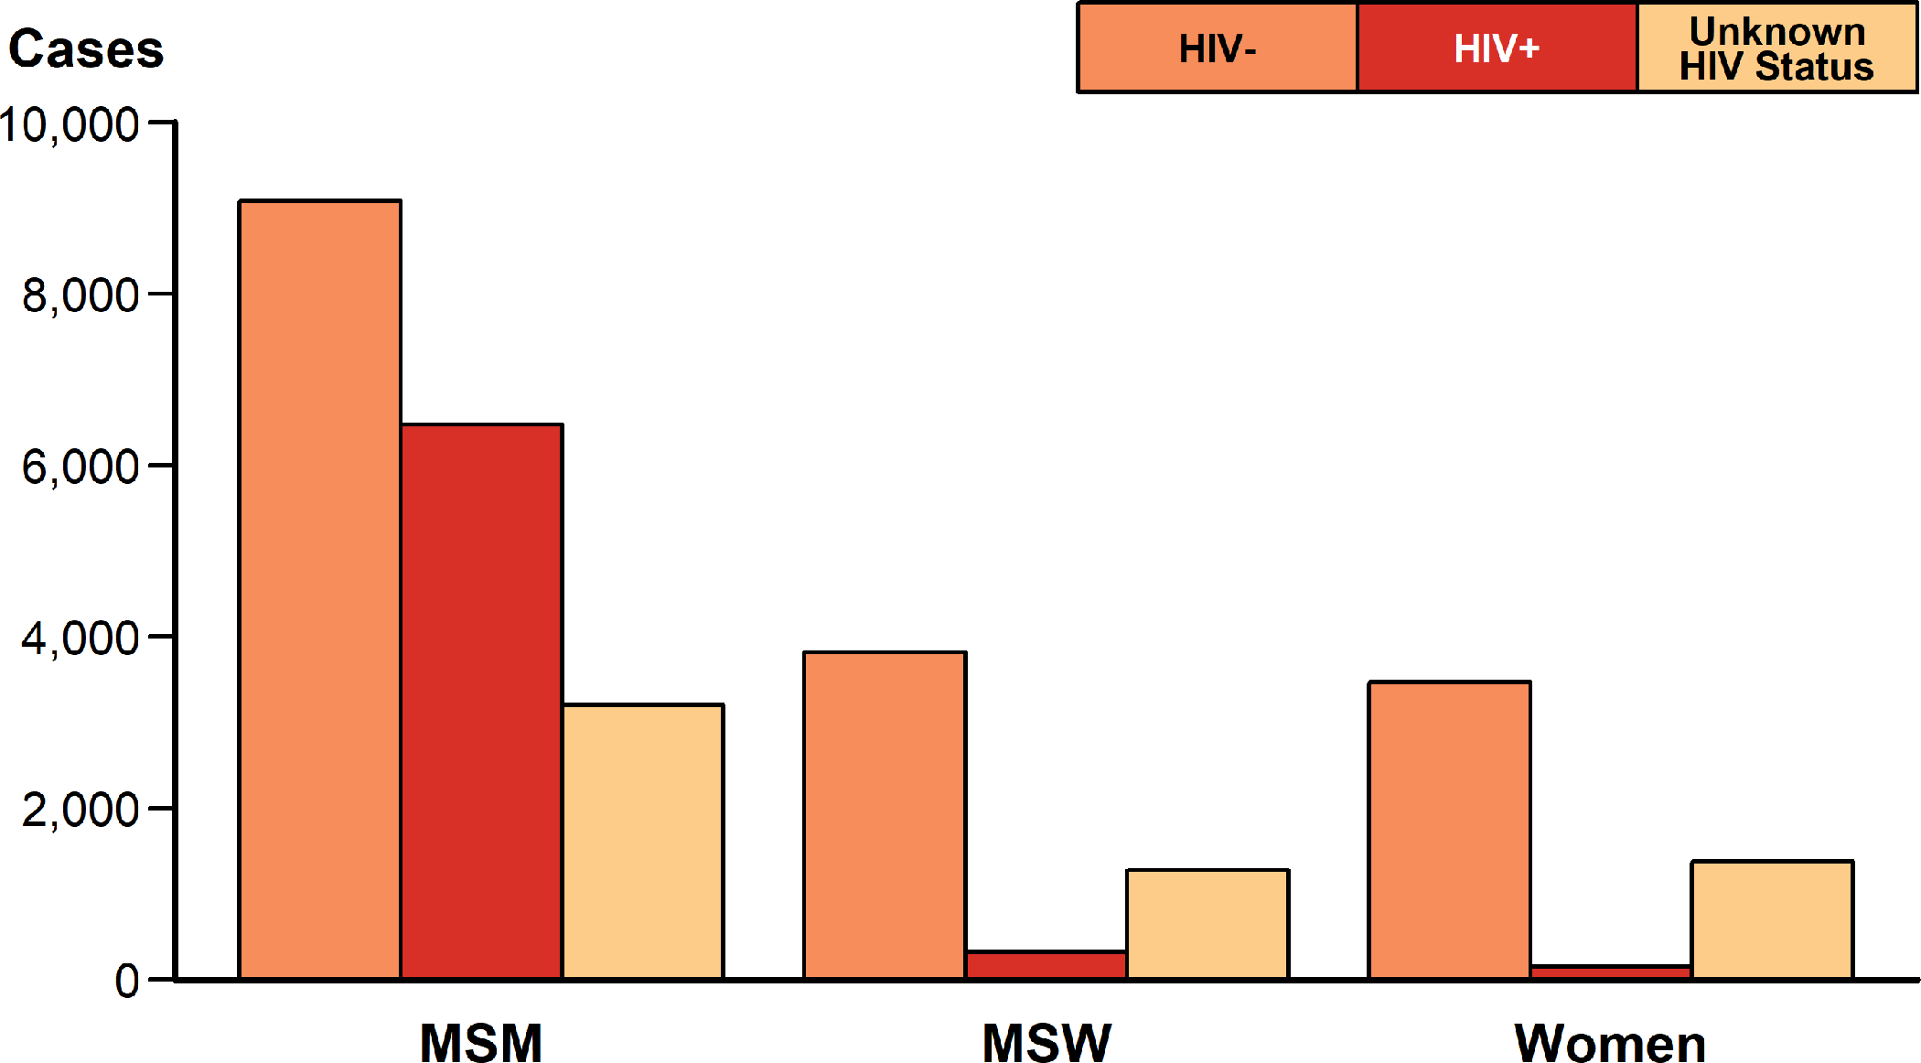
Primary and Secondary Syphilis — Reported Cases by Sex and Sex of Sex Partners and HIV Status, United States, 2018
ACRONYMS: MSM = Gay, bisexual, and other men who have sex with men; MSW = Men who have sex with women only.
Notes:
Bar graph showing reported cases of primary and secondary syphilis by sex and sex of sex partners and HIV status in the United States in 2018. Among cases with known HIV status, 41.6% of cases among men who have sex with men were HIV-positive, compared with 7.9% of cases among men who have sex with women only, and 4.0% of cases among women.

Slide 50
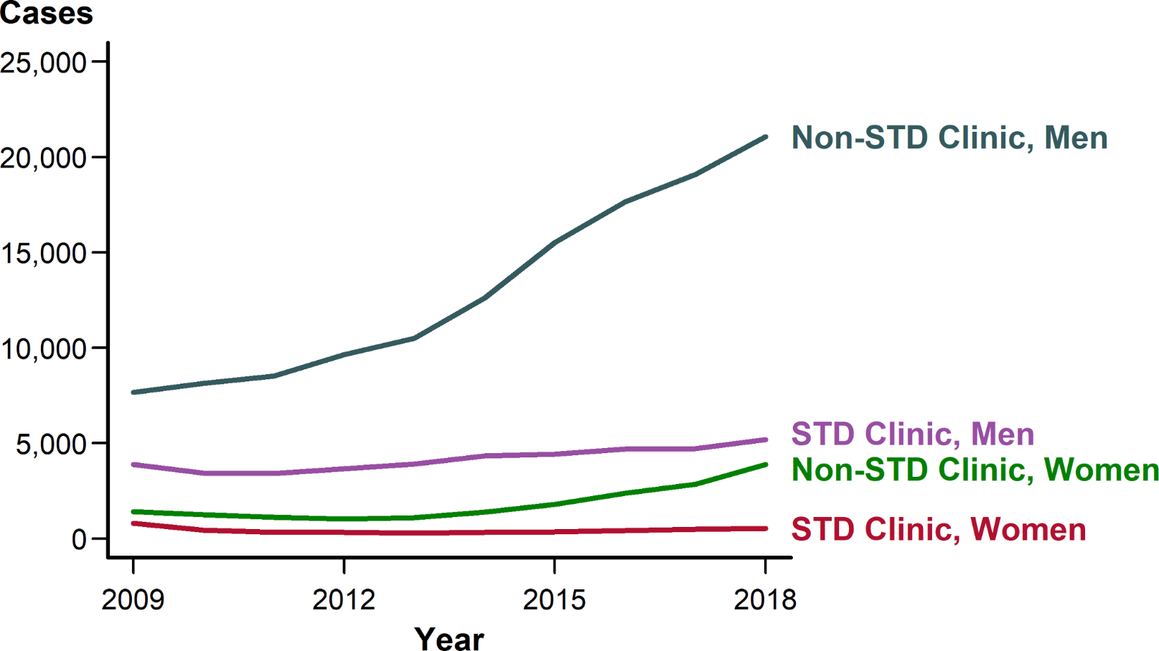
Primary and Secondary Syphilis — Reported Cases by Reporting Source and Sex, United States, 2009–2018
Notes:
Line graph showing reported cases of primary and secondary syphilis by reporting source and sex in the United States during 2009 to 2018. The number of cases reported from STD clinics has remained relatively stable for males and females during this time while the number of cases reported from non-STD clinics has increased for both males and females.

Slide 51
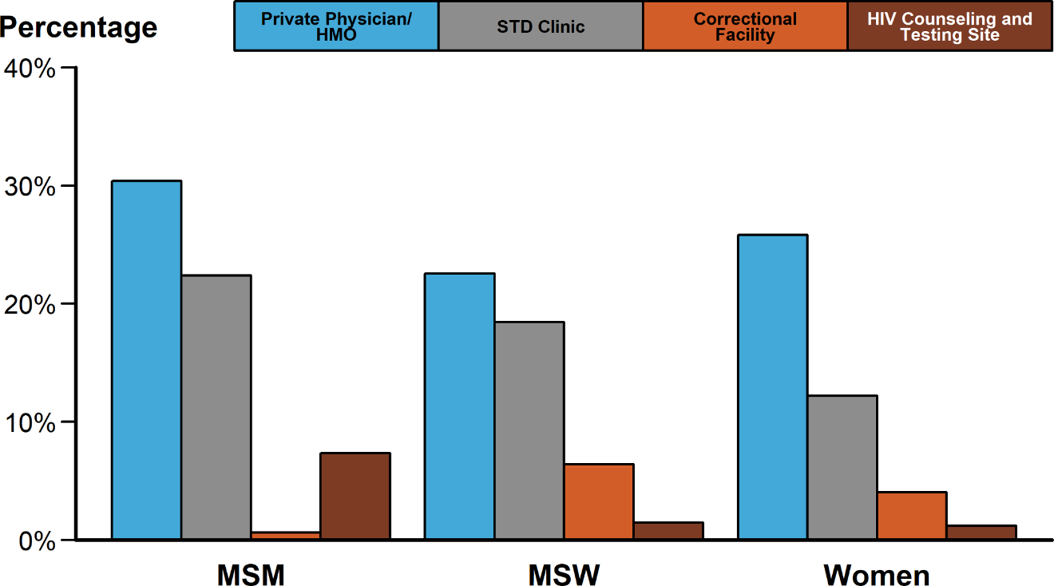
Primary and Secondary Syphilis — Percentage of Reported Cases* by Sex and Sex of Sex Partners and Selected Reporting Sources, United States, 2018
* Of all primary and secondary syphilis cases, 12.5% had a missing or unknown reporting source. Among all cases with a known reporting source, the reporting source categories presented represent 55.4% of cases.
ACRONYMS: HMO = Health maintenance organization; MSM = Gay, bisexual, and other men who have sex with men; MSW = Men who have sex with women only.
Notes:
Bar graph showing the percentage of reported cases of primary and secondary syphilis by sex and sex of sex partners and selected reporting sources. The selected reporting sources include private physicians/health maintenance organizations, STD clinics, correctional facilities, and HIV counseling and testing sites. Of cases reported among men who have sex with men, private physicians/health maintenance organizations and STD clinics reported the highest proportion of cases at 30.4% and 22.4% of cases, respectively. Although private physicians/health maintenance organizations and STD clinics are also the most common reporting sources for women and men who have sex with women, correctional facilities make up a more significant reporting source in these two groups.

Slide 52
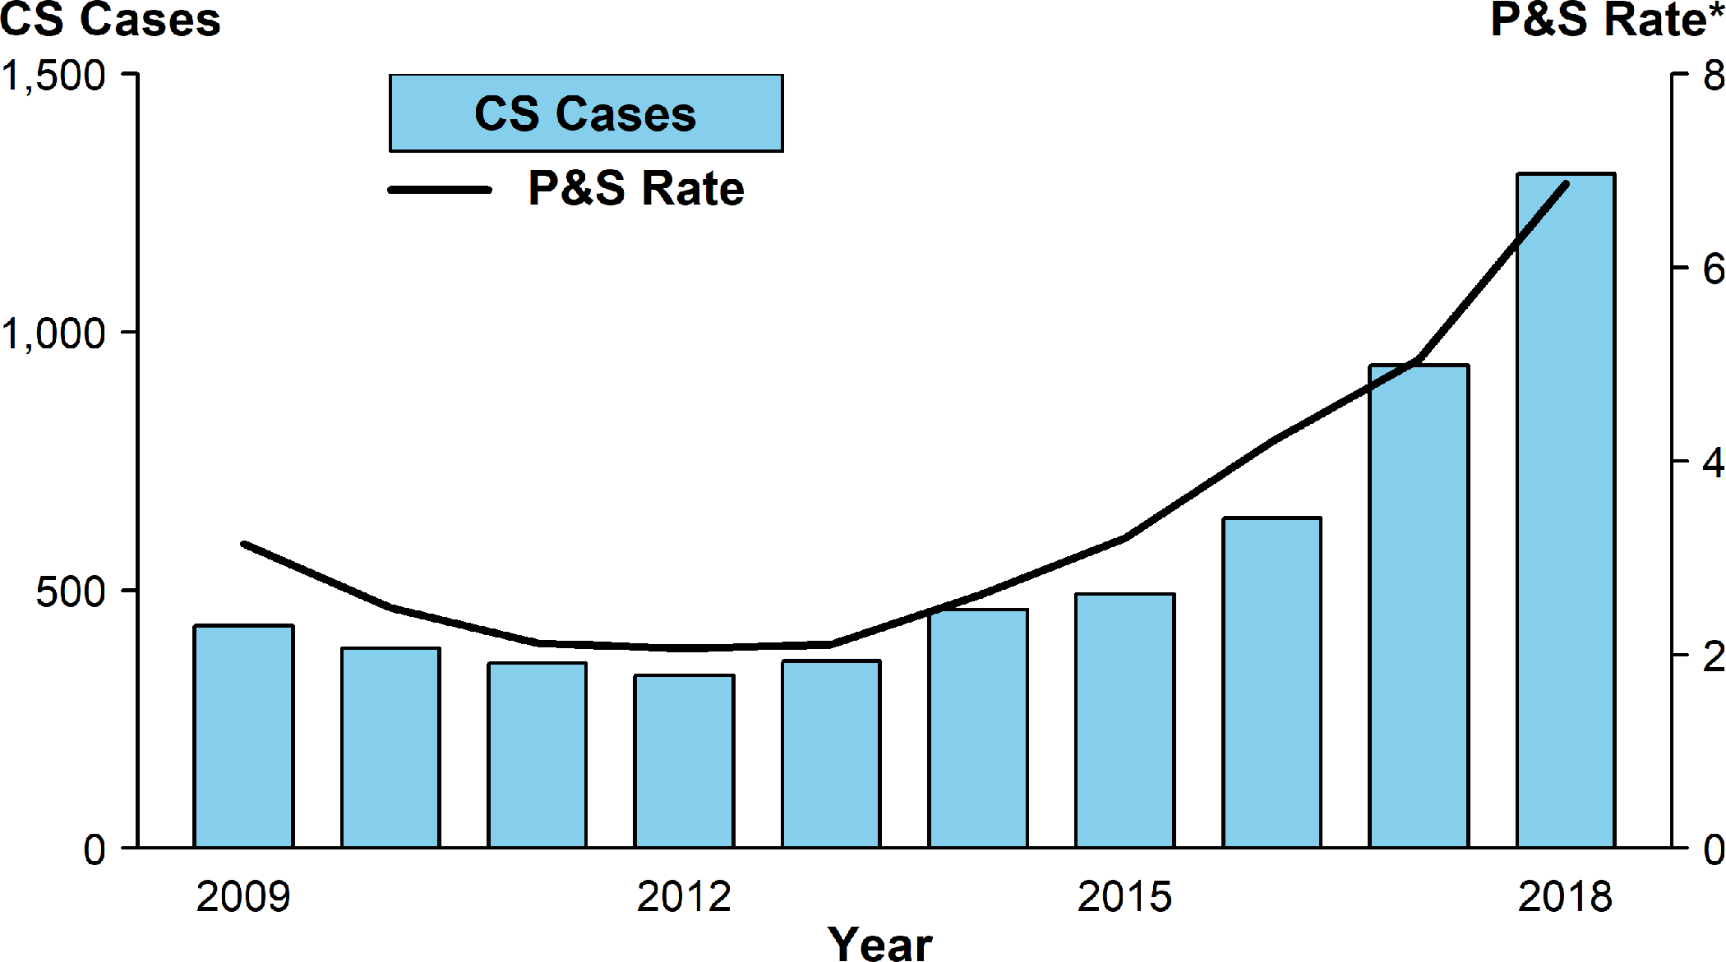
Congenital Syphilis — Reported Cases by Year of Birth and Rates of Reported Cases of Primary and Secondary Syphilis Among Females Aged 15–44 Years, United States, 2009–2018
* Per 100,000.
ACRONYMS: CS = Congenital syphilis; P&S = Primary and secondary syphilis.
Notes:
Bar graph showing reported cases of congenital syphilis by year of birth and rates of reported cases of primary and secondary syphilis among females aged 15–44 years in the United States from 2009 to 2018. Cases of congenital syphilis are represented by a bar graph and rates of syphilis among females are represented by a super-imposed line graph. In 2018, there were a total of 1,306 reported cases of congenital syphilis. As has been noted historically, this graph shows similar, parallel patterns of change for female syphilis rates and congenital syphilis case-counts. Both declined from 2009 until 2012 or 2013 and both increased, in parallel, through 2018.

Slide 53
Sexually Transmitted Disease
Division of STD Prevention
Surveillance 2018
Other Sexually Transmitted Diseases

Slide 54
Chancroid — Reported Cases by Year, United States, 1941–2018
NOTE: See section A1.3 in the Appendix for more information on chancroid case reporting.
Notes:
Line graph showing reported cares of chancroid in the United States by year from 1941 to 2018. Chancroid has declined since 1987; since 2000, the annual number of reported cases has been less than 100, and since 2011, the annual number of reported cases has been less than 20. In 2018, only three cases of chancroid were reported in the United States.

Slide 55
Cervical Intraepithelial Neoplasia Grades 2 and 3 — Prevalence per 1000 Person-Years Among Female Enrollees in Private Health Plans Aged 15–39 Years, by Age Group and Year, 2007–2014
SOURCE: Flagg EW, Torrone EA, Weinstock H. Ecological association of human papillomavirus vaccination with cervical dysplasia prevalence in the United States, 2007–2014. Am J Public Health. 2016;106(12):2211–2218.
Notes:
Line graph showing cervical intraepithelial neoplasia grades 2 and 3 prevalence per 1,000 person-years among female enrollees in private health plans aged 15 to 39 years by age group and year from 2007 to 2014. Annual prevalence of high-grade histologically-detected cervical intraepithelial neoplasia grades 2 and 3 during 2007–2014 was estimated using health-care claims from 9 million females aged 15–39 years who received cervical cancer screening in a given calendar year. Prevalence of cervical intraepithelial neoplasia grades 2 and 3 decreased significantly in females aged 15–19 and 20–24 years. Among those aged 15–19 years, annual percent change in cervical intraepithelial neoplasia grades 2 and 3 prevalence was -19.8% during 2007–2009 and -12.1% during 2009–2014. For women aged 20–24 years, annual percent change was -6.7% during 2007– 2012, and -12.5% during 2012–2014. No decreases in cervical intraepithelial neoplasia grades 2 and 3 prevalence were observed among women aged 25–39 years.

Slide 56
Anogenital Warts — Prevalence per 1000 Person-Years Among Enrollees in Private Health Plans Aged 15–39 Years by Sex, Age Group, and Year, 2006–2014
SOURCE: Flagg EW, Torrone EA. Declines in anogenital warts among age groups most likely to be impacted by human papillomavirus vaccination, United States, 2006–2014. Am J Public Health. 2018;108(1):112–119.
Notes:
Two-panel figure showing prevalence of anogenital warts per 1,000 person-years among enrollees in private health plans aged 15 to 39 years by sex, age group, and year from 2006 to 2014. Prevalence of anogenital warts among adolescent females aged 15–19 years declined non-significantly during 2006–2008, and then significantly decreased (annual percent change=-14.1) through 2014. Among women aged 20–24 years, genital wart prevalence was stable during 2006–2009, but declined significantly during 2009–2014 (annual percent change=-12.9). Prevalence among women aged 25–29 years also decreased significantly from 2009–2014 (annual percent change=-6.0). Prevalence increased or was stable during the entire period for women aged 30–39 years. Among males, anogenital wart prevalence increased significantly during 2006–2009 for all age groups except those aged 15–19 years. From 2009 to 2014, rates decreased somewhat among male adolescents aged 15–19 years (annual percent change=-5.4), but decreased significantly among men aged 20–24 years (annual percent change=-6.5). Among men aged 25–29 years, prevalence declined non-significantly during 2010–2014 (annual percent change=-1.7); prevalence increased or was stable throughout the entire period for men aged 30–39 years.

Slide 57
Herpes Simplex Virus Type 2 — National Estimates of Trends in Age-Adjusted Seroprevalence Among Persons Aged 14–49 Years by Race/ Hispanic Ethnicity, National Health and Nutrition Examination Survey (NHANES), 1999–2000 through 2015–2016
NOTE: Age-adjusted by the direct method to the 2000 US Census population, using age groups 14–19, 20–29, 30–39, and 40–49 years. Total population includes all race/Hispanic ethnicity groups, including those not shown separately.
SOURCE: McQuillan G, Kruszon-Moran D, Flagg EW, et al. Prevalence of herpes simplex virus type 1 and type 2 in persons aged 14–49: United States, 2015–2016. NCHS data brief, no 304. Hyattsville, MD: National Center for Health Statistics. 2018.
Notes:
Line graph showing national estimates of trends in age-adjusted seroprevalence of herpes simplex virus type 2 among persons aged 14 to 49 years by race/Hispanic ethnicity. National Health and Nutrition Examination Survey data indicate the seroprevalence of herpes simplex virus type 2 in the United States has decreased from 1999–2000 to 2015–2016; age-adjusted seroprevalence declined from 18.0% in 1999–2000 to 12.1% in 2015–2016. Although these declines were observed among all race/Hispanic ethnicity groups, herpes simplex virus type 2 seroprevalence was highest among non-Hispanic Blacks throughout the entire time period.

Slide 58
Trichomonas vaginalis and Other Vaginal Infections Among Females — Initial Visits to Physicians’ Offices, United States, 1966–2016
* In thousands.
NOTE: The relative standard errors for Trichomonas vaginalis infection estimates range from 23% to 17% and for other vaginal infection estimates range from 13% to 8%. See Section A2.5 in the Appendix and Table 44.
SOURCE: National Disease and Therapeutic Index, IMS Health, Integrated Promotional Services™, IMS Health Report, 1966–2016.
Notes:
Line graph showing initial visits to physicians’ offices for Trichomonas vaginalis and other vaginal infections among females in the United States from 1966 to 2016. Initial visits to physicians’ offices among females for Trichomonas vaginalis infection appear to have been fairly stable since the 1990’s; the number of initial visits in 2016 was 222,000.

Slide 59
Sexually Transmitted Disease
Division of STD Prevention
Surveillance 2018
STDs in Women and Infants

Slide 60
Chlamydia — Rates of Reported Cases Among Females by State and Territory, United States, 2018
* Per 100,000.
NOTE: See Sections A1.11 in the Appendix for more information on interpreting reported rates in US territories.
Notes:
United States map showing rates of reported cases of chlamydia among females by state and territory. Regionally, among all females, chlamydia case rates were highest among females in the South, with a rate of 744.2 cases per 100,000 females in 2018.

Slide 61
Chlamydia — Positivity Among Females Aged 14–39 Years by Race/Hispanic Ethnicity and Age Group in Clinics* Providing Family Planning and Reproductive Health Services, STD Surveillance Network (SSuN), 2018
* Includes clinics (n=26) that tested >100 females for chlamydia in 2018 and testing coverage was >60%.
NOTE: See section A2.2 in the Appendix for SSuN methods.
Notes:
Bar graph showing chlamydia positivity among females aged 14 to 39 years by race/Hispanic ethnicity and age group in clinics providing family planning and reproductive health services during 2018. In 2018, the overall positivity of chlamydia among females aged 14–24 years was 9.8%, but for females 14–19 years of age, chlamydia positivity was 10.5%. For females between the ages of 14–24 years, chlamydia positivity among non-Hispanic Blacks was about 1.5 times those of non-Hispanic Whites or Hispanics.

Slide 62
Gonorrhea — Rates of Reported Cases Among Females by State and Territory, United States, 2018
* Per 100,000.
NOTE: See Sections A1.11 in the Appendix for more information on interpreting reported rates in US territories.
Notes:
United States map showing rates of reported cases of gonorrhea among females by state and territory. Rates of reported chlamydia cases exceeded gonorrhea case rates among females in all regions.

Slide 63
Pelvic Inflammatory Disease — Initial Visits to Physicians’ Offices Among Females Aged 15–44 Years, United States, 2007–2016
* In thousands.
NOTE: The relative standard errors for these estimates are 23%–16%. See section A2.5 in the Appendix and Table 44.
SOURCE: National Disease and Therapeutic Index, IMS Health, Integrated Promotional Services™, IMS Health Report, 1966–2016.
Notes:
Line graph showing initial visits to physicians’ offices for pelvic inflammatory disease among United States females aged 15 to 44 years during 2007 to 2016. According to 2007–2016 data from the National Disease and Therapeutic Index, the number of initial visits to physicians’ offices where females aged 15–44 years were diagnosed with pelvic inflammatory disease decreased by 38.3% from 146,000 to 90,000 visits.

Slide 64
Estimated Percentage of Acute Pelvic Inflammatory Disease Emergency Department Visits Among Females Aged 15–44 Years by Age Group and Year, United States, 2006–2013
SOURCE: Kreisel, K, Flagg, EW, Torrone E. Trends in pelvic inflammatory disease emergency department visits, United States, 2006–2013. Am J Obstet Gynecol. 2018;218(1):117.e1–117.e10.
Notes:
Line graph showing the estimated percentage of acute pelvic inflammatory disease emergency department visits among United States females aged 15 to 44 years by age group and year during 2006 to 2013. The percentage of emergency department visits with an acute pelvic inflammatory disease diagnosis decreased during 2006–2013 among females aged 15–44 years, with the largest decreases among females aged 15–19 years.

Slide 65
Pelvic Inflammatory Disease — National Estimates of Lifetime Prevalence Among Sexually-Experienced Women Aged 18–44 Years by Race/Hispanic Ethnicity and Previous STD Diagnosis, National Health and Nutrition Examination Survey (NHANES), 2013–2014
NOTE: Error bars indicate 95% confidence intervals. Prevalence estimates among non-Hispanic Black women with a previous STD diagnosis have a relative standard error >40% but <50%.
SOURCE: Kreisel, K, Torrone, E, Bernstein, K, et al. Prevalence of pelvic inflammatory disease in sexually experienced women of reproductive age — United States, 2013–2014. MMWR Morb Mortal Wkly Rep. 2017;66(3):80–83.
Notes:
Bar graph showing national estimates of lifetime prevalence of pelvic inflammatory disease among sexually-experienced women aged 18 to 44 years by race/Hispanic ethnicity and previous STD diagnosis. Data from the 2013–2014 cycle of the National Health and Nutrition Examination Survey indicate that sexually-experienced non-Hispanic Black and non-Hispanic White females reporting a previous STD diagnosis had nearly equal self-reported lifetime pelvic inflammatory disease prevalence (10.3% vs. 10.0%). However, the lifetime prevalence of pelvic inflammatory disease among sexually-experienced non-Hispanic Black females was 2.2 times that among non-Hispanic White females if no previous STD was diagnosed (6.0% vs. 2.7%).

Slide 66
Ectopic Pregnancy — Ratio* Among Commercially Insured Females with Live Births Aged 15–44 Years by Age Group, 2006–2017
* Ratios represent the number of ectopic pregnancy diagnoses per 100,000 live births.
SOURCE: MarketScan Commercial Claims and Encounters Database, Truven Health Analytics, Ann Arbor, MI, 2006–2017.
Notes:
Line graph showing ratio of ectopic pregnancy among commercially insured females with live births aged 15 to 44 years by age group from 2006 to 2017. Data from MarketScan Commercial Claims and Encounters Database suggest that the ratio of ectopic pregnancy diagnoses to commercially insured females aged 15–44 years with live births have marginally increased across all age groups during 2006–2017. As in previous years, in 2017, the highest ratio of ectopic pregnancy diagnoses per 100,000 live births was among women aged 35–44 years.

Slide 67
Chlamydia and Gonorrhea — Rates of Reported Cases Among Infants <1 Year of Age by Year and Specimen Source, United States, 2014–2018
* Per 100,000 live births.
† Includes cases with specimen source reported as missing, unknown, or other.
ADAPTED FROM: Kreisel K, Weston E, Braxton J, et al. Keeping an eye on chlamydia and gonorrhea conjunctivitis in infants in the United States, 2010–2015. Sex Transm Dis. 2017;44(6):356–358.
ACRONYMS: CT = Chlamydia; GC = Gonorrhea.
Notes:
Line graph showing rates of reported cases of chlamydia and gonorrhea among United States infants younger than one year of age by year and specimen source. During 2014–2018, 438 chlamydia or gonorrhea cases among infants aged less than one year with a specimen source of either ‘eye’ or ‘conjunctiva’ (conjunctivitis infections) were reported to CDC. The overall reported rate of chlamydial conjunctivitis in infants was relatively stable during 2014–2018, ranging from 1.4 to 2.3 cases per 100,000 live births. Similarly, the rate of gonococcal conjunctivitis in infants remained relatively constant and low during 2014–2018, ranging from 0.2–0.4 cases per 100,000 live births.

Slide 68
Congenital Syphilis — Rates of Reported Cases by State and Territory, United States, 2018
* Per 100,000 live births.
NOTE: See Section A1.11 in the Appendix for more information on interpreting rates for US territories.
Notes:
United States map showing 2018 rates of reported congenital syphilis cases by state and territory. Rates of reported cases of congenital syphilis ranged from 0.0 to 92.2 cases per 100,000 live births. The highest rates of reported congenital syphilis cases were observed in the West and South.

Slide 69
Primary and Secondary Syphilis — Rates of Reported Cases Among Females by State and Territory, United States, 2018
* Per 100,000.
NOTE: See Sections A1.11 in the Appendix for more information on interpreting reported rates in US territories.
Notes:
United States map showing 2018 rates of reported primary and secondary syphilis cases among females by state and territory. Rates of reported primary and secondary syphilis cases among females ranged from 0.0 to 9.9 cases per 100,000 population. The highest rates of reported primary and secondary syphilis cases among females were observed in the West and South.

Slide 70
Sexually Transmitted Disease
Division of STD Prevention
Surveillance 2018
STDs in Adolescents and Young Adults

Slide 71
Chlamydia — Rates of Reported Cases Among Females Aged 15–24 Years by State and Territory, United States, 2018
* Per 100,000.
NOTE: See Sections A1.2 and A1.11 in the Appendix for more information on interpreting and estimating reported rates in US territories.
Notes:
United States map showing 2018 rates of reported cases of chlamydia among females aged 15 to 24 years by state and territory. Among females aged 15–24 years, the population targeted for chlamydia screening, the overall rate of reported cases of chlamydia in 2018 was 3,693.6 cases per 100,000 females. Rates of reported chlamydia cases varied by state for females aged 15–24 years, with the majority of states having the highest reported case rates in the South.

Slide 72
Chlamydia — Rates of Reported Cases Among Males Aged 15–24 Years by State and Territory, United States, 2018
* Per 100,000.
NOTE: See Sections A1.2 and A1.11 in the Appendix for more information on interpreting and estimating reported rates in US territories.
Notes:
United States map showing 2018 rates of reported cases of chlamydia among males aged 15 to 24 years by state and territory. Among males aged 15–24 years, the overall rate of reported cases of chlamydia in 2018 was 1,382.0 cases per 100,000 males. Rates of reported chlamydia cases varied by state for males aged 15–24 years, with the majority of states having the highest reported case rates in the South.

Slide 73
Gonorrhea — Rates of Reported Cases Among Females Aged 15–24 Years by State and Territory, United States, 2018
* Per 100,000.
NOTE: See Sections A1.2 and A1.11 in the Appendix for more information on interpreting and estimating reported rates in US territories.
Notes:
United States map showing 2018 rates of reported cases of gonorrhea among females aged 15 to 24 years by state and territory. In 2018, among females aged 15–24 years, the rate of reported gonorrhea was 627.0 cases per 100,000 females. Rates of reported gonorrhea cases varied by state for females aged 15–24 years, with the majority of states having the highest reported case rates in the South.

Slide 74
Gonorrhea — Rates of Reported Cases Among Males Aged 15–24 Years by State and Territory, United States, 2018
* Per 100,000.
NOTE: See Sections A1.2 and A1.11 in the Appendix for more information on interpreting and estimating reported rates in US territories.
Notes:
United States map showing 2018 rates of reported cases of gonorrhea among males aged 15 to 24 years by state and territory. Among males aged 15–24 years, the rate of reported gonorrhea was 525.6 cases per 100,000 males in 2018. Rates of reported gonorrhea cases varied by state for males aged 15–24 years, with the majority of states having the highest reported case rates in the South.

Slide 75
Chlamydia — Prevalence Among Females Aged 16–24 Years Entering the National Job Training Program (NJTP) by State and Territory of Residence, United States, 2018
* Fewer than 100 females who resided in these states/territories and entered the NJTP were screened for chlamydia in 2018.
NOTE: See Section A2.1 in the Appendix for more information regarding NJTP methods.
Notes:
United States map showing prevalence of chlamydia among females aged 16 to 24 years entering the National Job Training Program by state and territory of residence during 2018. Among females aged 16–24 years entering the National Job Training Program in 2018 in 41 states and the District of Columbia, the median state-specific chlamydia prevalence was 12.5% (range: 5.7% to 19.3%).

Slide 76
Chlamydia — Prevalence Among Males Aged 16–24 Years Entering the National Job Training Program (NJTP) by State and Territory of Residence, United States, 2018
* Fewer than 100 males who resided in these states/territories and entered the NJTP were screened for chlamydia in 2018.
NOTE: See Section A2.1 in the Appendix for more information regarding NJTP methods.
Notes:
United States map showing prevalence of chlamydia among males aged 16 to 24 years entering the National Job Training Program by state and territory of residence during 2018. Among males aged 16–24 years entering the National Job Training Program in 2018 in all 50 states, the District of Columbia, and Puerto Rico, the median state-specific chlamydia prevalence was 6.6% (range: 1.0% to 13.3%).

Slide 77
Gonorrhea — Prevalence Among Females Aged 16–24 Years Entering the National Job Training Program (NJTP) by State and Territory of Residence, United States, 2018
* Fewer than 100 females who resided in these states/territories and entered the NJTP were screened for gonorrhea in 2018.
NOTE: See Section A2.1 in the Appendix for more information regarding NJTP methods.
Notes:
United States map showing prevalence of gonorrhea among females aged 16 to 24 years entering the National Job Training Program by state and territory of residence during 2018. Among females aged 16–24 years entering the National Job Training Program in 41 states and the District of Columbia, the median state-specific gonorrhea prevalence in 2018 was 2.2% (range: 0.4% to 7.6%).

Slide 78
Gonorrhea — Prevalence Among Males Aged 16–24 Years Entering the National Job Training Program (NJTP) by State and Territory of Residence, United States, 2018
* Fewer than 100 males who resided in these states/territories and entered the NJTP were screened for gonorrhea in 2018.
NOTE: See Section A2.1 in the Appendix for more information regarding NJTP methods.
Notes:
United States map showing prevalence of gonorrhea among males aged 16 to 24 years entering the National Job Training Program by state and territory of residence during 2018. Among males aged 16–24 years entering the National Job Training Program in 46 states, the District of Columbia, and Puerto Rico, the median state-specific gonorrhea prevalence in 2018 was 0.7% (range: 0.0% to 4.8%).

Slide 79
Sexually Transmitted Disease
Division of STD Prevention
Surveillance 2018
STDs in Racial and Ethnic Minorities

Slide 80
Chlamydia — Rates of Reported Cases by Race/Hispanic Ethnicity and Sex, United States, 2018
* Per 100,000.
NOTE: See Section A1.5 in the Appendix for information on race/Hispanic ethnicity in STD case reporting.
ACRONYMS: AI/AN = American Indians/Alaska Natives; NHOPI = Native Hawaiians/Other Pacific Islanders.
Notes:
Bar graph showing rates of reported cases of chlamydia by race/Hispanic ethnicity and sex in the United States. In 2018, the overall rate of reported chlamydia cases among Blacks in the United States was 1,192.5 cases per 100,000 population. The rate of reported chlamydia cases among Black females was five times the rate among White females (1,411.1 and 281.7 cases per 100,000 population, respectively). The rate of reported chlamydia cases among Black males was 6.8 times the rate among White males (952.3 and 140.4 cases per 100,000 population, respectively).

Slide 81
Chlamydia — Rate Ratios* Among Females Aged 15–24 Years by Race/Hispanic Ethnicity and Region, United States, 2018
* For the rate ratios, Whites are the reference population.
† Y-axis is log scale.
NOTE: See Section A1.5 in the Appendix for information on reporting STD case data for race/Hispanic ethnicity.
ACRONYMS: AI/AN = American Indians/Alaska Natives; NHOPI = Native Hawaiians/Other Pacific Islanders.
Notes:
Bar graph showing rate ratios of chlamydia among females aged 15 to 24 years by race/Hispanic ethnicity and United States region. Among females aged 15–24 years, the population targeted for chlamydia screening, rate ratios of chlamydia were highest among Blacks in all United States regions.

Slide 82
Gonorrhea — Rates of Reported Cases by Race/Hispanic Ethnicity and Sex, United States, 2018
* Per 100,000.
NOTE: See Section A1.5 in the Appendix for information on race/Hispanic ethnicity in STD case reporting.
ACRONYMS: AI/AN = American Indians/Alaska Natives; NHOPI = Native Hawaiians/Other Pacific Islanders.
Notes:
Bar graph showing rates of reported cases of gonorrhea by race/Hispanic ethnicity and sex in the United States. In 2018, the disparity between gonorrhea rates for Blacks and Whites was larger for Black males (8.5 times the rate among White males) than Black females (6.9 times the rate among White females). The disparity between gonorrhea rates for American Indians/Alaska Natives and Whites was larger for American Indians/Alaska Native females (6.3 times the rate among White females) than for American Indians/Alaska Native males (3.3 times the rate among White males). The disparity between gonorrhea rates for Native Hawaiians/Other Pacific Islanders and Whites was larger for Native Hawaiians/Other Pacific Islander females (2.6 times the rate among White females) and Native Hawaiians/Other Pacific Islander males (2.5 times the rate among White males). The disparity between gonorrhea rates for Hispanics and Whites was larger for Hispanic females (1.4 times the rate among White females) and Hispanic males (1.8 times the rate among White males). The disparity between gonorrhea rates for Asians and Whites was larger for Asian females (0.3 times the rate among White females) than for Asian males (0.7 times the rate among White males).

Slide 83
Gonorrhea — Rate Ratios* by Race/Hispanic Ethnicity and Region, United States, 2018
* For the rate ratios, Whites are the reference population.
† Y-axis is log scale.
NOTE: See Section A1.5 in the Appendix for information on race/Hispanic ethnicity in STD case reporting.
ACRONYMS: AI/AN = American Indians/Alaska Natives; NHOPI = Native Hawaiians/Other Pacific Islanders.
Notes:
Bar graph showing rate ratios of gonorrhea by race/Hispanic ethnicity and United States region. As in previous years, the disparity in gonorrhea rates for Blacks in 2018 was larger in the Midwest and Northeast than in the South and West. The disparity in gonorrhea rates for American Indian/Alaska Natives and Native Hawaiians/Other Pacific Islanders, each, was larger in the Midwest than in the West, Northeast, and South. The disparity in gonorrhea rates for Hispanics was higher in the Northeast than in the Midwest, South, and West. In 2018, gonorrhea rates among Asians were lower than rates among Whites in all four regions of the United States.

Slide 84
Primary and Secondary Syphilis — Rates of Reported Cases by Race/Hispanic Ethnicity and Sex, United States, 2018
* Per 100,000.
NOTE: See Section A1.5 in the Appendix for information on reporting STD case data for race/Hispanic ethnicity.
ACRONYMS: AI/AN = American Indians/Alaska Natives; NHOPI = Native Hawaiians/Other Pacific Islanders.
Notes:
Bar graph showing rates of reported primary and secondary syphilis cases by race/Hispanic ethnicity and sex in the United States in 2018. The highest rates overall were observed among Black men with 49.5 cases per 100,000 males and and Native Hawaiian Other Pacific Islander men with 29.0 cases per 100,000 males. The highest rates among women were among American Indian/Alaska Natives with 9.8 cases per 100,000 females and Blacks with 8.4 cases per 100,000 females. In general, non-White males and females have a disproportionate burden of reported primary and secondary syphilis relative to White males and females. The only sub-groups with rates lower than their White counterparts are Asian males and females.

Slide 85
Primary and Secondary Syphilis — Rate Ratios* by Sex, Race/Hispanic Ethnicity, and Region, United States, 2018
* For the rate ratios, Whites are the reference population.
† Y-axis is log scale.
NOTE: See Section A1.5 in the Appendix for information on reporting STD case data for race/Hispanic ethnicity.
ACRONYMS: AI/AN = American Indians/Alaska Natives; NHOPI = Native Hawaiians/Other Pacific Islanders.
Notes:
Two-panel figure showing rate ratios of primary and secondary syphilis by sex, race/Hispanic ethnicity, and United States region. These two sets of bar graphs, one for males and one for females, depict the racial rate ratios of reported cases of primary and secondary syphilis by region in 2018. Across both sexes, the rates of reported primary and secondary syphilis cases among American Indians/Alaska Natives, Blacks, Hispanics, and Native Hawaiians/Other Pacific Islanders were higher than the rate among Whites in 2018. Similar disparities were seen in all regions of the United States.

Slide 86
Congenital Syphilis — Rates of Reported Cases by Year of Birth and Race/Hispanic Ethnicity of Mother, United States, 2009–2018
* Per 100,000 live births.
NOTE: National Center for Health Statistics bridged race categories are presented to allow the display of data across several years. See Section A1.5 in the Appendix for information on reporting STD case data for race/Hispanic ethnicity.
ACRONYMS: AI/AN = American Indians/Alaska Natives.
Notes:
Line graph showing rates of reported congenital syphilis cases by year of birth and race/Hispanic ethnicity in the United States during 2009 to 2018. Rates of reported congenital syphilis cases increased for all race/Hispanic ethnicity groups during 2014–2018, including a 500% increase among American Indians/Alaska Natives (from 13.2 to 79.2 cases per 100,000 live births), a 275% increase among Whites (from 3.6 to 13.5 cases per 100,000 live births), a 263% among Hispanics (from 12.3 to 44.7 cases per 100,000 live births), a 127% increase among Blacks (from 38.2 to 86.6 cases per 100,000 live births), and a 31% increase among Asian/Pacific Islanders (from 7.0 to 9.2 cases per 100,000 live births).

Slide 87
Primary and Secondary Syphilis — Reported Cases* by Sex and Sex of Sex Partners and Race/Hispanic Ethnicity, United States, 2018
* Of all reported cases of primary and secondary syphilis, 16.7% were among men without data on sex of sex partners, and <0.1% were cases with unknown sex; 6.1% of all cases had missing or unknown race/Hispanic ethnicity. Cases with missing or unknown race/Hispanic ethnicity are included in the “Other” category.
NOTE: See Section A1.5 in the Appendix for information on reporting STD case data for race/Hispanic ethnicity.
ACRONYMS: MSM = Gay, bisexual, and other men who have sex with men; MSW = Men who have sex with women only.
Notes:
Bar graph showing reported primary and secondary syphilis cases by sex and sex of sex partners and race/Hispanic ethnicity in the United States in 2018. Four race/Hispanic ethnicity groups (Whites, Blacks, Hispanics, and Other) are shown. Across all four race/Hispanic ethnicity groups, men who have sex with men accounted for the highest proportion of primary and secondary syphilis cases. Of primary and secondary syphilis cases among men who have sex with men, 36% were White, 29% were Black, and 24% were Hispanic.

Slide 88
Sexually Transmitted Disease
Division of STD Prevention
Surveillance 2018
STDs in Men Who Have Sex With Men

Slide 89
Primary and Secondary Syphilis — Estimated Rates of Reported Cases Among MSM by State, United States, 2018
* Per 100,000.
NOTE: States reporting less than 70% of cases identified as MSM, MSW, or women in 2018 are suppressed. See Section A1.2 in the Appendix for information on estimating MSM population sizes for rate denominators.
ACRONYMS: MSM = Gay, bisexual, and other men who have sex with men; MSW = Men who have sex with women only.
Notes:
United States map showing estimated rates of reported primary and secondary syphilis cases among men who have sex with men by state. In 2018, 44 states provided data to classify at least 70% of cases as men who have sex with men, men who have sex with women only, or women. Among these areas, estimated rates of primary and secondary syphilis cases in men who have sex with men ranged from 108.9 cases per 100,000 men who have sex with men in Vermont to 962.3 cases per 100,000 men who have sex with men in Mississippi, with 28 states (64%) estimated to have rates between 200 and 500 cases per 100,000 men who have sex with men.

Slide 90
Neisseria gonorrhoeae — Percentage of Urethral Isolates Obtained from MSM Attending STD Clinics, Gonococcal Isolate Surveillance Project (GISP), 1989–2018
ACRONYMS: MSM = Gay, bisexual, and other men who have sex with men.
Notes:
Line graph showing percentage of urethral Neisseria gonorrhoeae isolates obtained from men who have sex with men attending STD clinics during 1989 to 2018. Overall, the proportion of Neisseria gonorrhoeae isolates collected in selected STD clinics participating in GISP that were from men who have sex with men increased steadily from 3.9% in 1989 to a high of 38.5% in 2017. In 2018, this proportion was 37.2%.

Slide 91
Neisseria gonorrhoeae — Percentage of Urethral Isolates with Elevated Minimum Inhibitory Concentrations (MICs) to Azithromycin* and Ceftriaxone† by Sex and Sex of Sex Partners, Gonococcal Isolate Surveillance Project (GISP), 2009–2018
* Elevated Azithromycin MIC: ≥2.0 µg/mL.
† Elevated Ceftriaxone MIC: ≥0.125 μg/mL.
ACRONYMS: MSM = Gay, bisexual, and other men who have sex with men; MSW = Men who have sex with women only.
Notes:
Two-panel figure showing percentage of urethral Neisseria gonorrhoeae isolates with elevated minimum inhibitory concentrations to azithromycin and ceftriaxone by sex and sex of sex partners during 2009 to 2018. In 2018, the proportion of Neisseria gonorrhoeae isolates with elevated azithromycin minimum inhibitory concentrations (≥2.0 μg/mL) and elevated ceftriaxone minimum inhibitory concentrations (≥0.125 μg/mL) was higher in isolates from men who have sex with men than from men who have sex with women only. For azithromycin, 8.2% of isolates from men who have sex with men had elevated minimum inhibitory concentrations compared to 2.4% in men who have sex with women only. For ceftriaxone, the proportion was slightly higher at 0.22% in men who have sex with men compared to 0.16% in men who have sex with women only.

Slide 92
Gonorrhea and Chlamydia — Proportion* of MSM STD Clinic Patients Tested and Testing Positive† for Urogenital Gonorrhea and Chlamydia by Jurisdiction, STD Surveillance Network (SSuN), 2018
* Results based on data obtained from unique patients with known sex of sex partners tested for urogenital gonorrhea (n=26,151) and for urogenital chlamydia (n=26,087) ≥1 time in 2018.
† Percent positive among those tested for urogenital gonorrhea or chlamydia.
NOTE: See section A2.2 in the Appendix for SSuN methods.
ACRONYMS: MSM = Gay, bisexual, and other men who have sex with men.
Notes:
Bar graph showing the proportion of men who have sex with men STD clinic patients tested and testing positive for urogenital gonorrhea and chlamydia by SSuN jurisdiction. In 2018, 31,650 unique men who have sex with men presented for care in 18 STD clinics in nine SSuN jurisdictions. In total, 26,159 unique men who have sex with men were tested for urogenital gonorrhea and/or chlamydia (26,151 for gonorrhea and 26,087 for chlamydia). Urogenital testing varied between jurisdictions, with the proportion tested for urogenital gonorrhea ranging from 49.7% to 94.7% and the proportion tested for urogenital chlamydia ranging from 48.7% to 94.7%. However, the proportion tested for urogenital gonorrhea and for urogenital chlamydia was similar within each jurisdiction. When examining positivity among men who have sex with men tested for each disease, urogenital gonorrhea positivity was higher than urogenital chlamydia positivity in seven of the nine jurisdictions: Baltimore, Miami, Multnomah County, New York City, Philadelphia, San Francisco, and Seattle. Urogenital chlamydia positivity was equal or higher than urogenital gonorrhea positivity in Massachusetts and Minnesota. The median urogenital positivity for gonorrhea among men who have sex with men was 7.9% (range: 4.3%–13.3%) and for chlamydia was 5.8% (range: 4.3%–11.1%) across the nine jurisdictions.

Slide 93
Gonorrhea and Chlamydia — Proportion* of MSM STD Clinic Patients Tested and Testing Positive† for Rectal Gonorrhea and Chlamydia by Jurisdiction, STD Surveillance Network (SSuN), 2018
* Results based on data obtained from unique patients with known sex of sex partners tested for rectal gonorrhea (n=20,798) and for rectal chlamydia (n=20,755) ≥1 time in 2018.
† Percent positive among those tested for rectal gonorrhea or chlamydia.
NOTE: See section A2.2 in the Appendix for SSuN methods.
ACRONYMS: MSM = Gay, bisexual, and other men who have sex with men.
Notes:
Bar graph showing the proportion of men who have sex with men STD clinic patients tested and testing positive for rectal gonorrhea and chlamydia by SSuN jurisdiction. In 2018, there were 20,838 unique men who have sex with men tested for rectal gonorrhea and/or chlamydia (20,798 for gonorrhea and 20,755 for chlamydia). When compared to urogenital testing, rectal testing occurs less frequently in the majority of jurisdictions. The median positivity for rectal gonorrhea among men who have sex with men was 14.8% (range: 7.6%–18.1%) and for rectal chlamydia was 16.1% (range: 10.2%–20.8%) among the SSuN jurisdictions.

Slide 94
Gonorrhea and Chlamydia — Proportion* of MSM STD Clinic Patients Tested and Testing Positive† for Pharyngeal Gonorrhea and Chlamydia by Jurisdiction, STD Surveillance Network (SSuN), 2018
* Results based on data obtained from unique patients with known sex of sex partners tested for pharyngeal gonorrhea (n=23,695) and for pharyngeal chlamydia (n=21,767) ≥1 time in 2018.
† Percent positive among those tested for pharyngeal gonorrhea or chlamydia.
NOTE: See section A2.2 in the Appendix for SSuN methods.
ACRONYMS: MSM = Gay, bisexual, and other men who have sex with men.
Notes:
Bar graph showing the proportion of men who have sex with men STD clinic patients tested and testing positive for pharyngeal gonorrhea and chlamydia by SSuN jurisdiction. In 2018, 23,739 men who have sex with men were tested at the pharyngeal site for gonorrhea and/or chlamydia (23,695 for gonorrhea and 21,767 for chlamydia) in eight of the 10 SSuN jurisdictions where data was available. Pharyngeal testing varied between 52.2%–86.5% for gonorrhea and between 68.2–76.6% for chlamydia. Among men who have sex with men who were tested at the pharyngeal site for gonorrhea, the median positivity was 12.9% (range: 8.0%–19.8%). In contrast, men who have sex with men tested at the pharyngeal site for chlamydia was 2.7% (range: 2.0%–3.1%).

Slide 95
Proportion of MSM Attending STD Clinics with Primary and Secondary Syphilis*, Urogenital Gonorrhea, or Urogenital Chlamydia by Known HIV Status, STD Surveillance Network (SSuN), 2018
* Includes SSuN jurisdictions that reported data on at least 20 patients with a diagnosis of primary and secondary syphilis in 2018.
NOTE: See section A2.2 in the Appendix for SSuN methods.
ACRONYMS: MSM = Gay, bisexual, and other men who have sex with men.
Notes:
Bar graph showing the proportion of men who have sex with men attending STD clinics with primary and secondary syphilis, urogenital gonorrhea, or urogenital chlamydia by known HIV status. Among HIV-positive men who have sex with men attending SSuN STD clinics in seven of the 10 SSuN jurisdictions in 2018, urogenital chlamydia positivity was 6.1% and urogenital gonorrhea positivity was 12.7% (compared to 6.7% and 7.6%, respectively, among HIV-negative men who have sex with men). Among HIV-positive men who have sex with men, 7.0% were diagnosed with primary and secondary syphilis compared to 3.4% of HIV-negative men who have sex with men. Percentages represent the overall average of the mean value by jurisdiction.

