Slide 1
Sexually Transmitted Disease
Division of STD Prevention
Surveillance 2018
STDs in Adolescents and Young Adults

Slide 2
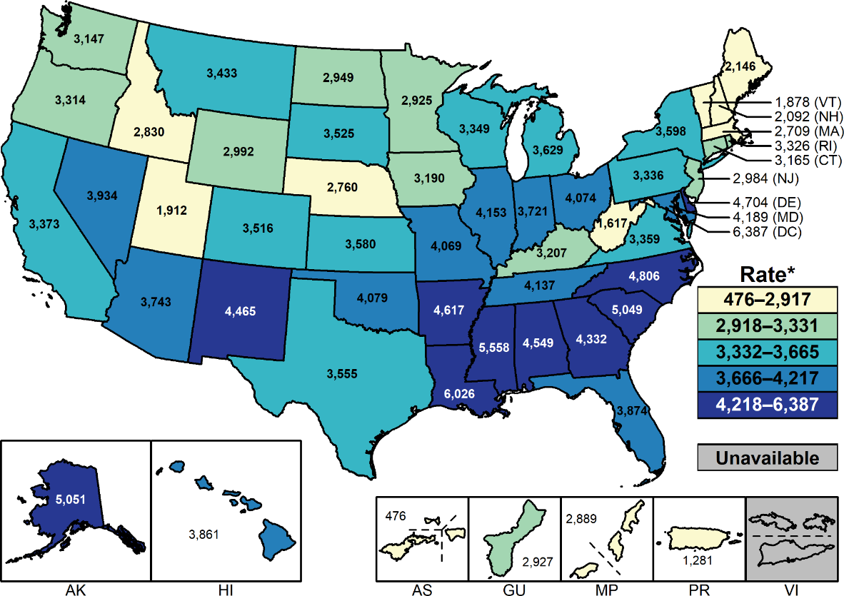
Chlamydia — Rates of Reported Cases Among Females Aged 15–24 Years by State and Territory, United States, 2018
* Per 100,000.
NOTE: See Sections A1.2 and A1.11 in the Appendix for more information on interpreting and estimating reported rates in US territories.
Notes:
United States map showing 2018 rates of reported cases of chlamydia among females aged 15 to 24 years by state and territory. Among females aged 15–24 years, the population targeted for chlamydia screening, the overall rate of reported cases of chlamydia in 2018 was 3,693.6 cases per 100,000 females. Rates of reported chlamydia cases varied by state for females aged 15–24 years, with the majority of states having the highest reported case rates in the South.

Slide 3
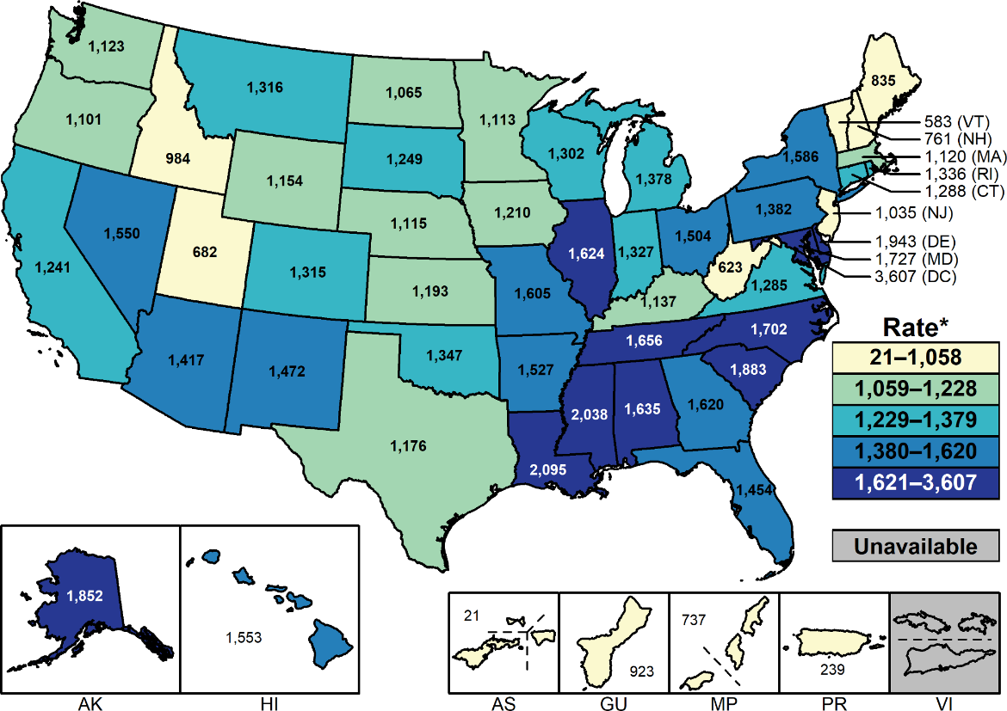
Chlamydia — Rates of Reported Cases Among Males Aged 15–24 Years by State and Territory, United States, 2018
* Per 100,000.
NOTE: See Sections A1.2 and A1.11 in the Appendix for more information on interpreting and estimating reported rates in US territories.
Notes:
United States map showing 2018 rates of reported cases of chlamydia among males aged 15 to 24 years by state and territory. Among males aged 15–24 years, the overall rate of reported cases of chlamydia in 2018 was 1,382.0 cases per 100,000 males. Rates of reported chlamydia cases varied by state for males aged 15–24 years, with the majority of states having the highest reported case rates in the South.

Slide 4
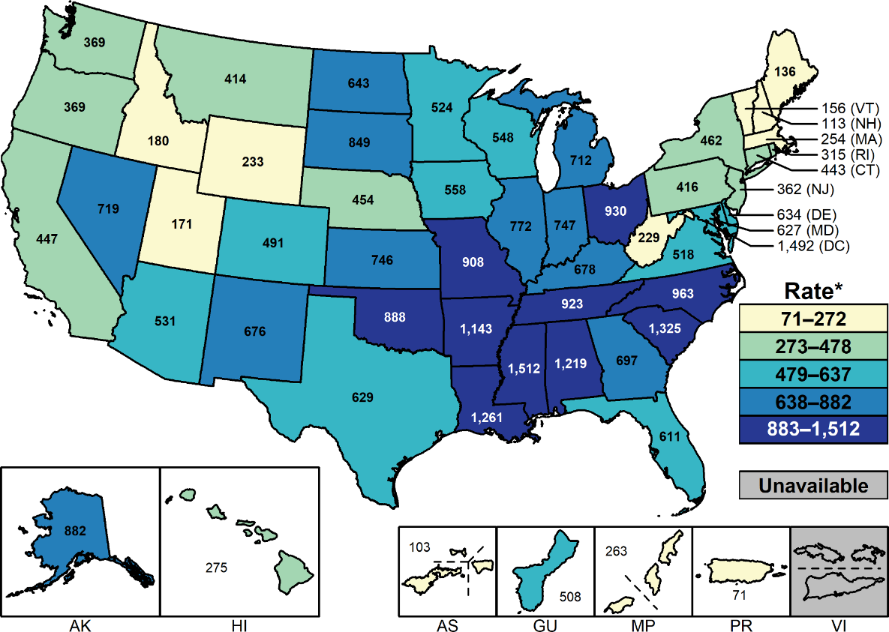
Gonorrhea — Rates of Reported Cases Among Females Aged 15–24 Years by State and Territory, United States, 2018
* Per 100,000.
NOTE: See Sections A1.2 and A1.11 in the Appendix for more information on interpreting and estimating reported rates in US territories.
Notes:
United States map showing 2018 rates of reported cases of gonorrhea among females aged 15 to 24 years by state and territory. In 2018, among females aged 15–24 years, the rate of reported gonorrhea was 627.0 cases per 100,000 females. Rates of reported gonorrhea cases varied by state for females aged 15–24 years, with the majority of states having the highest reported case rates in the South.

Slide 5
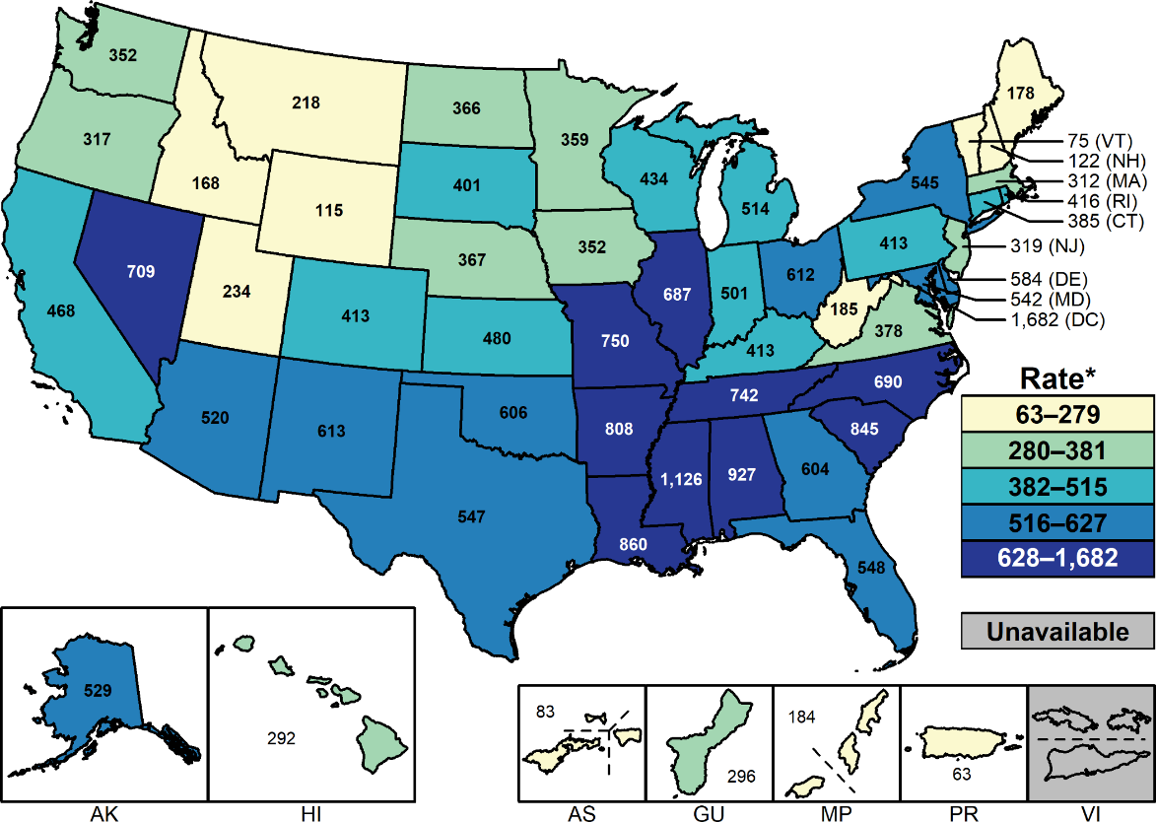
Gonorrhea — Rates of Reported Cases Among Males Aged 15–24 Years by State and Territory, United States, 2018
* Per 100,000.
NOTE: See Sections A1.2 and A1.11 in the Appendix for more information on interpreting and estimating reported rates in US territories.
Notes:
United States map showing 2018 rates of reported cases of gonorrhea among males aged 15 to 24 years by state and territory. Among males aged 15–24 years, the rate of reported gonorrhea was 525.6 cases per 100,000 males in 2018. Rates of reported gonorrhea cases varied by state for males aged 15–24 years, with the majority of states having the highest reported case rates in the South.

Slide 6
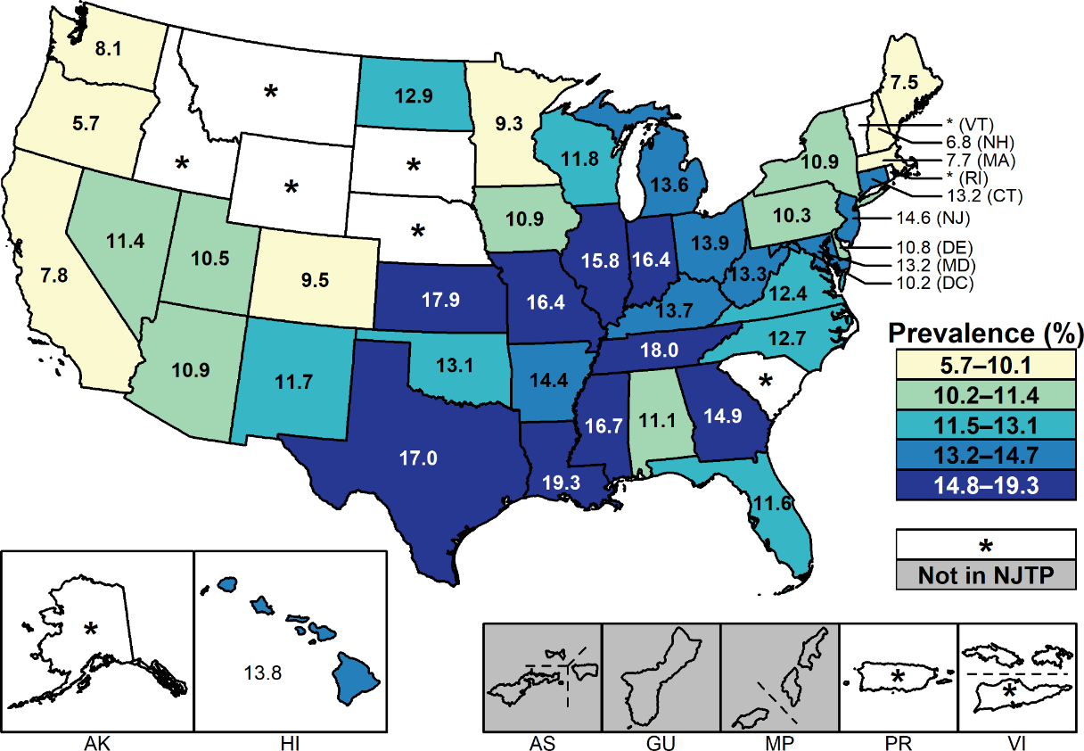
Chlamydia — Prevalence Among Females Aged 16–24 Years Entering the National Job Training Program (NJTP) by State and Territory of Residence, United States, 2018
* Fewer than 100 females who resided in these states/territories and entered the NJTP were screened for chlamydia in 2018.
NOTE: See Section A2.1 in the Appendix for more information regarding NJTP methods.
Notes:
United States map showing prevalence of chlamydia among females aged 16 to 24 years entering the National Job Training Program by state and territory of residence during 2018. Among females aged 16–24 years entering the National Job Training Program in 2018 in 41 states and the District of Columbia, the median state-specific chlamydia prevalence was 12.5% (range: 5.7% to 19.3%).

Slide 7
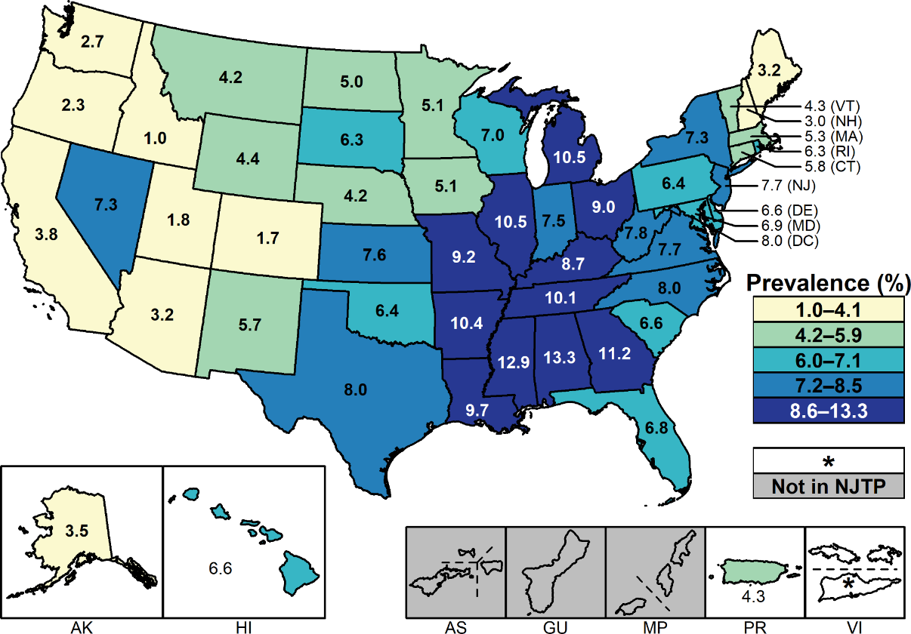
Chlamydia — Prevalence Among Males Aged 16–24 Years Entering the National Job Training Program (NJTP) by State and Territory of Residence, United States, 2018
* Fewer than 100 males who resided in these states/territories and entered the NJTP were screened for chlamydia in 2018.
NOTE: See Section A2.1 in the Appendix for more information regarding NJTP methods.
Notes:
United States map showing prevalence of chlamydia among males aged 16 to 24 years entering the National Job Training Program by state and territory of residence during 2018. Among males aged 16–24 years entering the National Job Training Program in 2018 in all 50 states, the District of Columbia, and Puerto Rico, the median state-specific chlamydia prevalence was 6.6% (range: 1.0% to 13.3%).

Slide 8
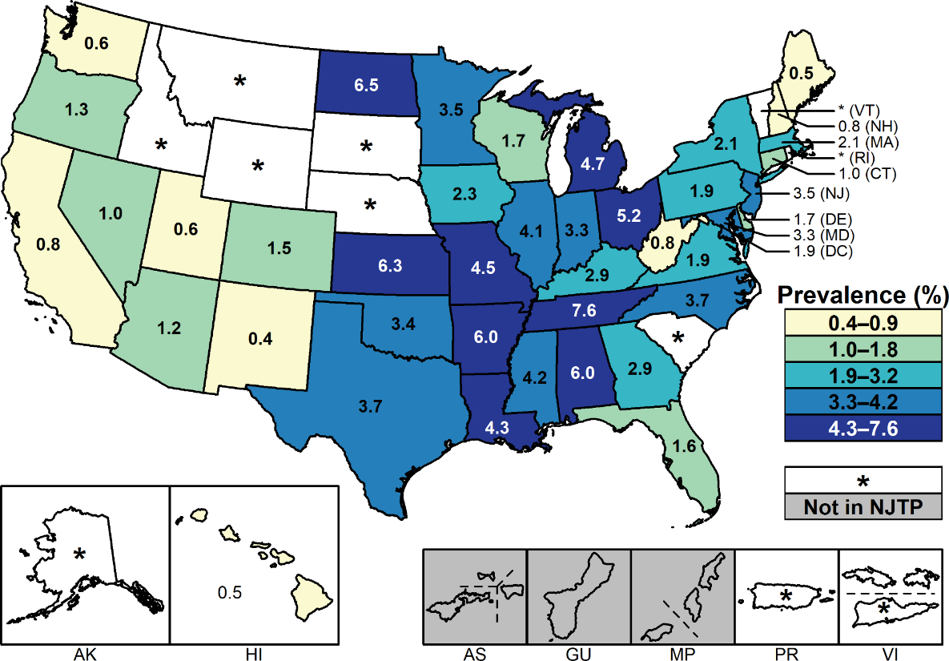
Gonorrhea — Prevalence Among Females Aged 16–24 Years Entering the National Job Training Program (NJTP) by State and Territory of Residence, United States, 2018
* Fewer than 100 females who resided in these states/territories and entered the NJTP were screened for gonorrhea in 2018.
NOTE: See Section A2.1 in the Appendix for more information regarding NJTP methods.
Notes:
United States map showing prevalence of gonorrhea among females aged 16 to 24 years entering the National Job Training Program by state and territory of residence during 2018. Among females aged 16–24 years entering the National Job Training Program in 41 states and the District of Columbia, the median state-specific gonorrhea prevalence in 2018 was 2.2% (range: 0.4% to 7.6%).

Slide 9
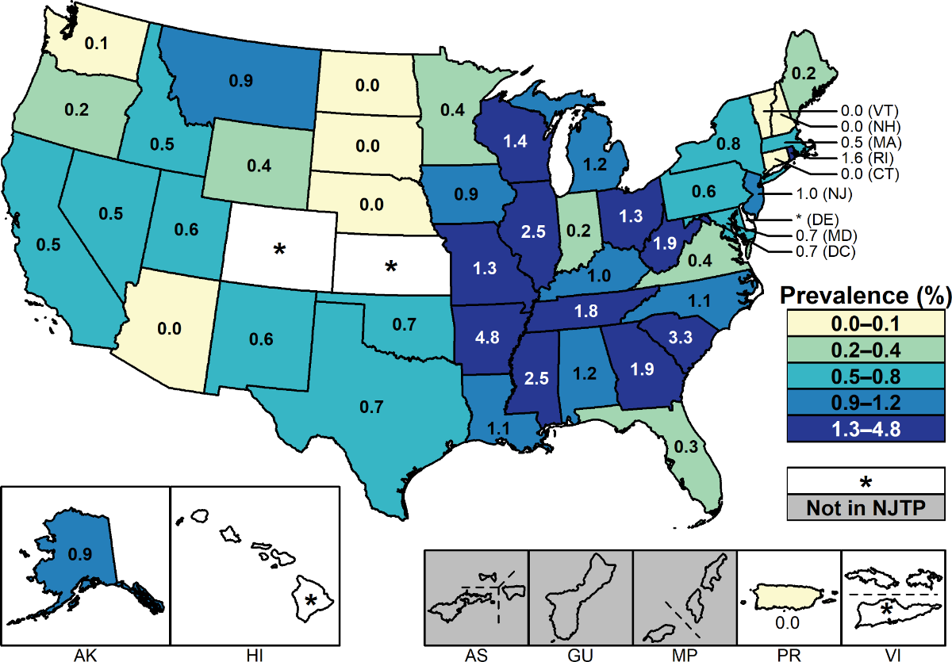
Gonorrhea — Prevalence Among Males Aged 16–24 Years Entering the National Job Training Program (NJTP) by State and Territory of Residence, United States, 2018
* Fewer than 100 males who resided in these states/territories and entered the NJTP were screened for gonorrhea in 2018.
NOTE: See Section A2.1 in the Appendix for more information regarding NJTP methods.
Notes:
United States map showing prevalence of gonorrhea among males aged 16 to 24 years entering the National Job Training Program by state and territory of residence during 2018. Among males aged 16–24 years entering the National Job Training Program in 46 states, the District of Columbia, and Puerto Rico, the median state-specific gonorrhea prevalence in 2018 was 0.7% (range: 0.0% to 4.8%).

