Slide 1
Sexually Transmitted Infections
Surveillance 2022
Congenital Syphilis
Notes:
This slide set was prepared by the Division of STD Prevention, National Center for HIV, Viral Hepatitis, STD, and TB Prevention (NCHHSTP), Centers for Disease Control and Prevention (CDC). These slides display trends for STIs in the United States through 2022. Data presented include case notifications provided to CDC through the National Notifiable Diseases Surveillance System (NNDSS) and data collected through projects and programs that monitor STIs in various settings, including the STD Surveillance Network (SSuN), and the Gonococcal Isolate Surveillance Project (GISP).
For more information on data sources, data collection and reporting practices, and case definitions, please see the Technical Notes, available at https://www.cdc.gov/std/statistics/2022/technical-notes.htm.
All data points for figures presented in these slides are available at https://www.cdc.gov/std/statistics/2022/data.zip.
NOTE: This slide set is in the public domain. You may reproduce these slides without permission; however, citation as to source is appreciated.
Centers for Disease Control and Prevention. Sexually Transmitted Infections Surveillance 2022. Atlanta: U.S. Department of Health and Human Services; 2024.
You are also free to adapt and revise these slides; however, you must remove the CDC name and logo if changes are made.

Slide 2
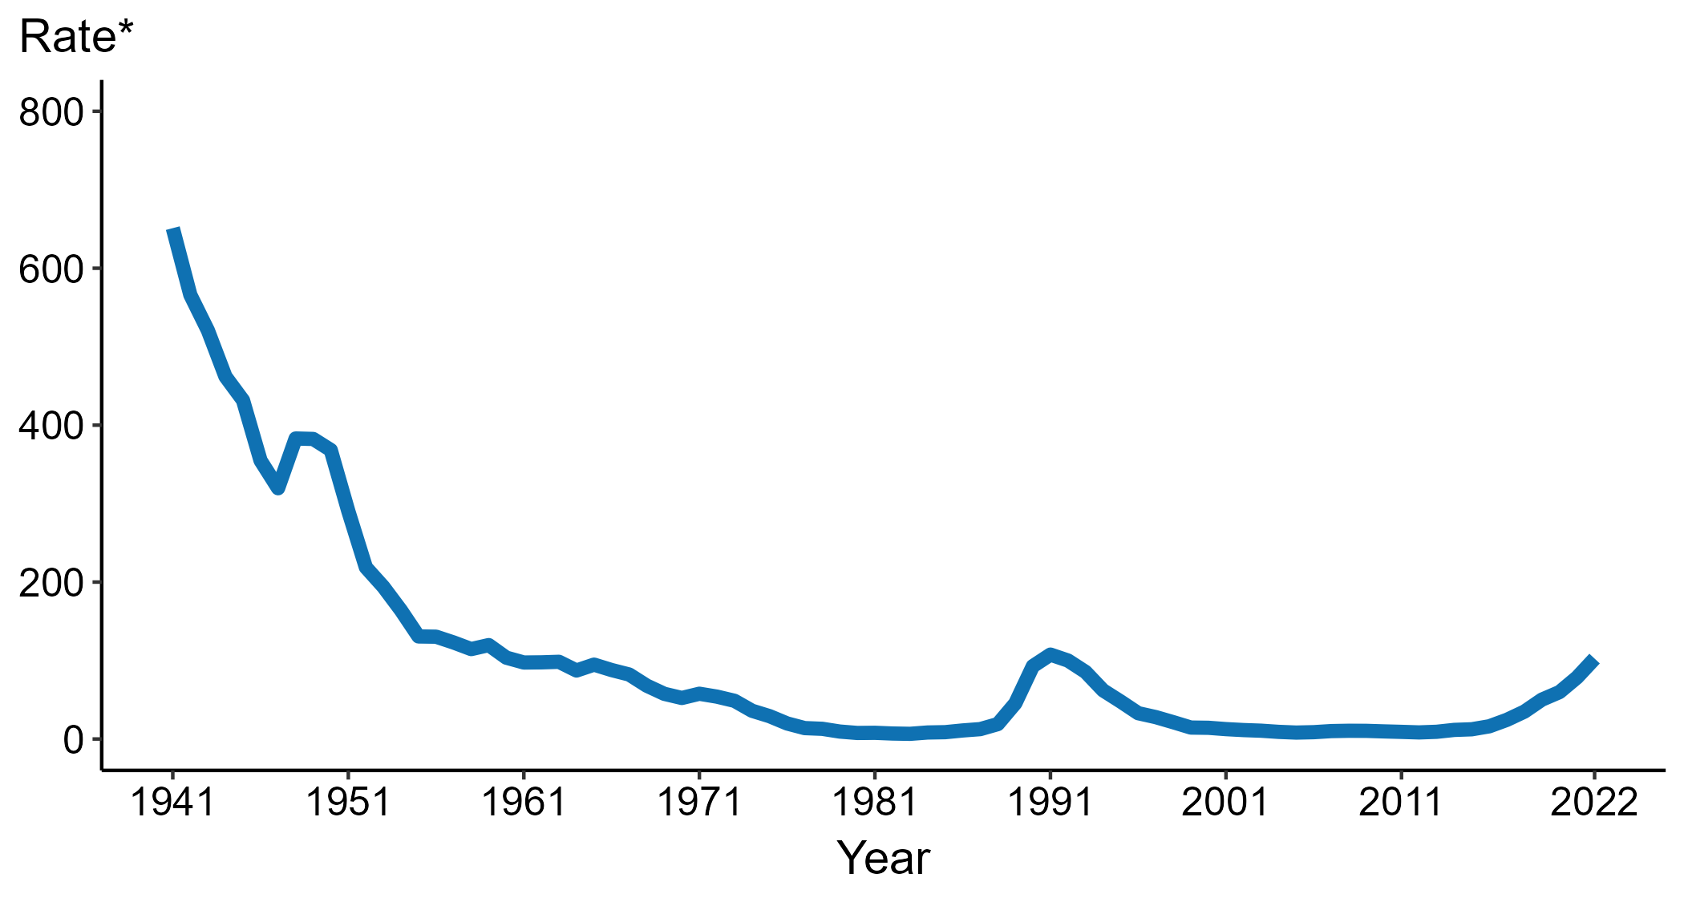
Congenital Syphilis — Rates of Reported Cases by Year of Birth, United States, 1941–2022
* Per 100,000 live births
Notes:
Data collection for congenital syphilis began in 1941, and congenital syphilis was made a nationally notifiable condition in 1944. There was a significant change in the congenital syphilis case definition in the 1990s and rates before versus after the case definition change should be interpreted with caution.
In 2022, there were a total of 3,755 cases of congenital syphilis reported for a rate of 102.5 per 100,000 live births.
During 2021 to 2022, the rate of reported congenital syphilis increased 30.6% (from 78.5 to 102.5 per 100,000 live births).
This report includes data from years that coincide with the COVID-19 pandemic, which introduced uncertainty and difficulty in interpreting STI surveillance data. See Impact of COVID-19 on STIs for more information.
See Technical Notes (https://www.cdc.gov/std/statistics/2022/technical-notes.htm) for information on syphilis case reporting, including changes in case definitions.
Data for all figures are available at https://www.cdc.gov/std/statistics/2022/data.zip. The file “CS - Rates by Year of Birth (US 1941-2022).xlsx” contains the data for the figure presented on this slide.

Slide 3
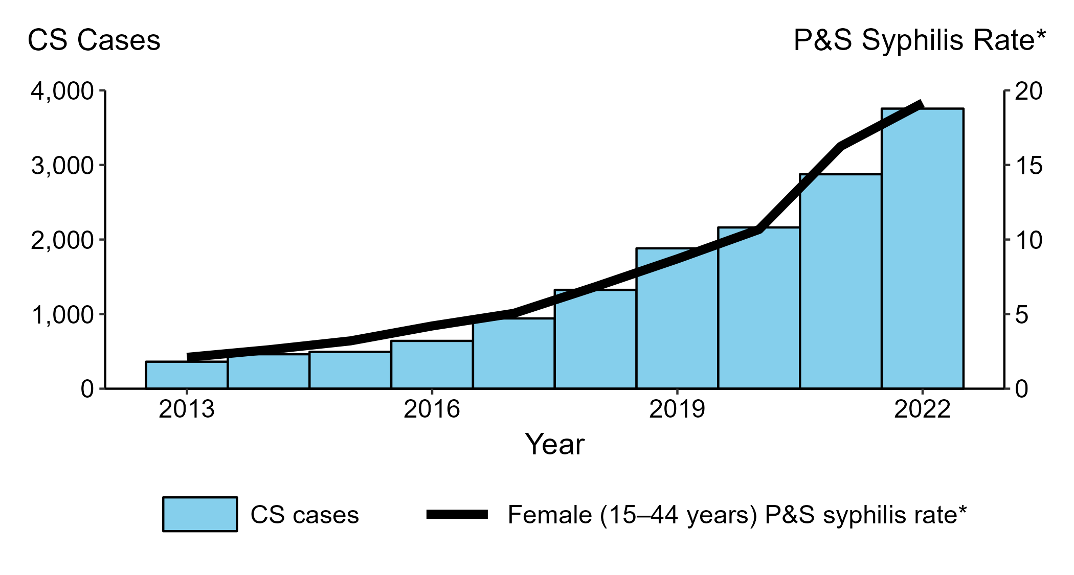
Congenital Syphilis — Reported Cases by Year of Birth and Rates of Reported Cases of Primary and Secondary Syphilis Among Women Aged 15–44 Years, United States, 2013–2022
* Per 100,000
ACRONYMS: CS = Congenital syphilis; P&S Syphilis = Primary and secondary syphilis
Notes:
In 2022, there were a total of 3,755 cases of congenital syphilis reported for a rate of 102.5 per 100,000 live births.
During 2021 to 2022, the number of cases of congenital syphilis increased 30.6% (2,875 to 3,755 cases), concurrent with a 17.2% increase (16.3 to 19.1 per 100,000) in the rate of primary and secondary syphilis among women aged 15 to 44 years.
During 2013 to 2022, the number of cases of congenital syphilis increased 937.3% (362 to 3,755 cases), concurrent with a 809.5% increase (2.1 to 19.1 per 100,000) in the rate of primary and secondary syphilis among women aged 15 to 44 years.
This report includes data from years that coincide with the COVID-19 pandemic, which introduced uncertainty and difficulty in interpreting STI surveillance data. See Impact of COVID-19 on STIs for more information.
See Technical Notes (https://www.cdc.gov/std/statistics/2022/technical-notes.htm) for information on syphilis case reporting.
Data for all figures are available at https://www.cdc.gov/std/statistics/2022/data.zip. The file “CS - Cases by Year of Birth and PS Syphilis Rates Women 15-44 (US 2013-2022).xlsx” contains the data for the figure presented on this slide.

Slide 4
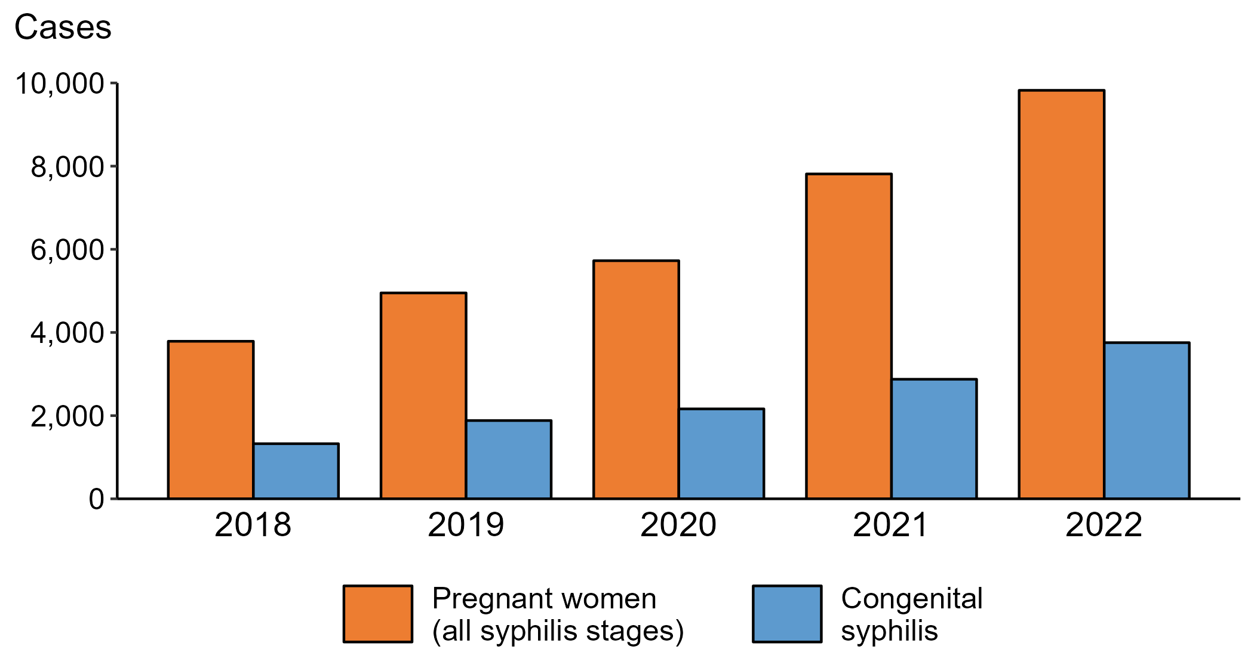
Syphilis— Reported Cases of Syphilis (All Stages) among Pregnant Women and Reported Cases of Congenital Syphilis by Year of Birth, United States, 2018–2022
Notes:
In 2022, there were a total of 3,755 cases of congenital syphilis reported for a rate of 102.5 per 100,000 live births.
During 2021 to 2022, the number of women reported with syphilis (all stages) who were pregnant increased 25.7% (from 7,812 in 2021 to 9,823 in 2022). During the same time period, the number of reported cases of congenital syphilis increased 30.6% (from 2,875 in 2021 to 3,755 in 2022).
During 2018 to 2022, the number of women reported with syphilis (all stages) who were pregnant increased 159.3% (from 3,788 in 2018 to 9,823 in 2022). During the same time period, the number of reported cases of congenital syphilis increased 183.4% (from 1,325 in 2018 to 3,755 in 2022).
This report includes data from years that coincide with the COVID-19 pandemic, which introduced uncertainty and difficulty in interpreting STI surveillance data. See Impact of COVID-19 on STIs for more information.
See Technical Notes (https://www.cdc.gov/std/statistics/2022/technical-notes.htm) for information on syphilis case reporting.
Data for all figures are available at https://www.cdc.gov/std/statistics/2022/data.zip. The file “CS and Syphilis - Cases Pregnant Women and CS Cases by Year of Birth (US 2018-2022).xlsx” contains the data for the figure presented on this slide.

Slide 5
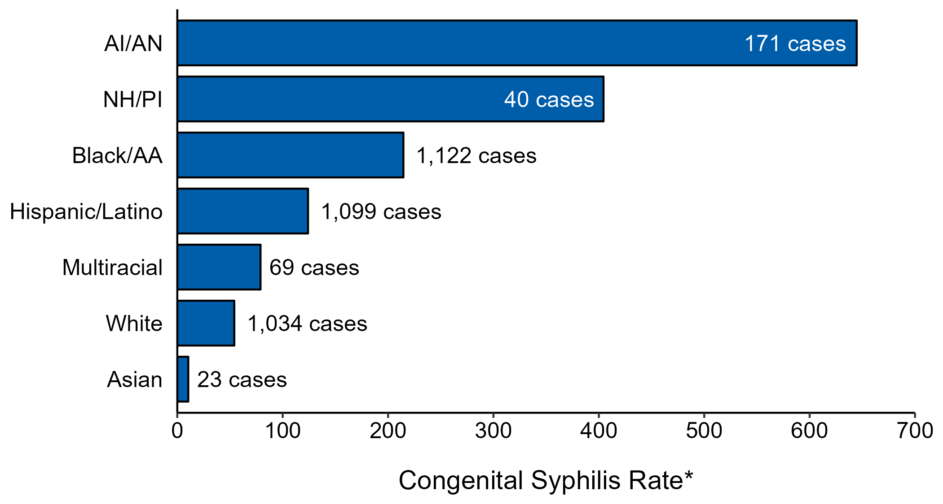
Congenital Syphilis — Case Counts and Rates of Reported Cases by Race/Hispanic Ethnicity of Mother, United States, 2022
* Per 100,000 live births
NOTE: In 2022, a total of 197 congenital syphilis cases (5.2%) had missing, unknown, or other race and were not reported to be of Hispanic ethnicity.
ACRONYMS: AI/AN = American Indian or Alaska Native; Black/AA = Black or African American; NH/PI = Native Hawaiian or other Pacific Islander
Notes:
In 2022, there were a total of 3,755 cases of congenital syphilis reported for a rate of 102.5 per 100,000 live births.
In 2022, rates of congenital syphilis were highest among mothers who were non-Hispanic American Indian or Alaska Native (644.7 per 100,000 live births), followed by mothers who were non-Hispanic Native Hawaiian or other Pacific Islander (404.4 per 100,000 live births) and mothers who were non-Hispanic Black or African American (214.5 per 100,000 live births). The greatest number of reported cases was among mothers who were non-Hispanic Black or African American (1,122 cases), followed by mothers who were Hispanic or Latino and of any race(s) (1,099 cases) and mothers who were non-Hispanic White (1,034 cases).
This report includes data from years that coincide with the COVID-19 pandemic, which introduced uncertainty and difficulty in interpreting STI surveillance data. See Impact of COVID-19 on STIs for more information.
See Technical Notes (https://www.cdc.gov/std/statistics/2022/technical-notes.htm) for information on syphilis case reporting, race/Hispanic ethnicity categorization, and reporting of race/Hispanic ethnicity for STI cases.
Data for all figures are available at https://www.cdc.gov/std/statistics/2022/data.zip. The file “CS - Counts and Rates by Race Hispanic Ethnicity of Mother (US 2022).xlsx” contains the data for the figure presented on this slide.

Slide 6
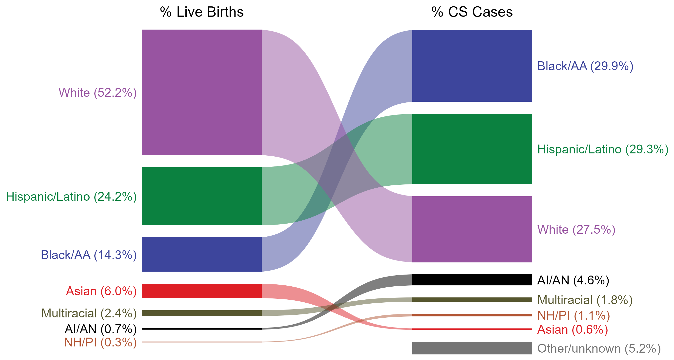
Congenital Syphilis — Total Live Births and Reported Cases by Race/Hispanic Ethnicity of Mother, United States, 2022
NOTE: In 2022, a total of 197 congenital syphilis cases (5.2%) had missing, unknown, or other race and were not reported to be of Hispanic ethnicity. These cases are included in the “other/unknown” category.
ACRONYMS: AI/AN = American Indian or Alaska Native; Black/AA = Black or African American; NH/PI = Native Hawaiian or other Pacific Islander
Notes:
In 2022, there were a total of 3,755 cases of congenital syphilis reported for a rate of 102.5 per 100,000 live births.
The percentages of congenital syphilis cases by race/Hispanic ethnicity of mother were disproportionate to the percentages among live births in the United States in 2022. The greatest absolute disparity was observed among non-Hispanic Black or African American mothers, who represented 29.9% of reported congenital syphilis cases (n = 1,122; 29.9% of congenital syphilis cases with reported race or Hispanic ethnicity of mother) despite being 14.3% of the live births, or 15.6% more cases than would be expected based on their proportion of live births. The greatest relative disparity was among non-Hispanic American Indian or Alaska Native mothers, who represented 4.6% of reported congenital syphilis cases (n = 171; 4.6% of congenital syphilis cases with reported race or Hispanic ethnicity of mother) despite being 0.7% of live births, or a burden 6.6 times what would be expected based on their proportion of live births. Additionally, Hispanic or Latino mothers of any race(s) and non-Hispanic Native Hawaiian or other Pacific Islander mothers were also overrepresented among congenital syphilis cases relative to their proportion of live births.
This report includes data from years that coincide with the COVID-19 pandemic, which introduced uncertainty and difficulty in interpreting STI surveillance data. See Impact of COVID-19 on STIs for more information.
See Technical Notes (https://www.cdc.gov/std/statistics/2022/technical-notes.htm) for information on syphilis case reporting, race/Hispanic ethnicity categorization, and reporting of race/Hispanic ethnicity for STI cases.
Data for all figures are available at https://www.cdc.gov/std/statistics/2022/data.zip. The file “CS - Live Births and Cases by Race Hispanic Ethnicity of Mother (US 2022).xlsx” contains the data for the figure presented on this slide.

Slide 7
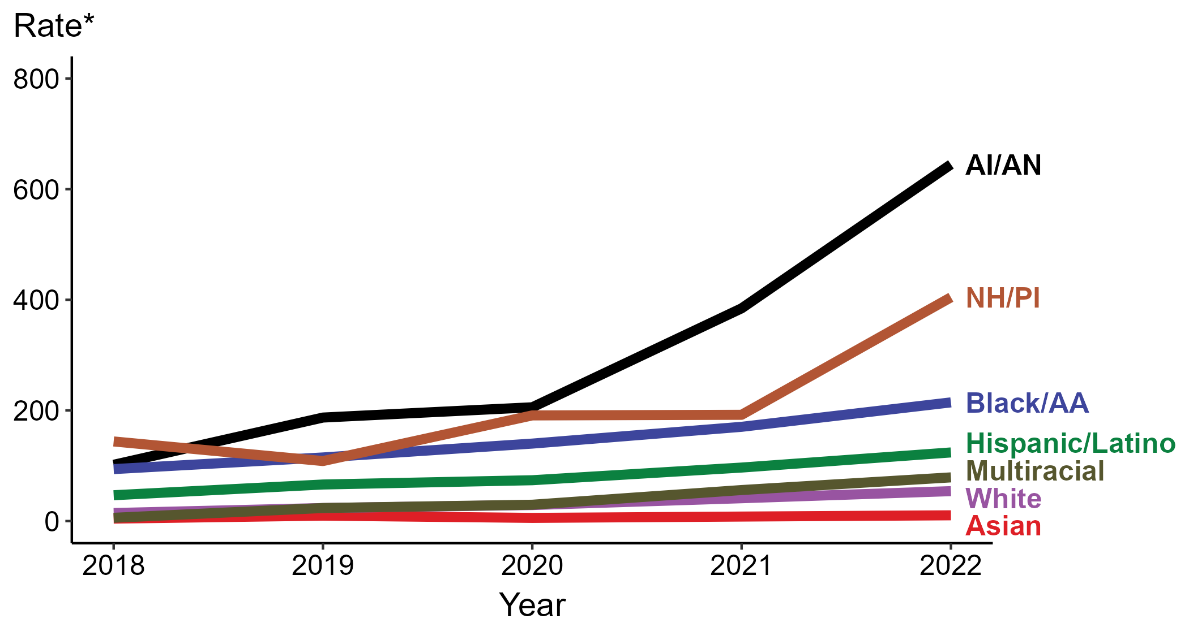
Congenital Syphilis — Rates of Reported Cases by Year of Birth, Race/Hispanic Ethnicity of Mother, United States, 2018–2022
* Per 100,000 live births
ACRONYMS: AI/AN = American Indian or Alaska Native; Black/AA = Black or African American; NH/PI = Native Hawaiian or other Pacific Islander
Notes:
In 2022, there were a total of 3,755 cases of congenital syphilis reported for a rate of 102.5 per 100,000 live births.
In 2022, the highest rate of reported cases of congenital syphilis per 100,000 live births was among mothers who were non-Hispanic American Indian or Alaska Native (644.7), followed by mothers who were non-Hispanic Native Hawaiian or other Pacific Islander (404.4).
During 2021 to 2022, the greatest increase in rate of reported cases of congenital syphilis per 100,000 live births was among mothers who were non-Hispanic Native Hawaiian or other Pacific Islander (192.1 to 404.4; 110.5% increase). Mothers who were non-Hispanic and of multiple races had the greatest five-year increase in rate of congenital syphilis (5.9 to 79.0; 1,239.0% increase from 2018).
There were no decreases in the rate of reported cases of congenital syphilis per 100,000 live births among any race or Hispanic ethnicity group during 2021 to 2022. There were also no decreases in the rate of congenital syphilis among any race or Hispanic ethnicity group during 2018 to 2022.
This report includes data from years that coincide with the COVID-19 pandemic, which introduced uncertainty and difficulty in interpreting STI surveillance data. See Impact of COVID-19 on STIs for more information.
See Technical Notes (https://www.cdc.gov/std/statistics/2022/technical-notes.htm) for information on syphilis case reporting, race/Hispanic ethnicity categorization, and reporting of race/Hispanic ethnicity for STI cases.
Data for all figures are available at https://www.cdc.gov/std/statistics/2022/data.zip. The file “CS - Rates by Race Hispanic Ethnicity of Mother (US 2022).xlsx” contains the data for the figure presented on this slide.

Slide 8
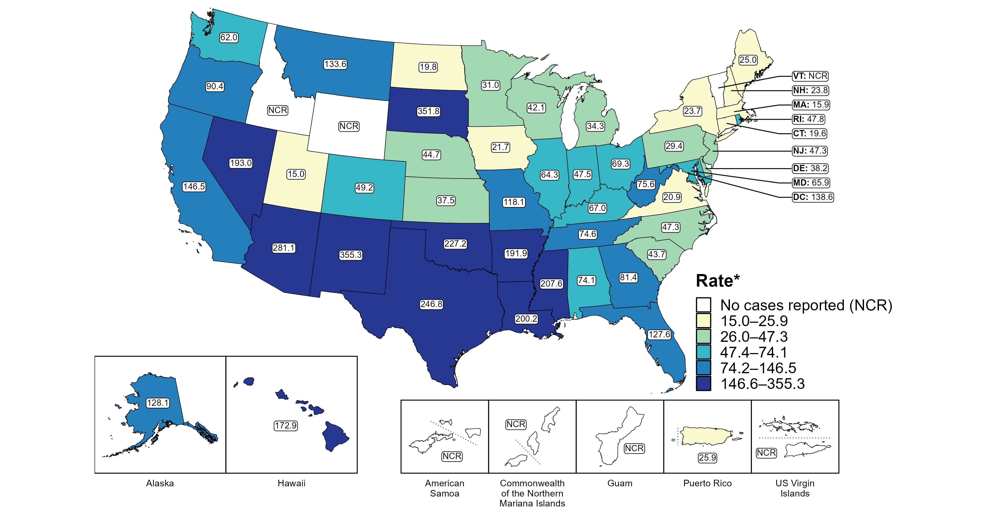
Congenital Syphilis — Rates of Reported Cases by Jurisdiction, United States and Territories, 2022
* Per 100,000 live births
Notes:
In 2022, there were a total of 3,755 cases of congenital syphilis reported among states and the District of Columbia (DC) for a rate of 102.5 per 100,000 live births. Rates of reported congenital syphilis among states reporting any cases ranged from 15.0 cases per 100,000 live births in Utah to 355.3 cases per 100,000 live births in New Mexico. No cases of congenital syphilis were reported in Idaho, Vermont, or Wyoming. The rate of reported congenital syphilis in DC was 138.6 per 100,000 live births.
Including data from US territories, there were a total of 3,760 cases of congenital syphilis reported for a rate of 101.9 per 100,000 live births in 2022. Among US territories, only Puerto Rico reported any congenital syphilis cases, with a rate of 25.9 reported cases per 100,000 live births. No cases of congenital syphilis were reported in American Samoa, Guam, the Commonwealth of the Northern Mariana Islands, or the US Virgin Islands.
This report includes data from years that coincide with the COVID-19 pandemic, which introduced uncertainty and difficulty in interpreting STI surveillance data. See Impact of COVID-19 on STIs for more information.
See Technical Notes (https://www.cdc.gov/std/statistics/2022/technical-notes.htm) for information on syphilis case reporting and on interpreting reported rates in US territories.
Data for all figures are available at https://www.cdc.gov/std/statistics/2022/data.zip. The file “CS - Rates by Jurisdiction (US and Terr 2022).xlsx” contains the data for the figure presented on this slide.
Note: the interpretative text on this slide was updated on April 2, 2024 to correct a data error. No changes were made to the figure or the underlying data file.

Slide 9
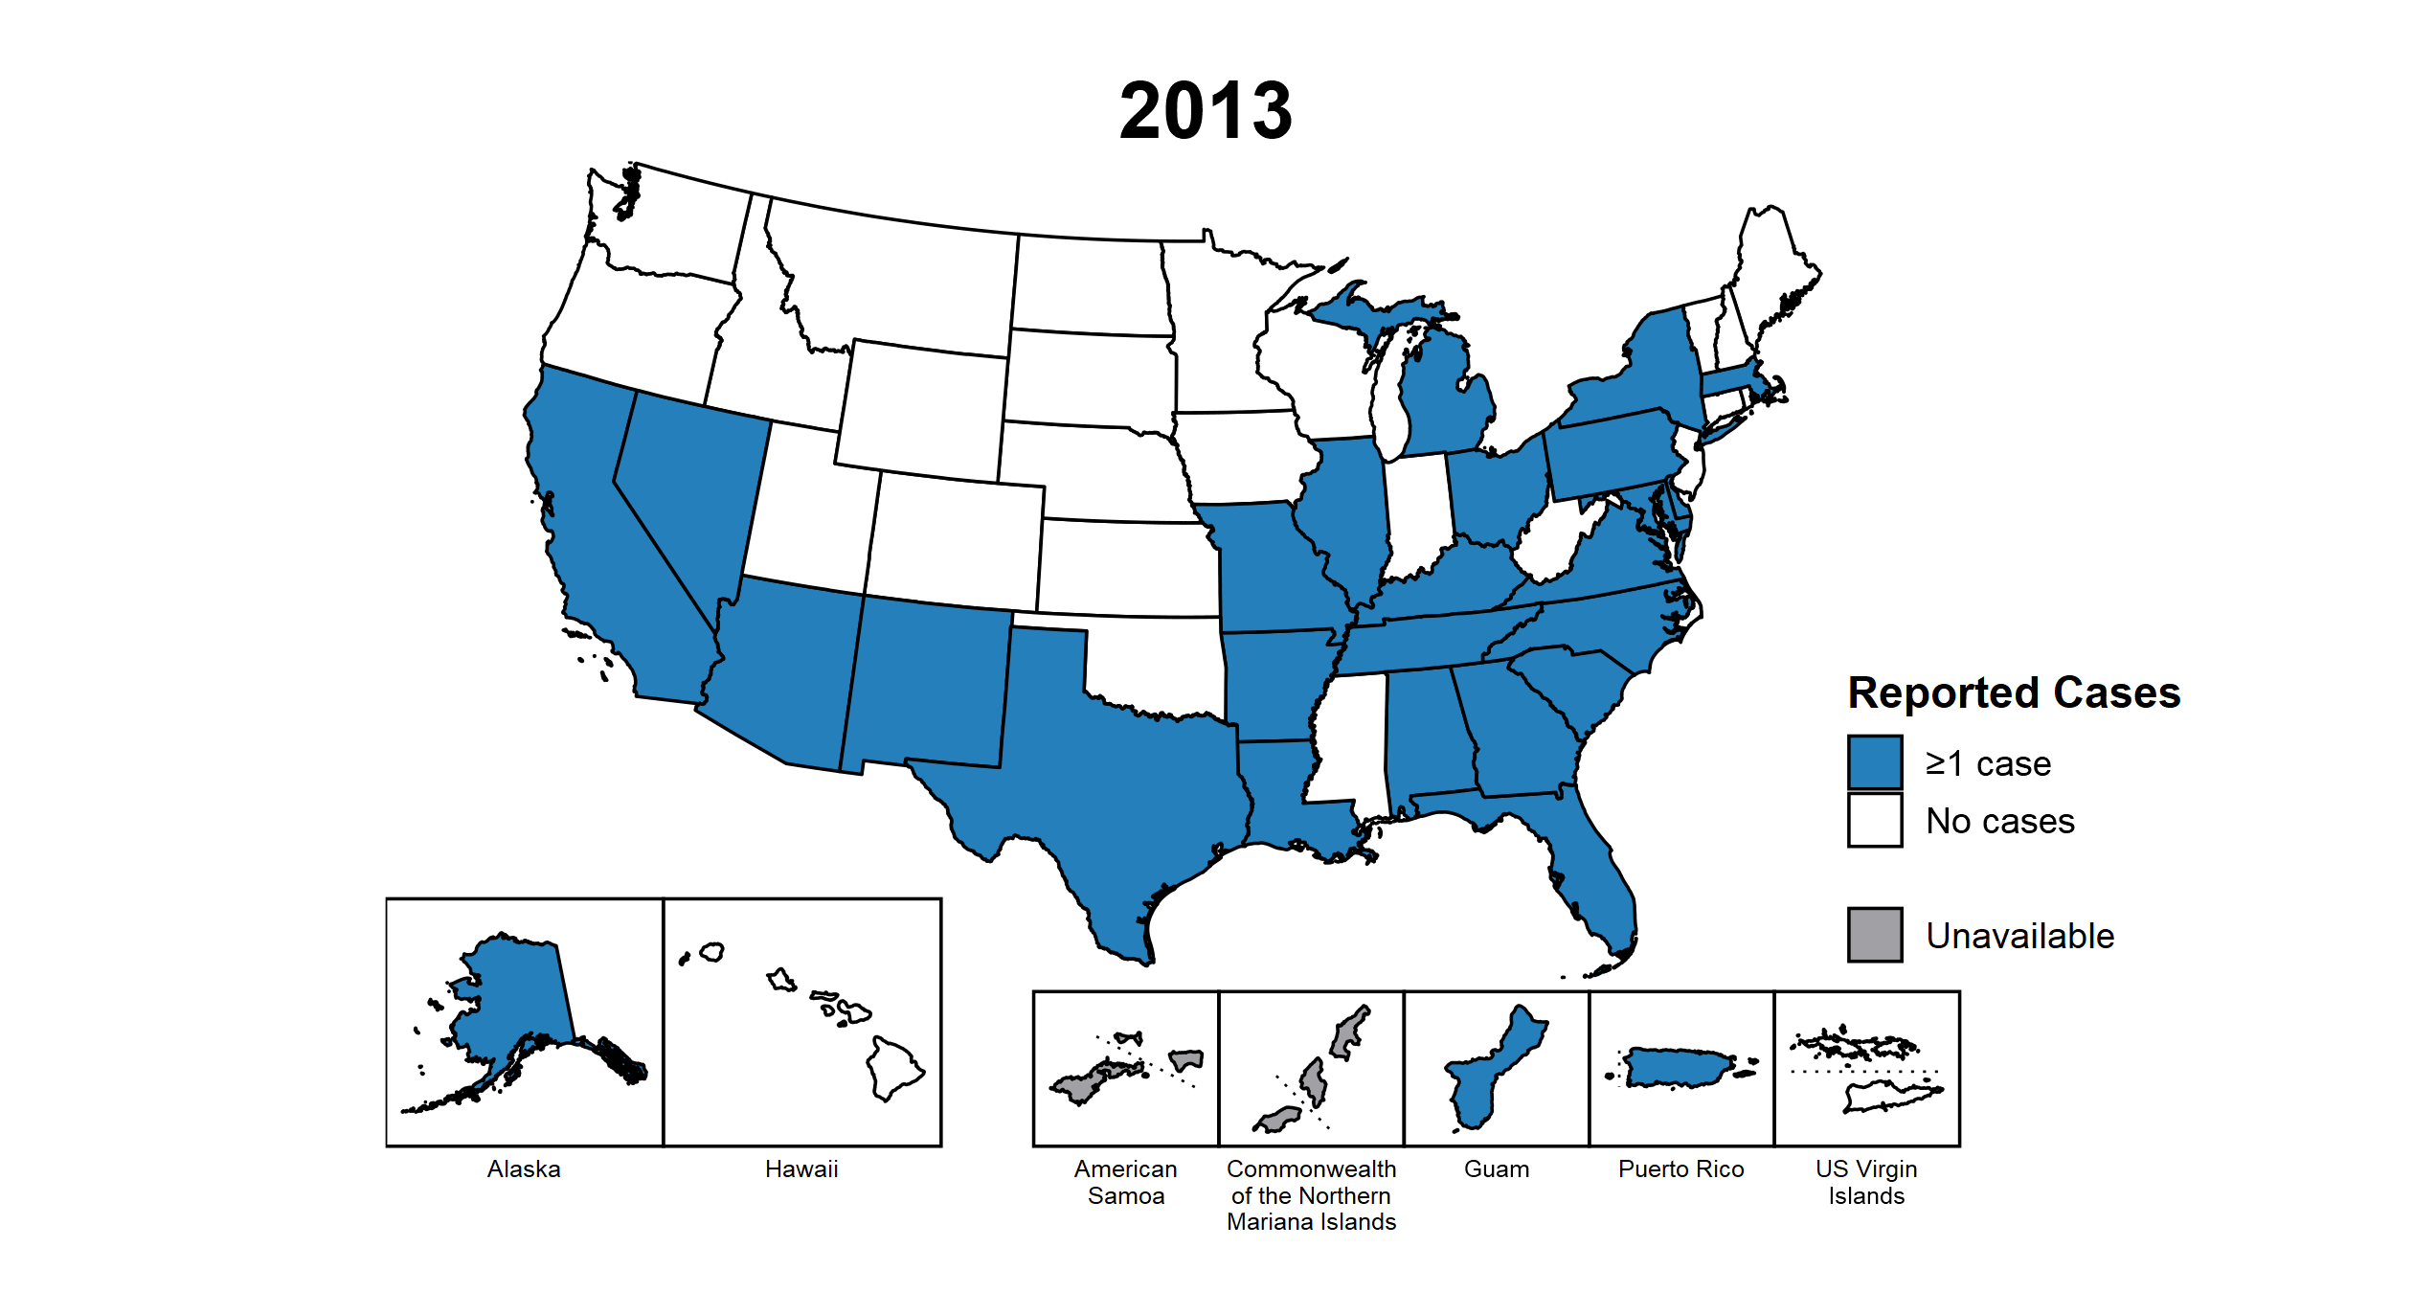
Congenital Syphilis — Reported Cases by Year of Birth and Jurisdiction, United States and Territories, 2013–2022
Notes:
This slide contains an animated figure that will play when the slide is in presentation mode. A static version of the figure that displays maps from the first and last years of the range is available as a separate slide.
In 2022, there were a total of 3,755 cases of congenital syphilis reported among states and the District of Columbia (DC) for a rate of 102.5 per 100,000 live births. Including data from US territories, there were a total of 3,760 cases of congenital syphilis reported for a rate of 101.9 per 100,000 live births.
In 2013, 25 states, DC, and two US territories (51.9% of areas with available data) reported one or more cases of congenital syphilis. This increased to 47 states, DC, and one US territory (87.5% of areas with available data) in 2022.
American Samoa and the Commonwealth of the Northern Mariana Islands began reporting data on congenital syphilis cases to CDC in 2018; data are not available for those areas prior to that year. In addition, data on reported congenital syphilis cases in 2018 are not available for the US Virgin Islands. Due to a network security incident in December 2021, the Maryland Department of Health could not finalize their 2021 STI case notification data. Data for 2021 from Maryland have been suppressed for this figure; however, they are included in national and regional case counts and rates displayed in other figures.
This report includes data from years that coincide with the COVID-19 pandemic, which introduced uncertainty and difficulty in interpreting STI surveillance data. See Impact of COVID-19 on STIs for more information.
See Technical Notes (https://www.cdc.gov/std/statistics/2022/technical-notes.htm) for information on syphilis case reporting and on interpreting reported rates in US territories.
Data for all figures are available at https://www.cdc.gov/std/statistics/2022/data.zip. The file “CS - Cases by Year of Birth and Jurisdiction (US and Terr, 2013-2022).xlsx” contains the data for the figure presented on this slide.
Note: the interpretative text on this slide was updated on April 2, 2024 to correct a data error. No changes were made to the figure or the underlying data file.

Slide 10
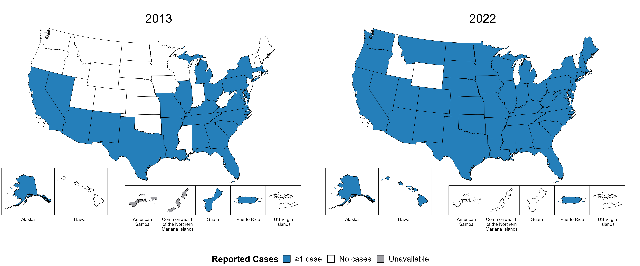
Congenital Syphilis — Reported Cases by Year of Birth and Jurisdiction, United States and Territories, 2013 and 2022
Notes:
In 2022, there were a total of 3,755 cases of congenital syphilis reported among states and the District of Columbia (DC) for a rate of 102.5 per 100,000 live births. Including data from US territories, there were a total of 3,760 cases of congenital syphilis reported for a rate of 101.9 per 100,000 live births.
In 2013, 25 states, DC, and two US territories (51.9% of areas with available data) reported one or more cases of congenital syphilis. This increased to 47 states, DC, and one US territory (87.5% of areas with available data) in 2022.
American Samoa and the Commonwealth of the Northern Mariana Islands began reporting data on congenital syphilis cases to CDC in 2018; data are not available for those areas prior to that year.
This report includes data from years that coincide with the COVID-19 pandemic, which introduced uncertainty and difficulty in interpreting STI surveillance data. See Impact of COVID-19 on STIs for more information.
See Technical Notes (https://www.cdc.gov/std/statistics/2022/technical-notes.htm) for information on syphilis case reporting and on interpreting reported rates in US territories.
Data for all figures are available at https://www.cdc.gov/std/statistics/2022/data.zip. The file “CS - Cases by Year of Birth and Jurisdiction (US and Terr, 2013 and 2022).xlsx” contains the data for the figure presented on this slide.
Note: the interpretative text on this slide was updated on April 2, 2024 to correct a data error. No changes were made to the figure or the underlying data file.

Slide 11
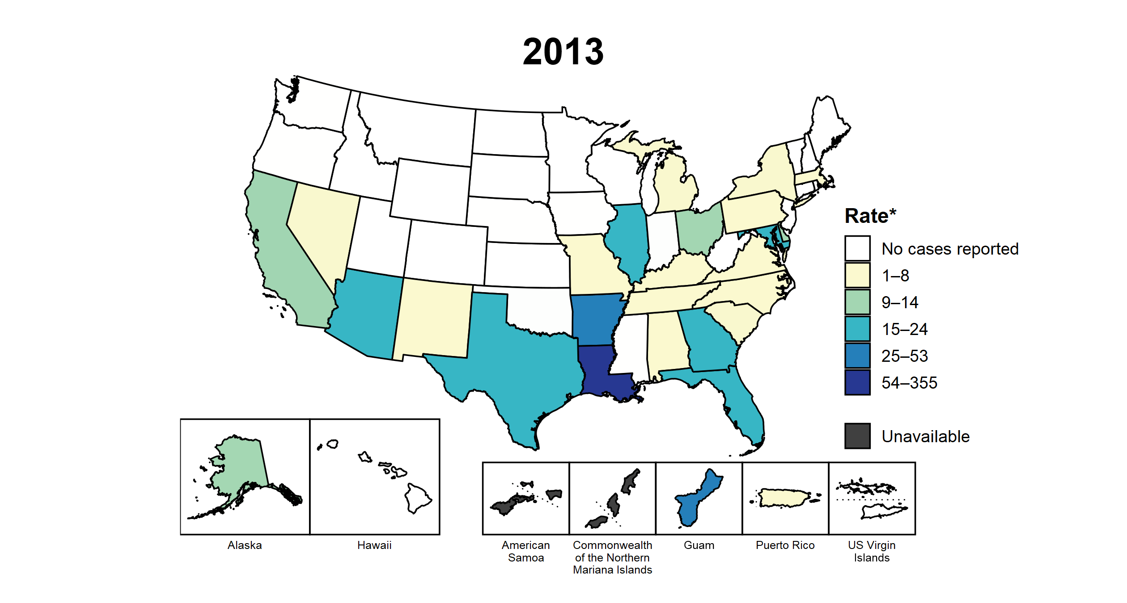
Congenital Syphilis — Rates of Reported Cases by Year of Birth and Jurisdiction, United States and Territories, 2013–2022
* Per 100,000 live births
Notes:
This slide contains an animated figure that will play when the slide is in presentation mode. A static version of the figure that displays maps from the first and last years of the range is available as a separate slide.
In 2022, there were a total of 3,755 cases of congenital syphilis reported among states and the District of Columbia (DC) for a rate of 102.5 per 100,000 live births. Including data from US territories, there were a total of 3,760 cases of congenital syphilis reported for a rate of 101.9 per 100,000 live births.
In 2013, two states and one US territory (5.6% of areas with available data) had a rate of reported congenital syphilis greater than or equal to 25 cases per 100,000 live births. This increased to 39 states, DC, and one US territory (73.2% of areas with available data) in 2022. During 2021 to 2022, rates of reported congenital syphilis among live births increased in 39 states and DC.
American Samoa and the Commonwealth of the Northern Mariana Islands began reporting data on congenital syphilis cases to CDC in 2018; data are not available for those areas prior to that year. In addition, data on reported congenital syphilis cases in 2018 are not available for the US Virgin Islands. Due to a network security incident in December 2021, the Maryland Department of Health could not finalize their 2021 STI case notification data. Data for 2021 from Maryland have been suppressed for this figure; however, they are included in national and regional case counts and rates displayed in other figures.
This report includes data from years that coincide with the COVID-19 pandemic, which introduced uncertainty and difficulty in interpreting STI surveillance data. See Impact of COVID-19 on STIs for more information.
See Technical Notes (https://www.cdc.gov/std/statistics/2022/technical-notes.htm) for information on syphilis case reporting and on interpreting reported rates in US territories.
Data for all figures are available at https://www.cdc.gov/std/statistics/2022/data.zip. The file “CS - Rates by Year of Birth and Jurisdiction (US and Terr, 2013-2022).xlsx” contains the data for the figure presented on this slide.
Note: the interpretative text on this slide was updated on April 2, 2024 to correct a data error. No changes were made to the figure or the underlying data file.

Slide 12
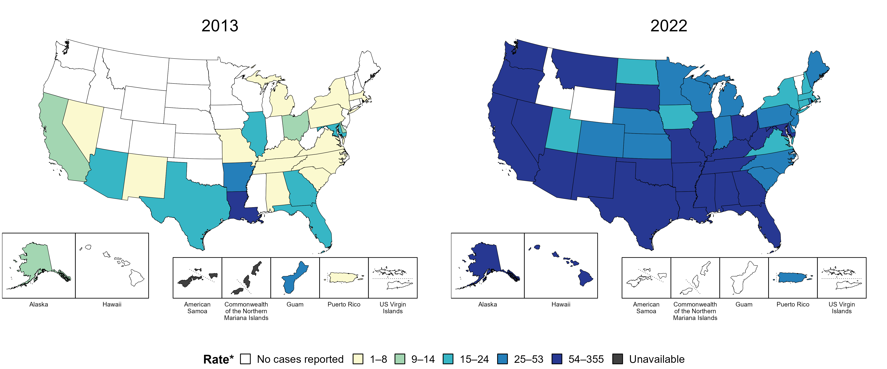
Congenital Syphilis — Rates of Reported Cases by Year of Birth and Jurisdiction, United States and Territories, 2013 and 2022
* Per 100,000 live births
Notes:
In 2022, there were a total of 3,755 cases of congenital syphilis reported among states and the District of Columbia (DC) for a rate of 102.5 per 100,000 live births. Including data from US territories, there were a total of 3,760 cases of congenital syphilis reported for a rate of 101.9 per 100,000 live births.
In 2013, two states and one US territory (5.6% of areas with available data) had a rate of reported congenital syphilis greater than or equal to 25 cases per 100,000 live births. This increased to 39 states, DC, and one US territory (73.2% of areas with available data) in 2022.
American Samoa and the Commonwealth of the Northern Mariana Islands began reporting data on congenital syphilis cases to CDC in 2018; data are not available for those areas prior to that year.
This report includes data from years that coincide with the COVID-19 pandemic, which introduced uncertainty and difficulty in interpreting STI surveillance data. See Impact of COVID-19 on STIs for more information.
See Technical Notes (https://www.cdc.gov/std/statistics/2022/technical-notes.htm) for information on syphilis case reporting and on interpreting reported rates in US territories.
Data for all figures are available at https://www.cdc.gov/std/statistics/2022/data.zip. The file “CS - Rates by Year of Birth and Jurisdiction (US and Terr 2013 and 2022).xlsx” contains the data for the figure presented on this slide.
Note: the interpretative text on this slide was updated on April 2, 2024 to correct a data error. No changes were made to the figure or the underlying data file.

Slide 13
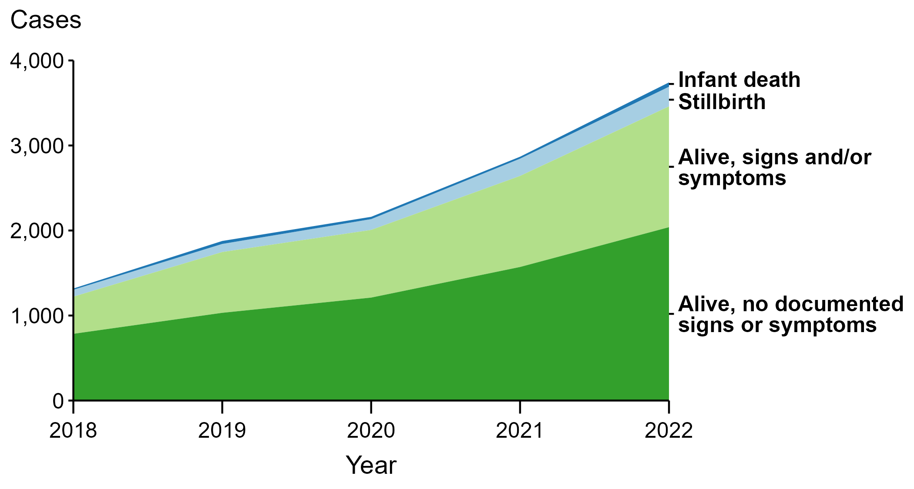
Congenital Syphilis — Reported Cases by Vital Status and Clinical Signs and Symptoms* of Infection, United States, 2018–2022
* Infants with signs and/or symptoms of congenital syphilis have documentation of at least one of the following: long bone changes consistent with congenital syphilis, snuffles, condylomata lata, syphilitic skin rash, pseudoparalysis, hepatosplenomegaly, edema, jaundice due to syphilitic hepatitis, reactive CSF-VDRL, elevated CSF WBC or protein values, or evidence of direct detection of T. pallidum.
NOTE: Of the 11,999 congenital syphilis cases reported during 2018 to 2022, 33 (0.3%) did not have sufficient information to be categorized.
Notes:
In 2022, there were a total of 3,755 cases of congenital syphilis reported for a rate of 102.5 per 100,000 live births.
In 2022, 51 congenital syphilis cases (1.4%) were infant deaths, 231 cases (6.2%) were stillbirths, 1,421 cases (37.8%) were born alive with congenital syphilis-related signs or symptoms, 2,039 cases (54.3%) were born alive with no documented congenital syphilis-related signs or symptoms, and 13 cases (0.3%) were missing information on vital status.
In 2022, there were 282 congenital syphilis-related deaths (231 stillbirths and 51 infant deaths), an increase of 24.8% from 2021 (226 in 2021 to 282 in 2022) and an increase of 193.8% from 2018 (96 in 2018 to 282 in 2022).
The number of infants reported with congenital syphilis who were born alive with congenital syphilis-related signs and symptoms increased 32.7% from 2021 to 2022 (1,071 in 2021 to 1,421 in 2022) and increased 225.2% from 2018 to 2022 (437 in 2018 to 1,421 in 2022).
This report includes data from years that coincide with the COVID-19 pandemic, which introduced uncertainty and difficulty in interpreting STI surveillance data. See Impact of COVID-19 on STIs for more information.
See Technical Notes (https://www.cdc.gov/std/statistics/2022/technical-notes.htm) for information on syphilis case reporting.
Data for all figures are available at https://www.cdc.gov/std/statistics/2022/data.zip. The file “CS - Cases by Vital Status and Clinical Signs and Symptoms (US 2018-2022).xlsx” contains the data for the figure presented on this slide.

Slide 14
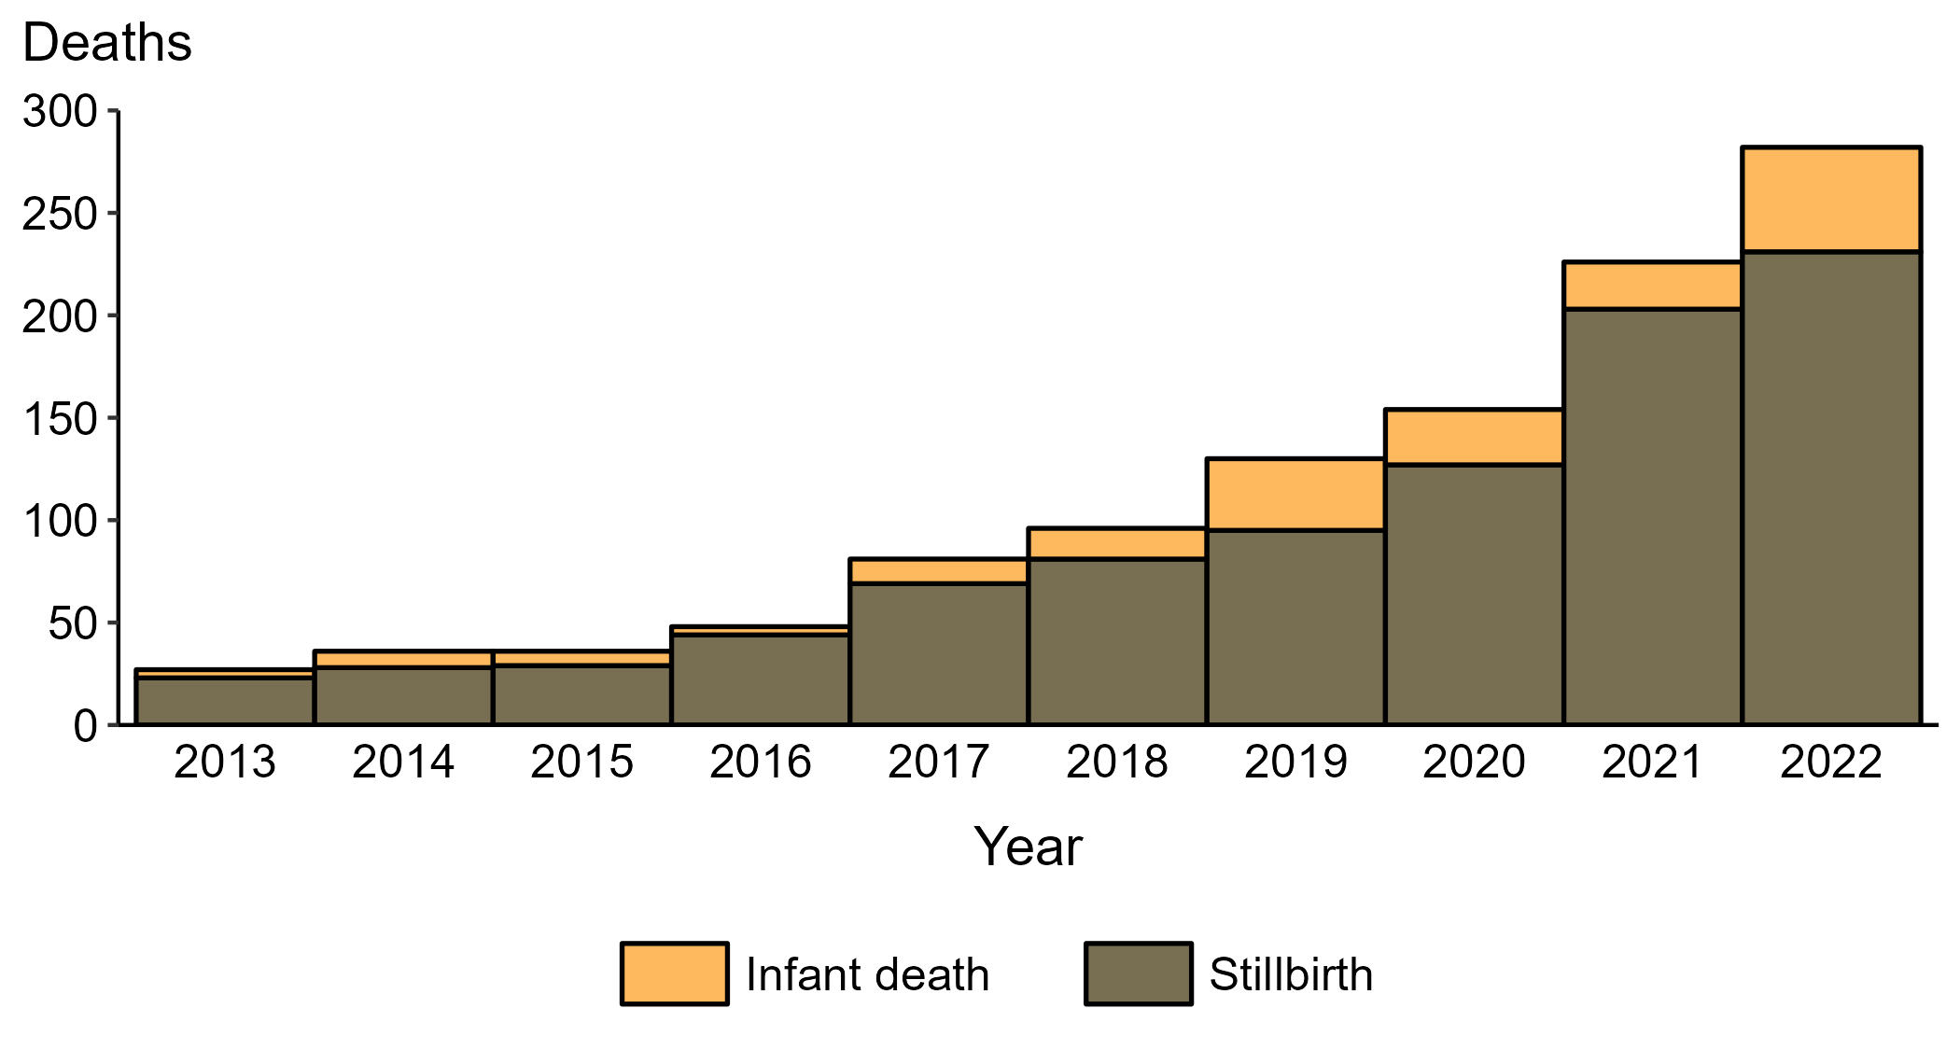
Congenital Syphilis — Reported Stillbirths and Infant Deaths, United States, 2013–2022
Notes:
In 2022, there were a total of 3,755 cases of congenital syphilis reported for a rate of 102.5 per 100,000 live births.
In 2022, 231 congenital syphilis-related stillbirths were reported, an increase of 13.8% since 2021 and an increase of 904.3% since 2013.
In 2022, 51 congenital syphilis-related infant deaths were reported, an increase of 121.7% since 2021 and an increase of 1,175.0% since 2013.
This report includes data from years that coincide with the COVID-19 pandemic, which introduced uncertainty and difficulty in interpreting STI surveillance data. See Impact of COVID-19 on STIs for more information.
See Technical Notes (https://www.cdc.gov/std/statistics/2022/technical-notes.htm) for information on syphilis case reporting.
Data for all figures are available at https://www.cdc.gov/std/statistics/2022/data.zip. The file “CS - Reported Stillbirths and Infant Deaths (US 2013-2022).xlsx” contains the data for the figure presented on this slide.

Slide 15
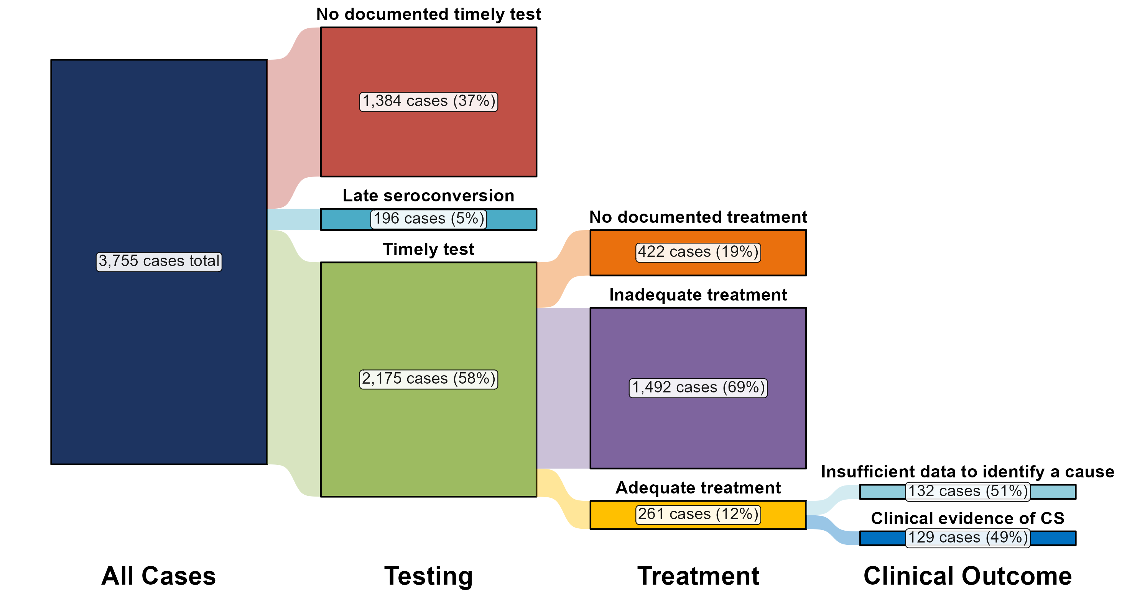
Congenital Syphilis — Distribution of Receipt of Testing and Treatment by Pregnant Persons with a Congenital Syphilis Outcome, United States, 2022
Notes:
In 2022, there were a total of 3,755 cases of congenital syphilis reported for a rate of 102.5 per 100,000 live births.
In 2022, the most common missed prevention opportunity among birthing parents of infants with congenital syphilis was inadequate treatment (n = 1,492; 39.7%), followed by no documented timely test (n = 1,319; 35.1%).
This report includes data from years that coincide with the COVID-19 pandemic, which introduced uncertainty and difficulty in interpreting STI surveillance data. See Impact of COVID-19 on STIs for more information.
See Technical Notes (https://www.cdc.gov/std/statistics/2022/technical-notes.htm) for information on syphilis case reporting and methodology for missed prevention opportunity categorization.
Data for all figures are available at https://www.cdc.gov/std/statistics/2022/data.zip. The file “CS - Receipt of Testing and Treatment by Pregnant Person with CS Outcome (US 2022).xlsx” contains the data for the figure presented on this slide.

Slide 16
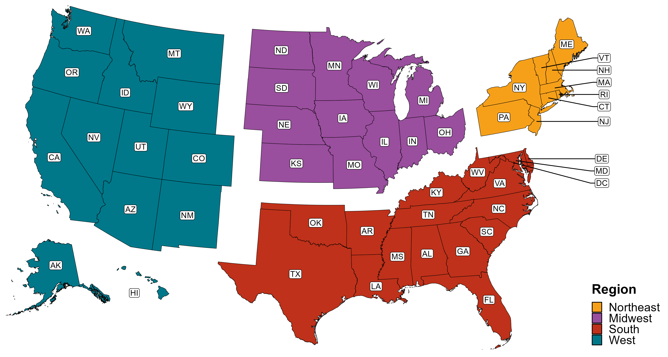
Reference Map of US Census Regions

