Slide 1
U.S. Selected Practice
Recommendations for Contraceptive Use, 2013
Division of Reproductive Health
Centers for Disease Control and Prevention
August 1, 2013
National Center for Chronic Disease Prevention and Health Promotion
Division of Reproductive Health

Slide 2
Learning Objectives
Participants will be able to:
Describe the US Selected Practice Recommendations for Contraceptive Use, 2013 (US SPR)
Identify intended use and target audience Understand how to use the US SPR
Apply the guidance in specific situations, based on clinical scenarios
Notes:
After this presentation, participants will be able to:
Describe the US Selected Practice Recommendations for Contraceptive Use or US SPR
Identify the intended use of this document and the target audience for the guidance
Understand how that audience can use the guidance
Apply the guidance in specific clinical scenarios

Slide 3
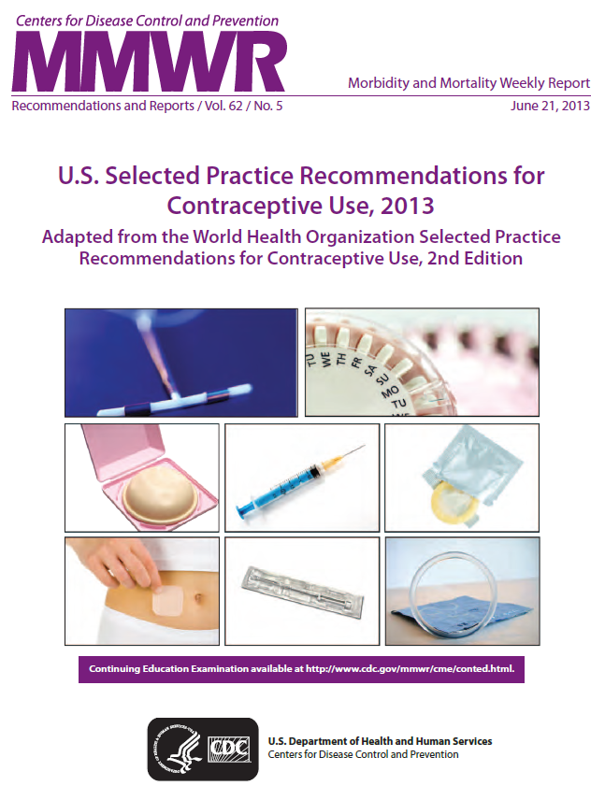

Slide 4
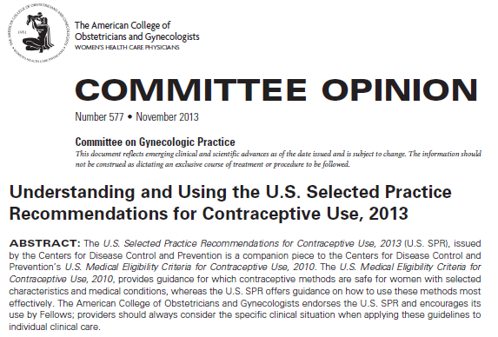

Slide 5
US Selected Practice Recommendations for Contraceptive Use, 2013
Follow-up to US Medical Eligibility Criteria for Contraceptive Use, 2010 (US MEC):
  Recommendations for who can safely use contraception
Adapted from World Health Organization (WHO) SPR
Intent: Evidence-based guidance for common, yet controversial, contraceptive management questions
  When to start
  Missed pills
  Bleeding problems
  Exams and tests
  Follow-up
  How to be reasonably certain that a woman is not pregnant
Notes:
The US SPR is a companion document to the US Medical Eligibility Criteria for Contraceptive Use, or US MEC, which was published in 2010.
The US MEC contains recommendations for health-care providers for the safe use of contraceptive methods by women and men with various characteristics and medical conditions.
These two family planning guidance documents were adapted from the World Health Organization MEC and SPR.
The intention of the US SPR is to provide evidence-based recommendations for common, yet controversial contraceptive management questions, such as issues listed here.

Slide 6
US Selected Practice Recommendations for Contraceptive Use, 2013
Target audience: health-care providers
Purpose: to assist health care providers when they counsel patients about contraceptive use
Selected Recommendations
  NOT comprehensive textbook
  NOT the US MEC
  NOT rigid guidelines
  NOT well-woman care
Notes:
The US SPR is intended for use by health-care providers in counseling patients about method use as well as management of certain concerns or problems with use.
The US SPR, like the title states, consists of selected recommendations. It is not a comprehensive textbook, it does not answer who can safely use methods like the US Medical Eligibility Criteria, it does not provide rigid guidelines or step-by-step protocols for contraceptive visits nor does it provide recommendations for well-woman care.

Slide 7
US Adaptation of WHO SPR
October, 2010, Small expert meeting
  Chose which existing WHO recommendations to adapt
  Chose new clinical questions to add
Systematic reviews for each topic
  Peer reviewed
October 4-7, 2011, Expert meeting
  36 experts from US
For each topic:
  Systematic review presentation
  Discussion
  Draft recommendation
  Research gaps
Notes:
The adaptation of the WHO SPR for the US started in October 2010 when a small expert meeting occurred and it was decided that a US SPR should be adapted from the WHO guidance.
It was also decided that most WHO recommendations should be adapted for best implementation in the US and that several new questions should be considered to add to the US guidance.
After that meeting, systematic reviews were conducted for each adaptation and new recommendation.
These systematic reviews underwent peer review and were then presented at an expert meeting in October, 2011.
For each topic, the evidence from the review was discussed as well as what recommendations could be made from the evidence; recommendations were drafted at that time and research gaps were identified throughout the meeting.

Slide 8
US Adaptation of WHO SPR
Much of the guidance is the same as or very similar to the guidance in the WHO SPR
Adaptations include:
  length of the grace period for progestin-only injectable contraceptives (DMPA),
  differences in some of the examinations and tests recommended prior to contraceptive method initiation,
  differences in recommendations for management of bleeding irregularities based on new data and drug availability in the US,
  simplified missed pill algorithms
Notes:
While much of the guidance is the same or very similar to the WHO SPR guidance, several adaptations are included in the US SPR, such as:
The length of the grace period for DMPA re-injection
Differences in some of the examinations and tests recommended prior to contraceptive method initiation
Differences in recommendations for management of bleeding irregularities based on new data and drug availability in the US
And changes to the missed pill algorithms to respond to concerns that simplified algorithms are preferable

Slide 9
US Adaptation of WHO SPR
The US SPR includes additional guidance:
Recommendations on patch and ring
How to start regular contraception after taking emergency contraceptive pills
Management of bleeding irregularities among women using extended or continuous combined hormonal contraceptives (CHCs)
When a woman can rely on female sterilization for contraception
When a woman can stop contracepting
Notes:
There is also additional new guidance in the US SPR, such as:
Recommendations for use of the contraceptive patch and ring
How to start regular contraception after taking ECPs
Management of bleeding irregularities among women using extended or continuous CHCs
When a woman can rely on female sterilization for contraception
When a woman can stop contracepting

Slide 10
US Adaptation of WHO SPR
Format
  Arranged by method
  For each recommendation:
    Recommendation itself
    Comments and evidence summary
  Simplified text of actual recommendations
  Bullets, tables, flowcharts, algorithms

Slide 11

How to use the US SPR
Notes:
Now that you know about the US SPR, and its intent and target audience, we will next describe how to access and use the guidance.

Slide 12
Locating CDC contraception guidance
Notes:
To access this guidance, search for CDC contraception to reach the CDC Contraceptive Guidance for Healthcare Providers page.

Slide 13
CDC CONTRACEPTIVE GUIDANCE FOR HEALTH CARE PROVIDERS
http://www.cdc.gov/reproductivehealth/UnintendedPregnancy/USSPR.htm

Slide 14
Resources
CDC evidence-based family planning guidance documents: http://www.cdc.gov/reproductivehealth/unintendedpregnancy/USMEC.htm
http://www.cdc.gov/reproductivehealth/unintendedpregnancy/USSPR.htm
  Sign up to receive alerts!
WHO evidence-based family planning guidance documents: http://www.who.int/reproductivehealth/publications/family_planning/en/index.html
Notes:
All of this US SPR information, as well as tools and aides for contraceptive guidance can be found at the listed website.
You can also sign up for email alerts to be up to date with any new guidance updates or new tools released from CDC.
The WHO family planning website is also listed to access WHO family planning guidance.

Slide 15
CLINICAL SCENARIOS
Notes:
To demonstrate how the guidance can be used, we will now go through several clinical scenarios for which the guidance may be useful.

Slide 16

Clinical scenario 1:
When to start a contraceptive method
24 y.o. female comes to office desiring contraception and wants to start pills
  Q: When can she start?

Slide 17
When to start a contraceptive method
Barriers to starting
  Filling a prescription
  Starting during menses
  Coming back for a second (or more) visit
Starting when woman requests contraception (“Quick start”)
  May reduce time woman is at risk for pregnancy
  May reduce barriers to starting
Notes:
There are several barriers to initiating contraception which increases the time a woman is at risk for unintended pregnancy.
Some examples of these barriers are the need to fill a prescription, to wait for next menses to start the method or to come back for another visit.
Quick start is the start of a contraceptive method when a woman requests it rather than waiting.
Quick start may reduce the time a woman is at risk for pregnancy and may reduce barriers to starting a method.

Slide 18
Evidence for Risk of Pregnancy
Two types of risk:
Risk of already being pregnant
  Risk that woman already pregnant with “Quick start” of CHCs low
Risk of becoming pregnant
  Risk of pregnancy with “Quick start” of CHCs low
Brahmi, Contraception, 2013.
Notes:
Providers may have concerns that a woman may already be pregnant and therefore may not want to start her on contraception right away.
A recent systematic review shows that the risk of pregnancy with Quick Start of combined hormonal contraceptives is low and that the risk that a woman is already pregnant using the Quick Start method is also low.

Slide 19
Other findings
Starting CHCs on different days of the cycle does not affect bleeding changes or other side effects
“Quick start” may increase continuation of combined oral contraceptives (COCs) and patch in the short term; this difference disappears over time
Brahmi, Contraception, 2013.
Notes:
Another concern may be that starting CHCs on days of the cycle not consistent with menses may cause irregular bleeding; however studies from the same systematic review have shown that starting on different days of the cycle does not affect bleeding changes or other side effects.
Quick start may increase short term continuation of both COCs and the patch, however this difference disappeared over time in studies comparing quick start to other initiation.

Slide 20
Exposure in early pregnancy
No increased risk for adverse outcomes (congenital anomalies, neonatal death, infant death) among infants exposed in utero to COCs
Bracken, Obstet Gynecol. 1990;76:552-7.
Notes:
Another concern is risk of fetal exposure to hormonal contraception in early pregnancy.
In several studies examining fetal exposure to COCs, there has been no increased risk for adverse outcomes among infants.

Slide 21

Need for back-up contraception
Later start days are associated with greater follicular activity, but not ovulation, through day 5 (implications for back up)
Brahmi, Contraception, 2013.
Notes:
Providers may also be concerned for how long a woman will have to wait until her method is effective if she does not start her method with menses.
The US SPR also provides evidence-based guidance on the need for back-up contraception or need to abstain from sexual intercourse for each method initiation.
For CHCs, starting on later days in the cycle is associated with greater follicular activity through day 5, but not including ovulation.

Slide 22
US SPR
When to start a contraceptive method
Contraceptive Method | When to start, if provider is reasonably certain woman is not pregnant | Back-up needed
LNG IUD | Any time | If > 7 days of cycle, use back-up method or abstain for 7 days
Copper IUD | Any time | Not needed
Implant (etonogestrel) | Any time | If > 5 days of cycle, use back-up method or abstain for 7 days
Injectable | Any time | If > 7 days of cycle, use back-up method or abstain for 7 days
CHC | Any time | If > 5 days of cycle, use back-up method or abstain for 7 days
Progestin-Only Pills (POPs) | Any time | If > 5 days of cycle, use back-up method or abstain for 2 days
Notes:
Thus the recommendation for initiation of CHCs is to use backup or abstain from intercourse for 7 days if the method is initiated greater than 5 days from the start of last menstrual period.
The US SPR also provides guidance both within the document and summarized in a user-friendly chart to guide providers on how to counsel patients on backup needs for all methods.
As you can see from this chart, all methods of contraception can be started at any time, if the provider is reasonably certain the woman is not pregnant. This ensures she is not pregnant at the time of initiation. To ensure that she not get pregnant once the method is started, she should use appropriate backup for the recommended time period to prevent a new unintended pregnancy.

Slide 23
Guidance for Special Considerations
Amenorrheic
Postpartum
  Breastfeeding
  Not breastfeeding
Postabortion
Switching from another contraceptive method
Notes:
For women in other situations who may not have a last menstrual cycle to refer to, guidance on how to initiate methods is also provided.
These situations refer to women who are amenorrheic, postpartum, postabortion or are switching from another method.

Slide 24
Clinical scenario 1:
When to start a contraceptive method ?
24 y.o. female comes to office desiring contraception and wants to start pills
  Q: When can she start?
  A:
    Anytime, if reasonably certain she is not pregnant.
    If it has been more than 5 days since menstrual bleeding started, she will need to abstain from sex or use additional contraceptive protection for the next 7 days
Notes:
To answer this question, the recommendation for pills and for all methods is a woman can start a method anytime, if a provider can be reasonably certain she is not pregnant.
If it has been more than 5 days since menstrual bleeding started, she will need to abstain from sex or use additional contraception for the next 7 days after starting her combined pills.

Slide 25
Clinical scenario 2:
How to be reasonably certain that a woman is not pregnant
24 y.o. female comes to office desiring contraception and wants to start pills
  Q: How can you be reasonably
  certain she is not pregnant?
Notes:
So how can you be reasonably certain she is not pregnant?

Slide 26
Evidence: Pregnancy test limitations
Pregnancy detection rates can vary based on sensitivity of test and timing with respect to missed menses
Pregnancy test not able to detect pregnancy resulting from recent intercourse
Pregnancy test may remain positive several weeks after pregnancy ends
Cervinski, Clin Chem Lab Med. 2010;48:935-42.
Cole LA, Expert Rev Mol Diagn. 2009;9:721-47.
Wilcox, JAMA. 2001;286:1759-61.
Korhonen, Clin Chem. 1997;43:2155-63.
Reyes, Am J Obstet Gynecol. 1985;153:486-9.
Steier, Obstet Gynecol. 1984;64:391-4.`
Notes:
Some providers may question whether or not they should do a pregnancy test to rule out pregnancy and may also question if a pregnancy test is enough.
The evidence shows that pregnancy testing does have limitations.
Pregnancy detection rates vary depending on the sensitivity of the test and the timing of testing with respect to missed menses, last intercourse or last pregnancy.
False negatives may occur with recent intercourse while false positives may occur after recent pregnancy.

Slide 27
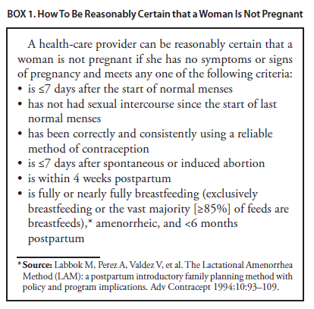
US SPR
Notes:
The US SPR provides highly accurate criteria, shown here, that a provider can review with a patient.
If a woman has no signs or symptoms of pregnancy and meets any one of the criteria, a provider can be reasonably certain that she is not pregnant.
Criteria include… (READ LIST)

Slide 28
Evidence on Pregnancy Checklist (PC)
Study, year, country | # Women | Positive preg test | Sensitivity of PC | Specificity of PC | PPV of PC | NPV of PC
Stanback, 1999, Kenya | 1852 | 1% | 64% | 89% | 6% | 99%
Stanback, 2006, Kenya | 1852 (without signs/sx) | 1% | 55% | 90% | 6% | 99%
Stanback, 2008, Nicaragua | 263 | 1% | 100% | 60% | 3% | 100%
Torpey, 2010, Africa | 535 HIV+ | 4% | 90.9% | 38.7% | 6% | 99%
Stanback, Lancet, 1999;354:566.
Stanback, J Fam Plann Reprod Health Care, 2006;32:27.
Stanback, Rev Panam Salud Publica, 2008;23:116.
Torpey, BMC Public Health, 2010;10:249.
Notes:
Several studies have been conducted comparing the negative predictive value of this criteria with a pregnancy test.
These studies all showed a negative predictive value of 99% or 100%.
This means of the 100 who had a negative result according to the pregnancy checklist, 99 to 100 of them were not pregnant according to a pregnancy test.
This indicates that this pregnancy checklist criteria can be used to accurately rule out pregnancy and safely start contraception.
Currently there are no published studies in the US but there is no reason to think it would be any different than the situations in these studies.

Slide 29
Clinical scenario 2:
How to be reasonably certain that a woman is not pregnant
24 y.o. female comes to office desiring contraception and wants to start pills
  Q: How can you be reasonably certain she is not pregnant?
  A: If she has no signs or symptoms of pregnancy and fulfills one of criteria, a provider can be reasonably certain that the woman is not pregnant.
Notes:
The recommendation therefore states that if a woman has no signs or symptoms of pregnancy and fulfills one of the criteria, a provider can be reasonably certain that the woman is not pregnant.
Routine pregnancy testing for every woman is not necessary.

Slide 30
Clinical scenario 3:
Exams and tests
24 y.o. female comes to office desiring contraception and wants to start pills
  Q: Do you need to do any exams or
    tests before she starts?
Notes:
Are there other tests to consider or exams that need to be done before providing her with pills?

Slide 31
US SPR
Exams and tests prior to initiation
Unnecessary tests may be barrier to starting
  Women (adolescents) may not be comfortable with pelvic exam
  Coming back for a second (or more) visit to receive test results
Recommendations address exams and tests needed prior to initiation
  Class A = essential and mandatory
  Class B = contributes substantially to safe and effective use, but implementation may be considered within the public health and/or service context
  Class C = does not contribute substantially to safe and effective use of the contraceptive method
Notes:
This question addresses other barriers to initiating contraception
A pelvic exam itself may be a barrier to women getting contraception, especially adolescents, if they are not willing to participate in the exam
Waiting for test results may be another barrier that delays contraceptive use
The US SPR provides recommendations that address exams and tests needed prior to starting a woman on a method
These recommendations are categorized into 3 classes:
Class A are essential and mandatory for a given method
Class B exams and tests contribute substantially to safe and effective use, but implementation may be considered within the public health and/or service context
Finally, Class C does not contribute substantially to safe and effective use of the method

Slide 32
US SPR
Exams and tests prior to initiation
Examination or test | Contraceptive method and class
Examination | LNG and Cu-IUD | Implant | Injectable | CHC | POP | Condom | Diaphragm or cervical cap | Spermicide
Blood pressure | C | C | C | A* | C | C | C | C
Weight (BMI) | — † | —† | —† | —† | —† | C | C | C
Clinical breast examination | C | C | C | C | C | C | C | C
Bimanual examination and cervical inspection | A | C | C | C | C | C | A | C
Laboratory test
Glucose | C | C | C | C | C | C | C | C
Lipids | C | C | C | C | C | C | C | C
Liver enzymes | C | C | C | C | C | C | C | C
Hemoglobin | C | C | C | C | C | C | C | C
Thrombogenic mutations | C | C | C | C | C | C | C | C
Cervical cytology (Papanicolaou smear) | C | C | C | C | C | C | C | C
STD screening with laboratory tests | —§ | C | C | C | C | C | C | C
HIV screening with laboratory tests | C | C | C | C | C | C | C | C
Notes:
This slide replicates the summary chart in the US SPR for all contraceptive methods and commonly performed screening exams and tests

Slide 33
US SPR
Exams and tests prior to initiation
Examination or test | Contraceptive method and class
Examination | LNG and Cu-IUD | Implant | Injectable | CHC | POP | Condom | Diaphragm or cervical cap | Spermicide
Blood pressure | C | C | C | A* | C | C | C | C
Weight (BMI) | — † | —† | —† | —† | —† | C | C | C
Clinical breast examination | C | C | C | C | C | C | C | C
Bimanual examination and cervical inspection | A | C | C | C | C | C | A | C
Laboratory test
Glucose | C | C | C | C | C | C | C | C
Lipids | C | C | C | C | C | C | C | C
Liver enzymes | C | C | C | C | C | C | C | C
Hemoglobin | C | C | C | C | C | C | C | C
Thrombogenic mutations | C | C | C | C | C | C | C | C
Cervical cytology (Papanicolaou smear) | C | C | C | C | C | C | C | C
STD screening with laboratory tests | —§ | C | C | C | C | C | C | C
HIV screening with laboratory tests | C | C | C | C | C | C | C | C
Notes:
This slide replicates the summary chart in the US SPR for all contraceptive methods and commonly performed screening exams and tests

Slide 34
Evidence: BP measurement
6 case-control studies
  Women who did not have blood pressure check prior to COC initiation had higher odds of acute myocardial infarction and ischemic stroke than women who had blood pressure check
  No increased risk for hemorrhagic stroke based on whether or not blood pressure measured
No evidence identified on other hormonal methods
Tepper, Contraception, 2012.
Notes:
The evidence behind this recommendation is based on 6 case-control studies discussed in a systematic review by Tepper et al
These studies showed that women who did not have a blood pressure check prior to initiating COCs had higher odds of acute MI and ischemic stroke than women who had their blood pressure checked. There was no increased odds of hemorrhagic stroke
No evidence was identified for other hormonal methods and blood pressure measurement

Slide 35
US SPR
Exams and tests prior to initiation
Examination or test | Contraceptive method and class
Examination | LNG and Cu-IUD | Implant | Injectable | CHC | POP | Condom | Diaphragm or cervical cap | Spermicide
Blood pressure | C | C | C | A* | C | C | C | C
Weight (BMI) | — † | —† | —† | —† | —† | C | C | C
Clinical breast examination | C | C | C | C | C | C | C | C
Bimanual examination and cervical inspection | A | C | C | C | C | C | A | C
Laboratory test
Glucose | C | C | C | C | C | C | C | C
Lipids | C | C | C | C | C | C | C | C
Liver enzymes | C | C | C | C | C | C | C | C
Hemoglobin | C | C | C | C | C | C | C | C
Thrombogenic mutations | C | C | C | C | C | C | C | C
Cervical cytology (Papanicolaou smear) | C | C | C | C | C | C | C | C
STD screening with laboratory tests | —§ | C | C | C | C | C | C | C
HIV screening with laboratory tests | C | C | C | C | C | C | C | C
Notes:
There are also the categories highlighted here which address body weight for hormonal methods and IUDs, as well as STD screening prior to IUD placement
For CHC initiation, the recommendation for checking weight is “Obese women generally can use combined hormonal contraceptives (U.S. MEC); therefore, screening for obesity is not necessary for the safe initiation of combined hormonal contraceptives. However, measuring weight and calculating BMI at baseline might be helpful for monitoring any changes and counseling women who might be concerned about weight change perceived to be associated with their contraceptive method .”
For IUD use, the US SPR recommendation states that most women do not require additional STD screening at the time of IUD insertion if they have already been screened according to CDC’s STD Treatment Guidelines
Those who have not be screened can be screened at time of IUD placement and insertion should not be delayed for test results unless at a very high individual likelihood of STD exposure

Slide 36

Clinical scenario 3:
Exams and tests
24 y.o. female comes to office desiring contraception and wants to start pills
  Q: Do you need to do any exams or tests before she starts?
  A: Blood pressure measurement essential
Notes:
Thus the recommendation is that blood pressure measurement should be obtained and evaluated before a woman starts combined hormonal contraceptives, including pills

Slide 37

Pelvic Exam before Initiating CHCs
Is not necessary before starting CHCs
No concerning conditions will be detected by pelvic
Evidence:
  Two case-control studies
  Delayed versus immediate pelvic exam before contraception
Tepper Contraception 2013
Notes:
Pelvic examination is not necessary before initiation of combined hormonal contraceptives because it does not facilitate detection of conditions for which hormonal contraceptives would be unsafe
Women with certain conditions such as current breast cancer, severe hypertension or vascular disease, heart disease, migraine headaches with aura, and certain liver diseases, as well as women aged ≥35 years who smoke ≥15 cigarettes per day, should not use or generally should not use combined hormonal contraceptives (US MEC recommendations);
However, none of these conditions are likely to be detected by pelvic examination
A systematic review examined two case-control studies comparing delayed and immediate pelvic examination before initiation of oral contraceptives or DMPA
No differences in risk factors for cervical neoplasia, incidence of STDs, incidence of abnormal Papanicolaou smears, or incidence of abnormal wet mounts were found

Slide 38

Clinical scenario 4:
Management of IUD in woman with PID
26 y.o. female has been using a copper-IUD for 6 months. She is now diagnosed with Pelvic Inflammatory Disease (PID).
  Q: Does her IUD need to be removed?
Notes:
Now we have a 26yo female who has been using a copper IUD for the last 6 months. You diagnose PID at her visit
Does her IUD need to be removed?

Slide 39
Clinical scenario 4:
Management of IUD in woman with PID
Evidence
  3 RCTs and one cohort study, copper-IUD or non-hormonal IUD
  Compared PID outcomes among women who had the IUD removed compared with those who retained IUD
  Overall, similar outcomes between groups
    3 studies found that women with IUD removal had no difference in clinical or lab outcomes
    2 of these showed women with IUD removal had longer hospitalization times
    1 study found that women with IUD removal experienced improved recovery in clinical signs of PID
Tepper et al., Contraception 2013.
Notes:
The evidence tells us that there are similar outcomes between women who have their IUD removed compared with those who retain the IUD after PID diagnosis
This comes from 3 randomized controlled trials and one cohort study
3 studies found that women who had their IUD removed had no difference in clinical or lab outcomes over the course of PID
2 studies showed women with IUD removal had longer hospitalization times compared with those who kept the IUD
1 study showed those that had their IUD removed experienced improved recovery in clinical signs of PID compared with those who kept the IUD

Slide 40
US SPR Recommendation
Treat the PID according to the CDC STD Treatment Guidelines.
Provide comprehensive management for STDs, including counseling about condom use.
The IUD does not need to be removed immediately
Reassess in 48-72 hours
If not improvement, continue antibiotics and consider IUD removal
If woman does not want to keep the IUD, remove it after antibiotic treatment has been started.
If the IUD is removed, consider using emergency contraceptive pills and counsel on alternative methods
US Selected Practice Recommendations, 2013.
http://www.cdc.gov/std/treatment
Notes:
The recommendations of the US SPR include:
Treat the PID according to CDC STD Treatment Guidelines
Provide comprehensive STD management including counseling about condom use
The IUD does not need to be removed if the woman does not want it removed
If she does want removal, do so after antibiotics have been started
If she wants to keep the IUD, reassess after 48-72 hours of antibiotics
If there has been no improvement, consider removal and also consider emergency contraceptive pills and discuss alternatives

Slide 41
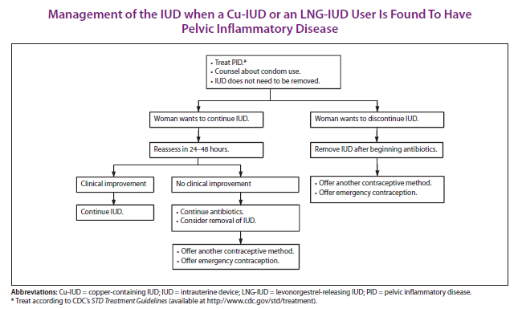

Slide 42

Clinical scenario 4:
Management of IUD in woman with PID
26 y.o. female has been using a copper-IUD for 6 months. She has been diagnosed with PID.
  Q: Does her IUD need to be removed?
  A: No, unless she wants it removed or if infection does not resolve.
Notes:
So her IUD does not need to be removed unless that is what she wants or if her infection does not resolve

Slide 43

Clinical scenario 5:
When to stop contracepting
46 y.o. female with a history of hypertension has been using progestin-only pills and wants to know when she can stop her contraception.
  Q: When can a woman stop contracepting?
Notes:
The next scenario addresses when a woman can stop contracepting in her life
A 46 year-old female with a history of hypertension has been using her progestin-only pills and wants to know when she can stop?

Slide 44
Evidence
There are no reliable tests to confirm a woman’s definitive loss of fertility
FSH levels may not be accurate
The median age of menopause is approximately 51 years in North America with a range of 40-60 years
Hillard, American College of Obstetricians and Gynecologists, 2007.
The North American Menopause Society, 2010.
TeVelde, Hum Reprod Update, 2002.
Notes:
There are no reliable tests to confirm that a woman is no longer fertile and thus no longer needs contraception
Checking FSH levels may not be an accurate measure of fertility loss
While the median age of menopause is 51 in North America, this age ranges between 40 and 60 years

Slide 45
Clinical scenario 5:
When to stop contracepting
46 y.o. female with a history of hypertension has been using progestin-only pills and wants to know when she can stop her contraception.
  Q: When can a woman stop contracepting?
  A: Contraceptive protection is still needed in women older than 44 years of age, if the woman wishes to avoid pregnancy.
US Selected Practice Recommendations, 2013.
Notes:
Contraception is still needed in women until menopause if the woman wishes to avoid pregnancy
Providers should consider the risks of becoming pregnant in a woman of advanced reproductive age as well as any risks of continuing contraception until menopause.

Slide 46

Clinical scenario 6:
When to rely on Female Sterilization
A 38 y.o. obese female with three prior cesarean deliveries has completed childbearing and decided she wants hysteroscopic sterilization to replace her DMPA.
  Q: When can she rely on
  her sterilization for
  contraception?
Notes:
For the next scenario, we have a 38 year old female with three prior cesarean deliveries
She has completed childbearing and wants hysteroscopic sterilization to replace the DMPA she has been using
How long after her procedure can she rely on her sterilization for contraception?

Slide 47
Evidence
Most pregnancies after hysteroscopic sterilization occurred when there was deviation from FDA directions:
  Early follicular phase placement
  Imaging at three months
  Effective alternative contraception until documented occlusion
Hysterosalpingogram confirmation necessary for contraceptive reliance
Very few pregnancies occurred among women with confirmed bilateral occlusion
Cleary et al, Contraception 2012.
Notes:
Most pregnancies following hysteroscopic sterilization occur when there is deviation from FDA directions. These directions include:
placement during the early follicular phase, imaging at three months and use of effective alternative contraception until documented occlusion
Hysterosalpingogram (HSG) confirmation is necessary to document bilateral occlusion before contraceptive reliance
Very few pregnancies occurred after documented bilateral occlusion

Slide 48
Clinical scenario 6:
When to rely on Female Sterilization
A 38 y.o. obese female with three prior cesarean deliveries has completed childbearing and decided she wants hysteroscopic sterilization to replace her DMPA.
  Q: When can she rely on her sterilization for contraception?
            A: She can rely on her hysteroscopic sterilization when hysterosalpingogram at 3 months confirms bilateral tubal occlusion. Continue DMPA till then.
Notes:
This patient can rely on her sterilization once an HSG at 3 months confirms bilateral tubal occlusion
She should continue her DMPA or another effective alternative contraceptive method until then.

Slide 49

Clinical scenario 7:
What if a woman has menstrual abnormalities using CHCs
28 y.o. female has been using continuous combined OCPs for the last 6 months but has had persistent spotting for the last month.
  Q: What can she do if she wants treatment?
Notes:
Clinical scenario 7 is a 28 year old female who has continuously been taking combined pills for the last 6 months. One month ago she started spotting and the spotting has been persistent
What can she do if she wants treatment for the spotting?

Slide 50
Evidence
Anticipatory counseling decreases method discontinuation from bleeding irregularities with DMPA
Hormone-free Interval (HFI) of 3-4 days improves bleeding after 2 weeks
Doxycycline has not been shown to improve bleeding
Notes:
Studies have shown that anticipatory counseling alerting future users that they will have irregular bleeding actually decreases discontinuation with DMPA use
This evidence can be used to support anticipatory counseling with other forms of hormonal contraception
Studies also show that introducing a hormonal free interval (HFI) can cause an initial increase in flow, followed by an abrupt decrease 7-8d later with eventual cessation of flow 11-12d later
A 5 day course of doxycycline has not been shown to improve bleeding

Slide 51
Clinical scenario 7:
What if a woman has menstrual abnormalities using CHCs
28 y.o. female has been using continuous oral contraceptive pills (OCPs) but has had persistent spotting for the last month.
  Q: What can she do if she wants treatment?
  A:
    Emphasize importance of correct use and timing
    Discuss HFI for 3-4 days if taking OCPs >21 days
Notes:
It is therefore recommended that providers emphasize the importance of correct use and timing of pills since inconsistent pill taking can lead to bleeding irregularities
Providers can also discuss introducing an HFI by stopping pills for 3-4 days. This can be discussed as long as the patient has already taken more than 21 pills since starting the method

Slide 52

Clinical scenario 8 :
Emergency Contraception
38 y.o. obese female had unprotected intercourse 4 days ago and is worried about pregnancy.
  Q: What are her emergency contraception options?
Notes:
Our next scenario addresses the use of Emergency Contraception
Here, we have a 38 year old obese female who had unprotected intercourse 4 days ago and is worried about pregnancy. She calls your office and wants to know what her options for EC are.

Slide 53
Four options for EC available in the US
Intrauterine device
  copper intrauterine device (Cu-IUD)
Emergency contraceptive pills (ECPs)
  ulipristal acetate (UPA) available in a single dose (30 mg)
  levonorgestrel (LNG) in a single dose combined
  estrogen/progestin in 2 doses
Notes:
Currently there are four options for emergency contraception or EC in the US
The copper Intrauterine device and three types of emergency contraceptive pills or ECPs
The three types of pills include ulipristal acetate or UPA, levonorgestrel or LNG as well as combined estrogen and progestin oral contraceptive pills

Slide 54
SPR Recommendation on Effectiveness
Large systematic review of 42 studies showed that the pregnancy rate among emergency IUD users is 0.09%
UPA and LNG ECPs have similar effectiveness when taken within 3 days after unprotected intercourse
  UPA has been shown to be more effective than the LNG formulation between 3 and 5 days after unprotected intercourse.
UPA may be more effective than LNG for women who are obese.
The combined estrogen/progestin regimen is less effective than UPA or LNG and is associated with more frequent side effects
Notes:
Since these options are not all the same, how can you help her choose the best option for her?
The evidence shows that Copper IUDs are highly effective as emergency contraception and can be continued as regular contraception if that is what she desires and she is willing to come in for a visit to have the IUD inserted
UPA and LNG have similar effectiveness when taken within 3 days after unprotected intercourse while UPA may be more effective between days 3 and 5 after unprotected sex
UPA may also be more effective than LNG for women who are obese according to one study
The combined regimen also known as Yuzpe method is less effective than the other two ECPs and is associated with more frequent side effects, particularly nausea and vomiting

Slide 55
Clinical scenario 8 :
Emergency Contraception
38 y.o. obese female had unprotected intercourse 4 days ago and is worried about pregnancy.
  Q: What are her emergency contraception options?
  A:
    Copper IUD
    Ulipristal acetate
    Levonorgestrel ECPs
    Combination estrogen/progestin pills
Notes:
This patient therefore has four options assuming she has no conditions or characteristics (such as being a smoker) that would effect her eligibility for combined hormonal methods

Slide 56
Clinical scenario 8 :
Initiation of regular contraception after emergency contraception pills
38 y.o. obese female had unprotected intercourse 4 days ago and is worried about pregnancy. She has chosen to take UPA
  Q: When can she start regular contraception after ECPs?
Notes:
If she decides to take ulipristal acetate, when can she start regular contraception after taking the pills?

Slide 57
Evidence
Data limited to expert opinion and product labeling.
Theoretical concerns for decreased effectiveness of systemic hormonal contraception after UPA use.
The resumption or initiation of regular hormonal contraception following ECP use involves consideration of the risk of pregnancy if ECPs fail.
Notes:
A systematic review conducted for the US SPR searched for articles concerning the resumption or initiation of contraception within the same cycle as ECP use
No articles met inclusion criteria, thus data for presentation at the US SPR expert meeting was limited to product labeling and the recommendation also is limited to expert opinion
The theoretical concern for decreased effectiveness of systemic hormonal contraception when initiated after UPA use was raised.
The risk of pregnancy if ECPs fail was also considered

Slide 58
US SPR Recommendation:
When to initiate regular contraception after emergency contraception pills
Any regular contraceptive method can be started immediately after the use of ECPs.
Advise the woman to have a pregnancy test, if she does not have a withdrawal bleed within 3 weeks.
UPA
  The woman will need to abstain from sex or use barrier contraception for 14 days or her next menses, whichever comes first.
LNG and combined estrogen/progestin formulations
  The woman will need to abstain from sex or use barrier contraception for 7 days.
Notes:
The recommendation states that any regular contraceptive method can be started immediately after ECP use
If a woman does not have a withdrawal bleed within 3 weeks of ECP use, she should take a pregnancy test
If she uses UPA, given the anti-progestogen action, she needs to abstain or use barrier contraception for 14 days or until her next menses
If she uses LNG or combined pills, she needs to abstain or use barrier contraception for 7 days

Slide 59
Clinical scenario 8 :
Initiation of regular contraception after emergency contraception pills
38 y.o. obese female had unprotected intercourse 4 days ago and is worried about pregnancy.
  Q: When can she start regular contraception after ECPs?
  A: She can start contraception immediately but she will need to abstain from sex or use barrier contraception for 7 days if she uses LNG or 14 days if she uses UPA or until her next menses, whichever comes first.

Slide 60

Clinical scenario 9 :
Delayed Insertion of Vaginal Ring
26 y.o. female calls your nursing line because she is 30 hours late for her vaginal ring reinsertion.
  Q: What should she do?
Notes:
Our final scenario is a 26 year old female who calls at 8am because she just realized she took out her ring the night before last when she had sex and she didn’t replace it. What should she do?

Slide 61
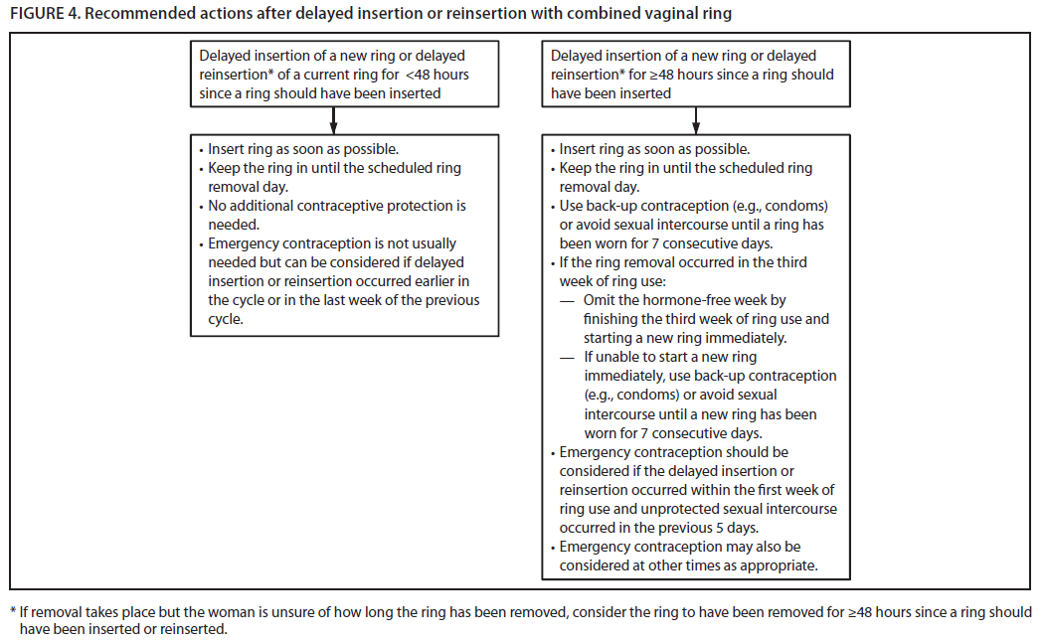
Recommended Actions after Delayed Insertion/Reinsertion with Ring
Notes:
Algorithms for late or missed pills, delayed application or detachment of patch and delayed insertion/reinsertion with combined vaginal ring are available in the US SPR and can be printed for quick reference

Slide 62
Delayed Insertion or Reinsertion of Vaginal Ring up to 48 hours
Insert ring as soon as possible
Keep the ring in until the scheduled ring removal day
No additional contraceptive protection is needed
Emergency contraception (EC) is not usually needed, but can be considered if delayed insertion or reinsertion occurred earlier in the cycle or in the last week of the previous cycle.
Notes:
First she should insert a ring as soon as possible. Either the same ring or a new ring
She should keep that ring in place until her scheduled ring removal day
Since the ring was out between 24 and less than 48 hours, she does not need additional contraceptive protection.
In studies examining the combined vaginal ring, 1) three studies found that nondeliberate extension of the hormone-free interval for >24–48 hours from the scheduled period did not increase the risk for pregnancy
Finally, emergency contraception (EC) is not usually needed but can be considered if this usage error occurred earlier in the cycle or in the last week of the previous cycle

Slide 63
Provider tools and learning aids
Summary tables and clinical algorithms
E-book and other electronic versions
Continuing Education Activities
Speaker-ready slides
Contraceptive Effectiveness Chart
Notes:
Tools and learning aids that are currently being developed include:
Summary tables of US SPR recommendations and clinical algorithms, some have been shown during this presentation
E-book and other electronic versions
Continuing education activities
Speaker-ready slides including this set to use at any time
And the Contraceptive Effectiveness Chart to aide in teaching or counseling

Slide 64
Continuing Education http://www.cdc.gov/mmwr/
Notes:
The continuing education activity is available via the MMWR website which can be found by searching MMWR from the CDC index
Or by going directly to http://www.cdc.gov/mmwr/
Under the left panel there is a Continuing Education tab with Weekly Publications underneath; on this page are current available courses for CE
There you can also find a link to http://www.cdc.gov/TCEOnline and instructions how to access the activity

Slide 65
Take Home Messages
Most women can start most methods anytime
Few, if any, exams or tests are needed
Recommendations for anticipatory counseling for potential bleeding problems and proper management provided
Routine follow-up generally not required
Many circumstances call for consideration of emergency contraception use
Regular contraception should be started after EC
Notes:
Most women can start most methods of contraception anytime (including on the day of the visit), as long as the provider is reasonably certain that the woman is not pregnant.
Few, if any, examinations or tests are needed before starting a contraceptive method.
Bleeding problems are a major reason for contraceptive discontinuation; recommendations on anticipatory counseling before starting a method and management of bleeding problems are provided.
Women should be advised to return at any time to discuss side effects or other problems, if they want to change the method being used, and when it is time to remove or replace the contraceptive method. Otherwise, routine follow-up is generally not required.
Many options for emergency contraception are available, including the copper-IUD and different formulations of pills, and there are many circumstances tor which EC use should be considered. Regular contraception should be started after emergency contraceptive use.

Slide 66
Why the US SPR is important
Evidence-based guidance
Quality family planning care
Help individuals use methods correctly and consistently
Decrease medical barriers to contraceptive use
Notes:
Let’s conclude by emphasizing why the US SPR is so important:
There are increasing numbers of safe and effective contraceptive choices to reduce the risk for unintended pregnancy. and therefore a need for evidence-based guidance to help providers offer quality family planning care to their patients
The US SPR provides evidence-based recommendations that aim to remove barriers so that patients may access methods quickly without unnecessary delays and so that individuals may use these methods correctly and consistently

Slide 67
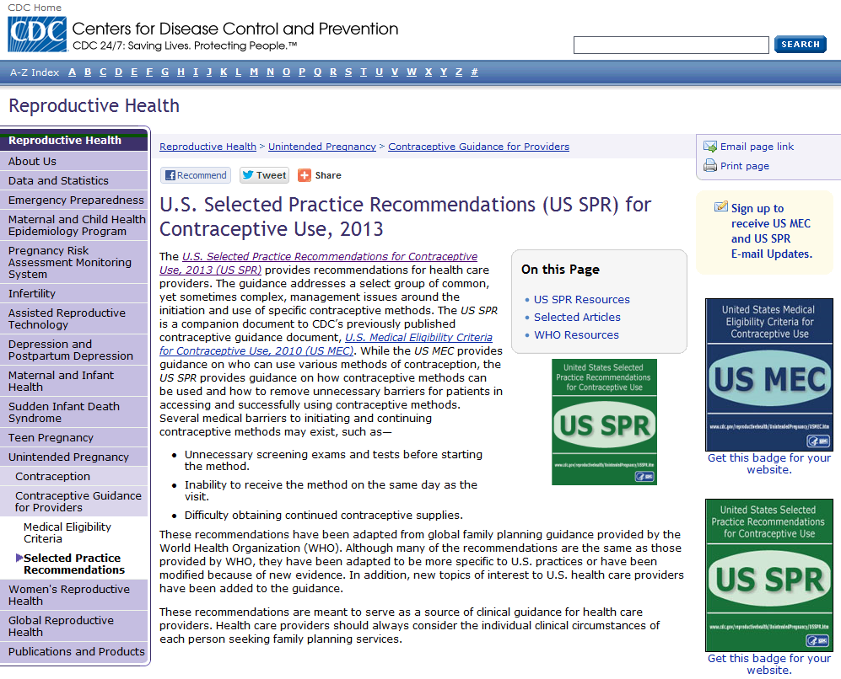
http://www.cdc.gov/reproductivehealth/unintendedpregnancy/USSPR.htm
National Center for Chronic Disease Prevention and Health Promotion
Division of Reproductive Health

