Slide 1
Contraception Resources from the CDC: 2016 U.S. Selected Practice Recommendations for Contraceptive Use
Division of Reproductive Health
Centers for Disease Control and Prevention
National Center for Chronic Disease Prevention and Health Promotion
Division of Reproductive Health

Slide 2
Disclaimer
The findings and conclusions in this report are those of the author and do not necessarily represent the official position of the Centers for Disease Control and Prevention

Slide 3
Objectives
Describe the U.S. Selected Practice Recommendations for Contraceptive Use, 2016 (U.S. SPR)
Identify intended use and target audience
Explain how to use the U.S. SPR
Discuss the guidance in specific situations, based on clinical scenarios
Notes:
This presentation will review:
The US Selected Practice Recommendations for Contraceptive Use
The intended use and target audience for these guidelines
Strategies that you can use to incorporate CDC contraceptive guidelines into every day practice to improve the quality of family planning care.

Slide 4
U.S. Selected Practice Recommendations for Contraceptive Use, 2016
Recommendations for contraceptive management questions
Target audience: health care providers
Purpose: to assist health care providers when they counsel patients on contraceptive use and to serve as a source of clinical guidance
Content: Guidance for common contraceptive management topics such as:
How to be reasonably certain that a woman is not pregnant
When to start contraception
Medically indicated exams and tests
Follow-up and management of problems
Notes:
US Selected Practice Recommendations for Contraceptive Use is an evidence-based source of clinical guidance which answers common contraceptive management questions.
The US SPR is arranged by contraceptive method and is sub-divided into recommendations such as how to start a method, whether backup is needed, how to manage side effects or missed doses, etc.
The guidance is provided both within the text document and summarized in user-friendly charts to guide providers on how to counsel patients for all methods.
The US SPR, like the title states, consists of selected recommendations. It is not a comprehensive textbook, it does not provide rigid guidelines or step-by-step protocols for contraceptive visits nor does it provide recommendations for well-woman care.

Slide 5
Methods for 2016 U.S. SPR
Adapted from WHO guidelines
On-going monitoring of published evidence
Expert meeting in August 2014 to discuss scope
Expert meeting in August 2015 to review evidence and discuss specific recommendations
CDC staff and outside authors conducted independent systematic reviews to inform recommendations
These systematic reviews have been e-published
CDC determined final recommendations
Notes:
The US Medical Eligibility Criteria (MEC) and US SPR are companion documents
Both were adapted from the World Health Organization for the US context.
The CDC and WHO use an automated system to continuously monitor newly published evidence on relevant contraception topics. Topics with new evidence that was inconsistent with current recommendations were selected for guideline updates at a meeting of subject matter experts in 2014; in addition, new topics were also considered. Over the next year, CDC and outside staff conducted systematic reviews of the evidence for these topics. These reviews were presented and discussed at a second meeting of national experts on family planning and reproductive health in 2015, with subject matter experts present for discussion of each medical condition. The CDC then finalized recommendations for the 2016 updates.

Slide 6
Why is evidence-based guidance for contraceptive use needed?
To base family planning practices on the best available evidence
To address misconceptions regarding who can safely use contraception
To remove unnecessary medical barriers
To improve access and quality of care in family planning
Notes:
Prior to the development of the WHO and CDC guidelines, most contraceptive guides around the world were based on medical textbooks or on the individual clinical practice of the author.
They also generally addressed contraceptive use for healthy women, with the result that in many places around the world including the US, women with medical conditions were denied access to contraceptive methods.
CDC and WHO wanted to develop guidelines that were based on the best available evidence, that would address misconceptions regarding who can safely use contraception, and remove unnecessary medical barriers, thereby improving access and quality of care in family planning.
CDC’s contraception guidelines including the US SPR and the US Medical Eligibility Criteria for Contraceptive Use have been endorsed by American College of Obstetricians and Gynecologists and the North American Society for pediatric and adolescent gynecology

Slide 8
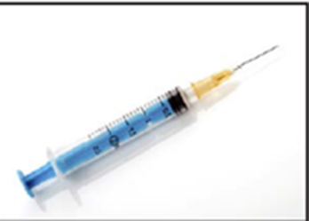
Contraceptive Methods in US SPR
Intrauterine devices
Progestin-only contraceptives
Combined hormonal contraceptives
Emergency contraception
Fertility Awareness-Based Methods
Female and Male Sterilization
Notes:
The US SPR contains recommendations regarding a range of contraceptive methods listed here
Intrauterine devices including copper and levonorgestrel IUDs
Progestin-only contraceptives include progestin-only pills, depo medroxyprogesterone acetate injections and etonogestrel implants.
Combined hormonal contraceptives (contain estrogen and a progestin) include combined pills, patch and ring.
Emergency contraceptive pills include levonorgestrel, ulipristal acetate and combined oral contraceptive pills.
Fertility Awareness-Based Methods such as the standard days methods.
And also sterilization.

Slide 9
Notes:
This chart depicts the effectiveness of contraceptive methods. The US MEC and SPR are organized according to contraceptive effectiveness, with the most effective reversible methods (IUDs and implants) listed first, followed by moderately effective methods (injection, combined hormonal methods) and less effective methods (barrier methods).

Slide 10
Major Updates to 2016 U.S. SPR
New recommendation
Using medications to ease IUD insertion
Update of existing recommendation
When to start regular contraception after ulipristal acetate
Notes:
There are two new major recommendations in the SPR in 2016. These include recommendations on the use of medication to ease IUD insertion, and updated guidance on when to start regular contraception after taking ulipristal acetate for emergency contraception. Both of these updates are addressed later in the presentation.

Slide 11
CLINICAL SCENARIOS
Notes:
To demonstrate how the guidance can be used, we will now go through several clinical scenarios for which the guidance may be useful.

Slide 12
Clinical scenario 1: When to start a contraceptive method
24 y.o. woman comes to office desiring contraception and wants to start pills
Q: When can she start?
Notes:
For the first scenario, we have a 24 y.o. woman who comes to office desiring contraception. She wants to start pills. How soon can she start taking them?

Slide 13
When to start a contraceptive method
Barriers to starting
Filling a prescription
Starting during menses
Coming back for a second (or more) visit
Starting when woman requests contraception (“Quick start”)
May reduce time woman is at risk for pregnancy
May reduce barriers to starting
Notes:
There are several barriers to initiating contraception which increases the time a woman is at risk for unintended pregnancy.
Some examples of these barriers are the need to fill a prescription, to wait for next menses to start the method or to come back for another visit.
Quick start is the start of a contraceptive method when a woman requests it rather than waiting.
Quick start may reduce the time a woman is at risk for pregnancy and may reduce barriers to starting a method.

Slide 14
Evidence for Risk of Pregnancy
Two types of risk:
Risk of already being pregnant
Risk that woman already pregnant with “Quick start” of CHCs low
Risk of becoming pregnant
Risk of pregnancy with “Quick start” of CHCs low
Brahmi, Contraception, 2013.
Notes:
Providers may have concerns that a woman may already be pregnant and therefore may not want to start her on contraception right away.
A recent systematic review shows that the risk of pregnancy with Quick Start of combined hormonal contraceptives is low and that the risk that a woman is already pregnant using the Quick Start method is also low.

Slide 15
Other findings
Starting CHCs on different days of the cycle does not affect bleeding or other side effects
“Quick start” may increase continuation of combined oral contraceptives (COCs) and patch in the short term; this difference disappears over time
No increased risk for adverse outcomes (congenital anomalies, neonatal death, infant death) among infants exposed in utero to COCs
Brahmi, Contraception, 2013.
Bracken, Obstet Gynecol. 1990;76:552-7.
Notes:
Another concern may be that starting CHCs on days of the cycle not consistent with menses may cause irregular bleeding; however studies from the same systematic review have shown that starting on different days of the cycle does not affect bleeding changes or other side effects.
Quick start may increase short term continuation of both COCs and the patch, however this difference disappeared over time in studies comparing quick start to other initiation.
Another concern is risk of fetal exposure to hormonal contraception in early pregnancy.
In several studies examining fetal exposure to COCs, there has been no increased risk for adverse outcomes among infants.

Slide 16
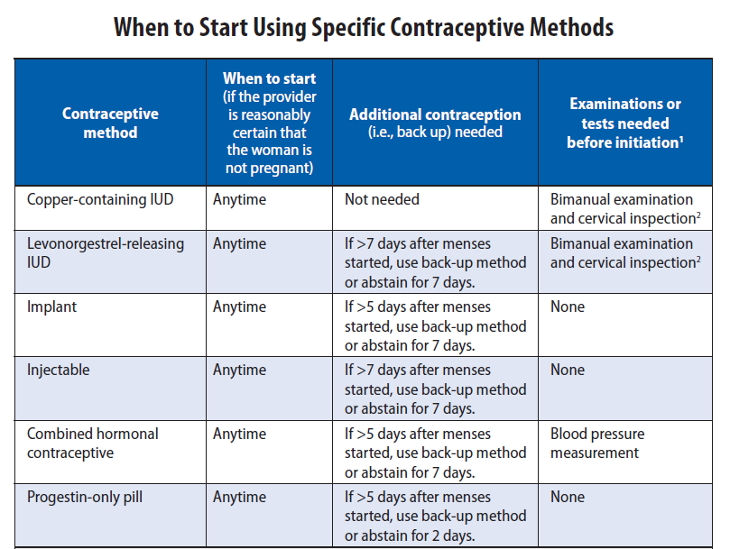
Example: U.S. SPR
Notes:
This chart summarizes SPR recommendations for initiating contraception. As you can see, all methods of contraception can be started at any time, if the provider is reasonably certain the woman is not pregnant. To ensure that she not get pregnant once the method is started, she should use appropriate backup for the recommended time period to prevent a new unintended pregnancy.

Slide 17
Clinical scenario 1: When to start a contraceptive method ?
24 y.o. female comes to office desiring contraception and wants to start pills
Q: When can she start?
A:
Anytime, if reasonably certain she is not pregnant.
If it has been more than 5 days since menstrual bleeding started, she will need to abstain from sex or use additional contraceptive protection for the next 7 days
Notes:
To answer this question, the recommendation for pills and for all methods is a woman can start a method anytime, if a provider can be reasonably certain she is not pregnant.
If it has been more than 5 days since menstrual bleeding started, she will need to abstain from sex or use additional contraception for the next 7 days after starting her combined pills.

Slide 18
Clinical scenario 2: How to be reasonably certain that a woman is not pregnant
24 y.o. female comes to office desiring contraception and wants to start pills
Q: How can you be reasonably
certain she is not pregnant?
Notes:
For the next question, we want to know how we can be reasonably certain she is not pregnant.

Slide 19
Evidence: Pregnancy test limitations
Pregnancy detection rates can vary based on sensitivity of test and timing with respect to missed menses
Pregnancy test not able to detect pregnancy resulting from recent intercourse
Pregnancy test may remain positive several weeks after pregnancy ends
Cervinski, Clin Chem Lab Med. 2010;48:935-42.
Cole LA, Expert Rev Mol Diagn. 2009;9:721-47.
Wilcox, JAMA. 2001;286:1759-61.
Korhonen, Clin Chem. 1997;43:2155-63.
Reyes, Am J Obstet Gynecol. 1985;153:486-9.
Steier, Obstet Gynecol. 1984;64:391-4.`
Notes:
Some providers may question whether or not they should do a pregnancy test to rule out pregnancy and may also question if a pregnancy test is enough.
The evidence shows that pregnancy testing does have limitations.
Pregnancy detection rates vary depending on the sensitivity of the test and the timing of testing with respect to missed menses, last intercourse or last pregnancy.
False negatives may occur with recent intercourse while false positives may occur after recent pregnancy.

Slide 20
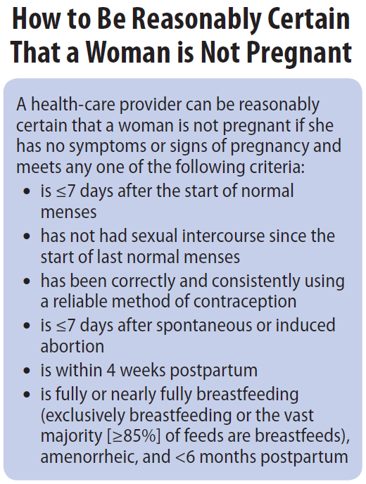
U.S. SPR
Notes:
The US SPR provides highly accurate criteria that a provider can review with a patient to be reasonably certain the patient is not pregnant prior to initiating contraception
If a woman has no signs or symptoms of pregnancy and meets any one of the SPR criteria listed here, a provider can be reasonably certain that she is not pregnant and can quick start contraception.
Several studies have been conducted comparing the negative predictive value of this criteria with a pregnancy test.
These studies all showed a negative predictive value of 99% or 100%.
This means of the 100 who had a negative result according to the pregnancy checklist, 99 to 100 of them were not pregnant according to a pregnancy test.

Slide 21
Clinical scenario 2: How to be reasonably certain that a woman is not pregnant
24 y.o. female comes to office desiring contraception and wants to start pills
Q: How can you be reasonably certain she is not pregnant?
A: If she has no signs or symptoms of pregnancy and fulfills one of the SPR criteria, a provider can be reasonably certain that the woman is not pregnant.
Notes:
The recommendation therefore states that if a woman has no signs or symptoms of pregnancy and fulfills one of the criteria, a provider can be reasonably certain that the woman is not pregnant.
Routine pregnancy testing for every woman is not necessary.

Slide 22
Clinical scenario 3: Exams and tests
24 y.o. female comes to office desiring contraception and wants to start pills
Q: Do you need to do any exams or
tests before she starts?
Notes:
Are there other tests to consider or exams that need to be done before providing her with pills?

Slide 23
U.S. SPR Exams and tests prior to initiation
Unnecessary tests may create barriers to starting contraception
Women (adolescents) may not be comfortable with pelvic exam
Coming back for a second (or more) visit to receive test results
Recommendations address exams and tests needed prior to initiation
Class A = essential and mandatory
Class B = contributes substantially to safe and effective use, but implementation may be considered within the public health and/or service context
Class C = does not contribute substantially to safe and effective use of the contraceptive method
Notes:
The US SPR also provides recommendations that address exams and tests needed prior to starting a woman on a method, as unnecessary tests may create barriers to contraceptive initiation.
For example, a pelvic exam itself may be a barrier to women getting contraception, especially adolescents, if they are not willing to participate in the exam
Waiting for test results may be another barrier that delays contraceptive use
The US SPR provides recommendations that address exams and tests needed prior to starting a woman on a method
These recommendations are categorized into 3 classes:
Class A are essential and mandatory for a given method
Class B exams and tests contribute substantially to safe and effective use, but implementation may be considered within the public health and/or service context
Finally, Class C does not contribute substantially to safe and effective use of the method

Slide 24
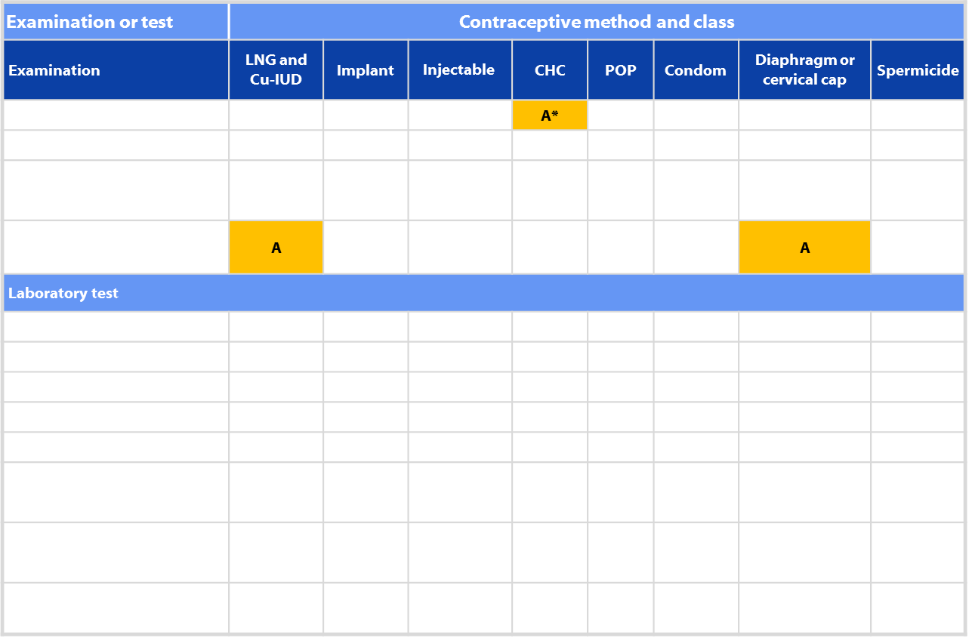
US SPR Exams and tests prior to initiation
Notes:
This is an example of a chart of the recommendations for exams and tests prior to initiation of contraception
Down the left side, you can see a summary of potential exams and tests
Across the top are the various contraceptive methods.
The only A level recommendations (meaning essential and mandatory) are a blood pressure measurement prior to initiation of CHCs, and a bimanual exam and cervical inspection prior to initiation of an IUD or diaphragm. These are highlighted. Most other exams and tests are category C, meaning they do not contribute to safe and effective use of the contraceptive method.

Slide 25
Evidence: BP measurement
6 case-control studies
Women who did not have blood pressure check prior to COC initiation had higher odds of acute myocardial infarction and ischemic stroke than women who had blood pressure check
No increased risk for hemorrhagic stroke based on whether or not blood pressure measured
No evidence identified on other hormonal methods
Tepper, Contraception, 2012.
Notes:
The evidence behind this recommendation is based on 6 case-control studies discussed in a systematic review by Tepper et al
These studies showed that women who did not have a blood pressure check prior to initiating COCs had higher odds of acute MI and ischemic stroke than women who had their blood pressure checked. There was no increased odds of hemorrhagic stroke
No evidence was identified for other hormonal methods and blood pressure measurement

Slide 26
Pelvic Exam before Initiating CHCs
Is not necessary before starting CHCs
No conditions for which CHCs would be unsafe would be detected by pelvic exam
Evidence:
Two case-control studies
Delayed versus immediate pelvic exam before contraception
No difference in risk factors for cervical neoplasia, incidence of STDs, incidence of abnormal Papanicolaou smears, or incidence of abnormal wet mounts.
Tepper Contraception 2013
Notes:
Pelvic examination is not necessary before initiation of combined hormonal contraceptives because it does not facilitate detection of conditions for which hormonal contraceptives would be unsafe
Women with certain conditions such as current breast cancer, severe hypertension or vascular disease, heart disease, migraine headaches with aura, and certain liver diseases, as well as women aged ≥35 years who smoke ≥15 cigarettes per day, should not use or generally should not use combined hormonal contraceptives (US MEC recommendations);
However, none of these conditions are likely to be detected by pelvic examination
A systematic review examined two case-control studies comparing delayed and immediate pelvic examination before initiation of oral contraceptives or DMPA
No differences in risk factors for cervical neoplasia, incidence of STDs, incidence of abnormal Papanicolaou smears, or incidence of abnormal wet mounts were found

Slide 27
Clinical scenario 3: Exams and tests
24 y.o. female comes to office desiring contraception and wants to start pills
Q: Do you need to do any exams or tests before she starts?
A: Blood pressure measurement essential
Notes:
Thus the recommendation is that blood pressure measurement should be obtained and evaluated before a woman starts combined hormonal contraceptives, but other tests are not required before initiating this method.

Slide 28
Clinical scenario 4: Emergency Contraception
38 y.o. obese female had unprotected intercourse 4 days ago and is worried about pregnancy.
Q: What are her emergency contraception options?
Notes:
Our next scenario addresses the use of Emergency Contraception
Here, we have a 38 year old obese female who had unprotected intercourse 4 days ago and is worried about pregnancy. She calls your office and wants to know about her options for emergency contraception.

Slide 29
Four options for EC available in the US
Intrauterine device
Copper intrauterine device (Cu-IUD)
Emergency contraceptive pills (ECPs)
Ulipristal acetate (UPA) available in a single dose (30 mg)
Levonorgestrel (LNG) in a single or split dose
Estrogen/progestin in 2 doses
Notes:
Currently there are four options for emergency contraception or emergency contraception in the US: the copper intrauterine device and three types of emergency contraceptive pills or ECPs
The three types of pills include ulipristal acetate or UPA, levonorgestrel or LNG as well as combined estrogen and progestin oral contraceptive pills

Slide 30
SPR Recommendation on Effectiveness
Large systematic review of 42 studies showed that the pregnancy rate among emergency IUD users is 0.09%
UPA and LNG ECPs have similar effectiveness when taken within 3 days after unprotected intercourse
UPA has been shown to be more effective than the LNG formulation between 3 and 5 days after unprotected intercourse.
UPA may be more effective than LNG for women who are obese.
The combined estrogen/progestin regimen is less effective than UPA or LNG and is associated with more frequent side effects
Cleland K. Hum Reprod 2012;27:1994-2000; Jatlaoui T. Contraception 2016;93:93-112; Jatlaoui T. Contraception 2016;94:605-11.
Notes:
Since these options are not all the same, how can you help her choose the best option for her?
The evidence shows that Copper IUDs are highly effective as emergency contraception and can be continued as regular contraception if that is what she desires and she is willing to come in for a visit to have the IUD inserted
For pills, UPA and LNG have similar effectiveness when taken within 3 days after unprotected intercourse while UPA may be more effective between days 3 and 5 after unprotected sex
UPA may also be more effective than LNG for women who are obese according to one study
The combined regimen also known as Yuzpe method is less effective than the other two ECPs and is associated with more frequent side effects, particularly nausea and vomiting

Slide 31
Clinical scenario 4: Emergency Contraception
38 y.o. obese female had unprotected intercourse 4 days ago and is worried about pregnancy.
Q: What are her emergency contraception options?
A:
Copper IUD
Ulipristal acetate
Levonorgestrel ECPs
Combination estrogen/progestin pills
Notes:
This patient therefore has four options for emergency contraception – there are no conditions for which she cannot take emergency contraceptive pills; for emergency IUD use, she needs to meet the eligibility criteria for regular IUD insertion.

Slide 32
Clinical scenario 5: Initiation of regular contraception after emergency contraception pills
38 y.o. obese female had unprotected intercourse 4 days ago and is worried about pregnancy. She has chosen to take UPA.
Q: When can she start regular contraception contraception after ECPs?
Notes:
If she decides to take ulipristal acetate, when can she start regular contraception after taking the pills?

Slide 33
Evidence
Data limited to pharmacodynamics data and expert opinion.
One pharmacodynamics study raised concern for decreased effectiveness of UPA if hormonal contraception was started the next day.
Cameron et al, Human Reproduction, 2015
Brache et al, Human Reproduction, 2015
Salcedo et al, Contraception, 2013
Notes:
Resuming regular contraception after emergency contraceptive pills (ECPs) requires consideration of the risk for pregnancy if ECPs fail and the risk of unintended pregnancy if contraception initiation is delayed until the next menstrual cycle.
There is no concern with starting or resuming hormonal contraception concurrently with estrogen or progestin ECPs because these methods do not contain an anti-progestin and have not been shown to have negative effects on an early pregnancy.
Data on when to start contraception after UPA ECPs is limited to pharmacodyamic data and expert opinion.
One pharmacodynamics study raised concern for decreased effectiveness of UPA if hormonal contraception was started the next day, specifically, less ovulation suppression.

Slide 34
US SPR Recommendation: When to initiate regular contraception after ECPs
Levonorgestrel or combined ECPs:
Any regular contraceptive method can be started immediately
Abstain from intercourse or use backup for 7 days
UPA ECPs:
Resume or start hormonal contraception no sooner than five days after UPA
Non-hormonal contraception can be started immediately
Abstain from intercourse or use backup for 7 days after starting contraception
Advise the woman to have a pregnancy test, if she does not have a withdrawal bleed within 3 weeks.
Notes:
Therefore, after levonorgestrel or combined ECPs, any regular contraceptive method can be started immediately. The woman should abstain from intercourse or use backup for 7 days, and take a pregnancy test if she does not have a withdrawal bleed within three weeks
For women using UPA, she should resume or start hormonal contraception no sooner than five days after UPA due to possible concerns of decreased effectiveness of UPA if hormonal contraception is started sooner. This may require a repeat visit depending on her method choice.
Non-hormonal contraception can be started immediately
Abstain from intercourse or use backup for 7 days after starting contraception

Slide 35
Clinical scenario 5: Initiation of regular contraception after emergency contraception pills
38 y.o. obese female had unprotected intercourse 4 days ago and is worried about pregnancy. She has chosen to take UPA.
Q: When can she start regular contraception after UPA?
A: She can resume hormonal contraception five days after taking UPA. She will need to abstain or use backup for 7 days after resuming contraception, or until next menses, whichever comes first.
Notes:
For this patient, she can resume hormonal contraception five days after taking UPA. She will need to abstain or use backup for 7 days after resuming contraception, or until next menses, whichever comes first.

Slide 36
Clinical scenario 4: Medications to ease IUD insertion
A 19 year old nulliparous woman desires a levonorgestrel IUD.
Q: Should any medications be administered before IUD insertion?
Notes:
For our last scenario, we have a 19 year old nulliparous woman desiring a levonorgestrel IUD. She heard that insertion may be painful.
Should any medications be administered before IUD insertion to ease the insertion process?

Slide 37
Evidence
Misoprostol is not recommended for routine use before IUD insertion.
A total of 10 randomized trials suggest that misoprostol does not improve ease of insertion, reduce the need for adjunctive insertion measures or improve insertion success
Misoprostol might increase patient pain and side effects
Paracervical block with lidocaine might reduce pain during IUD insertion.
Limited evidence on NSAIDs and nitric oxide generally suggests no positive effect
Lopez et al. Cochrane Database Sys Rev 2015
Zapata et al. Contraception 2016
Notes:
A recent systematic review including 10 randomized trials concluded that misoprostol does not improve ease of insertion, reduce the need for adjunctive insertion measures or improve insertion success
It also may be associated with increased pain and side effects, particularly GI side effects
Routine use of misoprostol is not recommended prior to IUD insertion.
Misoprostol may be helpful in select situations, such as women with a recent failed insertion.
Paracervical block with lidocaine might reduce pain with IUD insertion.
Evidence was insufficient to make recommendations on the routine use of NSAIDs or nitric oxide prior to IUD insertion.

Slide 38
Clinical scenario 4: Medications to ease IUD insertion
A 19 year old nulliparous woman desires a levonorgestrel IUD.
Q: Should any medications be administered before attempting insertion?
A: No adjunctive medications are needed
Notes:
Based on this evidence, the US SPR does not recommend the use of adjunctive medications to ease IUD insertion as no intervention has been shown to ease insertion or reduce patient pain. You can therefore proceed with IUD placement without premedication.

Slide 39
Take Home Messages, U.S. SPR
U.S. SPR can help providers decrease medical barriers to initiating and using contraception
Most women can start most methods anytime
Few, if any, exams or tests are needed
Routine follow-up generally not required
Regular contraception should be started after emergency contraception
Recommendations for anticipatory counseling for potential bleeding problems and proper management are provided
Notes:
In conclusion, the U.S. SPR can help providers decrease medical barriers to initiating and using contraception.
Most women can start most methods of contraception anytime (including on the day of the visit), as long as the provider is reasonably certain that the woman is not pregnant.
Few, if any, examinations or tests are needed before starting a contraceptive method.
Women should be advised to return at any time to discuss side effects or other problems, if they want to change the method being used, and when it is time to remove or replace the contraceptive method. Otherwise, routine follow-up is generally not required.
Many options for emergency contraception are available, including the copper-IUD and different formulations of pills, and there are many circumstances for which EC use should be considered. Regular contraception should be started after emergency contraceptive use.
Bleeding problems are a major reason for contraceptive discontinuation; recommendations on anticipatory counseling before starting a method and management of bleeding problems are provided.

Slide 40
Notes:
The US SPR has a companion document: the US Medical Eligibility Criteria for Contraceptive Use. This document was also updated in 2016 and includes evidence-based guidance on the safe use of contraceptive methods by women and men with various medical conditions or characteristics.

Slide 41
U.S. Medical Eligibility Criteria for Contraceptive Use, 2016
Safe use of contraceptive methods by women and men with certain characteristics or medical conditions
Target audience: health care providers
Purpose: to assist health care providers when they counsel patients about contraceptive use and to serve as a source of clinical guidance
Content: more than 1800 recommendations for over 60 conditions
Notes:
The US Medical eligibility criteria or MEC is an evidence-based source of clinical guidance for the safe use of contraceptive methods by women and men with various characteristics and medical conditions.
It is intended to assist health-care providers when they counsel women, men, and couples about contraceptive method choice.
The US MEC includes over 1800 recommendations for more than 60 conditions and characteristics and also includes information on certain drug interactions.

Slide 42
Accessing the MEC and SPR in everyday practice

Slide 43
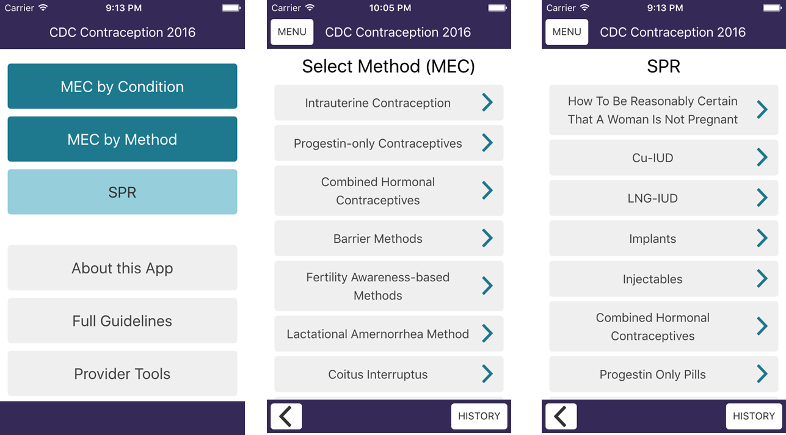
2016 U.S. MEC and SPR App
Notes:
The updated CDC Contraception app for apple and android smart phones and tablets now includes both the MEC and SPR in a user-friendly format, with easy navigation between the two sets of guidance. It also easily links to other CDC guidance such as STD treatment guidelines. This updated app is available for download through our website. Many providers who use smartphones for other clinical references find this to be the easiest way to access the guidelines in everyday practice.

Slide 44
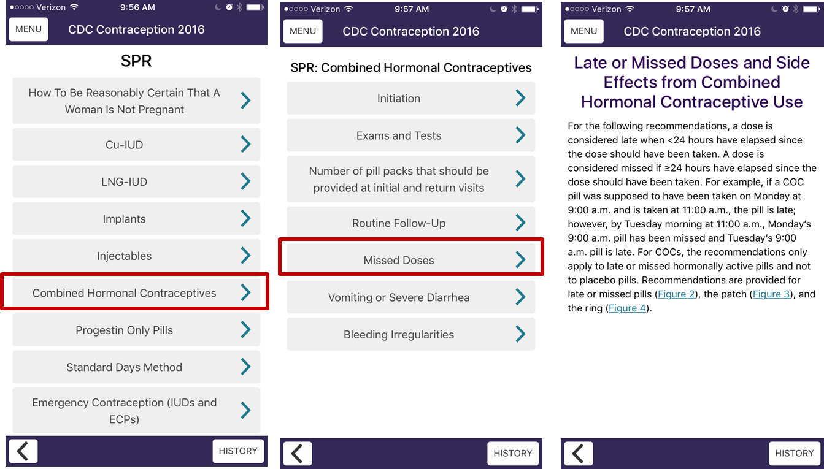
Using the U.S. SPR App
Notes:
These screen shots show an example of how to use the app.
Let’s say we are trying to determine how to counsel a patient who had an early detachment of her contraceptive patch. We first would select the SPR from the main menu, and then select combined hormonal contraceptives.
We can see the various topics for combined hormonal contraceptives on this screen. If we select missed doses, we then see the detailed information on how to manage missed doses of combined hormonal contraceptives. There are also links to flow chart figures for each individual method, like pills, patches or rings.
The app includes a similar click-through approach for the MEC.

Slide 45
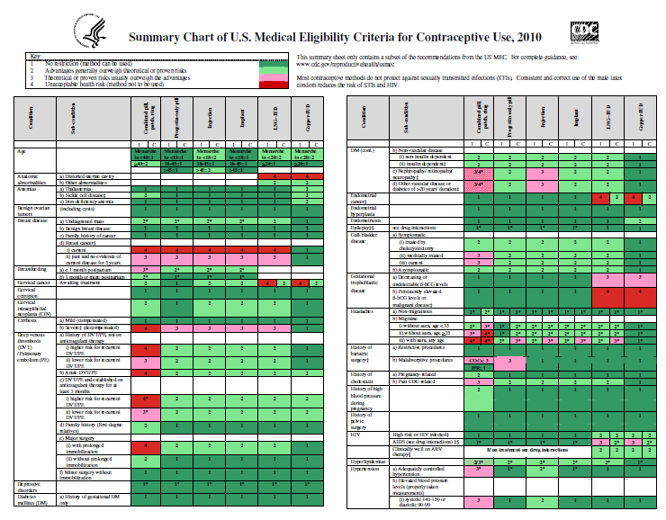
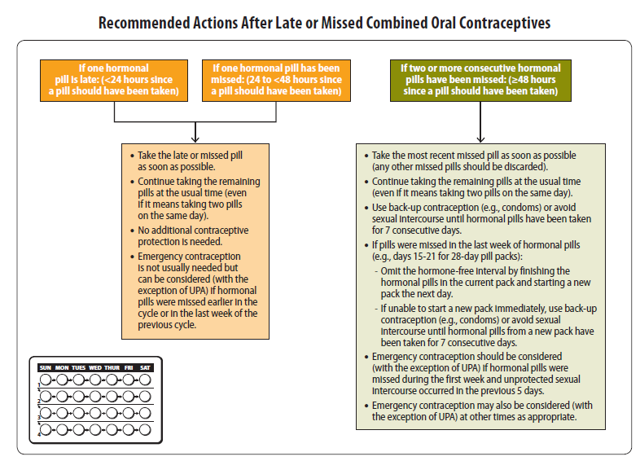
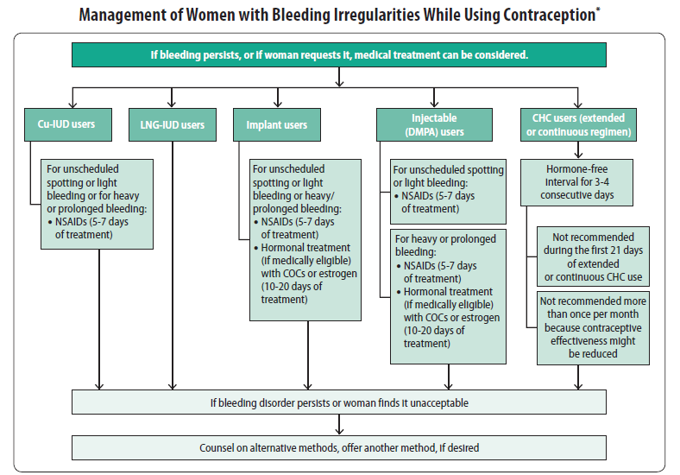
Summary tables and charts
MEC summary table in English, Spanish
SPR quick reference charts
When to start contraceptive methods and routine follow up
What to do for late, missed or delayed combined hormonal contraception
Management of IUD when PID is found
Management of women with bleeding irregularities while using contraception
Notes:
CDC also has printed and laminated summary tables and charts which can be ordered or printed from our website. These include color-coded summary charts for the MEC, and flowcharts with management strategies for the SPR including how to be reasonable certain a women is not pregnant, when to start contraception, how to manage late or missed combined hormonal contraceptive methods, management of an IUD with pelvic inflammatory disease, and management of bleeding irregularities while using contraception. Posting the colorful flowcharts in staff work areas can help to raise awareness and use of the guidelines.

Slide 46
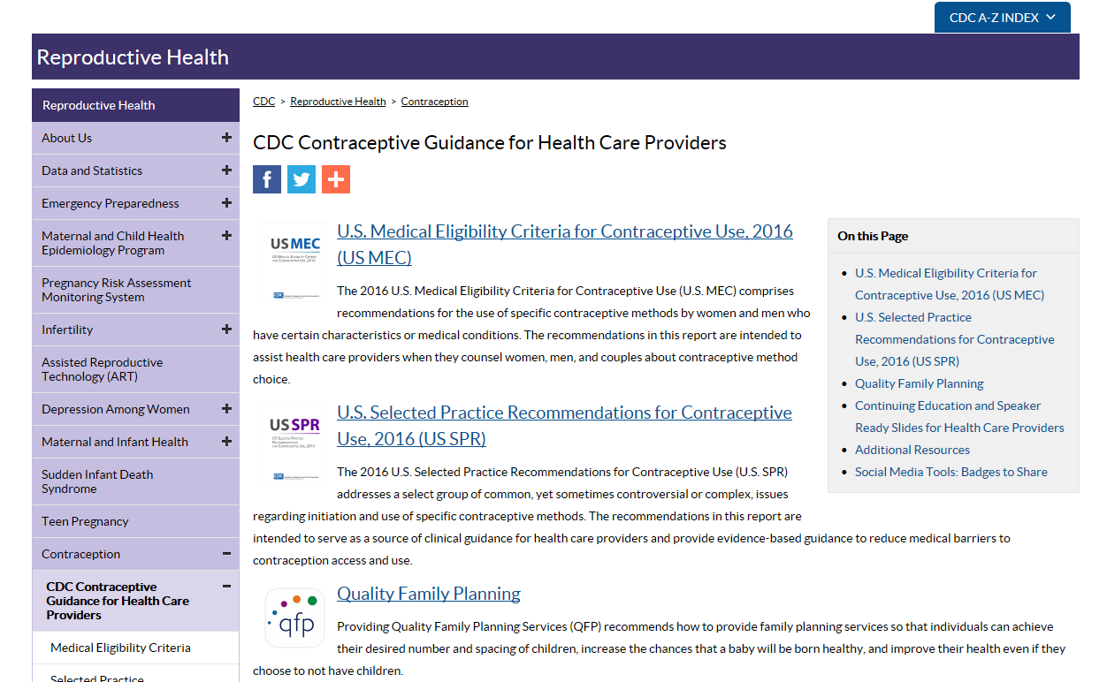
Online access
http://wwwdev.cdc.gov/reproductivehealth/contraception/contraception_guidance.htm
Notes:
The CDC contraception web page for healthcare providers is being updated to include an easy click-through version of the MEC and SPR for providers who prefer to access these resources online.

Slide 47
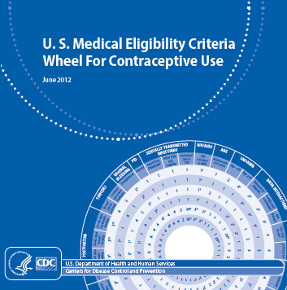
Other Tools and Aids
MEC Wheel
Continuing Education Activities
Speaker-ready slides
Contraceptive Effectiveness Charts
Online alerts to receive updates
eBook for SPR
Residency training and certification
Notes:
Finally, we updated several additional provider tools.
Many providers find the MEC pocket wheel pictured here to be useful. It is available for order on our website.
Several additional educational tools such as pre-made speaker slides, contraception effectiveness charts, and CME approved activities are available on our website.

Slide 48
Resources
CDC evidence-based family planning guidance documents: http://www.cdc.gov/reproductivehealth/contraception/contraception_guidance.htm
Sign up to receive alerts!
Notes:
All of this information, as well as tools and aides for contraceptive guidance can be found on our website.
You can also sign up for email alerts to be up to date with any new guidance updates or new tools released from CDC.

