Slide 1
Contraception Resources from the CDC:
2016 U.S. Medical Eligibility Criteria for Contraceptive Use
Division of Reproductive Health
Centers for Disease Control and Prevention
National Center for Chronic Disease Prevention and Health Promotion
Division of Reproductive Health

Slide 2
Disclaimer
The findings and conclusions in this report are those of the author and do not necessarily represent the official position of the Centers for Disease Control and Prevention

Slide 3
Objectives
Describe the U.S. Medical Eligibility Criteria for Contraceptive Use, 2016 (U.S. MEC)
Identify intended use and target audience
Explain how to use the U.S. MEC
Discuss the guidance in specific situations, based on clinical scenarios
Notes:
This presentation will review:
The US Medical Eligibility Criteria for Contraceptive Use
The intended use and target audience for these guidelines
Strategies that you can use to incorporate CDC contraceptive guidelines into every day practice to improve the quality of family planning care.

Slide 4
U.S. Medical Eligibility Criteria for Contraceptive Use, 2016
Safe use of contraceptive methods by women and men with certain characteristics or medical conditions
Target audience: health care providers
Purpose: to assist health care providers when they counsel patients about contraceptive use and to serve as a source of clinical guidance
Content: more than 1800 recommendations for over 120 conditions and subconditions
Notes:
The US Medical eligibility criteria or MEC is an evidence-based source of clinical guidance for the safe use of contraceptive methods by women and men with various characteristics and medical conditions.
It is intended to assist health-care providers when they counsel women, men, and couples about contraceptive method choice.
The US MEC includes over 1800 recommendations for more than 120 conditions and characteristics and also includes information on certain drug interactions.

Slide 5
Methods for 2016 U.S. MEC
Adapted from WHO guidelines
On-going monitoring of published evidence
Expert meeting in August 2014 to discuss scope
Expert meeting in August 2015 to review evidence and discuss specific recommendations
  CDC staff and outside authors conducted independent systematic reviews to inform recommendations
  These systematic reviews have been e-published
  CDC determined final recommendations
Notes:
The US MEC and US SPR are companion documents
Both were adapted from the World Health Organization for the US context.
The CDC and WHO use an automated system to continuously monitor newly published evidence on relevant contraception topics. Topics with new evidence that was inconsistent with current recommendations were selected for guideline updates at a meeting of subject matter experts in 2014; in addition, new topics were also considered. Over the next year, CDC and outside staff conducted systematic reviews of the evidence for these topics. These reviews were presented and discussed at a second meeting of national experts on family planning and reproductive health in 2015, with subject matter experts present for discussion of each medical condition. The CDC then finalized recommendations for the 2016 updates.

Slide 6
Why is evidence-based guidance for contraceptive use needed?
To base family planning practices on the best available evidence
To address misconceptions regarding who can safely use contraception
To remove unnecessary medical barriers
To improve access and quality of care in family planning
Notes:
Prior to the development of the WHO and CDC guidelines, most contraceptive guides around the world were based on medical textbooks or on the individual clinical practice of the author.
They also generally addressed contraceptive use for healthy women, with the result that in many places around the world including the US, women with medical conditions were denied access to contraceptive methods.
CDC and WHO wanted to develop guidelines that were based on the best available evidence, that would address misconceptions regarding who can safely use contraception, and remove unnecessary medical barriers, thereby improving access and quality of care in family planning.
Both documents have been endorsed by American College of Obstetricians and Gynecologists and the North American Society for pediatric and adolescent gynecology

Slide 7
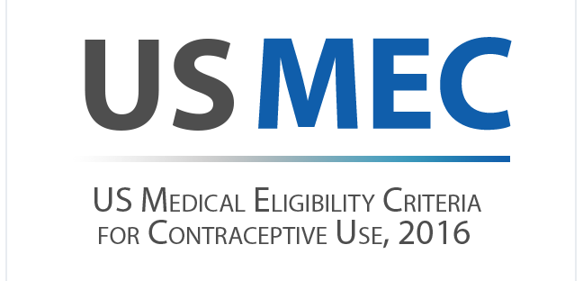

Slide 8
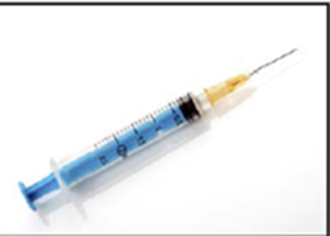


Contraceptive Methods in US MEC
Intrauterine devices
Progestin-only contraceptives
Combined hormonal contraceptives
Emergency contraceptive pills
Barrier contraceptive methods
Fertility Awareness-Based Methods
Lactational Amenorrhea Method
Coitus Interruptus
Female and Male Sterilization
Notes:
The US MEC contains recommendations regarding a full range of contraceptive methods listed here
Intrauterine devices including copper and levonorgestrel IUDs
Progestin-only contraceptives include progestin-only pills, depo medroxyprogesterone acetate injections and etonogestrel implants.
Combined hormonal contraceptives (contain estrogen and a progestin) include combined pills, patch and ring.
Emergency contraceptive pills include levonorgestrel, ulipristal acetate and combined oral contraceptive pills.
Barrier contraceptive methods include male and female condoms, spermicides, diaphragm with spermicide and cervical cap.
Fertility Awareness-Based Methods include symptom-based and calendar-based methods.
And also lactational amenorrhea, withdrawal, and sterilization.
Within the MEC, recommendations for use of contraceptive methods are based on specific preexisting medical conditions or individual characteristics.
Recommendations refer to methods being used for contraception, not for treatment of a medical condition, which may change the risk benefit analysis.

Slide 9
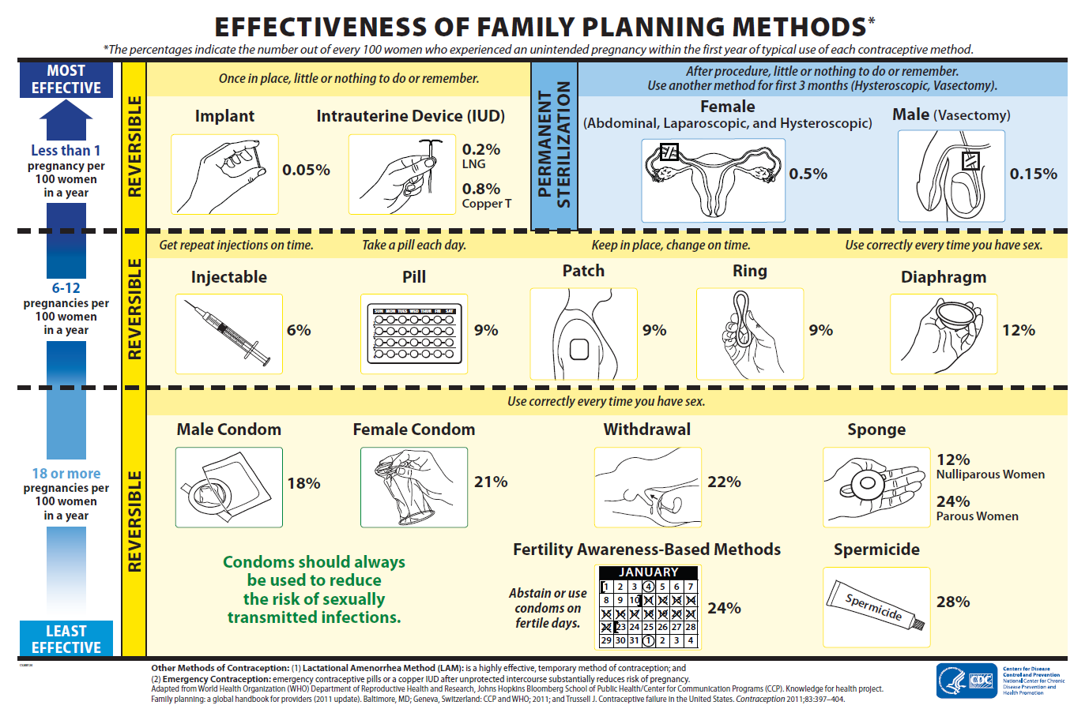
Notes:
This chart depicts the effectiveness of contraceptive methods. The US MEC and SPR are organized according to contraceptive effectiveness, with the most effective reversible methods (IUDs and implants) listed first, followed by moderately effective methods (injection, combined hormonal methods) and less effective methods (barrier methods).

Slide 10
U.S. MEC: Categories
1 | No restriction for the use of the contraceptive method for a woman with that condition
2 | Advantages of using the method generally outweigh the theoretical or proven risks
3 | Theoretical or proven risks of the method usually outweigh the advantages – not usually recommended unless more appropriate methods are not available or acceptable
4 | Unacceptable health risk if the contraceptive method is used by a woman with that condition
Notes:
Within the MEC, each combination of a medical condition with a contraceptive method has a recommendation for use, which is provided as a numeric classification- 1, 2, 3 or 4.
The numbers reflect an increasing degree of theoretical or proven risks for use of a particular contraceptive method for a woman with a particular condition. Category 1 classifications indicate no restriction for use, while category 4 classifications represent unacceptable health risks.
A number 2 means that most evidence suggests that it is generally safe for someone with the particular condition to use a particular method, and that the advantages of using the method generally outweigh the theoretical or proven risks.
A number 3 means that the theoretical or proven risks of the method usually outweigh the benefits of using that method, and other methods should be considered, if possible.
For some conditions, the numeric classification does not entirely capture the recommendation and a clarification statement is given.

Slide 11
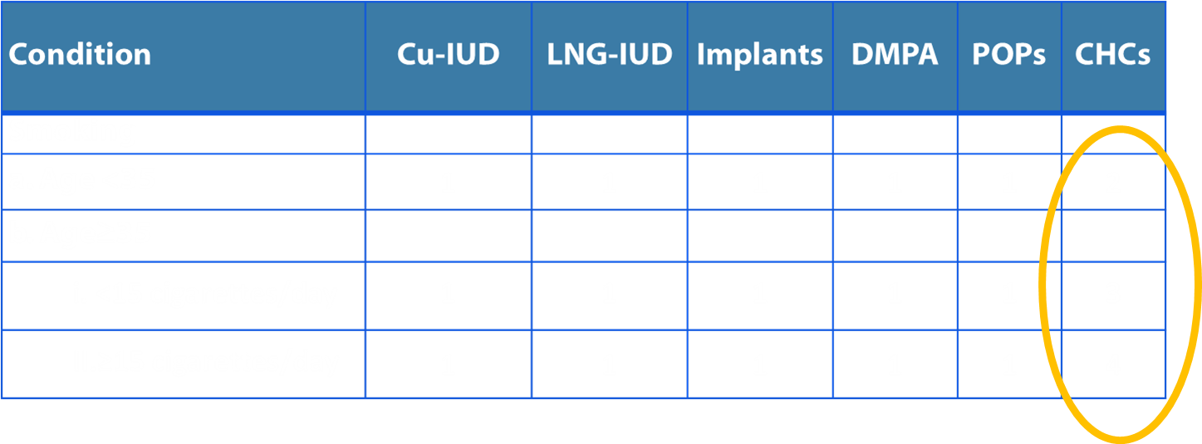
Example: Smoking and Contraceptive Use
Cu IUD: Copper IUD;
LNG-IUD: Levonorgestrel IUD;
DMPA: Depo-Medroxyprogesterone Acetate;
POPs: Progestin-only pills;
CHCs: Combined hormonal contraceptives including pills, patch, and ring
Notes:
This is an example of the recommendations for Smoking and Contraceptive Use.
Down the left side, you can see that smoking is categorized by age and level of smoking.
Across the top are the various contraceptive methods.
For CHCs (combined hormonal contraceptives) which include combined oral contraceptives, the patch and the ring, you can see that the recommendations reflect increasing safety risks with smoking, as age and the level of smoking increases.
A smoker aged <35 years generally can use CHCs (Category 2).For a smoker 35 years or older who smokes <15 cigarettes per day, however, the use of CHCs is usually not recommended unless other methods are not available or acceptable to her (Category 3).
For smokers 35 years or older who smoke 15 or more cigarettes, the use of CHCs poses unacceptable health risks, primarily, the risk for myocardial infarction and stroke (Category 4).

Slide 12
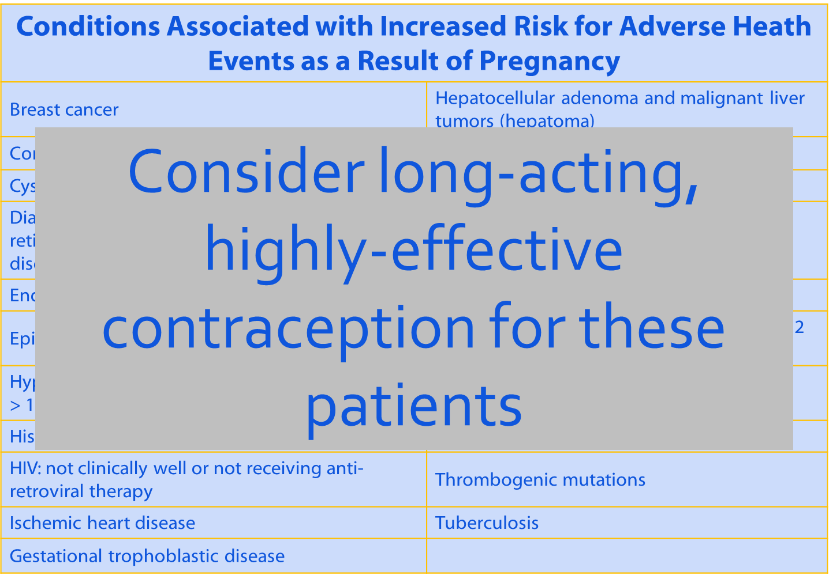
Notes:
The MEC also identifies medical conditions that may be worsened should pregnancy occur. This is a list of such conditions, which are highlighted throughout the document.
For women with these conditions that may make pregnancy an unacceptable health risk, long-acting highly effective contraceptive methods may be the best choice when pregnancy is not desired. (click)
Sole use of barrier and behavior-based methods may not be the most appropriate choice because of their relatively higher typical-use rates of failure.

Slide 13
2016 Updates to U.S. MEC:
New Recommendations
4 new conditions
  Cystic fibrosis
  Multiple sclerosis
  Women using selective serotonin reuptake inhibitors (SSRIs)
  Women using St. John’s wort
1 new emergency contraception method
  Ulipristal acetate (UPA)
Notes:
The 2016 updates to the MEC include four new conditions: Cystic Fibrosis, Multiple Sclerosis, selective serotonin reuptake inhibitors and St John’s wort. It also includes a revised section on emergency contraception including the addition of ulipristal acetate.

Slide 14
2016 Updates to U.S. MEC:
Changes to Existing Recommendations
Hormonal methods (Implants, DMPA, POP, CHCs)
  Migraine headaches
  Superficial venous disease
  Women using antiretroviral therapy
  Women with known dyslipidemia
Intrauterine devices (Cu-IUD, LNG-IUD)
  Gestational trophoblastic disease
  Postpartum and breastfeeding women
  Human immunodeficiency virus
  Factors related to sexually transmitted diseases
Notes:
The updates also include revisions to existing recommendations for women using hormonal methods with migraine headache, superficial venous disease, antiretrovirals, or known dyslipidemias. For IUD users, there are revisions to recommendations on gestational trophoblastic disease, postpartum and breastfeeding women, women with HIV, and factors related to sexually transmitted diseases.

Slide 15
CLINICAL SCENARIOS
Notes:
To further demonstrate how the guidance can be used, we will now go through several clinical scenarios for which the guidance may be useful.

Slide 16

Scenario 1
28 year old G1P0 female is pregnant and being counseled for postpartum family planning. She is not planning on breastfeeding. What options are available to her postpartum?
  A. IUD (copper or levonorgestrel)
  B. Progestin-only methods (pill, injectable, implant)
  C. Combined hormonal methods (pill, patch, ring)
Notes:
First we have a 28 year old gravida 1 para 0 female who is pregnant and being counseled for postpartum family planning. She is not planning on breastfeeding. What options are available to her postpartum?
A. IUD (copper or levonorgestrel)
B. Progestin-only methods (pill, injectable, implant)
C. Combined hormonal methods (pill, patch, ring)

Slide 17
Why is postpartum contraception important?
Avoid unintended pregnancy and short birth interval
May be ideal time to provide contraception
  Motivation
  Access to health care services, especially during delivery hospitalization
Prevent repeat adolescent pregnancies
  20% of adolescent births are repeat births
Vital signs: Repeat births among teens - United States, 2007-2010. MMWR 2013 Apr 5;62(13):249-55.
Notes:
Postpartum contraception is important for many reasons:
It allows for birth spacing and avoiding an unintended pregnancy.
It may be an ideal time to provide contraception while a woman is accessing services and may be motivated to start a contraceptive method.
Postpartum contraception may be particularly important for adolescents. A recent CDC Morbidity and Mortality Weekly Report found that 20% of adolescent births are repeat births, so for teens especially this may be an ideal time to prevent a repeat teen pregnancy.

Slide 18
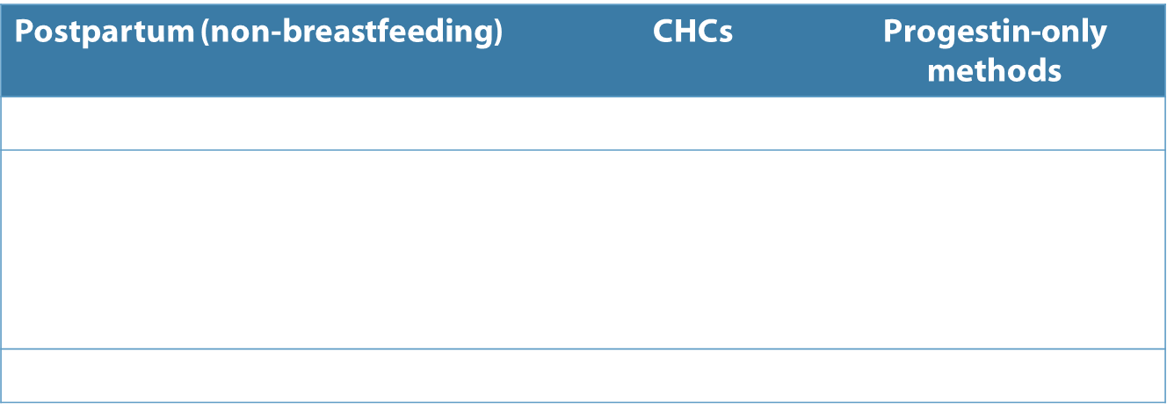
Hormonal methods for non-breastfeeding postpartum women
*Clarification: Other risk factors might increase classification to “4”
Notes:
Because postpartum women are at increased risk of venous thromboembolism (VTE), there is concern that the use of combined hormonal methods (pill, patch and ring) may further increase the risk of VTE.
Therefore combined methods should not be used immediately postpartum, but become an acceptable option outside of the immediate postpartum period when VTE risk returns to baseline. As you can see from the recommendations here, the recommendations decrease in restriction depending on timing from delivery and the woman’s other VTE risk factors.
All progestin-only methods are category 1 at anytime postpartum as these methods are not thought to increase VTE risk.

Slide 19
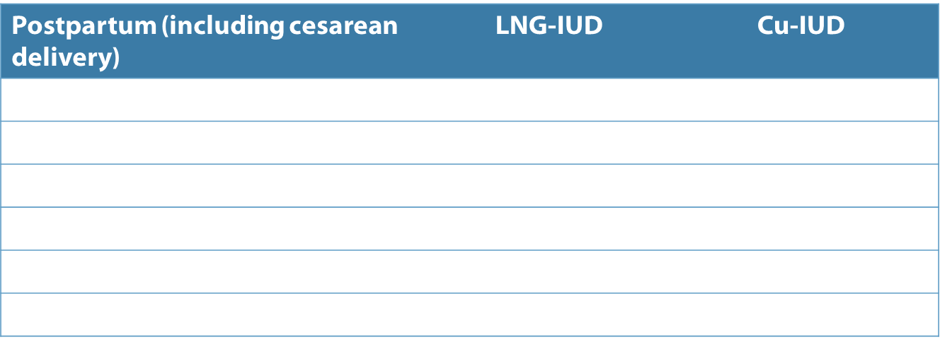
Postpartum IUD insertion
Notes:
The postpartum IUD insertion recommendations include the placement of IUDs in the postpartum period based on timing from delivery.
The timing is separated into immediate placement (within 10 minutes after placental delivery), delayed placement (from 10 minutes to four weeks postpartum) and interval placement (4 weeks or more from delivery)
IUDs can be placed at anytime postpartum, although there may be an increased risk of expulsion if placed less than 4 weeks from delivery.
IUDs should not be placed in women with postpartum sepsis (Category 4).

Slide 20
Scenario 1
28 year old G1P0 female is pregnant and being counseled for postpartum family planning. She is not planning on breastfeeding. What options are available to her immediately postpartum?
  A. IUD (copper or levonorgestrel)
  B. Progestin-only methods (pill, injectable, implant)
  C. Combined hormonal methods (pill, patch, ring)
    (Wait until 21-42 days postpartum, depending on VTE risk factors)
Notes:
So returning to our patient, this woman who is not planning on breastfeeding can have an IUD placed immediately if this option is available in her hospital, or start a progestin only method prior to leaving the hospital.
If she wants a combined hormonal contraceptive, she will need to wait until 21-42 days postpartum, depending on VTE risk factors. However, she can be given the method or a prescription before she leaves the hospital.
If she is planning to breastfeed, please refer to the US MEC recommendations for breastfeeding.

Slide 21

Scenario 2
38 year old G2P2 female with diabetes has been using condoms for contraception and is looking for a more effective method. What methods are safe for her to use?
  A. IUD (copper or levonorgestrel)
  B. Progestin-only methods (pill, injectable, implant)
  C. Combined hormonal methods (pill, patch, ring)
Notes:
Next we have a 38 year old gravida 2 para 2 female with diabetes who has been using condoms for contraception and is looking for a more effective method. What methods are safe for her to use?
A. IUD (copper or levonorgestrel)
B. Progestin-only methods (pill, injectable, implant)
C. Combined hormonal methods (pill, patch, ring)

Slide 22
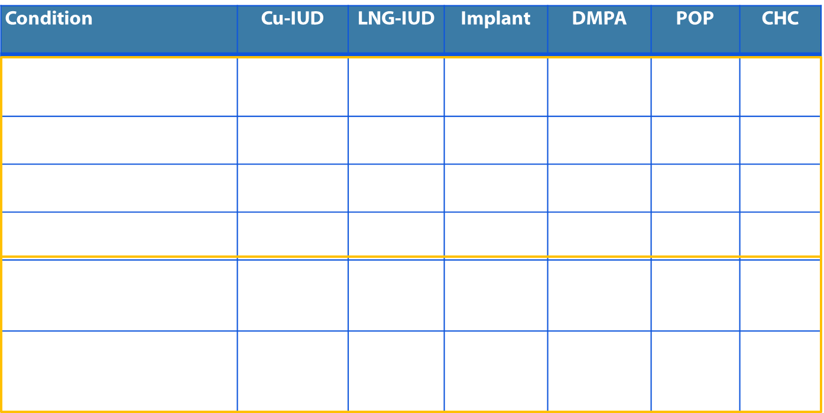
Diabetes
§ This condition is associated with increased risk for adverse health events as a result of pregnancy
† This category should be assessed according to the severity of the condition
Notes:
Recommendations for diabetes depend on the subgroup of diabetes, which have different risks.
For women with a history of gestational diabetes or with nonvascular diabetes, recommendations are based on several studies, and all methods are classified as category 1 or 2.
(click click) By contrast, in the lower portion of the screen we see recommendations for the more severe subgroups of diabetes, including diabetes with nephropathy/retinopathy/neuropathy or other vascular disease or diabetes of >20 years duration.
In review of the literature, no direct evidence was found for contraceptive safety for these more severe forms of diabetes. Most of the decisions for recommendations in these situations were based on:
Extrapolations from studies that primarily included healthy women
Theoretical considerations about risks and benefits
Expert opinion
CDC final recommendations for complicated diabetes subgroups have category 3 recommendations for DMPA and a mixed recommendation of 3/4 for combined hormonal methods according to the severity of the complicated diabetes.
Importantly, these more severe forms of diabetes are conditions that expose a woman to increased risk in pregnancy, which is noted in the MEC by a superscript notation. Effectiveness should be emphasized when discussing method options for conditions with this notation.

Slide 23
Scenario 2
38 year old G2P2 female with diabetes has been using condoms for contraception and is looking for a more effective method. You now know that she is non-insulin dependent and has no vascular disease. What methods are safe for her to use?
  A. IUD (copper or levonorgestrel)
  B. Progestin-only methods (pill, injectable, implant)
  C. Combined hormonal methods (pill, patch, ring)
  ALL OF THE ABOVE
  Discuss risk of adverse events with pregnancy and
  consider highly effective methods
Notes:
While all methods are safe, an unintended pregnancy in a woman with diabetes may have increased risk of adverse events and thus effectiveness should be emphasized when discussing method options.

Slide 24

Scenario 3
A 30 year old female has a history of migraine headaches with light sensitivity. She does not experience any visual warning signs for a coming headache. She is interested in starting contraception. What methods are safe for her to consider?
A. Combined hormonal methods (pill, patch, ring)
B. Progestin implant
C. Intrauterine device
Notes:
Next we have a 30 year old female with a history of migraine headaches with light sensitivity. She does not experience any visual warning signs for a coming headache. She is interested in starting contraception. What methods are safe for her to consider?
24

Slide 25
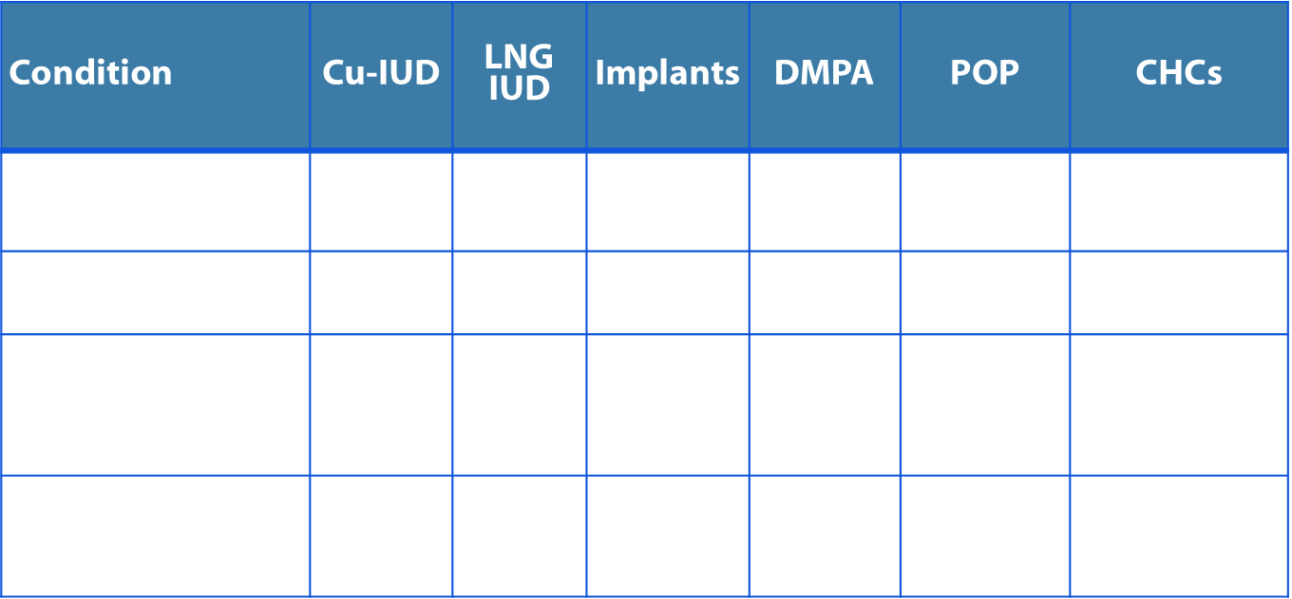
Headaches
* These recommendations rely upon accurate diagnosis of headache as migraine with or without aura. They are intended for women without other risk factors for stroke. Consult full guidance for additional clarification.
Notes:
Recommendations for headache rely on proper classification of headache, particularly with regard to auras. This is important because migraine with aura is associated with an increased risk of stroke while migraine without aura is generally not. According to the International Headache Society Classification System, menstrual associated migraines are considered migraine without aura.
These recommendations also assume women have no other risk factors for stroke (HTN, smoking)
There is theoretical concern that, among women with migraine with aura, use of CHCs would further increase the risk of stroke which is why CHCs are category 4 for those women.
Overall, women with migraine can use any method of contraception, with the exception of CHCs for women with aura.
25

Slide 26
Scenario 3
A 30 year old female has a history of migraine headaches with light sensitivity. She does not experience any visual warning signs for a coming headache. She is interested in starting contraception. What methods are safe for her to consider?
Answer:
A. Combined hormonal methods (pill, patch, ring)
B. Progestin implant
Intrauterine device
All of the above, so long as she does
not have other risk factors for stroke.
(If so, progestin-only methods and IUDs are safe
or generally safe to use.)
Notes:
Therefore, this patient who has migraine but no aura has the option to use any of these methods of contraception, so long as she does not have other risk factors for stroke.
26

Slide 27

Scenario 4:
A19 y.o. woman comes to the office desiring an IUD. She has a history of chlamydia 6 months ago that was treated, and reports one new partner since then.
  Q: Given her STD risk factors, can you place an IUD today?
Notes:
Next, we have a 19 y.o. woman who comes to the office desiring an IUD. She has a history of chlamydia 6 months ago that was treated, and reports one new partner since then. Given her STD risk factors, can you place an IUD today?

Slide 28
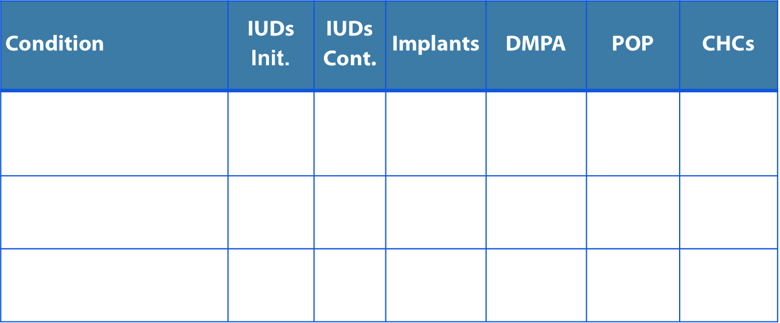
Sexually transmitted diseases
*Clarification: If a woman with risk factors for STDs has not been screened for gonorrhea and chlamydia according to CDC STD treatment guidelines, screening may be performed at the time of IUD insertion and insertion should not be delayed.
Notes:
Categories for sexually transmitted diseases in the 2016 US MEC have been streamlined to include the following: (1) current purulent cervicitis or chlamydial or gonococcal infection, (2) vaginitis including trichomonas vaginalis and bacterial vaginosis, and (3) other factors related to STDs. All methods other than IUDs are category 1 for all STD categories. IUD insertion is category 2 for all STDs except for current purulent cervicitis or known chlamydial/gonococcal infection, which is category 4 (contraindicated).
The category “increased risk of STIs” was removed in the 2016 US MEC. In a systematic review, the CDC found that algorithms based on demographics, history and exam findings have very low predictive value for the diagnosis of gonococcal and chlamydial infection. Instead, if STD screening has not been performed according to CDC STD guidelines at the time of a contraceptive initiation visit, screening can be performed at that time. Provision of contraception, including intrauterine devices (IUDs), should not be delayed or restricted for asymptomatic women at risk for STDs.
28

Slide 29
Scenario 4:
A19 y.o. woman comes to the office desiring an IUD. She has a history of chlamydia 6 months ago that was treated, and reports one new partner since then.
  Q: Can you place an IUD today?
  A: Yes, so long as she does not have purulent cervicitis or other contraindications. Perform screening for gonorrhea/chlamydia at the time of IUD insertion. Refer to the SPR for guidelines on assessment of pregnancy and follow-up.
Notes:
This young woman meets CDC criteria for STD screening based on age and having a new partner. Therefore, we would want to perform a cervical inspection, bimanual exam, and screening for gonorrhea/chlamydial infection at the time of IUD placement. So long as she does not have purulent cervicitis or other contraindications to IUD placement, you can proceed with IUD placement without waiting for the results of screening tests. The US SPR has additional guidelines on assessment of pregnancy and follow-up.

Slide 30

Scenario 5:
A 26 y.o. female who has been using combined oral contraceptives for one year calls you to ask whether it is safe to start taking sertraline for depression.
  Q: What should she do?
Notes:
For the last scenario, we have a 26 year old woman who is a long time user of combined oral contraceptives. She calls wanting to know whether she can start taking sertraline for depression, and whether it might make her birth control less effective.

Slide 31
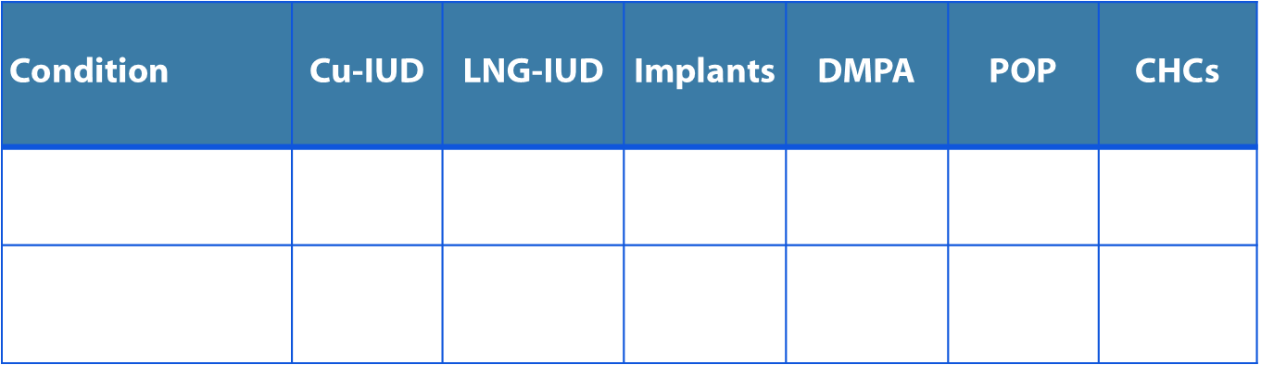
Psychotropic drugs
Notes:
The 2016 MEC includes new drug interaction recommendations for selected serotonin reuptake inhibitors and St. John’s wort.
Based on currently available evidence, a systematic review found no evidence for a drug interaction between SSRIs and hormonal contraceptives. There was no evidence for reduced effect of the contraceptive, the SSRI, or for increased side effects from either drug. Therefore, all methods are category 1 with SSRIs.
A systematic review of St. John’s wort and hormonal contraception found that St John’s wort affected breakthrough bleeding, predictors of ovulation, and pharmacokinetics of estrogen and progestins. Though no studies looked directly at pregnancy outcomes, these findings suggest that St. John’s wort may have the potential to reduce the effectiveness of hormonal contraceptives. Therefore, St. John’s wort is a category 2 for oral contraceptive pills and progestin implants.
31

Slide 32

Scenario 5:
26 y.o. female who has been using combined oral contraceptives for one year calls you to ask whether it is safe to start taking sertraline for depression.
  Q: What should she do?
  A: She can start taking the sertraline and continue her COCs, if she still desires this method of contraception. There is no evidence for increased adverse events or decreased effectiveness for either drug when taken in combination.
Notes:
Returning to this patient, she can start taking the sertraline with her oral contraceptives without concern for decreased contraceptive effectiveness.

Slide 33
Take Home Messages, U.S. MEC
U.S. MEC can help providers decrease barriers to choosing contraceptive methods
Most women can safely use most contraceptive methods
Certain conditions are associated with increased risk for adverse health events as a result of pregnancy
  Affected women may especially benefit from highly effective contraception for family planning
Women, men, and couples should be informed of the full range of methods to decide what will be best for them
Notes:
In summary, the US MEC aims to reduce barriers to contraceptive use, and these evidence based guidelines demonstrate that most women can safely use most contraceptive methods.
Certain conditions are associated with an increased risk for adverse health events in pregnancy, and these women especially need highly effective contraception when not desiring pregnancy.
Women, men, and couples should be informed of the full range of methods to decide what will be best for them

Slide 34
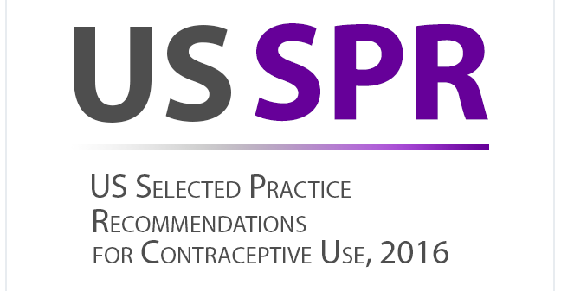
Notes:
The US MEC has a companion document: the US Selected Practice Recommendations for Contraceptive Use. This document was also updated in 2016 and includes evidence-based answers to common contraceptive management questions.

Slide 35
U.S. Selected Practice Recommendations for Contraceptive Use, 2016
Recommendations for contraceptive management questions
Target audience: health care providers
Purpose: to assist health care providers when they counsel patients on contraceptive use and to serve as a source of clinical guidance
Content: Guidance for common contraceptive management topics such as:
  How to be reasonably certain that a woman is not pregnant
  When to start contraception
  Medically indicated exams and tests
  Follow-up and management of problems
Notes:
The US SPR is arranged by contraceptive method and is sub-divided into recommendations such as how to start a method, whether backup is needed, how to manage side effects or missed doses, etc.
The guidance is provided both within the text document and summarized in user-friendly charts to guide providers on how to counsel patients for all methods.
The US SPR, like the title states, consists of selected recommendations. It is not a comprehensive textbook, it does not provide rigid guidelines or step-by-step protocols for contraceptive visits nor does it provide recommendations for well-woman care.

Slide 36
Accessing the MEC and SPR in everyday practice

Slide 37

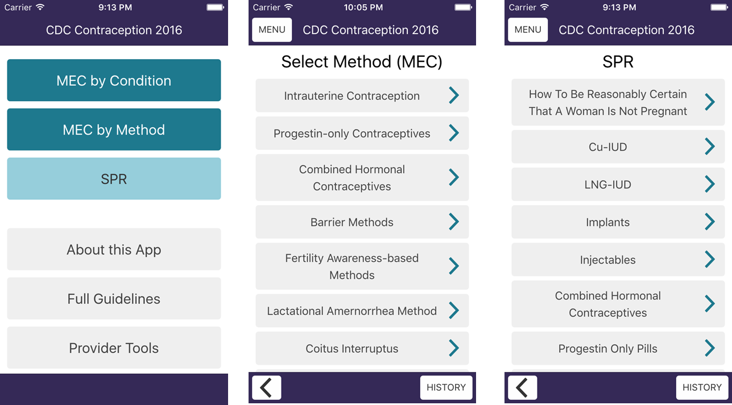
2016 U.S. MEC and SPR App
Notes:
The updated CDC Contraception app for apple and android smart phones and tablets now includes both the MEC and SPR in a user-friendly format, with easy navigation between the two sets of guidance. It also easily links to other CDC guidance such as STD treatment guidelines. This updated app is available for download through our website. Many providers who use smartphones for other clinical references find this to be the easiest way to access the guidelines in everyday practice.

Slide 38
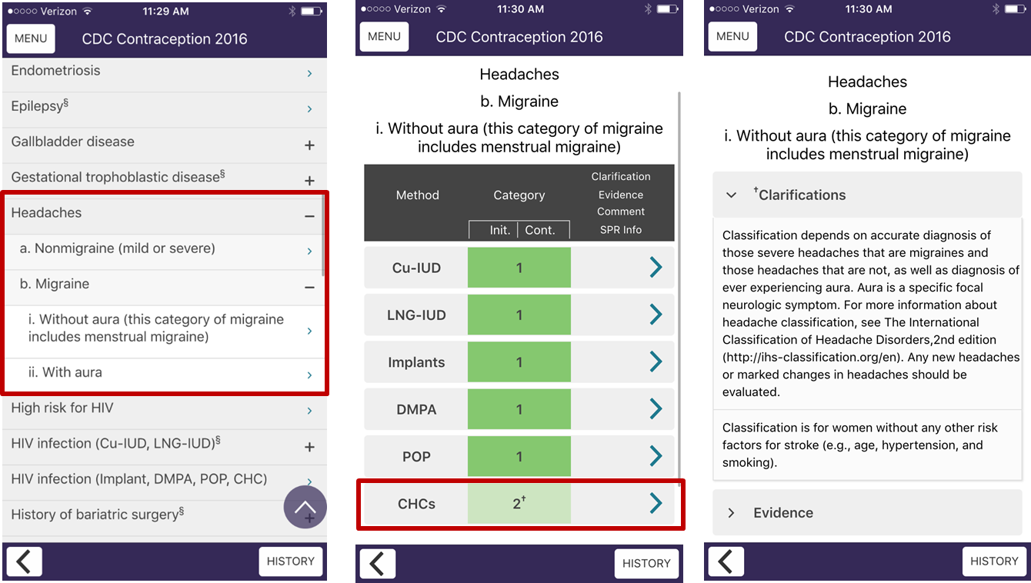
Using the U.S. MEC App
Notes:
These screen shots show an example of how to use the app.
Let’s say we are interested in reviewing guidelines for women with migraine headaches. On the left we see the category headache expanded to reveal the subcategories of nonmigraine, and migraine with and without aura. If we click on migraine without aura, we are redirected to the next screen.
Now we see the recommendations for each method for migraine without aura. For combined hormonal methods, we see they are category 2 with a clarification indicated by the superscript cross. By clicking on this method, we can review the clarification plus any available evidence statements.
The app includes a similar click-through approach for the SPR.

Slide 39
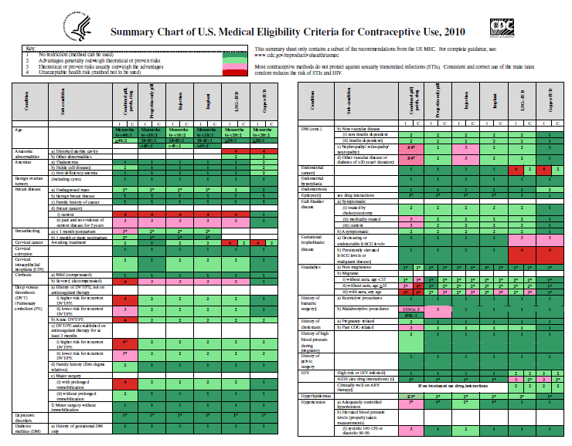
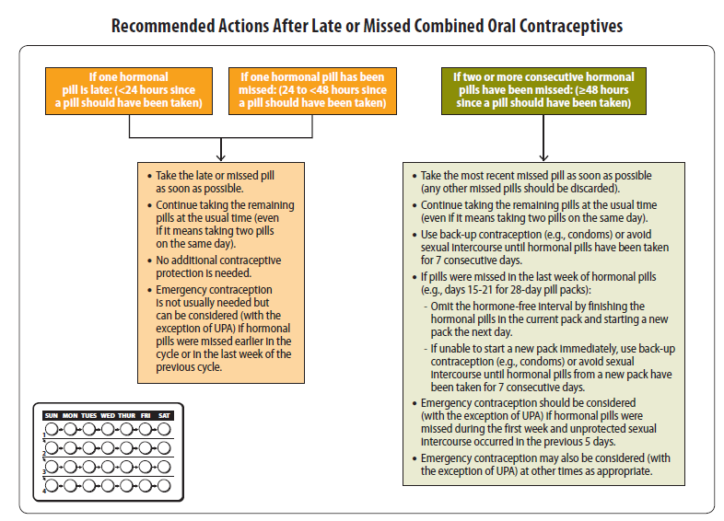
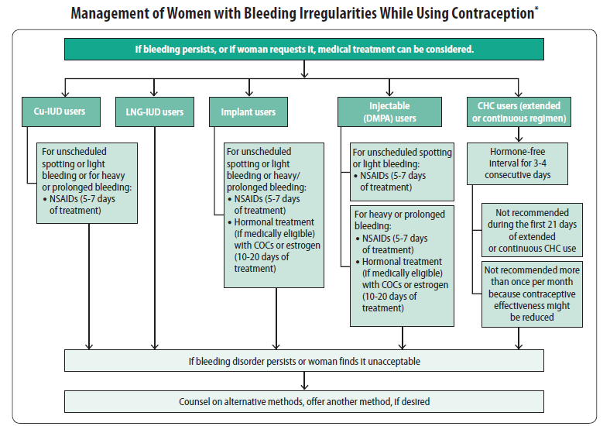
Summary tables and charts
MEC summary table in English, Spanish
SPR quick reference charts
  When to start contraceptive methods and routine follow up
  What to do for late, missed or delayed combined hormonal contraception
  Management of IUD when PID is found
  Management of women with bleeding irregularities while using contraception
Notes:
CDC also has printed and laminated summary tables and charts which can be ordered or printed from our website. These include color-coded summary charts for the MEC, and flowcharts with management strategies for the SPR including how to be reasonable certain a women is not pregnant, when to start contraception, how to manage late or missed combined hormonal contraceptive methods, management of an IUD with pelvic inflammatory disease, and management of bleeding irregularities while using contraception. Posting the colorful flowcharts in staff work areas can help to raise awareness and use of the guidelines.

Slide 40
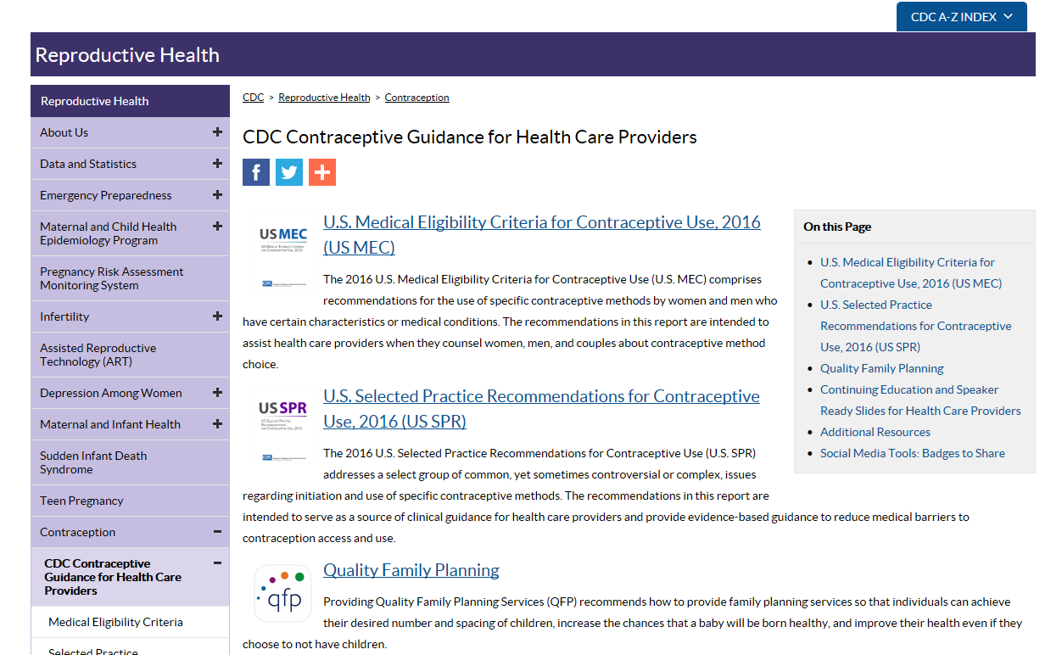
Online access
http://wwwdev.cdc.gov/reproductivehealth/contraception/contraception_guidance.htm
Notes:
The CDC contraception web page for healthcare providers is being updated to include an easy click-through version of the MEC and SPR for providers who prefer to access these resources online.

Slide 41
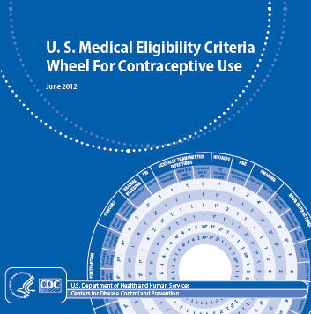
Other Tools and Aids
MEC Wheel
Continuing Education Activities
Speaker-ready slides
Contraceptive Effectiveness Charts
Online alerts to receive updates
eBook for SPR
Residency training and certification
Notes:
Finally, we updated several additional provider tools.
Many providers find the MEC pocket wheel pictured here to be useful. It is available for order on our website.
Several additional educational tools such as pre-made speaker slides, contraception effectiveness charts, and CME approved activities are available on our website.

Slide 42
Resources
CDC evidence-based family planning guidance documents: http://www.cdc.gov/reproductivehealth/contraception/contraception_guidance.htm
Sign up to receive alerts!
Notes:
All of this information, as well as tools and aides for contraceptive guidance can be found on our website.
You can also sign up for email alerts to be up to date with any new guidance updates or new tools released from CDC.

