Slide 1
Teen Pregnancy Prevention:
Application of CDC’s Evidence-Based Contraception Guidance
Division of Reproductive Health
Centers for Disease Control and Prevention
National Center for Chronic Disease Prevention and Health Promotion
Division of Reproductive Health
Notes:
This presentation will provide an overview of the current trends in teen pregnancy and introduce efforts that providers can take to increase access to safe and effective contraception using CDC’s evidence-based Contraception Guidelines.

Slide 2
Learning Objectives
Participants will be able to:
Review the trends in teen pregnancy, sexual behavior and contraceptive use
Describe current contraceptive methods available to teens
Describe the current evidence-based recommendations about the safety and effectiveness of contraceptive methods for teens
Discuss clinical preventive services to improve outcomes and quality of life

Slide 3
SECTION I.
Trends in teen pregnancy, SEXUAL Behavior and contraceptive use

Slide 4
Current Trends
Pregnancy, birth and abortion rates are declining in the U.S. for teens aged 15-19 years old.
Teen birth rates vary by age, race/ethnicity and state.
The U.S. still has the highest teen birth rate of any industrialized country.
Teens use less effective methods and use these methods inconsistently.

Slide 5
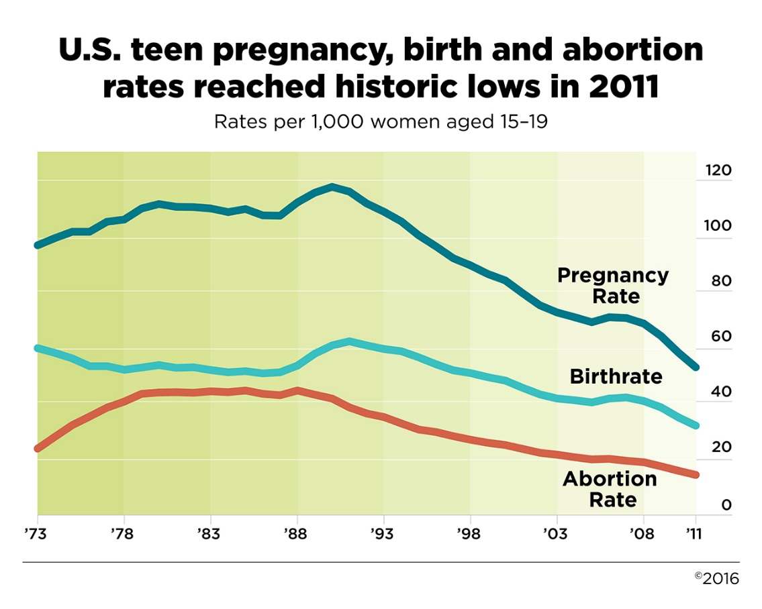
Pregnancy, birth and abortion rates for teens,
15-19 years old
Kost, K., & Maddow-Zimet, I. (2016). U.S. Teenage Pregnancies, Births and Abortions, 2011: National Trends by Age, Race and Ethnicity. New York: Guttmacher Institute. Retrieved from: https://www.guttmacher.org/report/us-teen-pregnancy-trends-2011
Notes:
This graph, compiled by the Guttmacher Institute, shows pregnancy, birth and abortion rates for teens ages 15-19 years old in the United States from 1973 through 2011.
Overall pregnancy, birth and abortion rates for 15-19 year olds are declining, including a 23% decline in pregnancy rates since 2008.
Still, in 2011 there were nearly 553,000 pregnancies to teen women for a rate of 52.4 per 1000 women 15-19 years old.
Of these pregnancies, 60% ended in birth and 26% ended in abortion.
Source: https://www.guttmacher.org/infographic/2016/us-teen-pregnancy-birth-and-abortion-rates-reached-historic-lows-2011

Slide 6

Adolescent pregnancy in U.S.
1 in 4 adolescent girls
will become pregnant by age 20
The National Campaign to Prevent Teen and Unplanned Pregnancy, April 2016. http://thenationalcampaign.org/sites/default/files/resource-primary-download/fast_facts_-_teen_pregnancy_in_the_united_states.pdf

Slide 7
Adolescent pregnancy in U.S.
2 in 5 Black girls
will become pregnant by age 20
1 in 3 Hispanic girls
will become pregnant by age 20
The National Campaign to Prevent Teen and Unplanned Pregnancy, April 2016. http://thenationalcampaign.org/sites/default/files/resource-primary-download/fast_facts_-_teen_pregnancy_in_the_united_states.pdf

Slide 8
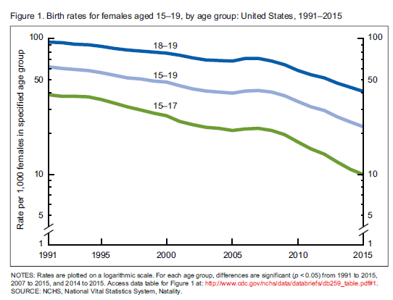
Teen birth rate by age
Hamilton. Continued Declines in Teen Births in the United States, 2015. NCHS Data Brief. 2016;No.259:Figure 1.
Notes:
This graph shows birth rates for females 15-19, 15-17, and 18-19 years old from 1991 through 2015, according to 2015 Preliminary Birth Data from the National Center for Health Statistics.
The birth rate dropped 8% in 2015 (prelim) from the previous year (2014).
Overall, from 2007 to 2015, the teen birth rate has decreased 46%, and from 1991 to 2015 it has decreased 64%; this is a historic low.

Slide 9
Teen birth rate by race and ethnicity
Rate per 1,000 females in age group by race
Hamilton. Continued Declines in Teen Births in the United States, 2015. NCHS Data Brief. 2016;No.259:Figure 1.
Hamilton. Births: Final data for 2014. National Vital Statistics Reports. 2015;64(12):Table 4.
Notes:
This graph shows the teen birth rates according to race for females, 15-19 years old from 2000 through 2015.
The highest rates are among Blacks and Hispanics.
Rates for all races are also at historic lows.

Slide 10

Teen pregnancy birth rates by state per 1,000 girls, 2012
Ventura. National and State Patterns of Teen Births in the United States, 1940-2013. National Vital Statistics Reports. 2014;63(4):Figure 11
Notes:
This is a map of the United States representing standardized teen birth rates, by state, 2012.
Teen Birth rates were lowest in the Northeast and West and highest across the Southern states and Midwest.
The states in dark green have standardized teen birth rates of 36 or more per 1000 women aged 15-19 years.
The states in light gray have standardized rates of 14-22.9 teen births per 1000 women aged 15-19 years.

Slide 11
Teen birth rate (per 1,000 females, 15-19 years old) by country
Countries
Rate* (per 1,000 females in the age group)
*All rates are from 2013 unless otherwise stated
United Nations Statistical Division. Demographic Yearbook 2014. New York: United Nations.
Notes:
This graph shows the teen birth rates per 1000 women aged 15-19 years by country.
All birth rates are for 2013 unless otherwise noted.
Though rates have been declining, the US still has the highest teen birth rate (ages 15-19), up to 10 times that of other developed countries.
In 2012, there were 29.4 births per 1000 female teenagers ages 15-19 in the U.S. and that rate has decreased since 2008 when it was 41.5.
This is much higher than the highest rate in Europe– 17.3 births per 1000 female teenagers in the UK, and almost 10 times the lowest rate in Switzerland.

Slide 12
Percent of U.S. pregnancies that were unintended, 2011
Finer, N Engl J Med, 2016 Mar 3;374(9):843-52.
Notes:
This graph shows the percent of pregnancies that were unintended in the US in 2011 categorized by age.
45% of all pregnancies in the US in 2011 were unintended.
Percentages are highest among younger age groups with about 3 out of 4 pregnancies being unintended among women age 19 and younger.
Specifically, among women 15-17 and 18-19 years old, 72% and 76% respectively were unintended in 2011.

Slide 13
Consequences
Infant
  Prematurity
  Infant mortality
  Abuse
  Future teen pregnancy
Teen Mom
  Low educational attainment
  Unemployment
  Poverty
  Risk for repeat pregnancy
Society
  $9.4 billion national cost in 2010
  $2.1 billion in public sector healthcare in 2010
Santelli, Annu Rev Public Health. 2010;31:371-83
http://www.guttmacher.org/pubs/FB-ATSRH.html
Klein, Pediatrics. 2005 Jul;116(1):281-6
http://thenationalcampaign.org/sites/default/files/resource-primary-download/counting-it-up-key-data-2013-update.pdf
Notes:
Significant consequences result for the infant, teen mother and society as a whole.
The risks of poor neonatal outcomes such as a low birth weight infant, preterm delivery or neonatal death are more than double the risk for an adult woman.
Children of teen mothers are more likely to be subject to abuse and neglect.
As many as 60% of those who become pregnant in early or mid adolescence have a history of childhood sexual or physical abuse and that cycle also may repeat itself.
At least one-third of parenting adolescents of both sexes are themselves products of adolescent pregnancy.
Fewer than 2% of teens who give birth before age 18 will graduate from college by age 30.
Teen mothers are also more likely to come from poverty and have higher rates of school dropout.
Teen mothers are also at risk for repeat pregnancy and over 15% of teen births are repeat pregnancies.
Teen childbirth cost the US $9.4 billion tax dollars and $2.1 billion in public sector healthcare in 2010 according to the National Campaign to Prevent Teen Pregnancy.

Slide 14
Goals of teen pregnancy prevention
Decrease pregnancies among sexually active female teens
Delay initiation of teen sexual activity
Increase use of effective contraceptive methods, including LARC
http://www.cdc.gov/winnablebattles/Goals.html
Notes:
Teen Pregnancy Prevention Goals are to:
Decrease pregnancies among female teens
Delay initiation of teen sexual activity
Increase use of contraception, particularly long-acting, reversible methods, among sexually active teens

Slide 15
Percentage of high school students who ever had sexual intercourse, by sex and race/ethnicity, 2015
CDC. MMWR Surveill Summ. 2016;65(6):1-174
Notes:
This graph shows the percentage of high school students in 2015 who have ever had sexual intercourse by sex and race/ethnicity.
41.2% of all high school students surveyed had ever had sexual intercourse.
The prevalence of having ever had sexual intercourse was 39.2% among female students and 43.2% among male students.
The prevalence of having ever had sexual intercourse was higher among black (48.5%) than Hispanic (42.5%) students and higher among Hispanic than white (39.9%) students.

Slide 16
Percentage of high school students who were currently* sexually active, by sex and race/ethnicity, 2015
*Currently is defined as having had sexual intercourse in the 3 months before the administered survey
CDC. MMWR Surveill Summ. 2016;65(6):1-174
Notes:
This graph shows the percentage of high school students who were currently sexually active or had had sexual intercourse with at least one person during the 3 months before the survey by sex and race/ethnicity.
30.1% of all high school students surveyed reported current sexually activity.
The prevalence of being currently sexually active was 29.8% among female students and 30.3% among male students.
The prevalence of being currently sexually active was higher among black (33.1%) than white (30.3%) and Hispanic (30.3%) students but the magnitude of the difference has decreased since 2011.

Slide 17
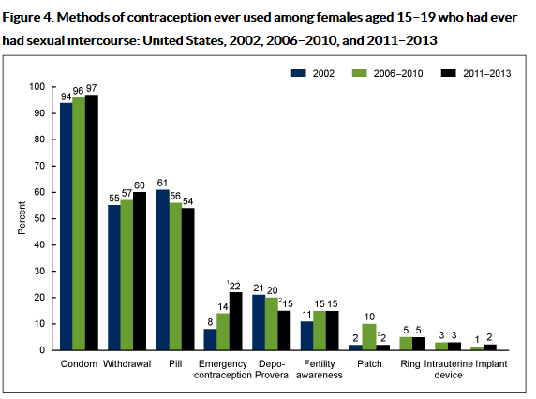
Use of contraception among sexually experienced females, 15-19 years old
Sexual Activity, Contraceptive Use, and Childbearing of Teenagers Aged 15-19 in the United States. National Survey of Family Growth, 2011-2013. Figure 4.
Notes:
This graph shows ever-use of contraception among sexually experienced females, 15-19 years old by contraceptive method.
This data is from the National Survey of Family Growth 2011-2013.
Most sexually experienced female teens have used contraception, with condoms being most frequently reported (97%), followed by the pill (54%).
Over half (60%) of teens have used withdrawal for contraception.
Less than 20% have used the more effective injectable depot medroxyprogesterone (DMPA) method.
Less than 5% have used the most effective reversible methods: Intrauterine Devices (IUDs) or Implants.

Slide 18
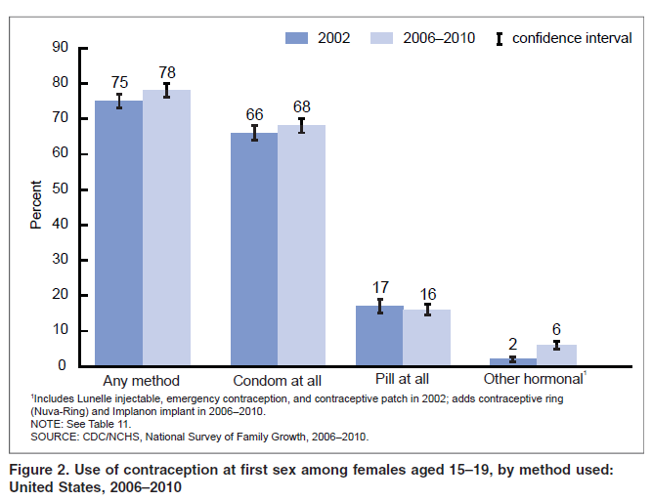
Use of contraception at first sex among females, 15-19 years old
Notes:
This graph shows use of contraception at first sex among females, 15-19 years old.
Use of contraception at first sex among this population has generally increased between 2002 and 2006-2010.
Still, only two-thirds have used a condom at first sex and less than a fifth have used the pill.
50% of adolescent pregnancies occur within the first 6 months of coitarche. (Haffner ed. Facing Facts 1995)
Note: Statistics for condom ‘‘at all,’’ pill ‘‘at all,’’ and other hormonal reflect use of that method regardless of whether it was used alone or in combination with another method.

Slide 19
Use of contraceptive at last sex among teens
Females, 15-19 years old: 86%
Males, 15-19 years old: 93%
Martinez, Teenagers in the United States: Sexual Activitiy, Contraceptive Use, and Childbearing, 2006-2010. National Survey of Family Growth.
Notes:
The percentage of females and males 15-19 years old that used contraception at last sex has also increased.

Slide 20
Percentage of high school students who used a condom during last sexual intercourse* by sex and race/ethnicity, 2015
* Among the 30.1% of students nationwide who were currently sexually active.
CDC, MMWR Surveill Summ. 2016;65(6):1-174
Notes:
This graph also depicts data from the National Youth Risk Behavior Survey, 2015 showing the percentage of high school students who used a condom during last intercourse, by sex and race/ethnicity.
Among the 30.1% of high school students surveyed nationwide who were currently sexually active, 56.9% reported that either they or their partner had used a condom during last sexual intercourse.
The prevalence of having used a condom during last sexual intercourse was higher among male (61.5%) compared to female (52.0%) students.
The prevalence of having used a condom during last sexual intercourse was higher among black (63.4%) compared to white (56.8%) and Hispanic (55.6%) students.

Slide 21

Impact of inconsistent and non-use of contraception on teens
46% of teen pregnancies due to non-use of contraception
54% of teen pregnancies due to contraceptive failure related to:
  Use of moderately or less
  effective methods
  Incorrect or inconsistent use
Santelli, Perspect Sex Reprod Health. 2006;38(2):106-11.
Notes:
While the majority of teens have used contraception in the past, most are using condoms or pills.
Approximately half of teens who are having sex are not using contraception.
Of the teens who are having sex and using contraception, more than half experience contraceptive failure because they are using moderately or less effective methods, such as condoms or pills, and they are using them incorrectly or inconsistently. So even if the adolescent is using contraception, she may experience failure of the method itself, or more likely, she may not be using the method correctly and consistently, for example forgetting to take her pill or not using a condom.

Slide 22
Declines in adolescent pregnancy
From 2007-2011 pregnancy rate among adolescents 15-19 years old in the U.S. dropped 25%
Majority of decline attributable to increased contraceptive use among adolescents
Santelli, Am J Public Health. 2007;97(1):150-6.
Santelli, Perspect Sex Reprod Health. 2006;38(2):106-11.
Lindberg, J Adolesc Health. 2016.06.024; [Epub ahead of print]
Notes:
The majority of the decline in adolescent pregnancy is attributable to increased use of contraception among adolescents.

Slide 23
Why teen moms did not use contraception
Reason | Percent
Thought could not get pregnant | 31.4
Partner did not want to use contraception | 23.6
Did not mind if got pregnant | 22.1
Trouble getting birth control | 13.1
Side effects from contraception | 9.4
Thought she or partner was sterile | 8.0
CDC, MMWR Morb Mortal Wkly Rep. 2012;61(2):25-9.
Notes:
This table shows reasons that women age 15-19 who recently delivered a live birth from an unintended pregnancy did not use contraception.
This data comes from PRAMS (Pregnancy Risk Assessment Monitoring System) from 2004-2008.
The most common reason was that they thought they could not get pregnant.
Almost 25% stated that their partner did not want to use contraception, which likely was a condom.
Pregnancy ambivalence was also a common reason.

Slide 24



Abstinence is the only 100% effective way to prevent HIV, other sexually transmitted infections (STIs), and pregnancy
Notes:
Abstinence is most effective way to prevent HIV, other STIs (sexually transmitted infections) and pregnancy.
It should be included in counseling not just for teens who have not yet engaged in sexual intercourse but also as an option for teens who are sexually active but may not have a reliable method available at a given time.

Slide 25
SECTION II.
CONTRACEPTIVE METHODS
Notes:
Objectives for this section are:
Review data on current use of contraceptive methods in the US
Describe the Tier System of Contraceptive Effectiveness
Review the currently available contraceptive methods in the US, including dual protection
Highlight the need for more consistent and effective method use

Slide 26
Use of specific method(s) at last intercourse by females,15-19 years old in 2012
Lindberg, J Adolesc Health. 2016.06.024; [Epub ahead of print]
Notes:
Of females 15-19 years old who are sexually active, this graph shows the percentage of current method use among those using contraception.
Despite increasing recommendations that adolescents should consider using long-acting reversible contraception or LARC, this graph shows that most adolescents are using the pill or condoms.
Note only 3% are using IUDs or implants.

Slide 27
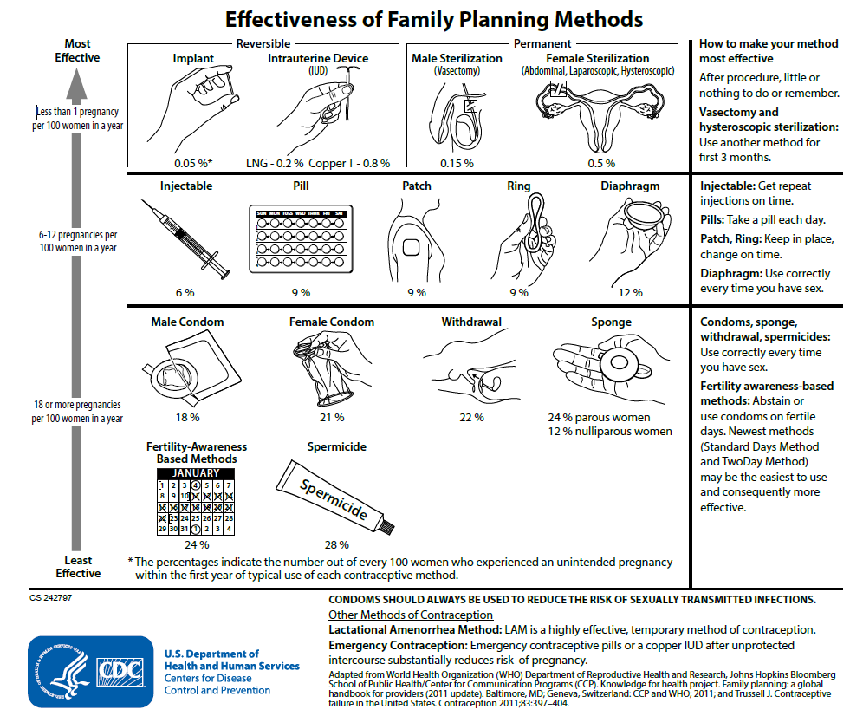
Effectiveness of family planning methods
Tier 1
Tier 2
Tier 3
http://www.cdc.gov/reproductivehealth/UnintendedPregnancy/Contraception.htm
Notes:
This figure shows currently available contraceptive methods, ranked by typical effectiveness, meaning how effective is the method at preventing pregnancy with real-world use.
Incorrect or inconsistent use can impact the effectiveness of the contraceptive method.
In tier 1 are the most effective methods, with less than 1 pregnancy occurring per 100 women per year. The most effective reversible methods include implants and IUDs.
Tier 2 methods include injectables, pills, patch, vaginal ring, and diaphragm; failure rates range from 6-12%.
Tier 3 methods include condoms, withdrawal, sponge, spermicide, and fertility awareness based methods; failure rates range from 18-28%.
The more commonly used method among teens, the pill and the condom, are listed in the second and third tier, respectively.

Slide 28
Typical Use and Perfect Use
Typical Use
  Failure rate
  Average person
  Not always consistent or correct
  During first year
Perfect Use
  Failure rate
  Use is consistent and correct
  At every sex act
  During the first year
Trussell, Contraception. 2011 May;83(5):397-404
Notes:
Along with other features of individual contraceptive methods, it is important to highlight typical use failure rates when counseling teens on contraception options.
Failure rates during typical use describe the number of pregnancies for the average person who does not always use the method correctly or consistently. This reflects the effectiveness of a method.
Failure rates during perfect use are estimated based on consistent, correct use at every act of intercourse. For pills (combined or progestin-only), the perfect use failure rate is 0.3% compared to the typical use failure rate of 9%. The levonorgestrel IUD is not user-dependent like the pill and therefore, has the same perfect use and typical use failure rate of 0.2%.
Among 100 couples who use no contraception it is estimated that 85 will experience a pregnancy in the first year.
Typical use estimates for most methods are based on the National Survey of Family Growth (spermicides, withdrawal, fertility awareness-based methods, diaphragm, male condom, OCPs and DMPA).
Other estimates were based on previous studies or were extrapolated from similar methods.

Slide 29
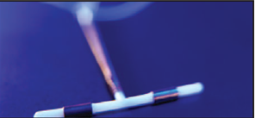
Reversible Tier 1 Methods:
“Most Effective”
Long Acting Reversible Contraception (LARC)
Levonorgestrel-releasing IUD
Copper IUD
Implant
Notes:
While Tier One includes both permanent methods or sterilization and reversible methods, this talk will focus on reversible methods only.
Long-acting reversible contraception (LARC) are highly effective tier one methods that do not impact future fertility and provide easy long-term contraception with typical use failure rates <1%.
In the US, LARCs include several levonorgestrel IUDs that vary by inserter, dose of LNG, and duration of use, as well as the copper IUD and the etonorgestrel implant.

Slide 30
TIER 1 for Adolescents:
Long Acting Reversible Contraception (LARC)
“Forgettable contraception”
Not dependent on compliance/adherence
“Expanding access to LARC for young women has been declared a national priority” (IOM)
“Should be considered as first-line choices for both nulliparous and parous adolescents” (ACOG 2007)
“LARC methods should be considered first-line contraceptive choices for adolescents” (AAP 2014)
Finer, Fertil Steril. 2012 Oct;98(4):893-7
Notes:
LARCs have been growing in popularity among all contraceptive users, including 15-19 year olds.
The Institute of Medicine (IOM), ACOG (the American Congress of Obstetricians and Gynecologists), and the American Academy of Pediatrics (AAP) all recommend LARCs for this at risk populations.
These are easy highly effective methods since they are not user-dependent, also called “forgettable contraception”.

Slide 31
Levonorgestrel IUD
Effective for at least 3 or 5 years
Side effects: irregular bleeding
Reduces dysmenorrhea and menstrual blood loss
Does not protect against STIs
Contraceptive Technology, 20th edition
http://www.accessdata.fda.gov/scripts/cder/drugsatfda
Notes:
There are now four levonorgestrel IUDs FDA-approved in the US.
Mirena was approved in 2000. It initially releases 20ug of levonorgestrel daily and is effective for at least 5 years.
Skyla was recently approved in 2013. It initially releases 14ug of levonorgestrel and is effective for at least 3 years.
Liletta was approved in 2015. Like Mirena, it releases 20ug of levonorgestrel daily. It is currently approved for 3 years.
Kyleena is the newest available IUD, approved in 2016. It releases 17.5ug of levonorgestrel daily and is currently approved for 5 years.
Since the local effects of levonorgestrel cause an atrophic endometrium, side effects include irregular bleeding for the first 3-6 months followed by lighter bleeding or amenorrhea and reduced dysmenorrhea.
Studies with the 5-year IUD show that it may alleviate heavy bleeding from many causes including bleeding diatheses, anticoagulation, fibroids and adenomyosis.
These IUDS do not protect against sexually transmitted infections (STIs) and dual protection with condoms should be strongly encouraged.

Slide 32
Copper IUD
Approved for 10 years
Side effects: irregular bleeding, heavy bleeding
Most effective emergency contraception
Does not protect against STIs
Contraceptive Technology, 20th edition
http://www.accessdata.fda.gov/scripts/cder/drugsatfda
Notes:
The Copper T380A has been FDA-approved since the 1980s for 10 years but studies suggest it is effective for up to 12 years.
The most common reason for Copper IUD discontinuation is heavier, more painful periods which may decrease over time.
Anticipatory counseling regarding menstrual changes after both IUDs are placed is extremely important and may help with continuation.
The Copper IUD can also be offered for emergency contraception up to 5 days after unprotected intercourse and is more than 99% effective.
The Copper IUD does not protect against STIs and dual protection with condoms should be strongly encouraged.

Slide 33
Contraceptive implant
Effective for at least 3 years
Side effects: irregular bleeding
Does not protect against STIs
Contraceptive Technology, 20th edition
Notes:
There is currently one contraceptive implant containing etonogestrel which was approved in the US in 2006.
The implant was updated to Nexplanon in 2011 and is now radioopaque and has a new inserter.
Etonorgestrel levels remain stable over three years which leads primarily to anovulation. Similarly to the levonorgestrel IUD, it also acts on the uterus to cause an atrophic endometrium and thickens cervical mucus to block sperm penetration.
The effects on the uterine cavity may disrupt menstrual cycles leading to amenorrhea, irregular bleeding or infrequent bleeding and, less often, prolonged or frequent bleeding.
The contraceptive implant does not protect against STIs and dual protection with condoms should be strongly encouraged.

Slide 34
Barriers to LARC provision
Patient preference
Concern about safety
  Risk of PID
  Risk of STIs
  Nulliparous, adolescent, not monogamous
Not trained in IUD insertion
IUDs not available on site
Full reimbursement challenges
Tyler, Obstet Gynecol. 2012;119(4):762-71
Madden, Contraception. 2010;81(2):112.-6
Holland, Womens Health Issues. 2015;25(4):355-8
Notes:
Two publications surveyed providers to determine why LARCs are not being provided.
Concerns for safety including risk of PID was included in the previous slide as one of the contraception myths.
Other common factors included patient preference, concern about safety for other reasons, not being trained in insertion and not having IUDs available.

Slide 35
Teen use of LARCs
Barriers
  Cost
  Knowledge and attitudes
    80% of adolescents never heard of IUD
Opportunity – CHOICE Project in St. Louis, MO
  women educated about LARC
  Provided all methods without cost
    62% of adolescents (15-19 years) chose LARC
Whitaker, Contraception 2008;78:211.
Mestad, Contraception 2011;84:493.
Notes:
Medical barriers due to these myths held by providers as well as patients are just some of the reasons that teens are not accessing effective contraception, especially LARCs.
Cost, knowledge and attitudes are other barriers to LARC use.
The CHOICE project in St. Louis provided no-cost contraception of a woman’s choice after listening to a comprehensive educational script.
Over 60% of teens chose a LARC method when knowledge and cost barriers were removed.

Slide 36
Results among females aged 15-19 years from CHOICE project
Teen Pregnancy Rates (no. per 1000)
  CHOICE teens†: 34.0
  U.S. sexually experienced teens*: 158.5
Teen Birth Rates (no. per 1000)
  CHOICE teens: 19.4
  U.S. sexually experienced teens: 94.0
Teen Abortion Rates (no. per 1000)
  CHOICE teens: 9.7
  U.S. sexually experienced teens: 41.5
† Data are the mean annual rates for the years 2008-2013
* Data are the U.S. rates for the year 2008
Secura, N Engl J Med. 2014 Oct;371(14):1316-23
Notes:
There were very significant decreases in the rates of teen pregnancy, births, and abortions among teenagers participating in the CHOICE project. This highlights the importance of overcoming the financial and educational barriers when it comes to increasing effective contraceptive use.

Slide 37
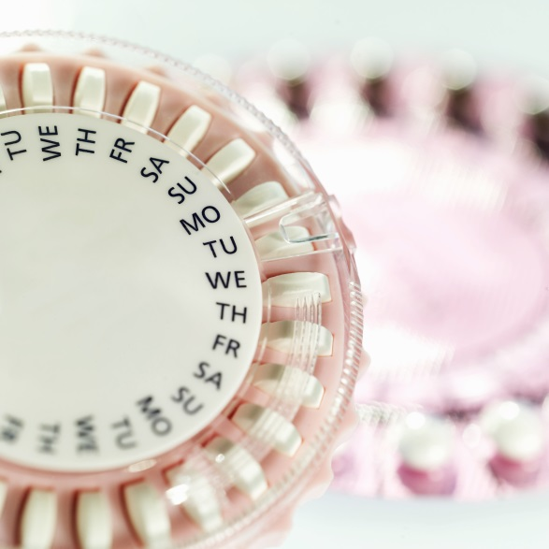
Tier 2 Methods:
“Moderately Effective”
Injectable (DMPA)
Pill
Patch
Ring
Contraceptive Technology, 20th edition
Notes:
The tier 2 methods include the injectable (DMPA), the pill (both combined and progestin-only), the combined hormonal patch and the combined vaginal ring.
These methods have higher typical use failure rates because they require more effort by the user.

Slide 38
Correct and consistent use
Methods that require more effort by the user have higher typical failure rates
Correct and consistent use of pills and condoms may be difficult for all ages
Women ages 18-24, in last 3 months
  45% missed > 1 pill
  62% did not use condoms every time
Frost, Perspect Sex Reprod Health. 2008 Jun;40(2):94-104
Notes:
The most effective method of contraception is the method a woman or couple is most likely to use consistently and correctly.
Correct and consistent use helps close the gap between typical use and perfect use.
Methods that require more effort by the user have higher typical failure rates because there is more room to not use the method correctly and consistently.
Both the pill and condom (which were shown earlier as the most common methods used by teens) are difficult to use correctly and consistently by most users.
One study that surveyed 2000 women nationwide found that 45% of young women age 18-45 using pills missed one or more pills in the last 3 months and 62% of those using condoms were not using them every time they had sex.

Slide 39
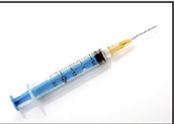
Depot medroxyprogesterone acetate (DMPA)
One injection every 3 months
Reliable contraception for 3 months, but effects may last up to 9 months
Side effects: irregular bleeding and amenorrhea
Does not protect against STIs
Contraceptive Technology, 20th edition
Notes:
Depot medroxyprogesterone acetate, DMPA, Depo, or the shot are all names used for an injectable projestin that is given either intramuscularly or less commonly subcutaneously every 3 months.
Due to the larger dose of systemic hormone, effects on ovulation may last up to 9 months.
Amenorrhea and irregular bleeding again may be a side effect; in one study of teenagers, almost 2/3 reported amenorrhea at 6 months.
DMPA does not protect against STIs and dual protection with condoms should be strongly encouraged.

Slide 40
Contraceptive pills
Combined pills contain estrogen and progestin (COCs)
Progestin-only pills (POPs)
Extended use
Side effects: irregular bleeding
Do not protect against STIs
Contraceptive Technology, 20th edition
Notes:
Contraceptive pills include both combined oral contraceptives (COCs) and progestin-only pills (POPs).
Combined pills are generally dosed over a 28-day cycle with 21 active pills and 7 days of placebo.
POPs are dosed over a 28-day cycle with 28 active pills and no placebo and can be useful for women who are breastfeeding or have other conditions that may not make them candidates for safe estrogen use.
Extended use of combined pills may aid in compliance and can decrease symptoms associated with menses including heavy menstrual bleeding and dysmenorrhea.
OCPs do not protect against STIs and dual protection with condoms should be strongly encouraged.

Slide 41
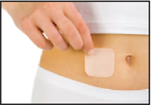
Contraceptive patch
Releases estrogen and progestin
One patch per week for 3 weeks, then 1 patch-free week
Side effects: irregular bleeding
Does not protect against STIs
Contraceptive Technology, 20th edition
Notes:
The contraceptive patch is another combined hormonal contraceptive containing both estrogen and progestin which are delivered transdermally.
The user applies one new patch and removes the old patch each week for three weeks. The last week of the cycle the user does not use a patch and this is generally the time of bleeding.
The patch does not protect against STIs and dual protection with condoms should be strongly encouraged.

Slide 42
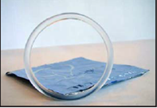
Contraceptive vaginal ring
Releases estrogen and progestin
One ring for 3 weeks, then 1 ring-free week
Side effects: irregular bleeding
Does not protect against STIs
Contraceptive Technology, 20th edition
Notes:
The contraceptive vaginal ring is another combined hormonal contraceptive that delivers estrogen and progestin vaginally.
The user places the plastic ring in the vagina and leaves it in place for 3 weeks. It can be removed in the fourth week at which point bleeding occurs.
The ring does not protect against STIs and dual protection with condoms should be strongly encouraged.

Slide 43
Quick Start
Initiation of contraception on any day of the cycle if reasonably certain the woman is not pregnant
More reliable and faster protection from unplanned pregnancies
Advise 7 days of backup or abstinence if needed
Improves short-term continuation
No increase in unscheduled bleeding
Contraceptive Technology, 20th edition
Notes:
Quick start refers to the initiation of contraception on any day of the cycle to allow for more reliable and faster protection from unplanned pregnancies as long as reasonably certain that the woman is not pregnant.
Encourage 7 days of back-up contraception such as condom or abstinence until method takes effect which may vary.
Quick start initiation may improve short-term continuation of combined oral contraceptives and has not been shown to increase unscheduled bleeding.

Slide 44
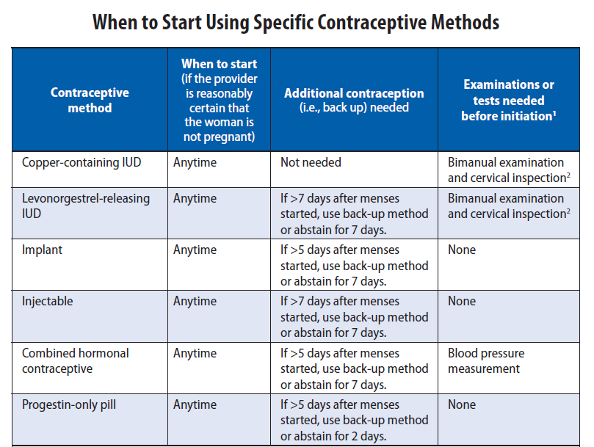
U.S. Selected Practice Recommendations (US SPR)
MMWR. Recommendations and Reports. 2016 Jul;65(4):1-66
Notes:
Thus the recommendation for initiation of CHCs is to use backup or abstain from intercourse for 7 days if the method is initiated greater than 5 days from the start of last menstrual period.
The US SPR also provides guidance both within the document and summarized in a user-friendly chart to guide providers on how to counsel patients on backup needs for all methods.
As you can see from this chart, all methods of contraception can be started at any time, if the provider is reasonably certain the woman is not pregnant.

Slide 45
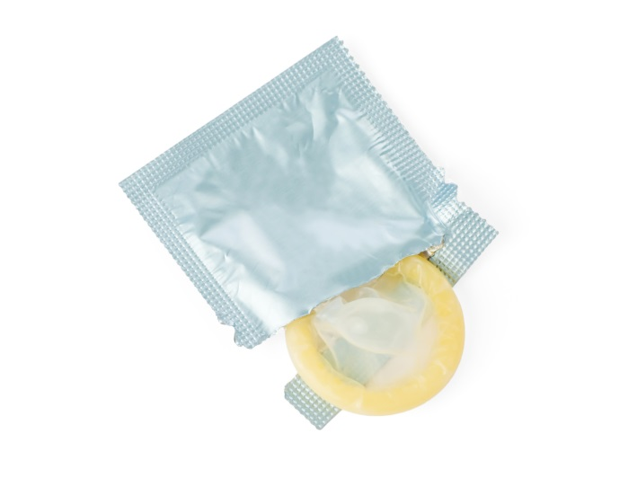
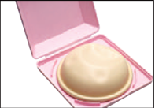
Tier 3:
“Least Effective”
Condoms (male and female)
Diaphragms, cervical cap, sponge
Fertility awareness-based methods
Withdrawal
Spermicides
Contraceptive Technology, 20th edition
Notes:
These are examples of Tier 3 methods, or less effective methods.
These methods require even more effort by the user and have higher typical failure rates.
Correct and consistent use of condoms may be difficult for all ages.
Fertility-based methods refer to a range of techniques used to avoid the fertile window, including rhythm method, cycle beads, basal body temperature, etc.
Given the high incidence of anovulatory cycles in teens, fertility awareness based methods should be used with caution in this population as ovulation can be predicted.
Withdrawal-- or removal of the penis from the vagina prior to ejaculation– and spermicides have typical use failure rates >20%; withdrawal at 22% and spermicides at 28%.
It is important to note that over half of sexually active teens have used withdrawal for contraception in the past and likely underestimate the failure rate of this method.

Slide 46

Emergency Contraception
Up to 120 hours after unprotected sex
Two methods of delivery
  Copper IUD
  Emergency Contraceptive Pills (ECPs)
Contraceptive Technology, 20th edition
Notes:
Emergency contraception was mentioned earlier while introducing the Copper T380A.
Emergency contraception, otherwise known as EC, are the methods used to prevent pregnancy AFTER unprotected intercourse which may include assault, condom breakage or slippage, missed or late hormonal methods or no method used.
EC includes the Copper IUD and emergency contraceptive pills, or ECPs.

Slide 47
Emergency contraceptive pills
Ulipristal acetate
  Anti-progesterone, single pill
  More effective than LNG between 3-5 days
  May be more effective than LNG among obese
  Prescription only
Levonorgestrel
  Available as one or two pills over the counter
  Progestin-only
Yuzpe Method
  Combined estrogen/progestin pills, multiple pills
  less effective, more side effects
Contraceptive Technology, 20th edition
MMWR. Recommendations and Reports. 2016 Jul;65(4):1-66
Notes:
There are 3 formulations of ECPs that can be used and all work primarily by delaying or inhibiting ovulation; ECPs do not cause abortion or harm an already established pregnancy.
Since ovulation may only be delayed for the cycle, a woman may become pregnant if she has unprotected intercourse in the coming weeks before her next menses.
It is recommended by the American Academy of Pediatrics and the US Selected Practice Recommendations for Contraceptive Use, 2016 (US SPR) that appropriate patients be offered advance prescription of ECPs and that ongoing contraception be addressed if ECPs are used (Committee on Adolescence Policy Statement: Emergency Contraception, Pediatrics: 130;1174-1182: 2012).
The newest formulation available is ulipristal acetate, an anti-progesterone, which was approved in 2010 for up to 120 hours.
It is available by prescription only and has been shown in a few studies to be more effective than levonorgestrel at and beyond 72 hours.
Levonorgestrel has been available as one or two pills since first approved in 1998. It is now available as one pill without prescription regardless of age.
It is recommended to take the single or two pills as soon as possible after unprotected sex as effectiveness declines over time.
The Yuzpe method, an off-label use of combined oral contraceptives requires taking multiple OCPs at once in two doses which is not as effective as the other methods and often causes nausea and vomiting.

Slide 48
Non-contraceptive benefits
Dysmenorrhea: COCs, implant, LNG-IUD
Cycle Control: LNG-IUD, DMPA, COCs
Cancer protection: COCs protect against ovarian and endometrial cancer
Ectopic Pregnancy: COCs
Acne: COCs and possibly patch and ring
Menstrual suppression: Continuous CHCs, DMPA, implants, LNG-IUD
Pain from Endometriosis: COCs, DMPA, implant, LNG-IUD
Premenstrual or menstrual-related symptoms: extended or continuous use of CHCs, or any menstrual suppression
Contraceptive Technology, 20th edition
ACOG Practice Bulletin No 110, 2012
Notes:
Hormonal contraceptives have several non-contraceptive benefits that may relieve symptoms of patients not in need of contraception or may provide added benefit while also providing contraception.
Dysmenorrhea affects up to 90% of young women and can be improved or alleviated with combined oral contraceptives, the etonorgestrel implant or the levonorgestrel IUD.
Irregular cycles or heavy cycles which are common with anovulation in young women may be improved with LNG-IUD, DMPA, or oral contraceptive pills (OCPs) as either cyclic, extended or continuous use of combined oral contraceptives or as progestin-only pills.
COCs have been also shown to protect against both ovarian and endometrial cancer as well as ectopic pregnancy. Combined hormonal contraceptives (CHCs) especially pills may improve acne.
Menstrual suppression may be desirable for life events, disabled patients or for menstrual-related symptoms and can be achieved with continuous use of CHCs, DMPA, implants or the LNG-IUD.
Endometriosis-related pain may be alleviated with COCs, DMPA, implant or LNG-IUD.
Extended or continuous use of CHCs may also improve premenstrual symptoms otherwise experienced without hormonal contraception or on cyclic regimens that have a 7 day hormone-free interval.

Slide 49
DUAL Protection
Notes:
While abstinence is the most effective way to prevent both pregnancy and sexually transmitted infections, we need to educate teens how to prevent these outcomes if they are sexually active or are planning to be sexually active.
Now that we understand the contraceptive methods that are available and their failure rates, let’s discuss dual protection.
Dual protection for those sexually active is the protection against both pregnancy and STIs using either a hormonal method, an IUD or a condom AND consistently and correctly using condoms

Slide 50
Typical effectiveness of family planning methods
Tier 1
Tier 2
Tier 3
http://www.cdc.gov/reproductivehealth/UnintendedPregnancy/Contraception.htm
Notes:
Again looking at typical use contraceptive failure rates, male and female condoms are in Tier 3 with failure rates of 18 and 21%, respectively

Slide 51
Condoms
Male and female condoms
Male latex condoms reduce risk of STIs, including HIV, when used correctly and consistently
Female condoms give women shared responsibility of the condom in addition to reducing the risk of STIs and HIV.
Contraceptive Technology, 20th edition
Notes:
While not highly effective contraceptive methods, male and female condoms have an extremely important role in healthy sexual behaviors.
Consistent and correct use of the male latex condom reduces the risk for HIV infection and other STIs, including chlamydial infection, gonorrheal infection and trichomoniasis.
When male latex condoms cannot be used properly, a female condom should be considered.

Slide 52
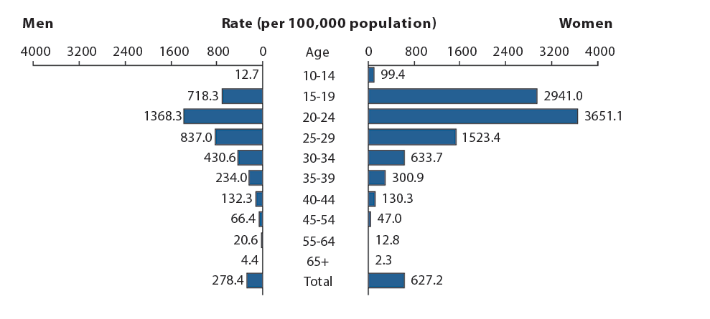
Chlamydia – Rates of Reported Cases by Age and Sex, United States, 2014
CDC 2015; STD Surveillance 2014 – Chlamydia: Figure. 5
Notes:
This graph shows age- and sex-specific rates of chlamydia infection per 100,000.
Men are on the left and women on the right, stratified by age group.
Rates of chlamydia in young women ages 15 to 19 are particularly high compared to teenage boys or compared to women of older age groups.
For example, young women ages 15-19 have a rate of chlamydia infection over 4 times the rate of infection of their male counterparts.
http://www.cdc.gov/std/stats14/figures/5.htm

Slide 53
Effectiveness of Contraceptive Methods at
Preventing STIs and Pregnancy
STI Protection
Dual
Protection Strategies
Hormonal/IUD+ condoms
(dual method)
Consistent condom use
Good
Male Condoms
Moderate
Female Condoms
Spermicides
Periodic Abstinence
IUD
Injectables
Implants
OCs
None
Moderate
Good
Pregnancy Protection (Typical Use)
Adapted from Cates, Sex Transm Dis. 2002 Mar;29(3):168-74
Notes:
9
This graph shows how STI protection and pregnancy protection overlap. Since no method is good at both, it is important for those at risk for pregnancy and infection to use dual protection.
Male condoms and LARCs provide the most effective combination.

Slide 54
Dual Protection Guidance
“Although hormonal contraceptives and IUDs are highly effective at preventing pregnancy, they do not protect against STDs, including HIV. Consistent and correct use of the male latex condom reduces the risk for HIV infection and other STDs, including chlamydial infection, gonococcal infection, and trichomoniasis“ ---U.S. Medical Eligibility Criteria for Contraceptive Use, 2016
“Condoms…should be used by all sexually active adolescents regardless of whether an additional method of contraception is used….. When initiating any hormonal contraceptive method, the need for consistent protection against STIs (either male or female condoms) should be reinforced. “ --- American Academy of Pediatrics, Committee on Adolescence
MMWR. Recommendations and Reports.2016 Jul;65(3):1-104
Blythe, Pediatrics. 2007 Nov;120(5):1135-48
Notes:
What guidance do we have regarding dual protection?
We know that other contraceptive methods do not protect against STIs and HIV.
The US Medical Eligibility Criteria as well as the American Academy of Pediatrics (AAP) recommends correct and consistent condom use if the risk for STIs and HIV are present either alone or with another method for contraception. The AAP states condoms should be used by all sexually active adolescents, regardless if another additional method is used for contraception.

Slide 55
Dual Protection in Healthy People 2020
FP-10 Increase the proportion of sexually active persons aged 15 to 19 years who use condoms to both effectively prevent pregnancy and provide barrier protection against disease
FP-11 Increase the proportion of sexually active persons aged 15 to 19 years who use condoms and hormonal or intrauterine contraception to both effectively prevent pregnancy and provide barrier protection against disease
http://www.healthypeople.gov/2020/topicsobjectives2020/objectiveslist.aspx?topicid=13
Notes:
Healthy People 2020 addresses dual protection with a goal to increase the proportion of sexually active persons aged 15-19 years who use condoms alone for both contraception and STI prevention as well as the proportion of this population who use condoms along with hormonal or intrauterine contraception.

Slide 56
Prevalence of Dual Protection among
Female Teens in the U.S.
Source | Population | Dual Method (at last sex) (hormonal and condom) | Consistent Condom Use (last 4 weeks)
NSFG, 2006-2008 | Ages 15-19, sexually active unmarried females | 20.8% | 51.6%
Abma, Vital Health Stat. 2010 Jun;(30):1-47
http://www.cdc.gov/nchs/data/series/sr_23/sr23_030.pdf
Notes:
If our goal is to increase the proportion of teens using dual protection, we should understand where we are starting from.
According to NSFG 2006-2008, only 20.8% of unmarried female teens used dual protection at last sex.
51.6% consistently used condoms in the previous four weeks.

Slide 57
SECTION III.
U.S. FAMILY PLANNING GUIDANCE
Notes:
In this next section, the objectives are:
1. Become familiar with the US MEC categories
Focus on recommendations for use of LARC in teen population to be comfortable supplying teens with highly effective methods
Introduce the US Selected Practice Recommendations and understand how it can help with contraception provision

Slide 58
U.S. MEDICal eligibility criteria, 2016

Slide 59
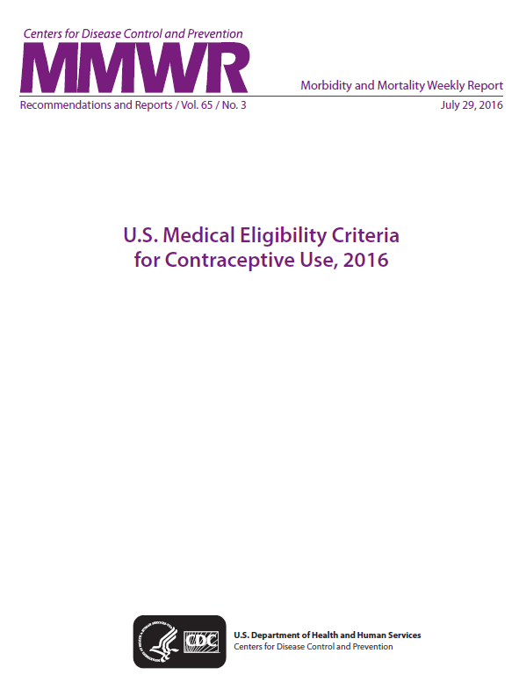
U.S. Medical Eligibility Criteria for Contraceptive Use, 2016
Notes:
59

Slide 60
U.S. Medical Eligibility Criteria for Contraceptive Use, 2016 (U.S. MEC)
First published in 2010 and updated in 2016
Guidelines for providers to determine safety of contraceptives for women with certain medical conditions or characteristics
  Ex: Is it safe for woman with hypertension to use the pill?
  Ex: Is it safe for a postpartum woman to use IUDs?
Guidance for 17 contraceptive methods and >120 conditions
Providers should always consider individual clinical circumstances when counseling patients
Notes:
As we’ve already seen, contraceptive use is key for adolescents who are attempting to avoid unintended pregnancy. CDC’s Division of Reproductive Health has been working to develop guidelines for the safe and effective use of contraception.

Slide 61
MEC Categories
1. A condition for which there is no restriction for the use of the contraceptive method.
2. A condition where the advantages of using the method generally outweigh the theoretical or proven risks.
3. A condition where the theoretical or proven risks usually outweigh the advantages of using the method.
4. A condition which represents an unacceptable health risk if the contraceptive method is used.
Notes:
The US MEC uses a numeric scheme to provide the recommendations for specific contraceptive method and medical condition combinations.
A “1” means that there is no restriction for the use of the contraceptive method for a woman with that given medical condition, for example copper IUD use among women with hypertension.
A “2” means that the advantages of using the method generally outweigh the theoretical or proven risks.
A “3” flips the risk-benefit ratios and says that the theoretical or proven risks of the method usually outweigh the advantages – or that there are no other methods that are available or acceptable to the women with that medical condition.
Finally, a “4” means that there is an unacceptable health risk if the contraceptive method is used by a woman with that medical condition.

Slide 62
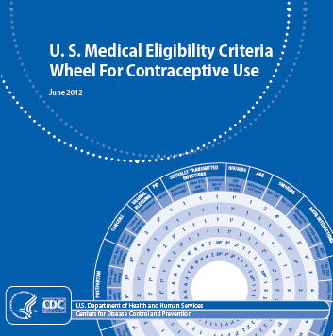
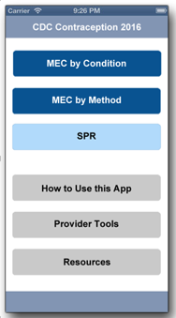
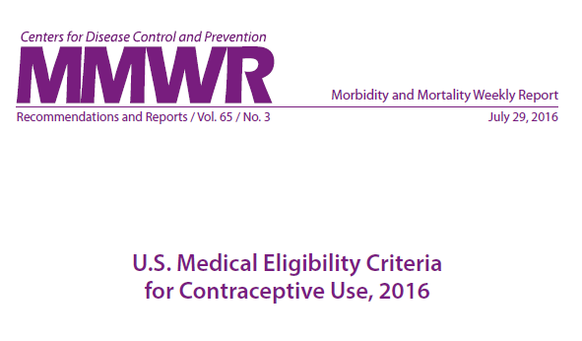
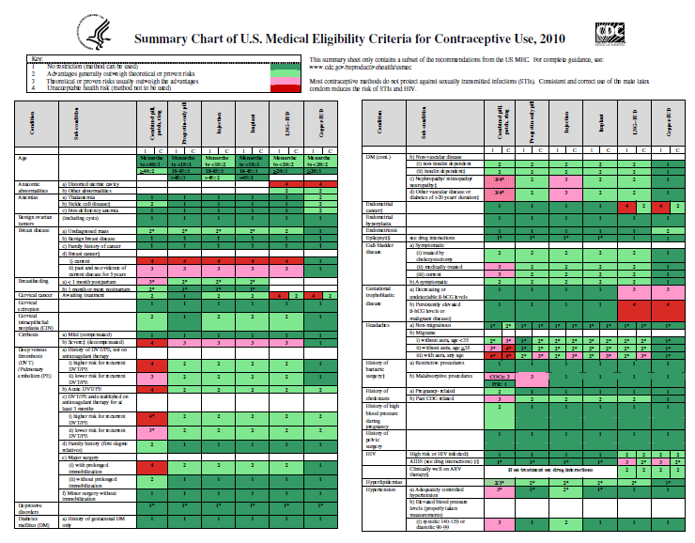
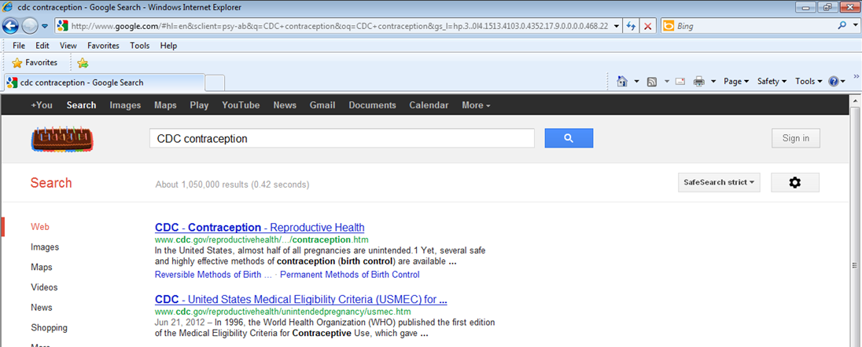
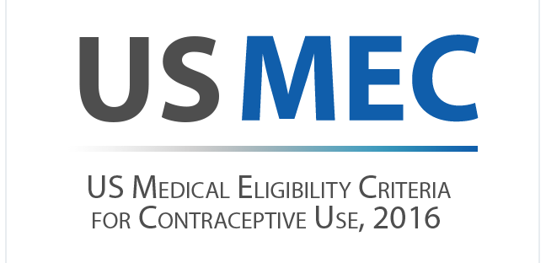
How you can use the US MEC
Notes:
The US MEC can be used in several ways.
62

Slide 63
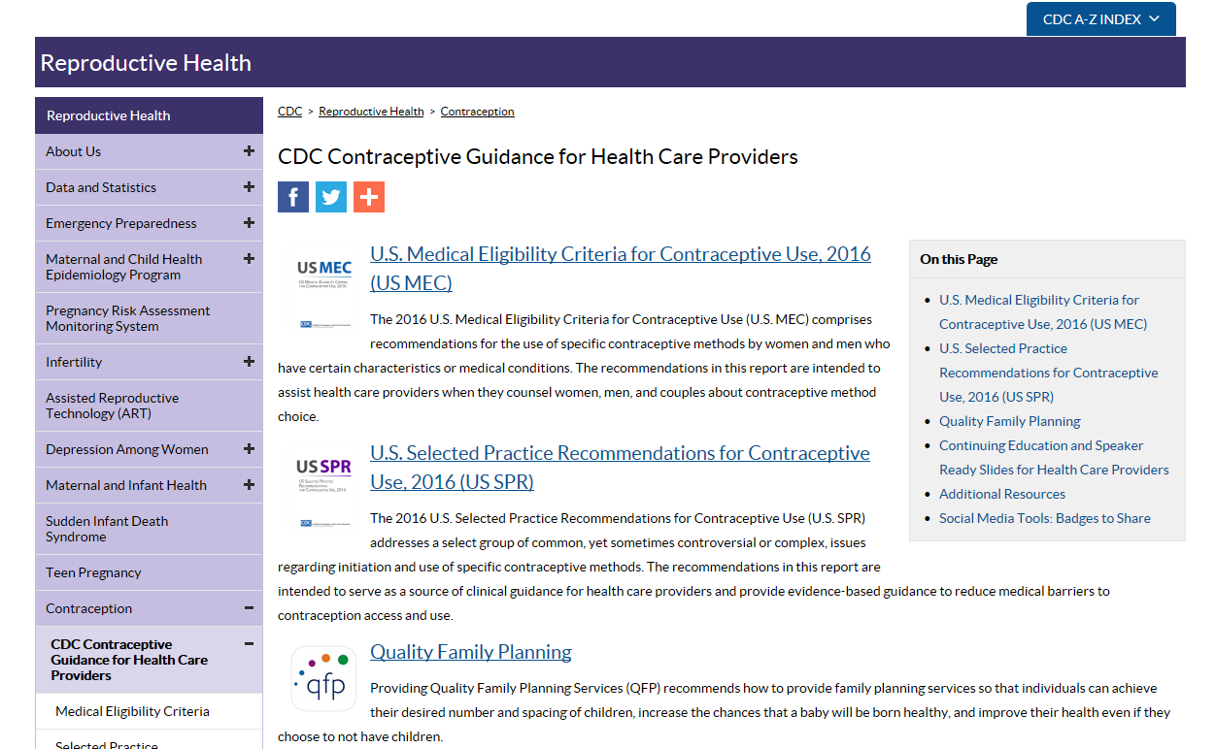
Online access
http://wwwdev.cdc.gov/reproductivehealth/contraception/contraception_guidance.htm
Notes:
The CDC contraception web page for healthcare providers is provided on this slide.
On the U.S. MEC page, you can find the link to the original publication in CDC’s weekly Morbidity and Mortality Weekly Report (MMWR).
In addition, the page is being updated to include an easy click-through version of the MEC.

Slide 64
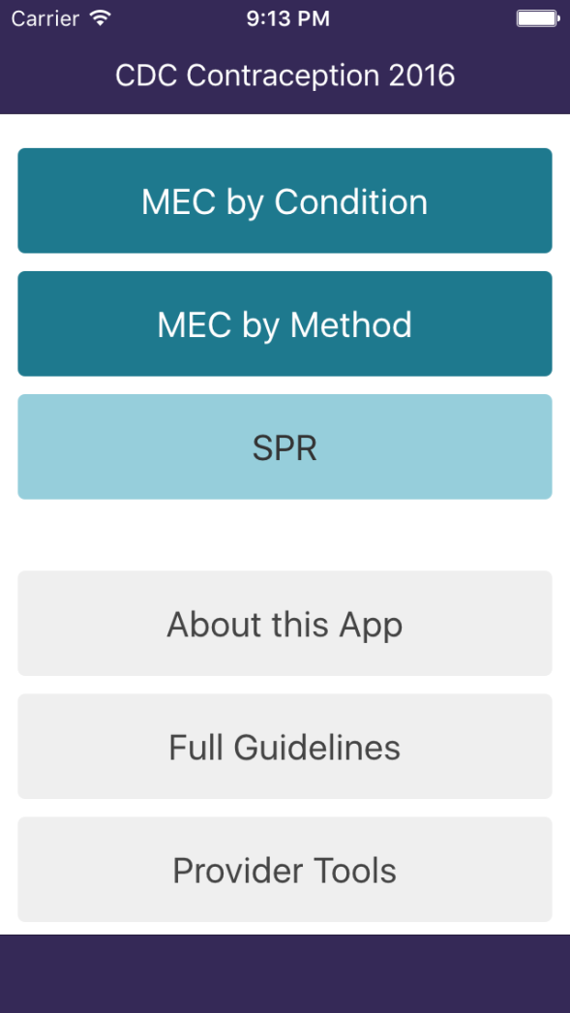
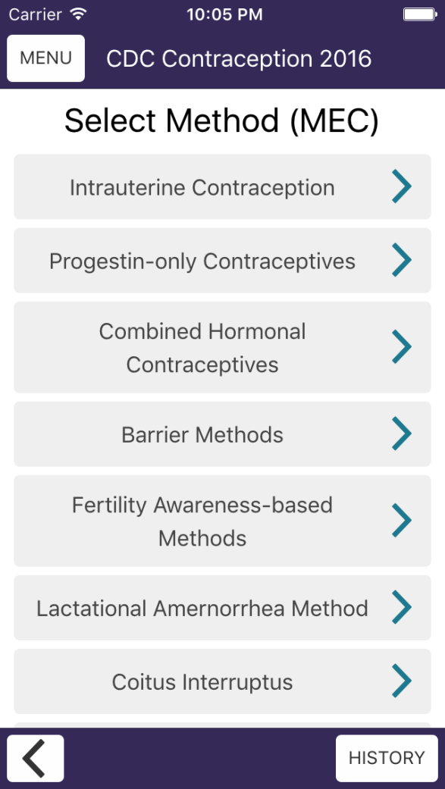
2016 U.S. MEC App
Notes:
The updated CDC Contraception app for apple and android smart phones and tablets now includes the MEC in a user-friendly format, with easy navigation between the MEC and SPR. It also easily links to other CDC guidance such as STD treatment guidelines. This updated app is available for download through our website. Many providers who use smartphones for other clinical references find this to be the easiest way to access the guidelines in everyday practice.

Slide 65
U.S. MEC Summary Chart and Wheel
Notes:
CDC also has printed and laminated MEC quick-reference summary tools which can be ordered or printed from our website. These include a color-coded summary chart and handy pocket wheel which many providers find to be very useful

Slide 66
US MEC categories for safety of methods among women of different ages
 | IUD | Implant | DMPA | POP | CHCs | Barrier
Age | < 20 | All ages | <18 | All ages | <40 | All ages
 | 2 | 1 | 2 | 1 | 1 | 1
1 | No restriction
2 | Generally can use
3 | Generally do not use
4 | Do not use
Notes:
Here is an example of the numeric scheme in the MEC for age.
Age as a characteristic for the MEC, and subgroups for age are different for different methods.
For progestin-only pills, the implant and barrier methods, recommendations are the same for all ages.
Since risks and benefits vary for different methods, the subgroup divisions for combined hormonal contraception, the injection and the IUD are set at different ages.
These recommendations may differ for teens with certain medical conditions, the MEC can be consulted for full recommendations

Slide 67
Contraception: Myths and Misconceptions
Myth: IUDs cause pelvic inflammatory disease and infertility
  Fact: Chlamydia and gonorrhea cause PID and can lead to infertility
Myth: DMPA causes fractures
  Fact: Small amount of bone mineral density lost during use, regained after discontinuation
Myth: Contraceptive pills cause cancer
  Fact: Protects against ovarian and endometrial cancer
Notes:
There are many myths and misconceptions that commonly prevent women from accessing effective contraceptive methods.
Three such myths are noted here.
Evidence-based recommendations help dispel these myths.

Slide 68

Clinical Scenario 1
16 year old female, healthy, nulliparous, currently using condoms, but wants more reliable method. Which of the following options are available to her?
  A. IUD (copper or levonorgestrel)
  B. Implants
  C. DMPA
  D. Combined hormonal methods (pill, patch, ring)

Slide 69
Safety of IUDs for Teens
IUDs and age <20: US MEC 2
IUDs and Expulsion
  Evidence shows slightly increased risk of expulsion in younger women
IUDs and infertility
  No evidence that IUDs cause later infertility
  Infertility associated with gonorrhea and chlamydia
IUDs and STIs
  No evidence that IUDs increase risk of STI acquisition
  Women with current purulent cervicitis, chlamydial infection, gonorrhea should not start an IUD (US MEC 4)
  Women with risk factors for STDs may be screened at the time of IUD insertion, but insertion should not be delayed (US MEC 2)
Notes:
Like previously mentioned, there are various myths and misperceptions regarding IUD use in adolescents.
These concerns are real and should be addressed with reassurance that evidence-based recommendations tell us that the IUD is generally safe for use in adolescents.
There is concern regarding an increased risk for expulsion which has been shown in some studies and thus the recommendation for IUD in women less than 20 is a category 2.
Risk of infertility has been shown to be associated with gonorrheal and chlamydial infection, not due to age.
Risk of STIs is another common concern for this population and IUD use. Those with an active infection should not have an IUD placed.

Slide 70
Safety of DMPA for Teens
DMPA and age <18: US MEC 2
DMPA and Bone mineral density (BMD)
  Small amounts of BMD lost using DMPA
  BMD regained after discontinuation
  Unclear how BMD relates to fracture risk in adolescents
  No evidence that DMPA increases fracture in adolescents
DMPA and Obesity
  Obese adolescents who use DMPA may be more likely to gain weight than non-obese DMPA users and obese users of other methods
Notes:
There has also been a lot of concern regarding use of DMPA in adolescents, specifically regarding loss of bone mineral density and weight gain.
There is no evidence that DMPA use increases fracture risk in adolescents and it is unclear how bone mineral density measures are associated with future fractures in adolescents.
We do know that bone mineral density is lost in small amounts during DMPA use in women, including adolescents.
And we also know that the bone mineral density is regained after discontinuation.
As for obesity, obese adolescents using DMPA may be more likely to gain weight compared to non-obese users and obese users of other methods.
Thus, DMPA is a category 2 opposed to a category 1 for women <18 years old.

Slide 71
Clinical Scenario 1
16 year old female, healthy, nulliparous, currently using condoms, but wants more reliable method. What options are available to her?
  A. IUD (copper or levonorgestrel) (US MEC 2)
  B. Implants (US MEC 1)
  C. DMPA (US MEC 2)
  D. Combined hormonal methods (pill, patch, ring) (US MEC 1)
  ALL OF THE ABOVE! Plus…
Encourage continued condom use for dual protection

Slide 72

Clinical Scenario 2
18 year old G1P0, pregnant, and being counseled for postpartum family planning. She is not planning on breastfeeding. What options are available to her immediately postpartum?
  A. IUD (copper or levonorgestrel)
  B. Progestin-only methods (pill, injectable, implant)
  C. Combined hormonal methods (pill, patch, ring)

Slide 73
Postpartum: Hormonal Contraception
Condition | Combined methods | Progestin-only methods
Postpartum (non-breastfeeding women)
a) < 21 days | 4 | 1
b) 21 days to 42 days
i) With other risk factors for VTE | 3* | 1
ii) Without other risk factors for VTE | 2 | 1
c) > 42 days | 1 | 1
1 | No restriction
2 | Generally can use
3 | Generally do not use
4 | Do not use
Notes:
Recommendations include:
First 21 days, CHCs are category “4”, meaning should not be used, given high risk of venous thromboembolism (VTE).
For 21-42 days after delivery, the recommendation acknowledges that there may still be some safety concerns, but this depends on presence of other risk factors. With risk factors, CHCs are category “3”, meaning that risks generally outweigh benefits; the asterisk next to the 3 means there is a clarification to this recommendation in the guidance – the clarification states that depending on the other risk factors present, this might be a “4”. Without risk factors, “2”, meaning that benefits generally outweigh risks.
Beyond 42 days, CHCs are category “1”, meaning there are no safety concerns based on postpartum status.

Slide 74
Postpartum IUD Insertion
Condition | Sub-Condition | LNG-IUD | Cu-IUD
Postpartum (including cesarean delivery) | a) <10 minutes after delivery of placenta
 | Breastfeeding | 2* | 1*
 | Not breastfeeding | 1* | 1*
 | b) 10 minutes after delivery of placenta to <4 weeks | 2* | 2*
 | c) ≥ 4 weeks | 1* | 1*
 | d) Postpartum sepsis | 4 | 4
* Higher rates of expulsion should be considered
1 | No restriction
2 | Generally can use
3 | Generally do not use
4 | Do not use
Notes:
There are separate subgroups for postpartum IUD insertion.
Rather than recommendation based on days after delivery, recommendations are based on whether the IUD is placed within 10 minutes after placental delivery or from 10 minutes up until 4 weeks after placental delivery or at 4weeks or more from delivery. All of these time frames are a category 1 or 2 so are safe or generally safe to use among women of any age.
Postpartum sepsis is a category 4 meaning do not use.

Slide 75
Clinical Scenario 2
18 year old G1P0, pregnant, and being counseled for postpartum family planning. She is not planning on breastfeeding. What options are available to her immediately postpartum?
  IUD: Cu-IUD (US MEC 1) or LNG-IUD (US MEC 2)
  Progestin-only methods (pill, injectable, implant) (US MEC 1)
  C. Combined hormonal methods (pill, patch, ring) (US MEC 4)
    (Wait until 21-42 days postpartum, depending on VTE risk factors)
  Encourage Dual protection with condom use
Notes:
Given the US MEC recommendations, she can safely use either IUD or a progestin-only method immediately postpartum.
Depending on other VTE risk factors, she may also use combined hormonal methods at 21 days or 42 days postpartum.

Slide 76

Clinical Scenario 3
16yo nulliparous female with heavy cycles and dysmenorrhea presents with her mother since she is missing school at the start of most periods. She is sexually active with her boyfriend using condoms. What options are available to her?
  A. IUD (copper or levonorgestrel)
  B. Implants
  C. DMPA
  D. Combined hormonal methods (pill, patch, ring)

Slide 77
Clinical Scenario 3
16yo nulliparous female with heavy cycles and dysmenorrhea presents with her mother since she is missing school at the start of most periods. She is sexually active with her boyfriend using condoms. What options are available to her?
  A. IUD (copper or levonorgestrel) (US MEC 2)
  B. Implants (US MEC 1)
  C. DMPA (US MEC 2)
  D. Combined hormonal methods (pill, patch, ring) (US MEC 1)
  All of the above
Encourage continued condom use for dual protection
Notes:
According to the US MEC, she can safely start any of the methods above for contraceptive use
However, all methods other than the Copper IUD have been shown to be beneficial to women who have heavy cycles and dysmenorrhea

Slide 78
US SELECTED PRACTICE RECOMMENDATIONS
Notes:
In this next section, the objectives are:
1. Become familiar with the US SPR categories
Focus on recommendations for use of LARC in teen population to be comfortable supplying teens with highly effective methods
Introduce the US Selected Practice Recommendations and understand how it can help with contraception provision

Slide 79
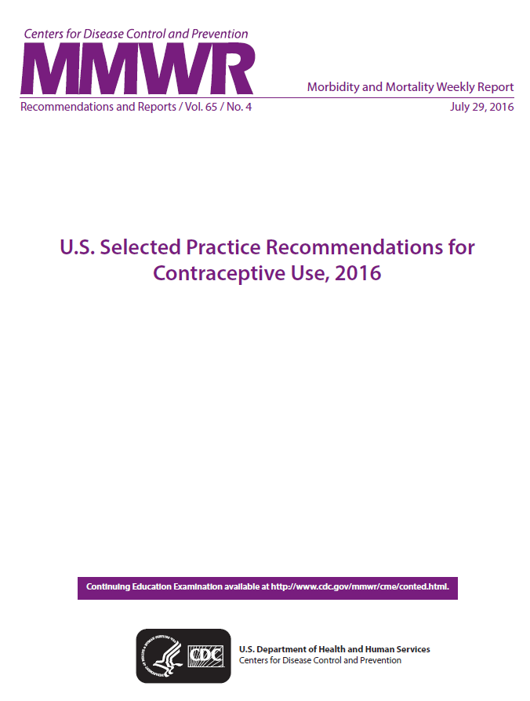
U.S. Selected Practice Recommendations for Contraceptive Use, 2016
Notes:
The US Selected Practice Recommendations for Contraceptive Use (US SPR) was first published in 2013 and updated in 2016.
79

Slide 80
US Selected Practice Recommendations for Contraceptive Use, 2016
Companion document to US MEC, 2016
First published in 2013 and updated in 2016
Intent: Evidence-based guidance for common contraceptive management questions
  When to start
  Missed pills
  Bleeding problems
  Exams and test
  Follow-up
  How to be reasonably certain that a woman is not pregnant
Notes:
The US SPR is a companion document to the US MEC and like the US MEC was adapted from the World Health Organization.
The intention of the US SPR is to provide evidence-based recommendations for common, yet controversial contraceptive management questions, such as issues listed here.

Slide 81
US Selected Practice Recommendations for Contraceptive Use, 2016
Target audience: health-care providers
Guidance for healthcare providers when counseling patients about initiation and use of specific contraceptive methods
Applies to women of all ages, including adolescents
What is NOT included in the US SPR
  NOT the Medical Eligibility Criteria
  NOT comprehensive textbook
  NOT rigid guidelines
  NOT well-woman care
Notes:
The US SPR is intended for use by health-care providers in counseling patients about method use as well as management of certain problems with use.
The US SPR is not a comprehensive textbook, does not answer who can safely use methods like the US MEC, does not provide rigid guidelines to follow and does not address guidance for well-woman care.
The recommendations in the US SPR apply to women of all ages, including adolescents. Adolescents in particular may face certain barriers to initiating and using contraception effectively, including challenges in accessing supplies and difficulties with adherence. The goal of the US SPR is to reduce these barriers by providing guidance for how all women, including adolescents, can initiate methods easily and continue use effectively.

Slide 82
Format of US SPR
Arranged by contraceptive method
For each recommendation:
  Recommendation itself
  Comments and evidence summary
Simplified text of actual recommendations
Bullets, tables, flowcharts, algorithms

Slide 83
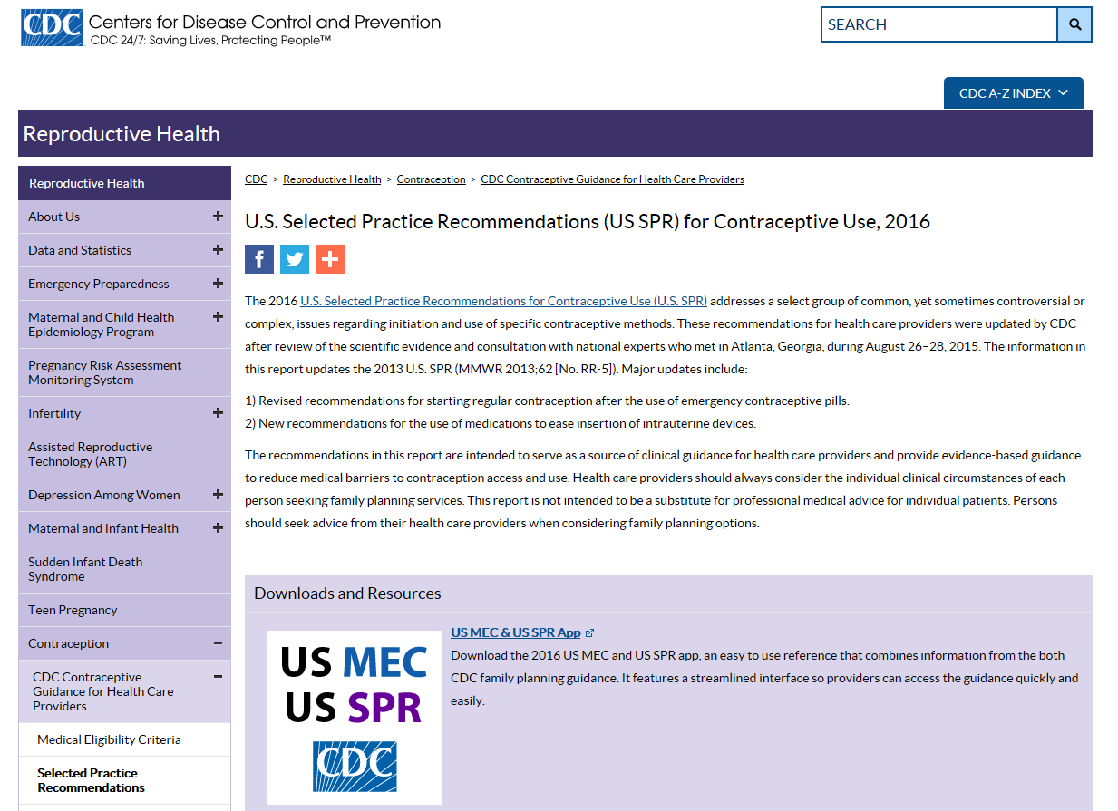
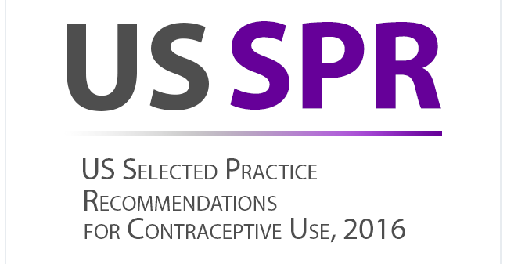
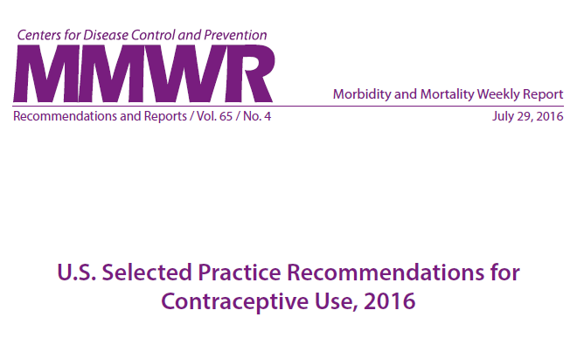
How you can use the US SPR
Notes:
The US SPR can be used in several ways.
83

Slide 84
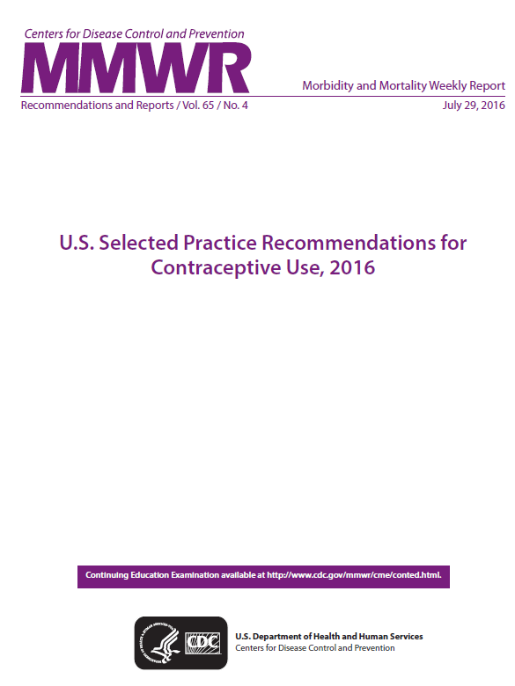
Online access
http://wwwdev.cdc.gov/reproductivehealth/contraception/contraception_guidance.htm
Notes:
The CDC contraception web page for healthcare providers allows for online access to the SPR, similar to the MEC
On the U.S. SPR page, you can find the link to the original publication in CDC’s weekly Morbidity and Mortality Weekly Report (MMWR).
In addition, the page is being updated to include an easy click-through version of the SPR.

Slide 85
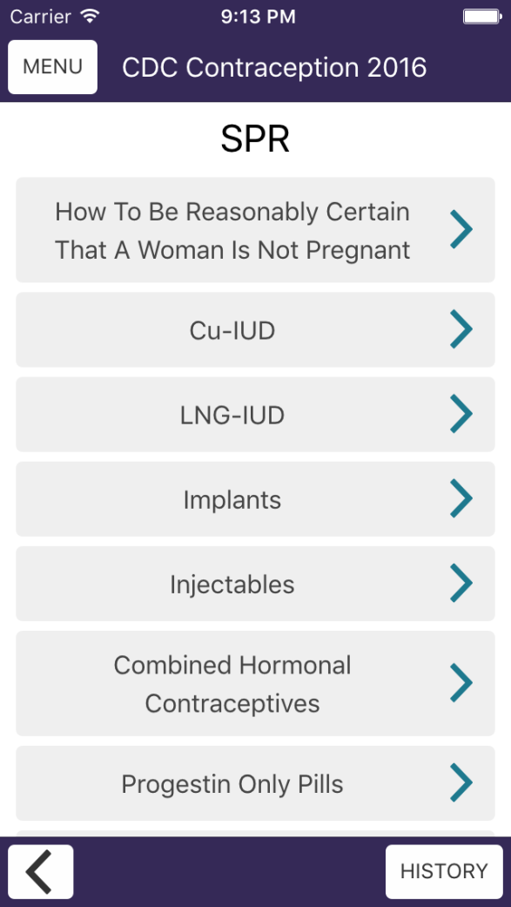
2016 U.S. SPR App
Notes:
The updated CDC Contraception app for apple and android smart phones and tablets now includes the SPR in a user-friendly format, with easy navigation between the SPR and MEC. It also easily links to other CDC guidance such as STD treatment guidelines. This updated app is available for download through our website. Many providers who use smartphones for other clinical references find this to be the easiest way to access the guidelines in everyday practice.

Slide 86
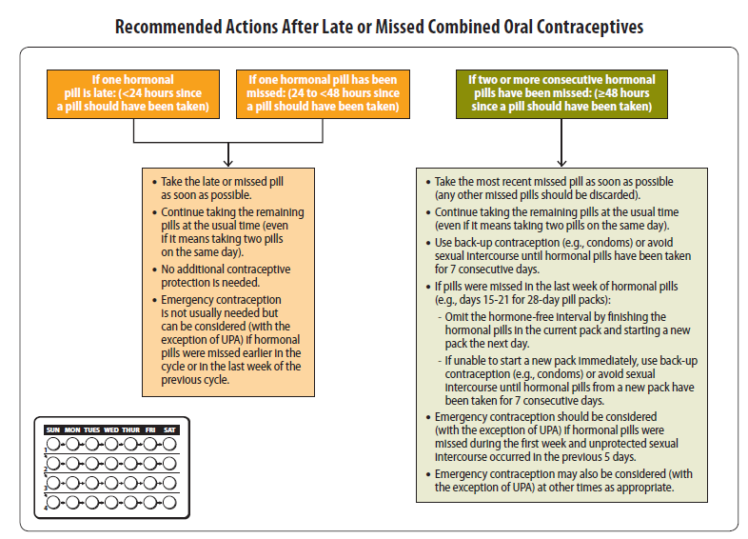
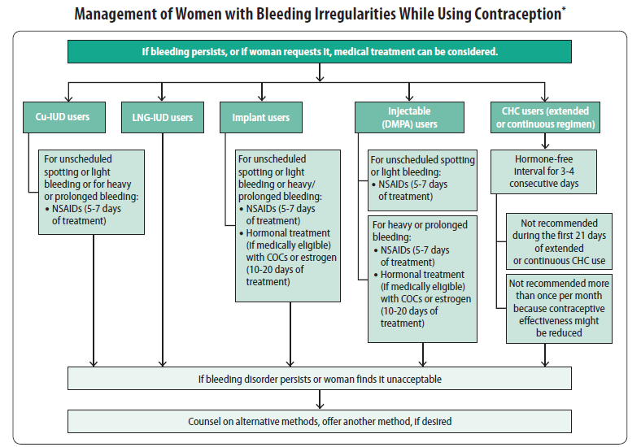
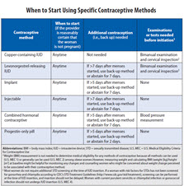
Summary flow charts
Notes:
CDC also has printed and laminated SPR summary charts which can be ordered or printed from our website. Flowcharts for the SPR include management strategies for common issues such as how to be reasonably certain a women is not pregnant, when to start contraception, how to manage late or missed combined hormonal contraceptive methods, management of an IUD with pelvic inflammatory disease, and management of bleeding irregularities while using contraception. Posting the colorful flowcharts in staff work areas can help to raise awareness and use of the guidelines.

Slide 87
CLINICAL SCENARIOS

Slide 88

Clinical Scenario 1:
When to start a contraceptive method?
16 y.o. female comes to office desiring contraception and decides she wants the implant.
  Q: When can she start?

Slide 89
When can a woman start a contraceptive method
Barriers to starting any method
  Waiting for next menses to initiate method
  Coming back for a second (or more) visit
  Filling a prescription
Starting when woman requests contraception (“Quick start”)
  May reduce time woman is at risk for pregnancy
  May reduce barriers to starting
Notes:
There are several barriers to initiating contraception which increases the time a woman is at risk for unintended pregnancy.
Some examples of these barriers are waiting for next menses to start the method or coming back for another visit or the need to fill a prescription.
Quick start is the start of a contraceptive method when a woman requests it.
This may reduce the time a woman is at risk for pregnancy and may reduce barriers to starting a method.

Slide 90
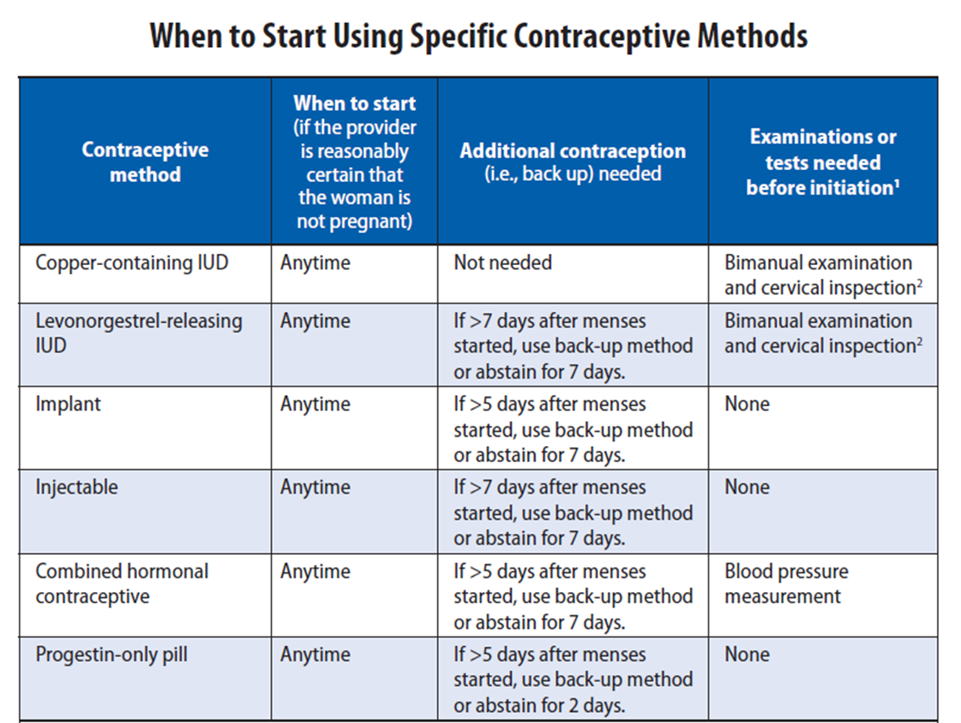
US SPR
Notes:
The US SPR provides guidance both within the document and summarized in a user-friendly chart to guide providers on when to start a method and how to counsel patients on backup needs for all methods.
Any of the methods can be started at any time if a provider is reasonably certain that a woman is not pregnant.
For the implant, if it has been more than 5 days since last cycle, she will need to use a back-up method or abstain from sexual intercourse for 7 days.

Slide 91
When to start a contraceptive method:
Other situations
Amenorrheic
Postpartum
  Breastfeeding
  Not breastfeeding
Postabortion
Switching from another contraceptive method
Notes:
For women in other situations that may not have a last menstrual cycle to refer to, guidance on how to initiate methods is also provided.
These situations include for women who are amenorrheic, postpartum, postabortion or are switching from another method.
These recommendations can be found under each contraceptive method in the When to Start section.

Slide 92
Clinical Scenario 1:
When to start a contraceptive method?
16 y.o. female comes to office desiring contraception and decides she wants the implant.
  Q: When can she start?
  A: Anytime, if reasonably certain she is not pregnant.
    If it has been more than 5 days since menstrual bleeding started, she will need to abstain from sex or use additional contraceptive protection for the next 7 days
Notes:
To answer this question, the recommendation for pills and for all methods is a woman can start a method anytime, if a provider can be reasonably certain she is not pregnant
If it has been more than 5 days since menstrual bleeding started, she will need to abstain from sex or use additional contraception for the next 7 days after starting her combined pills

Slide 93

Clinical Scenario 2:
How to be reasonably certain that a woman is not pregnant
16 y.o. female comes to office desiring contraception and decides she wants the implant.
  Q: How can you be reasonably certain
  she is not pregnant?

Slide 94
Evidence: Pregnancy test limitations
Pregnancy detection rates can vary based on sensitivity of test and timing with respect to missed menses
Pregnancy test not able to detect pregnancy resulting from recent intercourse
Pregnancy test may remain positive several weeks after pregnancy ends
Cervinski, Clin Chem Lab Med. 2010;48:935-42.
Cole LA, Expert Rev Mol Diagn. 2009;9:721-47.
Wilcox, JAMA. 2001;286:1759-61.
Korhonen, Clin Chem. 1997;43:2155-63.
Reyes, Am J Obstet Gynecol. 1985;153:486-9.
Steier, Obstet Gynecol. 1984;64:391-4.
Notes:
Some providers may question whether or not they should do a pregnancy test to rule out pregnancy and may also question if a pregnancy test is enough.
The evidence shows that pregnancy testing does have limitations.
Pregnancy detection rates vary depending on the sensitivity of the test and the timing of testing with respect to missed menses, last intercourse or last pregnancy.
False negatives may occur with recent intercourse while false positives may occur after recent pregnancy.

Slide 95
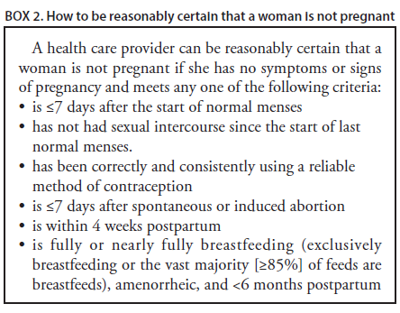
US SPR

Slide 96
Evidence on Pregnancy Checklist (PC)
Study, year, country | # Women | Positive preg test | Sensitivity of PC | Specificity of PC | PPV of PC | NPV of PC
Stanback, 1999, Kenya | 1852 | 1% | 64% | 89% | 6% | 99%
Stanback, 2006, Kenya | 1852 (without signs/sx) | 1% | 55% | 90% | 6% | 99%
Stanback, 2008, Nicaragua | 263 | 1% | 100% | 60% | 3% | 100%
Torpey, 2010, Africa | 535 HIV+ | 4% | 90.9% | 38.7% | 6% | 99%
Whiteman, 2015, USA | 350 teens | 9% | 71% | 76% | 22% | 96%
Stanback, Lancet, 1999;354:566.
Stanback, J Fam Plann Reprod Health Care, 2006;32:27.
Stanback, Rev Panam Salud Publica, 2008;23:116.
Torpey, BMC Public Health, 2010;10:249.
Whiteman, Obstet Gynecol, 2014:123;777-84.
Notes:
Several studies have been conducted comparing the negative predictive value of this criteria with a pregnancy test.
These studies all showed a negative predictive value of 96% to 100%.
This means of the 100 who had a negative result according to the pregnancy checklist, 96 to 100 of them were not pregnant according to a pregnancy test.
This indicates that this pregnancy checklist criteria can be used to accurately rule out pregnancy and safely start contraception.

Slide 97
Clinical scenario 2:
How to be reasonably certain that a woman is not pregnant
16 y.o. female comes to office desiring contraception and decides she wants the implant.
  Q: How can you be reasonably certain she is not pregnant?
  A: If she has no signs or symptoms of pregnancy and fulfills one of criteria, a provider can be reasonably certain that the women is not pregnant.

Slide 98

Clinical Scenario 3:
Exams and tests
16 y.o. female comes to office desiring contraception and decides she wants the implant.
  Q: Do you need to do any exams or test before she starts?

Slide 99
US SPR
Exams and tests prior to initiation
Unnecessary tests may be barrier to starting
  Women (adolescents) may not be comfortable with pelvic exam
  Coming back for a second (or more) visit to receive test results
Recommendations address exams and test needed prior to initiation
  Class A = essential and mandatory
  Class B = contributes substantially to safe and effective use, but implementation may be considered within the public health and/or service context
  Class C = does not contribute substantially to safe and effective use of the contraceptive method
Notes:
The US SPR also provides recommendations that address exams and tests needed prior to starting a woman on a method, as unnecessary tests may create barriers to contraceptive initiation.
For example, a pelvic exam itself may be a barrier to women getting contraception, especially adolescents, if they are not willing to participate in the exam
Waiting for test results may be another barrier that delays contraceptive use
The US SPR provides recommendations that address exams and tests needed prior to starting a woman on a method
These recommendations are categorized into 3 classes:
Class A are essential and mandatory for a given method
Class B exams and tests contribute substantially to safe and effective use, but implementation may be considered within the public health and/or service context
Finally, Class C does not contribute substantially to safe and effective use of the method

Slide 100
US SPR
Exams and tests prior to initiation
Examination or test | Contraceptive method and class
Examination | LNG and Cu-IUD | Implant | Injectable | CHC | POP | Condom
Blood pressure | C | C | C | A* | C | C
Weight (BMI) | — † | —† | —† | —† | —† | C
Clinical breast examination | C | C | C | C | C | C
Bimanual examination and cervical inspection | A | C | C | C | C | C
Laboratory test
Glucose | C | C | C | C | C | C
Lipids | C | C | C | C | C | C
Liver enzymes | C | C | C | C | C | C
Hemoglobin | C | C | C | C | C | C
Thrombogenic mutations | C | C | C | C | C | C
Cervical cytology (Papanicolaou smear) | C | C | C | C | C | C
STD screening with laboratory tests | —§ | C | C | C | C | C
HIV screening with laboratory tests | C | C | C | C | C | C
Notes:
This slide replicates the summary chart in the US SPR for all contraceptive methods and commonly performed screening exams and tests

Slide 101
US SPR
Exams and tests prior to initiation
Examination or test | Contraceptive method and class
Examination | LNG and Cu-IUD | Implant | Injectable | CHC | POP | Condom
Blood pressure | C | C | C | A* | C | C
Weight (BMI) | — † | —† | —† | —† | —† | C
Clinical breast examination | C | C | C | C | C | C
Bimanual examination and cervical inspection | A | C | C | C | C | C
Laboratory test
Glucose | C | C | C | C | C | C
Lipids | C | C | C | C | C | C
Liver enzymes | C | C | C | C | C | C
Hemoglobin | C | C | C | C | C | C
Thrombogenic mutations | C | C | C | C | C | C
Cervical cytology (Papanicolaou smear) | C | C | C | C | C | C
STD screening with laboratory tests | —§ | C | C | C | C | C
HIV screening with laboratory tests | C | C | C | C | C | C
Notes:
Here you can see that there are very few class A exams and tests, none of which are listed under Implant.
The blood pressure recommendation before initiating combined hormonal contraceptives is class A accompanied by this statement:
† In cases in which access to health care might be limited, the blood pressure measurement can be obtained by the woman in a non–health-care setting (e.g., pharmacy or fire station) and self-reported to the provider
A pelvic exam is essential before placement of an IUD or to fit a diaphragm or cervical cap but is not necessary for any other method.

Slide 102
Pelvic Exam before Initiating Contraception
Is not necessary before starting implant
No US MEC 3 or 4 conditions will be detected by pelvic
Evidence:
  Two case-control studies
  Delayed versus immediate pelvic exam before contraception
  No differences in risk factors for cervical neoplasia incidence of STDs, incidence of abnormal Papanicoolaou smears, or incidence of abnormal wet mounts were found
Tepper, Contraception. 2013 May;87(5):650-4.
Notes:
Pelvic examination is not necessary before initiation of the implant because it does not facilitate detection of conditions for which hormonal contraceptives would be unsafe.
A systematic review examined two case-control studies comparing delayed and immediate pelvic examination before initiation of oral contraceptives or DMPA.
No differences in risk factors for cervical neoplasia, incidence of STDs, incidence of abnormal Papanicolaou smears, or incidence of abnormal wet mounts were found.

Slide 103
US SPR
Exams and tests prior to initiation
Examination or test | Contraceptive method and class
Examination | LNG and Cu-IUD | Implant | Injectable | CHC | POP | Condom
Blood pressure | C | C | C | A* | C | C
Weight (BMI) | — † | —† | —† | —† | —† | C
Clinical breast examination | C | C | C | C | C | C
Bimanual examination and cervical inspection | A | C | C | C | C | C
Laboratory test
Glucose | C | C | C | C | C | C
Lipids | C | C | C | C | C | C
Liver enzymes | C | C | C | C | C | C
Hemoglobin | C | C | C | C | C | C
Thrombogenic mutations | C | C | C | C | C | C
Cervical cytology (Papanicolaou smear) | C | C | C | C | C | C
STD screening with laboratory tests | —§ | C | C | C | C | C
HIV screening with laboratory tests | C | C | C | C | C | C
Notes:
The highlighted area shows that there is a footnoted recommendation for measuring weight and calculating body mass index (BMI) before initiation of methods
For Implant initiation, the recommendation for checking weight is “Weight (BMI) measurement is not needed to determine medical eligibility for any methods of contraception because all methods can be used (USMEC 1) or generally can be used (USMEC 2) among obese women (5). However, measuring weight and calculating BMI at baseline might be helpful to monitor any changes and counsel women who might be concerned about weight change perceived to be associated with their contraceptive method.”

Slide 104
Weight (BMI) Measurement before Initiating Contraception
Is not necessary before starting implant
Footnote states:
  “Weight (BMI) measurement is not needed to determine medical eligibility for any methods of contraception because all methods can be used (U.S. MEC 1) or generally can be used (U.S. MEC 2) among obese women. However, measuring weight and calculating BMI at baseline might be helpful for monitoring any changes and counseling women who might be concerned about weight change perceived to be associated with their contraceptive method.”

Slide 105
Clinical Scenario 3:
Exams and tests
16 y.o. female comes to office desiring contraception and decides she wants the implant.
  Q: Do you need to do any exams or test before she starts?
  A: No
Notes:
There are no exams or tests that are necessary before initiating the implant.
Measuring weight and calculating BMI at baseline might be helpful to monitor any changes and counsel women who might be concerned about weight change perceived to be associated with their contraceptive method.

Slide 106
Clinical Scenario 3:
Exams and tests
16 y.o. female comes to office desiring contraception and now decides she wants the levonorgestrel IUD.
  Do any of the previous steps change?
  Q1: When can she start?
  Q2: How can you be reasonably certain she is not pregnant?
  Q3: Do you need to do any exams or tests before she starts?
Notes:
What if she decided to get a levonorgestrel IUD instead of an implant? Do any of the previous steps change?
The first question was “When can she start?” She can start anytime as long as a provider can be reasonably certain that she is not pregnant.
The criteria to answer the second question, how to be reasonably certain that she is not pregnant, have also been reviewed.
Finally, the third question asks if any exams or tests need to be done before initiating. Explore the chart on the next slide for the answer.

Slide 107
US SPR
Exams and tests prior to initiation
Examination or test | Contraceptive method and class
Examination | LNG and Cu-IUD | Implant | Injectable | CHC | POP | Condom
Blood pressure | C | C | C | A* | C | C
Weight (BMI) | — † | —† | —† | —† | —† | C
Clinical breast examination | C | C | C | C | C | C
Bimanual examination and cervical inspection | A | C | C | C | C | C
Laboratory test
Glucose | C | C | C | C | C | C
Lipids | C | C | C | C | C | C
Liver enzymes | C | C | C | C | C | C
Hemoglobin | C | C | C | C | C | C
Thrombogenic mutations | C | C | C | C | C | C
Cervical cytology (Papanicolaou smear) | C | C | C | C | C | C
STD screening with laboratory tests | —§ | C | C | C | C | C
HIV screening with laboratory tests | C | C | C | C | C | C
Notes:
There are few exams and tests that are necessary before starting contraception.
A pelvic exam is essential before placement of an IUD, therefore it is the only class A exam or test listed for an IUD.
Measuring weight and calculating BMI at baseline might be helpful to monitor any changes and counsel women who might be concerned about weight change perceived to be associated with their contraceptive method.
For IUD use, the US SPR recommendation states that most women do not require additional STD screening at the time of IUD insertion. If a woman with risk factors for STDs has not been screened for gonorrhea and according to CDC’s STD Treatment Guidelines (http://www.cdc.gov/std/treatment/2010/), screening can be performed at the time of IUD insertion, and insertion should not be delayed.
Women with current purulent cervicitis or chlamydial infection or gonococcal infection should not undergo IUD insertion.

Slide 108
Clinical scenario 3:
Exams and tests
16 y.o. female comes to office desiring contraception and now decides she wants the levonorgestrel IUD.
  Q3: Do you need to do any exams or test before she starts?
  A: Pelvic exam and STI screening as appropriate.
Centers for Disease Control and Prevention. Sexually Transmitted Diseases Treatment Guidelines, 2010. MMWR 2010;59. No RR-12
Notes:
For IUD placement, a bimanual exam is necessary before placement.
STI screening should also be performed according to CDC STD Treatment Guidelines.
That means annual screening of all sexually active females aged ≤25 years for C. trachomatis and N. gonorrhoeae. Women aged <25 years are at highest risk for gonorrhea infection. For IUD use, the US SPR recommendation states that most women do not require additional STD screening at the time of IUD insertion. If a woman with risk factors for STDs has not been screened for gonorrhea and according to CDC’s STD Treatment Guidelines (http://www.cdc.gov/std/treatment/2010/), screening can be performed at the time of IUD insertion, and insertion should not be delayed.
Women with current purulent cervicitis or chlamydial infection or gonococcal infection should not undergo IUD insertion.

Slide 109

Clinical Scenario 4 :
Emergency Contraception
17 y.o. female had unprotected intercourse 4 days ago and is worried about pregnancy.
  Q: What are her emergency
  contraception options?

Slide 110
Four options available in the US
Intrauterine device
  copper intrauterine device (Cu-IUD)
Emergency contraceptive pills (ECPs)
  ulipristal acetate (UPA) available in a single dose (30 mg)
  levonorgestrel (LNG) in a single or split dose
  estrogen/progestin in 2 doses
Notes:
Currently there are four options for emergency contraception or EC.
The copper Intrauterine device and three types of emergency contraceptive pills or ECPs.
The three types of pills include ulipristal acetate or UPA, levonorgestrel or LNG as well as combined estrogen and progestin oral contraceptive pills.
All options may be utilized within 5 days of unprotected sexual intercourse.
The Copper IUD should be placed within 5 days of the first act of unprotected sexual intercourse.

Slide 111
SPR Recommendation on Effectiveness
Large systematic review of 42 studies showed that the pregnancy rate among emergency Cu-IUD users is 0.09%
UPA and LNG ECPs have similar effectiveness when taken within 3 days after unprotected intercourse
  UPA has been shown to be more effective than the LNG formulation between 3 and 5 days after unprotected intercourse.
UPA may be more effective than LNG for women who are obese.
The combined estrogen/progestin regimen is less effective than UPA or LNG and is associated with more frequent side effects
Cleland K. Hum Reprod 2012;27:1994-2000.
Jatlaoui T. Contraception 2016;93:93-112.
Jatlaoui T. Contraception 2016;94:605-11.
Notes:
Since these options are not all the same, how can you help her choose the best option for her?
The evidence shows that Copper IUDs are highly effective as emergency contraception and can be continued as regular contraception if that is what she desires and she is willing to come in for a visit.
UPA and LNG have similar effectiveness when taken within 3 days after unprotected intercourse while UPA may be more effective between days 3 and 5 after unprotected sex.
UPA may also be more effective than LNG for women who are obese according to one study.
The combined regimen also known as Yuzpe method is less effective than the other two ECPs and is associated with more frequent side effects particularly nausea and vomiting.

Slide 112
Clinical Scenario 4 :
Emergency Contraception
17 y.o. female had unprotected intercourse 4 days ago and is worried about pregnancy.
  Q: What are her emergency contraception options?
  A:
    Copper IUD
    Ulipristal acetate
    Levonorgestrel ECPs
    Combination estrogen/progestin pills
Notes:
This patient therefore has four options for emergency contraception – there are no conditions for which she cannot take emergency contraceptive pills; for emergency IUD use, she needs to meet the eligibility criteria for regular IUD insertion.

Slide 113
Clinical Scenario 4 :
Initiation of regular contraception after emergency contraception pills
17 y.o. female had unprotected intercourse 4 days ago and is worried about pregnancy. She has chosen to take UPA
  Q: When can she start regular
  contraception after ECPs?
Notes:
If she decides to take ulipristal acetate, when can she start regular contraception after taking the pills?

Slide 114
Evidence
Data limited to pharmacodynamics data and expert opinion.
One pharmacodynamic study raised concern for decreased effectiveness of UPA if hormonal contraception was started the next day.
Cameron et al, Human Reproduction, 2015
Brache et al, Human Reproduction, 2015
Salcedo et al, Contraception, 2013
Notes:
Resuming regular contraception after emergency contraceptive pills (ECPs) requires consideration of the risk for pregnancy if ECPs fail and the risk of unintended pregnancy if contraception initiation is delayed until the next menstrual cycle.
There is no concern with starting or resuming hormonal contraception concurrently with estrogen or progestin ECPs because these methods do not contain an anti-progestin and have not been shown to have negative effects on an early pregnancy.
Data on when to start contraception after UPA ECPs is limited to pharmacodyamic data and expert opinion.
One pharmacodynamics study raised concern for decreased effectiveness of UPA if hormonal contraception was started the next day, specifically, less ovulation suppression.

Slide 115
US SPR Recommendation:
When to initiate regular contraception after ECPs
Levonorgestrel or combined ECPs:
  Any regular contraceptive method can be started immediately
  Abstain from intercourse or use backup for 7 days
UPA ECPs:
  Resume or start hormonal contraception no sooner than five days after UPA
  Non-hormonal contraception can be started immediately
  Abstain from intercourse or use backup for 7 days after starting contraception
Advise the woman to have a pregnancy test, if she does not have a withdrawal bleed within 3 weeks.
Notes:
Therefore, after levonorgestrel or combined ECPs, any regular contraceptive method can be started immediately. The woman should abstain from intercourse or use backup for 7 days, and take a pregnancy test if she does not have a withdrawal bleed within three weeks
For women using UPA, she should resume or start hormonal contraception no sooner than five days after UPA due to possible concerns of decreased effectiveness of UPA if hormonal contraception is started sooner. This may require a repeat visit depending on her method choice.
Non-hormonal contraception can be started immediately
Abstain from intercourse or use backup for 7 days after starting contraception

Slide 116
Clinical Scenario 4 :
Initiation of regular contraception after emergency contraception pills
17y.o. female had unprotected intercourse 4 days ago and is worried about pregnancy.
  Q: When can she start regular contraception after ECPs?
  A: Depends on the type of ECP:
    UPA: After 5 days
    LNG/CHCs: Immediately
    She will need to abstain from sex or use barrier contraception until she has been on the new method for 7 days or until her next menses, whichever comes first.

Slide 117
Take Home Messages
Rates of adolescent pregnancy in the US are decreasing, but remain high
Adolescents who are at risk of unintended pregnancy need access to highly effective contraceptive methods
Adolescents are eligible to use all methods of contraception
  There is no contraceptive method that an adolescent cannot use based on age alone
Long-acting, reversible contraception (LARCs) may be particularly suitable for many adolescents
  IUDs
  Implants
Dual protection should be encouraged for adolescents
Notes:
Rates of adolescent pregnancy in the US are decreasing, but remain high.
Adolescents who are at risk of unintended pregnancy need access to highly effective contraceptive methods.
Adolescents are eligible to use all methods of contraception.
There is no contraceptive method that an adolescent cannot use based on age alone.
Long-acting, reversible contraception (LARCs) including IUDs and implants may be particularly suitable for many adolescents.
Dual protection should be encouraged for adolescents.

Slide 118
Take Home Messages
Most women of any age can start methods anytime
Few, if any, exams or tests are needed
Anticipatory counseling for potential bleeding problems and proper management provided
Routine follow-up generally not required
Discuss emergency contraception often
Regular contraception should be started after EC
Notes:
Most women, including teens, can start methods of contraception anytime (including on the day of the visit), as long as the provider is reasonably certain that the woman is not pregnant.
Few, if any, examinations or tests are needed before starting a contraceptive method.
Bleeding problems are a major reason for contraceptive discontinuation; recommendations on anticipatory counseling before starting a method and management of bleeding problems are provided.
Adolescents should be advised to return at any time to discuss side effects or other problems, if she wants to change the method being used, and when it is time to remove or replace the contraceptive method. Otherwise, routine follow-up is generally not required.
Many options for emergency contraception are available, including the copper-IUD and different formulations of pills. Regular contraception should be started after emergency contraceptive use.

Slide 119
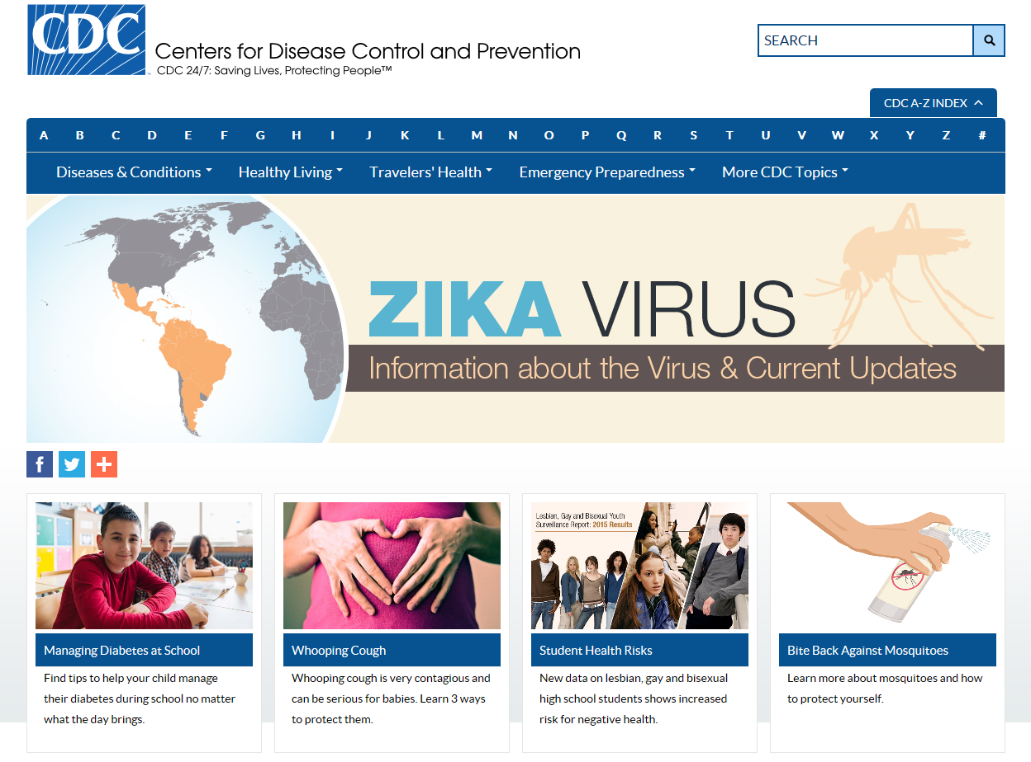
How to find Teen Pregnancy information?
www.cdc.gov
Notes:
More Teen Pregnancy information can be found at cdc.gov then clicking on “T” from the A-Z Index
Teen Pregnancy is then listed on the left hand side of the following page

Slide 120
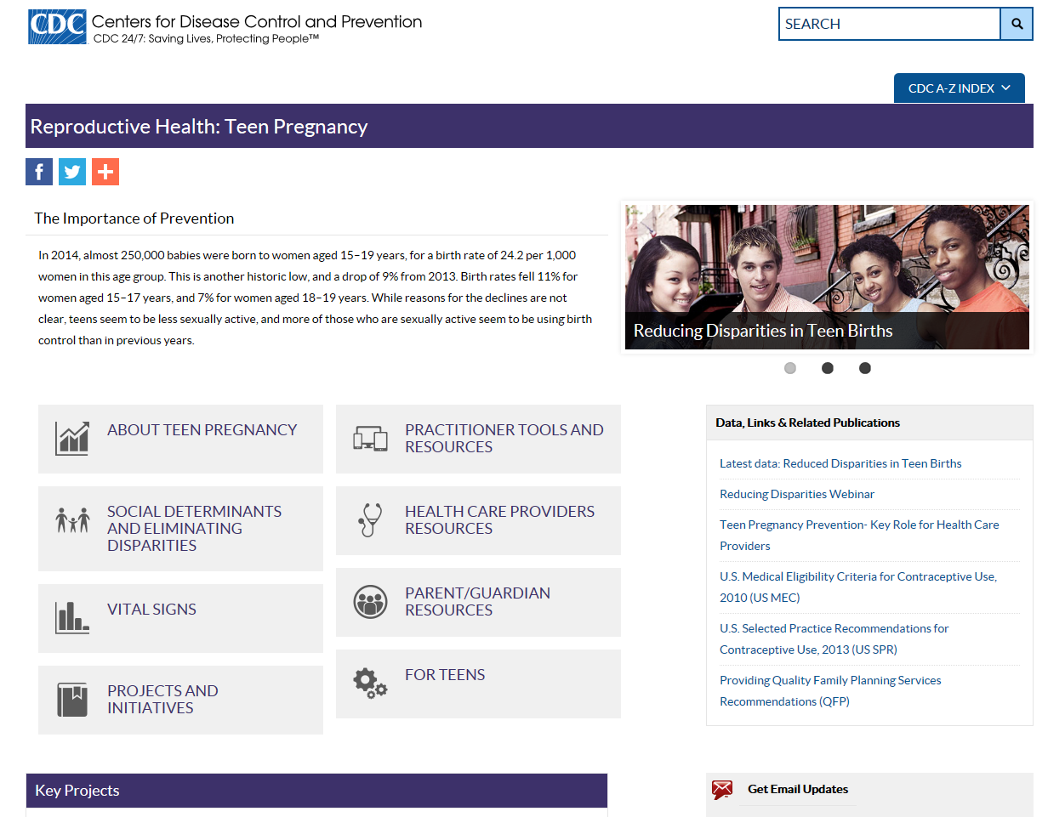
CDC Teen Pregnancy
http://www.cdc.gov/teenpregnancy/

Slide 121
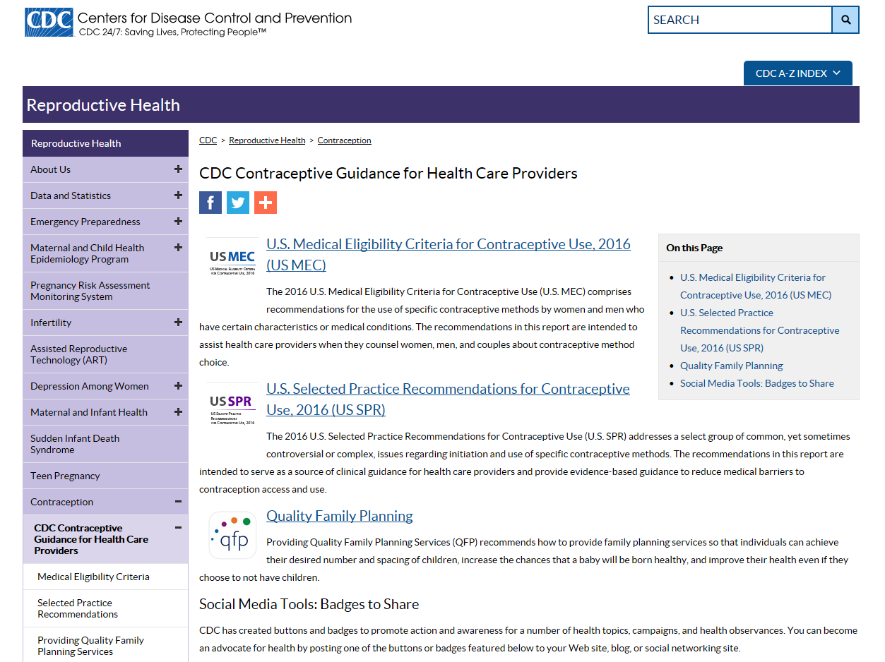
CDC Contraceptive Guidance
http://www.cdc.gov/reproductivehealth/contraception/contraception_guidance

Slide 122
Resources
US MEC published in CDC’s Morbidity and Mortality Weekly Report (MMWR):
http://www.cdc.gov/mmwr/volumes/65/rr/rr6503a1.htm?s_cid=rr6503a1_w
US SPR published in CDC’s Morbidity and Mortality Weekly Report (MMWR):
http://www.cdc.gov/mmwr/volumes/65/rr/rr6504a1.htm
CDC evidence-based family planning guidance documents:
http://www.cdc.gov/reproductivehealth/UnintendedPregnancy/USMEC.htm
CDC Vital Signs:
http://www.cdc.gov/vitalsigns/teenpregnancy

Slide 123
Use of trade names and commercial sources is for identification only and does not imply endorsement by the US Department of Health and Human Services.
The findings and conclusions in this presentation have not been formally disseminated by the Centers for Disease Control and Prevention and should not be construed to represent any agency determination or policy.

