Slide 1
Topic 9:
Hand Hygiene
Notes:
Facilitator Notes
Participants log in and get settled.

Slide 2
Agenda
Introduction
Hand Hygiene
Reflection & Next Steps
Notes:
Facilitator Notes
Welcome
Housekeeping, either orally or via chat
If needed, additional notes specific to the platform you’re using (e.g., how to “raise your hand,” how to post questions)
Overview of agenda
If this session is part of an ongoing series, you may choose to say “welcome back,” “thank you for joining us again,” etc.
Sample Script
“Welcome to Project Firstline. Over the next hour, we’ll focus on the importance of hand hygiene in healthcare. Please keep your videos on, to the extent possible, and keep your microphone muted when you are not contributing to the discussion. It’s great to see you all here today!
“Today we’ll discuss the importance of having clean hands in healthcare, review how and why germs can be spread by hands, and practice supporting good hand hygiene practices at work. We’ll also have an opportunity to reflect before we wrap up for the day.”

Slide 3
Learning Objectives
Describe two (2) reasons why having clean hands is especially important in healthcare.
Discuss two (2) reasons why hands are a main way that germs can spread in the environment.
Notes:
Facilitator Notes
Provide an overview of the session’s learning objectives.
Sample Script
“Here is what we expect we will learn today. By the end of today’s training, you will be able to describe why it’s so important for those of us in healthcare to have clean hands. You’ll also be able to describe why hands are a main way that germs can spread in the environment.”

Slide 4
INTRODUCTIONS
Please introduce yourself with:
Your name
Your role
Notes:
Facilitator Notes
These questions will give you a better understanding of your participants’ backgrounds, experience, and level of knowledge.
Tailor your slide delivery for the virtual format and platform, and the number of participants:
You may wish to call on participants individually.
You may wish to add role- or facility-specific questions to the introductions.
If you have a large group, you may decide to skip oral introductions and use the chat.
If your group meets regularly, you may wish to skip or shorten the introductions, or use a different “icebreaker” approach.
Be sure to introduce yourself, and anyone who is assisting you.
Sample Script
“Let’s take a minute to get to know each other. Please share in 30 seconds or less your name and your role at work. I’ll start. My name is …”

Slide 5
Definitions
Hand Hygiene | Hand hygiene means cleaning your hands by using either handwashing (washing hands with soap and water), antiseptic hand wash, antiseptic hand rub (i.e., alcohol-based hand sanitizer including foam or gel), or surgical hand antisepsis.
Notes:
Facilitator Notes
Either allow time for participants to read the definition themselves or read it aloud.
“Hand Hygiene means cleaning your hands by using either handwashing (washing hands with soap and water), antiseptic hand wash, antiseptic hand rub (i.e., alcohol-based hand sanitizer including foam or gel), or surgical hand antisepsis.”
CDC source for the definition: https://www.cdc.gov/handhygiene/providers/index.html
Establish that hand hygiene, or cleaning your hands, includes both washing hands with soap and water and using alcohol-based hand sanitizer.
You may choose to ask participants to share their reactions orally, via chat, or both.
Sample Script
“Before we get started, let’s review a definition of hand hygiene. Go ahead and read the definition to yourself.”
(Pause as participants read.)
“We talk about hand hygiene – the simpler way to say it is just ‘cleaning your hands!’ – and not ‘washing your hands.’ Does anyone have an idea why?”
(Pause for responses.)
“Right. It’s because hand hygiene includes washing your hands with soap and water and using alcohol-based hand sanitizer.”

Slide 6
Share Your Current Practice
How many times do you wash your hands or use alcohol-based hand sanitizer throughout an average workday?
Notes:
Facilitator Notes
Invite participants to estimate how many times they clean their hands during their workday.
Depending on your platform, you could use hand-raising, thumbs-up, or the chat function.
Ask participants how many times they clean their hands in increasing amounts until you find the one(s) with the highest count.
This activity is meant to serve as an ice-breaker and introduction; it is not meant to make anyone feel embarrassed that they do not clean their hands enough!
You could choose to ask participants to share some examples of when they clean their hands during a workday.
Sample Script
“We all recognize and appreciate the importance of hand hygiene. We hear it all the time: wash your hands! Even before COVID-19, hand hygiene was a big part of our daily lives in healthcare. But did you ever stop to think about how often you clean your hands, either by washing with soap and water, or by using alcohol-based hand sanitizer?
“Spend a few minutes reflecting on your average day and try to count the number of times you clean your hands on the job. You can use the blank pages in your participant booklet if you’d like to keep a tally. When you have your estimate, use the hand-raising feature to let me know you’re ready.”
(Pause for 1-2 minutes as participants reflect.)
“Great. It looks like everyone is ready. Let’s see who has the highest count! Who cleans their hands more than 10 times a day during work?”
(Pause for responses.)
“How about 20 times per workday?”
(Pause for responses. Continue in this way until you find the individual who has the highest estimate.)
“Wow! And if we factored in cleaning our hands before and after our workdays, the numbers would get even higher! So, you may ask, why talk about hand hygiene again?”

Slide 7
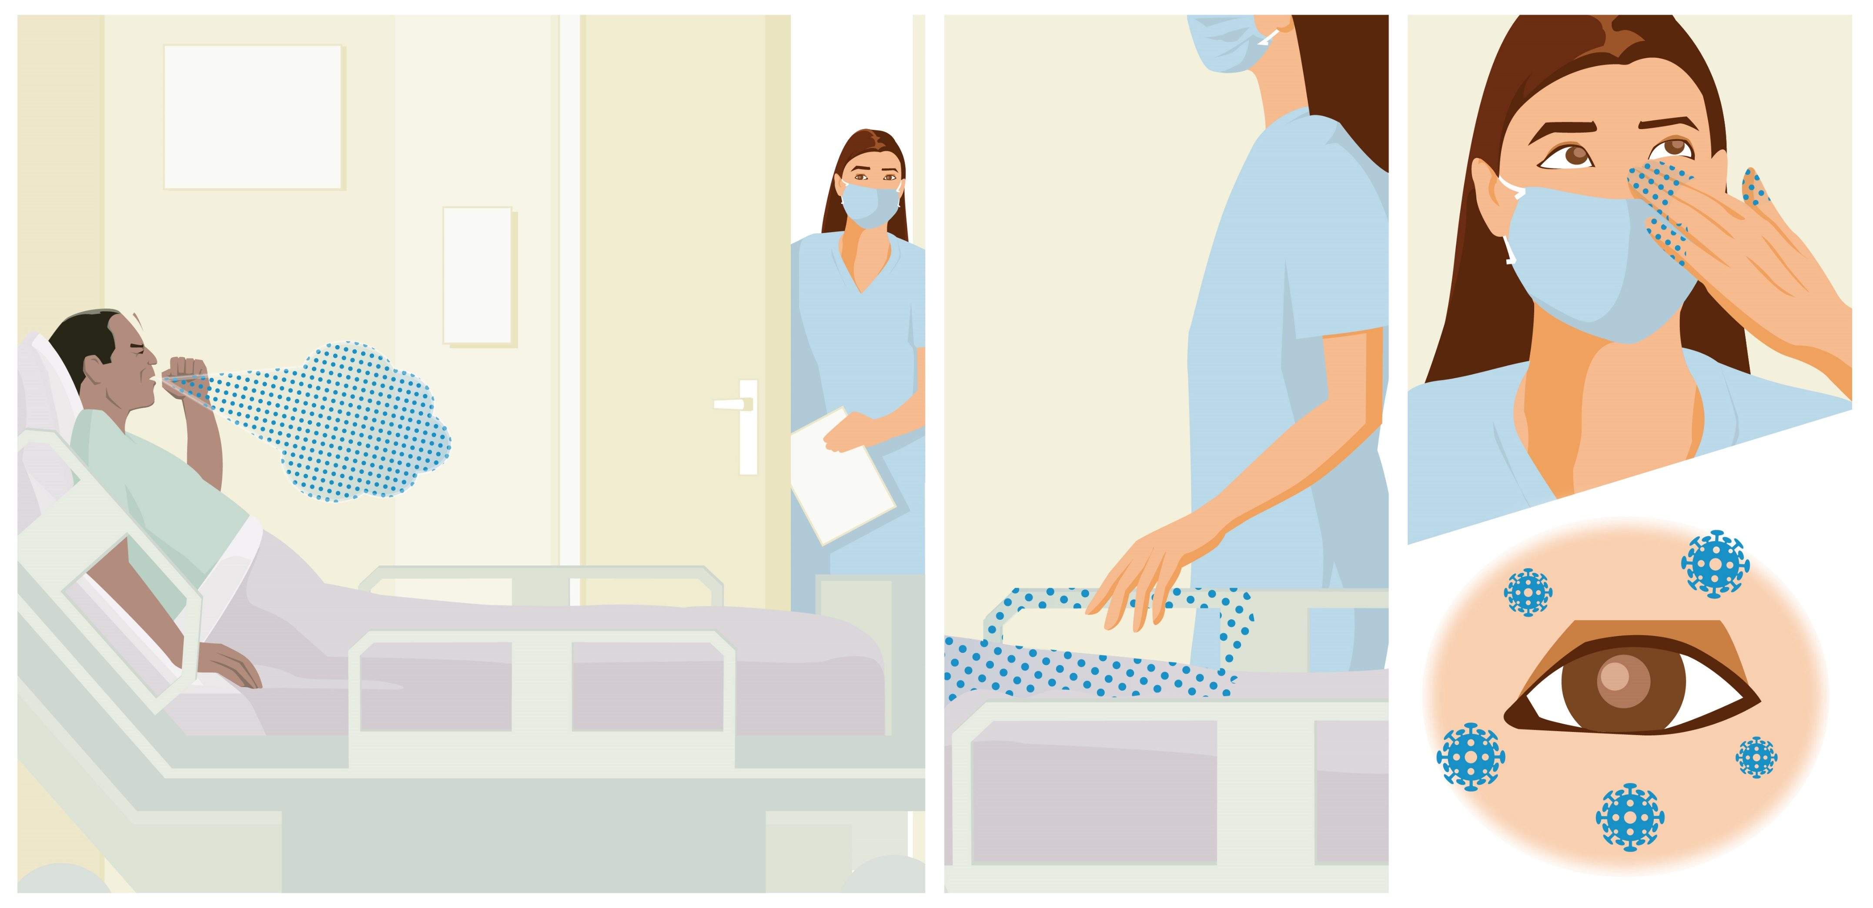
GERMS Can SPREAD From Surfaces
Notes:
Facilitator Notes
While this graphic provides an overview of how viruses can spread from surfaces to people, for more information, you can also share Episode 6 of Inside Infection Control: How Do Viruses Spread from Surfaces to People?: bit.ly/SurfaceToPeopleSpread
The Content Outline for this video episode is provided at the end of this document for your reference.
CDC sources for statistics about healthcare provider hand hygiene compliance: Hand Hygiene in Healthcare Settings | CDC (https://www.cdc.gov/handhygiene/index.html) and Show Me the Science | Hand Hygiene | CDC (https://www.cdc.gov/handhygiene/science/index.html).
You may choose to research specific rates for your audience.
Sample Script
“Germs are everywhere, and we can spread them, without knowing it, to other surfaces, things, and people. In healthcare, you are likely to come into contact with things that carry germs, like respiratory droplets, saliva, blood, and waste, and you’re more likely to touch patients at risk for bad infections.
“In this graphic, we see a patient who is ill and coughing, with respiratory droplets traveling into the air and landing on surfaces, where the healthcare worker picks them up with her hands and, unfortunately, carries the germs to her eyes. The healthcare worker could also easily carry the germs to her nose or mouth while or after removing her mask.
“As a quick reminder, if we touch something that has germs on it with our hands and then touch our eyes, mouth, or nose, without cleaning our hands first, we could get sick. If we touch something with germs on it, and then touch something else without cleaning our hands first, we can spread germs that can be picked up by someone else. This is how a lot of germs spread in healthcare – not just viruses.
“That’s why cleaning our hands is such an important part of infection control.
“Let’s hear more about how hand hygiene can help from the CDC’s Dr. Carlson.”

Slide 8
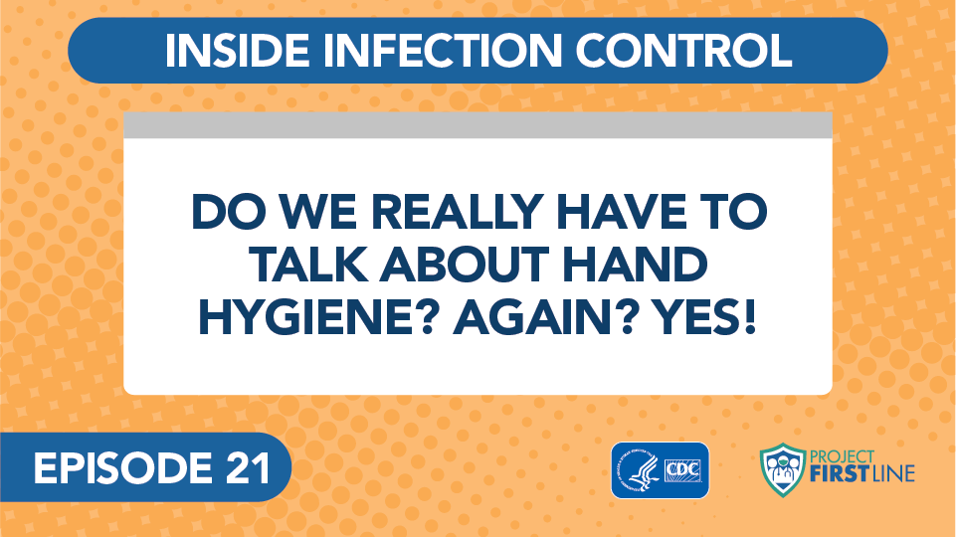
Inside Infection Control
Notes:
Facilitator Notes
Access the video here:
CDC Website: https://www.cdc.gov/infectioncontrol/projectfirstline/videos/EP21-Hands-LowRes.mp4
OR
Project Firstline YouTube Playlist: https://www.youtube.com/watch?v=n1oqVM-N3j8

Slide 9
Discussion
What did we learn from the nursing example?
Healthcare workers touch a lot of items during their workday,
so being diligent about hand hygiene matters.
Notes:
Facilitator Notes
Invite participants to share what they learned, either orally or in the chat.
The main takeaway from this discussion should be that hospital staff touch a lot of items during the day, so being diligent about hand hygiene matters. You may wish to use the following talking points, and additional points from the Content Outline for this video, to confirm participant responses:
Nursing staff touch up to 15 different surfaces during a single patient interaction.
For the average nurse, that’s 912 different surfaces during a 12-hour shift.
Every one of those surfaces has germs on it, so it makes sense that cleaning your hands and using gloves correctly are so important.
This slide uses animations. After the discussion, advance the slide to reveal the text in bold.
Sample Script
“Hearing Dr. Carlson talk about a nurse’s workday, and the number of surfaces that are touched, what did we learn?”
(Pause for responses. Reveal text in bold.)
“That’s right. To sum up, healthcare workers touch a lot of things during their workday, so being diligent about hand hygiene is really important. But even though we all know how important it is to clean our hands to keep germs from spreading, studies show that on average, healthcare providers clean their hands less than half of the times they should.
“We might need to clean our hands as many as 100 times per 12-hour shift, depending on the number of patients and intensity of care.” (Source: https://www.cdc.gov/handhygiene/science/index.html)

Slide 10
Discussion
What stands out as particularly important about hand hygiene in healthcare?
Some parts of the hands make it easier for germs to grow, like between fingers, under the fingernails, and in breaks in the skin. That’s why we need to clean our hands very well.
Notes:
Facilitator Notes
Invite volunteers to share their reactions and reflections.
You may also wish to refer to the Content Outline for the video episode, which is provided at the end of this document, for points to emphasize.
The main takeaway from this discussion is that it is especially easy for germs to grow in certain parts of the hand.
This slide uses animations. After the discussion, use the animation to reveal the text in bold.
Sample Script
“I’d love to hear your thoughts about hand hygiene. Did anything from the video stand out as particularly important about hand hygiene in healthcare?”
(Pause for responses. Reveal text in bold.)
“To recap, some parts of the hand make it easier for germs to grow, like between fingers, under the fingernails, and in breaks in the skin, such as a rash or cut. So, we need to be very careful to clean our hands - and those parts in particular - very well.”

Slide 11
Breakout Groups
Instructions
Discuss the scenario.
Brainstorm a strategy that you could use if you find yourself in this situation.
Breakout Groups 1 and 2
Scenario: In patient care environments, you notice a supervisor who never washes their hands after removing gloves.
Breakout Groups 3 and 4
Scenario: You notice a colleague who seems to leave their phone everywhere – on the floor, on the counter, at the nurses’ station, in patient rooms, and on other high-touch surfaces.
Notes:
Facilitator Notes
Use breakout rooms appropriate to your virtual platform to divide participants into four groups and task each with exploring a scenario involving hand hygiene in healthcare.
As needed, provide instructions related to the breakout room format, such as how to ask questions.
Inform the groups that they have 10 minutes to work together.
Ask each group to identify a spokesperson who will be willing to share the group’s ideas when everyone reconvenes.
If applicable and possible, try to create groupings of participants who haven’t yet had an opportunity to speak together during the training.
Groups 1 and 2: In patient care environments, you notice a supervisor who never washes their hands after removing gloves.
Groups 3 and 4: You notice a colleague who seems to leave their phone everywhere. On the floor, on the counter, at the nurses’ station, in patient rooms, and on other high-touch surfaces.
After the small groups have gathered, depending on your virtual platform, you may use the broadcast message feature or another means to send reminders of the scenarios, how much time is remaining, etc. You may also choose to “visit” each group to encourage conversation and to hear their thoughts.
Use your chime or timekeeper to warn participants when they have 2 minutes remaining.
Sample Script
“Now let’s dig a little deeper and talk about hand hygiene in practice. We all know how important it is to have clean hands, but it can be challenging to stay vigilant all the time—for many reasons.
“We’re going to break into small groups, and each will be given a scenario to explore. As a group, talk through your scenario, and brainstorm together on a strategy that you could employ if you found yourself in this same situation.
“You’ll have 10 minutes to work. Two groups will discuss each scenario, and when we reconvene, we’ll compare our answers. Please decide on one person from your group to report out the group’s ideas! I’ll give you a warning when you have 2 minutes left.”

Slide 12
Report Out
Share your strategies for addressing the scenarios:
Scenario: In patient care environments, you notice a supervisor who never washes their hands after removing gloves.
Scenario: You notice a colleague who seems to leave their phone everywhere – on the floor, on the counter, at the nurses’ station, in patient rooms, and on other high-touch surfaces.
Notes:
Facilitator Notes
After 10 minutes, reconvene the groups.
In turn, invite one person from each group to share their strategies for addressing the scenario. After each group’s report, acknowledge the strategies named.
After the presentations, lead a group discussion of the commonalities and differences across the strategies.
You may choose for participants to respond orally, in the chat, or both.
Building on the commonalities and differences observed, ask the group to reflect on any new ideas that might be helpful in their daily work.
Sample Script
“I can’t wait to hear about your discussions! Let’s start with scenario 1.”
(Ask Groups 1 and 2 to share the strategies they discussed. Acknowledge and react to their reports.)
“That was interesting, wasn’t it? Now let’s talk about scenario 2.”
(Ask Groups 3 and 4 to share the strategies they discussed. Acknowledge and react to their reports)
“I heard some common themes across your strategies – and some different ideas, too. Does anyone want to share what they noticed?”
(Pause for responses.)
“Great! Did anyone hear something that would be helpful to you at work, maybe a new idea?”
(Pause for responses.)

Slide 13
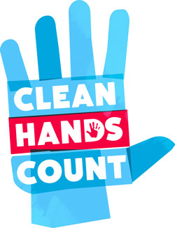
Strategies
Talk with your supervisor
Talk with your colleagues
Share CDC hand hygiene resources
  Clean Hands Count for Healthcare Providers
  Clean Hands Count for Patients
  Clean Hands Save Lives
Notes:
Facilitator Notes
Use this slide to recap the discussion and share online resources from the CDC about hand hygiene. You can share the links in the chat as well.
Clean Hands Count for Healthcare Providers: https://www.cdc.gov/handhygiene/providers/index.html
Clean Hands Count for Patients: https://www.cdc.gov/handhygiene/patients/index.html
Clean Hands Save Lives: https://www.cdc.gov/handwashing/index.html *Community-Focused resource
Sample Script
“The groups did a great job of sharing good, useful strategies. To recap, if you are unsure what to do, you can always talk with your supervisor or colleagues. The CDC also has a lot of resources about hand hygiene. They have materials for healthcare providers and healthcare settings, as well as materials for the community that may help you.”

Slide 14
Reflection
Notes:
Facilitator Notes
Invite participants to share what they learned during the session.
Sample Script
“Let’s use our last few minutes together to reflect on what we’ve learned and think about how we can put what we’ve learned into practice.”

Slide 15
Personal Reflection
Think honestly about your own hand hygiene practices. Imagining yourself throughout the workday,
In what instances do you find it easy to consistently practice good hand hygiene? Celebrate this success! Is there something you could do for yourself to honor this achievement?
Can you identify opportunities for improvement? What could you do to make hand hygiene easier in these instances?
Notes:
Facilitator Notes
Encourage participants to consider the questions on the slide, and to write their thoughts in their Participant Booklets if they wish. The questions on the slide are:
In what instances do you find it easy to consistently practice good hand hygiene? Celebrate this success! Is there something you could do for yourself to honor this achievement?
Can you identify opportunities for improvement? What could you do to make hand hygiene easier in these instances?
Allow 2-3 minutes for this reflection and then use your gentle chime or timekeeper to reconvene the group.
Sample Script
“Let’s conclude with an opportunity for personal assessment. On the slide you’ll see some questions. Please spend a few moments considering these questions. This is entirely for you, and I won’t ask you to share your reflections.”
(Allow 2-3 minutes of quiet time, then reconvene the group.)

Slide 16
Questions?
Are there any remaining questions about hand hygiene?
Notes:
Facilitator Notes
Invite additional, remaining questions.
If the answers are information that is already included in this session, please respond.
If the questions address content that is not covered in this session, please do not attempt to answer. Instead, take note of the questions and consult with CDC resources to follow up with answers after the session.
Sample Script
“Thank you all for your time today! Does anyone have any questions still remaining?”
(Address questions as appropriate.)
“Thank you for sharing those questions. Project Firstline is actively collecting your questions to help inform more training resources as they’re developed. I’ve written them down and I will get back to you with responses.”

Slide 17
Resources and Future Training sessions
CDC’s Hand Hygiene in Healthcare Settings: https://www.cdc.gov/handhygiene/index.html
Project Firstline on CDC:
https://www.cdc.gov/infection control/projectfirstline/index.html
CDC’s Project Firstline on Facebook:
https://www.facebook.com/CDCProjectFirstline
CDC’s Project Firstline on Twitter:
https://twitter.com/CDC_Firstline
Project Firstline Inside Infection Control on YouTube:
https://www.youtube.com/playlist?list=PLvrp9iOILTQZQGtDnSDGViKDdRtIc13VX
To sign up for Project Firstline e-mails, click here: https://tools.cdc.gov/campaignproxyservice/subscriptions.aspx?topic_id=USCDC_2104
Notes:
Facilitator Notes
Share additional resources from Project Firstline and CDC.
Explain how participants can reach you, by the means of your choosing, and how they can reach Project Firstline.
If this session is part of a series, you may choose to describe the themes of upcoming sessions.
Sample Script
“We covered a lot today, and there is still more to learn. You can keep exploring these topics on your own using the resources on this slide. You can also follow us on social media. I will stay on the line for a few minutes after our session ends and will be happy to discuss any other questions!”
(If this session is part of a series) “Next time, we will cover [insert next training topic].”

Slide 18
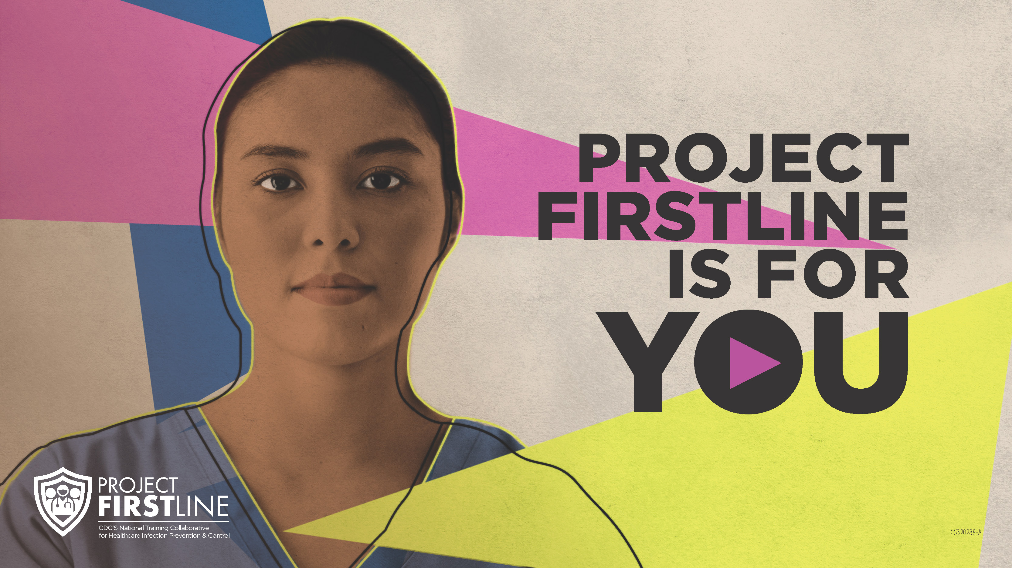
Feedback Form
Notes:
Facilitator Notes
Explain how to access the Feedback Form.
Sample Script
“And, finally, please let us know how you enjoyed today’s session by completing the feedback form. Thanks again for joining us today.”
After the Session
Send list of participant questions compiled during this session to ProjectFirstline@cdc.gov.

