Slide 1
Topic 8: Ppe part 2 – gowns
[Date of training]
Notes:
Participants log in and get settled.

Slide 2
Agenda
Objectives
Discussion
Role of Gowns in Infection Control
“Dos and Don’ts” for Using Gowns at Work
Next Steps
Notes:
Facilitator Notes
Welcome the group and add a greeting to the chat box.
If this session is part of an ongoing series, you may choose to say “welcome back,” “thank you for joining us again,” etc.
Announce housekeeping notes, either orally or via chat.
If needed, provide additional notes specific to the platform you’re using (e.g., how to “raise your hand,” how to post questions).
Establish that the session focuses on gowns.
Provide an overview of the agenda.
Adapt this section of the session as needed: for instance, you may choose to spend additional time on introductions if there are new faces, or if participants do not know each other.
Sample Script
“Welcome to Project Firstline. Over the next 10 minutes, we’ll focus on one important piece of your PPE – your personal protective equipment – gowns. Please keep your videos on, to the extent possible, and keep your microphone muted when you are not contributing to the discussion. It’s great to see you all here today!”
“Today we’ll talk about the role of gowns in infection control, and we’ll also cover some ‘dos and don’ts’ for using them at work every day.”

Slide 3
Learning Objectives
Describe two (2) reasons why wearing gowns is important for infection control.
Discuss three (3) reasons why wearing more than one gown at once is not recommended for routine care.
Notes:
Facilitator Notes
Provide an overview of the session’s learning objectives.
Sample Script
“Here is what we expect to learn today. By the end of today’s training, you will be able to describe why it’s important to wear gowns, and how to wear them properly.”

Slide 4
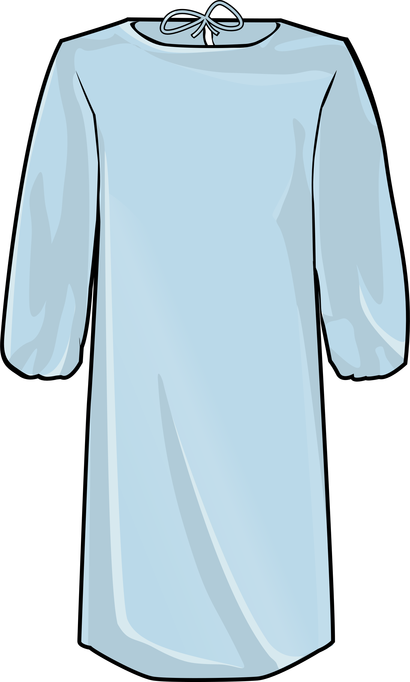
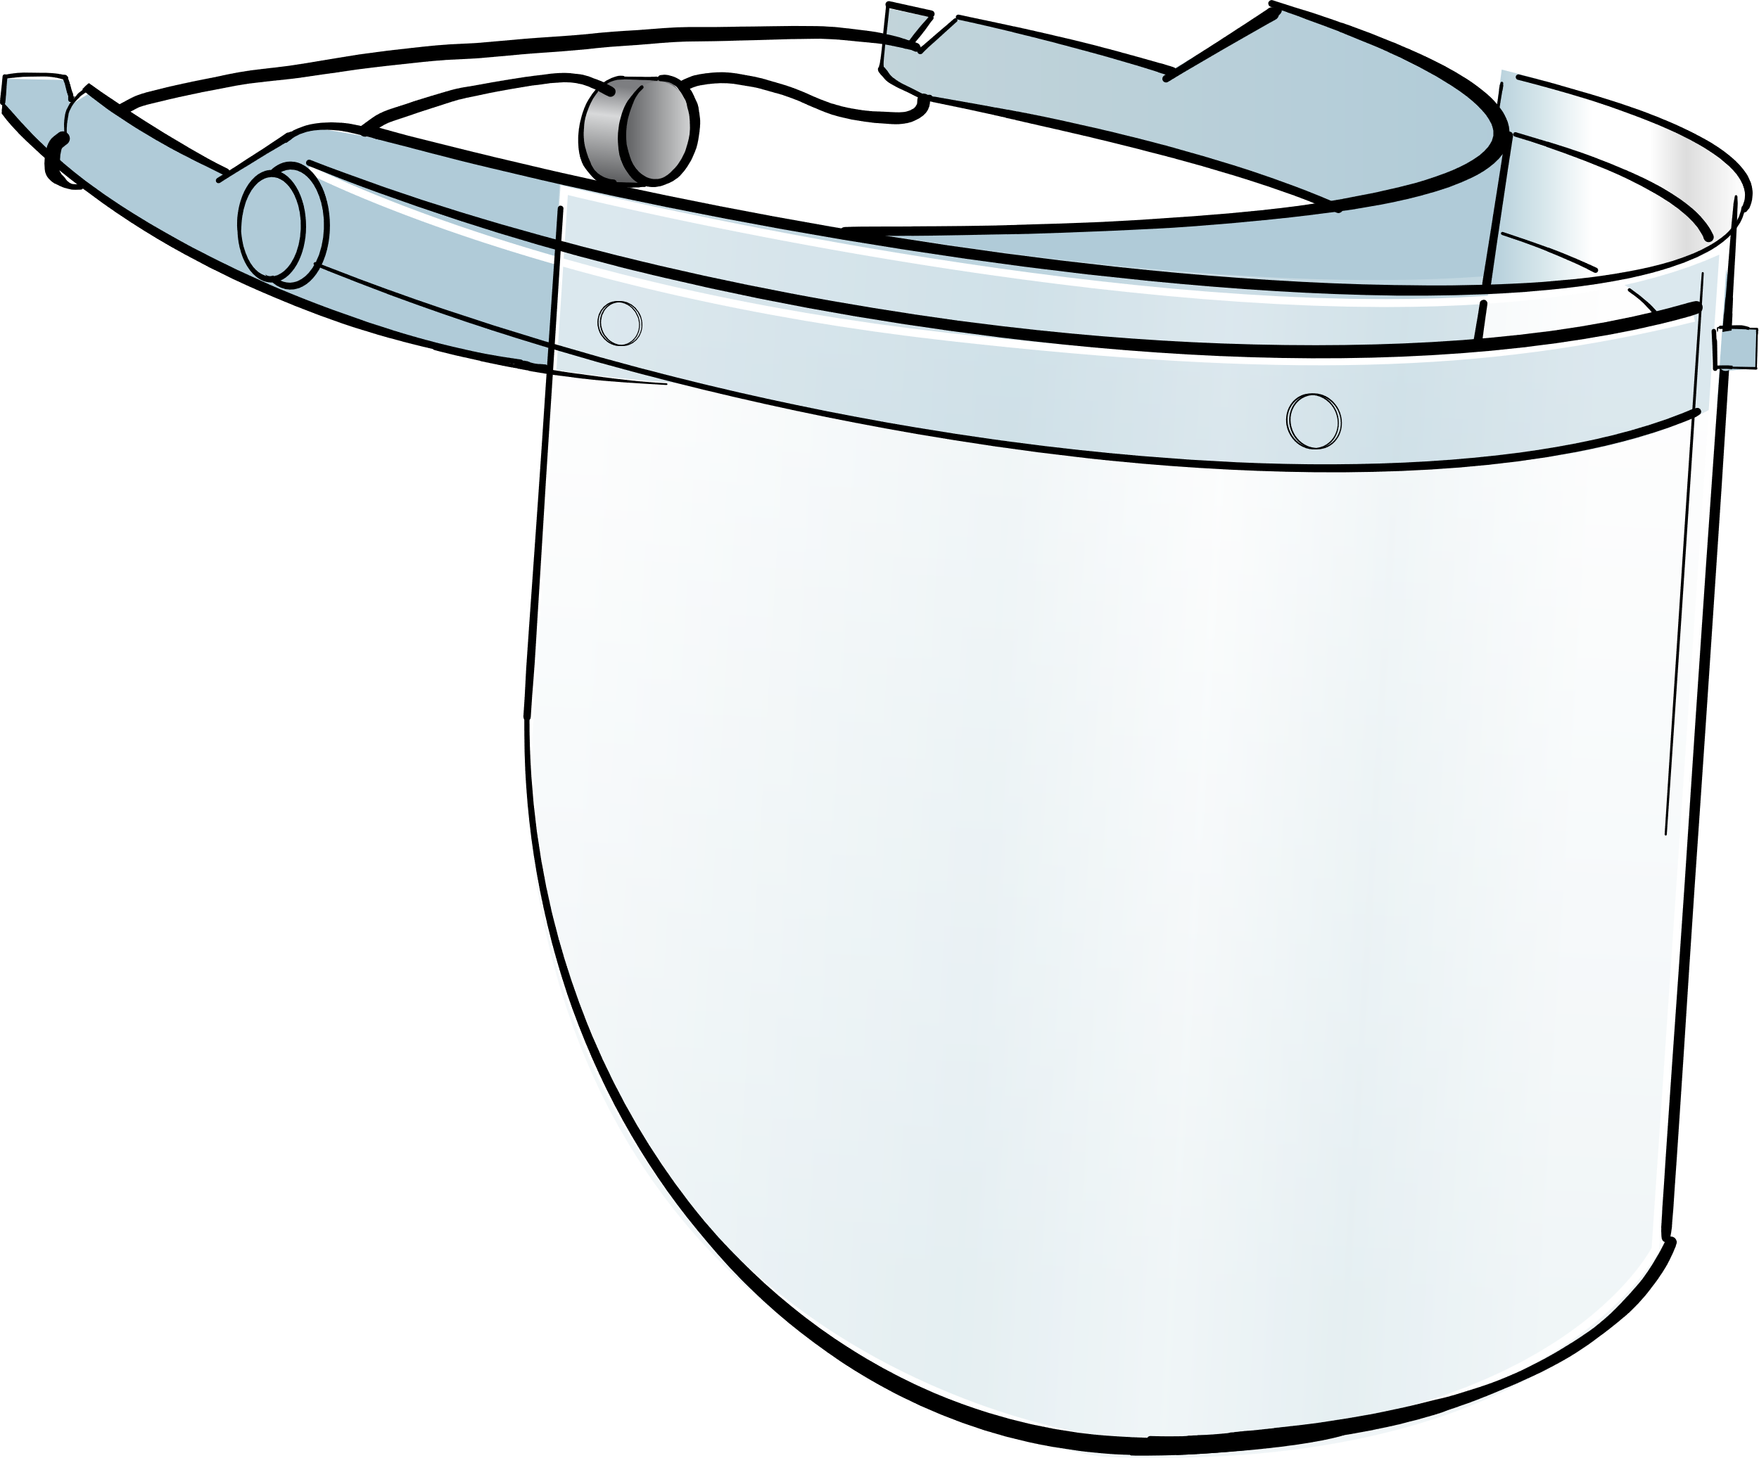

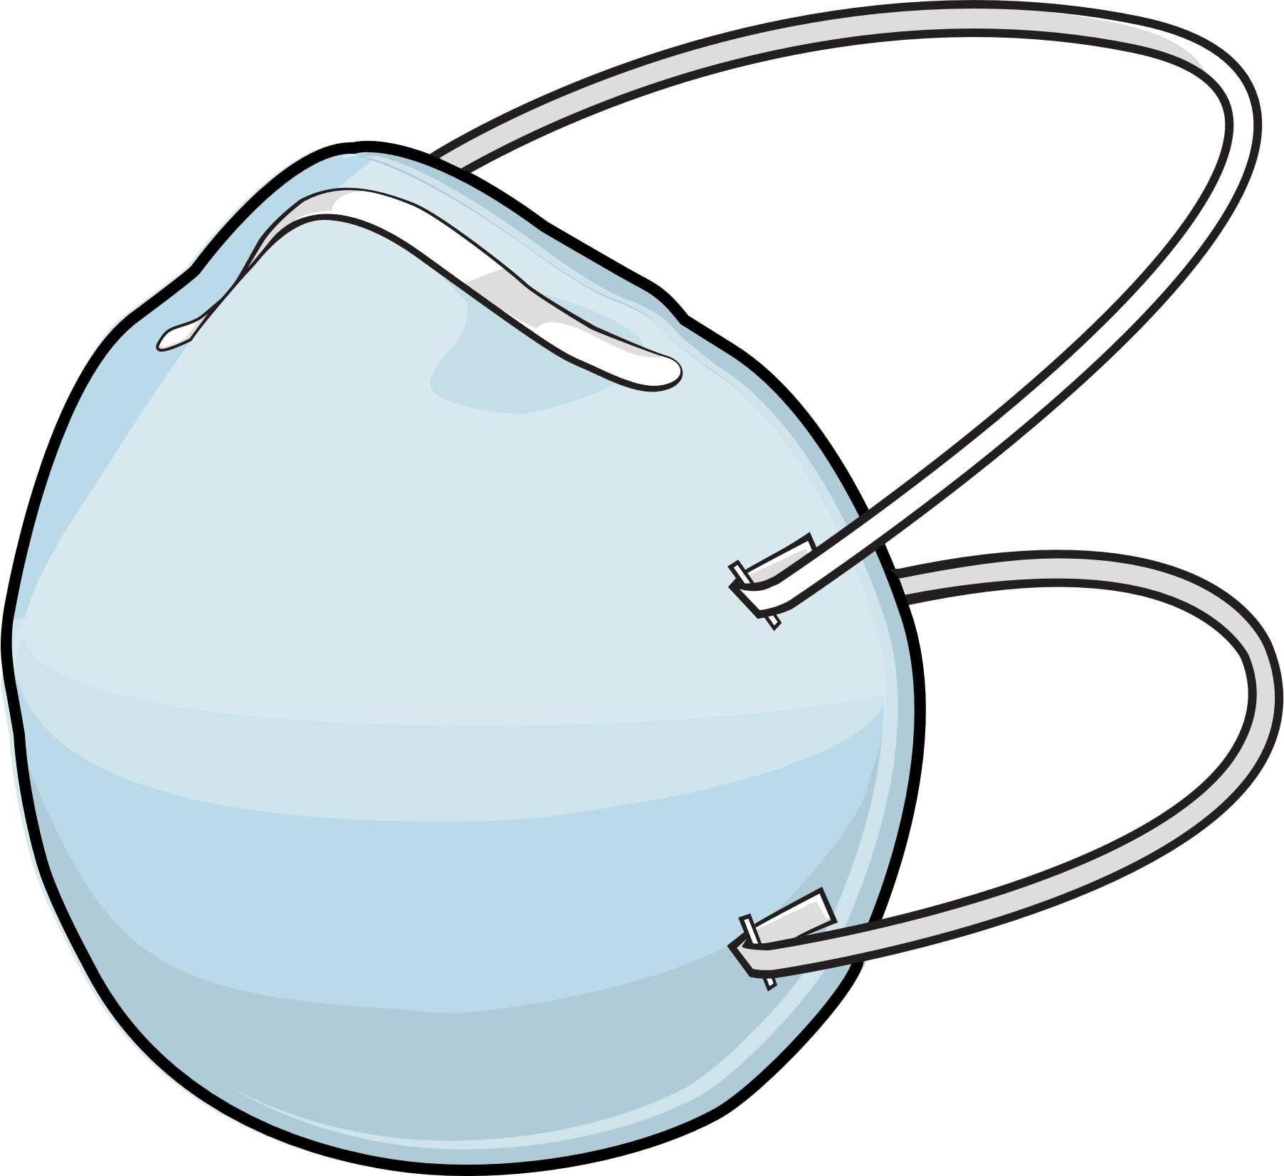

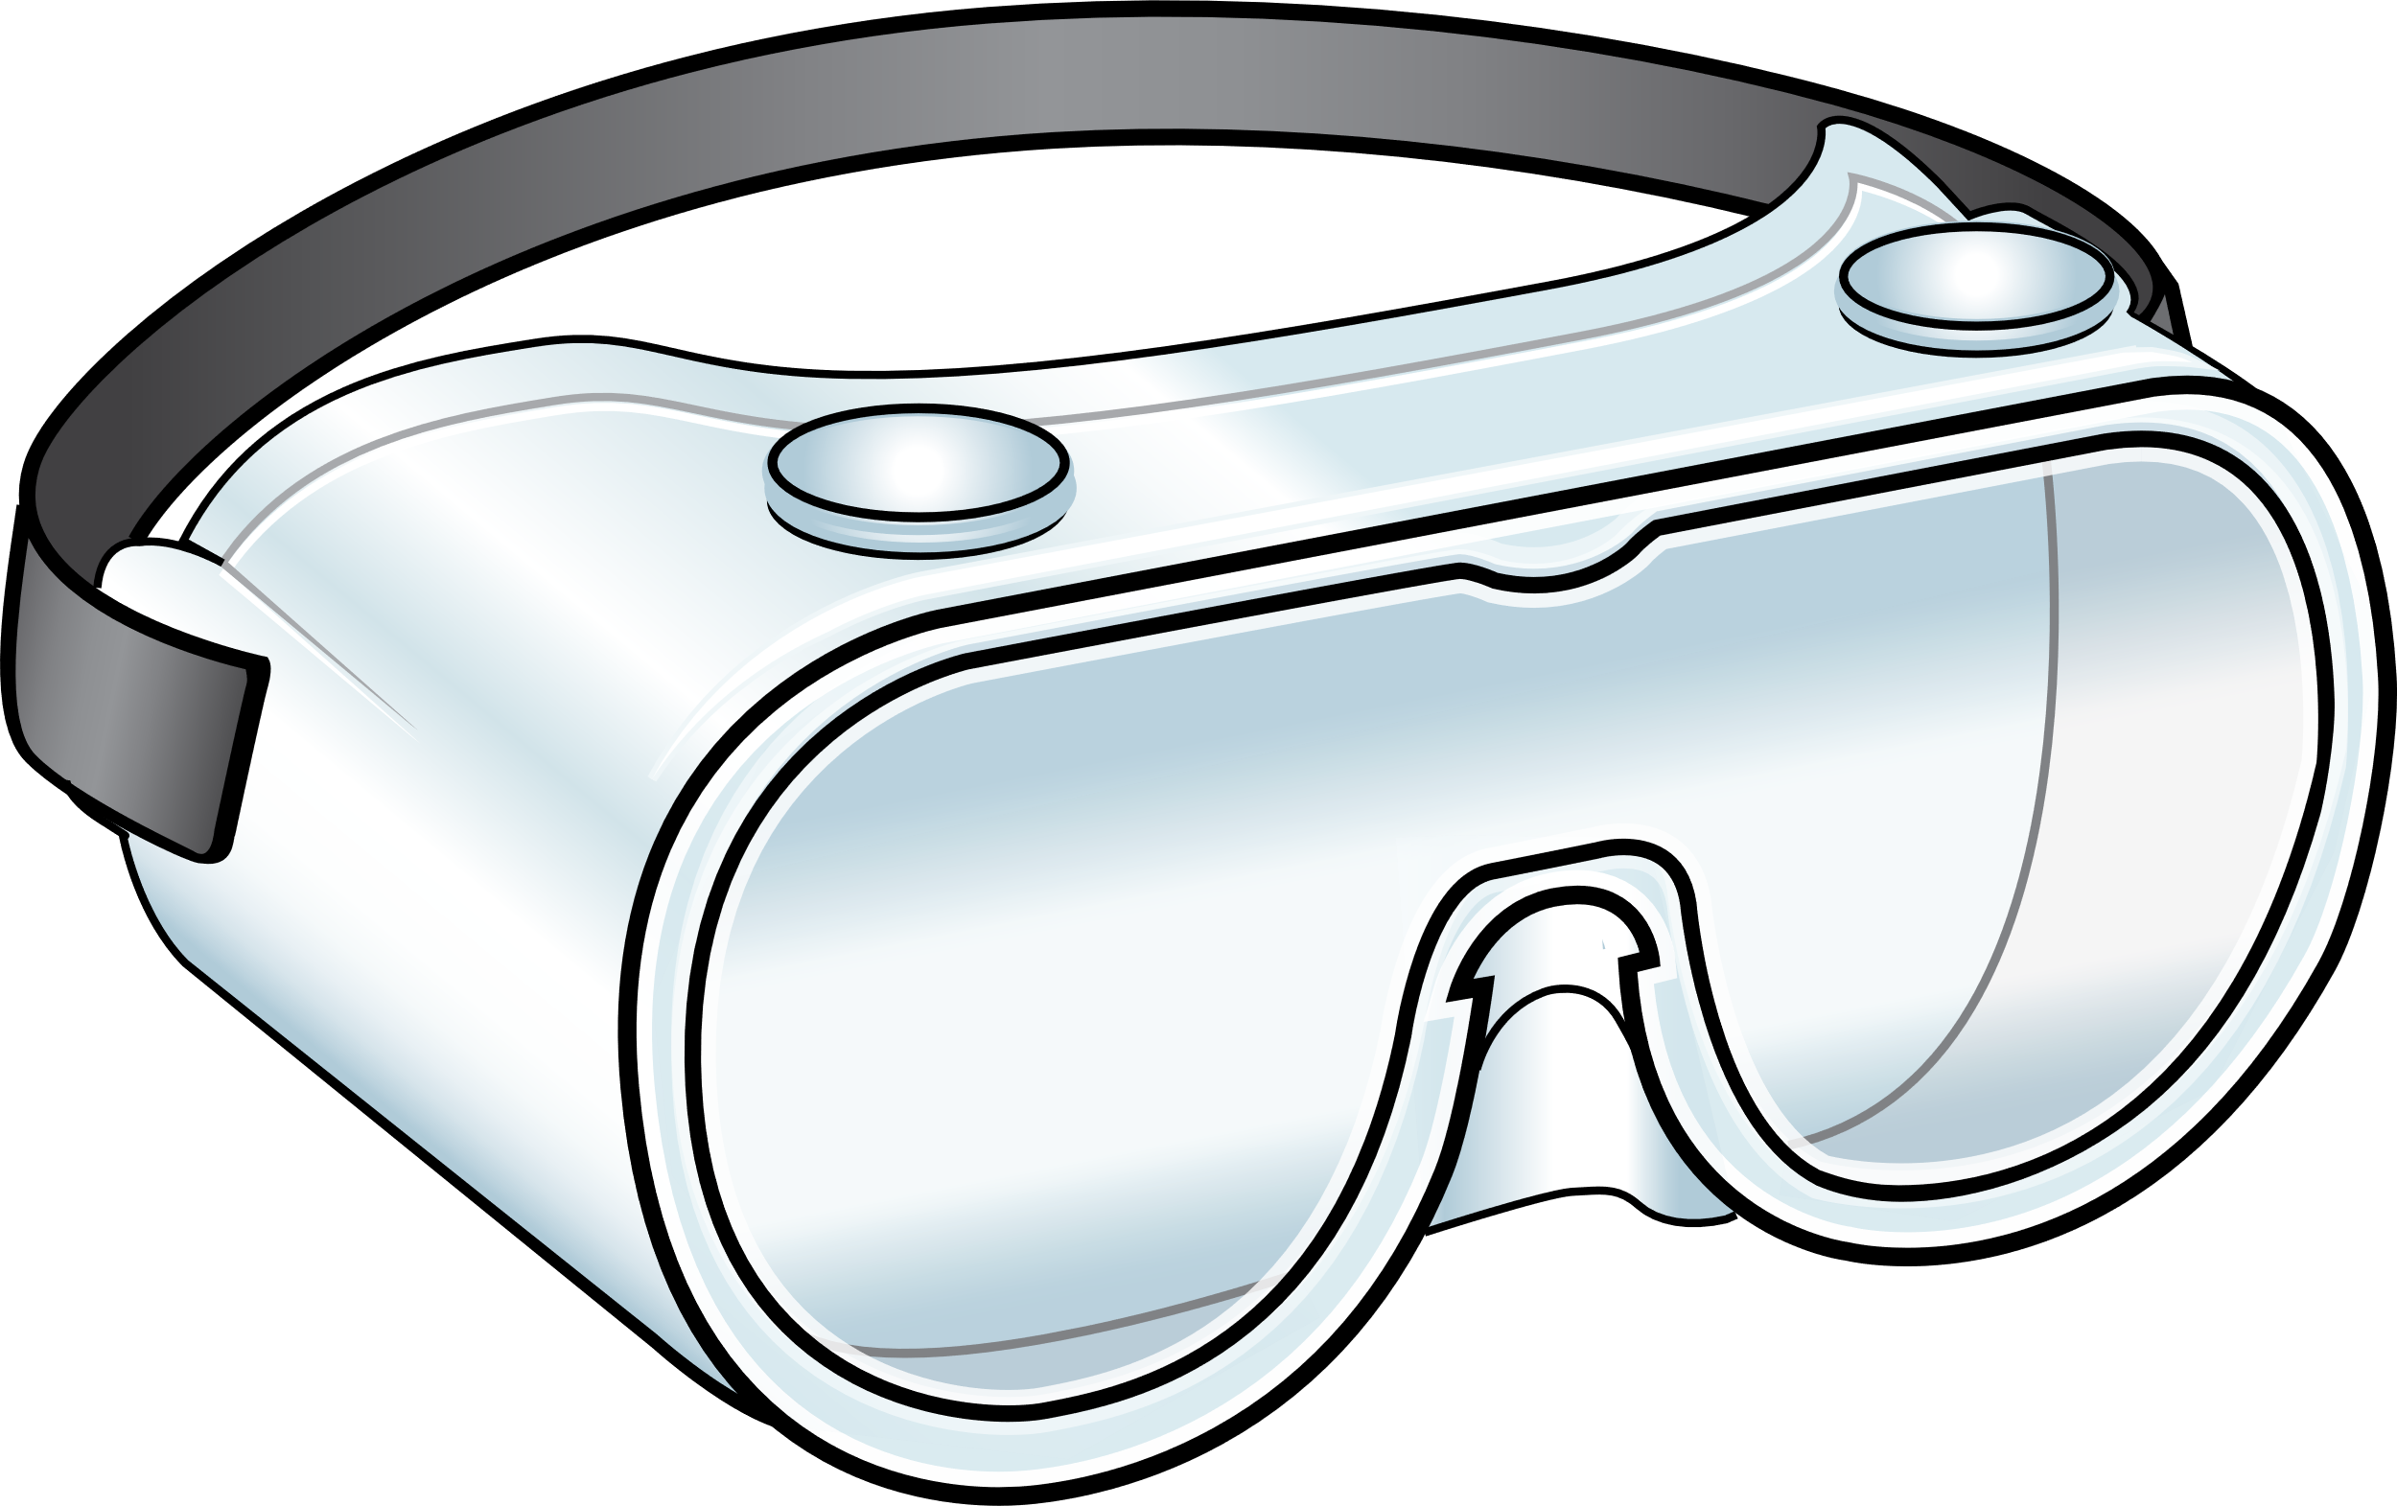
Recommended PPE for COVID-19
Eye Protection
Gloves & Gown
Respirator
Notes:
Facilitator Notes
Establish that the session will focus on gowns, which are part of the PPE recommended for COVID-19.
If this session is part of a series, you may choose to indicate that future sessions will focus on other pieces of PPE.
Sample Script
“Let’s start by thinking about the specific PPE recommended for COVID-19. Today, we’ll focus on gowns. In future sessions, we’ll examine other types of PPE.”

Slide 5
Gowns protect you and keep germs from spreading
How?
Gowns protect you from germs.
Gowns protect others by keeping germs out of the environment.
Gowns make it easier to remove things, such as germs and body fluids, that might get on you while you work, so you don’t have to change clothes every time your clothes get dirty.
When you remove and dispose of your gown properly, you keep germs from spreading in the environment.
Notes:
Facilitator Notes
The bullet points on slides 5 and 6 summarize content from Episode 12 of Inside Infection Control: Why are Gowns Recommended for COVID-19? For time reasons, the video is not shown during the 10-minute session. You may wish to refer to the Content Outline for Episode 12 for additional discussion points.
Note: This slide has animations for the second column. When you advance to the slide, only the first column will appear.
After you introduce the points, ask participants to share answers to the questions “Why?” or “How?” either orally or in the chat.
After they provide responses, use the animation to reveal the answers.
Sample Script
“Let’s review some important points about gowns. Gowns protect you, and they protect others. How do they protect you?”
(Pause for responses.)
“That’s right. Gowns make it easier to remove things, such as germs and body fluids, that might get on you while you work, so you don’t have to change clothes every time your clothes get dirty. How do gowns protect others?”
(Pause for responses.)
“Yes! When you remove and dispose of your gown properly, you keep germs from spreading in the environment.”

Slide 6
Gowns MUST be worn properly to be effective
Remove your gown:
When it gets dirty.
Before moving to the next patient or task.
Make sure that your gown fits properly and that it doesn’t touch other surfaces while you’re wearing it.
Gowns designed for use as PPE are intended to be worn as a single gown.
Notes:
Facilitator Notes
Note: This slide has animations for the first set of sub-bullets and the second and third bullets. When you advance to the slide, only the first level of bullets will appear.
After you have posed each question, ask for responses from participants.
After they provide responses, use the animation to have the sub-bullets appear.
Sample Script
“Gowns must be worn properly. Let’s review some important points about wearing gowns correctly. When should you remove your gown?”
(Pause for responses.)
“That’s right. To keep germs out of the environment, you should remove and dispose of your gown when it gets dirty, and before you move on to the next patient or task. What are some other important ‘dos’ and ‘don’ts’ for gowns?”
(Pause for responses.)
“Yes, it’s important to try not to touch other surfaces with your gown – you could pick up germs and spread them without meaning to. Also, your gown should fit you well. If it’s too big, it could get in your way and trip you up, or the edges or sleeves could drag across surfaces and pick up germs. If it’s too small, it won’t cover you enough, and you might not be able to move as easily. Or it could rip or tear!”
“Are there any other things to remember for gowns?”
(Pause for responses.)
“Exactly. Wearing more than one gown designed for PPE at once is not recommended. You’re not any more protected from germs, and the extra layers can get in your way. Even if you change the top layer when it gets dirty, you could contaminate the bottom layer in the process, and spread germs.”

Slide 7
What questions do you still have about gowns?
Notes:
Facilitator Notes
Invite additional, remaining questions.
You may choose to ask participants to respond orally, in the chat, or both.
If the answers are information that is already included in this session, please respond.
If the questions address content that is not covered in this session, please do not attempt to answer. Instead, take note of the questions and consult with CDC resources to follow up with answers after the session.
Sample Script
“Thank you all for your time! Please take a moment to reflect on today’s session and share any remaining questions you have. Does anyone have any questions still remaining?”
(Address questions as appropriate.)
“Thank you for sharing those questions. Project Firstline is actively collecting your questions to help inform more training resources as they’re developed. I’ve written them down, and I will get back to you with responses.”

Slide 8
Key takeaways
Wearing gowns is an important strategy for infection control.
They protect you and keep you from accidentally spreading germs into your environment.
Gowns must be worn properly to be effective.
Wearing more than one gown at once is not recommended for routine care and can be an infection control risk.
Notes:
Facilitator Notes
Review key takeaways.
You may choose to revisit discussion points or questions that arose during the session.
Sample Script
“I hope this training gave you some good information about gowns, and why they are so important for infection control. I’ve captured some key takeaways here, which you can review at your leisure after the session today.”

Slide 9
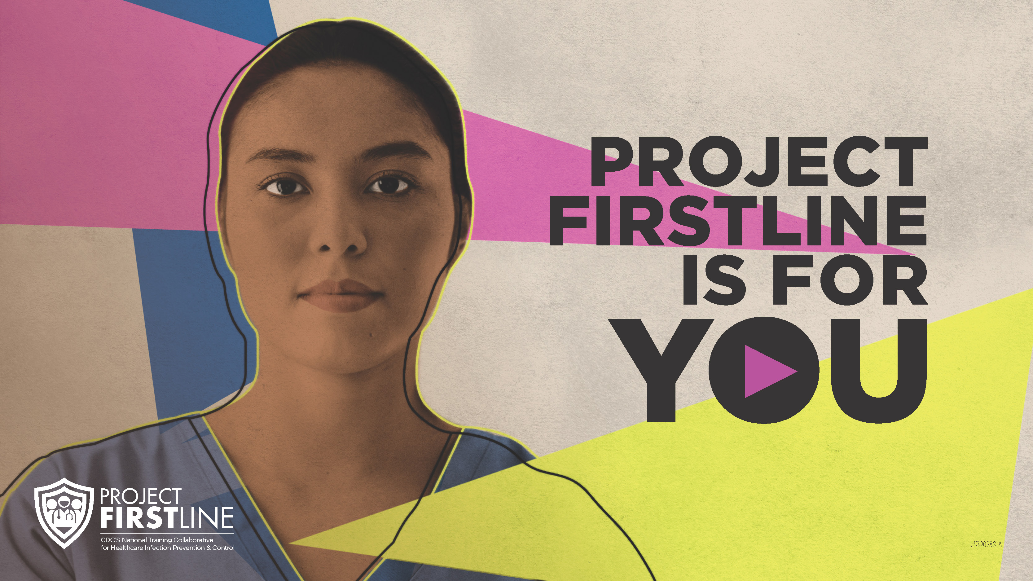
Feedback Form
Notes:
Facilitator Notes
Explain how to access the Feedback Form.
Sample Script
“And, finally, please let us know how you enjoyed today’s session by completing the following feedback form. Thanks again for joining us today.”
After the Session
Send list of participant questions compiled during this session to ProjectFirstline@cdc.gov.

