Slide 1
Topic 8:
Ppe part 2 – gloves & gowns
[Date of training]
Notes:
Participants log in and get settled.

Slide 2
Agenda
Introductions
Videos and Discussion
  Gloves
  Gowns
Next Steps
Notes:
Facilitator Notes
Welcome the group and add a greeting to the chat box.
If this session is part of an ongoing series, you may choose to say “welcome back,” “thank you for joining us again,” etc.
Announce housekeeping notes, either orally or via chat.
If needed, provide additional notes specific to the platform you’re using (e.g., how to “raise your hand,” how to post questions).
Provide an overview of the agenda.
Adapt this section of the session as needed: for instance, you may choose to spend additional time on introductions if there are new faces, or if participants do not know each other.
Sample Script
“Welcome to Project Firstline. Over the next hour, we’ll focus on two important pieces of your PPE – your personal protective equipment – gloves and gowns. Please keep your videos on, to the extent possible, and keep your microphone muted when you are not contributing to the discussion. It’s great to see you all here today!”
“Today we’ll talk about the role of gloves and gowns in infection control, and we’ll also cover some ‘dos and don’ts’ for using them at work every day.”

Slide 3
Learning Objectives
Describe two (2) reasons why wearing gloves is important for infection control.
Describe two (2) ways that gowns are important for infection control.
Discuss three (3) reasons why wearing more than one pair of gloves at once, or wearing more than one gown at once, is not recommended for routine care.
Notes:
Facilitator Notes
Provide an overview of the session’s learning objectives.
Sample Script
“Here is what we expect to learn today. By the end of today’s training, you will be able to describe why it’s important to wear gloves and gowns, and how to wear them properly.”

Slide 4
Introductions
Please introduce yourself with:
Your name
Your role (e.g., organization, unit)
One example of how you use PPE on the job
Notes:
Facilitator Notes
These questions will give you a better understanding of your participants’ backgrounds, experience, and level of knowledge.
Tailor your slide delivery for the virtual format and platform, and the number of participants:
You may wish to call on participants individually.
You may wish to add role- or facility-specific questions to the introductions.
If you have a large group, you may decide to skip oral introductions and use the chat.
If your group meets regularly, you may wish to skip or shorten the introductions, or use a different “icebreaker” approach.
Be sure to introduce yourself, and anyone who is assisting you.
Sample Script
“Let’s take a minute to get to know each other. Please share in 30 seconds or less your name and your role, and how you use PPE on the job.”

Slide 5
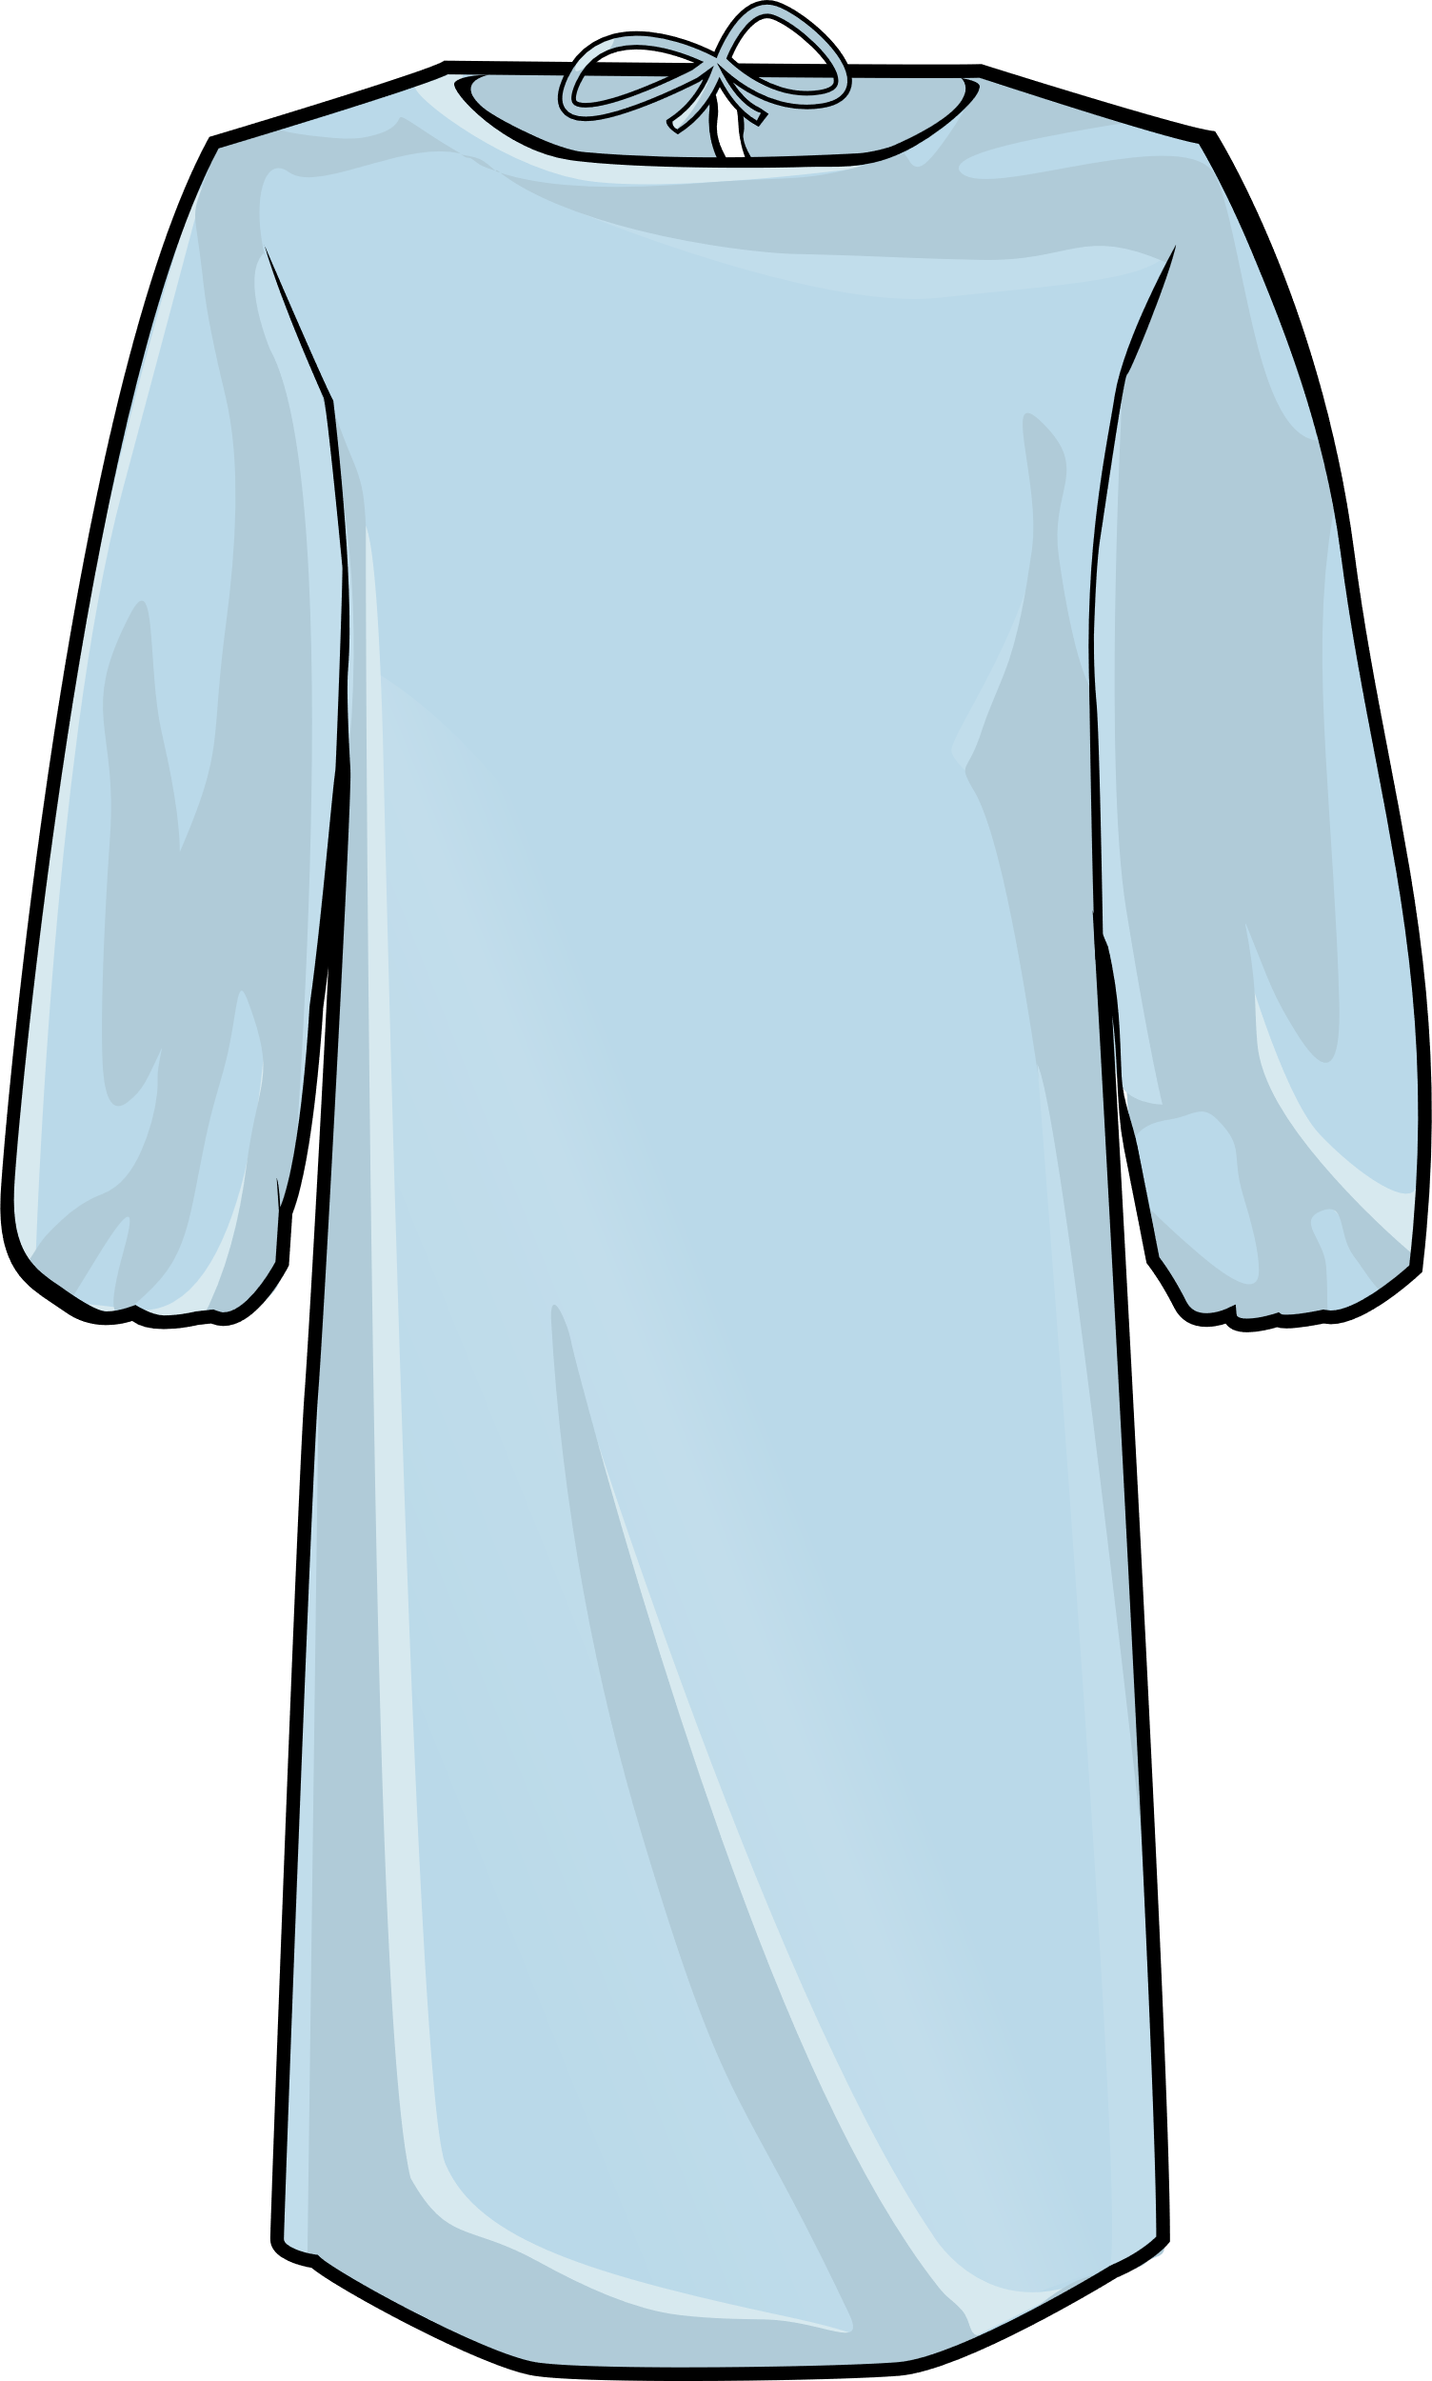
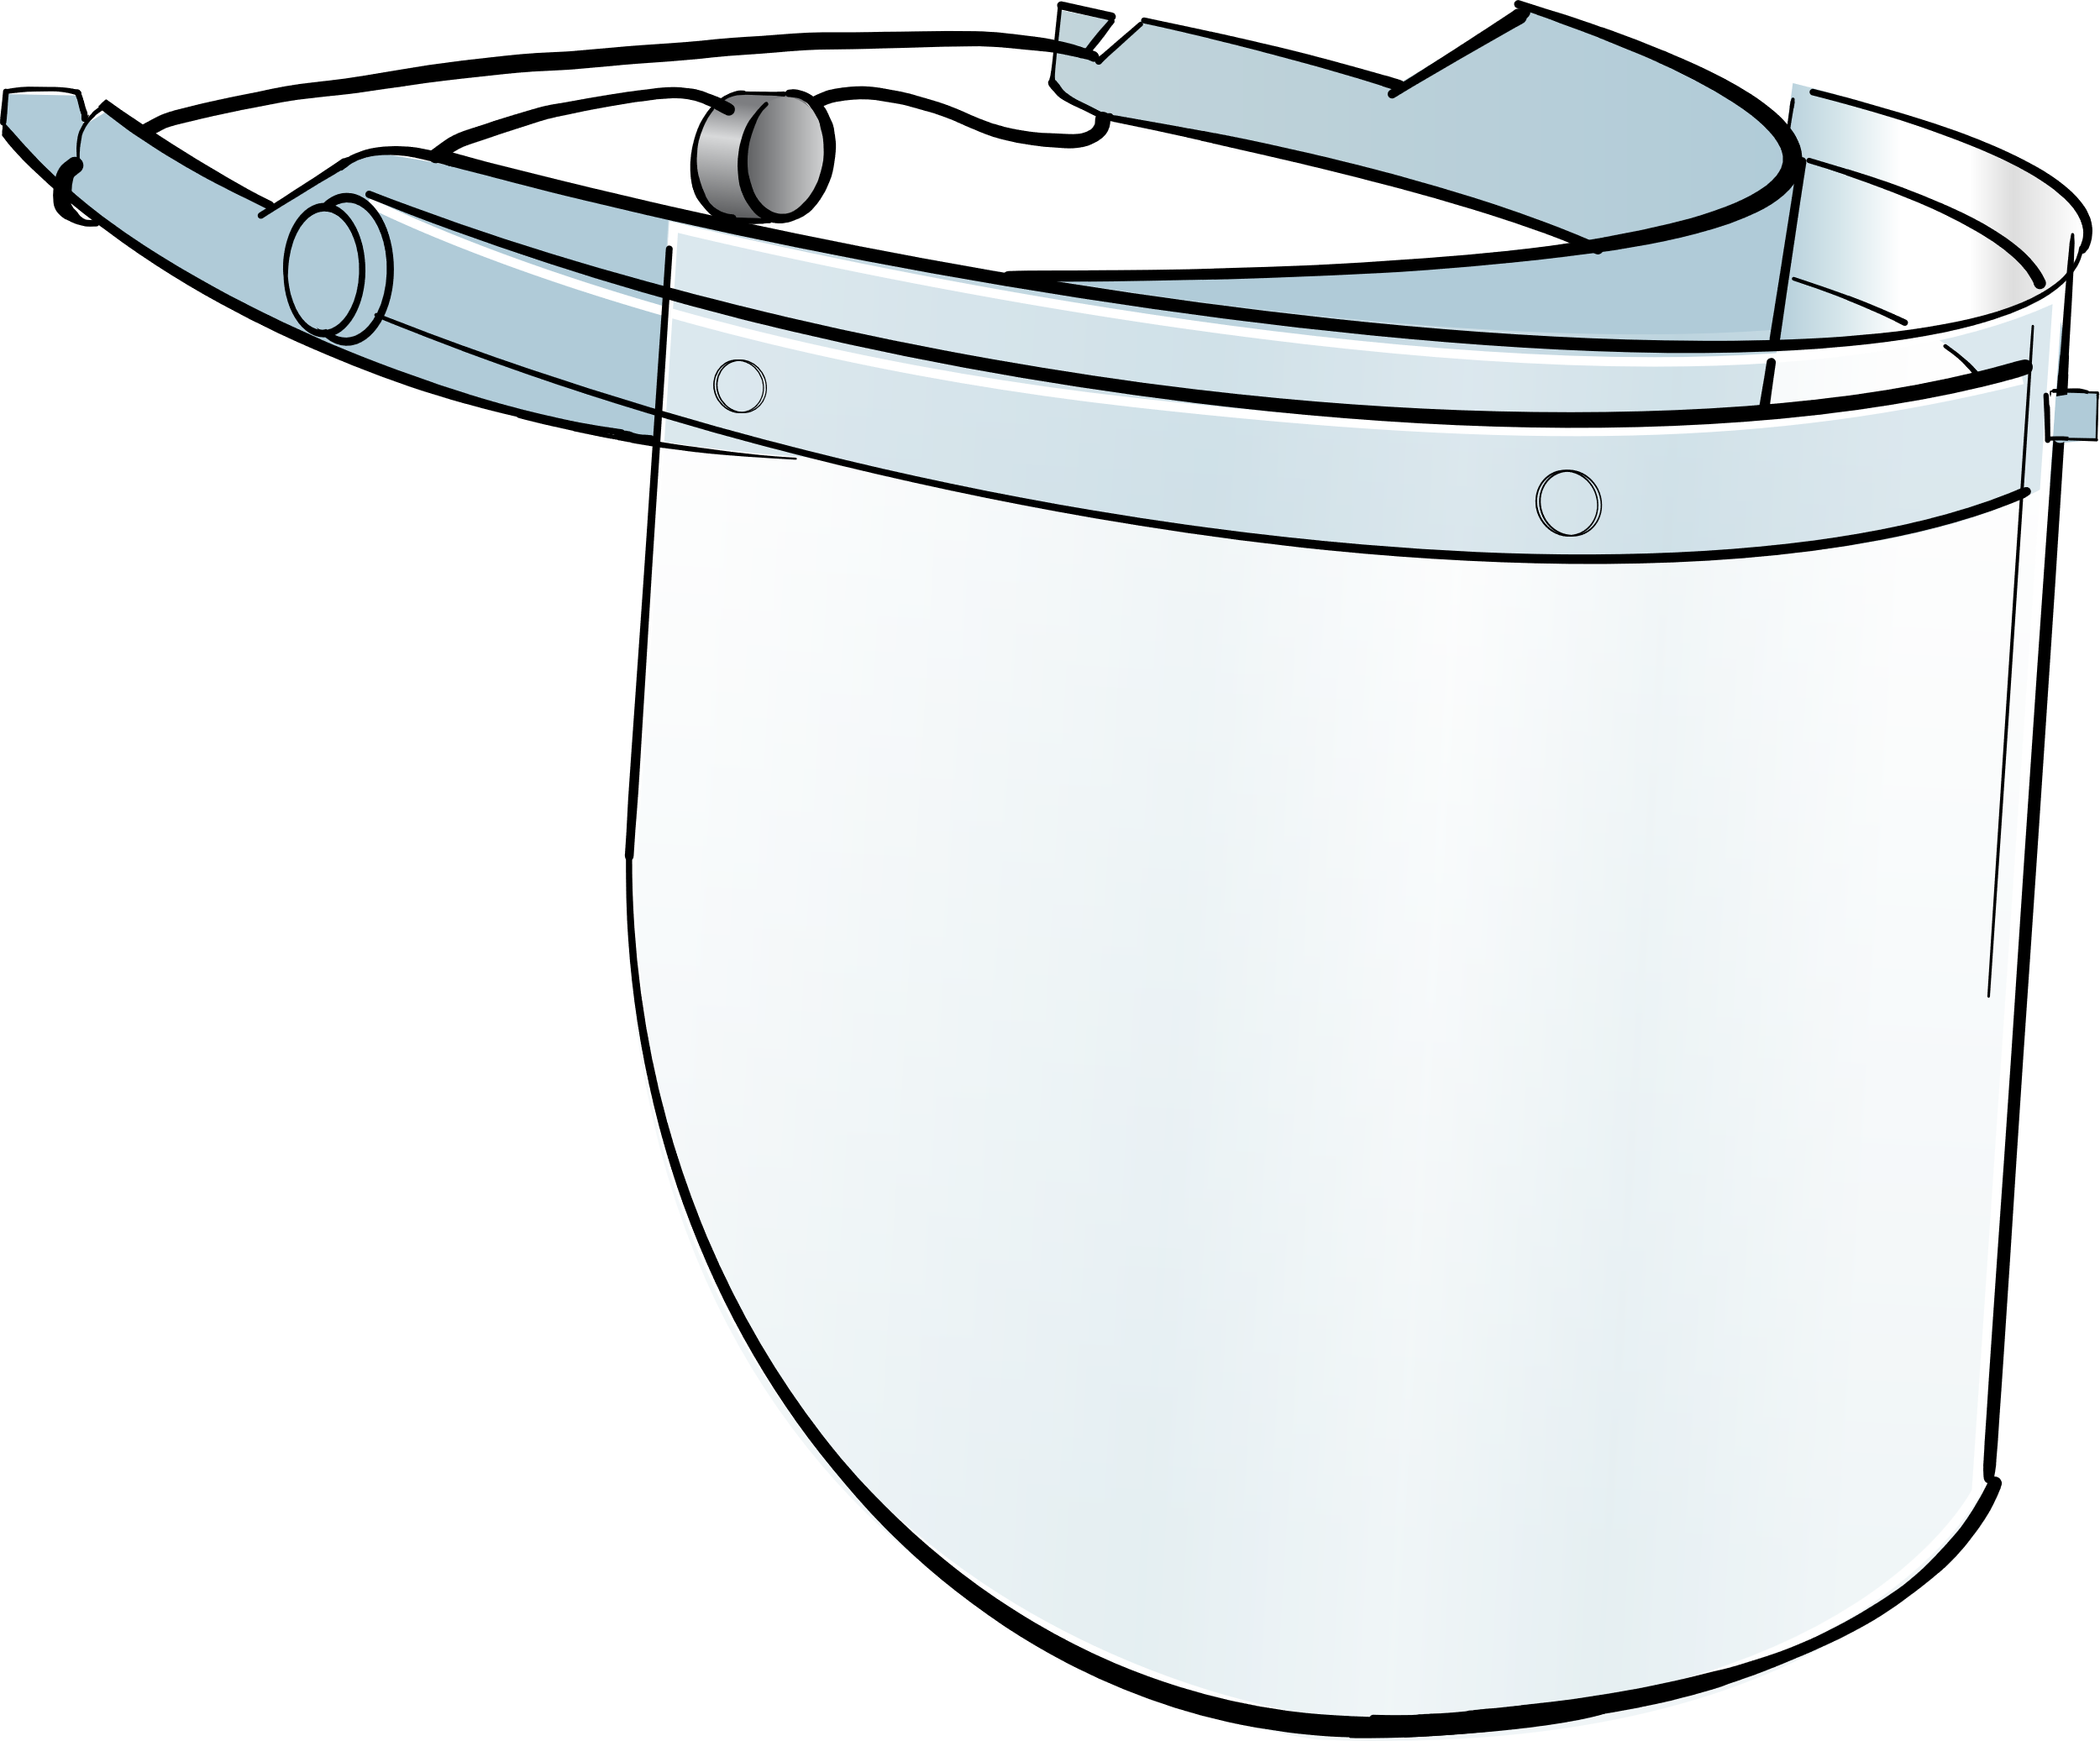

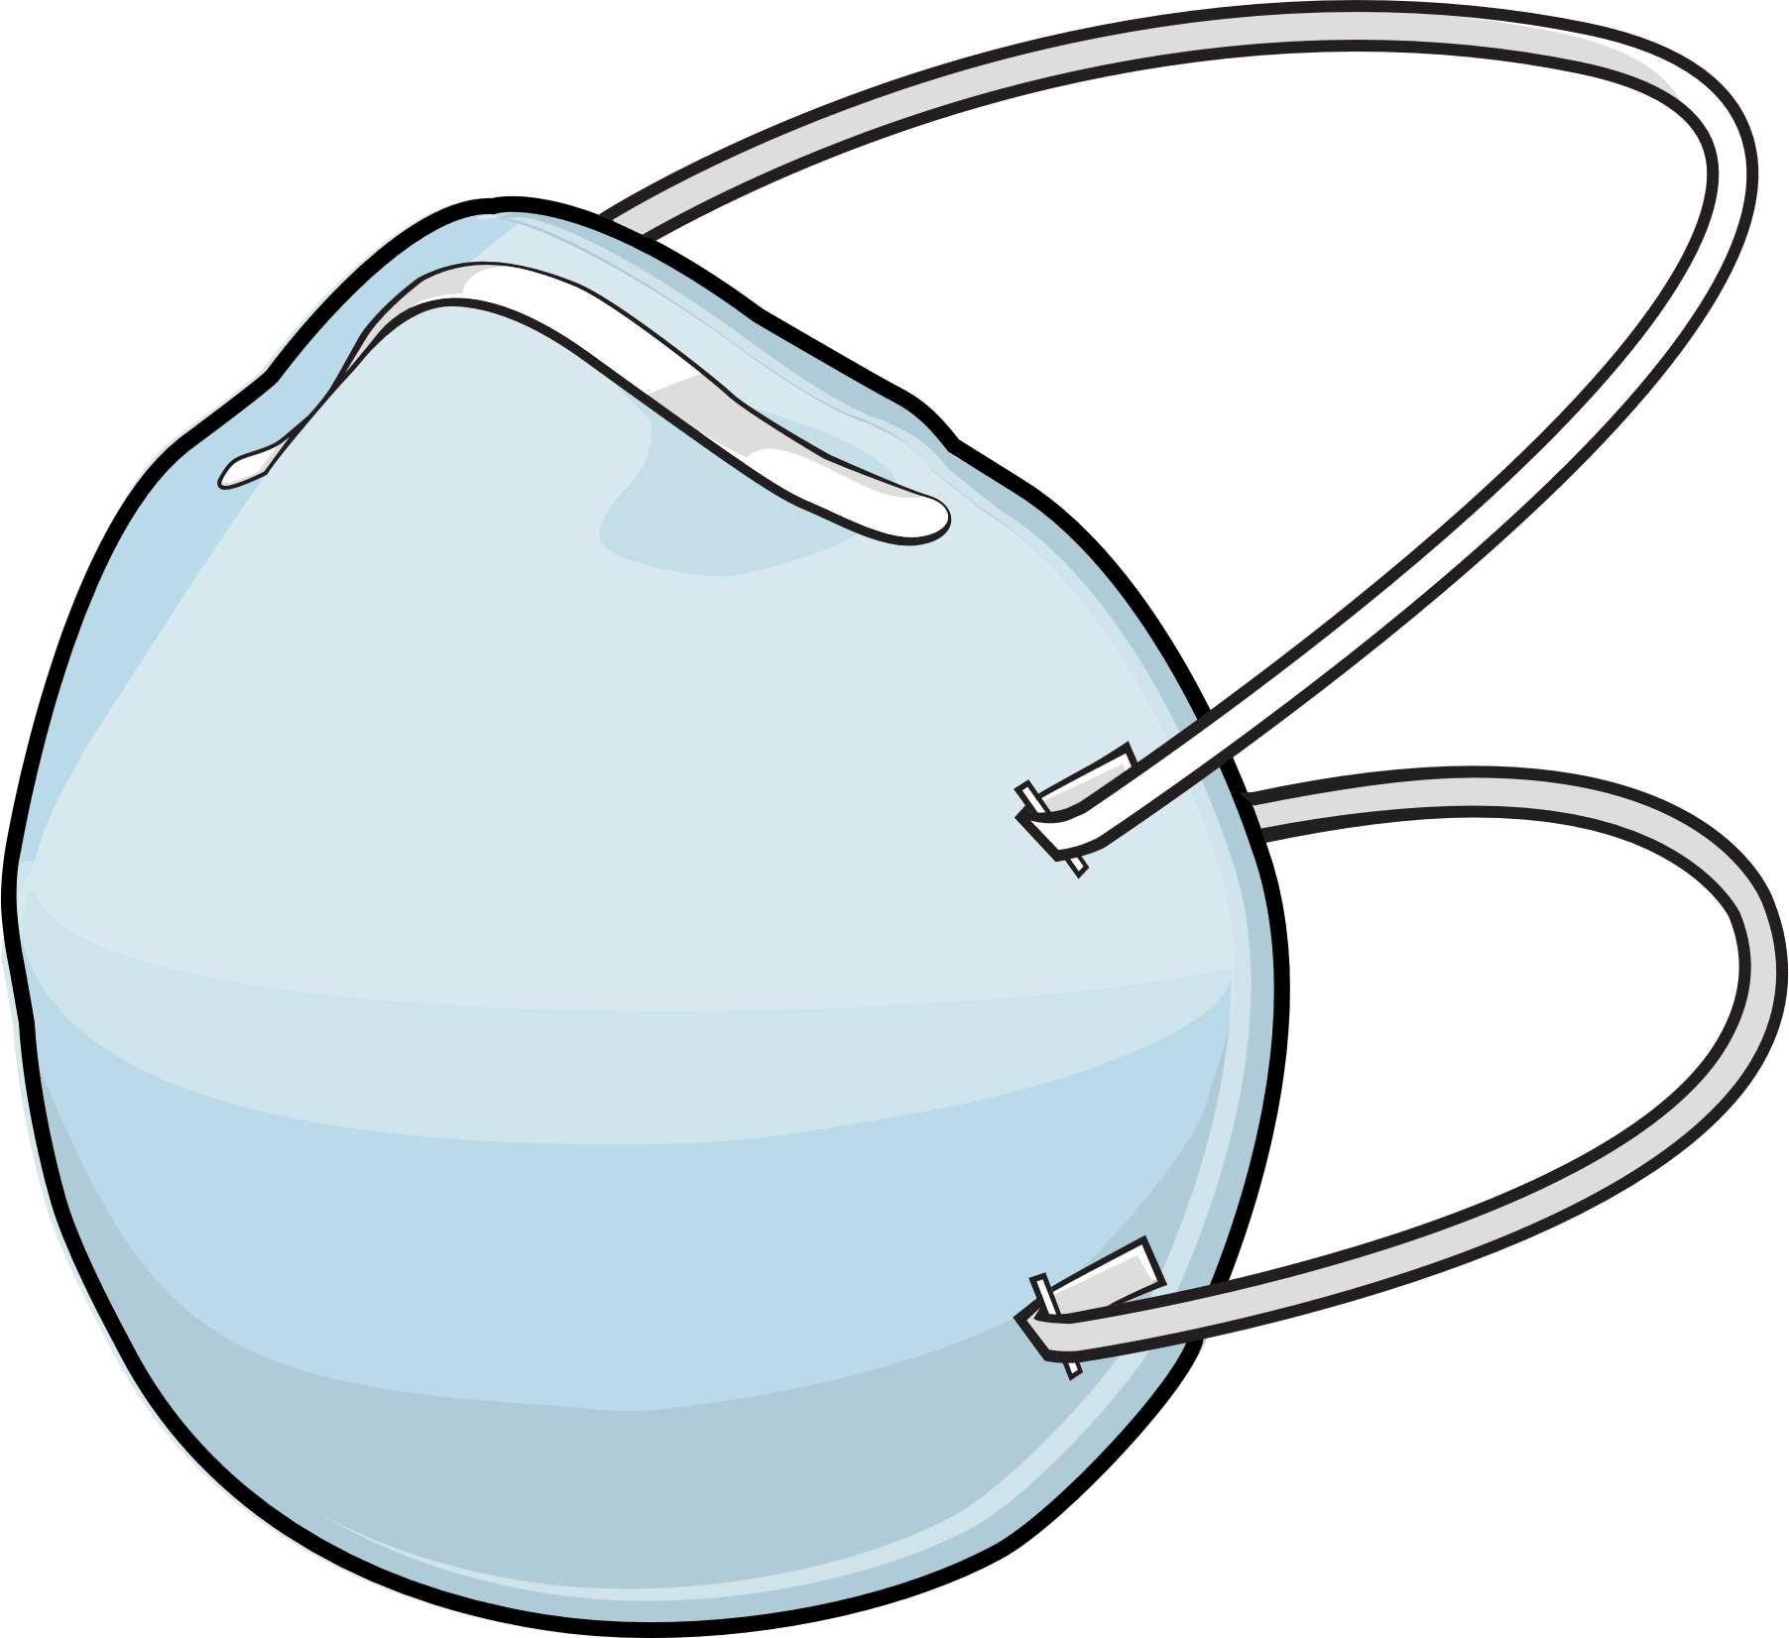

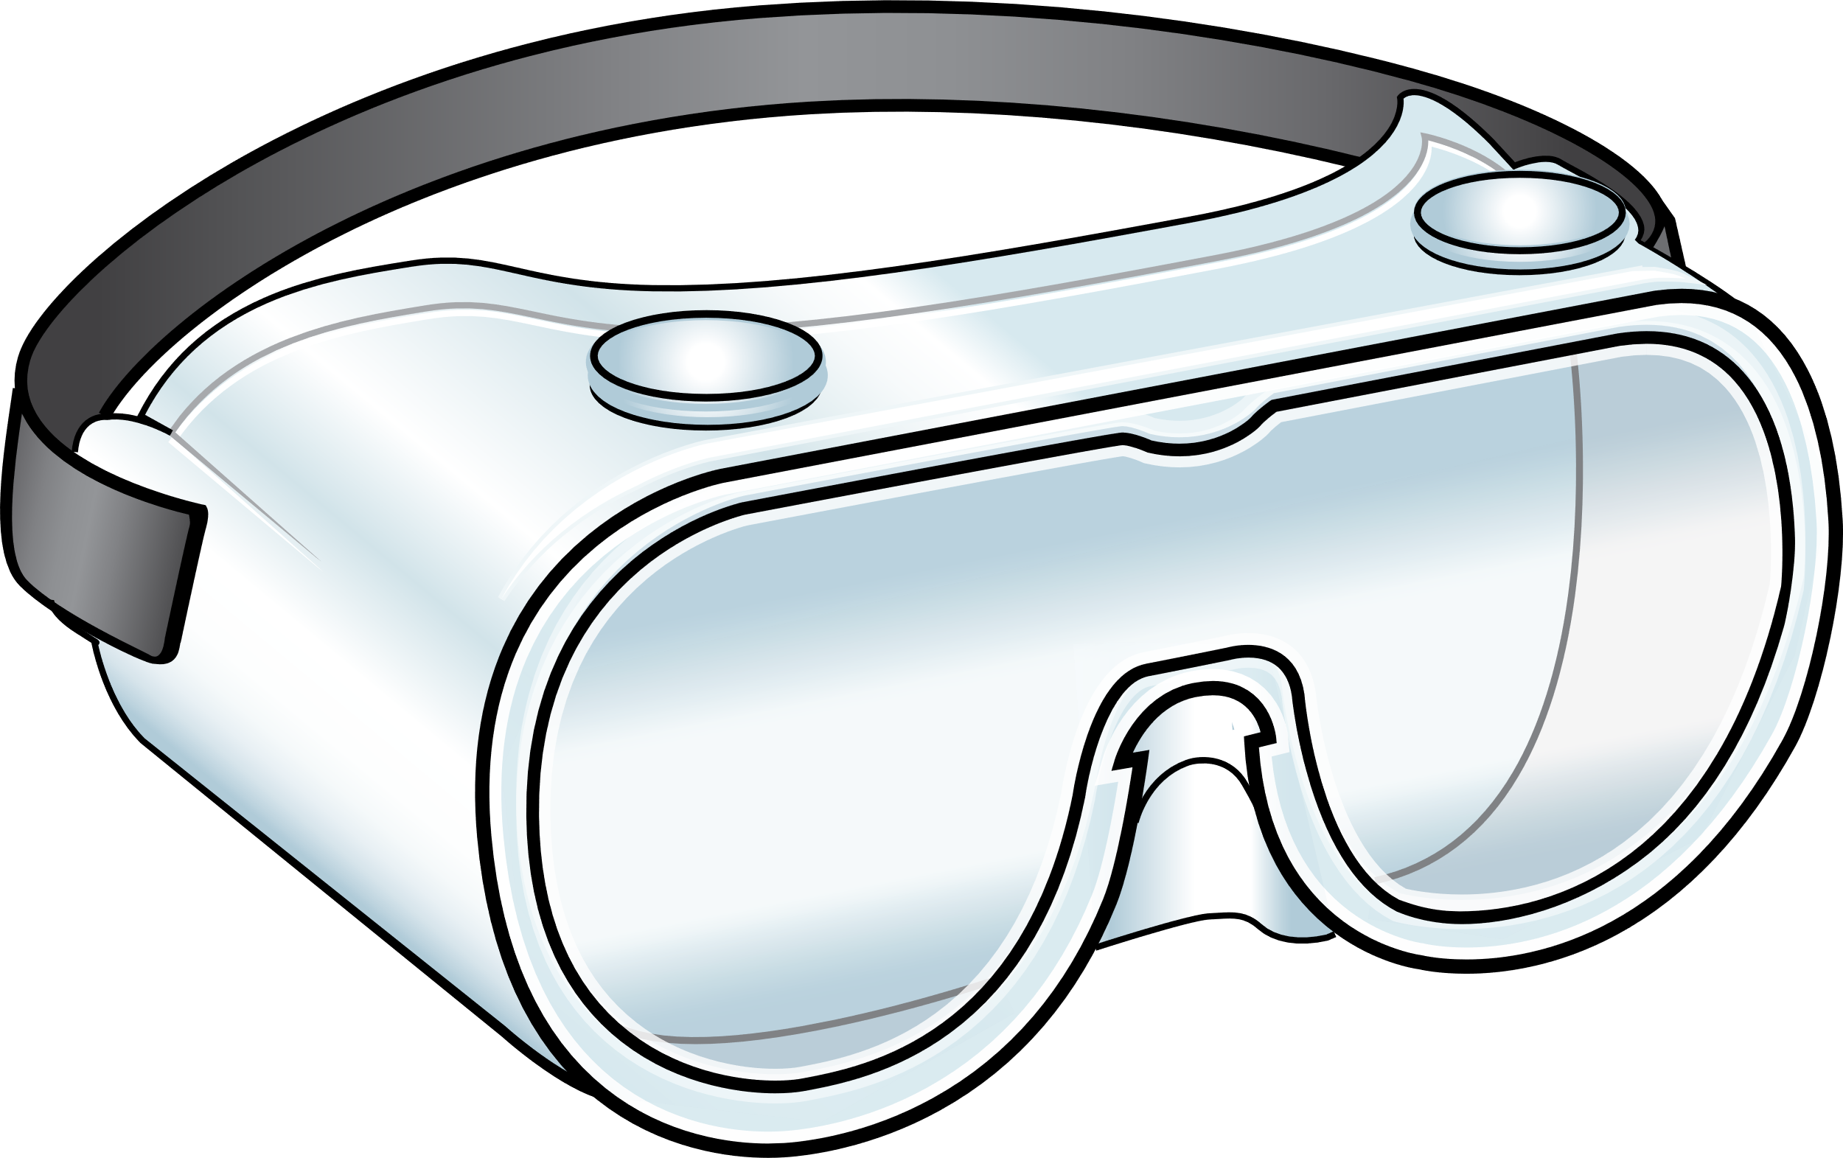
Recommended PPE for COVID-19
Eye Protection
Gloves & Gown
Respirator
Notes:
Facilitator Notes
Transition to discussion of PPE recommended for COVID-19.
If this session is part of a series, you may choose to indicate that future sessions will focus on other pieces of PPE.
Sample Script
“Now let’s think about the specific PPE recommended for COVID-19. Today, we’ll focus on gloves and gowns. In future sessions, we’ll examine other types of PPE.”

Slide 6
Gloves
While watching the video:
Jot down anything that you think is interesting or that surprises you about wearing gloves.
Notes:
Facilitator Notes
Encourage participants to make note of points in the video on gloves that are interesting or surprising.
Sample Script
“Let’s check in with the CDC’s Dr. Abby Carlson. She’ll talk about why gloves are so important for infection control in healthcare. As you watch, please make note of anything that’s interesting or surprising to you about wearing gloves. Please jot down your thoughts in your Participant Booklet.”

Slide 7
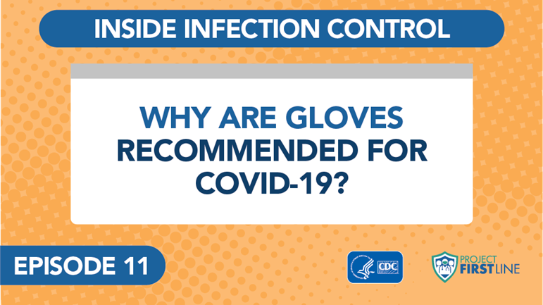
Inside infection control
Notes:
Facilitator Notes
Access the video here:
CDC Website: https://www.cdc.gov/infectioncontrol/projectfirstline/videos/EP11-Gloves-LowRes-New.mp4
OR
Project Firstline YouTube Playlist: https://www.youtube.com/watch?v=VhR3RIex9ss&list=PLvrp9iOILTQZQGtDnSDGViKDdRtIc13VX&index=13

Slide 8
What did you learn about wearing gloves?
Notes:
Facilitator Notes
Invite participants to review the notes they wrote down during the video and share, either orally or in the chat, things that they found interesting or surprising.
Acknowledge responses and link them to the next slide.
Sample Script
“Take a moment to review the notes you took during the video. What did you learn about gloves? Or what was surprising to you?”
(Pause for responses.)
“That’s great, thank you!”

Slide 9
Gloves protect you and keep germs from spreading
How?
Gloves protect you and keep you from accidentally spreading germs into your work environment.
Gloves help stop germs from spreading from place to place while carried on your hands.
Gloves cover any breaks and cracks in your skin so that germs can’t get to them, and they keep germs from spreading from your broken skin to others, or the environment.
If you touch something with germs on it, the germs can get on your gloves.
Notes:
Facilitator Notes
Note: This slide has animations for the second column. When you advance to the slide, only the first column will appear.
After you introduce the points, ask participants to share answers to the questions “Why?” or “How?” either orally or in the chat.
After they provide responses, use the animation to reveal the answers.
Sample Script
“Let’s break down some of the important messages from Dr. Carlson. First, gloves protect you and also keep you from accidentally spreading germs into your work environment. How do they do that?”
(Pause for responses.)
“That’s right. Gloves cover any breaks and cracks in your skin so that germs can’t get to them, and also keep germs from spreading from your broken skin to others, or to the environment. Gloves also help stop germs from spreading from place to place on your hands. How do they do that?”
(Pause for responses.)
“Yes! When you’re wearing gloves, if you touch something with germs on it, the germs can get on your gloves. That’s why, when you move from one patient or one task to another, you take those gloves off and throw them away and, if needed, put on clean ones, so you’ve removed whatever is on them and you don’t carry germs to your next patient or task.”

Slide 10
Gloves MUST be worn properly to be effective
Clean your hands
After you’ve taken your gloves off and before you put on a new pair
Before you reach into the box to pull out new gloves
Do not wear two pairs of gloves at once, which can
Add new risks, like making your fingers harder to move
Spread germs when removing and replacing the top layer
Notes:
Facilitator Notes
Note: This slide has animations for both sets of sub-bullets. When you advance to the slide, only the first level of bullets will appear.
After you have posed each question, ask for responses from participants.
After they provide responses, use the animation to have the sub-bullets appear.
Sample Script
“Gloves must be worn properly, or they won’t work. Let’s review what was in the video about how to wear gloves. What did Dr. Carlson say about cleaning your hands and wearing gloves?”
(Pause for responses.)
“That’s right. It’s important to clean your hands after you remove your used gloves, and before you pull a new pair out of the box. If you reach into the box with dirty hands, what happens? You’ve contaminated all of the gloves in the box!”
“What are some of the reasons why we shouldn’t wear two pairs of gloves at once?”
(Pause for responses.)
“That’s right. Wearing more than one pair of gloves can make it harder to move your hands and fingers while providing care, which can lead to mistakes. Also, removing and replacing the top layer of gloves between patients or tasks increases your risk of contaminating the bottom pair of gloves and spreading germs to yourself, others, and the environment.”

Slide 11
What questions do you still have about wearing gloves?
Notes:
Facilitator Notes
Invite additional, remaining questions.
You may choose to ask participants to respond orally, in the chat, or both.
If the answers are information that is already included in this session, please respond.
If the questions address content that is not covered in this session, please do not attempt to answer. Instead, take note of the questions and consult with CDC resources to follow up with answers after the session.
If you receive questions about why double gloving was recommended in Ebola care, you may refer participants to the following CDC guidance: Guidance on Personal Protective Equipment (PPE) | Personal Protective Equipment (PPE) | Public Health Planners | Ebola (Ebola Virus Disease) | CDC
If you receive questions about double gloving during dental procedures, you may refer participants to the following CDC guidance: Guidelines for Infection Control in Dental Health-Care Settings --- 2003 (cdc.gov)
Sample Script
“Before we move on, I just want to open it up in case there are any unanswered questions or items I can clarify about glove wearing.”
(Pause for responses.)
“Thank you for sharing those questions. I’ve written them down, and I will get back to you with responses.”

Slide 12
gowns
While watching the video:
Jot down anything that you think is interesting or that surprises you about gown wearing.
Notes:
Facilitator Notes
Transition to video and discussion of gowns.
Encourage participants to make note of similarities and differences between the role and function of gowns, versus gloves, in healthcare.
If your audience is not receptive to watching two video episodes in one session, you may consider showing only one episode and using the Content Outline for the other to share the information and to allow more time for discussion.
Sample Script
“Now that we understand why wearing gloves is so important, let’s move on to gowns.”
“Let’s check in with Dr. Carlson again to learn more about gowns. As you watch, please jot down in your Participant Booklet things that you notice are similar about gowns and gloves, and things that are different. We will discuss what you noted after we watch the video.”

Slide 13
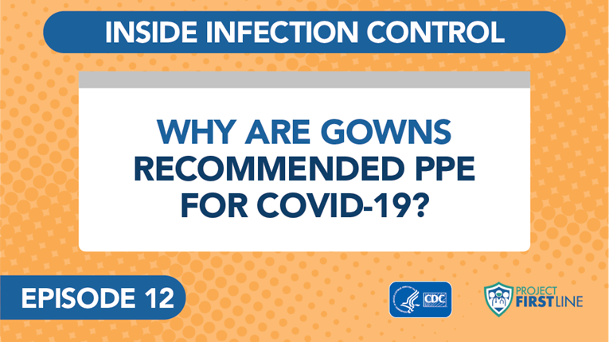
Video blog 6: How Do Viruses Spread from Surfaces to People? (link)
Notes:
Facilitator Notes:
Access the video here:
CDC Website: https://www.cdc.gov/infectioncontrol/projectfirstline/videos/EP12-Gowns-LowRes-New.mp4
OR
Project Firstline YouTube Playlist: https://www.youtube.com/watch?v=qG70h5MOADM&list=PLvrp9iOILTQZQGtDnSDGViKDdRtIc13VX&index=14

Slide 14
What did you learn about gowns?
What do gowns and gloves have in common? How are they different?
Notes:
Facilitator Notes
Invite participants to review the notes they wrote down during the video and share, either orally or in the chat, similarities and differences between gowns and gloves in healthcare.
Potential responses could include:
Gowns and gloves protect the wearer by keeping germs off their body, either their hands or their clothes.
Gowns and gloves keep the wearer from accidentally spreading germs: when you remove and properly dispose of gloves or the gown, you keep germs out of the environment.
Do not wear more than one pair of gloves, or more than one gown, at the same time. Gowns designed for use as PPE are intended to be worn as a single gown. Removing and replacing the top layer of gloves between patients or tasks increases your risk of contaminating the bottom pair of gloves.
Acknowledge responses and link them to the next slide.
Sample Script
“Take a moment to review the notes you took during the video. What do gowns and gloves have in common? How are they different?”
(Pause for responses.)
“That’s great, thank you!”

Slide 15
Gowns protect you and keep germs from spreading
How?
Gowns protect you from germs.
Gowns protect others by keeping germs out of the environment.
Gowns make it easier to remove things, such as germs and body fluids, that might get on you while you work, so you don’t have to change clothes every time your clothes get dirty.
When you remove and dispose of your gown properly, you keep germs from spreading in the environment.
Notes:
Facilitator Notes
Note: This slide has animations for the second column. When you advance to the slide, only the first column will appear.
After you introduce the points, ask participants to share answers to the questions “Why?” or “How?” either orally or in the chat.
After they provide responses, use the animation to reveal the answers.
Sample Script
“Let’s review some important points about gowns. Just like gloves, gowns protect you, and they protect others. How do they protect you?”
(Pause for responses.)
“That’s right. Gowns make it easier to remove things, such as germs and body fluids, that might get on you while you work, so you don’t have to change clothes every time your clothes get dirty. How do gowns protect others?”
(Pause for responses.)
“Yes! When you remove and dispose of your gown properly, you keep germs from spreading in the environment. ”

Slide 16
Gowns MUST be worn properly to be effective
Remove your gown:
  When it gets dirty.
  Before moving to the next patient or task.
Make sure that your gown fits properly and that it doesn’t touch other surfaces while you’re wearing it.
Gowns designed for use as PPE are intended to be worn as a single gown.
Notes:
Facilitator Notes
Note: This slide has animations for the first set of sub-bullets and the second and third bullets. When you advance to the slide, only the first level of bullets will appear.
After you have posed each question, ask for responses from participants.
After they provide responses, use the animation to have the sub-bullets appear.
Sample Script
“Just like gloves, gowns must be worn properly. Let’s review some important points about wearing gowns correctly. When should you remove your gown?”
(Pause for responses.)
“That’s right. To keep germs out of the environment, you should remove and dispose of your gown when it gets dirty, and before you move on to the next patient or task. What are some other important ‘dos’ and ‘don’ts’ for gowns?”
(Pause for responses.)
“Yes, it’s important to try not to touch other surfaces with your gown – you could pick up germs and spread them without meaning to. Also, your gown should fit you well. If it’s too big, it could get in your way and trip you up, or the edges or sleeves could drag across surfaces and pick up germs. If it’s too small, it won’t cover you enough, and you might not be able to move as easily. Or it could rip or tear!“
“Are there any other things to remember for gowns?”
(Pause for responses.)
“Exactly. Just like with gloves, wearing more than one gown at once is not recommended. You’re not any more protected from germs, and the extra layers can get in your way. Even if you change the top layer when it gets dirty, you could contaminate the bottom layer in the process, and spread germs.”

Slide 17
Reflection
What questions do you still have about wearing gowns?
Notes:
Facilitator Notes
Invite additional, remaining questions.
You may choose to ask participants to respond orally, in the chat, or both.
If the answers are information that is already included in this session, please respond.
If the questions address content that is not covered in this session, please do not attempt to answer. Instead, take note of the questions and consult with CDC resources to follow up with answers after the session.
Sample Script
“Before we move on, I just want to open it up in case there are any unanswered questions or items I can clarify about gowns.”
(Pause for responses.)
“Thank you for sharing those questions. I’ve written them down, and I will get back to you with responses.”

Slide 18
Gloves and gowns at work
Notes:
Facilitator Notes
Transition to small group breakouts and discussion of practical aspects of gown and glove use on the job.
Sample Script
“Now let’s discuss how you use gloves and gowns at work.”

Slide 19
Breakout Groups
How are gloves and gowns used at your workplace?
1. How are gloves and gowns used at your workplace?
  What does your facility do well with using gloves and gowns?
2. What strategies could you use to suggest improvements for glove and gown use at work?
Notes:
Facilitator Notes
Use breakout rooms appropriate to your virtual platform to divide participants into groups of approximately three, and task each with discussing how gloves and gowns are used at their facility.
As needed, provide instructions related to the breakout room format, such as how to ask questions.
Inform the groups that they have 10 minutes to work together.
Ask each group to identify a spokesperson who will share the group’s ideas when everyone reconvenes.
If applicable and possible, try to create groupings of participants who haven’t yet had an opportunity to speak together during the training.
After the small groups have gathered, depending on your virtual platform, you may use the broadcast message feature or another means to send reminders of the scenarios, how much time is remaining, etc. You may also choose to “visit” each group to encourage conversation and to hear their thoughts.
The groups will discuss the first question, and when the full group reconvenes, they will discuss the second question:
How are gloves and gowns used at your workplace? What does your facility do well with using gloves and gowns?
What strategies could you use to suggest improvements for glove and gown use at work?
Remind participants of the beginning of the session and how they responded to the question of how they use gowns and gloves and encourage them to think in-depth about the questions on the slide, using the information from the videos and discussion.
Sample Script
“Now let’s dig a little deeper and talk about gloves and gowns in practice. We’re going to break into small groups and consider together the first question on the slide: How are gloves and gowns used at your workplace? What does your facility do well with using gloves and gowns? As you’re sharing, think about your responses at the beginning of the session, when we shared how we use gowns and gloves at work – and about how you could apply the information from the videos and discussion.”
“You’ll have about 10 minutes to work, and then we’ll come back together as a large group to share ideas for the second question: What strategies could you use to suggest improvements for glove and gown use at work?”
“Please decide on one person from your group to report out your thoughts! I’ll give you a warning when you have 2 minutes left.”

Slide 20
Report out
Gloves and gowns at your workplace
Working Well | Improvement Strategies
Notes:
Facilitator Notes
After 10 minutes, reconvene the group.
In turn, invite one person from each small group to share their responses to the questions about glove and gown use at work, and what their facilities do well.
After each group’s report, acknowledge the responses.
You may choose to capture high-level summaries of their responses on a slide, or in the chat.
After the reports, lead a group discussion of strategies that they could employ to suggest improvements for glove and gown use at work.
You may choose for participants to respond orally or in the chat.
You may choose to summarize the group’s ideas on a slide or in the chat.
Encourage participants to think about how they can use their knowledge about gloves and gowns at work.
Building on the suggested strategies, ask the group to reflect on any new ideas that might be helpful in their daily work.
Sample Script
“Welcome back. I’d like for each group to report on your discussion, and what’s going well at your facilities. I’ll capture some high-level points as you share.”
(Acknowledge and react to their reports.)
“Great. Thank you for sharing your ideas! Now let’s think about the next question, and how we can suggest improvements in glove and gown use at work. Does anyone have any ideas?”
(Pause for responses.)
“Thanks for the good ideas. Did anyone hear something that might be helpful to you at work, maybe a new idea?”
(Pause for responses.)

Slide 21
Reflection
Notes:
Facilitator Notes
Invite participants to reflect on what they learned during the session.
Sample Script
“You all did a great job of sharing useful, good strategies. Remember, if you’re unsure about what to do, you can always talk with your supervisor, or your colleagues.”
“Let’s use our last few minutes together to reflect on what we’ve learned and think about how we can put what we’ve learned into practice.”

Slide 22
Reflection, Continued
What is one
thing you learned today about the use of gloves
and gowns for infection control?
Notes:
Facilitator Notes
Invite participants to share something that they learned about how using gloves and gowns prevents the spread of germs in healthcare.
You may choose for participants to respond orally or in the chat.
Acknowledge responses. Consider reading them aloud if they are in the chat.
Sample Script
“I hope you’ve learned a lot today. Before we go, I’d like for you to share with me one thing you learned about how the proper use of gloves and gowns can keep germs from spreading.”
(Pause for responses.)

Slide 23
Questions?
Notes:
Facilitator Notes
Invite additional, remaining questions.
You may choose to ask participants to respond orally, in the chat, or both.
If the answers are information that is already included in this session, please respond.
If the questions address content that is not covered in this session, please do not attempt to answer. Instead, take note of the questions and consult with CDC resources to follow up with answers after the session.
Sample Script
“Thank you all for your time! Please take a moment to reflect on today’s session and share any remaining questions you have. Does anyone have any questions still remaining?”
(Address questions as appropriate.)
“Thank you for sharing those questions. Project Firstline is actively collecting your questions to help inform more training resources as they’re developed. I’ve written them down and I will get back to you with responses.”

Slide 24
Key takeaways
Wearing gloves and gowns is an important strategy for infection control.
They protect you and keep you from accidentally spreading germs into your environment.
Gloves and gowns must be worn properly to be effective.
Wearing two pairs of gloves or two gowns at once is not recommended for routine care and can be an infection control risk.
Notes:
Facilitator Notes
Review key takeaways.
You may choose to revisit discussion points or questions that arose during the session.
Sample Script
“I hope this training gave you some good information about gloves and gowns, and why they are so important for infection control. I’ve captured some key takeaways here, which you can review at your leisure after the session today.”

Slide 25
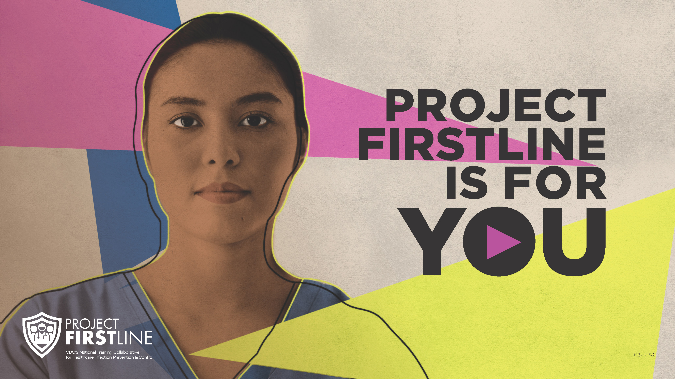
Feedback Form
Notes:
Facilitator Notes
Explain how to access the Feedback Form.
Sample Script
“And, finally, please let us know how you enjoyed today’s session by completing the following feedback form. Thanks again for joining us today.”
After the Session
Send list of participant questions compiled during this session to ProjectFirstline@cdc.gov.

