Slide 1
Topic 8:
Ppe part 2 – gloves & gowns
[Date of training]
Notes:
Participants log in and get settled.

Slide 2
Agenda
Introductions
Discussion
  Gloves
  Gowns
Next Steps
Notes:
Facilitator Notes
Welcome the group and add a greeting to the chat box.
If this session is part of an ongoing series, you may choose to say “welcome back,” “thank you for joining us again,” etc.
Announce housekeeping notes, either orally or via chat.
If needed, provide additional notes specific to the platform you’re using (e.g., how to “raise your hand,” how to post questions).
Provide an overview of the agenda.
Adapt this section of the session as needed: for instance, you may choose to spend additional time on introductions if there are new faces, or if participants do not know each other.
Sample Script
“Welcome to Project Firstline. Over the next 20 minutes, we’ll focus on two important pieces of your PPE – your personal protective equipment – gloves and gowns. Please keep your videos on, to the extent possible, and keep your microphone muted when you are not contributing to the discussion. It’s great to see you all here today!”
“Today we’ll talk about the role of gowns and gloves in infection control, and we’ll also cover some ‘dos and don’ts’ for using them at work every day.”

Slide 3
Learning Objectives
Describe two (2) reasons why wearing gloves is important for infection control.
Describe two (2) ways that gowns are important for infection control.
Discuss three (3) reasons why wearing more than one pair of gloves at once, or wearing more than one gown at once, is not recommended for routine care.
Notes:
Facilitator Notes
Provide an overview of the session’s learning objectives.
Sample Script
“Here is what we expect to learn today. By the end of today’s training, you will be able to describe why it’s important to wear gloves and gowns, and how to wear them properly.”

Slide 4
Introductions
Please introduce yourself with:
Your name
Your role (e.g., organization, unit)
Notes:
Facilitator Notes
These questions will give you a better understanding of your participants’ backgrounds, experience, and level of knowledge.
Tailor your slide delivery for the virtual format and platform, and the number of participants:
You may wish to call on participants individually.
You may wish to add role- or facility-specific questions to the introductions.
If you have a large group, you may decide to skip oral introductions and use the chat.
If your group meets regularly, you may wish to skip or shorten the introductions, or use a different “icebreaker” approach.
Be sure to introduce yourself, and anyone who is assisting you.
Sample Script
“Let’s take a minute to get to know each other. Please share in 10 seconds or less your name and your role.”

Slide 5
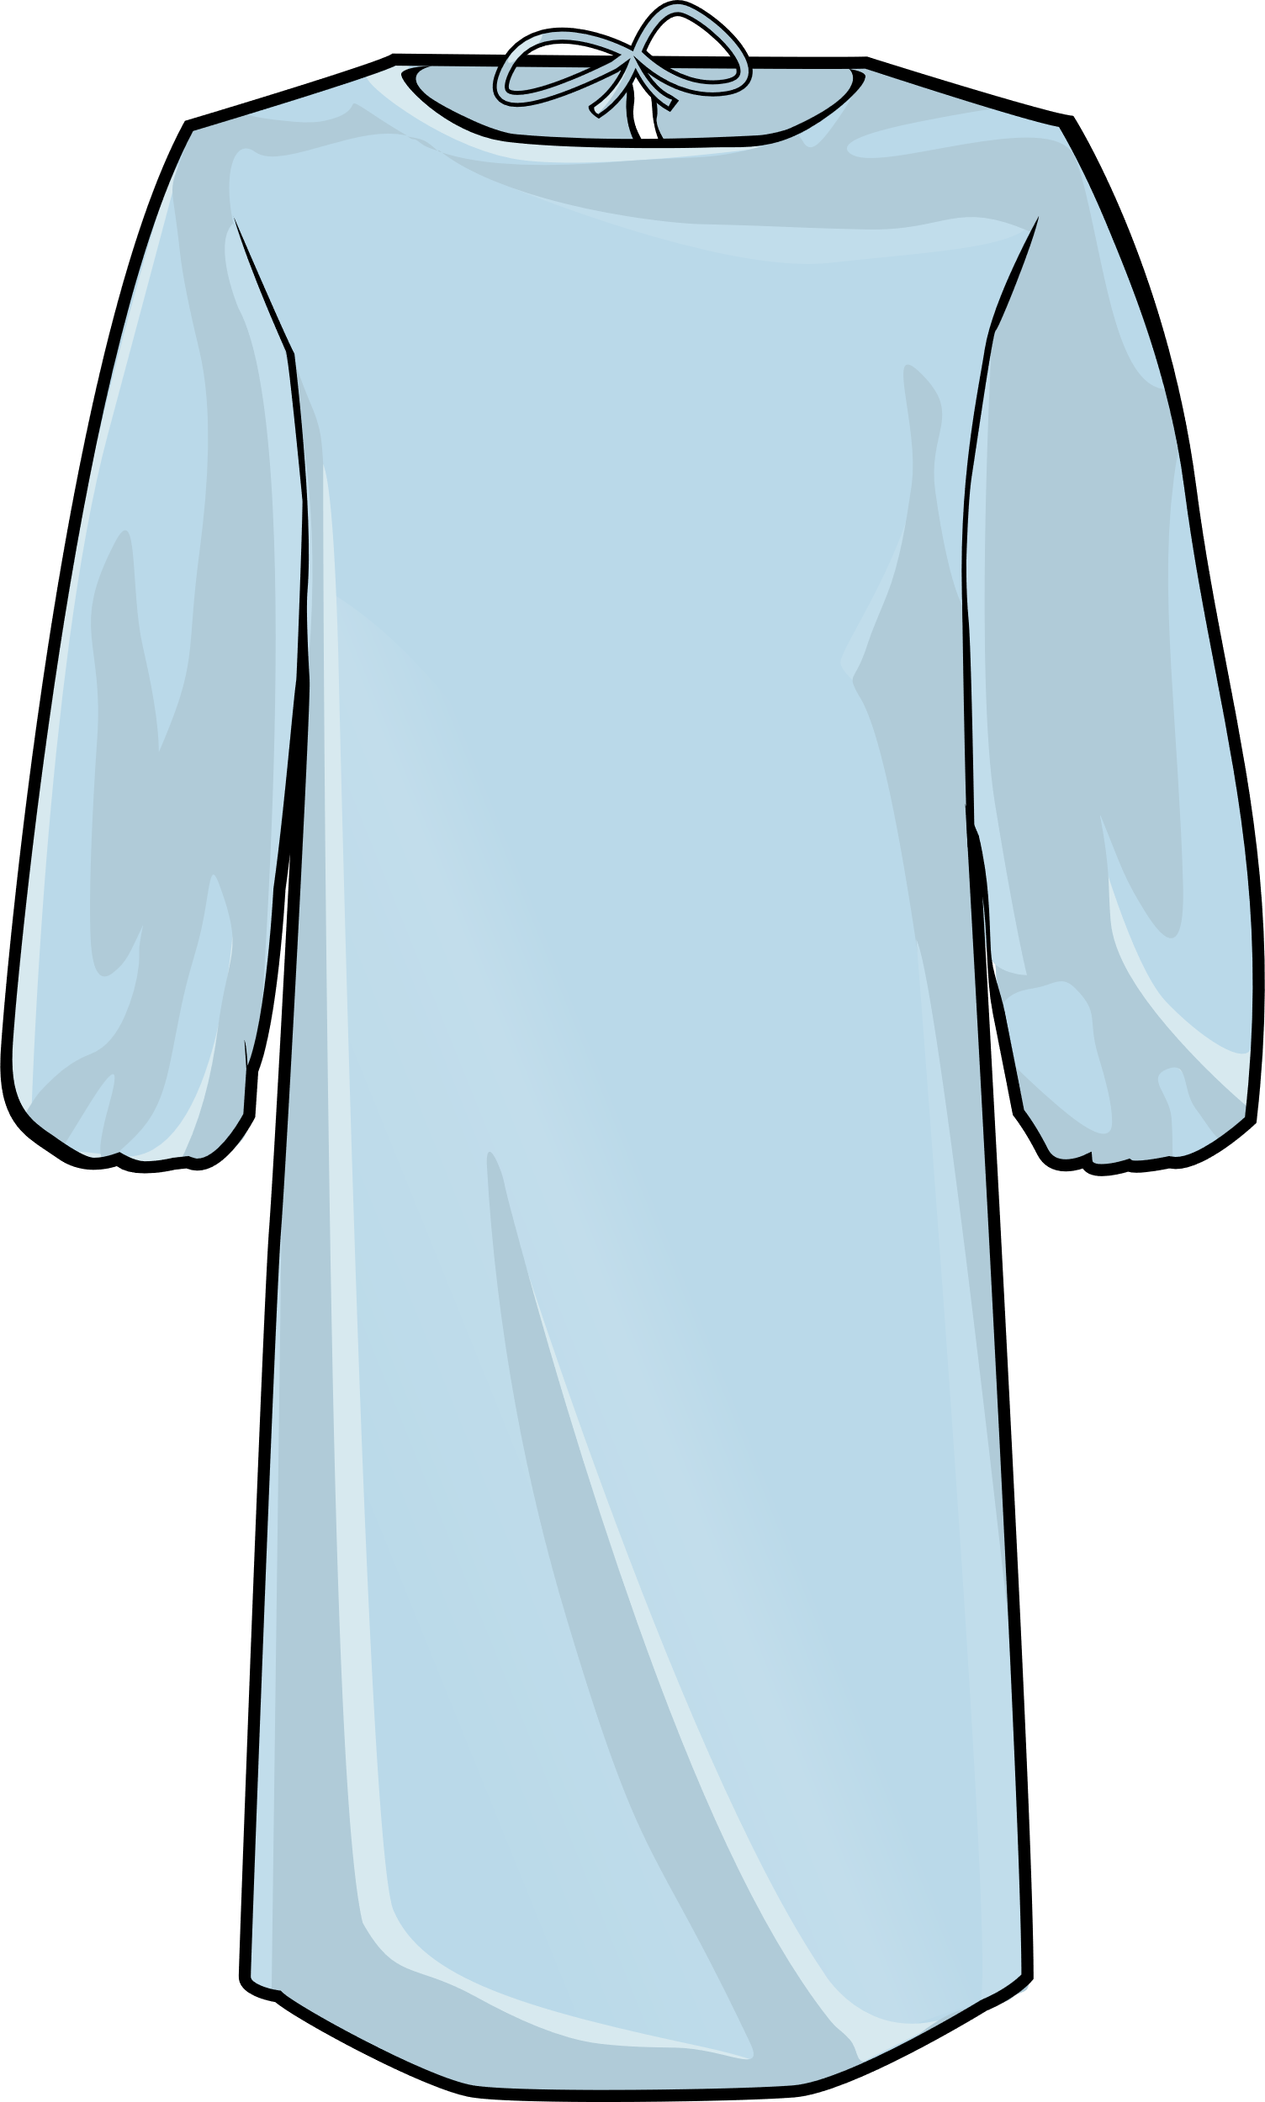
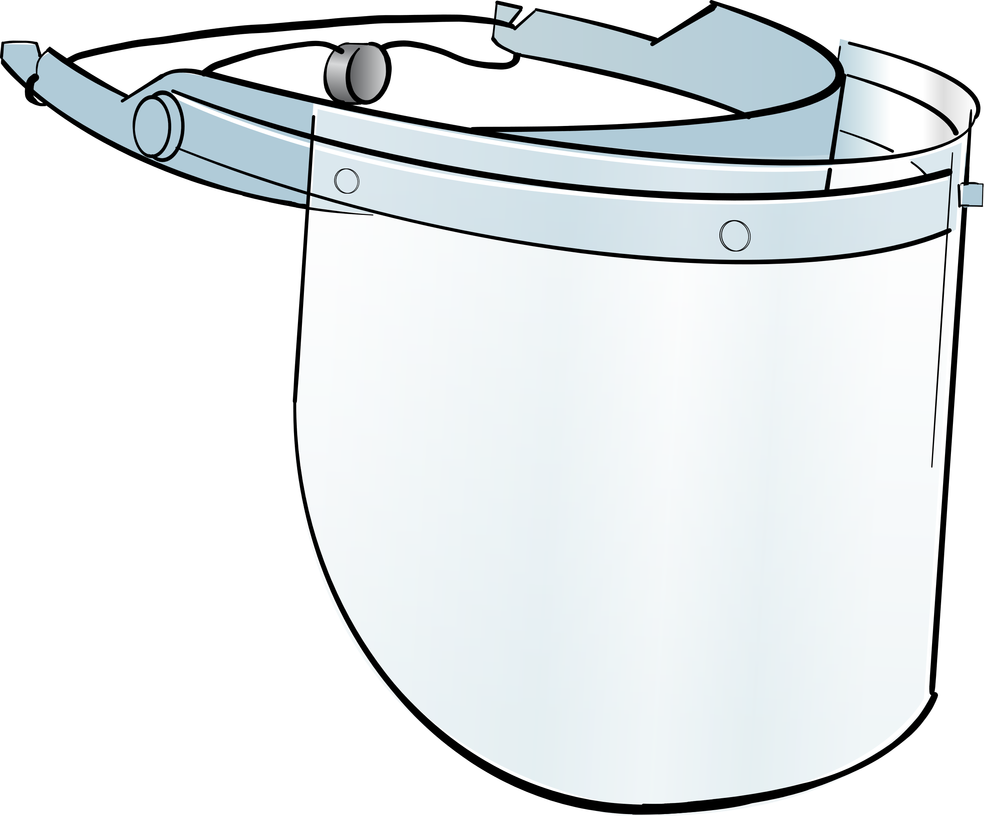

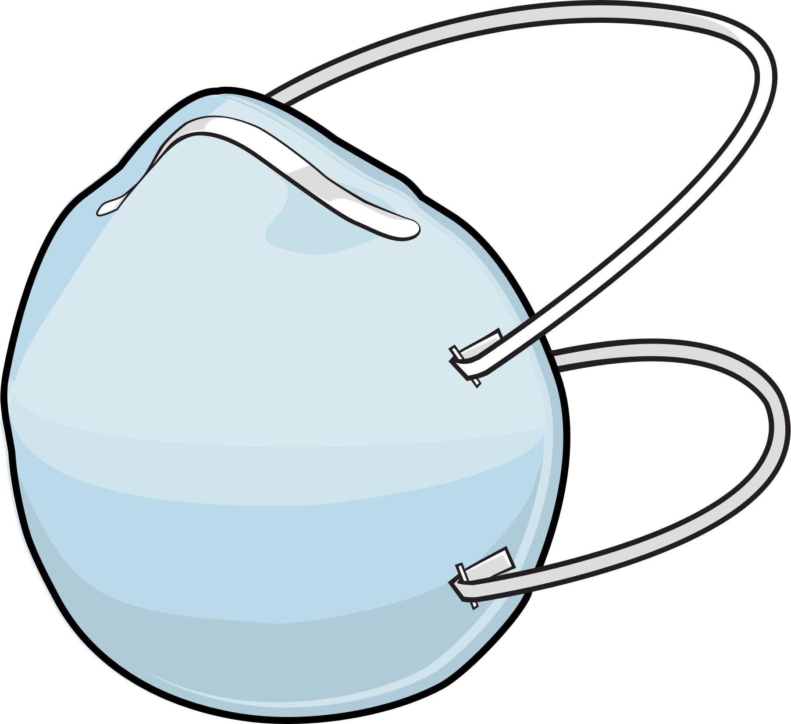

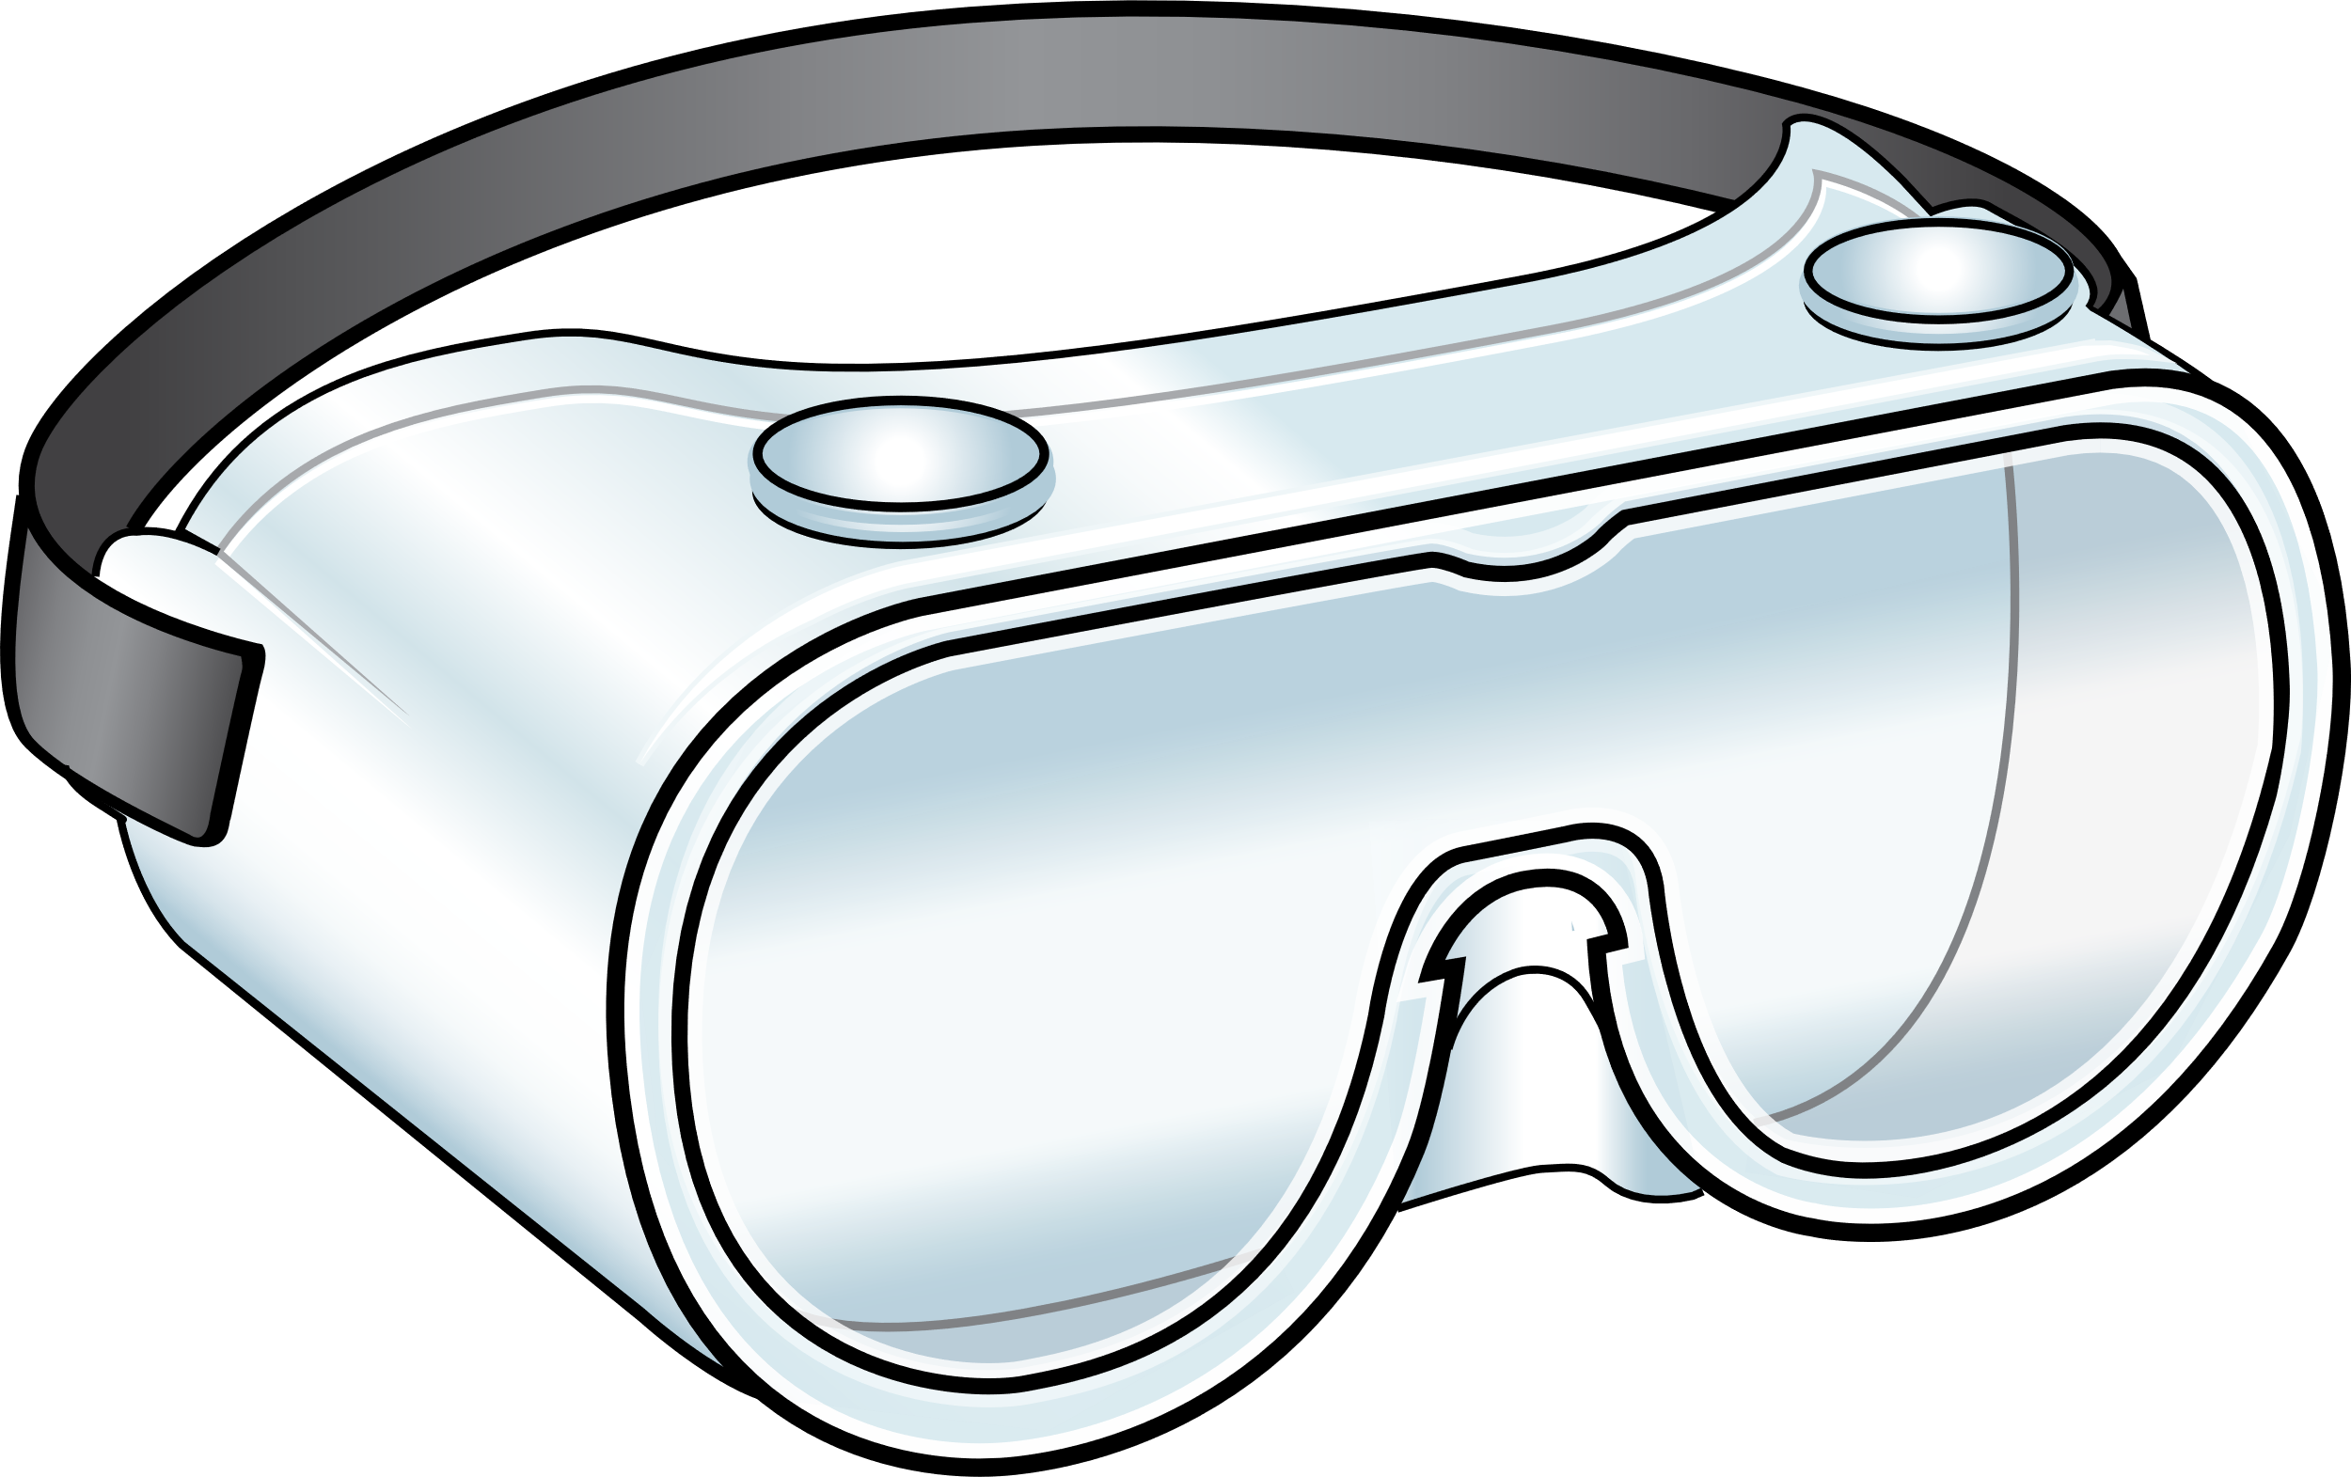
Recommended PPE for COVID-19
Eye Protection
Gloves & Gown
Respirator
Notes:
Facilitator Notes
Establish that the session will focus on gloves and gowns, which are part of the PPE recommended for COVID-19.
If this session is part of a series, you may choose to indicate that future sessions will focus on other types of PPE.
Sample Script
“To get started, let’s think about the specific PPE recommended for COVID-19. Today, we’ll focus on gloves and gowns. In future sessions, we’ll examine other types of PPE.”

Slide 6
Gloves protect you and keep germs from spreading
How?
Gloves protect you and keep you from accidentally spreading germs into your work environment.
Gloves help stop germs from spreading from place to place while carried on your hands.
Gloves cover any breaks and cracks in your skin so that germs can’t get to them, and they keep germs from spreading from your broken skin to others, or the environment.
If you touch something with germs on it, the germs can get on your gloves.
Notes:
Facilitator Notes
The bullet points on slides 6 and 7 summarize content from Episode 11 of Inside Infection Control: Why are Gloves Recommended for COVID-19? For time reasons, the video is not shown during the 20-minute session. You may wish to refer to the Content Outline for Episode 11 for additional discussion points.
Note: This slide has animations for the second column. When you advance to the slide, only the first column will appear.
After you introduce the points, ask participants to share answers to the questions “Why?” or “How?” either orally or in the chat.
After they provide responses, use the animation to reveal the answers.
Sample Script
“Let’s break down some of the reasons why gloves are so important for infection control in healthcare. First, gloves protect you and also keep you from accidentally spreading germs into your work environment. How do they do that?”
(Pause for responses.)
“That’s right. Gloves cover any breaks and cracks in your skin so that germs can’t get to them, and also keep germs from spreading from your broken skin to others, or to the environment. Gloves also help stop germs from spreading from place to place while carried on your hands. How do they do that?”
(Pause for responses.)
“Yes! When you’re wearing gloves, if you touch something with germs on it, the germs can get on your gloves. That’s why, when you move from one patient or one task to another, you take those gloves off and throw them away and, if needed, put on clean ones, so you’ve removed whatever is on them and you don’t carry germs to your next patient or task.”

Slide 7
Gloves MUST be worn properly to be effective
Clean your hands
After you’ve taken your gloves off and before you put on a new pair
Before you reach into the box to pull out new gloves
Do not wear two pairs of gloves at once, which can
Add new risks, like making your fingers harder to move
Spread germs when removing and replacing the top layer
Notes:
Facilitator Notes
Note: This slide has animations for both sets of sub-bullets. When you advance to the slide, only the first level of bullets will appear.
After you have posed each question, ask for responses from participants.
After they provide responses, use the animation to have the sub-bullets appear.
Sample Script
“Gloves must be worn properly, or they won’t be effective. When you’ve been wearing gloves, when should you clean your hands?”
(Pause for responses.)
“That’s right. It’s important to clean your hands after you remove your used gloves, and before you pull a new pair out of the box. If you reach into the box with dirty hands, what happens? You’ve contaminated all of the gloves in the box!”
“What are some of the reasons why we shouldn’t wear two pairs of gloves at once for routine care?”
(Pause for responses.)
“That’s right. Wearing more than one pair of gloves can make it harder to move your hands and fingers while providing care, which can lead to mistakes. Also, removing and replacing the top layer of gloves between patients or tasks increases your risk of contaminating the bottom pair of gloves and spreading germs to yourself, others, and the environment.”

Slide 8
What questions do you still have about wearing gloves?
Notes:
Facilitator Notes
Invite additional, remaining questions.
You may choose to ask participants to respond orally, in the chat, or both.
If the answers are information that is already included in this session, please respond.
If the questions address content that is not covered in this session, please do not attempt to answer. Instead, take note of the questions and consult with CDC resources to follow up with answers after the session.
If you receive questions about why double gloving was recommended in Ebola care, you may refer participants to the following CDC guidance: Guidance on Personal Protective Equipment (PPE) | Personal Protective Equipment (PPE) | Public Health Planners | Ebola (Ebola Virus Disease) | CDC (https://www.cdc.gov/vhf/ebola/healthcare-us/ppe/guidance.htm )
If you receive questions about double gloving during dental procedures, you may refer participants to the following CDC guidance: ” Guidelines for Infection Control in Dental Health-Care Settings --- 2003 (cdc.gov) (https://www.cdc.gov/mmwr/preview/mmwrhtml/rr5217a1.htm)
Sample Script
“Before we move on, I just want to open it up in case there are any unanswered questions or items I can clarify about glove wearing.”
(Pause for responses.)
“Thank you for sharing those questions. I’ve written them down, and I will get back to you with responses.”

Slide 9
Gowns protect you and keep germs from spreading
How?
Gowns protect you from germs.
Gowns protect others by keeping germs out of the environment.
Gowns make it easier to remove things, such as germs and body fluids, that might get on you while you work, so you don’t have to change clothes every time your clothes get dirty.
When you remove and dispose of your gown properly, you keep germs from spreading in the environment.
Notes:
Facilitator Notes
The bullet points on slides 9 and 10 summarize content from Episode 12 of Inside Infection Control: Why are Gowns Recommended for COVID-19? For time reasons, the video is not shown during the 20-minute session. You may wish to refer to the Content Outline for Episode 12 for additional discussion points.
Note: This slide has animations for the second column. When you advance to the slide, only the first column will appear.
After you introduce the points, ask participants to share answers to the questions “Why?” or “How?” either orally or in the chat.
After they provide responses, use the animation to reveal the answers.
Sample Script
“Let’s review some important points about gowns. Just like gloves, gowns protect you, and they protect others. How do they protect you?”
(Pause for responses.)
“That’s right. Gowns make it easier to remove things, such as germs and body fluids, that might get on you while you work, so you don’t have to change clothes every time your clothes get dirty. How do gowns protect others?”
(Pause for responses.)
“Yes! When you remove and dispose of your gown properly, you keep germs from spreading in the environment.”

Slide 10
Gowns MUST be worn properly to be effective
Remove your gown:
  When it gets dirty.
  Before moving to the next patient or task.
Make sure that your gown fits properly and that it doesn’t touch other surfaces while you’re wearing it.
Gowns designed for use as PPE are intended to be worn as a single gown.
Notes:
Facilitator Notes
Note: This slide has animations for the first set of sub-bullets and the second and third bullets. When you advance to the slide, only the first level of bullets will appear.
After you have posed each question, ask for responses from participants.
After they provide responses, use the animation to have the sub-bullets appear.
Sample Script
“Just like gloves, gowns must be worn properly. Let’s review some important points about wearing gowns correctly. When should you remove your gown?”
(Pause for responses.)
“That’s right. To keep germs out of the environment, you should remove and dispose of your gown when it gets dirty, and before you move on to the next patient or task. What are some other important ‘dos’ and ‘don’ts’ for gowns?”
(Pause for responses.)
“Yes, it’s important to try not to touch other surfaces with your gown – you could pick up germs and spread them without meaning to. Also, your gown should fit you well. If it’s too big, it could get in your way and trip you up, or the edges or sleeves could drag across surfaces and pick up germs. If it’s too small, it won’t cover you enough, and you might not be able to move as easily. Or it could rip or tear!”
“Are there any other things to remember for gowns?”
(Pause for responses.)
“Exactly. Just like with gloves, wearing more than one gown designed for PPE at once is not recommended. You’re not any more protected from germs, and the extra layers can get in your way. Even if you change the top layer when it gets dirty, you could contaminate the bottom layer in the process, and spread germs.”

Slide 11
What questions do you still have about wearing gowns?
Notes:
Facilitator Notes
Invite additional, remaining questions.
You may choose to ask participants to respond orally, in the chat, or both.
If the answers are information that is already included in this session, please respond.
If the questions address content that is not covered in this session, please do not attempt to answer. Instead, take note of the questions and consult with CDC resources to follow up with answers after the session.
Sample Script
“Before we move on, I just want to open it up in case there are any unanswered questions or items I can clarify about gowns.”
(Pause for responses.)
“Thank you for sharing those questions. I’ve written them down, and I will get back to you with responses.”

Slide 12
discussion
How are gloves and gowns used at your workplace?
1. How are gloves and gowns used at your workplace?
  What does your facility do well with using gloves and gowns?
2. What strategies could you use to suggest improvements for glove and gown use at work?
Notes:
Facilitator Notes
Transition to discussion about the practical aspects of gown and glove use on the job.
Encourage participants to think about how they can use their knowledge about gloves and gowns at work.
You may choose to ask participants to respond orally, in the chat, or both.
Building on the suggested strategies, ask the group to reflect on any new ideas that might be helpful in their daily work.
Sample Script
“Now let’s dig a little deeper and talk about gloves and gowns in practice. How are gloves and gowns used at your workplace? What does your facility do well with using gloves and gowns? Take a few minutes to reflect on this conversation and be prepared to share with the group.”
(Pause for reflection and responses.)
“Great. Thank you for sharing your ideas! Now let’s think about the next question, and how we can suggest improvements in glove and gown use at work. Does anyone have any ideas?”
(Pause for responses.)
“Thanks for the good ideas. Did anyone hear something that might be helpful to you at work, maybe a new idea?”
(Pause for responses.)

Slide 13
Key takeaways
Wearing gloves and gowns is an important strategy for infection control.
They protect you and keep you from accidentally spreading germs into your environment.
Gloves and gowns must be worn properly to be effective.
Wearing two pairs of gloves or two gowns at once is not recommended for routine care and can be an infection control risk.
Notes:
Facilitator Notes
Review key takeaways.
You may choose to revisit discussion points or questions that arose during the session.
Sample Script
“I hope this training gave you some good information about gloves and gowns, and why they are so important for infection control. I’ve captured some key takeaways here, which you can review at your leisure after the session today.”

Slide 14
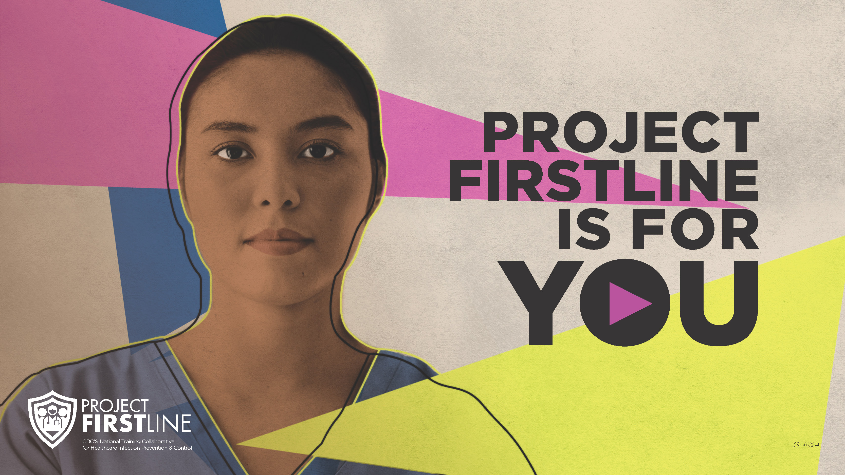
Feedback Form
Notes:
Facilitator Notes
Explain how to access the Feedback Form.
Sample Script
“And, finally, please let us know how you enjoyed today’s session by completing the following feedback form. Thanks again for joining us today.”
After the Session
Send list of participant questions compiled during this session to ProjectFirstline@cdc.gov.

