Slide 1

Topic 5: How COVID-19 Spreads: A Review [Date of training]
Notes:
Participants log in and get settled.

Slide 2

Agenda
Introductions
How COVID-19 Spreads: A Review
Video
Discussion and reflection
Session feedback form and next steps
Notes:
[Please note that the toolkit topics are presented in sequence, with the expectation that participants will progress through the series. You may, however, mix and match content to meet participant needs and you will need to adjust the sample script below.]
Sample Script
“Welcome back to Project Firstline. We’ll meet today for one hour. Please keep your videos on, to the extent possible, and keep your microphone muted when you are not contributing to the discussion. It’s great to see you all here today!”

Slide 3
Learning Objective
Describe two (2) ways that SARS-CoV-2 spreads

Slide 4
Thinking back to last session…
Notes:
[Please note that the toolkit topics are presented in sequence, with the expectation that participants will progress through the series. You may, however, mix and match content to meet participant needs and you will need to adjust the sample script below.]
Sample Script
“Last time, we focused on how viruses spread from surfaces to people. Would anyone like to share key messages or ideas from the last session that stand out in your memory?
[Pause for a minute, allowing time for responses]
“Great, thank you for those responses. Today we will focus on a review of how COVID-19 spreads.”

Slide 5
Session Topics
What We’ve Covered So Far
The Concept of Infection Control
The Basic Science of Viruses
How Respiratory Droplets Spread COVID-19
How Viruses Spread from Surfaces to People
Broader Themes and Topics
Infection Control: The Basics
Source Control
PPE: Basics
PPE: Donning and Doffing
Hand Hygiene
Crisis Standards of Care
Triage
Microbiology Basics
Recognizing Risk
Environmental Cleaning and Disinfection
Notes:
Sample Script
“Today we’re going to review these concepts and think about what questions have been answered, and what new questions we have. You may remember a slide similar to this from our very first session. On the left are the topics we’ve started to cover. On the right are broader themes and topics included across the training series. Which topics on the right do you think you understand better than you did before?”
[after audience has answered]
“Now look at the list on the left. Hopefully, we’ve all learned together some new information together. Let’s take a minute to reflect on that learning.”

Slide 6
What I know and still want to know…
What I know | What I think I know | What I want to know
Notes:
Sample Script
“Please turn in your participant booklets to the blank journaling space for this session and make a simple table for yourself like the one on the screen. Please take a moment to fill it in, based on the content we’ve covered so far. This is your chance to jot down what you’ve learned, and what you still want to know. Please try to fill in all three columns.”
“We’re going to come back to these lists in a moment. First, let’s see how Dr. Carlson would sum up ‘what we know’ collectively, based on the session we’ve had so far.”

Slide 7
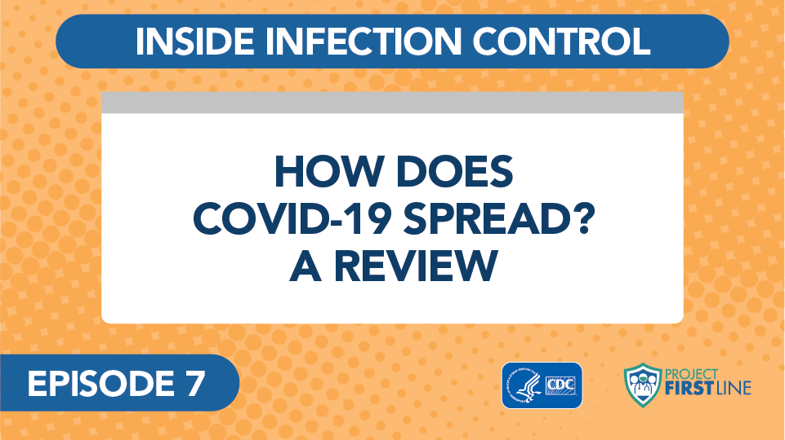

Video blog 99: How does COVID-19 spread? A Review (link)
Notes:
Sample Script
[after video]
“If you’d like to make any changes to your lists, please feel free to do so!”
Access the video here:
CDC Website: https://www.cdc.gov/infectioncontrol/projectfirstline/videos/Ep7-Review-LowRes-New.mp4
OR
Project Firstline YouTube Playlist: https://www.youtube.com/watch?v=1LZZz1yMGvY

Slide 8
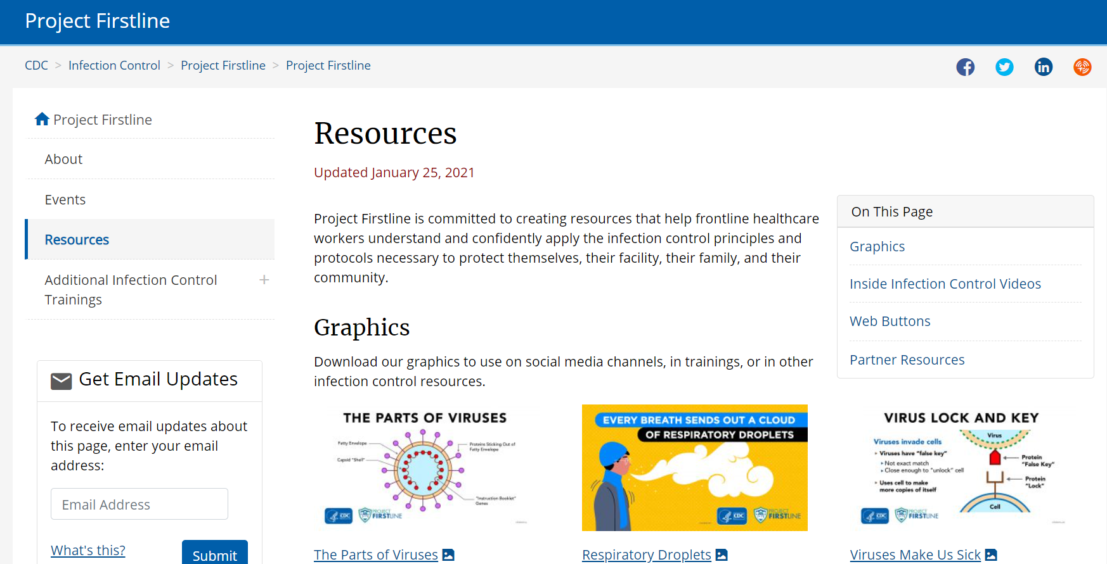
What I Want to Know
Resources | Project Firstline | Infection Control | CDC
Notes:
Sample Script
“Now let’s talk about the last column, what we want to know. As we discussed in the first session, CDC is actively collecting participant questions and will generate future videos and other resources for answering these questions. Some of them will also be a direct focus of future sessions, such as a closer look at specific recommendations for PPE, hand hygiene, triage and screening, source control, and disinfection and environmental cleaning. But there’s a lot we can learn now, too.
“Instead of breaking into groups today, we’re going to each take some focused individual time to investigate something you want to know from the list generated today. Here’s how this will work. I’m going to give you 15 minutes. In this time, please visit CDC’s Project Firstline Resources Page to become familiar with what resources are available.
[Resources | Project Firstline | Infection Control | CDC]
“There you will find graphics, Inside Infection Control videos, and partner resources where Project Firstline has answered questions from frontline healthcare workers and public health staff across multiple topics. CDC will continue to update this page as new resources are released, so make sure to bookmark it and check back often.
“If you do not see resources that could help answer questions you still have, try to find related questions that have been answered and see what you learn. You can use your Participant Booklet to write down what you find. Everyone should be ready to report back helpful resources that they found.”

Slide 9
Let’s Reconvene
What resources did you find?
Did they help you find answers to questions that you still have?
If not, did you find similar questions? What did you learn?
Notes:
Sample Script
“Let’s reconvene and see what we’ve learned.”

Slide 10
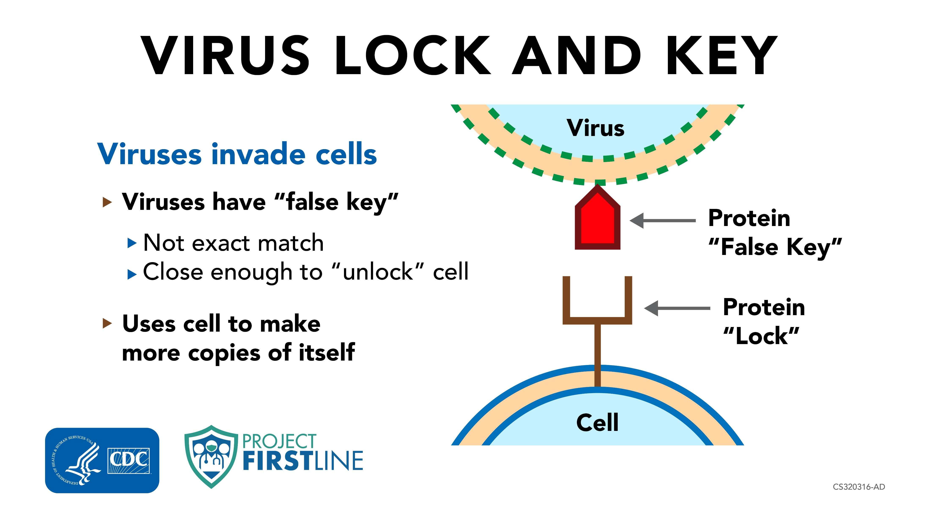
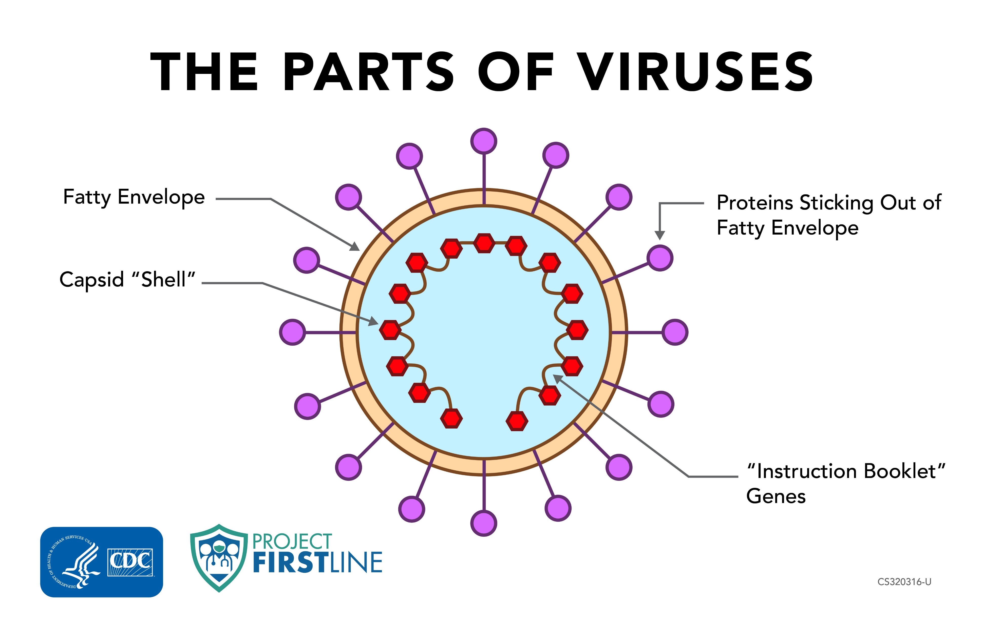
Job Aids Available to You
Notes:
Sample Script
“A reminder that you have the Virus Lock and Key and The Parts of Viruses job aids available to you to help explain these concepts to others.”
Resources | Project Firstline | Infection Control | CDC

Slide 11
Reflection
Notes:
Sample Script
“Take 60 seconds and reflect and identify personal goals and action steps that you would like to take to help stop disease from spreading.”

Slide 12
Key Messages
The main way that SARS-CoV-2, the virus that causes the disease COVID-19, travels between people is through respiratory droplets in our breath.
Another way you can get sick with COVID-19 is if you touch something that has live SARS-CoV-2 virus on it, and then touch your face without cleaning your hands first.
Notes:
[Be ready to add to the list, as needed.]
Sample Script
“I hope you enjoyed today’s conversation. I’ve captured some key messages here, which you can review at your leisure after the session today.”

Slide 13
Resources and Future Training sessions
Project Firstline on CDC:
https://www.cdc.gov/infectioncontrol/projectfirstline/index.html
Project Firstline on Facebook:
https://www.facebook.com/CDCProjectFirstline/
Twitter:
https://twitter.com/CDC_Firstline
YouTube:
https://www.youtube.com/playlist?list=PLvrp9iOILTQZQGtDnSDGViKDdRtIc13VX
To sign up for Project Firstline emails, click here: https://tools.cdc.gov/campaignproxyservice/subscriptions.aspx?topic_id=USCDC_2104
Notes:
Sample Script
“Please keep exploring these topics on your own, using the resources on this slide. You can also follow us on social media.”

Slide 14
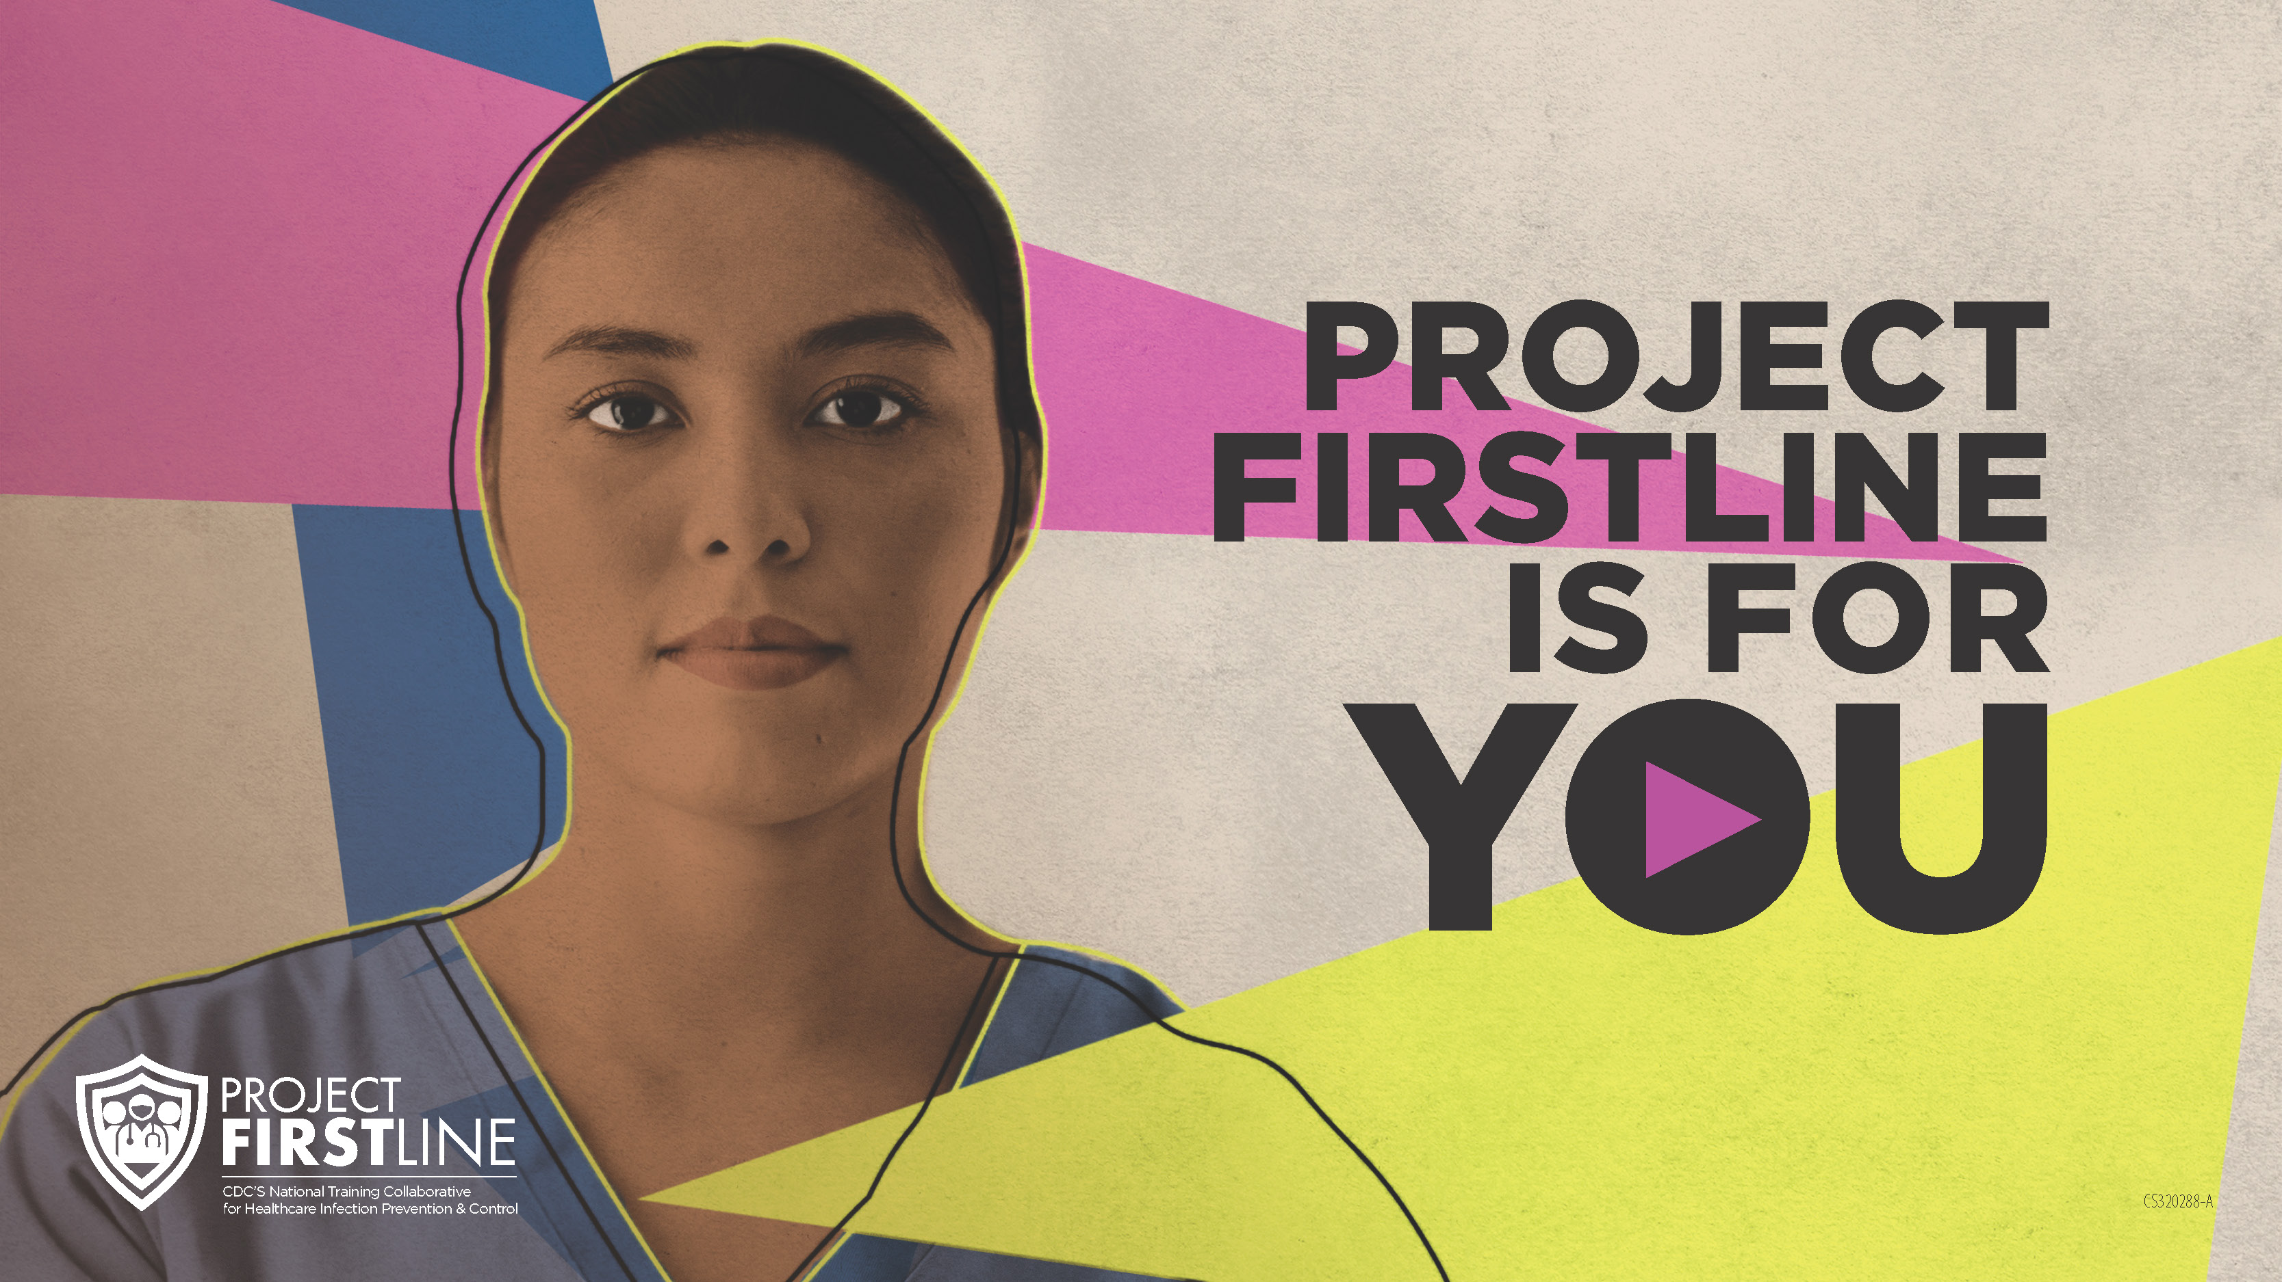
Feedback Form
Notes:
[Facilitator should add information about how to access form]
Sample Script
“And finally, please let us know how you enjoyed today’s session by completing the following feedback form. Thanks again for joining us today.”

