Slide 1

Topic 1: The Concept of Infection Control
[Date of training]
Notes:
Participants log in and get settled

Slide 2

Agenda:
Introduction
Project Firstline and the concept of infection control
  Video
  Discussion and reflection
Session feedback form and next steps
Learning Objectives:
Articulate at least one (1) primary goal of infection control
Notes:
Sample Script
“Welcome! Thank you for joining us for this segment of today’s meeting. As you see on the slide, today we’ll introduce Project Firstline, and we’ll begin discussing the concept of infection control as it relates to our day-to-day work. Today’s session will be more general in nature, but in future sessions we’ll get deeper into the details of infection control.”

Slide 3
Why do we do infection control?
Notes:
Sample Script
“Since we only have 20 minutes together, let’s jump right in. I’d like to begin with a question. Why do you personally do infection control? What’s the goal? What’s the point? I’d like to play for you a brief video from a CDC doctor who talks about this. As we watch the following video, I invite you to think about this question and post your answers in chat. Infection control is important for so many reasons.”

Slide 4
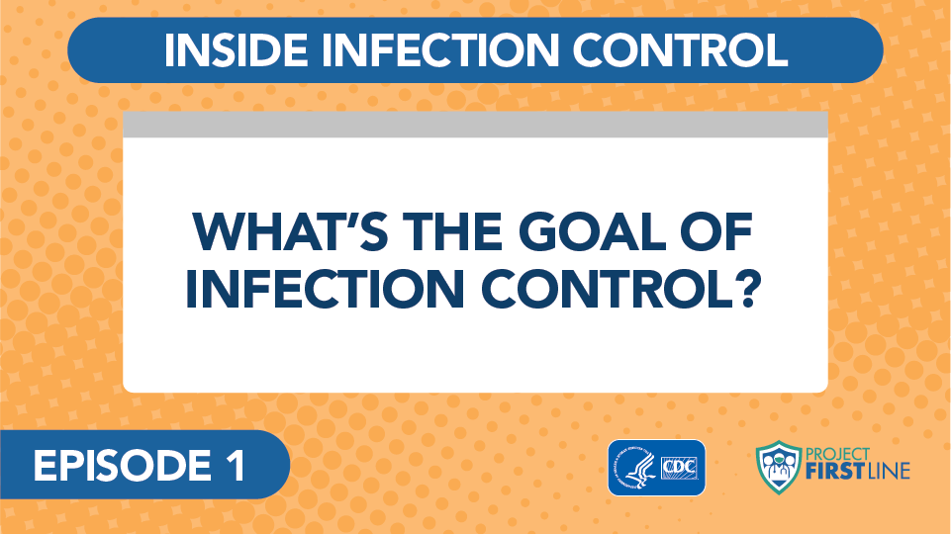
Video: What’s the Goal of Infection Control?
Notes:
Access the video here:
CDC website: https://www.cdc.gov/infectioncontrol/projectfirstline/videos/Ep1-Goal-LowRes-New.mp4
Or
Project Firstline YouTube Playlist:
https://www.youtube.com/watch?v=atLgq4fsVvo

Slide 5
Let’s Discuss
Why do you engage in infection control?
Dr. Carlson talks about several challenges we face working in healthcare right now. Which of these issues are most important to you?
Notes:
Sample Script
“Now, let’s talk about these questions. I see some great answers to this first question in the chat. Infection control is important for all these reasons. We engage in infection control strategies to keep everyone safe and healthy. Who would like to share more thoughts about the concept of infection control, or address this second question about the challenges of working in healthcare right now?
[After audience has shared answers and thoughts]
“Thank you for sharing these important thoughts. We’re going to work on addressing these challenges in our time together, over a series of 20-minute segments. Project Firstline aims to explain the “whys” of infection control, the reasons for the current guidance, and to give us all a chance to get our own questions answered.
“I’d like to show you what’s coming up in this session series.”

Slide 6
Upcoming Session Topics
Coming Up Next:
Broader Themes and Topics:
  The Basic Science of Viruses
  How Respiratory Droplets Spread COVID-19
  How Viruses Spread from Surfaces to People
  How COVID-19 Spreads: A Review
  Infection Control: The Basics
  Source Control
  PPE: Basics
  PPE: Donning and Doffing
  Hand Hygiene
  Crisis Standards of Care
  Triage
  Standard and Transmission-Based Precautions
  Microbiology Basics
  Recognizing Risk
  Environmental Cleaning and Disinfection
Notes:
Sample Script
“As you can see, we have a lot to cover together. In the left-hand column, I’ve listed the specific topics that will be coming up right away. In the right-hand column, I’ve listed the broader themes that are woven into these upcoming sessions as well as future sessions. “

Slide 7
Questions Covered
SARS-CoV-2 is a virus. What’s a virus?
How do viruses make you sick?
How does a virus like SARS-CoV-2 get from one person to another: what is a respiratory droplet?
What happens when we breathe in these droplets?
What happens when these droplets get in our eyes?
  Exposure does not always mean infection: why?
  What makes us feel sick?
…and many more
Notes:
Sample Script
“This slide shows some of the specific questions that our upcoming sessions will cover. What questions do you have? If you have a question, please post it to the chat. CDC is collecting questions from the frontlines for future episodes and materials. We want to make sure your voices get heard, and after today’s session I’m going to submit our group’s questions to CDC.”

Slide 8
What’s one action you can take to support infection control at the workplace?
Is it something you can do for yourself? Does it build on something you already do?
Is it something you can do for others?
Is it thanking some else for something that makes your job easier?
Notes:
Sample Script
“Before we close today, let’s pause and reflect. We have a lot of questions and challenges to cover in upcoming sessions, but we already know that infection control involves all of us. I have a question on this slide, and I’d like us each to reflect individually. Is there something you can do today, now, to support infection control? Maybe it’s taking time for yourself, so you can recharge. Maybe it’s thanking your team members. Maybe it’s encouraging each other to wear our masks on break. We need to support each other in infection control, every day. I’m going to pause for one minute to give everyone a chance to reflect.
[Give participants one full minute to reflect.]
“You don’t have to share your answers, but please write it down in your participant booklet.”

Slide 9
Key Messages
The goal of everything we do in infection control, for any disease, is to keep people from getting sick.
The goal of Project Firstline is to make sure you have the infection control knowledge that you need and deserve to keep yourself, your patients, your colleagues, and your family safe.
Notes:
Sample Script
“This slide summarizes the key messages from today. I’d like to point out that you’ve been given a participant booklet with each session’s learning objectives and key messages, as well as some space to write. Please feel free to use this space to reflect further on today’s session. The booklet is for you.”

Slide 10
Resources and Future Training Sessions
Project Firstline on CDC:
https://www.cdc.gov/infectioncontrol/projectfirstline/index.html
Project Firstline on Facebook:
https://www.facebook.com/CDCProjectFirstline/
Twitter:
https://twitter.com/CDC_Firstline
YouTube Playlist:
https://www.youtube.com/playlist?list=PLvrp9iOILTQZQGtDnSDGViKDdRtIc13VX
To sign up for Project Firstline e-mails, click here: https://tools.cdc.gov/campaignproxyservice/subscriptions.aspx?topic_id=USCDC_2104
Notes:
Sample Script
“Next time, we will dig into some basic microbiology, how viruses work, and how COVID-19 makes us sick. In the meantime, you can keep exploring these topics on your own using the resources on this slide. You can also follow us on social media. Finally, I’d like to share a small welcome gift as a thank you for participating today.”
[Digitally distribute “Project Firstline Is for You” poster.]

Slide 11
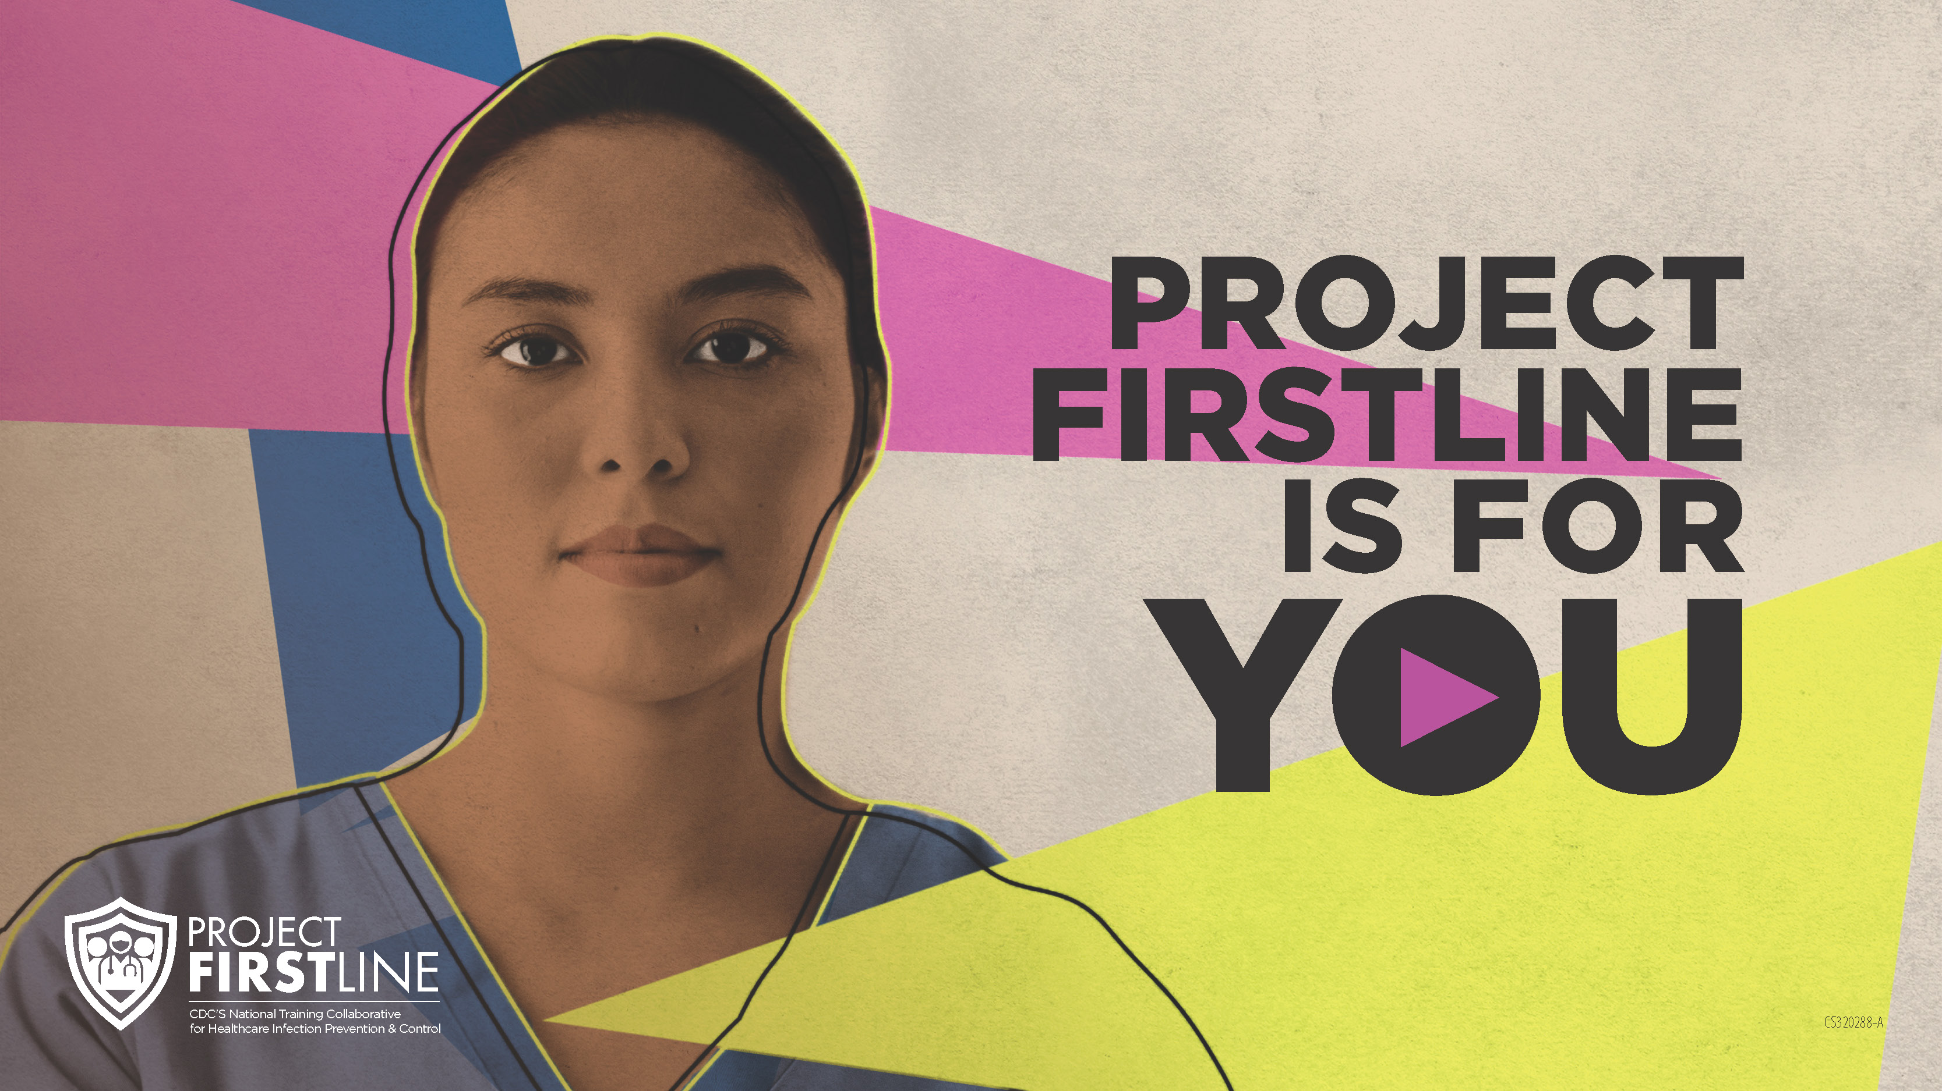
Feedback Form
Notes:
[Facilitator should add information about how to access form]
Sample Script
“And finally, please let us know how you enjoyed today’s session by completing the following feedback form. Thanks again for joining us today.”

