Slide 1


Built Environment (BE) Approaches
Community Preventive Services Task Force
Combine interventions from two major categories
Pedestrian or Bicycle Transportation Systems
Street pattern and connectivity
Pedestrian infrastructure
Bicycle infrastructure
Public transit infrastructure and access
Land Use and Environmental Design
Proximity to destinations
Mixed land use
Residential density
Parks and recreational facilities
Guide to Community Preventive Services. Physical Activity: Built Environment Approaches Combining Transportation System Interventions with Land Use and Environmental Design. https://www.thecommunityguide.org/findings/physical-activity-built-environment-approaches. Page last updated: May 01, 2017. Page accessed: May 4, 2017
Notes:
To increase physical activity, the Community Preventive Services Task Force (Task Force) recommends combined built environment approaches that link one or more interventions to improve pedestrian or bicycle transportation systems with one or more land use and environmental design interventions.
The Task Force is an independent, nonfederal, voluntary panel of public health and prevention experts that provides evidence-based findings about community programs to improve health. This built environment recommendation is based on evidence from a systematic review of 90 studies about interventions to increase physical activity that create or modify environmental characteristics in a community to make physical activity easier or more accessible. The review found that combinations of activity-supportive built environment characteristics were associated with higher levels of transportation-related physical activity, recreational physical activity, and total walking.

Slide 2

A Step it Up! Goal
Released September 9, 2015
Design communities that make it safe and easy to walk for people of all ages and abilities
https://www.surgeongeneral.gov/library/calls/walking-and-walkable-communities/call-to-action-walking-and-walkable-communites.pdf
Notes:
The Task Force recommendation also supports Step It Up! The Surgeon General’s Call to Action to Promote Walking and Walkable Communities. One of the five goals is to design communities that make it safe and easy to walk for people of all ages and abilities. Designing streets and communities to encourage pedestrian activity will make it safer and easier for all users, including those with mobility limitations and other disabilities.

Slide 3
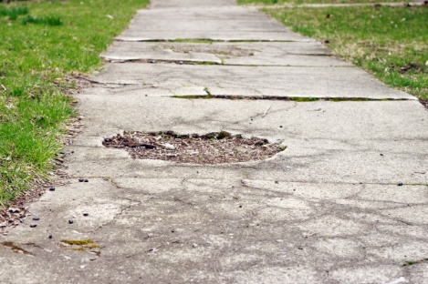
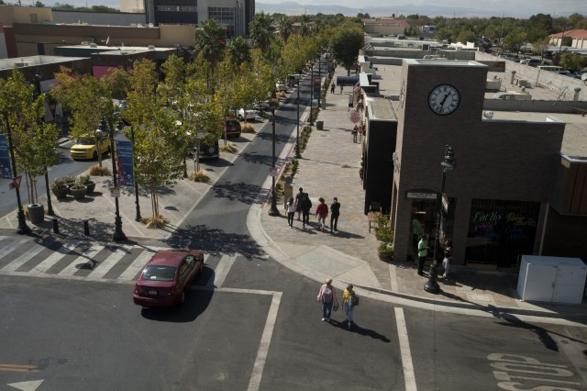
Bringing the Recommendation to Life
Disconnected Sidewalk
Connected Pathway
Notes:
The Task Force recommendation tells us that when communities connect activity-friendly routes to everyday destinations, it can lead to an improvement in physical activity. Therefore, creating connections is key. On this slide, the photo on the left is a disconnected sidewalk to “nowhere” – as opposed to the photo on the right showing a connected pathway that leads to useful, everyday destinations, such as a transit stop, grocery store, or workplace.

Slide 4


Connecting Activity-Friendly Routes with Everyday Destinations
The Knowledge from Community Guide:
Built Environment Approaches Combining Transportation System Interventions with Land Use and Environmental Design
Pedestrian or Bicycle Transportation Systems
Street pattern and connectivity
Pedestrian infrastructure
Bicycle infrastructure
Public transit infrastructure and access
Land Use and Environmental Design
Proximity to destinations
Mixed land use
Residential density
Parks and recreational facilities
Notes:
In physical activity, there is a wide audience to consider when making community-level changes to the built environment including public health, planners, parks and recreation, public works departments, and traffic engineers. CDC’s new Connecting Routes + Destinations translation delivers the Task Force recommendation’s detailed and somewhat technical “combo menu” in a simple and concise way that can resonate with a variety of practitioners and stakeholders: “Connecting activity-friendly routes with everyday destinations.”

Slide 5
Connecting Activity-Friendly Routes with Everyday Destinations
Combined Approaches to Increase Physical Activity
The Knowledge from Community Guide:
Built Environment Approaches Combining Transportation System Interventions with Land Use and Environmental Design
Activity-Friendly Routes
A direct and convenient connection with everyday destinations, offering physical protection from cars, and making it easy to cross the street.
Everyday Destinations
Places people can get to from where they live by walking, bicycling, or public transit, i.e. grocery stores, schools, worksites, parks, restaurants, etc.
Pedestrian or Bicycle Transportation Systems
Street pattern and connectivity
Pedestrian infrastructure
Bicycle infrastructure
Public transit infrastructure and access
Land Use and Environmental Design
Proximity to destinations
Mixed land use
Residential density
Parks and recreational facilities
Notes:
In physical activity, there is a wide audience to consider when making community-level changes to the built environment including public health, planners, parks and recreation, public works departments, and traffic engineers. CDC’s new Connecting Routes + Destinations translation delivers the Task Force recommendation’s detailed and somewhat technical “combo menu” in a simple and concise way that can resonate with a variety of practitioners and stakeholders: “Connecting activity-friendly routes with everyday destinations.”

Slide 6
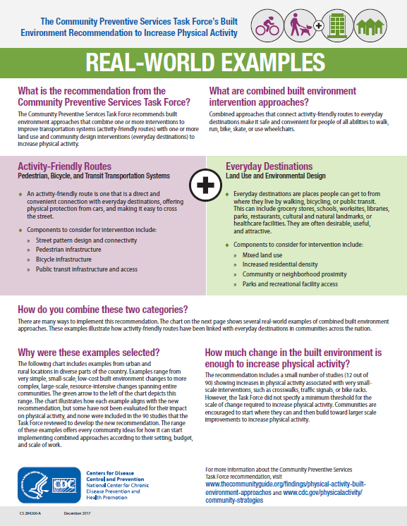
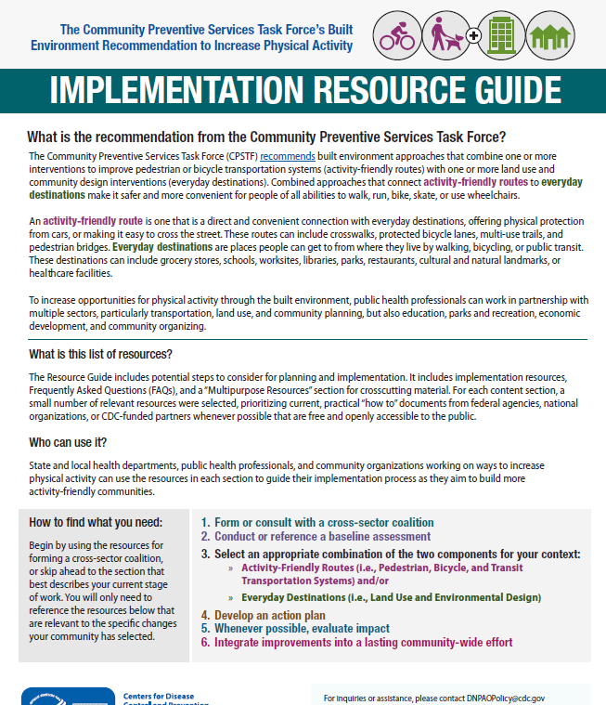
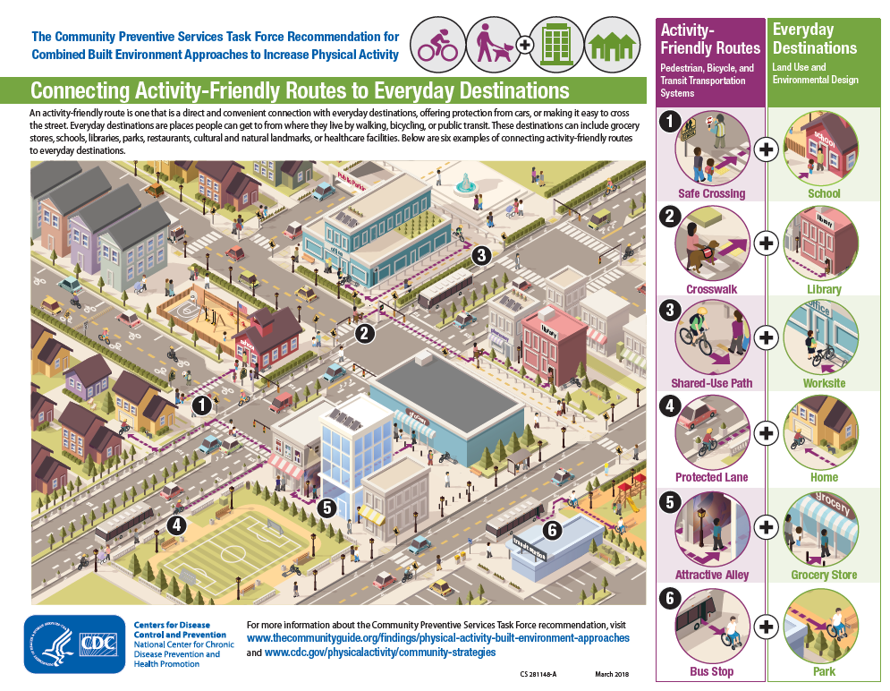
The Connecting Routes + Destinations Resources
www.cdc.gov/physicalactivity/community-strategies/beactive
Notes:
The Connecting Routes + Destinations resources can help public health professionals and community organizations promote activity-friendly communities and implement the built environment recommendation to increase physical activity. There are currently three resources: a collection of Real-World Examples, an Implementation Resource Guide, and a Visual Guide.

