Slide 1

The 2026 PHAP Host Site Application Process: eFMS 3.0 Demonstration and Updates
Public Health Associate Program for Recent Graduates (PHAP)
National Center for State, Tribal, Local, and Territorial Public Health Infrastructure and Workforce (Public Health Infrastructure Center/PHIC)
Centers for Disease Control and Prevention (CDC)
January 13, 2026

Slide 2

Welcome
Heidi Davidson, MPH
Team Lead, PHAP Data Management Team (DMT)
Field Services Workforce Branch (FSWB)
Division of Workforce Development (DWD)
National Center for State, Tribal, Local, and Territorial Public Health Infrastructure and Workforce (Public Health Infrastructure Center/PHIC)
Centers for Disease Control and Prevention (CDC)

Slide 3
Session Agendas
Webinar #1: Thursday, January 8, 2026, @ 2:00 PM ET
PHAP Class of 2026 Host Site application timeline
PHAP program overview
Characteristics of a quality host site application (CO-STARR model)
PHAP Host Site application submission and selection process
Enterprise Fellowship Management System (eFMS) 3.0 and program updates/new requirements for host sites
Webinar #2: Tuesday, January 13, 2026, @ 2:00 PM ET
PHAP Host Site application portal demonstration (eFMS 3.0)

Slide 4
Key Takeaways from Webinar #1
Host site application period January 14 – February 13, 2026
New requirements for host sites
Associates must report to the host site on a full-time basis (no telework) – assignments cannot be 100% remote
Both primary and secondary host site supervisor required, ≥ 1 supervisor must be in office with associate at least 3 days per week.
Host site to meet health/safety requirements for associate to perform work
Selection process will focus heavily on key program priority areas
Revised host site application portal/questions in eFMS 3.0
Resources available for host sites
Application guidance and tips
Preview of application questions (this slide deck)

Slide 5
Enterprise Fellowship Management System (eFMS) 3.0 Host Site Application Portal

Slide 6

eFMS 3.0 Host Site Application Portal
Rafel Jackson
Management Analyst, PHAP Data Management Team (DMT)
Field Services Workforce Branch (FSWB)
Division of Workforce Development (DWD)
National Center for State, Tribal, Local, and Territorial Public Health Infrastructure and Workforce (Public Health Infrastructure Center/PHIC)
Centers for Disease Control and Prevention (CDC)

Slide 7

Accessing the eFMS 3.0 Host Site Application Portal
The portal link will be posted on PHAP’s website at www.cdc.gov/phap/
Associates at CDC Headquarters during a training event.

Slide 8
Register and Sign in

Slide 9

Application Process

Slide 10

Register and Sign in Host Site Application

Slide 11
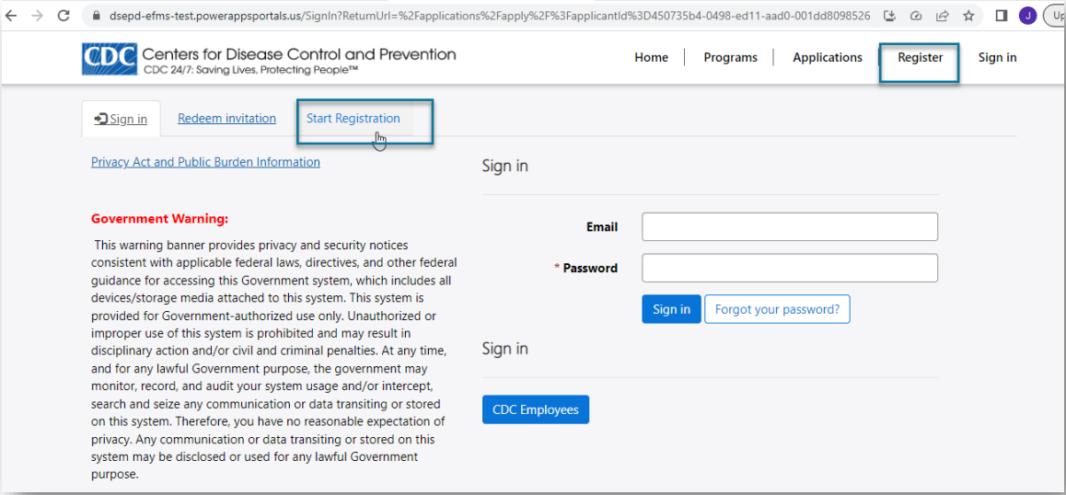
Register and Sign in (Non-CDC Employee)

Slide 12
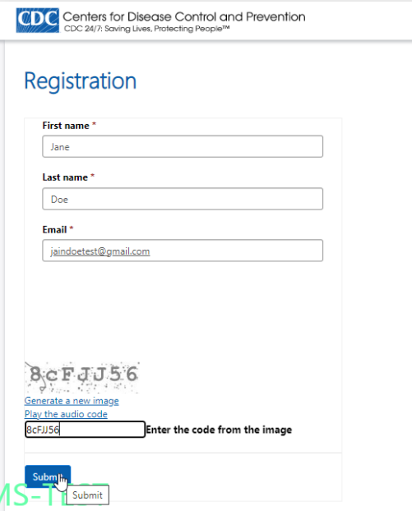

Register and Sign in (Non-CDC Employee)

Slide 13
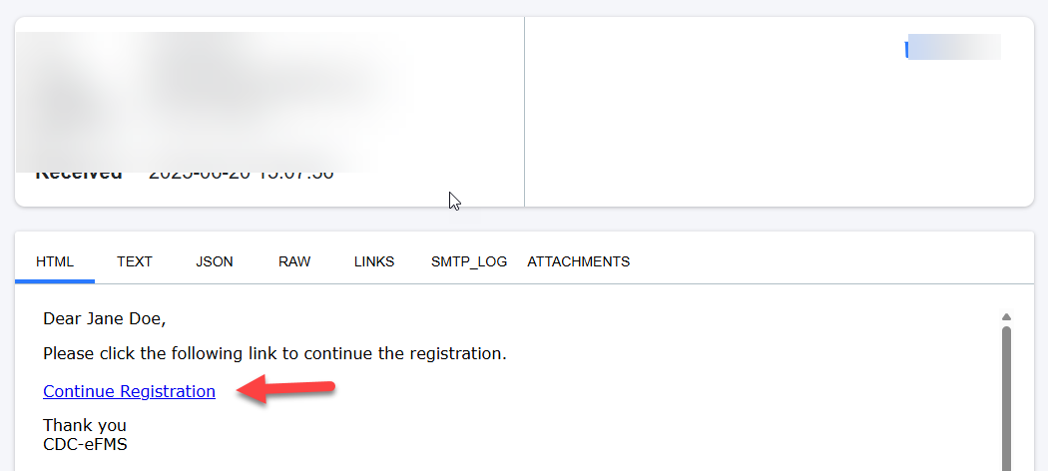
Register and Sign in (Non-CDC Employee) (cont’d 1)

Slide 14
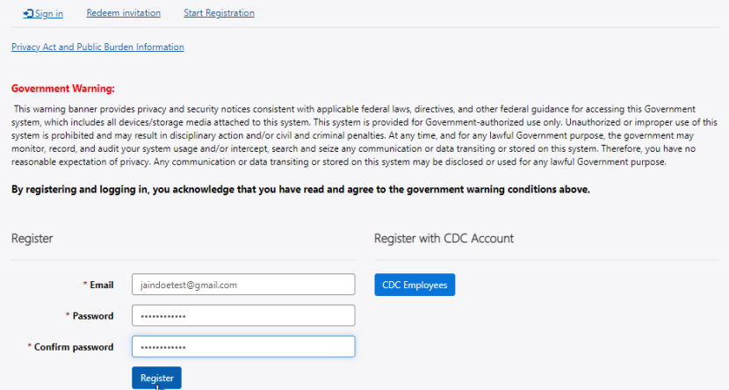
Register and Sign in (Non-CDC Employee) (cont’d 2)

Slide 15
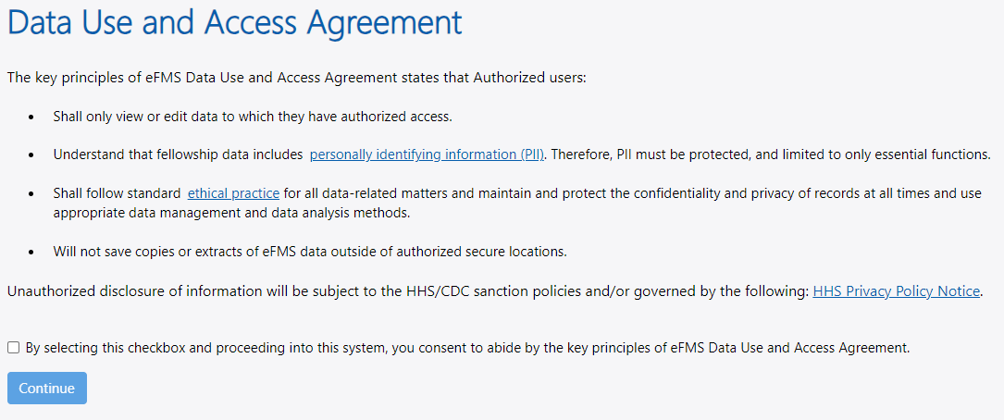
Register and Sign in (Non-CDC Employee) (cont’d 3)
Click here to continue

Slide 16
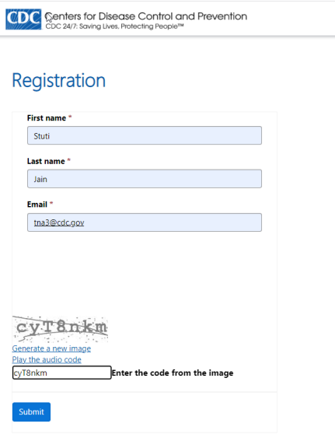
Register and Sign in (CDC Employee) (cont’d 4)

Slide 17
Register and Sign in (CDC Employee) (cont’d 5)

Slide 18
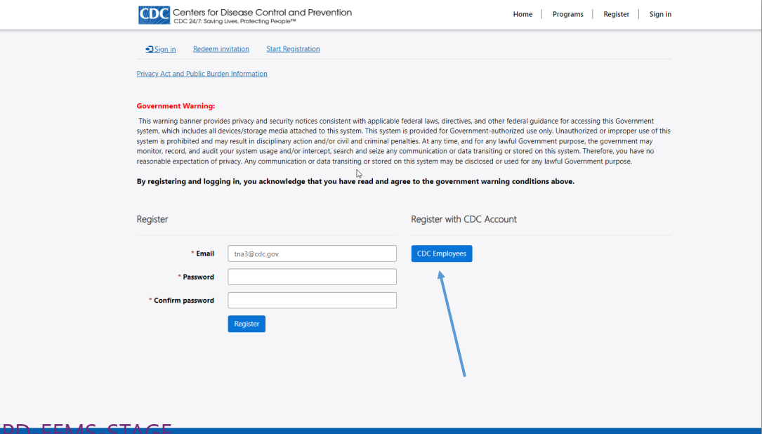
Register and Sign in (CDC Employee) (cont’d 6)

Slide 19
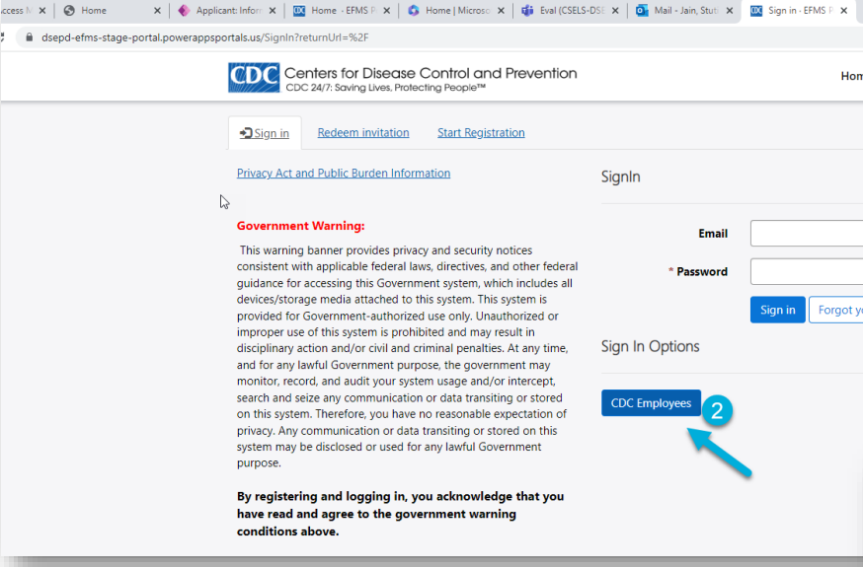
Register and Sign in (CDC Employee) (cont’d 7)

Slide 20
Application Process (Organization Details)

Slide 21

Application Process (Organization Details) 2026

Slide 22
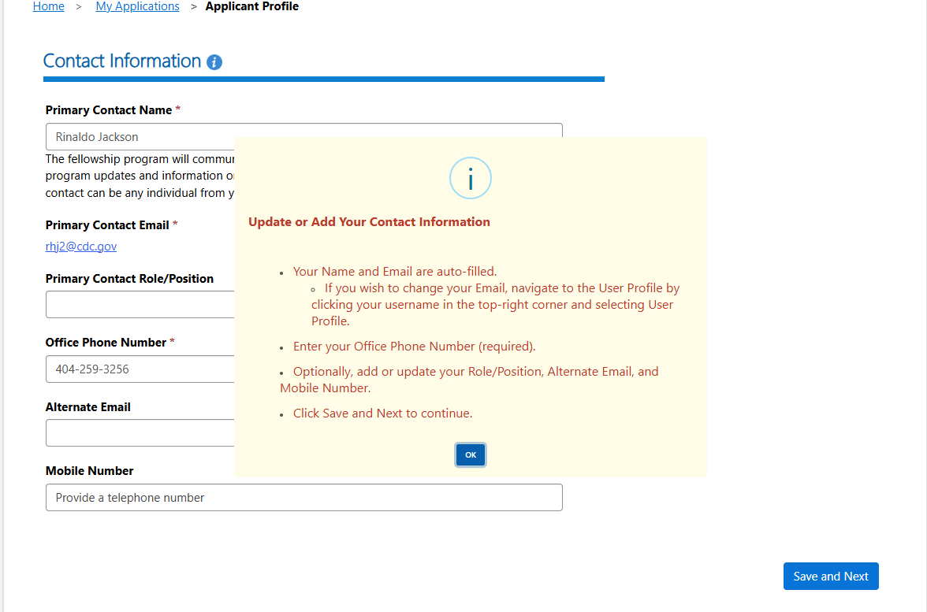
Application Process (Applicant Profile)

Slide 23
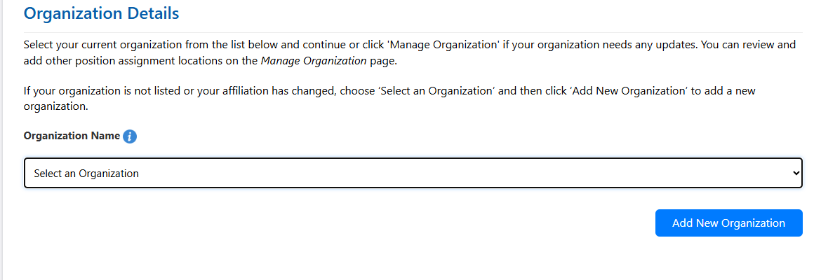
Organization Details

Slide 24
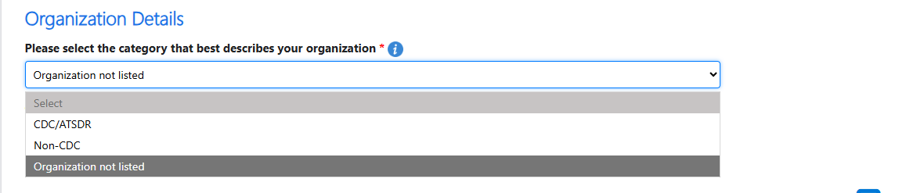
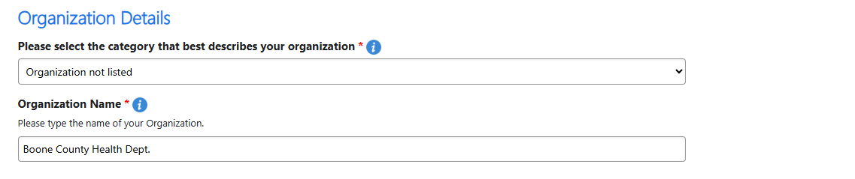
Organization Details (Cont’d 1)

Slide 25
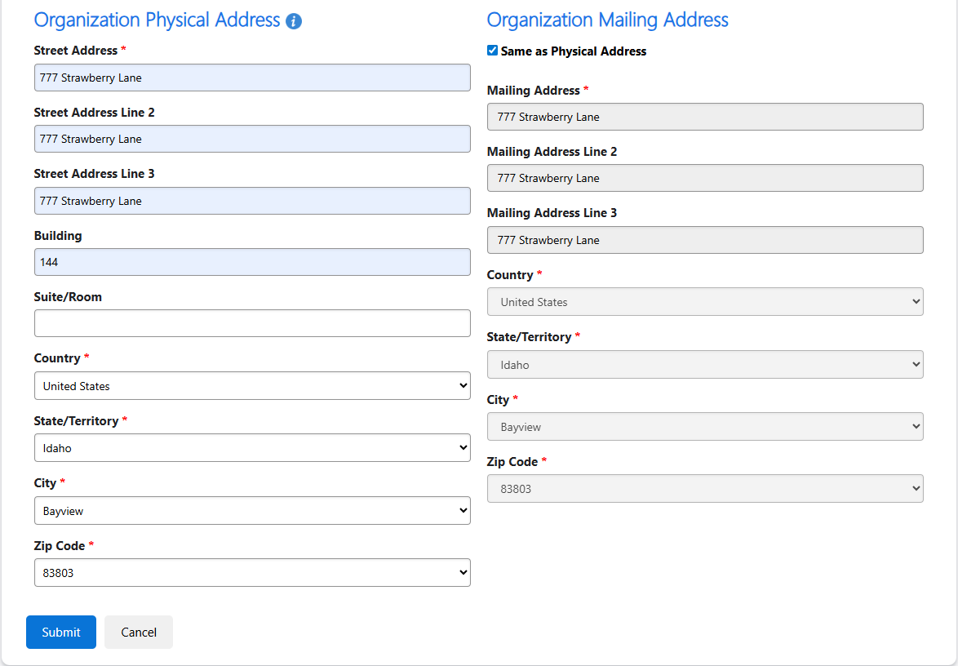
Organization Details (Cont’d 2)

Slide 26
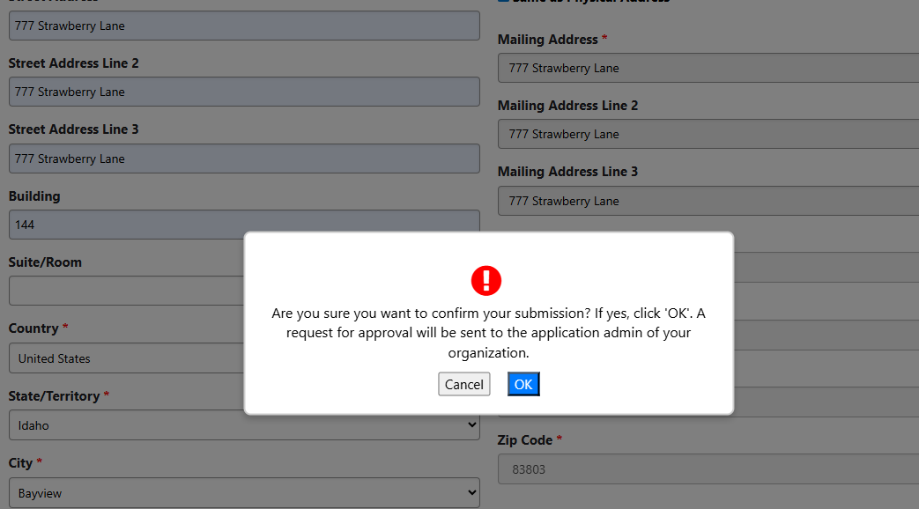
Organization Details (Cont’d 3)

Slide 27
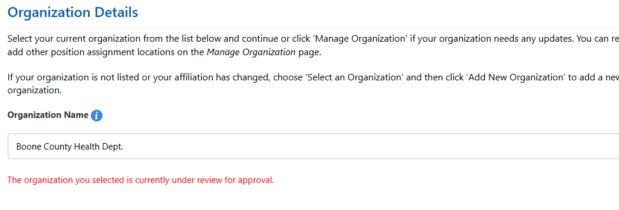
Organization Details (Cont’d 4)

Slide 28
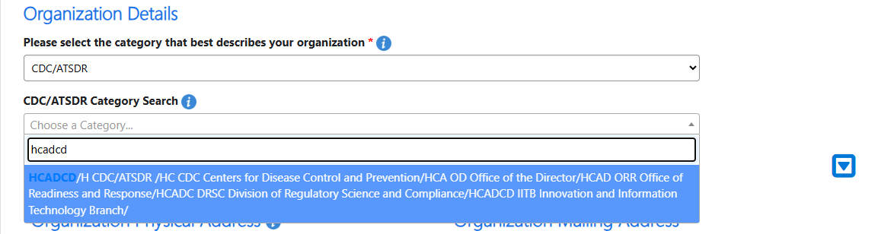
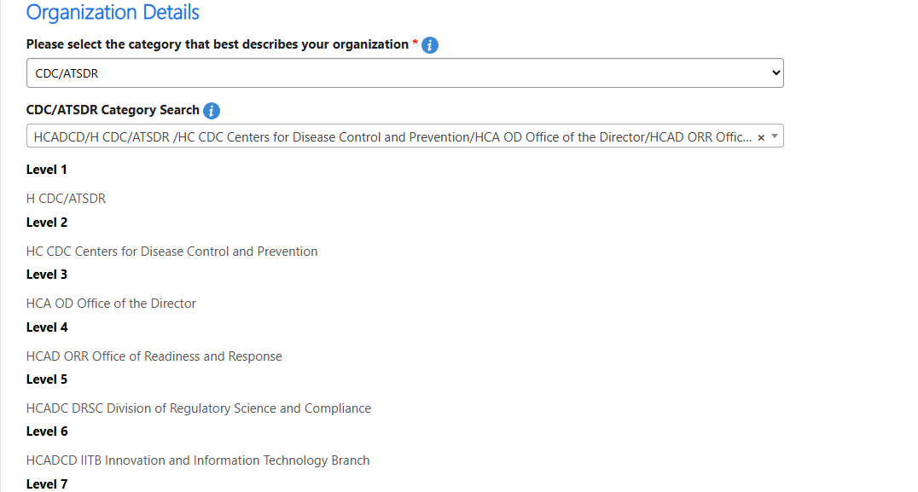
Organization Details (Cont’d 5)

Slide 29
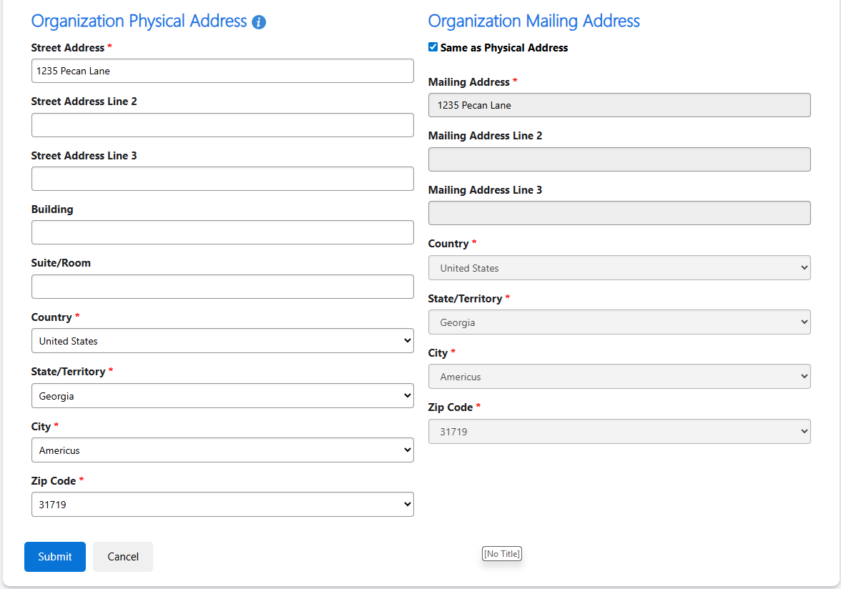
Organization Details (Cont’d 6)

Slide 30
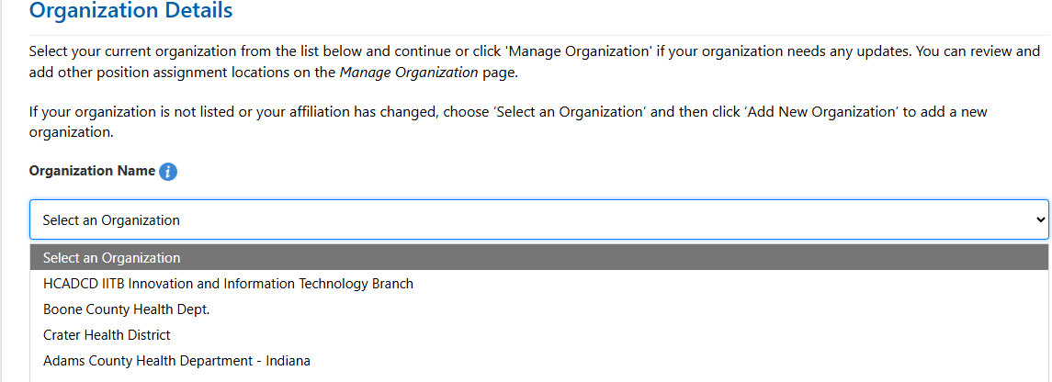
Organization Details (Cont’d 7)

Slide 31
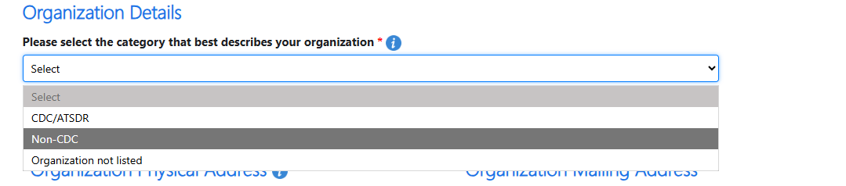
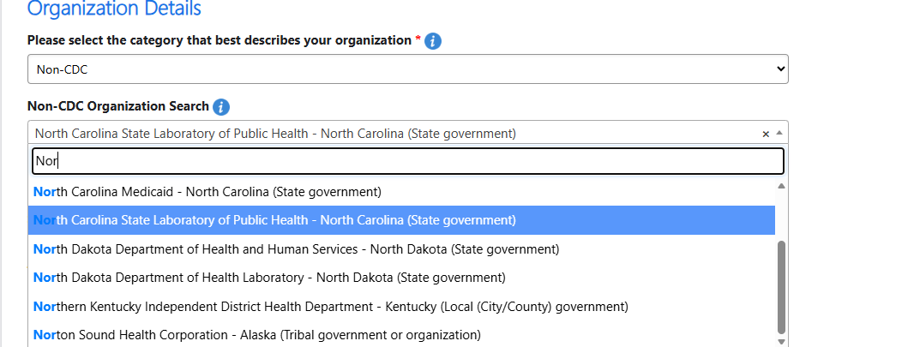
Organization Details (Cont’d 8)

Slide 32
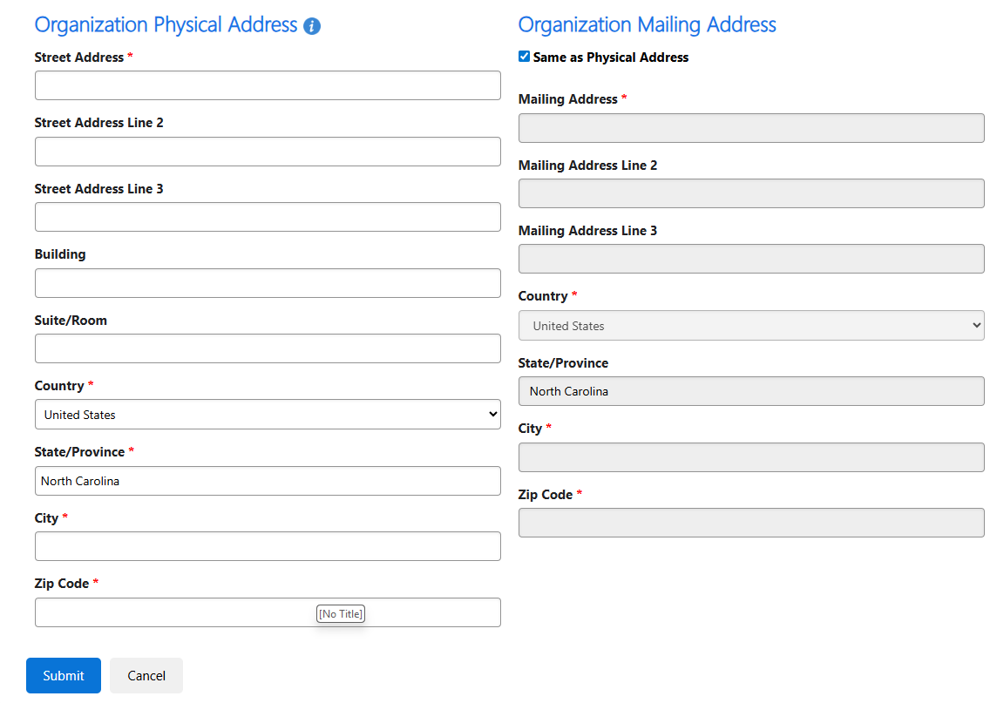
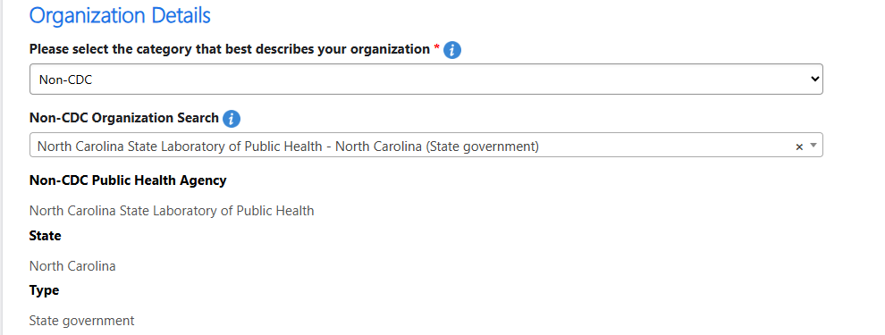
Organization Details (Cont’d 9)

Slide 33
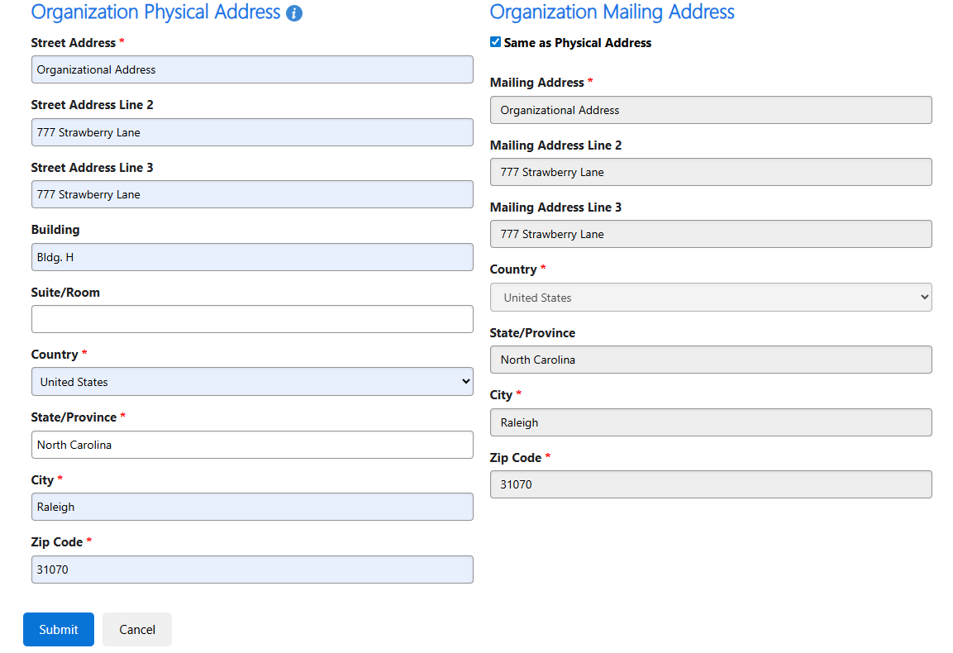
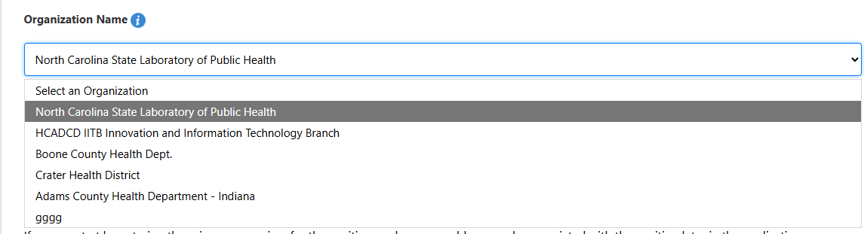
Organization Details (Cont’d 10)

Slide 34
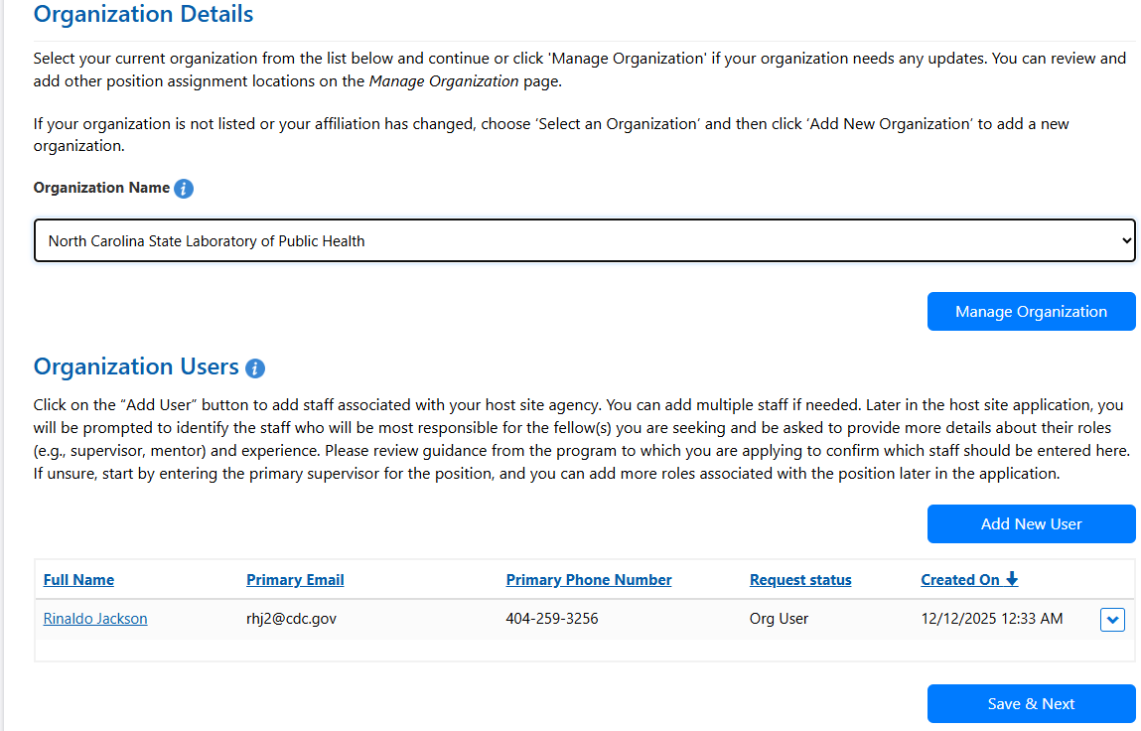
Organization Details (Cont’d 11)

Slide 35
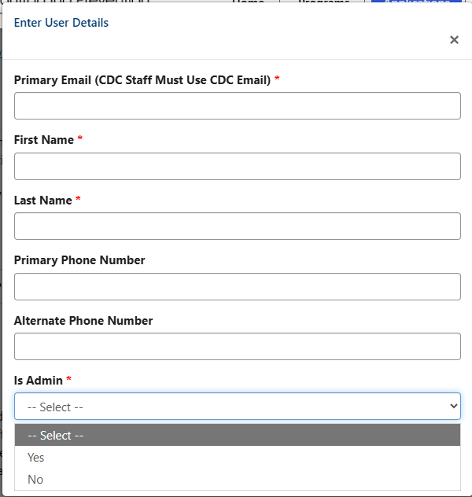
Organization Details (Cont’d 12)

Slide 36
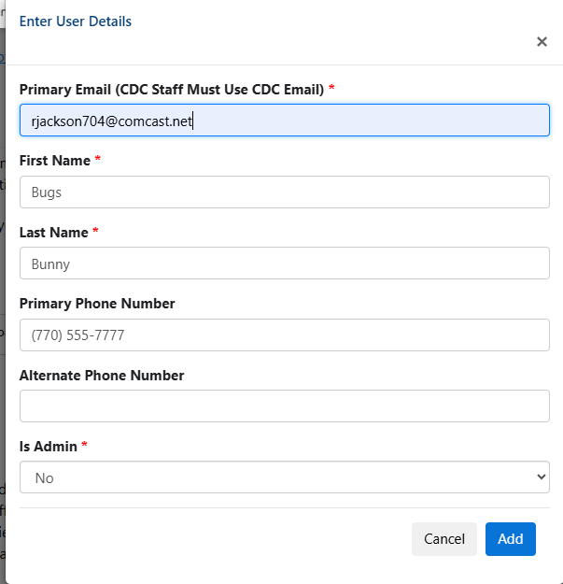
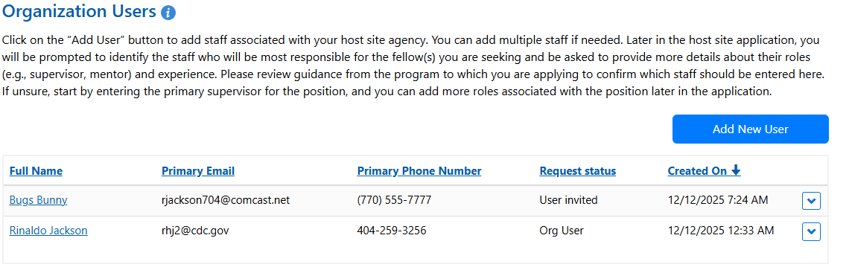
Organization Details (Cont’d 13)

Slide 37
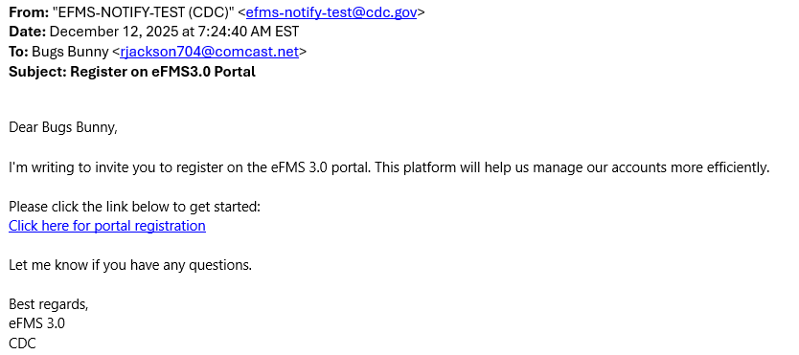
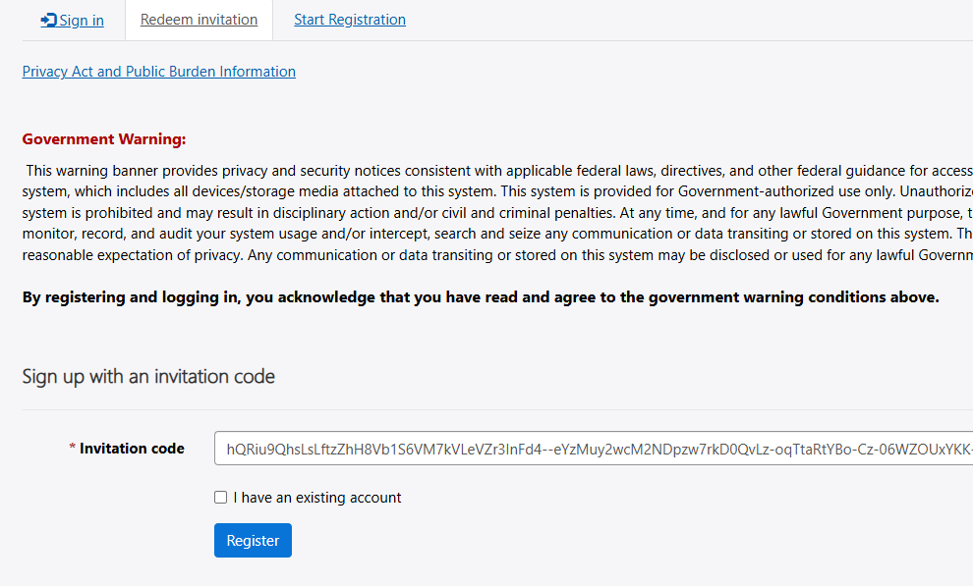
Organization Details (Cont’d 14)

Slide 38
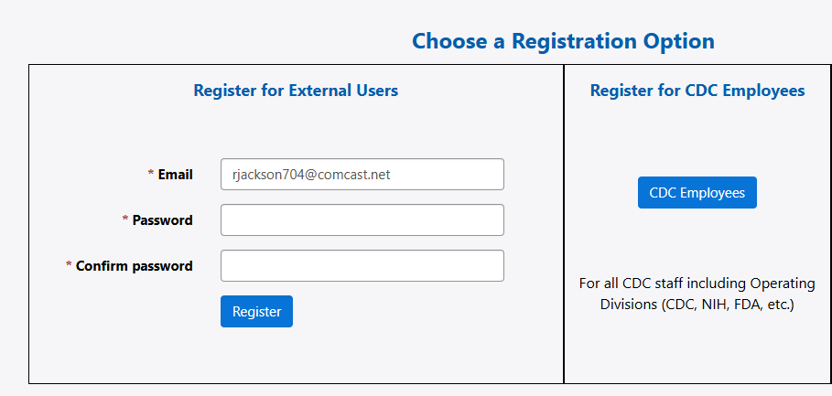
Organization Details (Cont’d 15)

Slide 39
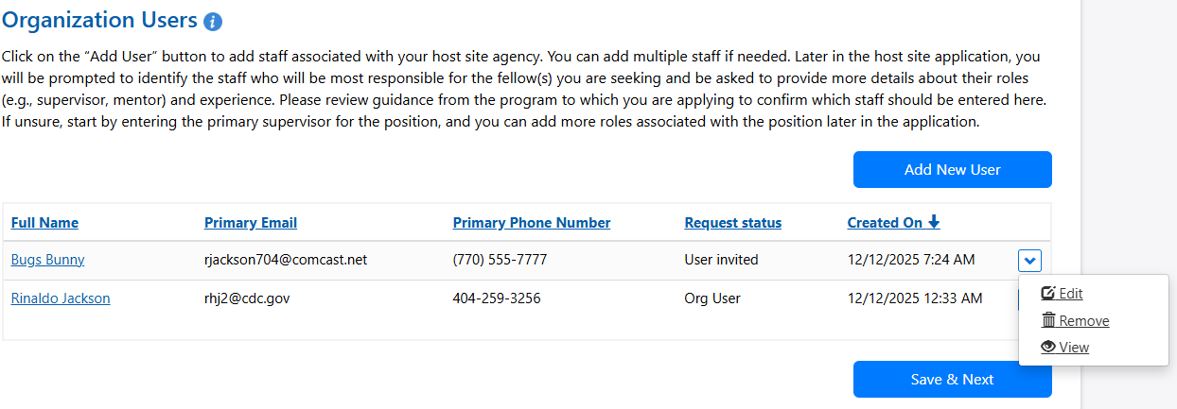
Organization Details (Cont’d 16)

Slide 40
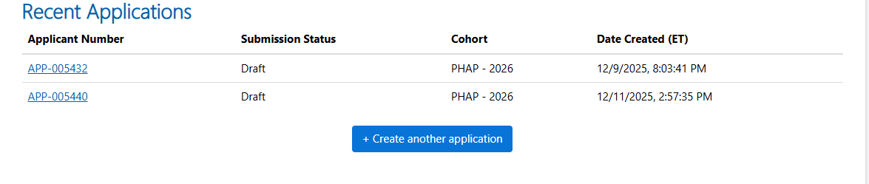

Application Process Host Site

Slide 41
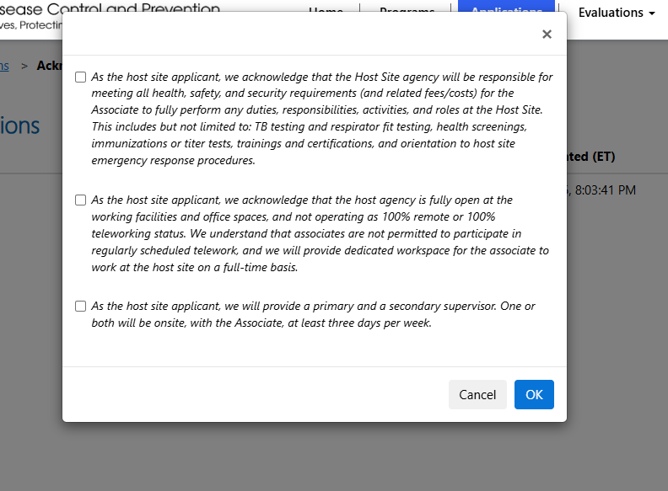
Application Process (Cont’d 1)

Slide 42
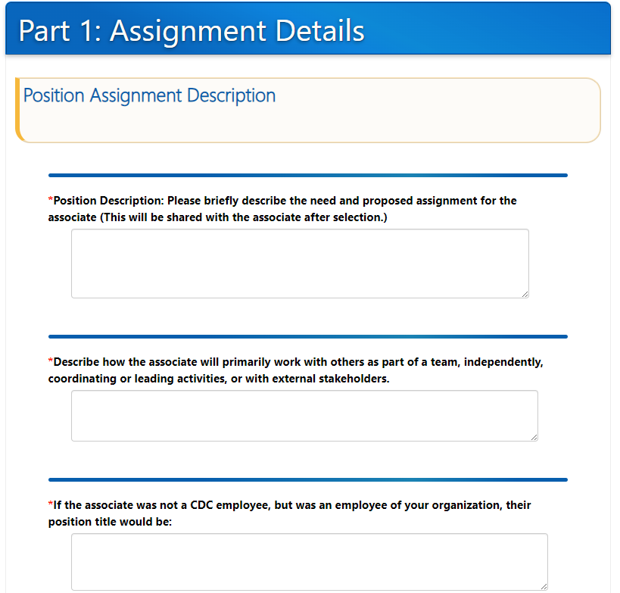
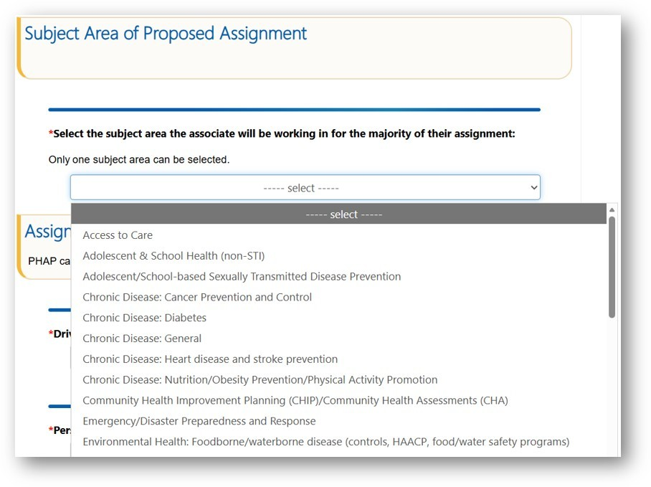
Application Process (Part 1: Assignment Details)

Slide 43
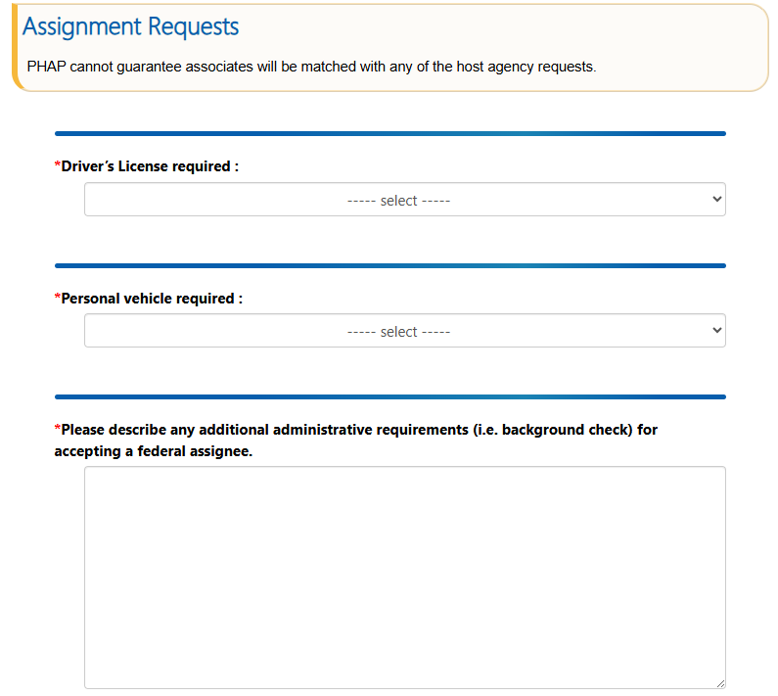
Application Process (Part 1: Assignment Details) (Cont’d 1)

Slide 44
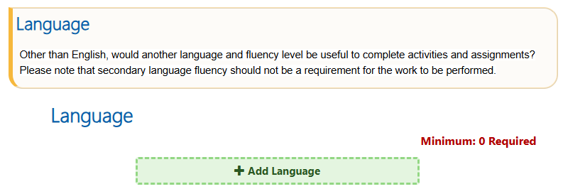
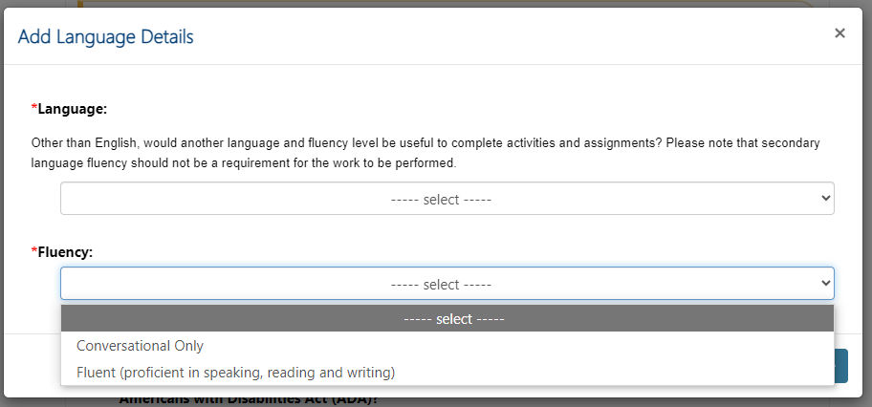
Application Process (Part 1: Assignment Details) (Cont’d 2)

Slide 45
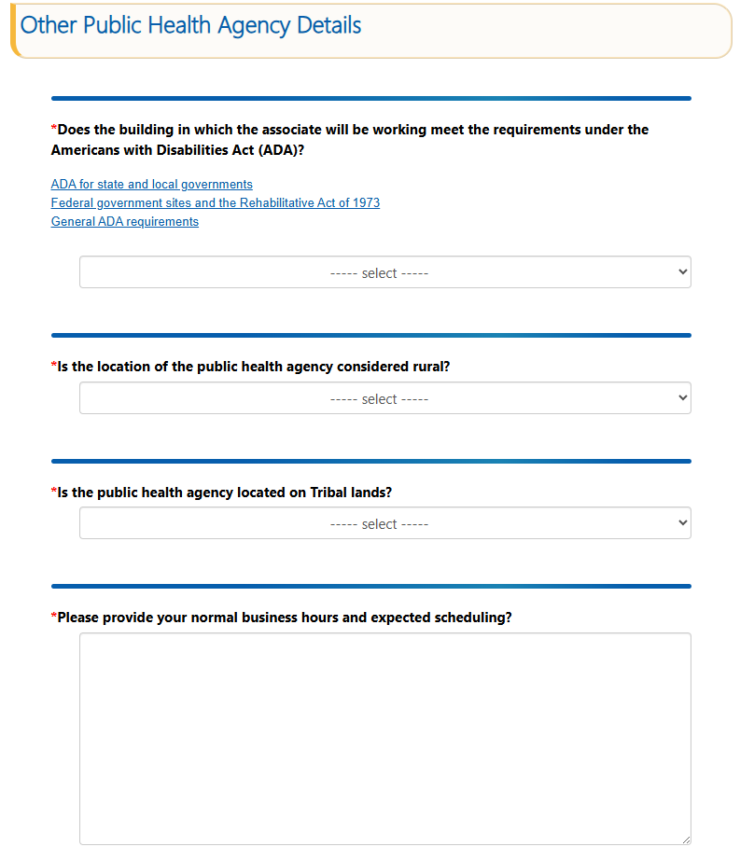
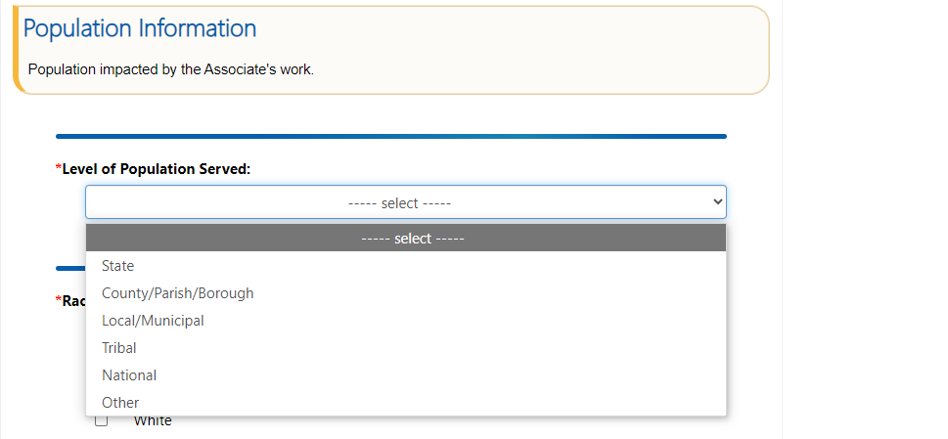
Application Process (Part 1: Assignment Details) (Cont’d 3)

Slide 46
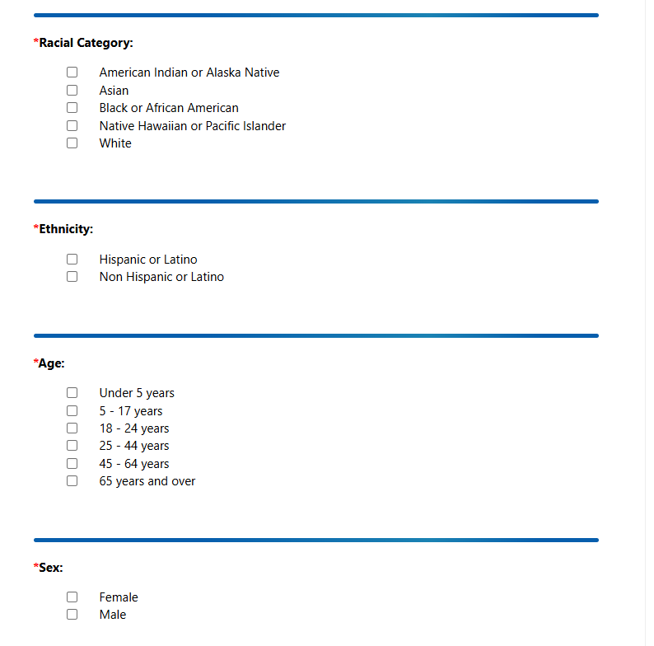
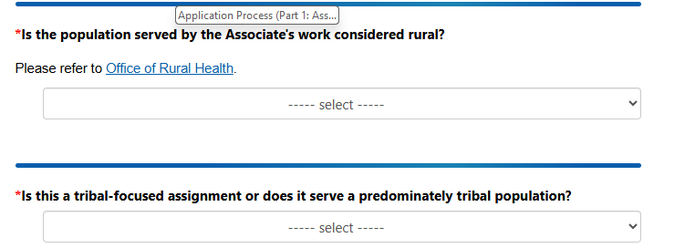
Application Process (Part 1: Assignment Details) (Cont’d 4)

Slide 47
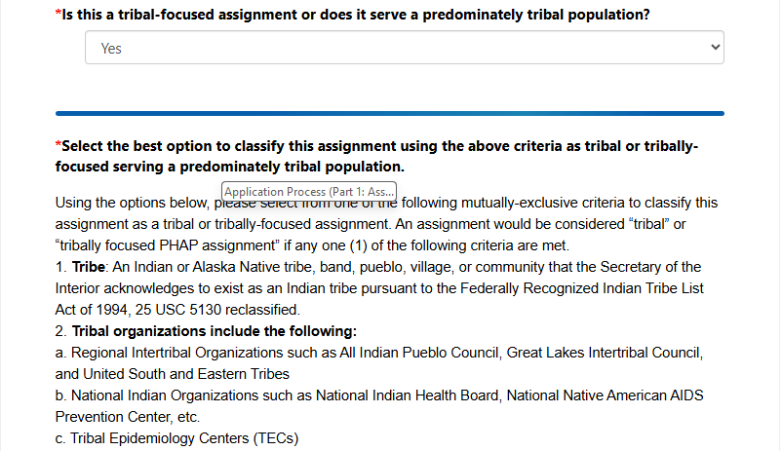
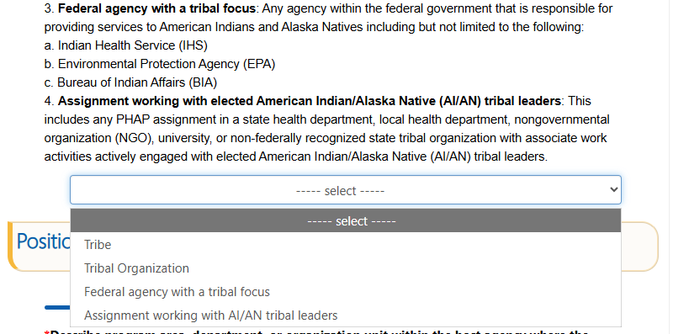
Application Process (Part 1: Assignment Details) (Cont’d 5)

Slide 48
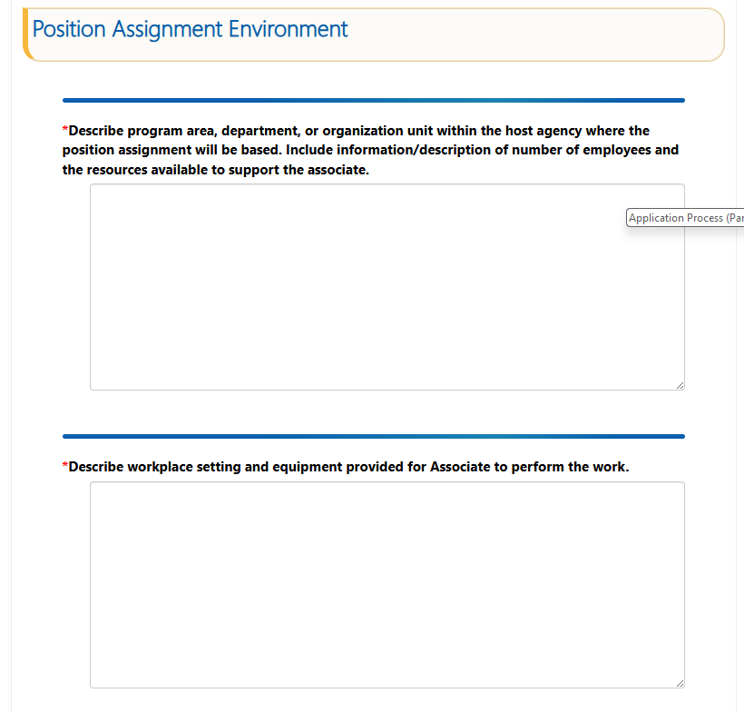
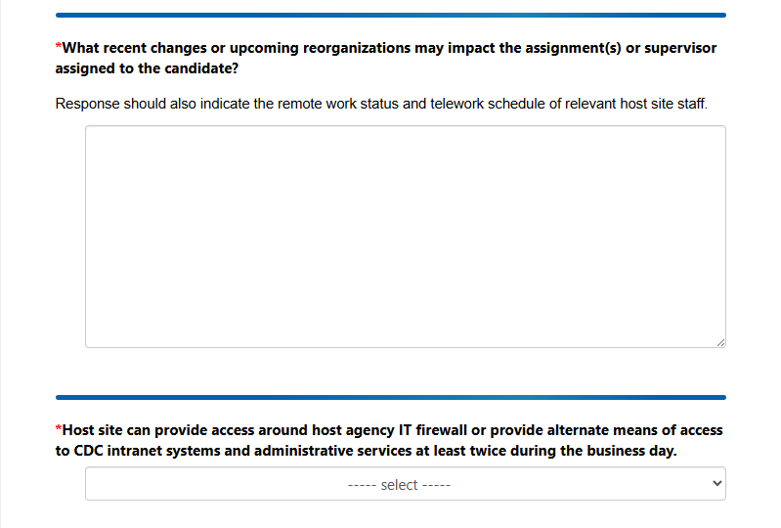
Application Process (Part 1: Assignment Details) (Cont’d 6)

Slide 49
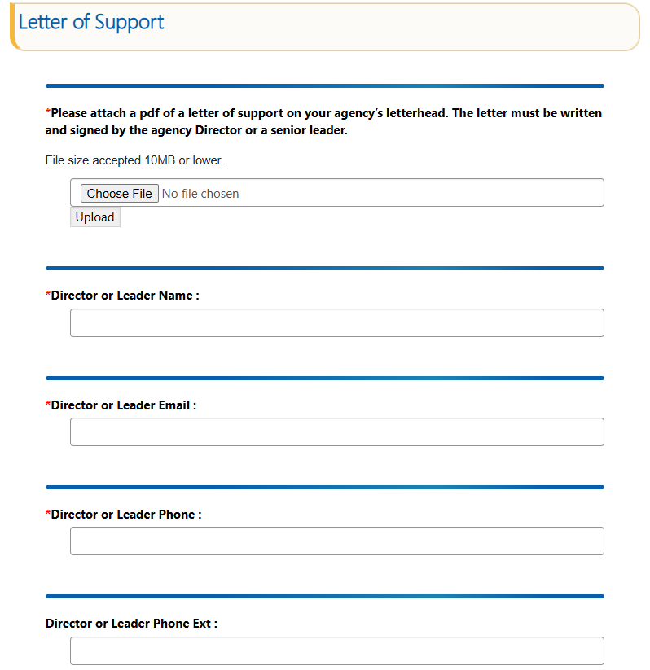
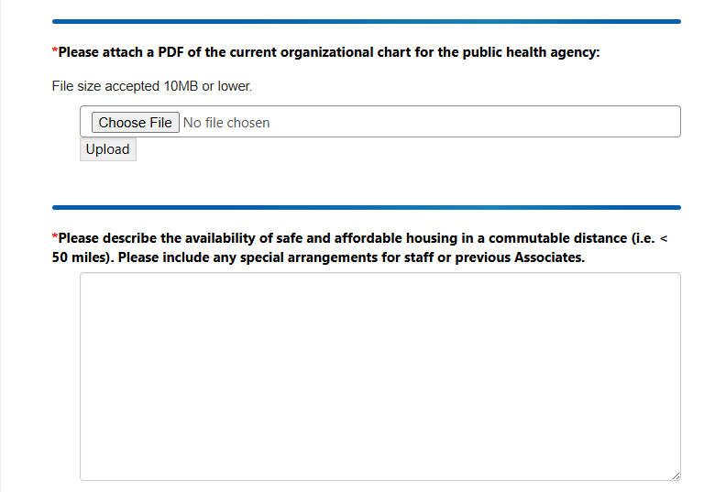
Application Process (Part 1: Assignment Details) (Cont’d 7)

Slide 50

Application Process (Part 1: Assignment Details) (Cont’d 8)

Slide 51

Application Process (Part 2: Activity)

Slide 52


Application Process (Part 2: Activity) (Cont’d 1)

Slide 53


Application Process (Part 2: Activity) (Cont’d 2)

Slide 54

Application Process (Part 2: Activity) (Cont’d 3)

Slide 55


Application Process (Part 2: Activity) (Cont’d 4)

Slide 56



Application Process (Part 2: Activity) (Cont’d 5)

Slide 57


Application Process (Part 3: Training)

Slide 58



Application Process (Part 3: Training) (Cont’d 1)

Slide 59



Application Process (Part 3: Training) (Cont’d 2)

Slide 60

Application Process (Part 4: Host Site Supervisors)

Slide 61


Application Process (Part 4: Host Site Supervisors) (Cont’d 1)

Slide 62


Application Process (Part 4: Host Site Supervisors) (Cont’d 2)

Slide 63


Application Process (Part 4: Host Site Supervisors) (Cont’d 3)

Slide 64


Application Process (Part 4: Host Site Supervisors) (Cont’d 4)

Slide 65


Application Process (Part 4: Host Site Supervisors) (Cont’d 5)

Slide 66


Application Process (Part 4: Host Site Supervisors) (Cont’d 6)

Slide 67


Application Process (Part 4: Host Site Supervisors) (Cont’d 7)

Slide 68


Application Process (Part 4: Host Site Supervisors) (Cont’d 8)

Slide 69


Application Process (Part 4: Host Site Supervisors) (Cont’d 9)

Slide 70


Application Process (Part 4: Host Site Supervisors) (Cont’d 10)

Slide 71

Application Process (Manage Assignment Location)

Slide 72

Application Details (Manage Assignment Location) (cont’d 1)

Slide 73


Application Details (Manage Assignment Location) (cont’d 2)

Slide 74


Application Details (Manage Assignment Location) (cont’d 3)

Slide 75


Application Details (Manage Assignment Location) (cont’d 4)

Slide 76

Application Details (Manage Assignment Location) (cont’d 5)

Slide 77


Application Details (Manage Assignment Location) (cont’d 6)

Slide 78



Application Details (Manage Assignment Location) (cont’d 7)

Slide 79


2026 Application Details

Slide 80

2026 Application Details (cont’d)

Slide 81


Account Admin Role

Slide 82

Account Admin Role (Organization Addresses)

Slide 83

Account Admin Role (Assignment Locations)

Slide 84


Account Admin Role (Assignment Locations) (cont’d)

Slide 85



Account Admin Role (Organization Users)

Slide 86



Account Admin Role (List of Applications)

Slide 87



Account Admin Role (Application User Management)

Slide 88



Account Admin Role (Assignment Location Management)

Slide 89

Non-Admin Role (Organization Addresses)

Slide 90


Non-Admin Role (Assignment Locations)

Slide 91


Non-Admin Role (Organization Users)

Slide 92


Non-Admin Role (List of Applications)

Slide 93

Non-Admin Role (Application User Management)

Slide 94


Non-Admin Role (Assignment Location Management)

Slide 95


Non-Admin Role (Application User Management) (cont’d)

Slide 96

Non-Admin Role (Assignment Location Management) (cont’d 2)

Slide 97
Application Reminders
All users must create an account and profile
Create a new application for each associate’s assignment
All three PHAP requirements to host an associate must be checked to proceed with application
Complete all sections of the application
Include enough activities to address the PHAP competencies
Save your work often by clicking “Save”
Click the “Submit” button on the application page by the deadline of 5:00 PM ET Friday, February 13, 2026.
Once you submit your application, you will no longer be able to make changes.

Slide 98
Wrap-Up

Slide 99
Resources for PHAP Host Site Applicants
Coming soon to the PHAP website:
Host Site Application Guidance – new!
Tips and advice for creating a quality host site application
Organized in same layout as application in eFMS 3.0
Host Site Application Questions – new!
Included in slides from today’s webinar
Agreement to Detail
Binding agreement signed by the Host Site and CDC
Cannot be revised

Slide 100
Highlights
Host site application period opens January 14 at 8:00AM (ET), closes February 13 at 5:00PM (ET)
The link to eFMS 3.0 will be found on www.cdc.gov/PHAP
For technical issues or questions about eFMS, email the PHAP Helpdesk at phap@cdc.gov
Contact PHAP with any general questions at phap@cdc.gov

Slide 101
For more information, please contact CDC’s Public Health Associate Program for Recent Graduates
Email: PHAP@cdc.gov
Website: www.cdc.gov/PHAP
Thank you for your interest in hosting an associate!

Slide 102
Questions?
For more information, contact CDC 1-800-CDC-INFO (232-4636) TTY: 1-888-232-6348 cdc.gov atsdr.cdc.gov
Follow us on X (Twitter) @CDCgov & @CDCEnvironment The findings and conclusions in this report are those of the authors and do not necessarily represent the official position of the U. S. Centers for Disease Control and Prevention and the Agency for Toxic Substances and Disease Registry.

