Slide 1
PHAP 101 Overview of the Public Health Associate Program Does My Organization Want to Host an Associate?
Public Health Associate Program (PHAP)
Center for State, Tribal, Local, and Territorial Support
Centers for Disease Control and Prevention

Slide 2

Session Objectives
Upon completion, participants should be able to—
Identify the mission of PHAP
Describe the history of PHAP
List at least two of the goals of PHAP
Name at least three characteristics of the typical PHAP candidate and host site
Understand the PHAP application process

Slide 3

PHAP Mission
The mission of the Public Health Associate Program is to train and provide experiential learning to early-career professionals who contribute to the public health workforce.

Slide 4
What Is the Public Health Associate Program?
A two-year, paid, and competency-based training program
Associates have little to no public health experience
Some have little to no work experience
A two-year assignment in one primary focus area
Associates are federal government employees while in the program
A partnership between CDC and—
State, tribal, local, and territorial health departments
Nongovernmental organizations

Slide 5
Nine PHAP Competency Domains
1.0: Analytic and assessment
2.0: Public health service
3.0: Program planning, management, and improvement
4.0: Public health policy and law
5.0: Professionalism
6.0: Communication
7.0: Cultural competency
8.0: Community dimensions of public health
9.0: Financial planning and management
Source: Public Health Associate Program Competencies (as of 9/2019). Available at https://www.cdc.gov/phap/pdf/PHAP_Competencies_Curriculum.pdf

Slide 6
PHAP Is NOT—
An internship program
A source of administrative staffing support
A federal government employment service
A program that provides host sites with CDC subject matter experts

Slide 7
History of PHAP
Piloted in Florida in 2007
Field-based CDC program began to train early career public health professionals
Since 2007, 1284 associates have been hired into PHAP
PHAP Class

Slide 8
Candidate and Host Site Applications, 2012–2019

Slide 9

“Three-Legged Stool” Concept of PHAP Goals
Provide a value-added service to the host site to help it meet its goals
Traditional public health programs
Accreditation
Local emergency response efforts
Provide associates with experience in public health programs and service delivery
Ensure that associates achieve the PHAP competencies

Slide 10
Value Added to Host Sites
Associates add value to host sites by:
Supporting host sites’ efforts to meet program goals (e.g., reviewing an immunization registry)
Providing capacity-building support (e.g., assisting with preparing for public health accreditation process)
Advancing public health project initiatives (e.g., aligning hospital preparedness program goals with public health emergency preparedness)

Slide 11
Minimum Candidate Application Criteria
Earned at least a bachelor’s degree from an accredited four-year college or university
Have at least a 3.0 grade-point average
Graduated with most recent degree within the last two years
Be a US citizen or permanent resident
US nationals are also eligible to apply

Slide 12
BEST FIT Characteristics of the Associate
Big picture thinker
Effective communicator
Socially and culturally competent
Thrives in a dynamic environment
Flexible
Intelligent
Tactile learner

Slide 13
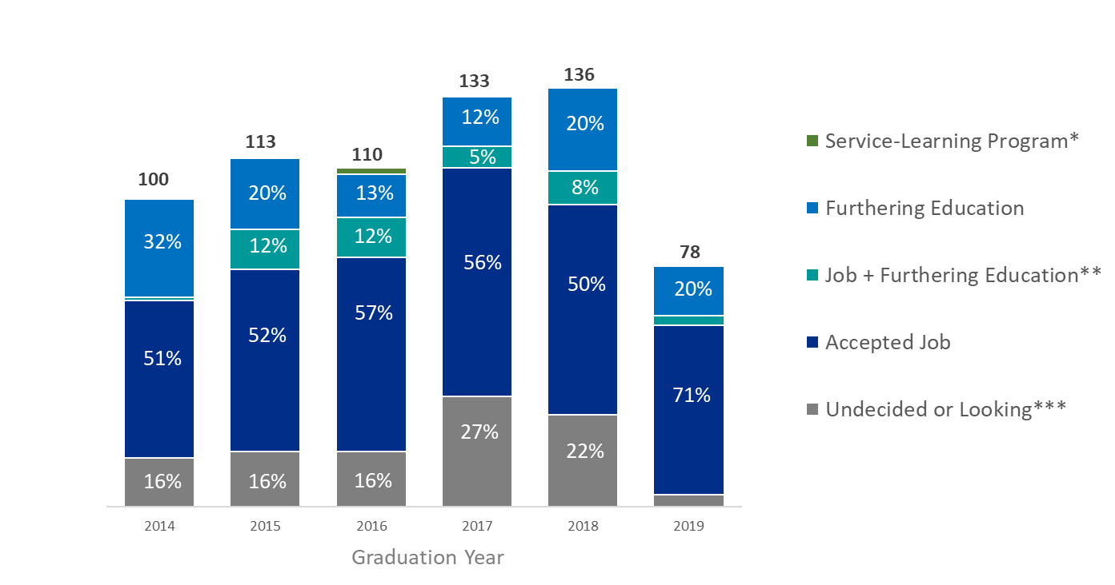
Disposition of PHAP Graduates
The majority of graduates accepted a job immediately after PHAP..
*2% of PHAP 2014 enrolled in another service-learning program
**1% of PHAP 2012 accepted a job and were furthering education at the same time; 4% of PHAP 2017 accepted a job and were furthering education at the same time.
*** 5% of PHAP 2017 were undecided or looking at graduation.
Data Source: CSTLTS Science Unit, Graduate Survey

Slide 14
Type of Employment
Most employed graduates accepted a job in public health after PHAP.
Public health
Health care
Other
Graduation Year
Data Source: CSTLTS Science Unit, Graduate Survey

Slide 15
Typical Host Site Administrative Requirements
Pay for associate’s local travel and training costs
Provide work space, telephone, internet access, computer, and other necessary work supplies
Approve associate’s time and attendance

Slide 16
CO-STARR Model Characteristics of a Quality PHAP Training Experience
Core competencies
Opportunities for skill-building
Supervisor involvement
Training and development are ongoing
Aligns with the program goals and strategy
Realistic for an early-career public health professional
Robust public health learning experience

Slide 17
Annual PHAP Host Site Application Process
By April
Develop your associate’s training experience and work plan based on the CO-STARR model
Complete PHAP application to host an associate
May–June
Host sites notified of the outcome of their application
July–August
Matching of accepted PHAP candidates to PHAP host sites
October
New associates report to host sites
Late October/Early November
In-person orientation for associates at CDC headquarters in Atlanta

Slide 18
My Organization Wants To Host an Associate. What Should We Do Next?
Develop your host site strategy to host an associate before applications open. This includes
Proposed work activities
Host site supervisor
Training activities
View PHAP 201: Strategic Development of a Quality PHAP Training Experience―The CO-STARR Model
https://www.cdc.gov/phap/become_hostsite/webinars.html

Slide 19
Public Health Associate Program
Center for State, Tribal, Local, and Territorial Support
E-mail: phap@cdc.gov
Web: www.cdc.gov/phap
www.facebook.com/CDCSTLTConnection

