Slide 1

Prevalence of Obesity Based on Self-Reported Weight and Height Among US Adults by Age, State and Territory, BRFSS, 2024
Definitions
Obesity: Body mass index (BMI) of 30 kg/m² or higher.
Body mass index (BMI): A calculated measure of weight relative to height, defined as body weight in kilograms divided by height in meters squared.

Slide 2

Prevalence of Obesity Based on Self-Reported Weight and Height Among US Adults by Age, State and Territory, BRFSS, 2024
Method
The data were collected through the Behavioral Risk Factor Surveillance System (BRFSS), an ongoing, state-based, telephone interview survey conducted by state health departments with assistance from CDC.
Height and weight data used in the BMI calculations were self-reported.

Slide 3
Prevalence of Obesity Based on Self-Reported Weight and Height Among US Adults by Age, State and Territory, BRFSS, 2024
Exclusion Criteria
Records with the following were excluded:
Height: <3 feet or ≥8 feet
Weight: <50 pounds or ≥650 pounds
BMI: <12 kg/m² or ≥100 kg/m²
Pregnant women

Slide 4
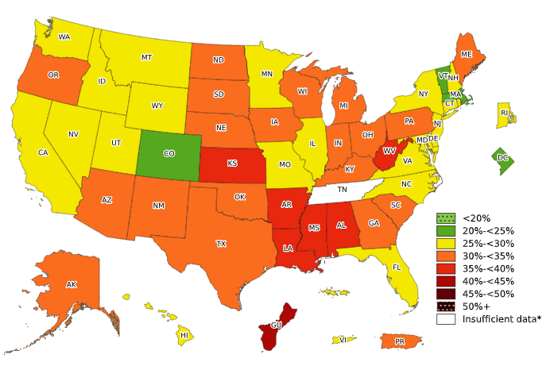
Prevalence of Obesity Based on Self-Reported Weight and Height Among Adults Aged 18–39 Years, by State and Territory, BRFSS, 2024
*Sample size <50, the relative standard error (dividing the standard error by the prevalence) ≥30%, or no data in a specific year.

Slide 5
Prevalence of Obesity Based on Self-Reported Weight and Height Among Adults Aged 18–39 Years, by State and Territory, BRFSS, 2024
*Sample size <50, the relative standard error (dividing the standard error by the prevalence) ≥30%, or no data in a specific year.
Source: Behavioral Risk Factor Surveillance System, CDC.

Slide 6
Prevalence of Obesity Based on Self-Reported Weight and Height Among Adults Aged 18–39 Years, by State and Territory, BRFSS, 2024
Summary
No states had a prevalence of obesity less than 20%.
3 states and the District of Columbia had a prevalence of obesity between 20% and <25%.
21 states and the Virgin Islands had a prevalence of obesity between 25% and <30%.
19 states and Puerto Rico had a prevalence of obesity between 30% and <35%.
6 states had a prevalence of obesity between 35% and <40%.
Guam had a prevalence of obesity 40% or greater.

Slide 7
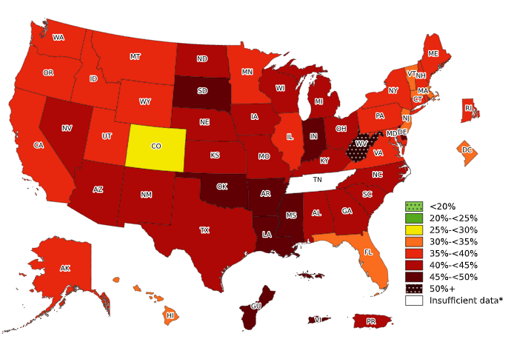
Prevalence of Obesity Based on Self-Reported Weight and Height Among Adults Aged 40–59 Years, by State and Territory, BRFSS, 2024
*Sample size <50, the relative standard error (dividing the standard error by the prevalence) ≥30%, or no data in a specific year.

Slide 8
Prevalence of Obesity Based on Self-Reported Weight and Height Among Adults Aged 40–59 Years, by State and Territory, BRFSS, 2024
*Sample size <50, the relative standard error (dividing the standard error by the prevalence) ≥30%, or no data in a specific year.
Source: Behavioral Risk Factor Surveillance System, CDC.

Slide 9
Prevalence of Obesity Based on Self-Reported Weight and Height Among Adults Aged 40–59 Years, by State and Territory, BRFSS, 2024
Summary
No states had a prevalence of obesity less than 25%.
Colorado had a prevalence of obesity between 25% and <30%.
5 states and the District of Columbia had a prevalence of obesity between 30% and <35%.
18 states had a prevalence of obesity between 35% and <40%.
17 states and Puerto Rico had a prevalence of obesity between 40% and <45%.
7 states, Gum and the Virgin Islands had a prevalence of obesity between 45% and <50%.​
West Virginia had a prevalence of obesity 50% or greater.​

Slide 10
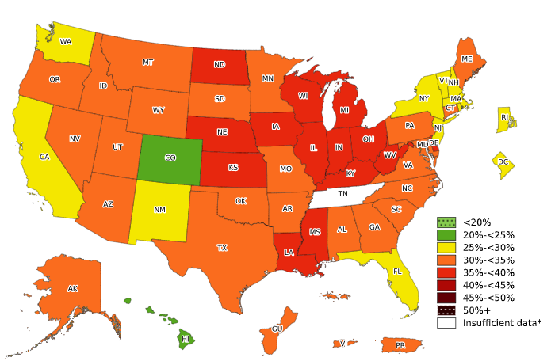
Prevalence of Obesity Based on Self-Reported Weight and Height Among Adults Aged 60 Years and Older, by State and Territory, BRFSS, 2024
*Sample size <50, the relative standard error (dividing the standard error by the prevalence) ≥30%,
or no data in a specific year.

Slide 11
Prevalence of Obesity Based on Self-Reported Weight and Height Among Adults Aged 60 Years and Older, by State and Territory, BRFSS, 2024
*Sample size <50, the relative standard error (dividing the standard error by the prevalence) ≥30%, or no data in a specific year.
Source: Behavioral Risk Factor Surveillance System, CDC.

Slide 12
Prevalence of Obesity Based on Self-Reported Weight and Height Among Adults Aged 60 Years and Older, by State and Territory, BRFSS, 2024
Summary
No states had a prevalence of obesity less than 20%.
Colorado and Hawaii had a prevalence of obesity between 20% and <25%.
10 states and the District of Columbia had a prevalence of obesity between 25% and <30%.
23 states, Gum, Puerto Rico, and the Virgin Islands had a prevalence of obesity between 30% and <35%.
14 states had a prevalence of obesity between 35% and <40%.
No states had a prevalence of obesity 40% or greater.

