Slide 1
Prevalence of Self-Reported Obesity Among U.S. Adults by Race/Ethnicity, State and Territory, BRFSS, 2014-2016
Definitions
Obesity: Body Mass Index (BMI) of 30 or higher.
Body Mass Index (BMI): A measure of an adult’s weight in relation to his or her height, calculated by using the adult’s weight in kilograms divided by the square of his or her height in meters.

Slide 2
Prevalence of Self-Reported Obesity Among U.S. Adults by Race/Ethnicity, State and Territory, BRFSS, 2014-2016
Method
The data were collected through the Behavioral Risk Factor Surveillance System (BRFSS), an ongoing, state-based, telephone interview survey conducted by state health departments with assistance from CDC.
Height and weight data used in the BMI calculations were self-reported.
Three years of data were combined to ensure sufficient sample size.

Slide 3
Prevalence of Self-Reported Obesity Among U.S. Adults by Race/Ethnicity, State and Territory, BRFSS, 2014-2016
Exclusion Criteria
Records with the following were excluded:
Height: <3 feet or ≥8 feet
Weight: <50 pounds or ≥650 pounds
BMI: <12 kg/m² or ≥100 kg/m²
Pregnant women

Slide 4
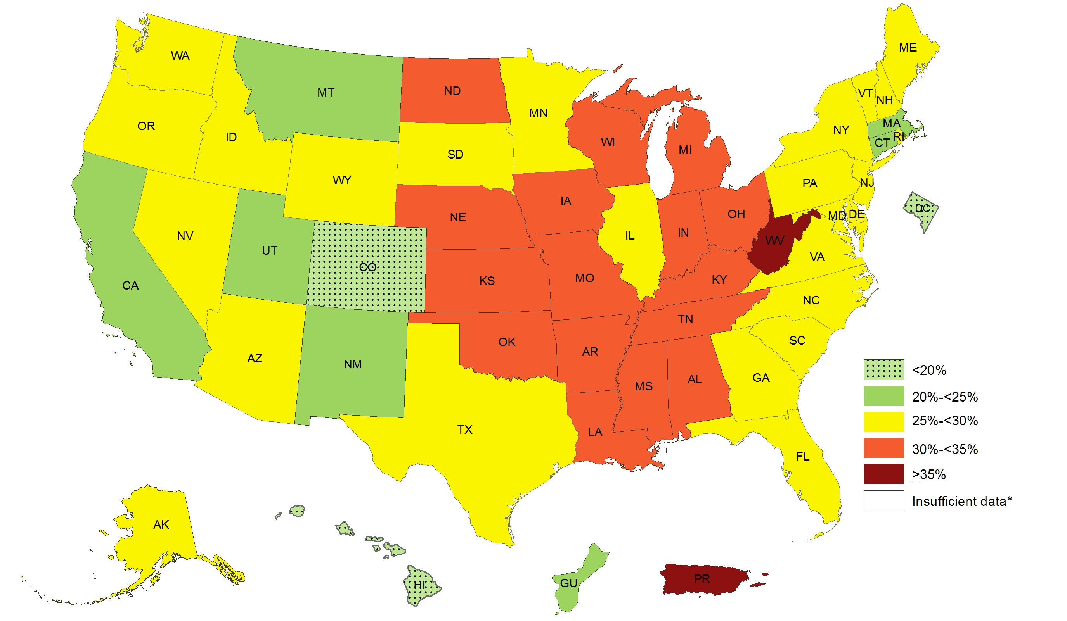
Prevalence of Self-Reported Obesity Among Non-Hispanic White Adults, by State and Territory, BRFSS, 2014-2016
*Sample size <50 or the relative standard error (dividing the standard error by the prevalence) ≥ 30%.

Slide 5
Prevalence of Self-Reported Obesity Among Non-Hispanic White Adults, by State and Territory, BRFSS, 2014-2016
State | Prevalence | 95% Confidence Interval
Alabama | 32.4 | (31.4, 33.4)
Alaska | 28.7 | (27.2, 30.2)
Arizona | 26.0 | (25.1, 26.9)
Arkansas | 34.0 | (32.5, 35.4)
California | 22.7 | (21.9, 23.6)
Colorado | 19.8 | (19.2, 20.4)
Connecticut | 24.3 | (23.5, 25.1)
Delaware | 29.4 | (28.0, 30.9)
District of Columbia | 9.7 | (8.5, 11.2)
Florida | 25.7 | (24.9, 26.5)
Georgia | 28.9 | (27.7, 30.1)
Guam | 24.8 | (19.9, 30.5)
Hawaii | 17.6 | (16.3, 19.0)
Idaho | 27.6 | (26.6, 28.7)
Illinois | 29.2 | (28.1, 30.3)
Indiana | 31.8 | (30.9, 32.7)
Iowa | 31.9 | (31.1, 32.8)
Kansas | 31.5 | (30.9, 32.1)
Kentucky | 33.4 | (32.4, 34.3)
Louisiana | 32.6 | (31.4, 33.9)
Maine | 29.5 | (28.7, 30.3)
Maryland | 27.8 | (26.8, 28.8)
Massachusetts | 22.9 | (22.2, 23.7)
Michigan | 30.7 | (29.9, 31.4)
Minnesota | 27.3 | (26.8, 27.8)
Mississippi | 31.9 | (30.6, 33.3)
State | Prevalence | 95% Confidence Interval
Missouri | 30.7 | (29.7, 31.8)
Montana | 24.4 | (23.5, 25.4)
Nebraska | 30.8 | (30.1, 31.5)
Nevada | 26.2 | (24.7, 27.9)
New Hampshire | 27.2 | (26.3, 28.2)
New Jersey | 25.4 | (24.5, 26.4)
New Mexico | 23.9 | (22.7, 25.2)
New York | 25.1 | (24.3, 25.9)
North Carolina | 28.1 | (27.2, 29.1)
North Dakota | 31.5 | (30.5, 32.6)
Ohio | 30.8 | (30.0, 31.7)
Oklahoma | 32.3 | (31.3, 33.2)
Oregon | 29.0 | (28.1, 30.0)
Pennsylvania | 29.5 | (28.6, 30.4)
Puerto Rico | 36.0 | (24.8, 49.0)
Rhode Island | 26.0 | (24.9, 27.1)
South Carolina | 28.9 | (28.1, 29.8)
South Dakota | 29.5 | (28.4, 30.7)
Tennessee | 31.3 | (30.2, 32.4)
Texas | 29.2 | (28.1, 30.3)
Utah | 24.9 | (24.3, 25.6)
Vermont | 25.7 | (24.9, 26.6)
Virginia | 27.3 | (26.5, 28.2)
Washington | 28.2 | (27.5, 28.8)
West Virginia | 36.0 | (35.2, 36.9)
Wisconsin | 30.5 | (29.5, 31.5)
Wyoming | 27.9 | (26.8, 29.2)
Source: Behavioral Risk Factor Surveillance System, CDC.

Slide 6
Prevalence of Self-Reported Obesity Among Non-Hispanic White Adults, by State and Territory, BRFSS, 2014-2016
Summary
2 states (Colorado and Hawaii) and the District of
Columbia had a prevalence of obesity less than 20%.
6 states and Guam had a prevalence of obesity between 20% and <25%.
25 states had a prevalence of obesity between 25% and <30%.
16 states had a prevalence of obesity between 30% and <35%.
West Virginia and Puerto Rico had a prevalence of obesity of 35% or greater.
http://www.cdc.gov/obesity/data/adult.html

Slide 7
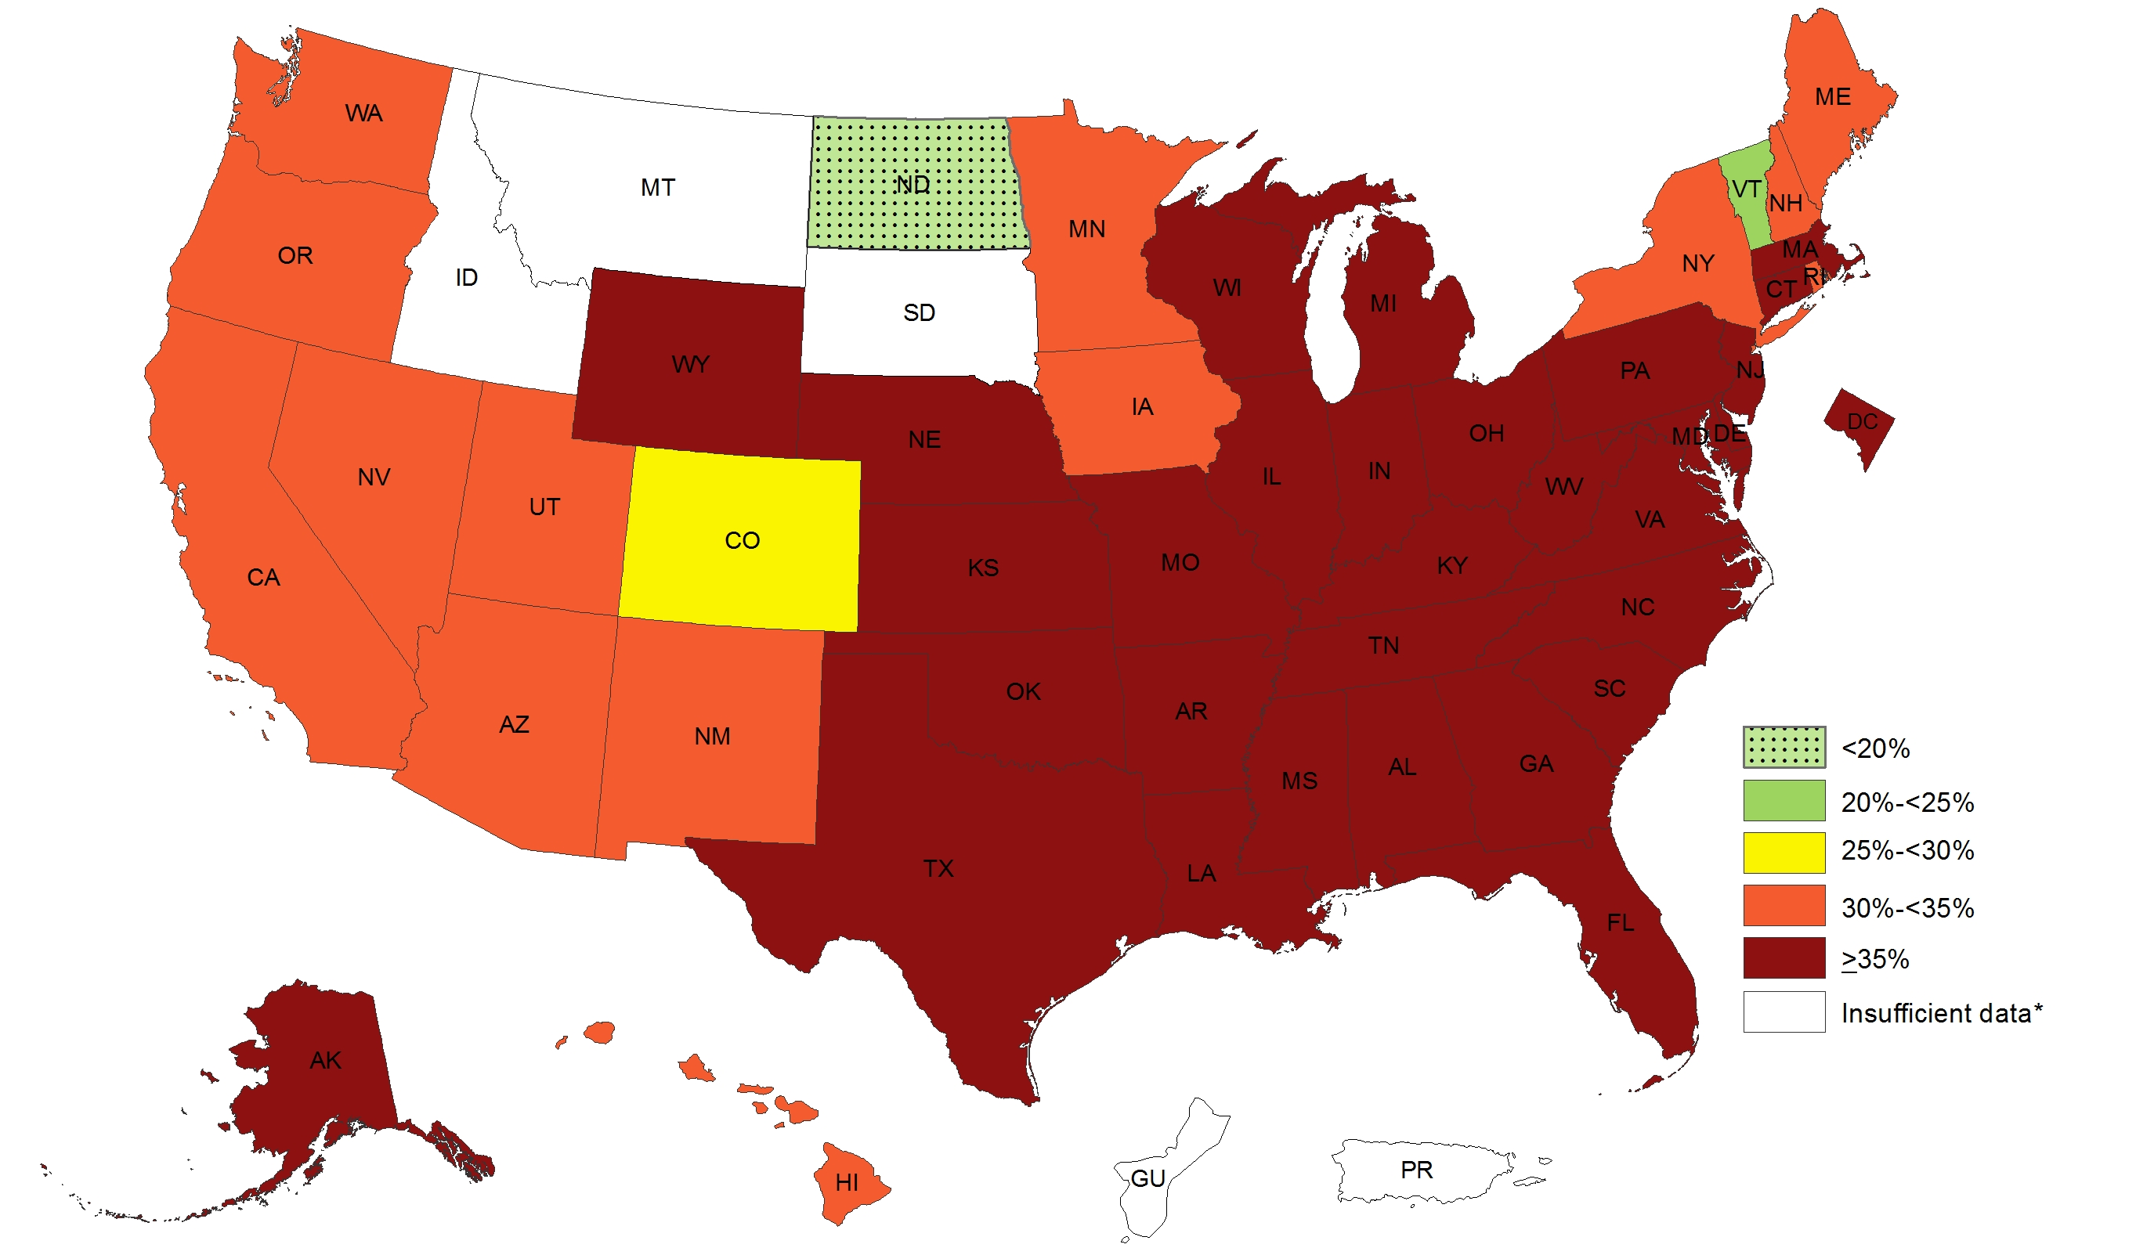
Prevalence of Self-Reported Obesity Among Non-Hispanic Black Adults, by State and Territory, BRFSS, 2014-2016
*Sample size <50 or the relative standard error (dividing the standard error by the prevalence) ≥ 30%.

Slide 8
Prevalence of Self-Reported Obesity Among Non-Hispanic Black Adults, by State and Territory, BRFSS, 2014-2016
State | Prevalence | 95% Confidence Interval
Alabama | 44.1 | (42.3, 46.0)
Alaska | 43.6 | (32.6, 55.1)
Arizona | 33.1 | (28.6, 38.0)
Arkansas | 44.2 | (40.3, 48.3)
California | 31.0 | (28.2, 34.0)
Colorado | 29.1 | (25.4, 33.0)
Connecticut | 37.7 | (34.8, 40.8)
Delaware | 36.5 | (33.4, 39.8)
District of Columbia | 35.5 | (33.4, 37.6)
Florida | 35.2 | (32.8, 37.6)
Georgia | 37.7 | (35.6, 39.9)
Guam | Insufficient data* | Insufficient data*
Hawaii | 31.3 | (22.3, 41.9)
Idaho | Insufficient data* | Insufficient data*
Illinois | 41.3 | (38.2, 44.4)
Indiana | 41.7 | (38.2, 45.3)
Iowa | 32.1 | (25.9, 38.9)
Kansas | 43.1 | (40.0, 46.3)
Kentucky | 42.4 | (38.5, 46.4)
Louisiana | 42.9 | (40.7, 45.2)
Maine | 34.3 | (23.2, 47.4)
Maryland | 38.1 | (36.3, 40.0)
Massachusetts | 36.6 | (33.0, 40.4)
Michigan | 37.4 | (35.1, 39.7)
Minnesota | 30.4 | (27.4, 33.5)
Mississippi | 44.6 | (42.7, 46.6)
State | Prevalence | 95% Confidence Interval
Missouri | 38.6 | (35.2, 42.1)
Montana | Insufficient data* | Insufficient data*
Nebraska | 37.2 | (32.8, 41.9)
Nevada | 30.8 | (25.8, 36.2)
New Hampshire | 30.3 | (19.2, 44.2)
New Jersey | 37.2 | (34.7, 39.8)
New Mexico | 34.4 | (26.2, 43.7)
New York | 32.1 | (30.1, 34.3)
North Carolina | 40.2 | (38.3, 42.2)
North Dakota | 15.9 | (9.6, 25.2)
Ohio | 37.6 | (34.7, 40.5)
Oklahoma | 36.6 | (33.0, 40.4)
Oregon | 30.2 | (21.4, 40.6)
Pennsylvania | 36.4 | (33.5, 39.5)
Puerto Rico | Insufficient data* | Insufficient data*
Rhode Island | 31.9 | (27.2, 37.1)
South Carolina | 41.7 | (40.2, 43.3)
South Dakota | Insufficient data* | Insufficient data*
Tennessee | 45.1 | (41.7, 48.6)
Texas | 42.4 | (39.2, 45.7)
Utah | 30.1 | (22.3, 39.1)
Vermont | 21.9 | (13.3, 33.9)
Virginia | 39.4 | (37.4, 41.4)
Washington | 34.2 | (29.9, 38.7)
West Virginia | 44.6 | (39.3, 50.1)
Wisconsin | 39.9 | (34.0, 46.1)
Wyoming | 43.8 | (29.3, 59.4)
*Sample size <50 or the relative standard error (dividing the standard error by the prevalence) ≥ 30%.
Source: Behavioral Risk Factor Surveillance System, CDC.

Slide 9
Prevalence of Self-Reported Obesity Among Non-Hispanic Black Adults, by State and Territory, BRFSS, 2014-2016
Summary
1 state (North Dakota) had a prevalence of obesity less than 20%.
1 state (Vermont) had a prevalence of obesity between 20% and <25%.
1 state (Colorado) had a prevalence of obesity between 25% and <30%.
14 states had a prevalence of obesity between 30% and <35%.
30 states and the District of Columbia had a prevalence of obesity of 35% or greater.
http://www.cdc.gov/obesity/data/adult.html

Slide 10
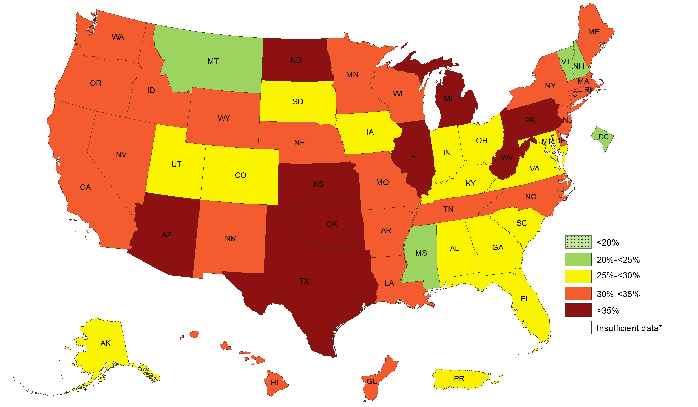
Prevalence of Self-Reported Obesity Among Hispanic Adults, by State and Territory, BRFSS, 2014-2016
*Sample size <50 or the relative standard error (dividing the standard error by the prevalence) ≥ 30%.

Slide 11
Prevalence of Self-Reported Obesity Among Hispanic Adults, by State and Territory, BRFSS, 2014-2016
State | Prevalence | 95% Confidence Interval
Alabama | 28.1 | (21.7, 35.6)
Alaska | 27.9 | (21.3, 35.5)
Arizona | 35.0 | (32.8, 37.2)
Arkansas | 32.4 | (25.4, 40.3)
California | 32.3 | (31.1, 33.5)
Colorado | 27.1 | (25.5, 28.8)
Connecticut | 30.3 | (28.0, 32.8)
Delaware | 32.1 | (27.6, 37.1)
District of Columbia | 20.0 | (15.0, 26.1)
Florida | 26.8 | (25.1, 28.6)
Georgia | 28.4 | (23.9, 33.4)
Guam | 32.6 | (27.0, 38.7)
Hawaii | 31.4 | (28.3, 34.6)
Idaho | 33.6 | (29.3, 38.2)
Illinois | 36.3 | (33.2, 39.6)
Indiana | 28.7 | (24.9, 32.9)
Iowa | 29.9 | (24.9, 35.5)
Kansas | 35.2 | (32.8, 37.6)
Kentucky | 25.0 | (18.4, 33.0)
Louisiana | 32.2 | (25.9, 39.2)
Maine | 30.5 | (22.5, 39.9)
Maryland | 25.4 | (21.6, 29.5)
Massachusetts | 31.4 | (28.8, 34.2)
Michigan | 38.4 | (33.8, 43.3)
Minnesota | 33.1 | (30.0, 36.3)
Mississippi | 22.3 | (14.2, 33.4)
State | Prevalence | 95% Confidence Interval
Missouri | 32.7 | (26.1, 40.2)
Montana | 24.8 | (19.1, 31.7)
Nebraska | 31.8 | (29.1, 34.7)
Nevada | 30.6 | (27.3, 34.1)
New Hampshire | 24.7 | (17.7, 33.4)
New Jersey | 31.4 | (29.1, 33.7)
New Mexico | 31.3 | (29.7, 33.0)
New York | 30.6 | (28.7, 32.5)
North Carolina | 31.2 | (28.1, 34.4)
North Dakota | 37.2 | (28.8, 46.5)
Ohio | 27.8 | (22.7, 33.5)
Oklahoma | 36.7 | (32.7, 41.0)
Oregon | 32.4 | (28.6, 36.6)
Pennsylvania | 39.5 | (34.3, 45.0)
Puerto Rico | 29.4 | (28.5, 30.4)
Rhode Island | 30.8 | (27.4, 34.4)
South Carolina | 28.2 | (23.9, 33.0)
South Dakota | 29.5 | (20.0, 41.3)
Tennessee | 33.0 | (25.1, 42.0)
Texas | 37.4 | (35.7, 39.1)
Utah | 28.1 | (26.0, 30.4)
Vermont | 24.3 | (16.7, 34.1)
Virginia | 29.6 | (26.1, 33.3)
Washington | 34.4 | (31.7, 37.1)
West Virginia | 37.7 | (28.7, 47.6)
Wisconsin | 31.2 | (25.7, 37.1)
Wyoming | 32.4 | (27.2, 38.1)
Source: Behavioral Risk Factor Surveillance System, CDC.

Slide 12
Prevalence of Self-Reported Obesity Among Hispanic Adults, by State and Territory, BRFSS, 2014-2016
Summary
No state had a prevalence of obesity less than 20%.
4 states and the District of Columbia had a prevalence of obesity between 20% and <25%.
14 states and Puerto Rico had a prevalence of obesity between 25% and <30%.
23 states and Guam had a prevalence of obesity between 30% and <35%.
9 states had a prevalence of obesity of 35% or greater.
http://www.cdc.gov/obesity/data/adult.html

