Slide 1
Prevalence of Self-Reported Obesity Among U.S. Adults by State and Territory
Definitions
Obesity: Body Mass Index (BMI) of 30 kg/m² or higher.
Body Mass Index (BMI): A measure of an adult’s weight in relation to his or her height, calculated by using the adult’s weight in kilograms divided by the square of his or her height in meters.

Slide 2
Prevalence of Self-Reported Obesity Among U.S. Adults by State and Territory
Source of the Data
The data were collected through the Behavioral Risk Factor Surveillance System (BRFSS), an ongoing, state-based, telephone interview survey conducted by state health departments with assistance from CDC.
Height and weight data used in the BMI calculations were self-reported.

Slide 3
Prevalence of Self-Reported Obesity Among U.S. Adults by State and Territory
BRFSS Methodological Changes Started in 2011
New sampling frame that included both landline and cell phone households.
New weighting methodology used to provide a closer match between the sample and the population.

Slide 4
Prevalence of Self-Reported Obesity Among U.S. Adults by State and Territory
Exclusion Criteria Used Beginning with 2011 BRFSS Data
Records with the following were excluded:
Height: <3 feet or ≥8 feet
Weight: <50 pounds or ≥650 pounds
BMI: <12 kg/m² or ≥100 kg/m²
Pregnant women

Slide 5
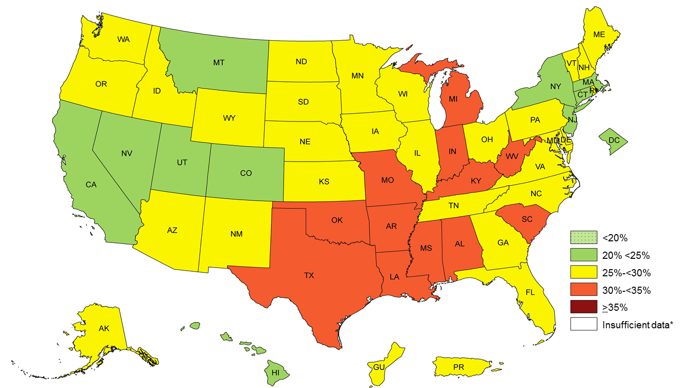
Prevalence¶ of Self-Reported Obesity Among U.S. Adults by State and Territory, BRFSS, 2011
¶ Prevalence estimates reflect BRFSS methodological changes started in 2011. These estimates should not be
compared to prevalence estimates before 2011.
*Sample size <50, the relative standard error (dividing the standard error by the prevalence) ≥30%, or no data in a specific year.

Slide 6
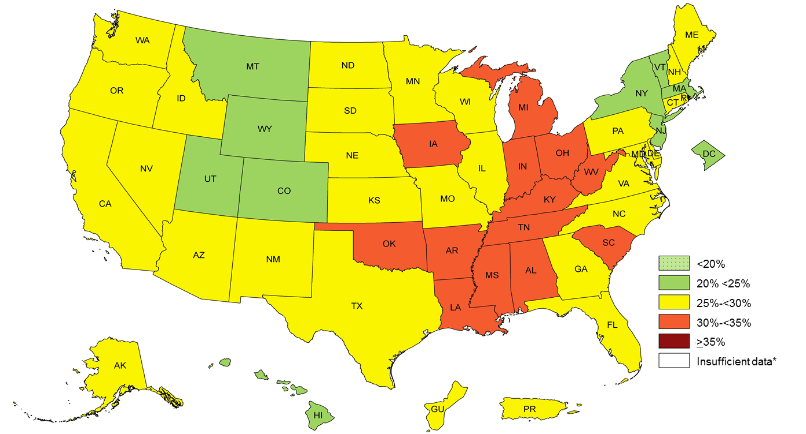
Prevalence¶ of Self-Reported Obesity Among U.S. Adults by State and Territory, BRFSS, 2012
¶ Prevalence estimates reflect BRFSS methodological changes started in 2011. These estimates should not be
compared to prevalence estimates before 2011.
*Sample size <50, the relative standard error (dividing the standard error by the prevalence) ≥30%, or no data in a specific year.

Slide 7
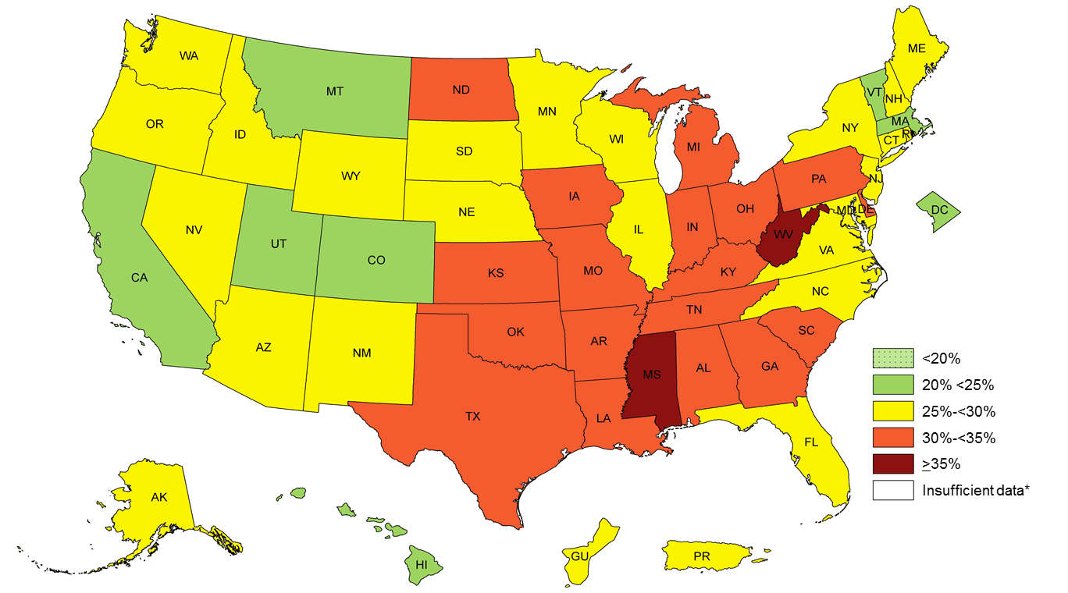
Prevalence¶ of Self-Reported Obesity Among U.S. Adults by State and Territory, BRFSS, 2013
¶ Prevalence estimates reflect BRFSS methodological changes started in 2011. These estimates should not be
compared to prevalence estimates before 2011.
*Sample size <50, the relative standard error (dividing the standard error by the prevalence) ≥30%, or no data in a specific year.

Slide 8
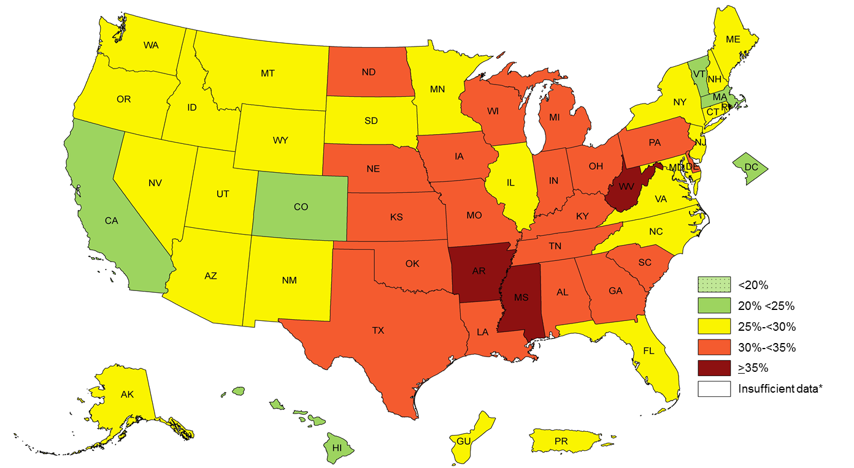
Prevalence¶ of Self-Reported Obesity Among U.S. Adults by State and Territory, BRFSS, 2014
¶ Prevalence estimates reflect BRFSS methodological changes started in 2011. These estimates should not be
compared to prevalence estimates before 2011.
*Sample size <50, the relative standard error (dividing the standard error by the prevalence) ≥30%, or no data in a specific year.

Slide 9
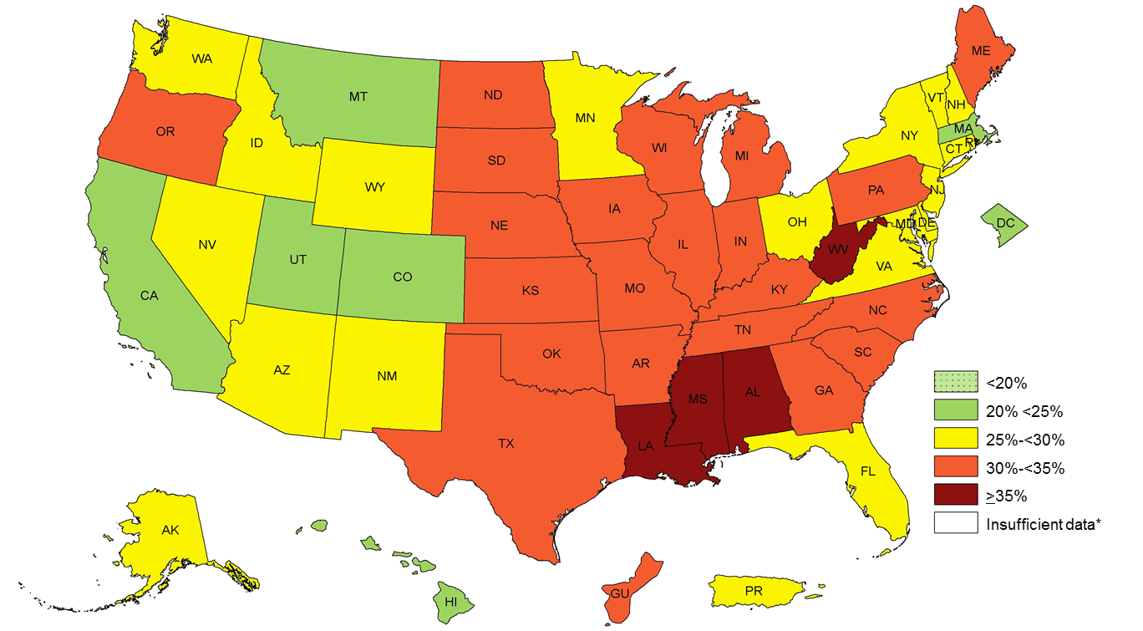
Prevalence¶ of Self-Reported Obesity Among U.S. Adults by State and Territory, BRFSS, 2015
¶ Prevalence estimates reflect BRFSS methodological changes started in 2011. These estimates should not be
compared to prevalence estimates before 2011.
*Sample size <50, the relative standard error (dividing the standard error by the prevalence) ≥30%, or no data in a specific year.

Slide 10
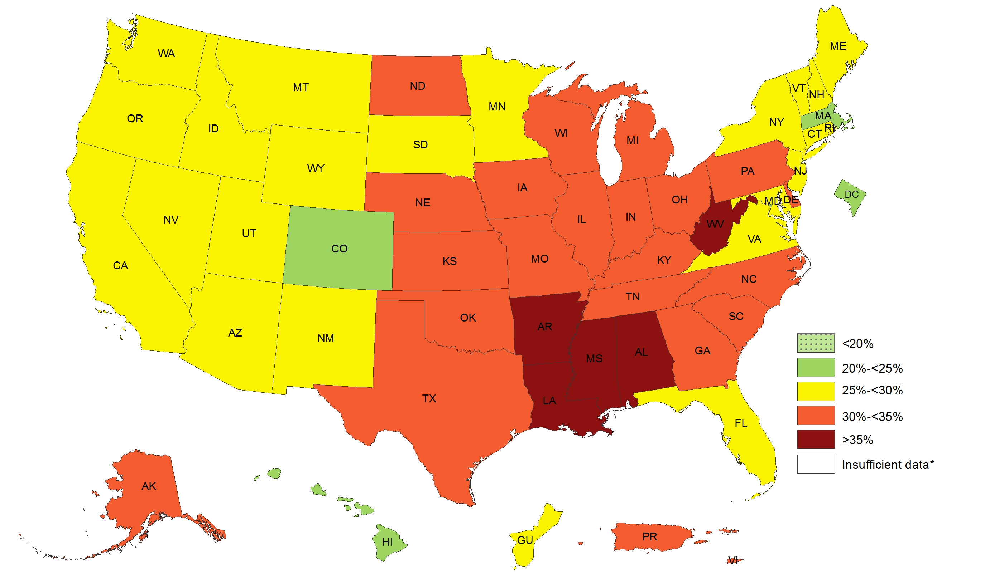
Prevalence¶ of Self-Reported Obesity Among U.S. Adults by State and Territory, BRFSS, 2016
¶ Prevalence estimates reflect BRFSS methodological changes started in 2011. These estimates should not be
compared to prevalence estimates before 2011.
*Sample size <50, the relative standard error (dividing the standard error by the prevalence) ≥30%, or no data in a specific year.

Slide 11
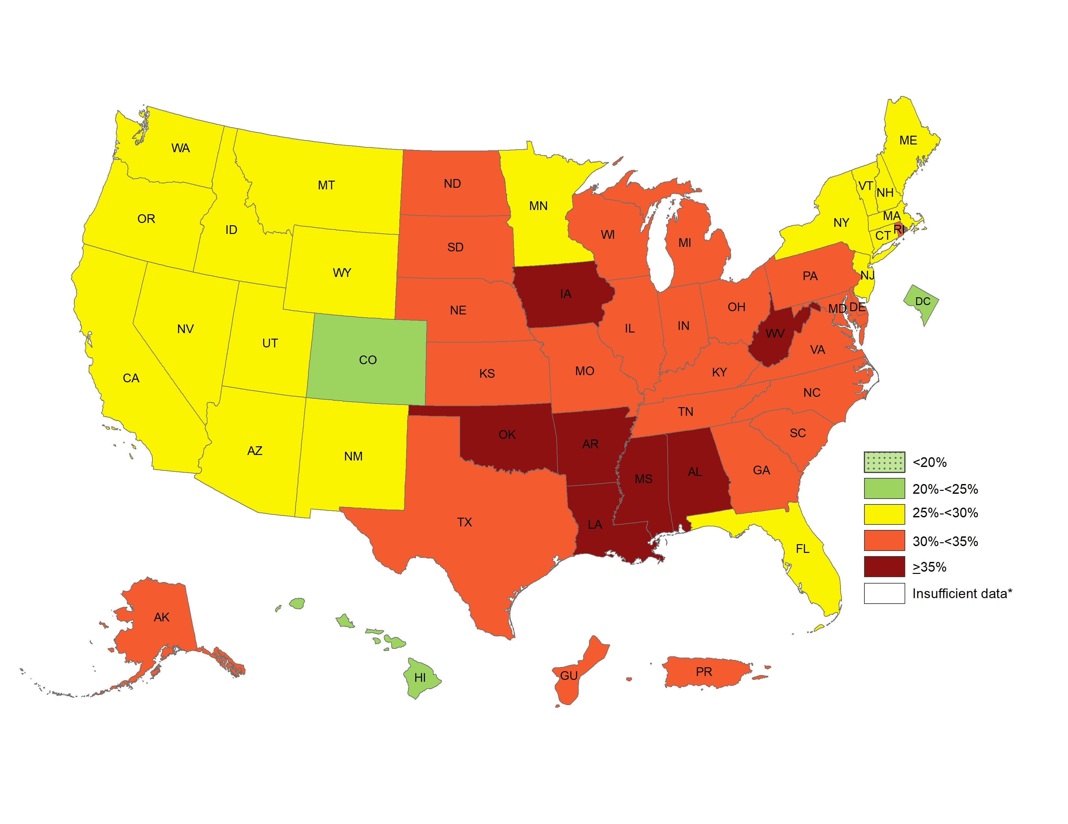
Prevalence¶ of Self-Reported Obesity Among U.S. Adults by State and Territory, BRFSS, 2017
¶ Prevalence estimates reflect BRFSS methodological changes started in 2011. These estimates should not be
compared to prevalence estimates before 2011.
*Sample size <50, the relative standard error (dividing the standard error by the prevalence) ≥30%, or no data in a specific year.

Slide 12
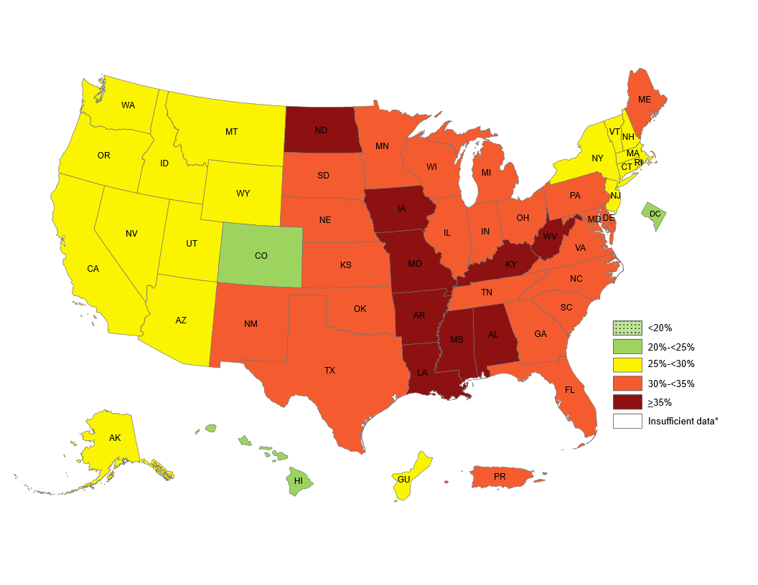
Prevalence¶ of Self-Reported Obesity Among U.S. Adults by State and Territory, BRFSS, 2018
¶ Prevalence estimates reflect BRFSS methodological changes started in 2011. These estimates should not be
compared to prevalence estimates before 2011.
*Sample size <50, the relative standard error (dividing the standard error by the prevalence) ≥30%, or no data in a specific year.

Slide 13
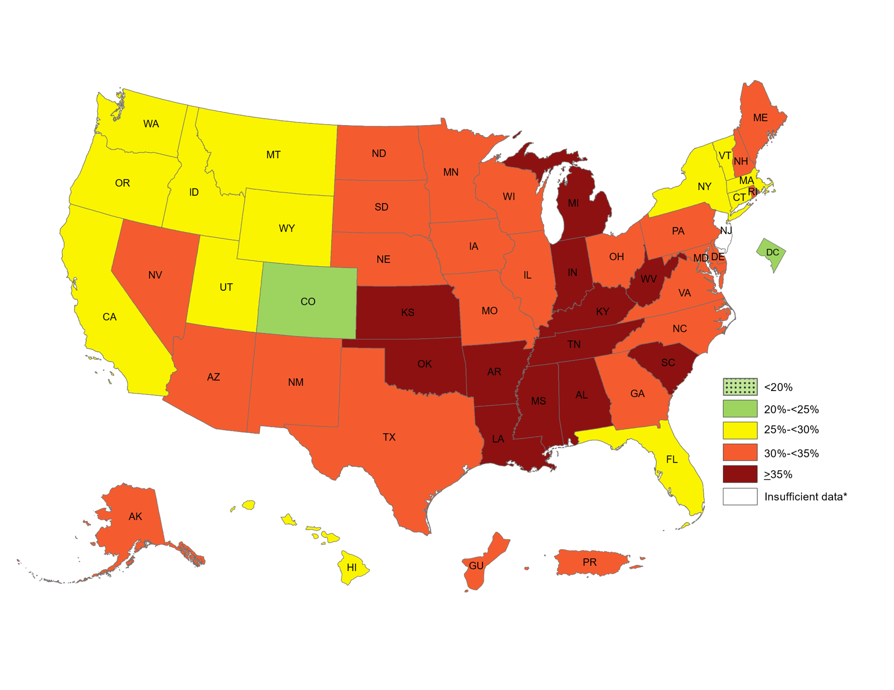
Prevalence¶ of Self-Reported Obesity Among U.S. Adults by State and Territory, BRFSS, 2019
¶ Prevalence estimates reflect BRFSS methodological changes started in 2011. These estimates should not be
compared to prevalence estimates before 2011.
*Sample size <50, the relative standard error (dividing the standard error by the prevalence) ≥30%, or no data in a specific year.

Slide 14
Prevalence¶ of Self-Reported Obesity Among U.S. Adults by State and Territory, BRFSS, 2011
State | Prevalence | 95% Confidence Interval
Alabama | 32.0 | (30.5, 33.5)
Alaska | 27.4 | (25.3, 29.7)
Arizona | 25.1 | (23.0, 27.3)
Arkansas | 30.9 | (28.8, 33.1)
California | 23.8 | (22.9, 24.7)
Colorado | 20.7 | (19.7, 21.8)
Connecticut | 24.5 | (23.0, 26.0)
Delaware | 28.8 | (26.9, 30.7)
District of Columbia | 23.7 | (21.9, 25.7)
Florida | 26.6 | (25.4, 27.9)
Georgia | 28.0 | (26.6, 29.4)
Guam | 27.4 | (24.8, 30.2)
Hawaii | 21.8 | (20.4, 23.4)
Idaho | 27.0 | (25.3, 28.9)
Illinois | 27.1 | (25.4, 28.9)
Indiana | 30.8 | (29.5, 32.3)
Iowa | 29.0 | (27.6, 30.3)
Kansas | 29.6 | (28.7, 30.4)
Kentucky | 30.4 | (28.9, 31.9)
Louisiana | 33.4 | (32.0, 34.9)
Maine | 27.8 | (26.8, 28.9)
Maryland | 28.3 | (26.9, 29.7)
Massachusetts | 22.7 | (21.8, 23.7)
Michigan | 31.3 | (30.0, 32.6)
Minnesota | 25.7 | (24.6, 26.8)
Mississippi | 34.9 | (33.5, 36.3)
State | Prevalence | 95% Confidence Interval
Missouri | 30.3 | (28.6, 32.0)
Montana | 24.6 | (23.3, 26.0)
Nebraska | 28.4 | (27.6, 29.2)
Nevada | 24.5 | (22.5, 26.6)
New Hampshire | 26.2 | (24.7, 27.7)
New Jersey | 23.7 | (22.7, 24.8)
New Mexico | 26.3 | (25.1, 27.6)
New York | 24.5 | (23.2, 25.9)
North Carolina | 29.1 | (27.7, 30.6)
North Dakota | 27.8 | (26.3, 29.4)
Ohio | 29.6 | (28.3, 31.0)
Oklahoma | 31.1 | (29.7, 32.5)
Oregon | 26.7 | (25.2, 28.3)
Pennsylvania | 28.6 | (27.3, 29.8)
Puerto Rico | 26.3 | (25.0, 27.7)
Rhode Island | 25.4 | (23.9, 27.0)
South Carolina | 30.8 | (29.6, 32.1)
South Dakota | 28.1 | (26.3, 30.1)
Tennessee | 29.2 | (26.8, 31.7)
Texas | 30.4 | (29.1, 31.8)
Utah | 24.4 | (23.4, 25.5)
Vermont | 25.4 | (24.1, 26.8)
Virginia | 29.2 | (27.5, 30.9)
Washington | 26.5 | (25.3, 27.7)
West Virginia | 32.4 | (30.9, 34.0)
Wisconsin | 27.7 | (25.8, 29.7)
Wyoming | 25.0 | (23.5, 26.6)
¶ Prevalence estimates reflect BRFSS methodological changes started in 2011. These estimates should not be compared to prevalence estimates before 2011. Source: Behavioral Risk Factor Surveillance System, CDC.

Slide 15
Prevalence¶ of Self-Reported Obesity Among U.S. Adults by State and Territory, BRFSS, 2012
State | Prevalence | 95% Confidence Interval
Alabama | 33.0 | (31.5, 34.4)
Alaska | 25.7 | (23.9, 27.5)
Arizona | 26.0 | (24.3, 27.8)
Arkansas | 34.5 | (32.7, 36.4)
California | 25.0 | (23.9, 26.0)
Colorado | 20.5 | (19.5, 21.4)
Connecticut | 25.6 | (24.3, 26.9)
Delaware | 26.9 | (25.2, 28.6)
District of Columbia | 21.9 | (19.8, 24.0)
Florida | 25.2 | (23.6, 26.7)
Georgia | 29.1 | (27.4, 30.8)
Guam | 29.1 | (26.3, 31.9)
Hawaii | 23.6 | (22.0, 25.1)
Idaho | 26.8 | (24.8, 28.8)
Illinois | 28.1 | (26.4, 29.9)
Indiana | 31.4 | (30.1, 32.7)
Iowa | 30.4 | (29.1, 31.8)
Kansas | 29.9 | (28.7, 31.0)
Kentucky | 31.3 | (29.9, 32.6)
Louisiana | 34.7 | (33.1, 36.4)
Maine | 28.4 | (27.2, 29.5)
Maryland | 27.6 | (26.3, 28.9)
Massachusetts | 22.9 | (22.0, 23.8)
Michigan | 31.1 | (29.8, 32.3)
Minnesota | 25.7 | (24.7, 26.8)
Mississippi | 34.6 | (33.0, 36.2)
State | Prevalence | 95% Confidence Interval
Missouri | 29.6 | (28.0, 31.2)
Montana | 24.3 | (23.1, 25.5)
Nebraska | 28.6 | (27.7, 29.6)
Nevada | 26.2 | (24.3, 28.1)
New Hampshire | 27.3 | (25.8, 28.8)
New Jersey | 24.6 | (23.6, 25.6)
New Mexico | 27.1 | (25.9, 28.3)
New York | 23.6 | (22.0, 25.1)
North Carolina | 29.6 | (28.5, 30.7)
North Dakota | 29.7 | (27.9, 31.4)
Ohio | 30.1 | (29.0, 31.2)
Oklahoma | 32.2 | (30.8, 33.6)
Oregon | 27.3 | (25.7, 29.0)
Pennsylvania | 29.1 | (28.1, 30.1)
Puerto Rico | 28.4 | (27.0, 29.7)
Rhode Island | 25.7 | (24.1, 27.4)
South Carolina | 31.6 | (30.4, 32.8)
South Dakota | 28.1 | (26.5, 29.8)
Tennessee | 31.1 | (29.6, 32.7)
Texas | 29.2 | (27.8, 30.5)
Utah | 24.3 | (23.3, 25.3)
Vermont | 23.7 | (22.3, 25.1)
Virginia | 27.4 | (26.0, 28.7)
Washington | 26.8 | (25.8, 27.8)
West Virginia | 33.8 | (32.2, 35.4)
Wisconsin | 29.7 | (27.8, 31.6)
Wyoming | 24.6 | (22.8, 26.4)
¶ Prevalence estimates reflect BRFSS methodological changes started in 2011. These estimates should not be compared to prevalence estimates before 2011. Source: Behavioral Risk Factor Surveillance System, CDC.

Slide 16
Prevalence¶ of Self-Reported Obesity Among U.S. Adults by State and Territory, BRFSS, 2013
State | Prevalence | 95% Confidence Interval
Alabama | 32.4 | (30.8, 34.1)
Alaska | 28.4 | (26.5, 30.4)
Arizona | 26.8 | (24.3, 29.4)
Arkansas | 34.6 | (32.7, 36.6)
California | 24.1 | (23.0, 25.3)
Colorado | 21.3 | (20.4, 22.2)
Connecticut | 25.0 | (23.5, 26.4)
Delaware | 31.1 | (29.3, 32.8)
District of Columbia | 22.9 | (21.0, 24.8)
Florida | 26.4 | (25.3, 27.4)
Georgia | 30.3 | (28.9, 31.8)
Guam | 27.0 | (24.4, 29.8)
Hawaii | 21.8 | (20.4, 23.2)
Idaho | 29.6 | (27.8, 31.4)
Illinois | 29.4 | (27.7, 31.2)
Indiana | 31.8 | (30.6, 33.1)
Iowa | 31.3 | (29.9, 32.7)
Kansas | 30.0 | (29.2, 30.7)
Kentucky | 33.2 | (31.8, 34.6)
Louisiana | 33.1 | (31.1, 35.2)
Maine | 28.9 | (27.5, 30.2)
Maryland | 28.3 | (27.0, 29.5)
Massachusetts | 23.6 | (22.5, 24.8)
Michigan | 31.5 | (30.4, 32.6)
Minnesota | 25.5 | (24.1, 26.8)
Mississippi | 35.1 | (33.5, 36.8)
State | Prevalence | 95% Confidence Interval
Missouri | 30.4 | (28.8, 32.1)
Montana | 24.6 | (23.4, 25.8)
Nebraska | 29.6 | (28.4, 30.7)
Nevada | 26.2 | (24.0, 28.6)
New Hampshire | 26.7 | (25.3, 28.3)
New Jersey | 26.3 | (25.1, 27.5)
New Mexico | 26.4 | (25.1, 27.7)
New York | 25.4 | (24.2, 26.6)
North Carolina | 29.4 | (28.1, 30.7)
North Dakota | 31.0 | (29.5, 32.5)
Ohio | 30.4 | (29.2, 31.6)
Oklahoma | 32.5 | (31.2, 33.9)
Oregon | 26.5 | (24.9, 28.1)
Pennsylvania | 30.0 | (28.9, 31.2)
Puerto Rico | 27.9 | (26.4, 29.5)
Rhode Island | 27.3 | (25.8, 28.8)
South Carolina | 31.7 | (30.5, 33.1)
South Dakota | 29.9 | (28.0, 31.8)
Tennessee | 33.7 | (31.9, 35.5)
Texas | 30.9 | (29.5, 32.3)
Utah | 24.1 | (23.2, 25.1)
Vermont | 24.7 | (23.4, 26.1)
Virginia | 27.2 | (25.9, 28.5)
Washington | 27.2 | (26.0, 28.3)
West Virginia | 35.1 | (33.6, 36.6)
Wisconsin | 29.8 | (28.0, 31.6)
Wyoming | 27.8 | (26.2, 29.5)
¶ Prevalence estimates reflect BRFSS methodological changes started in 2011. These estimates should not be compared to prevalence estimates before 2011. Source: Behavioral Risk Factor Surveillance System, CDC.

Slide 17
Prevalence¶ of Self-Reported Obesity Among U.S. Adults by State and Territory, BRFSS, 2014
State | Prevalence | 95% Confidence Interval
Alabama | 33.5 | (32.1, 35.0)
Alaska | 29.7 | (27.8, 31.7)
Arizona | 28.9 | (27.7, 30.2)
Arkansas | 35.9 | (33.8, 38.0)
California | 24.7 | (23.5, 25.9)
Colorado | 21.3 | (20.4, 22.2)
Connecticut | 26.3 | (24.9, 27.7)
Delaware | 30.7 | (28.6, 32.8)
District of Columbia | 21.7 | (19.5, 24.0)
Florida | 26.2 | (25.0, 27.5)
Georgia | 30.5 | (28.9, 32.1)
Guam | 28.0 | (25.6, 30.5)
Hawaii | 22.1 | (20.7, 23.5)
Idaho | 28.9 | (27.1, 30.8)
Illinois | 29.3 | (27.6, 31.1)
Indiana | 32.7 | (31.6, 34.0)
Iowa | 30.9 | (29.6, 32.3)
Kansas | 31.3 | (30.3, 32.2)
Kentucky | 31.6 | (30.2, 33.1)
Louisiana | 34.9 | (33.4, 36.4)
Maine | 28.2 | (26.9, 29.5)
Maryland | 29.6 | (28.1, 31.1)
Massachusetts | 23.3 | (22.3, 24.4)
Michigan | 30.7 | (29.4, 32.0)
Minnesota | 27.6 | (26.8, 28.5)
Mississippi | 35.5 | (33.4, 37.6)
State | Prevalence | 95% Confidence Interval
Missouri | 30.2 | (28.6, 31.9)
Montana | 26.4 | (24.9, 27.9)
Nebraska | 30.2 | (29.2, 31.3)
Nevada | 27.7 | (25.4, 30.1)
New Hampshire | 27.4 | (25.8, 29.1)
New Jersey | 26.9 | (25.7, 28.1)
New Mexico | 28.4 | (27.0, 30.0)
New York | 27.0 | (25.6, 28.5)
North Carolina | 29.7 | (28.4, 31.0)
North Dakota | 32.2 | (30.5, 34.0)
Ohio | 32.6 | (31.2, 34.1)
Oklahoma | 33.0 | (31.7, 34.3)
Oregon | 27.9 | (26.3, 29.6)
Pennsylvania | 30.2 | (28.9, 31.4)
Puerto Rico | 28.3 | (26.8, 29.8)
Rhode Island | 27.0 | (25.4, 28.6)
South Carolina | 32.1 | (30.9, 33.3)
South Dakota | 29.8 | (27.9, 31.8)
Tennessee | 31.2 | (29.3, 33.2)
Texas | 31.9 | (30.6, 33.3)
Utah | 25.7 | (24.9, 26.6)
Vermont | 24.8 | (23.5, 26.1)
Virginia | 28.5 | (27.2, 29.7)
Washington | 27.3 | (26.0, 28.5)
West Virginia | 35.7 | (34.2, 37.2)
Wisconsin | 31.2 | (29.6, 32.8)
Wyoming | 29.5 | (27.5, 31.5)
¶ Prevalence estimates reflect BRFSS methodological changes started in 2011. These estimates should not be compared to prevalence estimates before 2011. Source: Behavioral Risk Factor Surveillance System, CDC.
.

Slide 18
Prevalence¶ of Self-Reported Obesity Among U.S. Adults by State and Territory, BRFSS, 2015
State | Prevalence | 95% Confidence Interval
Alabama | 35.6 | (34.1, 37.2)
Alaska | 29.8 | (27.5, 32.3)
Arizona | 28.4 | (26.9, 30.0)
Arkansas | 34.5 | (32.2, 36.9)
California | 24.2 | (23.2, 25.2)
Colorado | 20.2 | (19.1, 21.3)
Connecticut | 25.3 | (24.1, 26.4)
Delaware | 29.7 | (27.6, 31.8)
District of Columbia | 22.1 | (19.7, 24.8)
Florida | 26.8 | (25.5, 28.1)
Georgia | 30.7 | (28.8, 32.6)
Guam | 31.6 | (28.2, 35.1)
Hawaii | 22.7 | (21.3, 24.1)
Idaho | 28.6 | (26.9, 30.4)
Illinois | 30.8 | (29.2, 32.4)
Indiana | 31.3 | (29.5, 33.1)
Iowa | 32.1 | (30.5, 33.8)
Kansas | 34.2 | (33.4, 35.0)
Kentucky | 34.6 | (32.9, 36.3)
Louisiana | 36.2 | (34.3, 38.1)
Maine | 30.0 | (28.6, 31.4)
Maryland | 28.9 | (27.2, 30.7)
Massachusetts | 24.3 | (23.0, 25.6)
Michigan | 31.2 | (29.9, 32.4)
Minnesota | 26.1 | (25.3, 27.0)
Mississippi | 35.6 | (33.8, 37.5)
State | Prevalence | 95% Confidence Interval
Missouri | 32.4 | (30.8, 34.0)
Montana | 23.6 | (22.1, 25.2)
Nebraska | 31.4 | (30.3, 32.5)
Nevada | 26.7 | (24.1, 29.5)
New Hampshire | 26.3 | (24.8, 27.9)
New Jersey | 25.6 | (24.3, 26.9)
New Mexico | 28.8 | (27.1, 30.6)
New York | 25.0 | (24.0, 26.1)
North Carolina | 30.1 | (28.7, 31.5)
North Dakota | 31.0 | (29.3, 32.8)
Ohio | 29.8 | (28.4, 31.2)
Oklahoma | 33.9 | (32.2, 35.6)
Oregon | 30.1 | (28.4, 31.8)
Pennsylvania | 30.0 | (28.4, 31.6)
Puerto Rico | 29.5 | (28.0, 31.1)
Rhode Island | 26.0 | (24.3, 27.7)
South Carolina | 31.7 | (30.5, 33.0)
South Dakota | 30.4 | (28.5, 32.3)
Tennessee | 33.8 | (31.9, 35.7)
Texas | 32.4 | (30.9, 33.9)
Utah | 24.5 | (23.5, 25.5)
Vermont | 25.1 | (23.8, 26.6)
Virginia | 29.2 | (27.9, 30.6)
Washington | 26.4 | (25.5, 27.4)
West Virginia | 35.6 | (34.1, 37.1)
Wisconsin | 30.7 | (29.0, 32.4)
Wyoming | 29.0 | (27.0, 31.1)
¶ Prevalence estimates reflect BRFSS methodological changes started in 2011. These estimates should not be compared to prevalence estimates before 2011. Source: Behavioral Risk Factor Surveillance System, CDC.
.

Slide 19
Prevalence¶ of Self-Reported Obesity Among U.S. Adults by State and Territory, BRFSS, 2016
State | Prevalence | 95% Confidence Interval
Alabama | 35.7 | (34.2, 37.3)
Alaska | 31.4 | (28.5, 34.4)
Arizona | 29.0 | (27.5, 30.6)
Arkansas | 35.7 | (33.3, 38.1)
California | 25.0 | (23.9, 26.1)
Colorado | 22.3 | (21.4, 23.2)
Connecticut | 26.0 | (24.8, 27.2)
Delaware | 30.7 | (28.7, 32.8)
District of Columbia | 22.6 | (20.9, 24.3)
Florida | 27.4 | (26.4, 28.5)
Georgia | 31.4 | (29.7, 33.2)
Guam | 28.3 | (25.1, 31.7)
Hawaii | 23.8 | (22.5, 25.2)
Idaho | 27.4 | (25.6, 29.3)
Illinois | 31.6 | (29.9, 33.3)
Indiana | 32.5 | (31.2, 33.8)
Iowa | 32.0 | (30.5, 33.4)
Kansas | 31.2 | (30.1, 32.3)
Kentucky | 34.2 | (32.7, 35.6)
Louisiana | 35.5 | (33.4, 37.7)
Maine | 29.9 | (28.5, 31.3)
Maryland | 29.9 | (28.9, 31.0)
Massachusetts | 23.6 | (22.3, 24.9)
Michigan | 32.5 | (31.4, 33.6)
Minnesota | 27.8 | (26.9, 28.6)
Mississippi | 37.3 | (35.4, 39.1)
Missouri | 31.7 | (30.0, 33.4)
State | Prevalence | 95% Confidence Interval
Montana | 25.5 | (23.9, 27.2)
Nebraska | 32.0 | (30.8, 33.2)
Nevada | 25.8 | (23.9, 27.8)
New Hampshire | 26.6 | (25.0, 28.2)
New Jersey | 27.4 | (25.7, 29.1)
New Mexico | 28.3 | (26.6, 30.1)
New York | 25.5 | (24.6, 26.5)
North Carolina | 31.8 | (30.4, 33.3)
North Dakota | 31.9 | (30.3, 33.6)
Ohio | 31.5 | (30.2, 32.8)
Oklahoma | 32.8 | (31.2, 34.3)
Oregon | 28.7 | (27.3, 30.3)
Pennsylvania | 30.3 | (28.8, 31.8)
Puerto Rico | 30.7 | (29.0, 32.5)
Rhode Island | 26.6 | (24.9, 28.4)
South Carolina | 32.3 | (31.0, 33.6)
South Dakota | 29.6 | (27.6, 31.7)
Tennessee | 34.8 | (33.0, 36.7)
Texas | 33.7 | (31.9, 35.4)
Utah | 25.4 | (24.2, 26.5)
Vermont | 27.1 | (25.5, 28.7)
Virgin Islands | 32.5 | (28.6, 36.6)
Virginia | 29.0 | (27.7, 30.3)
Washington | 28.6 | (27.6, 29.6)
West Virginia | 37.7 | (36.3, 39.0)
Wisconsin | 30.7 | (29.0, 32.5)
Wyoming | 27.7 | (25.7, 29.8)
¶ Prevalence estimates reflect BRFSS methodological changes started in 2011. These estimates should not be compared to prevalence estimates before 2011. Source: Behavioral Risk Factor Surveillance System, CDC.
.

Slide 20
Prevalence¶ of Self-Reported Obesity Among U.S. Adults by State and Territory, BRFSS, 2017
State | Prevalence | 95% Confidence Interval
Alabama | 36.3 | (34.7, 38.0)
Alaska | 34.2 | (31.4, 37.1)
Arizona | 29.5 | (28.5, 30.5)
Arkansas | 35.0 | (32.6, 37.5)
California | 25.1 | (23.8, 26.4)
Colorado | 22.6 | (21.6, 23.7)
Connecticut | 26.9 | (25.6, 28.1)
Delaware | 31.8 | (29.7, 34.0)
District of Columbia | 22.9 | (21.1, 24.7)
Florida | 28.4 | (27.0, 29.9)
Georgia | 31.6 | (30.0, 33.3)
Guam | 34.3 | (31.2, 37.6)
Hawaii | 23.8 | (22.4, 25.2)
Idaho | 29.3 | (27.5, 31.2)
Illinois | 31.1 | (29.5, 32.7)
Indiana | 33.6 | (32.5, 34.7)
Iowa | 36.4 | (35.1, 37.7)
Kansas | 32.4 | (31.5, 33.2)
Kentucky | 34.3 | (32.6, 36.0)
Louisiana | 36.2 | (34.4, 38.1)
Maine | 29.1 | (27.7, 30.6)
Maryland | 31.3 | (30.0, 32.6)
Massachusetts | 25.9 | (24.1, 27.7)
Michigan | 32.3 | (31.1, 33.4)
Minnesota | 28.4 | (27.5, 29.4)
Mississippi | 37.3 | (35.3, 39.3)
Missouri | 32.5 | (30.9, 34.0)
State | Prevalence | 95% Confidence Interval
Montana | 25.3 | (23.8, 26.9)
Nebraska | 32.8 | (31.6, 34.0)
Nevada | 26.7 | (24.5, 29.0)
New Hampshire | 28.1 | (26.3, 29.9)
New Jersey | 27.3 | (25.8, 28.7)
New Mexico | 28.4 | (26.8, 30.0)
New York | 25.7 | (24.6, 26.9)
North Carolina | 32.1 | (30.4, 34.0)
North Dakota | 33.2 | (31.6, 34.7)
Ohio | 33.8 | (32.5, 35.1)
Oklahoma | 36.5 | (34.9, 38.1)
Oregon | 29.4 | (27.9, 30.9)
Pennsylvania | 31.6 | (30.0, 33.2)
Puerto Rico | 32.9 | (31.0, 34.9)
Rhode Island | 30.0 | (28.1, 31.9)
South Carolina | 34.1 | (32.8, 35.4)
South Dakota | 31.9 | (29.8, 34.1)
Tennessee | 32.8 | (31.1, 34.6)
Texas | 33.0 | (31.2, 34.9)
Utah | 25.3 | (24.2, 26.4)
Vermont | 27.6 | (26.0, 29.2)
Virginia | 30.1 | (28.7, 31.4)
Washington | 27.7 | (26.6, 28.7)
West Virginia | 38.1 | (36.4, 39.7)
Wisconsin | 32.0 | (30.3, 33.8)
Wyoming | 28.8 | (27.1, 30.6)
¶ Prevalence estimates reflect BRFSS methodological changes started in 2011. These estimates should not be compared to prevalence estimates before 2011. Source: Behavioral Risk Factor Surveillance System, CDC.
.

Slide 21
Prevalence¶ of Self-Reported Obesity Among U.S. Adults by State and Territory, BRFSS, 2018
State | Prevalence | 95% Confidence Interval
Alabama | 36.2 | (34.6, 37.9)
Alaska | 29.5 | (27.0, 32.2)
Arizona | 29.5 | (27.8, 31.3)
Arkansas | 37.1 | (35.1, 39.1)
California | 25.8 | (24.8, 26.9)
Colorado | 23.0 | (21.9, 24.0)
Connecticut | 27.4 | (26.2, 28.7)
Delaware | 33.5 | (31.7, 35.4)
District of Columbia | 24.7 | (22.9, 26.5)
Florida | 30.7 | (29.1, 32.3)
Georgia | 32.5 | (31.2, 33.8)
Guam | 29.8 | (26.6, 33.3)
Hawaii | 24.9 | (23.6, 26.3)
Idaho | 28.4 | (26.3, 30.5)
Illinois | 31.8 | (30.2, 33.4)
Indiana | 34.1 | (32.6, 35.6)
Iowa | 35.3 | (34.2, 36.5)
Kansas | 34.4 | (33.2, 35.6)
Kentucky | 36.6 | (34.9, 38.4)
Louisiana | 36.8 | (34.9, 38.7)
Maine | 30.4 | (28.9, 31.9)
Maryland | 30.9 | (29.8, 32.1)
Massachusetts | 25.7 | (24.3, 27.2)
Michigan | 33.0 | (31.8, 34.2)
Minnesota | 30.1 | (29.2, 30.9)
Mississippi | 39.5 | (37.8, 41.2)
Missouri | 35.0 | (33.3, 36.8)
State | Prevalence | 95% Confidence Interval
Montana | 26.9 | (25.2, 28.5)
Nebraska | 34.1 | (32.9, 35.3)
Nevada | 29.5 | (27.1, 32.0)
New Hampshire | 29.6 | (27.9, 31.4)
New Jersey | 25.7 | (23.3, 28.2)
New Mexico | 32.3 | (30.7, 34.0)
New York | 27.6 | (26.7, 28.6)
North Carolina | 33.0 | (31.2, 34.8)
North Dakota | 35.1 | (33.3, 37.0)
Ohio | 34.0 | (32.7, 35.3)
Oklahoma | 34.8 | (33.1, 36.6)
Oregon | 29.9 | (28.4, 31.4)
Pennsylvania | 30.9 | (29.4, 32.5)
Puerto Rico | 32.9 | (31.2, 34.7)
Rhode Island | 27.7 | (26.0, 29.5)
South Carolina | 34.3 | (33.0, 35.6)
South Dakota | 30.1 | (28.1, 32.1)
Tennessee | 34.4 | (32.5, 36.3)
Texas | 34.8 | (32.8, 36.8)
Utah | 27.8 | (26.7, 28.9)
Vermont | 27.5 | (25.9, 29.2)
Virginia | 30.4 | (29.1, 31.6)
Washington | 28.7 | (27.6, 29.8)
West Virginia | 39.5 | (37.8, 41.3)
Wisconsin | 32.0 | (30.2, 33.8)
Wyoming | 29.0 | (27.3, 30.8)
¶ Prevalence estimates reflect BRFSS methodological changes started in 2011. These estimates should not be compared to prevalence estimates before 2011. Source: Behavioral Risk Factor Surveillance System, CDC.
.

Slide 22
Prevalence¶ of Self-Reported Obesity Among U.S. Adults by State and Territory, BRFSS, 2019
State | Prevalence | 95% Confidence Interval
Alabama | 36.1 | (34.6, 37.7)
Alaska | 30.5 | (27.8, 33.4)
Arizona | 31.4 | (29.7, 33.2)
Arkansas | 37.4 | (35.5, 39.4)
California | 26.2 | (25.1, 27.2)
Colorado | 23.8 | (22.7, 24.9)
Connecticut | 29.1 | (27.8, 30.5)
Delaware | 34.4 | (32.1, 36.6)
District of Columbia | 23.8 | (21.7, 25.9)
Florida | 27.0 | (25.6, 28.5)
Georgia | 33.1 | (31.3, 35.0)
Guam | 33.6 | (30.5, 37.0)
Hawaii | 25.0 | (23.7, 26.3)
Idaho | 29.5 | (27.6, 31.4)
Illinois | 31.6 | (30.1, 33.1)
Indiana | 35.3 | (34.0, 36.7)
Iowa | 33.9 | (32.8, 35.1)
Kansas | 35.2 | (34.1, 36.4)
Kentucky | 36.5 | (34.7, 38.2)
Louisiana | 35.9 | (34.1, 37.7)
Maine | 31.7 | (30.3, 33.1)
Maryland | 32.3 | (31.1, 33.4)
Massachusetts | 25.2 | (23.9, 26.5)
Michigan | 36.0 | (34.7, 37.3)
Minnesota | 30.1 | (29.2, 31.1)
Mississippi | 40.8 | (39.0, 42.7)
Missouri | 34.8 | (33.2, 36.4)
State | Prevalence | 95% Confidence Interval
Montana | 28.3 | (27.0, 29.7)
Nebraska | 34.1 | (33.0, 35.2)
Nevada | 30.6 | (28.2, 33.1)
New Hampshire | 31.8 | (30.0, 33.6)
New Jersey | Insufficient data* | Insufficient data*
New Mexico | 31.7 | (30.0, 33.5)
New York | 27.1 | (26.0, 28.2)
North Carolina | 34.0 | (32.2, 35.8)
North Dakota | 34.8 | (33.0, 36.7)
Ohio | 34.8 | (33.5, 36.1)
Oklahoma | 36.8 | (35.2, 38.4)
Oregon | 29.0 | (27.5, 30.4)
Pennsylvania | 33.2 | (31.7, 34.7)
Puerto Rico | 32.5 | (31.0, 34.0)
Rhode Island | 30.0 | (28.2, 31.9)
South Carolina | 35.4 | (33.8, 36.9)
South Dakota | 33.0 | (30.6, 35.5)
Tennessee | 36.5 | (34.8, 38.3)
Texas | 34.0 | (32.2, 35.7)
Utah | 29.2 | (28.2, 30.3)
Vermont | 26.6 | (25.0, 28.3)
Virginia | 31.9 | (30.6, 33.2)
Washington | 28.3 | (27.3, 29.4)
West Virginia | 39.7 | (38.0, 41.5)
Wisconsin | 34.2 | (32.4, 36.1)
Wyoming | 29.7 | (27.7, 31.7)
¶ Prevalence estimates reflect BRFSS methodological changes started in 2011. These estimates should not be compared to prevalence estimates before 2011. Source: Behavioral Risk Factor Surveillance System, CDC.
*Sample size <50, the relative standard error (dividing the standard error by the prevalence) ≥30%, or no data in a specific year.
.

Slide 23
Prevalence¶ of Self-Reported Obesity Among U.S. Adults by State and Territory, BRFSS, 2019
Summary
No state or territory had a prevalence of obesity less than 20%.
1 state (Colorado) and the District of Columbia had a prevalence of obesity between 20% and <25%.
13 states had a prevalence of obesity between 25% and <30%.
23 states, Guam, and Puerto Rico had a prevalence of obesity between 30% and <35%.
12 states (Alabama, Arkansas, Indiana, Kansas, Kentucky, Louisiana, Michigan, Mississippi, Oklahoma, South Carolina, Tennessee, and West Virginia) had a prevalence of obesity of 35% or greater.
¶ Prevalence estimates reflect BRFSS methodological changes started in 2011. These estimates should not be compared to prevalence estimates before 2011.
http://www.cdc.gov/obesity/data/prevalence-maps.html

