Slide 1
Prevalence of Self-Reported Obesity Among U.S. Adults by Race/Ethnicity, State and Territory, BRFSS
Definitions
Obesity: Body Mass Index (BMI) of 30 or higher.
Body Mass Index (BMI): A measure of an adult’s weight in relation to his or her height, calculated by using the adult’s weight in kilograms divided by the square of his or her height in meters.

Slide 2
Prevalence of Self-Reported Obesity Among U.S. Adults by Race/Ethnicity, State and Territory, BRFSS,
Method
The data were collected through the Behavioral Risk Factor Surveillance System (BRFSS), an ongoing, state-based, telephone interview survey conducted by state health departments with assistance from CDC.
Height and weight data used in the BMI calculations were self-reported.
Three years of data were combined to ensure sufficient sample size.

Slide 3
Prevalence of Self-Reported Obesity Among U.S. Adults by Race/Ethnicity, State and Territory, BRFSS
Exclusion Criteria
Records with the following were excluded:
Height: <3 feet or ≥8 feet
Weight: <50 pounds or ≥650 pounds
BMI: <12 kg/m² or ≥100 kg/m²
Pregnant women

Slide 4
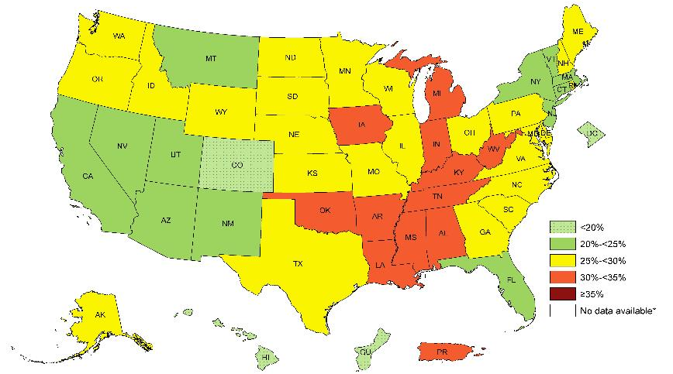
Prevalence of Self-Reported Obesity Among Non-Hispanic White Adults, by State and Territory, BRFSS, 2011-2013
*Sample size <50 or the relative standard error (dividing the standard error by the prevalence) ≥30%.

Slide 5
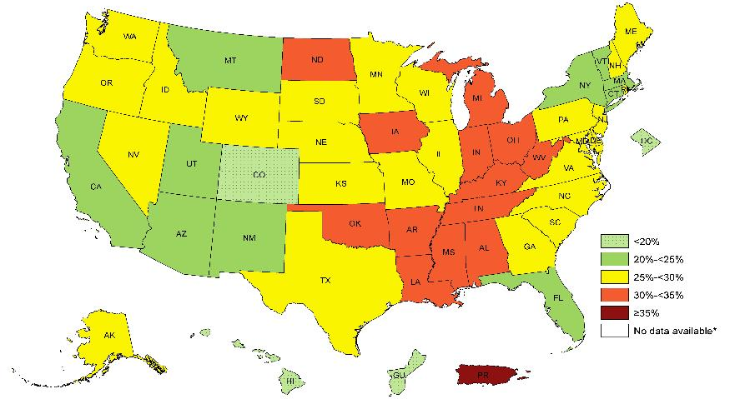
Prevalence of Self-Reported Obesity Among Non-Hispanic White Adults, by State and Territory, BRFSS, 2012-2014
*Sample size <50 or the relative standard error (dividing the standard error by the prevalence) ≥30%.

Slide 6
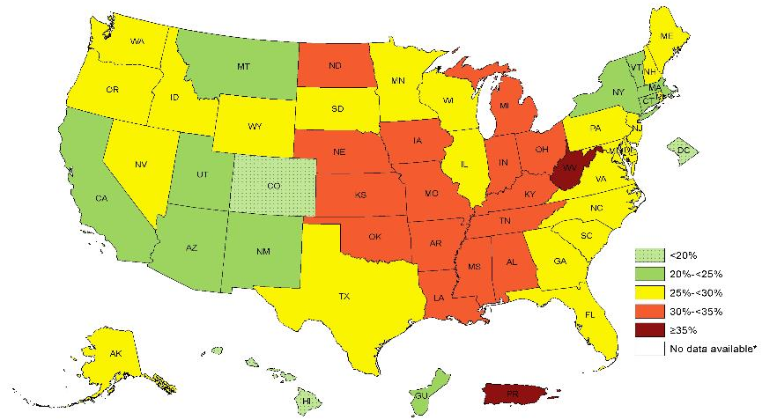
Prevalence of Self-Reported Obesity Among Non-Hispanic White Adults, by State and Territory, BRFSS, 2013-2015
*Sample size <50 or the relative standard error (dividing the standard error by the prevalence) ≥30%.

Slide 7
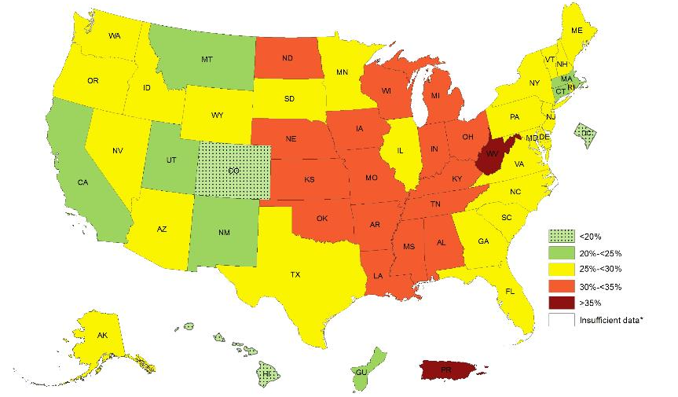
Prevalence of Self-Reported Obesity Among Non-Hispanic White Adults, by State and Territory, BRFSS, 2014-2016
*Sample size <50 or the relative standard error (dividing the standard error by the prevalence) ≥30%.

Slide 8
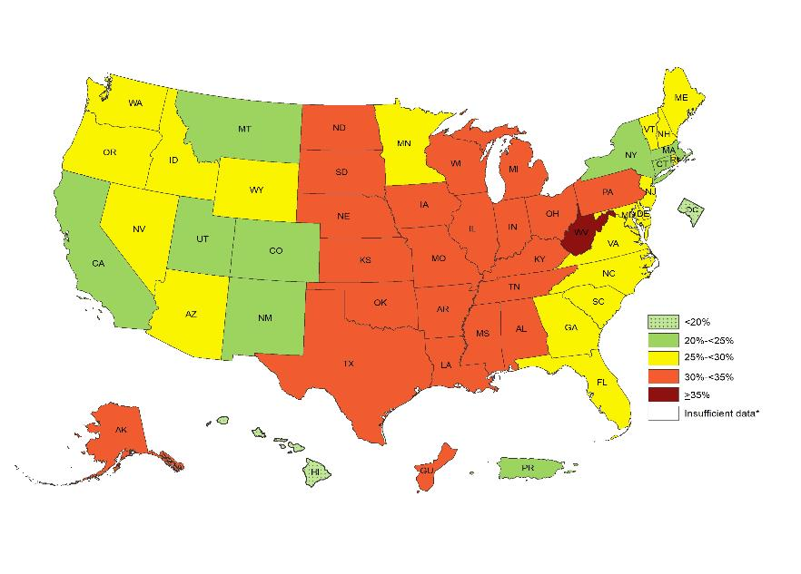
Prevalence of Self-Reported Obesity Among Non-Hispanic White Adults, by State and Territory, BRFSS, 2015-2017
*Sample size <50 or the relative standard error (dividing the standard error by the prevalence) ≥30%.

Slide 9
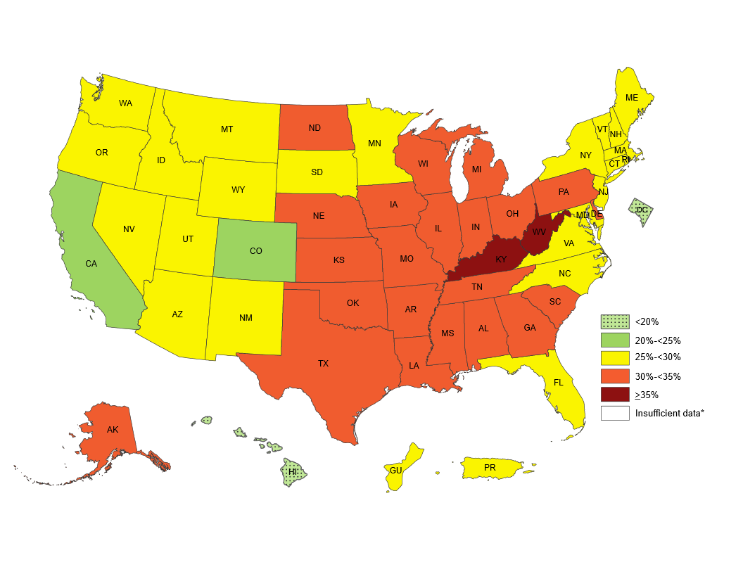
Prevalence of Self-Reported Obesity Among Non-Hispanic White Adults, by State and Territory, BRFSS, 2016-2018
*Sample size <50 or the relative standard error (dividing the standard error by the prevalence) ≥30%.

Slide 10
Prevalence of Self-Reported Obesity Among Non-Hispanic White Adults, by State and Territory, BRFSS, 2011-2013
State | Prevalence | Confidence Interval
Alabama | 29.8 | (28.8, 30.9)
Alaska | 26.1 | (24.9, 27.4)
Arizona | 22.0 | (20.8, 23.3)
Arkansas | 32.0 | (30.7, 33.2)
California | 22.4 | (21.7, 23.1)
Colorado | 18.8 | (18.2, 19.4)
Connecticut | 23.5 | (22.6, 24.4)
Delaware | 27.4 | (26.3, 28.5)
District of Columbia | 10.0 | (8.8, 11.3)
Florida | 24.5 | (23.7, 25.3)
Georgia | 26.2 | (25.2, 27.2)
Guam | 18.8 | (15.1, 23.2)
Hawaii | 19.3 | (17.8, 20.8)
Idaho | 26.8 | (25.7, 27.9)
Illinois | 27.0 | (26.0, 28.1)
Indiana | 30.1 | (29.3, 30.9)
Iowa | 30.1 | (29.3, 30.9)
Kansas | 29.2 | (28.6, 29.7)
Kentucky | 31.0 | (30.2, 31.8)
Louisiana | 30.4 | (29.3, 31.6)
Maine | 28.5 | (27.8, 29.2)
Maryland | 25.3 | (24.5, 26.2)
Massachusetts | 22.4 | (21.8, 23.1)
Michigan | 30.1 | (29.3, 30.8)
Minnesota | 25.5 | (24.8, 26.2)
Mississippi | 30.7 | (29.6, 31.8)
State | Prevalence | Confidence Interval
Missouri | 28.8 | (27.8, 29.9)
Montana | 23.4 | (22.7, 24.2)
Nebraska | 28.6 | (28.0, 29.2)
Nevada | 24.7 | (23.4, 26.0)
New Hampshire | 27.1 | (26.3, 28.0)
New Jersey | 24.4 | (23.7, 25.2)
New Mexico | 22.2 | (21.2, 23.1)
New York | 23.6 | (22.7, 24.5)
North Carolina | 26.6 | (25.8, 27.5)
North Dakota | 29.1 | (28.2, 30.0)
Ohio | 29.4 | (28.7, 30.2)
Oklahoma | 31.0 | (30.1, 31.9)
Oregon | 26.2 | (25.3, 27.1)
Pennsylvania | 28.7 | (28.0, 29.4)
Puerto Rico | 32.6 | (24.2, 42.2)
Rhode Island | 25.9 | (24.9, 26.9)
South Carolina | 27.5 | (26.6, 28.3)
South Dakota | 28.1 | (27.0, 29.2)
Tennessee | 30.2 | (28.9, 31.4)
Texas | 26.5 | (25.5, 27.4)
Utah | 24.1 | (23.5, 24.7)
Vermont | 24.5 | (23.7, 25.4)
Virginia | 26.3 | (25.4, 27.3)
Washington | 27.5 | (26.8, 28.2)
West Virginia | 33.8 | (32.9, 34.7)
Wisconsin | 28.6 | (27.5, 29.7)
Wyoming | 25.5 | (24.5, 26.5)
.
Source: Behavioral Risk Factor Surveillance System, CDC.

Slide 11
Prevalence of Self-Reported Obesity Among Non-Hispanic White Adults, by State and Territory, BRFSS, 2012-2014
State | Prevalence | 95% Confidence Interval
Alabama | 30.4 | (29.4, 31.4)
Alaska | 27.0 | (25.8, 28.2)
Arizona | 23.7 | (22.6, 24.8)
Arkansas | 32.9 | (31.7, 34.2)
California | 22.6 | (21.8, 23.4)
Colorado | 19.1 | (18.6, 19.7)
Connecticut | 24.2 | (23.3, 25.1)
Delaware | 28.2 | (27.0, 29.4)
District of Columbia | 9.9 | (8.7, 11.3)
Florida | 24.3 | (23.5, 25.2)
Georgia | 27.5 | (26.5, 28.6)
Guam | 18.2 | (14.6, 22.6)
Hawaii | 18.8 | (17.3, 20.3)
Idaho | 27.4 | (26.3, 28.5)
Illinois | 27.5 | (26.5, 28.6)
Indiana | 31.1 | (30.3, 31.9)
Iowa | 30.9 | (30.1, 31.7)
Kansas | 29.6 | (29.1, 30.2)
Kentucky | 31.6 | (30.7, 32.4)
Louisiana | 30.5 | (29.3, 31.7)
Maine | 28.5 | (27.8, 29.3)
Maryland | 26.0 | (25.1, 26.9)
Massachusetts | 22.6 | (22.0, 23.3)
Michigan | 30.2 | (29.5, 31.0)
Minnesota | 26.1 | (25.4, 26.7)
Mississippi | 31.3 | (30.0, 32.5)
State | Prevalence | 95% Confidence Interval
Missouri | 28.9 | (27.8, 29.9)
Montana | 23.9 | (23.1, 24.7)
Nebraska | 29.0 | (28.4, 29.6)
Nevada | 26.4 | (25.0, 27.8)
New Hampshire | 27.5 | (26.6, 28.5)
New Jersey | 25.4 | (24.6, 26.2)
New Mexico | 22.5 | (21.5, 23.5)
New York | 24.5 | (23.6, 25.4)
North Carolina | 26.8 | (26.0, 27.7)
North Dakota | 30.7 | (29.7, 31.7)
Ohio | 30.4 | (29.6, 31.1)
Oklahoma | 31.9 | (31.0, 32.7)
Oregon | 27.0 | (26.1, 28.0)
Pennsylvania | 29.2 | (28.5, 29.9)
Puerto Rico | 46.7 | (35.4, 58.3)
Rhode Island | 26.6 | (25.6, 27.6)
South Carolina | 28.1 | (27.2, 28.9)
South Dakota | 28.9 | (27.8, 30.0)
Tennessee | 30.7 | (29.6, 31.8)
Texas | 26.7 | (25.8, 27.7)
Utah | 24.5 | (24.0, 25.1)
Vermont | 24.3 | (23.5, 25.1)
Virginia | 26.1 | (25.2, 26.9)
Washington | 27.8 | (27.1, 28.5)
West Virginia | 34.7 | (33.8, 35.6)
Wisconsin | 29.6 | (28.6, 30.7)
Wyoming | 26.8 | (25.7, 27.9)
Source: Behavioral Risk Factor Surveillance System, CDC.

Slide 12
Prevalence of Self-Reported Obesity Among Non-Hispanic White Adults, by State and Territory, BRFSS, 2013-2015
State | Prevalence | 95% Confidence Interval
Alabama | 31.1 | (30.1, 32.1)
Alaska | 27.7 | (26.4, 29.0)
Arizona | 24.4 | (23.4, 25.5)
Arkansas | 33.2 | (31.9, 34.6)
California | 22.2 | (21.4, 23.1)
Colorado | 19.1 | (18.5, 19.7)
Connecticut | 24.0 | (23.2, 24.9)
Delaware | 29.4 | (28.1, 30.8)
District of Columbia | 9.9 | (8.6, 11.4)
Florida | 25.2 | (24.4, 26.0)
Georgia | 28.0 | (27.0, 29.2)
Guam | 21.1 | (16.7, 26.2)
Hawaii | 17.9 | (16.6, 19.4)
Idaho | 28.1 | (27.0, 29.2)
Illinois | 28.3 | (27.2, 29.3)
Indiana | 31.3 | (30.4, 32.2)
Iowa | 31.6 | (30.8, 32.5)
Kansas | 31.0 | (30.5, 31.6)
Kentucky | 32.9 | (32.0, 33.8)
Louisiana | 31.9 | (30.7, 33.2)
Maine | 29.2 | (28.4, 30.0)
Maryland | 26.7 | (25.8, 27.8)
Massachusetts | 23.0 | (22.3, 23.8)
Michigan | 30.2 | (29.5, 31.0)
Minnesota | 26.5 | (25.8, 27.1)
Mississippi | 31.5 | (30.2, 32.8)
State | Prevalence | 95% Confidence Interval
Missouri | 30.4 | (29.4, 31.4)
Montana | 23.8 | (22.9, 24.6)
Nebraska | 30.0 | (29.3, 30.6)
Nevada | 26.3 | (24.7, 27.9)
New Hampshire | 27.3 | (26.4, 28.2)
New Jersey | 25.6 | (24.8, 26.5)
New Mexico | 22.8 | (21.7, 24.0)
New York | 24.9 | (24.1, 25.8)
North Carolina | 27.2 | (26.3, 28.1)
North Dakota | 31.3 | (30.4, 32.3)
Ohio | 30.5 | (29.7, 31.4)
Oklahoma | 32.5 | (31.5, 33.4)
Oregon | 28.1 | (27.1, 29.1)
Pennsylvania | 29.5 | (28.6, 30.3)
Puerto Rico | 45.4 | (33.4, 58.0)
Rhode Island | 26.4 | (25.4, 27.4)
South Carolina | 28.3 | (27.5, 29.2)
South Dakota | 29.6 | (28.5, 30.8)
Tennessee | 31.5 | (30.3, 32.6)
Texas | 27.9 | (26.9, 28.9)
Utah | 24.5 | (23.9, 25.1)
Vermont | 24.8 | (24.0, 25.6)
Virginia | 26.7 | (25.9, 27.5)
Washington | 27.7 | (27.0, 28.5)
West Virginia | 35.2 | (34.3, 36.1)
Wisconsin | 29.8 | (28.9, 30.8)
Wyoming | 28.0 | (26.9, 29.1)
Source: Behavioral Risk Factor Surveillance System, CDC.

Slide 13
Prevalence of Self-Reported Obesity Among Non-Hispanic White Adults, by State and Territory, BRFSS, 2014-2016
State | Prevalence | 95% Confidence Interval
Alabama | 32.4 | (31.4, 33.4)
Alaska | 28.7 | (27.2, 30.2)
Arizona | 26.0 | (25.1, 26.9)
Arkansas | 34.0 | (32.5, 35.4)
California | 22.7 | (21.9, 23.6)
Colorado | 19.8 | (19.2, 20.4)
Connecticut | 24.3 | (23.5, 25.1)
Delaware | 29.4 | (28.0, 30.9)
District of Columbia | 9.7 | (8.5, 11.2)
Florida | 25.7 | (24.9, 26.5)
Georgia | 28.9 | (27.7, 30.1)
Guam | 24.8 | (19.9, 30.5)
Hawaii | 17.6 | (16.3, 19.0)
Idaho | 27.6 | (26.6, 28.7)
Illinois | 29.2 | (28.1, 30.3)
Indiana | 31.8 | (30.9, 32.7)
Iowa | 31.9 | (31.1, 32.8)
Kansas | 31.5 | (30.9, 32.1)
Kentucky | 33.4 | (32.4, 34.3)
Louisiana | 32.6 | (31.4, 33.9)
Maine | 29.5 | (28.7, 30.3)
Maryland | 27.8 | (26.8, 28.8)
Massachusetts | 22.9 | (22.2, 23.7)
Michigan | 30.7 | (29.9, 31.4)
Minnesota | 27.3 | (26.8, 27.8)
Mississippi | 31.9 | (30.6, 33.3)
State | Prevalence | 95% Confidence Interval
Missouri | 30.7 | (29.7, 31.8)
Montana | 24.4 | (23.5, 25.4)
Nebraska | 30.8 | (30.1, 31.5)
Nevada | 26.2 | (24.7, 27.9)
New Hampshire | 27.2 | (26.3, 28.2)
New Jersey | 25.4 | (24.5, 26.4)
New Mexico | 23.9 | (22.7, 25.2)
New York | 25.1 | (24.3, 25.9)
North Carolina | 28.1 | (27.2, 29.1)
North Dakota | 31.5 | (30.5, 32.6)
Ohio | 30.8 | (30.0, 31.7)
Oklahoma | 32.3 | (31.3, 33.2)
Oregon | 29.0 | (28.1, 30.0)
Pennsylvania | 29.5 | (28.6, 30.4)
Puerto Rico | 36.0 | (24.8, 49.0)
Rhode Island | 26.0 | (24.9, 27.1)
South Carolina | 28.9 | (28.1, 29.8)
South Dakota | 29.5 | (28.4, 30.7)
Tennessee | 31.3 | (30.2, 32.4)
Texas | 29.2 | (28.1, 30.3)
Utah | 24.9 | (24.3, 25.6)
Vermont | 25.7 | (24.9, 26.6)
Virginia | 27.3 | (26.5, 28.2)
Washington | 28.2 | (27.5, 28.8)
West Virginia | 36.0 | (35.2, 36.9)
Wisconsin | 30.5 | (29.5, 31.5)
Wyoming | 27.9 | (26.8, 29.2)
Source: Behavioral Risk Factor Surveillance System, CDC.

Slide 14
Prevalence of Self-Reported Obesity Among Non-Hispanic White Adults, by State and Territory, BRFSS, 2015-2017
State | Prevalence | 95% Confidence Interval
Alabama | 33.1 | (32.1, 34.2)
Alaska | 30.0 | (28.3, 31.7)
Arizona | 26.1 | (25.3, 27.0)
Arkansas | 34.0 | (32.5, 35.5)
California | 23.1 | (22.2, 24.0)
Colorado | 20.3 | (19.6, 20.9)
Connecticut | 24.4 | (23.7, 25.2)
Delaware | 29.7 | (28.3, 31.1)
District of Columbia | 10.3 | (9.0, 11.8)
Florida | 26.2 | (25.4, 27.0)
Georgia | 29.5 | (28.3, 30.8)
Guam | 30.2 | (24.8, 36.2)
Hawaii | 17.5 | (16.2, 18.9)
Idaho | 27.8 | (26.7, 28.9)
Illinois | 30.3 | (29.3, 31.5)
Indiana | 32.1 | (31.2, 32.9)
Iowa | 33.6 | (32.8, 34.5)
Kansas | 32.0 | (31.4, 32.5)
Kentucky | 34.4 | (33.4, 35.4)
Louisiana | 33.4 | (32.1, 34.7)
Maine | 29.8 | (29.0, 30.7)
Maryland | 28.1 | (27.1, 29.0)
Massachusetts | 24.0 | (23.1, 25.0)
Michigan | 30.9 | (30.2, 31.7)
Minnesota | 27.5 | (27.0, 28.1)
Mississippi | 32.1 | (30.8, 33.5)
Missouri | 31.6 | (30.6, 32.6)
State | Prevalence | 95% Confidence Interval
Montana | 24.0 | (23.0, 25.0)
Nebraska | 31.7 | (31.0, 32.4)
Nevada | 25.7 | (24.1, 27.3)
New Hampshire | 27.4 | (26.5, 28.5)
New Jersey | 25.7 | (24.6, 26.7)
New Mexico | 24.3 | (23.1, 25.6)
New York | 24.7 | (24.0, 25.5)
North Carolina | 29.3 | (28.3, 30.4)
North Dakota | 31.9 | (30.9, 32.9)
Ohio | 31.2 | (30.3, 32.0)
Oklahoma | 33.4 | (32.3, 34.4)
Oregon | 29.3 | (28.3, 30.3)
Pennsylvania | 30.1 | (29.2, 31.1)
Puerto Rico | 24.1 | (15.1, 36.0)
Rhode Island | 26.9 | (25.8, 28.0)
South Carolina | 29.6 | (28.8, 30.5)
South Dakota | 30.0 | (28.8, 31.3)
Tennessee | 31.8 | (30.7, 32.9)
Texas | 30.1 | (28.8, 31.3)
Utah | 24.7 | (24.1, 25.4)
Vermont | 26.7 | (25.8, 27.7)
Virginia | 27.9 | (27.0, 28.8)
Washington | 28.3 | (27.7, 29.0)
West Virginia | 37.0 | (36.1, 37.9)
Wisconsin | 31.0 | (30.0, 32.0)
Wyoming | 27.9 | (26.8, 29.1)
*Sample size <50 or the relative standard error (dividing the standard error by the prevalence) ≥ 30%.
Source: Behavioral Risk Factor Surveillance System, CDC.

Slide 15
Prevalence of Self-Reported Obesity Among Non-Hispanic White Adults, by State and Territory, BRFSS, 2016-2018
State | Prevalence | 95% Confidence Interval
Alabama | 33.8 | (32.7, 34.9)
Alaska | 30.4 | (28.6, 32.1)
Arizona | 26.8 | (25.9, 27.7)
Arkansas | 34.8 | (33.4, 36.2)
California | 23.3 | (22.4, 24.2)
Colorado | 21.1 | (20.5, 21.8)
Connecticut | 25.2 | (24.5, 26.0)
Delaware | 30.7 | (29.4, 32.1)
District of Columbia | 11.2 | (10.0, 12.6)
Florida | 26.9 | (26.1, 27.7)
Georgia | 30.1 | (29.0, 31.3)
Guam | 29.2 | (24.0, 35.0)
Hawaii | 17.8 | (16.6, 19.2)
Idaho | 27.7 | (26.6, 28.9)
Illinois | 30.8 | (29.7, 31.9)
Indiana | 33.0 | (32.2, 33.8)
Iowa | 34.5 | (33.7, 35.3)
Kansas | 32.1 | (31.5, 32.8)
Kentucky | 35.2 | (34.2, 36.2)
Louisiana | 32.9 | (31.7, 34.2)
Maine | 29.8 | (28.9, 30.6)
Maryland | 28.7 | (27.9, 29.5)
Massachusetts | 25.0 | (24.0, 26.0)
Michigan | 31.8 | (31.0, 32.5)
Minnesota | 28.7 | (28.2, 29.2)
Mississippi | 33.9 | (32.6, 35.2)
Missouri | 32.0 | (30.9, 33.0)
State | Prevalence | 95% Confidence Interval
Montana | 25.1 | (24.1, 26.1)
Nebraska | 32.6 | (31.9, 33.3)
Nevada | 26.4 | (24.9, 27.9)
New Hampshire | 28.5 | (27.5, 29.5)
New Jersey | 26.1 | (24.8, 27.5)
New Mexico | 25.1 | (23.9, 26.4)
New York | 25.7 | (25.0, 26.4)
North Carolina | 29.9 | (28.7, 31.1)
North Dakota | 33.1 | (32.2, 34.1)
Ohio | 32.6 | (31.8, 33.4)
Oklahoma | 33.9 | (32.9, 35.0)
Oregon | 29.2 | (28.2, 30.1)
Pennsylvania | 30.4 | (29.4, 31.3)
Puerto Rico | 29.9 | (17.9, 45.5)
Rhode Island | 27.1 | (26.0, 28.3)
South Carolina | 30.8 | (29.9, 31.7)
South Dakota | 29.7 | (28.5, 31.0)
Tennessee | 32.3 | (31.2, 33.4)
Texas | 31.5 | (30.2, 32.9)
Utah | 25.7 | (25.0, 26.4)
Vermont | 27.7 | (26.7, 28.6)
Virginia | 28.4 | (27.6, 29.2)
Washington | 29.0 | (28.4, 29.7)
West Virginia | 38.5 | (37.6, 39.5)
Wisconsin | 31.4 | (30.4, 32.5)
Wyoming | 28.0 | (26.9, 29.2)
Source: Behavioral Risk Factor Surveillance System, CDC.

Slide 16
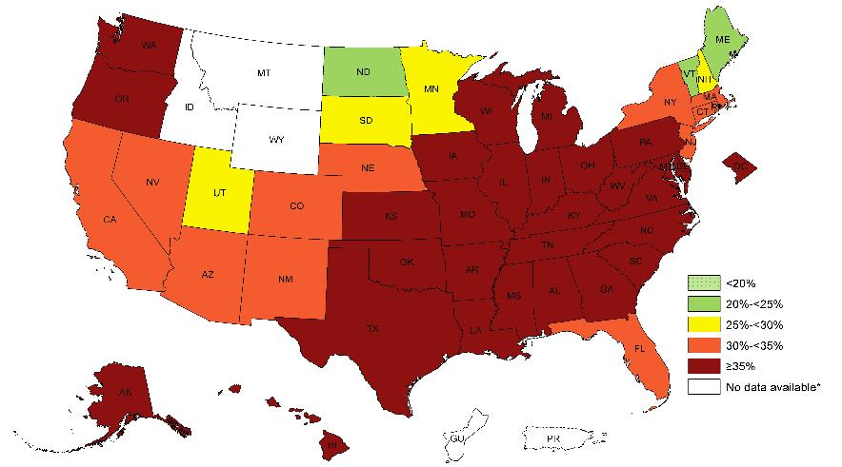
Prevalence of Self-Reported Obesity Among Non-Hispanic Black Adults, by State and Territory, BRFSS, 2011-2013
*Sample size <50 or the relative standard error (dividing the standard error by the prevalence) ≥30%.

Slide 17
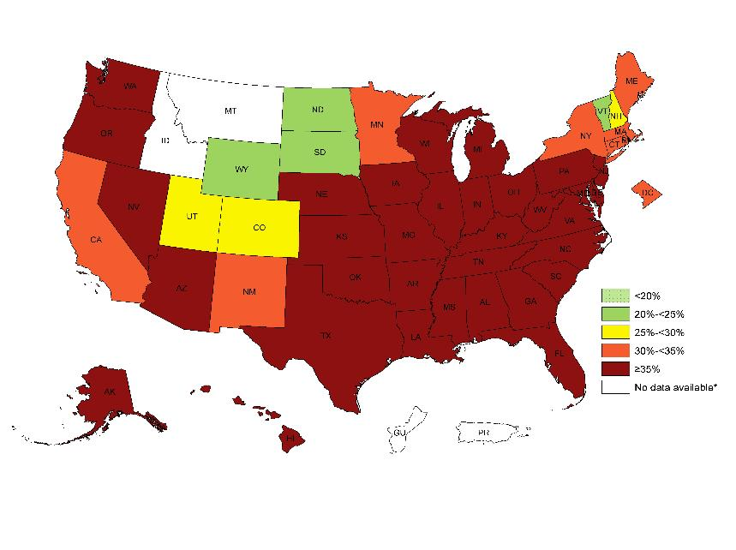
Prevalence of Self-Reported Obesity Among Non-Hispanic Black Adults, by State and Territory, BRFSS, 2012-2014
*Sample size <50 or the relative standard error (dividing the standard error by the prevalence) ≥30%.

Slide 18
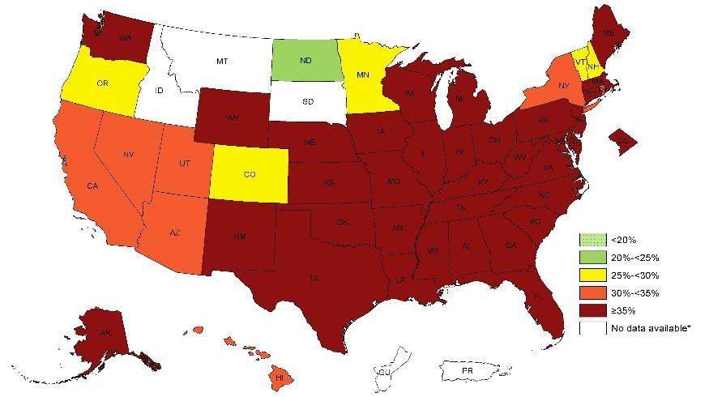
Prevalence of Self-Reported Obesity Among Non-Hispanic Black Adults, by State and Territory, BRFSS, 2013-2015
*Sample size <50 or the relative standard error (dividing the standard error by the prevalence) ≥30%.

Slide 19
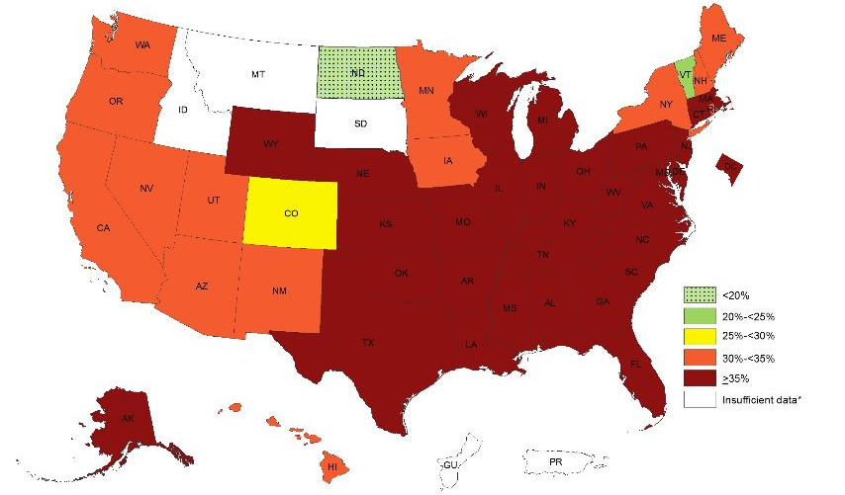
Prevalence of Self-Reported Obesity Among Non-Hispanic Black Adults, by State and Territory, BRFSS, 2014-2016
*Sample size <50 or the relative standard error (dividing the standard error by the prevalence) ≥30%.

Slide 20
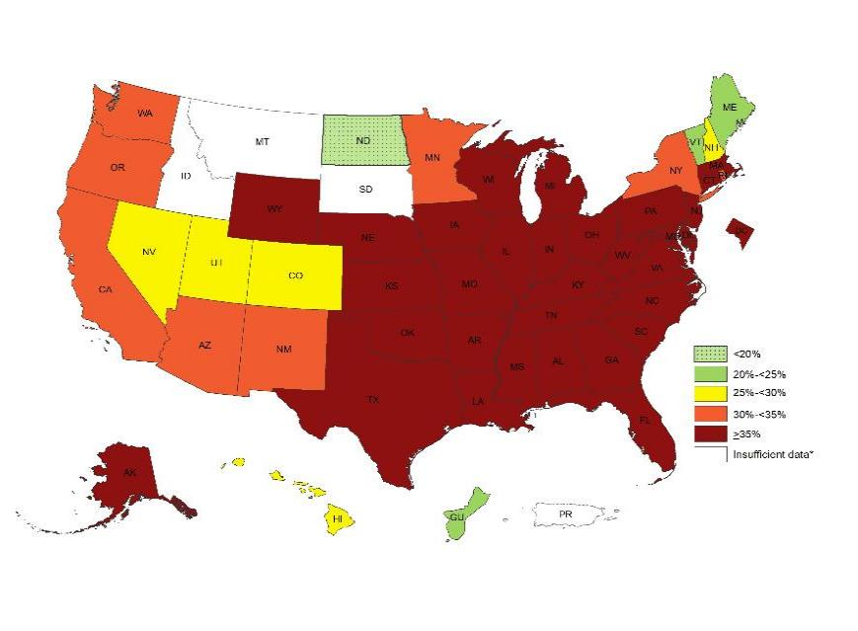
Prevalence of Self-Reported Obesity Among Non-Hispanic Black Adults, by State and Territory, BRFSS, 2015-2017
*Sample size <50 or the relative standard error (dividing the standard error by the prevalence) ≥30%.

Slide 21
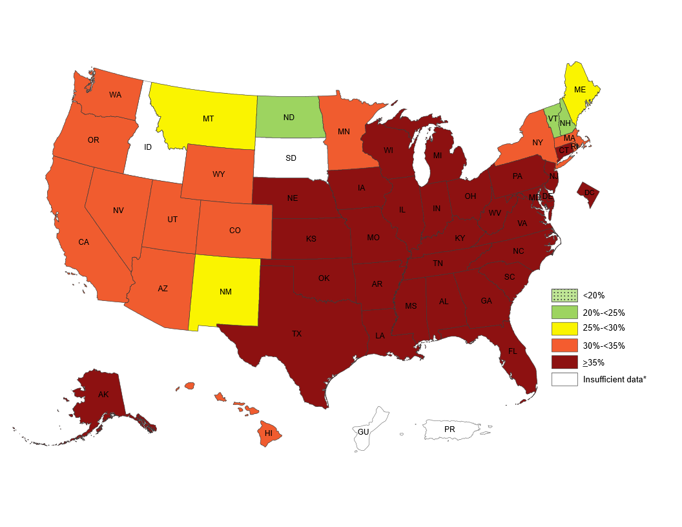
Prevalence of Self-Reported Obesity Among Non-Hispanic Black Adults, by State and Territory, BRFSS, 2016-2018
*Sample size <50 or the relative standard error (dividing the standard error by the prevalence) ≥30%.

Slide 22
Prevalence of Self-Reported Obesity Among Non-Hispanic Black Adults, by State and Territory , BRFSS, 2011-2013
State | Prevalence | Confidence Interval
Alabama | 41.8 | (39.9, 43.8)
Alaska | 37.9 | (29.1, 47.6)
Arizona | 32.5 | (25.7, 40.2)
Arkansas | 42.2 | (38.7, 45.7)
California | 34.8 | (31.8, 38.0)
Colorado | 30.5 | (26.6, 34.7)
Connecticut | 33.2 | (30.1, 36.5)
Delaware | 37.3 | (34.6, 40.1)
District of Columbia | 35.6 | (33.7, 37.6)
Florida | 34.8 | (32.2, 37.5)
Georgia | 37.2 | (35.3, 39.0)
Guam | Insufficient data* | Insufficient data*
Hawaii | 41.1 | (30.6, 52.4)
Idaho | Insufficient data* | Insufficient data*
Illinois | 38.7 | (35.3, 42.3)
Indiana | 42.5 | (39.4, 45.7)
Iowa | 39.5 | (32.7, 46.7)
Kansas | 39.2 | (36.2, 42.2)
Kentucky | 42.0 | (38.1, 46.0)
Louisiana | 41.9 | (39.9, 44.0)
Maine | 22.6 | (13.0, 36.3)
Maryland | 37.5 | (35.8, 39.2)
Massachusetts | 33.6 | (30.8, 36.5)
Michigan | 39.3 | (37.0, 41.7)
Minnesota | 29.8 | (26.1, 33.7)
Mississippi | 42.9 | (41.2, 44.5)
State | Prevalence | Confidence Interval
Missouri | 40.0 | (36.5, 43.5)
Montana | Insufficient data* | Insufficient data*
Nebraska | 33.7 | (30.0, 37.6)
Nevada | 34.9 | (29.7, 40.4)
New Hampshire | 27.7 | (18.7, 39.0)
New Jersey | 34.5 | (32.6, 36.5)
New Mexico | 30.1 | (24.1, 36.9)
New York | 32.7 | (30.1, 35.4)
North Carolina | 40.4 | (38.6, 42.4)
North Dakota | 24.7 | (15.5, 36.9)
Ohio | 36.0 | (33.5, 38.5)
Oklahoma | 38.7 | (35.2, 42.3)
Oregon | 39.5 | (29.3, 50.6)
Pennsylvania | 35.6 | (33.2, 38.0)
Puerto Rico | Insufficient data* | Insufficient data*
Rhode Island | 31.4 | (26.7, 36.6)
South Carolina | 42.6 | (41.1, 44.2)
South Dakota | 26.1 | (15.6, 40.3)
Tennessee | 40.4 | (37.0, 43.9)
Texas | 38.2 | (35.4, 41.1)
Utah | 26.0 | (18.8, 34.7)
Vermont | 20.2 | (11.2, 33.7)
Virginia | 38.5 | (36.2, 41.0)
Washington | 37.6 | (32.8, 42.7)
West Virginia | 36.5 | (30.4, 43.0)
Wisconsin | 38.5 | (33.0, 44.3)
Wyoming | Insufficient data* | Insufficient data*
*Sample size <50 or the relative standard error (dividing the standard error by the prevalence) ≥30%.
Source: Behavioral Risk Factor Surveillance System, CDC.

Slide 23
Prevalence of Self-Reported Obesity Among Non-Hispanic Black Adults, by State and Territory, BRFSS, 2012-2014
State | Prevalence | 95% Confidence Interval
Alabama | 42.4 | (40.5, 44.3)
Alaska | 40.4 | (32.0, 49.4)
Arizona | 35.5 | (29.3, 42.2)
Arkansas | 44.4 | (41.2, 47.8)
California | 34.7 | (31.6, 38.0)
Colorado | 29.3 | (25.7, 33.2)
Connecticut | 34.7 | (31.7, 37.8)
Delaware | 37.2 | (34.4, 40.1)
District of Columbia | 34.7 | (32.7, 36.7)
Florida | 35.0 | (32.4, 37.6)
Georgia | 37.5 | (35.6, 39.4)
Guam | Insufficient data* | Insufficient data*
Hawaii | 36.0 | (26.5, 46.7)
Idaho | Insufficient data* | Insufficient data*
Illinois | 40.2 | (36.8, 43.7)
Indiana | 42.5 | (39.4, 45.6)
Iowa | 40.0 | (33.2, 47.3)
Kansas | 39.5 | (36.5, 42.7)
Kentucky | 41.9 | (38.0, 45.9)
Louisiana | 43.2 | (41.1, 45.3)
Maine | 32.2 | (21.1, 45.7)
Maryland | 37.9 | (36.2, 39.7)
Massachusetts | 34.6 | (31.6, 37.7)
Michigan | 36.9 | (34.6, 39.2)
Minnesota | 31.2 | (27.7, 35.0)
Mississippi | 43.0 | (41.2, 44.9)
State | Prevalence | 95% Confidence Interval
Missouri | 39.9 | (36.5, 43.5)
Montana | Insufficient data* | Insufficient data*
Nebraska | 35.2 | (31.2, 39.4)
Nevada | 37.1 | (31.7, 42.8)
New Hampshire | 25.3 | (16.0, 37.7)
New Jersey | 36.7 | (34.7, 38.8)
New Mexico | 34.9 | (28.1, 42.5)
New York | 32.5 | (29.9, 35.1)
North Carolina | 40.0 | (38.2, 41.8)
North Dakota | 24.9 | (16.0, 36.7)
Ohio | 38.6 | (35.9, 41.4)
Oklahoma | 38.3 | (34.9, 41.7)
Oregon | 35.3 | (25.9, 46.1)
Pennsylvania | 36.0 | (33.6, 38.4)
Puerto Rico | Insufficient data* | Insufficient data*
Rhode Island | 31.3 | (26.8, 36.2)
South Carolina | 42.7 | (41.2, 44.2)
South Dakota | 24.3 | (14.4, 37.9)
Tennessee | 40.6 | (37.6, 43.6)
Texas | 40.7 | (37.8, 43.6)
Utah | 25.6 | (18.7, 34.0)
Vermont | 23.2 | (13.5, 37.0)
Virginia | 38.9 | (36.8, 41.0)
Washington | 35.7 | (31.1, 40.6)
West Virginia | 40.9 | (34.8, 47.3)
Wisconsin | 38.8 | (33.2, 44.7)
Wyoming | 24.3 | (14.3, 38.2)
*Sample size <50 or the relative standard error (dividing the standard error by the prevalence) ≥30%.
Source: Behavioral Risk Factor Surveillance System, CDC.

Slide 24
Prevalence of Self-Reported Obesity Among Non-Hispanic Black Adults, by State and Territory, BRFSS, 2013-2015
State | Prevalence | 95% Confidence Interval
Alabama | 43.2 | (41.3, 45.2)
Alaska | 40.5 | (31.7, 49.9)
Arizona | 34.2 | (28.4, 40.5)
Arkansas | 43.9 | (40.4, 47.6)
California | 32.8 | (29.7, 36.0)
Colorado | 27.7 | (24.1, 31.6)
Connecticut | 35.5 | (32.5, 38.6)
Delaware | 36.6 | (33.7, 39.7)
District of Columbia | 35.2 | (33.1, 37.4)
Florida | 35.3 | (32.9, 37.7)
Georgia | 37.8 | (35.8, 39.8)
Guam | Insufficient data* | Insufficient data*
Hawaii | 33.6 | (23.7, 45.1)
Idaho | Insufficient data* | Insufficient data*
Illinois | 40.7 | (37.5, 44.0)
Indiana | 41.5 | (38.0, 45.2)
Iowa | 35.4 | (28.8, 42.6)
Kansas | 42.7 | (39.9, 45.5)
Kentucky | 42.7 | (38.6, 46.9)
Louisiana | 42.5 | (40.3, 44.7)
Maine | 35.9 | (24.2, 49.6)
Maryland | 38.0 | (36.1, 40.0)
Massachusetts | 35.9 | (32.5, 39.4)
Michigan | 37.6 | (35.3, 40.0)
Minnesota | 29.9 | (26.6, 33.5)
Mississippi | 43.2 | (41.3, 45.2)
State | Prevalence | 95% Confidence Interval
Missouri | 38.4 | (35.0, 41.9)
Montana | Insufficient data* | Insufficient data*
Nebraska | 36.3 | (32.0, 40.8)
Nevada | 34.5 | (28.9, 40.6)
New Hampshire | 27.6 | (17.6, 40.5)
New Jersey | 36.6 | (34.4, 38.8)
New Mexico | 37.5 | (30.0, 45.6)
New York | 32.3 | (30.1, 34.6)
North Carolina | 39.9 | (37.9, 41.8)
North Dakota | 20.0 | (12.4, 30.6)
Ohio | 37.1 | (34.3, 40.1)
Oklahoma | 35.4 | (32.1, 38.8)
Oregon | 29.4 | (20.4, 40.4)
Pennsylvania | 35.7 | (33.0, 38.5)
Puerto Rico | Insufficient data* | Insufficient data*
Rhode Island | 34.5 | (29.8, 39.4)
South Carolina | 42.2 | (40.7, 43.7)
South Dakota | Insufficient data* | Insufficient data*
Tennessee | 43.0 | (39.8, 46.4)
Texas | 41.5 | (38.5, 44.6)
Utah | 30.9 | (23.2, 39.8)
Vermont | 29.0 | (17.7, 43.7)
Virginia | 39.2 | (37.1, 41.3)
Washington | 35.4 | (30.8, 40.2)
West Virginia | 41.5 | (35.8, 47.4)
Wisconsin | 41.6 | (35.5, 48.0)
Wyoming | 43.0 | (28.7, 58.5)
*Sample size <50 or the relative standard error (dividing the standard error by the prevalence) ≥30%.
Source: Behavioral Risk Factor Surveillance System, CDC.

Slide 25
Prevalence of Self-Reported Obesity Among Non-Hispanic Black Adults, by State and Territory, BRFSS, 2014-2016
State | Prevalence | 95% Confidence Interval
Alabama | 44.1 | (42.3, 46.0)
Alaska | 43.6 | (32.6, 55.1)
Arizona | 33.1 | (28.6, 38.0)
Arkansas | 44.2 | (40.3, 48.3)
California | 31.0 | (28.2, 34.0)
Colorado | 29.1 | (25.4, 33.0)
Connecticut | 37.7 | (34.8, 40.8)
Delaware | 36.5 | (33.4, 39.8)
District of Columbia | 35.5 | (33.4, 37.6)
Florida | 35.2 | (32.8, 37.6)
Georgia | 37.7 | (35.6, 39.9)
Guam | Insufficient data* | Insufficient data*
Hawaii | 31.3 | (22.3, 41.9)
Idaho | Insufficient data* | Insufficient data*
Illinois | 41.3 | (38.2, 44.4)
Indiana | 41.7 | (38.2, 45.3)
Iowa | 32.1 | (25.9, 38.9)
Kansas | 43.1 | (40.0, 46.3)
Kentucky | 42.4 | (38.5, 46.4)
Louisiana | 42.9 | (40.7, 45.2)
Maine | 34.3 | (23.2, 47.4)
Maryland | 38.1 | (36.3, 40.0)
Massachusetts | 36.6 | (33.0, 40.4)
Michigan | 37.4 | (35.1, 39.7)
Minnesota | 30.4 | (27.4, 33.5)
Mississippi | 44.6 | (42.7, 46.6)
State | Prevalence | 95% Confidence Interval
Missouri | 38.6 | (35.2, 42.1)
Montana | Insufficient data* | Insufficient data*
Nebraska | 37.2 | (32.8, 41.9)
Nevada | 30.8 | (25.8, 36.2)
New Hampshire | 30.3 | (19.2, 44.2)
New Jersey | 37.2 | (34.7, 39.8)
New Mexico | 34.4 | (26.2, 43.7)
New York | 32.1 | (30.1, 34.3)
North Carolina | 40.2 | (38.3, 42.2)
North Dakota | 15.9 | (9.6, 25.2)
Ohio | 37.6 | (34.7, 40.5)
Oklahoma | 36.6 | (33.0, 40.4)
Oregon | 30.2 | (21.4, 40.6)
Pennsylvania | 36.4 | (33.5, 39.5)
Puerto Rico | Insufficient data* | Insufficient data*
Rhode Island | 31.9 | (27.2, 37.1)
South Carolina | 41.7 | (40.2, 43.3)
South Dakota | Insufficient data* | Insufficient data*
Tennessee | 45.1 | (41.7, 48.6)
Texas | 42.4 | (39.2, 45.7)
Utah | 30.1 | (22.3, 39.1)
Vermont | 21.9 | (13.3, 33.9)
Virginia | 39.4 | (37.4, 41.4)
Washington | 34.2 | (29.9, 38.7)
West Virginia | 44.6 | (39.3, 50.1)
Wisconsin | 39.9 | (34.0, 46.1)
Wyoming | 43.8 | (29.3, 59.4)
*Sample size <50 or the relative standard error (dividing the standard error by the prevalence) ≥30%.
Source: Behavioral Risk Factor Surveillance System, CDC.

Slide 26
Prevalence of Self-Reported Obesity Among Non-Hispanic Black Adults, by State and Territory, BRFSS, 2015-2017
State | Prevalence | 95% Confidence Interval
Alabama | 45.0 | (43.1, 46.9)
Alaska | 44.7 | (33.3, 56.8)
Arizona | 32.4 | (28.1, 36.9)
Arkansas | 44.2 | (39.9, 48.5)
California | 31.4 | (28.3, 34.7)
Colorado | 28.9 | (25.1, 33.1)
Connecticut | 37.1 | (34.3, 40.0)
Delaware | 37.4 | (34.2, 40.7)
District of Columbia | 36.3 | (34.4, 38.2)
Florida | 35.4 | (33.0, 37.8)
Georgia | 37.1 | (35.0, 39.2)
Guam | 22.8 | (12.3, 38.4)
Hawaii | 29.8 | (21.0, 40.6)
Idaho | Insufficient data* | Insufficient data*
Illinois | 39.5 | (36.6, 42.5)
Indiana | 42.2 | (38.8, 45.7)
Iowa | 36.3 | (30.1, 43.0)
Kansas | 41.2 | (38.3, 44.2)
Kentucky | 40.2 | (36.2, 44.3)
Louisiana | 42.6 | (40.1, 45.0)
Maine | 24.8 | (16.2, 36.0)
Maryland | 39.1 | (37.4, 40.9)
Massachusetts | 35.1 | (30.8, 39.6)
Michigan | 39.9 | (37.7, 42.1)
Minnesota | 30.4 | (27.5, 33.5)
Mississippi | 45.4 | (43.4, 47.4)
Missouri | 39.1 | (35.8, 42.5)
State | Prevalence | 95% Confidence Interval
Montana | Insufficient data* | Insufficient data*
Nebraska | 39.9 | (35.3, 44.7)
Nevada | 29.2 | (24.5, 34.5)
New Hampshire | 25.9 | (15.7, 39.7)
New Jersey | 36.4 | (33.8, 39.1)
New Mexico | 31.2 | (22.9, 40.8)
New York | 33.4 | (31.5, 35.4)
North Carolina | 41.1 | (38.9, 43.3)
North Dakota | 19.6 | (13.3, 28.1)
Ohio | 37.5 | (34.9, 40.3)
Oklahoma | 37.6 | (33.8, 41.6)
Oregon | 30.8 | (22.7, 40.4)
Pennsylvania | 36.8 | (33.7, 40.0)
Puerto Rico | Insufficient data* | Insufficient data*
Rhode Island | 31.8 | (27.0, 37.1)
South Carolina | 42.0 | (40.5, 43.6)
South Dakota | Insufficient data* | Insufficient data*
Tennessee | 46.4 | (43.1, 49.8)
Texas | 39.8 | (36.4, 43.3)
Utah | 26.3 | (18.9, 35.4)
Vermont | 22.8 | (13.4, 36.1)
Virginia | 41.0 | (39.0, 43.0)
Washington | 33.7 | (29.8, 37.9)
West Virginia | 43.6 | (38.2, 49.3)
Wisconsin | 38.1 | (32.2, 44.4)
Wyoming | 44.8 | (30.8, 59.7)
*Sample size <50 or the relative standard error (dividing the standard error by the prevalence) ≥30%.
Source: Behavioral Risk Factor Surveillance System, CDC.

Slide 27
Prevalence of Self-Reported Obesity Among Non-Hispanic Black Adults, by State and Territory, BRFSS, 2016-2018
State | Prevalence | 95% Confidence Interval
Alabama | 44.1 | (42.2, 46.0)
Alaska | 42.4 | (30.9, 54.8)
Arizona | 32.8 | (28.4, 37.5)
Arkansas | 45.4 | (41.4, 49.5)
California | 34.5 | (31.3, 37.9)
Colorado | 31.4 | (27.4, 35.8)
Connecticut | 37.0 | (34.3, 39.9)
Delaware | 40.1 | (37.0, 43.3)
District of Columbia | 37.0 | (35.5, 38.6)
Florida | 36.3 | (33.8, 38.8)
Georgia | 38.3 | (36.5, 40.1)
Guam | Insufficient data* | Insufficient data*
Hawaii | 31.0 | (22.8, 40.7)
Idaho | Insufficient data* | Insufficient data*
Illinois | 40.1 | (37.3, 43.0)
Indiana | 41.7 | (38.8, 44.6)
Iowa | 41.7 | (35.8, 47.8)
Kansas | 39.7 | (36.5, 43.0)
Kentucky | 39.3 | (35.3, 43.5)
Louisiana | 43.5 | (41.1, 46.0)
Maine | 28.2 | (17.5, 42.2)
Maryland | 39.5 | (38.0, 40.9)
Massachusetts | 30.9 | (26.8, 35.3)
Michigan | 39.9 | (37.8, 42.1)
Minnesota | 32.7 | (29.8, 35.7)
Mississippi | 46.1 | (44.1, 48.1)
Missouri | 41.9 | (38.4, 45.5)
State | Prevalence | 95% Confidence Interval
Montana | 25.5 | (13.6, 42.5)
Nebraska | 41.9 | (37.2, 46.8)
Nevada | 34.8 | (29.8, 40.0)
New Hampshire | 23.1 | (13.4, 36.7)
New Jersey | 36.0 | (32.5, 39.5)
New Mexico | 27.6 | (19.7, 37.2)
New York | 34.1 | (32.3, 36.0)
North Carolina | 42.7 | (40.3, 45.1)
North Dakota | 23.5 | (16.9, 31.6)
Ohio | 37.9 | (35.3, 40.6)
Oklahoma | 39.8 | (35.8, 43.9)
Oregon | 33.8 | (25.7, 43.1)
Pennsylvania | 39.5 | (36.5, 42.6)
Puerto Rico | Insufficient data* | Insufficient data*
Rhode Island | 33.2 | (28.3, 38.6)
South Carolina | 42.3 | (40.7, 44.0)
South Dakota | Insufficient data* | Insufficient data*
Tennessee | 44.7 | (41.4, 48.0)
Texas | 40.0 | (36.4, 43.6)
Utah | 30.5 | (22.7, 39.6)
Vermont | 24.9 | (15.4, 37.7)
Virginia | 41.3 | (39.3, 43.3)
Washington | 34.3 | (30.2, 38.7)
West Virginia | 43.4 | (37.4, 49.6)
Wisconsin | 35.3 | (29.7, 41.3)
Wyoming | 34.0 | (20.9, 50.1)
*Sample size <50 or the relative standard error (dividing the standard error by the prevalence) ≥30%.
Source: Behavioral Risk Factor Surveillance System, CDC.

Slide 28
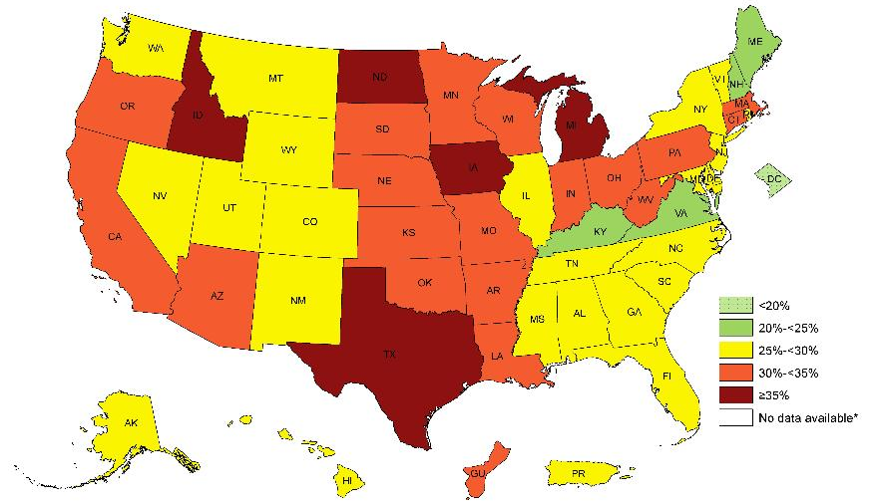
Prevalence of Self-Reported Obesity Among Hispanic Adults, by State and Territory, BRFSS, 2011-2013
*Sample size <50 or the relative standard error (dividing the standard error by the prevalence) ≥30%.

Slide 29
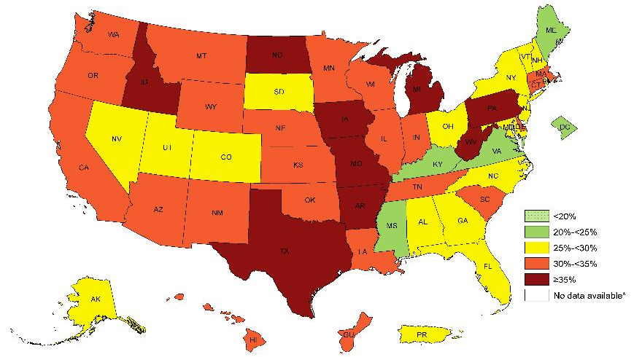
Prevalence of Self-Reported Obesity Among Hispanic Adults, by State and Territory, BRFSS, 2012-2014
*Sample size <50 or the relative standard error (dividing the standard error by the prevalence) ≥30%.

Slide 30
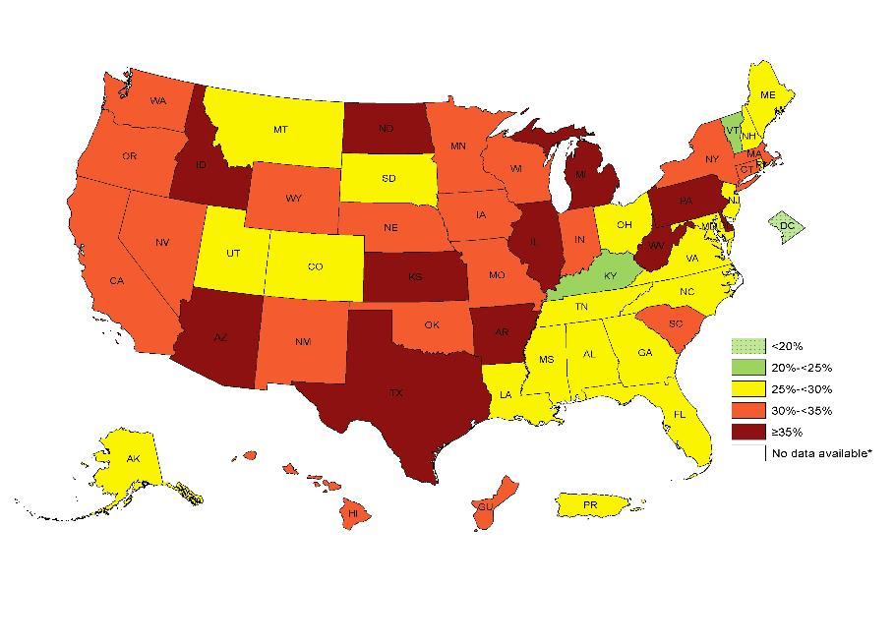
Prevalence of Self-Reported Obesity Among Hispanic Adults, by State and Territory, BRFSS, 2013-2015
*Sample size <50 or the relative standard error (dividing the standard error by the prevalence) ≥30%.

Slide 31
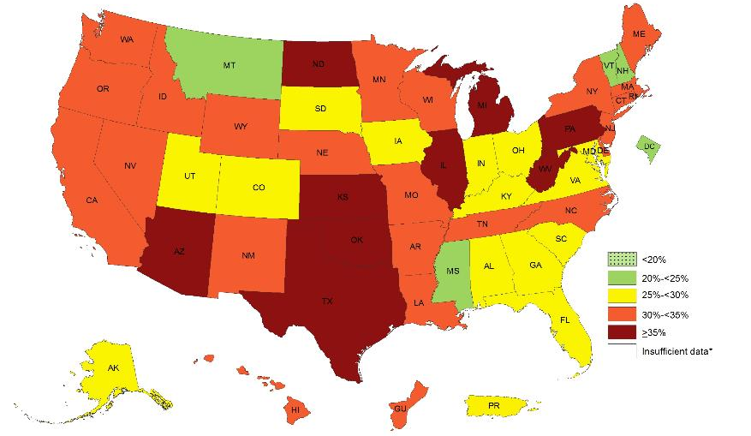
Prevalence of Self-Reported Obesity Among Hispanic Adults, by State and Territory, BRFSS, 2014-2016
*Sample size <50 or the relative standard error (dividing the standard error by the prevalence) ≥30%.

Slide 32
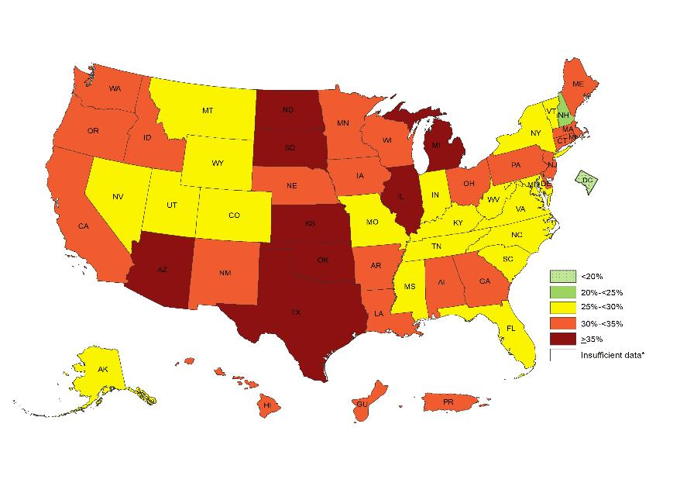
Prevalence of Self-Reported Obesity Among Hispanic Adults, by State and Territory, BRFSS, 2015-2017
*Sample size <50 or the relative standard error (dividing the standard error by the prevalence) ≥30%.

Slide 33
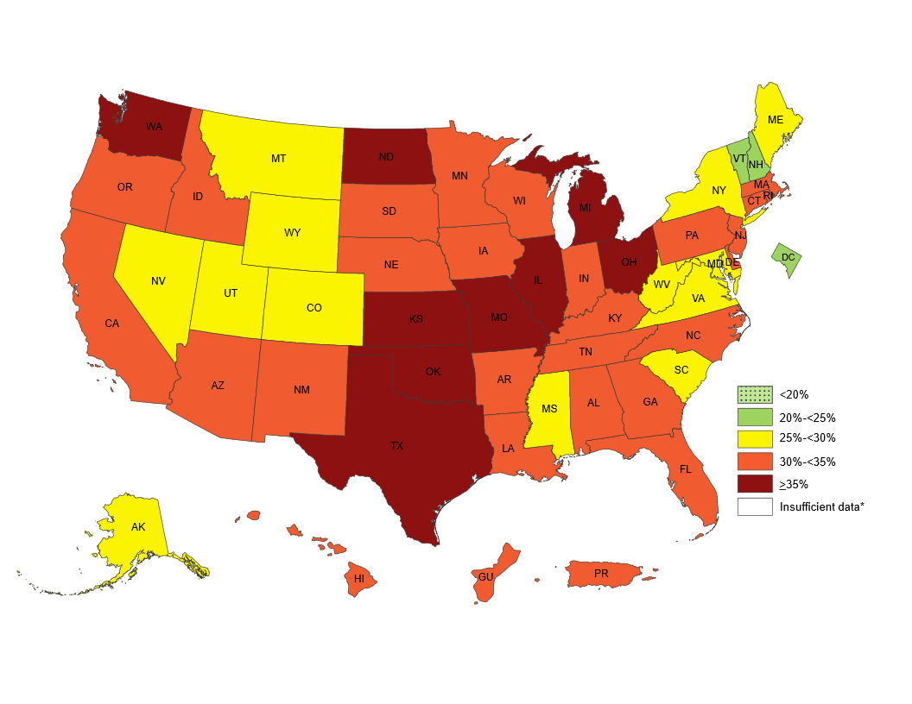
Prevalence of Self-Reported Obesity Among Hispanic Adults, by State and Territory, BRFSS, 2016-2018
*Sample size <50 or the relative standard error (dividing the standard error by the prevalence) ≥30%.

Slide 34
Prevalence of Self-Reported Obesity Among Hispanic Adults, by State and Territory, BRFSS, 2011-2013
State | Prevalence | Confidence Interval
Alabama | 27.3 | (19.6, 36.6)
Alaska | 28.4 | (22.1, 35.5)
Arizona | 33.8 | (30.5, 37.3)
Arkansas | 34.3 | (28.3, 40.9)
California | 30.7 | (29.5, 31.9)
Colorado | 28.0 | (26.2, 29.8)
Connecticut | 32.5 | (29.5, 35.7)
Delaware | 29.2 | (24.2, 34.8)
District of Columbia | 18.5 | (14.1, 24.0)
Florida | 26.4 | (24.4, 28.5)
Georgia | 28.1 | (24.3, 32.3)
Guam | 31.7 | (25.7, 38.5)
Hawaii | 29.4 | (26.0, 33.1)
Idaho | 35.3 | (30.5, 40.3)
Illinois | 29.9 | (26.3, 33.7)
Indiana | 33.2 | (29.1, 37.6)
Iowa | 37.6 | (32.5, 42.9)
Kansas | 33.5 | (30.8, 36.2)
Kentucky | 24.5 | (18.5, 31.6)
Louisiana | 32.6 | (26.0, 40.0)
Maine | 24.2 | (18.1, 31.6)
Maryland | 25.9 | (22.2, 29.9)
Massachusetts | 31.0 | (28.8, 33.3)
Michigan | 35.4 | (30.9, 40.3)
Minnesota | 30.5 | (26.1, 35.3)
Mississippi | 28.2 | (21.8, 35.6)
State | Prevalence | Confidence Interval
Missouri | 33.6 | (26.7, 41.2)
Montana | 29.6 | (23.9, 36.0)
Nebraska | 30.4 | (27.7, 33.1)
Nevada | 27.3 | (24.3, 30.6)
New Hampshire | 24.7 | (17.4, 33.6)
New Jersey | 27.5 | (25.7, 29.3)
New Mexico | 29.8 | (28.5, 31.0)
New York | 27.3 | (25.1, 29.6)
North Carolina | 27.0 | (24.0, 30.2)
North Dakota | 36.2 | (27.8, 45.5)
Ohio | 30.9 | (25.7, 36.6)
Oklahoma | 31.3 | (27.9, 34.9)
Oregon | 31.2 | (26.8, 36.0)
Pennsylvania | 34.8 | (31.0, 38.8)
Puerto Rico | 27.5 | (26.7, 28.3)
Rhode Island | 27.5 | (24.5, 30.9)
South Carolina | 29.7 | (24.7, 35.1)
South Dakota | 31.5 | (24.4, 39.6)
Tennessee | 25.6 | (17.5, 36.0)
Texas | 35.4 | (33.8, 37.0)
Utah | 26.1 | (23.9, 28.4)
Vermont | 27.1 | (19.6, 36.3)
Virginia | 24.1 | (20.3, 28.3)
Washington | 29.7 | (27.0, 32.6)
West Virginia | 32.1 | (24.3, 41.1)
Wisconsin | 32.4 | (24.9, 40.9)
Wyoming | 29.2 | (24.9, 33.9)
Source: Behavioral Risk Factor Surveillance System, CDC.

Slide 35
Prevalence of Self-Reported Obesity Among Hispanic Adults, by State and Territory, BRFSS, 2012-2014
State | Prevalence | 95% Confidence Interval
Alabama | 25.4 | (18.2, 34.3)
Alaska | 27.7 | (22.0, 34.2)
Arizona | 33.9 | (30.9, 36.9)
Arkansas | 39.5 | (33.1, 46.3)
California | 31.3 | (30.0, 32.6)
Colorado | 28.1 | (26.4, 29.8)
Connecticut | 30.9 | (28.0, 33.8)
Delaware | 31.9 | (27.1, 37.1)
District of Columbia | 20.5 | (15.5, 26.7)
Florida | 26.2 | (24.3, 28.3)
Georgia | 27.0 | (23.1, 31.2)
Guam | 34.8 | (28.8, 41.3)
Hawaii | 31.3 | (28.0, 34.8)
Idaho | 35.9 | (31.2, 40.9)
Illinois | 33.0 | (29.5, 36.7)
Indiana | 32.0 | (28.3, 35.9)
Iowa | 35.5 | (30.6, 40.8)
Kansas | 34.2 | (31.5, 37.0)
Kentucky | 23.2 | (17.2, 30.5)
Louisiana | 31.3 | (24.9, 38.6)
Maine | 24.2 | (17.6, 32.4)
Maryland | 26.0 | (22.4, 29.9)
Massachusetts | 31.4 | (29.1, 33.9)
Michigan | 35.5 | (30.7, 40.6)
Minnesota | 31.7 | (27.6, 36.0)
Mississippi | 21.1 | (14.8, 29.2)
State | Prevalence | 95% Confidence Interval
Missouri | 35.5 | (28.5, 43.1)
Montana | 30.1 | (24.4, 36.5)
Nebraska | 31.0 | (28.2, 33.8)
Nevada | 27.8 | (24.7, 31.1)
New Hampshire | 29.3 | (21.7, 38.3)
New Jersey | 28.8 | (26.9, 30.7)
New Mexico | 30.1 | (28.8, 31.5)
New York | 29.3 | (27.0, 31.6)
North Carolina | 29.7 | (26.9, 32.7)
North Dakota | 37.9 | (29.1, 47.7)
Ohio | 29.1 | (24.2, 34.4)
Oklahoma | 33.4 | (30.0, 37.0)
Oregon | 30.2 | (26.0, 34.8)
Pennsylvania | 36.7 | (32.6, 40.9)
Puerto Rico | 28.1 | (27.3, 28.9)
Rhode Island | 28.0 | (24.9, 31.3)
South Carolina | 32.2 | (27.3, 37.5)
South Dakota | 27.1 | (19.0, 37.1)
Tennessee | 31.7 | (23.4, 41.2)
Texas | 35.8 | (34.3, 37.3)
Utah | 27.5 | (25.4, 29.7)
Vermont | 25.5 | (17.9, 35.0)
Virginia | 24.5 | (21.2, 28.2)
Washington | 31.8 | (29.0, 34.9)
West Virginia | 37.1 | (28.8, 46.3)
Wisconsin | 33.9 | (27.5, 41.0)
Wyoming | 32.7 | (27.7, 38.0)
Source: Behavioral Risk Factor Surveillance System, CDC.

Slide 36
Prevalence of Self-Reported Obesity Among Hispanic Adults, by State and Territory, BRFSS, 2013-2015
State | Prevalence | 95% Confidence Interval
Alabama | 27.6 | (20.5, 36.0)
Alaska | 28.3 | (22.3, 35.1)
Arizona | 35.5 | (32.6, 38.4)
Arkansas | 36.9 | (30.1, 44.4)
California | 31.3 | (30.1, 32.6)
Colorado | 28.3 | (26.6, 30.1)
Connecticut | 30.3 | (27.6, 33.0)
Delaware | 35.3 | (30.5, 40.3)
District of Columbia | 18.5 | (13.2, 25.1)
Florida | 26.5 | (24.7, 28.4)
Georgia | 27.1 | (23.0, 31.8)
Guam | 32.9 | (27.3, 38.9)
Hawaii | 31.8 | (28.6, 35.1)
Idaho | 36.3 | (31.8, 41.0)
Illinois | 36.0 | (32.6, 39.6)
Indiana | 31.4 | (27.4, 35.7)
Iowa | 34.0 | (28.6, 39.8)
Kansas | 35.4 | (33.3, 37.5)
Kentucky | 24.3 | (17.9, 32.2)
Louisiana | 29.9 | (23.5, 37.3)
Maine | 25.3 | (18.5, 33.5)
Maryland | 25.1 | (21.2, 29.4)
Massachusetts | 32.4 | (29.9, 35.1)
Michigan | 36.9 | (32.2, 41.8)
Minnesota | 31.2 | (27.5, 35.2)
Mississippi | 25.4 | (16.7, 36.6)
State | Prevalence | 95% Confidence Interval
Missouri | 31.5 | (25.0, 38.8)
Montana | 26.8 | (21.2, 33.2)
Nebraska | 30.8 | (27.9, 33.8)
Nevada | 30.5 | (26.9, 34.3)
New Hampshire | 27.8 | (20.2, 36.8)
New Jersey | 28.8 | (26.8, 30.9)
New Mexico | 31.2 | (29.7, 32.8)
New York | 30.6 | (28.6, 32.7)
North Carolina | 28.1 | (25.2, 31.2)
North Dakota | 35.1 | (26.7, 44.6)
Ohio | 26.3 | (21.4, 31.8)
Oklahoma | 33.9 | (30.2, 37.8)
Oregon | 31.4 | (27.1, 36.1)
Pennsylvania | 39.1 | (34.1, 44.3)
Puerto Rico | 28.5 | (27.6, 29.4)
Rhode Island | 28.9 | (25.7, 32.3)
South Carolina | 32.1 | (27.3, 37.3)
South Dakota | 28.8 | (20.0, 39.5)
Tennessee | 27.6 | (19.7, 37.3)
Texas | 36.9 | (35.4, 38.5)
Utah | 27.7 | (25.7, 29.9)
Vermont | 22.4 | (15.4, 31.5)
Virginia | 27.9 | (24.3, 31.7)
Washington | 31.5 | (28.7, 34.5)
West Virginia | 40.2 | (31.4, 49.6)
Wisconsin | 33.4 | (27.6, 39.8)
Wyoming | 33.4 | (28.4, 38.8)
Source: Behavioral Risk Factor Surveillance System, CDC.

Slide 37
Prevalence of Self-Reported Obesity Among Hispanic Adults, by State and Territory, BRFSS, 2014-2016
State | Prevalence | 95% Confidence Interval
Alabama | 28.1 | (21.7, 35.6)
Alaska | 27.9 | (21.3, 35.5)
Arizona | 35.0 | (32.8, 37.2)
Arkansas | 32.4 | (25.4, 40.3)
California | 32.3 | (31.1, 33.5)
Colorado | 27.1 | (25.5, 28.8)
Connecticut | 30.3 | (28.0, 32.8)
Delaware | 32.1 | (27.6, 37.1)
District of Columbia | 20.0 | (15.0, 26.1)
Florida | 26.8 | (25.1, 28.6)
Georgia | 28.4 | (23.9, 33.4)
Guam | 32.6 | (27.0, 38.7)
Hawaii | 31.4 | (28.3, 34.6)
Idaho | 33.6 | (29.3, 38.2)
Illinois | 36.3 | (33.2, 39.6)
Indiana | 28.7 | (24.9, 32.9)
Iowa | 29.9 | (24.9, 35.5)
Kansas | 35.2 | (32.8, 37.6)
Kentucky | 25.0 | (18.4, 33.0)
Louisiana | 32.2 | (25.9, 39.2)
Maine | 30.5 | (22.5, 39.9)
Maryland | 25.4 | (21.6, 29.5)
Massachusetts | 31.4 | (28.8, 34.2)
Michigan | 38.4 | (33.8, 43.3)
Minnesota | 33.1 | (30.0, 36.3)
Mississippi | 22.3 | (14.2, 33.4)
State | Prevalence | 95% Confidence Interval
Missouri | 32.7 | (26.1, 40.2)
Montana | 24.8 | (19.1, 31.7)
Nebraska | 31.8 | (29.1, 34.7)
Nevada | 30.6 | (27.3, 34.1)
New Hampshire | 24.7 | (17.7, 33.4)
New Jersey | 31.4 | (29.1, 33.7)
New Mexico | 31.3 | (29.7, 33.0)
New York | 30.6 | (28.7, 32.5)
North Carolina | 31.2 | (28.1, 34.4)
North Dakota | 37.2 | (28.8, 46.5)
Ohio | 27.8 | (22.7, 33.5)
Oklahoma | 36.7 | (32.7, 41.0)
Oregon | 32.4 | (28.6, 36.6)
Pennsylvania | 39.5 | (34.3, 45.0)
Puerto Rico | 29.4 | (28.5, 30.4)
Rhode Island | 30.8 | (27.4, 34.4)
South Carolina | 28.2 | (23.9, 33.0)
South Dakota | 29.5 | (20.0, 41.3)
Tennessee | 33.0 | (25.1, 42.0)
Texas | 37.4 | (35.7, 39.1)
Utah | 28.1 | (26.0, 30.4)
Vermont | 24.3 | (16.7, 34.1)
Virginia | 29.6 | (26.1, 33.3)
Washington | 34.4 | (31.7, 37.1)
West Virginia | 37.7 | (28.7, 47.6)
Wisconsin | 31.2 | (25.7, 37.1)
Wyoming | 32.4 | (27.2, 38.1)
Source: Behavioral Risk Factor Surveillance System, CDC.

Slide 38
Prevalence of Self-Reported Obesity Among Hispanic Adults, by State and Territory, BRFSS, 2015-2017
State | Prevalence | 95% Confidence Interval
Alabama | 31.9 | (25.1, 39.6)
Alaska | 28.8 | (21.7, 37.1)
Arizona | 35.5 | (33.5, 37.5)
Arkansas | 30.1 | (22.6, 38.8)
California | 32.1 | (30.9, 33.3)
Colorado | 27.4 | (25.7, 29.1)
Connecticut | 31.8 | (29.5, 34.1)
Delaware | 31.9 | (27.4, 36.8)
District of Columbia | 19.7 | (15.1, 25.3)
Florida | 28.1 | (26.1, 30.2)
Georgia | 30.1 | (25.7, 34.9)
Guam | 33.0 | (27.3, 39.3)
Hawaii | 31.9 | (28.9, 35.1)
Idaho | 33.7 | (29.5, 38.1)
Illinois | 35.9 | (33.0, 38.9)
Indiana | 28.2 | (24.6, 32.1)
Iowa | 33.4 | (28.5, 38.8)
Kansas | 36.8 | (34.5, 39.2)
Kentucky | 28.5 | (21.6, 36.6)
Louisiana | 32.3 | (25.8, 39.6)
Maine | 32.2 | (23.4, 42.5)
Maryland | 27.6 | (23.8, 31.8)
Massachusetts | 31.0 | (28.2, 34.0)
Michigan | 38.6 | (34.4, 43.0)
Minnesota | 33.3 | (30.2, 36.5)
Mississippi | 29.2 | (20.1, 40.4)
Missouri | 29.9 | (23.8, 36.8)
State | Prevalence | 95% Confidence Interval
Montana | 26.0 | (20.0, 33.2)
Nebraska | 32.8 | (30.0, 35.7)
Nevada | 29.2 | (26.1, 32.4)
New Hampshire | 24.1 | (16.7, 33.4)
New Jersey | 31.9 | (29.4, 34.5)
New Mexico | 31.2 | (29.6, 33.0)
New York | 28.7 | (27.1, 30.4)
North Carolina | 28.3 | (25.0, 31.8)
North Dakota | 36.5 | (28.6, 45.1)
Ohio | 31.9 | (26.7, 37.6)
Oklahoma | 36.8 | (32.6, 41.3)
Oregon | 34.9 | (31.1, 38.9)
Pennsylvania | 34.7 | (29.9, 39.9)
Puerto Rico | 31.0 | (30.0, 32.1)
Rhode Island | 33.1 | (29.6, 36.9)
South Carolina | 27.8 | (23.6, 32.4)
South Dakota | 35.0 | (25.0, 46.5)
Tennessee | 29.6 | (22.6, 37.6)
Texas | 37.9 | (36.1, 39.8)
Utah | 27.9 | (25.6, 30.4)
Vermont | 26.4 | (18.7, 35.9)
Virginia | 29.9 | (26.3, 33.7)
Washington | 33.9 | (31.6, 36.2)
West Virginia | 29.0 | (21.0, 38.6)
Wisconsin | 31.5 | (26.0, 37.5)
Wyoming | 28.8 | (24.2, 33.9)
*Sample size <50 or the relative standard error (dividing the standard error by the prevalence) ≥ 30%.
Source: Behavioral Risk Factor Surveillance System, CDC.
.

Slide 39
Prevalence of Self-Reported Obesity Among Hispanic Adults, by State and Territory, BRFSS, 2016-2018
State | Prevalence | 95% Confidence Interval
Alabama | 31.7 | (24.6, 39.8)
Alaska | 29.8 | (22.6, 38.2)
Arizona | 34.8 | (32.7, 36.9)
Arkansas | 32.0 | (24.7, 40.4)
California | 32.8 | (31.6, 34.0)
Colorado | 28.1 | (26.5, 29.8)
Connecticut | 32.0 | (29.7, 34.4)
Delaware | 30.2 | (26.2, 34.5)
District of Columbia | 23.4 | (19.0, 28.5)
Florida | 30.7 | (28.4, 33.1)
Georgia | 30.1 | (26.6, 33.9)
Guam | 32.4 | (26.8, 38.6)
Hawaii | 33.2 | (30.3, 36.3)
Idaho | 33.3 | (29.1, 37.9)
Illinois | 35.6 | (32.9, 38.4)
Indiana | 31.7 | (28.1, 35.4)
Iowa | 34.4 | (30.5, 38.6)
Kansas | 36.3 | (33.7, 39.1)
Kentucky | 30.9 | (24.2, 38.6)
Louisiana | 31.7 | (25.6, 38.6)
Maine | 29.0 | (20.4, 39.4)
Maryland | 29.7 | (26.6, 33.1)
Massachusetts | 30.0 | (27.1, 33.1)
Michigan | 36.9 | (32.8, 41.1)
Minnesota | 34.5 | (31.6, 37.5)
Mississippi | 28.2 | (20.1, 38.0)
Missouri | 37.1 | (30.3, 44.5)
State | Prevalence | 95% Confidence Interval
Montana | 26.8 | (20.7, 33.9)
Nebraska | 34.0 | (31.4, 36.7)
Nevada | 28.9 | (26.1, 31.8)
New Hampshire | 24.2 | (17.0, 33.1)
New Jersey | 31.9 | (28.9, 35.0)
New Mexico | 32.8 | (31.2, 34.5)
New York | 29.4 | (27.9, 31.0)
North Carolina | 30.0 | (26.5, 33.7)
North Dakota | 40.2 | (32.1, 49.0)
Ohio | 39.8 | (34.3, 45.5)
Oklahoma | 36.9 | (32.8, 41.3)
Oregon | 34.5 | (31.2, 37.9)
Pennsylvania | 32.2 | (28.1, 36.7)
Puerto Rico | 32.1 | (31.1, 33.2)
Rhode Island | 34.3 | (30.8, 38.1)
South Carolina | 27.6 | (23.6, 31.9)
South Dakota | 32.9 | (23.6, 43.7)
Tennessee | 33.6 | (26.7, 41.4)
Texas | 37.9 | (35.8, 40.0)
Utah | 28.9 | (26.6, 31.3)
Vermont | 24.9 | (17.1, 34.6)
Virginia | 29.2 | (25.9, 32.8)
Washington | 35.9 | (33.5, 38.2)
West Virginia | 26.7 | (18.9, 36.2)
Wisconsin | 34.9 | (29.4, 40.9)
Wyoming | 29.7 | (25.5, 34.2)
Source: Behavioral Risk Factor Surveillance System, CDC.
.

