Slide 1
Prevalence of Self-Reported Obesity Among U.S. Adults by Race/Ethnicity, State and Territory, BRFSS, 2019–2021
Definitions
Obesity: Body Mass Index (BMI) of 30 kg/m² or higher.
Body Mass Index (BMI): A measure of an adult’s weight in relation to his or her height, calculated by using the adult’s weight in kilograms divided by the square of his or her height in meters.

Slide 2
Prevalence of Self-Reported Obesity Among U.S. Adults by Race/Ethnicity, State and Territory, BRFSS, 2019–2021
Method
The data were collected through the Behavioral Risk Factor Surveillance System (BRFSS), an ongoing, state-based, telephone interview survey conducted by state health departments with assistance from CDC.
Height and weight data used in the BMI calculations were self-reported.
Three years of data were combined to ensure sufficient sample size.

Slide 3
Prevalence of Self-Reported Obesity Among U.S. Adults by Race/Ethnicity, State and Territory, BRFSS, 2019–2021
Exclusion Criteria
Records with the following were excluded:
Height: <3 feet or ≥8 feet
Weight: <50 pounds or ≥650 pounds
BMI: <12 kg/m² or ≥100 kg/m²
Pregnant women

Slide 4
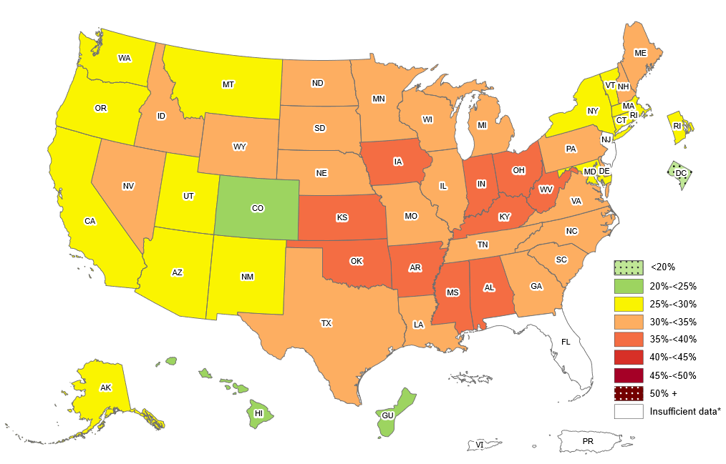
Prevalence of Self-Reported Obesity Among Non-Hispanic White Adults, by State and Territory, BRFSS, 2019–2021
*Sample size <50, the relative standard error (dividing the standard error by the prevalence) ≥30%, or no data in a specific year.

Slide 5
Prevalence of Self-Reported Obesity Among Non-Hispanic White Adults, by State and Territory, BRFSS, 2019–2021
State | Prevalence | 95% Confidence Interval
Alabama | 35.2 | (34.0, 36.4)
Alaska | 29.7 | (28.2, 31.3)
Arizona | 27.9 | (26.9, 28.8)
Arkansas | 36.7 | (35.5, 38.0)
California | 25.6 | (24.4, 26.8)
Colorado | 22.6 | (21.9, 23.3)
Connecticut | 27.5 | (26.5, 28.5)
Delaware | 33.1 | (31.6, 34.6)
District of Columbia | 11.4 | (10.2, 12.8)
Florida | Insufficient data* | Insufficient data*
Georgia | 31.0 | (29.8, 32.2)
Guam | 22.3 | (18.3, 26.9)
Hawaii | 20.2 | (18.9, 21.5)
Idaho | 30.2 | (29.2, 31.2)
Illinois | 31.9 | (30.6, 33.2)
Indiana | 35.7 | (34.8, 36.5)
Iowa | 35.9 | (35.1, 36.6)
Kansas | 35.1 | (34.4, 35.8)
Kentucky | 37.6 | (36.4, 38.7)
Louisiana | 34.6 | (33.3, 35.8)
Maine | 31.7 | (30.8, 32.5)
Maryland | 29.7 | (28.9, 30.5)
Massachusetts | 25.4 | (24.5, 26.4)
Michigan | 34.5 | (33.6, 35.3)
Minnesota | 31.1 | (30.5, 31.7)
Mississippi | 35.7 | (34.4, 37.0)
Missouri | 34.8 | (33.9, 35.7)
State | Prevalence | 95% Confidence Interval
Montana | 28.6 | (27.7, 29.5)
Nebraska | 34.5 | (33.8, 35.2)
Nevada | 30.0 | (28.3, 31.8)
New Hampshire | 31.0 | (30.0, 32.1)
New Jersey | Insufficient data* | Insufficient data*
New Mexico | 25.5 | (24.2, 26.8)
New York | 26.9 | (26.2, 27.6)
North Carolina | 31.0 | (29.8, 32.2)
North Dakota | 33.9 | (32.8, 35.0)
Ohio | 35.4 | (34.7, 36.2)
Oklahoma | 36.3 | (35.2, 37.5)
Oregon | 28.6 | (27.7, 29.6)
Pennsylvania | 32.2 | (31.2, 33.3)
Puerto Rico | Insufficient data* | Insufficient data*
Rhode Island | 29.1 | (28.0, 30.3)
South Carolina | 32.7 | (31.6, 33.8)
South Dakota | 33.5 | (32.0, 35.2)
Tennessee | 34.0 | (32.8, 35.1)
Texas | 31.6 | (30.4, 32.9)
Utah | 29.0 | (28.4, 29.7)
Vermont | 27.5 | (26.5, 28.5)
Virgin Islands | Insufficient data* | Insufficient data*
Virginia | 31.6 | (30.7, 32.5)
Washington | 29.3 | (28.6, 30.0)
West Virginia | 39.7 | (38.7, 40.7)
Wisconsin | 32.5 | (31.4, 33.6)
Wyoming | 30.5 | (29.3, 31.7)
*Sample size <50, the relative standard error (dividing the standard error by the prevalence) ≥30%, or no data in a specific year.
Source: Behavioral Risk Factor Surveillance System, CDC.

Slide 6
Prevalence of Self-Reported Obesity Among Non-Hispanic White Adults, by State and Territory, BRFSS, 2019–2021
Summary
The District of Columbia had a prevalence of obesity less than 20%.
2 states (Colorado, Hawaii) and Guam had a prevalence of obesity between 20% and <25%.
14 states had a prevalence of obesity between 25% and <30%.
22 states had a prevalence of obesity between 30% and <35%.
10 states (Alabama, Arkansas, Iowa, Indiana, Kansas, Kentucky, Mississippi, Ohio, Oklahoma and West Virginia) had a prevalence of obesity of between 35% and <40%.
No state had a prevalence of obesity 40% or greater.
http://www.cdc.gov/obesity/data/adult.html

Slide 7
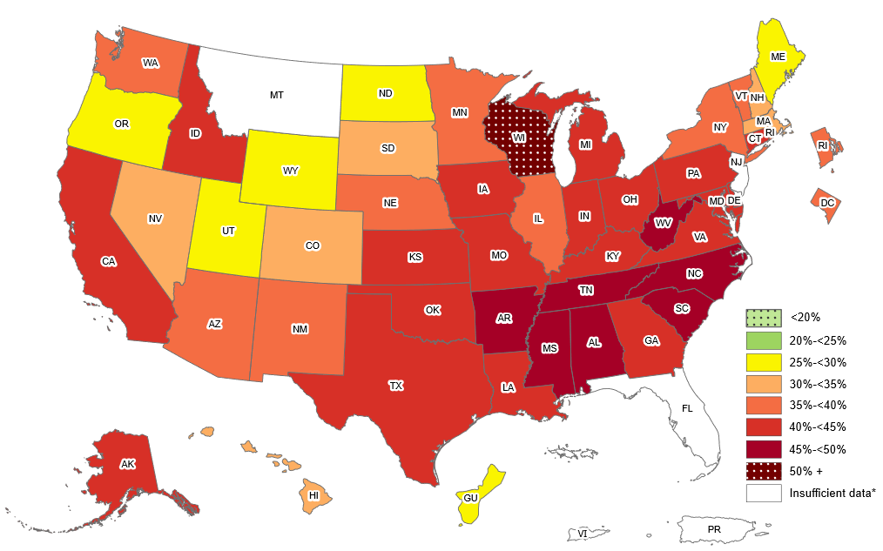
Prevalence of Self-Reported Obesity Among Non-Hispanic Black Adults, by State and Territory, BRFSS, 2019–2021
*Sample size <50, the relative standard error (dividing the standard error by the prevalence) ≥30%, or no data in a specific year.

Slide 8
Prevalence of Self-Reported Obesity Among Non-Hispanic Black Adults, by State and Territory, BRFSS, 2019–2021
State | Prevalence | 95% Confidence Interval
Alabama | 48.1 | (46.0, 50.3)
Alaska | 43.7 | (33.2, 54.7)
Arizona | 38.9 | (34.4, 43.7)
Arkansas | 47.0 | (43.1, 50.8)
California | 40.6 | (36.3, 45.1)
Colorado | 30.9 | (27.1, 35.0)
Connecticut | 42.9 | (39.6, 46.4)
Delaware | 42.6 | (39.3, 46.1)
District of Columbia | 38.7 | (36.6, 41.0)
Florida | Insufficient data* | Insufficient data*
Georgia | 41.2 | (39.0, 43.4)
Guam | 28.1 | (17.0, 42.7)
Hawaii | 30.2 | (23.0, 38.6)
Idaho | 44.5 | (30.0, 60.1)
Illinois | 39.5 | (36.2, 43.0)
Indiana | 42.1 | (39.3, 45.0)
Iowa | 44.0 | (39.0, 49.2)
Kansas | 42.4 | (39.1, 45.8)
Kentucky | 44.7 | (40.0, 49.6)
Louisiana | 44.9 | (42.5, 47.3)
Maine | 29.2 | (19.7, 40.9)
Maryland | 41.7 | (40.3, 43.1)
Massachusetts | 33.9 | (30.1, 37.9)
Michigan | 42.5 | (39.9, 45.1)
Minnesota | 35.1 | (32.4, 37.9)
Mississippi | 47.1 | (45.3, 49.0)
Missouri | 41.8 | (39.0, 44.8)
State | Prevalence | 95% Confidence Interval
Montana | Insufficient data* | Insufficient data*
Nebraska | 39.9 | (35.7, 44.3)
Nevada | 33.8 | (28.6, 39.4)
New Hampshire | 30.1 | (19.4, 43.5)
New Jersey | Insufficient data* | Insufficient data*
New Mexico | 39.5 | (31.0, 48.6)
New York | 36.1 | (34.2, 38.0)
North Carolina | 48.8 | (46.4, 51.2)
North Dakota | 25.2 | (17.9, 34.3)
Ohio | 42.7 | (40.1, 45.4)
Oklahoma | 43.9 | (39.7, 48.1)
Oregon | 29.8 | (23.0, 37.7)
Pennsylvania | 42.8 | (39.8, 45.8)
Puerto Rico | Insufficient data* | Insufficient data*
Rhode Island | 37.8 | (33.0, 42.9)
South Carolina | 45.2 | (42.9, 47.6)
South Dakota | 34.0 | (20.0, 51.4)
Tennessee | 45.8 | (42.4, 49.3)
Texas | 40.5 | (37.2, 43.8)
Utah | 28.9 | (22.2, 36.8)
Vermont | 38.4 | (26.3, 52.2)
Virgin Islands | Insufficient data* | Insufficient data*
Virginia | 44.8 | (42.7, 46.9)
Washington | 35.4 | (31.5, 39.5)
West Virginia | 45.4 | (38.8, 52.2)
Wisconsin | 51.8 | (45.4, 58.1)
Wyoming | 29.3 | (16.0, 47.5)
*Sample size <50, the relative standard error (dividing the standard error by the prevalence) ≥30%, or no data in a specific year.
Source: Behavioral Risk Factor Surveillance System, CDC.

Slide 9
Prevalence of Self-Reported Obesity Among Non-Hispanic Black Adults, by State and Territory, BRFSS, 2019–2021
Summary
No state or territory had a prevalence of obesity less than 25%.
5 states and Guam had a prevalence of obesity between 25% and <30%.
6 states had a prevalence of obesity between 30% and <35%.
9 states and the District of Columbia had a prevalence of obesity between 35% and <40%.
19 states had a prevalence of obesity between 40% and <45%.
7 states had a prevalence of obesity between 45% and <50%.
1 state (Wisconsin) had a prevalence of obesity 50% or greater.
http://www.cdc.gov/obesity/data/adult.html

Slide 10
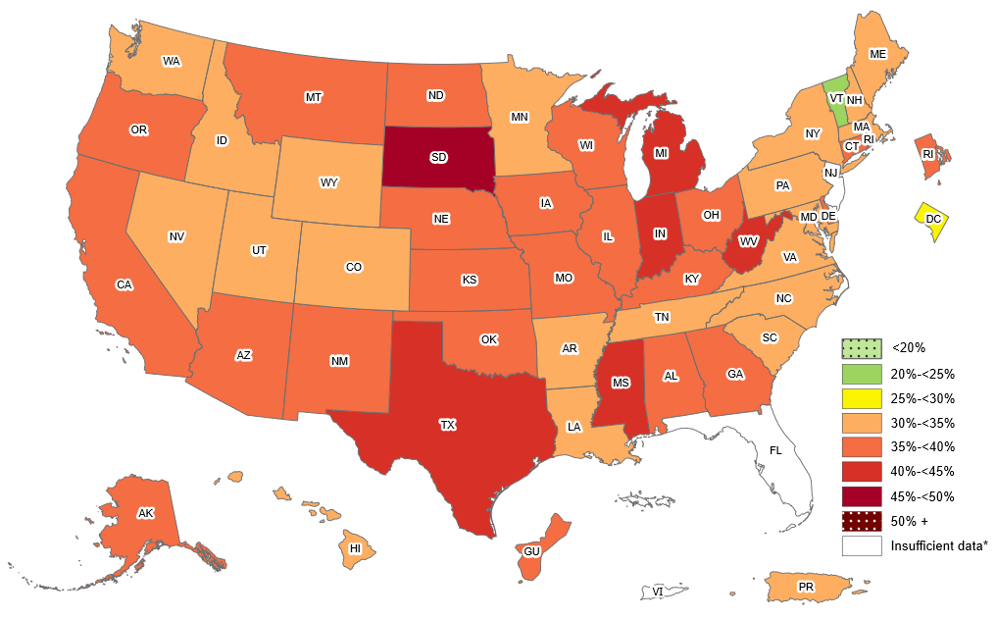
Prevalence of Self-Reported Obesity Among Hispanic Adults, by State and Territory, BRFSS, 2019–2021
*Sample size <50, the relative standard error (dividing the standard error by the prevalence) ≥30%,
or no data in a specific year.

Slide 11
Prevalence of Self-Reported Obesity Among Hispanic Adults, by State and Territory, BRFSS, 2019–2021
State | Prevalence | 95% Confidence Interval
Alabama | 37.9 | (30.1, 46.4)
Alaska | 37.7 | (30.7, 45.2)
Arizona | 36.5 | (34.5, 38.5)
Arkansas | 33.7 | (28.0, 39.9)
California | 37.0 | (35.4, 38.7)
Colorado | 31.4 | (29.8, 33.1)
Connecticut | 35.5 | (33.0, 38.0)
Delaware | 36.3 | (31.7, 41.2)
District of Columbia | 26.3 | (21.8, 31.4)
Florida | Insufficient data* | Insufficient data*
Georgia | 36.1 | (31.9, 40.4)
Guam | 36.3 | (29.4, 43.9)
Hawaii | 32.0 | (29.1, 35.1)
Idaho | 34.5 | (30.8, 38.5)
Illinois | 38.3 | (34.3, 42.5)
Indiana | 41.0 | (37.5, 44.7)
Iowa | 36.0 | (32.9, 39.3)
Kansas | 39.0 | (36.3, 41.9)
Kentucky | 35.6 | (27.8, 44.2)
Louisiana | 33.9 | (28.0, 40.4)
Maine | 31.4 | (25.0, 38.6)
Maryland | 32.8 | (30.3, 35.5)
Massachusetts | 32.5 | (29.6, 35.5)
Michigan | 43.2 | (38.4, 48.2)
Minnesota | 34.2 | (31.6, 37.0)
Mississippi | 40.0 | (28.9, 52.2)
Missouri | 37.2 | (32.1, 42.7)
State | Prevalence | 95% Confidence Interval
Montana | 35.1 | (29.3, 41.3)
Nebraska | 36.6 | (34.1, 39.2)
Nevada | 34.0 | (30.8, 37.3)
New Hampshire | 32.8 | (26.0, 40.5)
New Jersey | Insufficient data* | Insufficient data*
New Mexico | 35.9 | (34.2, 37.5)
New York | 31.0 | (29.4, 32.7)
North Carolina | 31.7 | (28.5, 35.1)
North Dakota | 36.8 | (29.7, 44.5)
Ohio | 37.1 | (32.7, 41.8)
Oklahoma | 38.6 | (34.8, 42.6)
Oregon | 36.1 | (32.9, 39.3)
Pennsylvania | 32.7 | (28.6, 37.1)
Puerto Rico | 33.4 | (32.3, 34.5)
Rhode Island | 35.7 | (32.5, 39.1)
South Carolina | 31.1 | (25.5, 37.3)
South Dakota | 45.2 | (35.2, 55.6)
Tennessee | 34.9 | (28.4, 42.0)
Texas | 41.0 | (39.0, 43.1)
Utah | 34.6 | (32.4, 36.9)
Vermont | 22.9 | (15.7, 32.0)
Virgin Islands | Insufficient data* | Insufficient data*
Virginia | 31.9 | (28.7, 35.4)
Washington | 34.4 | (32.2, 36.8)
West Virginia | 42.9 | (34.1, 52.2)
Wisconsin | 35.8 | (30.3, 41.7)
Wyoming | 34.0 | (29.2, 39.3)
*Sample size <50, the relative standard error (dividing the standard error by the prevalence) ≥30%, or no data in a specific year.
Source: Behavioral Risk Factor Surveillance System, CDC.

Slide 12
Prevalence of Self-Reported Obesity Among Hispanic Adults, by State and Territory, BRFSS, 2019–2021
Summary
No state or territory had a prevalence of obesity less than 20%.
1 state (Vermont) had a prevalence of obesity between 20% and <25%.
The District of Columbia had a prevalence of obesity between 25% and <30%.
20 states and Puerto Rico, had a prevalence of obesity between 30% and <35%.
21 states and Guam had a prevalence of obesity between 35% and <40%.
5 states had a prevalence of obesity between 40% and <45%.
1 state (South Dakota) had a prevalence of obesity 45% or greater.
http://www.cdc.gov/obesity/data/adult.html

Slide 13
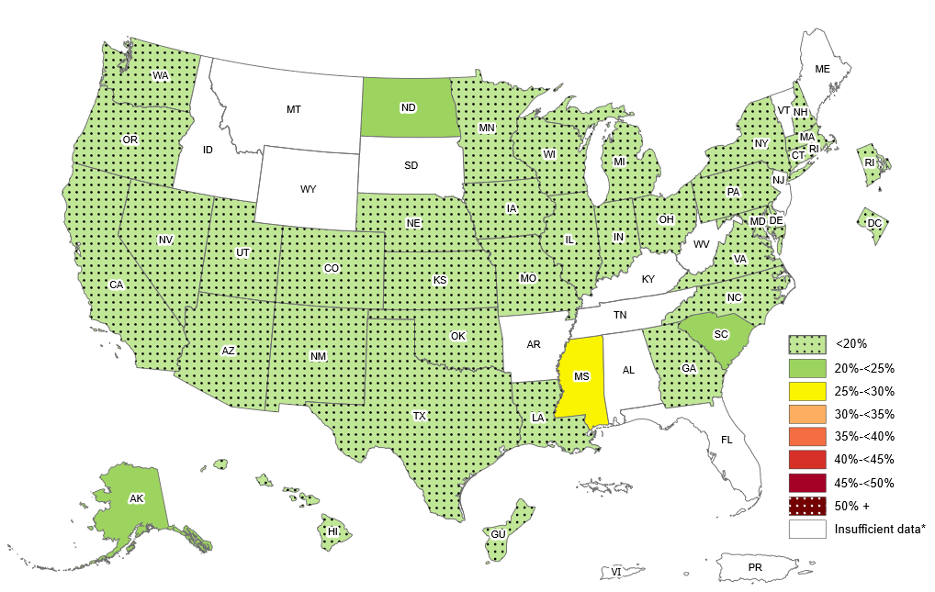
Prevalence of Self-Reported Obesity Among Non-Hispanic Asian Adults, by State and Territory, BRFSS, 2019–2021
*Sample size <50, the relative standard error (dividing the standard error by the prevalence) ≥30%,
or no data in a specific year.

Slide 14
Prevalence of Self-Reported Obesity Among Non-Hispanic Asian Adults, by State and Territory, BRFSS, 2019–2021
State | Prevalence | 95% Confidence Interval
Alabama | Insufficient data* | Insufficient data*
Alaska | 22.9 | (15.7, 32.1)
Arizona | 14.4 | (10.1, 20.2)
Arkansas | Insufficient data* | Insufficient data*
California | 10.0 | (8.2, 12.1)
Colorado | 6.9 | (4.7, 9.8)
Connecticut | 12.5 | (9.4, 16.6)
Delaware | 15.1 | (9.4, 23.5)
District of Columbia | 6.9 | (3.9, 11.9)
Florida | Insufficient data* | Insufficient data*
Georgia | 12.6 | (7.2, 21.1)
Guam | 17.0 | (14.4, 19.9)
Hawaii | 16.1 | (15.0, 17.3)
Idaho | Insufficient data* | Insufficient data*
Illinois | 12.3 | (9.3, 16.1)
Indiana | 6.9 | (4.2, 10.9)
Iowa | 10.6 | (7.1, 15.5)
Kansas | 9.9 | (7.3, 13.4)
Kentucky | Insufficient data* | Insufficient data*
Louisiana | 18.6 | (11.2, 29.3)
Maine | Insufficient data* | Insufficient data*
Maryland | 12.9 | (10.5, 15.7)
Massachusetts | 11.2 | (8.6, 14.4)
Michigan | 9.2 | (6.5, 12.8)
Minnesota | 19.5 | (16.7, 22.6)
Mississippi | 26.9 | (14.9, 43.5)
Missouri | 12.0 | (7.6, 18.5)
State | Prevalence | 95% Confidence Interval
Montana | Insufficient data* | Insufficient data*
Nebraska | 11.9 | (8.0, 17.4)
Nevada | 13.9 | (8.9, 21.2)
New Hampshire | 11.6 | (7.2, 18.2)
New Jersey | Insufficient data* | Insufficient data*
New Mexico | 16.5 | (9.2, 27.7)
New York | 11.6 | (9.8, 13.8)
North Carolina | 18.8 | (13.3, 26.0)
North Dakota | 23.4 | (14.6, 35.3)
Ohio | 12.0 | (8.5, 16.7)
Oklahoma | 18.1 | (11.4, 27.5)
Oregon | 16.6 | (11.9, 22.8)
Pennsylvania | 8.4 | (5.5, 12.5)
Puerto Rico | Insufficient data* | Insufficient data*
Rhode Island | 9.5 | (5.7, 15.4)
South Carolina | 20.6 | (12.3, 32.5)
South Dakota | Insufficient data* | Insufficient data*
Tennessee | Insufficient data* | Insufficient data*
Texas | 13.2 | (9.7, 17.6)
Utah | 10.3 | (7.0, 14.9)
Vermont | Insufficient data* | Insufficient data*
Virgin Islands | Insufficient data* | Insufficient data*
Virginia | 12.4 | (9.6, 15.9)
Washington | 9.9 | (8.2, 11.8)
West Virginia | Insufficient data* | Insufficient data*
Wisconsin | 15.9 | (9.8, 24.8)
Wyoming | Insufficient data* | Insufficient data*
*Sample size <50, the relative standard error (dividing the standard error by the prevalence) ≥30%, or no data in a specific year.
Source: Behavioral Risk Factor Surveillance System, CDC.

Slide 15
Prevalence of Self-Reported Obesity Among Non-Hispanic Asian Adults, by State and Territory, BRFSS, 2019–2021
Summary
33 states, the District of Columbia and Guam had a prevalence of obesity less than 20%.
3 states (Alaska, North Dakota and South Carolina) had a prevalence of obesity between 20% and <25%.
1 state (Mississippi) had a prevalence of obesity between 25% and <30%.
No state had a prevalence of obesity 30% or greater.
http://www.cdc.gov/obesity/data/adult.html

Slide 16
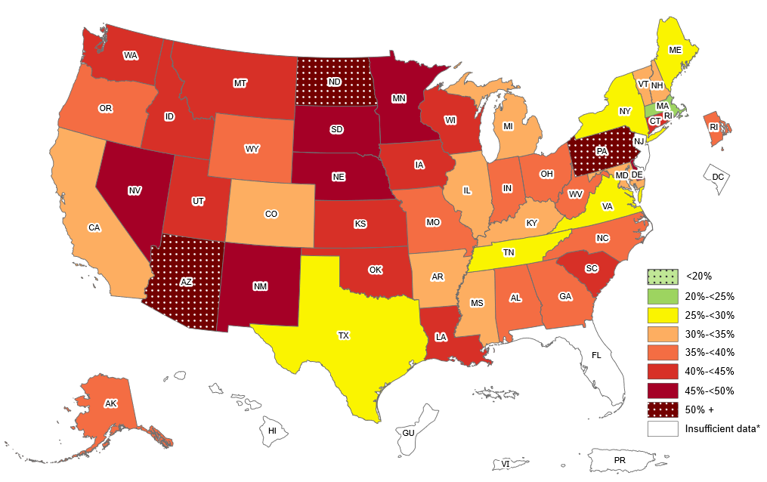
Prevalence of Self-Reported Obesity Among Non-Hispanic American Indian or Alaska Native Adults, by State and Territory, BRFSS, 2019–2021
*Sample size <50, the relative standard error (dividing the standard error by the prevalence) ≥30%,
or no data in a specific year.

Slide 17
Prevalence of Self-Reported Obesity Among Non-Hispanic American Indian or Alaska Native Adults, by State and Territory, BRFSS, 2019–2021
State | Prevalence | 95% Confidence Interval
Alabama | 39.6 | (30.5, 49.6)
Alaska | 37.5 | (33.6, 41.5)
Arizona | 50.5 | (46.2, 54.8)
Arkansas | 30.3 | (22.1, 40.0)
California | 31.1 | (21.0, 43.4)
Colorado | 31.3 | (24.8, 38.6)
Connecticut | 40.6 | (28.8, 53.6)
Delaware | 49.3 | (33.6, 65.1)
District of Columbia | Insufficient data* | Insufficient data*
Florida | Insufficient data* | Insufficient data*
Georgia | 35.2 | (24.2, 48.0)
Guam | Insufficient data* | Insufficient data*
Hawaii | Insufficient data* | Insufficient data*
Idaho | 41.1 | (32.4, 50.5)
Illinois | 30.6 | (18.9, 45.5)
Indiana | 38.4 | (29.7, 47.8)
Iowa | 40.0 | (29.6, 51.5)
Kansas | 43.1 | (36.7, 49.7)
Kentucky | 30.0 | (20.0, 42.3)
Louisiana | 41.2 | (32.0, 51.2)
Maine | 29.8 | (21.9, 39.1)
Maryland | 31.9 | (24.2, 40.9)
Massachusetts | 22.0 | (12.7, 35.4)
Michigan | 33.6 | (25.4, 43.0)
Minnesota | 47.2 | (41.6, 52.8)
Mississippi | 31.1 | (21.4, 42.7)
Missouri | 36.0 | (27.6, 45.4)
State | Prevalence | 95% Confidence Interval
Montana | 42.5 | (38.4, 46.7)
Nebraska | 45.8 | (38.8, 53.0)
Nevada | 49.4 | (34.9, 64.0)
New Hampshire | 33.3 | (22.0, 47.0)
New Jersey | Insufficient data* | Insufficient data*
New Mexico | 46.7 | (43.1, 50.4)
New York | 25.9 | (18.1, 35.6)
North Carolina | 37.5 | (31.1, 44.3)
North Dakota | 54.0 | (48.4, 59.6)
Ohio | 36.9 | (26.2, 49.0)
Oklahoma | 43.9 | (40.4, 47.5)
Oregon | 36.6 | (28.3, 45.7)
Pennsylvania | 53.6 | (38.6, 68.0)
Puerto Rico | Insufficient data* | Insufficient data*
Rhode Island | 38.5 | (27.2, 51.1)
South Carolina | 43.0 | (32.6, 54.0)
South Dakota | 46.4 | (39.7, 53.2)
Tennessee | 29.7 | (21.8, 39.1)
Texas | 26.3 | (17.7, 37.4)
Utah | 41.5 | (34.4, 49.0)
Vermont | 32.9 | (23.9, 43.3)
Virgin Islands | Insufficient data* | Insufficient data*
Virginia | 28.1 | (19.6, 38.4)
Washington | 42.5 | (36.3, 48.9)
West Virginia | 38.7 | (26.1, 53.1)
Wisconsin | 43.8 | (33.8, 54.4)
Wyoming | 35.5 | (25.8, 46.6)
*Sample size <50, the relative standard error (dividing the standard error by the prevalence) ≥30%, or no data in a specific year.
Source: Behavioral Risk Factor Surveillance System, CDC.

Slide 18
Prevalence of Self-Reported Obesity Among Non-Hispanic American Indian or Alaska Native Adults, by State and Territory, BRFSS, 2019–2021
Summary
No state or territory had a prevalence of obesity less than 20%.
1 state (Massachusetts) had a prevalence of obesity between 20% and <25%.
5 states had a prevalence of obesity between 25% and <30%.
10 states had a prevalence of obesity between 30% and <35%.
11 states had a prevalence of obesity between 35% and <40%.
11 states had a prevalence of obesity between 40% and <45%.
6 states had a prevalence of obesity between 45% and <50%.
3 states (Arizona, North Dakota and Pennsylvania) had a prevalence of obesity 50% or greater.
http://www.cdc.gov/obesity/data/adult.html

