Slide 1
Prevalence of Self-Reported Obesity Among U.S. Adults by Race/Ethnicity, State and Territory, BRFSS
Definitions
Obesity: Body Mass Index (BMI) of 30 or higher.
Body Mass Index (BMI): A measure of an adult’s weight in relation to his or her height, calculated by using the adult’s weight in kilograms divided by the square of his or her height in meters.

Slide 2
Prevalence of Self-Reported Obesity Among U.S. Adults by Race/Ethnicity, State and Territory, BRFSS,
Method
The data were collected through the Behavioral Risk Factor Surveillance System (BRFSS), an ongoing, state-based, telephone interview survey conducted by state health departments with assistance from CDC.
Height and weight data used in the BMI calculations were self-reported.
Three years of data were combined to ensure sufficient sample size.

Slide 3
Prevalence of Self-Reported Obesity Among U.S. Adults by Race/Ethnicity, State and Territory, BRFSS
Exclusion Criteria
Records with the following were excluded:
Height: <3 feet or ≥8 feet
Weight: <50 pounds or ≥650 pounds
BMI: <12 kg/m² or ≥100 kg/m²
Pregnant women

Slide 4
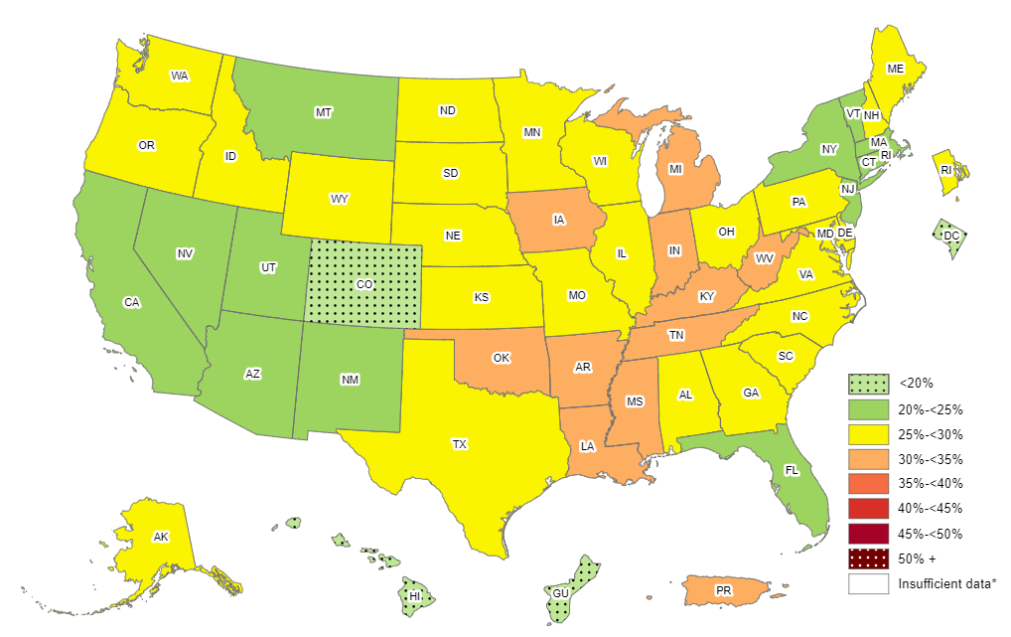
Prevalence of Self-Reported Obesity Among Non-Hispanic White Adults, by State and Territory, BRFSS, 2011-2013
*Sample size <50 or the relative standard error (dividing the standard error by the prevalence) ≥30%.

Slide 5
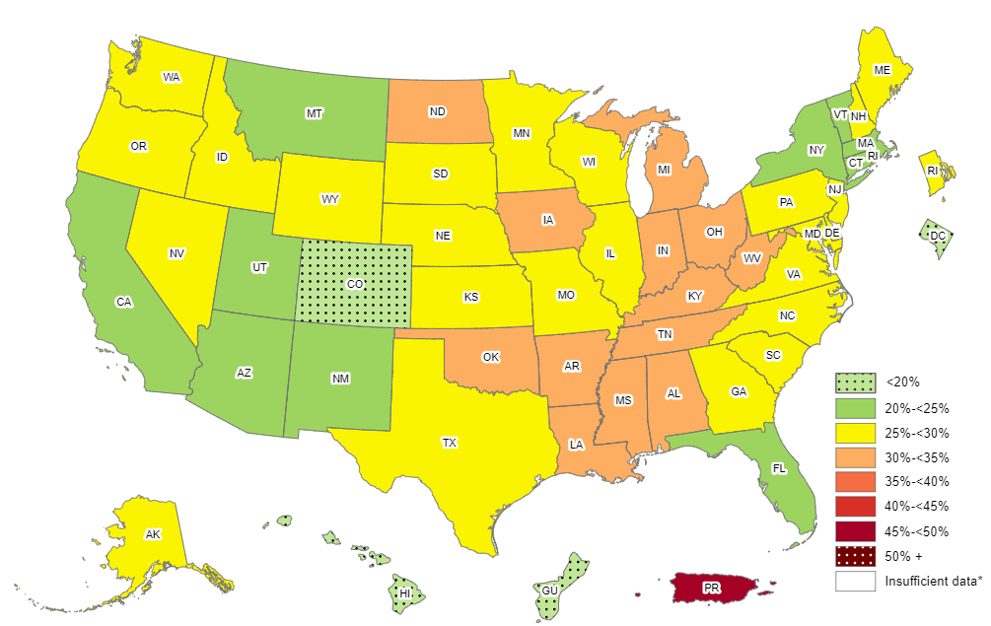
Prevalence of Self-Reported Obesity Among Non-Hispanic White Adults, by State and Territory, BRFSS, 2012-2014
*Sample size <50 or the relative standard error (dividing the standard error by the prevalence) ≥30%.

Slide 6
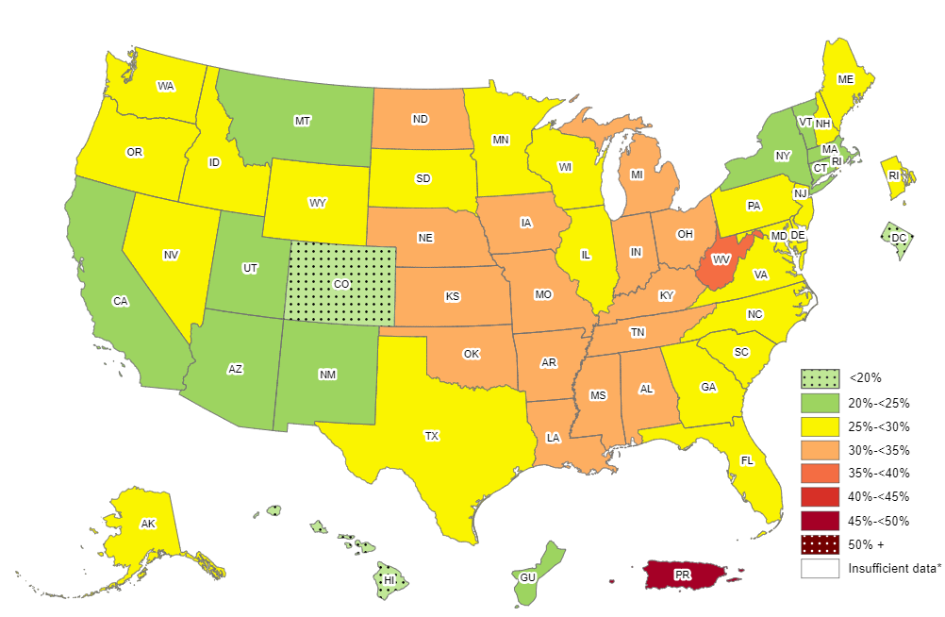
Prevalence of Self-Reported Obesity Among Non-Hispanic White Adults, by State and Territory, BRFSS, 2013-2015
*Sample size <50 or the relative standard error (dividing the standard error by the prevalence) ≥30%.

Slide 7
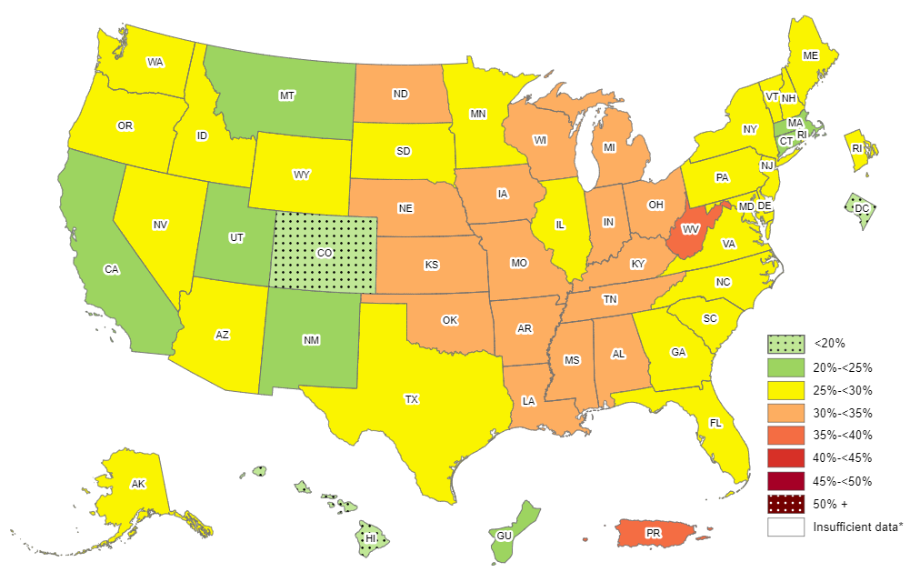
Prevalence of Self-Reported Obesity Among Non-Hispanic White Adults, by State and Territory, BRFSS, 2014-2016
*Sample size <50 or the relative standard error (dividing the standard error by the prevalence) ≥30%.

Slide 8
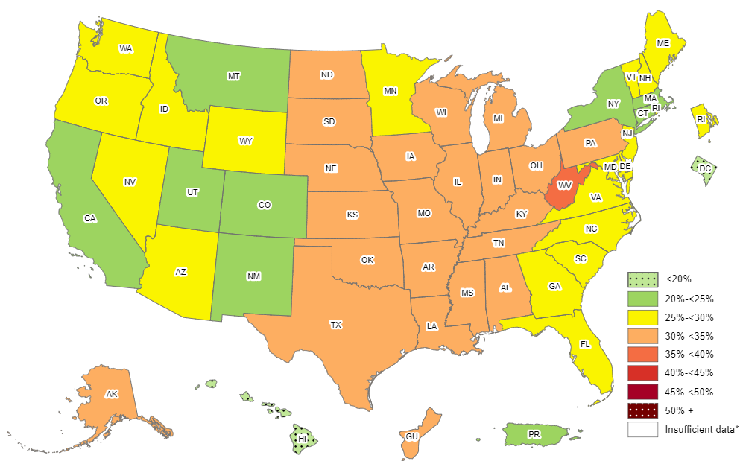
Prevalence of Self-Reported Obesity Among Non-Hispanic White Adults, by State and Territory, BRFSS, 2015-2017
*Sample size <50 or the relative standard error (dividing the standard error by the prevalence) ≥30%.

Slide 9
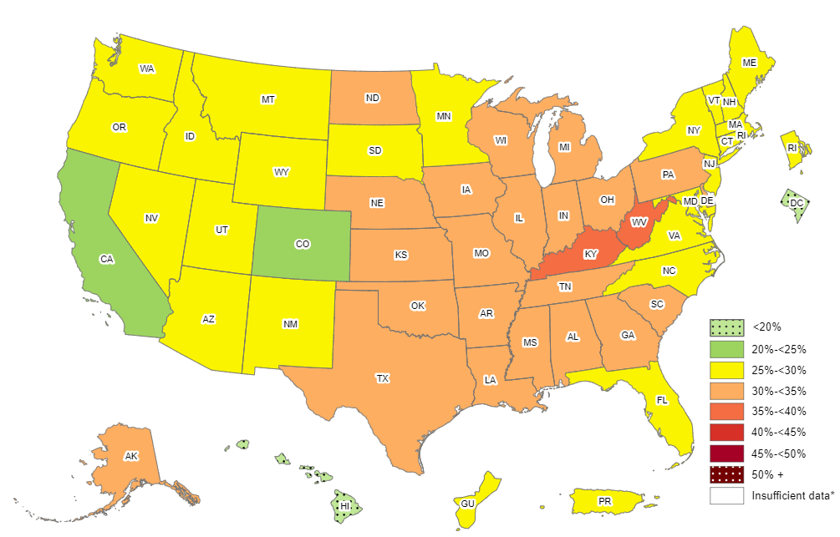
Prevalence of Self-Reported Obesity Among Non-Hispanic White Adults, by State and Territory, BRFSS, 2016-2018
*Sample size <50 or the relative standard error (dividing the standard error by the prevalence) ≥30%.

Slide 10
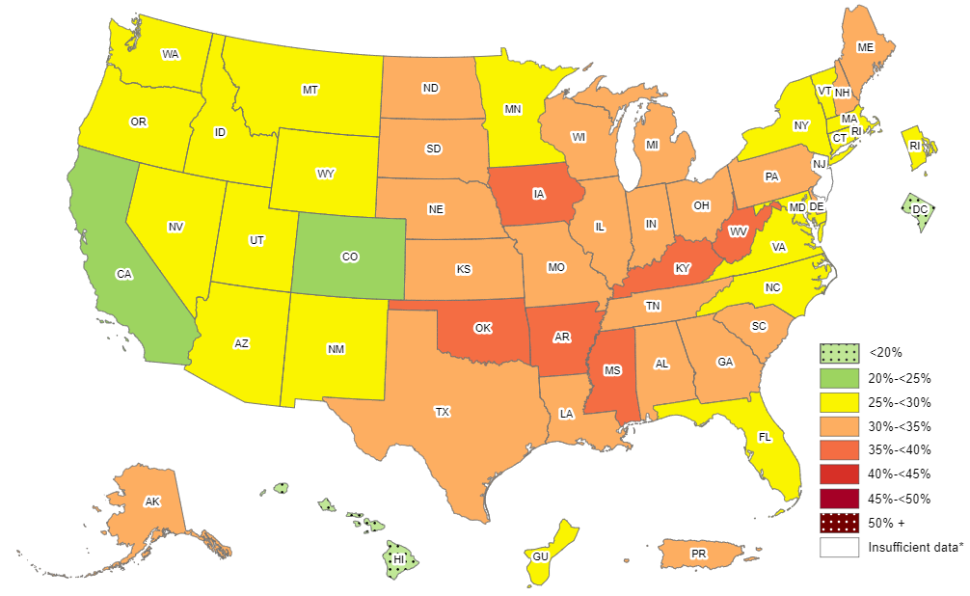
Prevalence of Self-Reported Obesity Among Non-Hispanic White Adults, by State and Territory, BRFSS, 2017-2019
*Sample size <50, the relative standard error (dividing the standard error by the prevalence) ≥30%, or no data in a specific year.

Slide 11
Prevalence of Self-Reported Obesity Among Non-Hispanic White Adults, by State and Territory, BRFSS, 2011-2013
State | Prevalence | 95% Confidence Interval
Alabama | 29.8 | (28.8, 30.9)
Alaska | 26.1 | (24.9, 27.4)
Arizona | 22.0 | (20.8, 23.3)
Arkansas | 32.0 | (30.7, 33.2)
California | 22.4 | (21.7, 23.1)
Colorado | 18.8 | (18.2, 19.4)
Connecticut | 23.5 | (22.6, 24.4)
Delaware | 27.4 | (26.3, 28.5)
District of Columbia | 10.0 | (8.8, 11.3)
Florida | 24.5 | (23.7, 25.3)
Georgia | 26.2 | (25.2, 27.2)
Guam | 18.8 | (15.1, 23.2)
Hawaii | 19.3 | (17.8, 20.8)
Idaho | 26.8 | (25.7, 27.9)
Illinois | 27.0 | (26.0, 28.1)
Indiana | 30.1 | (29.3, 30.9)
Iowa | 30.1 | (29.3, 30.9)
Kansas | 29.2 | (28.6, 29.7)
Kentucky | 31.0 | (30.2, 31.8)
Louisiana | 30.4 | (29.3, 31.6)
Maine | 28.5 | (27.8, 29.2)
Maryland | 25.3 | (24.5, 26.2)
Massachusetts | 22.4 | (21.8, 23.1)
Michigan | 30.1 | (29.3, 30.8)
Minnesota | 25.5 | (24.8, 26.2)
Mississippi | 30.7 | (29.6, 31.8)
State | Prevalence | 95% Confidence Interval
Missouri | 28.8 | (27.8, 29.9)
Montana | 23.4 | (22.7, 24.2)
Nebraska | 28.6 | (28.0, 29.2)
Nevada | 24.7 | (23.4, 26.0)
New Hampshire | 27.1 | (26.3, 28.0)
New Jersey | 24.4 | (23.7, 25.2)
New Mexico | 22.2 | (21.2, 23.1)
New York | 23.6 | (22.7, 24.5)
North Carolina | 26.6 | (25.8, 27.5)
North Dakota | 29.1 | (28.2, 30.0)
Ohio | 29.4 | (28.7, 30.2)
Oklahoma | 31.0 | (30.1, 31.9)
Oregon | 26.2 | (25.3, 27.1)
Pennsylvania | 28.7 | (28.0, 29.4)
Puerto Rico | 32.6 | (24.2, 42.2)
Rhode Island | 25.9 | (24.9, 26.9)
South Carolina | 27.5 | (26.6, 28.3)
South Dakota | 28.1 | (27.0, 29.2)
Tennessee | 30.2 | (28.9, 31.4)
Texas | 26.5 | (25.5, 27.4)
Utah | 24.1 | (23.5, 24.7)
Vermont | 24.5 | (23.7, 25.4)
Virginia | 26.3 | (25.4, 27.3)
Washington | 27.5 | (26.8, 28.2)
West Virginia | 33.8 | (32.9, 34.7)
Wisconsin | 28.6 | (27.5, 29.7)
Wyoming | 25.5 | (24.5, 26.5)
Source: Behavioral Risk Factor Surveillance System, CDC.

Slide 12
Prevalence of Self-Reported Obesity Among Non-Hispanic White Adults, by State and Territory, BRFSS, 2012-2014
State | Prevalence | 95% Confidence Interval
Alabama | 30.4 | (29.4, 31.4)
Alaska | 27.0 | (25.8, 28.2)
Arizona | 23.7 | (22.6, 24.8)
Arkansas | 32.9 | (31.7, 34.2)
California | 22.6 | (21.8, 23.4)
Colorado | 19.1 | (18.6, 19.7)
Connecticut | 24.2 | (23.3, 25.1)
Delaware | 28.2 | (27.0, 29.4)
District of Columbia | 9.9 | (8.7, 11.3)
Florida | 24.3 | (23.5, 25.2)
Georgia | 27.5 | (26.5, 28.6)
Guam | 18.2 | (14.6, 22.6)
Hawaii | 18.8 | (17.3, 20.3)
Idaho | 27.4 | (26.3, 28.5)
Illinois | 27.5 | (26.5, 28.6)
Indiana | 31.1 | (30.3, 31.9)
Iowa | 30.9 | (30.1, 31.7)
Kansas | 29.6 | (29.1, 30.2)
Kentucky | 31.6 | (30.7, 32.4)
Louisiana | 30.5 | (29.3, 31.7)
Maine | 28.5 | (27.8, 29.3)
Maryland | 26.0 | (25.1, 26.9)
Massachusetts | 22.6 | (22.0, 23.3)
Michigan | 30.2 | (29.5, 31.0)
Minnesota | 26.1 | (25.4, 26.7)
Mississippi | 31.3 | (30.0, 32.5)
State | Prevalence | 95% Confidence Interval
Missouri | 28.9 | (27.8, 29.9)
Montana | 23.9 | (23.1, 24.7)
Nebraska | 29.0 | (28.4, 29.6)
Nevada | 26.4 | (25.0, 27.8)
New Hampshire | 27.5 | (26.6, 28.5)
New Jersey | 25.4 | (24.6, 26.2)
New Mexico | 22.5 | (21.5, 23.5)
New York | 24.5 | (23.6, 25.4)
North Carolina | 26.8 | (26.0, 27.7)
North Dakota | 30.7 | (29.7, 31.7)
Ohio | 30.4 | (29.6, 31.1)
Oklahoma | 31.9 | (31.0, 32.7)
Oregon | 27.0 | (26.1, 28.0)
Pennsylvania | 29.2 | (28.5, 29.9)
Puerto Rico | 46.7 | (35.4, 58.3)
Rhode Island | 26.6 | (25.6, 27.6)
South Carolina | 28.1 | (27.2, 28.9)
South Dakota | 28.9 | (27.8, 30.0)
Tennessee | 30.7 | (29.6, 31.8)
Texas | 26.7 | (25.8, 27.7)
Utah | 24.5 | (24.0, 25.1)
Vermont | 24.3 | (23.5, 25.1)
Virginia | 26.1 | (25.2, 26.9)
Washington | 27.8 | (27.1, 28.5)
West Virginia | 34.7 | (33.8, 35.6)
Wisconsin | 29.6 | (28.6, 30.7)
Wyoming | 26.8 | (25.7, 27.9)
Source: Behavioral Risk Factor Surveillance System, CDC.

Slide 13
Prevalence of Self-Reported Obesity Among Non-Hispanic White Adults, by State and Territory, BRFSS, 2013-2015
State | Prevalence | 95% Confidence Interval
Alabama | 31.1 | (30.1, 32.1)
Alaska | 27.7 | (26.4, 29.0)
Arizona | 24.4 | (23.4, 25.5)
Arkansas | 33.2 | (31.9, 34.6)
California | 22.2 | (21.4, 23.1)
Colorado | 19.1 | (18.5, 19.7)
Connecticut | 24.0 | (23.2, 24.9)
Delaware | 29.4 | (28.1, 30.8)
District of Columbia | 9.9 | (8.6, 11.4)
Florida | 25.2 | (24.4, 26.0)
Georgia | 28.0 | (27.0, 29.2)
Guam | 21.1 | (16.7, 26.2)
Hawaii | 17.9 | (16.6, 19.4)
Idaho | 28.1 | (27.0, 29.2)
Illinois | 28.3 | (27.2, 29.3)
Indiana | 31.3 | (30.4, 32.2)
Iowa | 31.6 | (30.8, 32.5)
Kansas | 31.0 | (30.5, 31.6)
Kentucky | 32.9 | (32.0, 33.8)
Louisiana | 31.9 | (30.7, 33.2)
Maine | 29.2 | (28.4, 30.0)
Maryland | 26.7 | (25.8, 27.8)
Massachusetts | 23.0 | (22.3, 23.8)
Michigan | 30.2 | (29.5, 31.0)
Minnesota | 26.5 | (25.8, 27.1)
Mississippi | 31.5 | (30.2, 32.8)
State | Prevalence | 95% Confidence Interval
Missouri | 30.4 | (29.4, 31.4)
Montana | 23.8 | (22.9, 24.6)
Nebraska | 30.0 | (29.3, 30.6)
Nevada | 26.3 | (24.7, 27.9)
New Hampshire | 27.3 | (26.4, 28.2)
New Jersey | 25.6 | (24.8, 26.5)
New Mexico | 22.8 | (21.7, 24.0)
New York | 24.9 | (24.1, 25.8)
North Carolina | 27.2 | (26.3, 28.1)
North Dakota | 31.3 | (30.4, 32.3)
Ohio | 30.5 | (29.7, 31.4)
Oklahoma | 32.5 | (31.5, 33.4)
Oregon | 28.1 | (27.1, 29.1)
Pennsylvania | 29.5 | (28.6, 30.3)
Puerto Rico | 45.4 | (33.4, 58.0)
Rhode Island | 26.4 | (25.4, 27.4)
South Carolina | 28.3 | (27.5, 29.2)
South Dakota | 29.6 | (28.5, 30.8)
Tennessee | 31.5 | (30.3, 32.6)
Texas | 27.9 | (26.9, 28.9)
Utah | 24.5 | (23.9, 25.1)
Vermont | 24.8 | (24.0, 25.6)
Virginia | 26.7 | (25.9, 27.5)
Washington | 27.7 | (27.0, 28.5)
West Virginia | 35.2 | (34.3, 36.1)
Wisconsin | 29.8 | (28.9, 30.8)
Wyoming | 28.0 | (26.9, 29.1)
Source: Behavioral Risk Factor Surveillance System, CDC.

Slide 14
Prevalence of Self-Reported Obesity Among Non-Hispanic White Adults, by State and Territory, BRFSS, 2014-2016
State | Prevalence | 95% Confidence Interval
Alabama | 32.4 | (31.4, 33.4)
Alaska | 28.7 | (27.2, 30.2)
Arizona | 26.0 | (25.1, 26.9)
Arkansas | 34.0 | (32.5, 35.4)
California | 22.7 | (21.9, 23.6)
Colorado | 19.8 | (19.2, 20.4)
Connecticut | 24.3 | (23.5, 25.1)
Delaware | 29.4 | (28.0, 30.9)
District of Columbia | 9.7 | (8.5, 11.2)
Florida | 25.7 | (24.9, 26.5)
Georgia | 28.9 | (27.7, 30.1)
Guam | 24.8 | (19.9, 30.5)
Hawaii | 17.6 | (16.3, 19.0)
Idaho | 27.6 | (26.6, 28.7)
Illinois | 29.2 | (28.1, 30.3)
Indiana | 31.8 | (30.9, 32.7)
Iowa | 31.9 | (31.1, 32.8)
Kansas | 31.5 | (30.9, 32.1)
Kentucky | 33.4 | (32.4, 34.3)
Louisiana | 32.6 | (31.4, 33.9)
Maine | 29.5 | (28.7, 30.3)
Maryland | 27.8 | (26.8, 28.8)
Massachusetts | 22.9 | (22.2, 23.7)
Michigan | 30.7 | (29.9, 31.4)
Minnesota | 27.3 | (26.8, 27.8)
Mississippi | 31.9 | (30.6, 33.3)
State | Prevalence | 95% Confidence Interval
Missouri | 30.7 | (29.7, 31.8)
Montana | 24.4 | (23.5, 25.4)
Nebraska | 30.8 | (30.1, 31.5)
Nevada | 26.2 | (24.7, 27.9)
New Hampshire | 27.2 | (26.3, 28.2)
New Jersey | 25.4 | (24.5, 26.4)
New Mexico | 23.9 | (22.7, 25.2)
New York | 25.1 | (24.3, 25.9)
North Carolina | 28.1 | (27.2, 29.1)
North Dakota | 31.5 | (30.5, 32.6)
Ohio | 30.8 | (30.0, 31.7)
Oklahoma | 32.3 | (31.3, 33.2)
Oregon | 29.0 | (28.1, 30.0)
Pennsylvania | 29.5 | (28.6, 30.4)
Puerto Rico | 36.0 | (24.8, 49.0)
Rhode Island | 26.0 | (24.9, 27.1)
South Carolina | 28.9 | (28.1, 29.8)
South Dakota | 29.5 | (28.4, 30.7)
Tennessee | 31.3 | (30.2, 32.4)
Texas | 29.2 | (28.1, 30.3)
Utah | 24.9 | (24.3, 25.6)
Vermont | 25.7 | (24.9, 26.6)
Virginia | 27.3 | (26.5, 28.2)
Washington | 28.2 | (27.5, 28.8)
West Virginia | 36.0 | (35.2, 36.9)
Wisconsin | 30.5 | (29.5, 31.5)
Wyoming | 27.9 | (26.8, 29.2)
Source: Behavioral Risk Factor Surveillance System, CDC.

Slide 15
Prevalence of Self-Reported Obesity Among Non-Hispanic White Adults, by State and Territory, BRFSS, 2015-2017
State | Prevalence | 95% Confidence Interval
Alabama | 33.1 | (32.1, 34.2)
Alaska | 30.0 | (28.3, 31.7)
Arizona | 26.1 | (25.3, 27.0)
Arkansas | 34.0 | (32.5, 35.5)
California | 23.1 | (22.2, 24.0)
Colorado | 20.3 | (19.6, 20.9)
Connecticut | 24.4 | (23.7, 25.2)
Delaware | 29.7 | (28.3, 31.1)
District of Columbia | 10.3 | (9.0, 11.8)
Florida | 26.2 | (25.4, 27.0)
Georgia | 29.5 | (28.3, 30.8)
Guam | 30.2 | (24.8, 36.2)
Hawaii | 17.5 | (16.2, 18.9)
Idaho | 27.8 | (26.7, 28.9)
Illinois | 30.3 | (29.3, 31.5)
Indiana | 32.1 | (31.2, 32.9)
Iowa | 33.6 | (32.8, 34.5)
Kansas | 32.0 | (31.4, 32.5)
Kentucky | 34.4 | (33.4, 35.4)
Louisiana | 33.4 | (32.1, 34.7)
Maine | 29.8 | (29.0, 30.7)
Maryland | 28.1 | (27.1, 29.0)
Massachusetts | 24.0 | (23.1, 25.0)
Michigan | 30.9 | (30.2, 31.7)
Minnesota | 27.5 | (27.0, 28.1)
Mississippi | 32.1 | (30.8, 33.5)
Missouri | 31.6 | (30.6, 32.6)
State | Prevalence | 95% Confidence Interval
Montana | 24.0 | (23.0, 25.0)
Nebraska | 31.7 | (31.0, 32.4)
Nevada | 25.7 | (24.1, 27.3)
New Hampshire | 27.4 | (26.5, 28.5)
New Jersey | 25.7 | (24.6, 26.7)
New Mexico | 24.3 | (23.1, 25.6)
New York | 24.7 | (24.0, 25.5)
North Carolina | 29.3 | (28.3, 30.4)
North Dakota | 31.9 | (30.9, 32.9)
Ohio | 31.2 | (30.3, 32.0)
Oklahoma | 33.4 | (32.3, 34.4)
Oregon | 29.3 | (28.3, 30.3)
Pennsylvania | 30.1 | (29.2, 31.1)
Puerto Rico | 24.1 | (15.1, 36.0)
Rhode Island | 26.9 | (25.8, 28.0)
South Carolina | 29.6 | (28.8, 30.5)
South Dakota | 30.0 | (28.8, 31.3)
Tennessee | 31.8 | (30.7, 32.9)
Texas | 30.1 | (28.8, 31.3)
Utah | 24.7 | (24.1, 25.4)
Vermont | 26.7 | (25.8, 27.7)
Virginia | 27.9 | (27.0, 28.8)
Washington | 28.3 | (27.7, 29.0)
West Virginia | 37.0 | (36.1, 37.9)
Wisconsin | 31.0 | (30.0, 32.0)
Wyoming | 27.9 | (26.8, 29.1)
Source: Behavioral Risk Factor Surveillance System, CDC.

Slide 16
Prevalence of Self-Reported Obesity Among Non-Hispanic White Adults, by State and Territory, BRFSS, 2016-2018
State | Prevalence | 95% Confidence Interval
Alabama | 33.8 | (32.7, 34.9)
Alaska | 30.4 | (28.6, 32.1)
Arizona | 26.8 | (25.9, 27.7)
Arkansas | 34.8 | (33.4, 36.2)
California | 23.3 | (22.4, 24.2)
Colorado | 21.1 | (20.5, 21.8)
Connecticut | 25.2 | (24.5, 26.0)
Delaware | 30.7 | (29.4, 32.1)
District of Columbia | 11.2 | (10.0, 12.6)
Florida | 26.9 | (26.1, 27.7)
Georgia | 30.1 | (29.0, 31.3)
Guam | 29.2 | (24.0, 35.0)
Hawaii | 17.8 | (16.6, 19.2)
Idaho | 27.7 | (26.6, 28.9)
Illinois | 30.8 | (29.7, 31.9)
Indiana | 33.0 | (32.2, 33.8)
Iowa | 34.5 | (33.7, 35.3)
Kansas | 32.1 | (31.5, 32.8)
Kentucky | 35.2 | (34.2, 36.2)
Louisiana | 32.9 | (31.7, 34.2)
Maine | 29.8 | (28.9, 30.6)
Maryland | 28.7 | (27.9, 29.5)
Massachusetts | 25.0 | (24.0, 26.0)
Michigan | 31.8 | (31.0, 32.5)
Minnesota | 28.7 | (28.2, 29.2)
Mississippi | 33.9 | (32.6, 35.2)
Missouri | 32.0 | (30.9, 33.0)
State | Prevalence | 95% Confidence Interval
Montana | 25.1 | (24.1, 26.1)
Nebraska | 32.6 | (31.9, 33.3)
Nevada | 26.4 | (24.9, 27.9)
New Hampshire | 28.5 | (27.5, 29.5)
New Jersey | 26.1 | (24.8, 27.5)
New Mexico | 25.1 | (23.9, 26.4)
New York | 25.7 | (25.0, 26.4)
North Carolina | 29.9 | (28.7, 31.1)
North Dakota | 33.1 | (32.2, 34.1)
Ohio | 32.6 | (31.8, 33.4)
Oklahoma | 33.9 | (32.9, 35.0)
Oregon | 29.2 | (28.2, 30.1)
Pennsylvania | 30.4 | (29.4, 31.3)
Puerto Rico | 29.9 | (17.9, 45.5)
Rhode Island | 27.1 | (26.0, 28.3)
South Carolina | 30.8 | (29.9, 31.7)
South Dakota | 29.7 | (28.5, 31.0)
Tennessee | 32.3 | (31.2, 33.4)
Texas | 31.5 | (30.2, 32.9)
Utah | 25.7 | (25.0, 26.4)
Vermont | 27.7 | (26.7, 28.6)
Virginia | 28.4 | (27.6, 29.2)
Washington | 29.0 | (28.4, 29.7)
West Virginia | 38.5 | (37.6, 39.5)
Wisconsin | 31.4 | (30.4, 32.5)
Wyoming | 28.0 | (26.9, 29.2)
Source: Behavioral Risk Factor Surveillance System, CDC.

Slide 17
Prevalence of Self-Reported Obesity Among Non-Hispanic White Adults, by State and Territory, BRFSS, 2017-2019
State | Prevalence | 95% Confidence Interval
Alabama | 33.5 | (32.4, 34.5)
Alaska | 30.1 | (28.5, 31.9)
Arizona | 27.6 | (26.6, 28.6)
Arkansas | 35.6 | (34.2, 36.9)
California | 23.9 | (23.0, 24.9)
Colorado | 21.6 | (20.9, 22.3)
Connecticut | 26.1 | (25.2, 26.9)
Delaware | 32.3 | (31.0, 33.7)
District of Columbia | 11.4 | (10.1, 12.8)
Florida | 26.5 | (25.6, 27.3)
Georgia | 30.1 | (29.0, 31.2)
Guam | 27.7 | (23.1, 32.9)
Hawaii | 18.3 | (17.1, 19.6)
Idaho | 28.4 | (27.2, 29.6)
Illinois | 30.9 | (29.8, 32.0)
Indiana | 33.9 | (33.1, 34.7)
Iowa | 35.3 | (34.5, 36.0)
Kansas | 33.7 | (33.0, 34.3)
Kentucky | 35.8 | (34.8, 36.9)
Louisiana | 33.0 | (31.8, 34.3)
Maine | 30.4 | (29.5, 31.2)
Maryland | 28.9 | (28.1, 29.7)
Massachusetts | 25.8 | (24.8, 26.9)
Michigan | 32.8 | (32.0, 33.5)
Minnesota | 29.5 | (29.0, 30.0)
Mississippi | 35.7 | (34.4, 37.0)
Missouri | 33.1 | (32.0, 34.1)
State | Prevalence | 95% Confidence Interval
Montana | 25.8 | (24.9, 26.8)
Nebraska | 33.3 | (32.6, 34.0)
Nevada | 26.9 | (25.3, 28.6)
New Hampshire | 30.2 | (29.1, 31.3)
New Jersey | Insufficient data* | Insufficient data*
New Mexico | 25.1 | (23.9, 26.4)
New York | 26.4 | (25.6, 27.1)
North Carolina | 29.9 | (28.7, 31.2)
North Dakota | 34.1 | (33.0, 35.1)
Ohio | 33.6 | (32.8, 34.5)
Oklahoma | 35.3 | (34.3, 36.4)
Oregon | 29.0 | (28.1, 30.0)
Pennsylvania | 31.3 | (30.3, 32.3)
Puerto Rico | 31.3 | (18.9, 47.0)
Rhode Island | 28.2 | (27.1, 29.4)
South Carolina | 31.7 | (30.8, 32.7)
South Dakota | 30.2 | (29.0, 31.6)
Tennessee | 33.0 | (31.9, 34.1)
Texas | 31.5 | (30.2, 32.9)
Utah | 27.0 | (26.3, 27.6)
Vermont | 27.6 | (26.7, 28.6)
Virginia | 29.4 | (28.5, 30.2)
Washington | 29.0 | (28.3, 29.7)
West Virginia | 39.0 | (38.0, 40.0)
Wisconsin | 31.9 | (30.8, 32.9)
Wyoming | 28.9 | (27.9, 30.1)
*Sample size <50, the relative standard error (dividing the standard error by the prevalence) ≥30%, or no data in a specific year.
Source: Behavioral Risk Factor Surveillance System, CDC.

Slide 18
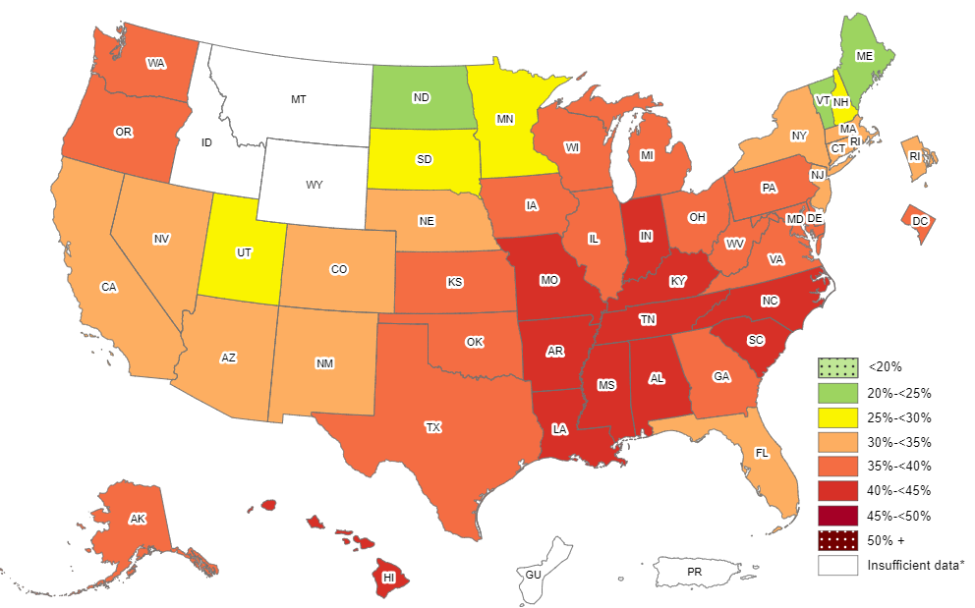
Prevalence of Self-Reported Obesity Among Non-Hispanic Black Adults, by State and Territory, BRFSS, 2011-2013
*Sample size <50 or the relative standard error (dividing the standard error by the prevalence) ≥30%.

Slide 19
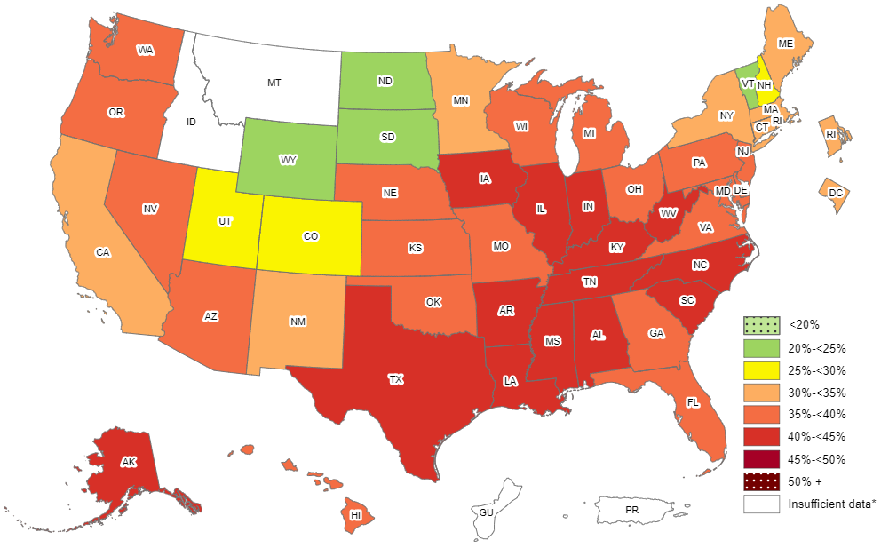
Prevalence of Self-Reported Obesity Among Non-Hispanic Black Adults, by State and Territory, BRFSS, 2012-2014
*Sample size <50 or the relative standard error (dividing the standard error by the prevalence) ≥30%.

Slide 20
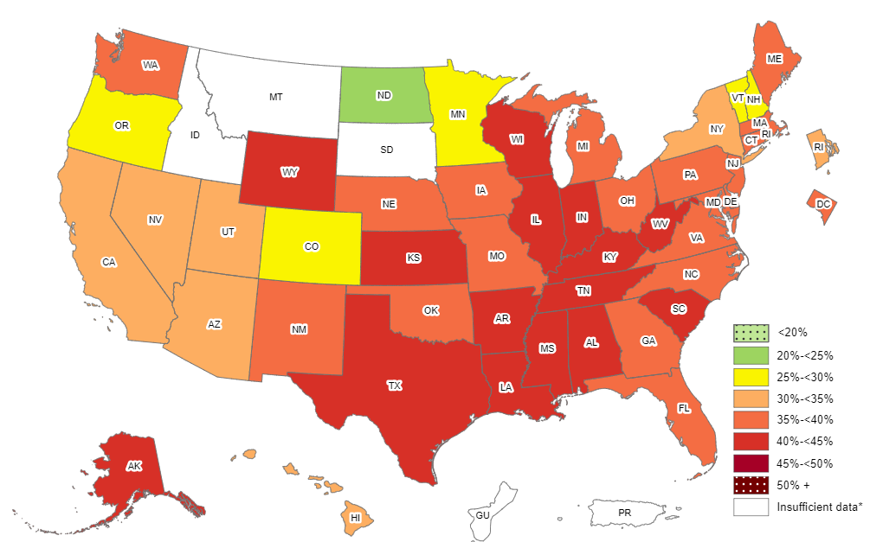
Prevalence of Self-Reported Obesity Among Non-Hispanic Black Adults, by State and Territory, BRFSS, 2013-2015
*Sample size <50 or the relative standard error (dividing the standard error by the prevalence) ≥30%.

Slide 21
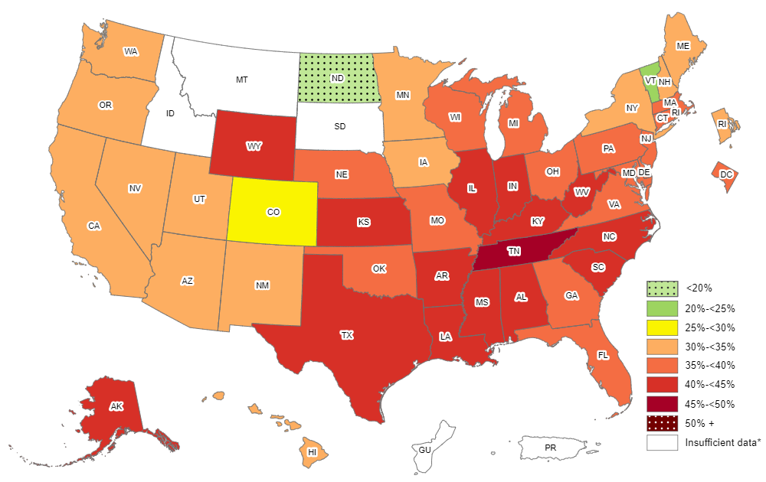
Prevalence of Self-Reported Obesity Among Non-Hispanic Black Adults, by State and Territory, BRFSS, 2014-2016
*Sample size <50 or the relative standard error (dividing the standard error by the prevalence) ≥30%.

Slide 22
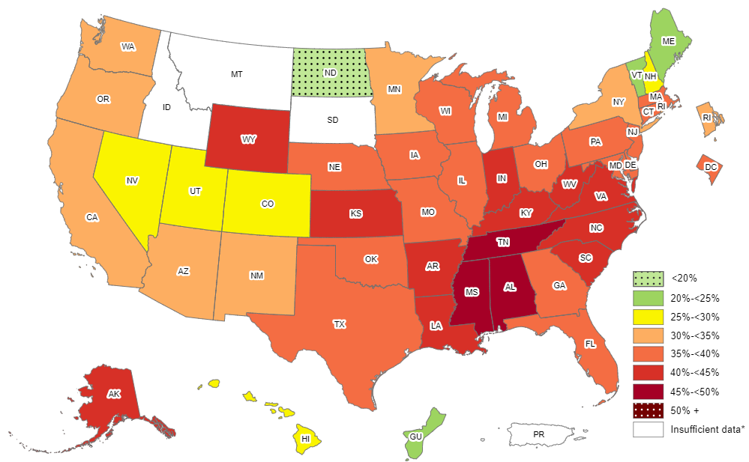
Prevalence of Self-Reported Obesity Among Non-Hispanic Black Adults, by State and Territory, BRFSS, 2015-2017
*Sample size <50 or the relative standard error (dividing the standard error by the prevalence) ≥30%.

Slide 23
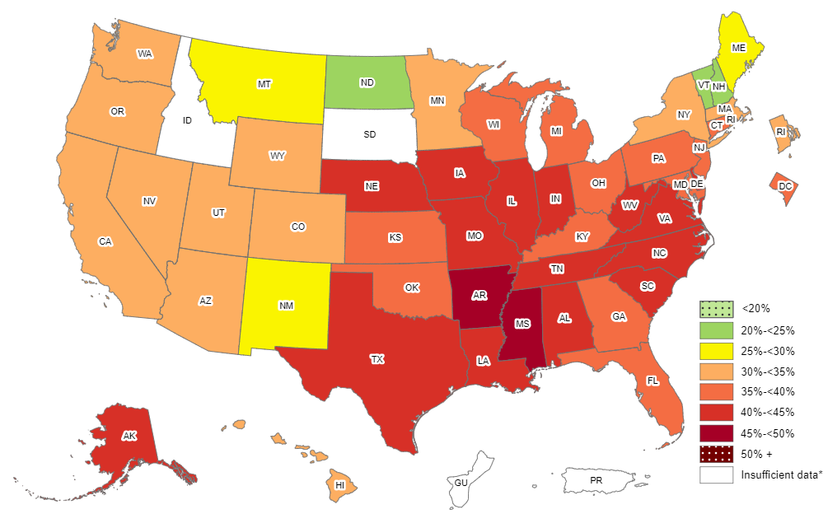
Prevalence of Self-Reported Obesity Among Non-Hispanic Black Adults, by State and Territory, BRFSS, 2016-2018
*Sample size <50 or the relative standard error (dividing the standard error by the prevalence) ≥30%.

Slide 24
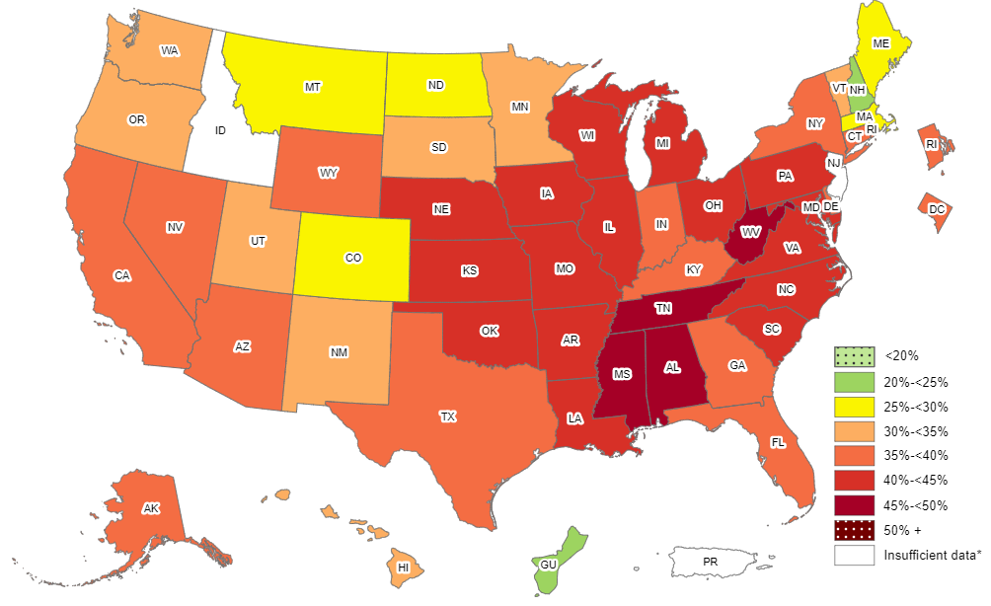
Prevalence of Self-Reported Obesity Among Non-Hispanic Black Adults, by State and Territory, BRFSS, 2017-2019
*Sample size <50, the relative standard error (dividing the standard error by the prevalence) ≥30%, or no data in a specific year.

Slide 25
Prevalence of Self-Reported Obesity Among Non-Hispanic Black Adults, by State and Territory, BRFSS, 2011-2013
State | Prevalence | 95% Confidence Interval
Alabama | 41.8 | (39.9, 43.8)
Alaska | 37.9 | (29.1, 47.6)
Arizona | 32.5 | (25.7, 40.2)
Arkansas | 42.2 | (38.7, 45.7)
California | 34.8 | (31.8, 38.0)
Colorado | 30.5 | (26.6, 34.7)
Connecticut | 33.2 | (30.1, 36.5)
Delaware | 37.3 | (34.6, 40.1)
District of Columbia | 35.6 | (33.7, 37.6)
Florida | 34.8 | (32.2, 37.5)
Georgia | 37.2 | (35.3, 39.0)
Guam | Insufficient data* | Insufficient data*
Hawaii | 41.1 | (30.6, 52.4)
Idaho | Insufficient data* | Insufficient data*
Illinois | 38.7 | (35.3, 42.3)
Indiana | 42.5 | (39.4, 45.7)
Iowa | 39.5 | (32.7, 46.7)
Kansas | 39.2 | (36.2, 42.2)
Kentucky | 42.0 | (38.1, 46.0)
Louisiana | 41.9 | (39.9, 44.0)
Maine | 22.6 | (13.0, 36.3)
Maryland | 37.5 | (35.8, 39.2)
Massachusetts | 33.6 | (30.8, 36.5)
Michigan | 39.3 | (37.0, 41.7)
Minnesota | 29.8 | (26.1, 33.7)
Mississippi | 42.9 | (41.2, 44.5)
State | Prevalence | 95% Confidence Interval
Missouri | 40.0 | (36.5, 43.5)
Montana | Insufficient data* | Insufficient data*
Nebraska | 33.7 | (30.0, 37.6)
Nevada | 34.9 | (29.7, 40.4)
New Hampshire | 27.7 | (18.7, 39.0)
New Jersey | 34.5 | (32.6, 36.5)
New Mexico | 30.1 | (24.1, 36.9)
New York | 32.7 | (30.1, 35.4)
North Carolina | 40.4 | (38.6, 42.4)
North Dakota | 24.7 | (15.5, 36.9)
Ohio | 36.0 | (33.5, 38.5)
Oklahoma | 38.7 | (35.2, 42.3)
Oregon | 39.5 | (29.3, 50.6)
Pennsylvania | 35.6 | (33.2, 38.0)
Puerto Rico | Insufficient data* | Insufficient data*
Rhode Island | 31.4 | (26.7, 36.6)
South Carolina | 42.6 | (41.1, 44.2)
South Dakota | 26.1 | (15.6, 40.3)
Tennessee | 40.4 | (37.0, 43.9)
Texas | 38.2 | (35.4, 41.1)
Utah | 26.0 | (18.8, 34.7)
Vermont | 20.2 | (11.2, 33.7)
Virginia | 38.5 | (36.2, 41.0)
Washington | 37.6 | (32.8, 42.7)
West Virginia | 36.5 | (30.4, 43.0)
Wisconsin | 38.5 | (33.0, 44.3)
Wyoming | Insufficient data* | Insufficient data*
*Sample size <50 or the relative standard error (dividing the standard error by the prevalence) ≥30%.
Source: Behavioral Risk Factor Surveillance System, CDC.

Slide 26
Prevalence of Self-Reported Obesity Among Non-Hispanic Black Adults, by State and Territory, BRFSS, 2012-2014
State | Prevalence | 95% Confidence Interval
Alabama | 42.4 | (40.5, 44.3)
Alaska | 40.4 | (32.0, 49.4)
Arizona | 35.5 | (29.3, 42.2)
Arkansas | 44.4 | (41.2, 47.8)
California | 34.7 | (31.6, 38.0)
Colorado | 29.3 | (25.7, 33.2)
Connecticut | 34.7 | (31.7, 37.8)
Delaware | 37.2 | (34.4, 40.1)
District of Columbia | 34.7 | (32.7, 36.7)
Florida | 35.0 | (32.4, 37.6)
Georgia | 37.5 | (35.6, 39.4)
Guam | Insufficient data* | Insufficient data*
Hawaii | 36.0 | (26.5, 46.7)
Idaho | Insufficient data* | Insufficient data*
Illinois | 40.2 | (36.8, 43.7)
Indiana | 42.5 | (39.4, 45.6)
Iowa | 40.0 | (33.2, 47.3)
Kansas | 39.5 | (36.5, 42.7)
Kentucky | 41.9 | (38.0, 45.9)
Louisiana | 43.2 | (41.1, 45.3)
Maine | 32.2 | (21.1, 45.7)
Maryland | 37.9 | (36.2, 39.7)
Massachusetts | 34.6 | (31.6, 37.7)
Michigan | 36.9 | (34.6, 39.2)
Minnesota | 31.2 | (27.7, 35.0)
Mississippi | 43.0 | (41.2, 44.9)
State | Prevalence | 95% Confidence Interval
Missouri | 39.9 | (36.5, 43.5)
Montana | Insufficient data* | Insufficient data*
Nebraska | 35.2 | (31.2, 39.4)
Nevada | 37.1 | (31.7, 42.8)
New Hampshire | 25.3 | (16.0, 37.7)
New Jersey | 36.7 | (34.7, 38.8)
New Mexico | 34.9 | (28.1, 42.5)
New York | 32.5 | (29.9, 35.1)
North Carolina | 40.0 | (38.2, 41.8)
North Dakota | 24.9 | (16.0, 36.7)
Ohio | 38.6 | (35.9, 41.4)
Oklahoma | 38.3 | (34.9, 41.7)
Oregon | 35.3 | (25.9, 46.1)
Pennsylvania | 36.0 | (33.6, 38.4)
Puerto Rico | Insufficient data* | Insufficient data*
Rhode Island | 31.3 | (26.8, 36.2)
South Carolina | 42.7 | (41.2, 44.2)
South Dakota | 24.3 | (14.4, 37.9)
Tennessee | 40.6 | (37.6, 43.6)
Texas | 40.7 | (37.8, 43.6)
Utah | 25.6 | (18.7, 34.0)
Vermont | 23.2 | (13.5, 37.0)
Virginia | 38.9 | (36.8, 41.0)
Washington | 35.7 | (31.1, 40.6)
West Virginia | 40.9 | (34.8, 47.3)
Wisconsin | 38.8 | (33.2, 44.7)
Wyoming | 24.3 | (14.3, 38.2)
*Sample size <50 or the relative standard error (dividing the standard error by the prevalence) ≥30%.
Source: Behavioral Risk Factor Surveillance System, CDC.

Slide 27
Prevalence of Self-Reported Obesity Among Non-Hispanic Black Adults, by State and Territory, BRFSS, 2013-2015
State | Prevalence | 95% Confidence Interval
Alabama | 43.2 | (41.3, 45.2)
Alaska | 40.5 | (31.7, 49.9)
Arizona | 34.2 | (28.4, 40.5)
Arkansas | 43.9 | (40.4, 47.6)
California | 32.8 | (29.7, 36.0)
Colorado | 27.7 | (24.1, 31.6)
Connecticut | 35.5 | (32.5, 38.6)
Delaware | 36.6 | (33.7, 39.7)
District of Columbia | 35.2 | (33.1, 37.4)
Florida | 35.3 | (32.9, 37.7)
Georgia | 37.8 | (35.8, 39.8)
Guam | Insufficient data* | Insufficient data*
Hawaii | 33.6 | (23.7, 45.1)
Idaho | Insufficient data* | Insufficient data*
Illinois | 40.7 | (37.5, 44.0)
Indiana | 41.5 | (38.0, 45.2)
Iowa | 35.4 | (28.8, 42.6)
Kansas | 42.7 | (39.9, 45.5)
Kentucky | 42.7 | (38.6, 46.9)
Louisiana | 42.5 | (40.3, 44.7)
Maine | 35.9 | (24.2, 49.6)
Maryland | 38.0 | (36.1, 40.0)
Massachusetts | 35.9 | (32.5, 39.4)
Michigan | 37.6 | (35.3, 40.0)
Minnesota | 29.9 | (26.6, 33.5)
Mississippi | 43.2 | (41.3, 45.2)
State | Prevalence | 95% Confidence Interval
Missouri | 38.4 | (35.0, 41.9)
Montana | Insufficient data* | Insufficient data*
Nebraska | 36.3 | (32.0, 40.8)
Nevada | 34.5 | (28.9, 40.6)
New Hampshire | 27.6 | (17.6, 40.5)
New Jersey | 36.6 | (34.4, 38.8)
New Mexico | 37.5 | (30.0, 45.6)
New York | 32.3 | (30.1, 34.6)
North Carolina | 39.9 | (37.9, 41.8)
North Dakota | 20.0 | (12.4, 30.6)
Ohio | 37.1 | (34.3, 40.1)
Oklahoma | 35.4 | (32.1, 38.8)
Oregon | 29.4 | (20.4, 40.4)
Pennsylvania | 35.7 | (33.0, 38.5)
Puerto Rico | Insufficient data* | Insufficient data*
Rhode Island | 34.5 | (29.8, 39.4)
South Carolina | 42.2 | (40.7, 43.7)
South Dakota | Insufficient data* | Insufficient data*
Tennessee | 43.0 | (39.8, 46.4)
Texas | 41.5 | (38.5, 44.6)
Utah | 30.9 | (23.2, 39.8)
Vermont | 29.0 | (17.7, 43.7)
Virginia | 39.2 | (37.1, 41.3)
Washington | 35.4 | (30.8, 40.2)
West Virginia | 41.5 | (35.8, 47.4)
Wisconsin | 41.6 | (35.5, 48.0)
Wyoming | 43.0 | (28.7, 58.5)
*Sample size <50 or the relative standard error (dividing the standard error by the prevalence) ≥30%.
Source: Behavioral Risk Factor Surveillance System, CDC.

Slide 28
Prevalence of Self-Reported Obesity Among Non-Hispanic Black Adults, by State and Territory, BRFSS, 2014-2016
State | Prevalence | 95% Confidence Interval
Alabama | 44.1 | (42.3, 46.0)
Alaska | 43.6 | (32.6, 55.1)
Arizona | 33.1 | (28.6, 38.0)
Arkansas | 44.2 | (40.3, 48.3)
California | 31.0 | (28.2, 34.0)
Colorado | 29.1 | (25.4, 33.0)
Connecticut | 37.7 | (34.8, 40.8)
Delaware | 36.5 | (33.4, 39.8)
District of Columbia | 35.5 | (33.4, 37.6)
Florida | 35.2 | (32.8, 37.6)
Georgia | 37.7 | (35.6, 39.9)
Guam | Insufficient data* | Insufficient data*
Hawaii | 31.3 | (22.3, 41.9)
Idaho | Insufficient data* | Insufficient data*
Illinois | 41.3 | (38.2, 44.4)
Indiana | 41.7 | (38.2, 45.3)
Iowa | 32.1 | (25.9, 38.9)
Kansas | 43.1 | (40.0, 46.3)
Kentucky | 42.4 | (38.5, 46.4)
Louisiana | 42.9 | (40.7, 45.2)
Maine | 34.3 | (23.2, 47.4)
Maryland | 38.1 | (36.3, 40.0)
Massachusetts | 36.6 | (33.0, 40.4)
Michigan | 37.4 | (35.1, 39.7)
Minnesota | 30.4 | (27.4, 33.5)
Mississippi | 44.6 | (42.7, 46.6)
State | Prevalence | 95% Confidence Interval
Missouri | 38.6 | (35.2, 42.1)
Montana | Insufficient data* | Insufficient data*
Nebraska | 37.2 | (32.8, 41.9)
Nevada | 30.8 | (25.8, 36.2)
New Hampshire | 30.3 | (19.2, 44.2)
New Jersey | 37.2 | (34.7, 39.8)
New Mexico | 34.4 | (26.2, 43.7)
New York | 32.1 | (30.1, 34.3)
North Carolina | 40.2 | (38.3, 42.2)
North Dakota | 15.9 | (9.6, 25.2)
Ohio | 37.6 | (34.7, 40.5)
Oklahoma | 36.6 | (33.0, 40.4)
Oregon | 30.2 | (21.4, 40.6)
Pennsylvania | 36.4 | (33.5, 39.5)
Puerto Rico | Insufficient data* | Insufficient data*
Rhode Island | 31.9 | (27.2, 37.1)
South Carolina | 41.7 | (40.2, 43.3)
South Dakota | Insufficient data* | Insufficient data*
Tennessee | 45.1 | (41.7, 48.6)
Texas | 42.4 | (39.2, 45.7)
Utah | 30.1 | (22.3, 39.1)
Vermont | 21.9 | (13.3, 33.9)
Virginia | 39.4 | (37.4, 41.4)
Washington | 34.2 | (29.9, 38.7)
West Virginia | 44.6 | (39.3, 50.1)
Wisconsin | 39.9 | (34.0, 46.1)
Wyoming | 43.8 | (29.3, 59.4)
*Sample size <50 or the relative standard error (dividing the standard error by the prevalence) ≥30%.
Source: Behavioral Risk Factor Surveillance System, CDC.

Slide 29
Prevalence of Self-Reported Obesity Among Non-Hispanic Black Adults, by State and Territory, BRFSS, 2015-2017
State | Prevalence | 95% Confidence Interval
Alabama | 45.0 | (43.1, 46.9)
Alaska | 44.7 | (33.3, 56.8)
Arizona | 32.4 | (28.1, 36.9)
Arkansas | 44.2 | (39.9, 48.5)
California | 31.4 | (28.3, 34.7)
Colorado | 28.9 | (25.1, 33.1)
Connecticut | 37.1 | (34.3, 40.0)
Delaware | 37.4 | (34.2, 40.7)
District of Columbia | 36.3 | (34.4, 38.2)
Florida | 35.4 | (33.0, 37.8)
Georgia | 37.1 | (35.0, 39.2)
Guam | 22.8 | (12.3, 38.4)
Hawaii | 29.8 | (21.0, 40.6)
Idaho | Insufficient data* | Insufficient data*
Illinois | 39.5 | (36.6, 42.5)
Indiana | 42.2 | (38.8, 45.7)
Iowa | 36.3 | (30.1, 43.0)
Kansas | 41.2 | (38.3, 44.2)
Kentucky | 40.2 | (36.2, 44.3)
Louisiana | 42.6 | (40.1, 45.0)
Maine | 24.8 | (16.2, 36.0)
Maryland | 39.1 | (37.4, 40.9)
Massachusetts | 35.1 | (30.8, 39.6)
Michigan | 39.9 | (37.7, 42.1)
Minnesota | 30.4 | (27.5, 33.5)
Mississippi | 45.4 | (43.4, 47.4)
Missouri | 39.1 | (35.8, 42.5)
State | Prevalence | 95% Confidence Interval
Montana | Insufficient data* | Insufficient data*
Nebraska | 39.9 | (35.3, 44.7)
Nevada | 29.2 | (24.5, 34.5)
New Hampshire | 25.9 | (15.7, 39.7)
New Jersey | 36.4 | (33.8, 39.1)
New Mexico | 31.2 | (22.9, 40.8)
New York | 33.4 | (31.5, 35.4)
North Carolina | 41.1 | (38.9, 43.3)
North Dakota | 19.6 | (13.3, 28.1)
Ohio | 37.5 | (34.9, 40.3)
Oklahoma | 37.6 | (33.8, 41.6)
Oregon | 30.8 | (22.7, 40.4)
Pennsylvania | 36.8 | (33.7, 40.0)
Puerto Rico | Insufficient data* | Insufficient data*
Rhode Island | 31.8 | (27.0, 37.1)
South Carolina | 42.0 | (40.5, 43.6)
South Dakota | Insufficient data* | Insufficient data*
Tennessee | 46.4 | (43.1, 49.8)
Texas | 39.8 | (36.4, 43.3)
Utah | 26.3 | (18.9, 35.4)
Vermont | 22.8 | (13.4, 36.1)
Virginia | 41.0 | (39.0, 43.0)
Washington | 33.7 | (29.8, 37.9)
West Virginia | 43.6 | (38.2, 49.3)
Wisconsin | 38.1 | (32.2, 44.4)
Wyoming | 44.8 | (30.8, 59.7)
*Sample size <50 or the relative standard error (dividing the standard error by the prevalence) ≥30%.
Source: Behavioral Risk Factor Surveillance System, CDC.

Slide 30
Prevalence of Self-Reported Obesity Among Non-Hispanic Black Adults, by State and Territory, BRFSS, 2016-2018
State | Prevalence | 95% Confidence Interval
Alabama | 44.1 | (42.2, 46.0)
Alaska | 42.4 | (30.9, 54.8)
Arizona | 32.8 | (28.4, 37.5)
Arkansas | 45.4 | (41.4, 49.5)
California | 34.5 | (31.3, 37.9)
Colorado | 31.4 | (27.4, 35.8)
Connecticut | 37.0 | (34.3, 39.9)
Delaware | 40.1 | (37.0, 43.3)
District of Columbia | 37.0 | (35.5, 38.6)
Florida | 36.3 | (33.8, 38.8)
Georgia | 38.3 | (36.5, 40.1)
Guam | Insufficient data* | Insufficient data*
Hawaii | 31.0 | (22.8, 40.7)
Idaho | Insufficient data* | Insufficient data*
Illinois | 40.1 | (37.3, 43.0)
Indiana | 41.7 | (38.8, 44.6)
Iowa | 41.7 | (35.8, 47.8)
Kansas | 39.7 | (36.5, 43.0)
Kentucky | 39.3 | (35.3, 43.5)
Louisiana | 43.5 | (41.1, 46.0)
Maine | 28.2 | (17.5, 42.2)
Maryland | 39.5 | (38.0, 40.9)
Massachusetts | 30.9 | (26.8, 35.3)
Michigan | 39.9 | (37.8, 42.1)
Minnesota | 32.7 | (29.8, 35.7)
Mississippi | 46.1 | (44.1, 48.1)
Missouri | 41.9 | (38.4, 45.5)
State | Prevalence | 95% Confidence Interval
Montana | 25.5 | (13.6, 42.5)
Nebraska | 41.9 | (37.2, 46.8)
Nevada | 34.8 | (29.8, 40.0)
New Hampshire | 23.1 | (13.4, 36.7)
New Jersey | 36.0 | (32.5, 39.5)
New Mexico | 27.6 | (19.7, 37.2)
New York | 34.1 | (32.3, 36.0)
North Carolina | 42.7 | (40.3, 45.1)
North Dakota | 23.5 | (16.9, 31.6)
Ohio | 37.9 | (35.3, 40.6)
Oklahoma | 39.8 | (35.8, 43.9)
Oregon | 33.8 | (25.7, 43.1)
Pennsylvania | 39.5 | (36.5, 42.6)
Puerto Rico | Insufficient data* | Insufficient data*
Rhode Island | 33.2 | (28.3, 38.6)
South Carolina | 42.3 | (40.7, 44.0)
South Dakota | Insufficient data* | Insufficient data*
Tennessee | 44.7 | (41.4, 48.0)
Texas | 40.0 | (36.4, 43.6)
Utah | 30.5 | (22.7, 39.6)
Vermont | 24.9 | (15.4, 37.7)
Virginia | 41.3 | (39.3, 43.3)
Washington | 34.3 | (30.2, 38.7)
West Virginia | 43.4 | (37.4, 49.6)
Wisconsin | 35.3 | (29.7, 41.3)
Wyoming | 34.0 | (20.9, 50.1)
*Sample size <50 or the relative standard error (dividing the standard error by the prevalence) ≥30%.
Source: Behavioral Risk Factor Surveillance System, CDC.

Slide 31
Prevalence of Self-Reported Obesity Among Non-Hispanic Black Adults, by State and Territory, BRFSS, 2017-2019
State | Prevalence | 95% Confidence Interval
Alabama | 45.0 | (43.0, 46.9)
Alaska | 39.8 | (29.1, 51.5)
Arizona | 35.0 | (30.3, 40.0)
Arkansas | 44.7 | (40.9, 48.5)
California | 35.6 | (32.4, 39.0)
Colorado | 29.4 | (25.3, 33.9)
Connecticut | 38.6 | (35.9, 41.5)
Delaware | 39.8 | (36.6, 43.1)
District of Columbia | 38.0 | (36.3, 39.8)
Florida | 36.6 | (34.0, 39.4)
Georgia | 39.2 | (37.2, 41.2)
Guam | 22.8 | (13.2, 36.4)
Hawaii | 31.5 | (23.2, 41.1)
Idaho | Insufficient data* | Insufficient data*
Illinois | 40.5 | (37.8, 43.4)
Indiana | 39.9 | (37.0, 42.8)
Iowa | 43.4 | (38.0, 48.9)
Kansas | 41.0 | (37.9, 44.2)
Kentucky | 39.9 | (35.4, 44.5)
Louisiana | 43.6 | (41.4, 45.9)
Maine | 29.0 | (18.1, 42.9)
Maryland | 41.0 | (39.5, 42.5)
Massachusetts | 29.7 | (25.8, 33.9)
Michigan | 41.8 | (39.5, 44.1)
Minnesota | 32.9 | (30.0, 35.9)
Mississippi | 46.0 | (44.0, 48.0)
Missouri | 42.0 | (38.7, 45.4)
State | Prevalence | 95% Confidence Interval
Montana | 25.0 | (13.6, 41.3)
Nebraska | 42.6 | (38.3, 47.1)
Nevada | 38.3 | (33.2, 43.7)
New Hampshire | 24.7 | (14.9, 38.2)
New Jersey | Insufficient data* | Insufficient data*
New Mexico | 33.5 | (25.2, 43.1)
New York | 35.0 | (33.1, 36.9)
North Carolina | 44.8 | (42.3, 47.3)
North Dakota | 27.7 | (20.5, 36.2)
Ohio | 40.1 | (37.4, 42.8)
Oklahoma | 41.7 | (37.8, 45.8)
Oregon | 30.8 | (23.4, 39.3)
Pennsylvania | 41.5 | (38.5, 44.5)
Puerto Rico | Insufficient data* | Insufficient data*
Rhode Island | 36.2 | (31.3, 41.5)
South Carolina | 43.7 | (41.8, 45.5)
South Dakota | 30.8 | (17.3, 48.7)
Tennessee | 45.0 | (41.8, 48.2)
Texas | 38.3 | (34.9, 41.8)
Utah | 32.2 | (24.8, 40.7)
Vermont | 34.5 | (22.0, 49.7)
Virginia | 42.8 | (40.7, 44.8)
Washington | 32.4 | (28.3, 36.7)
West Virginia | 47.4 | (40.2, 54.6)
Wisconsin | 42.9 | (36.7, 49.3)
Wyoming | 35.0 | (20.7, 52.6)
*Sample size <50, the relative standard error (dividing the standard error by the prevalence) ≥30%, or no data in a specific year.
Source: Behavioral Risk Factor Surveillance System, CDC.

Slide 32
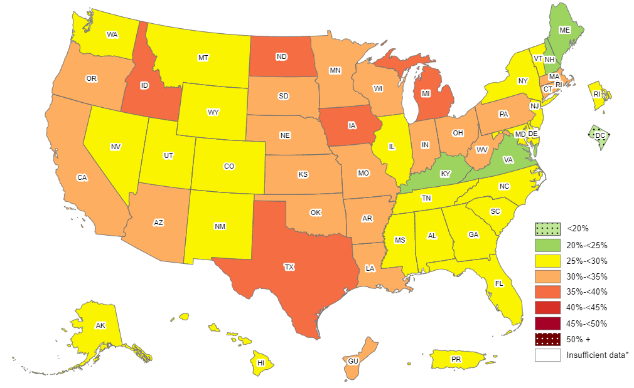
Prevalence of Self-Reported Obesity Among Hispanic Adults, by State and Territory, BRFSS, 2011-2013
*Sample size <50 or the relative standard error (dividing the standard error by the prevalence) ≥30%.

Slide 33
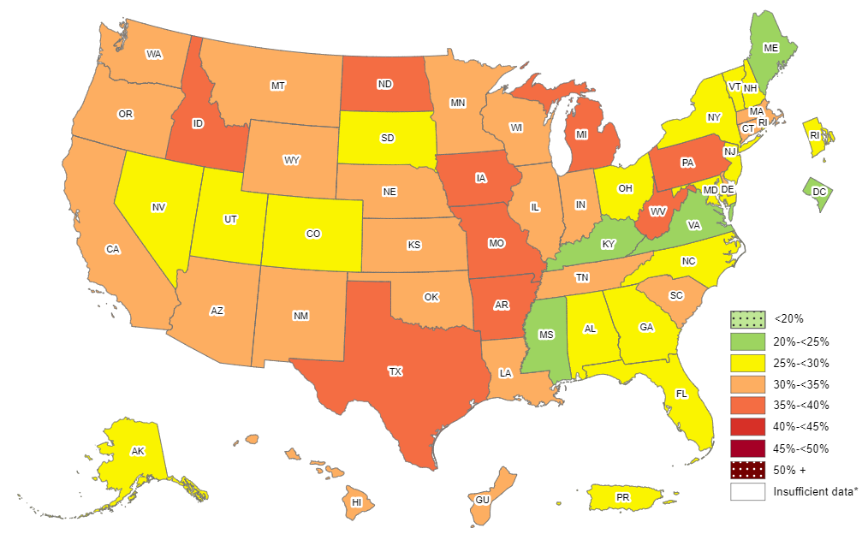
Prevalence of Self-Reported Obesity Among Hispanic Adults, by State and Territory, BRFSS, 2012-2014
*Sample size <50 or the relative standard error (dividing the standard error by the prevalence) ≥30%.

Slide 34
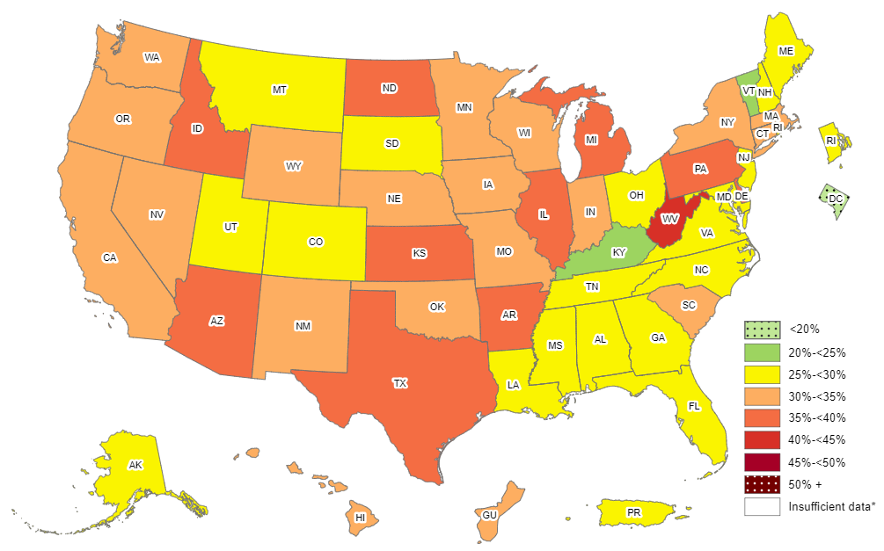
Prevalence of Self-Reported Obesity Among Hispanic Adults, by State and Territory, BRFSS, 2013-2015
*Sample size <50 or the relative standard error (dividing the standard error by the prevalence) ≥30%.

Slide 35
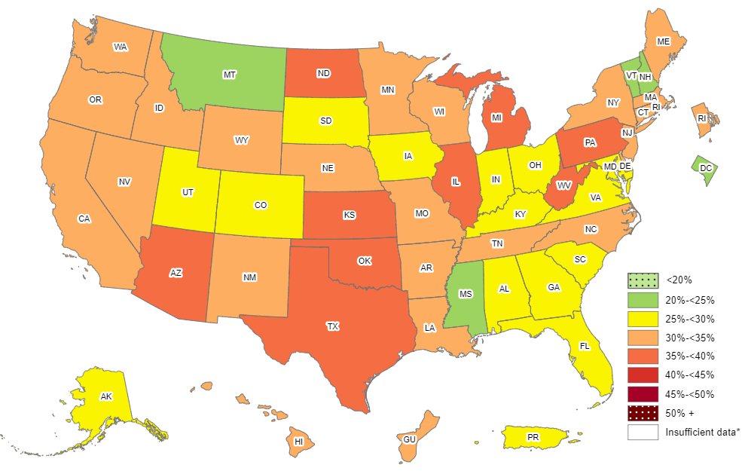
Prevalence of Self-Reported Obesity Among Hispanic Adults, by State and Territory, BRFSS, 2014-2016
*Sample size <50 or the relative standard error (dividing the standard error by the prevalence) ≥30%.

Slide 36
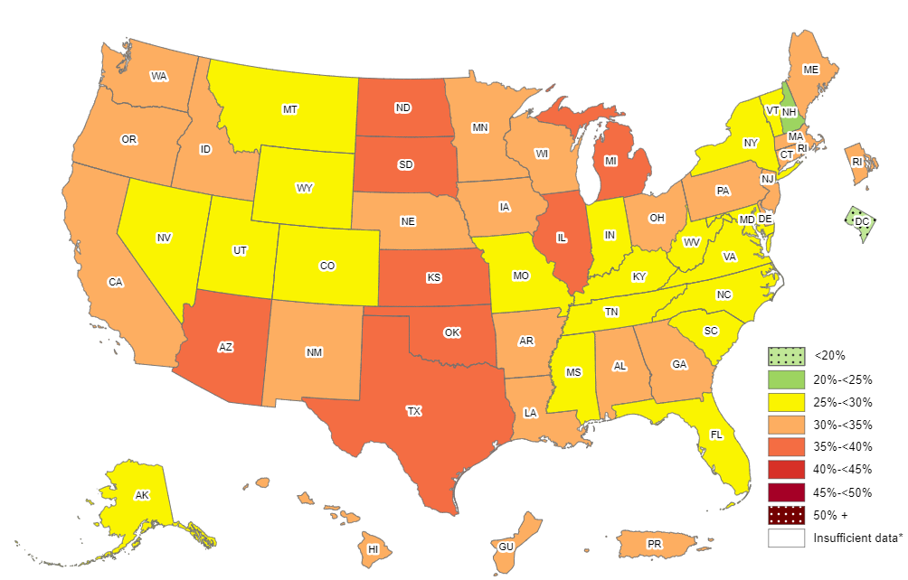
Prevalence of Self-Reported Obesity Among Hispanic Adults, by State and Territory, BRFSS, 2015-2017
*Sample size <50 or the relative standard error (dividing the standard error by the prevalence) ≥30%.

Slide 37
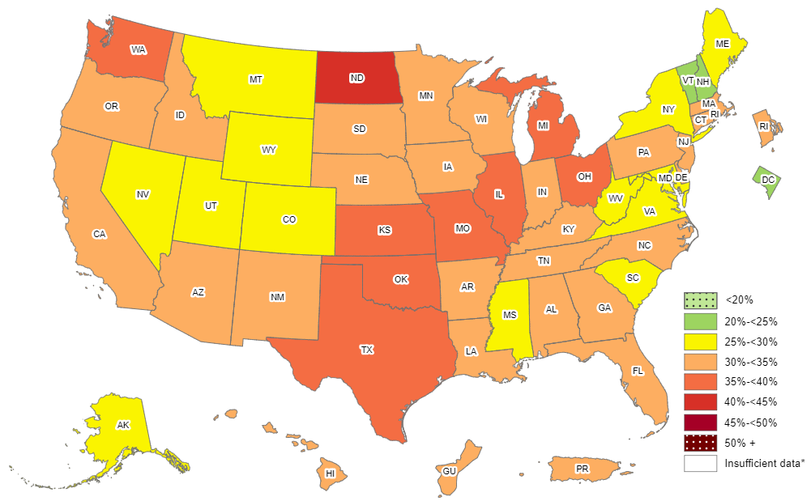
Prevalence of Self-Reported Obesity Among Hispanic Adults, by State and Territory, BRFSS, 2016-2018
*Sample size <50 or the relative standard error (dividing the standard error by the prevalence) ≥30%.

Slide 38
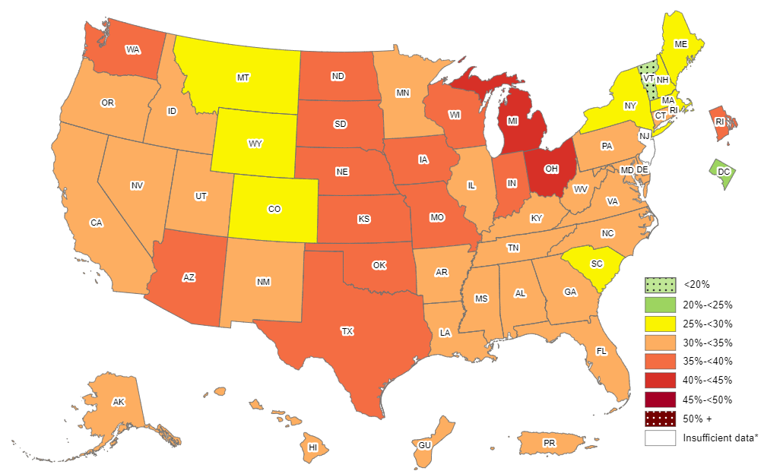
Prevalence of Self-Reported Obesity Among Hispanic Adults, by State and Territory, BRFSS, 2017-2019
*Sample size <50 or the relative standard error (dividing the standard error by the prevalence) ≥30%,
or no data in a specific year.

Slide 39
Prevalence of Self-Reported Obesity Among Hispanic Adults, by State and Territory, BRFSS, 2011-2013
State | Prevalence | 95% Confidence Interval
Alabama | 27.3 | (19.6, 36.6)
Alaska | 28.4 | (22.1, 35.5)
Arizona | 33.8 | (30.5, 37.3)
Arkansas | 34.3 | (28.3, 40.9)
California | 30.7 | (29.5, 31.9)
Colorado | 28.0 | (26.2, 29.8)
Connecticut | 32.5 | (29.5, 35.7)
Delaware | 29.2 | (24.2, 34.8)
District of Columbia | 18.5 | (14.1, 24.0)
Florida | 26.4 | (24.4, 28.5)
Georgia | 28.1 | (24.3, 32.3)
Guam | 31.7 | (25.7, 38.5)
Hawaii | 29.4 | (26.0, 33.1)
Idaho | 35.3 | (30.5, 40.3)
Illinois | 29.9 | (26.3, 33.7)
Indiana | 33.2 | (29.1, 37.6)
Iowa | 37.6 | (32.5, 42.9)
Kansas | 33.5 | (30.8, 36.2)
Kentucky | 24.5 | (18.5, 31.6)
Louisiana | 32.6 | (26.0, 40.0)
Maine | 24.2 | (18.1, 31.6)
Maryland | 25.9 | (22.2, 29.9)
Massachusetts | 31.0 | (28.8, 33.3)
Michigan | 35.4 | (30.9, 40.3)
Minnesota | 30.5 | (26.1, 35.3)
Mississippi | 28.2 | (21.8, 35.6)
State | Prevalence | 95% Confidence Interval
Missouri | 33.6 | (26.7, 41.2)
Montana | 29.6 | (23.9, 36.0)
Nebraska | 30.4 | (27.7, 33.1)
Nevada | 27.3 | (24.3, 30.6)
New Hampshire | 24.7 | (17.4, 33.6)
New Jersey | 27.5 | (25.7, 29.3)
New Mexico | 29.8 | (28.5, 31.0)
New York | 27.3 | (25.1, 29.6)
North Carolina | 27.0 | (24.0, 30.2)
North Dakota | 36.2 | (27.8, 45.5)
Ohio | 30.9 | (25.7, 36.6)
Oklahoma | 31.3 | (27.9, 34.9)
Oregon | 31.2 | (26.8, 36.0)
Pennsylvania | 34.8 | (31.0, 38.8)
Puerto Rico | 27.5 | (26.7, 28.3)
Rhode Island | 27.5 | (24.5, 30.9)
South Carolina | 29.7 | (24.7, 35.1)
South Dakota | 31.5 | (24.4, 39.6)
Tennessee | 25.6 | (17.5, 36.0)
Texas | 35.4 | (33.8, 37.0)
Utah | 26.1 | (23.9, 28.4)
Vermont | 27.1 | (19.6, 36.3)
Virginia | 24.1 | (20.3, 28.3)
Washington | 29.7 | (27.0, 32.6)
West Virginia | 32.1 | (24.3, 41.1)
Wisconsin | 32.4 | (24.9, 40.9)
Wyoming | 29.2 | (24.9, 33.9)
Source: Behavioral Risk Factor Surveillance System, CDC.

Slide 40
Prevalence of Self-Reported Obesity Among Hispanic Adults, by State and Territory, BRFSS, 2012-2014
State | Prevalence | 95% Confidence Interval
Alabama | 25.4 | (18.2, 34.3)
Alaska | 27.7 | (22.0, 34.2)
Arizona | 33.9 | (30.9, 36.9)
Arkansas | 39.5 | (33.1, 46.3)
California | 31.3 | (30.0, 32.6)
Colorado | 28.1 | (26.4, 29.8)
Connecticut | 30.9 | (28.0, 33.8)
Delaware | 31.9 | (27.1, 37.1)
District of Columbia | 20.5 | (15.5, 26.7)
Florida | 26.2 | (24.3, 28.3)
Georgia | 27.0 | (23.1, 31.2)
Guam | 34.8 | (28.8, 41.3)
Hawaii | 31.3 | (28.0, 34.8)
Idaho | 35.9 | (31.2, 40.9)
Illinois | 33.0 | (29.5, 36.7)
Indiana | 32.0 | (28.3, 35.9)
Iowa | 35.5 | (30.6, 40.8)
Kansas | 34.2 | (31.5, 37.0)
Kentucky | 23.2 | (17.2, 30.5)
Louisiana | 31.3 | (24.9, 38.6)
Maine | 24.2 | (17.6, 32.4)
Maryland | 26.0 | (22.4, 29.9)
Massachusetts | 31.4 | (29.1, 33.9)
Michigan | 35.5 | (30.7, 40.6)
Minnesota | 31.7 | (27.6, 36.0)
Mississippi | 21.1 | (14.8, 29.2)
State | Prevalence | 95% Confidence Interval
Missouri | 35.5 | (28.5, 43.1)
Montana | 30.1 | (24.4, 36.5)
Nebraska | 31.0 | (28.2, 33.8)
Nevada | 27.8 | (24.7, 31.1)
New Hampshire | 29.3 | (21.7, 38.3)
New Jersey | 28.8 | (26.9, 30.7)
New Mexico | 30.1 | (28.8, 31.5)
New York | 29.3 | (27.0, 31.6)
North Carolina | 29.7 | (26.9, 32.7)
North Dakota | 37.9 | (29.1, 47.7)
Ohio | 29.1 | (24.2, 34.4)
Oklahoma | 33.4 | (30.0, 37.0)
Oregon | 30.2 | (26.0, 34.8)
Pennsylvania | 36.7 | (32.6, 40.9)
Puerto Rico | 28.1 | (27.3, 28.9)
Rhode Island | 28.0 | (24.9, 31.3)
South Carolina | 32.2 | (27.3, 37.5)
South Dakota | 27.1 | (19.0, 37.1)
Tennessee | 31.7 | (23.4, 41.2)
Texas | 35.8 | (34.3, 37.3)
Utah | 27.5 | (25.4, 29.7)
Vermont | 25.5 | (17.9, 35.0)
Virginia | 24.5 | (21.2, 28.2)
Washington | 31.8 | (29.0, 34.9)
West Virginia | 37.1 | (28.8, 46.3)
Wisconsin | 33.9 | (27.5, 41.0)
Wyoming | 32.7 | (27.7, 38.0)
Source: Behavioral Risk Factor Surveillance System, CDC.

Slide 41
Prevalence of Self-Reported Obesity Among Hispanic Adults, by State and Territory, BRFSS, 2013-2015
State | Prevalence | 95% Confidence Interval
Alabama | 27.6 | (20.5, 36.0)
Alaska | 28.3 | (22.3, 35.1)
Arizona | 35.5 | (32.6, 38.4)
Arkansas | 36.9 | (30.1, 44.4)
California | 31.3 | (30.1, 32.6)
Colorado | 28.3 | (26.6, 30.1)
Connecticut | 30.3 | (27.6, 33.0)
Delaware | 35.3 | (30.5, 40.3)
District of Columbia | 18.5 | (13.2, 25.1)
Florida | 26.5 | (24.7, 28.4)
Georgia | 27.1 | (23.0, 31.8)
Guam | 32.9 | (27.3, 38.9)
Hawaii | 31.8 | (28.6, 35.1)
Idaho | 36.3 | (31.8, 41.0)
Illinois | 36.0 | (32.6, 39.6)
Indiana | 31.4 | (27.4, 35.7)
Iowa | 34.0 | (28.6, 39.8)
Kansas | 35.4 | (33.3, 37.5)
Kentucky | 24.3 | (17.9, 32.2)
Louisiana | 29.9 | (23.5, 37.3)
Maine | 25.3 | (18.5, 33.5)
Maryland | 25.1 | (21.2, 29.4)
Massachusetts | 32.4 | (29.9, 35.1)
Michigan | 36.9 | (32.2, 41.8)
Minnesota | 31.2 | (27.5, 35.2)
Mississippi | 25.4 | (16.7, 36.6)
State | Prevalence | 95% Confidence Interval
Missouri | 31.5 | (25.0, 38.8)
Montana | 26.8 | (21.2, 33.2)
Nebraska | 30.8 | (27.9, 33.8)
Nevada | 30.5 | (26.9, 34.3)
New Hampshire | 27.8 | (20.2, 36.8)
New Jersey | 28.8 | (26.8, 30.9)
New Mexico | 31.2 | (29.7, 32.8)
New York | 30.6 | (28.6, 32.7)
North Carolina | 28.1 | (25.2, 31.2)
North Dakota | 35.1 | (26.7, 44.6)
Ohio | 26.3 | (21.4, 31.8)
Oklahoma | 33.9 | (30.2, 37.8)
Oregon | 31.4 | (27.1, 36.1)
Pennsylvania | 39.1 | (34.1, 44.3)
Puerto Rico | 28.5 | (27.6, 29.4)
Rhode Island | 28.9 | (25.7, 32.3)
South Carolina | 32.1 | (27.3, 37.3)
South Dakota | 28.8 | (20.0, 39.5)
Tennessee | 27.6 | (19.7, 37.3)
Texas | 36.9 | (35.4, 38.5)
Utah | 27.7 | (25.7, 29.9)
Vermont | 22.4 | (15.4, 31.5)
Virginia | 27.9 | (24.3, 31.7)
Washington | 31.5 | (28.7, 34.5)
West Virginia | 40.2 | (31.4, 49.6)
Wisconsin | 33.4 | (27.6, 39.8)
Wyoming | 33.4 | (28.4, 38.8)
Source: Behavioral Risk Factor Surveillance System, CDC.

Slide 42
Prevalence of Self-Reported Obesity Among Hispanic Adults, by State and Territory, BRFSS, 2014-2016
State | Prevalence | 95% Confidence Interval
Alabama | 28.1 | (21.7, 35.6)
Alaska | 27.9 | (21.3, 35.5)
Arizona | 35.0 | (32.8, 37.2)
Arkansas | 32.4 | (25.4, 40.3)
California | 32.3 | (31.1, 33.5)
Colorado | 27.1 | (25.5, 28.8)
Connecticut | 30.3 | (28.0, 32.8)
Delaware | 32.1 | (27.6, 37.1)
District of Columbia | 20.0 | (15.0, 26.1)
Florida | 26.8 | (25.1, 28.6)
Georgia | 28.4 | (23.9, 33.4)
Guam | 32.6 | (27.0, 38.7)
Hawaii | 31.4 | (28.3, 34.6)
Idaho | 33.6 | (29.3, 38.2)
Illinois | 36.3 | (33.2, 39.6)
Indiana | 28.7 | (24.9, 32.9)
Iowa | 29.9 | (24.9, 35.5)
Kansas | 35.2 | (32.8, 37.6)
Kentucky | 25.0 | (18.4, 33.0)
Louisiana | 32.2 | (25.9, 39.2)
Maine | 30.5 | (22.5, 39.9)
Maryland | 25.4 | (21.6, 29.5)
Massachusetts | 31.4 | (28.8, 34.2)
Michigan | 38.4 | (33.8, 43.3)
Minnesota | 33.1 | (30.0, 36.3)
Mississippi | 22.3 | (14.2, 33.4)
State | Prevalence | 95% Confidence Interval
Missouri | 32.7 | (26.1, 40.2)
Montana | 24.8 | (19.1, 31.7)
Nebraska | 31.8 | (29.1, 34.7)
Nevada | 30.6 | (27.3, 34.1)
New Hampshire | 24.7 | (17.7, 33.4)
New Jersey | 31.4 | (29.1, 33.7)
New Mexico | 31.3 | (29.7, 33.0)
New York | 30.6 | (28.7, 32.5)
North Carolina | 31.2 | (28.1, 34.4)
North Dakota | 37.2 | (28.8, 46.5)
Ohio | 27.8 | (22.7, 33.5)
Oklahoma | 36.7 | (32.7, 41.0)
Oregon | 32.4 | (28.6, 36.6)
Pennsylvania | 39.5 | (34.3, 45.0)
Puerto Rico | 29.4 | (28.5, 30.4)
Rhode Island | 30.8 | (27.4, 34.4)
South Carolina | 28.2 | (23.9, 33.0)
South Dakota | 29.5 | (20.0, 41.3)
Tennessee | 33.0 | (25.1, 42.0)
Texas | 37.4 | (35.7, 39.1)
Utah | 28.1 | (26.0, 30.4)
Vermont | 24.3 | (16.7, 34.1)
Virginia | 29.6 | (26.1, 33.3)
Washington | 34.4 | (31.7, 37.1)
West Virginia | 37.7 | (28.7, 47.6)
Wisconsin | 31.2 | (25.7, 37.1)
Wyoming | 32.4 | (27.2, 38.1)
Source: Behavioral Risk Factor Surveillance System, CDC.

Slide 43
Prevalence of Self-Reported Obesity Among Hispanic Adults, by State and Territory, BRFSS, 2015-2017
State | Prevalence | 95% Confidence Interval
Alabama | 31.9 | (25.1, 39.6)
Alaska | 28.8 | (21.7, 37.1)
Arizona | 35.5 | (33.5, 37.5)
Arkansas | 30.1 | (22.6, 38.8)
California | 32.1 | (30.9, 33.3)
Colorado | 27.4 | (25.7, 29.1)
Connecticut | 31.8 | (29.5, 34.1)
Delaware | 31.9 | (27.4, 36.8)
District of Columbia | 19.7 | (15.1, 25.3)
Florida | 28.1 | (26.1, 30.2)
Georgia | 30.1 | (25.7, 34.9)
Guam | 33.0 | (27.3, 39.3)
Hawaii | 31.9 | (28.9, 35.1)
Idaho | 33.7 | (29.5, 38.1)
Illinois | 35.9 | (33.0, 38.9)
Indiana | 28.2 | (24.6, 32.1)
Iowa | 33.4 | (28.5, 38.8)
Kansas | 36.8 | (34.5, 39.2)
Kentucky | 28.5 | (21.6, 36.6)
Louisiana | 32.3 | (25.8, 39.6)
Maine | 32.2 | (23.4, 42.5)
Maryland | 27.6 | (23.8, 31.8)
Massachusetts | 31.0 | (28.2, 34.0)
Michigan | 38.6 | (34.4, 43.0)
Minnesota | 33.3 | (30.2, 36.5)
Mississippi | 29.2 | (20.1, 40.4)
Missouri | 29.9 | (23.8, 36.8)
State | Prevalence | 95% Confidence Interval
Montana | 26.0 | (20.0, 33.2)
Nebraska | 32.8 | (30.0, 35.7)
Nevada | 29.2 | (26.1, 32.4)
New Hampshire | 24.1 | (16.7, 33.4)
New Jersey | 31.9 | (29.4, 34.5)
New Mexico | 31.2 | (29.6, 33.0)
New York | 28.7 | (27.1, 30.4)
North Carolina | 28.3 | (25.0, 31.8)
North Dakota | 36.5 | (28.6, 45.1)
Ohio | 31.9 | (26.7, 37.6)
Oklahoma | 36.8 | (32.6, 41.3)
Oregon | 34.9 | (31.1, 38.9)
Pennsylvania | 34.7 | (29.9, 39.9)
Puerto Rico | 31.0 | (30.0, 32.1)
Rhode Island | 33.1 | (29.6, 36.9)
South Carolina | 27.8 | (23.6, 32.4)
South Dakota | 35.0 | (25.0, 46.5)
Tennessee | 29.6 | (22.6, 37.6)
Texas | 37.9 | (36.1, 39.8)
Utah | 27.9 | (25.6, 30.4)
Vermont | 26.4 | (18.7, 35.9)
Virginia | 29.9 | (26.3, 33.7)
Washington | 33.9 | (31.6, 36.2)
West Virginia | 29.0 | (21.0, 38.6)
Wisconsin | 31.5 | (26.0, 37.5)
Wyoming | 28.8 | (24.2, 33.9)
Source: Behavioral Risk Factor Surveillance System, CDC.
.

Slide 44
Prevalence of Self-Reported Obesity Among Hispanic Adults, by State and Territory, BRFSS, 2016-2018
State | Prevalence | 95% Confidence Interval
Alabama | 31.7 | (24.6, 39.8)
Alaska | 29.8 | (22.6, 38.2)
Arizona | 34.8 | (32.7, 36.9)
Arkansas | 32.0 | (24.7, 40.4)
California | 32.8 | (31.6, 34.0)
Colorado | 28.1 | (26.5, 29.8)
Connecticut | 32.0 | (29.7, 34.4)
Delaware | 30.2 | (26.2, 34.5)
District of Columbia | 23.4 | (19.0, 28.5)
Florida | 30.7 | (28.4, 33.1)
Georgia | 30.1 | (26.6, 33.9)
Guam | 32.4 | (26.8, 38.6)
Hawaii | 33.2 | (30.3, 36.3)
Idaho | 33.3 | (29.1, 37.9)
Illinois | 35.6 | (32.9, 38.4)
Indiana | 31.7 | (28.1, 35.4)
Iowa | 34.4 | (30.5, 38.6)
Kansas | 36.3 | (33.7, 39.1)
Kentucky | 30.9 | (24.2, 38.6)
Louisiana | 31.7 | (25.6, 38.6)
Maine | 29.0 | (20.4, 39.4)
Maryland | 29.7 | (26.6, 33.1)
Massachusetts | 30.0 | (27.1, 33.1)
Michigan | 36.9 | (32.8, 41.1)
Minnesota | 34.5 | (31.6, 37.5)
Mississippi | 28.2 | (20.1, 38.0)
Missouri | 37.1 | (30.3, 44.5)
State | Prevalence | 95% Confidence Interval
Montana | 26.8 | (20.7, 33.9)
Nebraska | 34.0 | (31.4, 36.7)
Nevada | 28.9 | (26.1, 31.8)
New Hampshire | 24.2 | (17.0, 33.1)
New Jersey | 31.9 | (28.9, 35.0)
New Mexico | 32.8 | (31.2, 34.5)
New York | 29.4 | (27.9, 31.0)
North Carolina | 30.0 | (26.5, 33.7)
North Dakota | 40.2 | (32.1, 49.0)
Ohio | 39.8 | (34.3, 45.5)
Oklahoma | 36.9 | (32.8, 41.3)
Oregon | 34.5 | (31.2, 37.9)
Pennsylvania | 32.2 | (28.1, 36.7)
Puerto Rico | 32.1 | (31.1, 33.2)
Rhode Island | 34.3 | (30.8, 38.1)
South Carolina | 27.6 | (23.6, 31.9)
South Dakota | 32.9 | (23.6, 43.7)
Tennessee | 33.6 | (26.7, 41.4)
Texas | 37.9 | (35.8, 40.0)
Utah | 28.9 | (26.6, 31.3)
Vermont | 24.9 | (17.1, 34.6)
Virginia | 29.2 | (25.9, 32.8)
Washington | 35.9 | (33.5, 38.2)
West Virginia | 26.7 | (18.9, 36.2)
Wisconsin | 34.9 | (29.4, 40.9)
Wyoming | 29.7 | (25.5, 34.2)
Source: Behavioral Risk Factor Surveillance System, CDC.
.

Slide 45
Prevalence of Self-Reported Obesity Among Hispanic Adults, by State and Territory, BRFSS, 2017-2019
State | Prevalence | 95% Confidence Interval
Alabama | 33.6 | (26.2, 41.8)
Alaska | 33.6 | (26.0, 42.3)
Arizona | 35.2 | (33.0, 37.4)
Arkansas | 32.5 | (25.7, 40.2)
California | 32.9 | (31.8, 34.1)
Colorado | 29.8 | (28.1, 31.5)
Connecticut | 32.9 | (30.4, 35.3)
Delaware | 33.6 | (29.1, 38.5)
District of Columbia | 24.6 | (20.1, 29.7)
Florida | 31.0 | (28.5, 33.6)
Georgia | 32.9 | (29.3, 36.8)
Guam | 34.0 | (28.2, 40.4)
Hawaii | 34.0 | (31.0, 37.0)
Idaho | 32.8 | (28.6, 37.4)
Illinois | 34.6 | (32.2, 37.1)
Indiana | 38.3 | (34.5, 42.2)
Iowa | 37.1 | (33.6, 40.7)
Kansas | 36.7 | (34.0, 39.4)
Kentucky | 31.6 | (24.3, 39.8)
Louisiana | 32.7 | (26.9, 39.1)
Maine | 28.6 | (21.2, 37.4)
Maryland | 30.8 | (27.8, 34.1)
Massachusetts | 29.8 | (26.8, 32.9)
Michigan | 40.0 | (35.8, 44.4)
Minnesota | 33.5 | (30.5, 36.5)
Mississippi | 30.8 | (22.1, 41.2)
Missouri | 38.8 | (32.4, 45.7)
State | Prevalence | 95% Confidence Interval
Montana | 28.2 | (22.4, 34.9)
Nebraska | 35.1 | (32.7, 37.7)
Nevada | 31.6 | (28.7, 34.6)
New Hampshire | 27.5 | (19.7, 37.0)
New Jersey | Insufficient data* | Insufficient data*
New Mexico | 34.4 | (32.8, 36.1)
New York | 29.3 | (27.7, 30.9)
North Carolina | 30.1 | (26.5, 33.9)
North Dakota | 39.5 | (31.5, 48.0)
Ohio | 40.2 | (34.9, 45.8)
Oklahoma | 36.8 | (32.9, 40.9)
Oregon | 34.4 | (31.3, 37.7)
Pennsylvania | 30.9 | (27.0, 35.1)
Puerto Rico | 32.8 | (31.8, 33.8)
Rhode Island | 35.1 | (31.6, 38.8)
South Carolina | 29.6 | (25.2, 34.5)
South Dakota | 38.6 | (28.9, 49.2)
Tennessee | 33.0 | (26.3, 40.4)
Texas | 38.7 | (36.6, 40.9)
Utah | 30.5 | (28.3, 32.8)
Vermont | 16.7 | (10.5, 25.6)
Virginia | 31.0 | (27.4, 34.7)
Washington | 35.2 | (32.9, 37.6)
West Virginia | 33.5 | (24.6, 43.8)
Wisconsin | 39.9 | (34.2, 46.0)
Wyoming | 29.0 | (25.0, 33.4)
*Sample size <50, the relative standard error (dividing the standard error by the prevalence) ≥30%, or no data in a specific year.
Source: Behavioral Risk Factor Surveillance System, CDC.
.

