Slide 1
What is Lockout and Tagout?
Intro and Overview
These are measures to control hazardous energy, as anyone working on machinery may be exposed to injuries from energy surges, machine startup, or release of energy stored in the equipment.

Slide 2
What is hazardous energy?
Intro and Overview
Energy that is not controlled can trigger hazards:
Electrical
Voltage or current that is not intrinsically safe.
Pressurized
High Pressure, Low pressure (escaping gas or motivating piping flanges etc. into motion during failure)
Gases which cause asphyxiation like Nitrogen even at room pressure

Slide 3
What is hazardous energy? (cont’d)
Intro and Overview
Explosive
Chemical, Dust (even substances only flammable normally)
Gravitational
Where weight can cause a hazard due to its force or motion such as free-fall

Slide 4
How to accomplish an effective Lockout and Tagout?
Intro and Overview
Your program must consist of :
Energy control procedures
Employee training
Periodic inspections to ensure that before service and maintenance is performed machines are effectively locked and tagged to prevent their starting or recycling
Notes:
Periodic inspections to ensure that before service and maintenance is performed machines and equipment that could unexpectedly startup, become energized, or release stored energy, are isolated from their energy source(s) and rendered safe.

Slide 5
Energy Control Procedures
Intro and Overview
Energy control procedures detail and document the specific information that an employee must know to accomplish effective lockout and tagout.
Documentation will include the scope, purpose, authorization rules and techniques to be utilized for the control of hazardous energy, including energy isolating devices.

Slide 6
Energy isolating devices are:
Intro and Overview
Mechanical devices that physically prevent the transmission or release of energy, including but not limited to:
A manually operated electrical circuit breaker
A disconnect switch; a manually operated switch by which the conductors of a circuit can be disconnected from all ungrounded supply conductors and, in addition, no pole can be operated independently
A line valve
A block
Any similar device used to block or isolate energy
The term does not include a push button, selector switch, and other control circuit type devices.

Slide 7
What is a Disconnect Switch?
Intro and Overview
Manually operated switch disconnecting all the conductors of a circuit from all ungrounded supply conductors and no pole is operated independently;
Simple switches are not allowed because it may be wired so that only a single conductor is removed in several circumstances this would be dangerous.
If the neutral has residual voltage or current
If the switch is switching the neutral and leaving the device with a “LIVE” powered conductor. In these circumstances the device runs when the GROUND or NEUTRAL is connected.
Controlling each phase of three phase with separate switches would allow one to stay on and provide a “LIVE” line with voltage

Slide 8
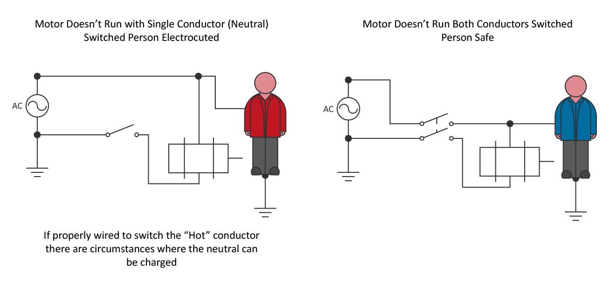
Diagram of Simple Switches and Disconnecting Means
Intro and Overview

Slide 9
Periodic Inspections
Intro and Overview
Periodic inspections of energy control procedures ensure that the requirements of the standard are being followed:
How often must the inspection take place?
Who performs the periodic inspection?
What does the periodic inspection entail?
The inspection must identify any deficiencies or deviations and recommend corrective action.
The employer is responsible for maintaining and implementing energy control procedures.
Notes:
1. How often must the inspection take place?
At least yearly
2. Who performs the periodic inspection?
An authorized employee not involved in the energy control procedure being inspected.
3. What does the periodic inspection entail?
The employer must identify any deficiencies or deviations and correct them.
Where lockout is used, the inspector must review each authorized employee's responsibilities under the procedure with that employee (group meetings are acceptable).
Where tagout is used, the inspector must review both the authorized and affected employee's responsibilities with those employees for the energy control procedure being inspected, and the additional training responsibilities of 1910.147(c)(7)(ii).
The employer must certify that the periodic inspections have been performed.

Slide 10
Training
Intro and Overview
Employee training ensures that the purpose and function of the energy control programs are understood
The standard requires different levels of training for the three categories of employees:
Authorized, Affected, and Other
What are the differences in the training required for these three categories?
Is training required annually?
Notes:
Authorized employees must receive training on the recognition of applicable hazardous energy sources, the type and magnitude of the energy available in the workplace, and the methods and means necessary for energy isolation and control. (c)(7)(i)(A)
Affected employees must receive training on the purpose and use of the energy control procedure. (c)(7)(i)(B)
Other employees (those whose work activities are or may be in an area where energy control procedures may be utilized) must be instructed about the procedure and about the prohibition relating to attempts to restart or reenergize machines or equipment that are locked out or tagged out. (c)(7)(i)(C)
Is training required annually?
No. BUT!
A change in job assignments. (c)(7)(iii)(A)
A change in machines, equipment, or processes that present a new hazard. (c)(7)(iii)(A)
A change in the energy control procedures. (c)(7)(iii)(A)
Periodic inspections reveal that there are deviations in the energy control procedure. (c)(7)(iii)(B)
The employer believes that there are deviations from, or inadequacies in, the employee's knowledge or use of the energy control procedures. (c)(7)(iii)(B)

Slide 11
Training should take place when:
Intro and Overview
There is a change in job assignments
There is a change in machines, equipment or processes (which present a new hazard)
There is a change in energy control procedures overall or for specific machines
Periodic inspections reveal deviations
An employer believes an employee’s knowledge of energy control procedures is inadequate or wrong

Slide 12
Your Lockout and Tagout policy should state:
Intro and Overview
It is the policy of [Company name] that any individual engaging in the maintenance, repairing, cleaning, servicing, or adjusting of machinery, or equipment on [Company name] property will abide by the procedures outlined in this document and specific procedures outlined in LO and TO program.
These procedures are designed to meet or exceed applicable OSHA standards for safe work practices.
Lockout is a first means of protection; warning tags only supplement the use of locks. Never Ignore a TAG!
Tags alone may be used only when the application of a lock is not practically feasible and with approval of the appropriate supervisor.

Slide 13
Safety Committees Work! Their functions are:
Intro and Overview
Performing regular shop and machine inspections
Training new employees about shop policies
Performing job hazard analysis or risk analysis
Providing and receiving input on decreasing workplace hazards from upper and lower level employees
Transferring requirements and lessons learned to relevant purchasing, engineering, maintenance, operations or management groups as appropriate
Regularly meeting to address new or ongoing issues
Bringing concerns to owners/management and helping to define corrective actions
Clearly defining roles and responsibilities of each member on the safety committee

Slide 14
Suggested Resource:
Intro and Overview
http://www.osha.gov/dts/osta/lototraining/tutorial/p-inspec.htm
This is a Federal OSHA training program and is free on the internet.

